Slide 1
HASPIDE GENERAL MEETING
Florence February 2-3, 2023
WG5 in collaboration with WG1
Space Weather and dosimetry in space
C. Grimani M. Fabi
F. Sabbatini & M. Villani
University of Urbino Carlo Bo and INFN Florence

Slide 2
WG5 Fi-Ub: scientific objectives
a-Si:H instrument configuration optimization for space
Solar flare detection: photon and electron detection in the keV-MeV range
Solar energetic proton (SEP) event monitoring (from MeV through at least 400 MeV)
Gamma-ray bursts detection from galactic magnetar
Preparation of the ASI proposal (HASPIDE Coll. + S. Perri UniCal + Industries)

Slide 3
Solar flare and energetic particle event monitoring
Magnetar flaring
Hard X rays and soft gamma rays associated with GRBs (we mainly focus here on magnetar flaring since many of them are galactic) allow for increasing the ionization of ionosphere thus disturbing VLF in the range 3-30 kHz – ozone layer depletion

Slide 5
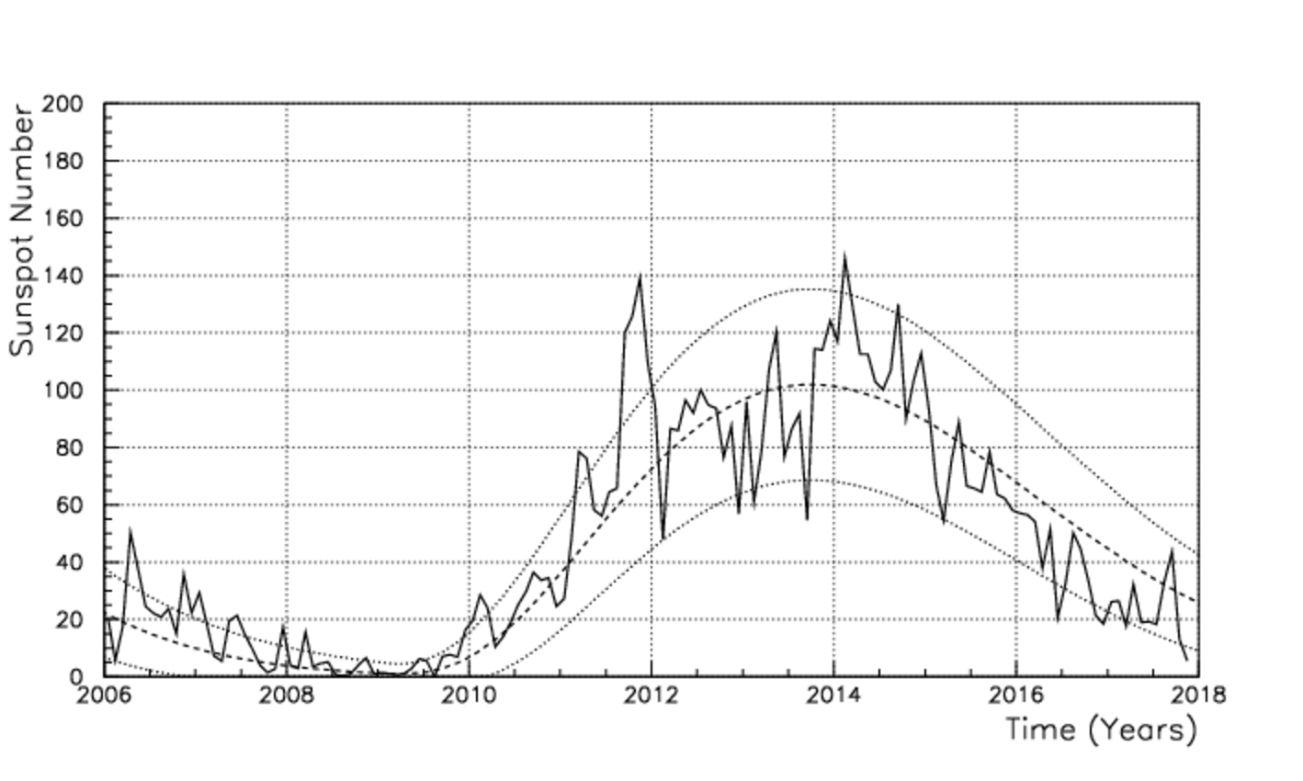
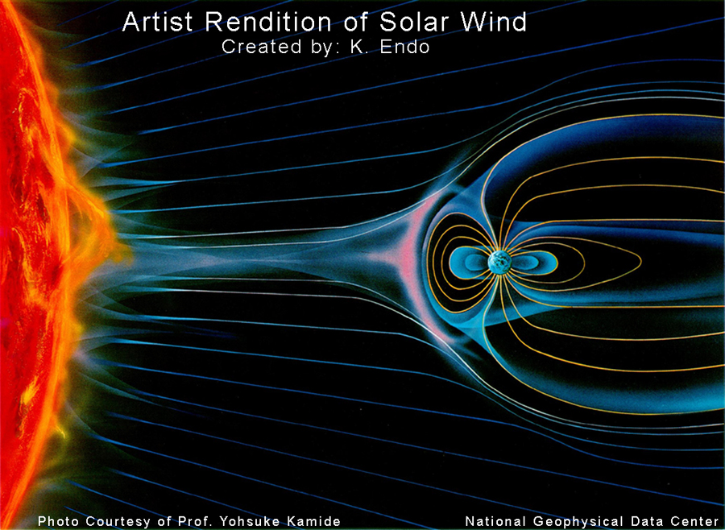
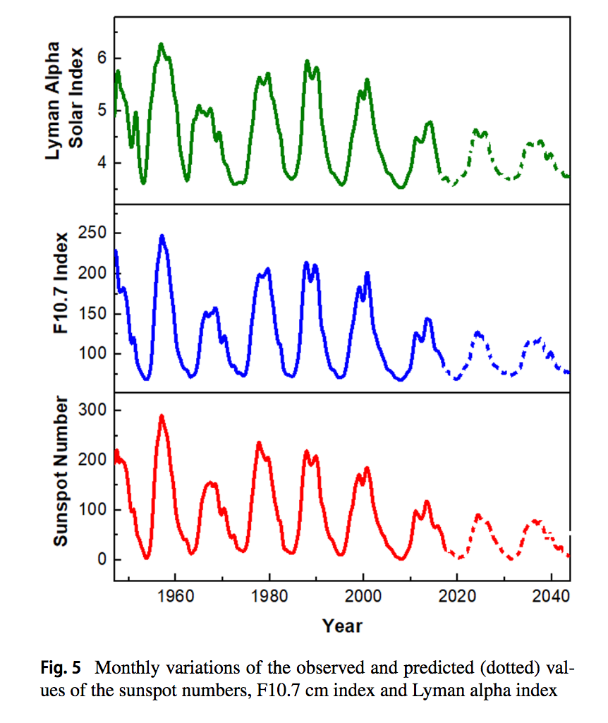
Solar activity
Solar activity intensity (11-year cycle) GSMF Polarity effects (22-year cycle; since 2013 + polarity)
10⁶ tons/s p,e⁻ 200-800 km/s
6 part/cm³ near Earth 0.3-5 keV
LPF
LISA
Singh & Bhargawa Astrophys. Space Sci. (2019) 364:12

Slide 7
Possible use in space of amorphous silicon hydrogenated
detectors: the scientific case
SEP continuous, multi-spacecraft observations allow us to study the role of particle interplanetary scattering and transport effects (PSP, SolO, BepiColombo, STEREO, ACE)
Critical energy differential flux measurements from tens of MeV up to not less than 400 MeV for protons are proposed for reliable measurement parameterization above this energy and for flux normalization with Space Station observations: goal medium-intense events (>10⁷ protons cm⁻² > 30 MeV)
SEP and inner S/C dose monitoring allowed by a:Si-H detectors. These detectors with different arrangements can be also considered for soft (1.55-12.42 keV) X-ray and solar electron detection
Neutron production in the atmosphere (SEP contribution vs Forbush decreases and proton precipitation in the atmosphere - mandatory SEP flux correct estimates above 500 MeV)
a:Si-H detectors are characterized by high dynamic range, radiation resistance, adjustable geometrical shape, low weight and power consumption

Slide 8
Halo CME and SEP event on October 29, 2021: a case study
Papaioannu et al., A&A, 660, L5, 9pp, 2021
Flare X1
Soft X-rays
Radio bursts:
III, II, IV
EUV

Slide 9
Photon and electron fluxes from star flaring
SGR 0525-66/GRB 790305b
Sun
5x10⁴⁴ erg
1.9×10⁴⁵ ergs s⁻¹
Electron fluxes from solar flares
Electron fluxes of IP and galactic origin
Fenimore, Klebesadel and Laros, ApJ, 460, 964, 1996
CG et al., CQG, 2009

Slide 10
SEP event on October 29, 2021 observations
Papaioannu et al., A&A, 660, L5, 9pp, 2021

Slide 11
Papaioannu et al., A&A, 660, L5, 9pp, 2021
Peak space
Peak GLE (red curve)
onset

Slide 12
Optimization of a a:Si-H detector for long-duration intense solar energetic particle event monitoring
SEP event October 28, 2021 GLE 73
Blue dots: data gathered in space up to 100 MeV with Solar Orbiter. Orange squares: Neutron Monitor data.
The blue curve is the best fit with data up to 100 MeV.
The red curve is the best fit with data up to 400 MeV-> SEP monitoring in space, far from Earth should be monitored up to minimum energies of 400 MeV. Only near-Earth detectors cover this energy range.
a:Si-H active material and tungsten as passive material
CSDA proton range in tungsten (Z=74)
Tungsten density: 19.25 g/cm³
Geometrical factor max for 400 MeV protons 0.6 cm² sr
for about 1 kg detector
Energia | CSDA range | Range | Massa
300 MeV | 99.33 g/cm^2 | 5.16 cm | 2.5x2.5 → 620 g 2.0x2.0 → 397 g 1.5x1.5 → 223 g
350 MeV | 127.1 g/cm^2 | 6.60 cm | 2.5x2.5 → 795 g 2.0x2.0 → 508 g 1.5x1.5 → 286 g
400 MeV | 156.8 g/cm^2 | 8.15 cm | 2.5x2.5 → 979 g 2.0x2.0 → 627 g 1.5x1.5 → 353 g

Slide 13
SEP critical observation energy interval
SEPs > 70 MeV e < 0.4 GeV
CG+, J. Ph. Conf. Ser. , 31, 045018, 2014
Proton percentage below 400 MeV
 | Solar minimum | Solar maximum | Onset | Peak/Decay
GCR | 19% | 6%
SEP 13/12/2006 |  |  | 90% | 98% (peak)
SEP 14/12/2006 |  |  | 99% | 100% (decay)
SEP 23/2/1956 |  |  | 25% | 99.5% (peak)

Slide 14
Intense SEP event occurrence
The yearly SEP-event occurrence in the fluence range 10⁶-10¹¹ protons/cm²
above 30 MeV can be estimated according to the Nymmik [ICRC proc. 1999a,b]
model on the basis of the number of the yearly predicted sunspot number:
N_{SEPs} [N_{SSmin}, N_{SSavg}, N_{SSmax}]=0.0694 N_{SS}[min, avg, max]
Nymmik has found that the SEP event fluence (φ) distribution shows a power-law
trend with an exponential cut-off
dN_{SEPs}=C φ^{−1.41} e^{- φ/ φx} dφ
where φ_{x}=4x10⁹
where C can be determined on the basis of the total number of expected SEP events

Slide 15
SEP predictions during the selar cycle 26
YEAR | Sunspot Number | # SEP events
2035 | 68 | 5
2036 | 76 | 5
2037 | 77 | 5
2038 | 74 | 5
2039 | 63 | 4
2040 | 42 | 3
2041 | 32 | 2
2042 | 21 | 1
2043 | 11 | 1
2044 | 5 | <1
65% of the
events belong to
the fluence range
10⁶ -10⁷ protons cm⁻²
For instance
November 13, 2006
and May 7, 1978
Nymmik R A et al 1999a Proc. 26th Int. Cosmic Ray Conf. (Salt Lake City) vol 6 pp 268–71
Nymmik R A et al 1999b Proc. 26th Int. Cosmic Ray Conf. (Salt Lake City) vol 6 pp 280–3
Singh & Bhargawa Astrophys. Space Sci. (2019) 364:12

Slide 16
SEP event November 29, 2020
Mason et al., A&A 656, L12 (2021)
Kollhoff et al., A&A 656, A20 (2021)
F. Sabbatini – SolO HET data

Slide 17
WG5 activity: highlights
WG5: general aims and scientific cases (C. Grimani)
Fluka Monte Carlo – Simulation geometries (M. Fabi)
SEP fluxes at low and high energies and simulations for particle detection
(M. Villani)

Slide 18
Manuscript submitted to Experimental Astronomy
just appeared on arXiv

