Slide 1
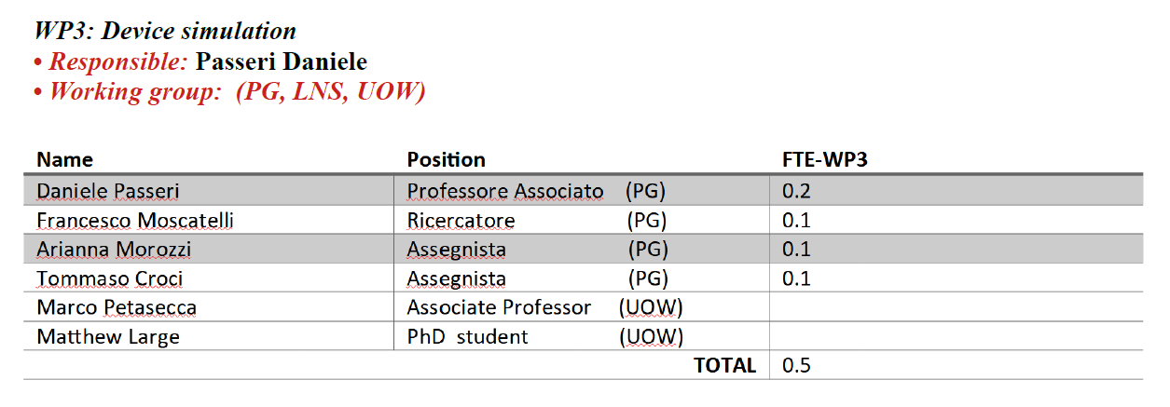
HASPIDE – WP3
Device Simulations
Status Activities & Future Plans
02/02/2023
Tecnologo
0.25
0.65

Slide 2
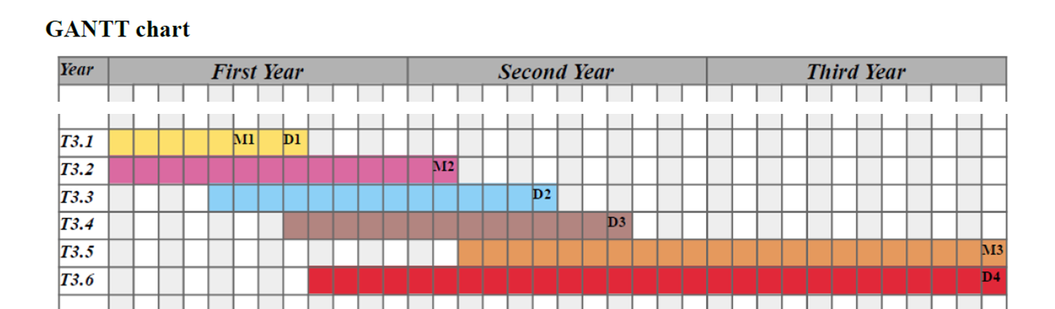

2

Slide 3
The initial activities rely upon the INFN 3D-SiAm background.
The a-Si:H band-gap engineering was codified according to Wollongong studies and the literature.
The a-Si:H material has been implemented within the TCAD environment
(bang-gap definition, trap level parametrization, …) (-> a-Si:H.par)
Different carriers’ mobilities models have been developed and implemented within the TCAD as external add-on PMI
(Physical Model Interface) (.c)
An extensive comparison between measurements (test structures) and simulations has been carried out, aiming at validation and optimization of the modeling scheme.
3

Slide 4
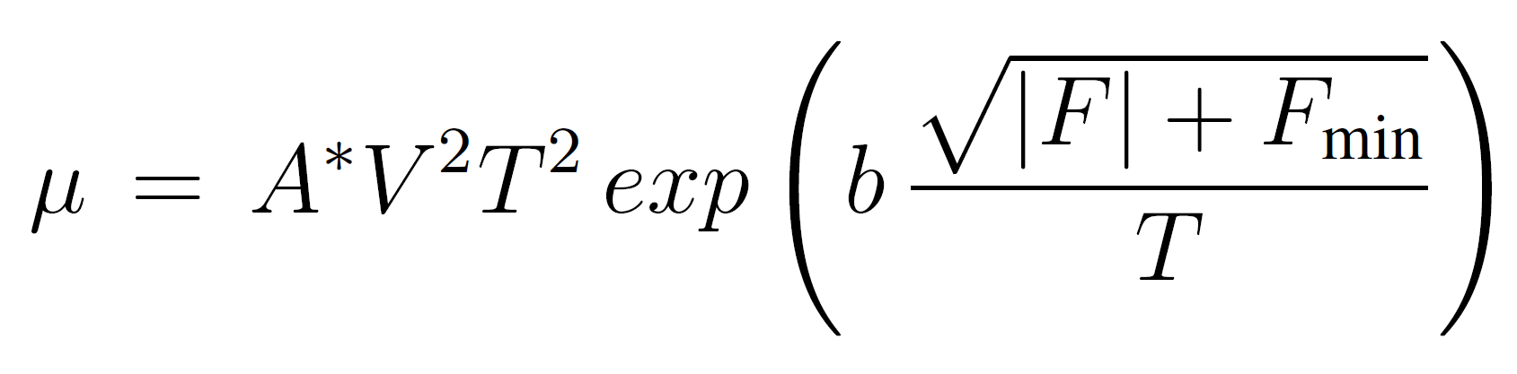
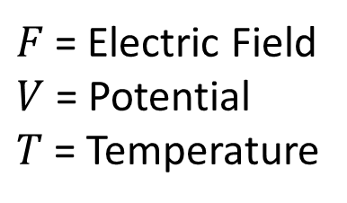

Charge Transport and Carriers Mobility Models
An extensive acvitity has been devoted to the modeling of the charge transport within the a-Si:H, relying on standard transport equations for monocrystlline silicon - drift-diffusion (DD) approximation and using a custom defined charge mobility, looking at the current-voltage responses at different temperatures.
  Embedded Transport Models
  (DD, TD, HD)
$F$ = Electric Field
$V$ = Potential
$T$ = Temperature
  $$∆T→∆μ→∆I$$
m
n
  Custom mobility model (PMI)
4

Slide 5
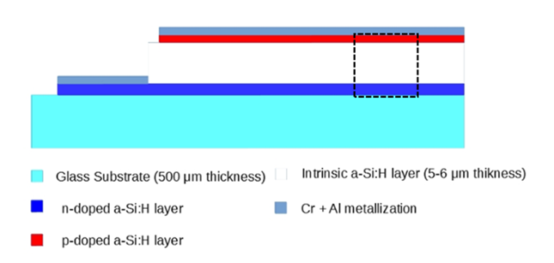
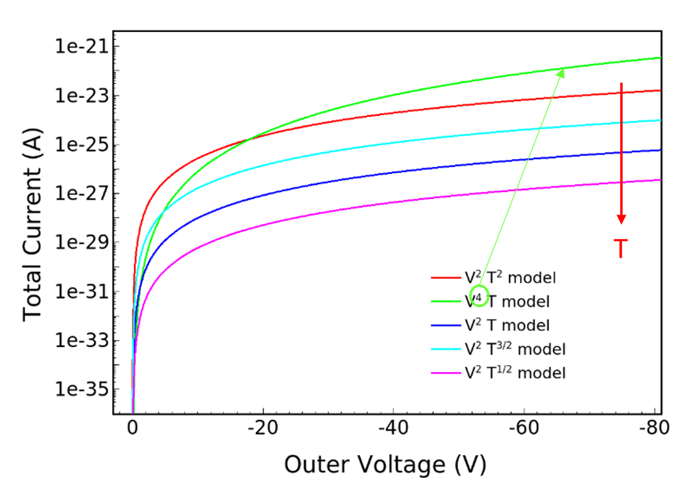
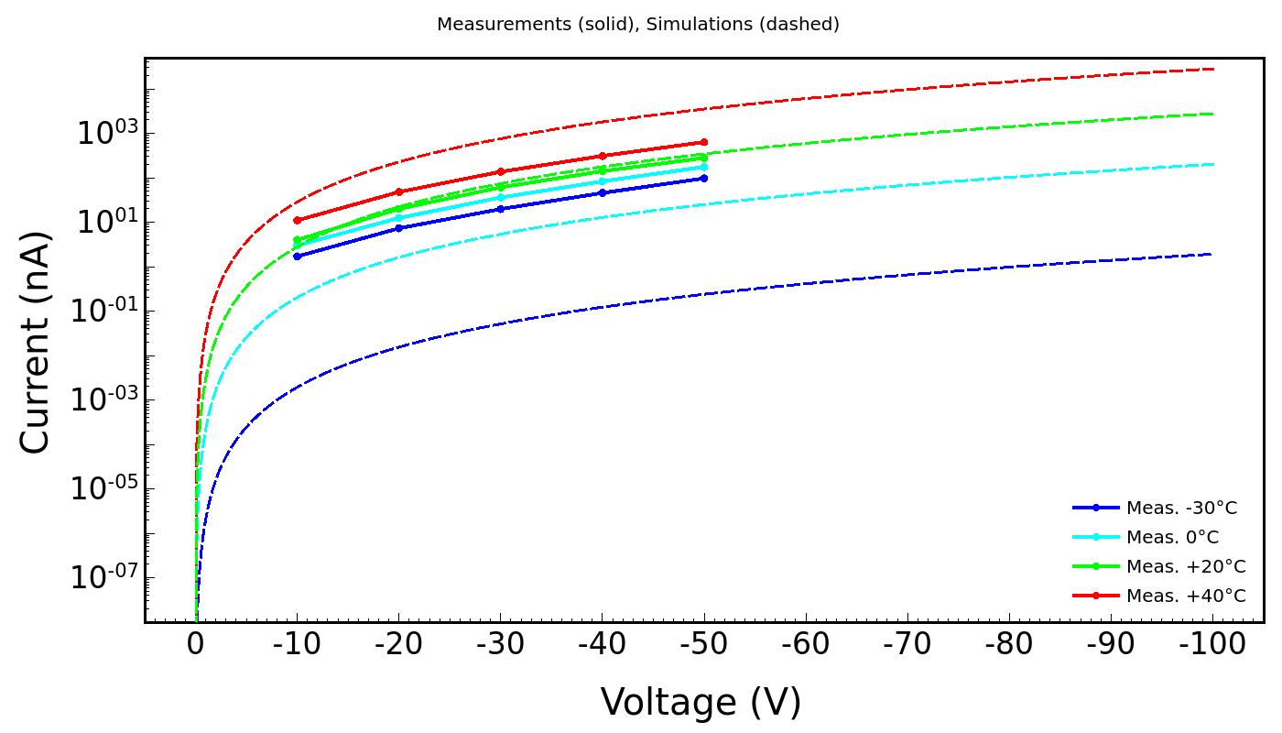
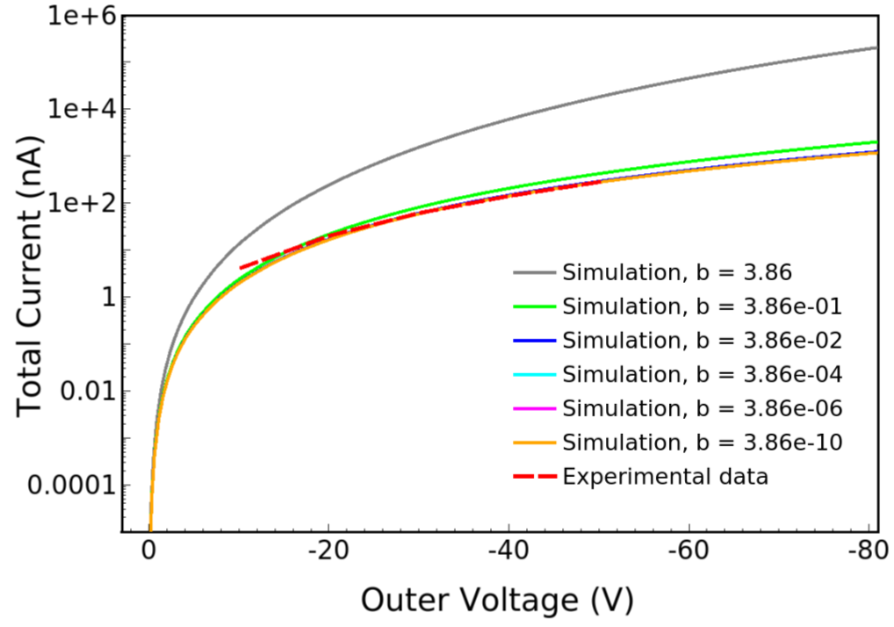
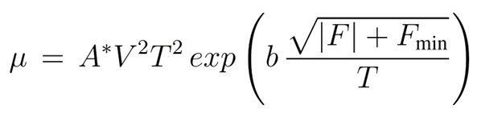
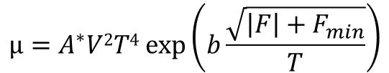
Model validation: Simulations vs. Measuremens (I-V)
The effects of changing the exponents of V and T
have been studied.
$$µ=A^{∗}V2T4 exp\left(b\frac{\sqrt{\left|F\right|+F_{min}}}{T}\right)$$
Current vs. Voltage Simulations @ mobilities models
Current vs. Voltage Simulations vs. Measurements
5
Notes:
Immagine a sx Na=0 (intrinsic).
Immagine a dx Na=4e15 cm-3

Slide 6
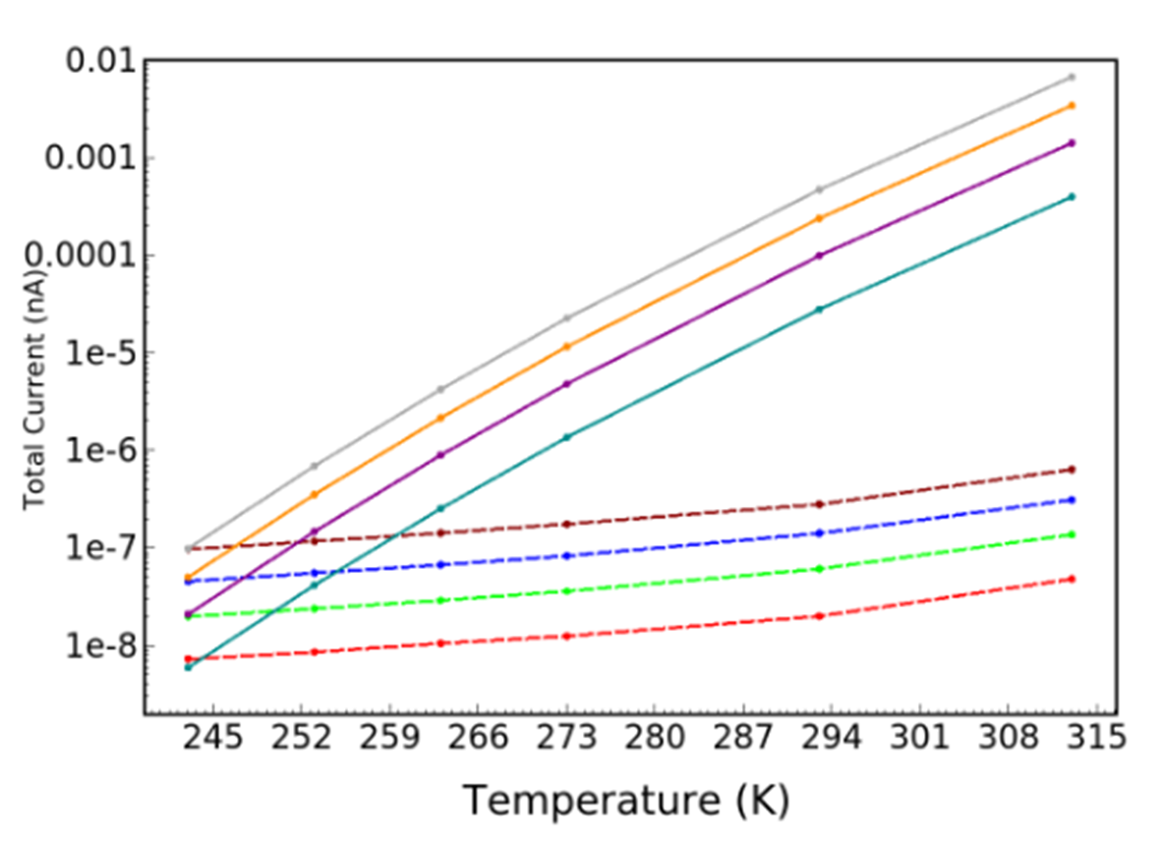
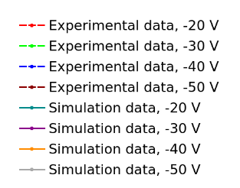
Model Predictivity….
I-V @T ok
I-T @ Voltage…
6

Slide 7
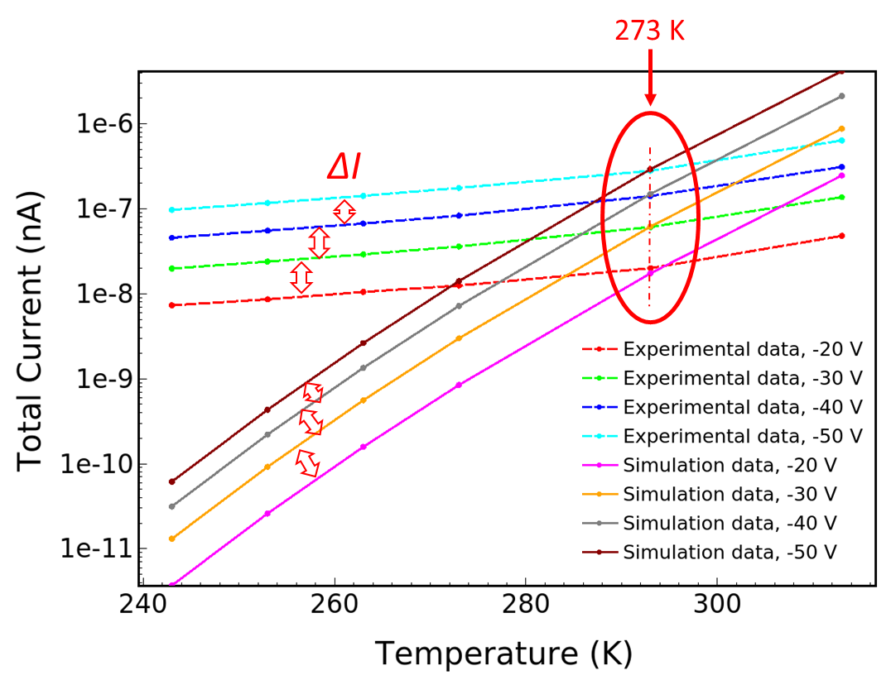
Model Predictivity….
I-V @T ok
I-T @ Voltage…
(a.u.)
7

Slide 8
TCAD Modelling scheme evolution
Area Factor
Capacitance-Voltage simulations:
    small-signal analyses
    comparison with measurements.
a:Si-H: band-gap re-engineering
(trap definition → … equivalent donor/acceptor modelling).
    De-activation / wipe out of not effective levels?
  Parametric Analysis: leverages
8

Slide 9
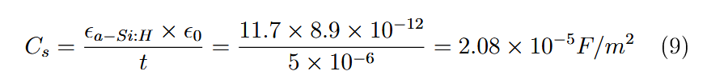
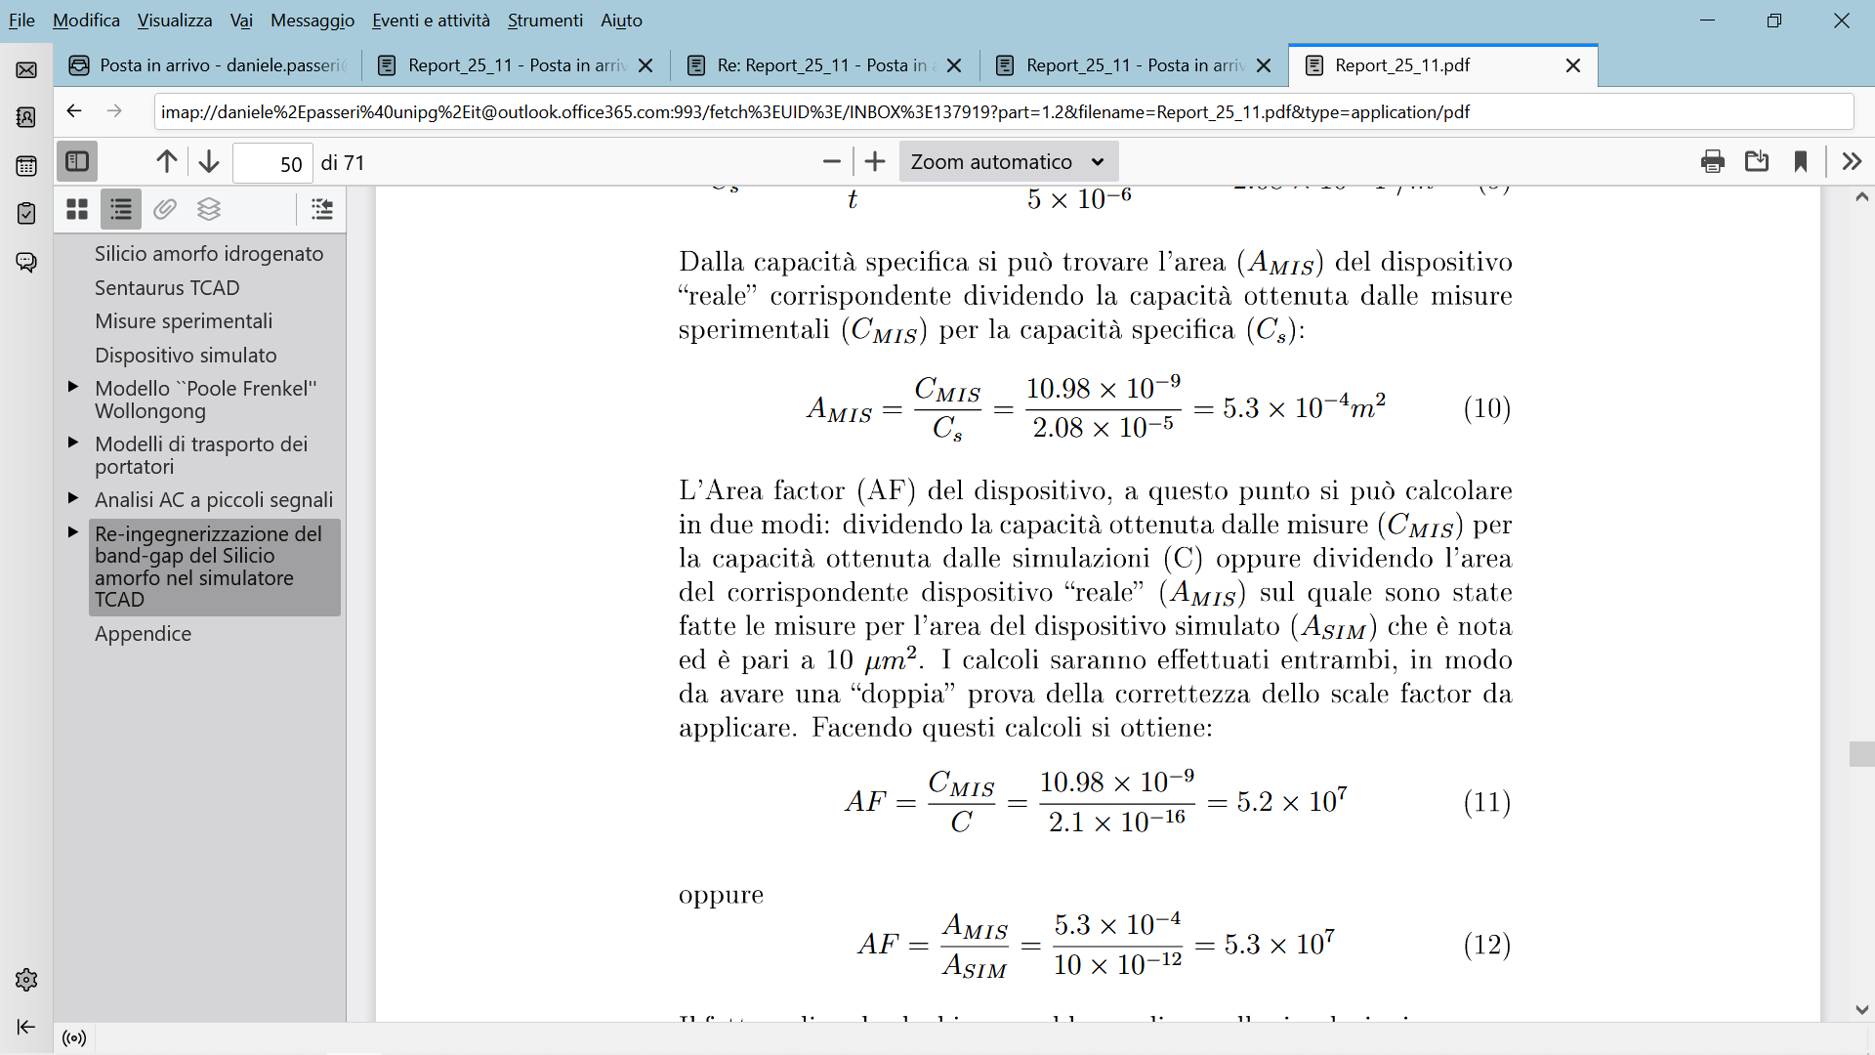
Area Factor
9

Slide 10
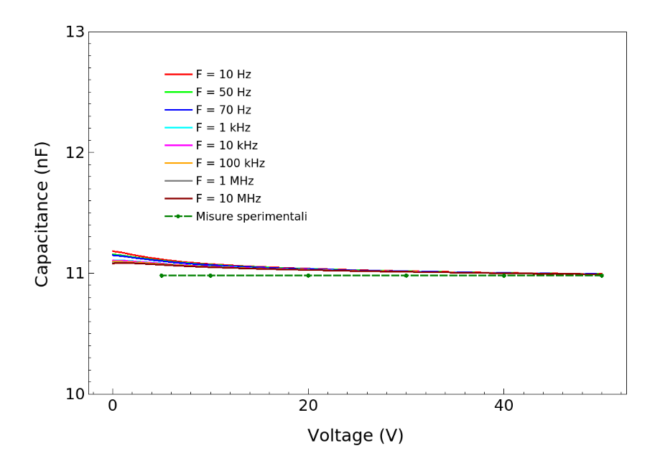
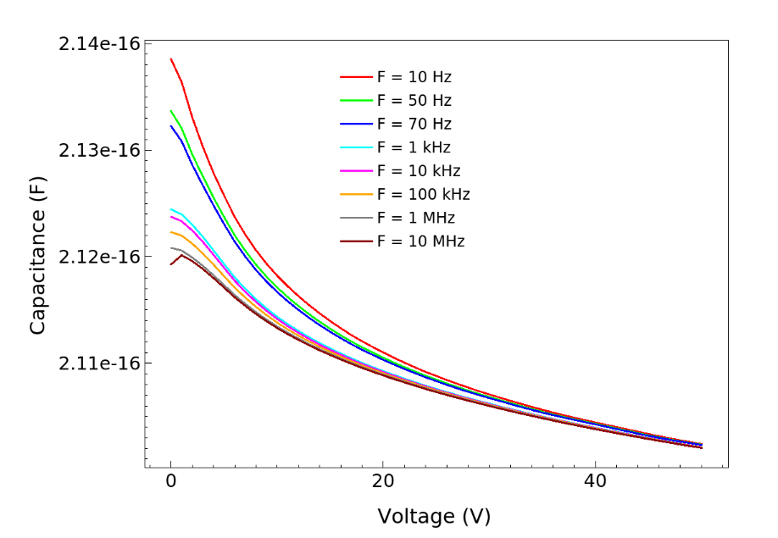
Capacitance-Voltage simulations
Comparison with measurements (small-signal analyses)
Simulations vs. Measurements
Simulations @ differente frequencies (detail)
10

Slide 11
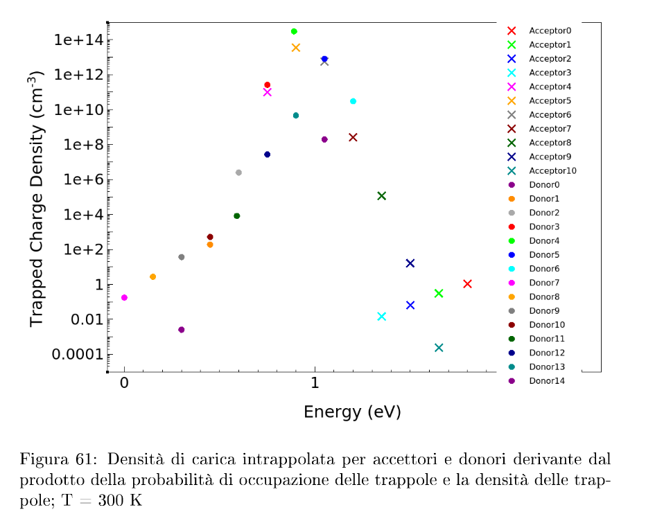
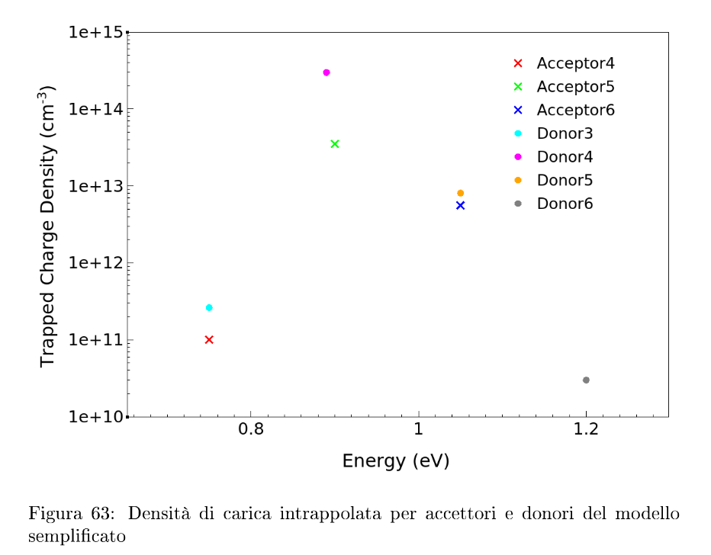
a-Si:H.par: Effect of the Traps: Original vs. Simplified model
ORIGINAL
SIMPLIFIED
11

Slide 12
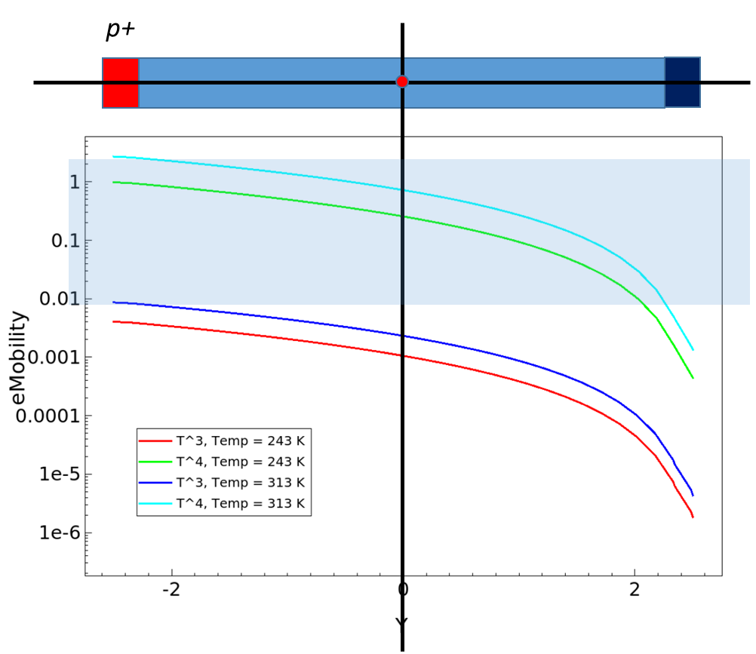
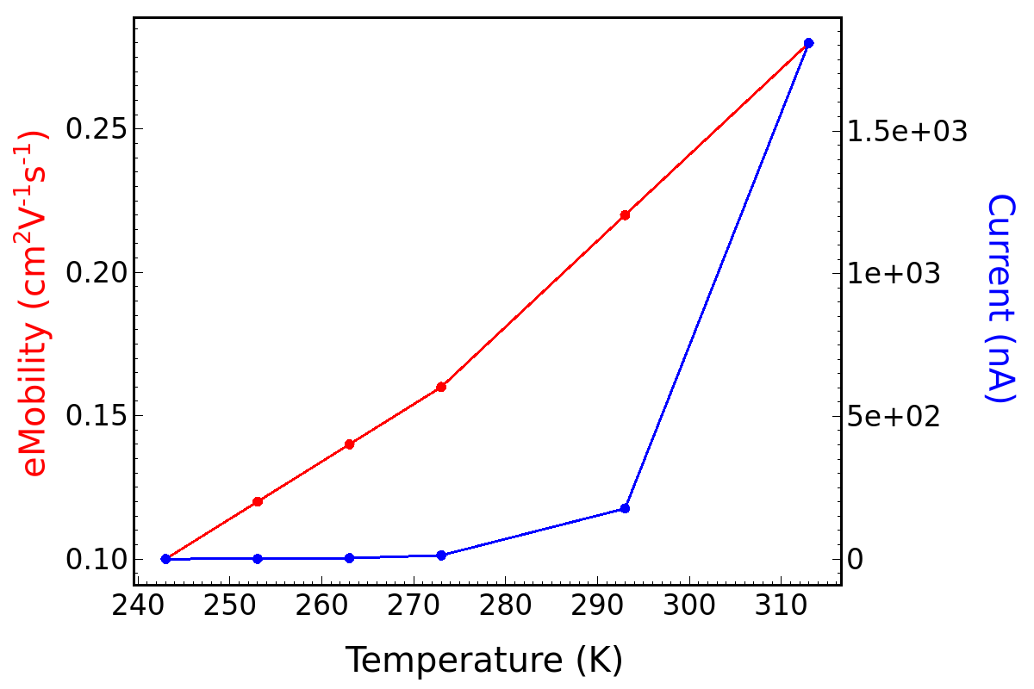
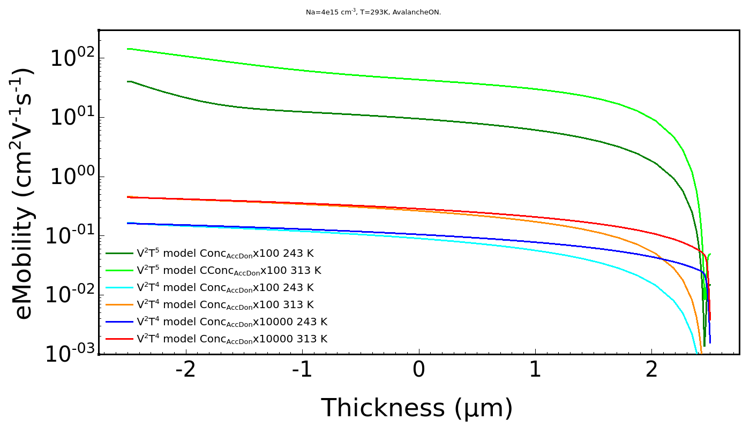
Model validation: eMobility and current variations (Δμ - ΔI)
Expected mobilities (cm²/Vs) range average μ_{n} = 0.1 μ_{p} = 10⁻⁴
T⁴
12
Notes:
Mobilità calcolate a 40V
Na=4e15 cm-3

Slide 13
Parametric Analysis: leverages on simulations outcomes
Analysis of the Fermi level’s position
Introduction of an “artificial” p-type doping
Optical Generation (additional charge – workaround for large band-gap materials).
Impact Ionization activation
Increase of the (effective) trap concentration
13

Slide 14
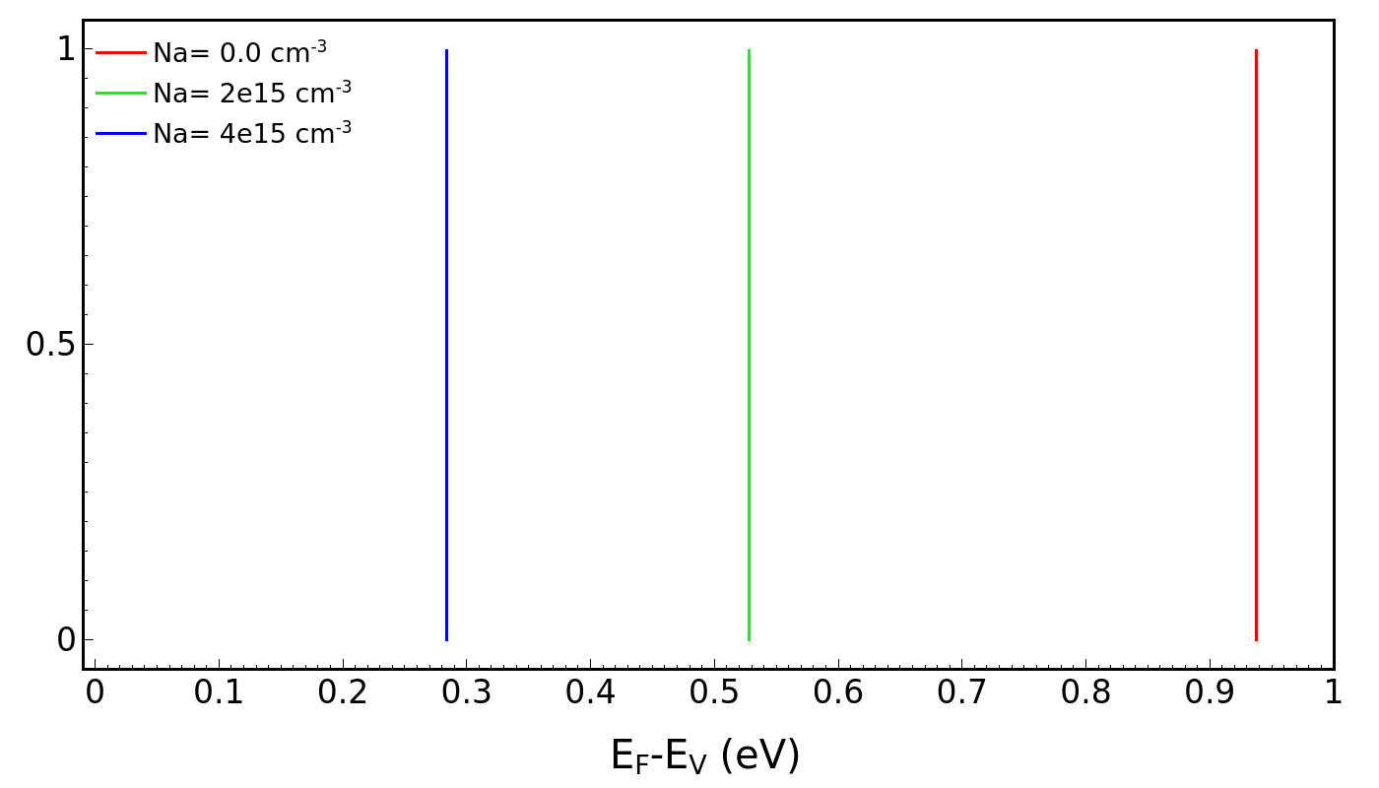
The intrinsic a-Si:H material has been modeled by considering an “artificial” p-type doping concentration in order to fix the Fermi level’s position within the bang-gap, according to experimental findings.
Expected E_{F} values
The activation of the Impact Ionization model (Avalanche) enables a more realistic carrier generation and recombination processes -> more realistic trend of the I-V curves.
14

Slide 15
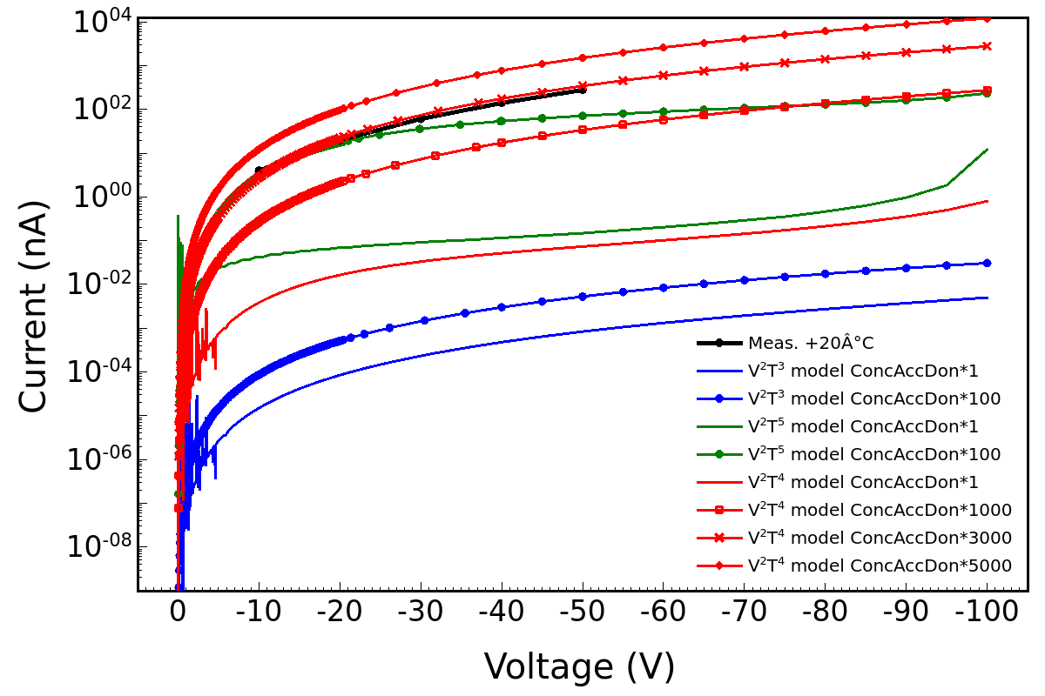
Increase of the of the Acceptor and Donor trap concentration
Good agreement between measurements and simulations
Accounts for a more realistic traps occupation probability
15
Notes:
La ragione più fisica dell’incremento della concentrazione delle trappole risiede nel fatto che le trappole per come sono definite nel TCAD e per come il TCAD le considera hanno una probabilità di occupazione che sottostima quella reale e quindi è necessario tenere in considerazione un fattore di normalizzazione.

Slide 16

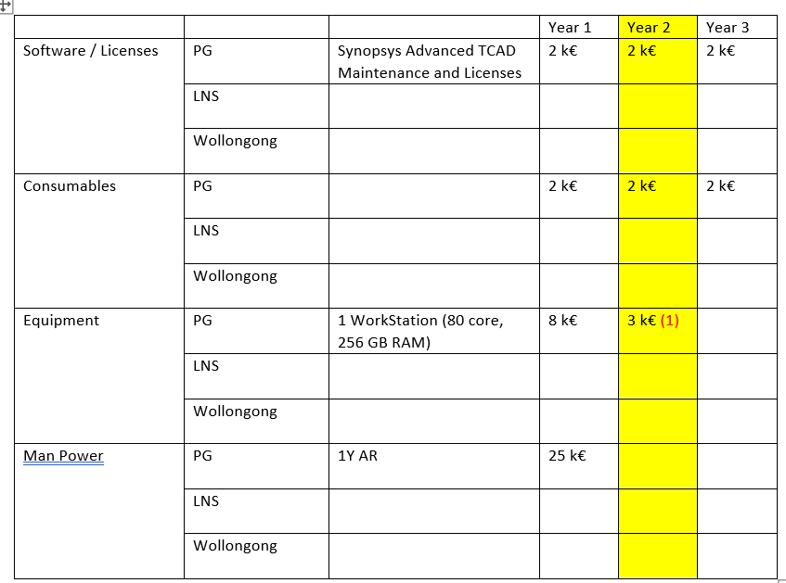
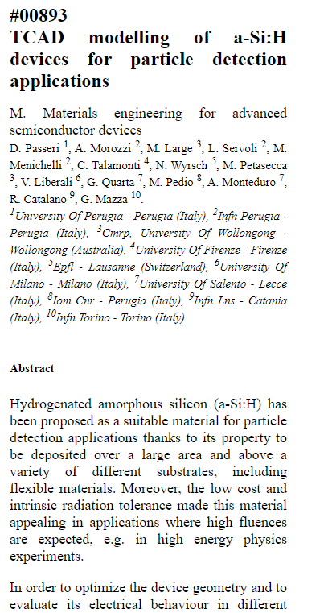
WP3 Budget & Dissemination
Dedicated WorkStation DELL
Abstract submitted to
2x AMD EPYC 7443 2.85GHz, 24C/48T, 128M Cache (200W) DDR4-3200
2x 16GB RDIMM, 3200MT/s, Dual Rank
You will be notified about its acceptance by the chairpersons of symposium you choosed by MARCH 10 at the latest.
16
Notes:
Workstation DELL:
- 2x AMD EPYC 7443 2.85GHz, 24C/48T, 128M Cache (200W) DDR4-3200
-2x 16GB RDIMM, 3200MT/s, Dual Rank

Slide 17
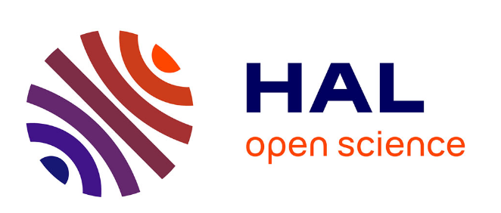
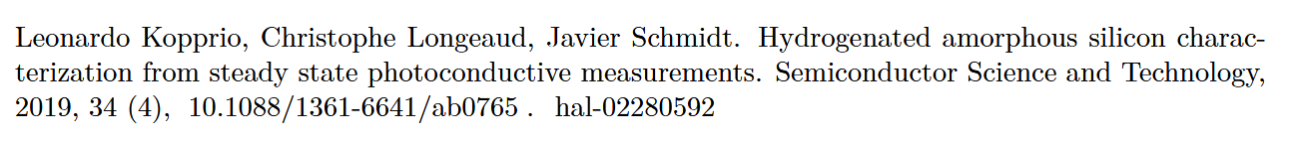
WP3 Future Plans
Additional model improvement
(see paper
Introduction of charge selective contacts model.
Study of the active behaviour of the device: TCAD transient analysis (response/charge collection to a single particle stimulus).
17

Slide 19
