Slide 1
Ion Beam Test 2022 IT SCD Data Analysis
A. Oliva
16/1/2022

Slide 2
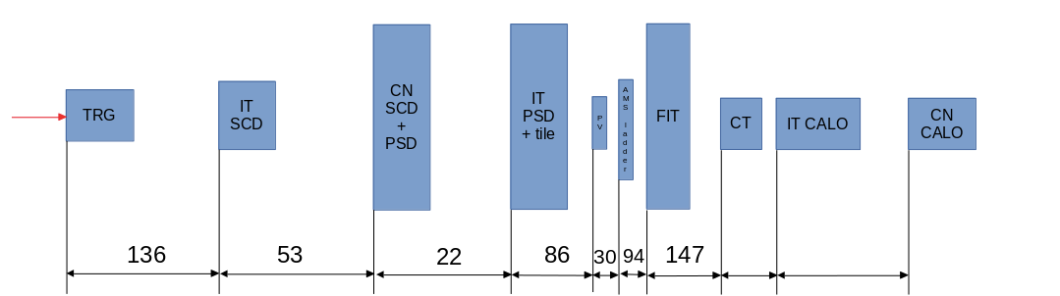
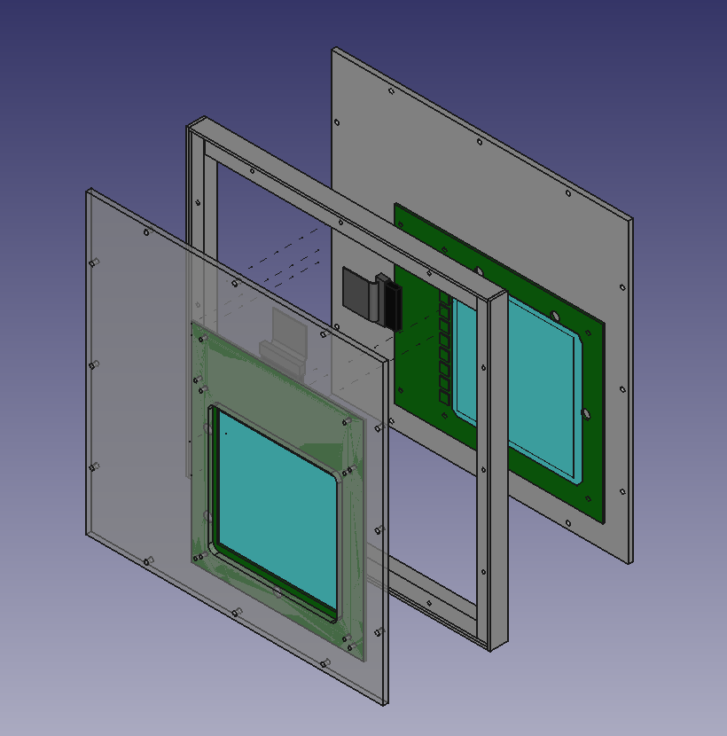
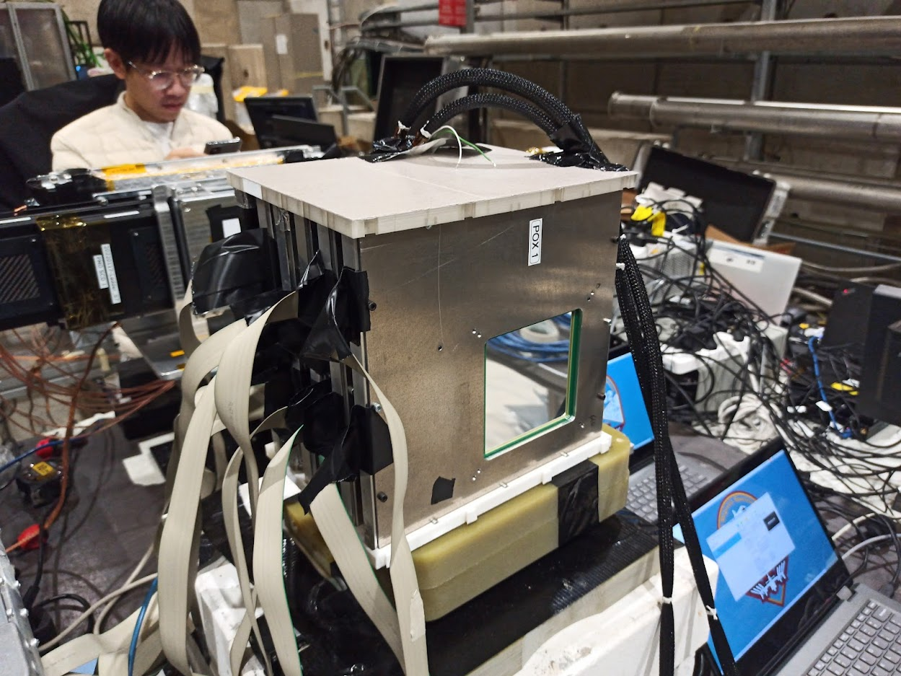
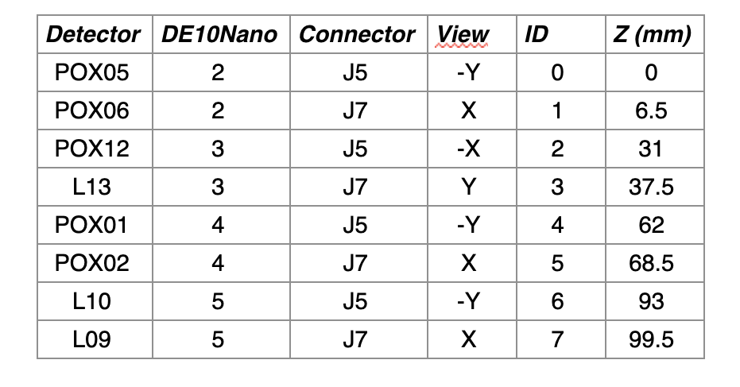
Ladder Under Test
8 similar sensors (96×96 mm², 150 μm thick, 150 μm readout pitch, 50 μm implantation) mounted in orthogonal pairs, inside a frame.
Globally 4 X and 4 Y independent position estimations.

Slide 3
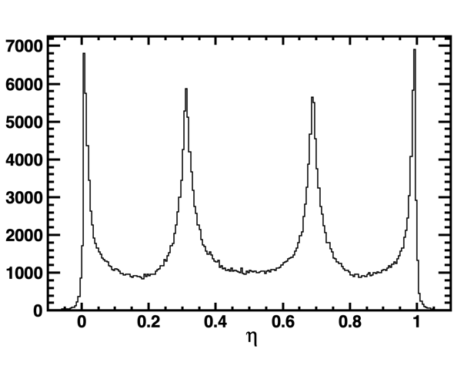
Position Estimation
Center of gravity of the two highest strips (suffers from saturation effects, however, good for first a first approximation).
→ Expected resolution from η is $50/\sqrt{12}$ $\sim 14 \text{μm}$.
→ For saturation region is expected to be $150/\sqrt{12}$ $\sim 43 \text{μm}$.
No-seed-saturation, S₁ < 2000
“1/3”
“2/3”
S₁
S₂
S₄
S₃
S_{LL}
S_{L}
S_{R}
S_{RR}
A note for CN SCD: in best conditions 4 measurement with 20 μm accuracy distributed over 10 cm give an extrapolation width at 50 cm of about 400 μm. We have to see if adding other far away sensors (AMS) may improve.

Slide 4
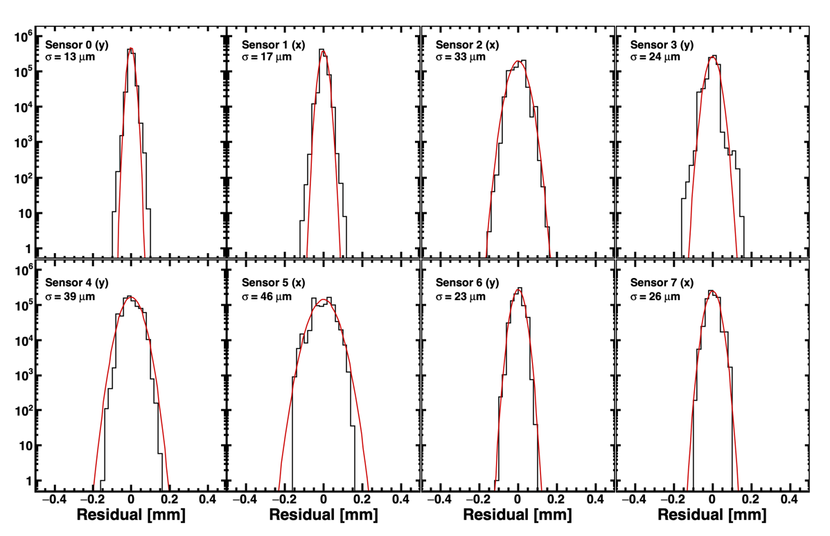
Alignment
Only one track per event reconstructed with the largest cluster per each sensor (4 cluster X, 4 cluster Y).
Track is fitted with a straight line in XZ and YZ planes. Quality on track fit $χ^{2}$ is required after the first alignment iteration.
Alignment is performed minimizing residuals of tracks along the two measurement coordinates (XY), with median or gaussian fit.
Alignment parameters converge quickly, globally shifts are of the order of mm.

Slide 5
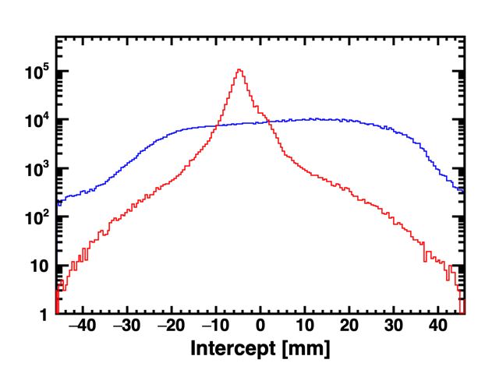
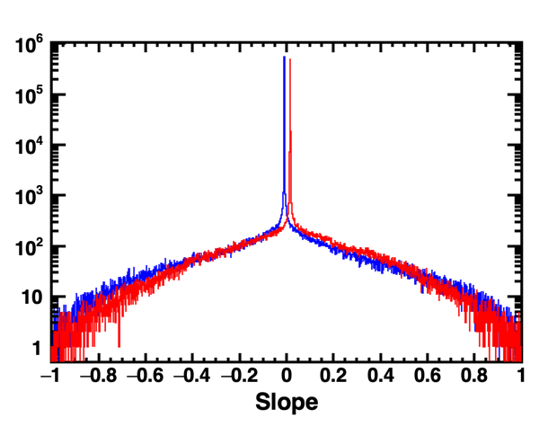
Beam
→ Beam is wide along Y, short along X.
→ Trajectories of the beam are very straight. Large inclinations only available for the halo (with low statistics).
→ The beam allows for alignment in X, Y and probably some XY rotation for X-oriented sensors (large arm). Under study.
→ Not much sensitivity for other alignment parameters (shift in Z, rotation along Y- and along X-axis).

