Slide 1
IHEP SCD Charge reconstruction

Slide 2
The IHEP SCDs
The 3.6 cm width detector is divided into 10 sections.
Each section has unique strip width & capacitance.
Each section has 40 implant strips and 20 readout channels.
0ohm
0ohm
68 pf
47 pf
20 pf
100 pf
60um
25um
3.6cm

Slide 3
Data analysis framework
Raw Data Conversion
Section Selection
Pedestal analysis and subtraction
ETA Selection
CN analysis and subtraction
PMO SCD provides PID
Cluster Finding
Charge reconstruction
Raw data processing
High-level data processing

Slide 4
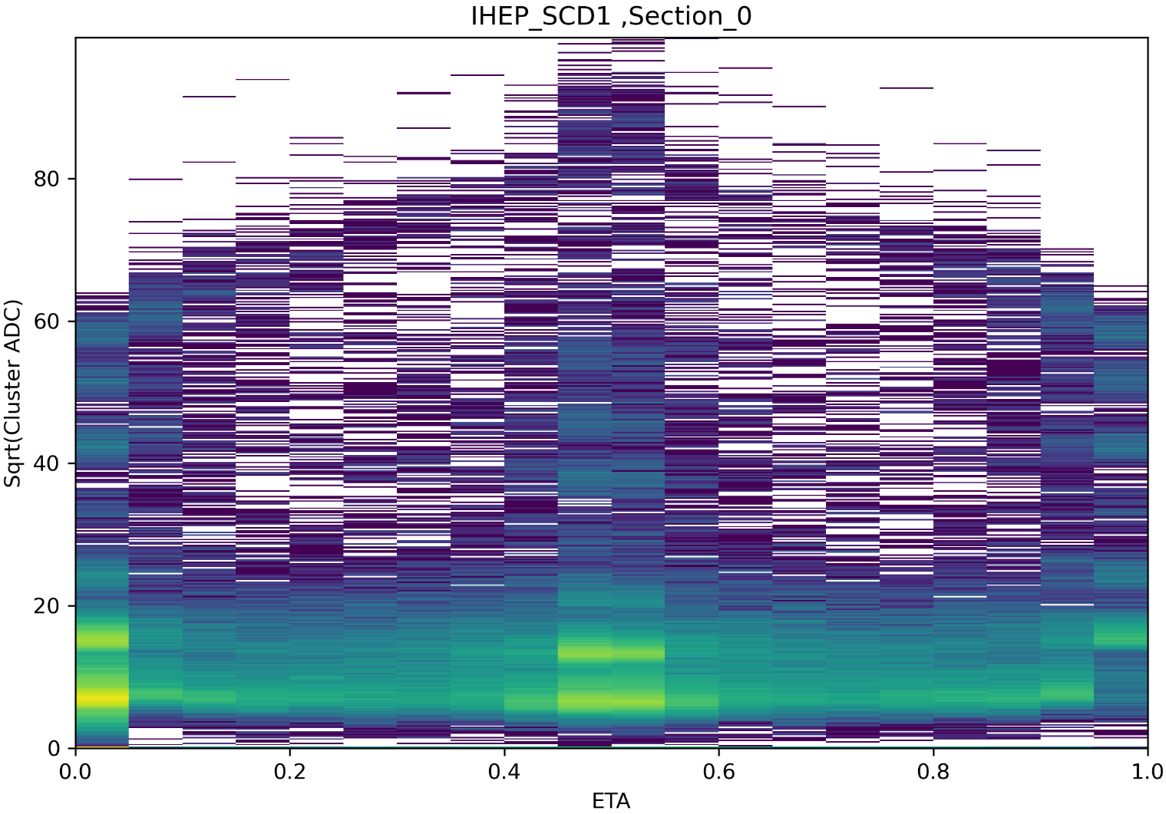
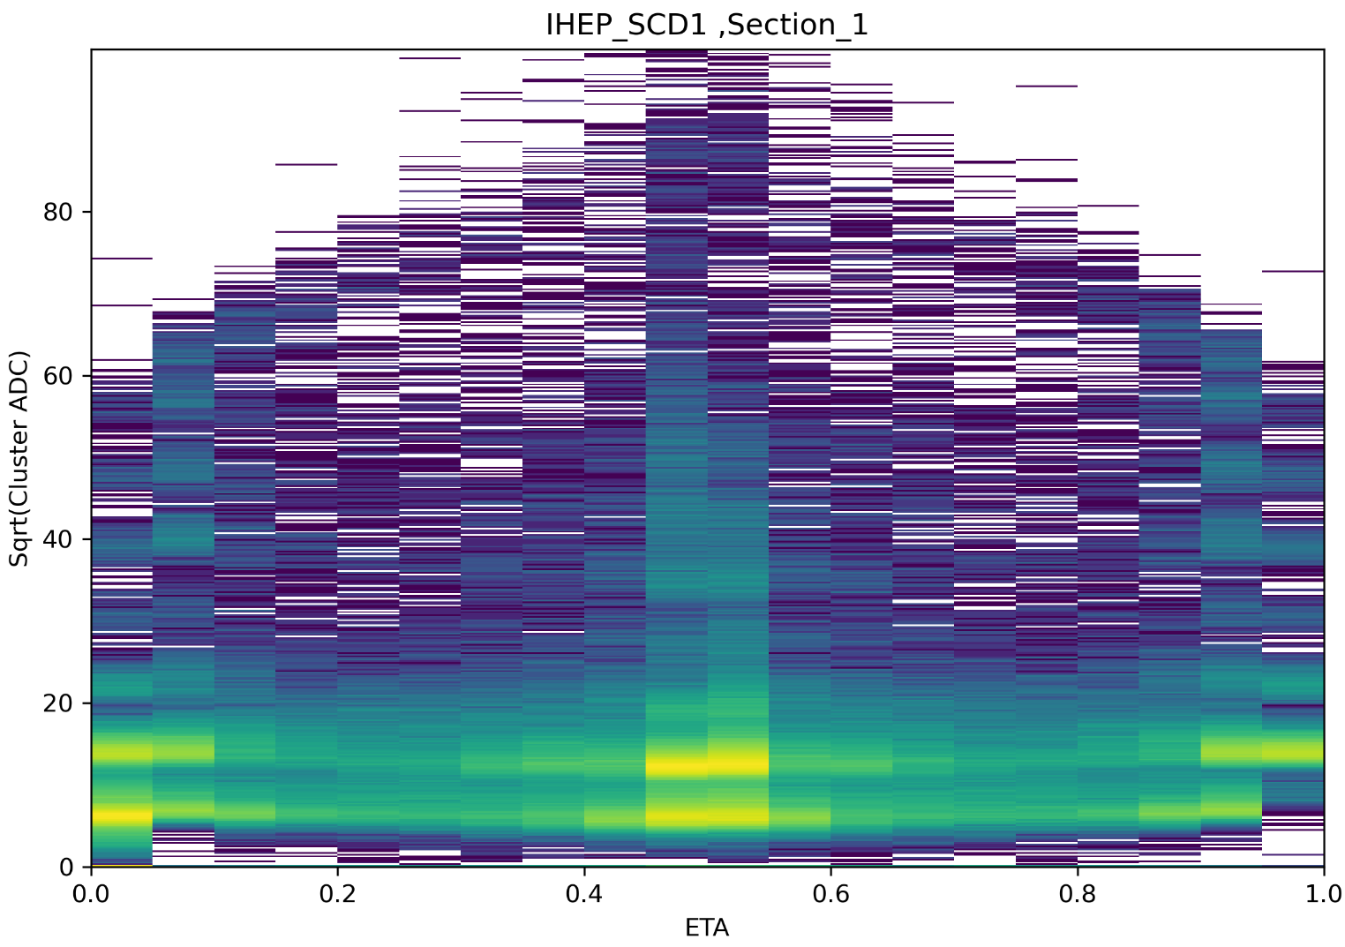
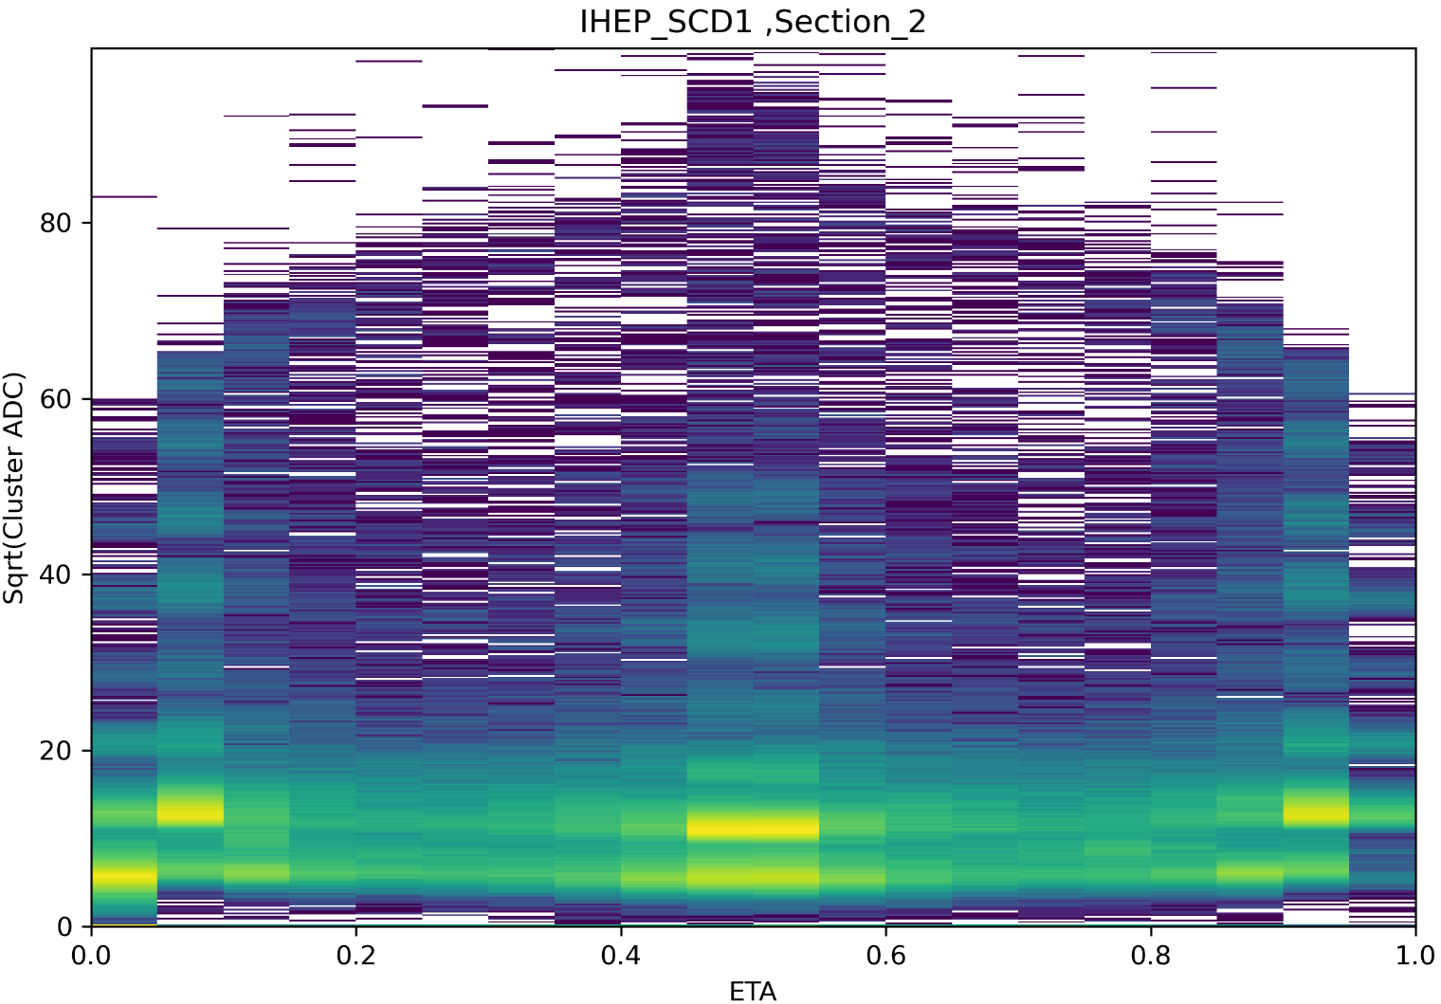
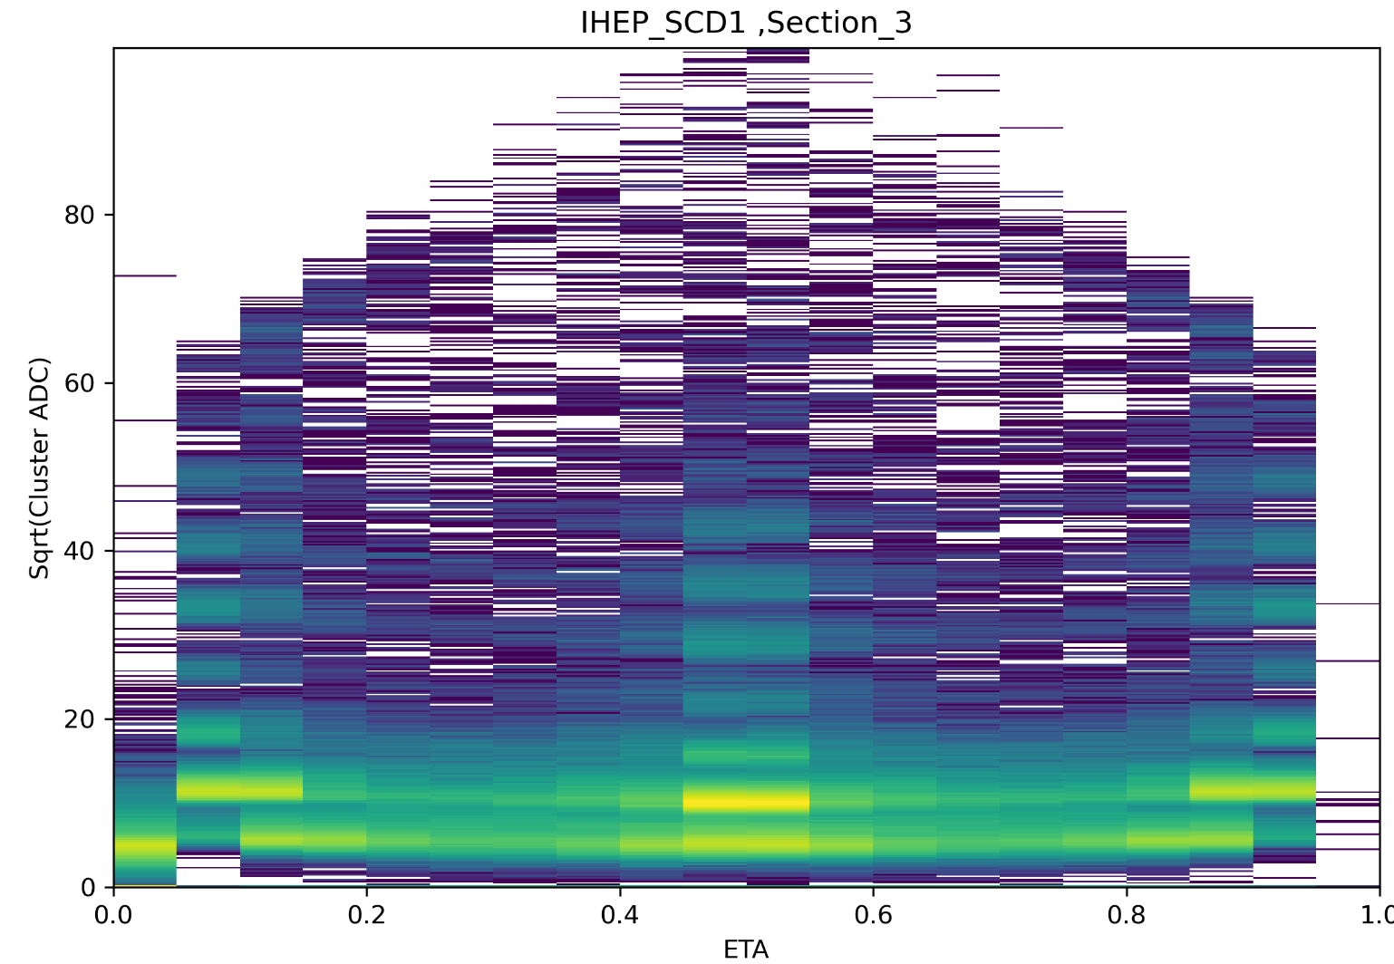
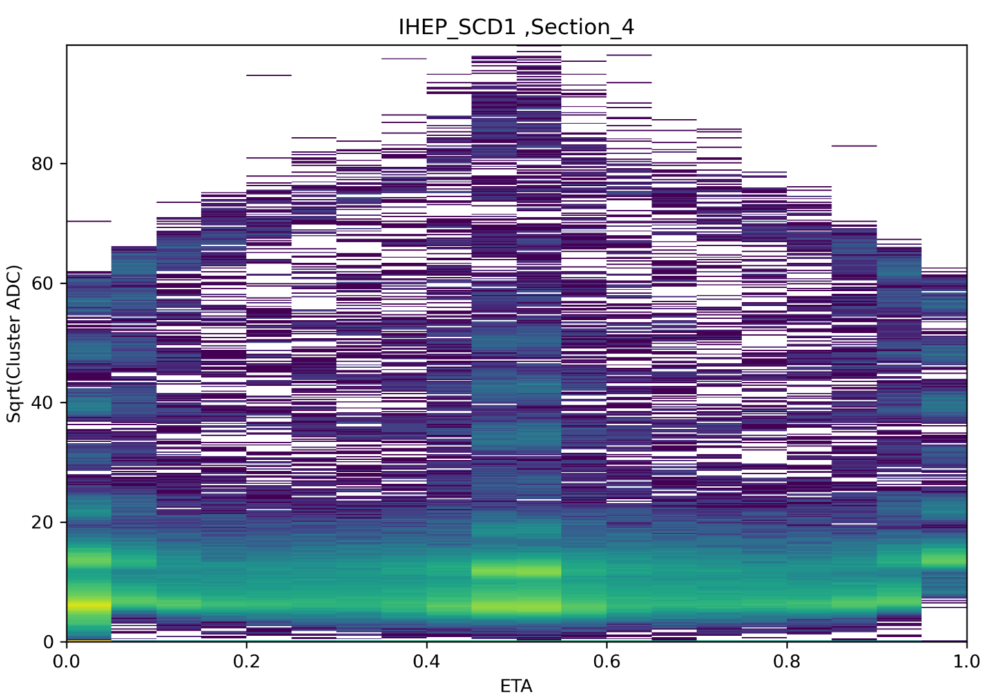
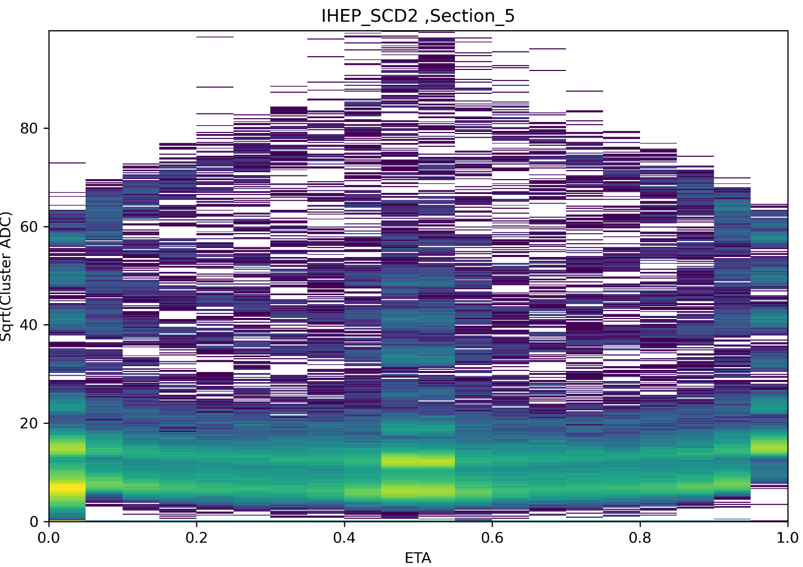
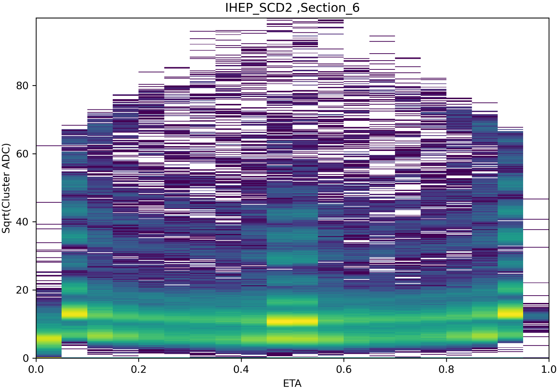
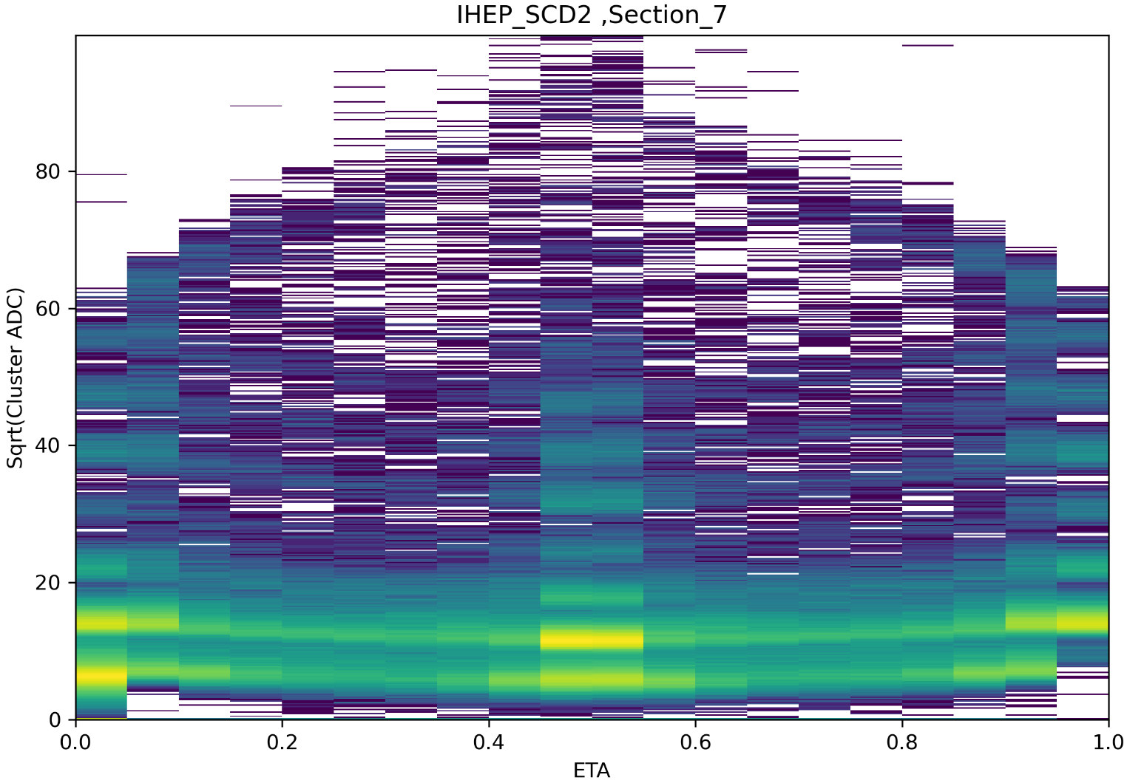
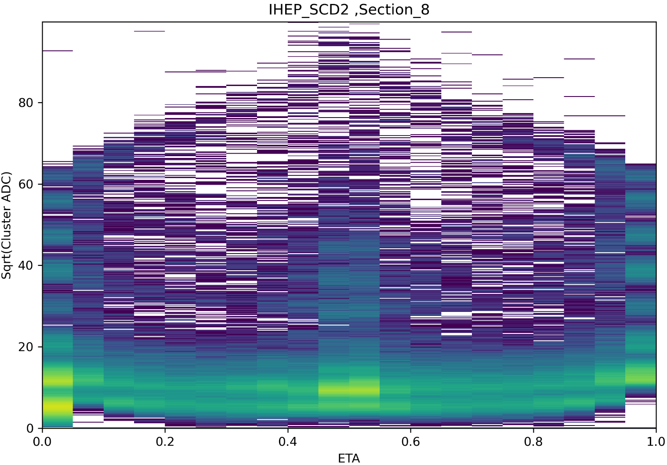
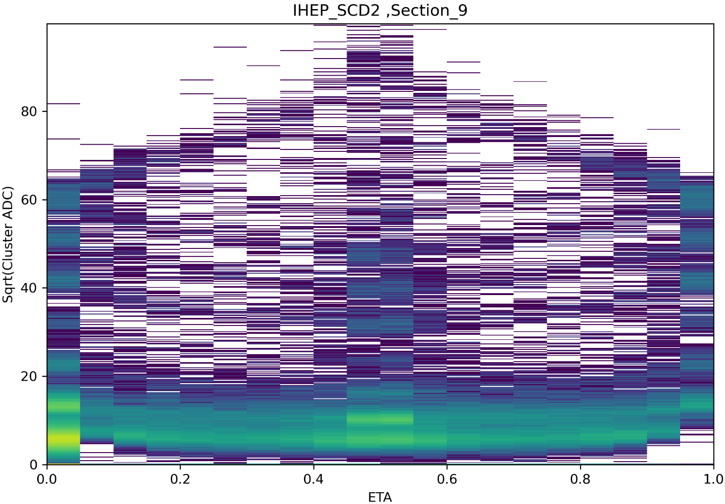
High-level data processing
Section Selection——10 section
The horizontal coordinate is ETA and the vertical coordinate is Sqrt (Cluster ADC)

Slide 5
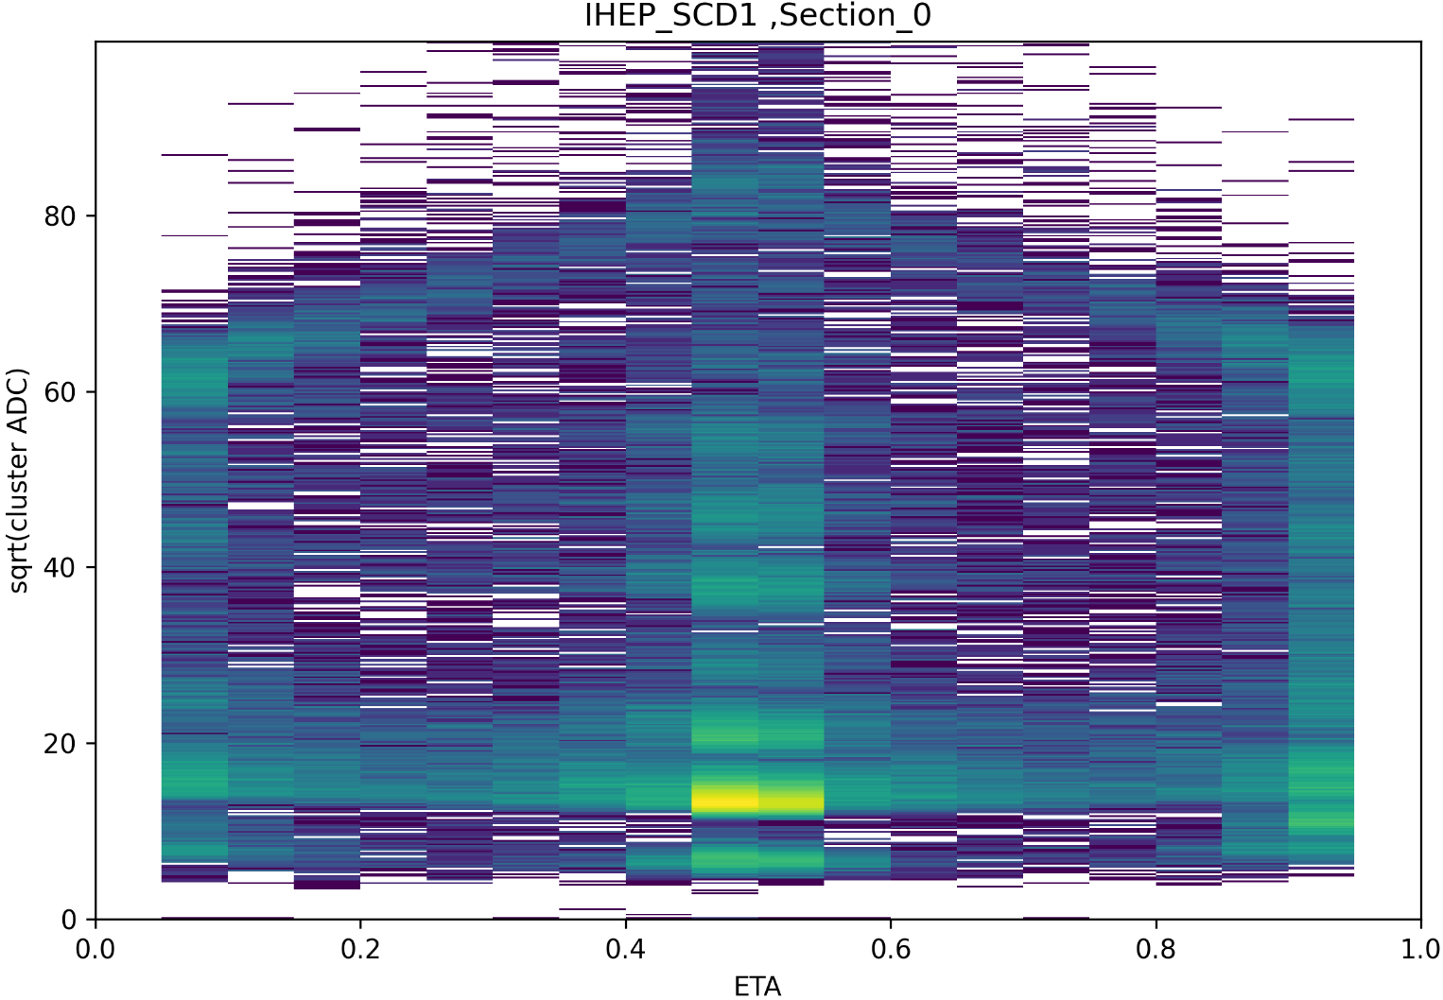
High-level data processing
ETA Selection ——20 ETAbin
eta selection , plot sqrt(ADC) spectrum
FIG.1

Slide 6
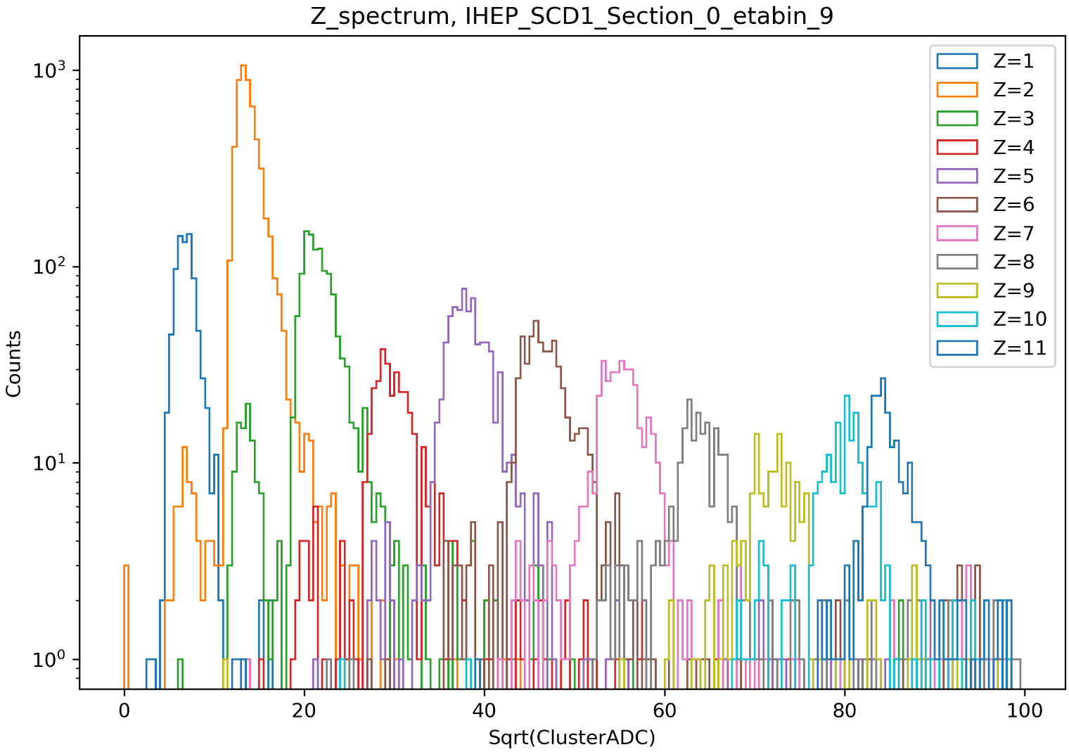
High-level data processing
FIG.2

Slide 7
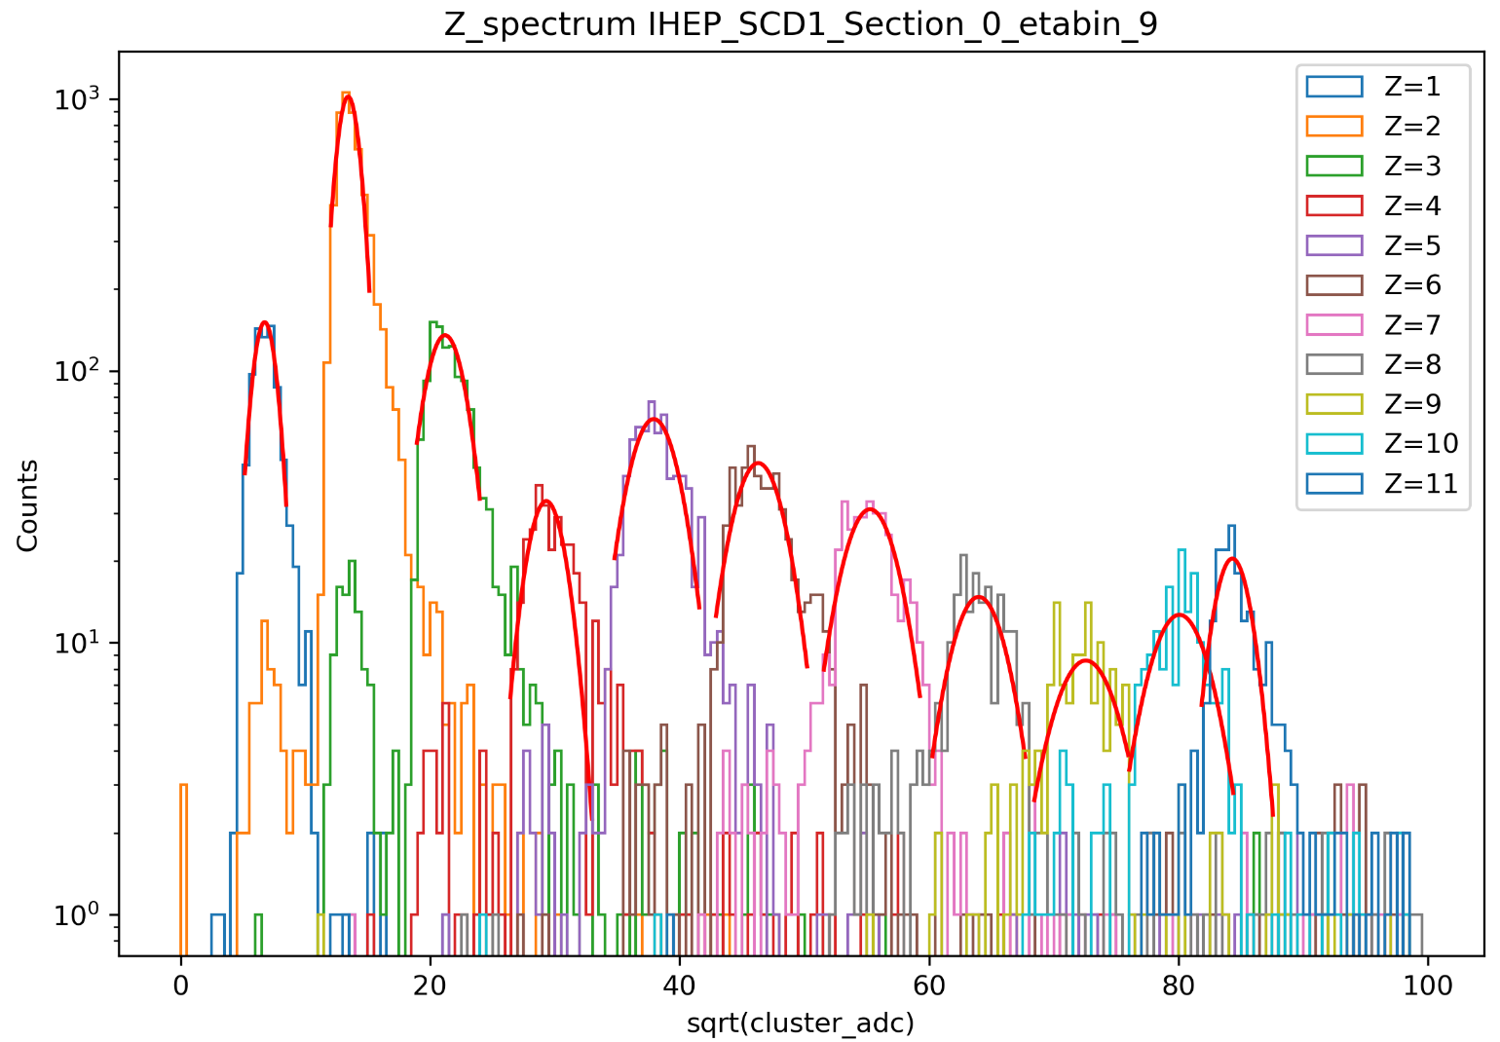
High-level data processing
Gaussian fitting
The peak positions of each particle were fitted using a Gaussian to obtain the corresponding mean values.
FIG.3

Slide 8
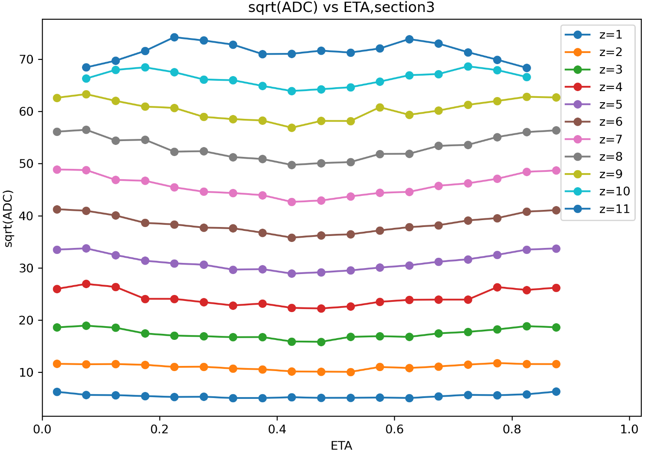
High-level data processing
Extracting the mean values for each ETAbin for each particle and plotting eta versus peak position, one can see a V-shaped band similar to that in Figure 1.
Too few counts to be fitted
FIG.4

Slide 9
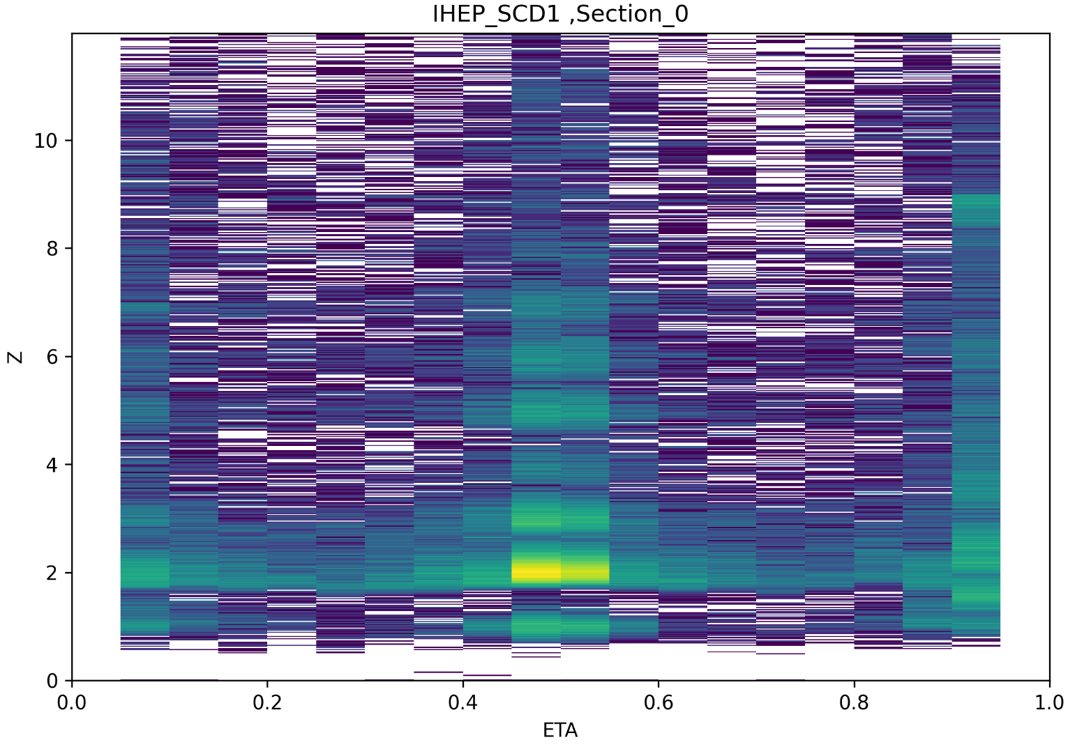
Charge reconstruction
Spline interpolation
By interpolating the spline curve ,plotting Z versus ETA, you can see that the V-shaped band in the graph becomes a horizontal band, eliminating the dependence on ETA.
FIG.5

Slide 10
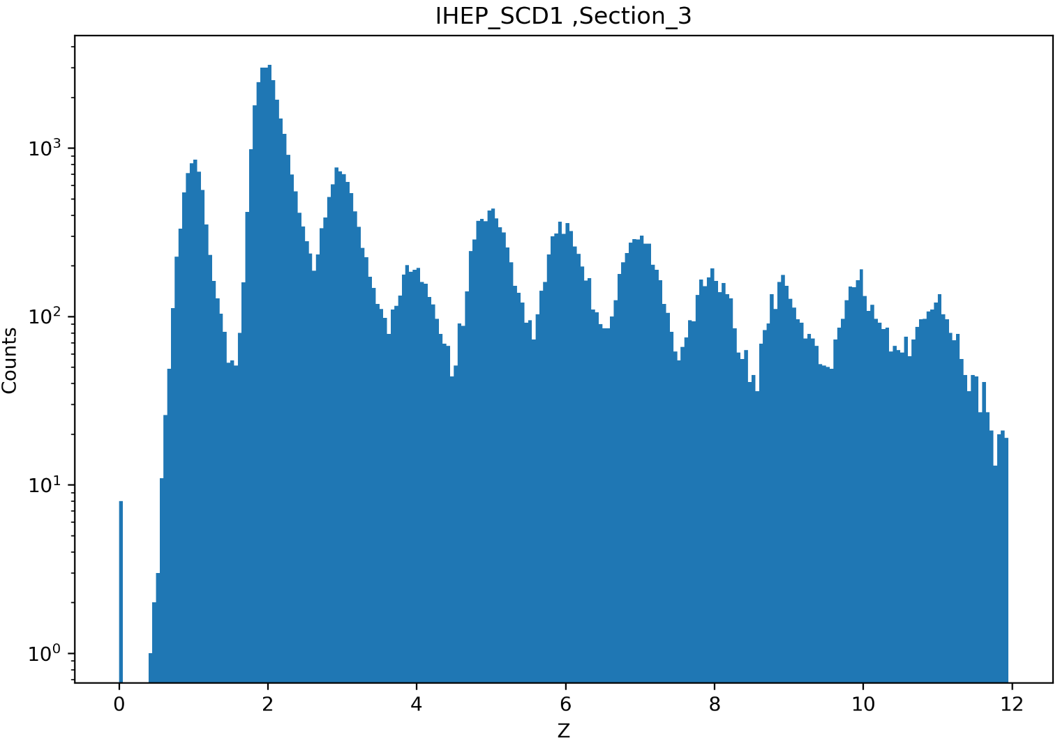
Charge reconstruction
Accumulated charge spectrum
FIG.6

Slide 11
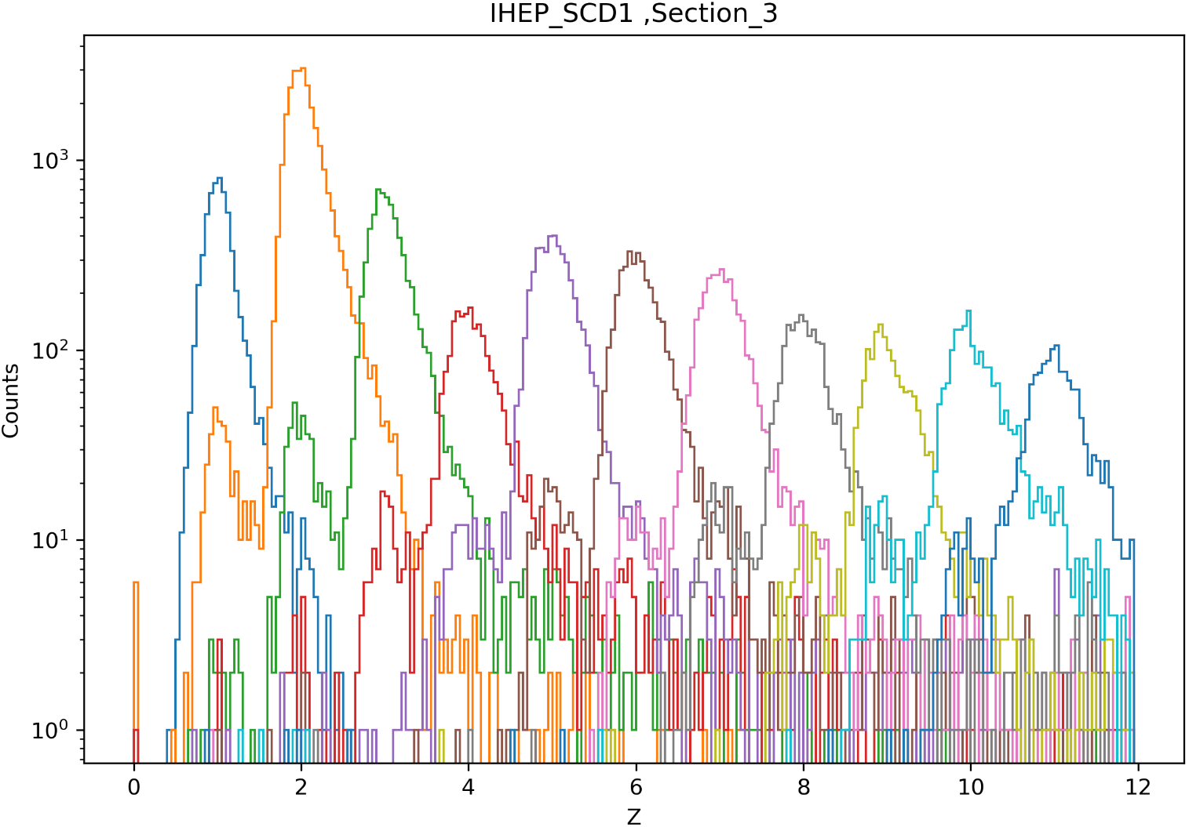
Charge reconstruction
The reconstructed charge spectrum for each particle in each section are accumulated in turn according to the PID.
FIG.7

Slide 12
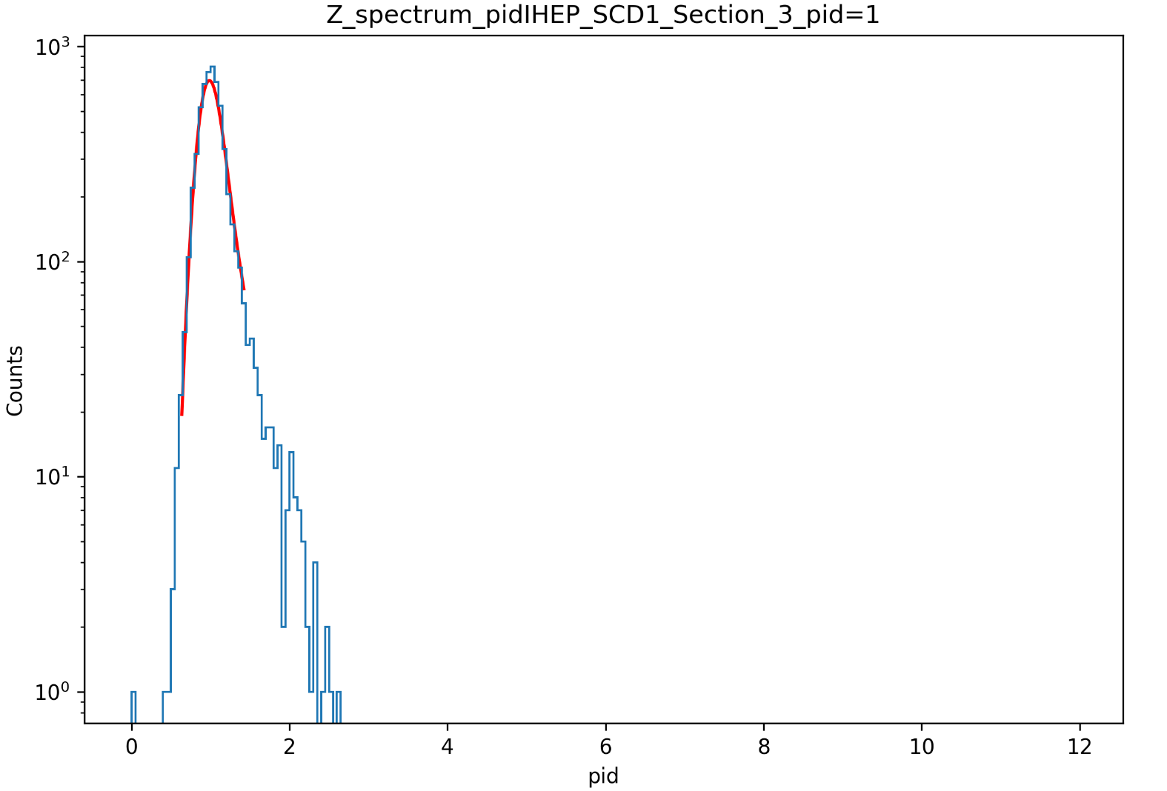
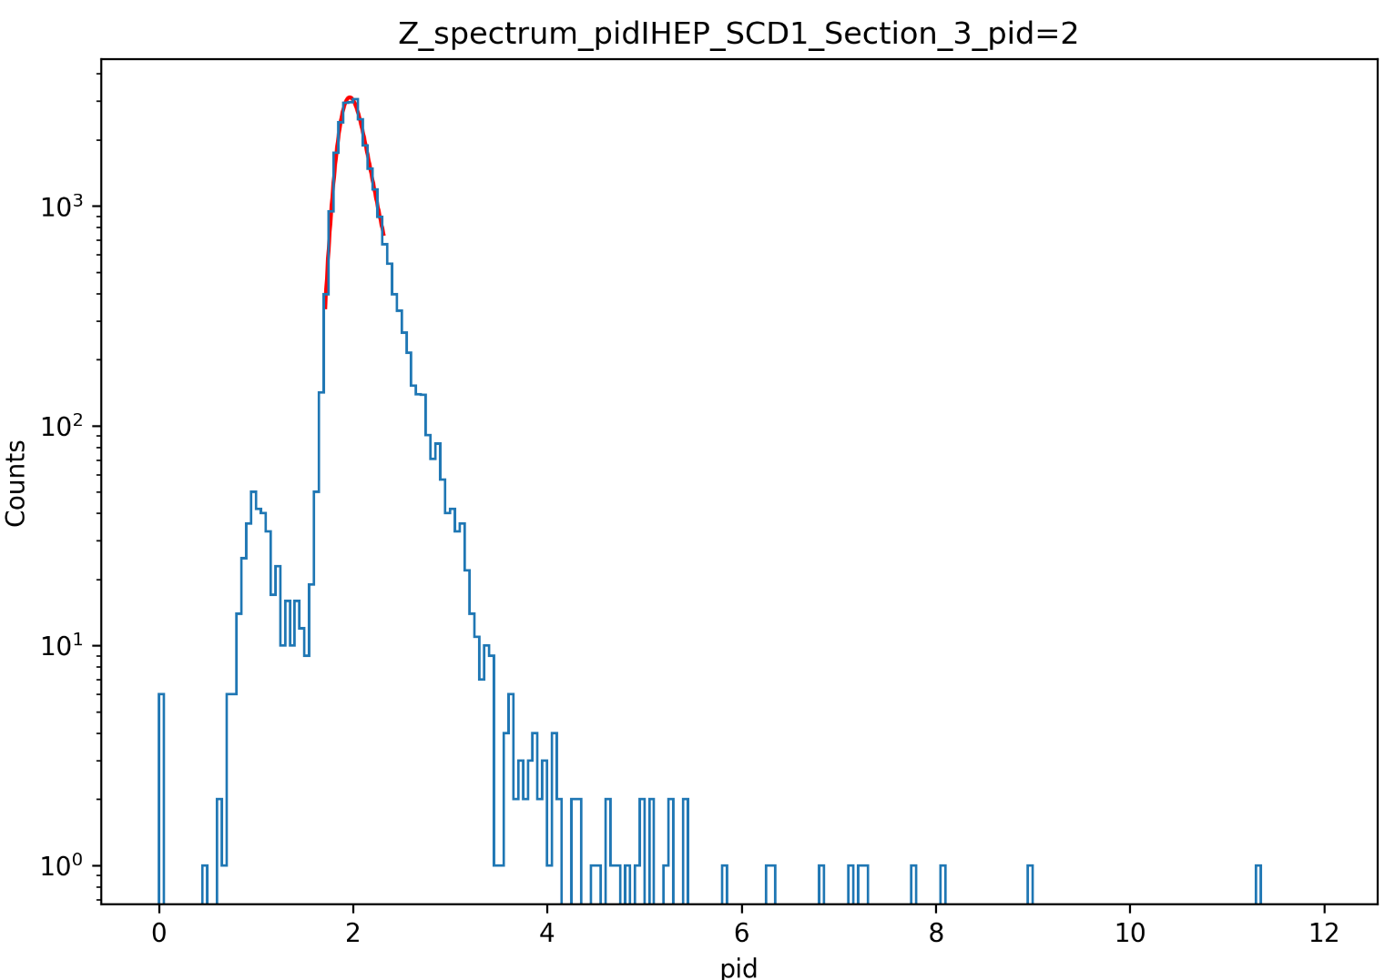
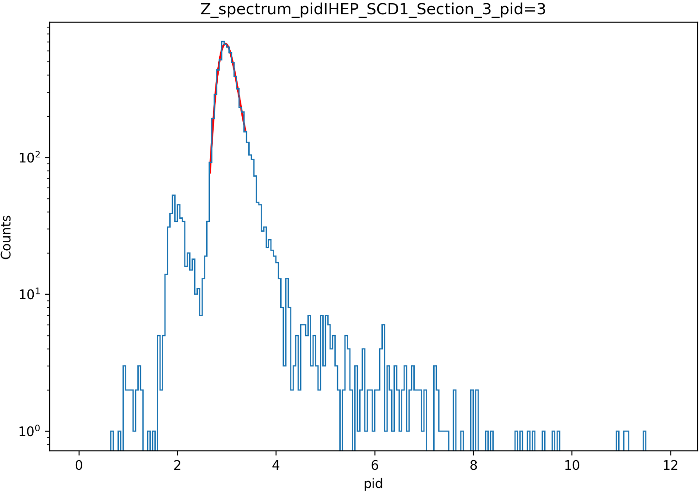
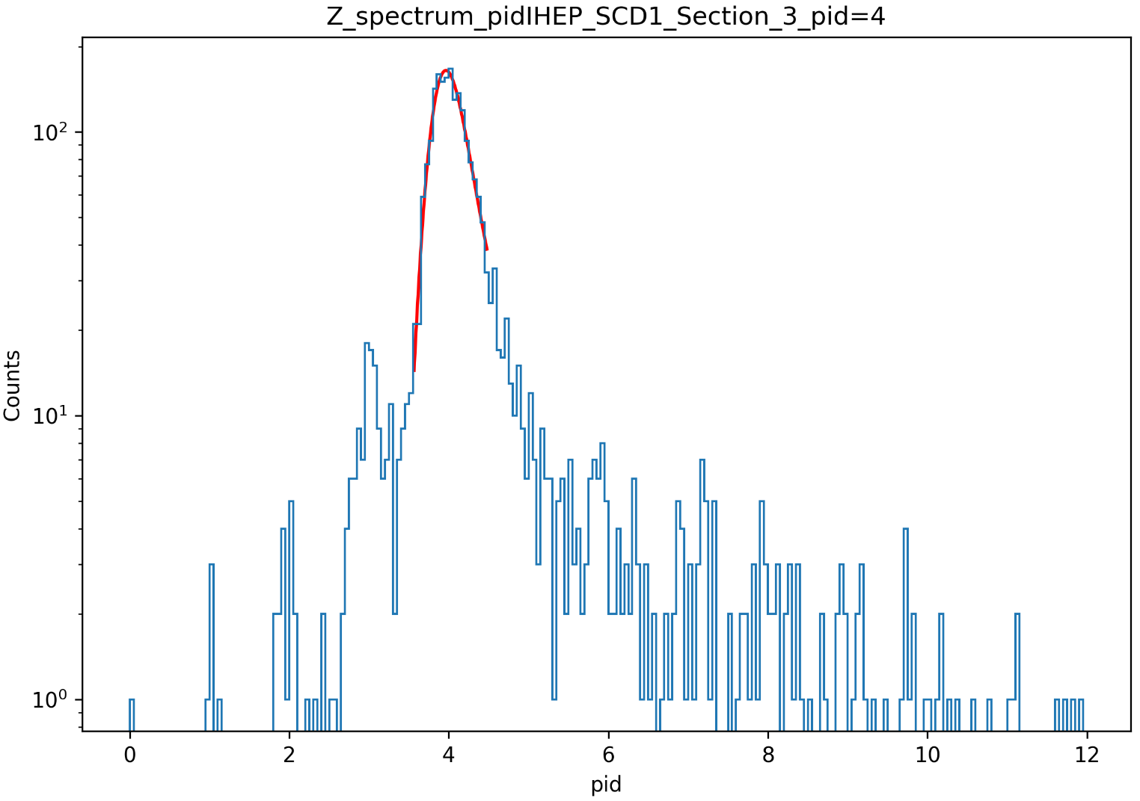
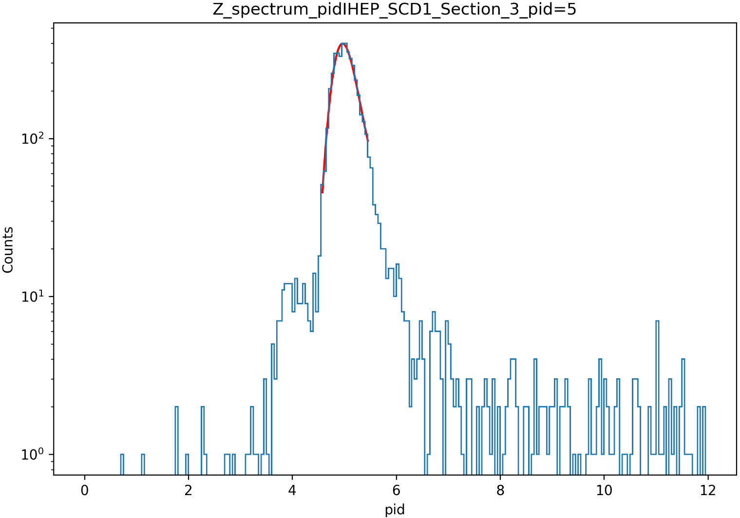
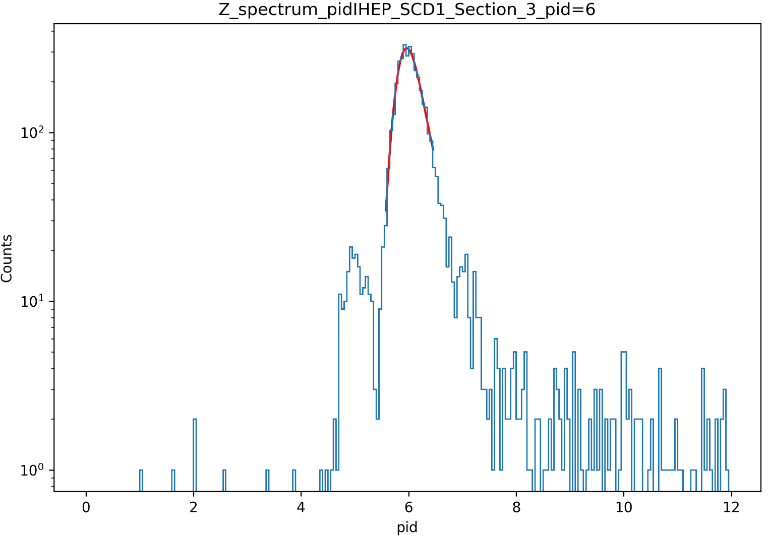
Charge reconstruction
Landau Gaussian fitting
The FWHM of each particle is calculated by a Landau Gaussian fit to obtain the final charge resolution.
Z=1
Z=2
Z=3
Z=4
Z=5
Z=6
FIG.8

Slide 13
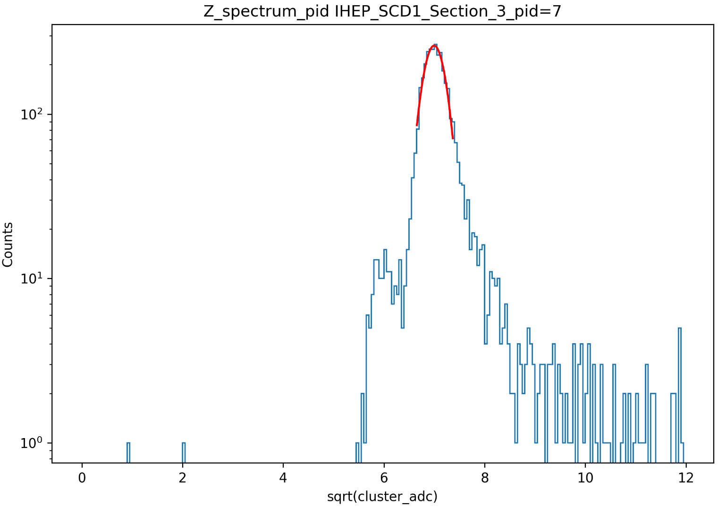
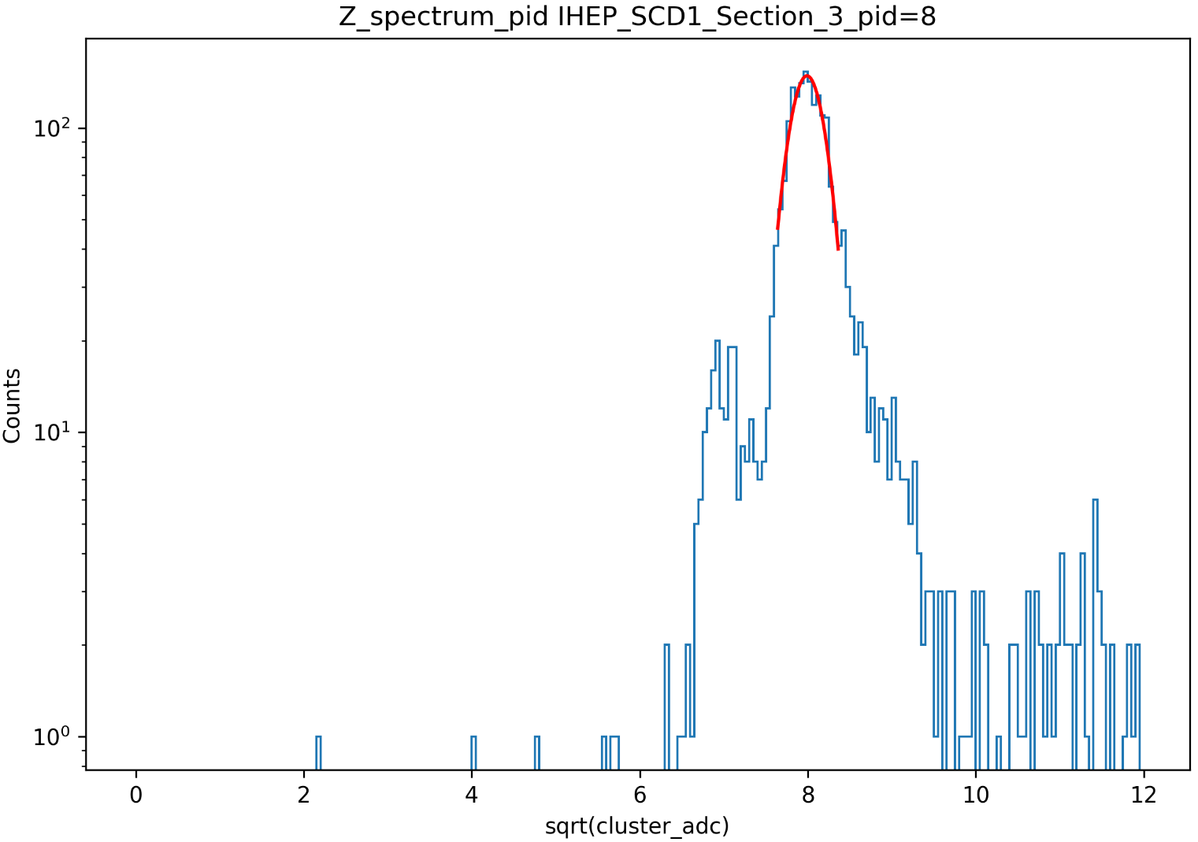
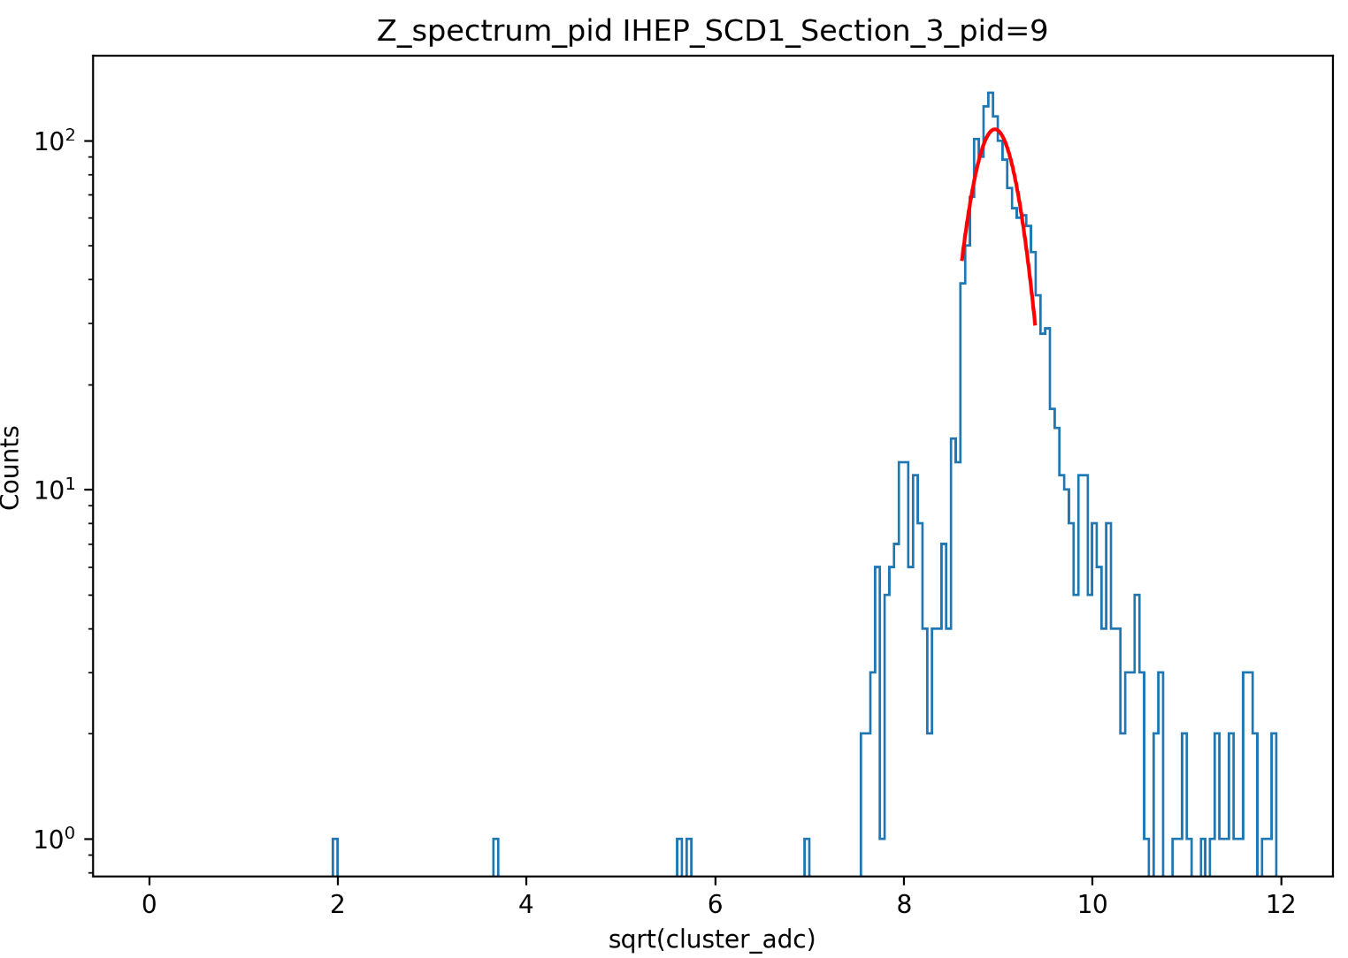
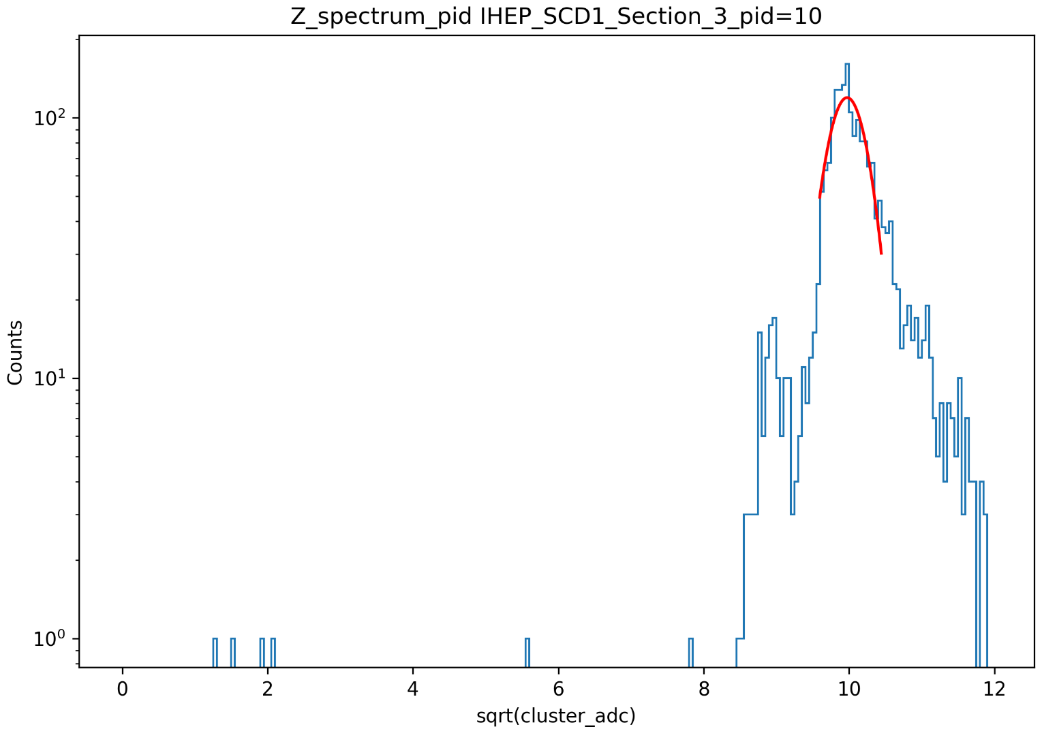
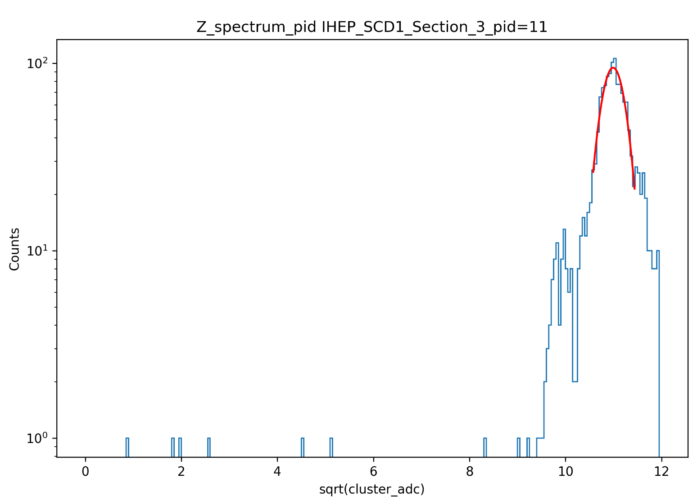
Charge reconstruction
Z=7
Z=8
Z=9
Z=10
Z=11

Slide 14
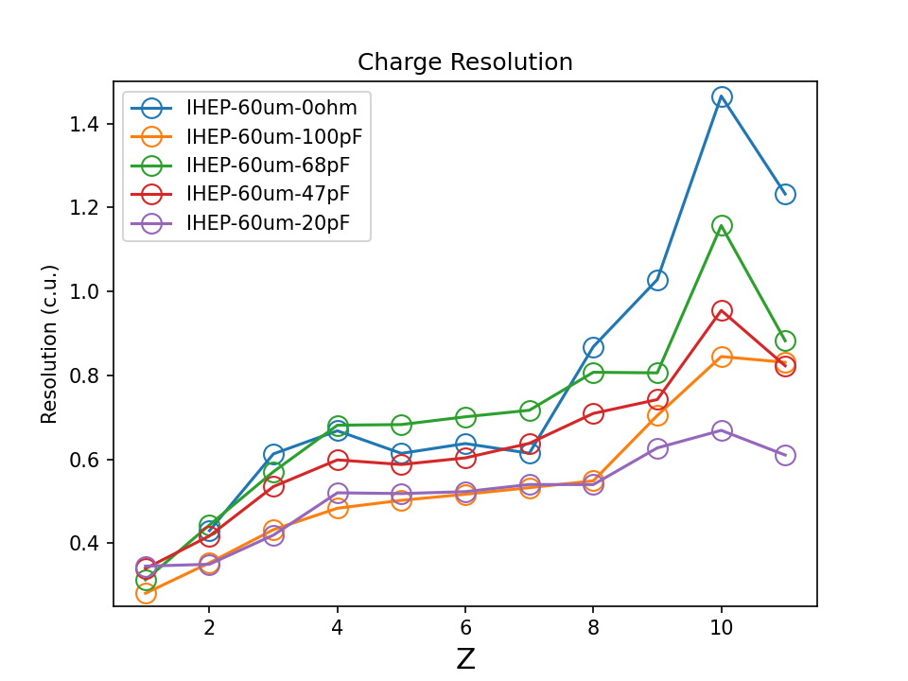
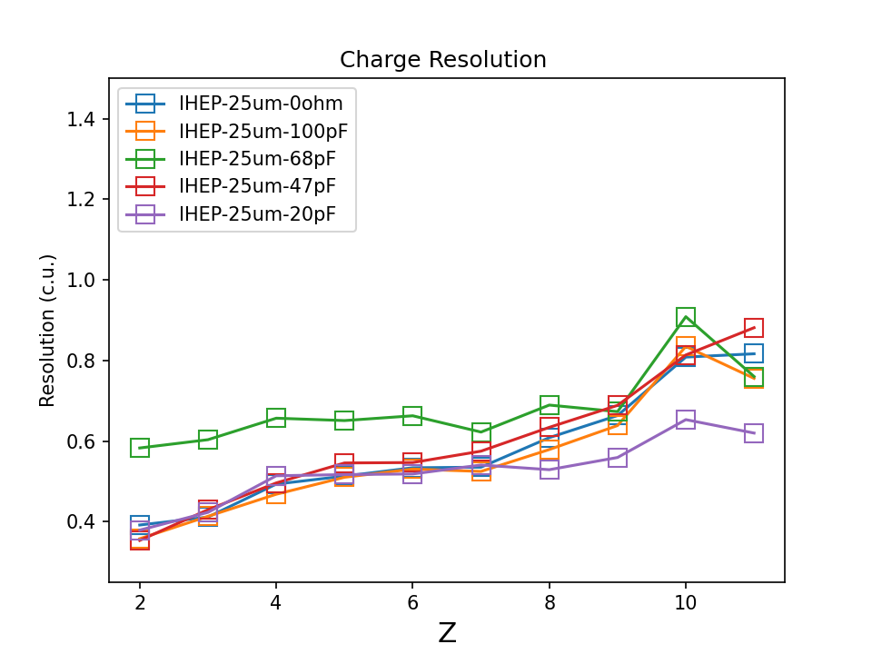
Charge reconstruction
Results of charge reconstruction in 10 sections
60um
25um
FIG.9
FIG.10

Slide 15
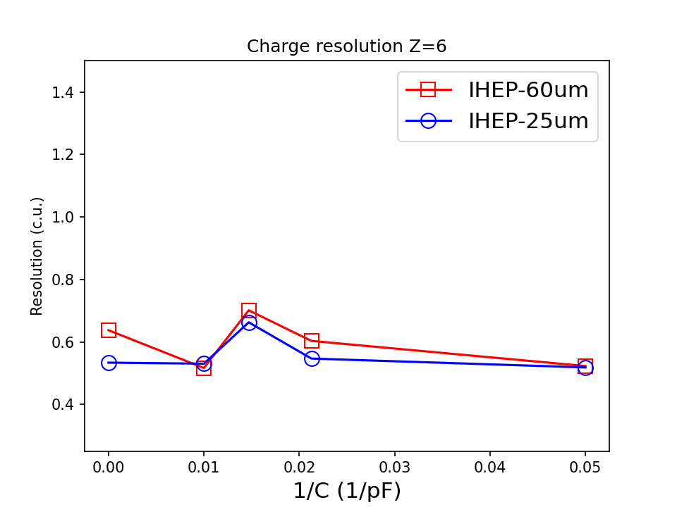
Charge reconstruction
FIG.11

Slide 16
Conclusion
Charge spectra from Z=1 ~ 11 were reconstructed with the help of the PMO PID using the ETA correction method.

Slide 17
Thanks!

