Slide 1
Report of charge sharing results for beam test
Lu Ruosi

Slide 2
outline
Analysis of particle hitting readout strip
Analysis of particle hitting floating strip

Slide 3
Data processing workflow
prepare advanced data
elements
amplitude of each channel in Cluster(ADC)
sequence number of maximum amplitude channel
the number of maximum amplitude channel in the cluster
Maximum channel amplitude(ADC)
the sum of amplitudes of all channels in the Cluster
ETA value
and so on
filter for 10 hit positions
filter ETA and particle types
post-processing

Slide 4
Data processing workflow
prepare advanced data
distinguish 10 different sections :
0ohm
0ohm
filter for 10 hit positions
68pF
47pF
0
1
2
3
4
5
6
7
8
9
20pF
100pF
filter ETA and particle types
60um width
25um width
post-processing

Slide 5
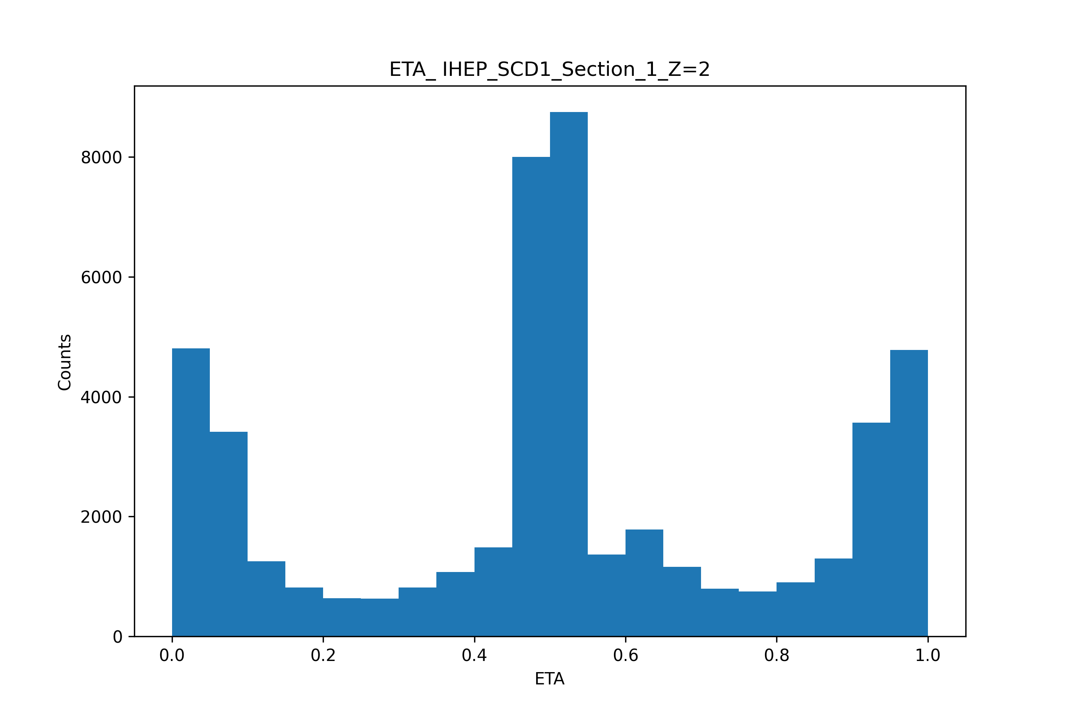
Data processing workflow
prepare advanced data
filter for 10 hit positions
filter ETA and particle types
readout strip
floating strip
readout strip
post-processing

Slide 6
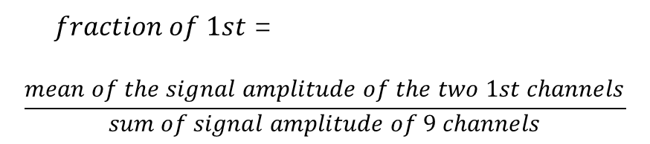
Signal amplitude of the cluster:
$fraction of 1st$ =
$$\frac{mean of the signal amplitude of the two 1st channels}{sum of signal amplitude of 9 channels}$$
hit readout strip
Ch42
float
Ch43
float
Ch44
float
Ch45
float
Ch46
float
Ch47
float
Ch48
float
Ch49
float
Ch50
4th
3rd
2nd
1st
seed
1st
2nd
3rd
4th

Slide 7
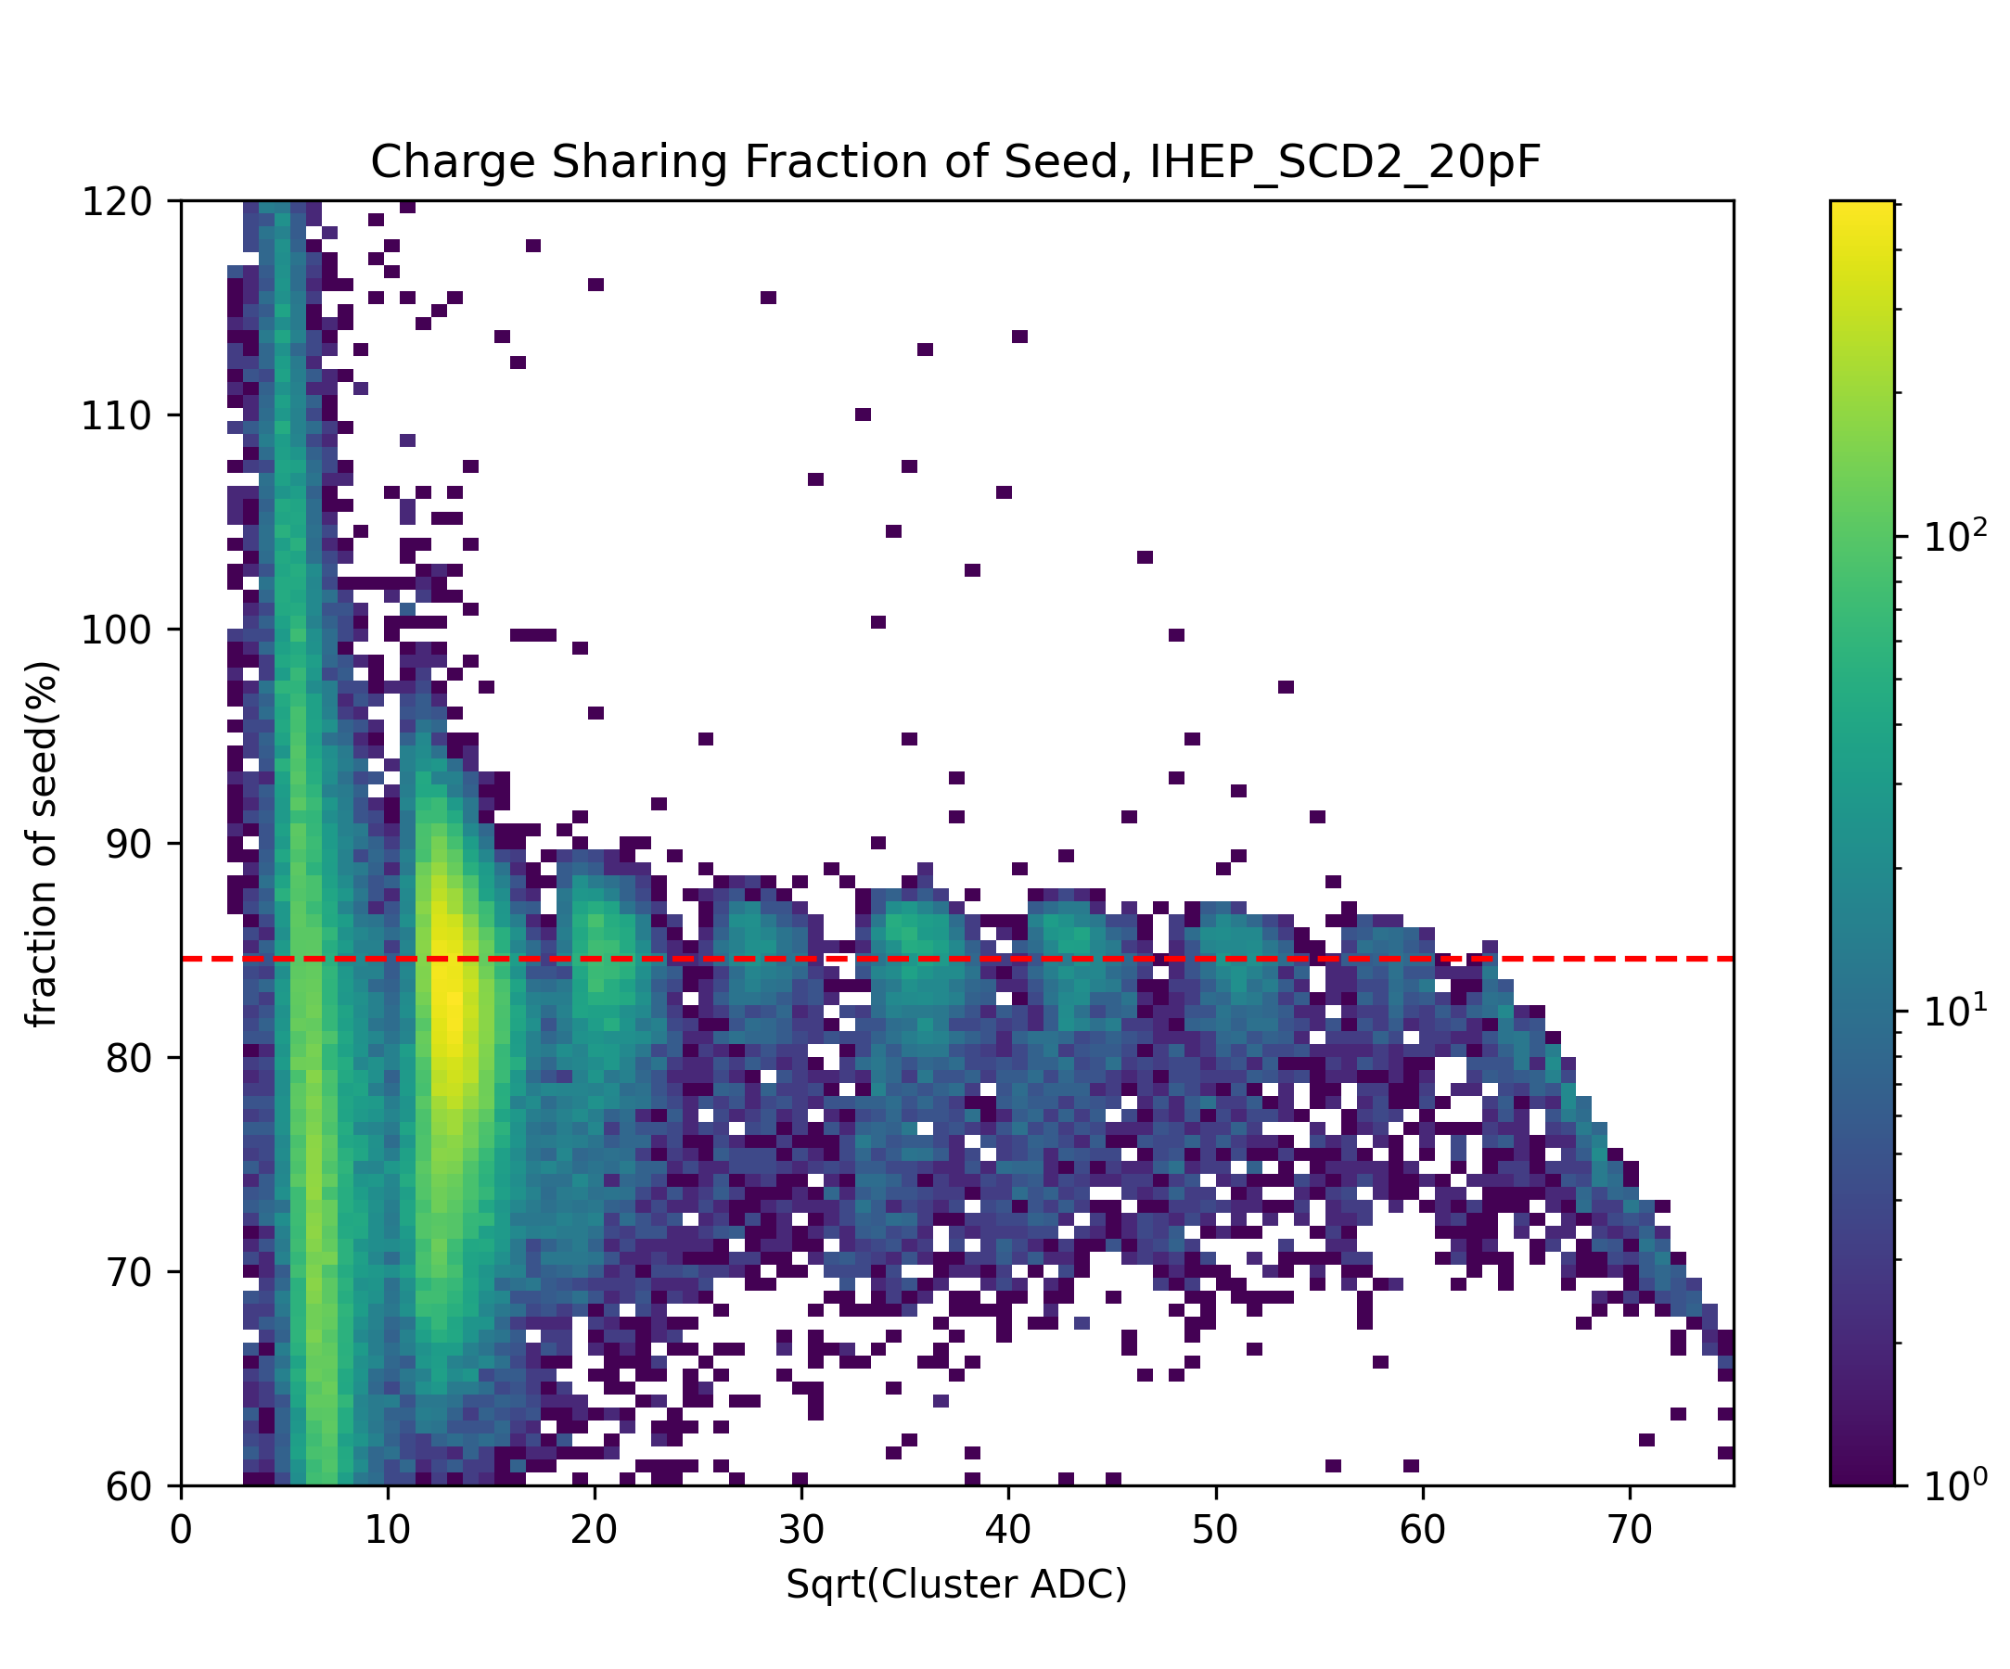
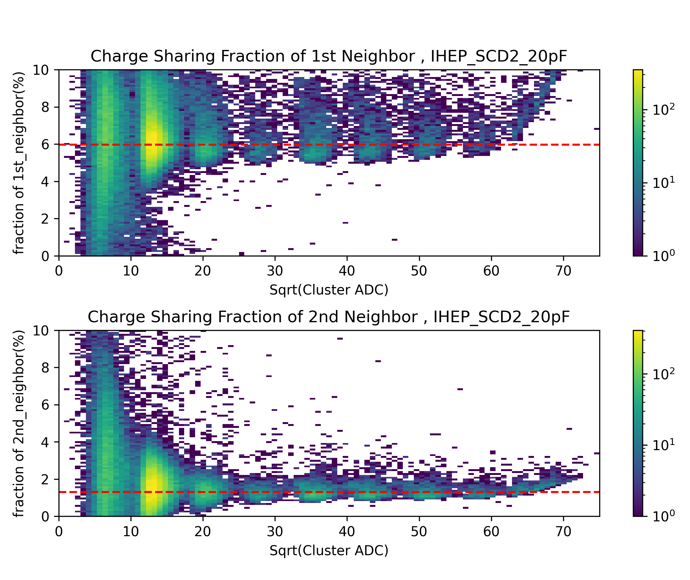
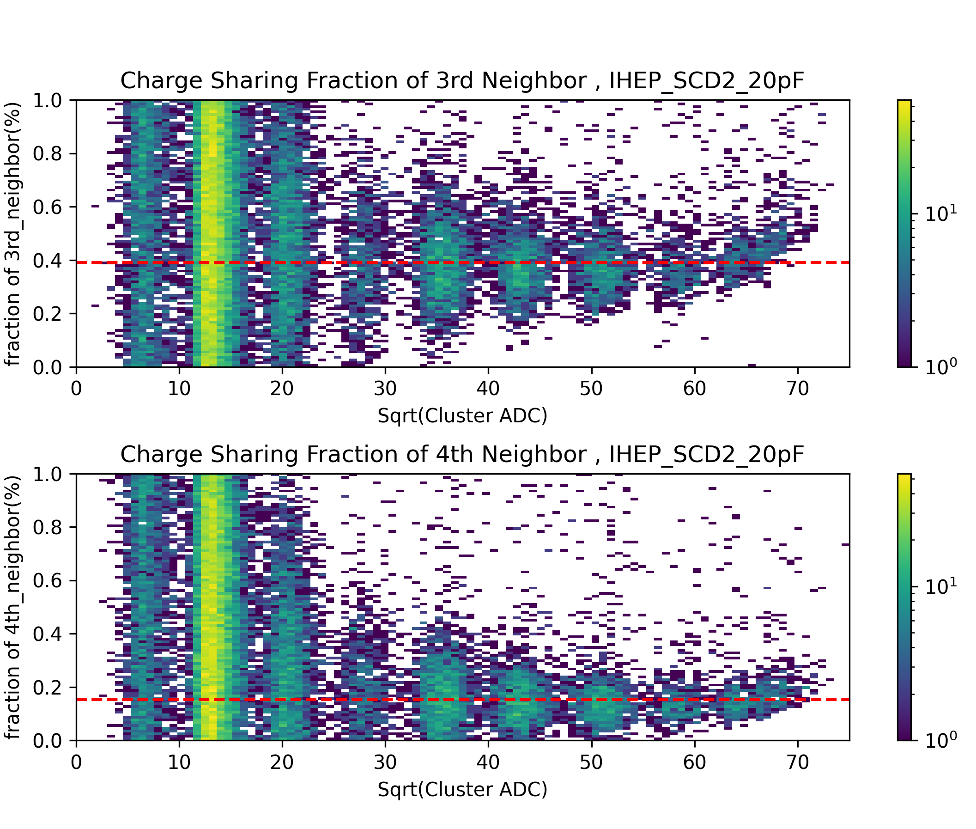
readout strip:
for example: silicon microstrip width is 25um, capacitance is 20pF
3rd
seed
1st
4th
2nd

Slide 8
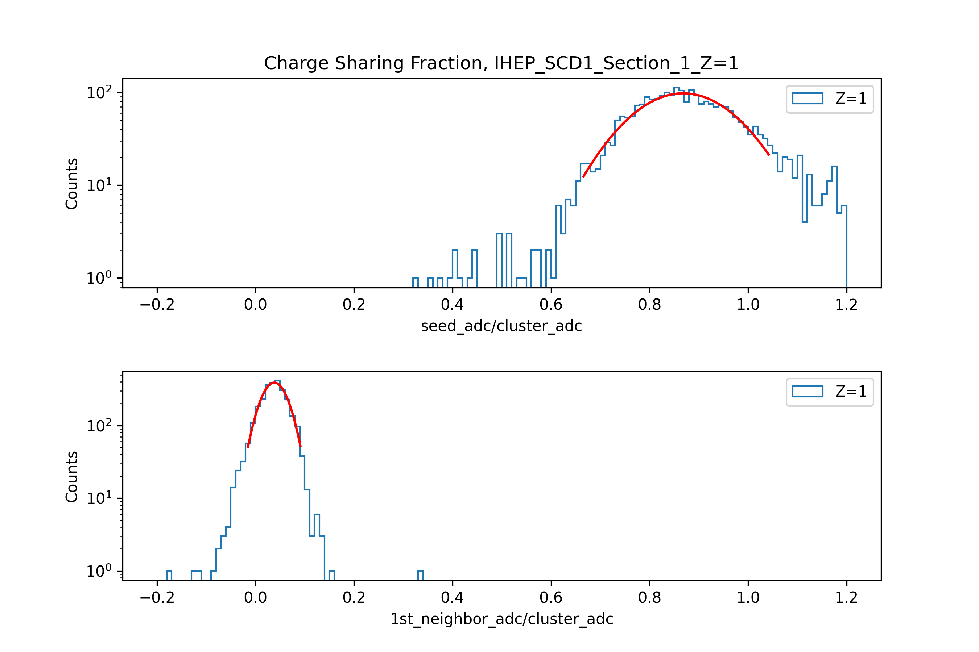
Data processing workflow
prepare advanced data
filter for 10 hit positions
gaussian fit for the accumulated histogram of the filtered
charge sharing ratio
filter ETA and particle types
Get the mean value and sigma value corresponding to different detector, section, Z
post-processing
through error transfer function, obtain the final charge sharing ratio that doesn’t distinguish between Z

Slide 9
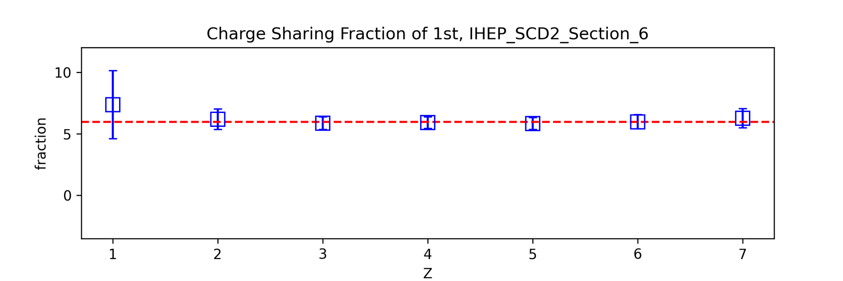
Data processing workflow
prepare advanced data
filter for 10 hit positions
1st
gaussian fit for the accumulated histogram of the filtered
charge sharing ratio
filter ETA and particle types
Get the mean value and sigma value corresponding to different detector, section, Z
post-processing
through error transfer function, obtain the final charge sharing ratio that doesn’t distinguish between Z

Slide 10
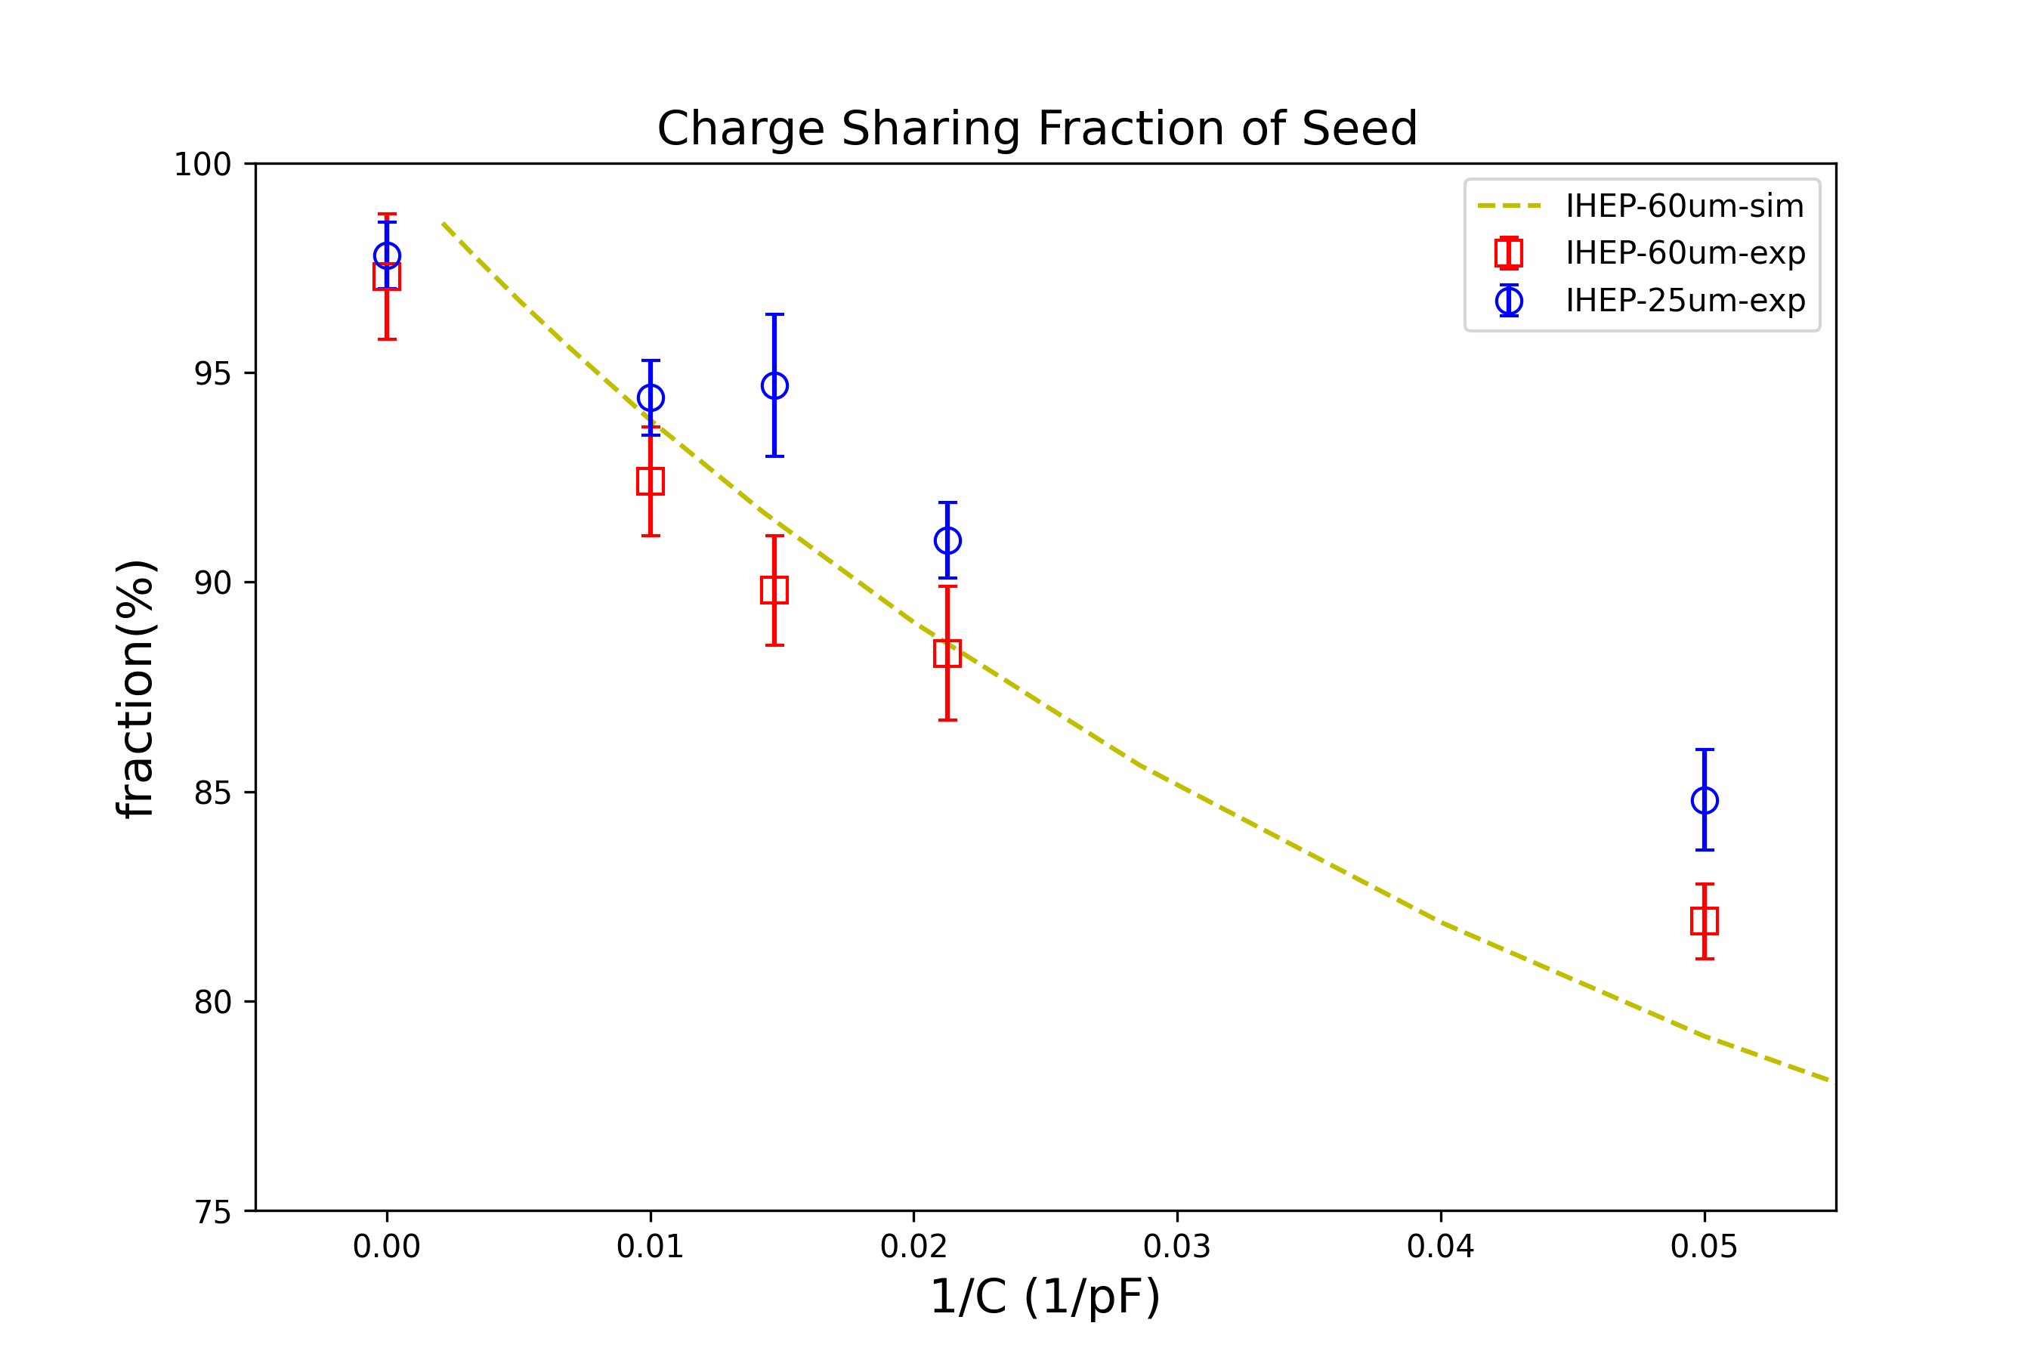
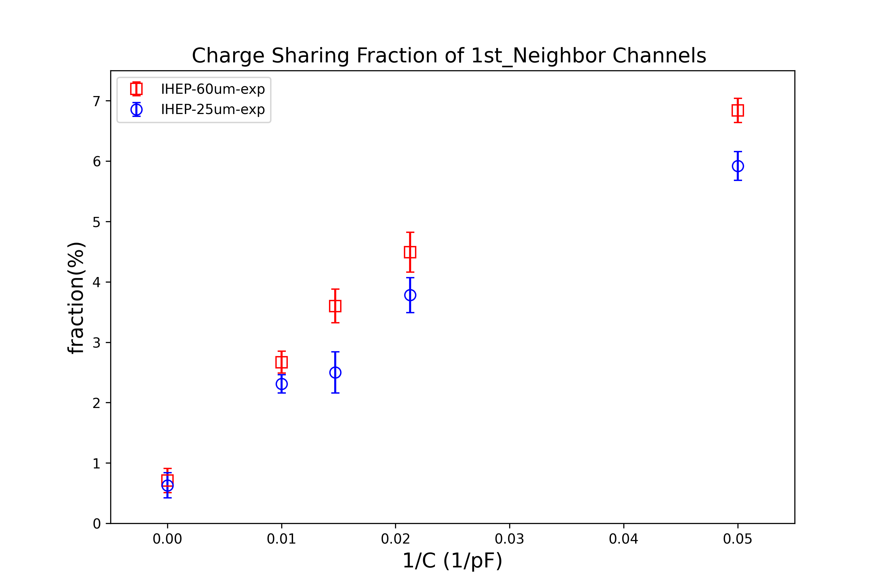
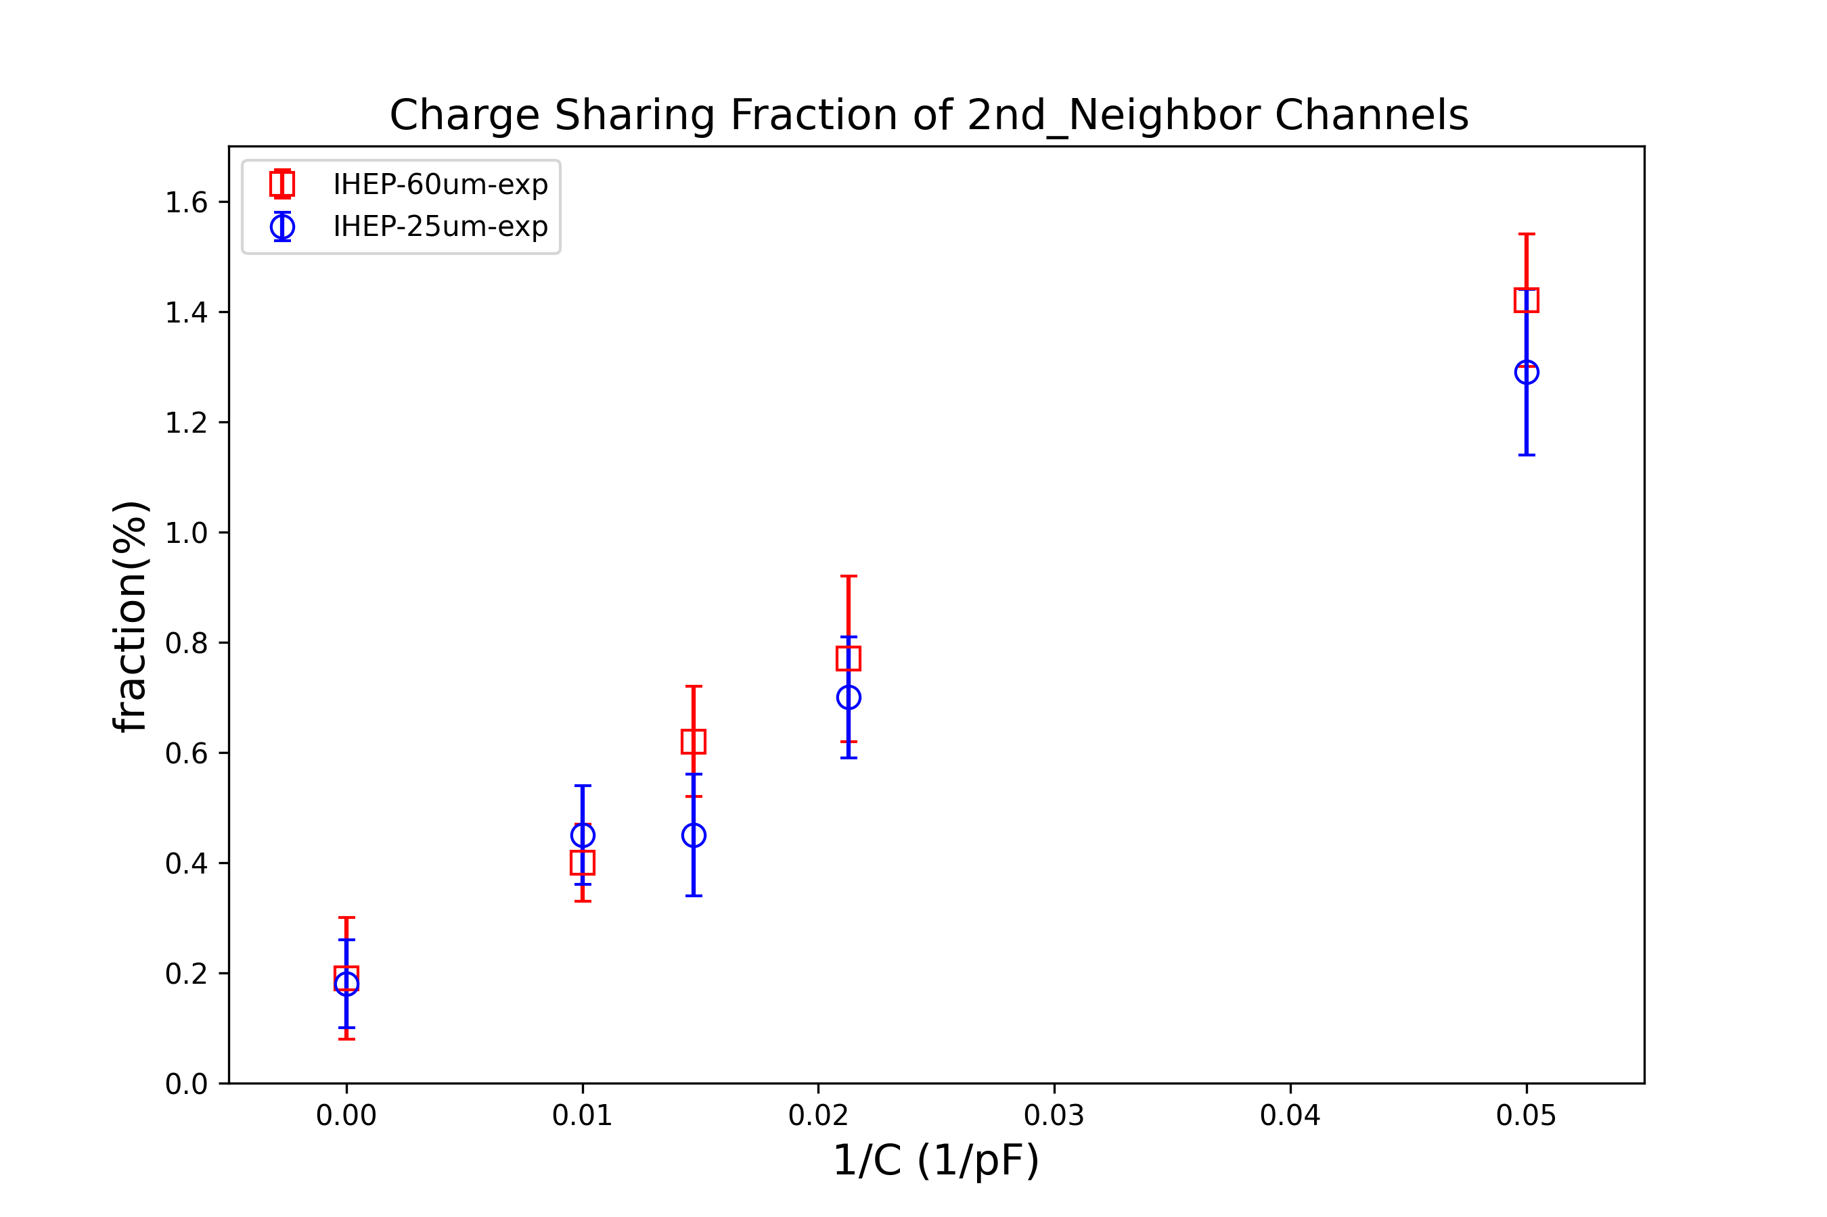
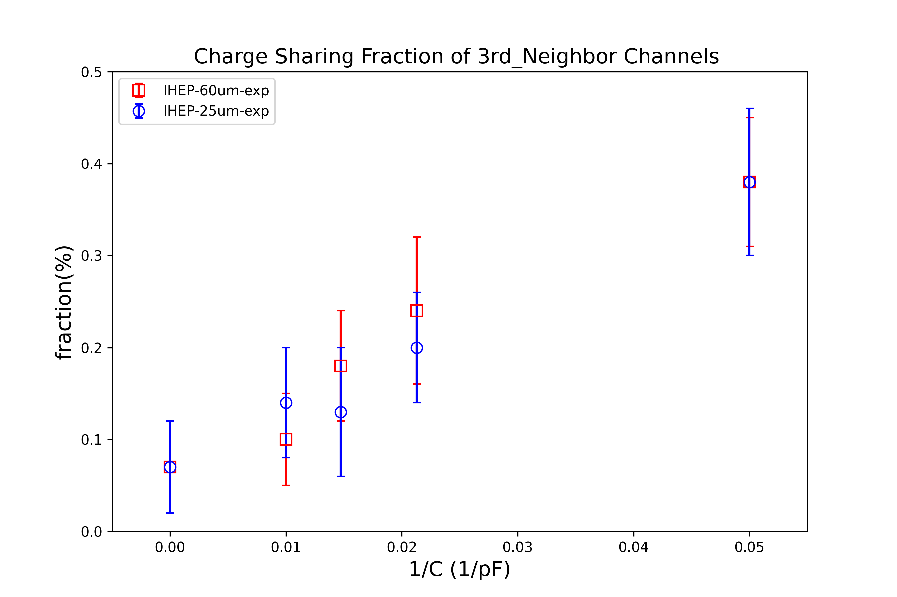
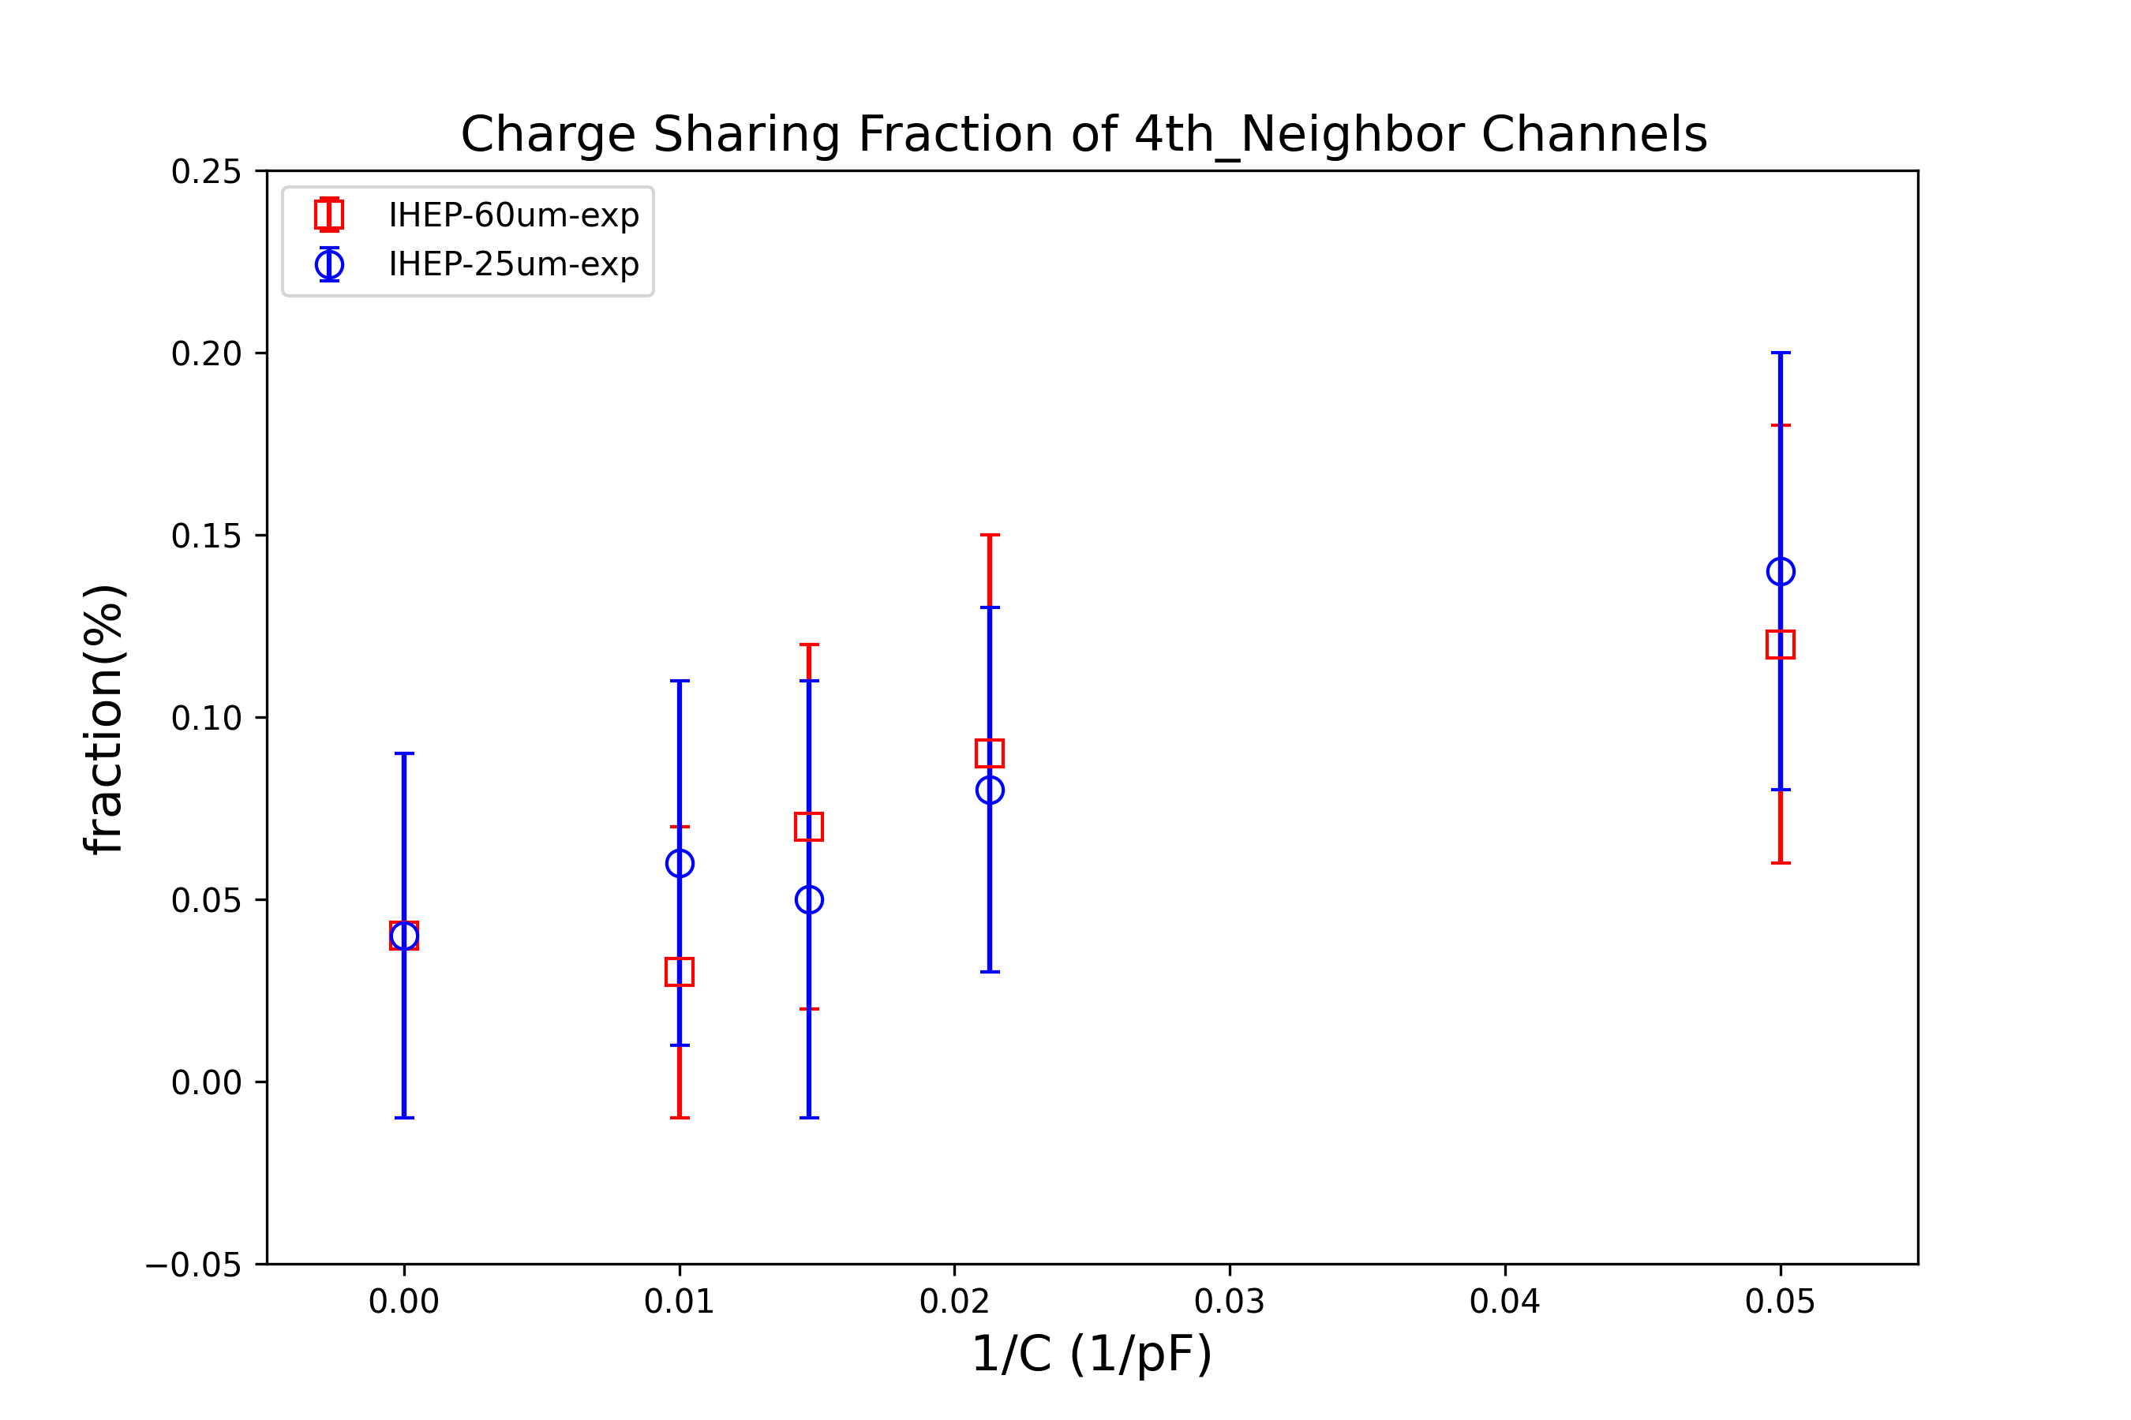
through error transfer function, obtain the final charge sharing ratio that doesn’t distinguish between Z
seed
1st
2nd
red:60um
blue:25um
3rd
4th

Slide 11
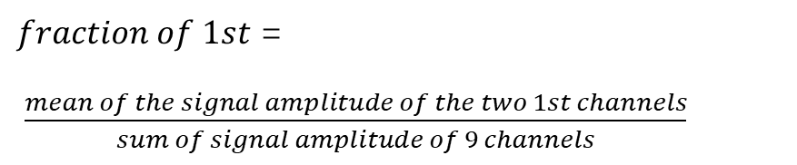
Signal amplitude of the cluster:
$fraction of 1st$ =
$\frac{mean of the signal amplitude of the two 1st channels}{sum of signal amplitude of 9 channels}$
hit floating strip
Ch42
float
Ch43
float
Ch44
float
Ch45
float
Ch46
float
Ch47
float
Ch48
float
Ch49
4th
3rd
2nd
1st
1st
2nd
3rd
4th

Slide 12
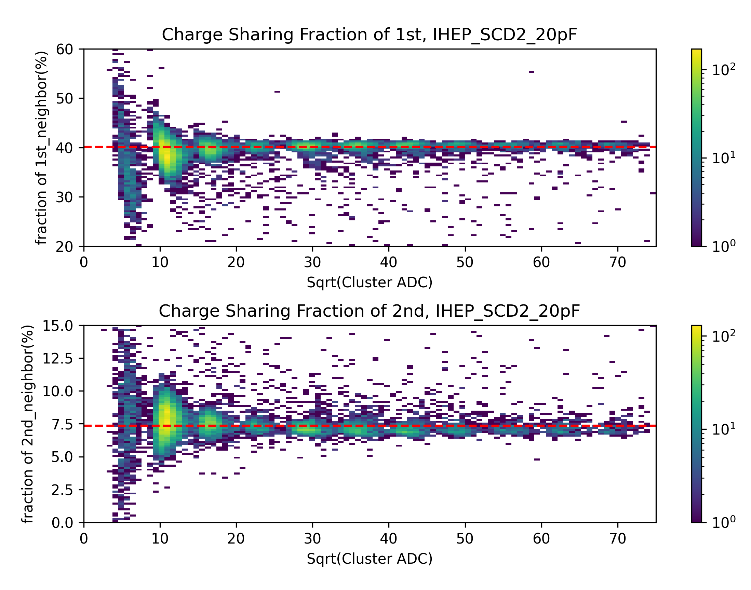
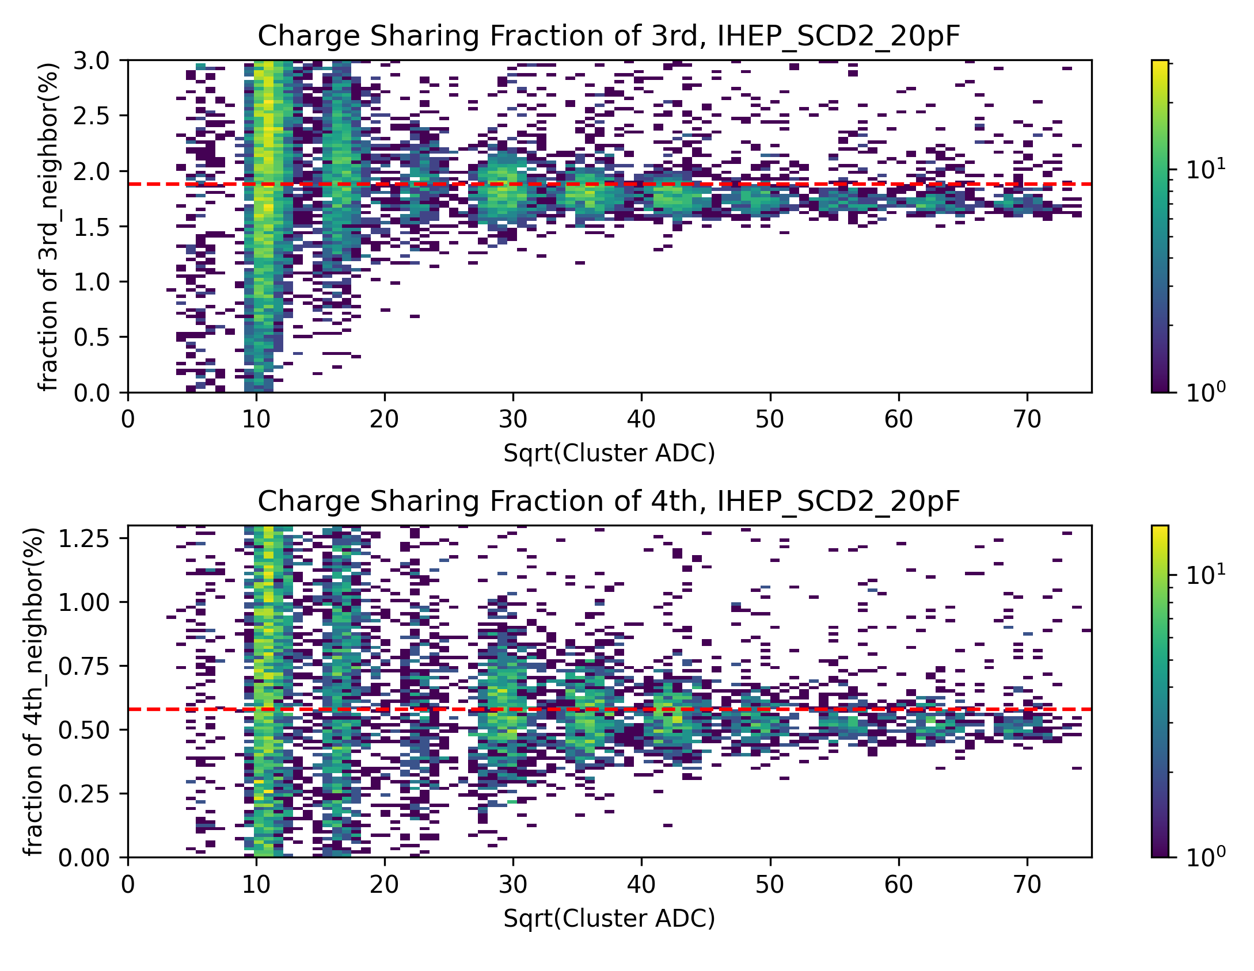
floating strip:
for example: silicon microstrip width is 25um, capacitance is 20pF
1st
3rd
2nd
4th

Slide 13
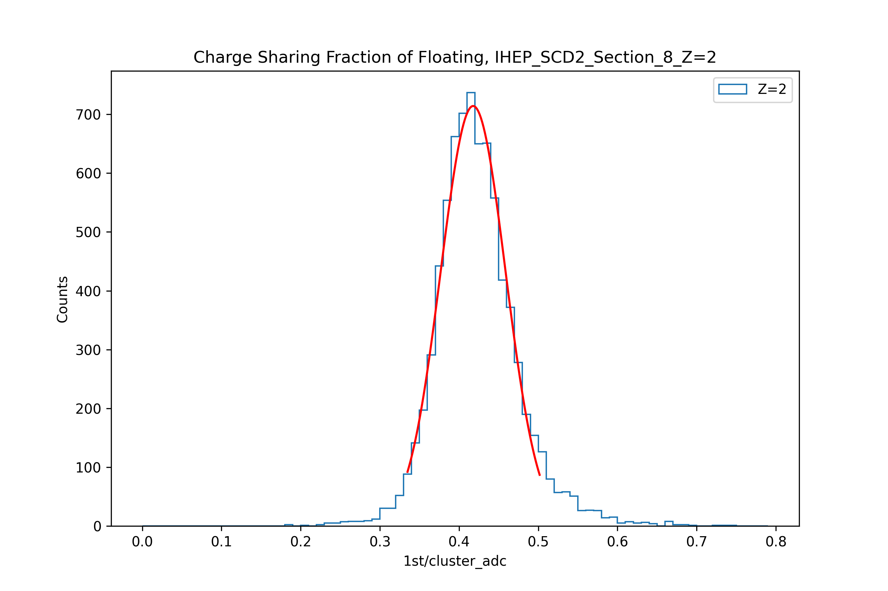
Data processing workflow
prepare advanced data
filter for 10 hit positions
gaussian fit for the accumulated histogram of the filtered
charge sharing ratio
filter ETA and particle types
Get the mean value and sigma value corresponding to different detector, section, Z
post-processing
through error transfer function, obtain the final charge sharing ratio that doesn’t distinguish between Z

Slide 14
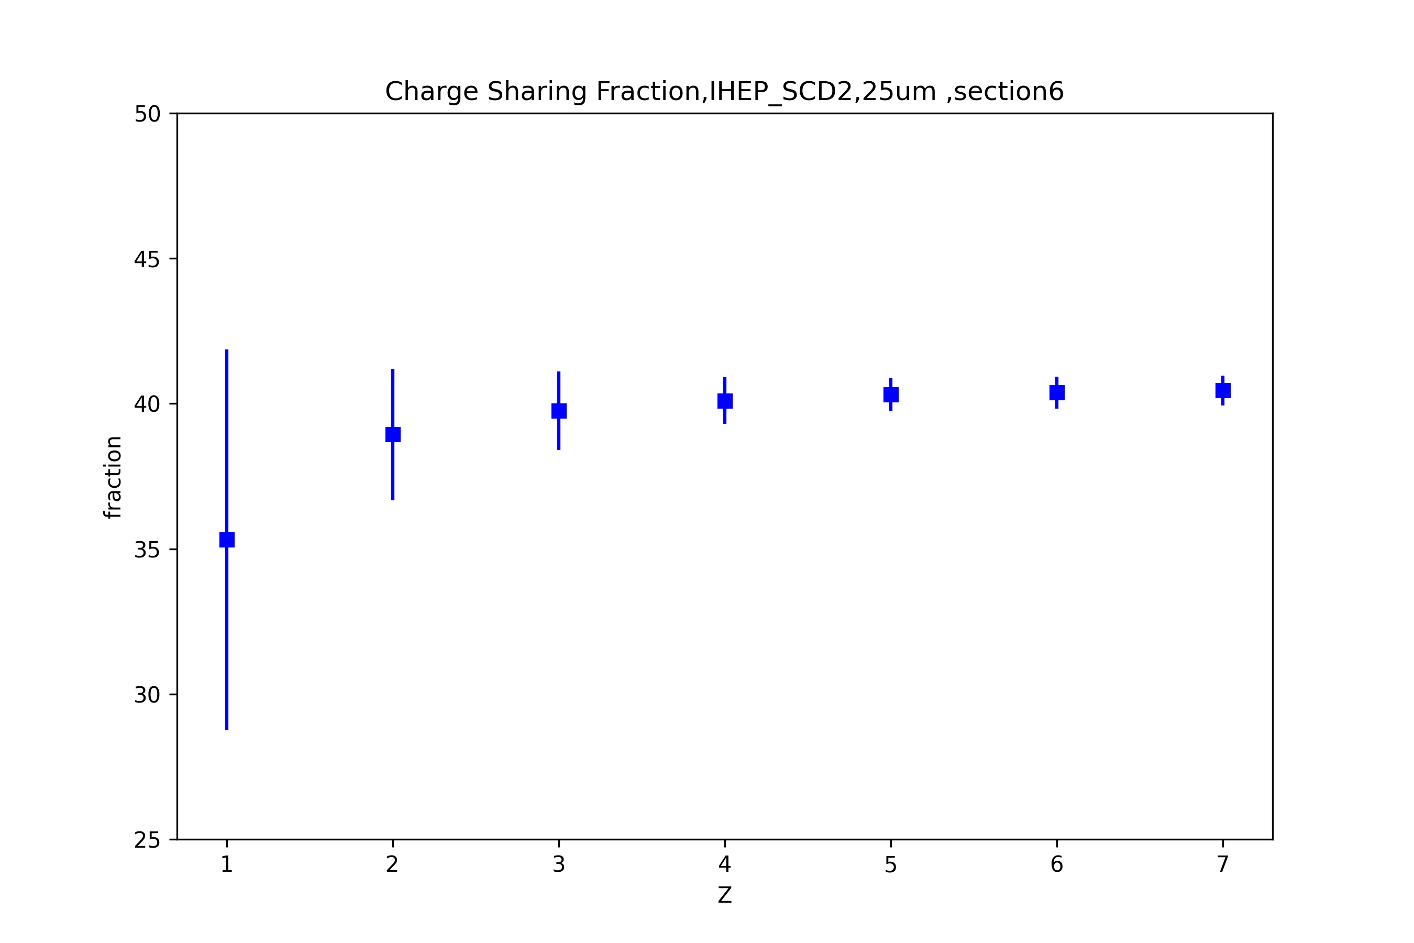
Data processing workflow
prepare advanced data
filter for 10 hit positions
1st
gaussian fit for the accumulated histogram of the filtered
charge sharing ratio
filter ETA and particle types
Get the mean value and sigma value corresponding to different detector, section, Z
post-processing
through error transfer function, obtain the final charge sharing ratio that doesn’t distinguish between Z

Slide 15
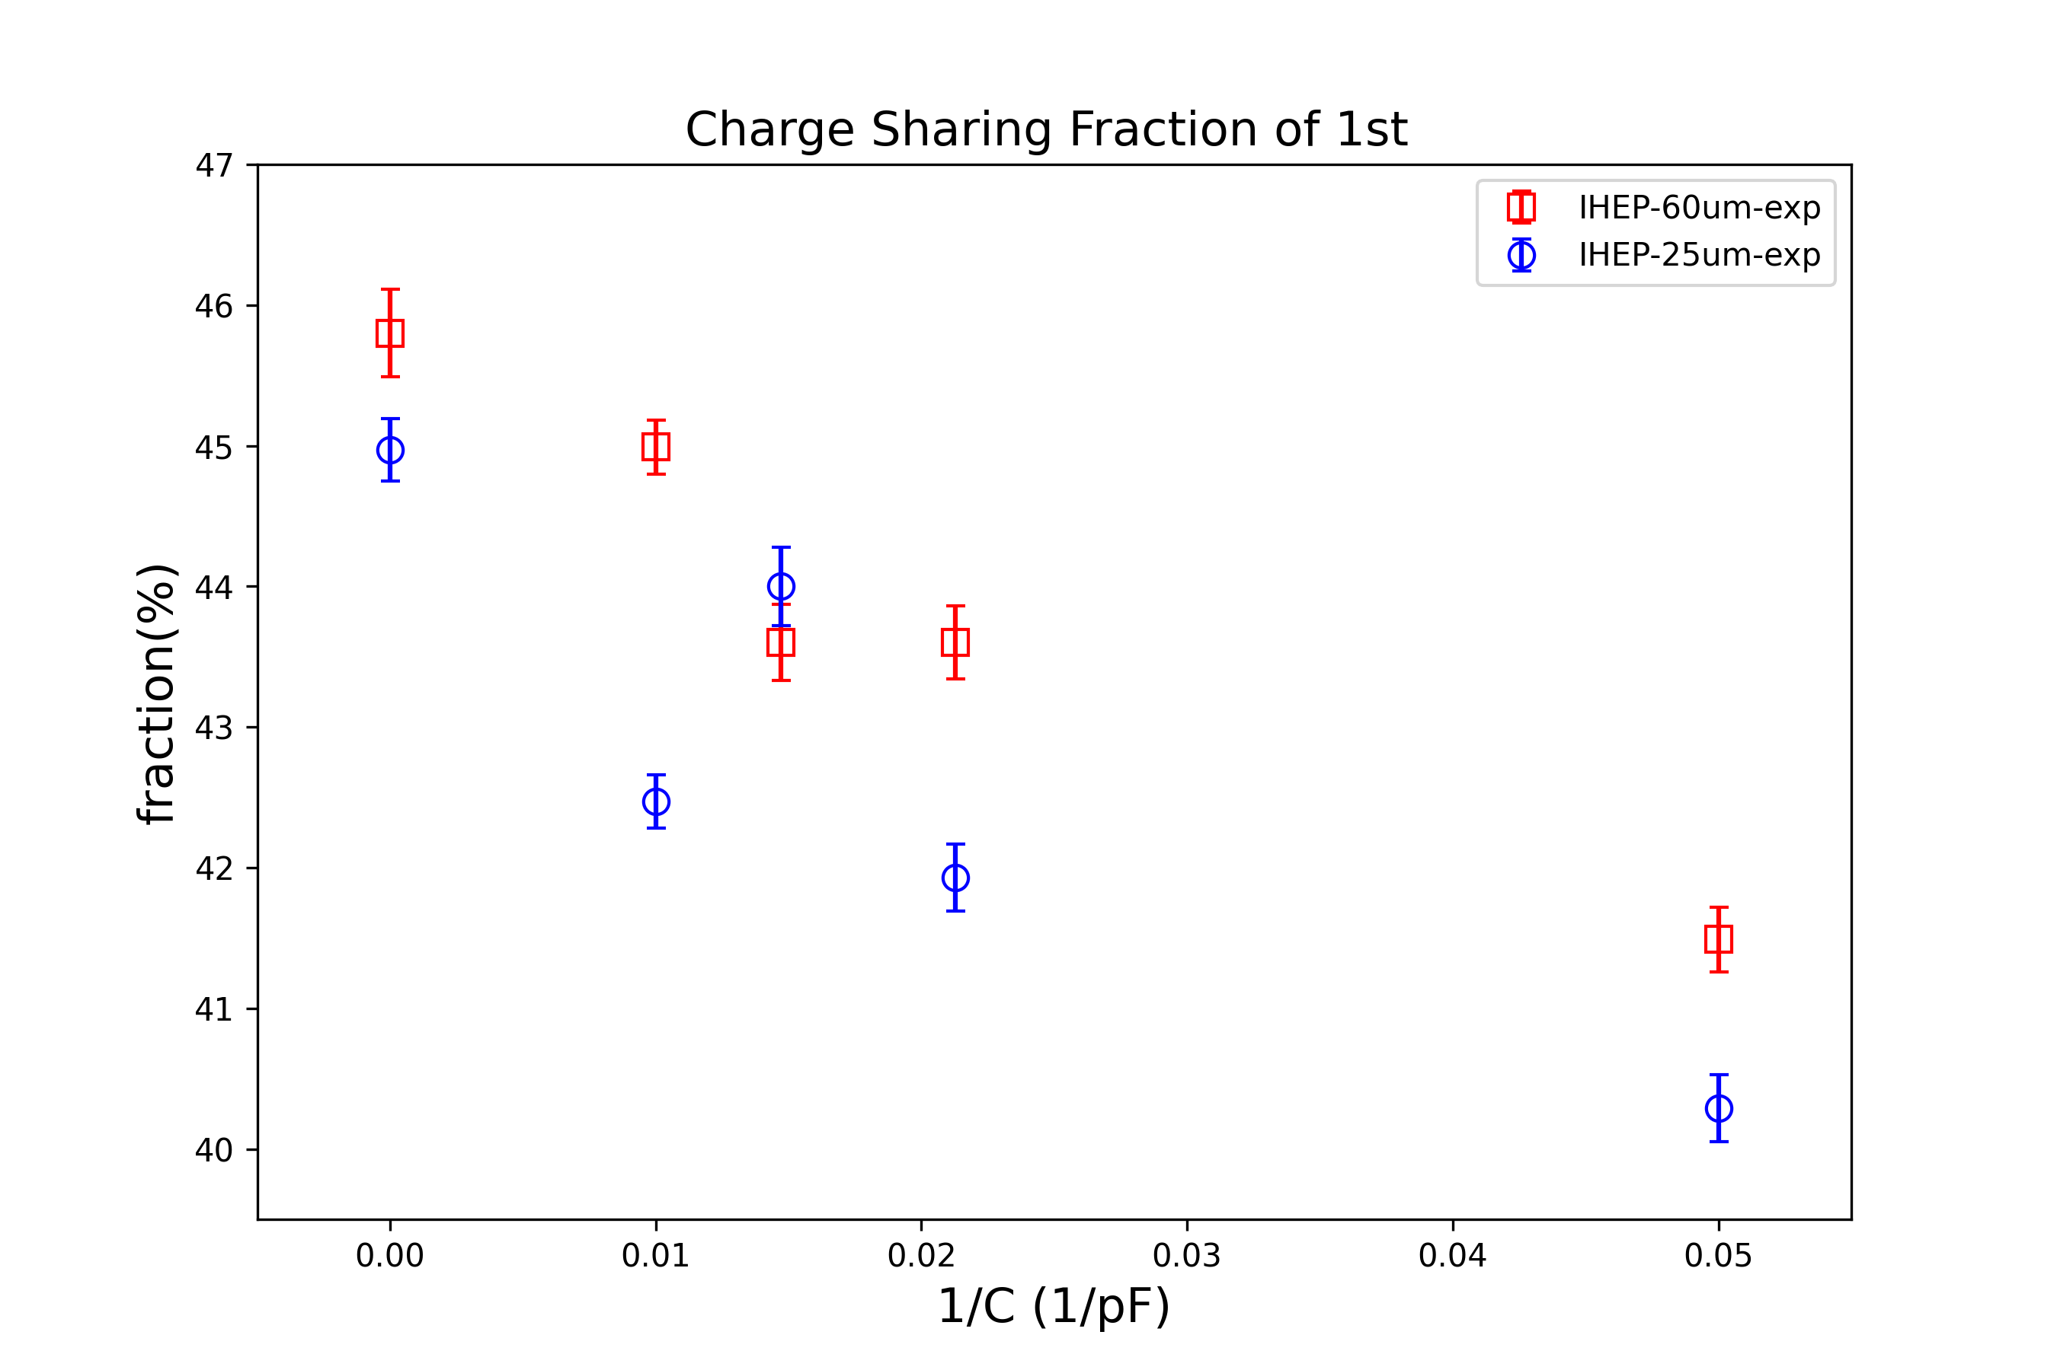
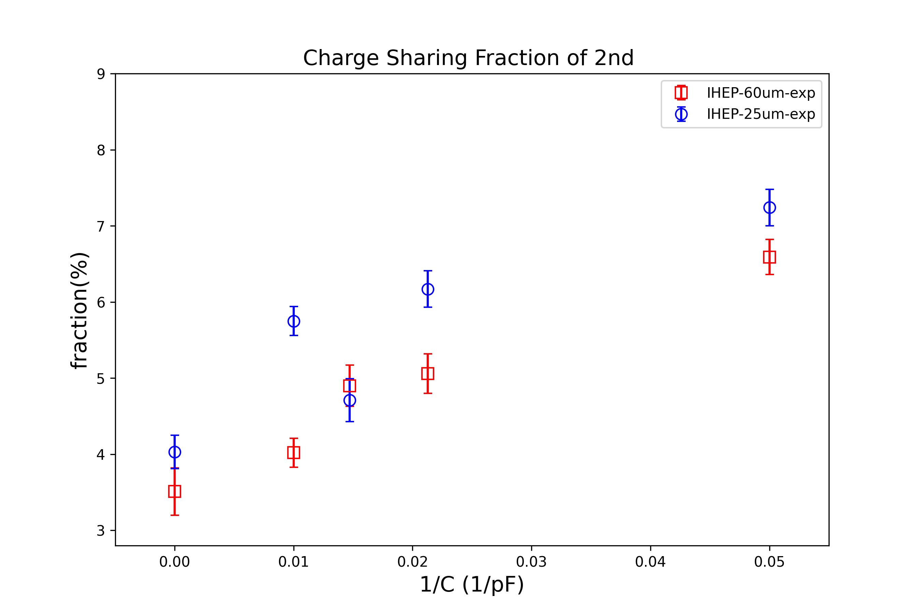
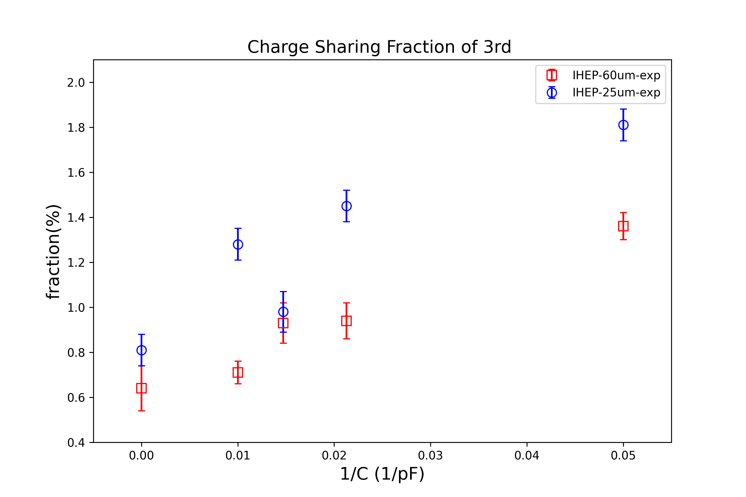
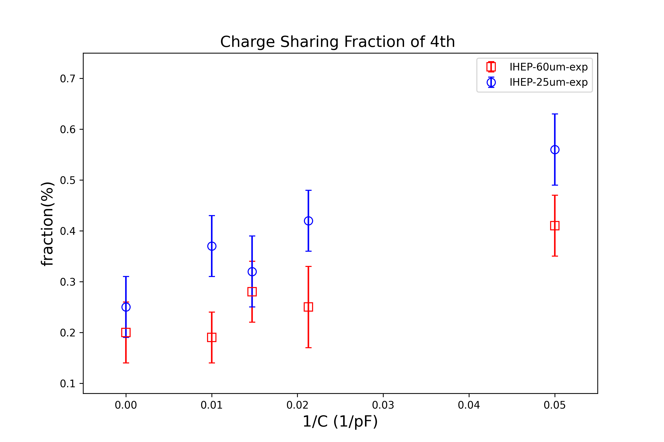
through error transfer function, obtain the final charge sharing ratio that doesn’t distinguish between Z:
1st
2nd
red:60um
blue:25um
3rd
4th

Slide 16
conclusion
Analyse the relationship between charge sharing ratio and external capacitance

Slide 17
Thanks!

