Slide 1
Learning with the spectrum
PhD Student
Lorenzo Giambagli
Notes:
Reti: oggetto matematico in grado di essere addestrato in maniera automatica ad assolvere certi compiti ->apprendimento automatico

Slide 2
Automatic Learning
Standard Programming
Automatic Programming
$$\left(X , f\right)→Y$$
$$\left(X,Y\right)→f :f\left(X\right)=Y$$
Classification:
$Y$ Discrete
Regression:
$Y$Continuous
Notes:
Esempi delle due task di classificazione e regressione->

Slide 3
Midjourney
Notes:
Esempi delle due task di classificazione e regressione->

Slide 4
ChatGPT
Notes:
Esempi delle due task di classificazione e regressione->

Slide 5
The function as a network
$$w^{(2)}$$
$$w^{(1)}$$
$$w^{(3)}$$
$$φ^{(3)}$$
$$y_{pred}\left(φ^{\left(3\right)}\left(x\right)\right)$$
or
$$y_{pred}=φ^{\left(3\right)}\left(x\right)$$
$x$
$$f$$
$$φ_{j}^{(k)}=σ\left(\sum_{i=1}^{N_{k−1}}{w_{ji}^{(k−1)}φ_{i}^{(k−1)}}\right),k=2…ℓ−1$$
$$φ^{\left(3\right)}=\sum_{i=1}^{N_{ℓ−1}}{w_{ji}^{\left(ℓ−1\right)}φ_{i}^{\left(ℓ−1\right)}}$$

Slide 6
Learning
Dataset
Loss Function
$$D=\left(x^{\left(i\right)},y^{\left(i\right)}\right),$$
$$i∈1…|D|$$
$$L=\sum_{i}{{\left({y\left[φ^{\left(3\right)}(x^{(i)},w^{(k)})\right]}_{pred}^{\left(i\right)}−y^{\left(i\right)}\right)}^{2}}$$
$∇_{w}L$ and minimize
$dim\left(w\right)∼10^{11}$ or more
Notes:
Parlare di Complessità parametri e accuracy [confronto l’attività con l’etichetta che classifica a priori il dato] [ref. adam e dnn]

Slide 7
Where is information stored?

Slide 8
Feedforward Network
$$N_{2}$$
$$N_{3}$$
$$N_{1}$$
$$N_{ℓ=4}$$
$$x^{(4)}$$
$$x^{(1)}$$
$$x^{(2)}$$
$$x^{(3)}$$
$$w_{1}$$
$$w_{2}$$
$$w_{3}$$

Slide 9
Adding a parameter
$$a_{i}^{(k+1)}=\sum_{j}{w_{ij}^{\left(k\right)}x_{j}^{\left(k\right)}}$$
$${\tilde{a}}_{i}^{(k+1)}=λ_{i}^{\left(k\right)}\sum_{j}{w_{ij}^{\left(k\right)}x_{j}^{\left(k\right)}}={λ_{i}^{(k)}a}_{i}^{(k+1)}$$
$$N_{k}$$
$$N_{k+1}$$

Slide 10
How does this changes the learning?
$${\tilde{a}}_{i}^{(k+1)}=λ_{i}^{\left(k\right)}\sum_{j}{w_{ij}^{\left(k\right)}x_{j}^{\left(k\right)}}={λ_{i}^{(k)}a}_{i}^{(k+1)}$$
Classical Learning:
$∇_{w}$with $λ=1$
Spectral Learning:
$$∇_{λ} or ∇_{w,λ }$$

Slide 11
Why «Spectral»?
$$N_{k}$$
$$N_{k+1}$$
$$1$$
$$Φ_{k}$$
$$∼w_{k}$$
$$=A_{k}$$
$$1$$
$$=Φ_{k}Λ_{k}Φ_{k}^{−1}$$
$$x^{(k)}$$
$$Λ_{k}$$
$$x^{(k+1)}$$
Machine Learning in the Spectral Domain, Nature Communications (2021)
LG, Lorenzo Buffoni, Timoteo Carletti, Walter Nocentini, Duccio Fanelli

Slide 12
Spectral Pruning
Train $Λ,Φ$
Train $Λ$
Evaluate $|λ_{i}^{\left(k\right)}|$
Evaluate $|λ_{i}^{\left(k\right)}|$
Prune nodes using $|λ_{i}^{\left(k\right)}|$
Prune nodes using $|λ_{i}^{\left(k\right)}|$
Train $Φ$
Smaller Network
Smaller Network
Notes:
Dopo che la rete ha imparato -> elimino a posteriori i nodi che non processano con lambda piccolo
SINGOLO LAYER (no bias)

Slide 13
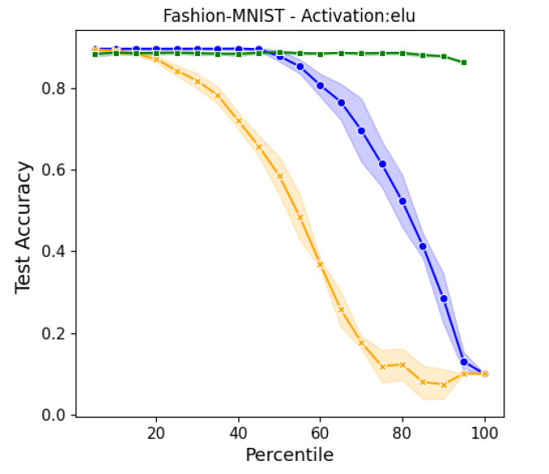
Spectral Pruning - Results
$$Fashion−MNIST$$
Train $Λ$first
Train $Λ, Φ$
Train $W$
Spectral Pruning of Fully Connected Layers, Scientific Reports (2022)
Lorenzo Buffoni, Enrico Civitelli, LG, Lorenzo Chicchi, Duccio Fanelli
Notes:
Link con il learning solo sugli autovalori

Slide 14
Ongoing research
Regression with $y=NN_{T}$ (Teacher - Student theoretical framework)
Inspect $λ$ after training:
Do they «feel» $NN_{T}$?
Notes:
Dopo che la rete ha imparato -> elimino a posteriori i nodi che non processano con lambda piccolo
SINGOLO LAYER (no bias)

Slide 15
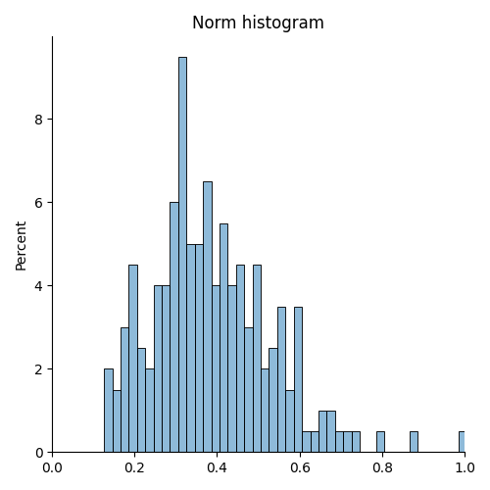
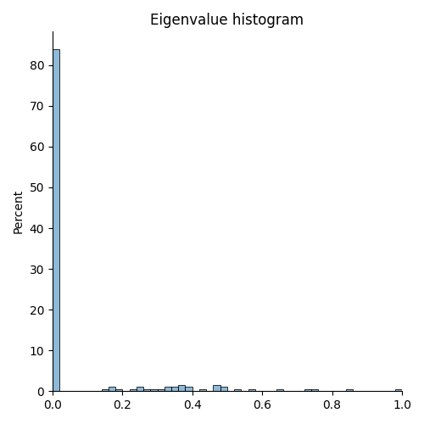
Preliminary Results: $L_{2}$ Reg.
Teacher 20 hid. neurons - Student 200 hid. neurons
Here!

Slide 16
Recurrent Spectral Network (RSN)
RSN

Slide 17
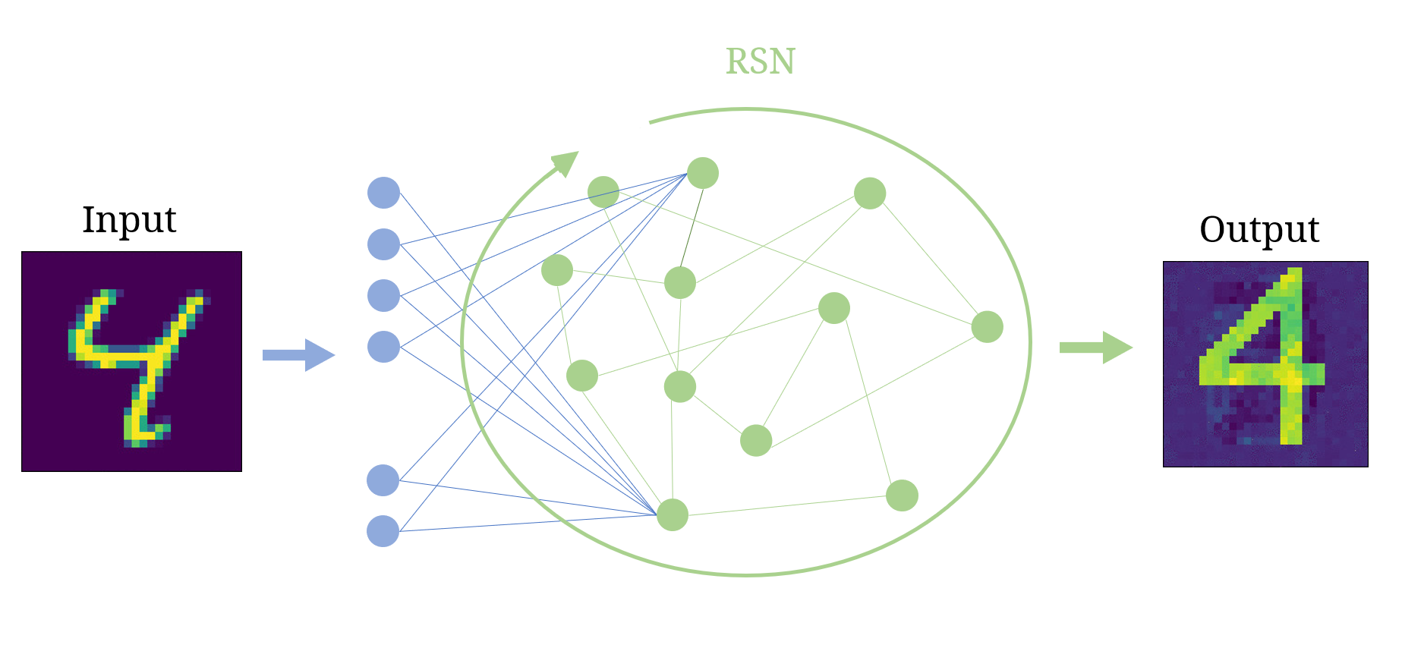
C$\text{lassification} \text{achieved} \text{via} \text{sculpting} \text{the} \text{basin} \text{of} \text{attraction} \text{of} \text{a} \text{discrete} \text{dynamical} \text{map}$
RSN: shaping the basin of attraction of a discrete map to reach automatic classification, CSF (2023)
Lorenzo Chicchi, Lorenzo Giambagli, Lorenzo Buffoni, Timoteo Carletti, and Duccio Fanelli

Slide 18
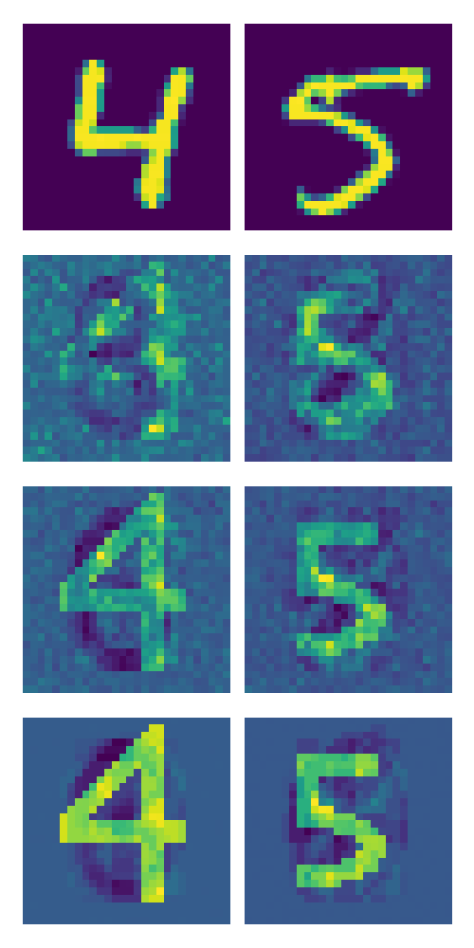
RSN – Results, MNIST
$$n$$
$$N−n$$
$$k$$
$$Φ$$
Fixed Memory Slots (Attractor)
Notes:
Stati finali bloccati quindi sceglibili a priori: in questo caso disegnino ganzo

Slide 19
Ongoing research
Deep Learning applied to:
Medicine
Astrophysics
Volcanology
Same analysis on the recurrent scenario
Notes:
Dopo che la rete ha imparato -> elimino a posteriori i nodi che non processano con lambda piccolo
SINGOLO LAYER (no bias)

Slide 20
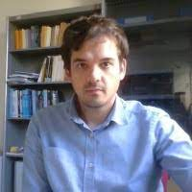
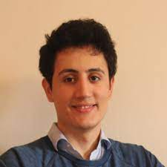
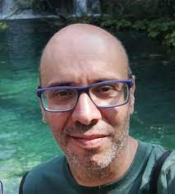
My Collaborators
Lorenzo Chicchi
PhD
Univ. of Florence
Lorenzo Buffoni
Researcher
Univ. of Florence
Timoteo Carletti
Full Professor
Univ. of Namur
Duccio Fanelli
Full Professor
Univ. of Florence

Slide 21
Thank you! Questions?
Notes:
Reti: oggetto matematico in grado di essere addestrato in maniera automatica ad assolvere certi compiti ->apprendimento automatico

