Slide 1
Cosmic Rays measurement in space
V. Formato – INFN Sezione di Roma Tor Vergata
25/01/2023 – Status and prospects of astroparticle physics

Slide 2
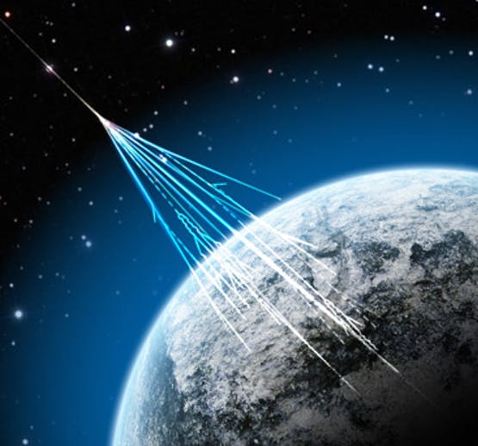
What are cosmic rays?
Particles coming from outer space
Mostly of galactic origin (at least in this talk...)

Slide 3
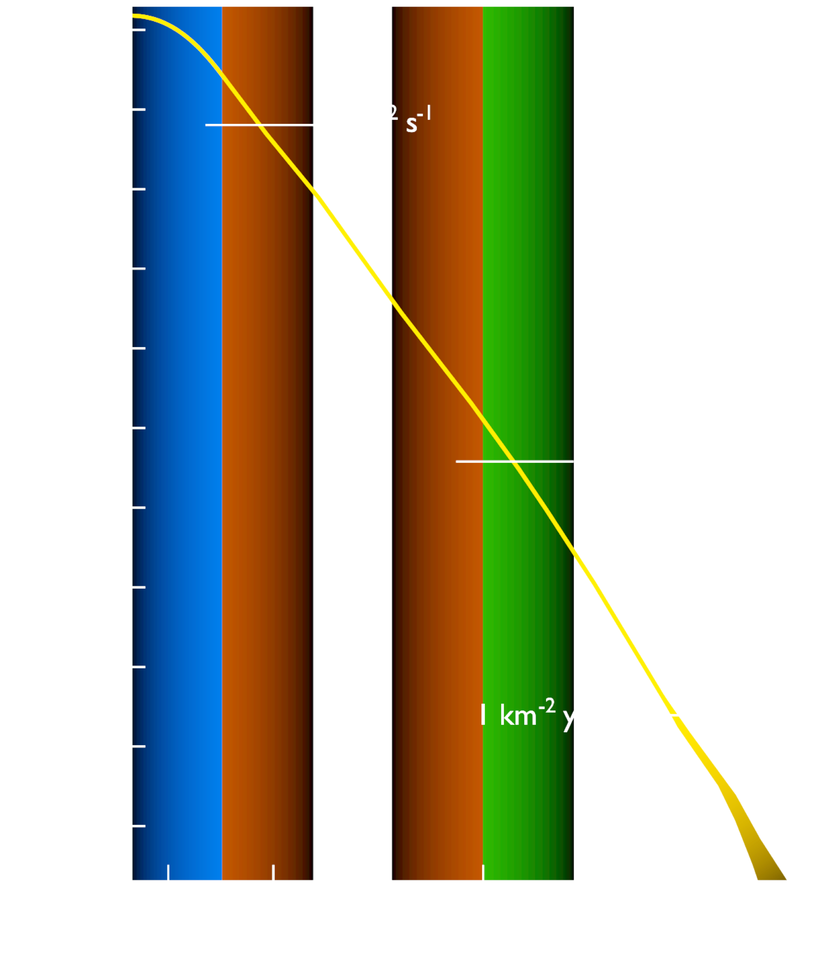
What are cosmic rays?
Particles coming from outer space
Mostly of galactic origin (at least in this talk...)
Accelerated by SNE shocks in the Galaxy**
Spend ~Myr random-walking against the galactic magnetic field, traversing the Interstellar Medium (ISM)***

Slide 4
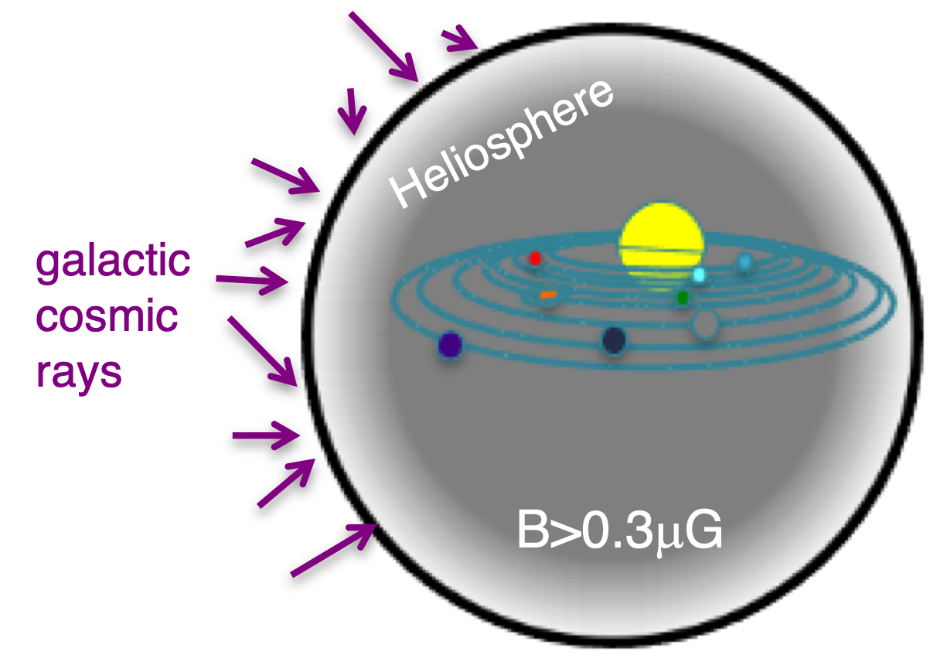
What are cosmic rays?
Particles coming from outer space
Mostly of galactic origin (at least in this talk...)
Accelerated by SNE shocks in the Galaxy**
Spend ~Myr random-walking against the galactic magnetic field, traversing the Interstellar Medium (ISM)***
Some will eventually reach the solar system and diffuse through the heliosphere

Slide 5
The early days
Discovered in the early 1900s
Started as “spontaneous discharge of electroscopes”, which increased in rate with altitude (and decreased underwater)

Slide 6
The early days
Discovered in the early 1900s
Started as “spontaneous discharge of electroscopes”, which increased in rate with altitude (and decreased underwater)

Slide 7
The early days
Discovered in the early 1900s
Started as “spontaneous discharge of electroscopes”, which increased in rate with altitude (and decreased underwater)
Eventually gave birth to what we know today as “Particle physics”. All major discoveries came through the study of cosmic rays.

Slide 8
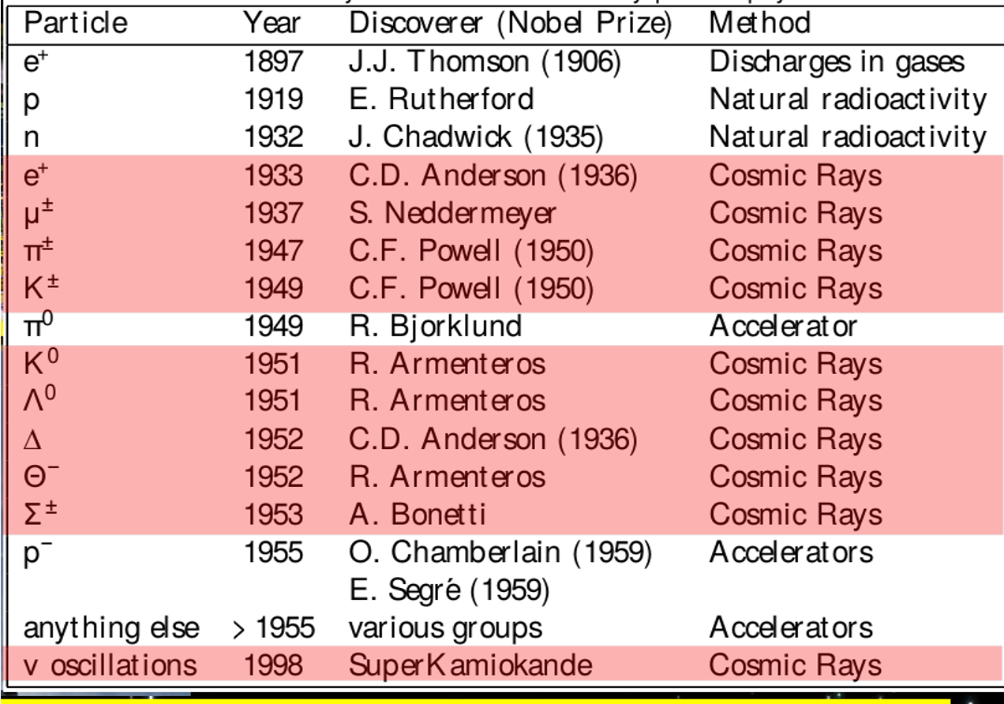
The early days
Discovered in the early 1900s
Started as “spontaneous discharge of electroscopes”, which increased in rate with altitude (and decreased underwater)
Eventually gave birth to what we know today as “Particle physics”. All major discoveries came through the study of cosmic rays.
...well, at least until the advent of particle accelerators.

Slide 9
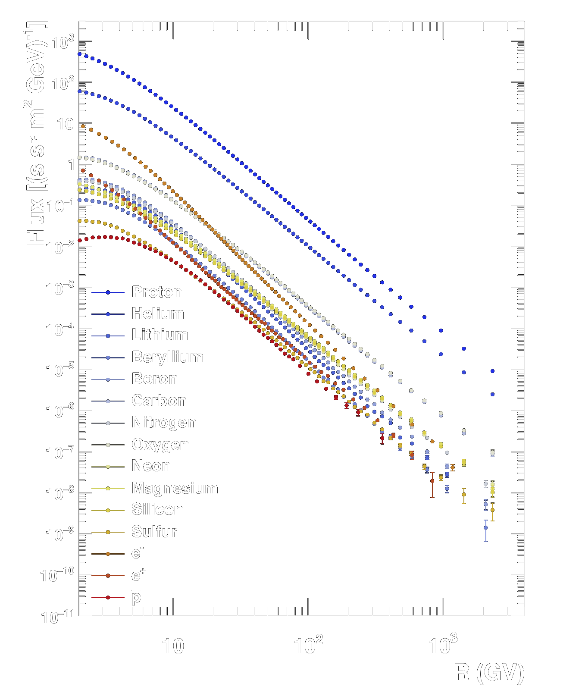
"Standard model" of cosmic rays
Mostly composed by protons (~89%) and helium nuclei (~9%), heavier nuclei (~1%), electrons (~1%) and traces of antimatter
Distributed according to a power-law spectrum which extends over several orders of magnitude in energy

Slide 10
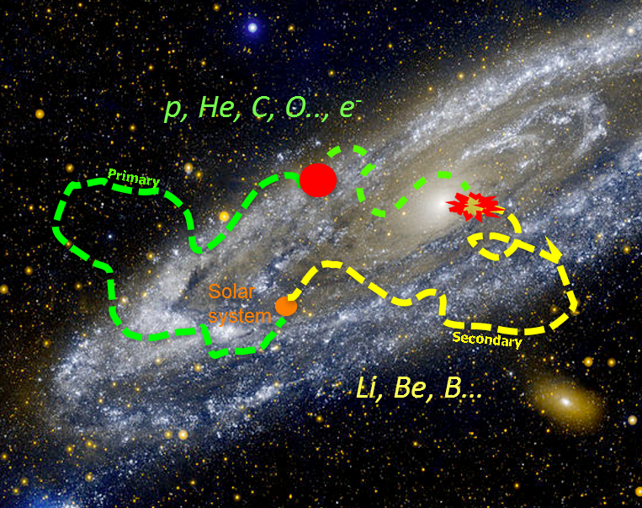
"Standard model" of cosmic rays
Mostly composed by protons (~89%) and helium nuclei (~9%), heavier nuclei (~1%), electrons (~1%) and traces of antimatter
Distributed according to a power-law spectrum which extends over several orders of magnitude in energy
During propagation cosmic rays can interact with the ISM, this creates a distinction between “primary” and “secondary” cosmic rays
The measurement of CR nuclei energy spectra carries information about sources, acceleration and propagation processes of all CRs.

Slide 11
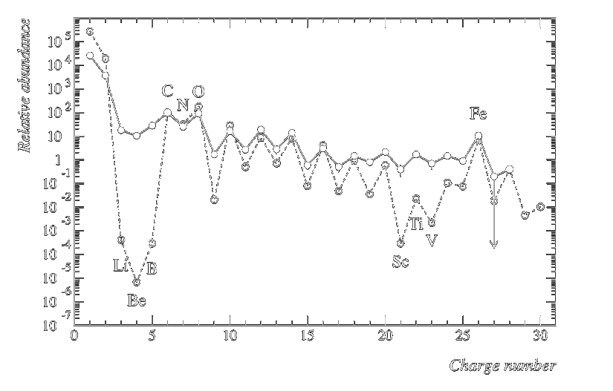
"Standard model" of cosmic rays
Mostly composed by protons (~89%) and helium nuclei (~9%), heavier nuclei (~1%), electrons (~1%) and traces of antimatter
Distributed according to a power-law spectrum which extends over several orders of magnitude in energy
During propagation cosmic rays can interact with the ISM, this creates a distinction between “primary” and “secondary” cosmic rays
The measurement of CR nuclei energy spectra carries information about sources, acceleration and propagation processes of all CRs.

Slide 12





Opportunities for "new physics"?
The low amount of secondary antimatter makes it a golden channel for any search for new physics
Any new effect should then produce an excess of positrons and/or antiprotons.
(And heavier antimatter is even rarer)
Annihilation
Scattering
Production

Slide 13
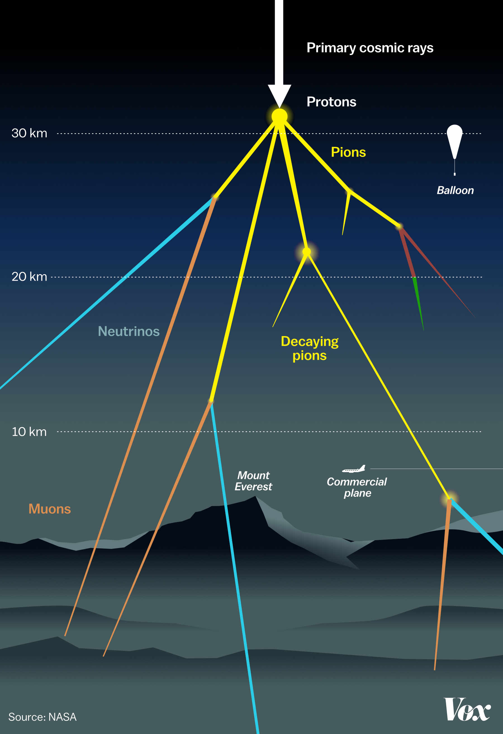
Space: The final frontier
Fortunately, we are surrounded by several km of atmosphere.
But this makes measuring cosmic rays more difficult.
For several decades cosmic rays research has been based on using balloons to elevate the instrumentation as high as possible, and still does today.
But several efforts have been made to study cosmic rays outside of the Earth atmosphere.

Slide 14
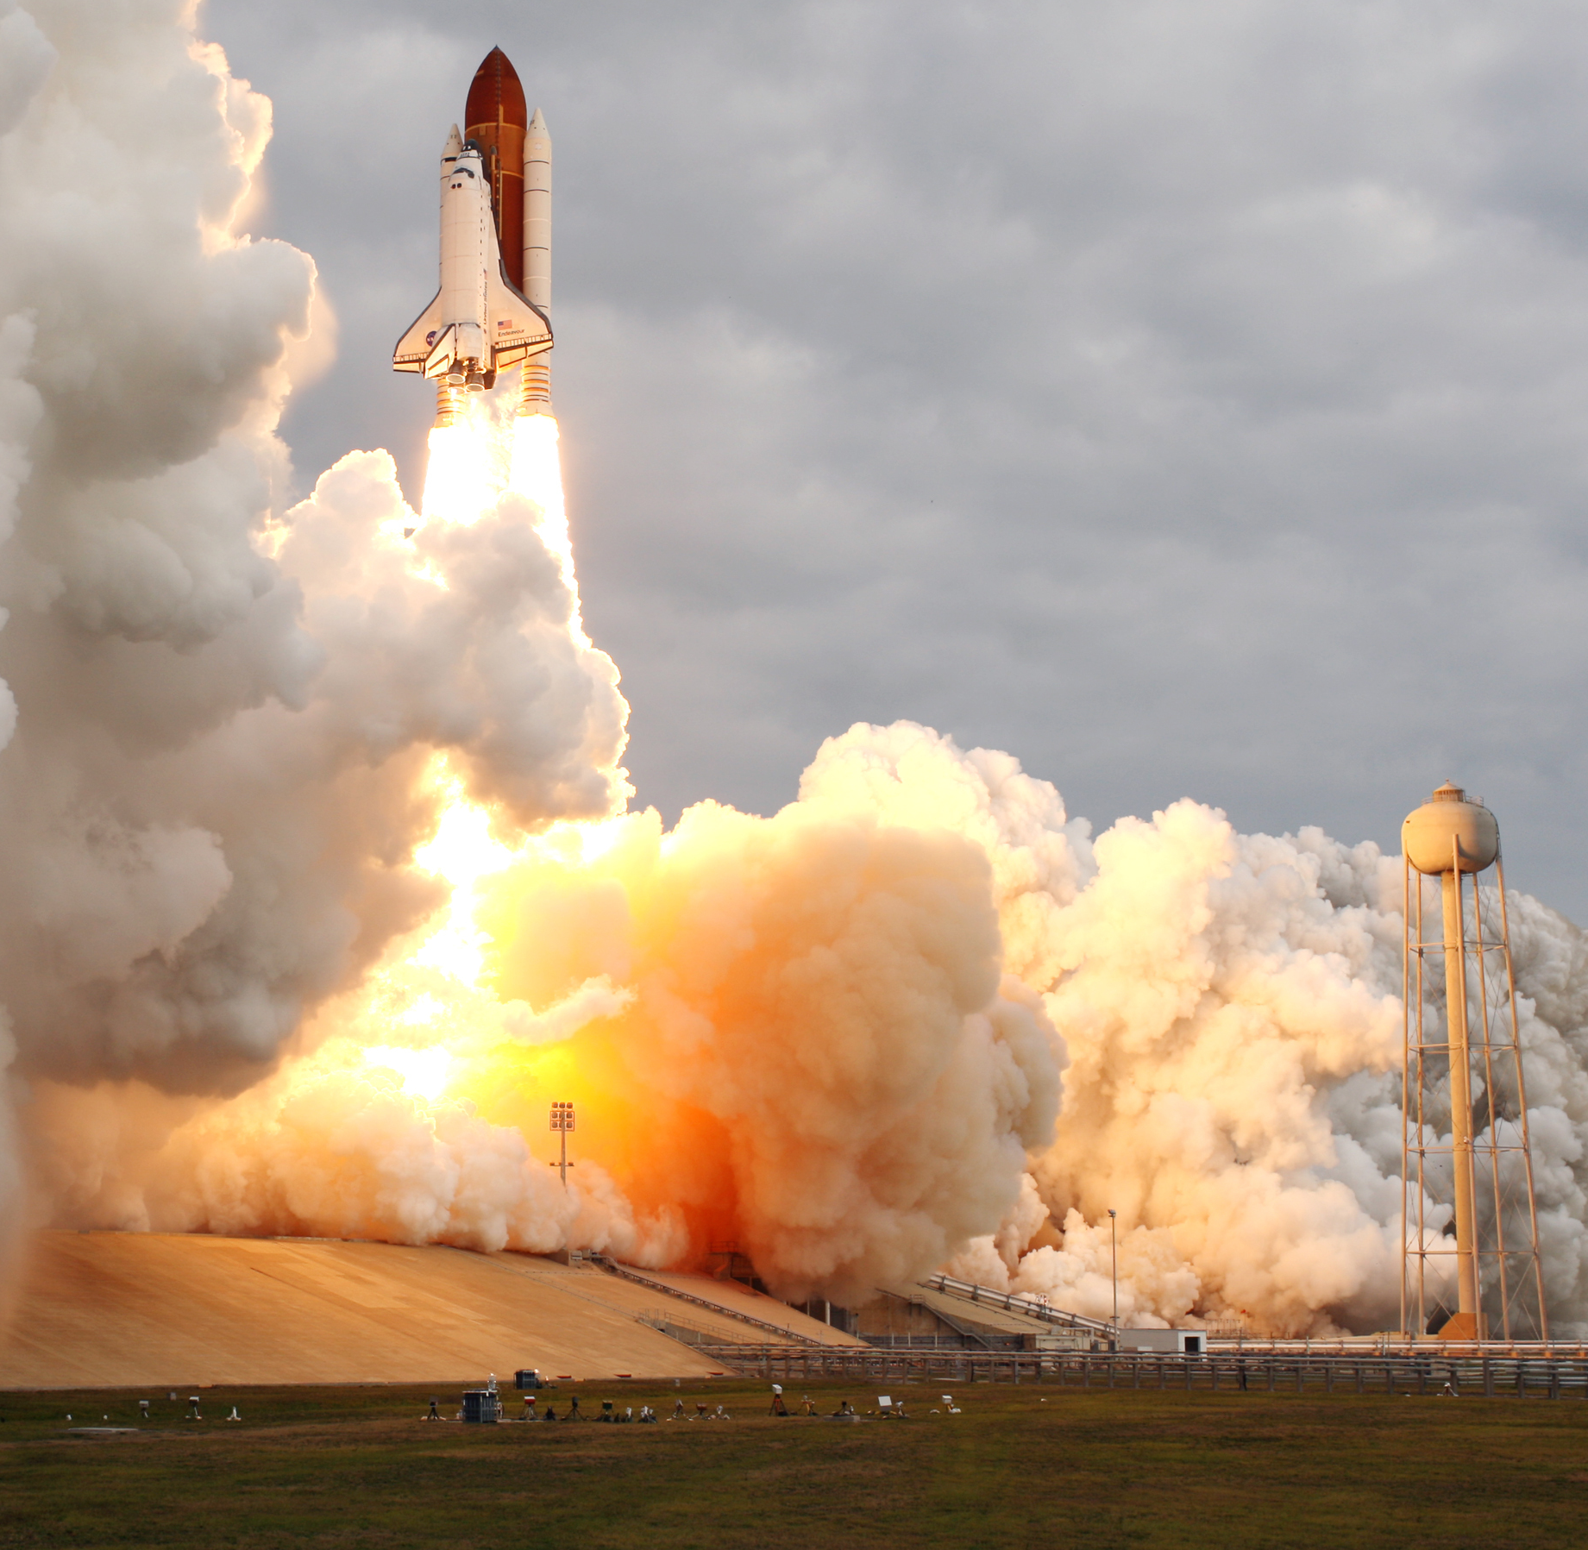
Challenges for space experiments
Pro:
No atmosphere
Con:
Extremely expensive
Instruments are very limited in terms of weight budget (and thus size/sensibility)
Instruments are very limited in terms of power budget (especially on free-flying satellites)
Every electronic component must be space-qualified (and radiation-hard)
Is it worth the effort?

Slide 15
Challenges for space experiments
Pro:
No atmosphere
Con:
Extremely expensive
Instruments are very limited in terms of weight budget (and thus size/sensibility)
Instruments are very limited in terms of power budget (especially on free-flying satellites)
Every electronic component must be space-qualified (and radiation-hard)
Is it worth the effort?
Yes

Slide 16
Disclaimer
This talk is focused on space-borne experiments
This talk is focused on galactic cosmic rays
...so apologies if some missions or detectors are missing

Slide 17
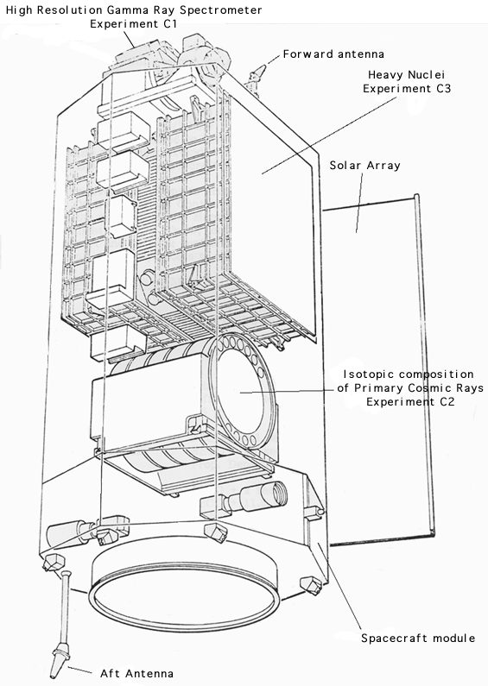
The ghost of experiments past
(HEAO-3)
The High Energy Astronomy Observatory 3 (1979-1981)
Two instruments on board dedicated to cosmic ray measurement up to ~30 GeV/n

Slide 18
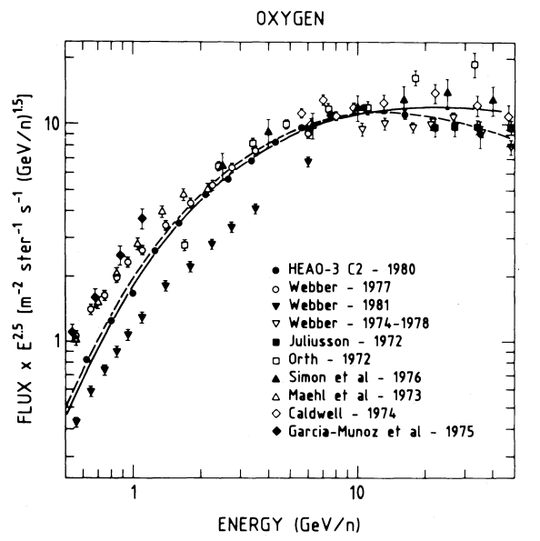
The ghost of experiments past
(HEAO-3)
The High Energy Astronomy Observatory 3 (1979-1981)
Two instruments on board dedicated to cosmic ray measurement up to ~30 GeV/n
In particular C2 provided flux measurement for nuclear species from Z=4 to Z=28 using a stack of 5 Cherenkov detectors.

Slide 19
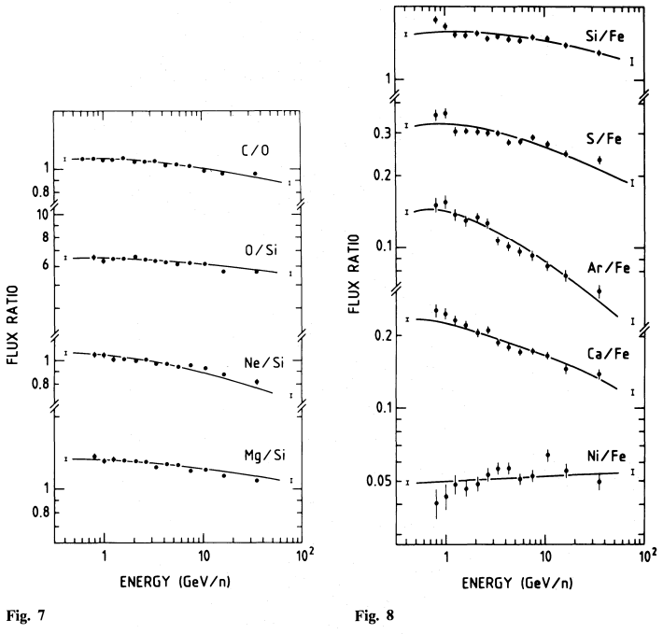
The ghost of experiments past
(HEAO-3)
The High Energy Astronomy Observatory 3 (1979-1981)
Two instruments on board dedicated to cosmic ray measurement up to ~30 GeV/n
In particular C2 provided flux measurement for nuclear species from Z=4 to Z=28 using a stack of 5 Cherenkov detectors.

Slide 20

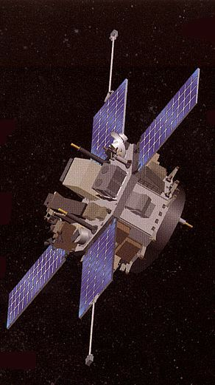
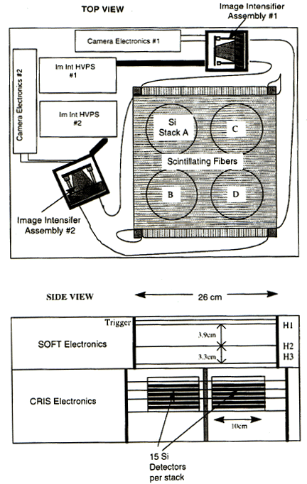
The ghost of experiments past
(ACE/CRIS)
The Cosmic Ray Isotope Spectrometer on the Advanced Composition Explorer (1997-today)

Slide 21
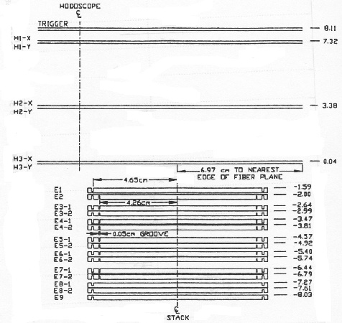
The ghost of experiments past
(ACE/CRIS)
The Cosmic Ray Isotope Spectrometer on the Advanced Composition Explorer (1997-today)
Composed by 4 stacks of silicon detectors with a scintillating fiber tracker on top.
Particle ID by measuring dE/dx in the silicon detectors and total energy by absorption in the silicon stack.

Slide 22
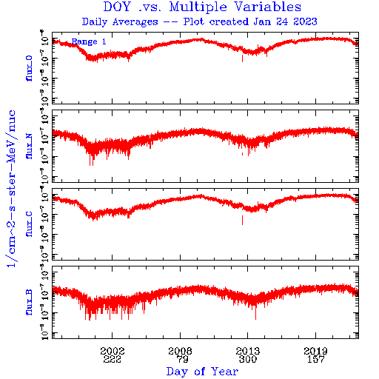
The ghost of experiments past
(ACE/CRIS)
The Cosmic Ray Isotope Spectrometer on the Advanced Composition Explorer (1997-today)
Composed by 4 stacks of silicon detectors with a scintillating fiber tracker on top.
Particle ID by measuring dE/dx in the silicon detectors and total energy by absorption in the silicon stack.
Can measure a wide variety of nuclear species, separating isotopes although at very low energy (~ GeV).

Slide 23
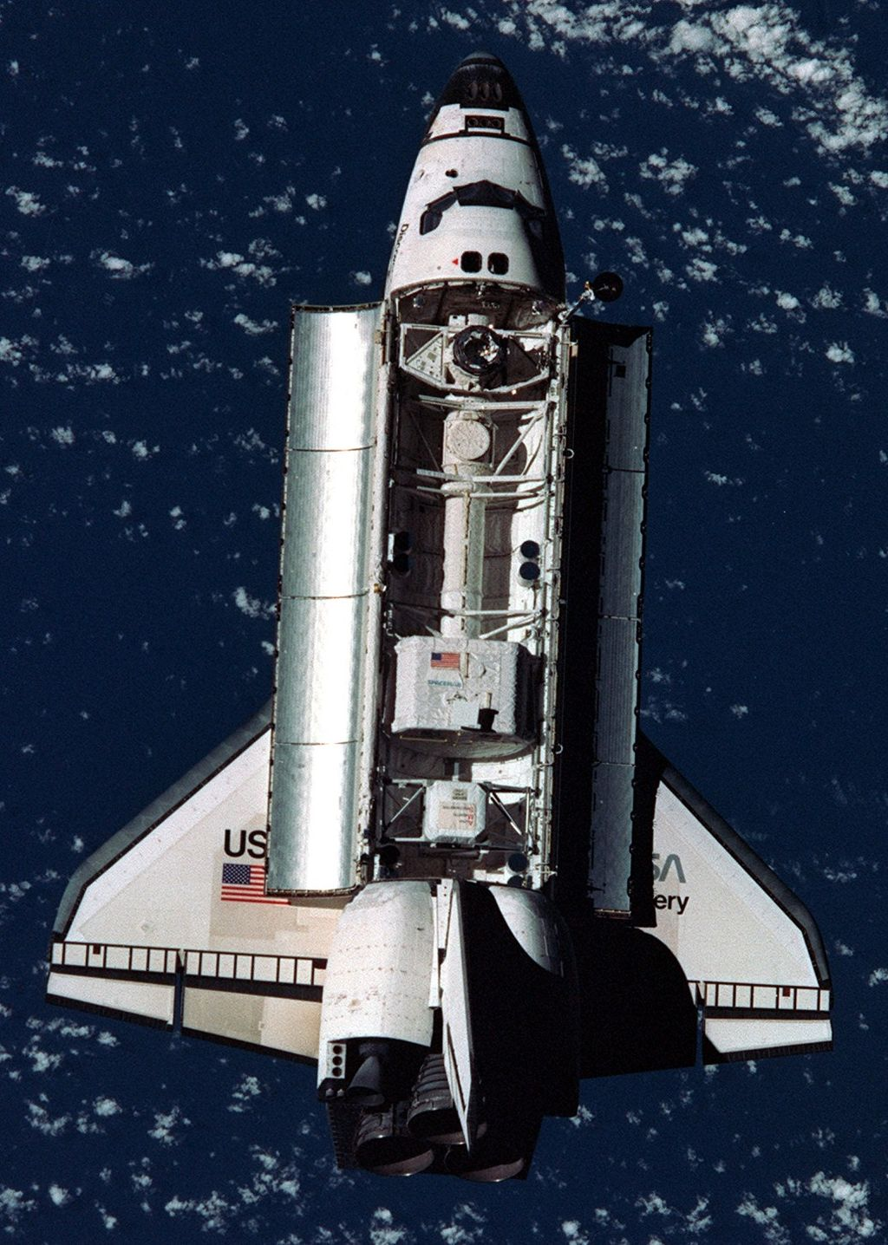
The ghost of experiments past
(AMS-01)
Prototype for the AMS-02 detector, flown on the Space Shuttle Discovery in June 1998
Demonstrated the feasibility of silicon microstrip trackers in space

Slide 24
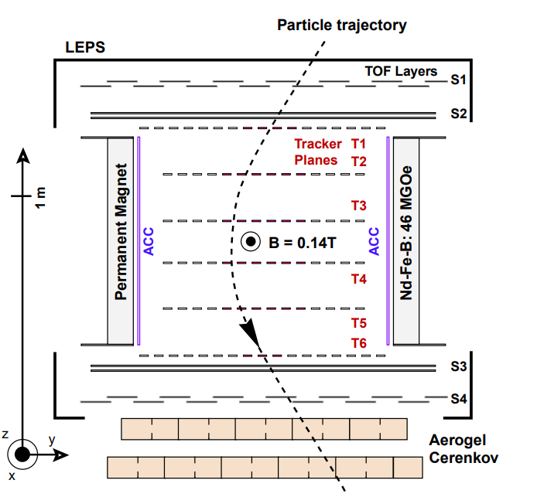
The ghost of experiments past
(AMS-01)
Prototype for the AMS-02 detector, flown on the Space Shuttle Discovery in June 1998
Demonstrated the feasibility of silicon microstrip trackers in space
First “real” particle detector flown in space
It was a real demonstrator of what a full-fledged particle detector could do outside the atmosphere for cosmic ray physics

Slide 25
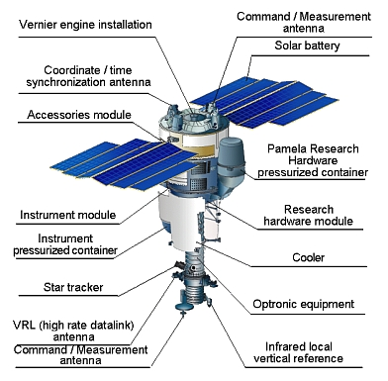
The ghost of experiments past
(PAMELA)
Payload for Matter, Antimatter and Light-Nuclei Astrophysics (2006-2014)

Slide 26
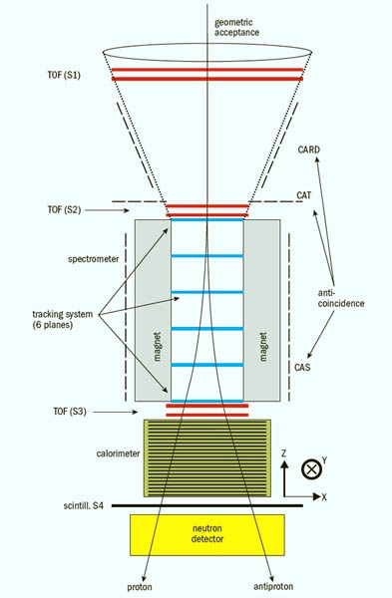
The ghost of experiments past
(PAMELA)
Payload for Matter, Antimatter and Light-Nuclei Astrophysics (2006-2014)
First detector in space to reach the TeV range, highly optimized for Z=1 particles (especially antimatter)

Slide 27
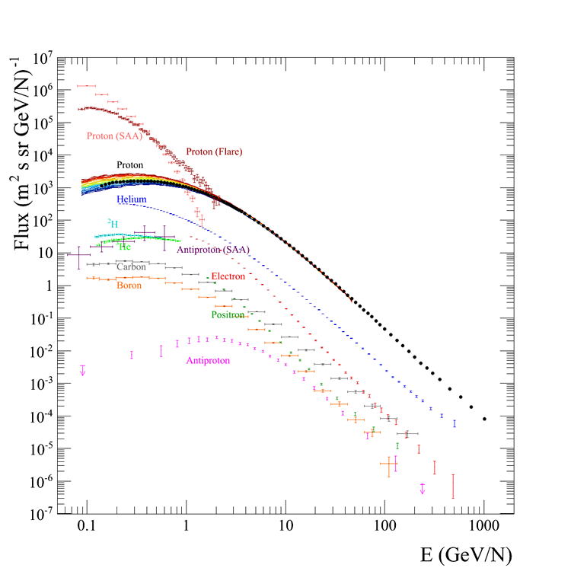
The ghost of experiments past
(PAMELA)
Payload for Matter, Antimatter and Light-Nuclei Astrophysics (2006-2014)
First detector in space to reach the TeV range, highly optimized for Z=1 particles (especially antimatter)
First comprehensive set of measurements of multiple cosmic rays species from the same detector.

Slide 28
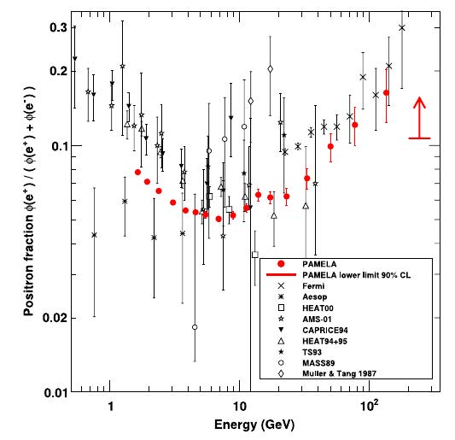
The ghost of experiments past
(PAMELA)
Payload for Matter, Antimatter and Light-Nuclei Astrophysics (2006-2014)
First detector in space to reach the TeV range, highly optimized for Z=1 particles (especially antimatter)
First comprehensive set of measurements of multiple cosmic rays species from the same detector.
2009 – Found a significative positron excess at high energy

Slide 29
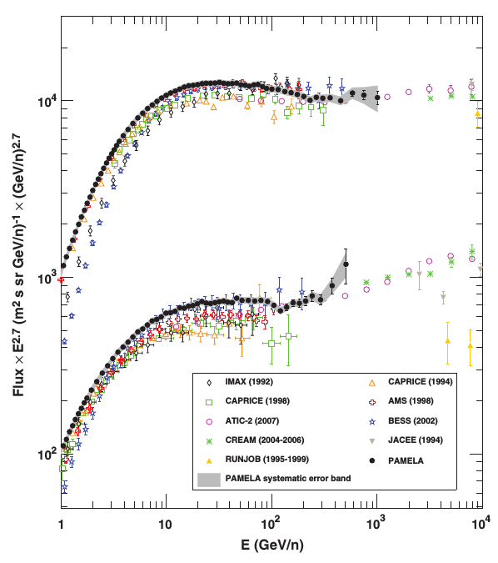
The ghost of experiments past
(PAMELA)
Payload for Matter, Antimatter and Light-Nuclei Astrophysics (2006-2014)
First detector in space to reach the TeV range, highly optimized for Z=1 particles (especially antimatter)
First comprehensive set of measurements of multiple cosmic rays species from the same detector.
2009 – Found a significative positron excess at high energy
2011 – First proof that cosmic ray spectra deviate from the single power-law assumption

Slide 30
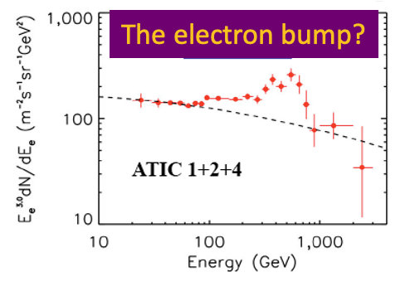
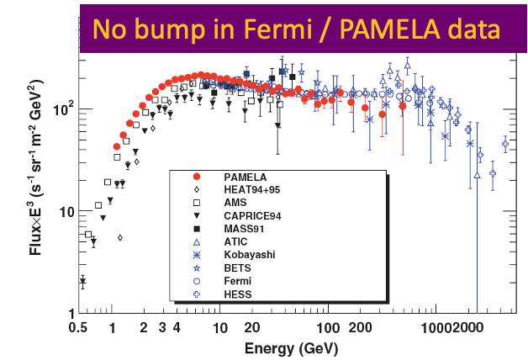
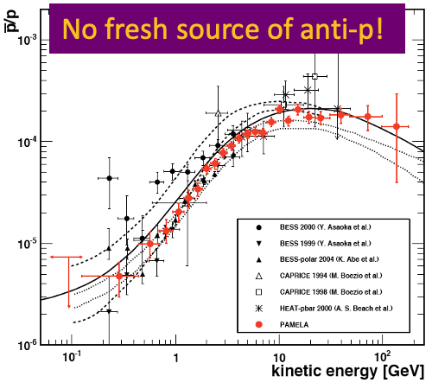
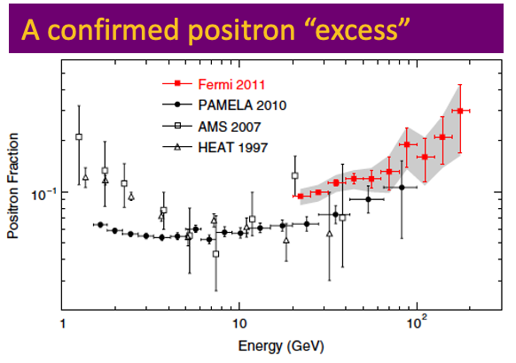
The antimatter puzzle (2011)

Slide 31
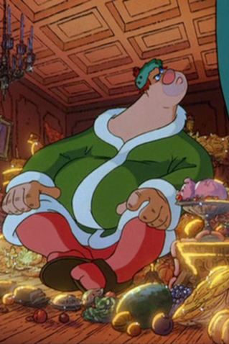
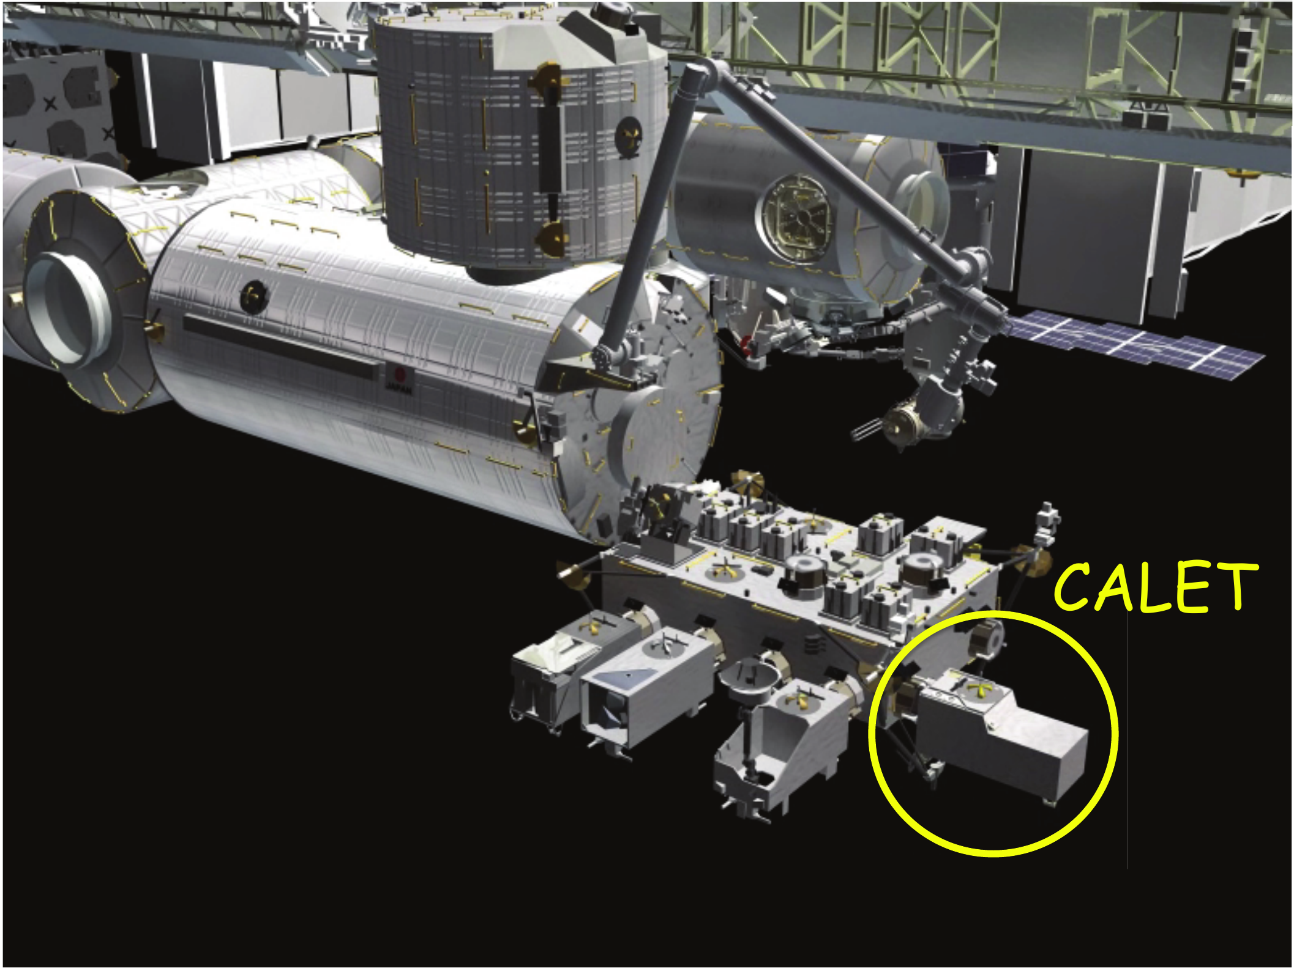
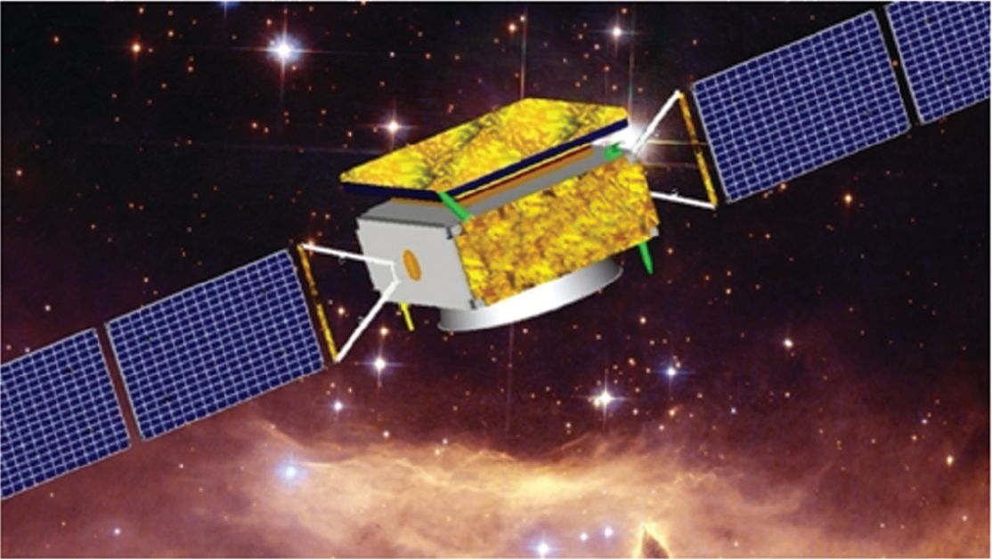
The ghost of experiments present
(CALET and DAMPE)
CALorimetric Electron Telescope (2015-today)
DArk Matter Particle Explorer (2015-today)

Slide 32
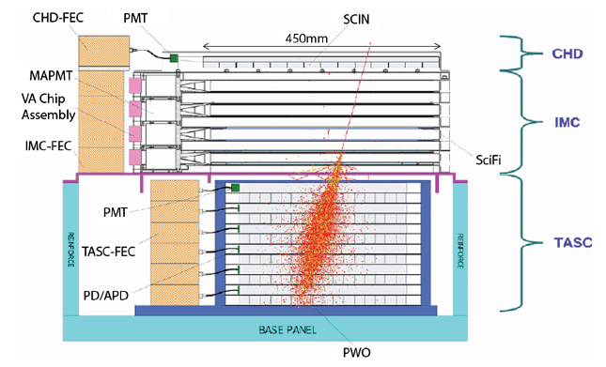
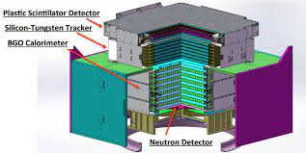
The ghost of experiments present
(CALET and DAMPE)
CALorimetric Electron Telescope (2015-today)
DArk Matter Particle Explorer (2015-today)

Slide 33
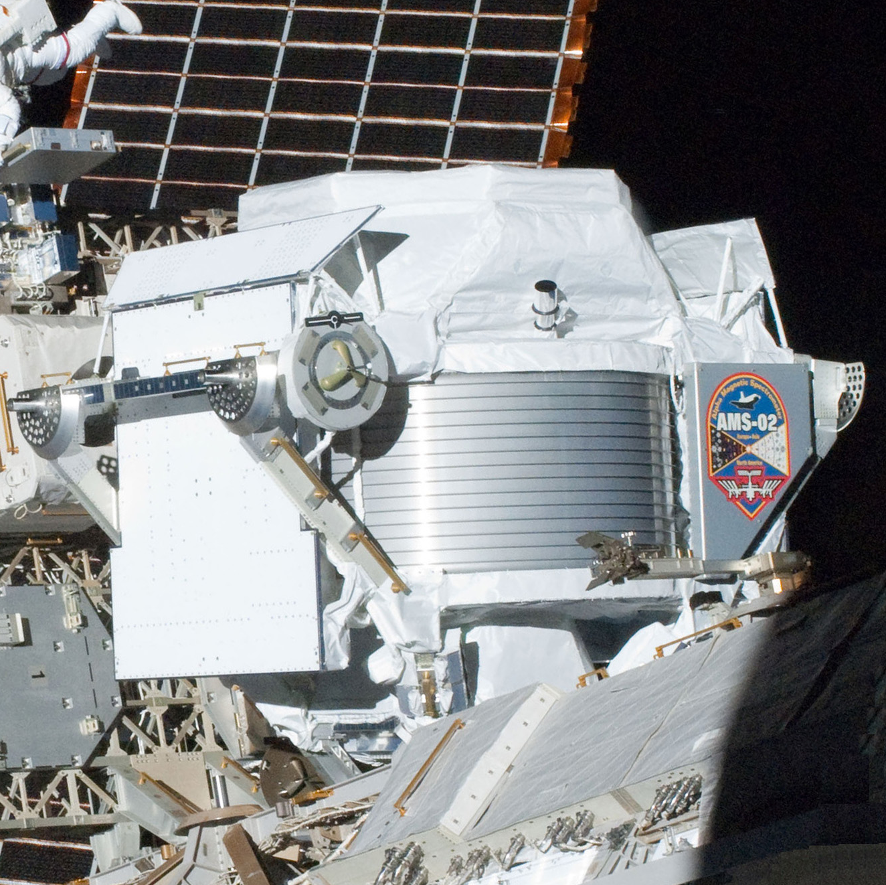
The ghost of experiments present
(AMS-02)
Alpha Magnetic Spectrometer (2011-today)
Taking data on the truss of the ISS for the last 12 years. Largest magnetic spectrometer in space so far.

Slide 34
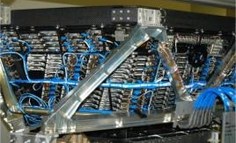
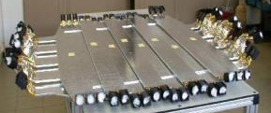
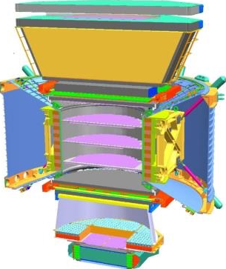
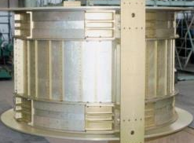
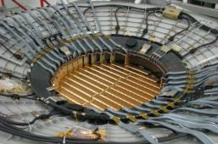
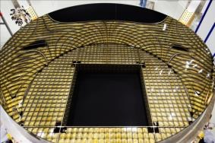
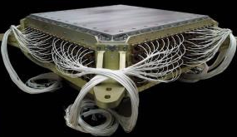
The ghost of experiments present
(AMS-02)
Full-fledged particle detector, redundant measurement of particle charge and momentum
TRD
Identify e⁺, e⁻
TOF
Z, 𝜷
1
TRD
Magnet
±Z
Silicon Tracker
Z, P
TOF
2
3-4
5-6
Tracker
7-8
TOF
RICH
9
RICH
Z, 𝜷
ECAL
E of e⁺, e⁻, γ
ECAL

Slide 35
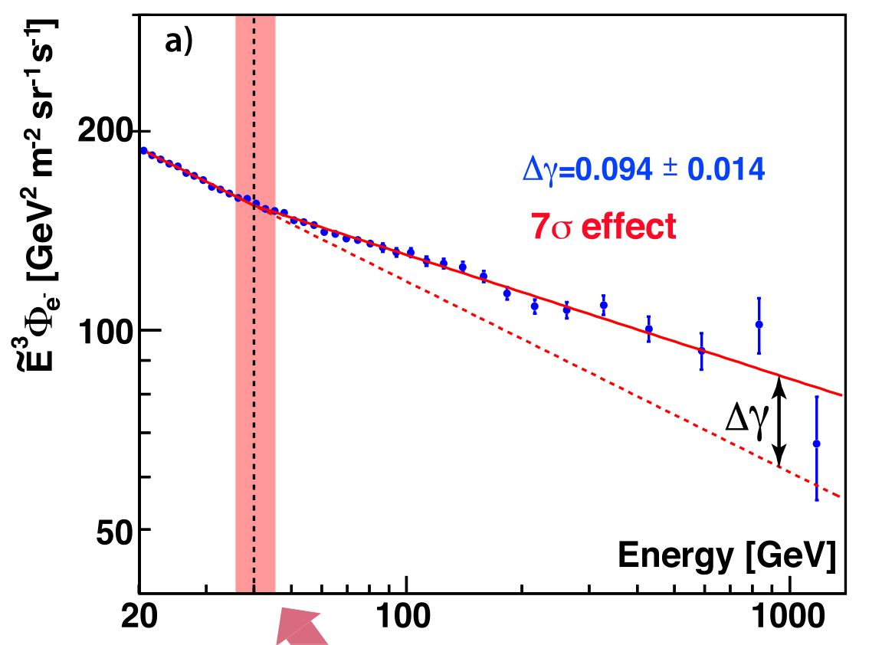
Electron and positrons
M. Aguilar et al., Phys.Rept. 894 (2021) 1-116
Clear hardening of the positron spectrum, followed by a steep descent (clearly visible also in the positron fraction)
The electron flux also hardens at higher energies

Slide 36
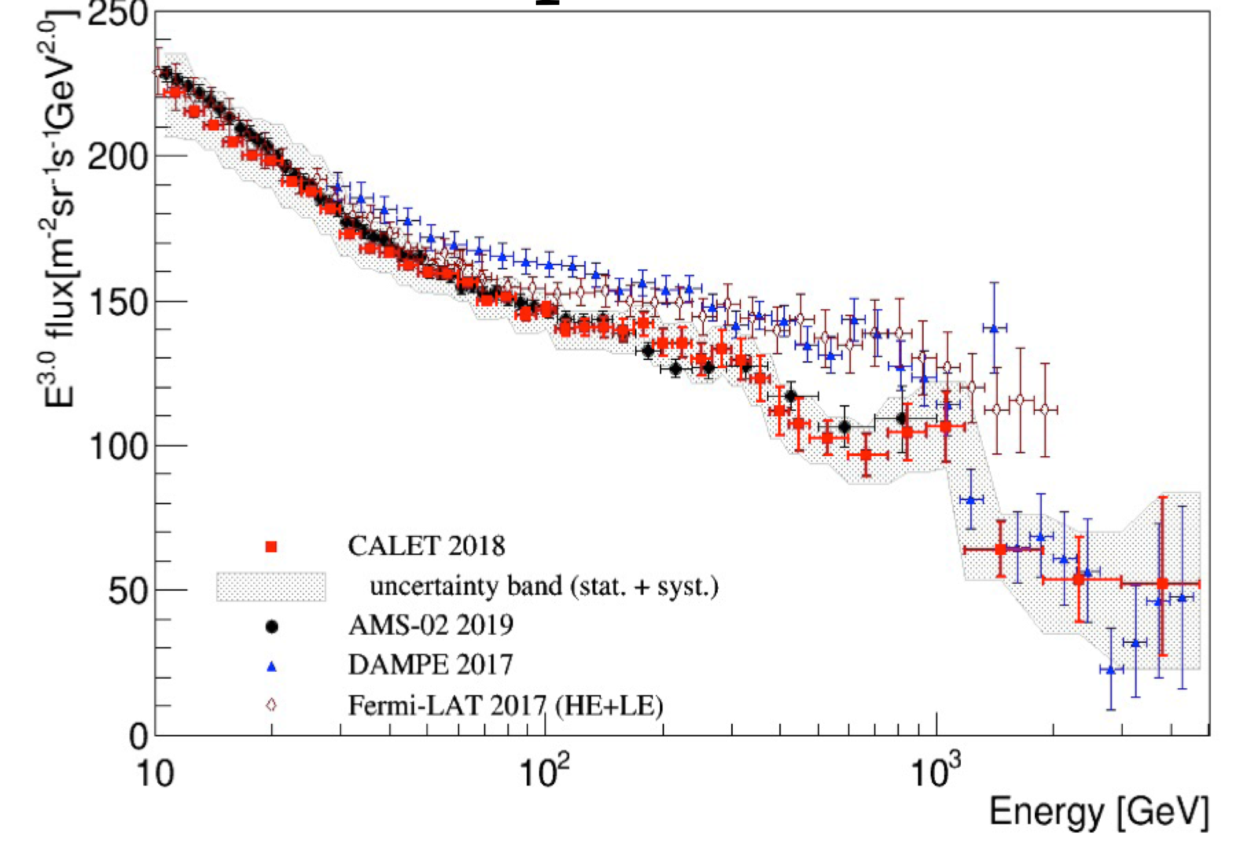
Electron and positrons
Measurements cluster into two groups: AMS-CALET, Fermi-DAMPE
Both CALET and DAMPE report a significant flux reduction above 1 TeV
Conventional diffusive models struggle to reproduce these data, and rely on the addition of CR sources to make up for the “missing flux” (DM, PWNe, close and/or old SNRs, millisecond pulsars, unknown nearby sources, etc…)
G. Ambrosi et al., Nature 552 (2017) 63-66
O. Adriani et al., PRL 119, 181101 (2017)
M. Aguilar et al., Phys.Rept. 894 (2021) 1-116

Slide 37
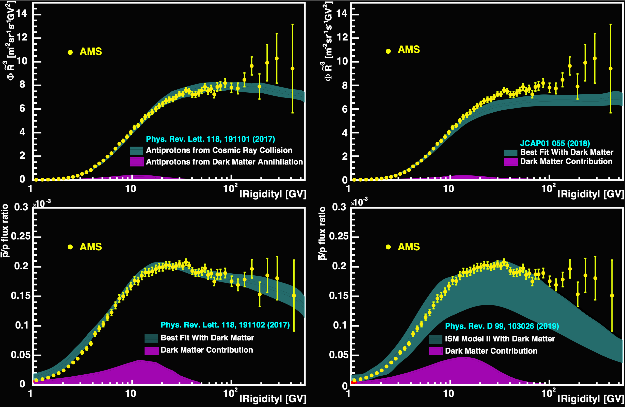
Antiprotons
Unfortunately, no extra contributions are visible in the antiproton spectrum or in the pbar/p ratio.
Eventual DM signals are hard to fit (especially since the high-energy behavior of the pbar flux predictions is highly dependent the pbar production cross-sections which are not well known in this energy range)

Slide 38
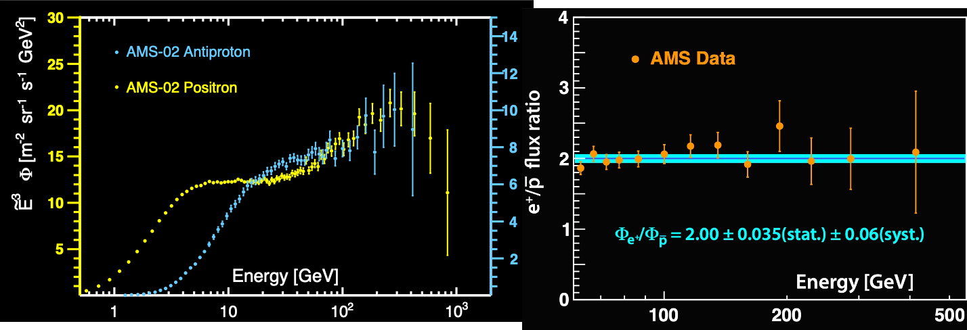
Antiprotons
Nevertheless, the fact that the positron/pbar ratio appears to be constant above 60 GV poses an interesting puzzle

Slide 39
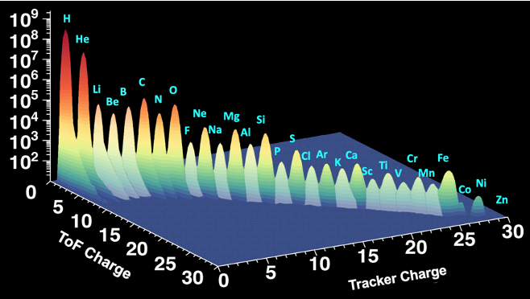
Cosmic ray nuclei
What is the origin of the spectral break?
Is the same break present in secondaries?
H and He are just the tip of the iceberg, what about higher-charge nuclei?

Slide 40
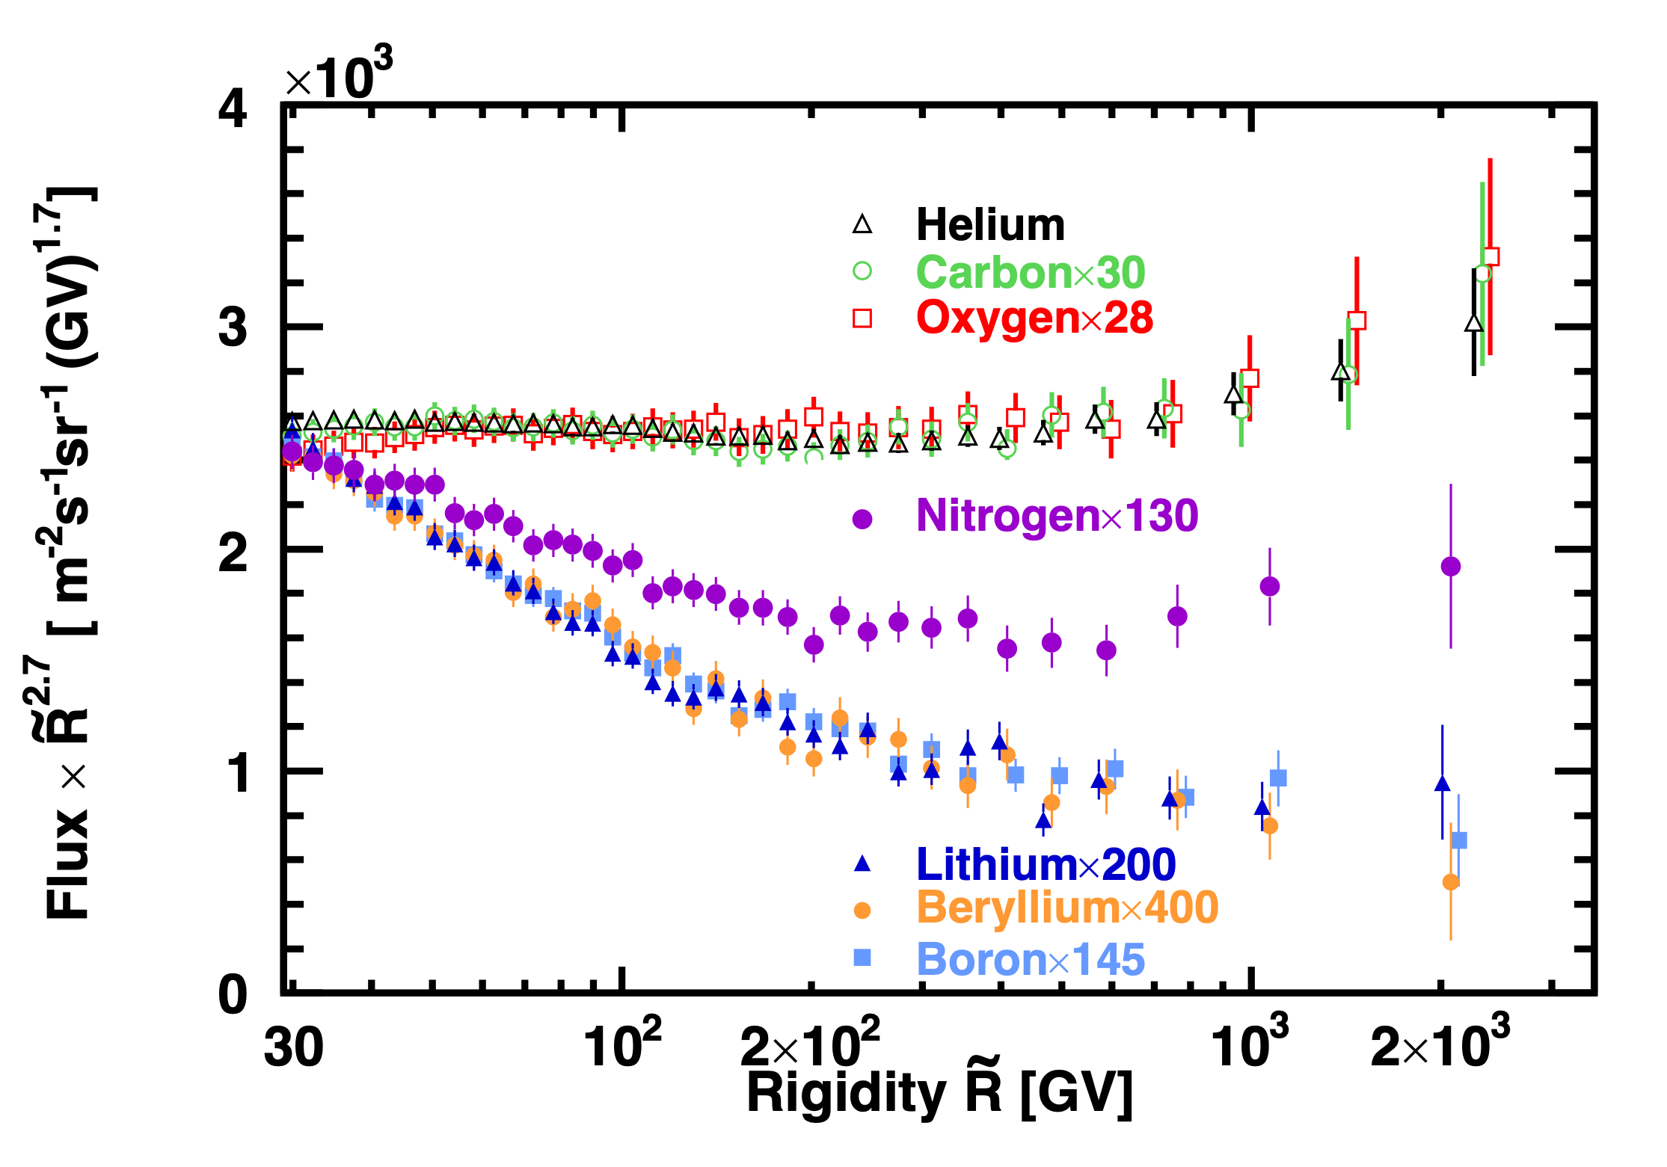
The situation in 2019
He, C, O
Are mostly primary species
Show the same spectral shape above ~50 GV
Show the same spectral break at ~300 GV
Li, Be, B
Are mostly secondary species
Show the same spectral shape above ~20 GV
Show the same spectral break at ~300 GV
But the magnitude of the break in secondaries is double the one in primaries, pointing to a propagation effect
N
Shows a spectral shape with mixed primary and secondary components
M. Aguilar et al., PRL 119, 251101 (2017)
M. Aguilar et al., PRL 120, 021101 (2018)
M. Aguilar et al., PRL 121, 051103 (2018)

Slide 41
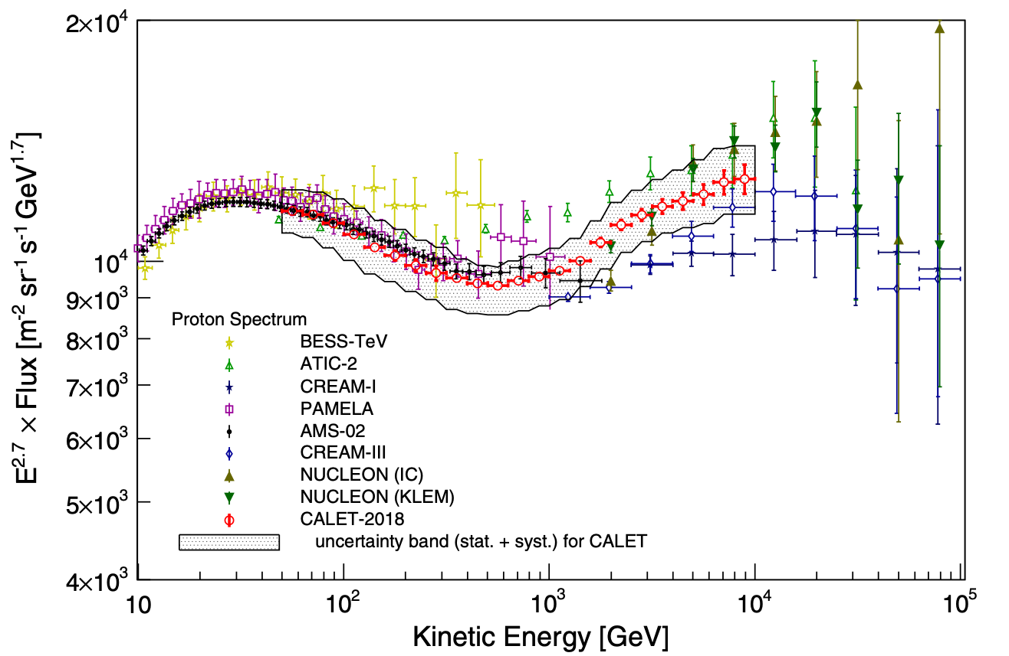
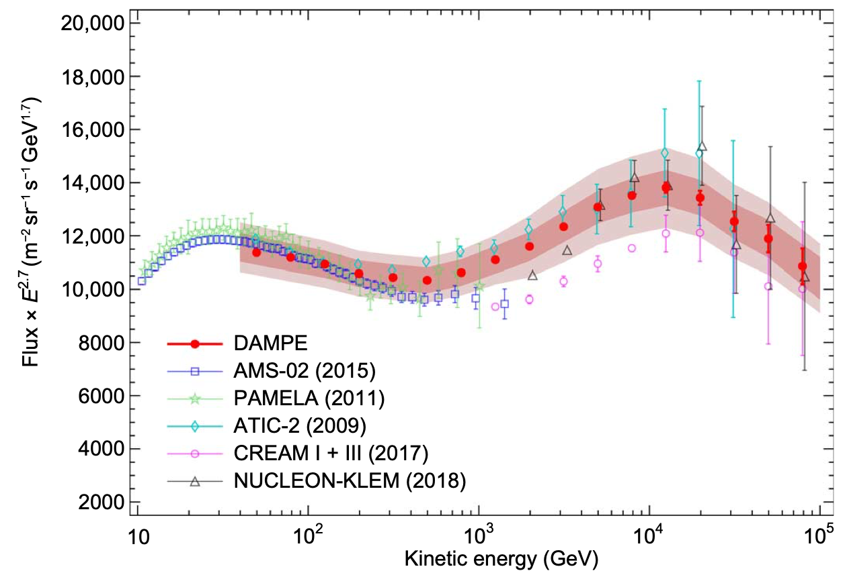
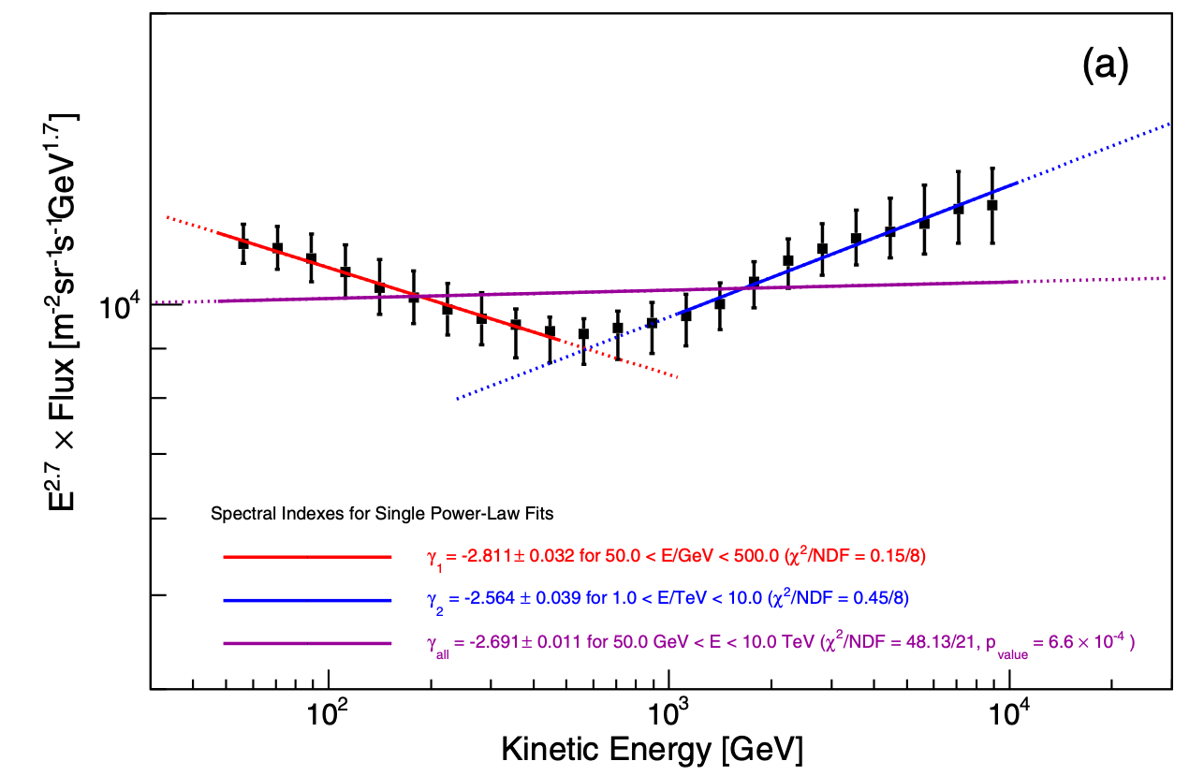
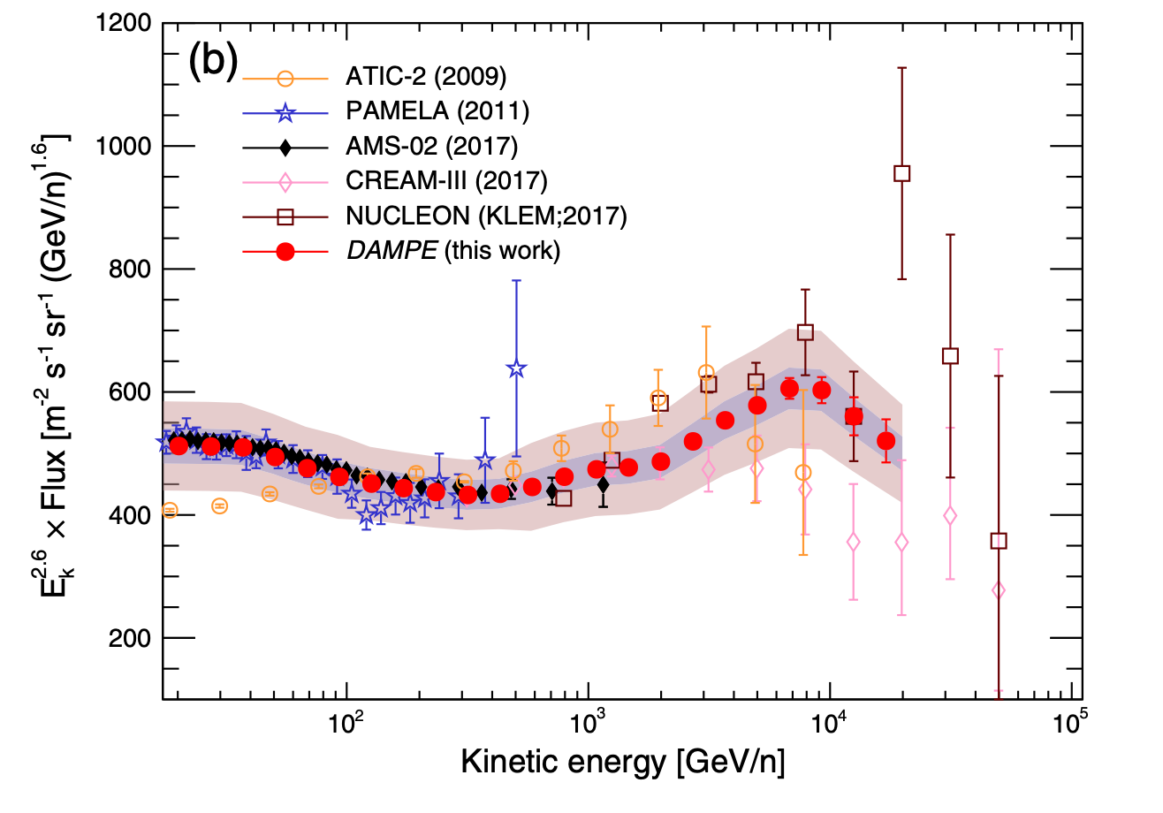
Proton and Helium
A spectral softening at tens of TeV appears after the break at ~500 GeV
Among the possibilities:
This is the contribution of an individual source (Shape of the bump determined by the source spectrum, age and distance)
This is a new population of CRs
(And the position in energy of the spectral features is related to environmental parameters)

Slide 42



Heavier nuclei
Measurements up to several TeV/n
Similar spectral break observed in both C and O
C/O ratio flat above 25 GeV/n similarly to what observed by AMS-02
B/C and B/O exhibit spectral break at ~200 GeV/n similarly to what observed by AMS-02

Slide 43


Heavier nuclei
M. Aguilar et al., PRL 124, 21102 (2020)
To examine the rigidity dependence difference between low-Z He, C and O and high-Z Ne, Mg and Si primaries the Ne/O, Mg/O, and Si/O flux ratios were studied. Their ratios differs by a power law by more than 5σ above 86.5 GV showing that Ne, Mg and Si is a different class of primary CRs than He, C and O.

Slide 44




Heavier nuclei - Iron
M. Aguilar et al., PRL 126, 041104 (2021)
First precise measurements of the Iron flux up to the TeV region
Fe belongs to the He, C, and O class of primary cosmic rays, which have a different rigidity dependence with respect to Ne, Mg, and Si.

Slide 45

A complex picture...

Slide 46
Open questions

Slide 47


Current operating “telescopes”
DAMPE Field of View ~ 1 sr
→ Acc ~ 0.3 m² sr
AMS Inner ~ 0.5 m² sr
AMS Full Span ~ 0.05 m² sr
1
TRD
TOF
2
3-4
5-6
Tracker
7-8
All the current and past detectors are designed as 'telescopes': they're sensitive only to particles impinging from "the top"
limited FoV → small acceptance
TOF
RICH
9
ECAL

Slide 48




The ghost of experiments yet to come
(HERD)
CSS expected to be completed in 2025
Life time | > 10y
Orbit | Circular LEO
Altitude | 340-450 km
Inclination | 42°
HERD expected to be installed around 2026
Life time | > 10y
FOV | +/- 70°
Power | < 1.5 kW
Mass | < 4 t

Slide 49










The ghost of experiments yet to come
(HERD)
PSD, 5 sides
γ identification
Charge
@INFN Perugia
~ 300k readout channels
@Univ. of Geneva
@CIEMAT Madrid
Tracker (SCD + FIT), 5 sides
Charge
CR trajectory
γ conversion & tracking
@INFN BA-GSSI-LE-PV-NA & IHEP
@Guangxi Univ.
@IHEP
TRD
TeV CR calibration
~7500 LYSO crystals (55 X₀, 3 λ_{I})
Trigger sub-system
Dual readout with IsCMOS & PD/SiPM
@XIOPM
CALO: 3-D
Energy
e/p separation

Slide 50
The ghost of experiments yet to come
(HERD)
Item | Value
Energy range (e/γ) | 10 GeV - 100 TeV (e); 0.5 GeV-100 TeV (γ)
Energy range (nuclei) | 30 GeV - 3 PeV
Angle resolution | 0.1 deg.@10 GeV
Charge resolution | 0.1-0.15 c.u
Energy resolution (e) | 1-1.5%@200 GeV
Energy resolution (p) | 20-30%@100 GeV - PeV
e/p separation | ~10⁻⁶
G.F. (e) | >3 m²sr@200 GeV
G.F. (p) | >2 m²sr@100 TeV
Field of View | ~ 6 sr
Envelope (L*W*H) | ~ 2300*2300*2000 mm³
Weight | ~ 4000 kg
Power Consumption | ~ 1400 W

Slide 51





The ghost of experiments yet to come
(HERD)
e⁺+e⁻
Proton
He
Li
B/C
Fe

Slide 52

The ghost of experiments yet to come
(ALADInO)
ToF
TRK
CALO
ToF
https://www.cosmos.esa.int/web/voyage-2050/white-papers
https://www.cosmos.esa.int/documents/1866264/3219248/BattistonR_ALADINO_PROPOSAL_20190805_v1.pdf

Slide 53


The ghost of experiments yet to come
(ALADInO)
Weight~(2300+300) kg
N. crystals: ~20.000
3 cm
LYSO
3 cm
Basic crystal: hexagonal base prisma
Z
Z
Y
X
X
Length: 95 cm
Diameter: 94 cm

Slide 54

The ghost of experiments yet to come
(ALADInO)
Benefit from the R&D of high temperature superconducting magnets (MgB₂, YBCO and in particular REBCO) for space applications (T ≈ 15÷40°K)
Field 0.8 T
Bending power > 1.1 T m
Weight ~ 1000 Kg

Slide 55
The ghost of experiments yet to come
(ALADInO)

Slide 56

The ghost of experiments yet to come
(ALADInO)
Weight: ~ 6 Tons
Power: ~ 4 kW
# channels: 2.5 M

Slide 57
The ghost of experiments yet to come
(AMS-100)
https://www.cosmos.esa.int/web/voyage-2050/white-papers
https://www.cosmos.esa.int/documents/1866264/3219248/SchaelS_AMS100_Voyage2050.pdf
arXiv:1907.04168v1 [astro-ph.IM] 9 Jul 2019

Slide 58
The ghost of experiments yet to come
(AMS-100)
The Calorimeter is essentially based on the HERD design
A Pre-Shower (silicon detectors + tungsten) is foreseen to provide an angular resolution for γ-rays similar to the Fermi-LAT one
An additional external γ-ray converter on the end-cap is foreseen to increase the γ-ray acceptance

Slide 59
The ghost of experiments yet to come
(AMS-100)

Slide 60
Conclusions
The last decade represented a major advance in the experimental knowledge of CR entering the field in the “precision era”
Interpretation of the new data leads to a lively debate, especially since new features and patterns start to emerge in the hadronic component of CRs, and no definite answer has emerged for the antimatter component puzzle
New space experiments are being planned or dreamed to connect the direct measurements with indirect measurements and push forward the boundaries of existing measurements

