Slide 1

Il Gruppo 3 nel 2023 composizione e attività
Da dove veniamo? Chi siamo? Dove andiamo? Paul Gauguin (1897) Museum of Fine Arts, Boston

Slide 2
Anagrafica ricercatori nel 2023 e 2024
Composizione Gruppo 2023
Ricercatori
Nome | ALICE | NA60+
Alocco Giacomo | 1,0
Aresti Mauro | 0,8 | 0,2
Boi Stefano | 1,0 | 0,0
Bosin Andrea | 1,0 | 0,0
Cicalò Corrado | 0,8 | 0,1
De Falco Alessandro | 0,7 | 0,2
Fionda Fiorella | 0,8 | 0,2
Masoni Alberto | 0,8 | 0,1
Paul Biswarup | 0,9 | 0,1
Sarritzu Valerio | 0,8 | 0,2
Usai Gianluca | 0,7 | 0,3
Totale FTE Ricercatori | 9,3 | 1,4
Composizione Gruppo 2024
Ricercatori
Nome | ALICE | NA60+
Alocco Giacomo | 1,0 | 0,0
Bosin Andrea | 1,0 | 0,0
Cicalò Corrado | 0,7 | 0,1
De Falco Alessandro | 0,7 | 0,2
Fionda Fiorella | 0,8 | 0,2
Masoni Alberto | 0,7 | 0,1
Mulliri Alice | 0,7 | 0,3
Sarritzu Valerio | 0,8 | 0,2
Usai Gianluca | 0,7 | 0,3
Totale FTE Ricercatori | 7,1 | 1,4
Contratto terminato
Dottorato conseguito
Piccole variazioni per
compatibilità con attività
in ET/Virgo
AdR
Contratto terminato
Riduzione FTE dovuta alle variazioni dei numeri di dottorandi/assegnisti
Borsa di ricerca nel prossimo futuro

Slide 3
Richieste impegno servizi
Tecnici | ALICE | NA60+ | Tot
Arba Mauro | 0,3 | 0 | 0,3
La Delfa Luigi | 0,2 | 0 | 0,2
Marras Davide | 0,3 | 0 | 0,3
Tuveri Marcellino | 0,2 | 0 | 0,2
Totale FTE Tecnici | 1 | 0 | 1
Tecnologi | ALICE | NA60+ | Tot
Mura Daniele | 0,6 | 0,1 | 0,8
Siddhanta Sabyasachi | 0,7 | 0,3 | 1,0
Puggioni Carlo | 0,8 | 0,2 | 1,0
Totale FTE Tecnologi | 2,1 | 0,6 | 2,8
-0.1 su ALICE
(comp. con ET)
Richieste per tecnici e tecnologi sostanzialmente immutate
Totale FTE (Ricercatori + tecnologi)
ALICE: 9.2 FTE
NA60+: 2 FTE

Slide 4



Attività del Gruppo 3 2022-2023
ALICE
  Sistema di tracciamento dello spettrometro per muoni
  ZDC
  Elettronica per ITS3 e sinergia con NA60+
  Analisi dati: dileptoni e quarkonia
NA60+
  R&D su magneti, rivelatori di vertice, camere traccianti
  Studi sull’apparato e test sotto fascio
    tracciamento per i muoni
    spettrometro di vertice
    Magnete toroidale
  Studi di physics performances: dimuoni termici, produzione di stranezza
  LoI

Slide 5
MCH status
04 luglio 2023

Slide 6
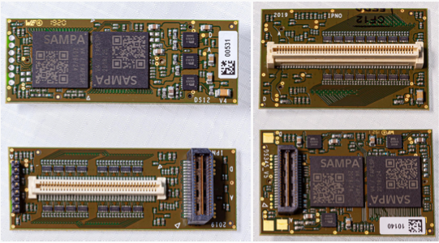
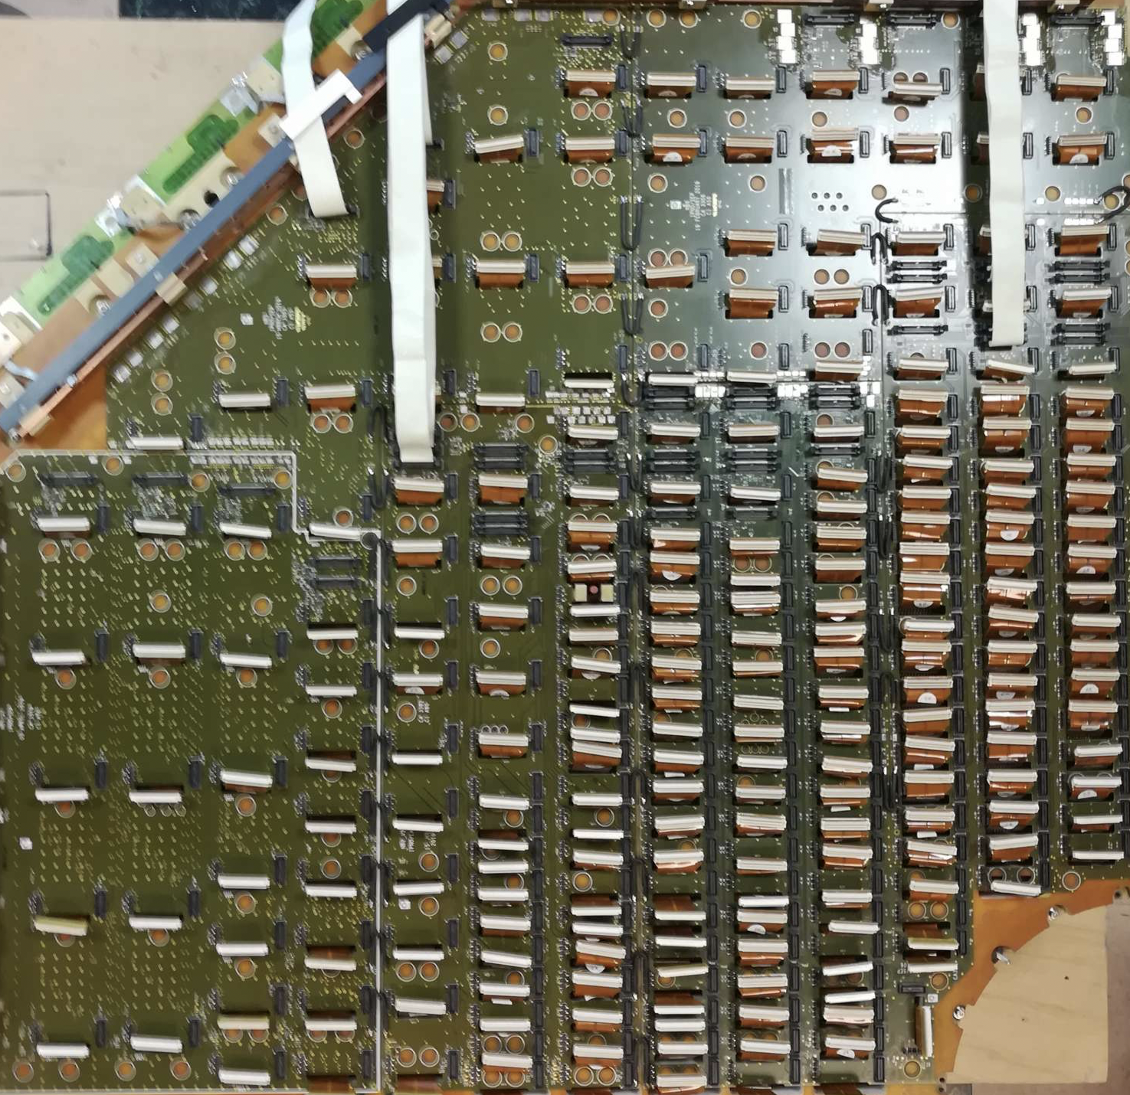
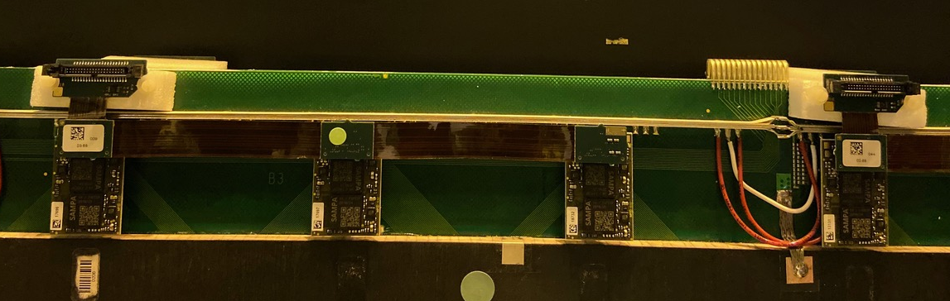
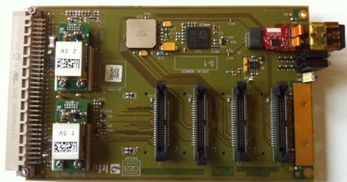
MCH upgrade project
Flex for slats
PCB St 1/2
DualSampa FEC
1 FEC = 2 SAMPA = DualSAMPA
16500 + 2500 (spares)
LVPS
WIENER PL512
SAMPA: Brazil
CRU: Hungary, India
HVPS
No change
Detection Element
Filter box
DCS
FEC: Orsay
FLEX: Cagliari
SOLAR : Saclay
CRU: India (Kolkata,Aligarh)
FEC
FEC
LV 3 busbars
1.2V analog
1.2V digital
GND
2.5V
GND
30
FLP
(O2)
SOLAR
CRU
FE link 80 Mbit/s (Data, Trigger, Config)
GBT link
3.2 Gbit/s
700
FE link:
FLEX (slats) /PCB(quadrants)
+ flat cable
~3000
LTU
CTP
Cavern
Control room
SOLAR board

Slide 7
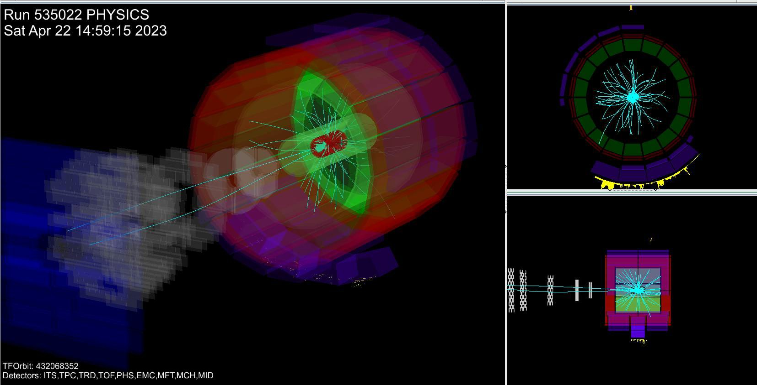
MCH data taking in pp (2023)
•
Dimuons are still here at low rate…. Run 535022 (Single_12b_8_8_8_2018)

Slide 8
MCH General status (since january 2023)
13
MCH is in good shape
  HV + LV are stable
    Few hardware issues with the LVPS but it should improve with the arrival of repaired ones.
  Physics pp data taking at 500 kHz is very smooth
Many cavern activities since the beginning of the year
  Station 2, Indian Team (5 people) came for more than one month to change 2 quadrants
  Station 1 cabling/readout improvements
  Station 345 noise and gas leak fixes
•

Slide 9
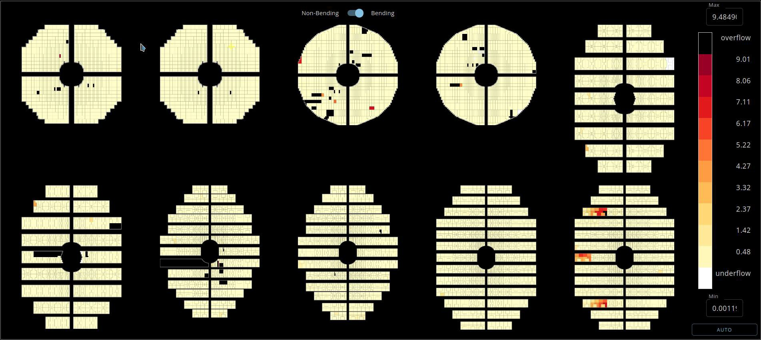
Current MCH readout status (occupancy plot)
•
Bending Run 537546 4 June 2023 at 21:28:49 CEST : occupancy
FEE does not configure
Check LV and contact with pipe absorber.
Faulty LVPS
Noise

Slide 10
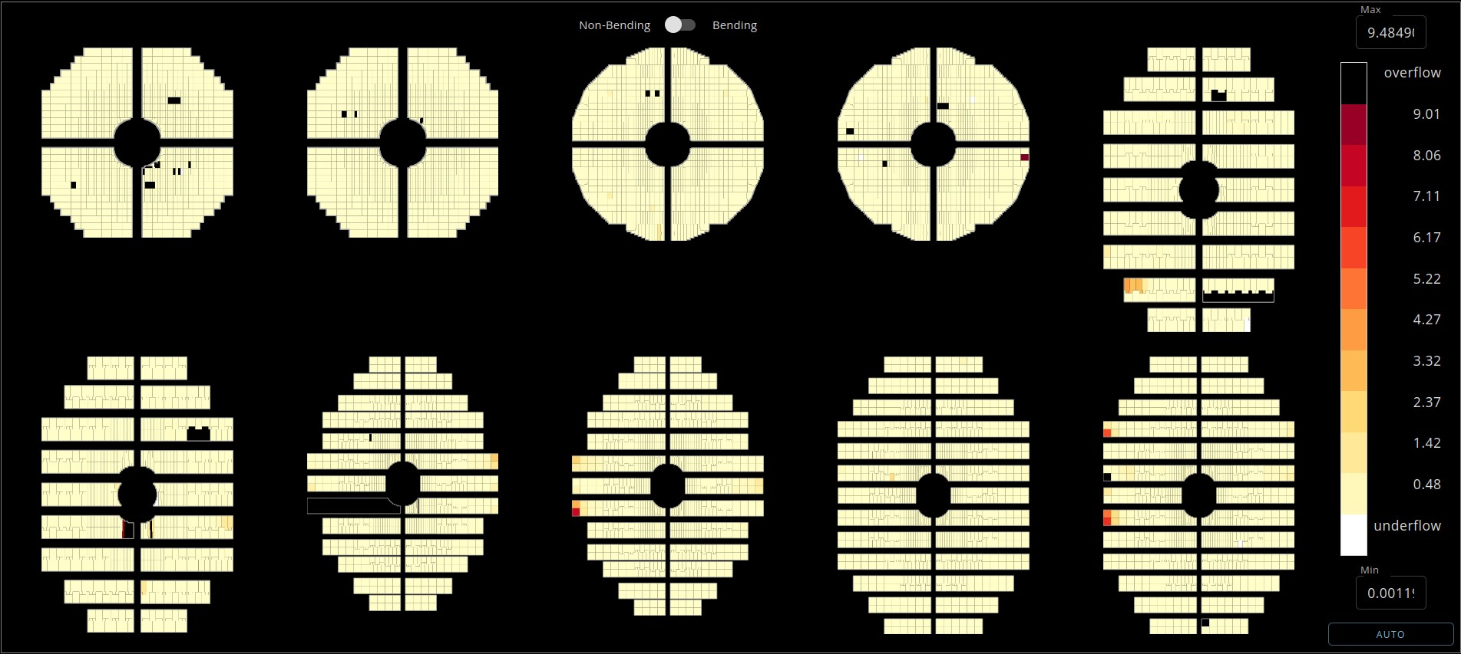
Current MCH readout status
•
Non-bending Run 537546 4 June 2023 at 21:28:49 CEST : occupancy
LV connection to check

Slide 11
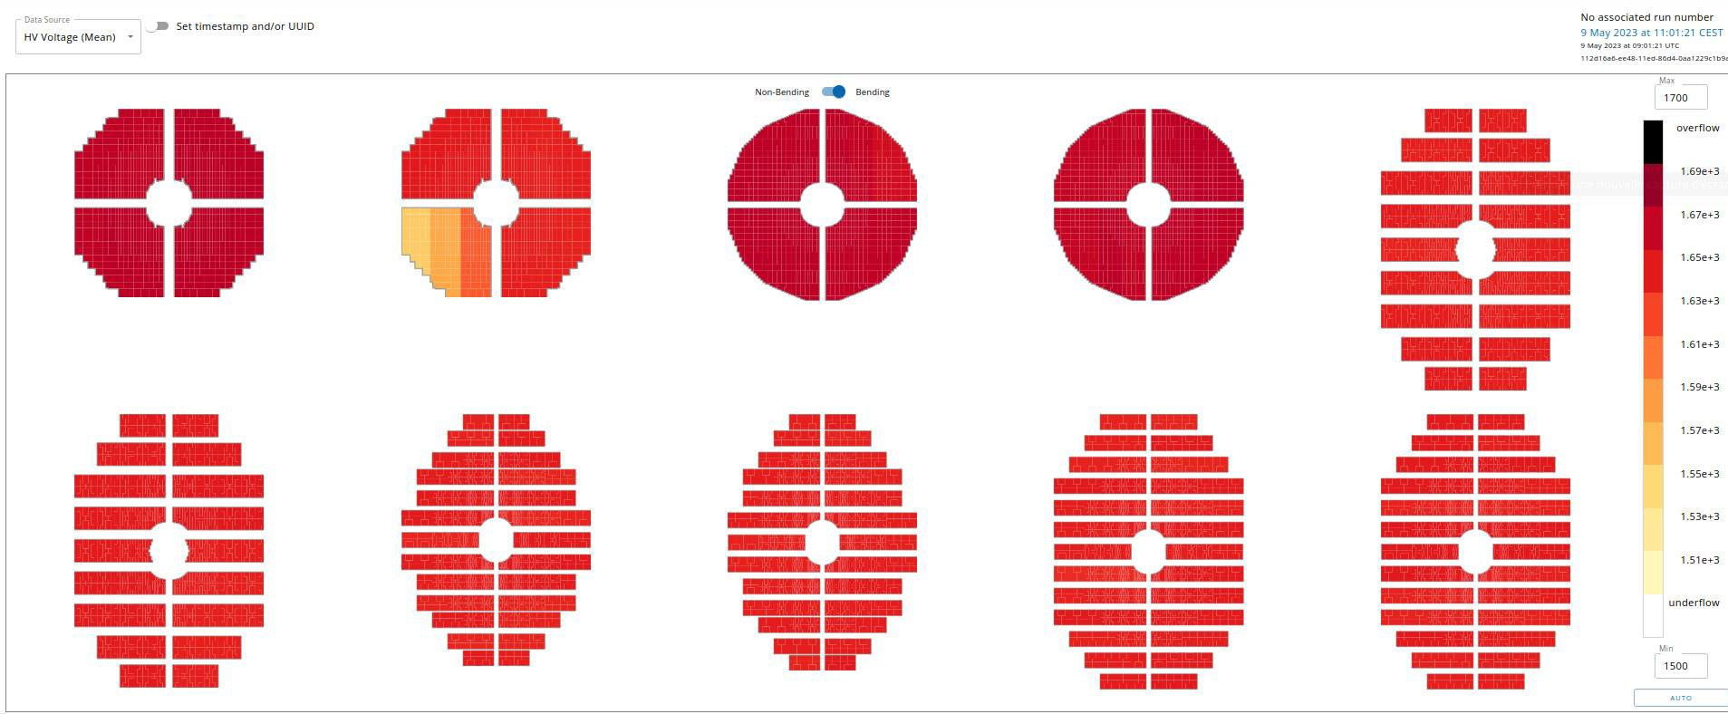
HV status: everything nominal
1
2
5
10
●
HV are very stable at pp 500 kHz
●
Chambers 1,3 and 4 at 1675 V
●
Chamber 1 gain is high enough so we will probably operate it at 1650 V (as Ch2)
●
Chambers 2 at 1650V, one quadrant with large gain has custom HV settings (same efficiency as the other)
Chambers 5-10 at 1650V
●
●
No trips observed so far (8.7 Hz/μb⁻¹, ~ 500 kHz FT0VX) but few DE have current spikes.

Slide 12
Richieste per il 2024
Composizione del gruppo ALICE Cagliari: 9.2 FTE
Richieste specifiche Missioni:
  Per interventi sull’apparato: 10 kEuro
Richieste specifiche consumo:
  4.5 keuro auto CERN x turni e oncall
  1.5 keuro consumo per interventi su MCH (e ZDC)

Slide 13
ZDC
Carlo Puggioni si è occupato dello sviluppo del monitoraggio dello ZDC (QC Quality Control)
Commissioning ZDC :
  Sono stati validati la QC, la ricostruzione dei dati, nuova elettronica di readout, l’uso dello ZDC come luminometro
  proton-proton LHCf Settembre 2022
  proton-proton VdM scan Novembre 2022
  Pb-Pb pilot run in Novembre 2022
  proton-proton VdM scan Giugno 2023
Presenza durante il periodo di presa dati Pb-Pb a ottobre 2023
Richiesta 2024 per Carlo Puggioni
  Manutenzione e aggiunta di nuove funzionalità per la QC dello ZDC
  Presenza presa dati run speciali protone-protone (VDM)
  Presenza presa dati Pb-Pb fine anno 2024

Slide 14
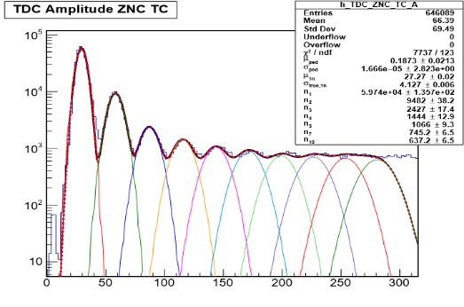
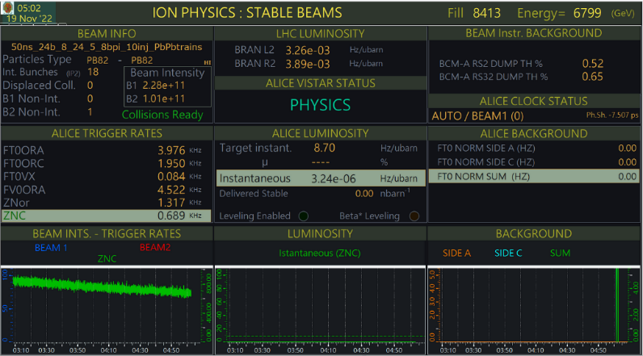
ZDC Performance
ZDC performances in Pb-Pb pilot run
Energy resolution in Pb-Pb pilot run
1n
2n
3n
4n
5n
1n peak resolution 15-16%!
It was 20% in run1 and run2
Luminosity estimation in Pb-Pb pilot run
ZNC operated as the ALICE luminometer

Slide 15
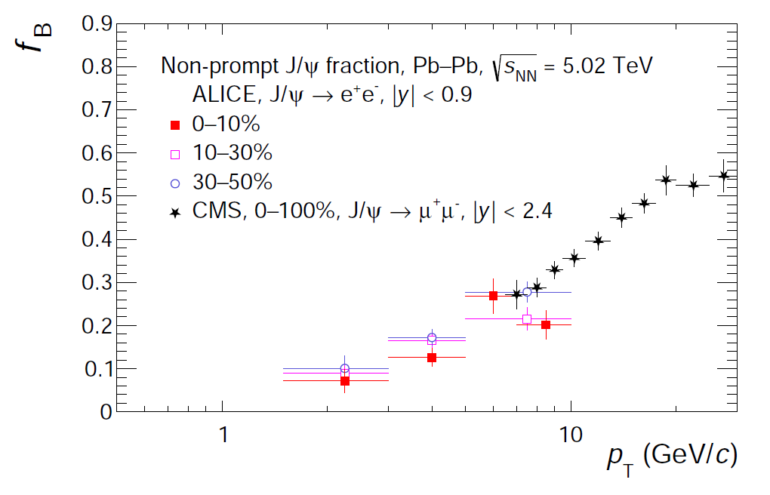
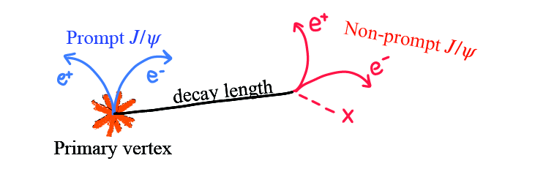
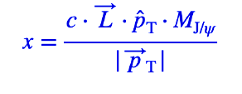
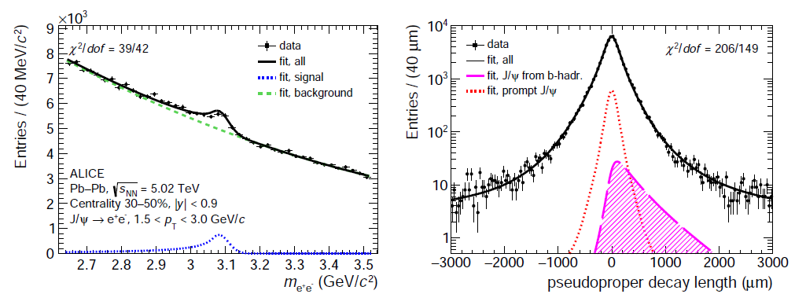
Separation of prompt and non-prompt J/𝜓 in Pb-Pb collisions at 5.02 TeV
F. Fionda (Cagliari), J.A. Saetre (PhD, Bergen)
Paper in preparation, under CR, targeting QM2023
Prompt and non-prompt separated at midrapidity down to very low p_{T} (1.5 GeV/c) at midrapidity → unique kinematic coverage of ALICE at the LHC !
Non-prompt J/ψ fraction show similar trends vs pT in pp and Pb-Pb collisions

Slide 16
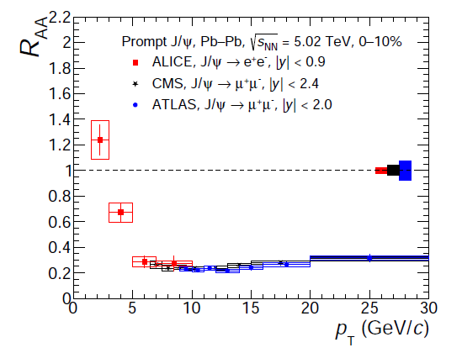
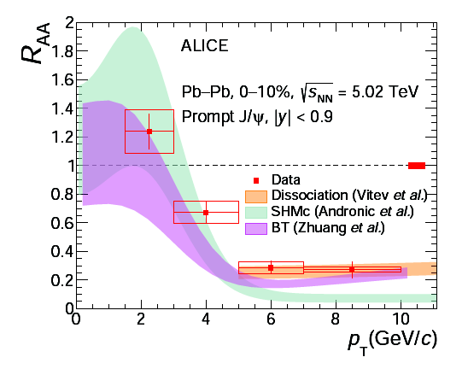
Prompt J/𝜓 R_{AA} in Pb-Pb collisions at midrapidity
Paper in preparation, under CR, targeting QM2023
F. Fionda (Cagliari), J.A. Saetre (PhD, Bergen)
ALICE R_{AA} measurements extend down to pT = 1.5 GeV/c and show an overall good agreement with similar measurements from other experiments at higher pT
Boltzmann transport model can describe within uncertainties pT-differential RAA in central collisions; SHMc provides a good description below 5 GeV/c; collisional dissociation model by Vitev et al in agreement with data for pT > 5 GeV/c (CNM effects assumed negligible)
=> models including regeneration can describe within uncertainties the rising trend at low pT !

Slide 17
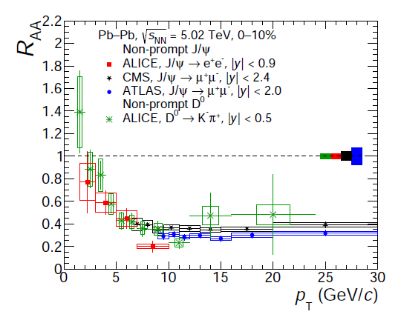
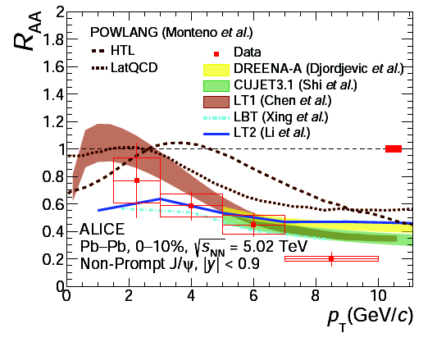
Non-prompt J/𝜓 R_{AA} in Pb-Pb collisions at midrapidity
Paper in preparation, under CR, targeting QM2023
F. Fionda (Cagliari), J.A. Saetre (PhD, Bergen)
Good proxy of beauty quark energy loss inside the medium
Good agreement with non-prompt D⁰ R_{AA} at low pT and with non-prompt J/psi R_{AA} measurements from CMS / ATLAS at high pT
Models predict similar RAA at higher pT, in agreement with data within uncertainties → larger uncertainties at low pT
All models include both collisional and radiative energy loss → can describe data within uncertainties
  Model including only collisional processes overestimates data at high-pt in central collisions

Slide 18
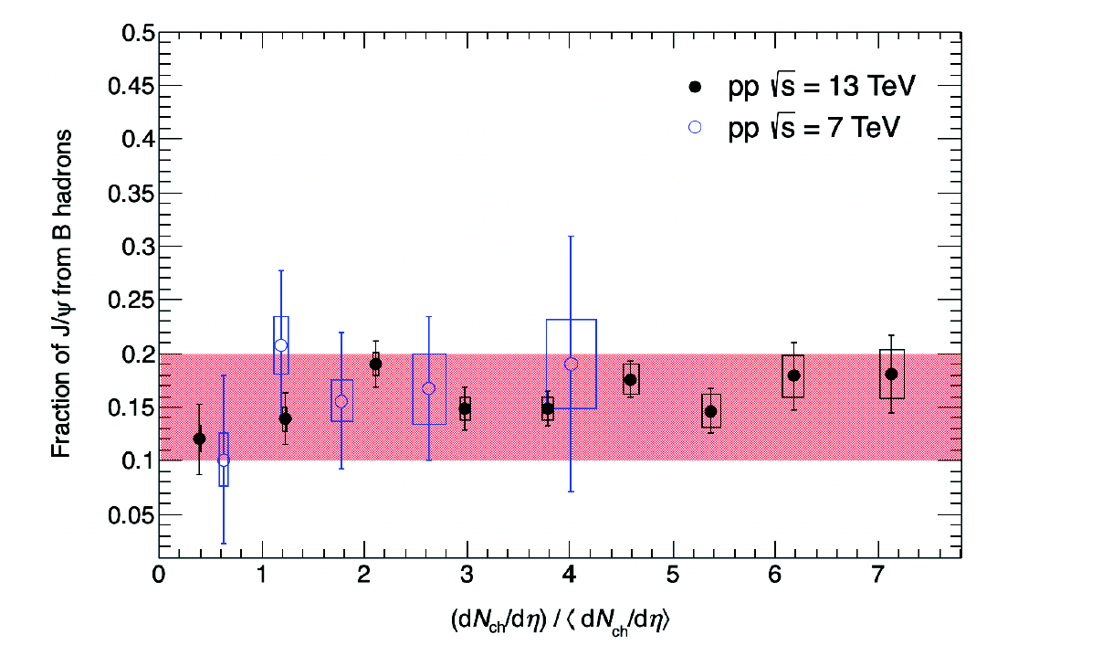
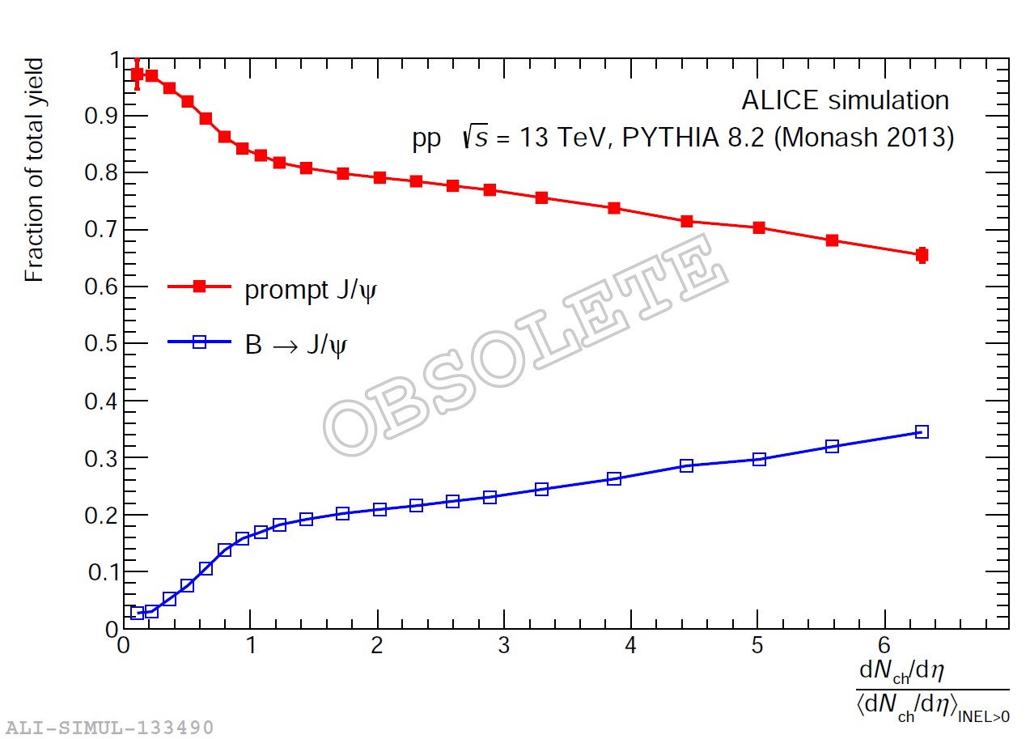
Non-prompt J/𝜓 vs charged particle multiplicity in pp at 13 TeV
Aiming at preliminary for QM2023
F. Fionda (Cagliari), Wenda Guo (PhD, Bergen & CCNU)
Non-prompt J/psi fraction measured in Run2 up to very high multiplicities (thanks to HM triggered data)
Higher multiplicity reach compared to Run 1 with significantly improved precision
Not significant multiplicity dependence observed for the non-prompt J/psi fraction → similar observation in PYTHIA simulations
PYTHIA8 sim

Slide 19
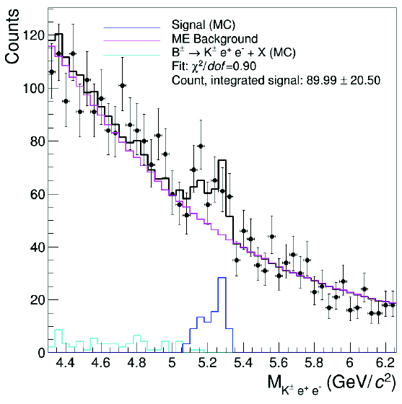
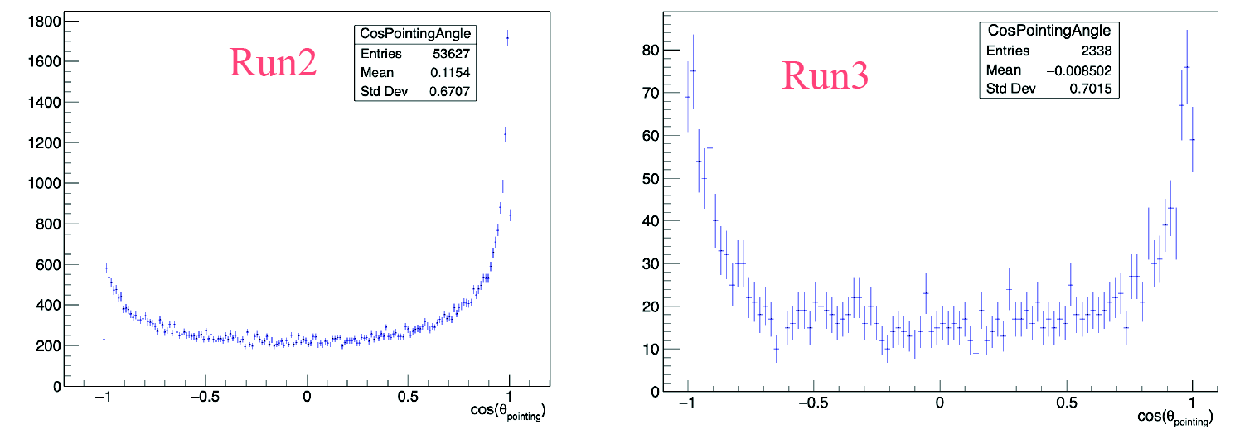
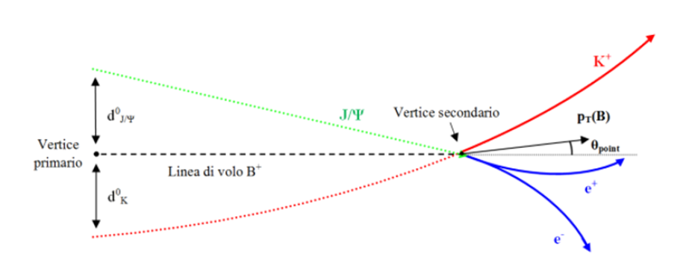
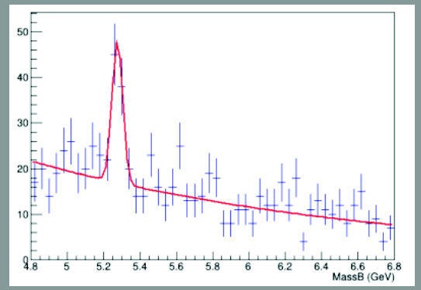
Exclusive B+→J/ψ(→ee) K⁺ meson reconstruction in Run3
Aiming at perfomance for QM2023
F. Fionda (Cagliari) , F. Quartu (master st., Cagliari), G. Alocco (PhD, Cagliari)
I. Arsene (Oslo), Ida Storehaugh (PhD, Oslo)
Run2, pp 13 TeV
INT7 + TRD
triggered data
(no pT selection)
Low pT
3 prongs vertexing algorithm implemented In the ALICE Run3 data analysis framework
Setup & validation of dedicated MC simulations performed
Signal peak not clearly visible yet with Run3 data (but very small sample inspected so far)
Topological selections investigated and compared with corresponding Run2 distributions
Outlook:
  Look at full 2022 (skimmed) pp sample
F. Quartu
Run2, pp 13 TeV
EMCal triggered data
(pT > 10 GeV/c)
High pT

Slide 20
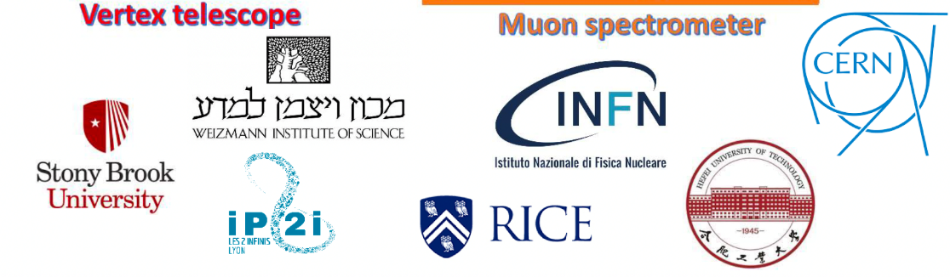
NA60+: Study of rare probes of the quark-gluon plasma at SPS energies
https://na60plus.ca.infn.it/

Slide 21
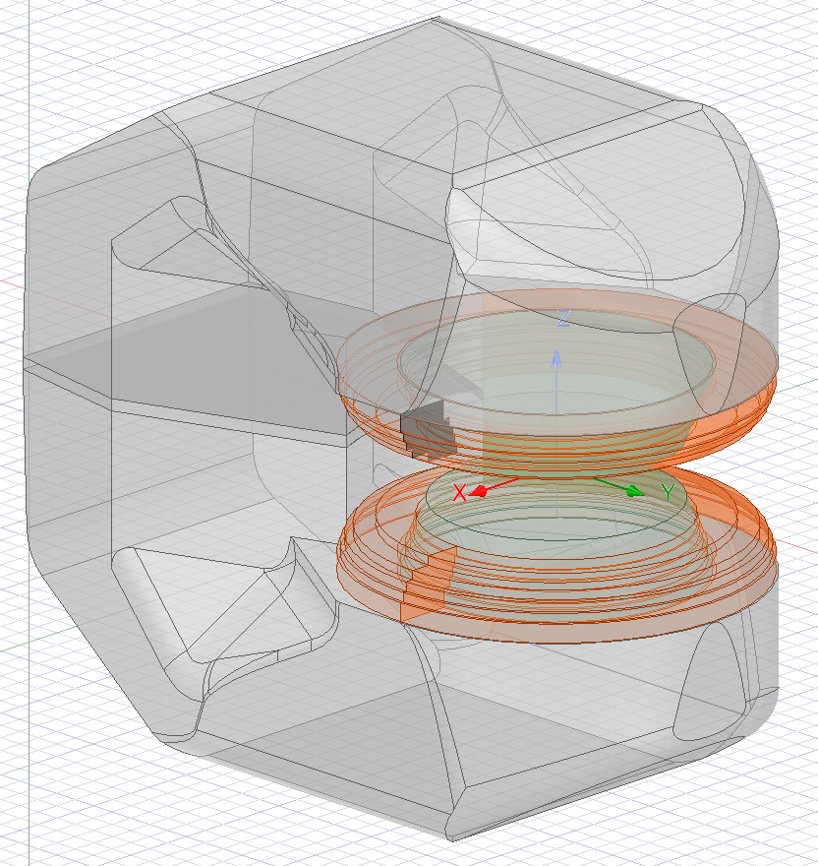
MEP48 dipole magnet
Ansys/Maxwell simulation
The MEP48 magnet was originally built for the PS170 experiment. It is now stored in building 190
The lower coil needs to be repaired, a work that can be taken care of by the EP-DT group (it is agreed that this will be done only after approval)
It is not clear if a power supply is (still) available. A rough cost estimate is 100-150 kCHF (CERN contribution)
Possibility to increase the maximum B-field (currently 1.5 T) being investigated
An increase up to ~2T would represent a significant improvement for various performance aspects
Discrepancy between simulated and expected field (1.32 vs 1.47 T) - Core / Yoke material exact composition not well known
Once validated, parametrically assess possibility to increase field intensity, options are:
  Minor increase in current
  Different winding (as the coils need to be replaced
  Change core metal for higher saturation

Slide 22
The NA60+ vertex telescope
Sensor based on 25 mm long units, replicated several times through stitching
→ up to 15 cm length for NA60+
R&D in progress
Common development
ALICE ←→ NA60+
(same timeline!)
State-of-the-art imaging technology
TowerJazz 65 nm
Sensor thickness:
few tens of microns of silicon
→ material budget <0.1% X₀
Spatial resolution ≤ 5 μm
30 cm
Cooling studies (NA60+ geometry)
→ airflow+water
Engineering run for a fully functional prototype
Possibility of a second run if optimizations
needed
12 inch Si wafer

Slide 23
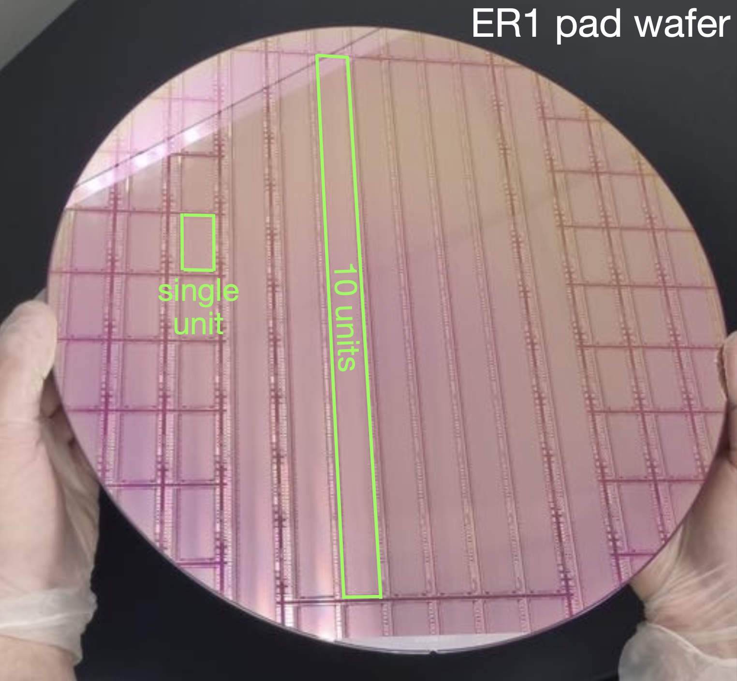
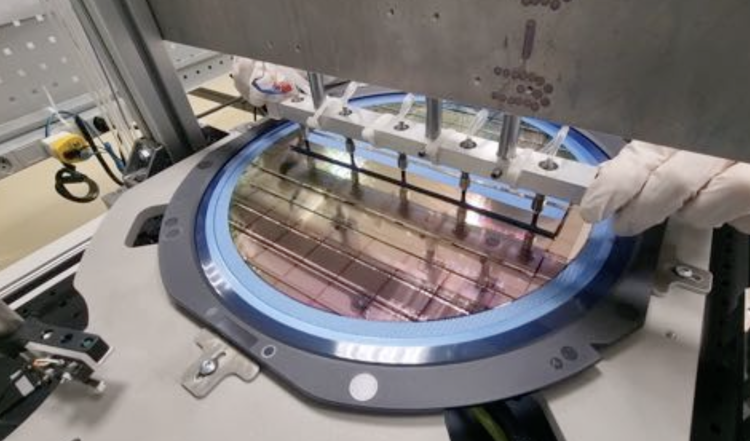
MOSS: ER1 wafer
ER1 Pad Wafer
MOSS: first stitched sensor produced!
Thinning/Dicing/Picking
Two pad wafers thinned (50 µm) and diced for handling tests
Chips picked from wafer using custom tooling, glued and bonded to carrier card
Procedure successful on pad wafers and on the first real MOSS!
ALICE geometry

Slide 24
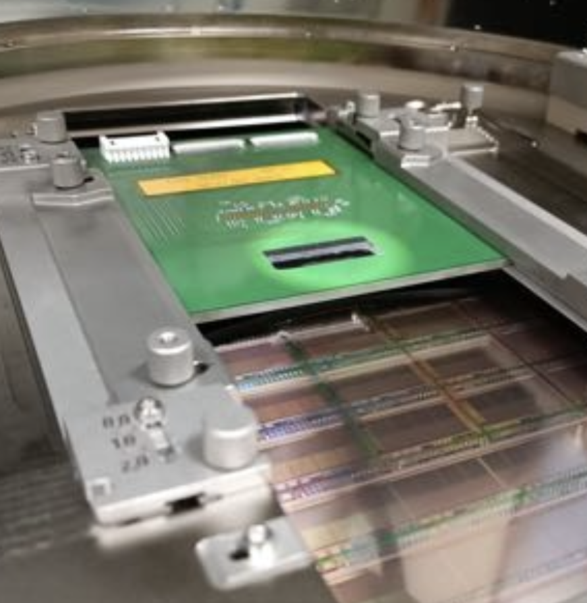
MOSS testing
Probe station & bonded
Probe card
|
Tests ongoing on wafers via probe card and in the lab on bonded chip
 | Probe station | Bonded
Power | Successful | Successful
Slow control | Works as expected | Works as expected
Pulsing | Digital: first tests OK Analog: TODO | Digital: first tests OK Analog: TODO
Fe55 | / | TODO
Beam | / | Developing mechanics, FW, SW
ER1 Wafer
|

Slide 25
R&D steps for silicon vertex tracker
2023:
  production of first stitched sensor. Tests on-going
  Simulation of cooling system with air-flow and water pipes done
  Measurements to validate cooling simulations started
  Construction of first frames; tooling for positioning and gluing of dummy sensors on-going
  Design of flex coupled to sensors for distribution power and data lines on-going
2024: continuation of 2023 R&D
  Consolidation of R&D towards the of construction of a mock-up of full tracker (5 stations)
  Bonding tests of flex to dummy sensors
  validation of flex for high-speed data transmission
R&D with several complex aspects and some difficulties:
  Difficult to define clear steps defined on a yearly basis (→ similar milestones across different years)
  Difficulties in buying materials, in particular during pandemics
  Exploiting ALICE experience for ITS3 (similar time-scale)

Slide 26
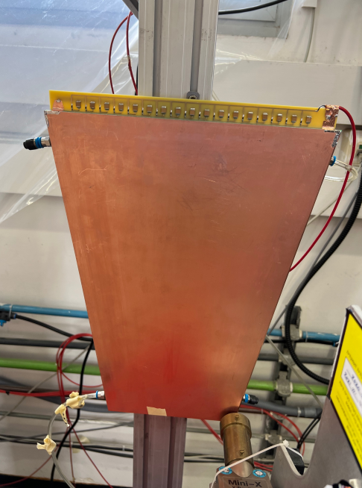
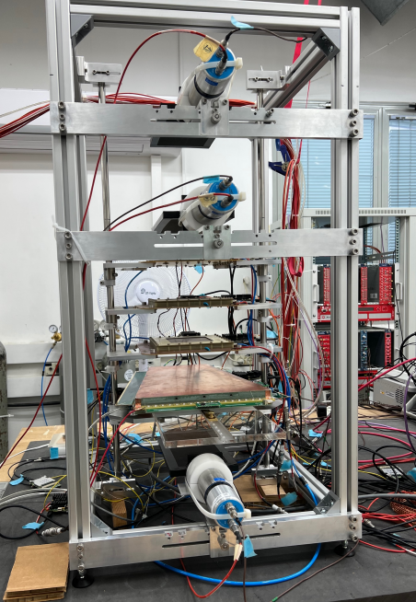
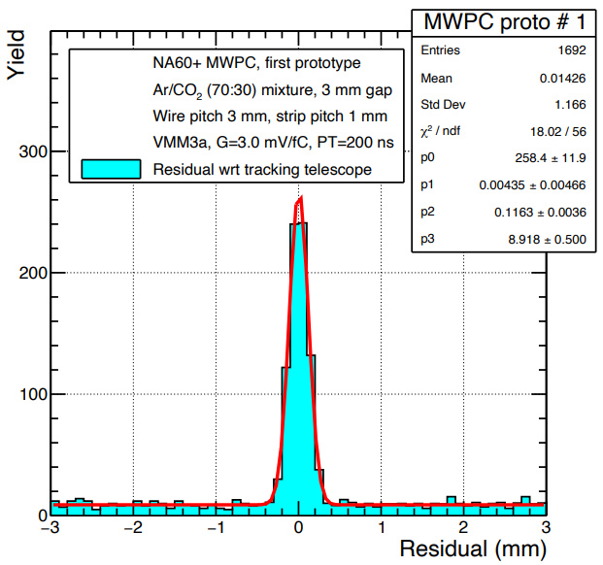
The NA60+ muon spectrometer R&D
Two prototypes of a MWPC module built and tested in the lab
Collaborating institutes have
availability of large facilities for
the production of the detector
modules for the NA60+ muon
spectrometer
70 cm
120 μm
resolution
90 cm
Prototype
Cosmic testbench
30 cm
Ongoing discussions on the final set-up of the spectrometer,
various possible solutions, as
  GEM technology for upstream stations (MS0-MS1)
  MWPC technology for downstream stations (MS2-MS5)
R/O electronics likely to be
based on the VMM3a ASIC,
interface card to be designed

Slide 27
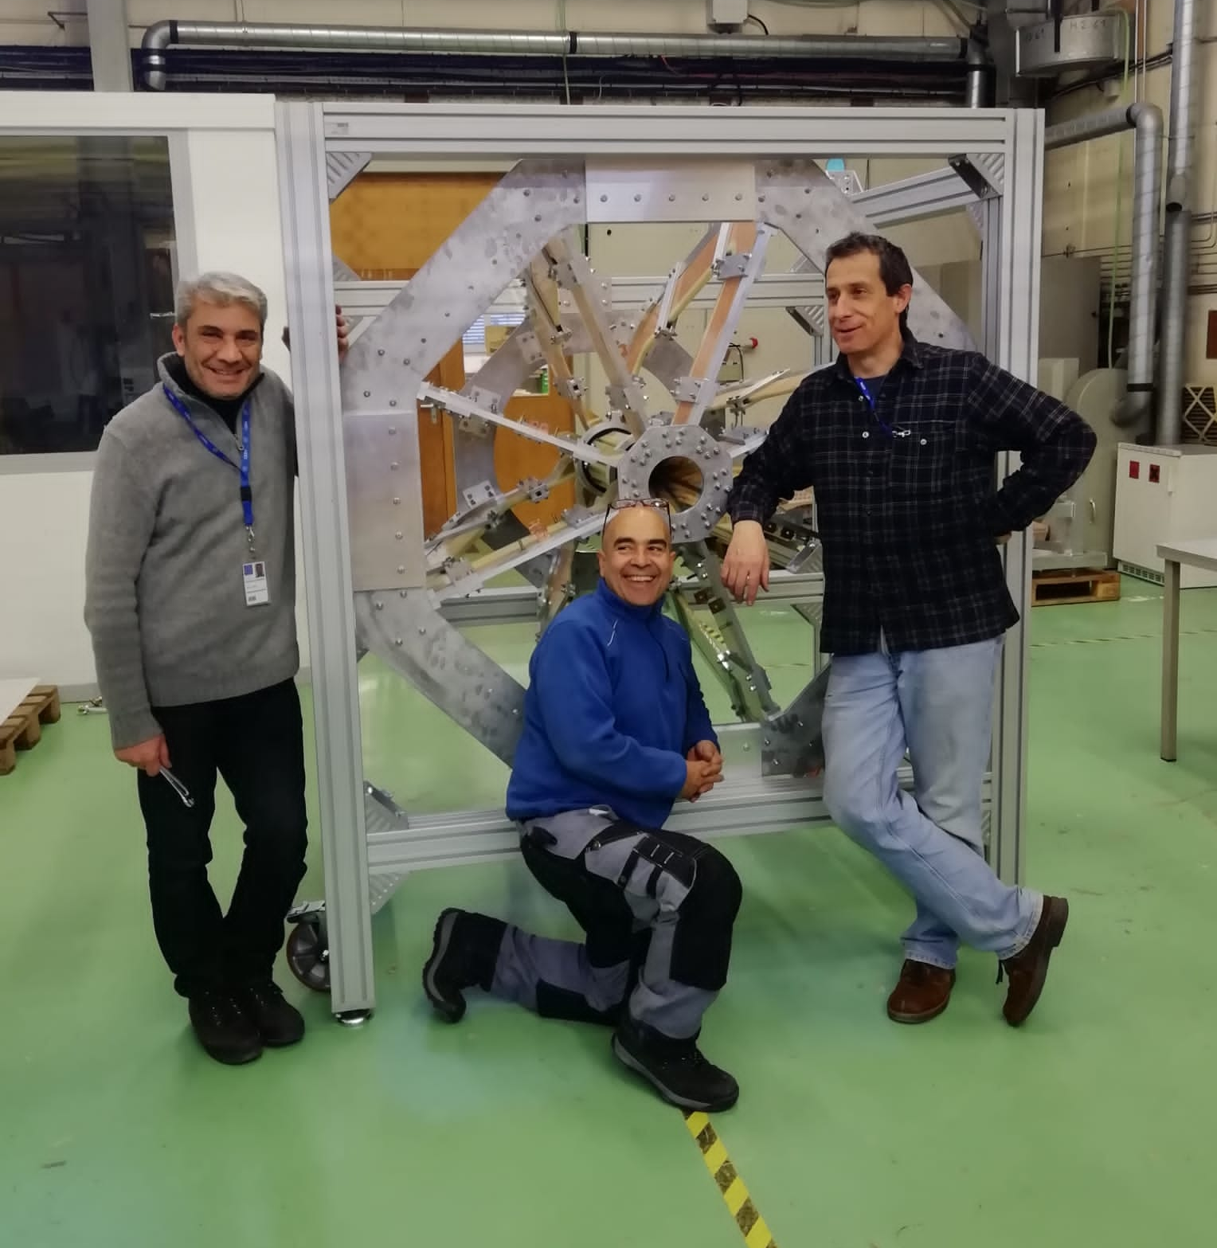
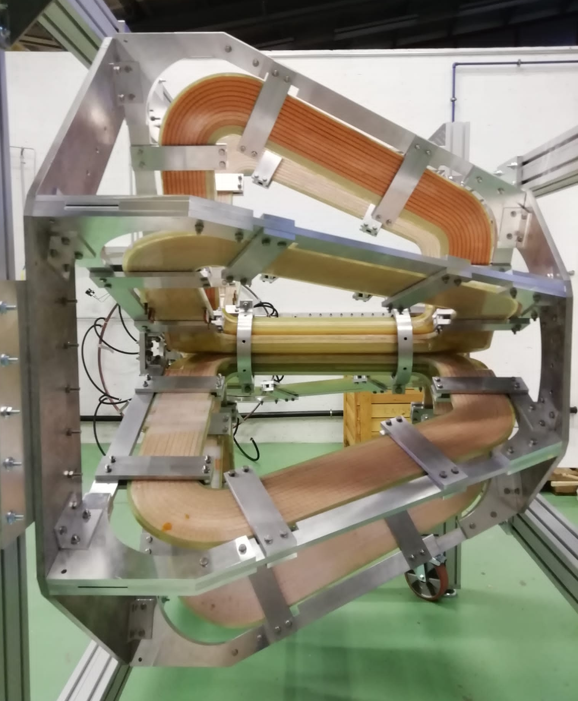
NA60+ toroid prototype: mechanics
Measurements of resistance,
inductance, cooling performance
and magnetic field were carried out
prototype (1:5 scale)
B measurement
→ agreement with simulations by 3%
→ end of 2022: installation and validation of mechanics designed by INFN CA-TO
Towards the design of a full-scale toroid:
Project leader from CERN magnet/accelerator group found
Required design activity for the TP seems on the right track
Funding of the magnet construction: still an issue

Slide 28
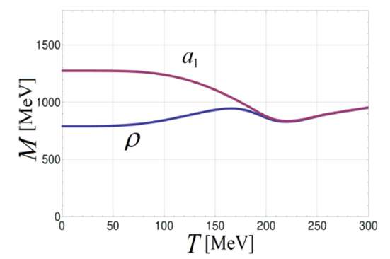
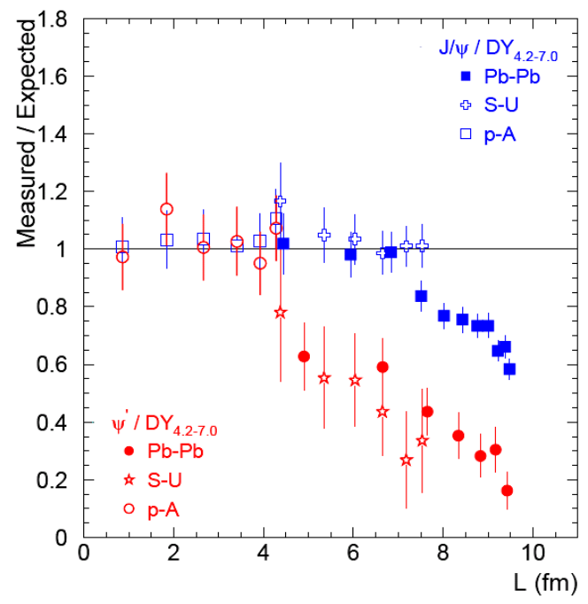
The pillars of the NA60+ physics program
All physics performance studies reworked in detail for H8 conditions
Caloric curve of QGP
Chiral symmetry
restoration
Measurement of
temperature
of thermal dimuons
vs √s_{NN}
ρ-a₁ mixing
in the
dimuon channel
Charmonium
melting
in the QGP
QGP transport
coefficients and
charm hadronization
Charmonium (J/ψ, ψ(2S))
suppression vs √s_{NN}
(dimuon decay channel)
Hadronic decays of
open HF
mesons/baryons

Slide 29
NA60+ LOI
LOI submitted in december 2022:
CERN-SPSC-2022-036 ; SPSC-I-259
The LoI was signed by 62 physicists/engineers/technicians representing institutions in
  Italy (Cagliari, Padova, Torino)
  Israel (Weizmann)
  USA (StonyBrook, Rice)
  France (Lyon)
  and CERN
Support also from prominent members of the QGP theory community

Slide 30
NA60+ presentation to SPSC and timeline
Feb 2023: project discussed by SPSC
The plan discussed with SPSC is to have the experiment on the floor by the end of LS3 → 2029
The SPSC recognizes the fundamental interest of the measurements proposed by the NA60+ collaboration, which are focused on electromagnetic and hard probes of the quark gluon plasma at high baryochemical potential. In order for the project to proceed with the suggested roadmap (starting construction in 2026 and data taking in 2029), the SPSC would expect to start examining a proposal by 2024
Roadmap
  Technical proposal: 2024-2025
  Construction and installation: 2026-2028
NA60+ data taking
yr1
yr2
yr3
yr4
yr5
yr6
yr7
2029
2030
2031
2032
2035
2036
2037

Slide 31
Manpower and preliminary financial requests 2024
Richieste ancora preliminari
Strutture | Missioni | Consumo | Inventario | Totali
CA | 14.5 + 8.5 SJ | 22 |  | 37.5 + 8.5 SJ
PD | 2.5+1.5 SJ |  |  | 2.5+1.5 SJ
TO | 14 + 7 SJ | 5 |  | 19 + 7 SJ
Totali | 31 + 17 SJ | 20 |  | 58 + 17 SJ
FTE: about 4 (similar to 2023)
Missioni:
  test beams per prototipi GEM, MWPC, MAPS (SJ ottenimento fascio)
  R/D prototipi piani con sistema di cooling (collaborazione CA-TO e sinergia con CERN)
  Collaborazione CERN per design magnete
  Riunioni comitati CERN
  Collaborazione Weiszmann Institute (Israele), Stony Brook (USA), Hefei (Cina)
  Workshop dedicato fisica NA60+
Consumo, inventariabile, licenze:
  Componentistica necessaria per il sistema di cooling 10 keuro
  Completamento del sistema di movimentazione –incollaggio dei sensori 5 keuro
  Prototipazione flex per studi trasmissione segnali, fibre ottiche, scheda di readout 5 keuro
  Licenza software COMSOL 7 keuro

Slide 32
Milestones 2024
Proposta milestones 2024:
  Preparazione technical proposal
  Sviluppo del tracking nel rivelatore di vertice
  Analisi dati test beam ioni e prototipi rivelatori 2022-23
  R/D meccanica/cooling pixel (lungo le linee discusse in dettaglio nella parte del rivelatore di vertice)

