Slide 1
Exactly solvable subspaces of spin-1 chains with boundaries & quasiparticle interactions
Chihiro Matsui
The University of Tokyo

Slide 2
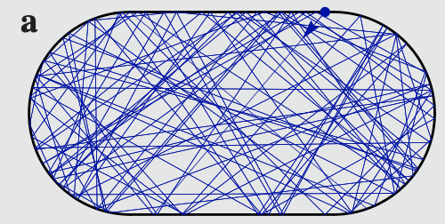
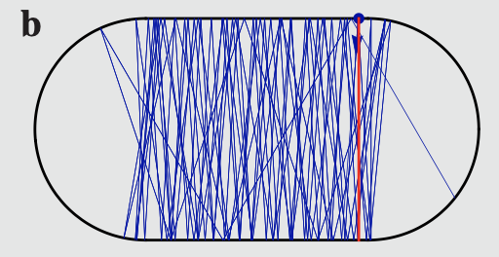
Classical thermalization & scar states
Almost all microstates are macroscopically indistinguishable from thermal states.
Non-thermal microstates (scar states) exist under the special initial condition.
  e.g. Scars in stadium billiard
[Serbyn et al. (2021)]
initial state:
away from unstable periodic trajectory
near unstable periodic trajectory

Slide 3
Quantum thermalization & scar states
Eigenstate thermalization hypothesis (ETH);
Integrable systems are known to break ETH.
More precisely, it is believed that exactly solvable energy eigenstates break ETH.
  Exactly solvable energy eigenstates exist in non-integrable systems.
  e.g. PXP model
  AKLT model
  η pairing in Hubbard model
  These states are macroscopically different from thermal states;
  “Quantum many-body scars (QMBS)”.
Studying exactly solvable states in non-integrable systems is interesting!
(candidates of QMBS)
[Turner et al. (2018), Lin (2019), Motrunich (2019)]
[Moudgalya et al. (2018)]
[Vefek et al. (2017), Moudgalya et al. (2020)]

Slide 4
Construction of scar subspace
Non-integrable models with QMBS have block diagonal Hamiltonian
  Projector embedding
  Spectrum generating algebra
  Krylov restricted thermalization
expected
scarred subspace W
expected to be scar subspace
e.g. PXP model, ….
e.g. Hubbard model,
AKLT model, PXP model
thermal subspace
e.g. Pair-hopping model,
t-Jz Model , …

Slide 5
Construction of scar subspace
Non-integrable models with QMBS have block diagonal Hamiltonian
  Projector embedding
[Shiraishi et al. (2017)]
expected
scarred subspace W
local projector
thermal subspace

Slide 6
Construction of scar subspace
Non-integrable models with QMBS have block diagonal Hamiltonian
  Spectrum generating algebra
[Arno et al. (1988), Ning Yang (1989)]
expected
scarred subspace W
local operator
energy eigenstate
thermal subspace

Slide 7
Construction of scar subspace
Non-integrable models with QMBS have block diagonal Hamiltonian
  Krylov restricted thermalization
[Moudgalya et al. (2019)]
expected
scarred subspace W
Hamiltonian
requires
not necessarily be the energy eigenstate
thermal subspace

Slide 8
Construction of scar subspace
Non-integrable models with QMBS have block diagonal Hamiltonian
  Projector embedding
  Spectrum generating algebra
  Krylov restricted thermalization
  Bethe-ansatz solvable subspace
expected
scarred subspace W
expected to be scar subspace
BA
solvable
e.g. PXP model
e.g. Hubbard model
AKLT model
thermal subspace
e.g. Pair-hopping model,
t-Jz Model , …

Slide 9
Our model
Spin-1 chains
  Spin-flip invariance
  Conserved magnetization
: nearest neighbor interactions
e.g.
Fateev-Zamolodchikov model (integrable)
AKLT model (non-integrable)

Slide 10
Matrix product energy eigenstates
Find the Hamiltonian with invariant subspace spanned by
  Matrix product zero-energy state
  Quasiparticle excitation states
⇒ area-law entanglement entropy
e.g. ⇒ periodic boundary
: small bond dimension
( )
⇒ open boundaries
⇒ expected to be sub-volume law entanglement entropy
: no particle creation or annihilation

Slide 11
Non-interacting solvable subspace
Which Hamiltonian has the invariant subspace given by
Non-interacting quasiparticles
  Spin-2 magnon excitation
  Local orthogonality
[Moudgalya et al. (2020)]
: forbid quasiparticles to locate at the same site or adjacent sites
⇒ Non-interacting quasiparticles for the nearest neighbor Hamiltonian
: identical quasiparticles (single mode quantum states)

Slide 12
Non-interacting solvable subspace
The sufficient conditions for W to be eigenspace of the Hamiltonian
  Frustration-free condition
  Eigenvalue problem for excitation states
[Moudgalya et al. (2020)]
: zero-energy eigenstate
Energy spectrum in W
: spectral generating algebra!!
equally-spaced spectrum
Possible generalization by keeping the block diagonal structure?

Slide 13
Non-interacting solvable subspace
Hamiltonian
  Local bulk interaction
  1 free parameters ( for AKLT model)
Energy spectrum for
Possible generalization by keeping the block diagonal structure?

Slide 14
Non-interacting solvable subspace
The sufficient conditions for W to be eigenspace of the Hamiltonian
  Generalized frustration-free condition
  Eigenvalue problem for excitation states
: crucial for boundary generalization
: spectral generating algebra!!
Equally-spacing energy spectrum structure holds.

Slide 15
Boundary generalization
Hamiltonian
  Local bulk interaction
  Boundary interactions
Energy spectrum for
Equally-spacing energy spectrum structure holds.

Slide 16
Generalization of solvable subspace
Non-integrable models with solvable subspaces
  Generalized frustration-free condition
  Eigenvalue problem for excitation states
  Without local orthogonality
Boundary generalization
Bethe-ansatz solvable subspace
⇒ orthogonality guaranteed by
Hermitian Hamiltonian

Slide 17
Bethe-ansatz solvable subspace
Find the Hamiltonian with invariant subspace spanned by
  Matrix product zero-energy state
  Bethe-like states (quasiparticle excitation states)

Slide 18
Bethe-ansatz solvable subspace
Require the spin-1/2 XXX-like relations
  Double and adjacent occupations are allowed.
  Doubly occupied states are not included in W.
  ⇒ W is not spanned by all possible quasiparticle excitation states.
⇒ frustration-free condition
⇒ forbid occupation of adjacent sites
⇒ interacting quasiparticles

Slide 19
Bethe-ansatz solvable subspace
Eigenspace of the Hamiltonian is given by
if
  Bethe equations for the spin-1/2 XXX model holds
⇒ not equally-spaced energy spectrum

Slide 20
Bethe-ansatz solvable subspace
Hamiltonian
  Local bulk interaction
Energy spectrum for
energy spectrum of
XXX model for N=4

Slide 21
Bethe-ansatz solvable subspace
Hamiltonian
  Local bulk interaction
Energy spectrum for
energy spectrum of
XXX model for N=4

Slide 22
Bethe-ansatz solvable subspace
Hamiltonian
  Local bulk interaction
Energy spectrum for
energy spectrum of
XXX model for N=4
Eigenenergy of the Bethe-ansatz solvable state
does not depend on !!

Slide 23
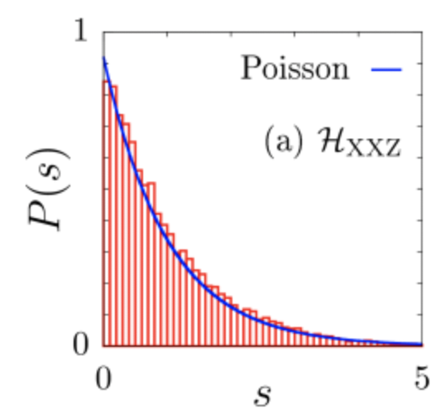
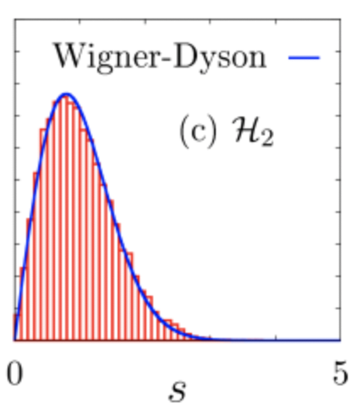
Summary & future works
We have constructed the solvable subspace of non-integrable spin-1 chains with interacting quasiparticles.
“Non-integrability” of the models and “non-thermal property” of the exactly solvable subspace?
  Non-integrability
  ⇒ Energy level statistics
  Distinguishability from thermal states
  ⇒ Expectation values of macro variables
  Area-low behavior of entanglement entropy
[Richter et al. (2020)]
matrix product states as the candidates

Slide 24
Summary & future works
We have constructed the solvable subspace of non-integrable spin-1 chains with interacting quasiparticles.
“Non-integrability” of the models and “non-thermal property” of the exactly solvable states?
Mathematical structure of the Bethe-ansatz solvable model?
⇒ Hidden Yang-Baxter equation?
Generalized tangent-space interpretation for the non-interacting case?
Thank you for listening!

