Slide 1
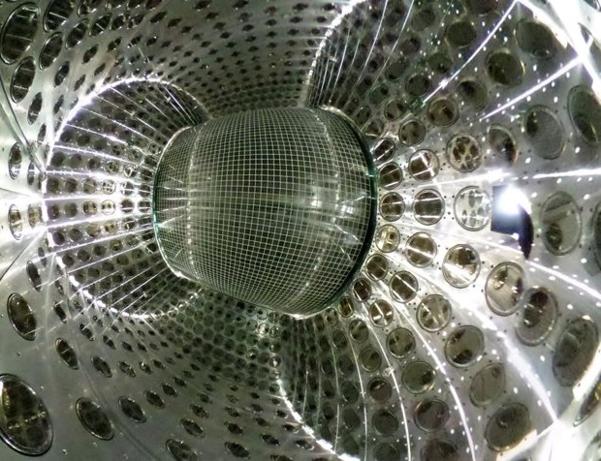
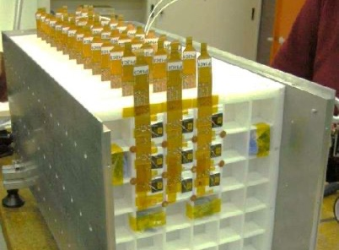
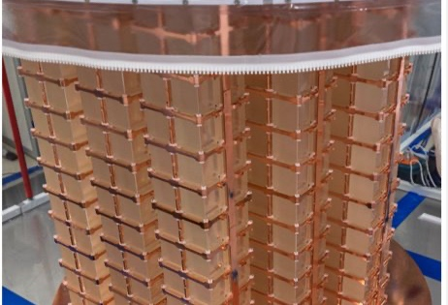
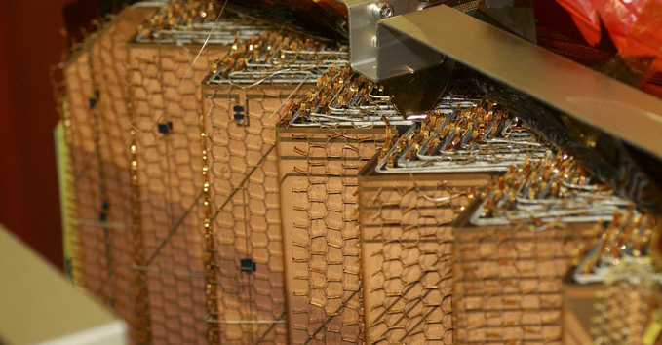
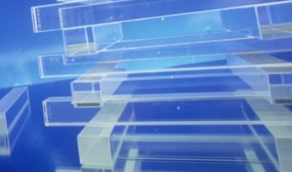
Trends and future applications in calorimetry towards DRD6
Francesca Cavallari (INFN Roma)

Slide 4
On 12 January 2023
Roberto Ferrari (INFN-Pavia, co-convener), Roman Pöschl (CNRS/IN2P3/IJCLab, co-convener)
Felix Sefkow (DESY, member of coordination group), Martin Aleksa (CERN), Etiennette Auffray (CERN),
Dave Barney (CERN), Tommaso Tabarelli de Fatis (University and INFN Milano-Bicocca),
Gabriella Gaudio (INFN-Pavia), Frank Simon (KIT/MPP)

Slide 5
Existing calorimetry collaborations and way forward
The various groups will concentrate on the Calorimetry R&D of their choice and develop/adapt them, if possible, to the requirements of the future detectors.
The funding for the specific sub-tasks will come from the Funding Agencies, the DRD will not fund the specific R&D.
Collaboration with other geographical areas is encouraged.
The DRD will be “anchored” at CERN.
European projects such as AIDAInnova and EURO Labs
CERN EP R&D programs
Existing collaborations (Atlas, CMS, NA62, DUNE, …)
R&D collaboration and communities (Calice, CalVision, Crystal Clear …)
Detector concept groups (ILD, SiD, IDEA, …)

Slide 6
High energy – future colliders
 | Ecm(GeV) | Length (km) | L(10ˆ34 cm-2s-1) | Lint(ab-1) | place | possible start of operation
HL-LHC | 14000 | 27 | 5 | 3-4 | CERN | 2028
ILC | 250-1000 | 30 | 1-10 | 2-8 | Japan
CLIC | 380-3000 | 11-50 | 1-8 | 1-5 | CERN
EIC |  |  |  |  | US | 2030
FCC-ee | 90-365 | 100 | 230-1.5 | 75-0.8 | CERN | 2045-2060
CEPC | 90-240 | 100 | 70-7 | 16-5.6 | China
FCC-hh | 100000 | 100 | 5 | 20-30 | CERN | 2070-2090
Muon Collider | 3000-10000 | 4.5-10 | 1.8-20 | 10 |  | 2045-2060
Requirements for calorimeters
- jets: σ(E)/E ~30%/sqrt(E) to separate Z and W hadronic decays
- photons: single photon channel requires photon energy precision
- B decays involving π⁰ require granularity and resolution σ(E)/E ~5%/sqrt(E)
- long lived particles emerging in the calorimeters require timing
e/y, π⁰/y, e/π separation
High radiation environment (hh)
High background (μμ)
European Strategy

Slide 7
From M. Lucchini

Slide 8
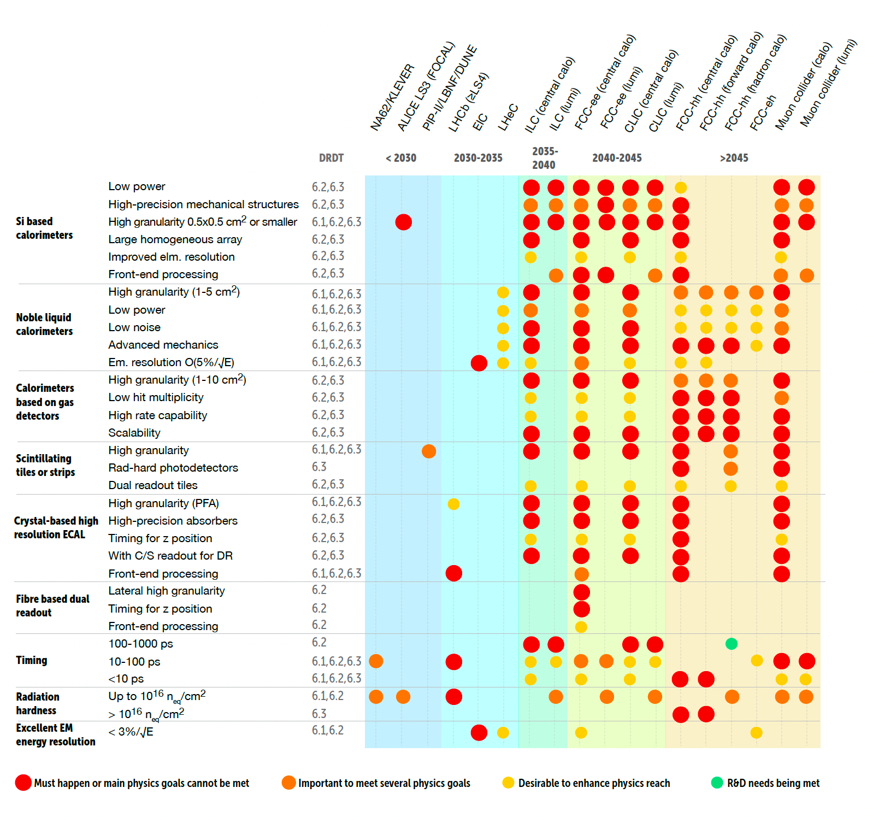
Key technological development needs

Slide 9
Trends in Calorimetry
Calorimeter Upgrade for the HL-LHC,
Particle flow calorimeters,
light based calorimeters and crystal developments,
noble liquids-based calorimeters
Disclaimer: personal choice of material ! many more new ideas

Slide 10
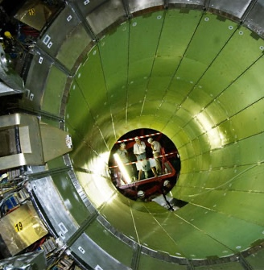
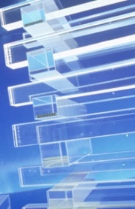
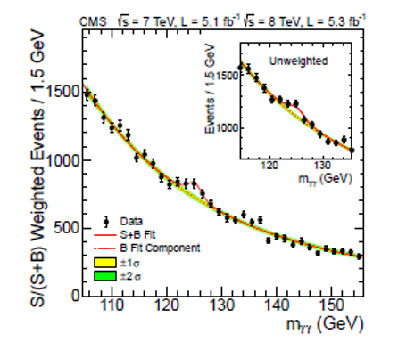
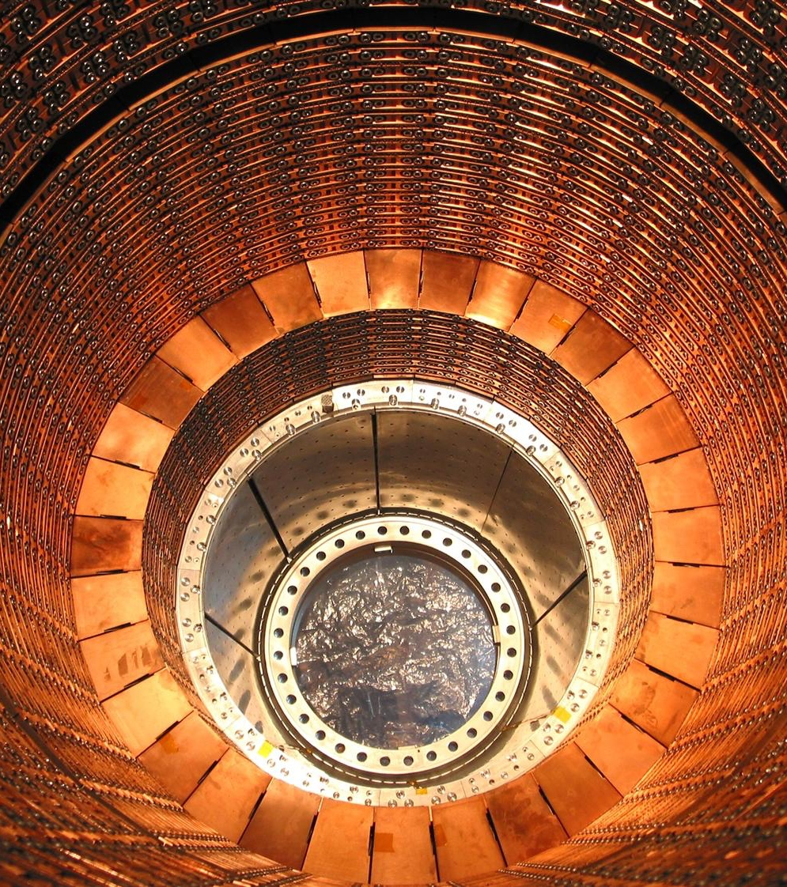
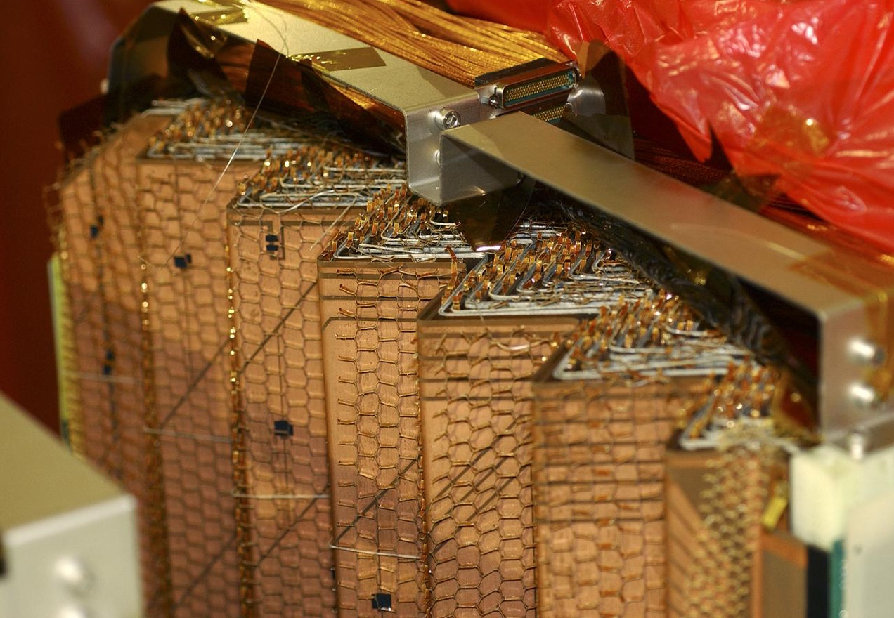
Upgrades of Atlas and CMS calorimeters for HL-LHC
CMS ECAL: PbWO₄ crystals+ APD (75000 channels)
HCAL: Brass+plastic scint.
Use of calorimeters at the LHC:
- measure/identify photons with excellent energy resolution (H->yy)
- measure/identify electrons
- measure hadrons/jets and missing energy
In preparation for the HL-LHC both Atlas and CMS calorimeters will replace the read-out electronics
Streaming of the data from front-end to off-detector electronics to improve trigger
Addition of precision timing (requires large and fast signal)
Atlas: e.m. LAr+lead (~200000 ch.)
Longitudinally segmented
Hadr.: Plastic scint.+steel

Slide 11
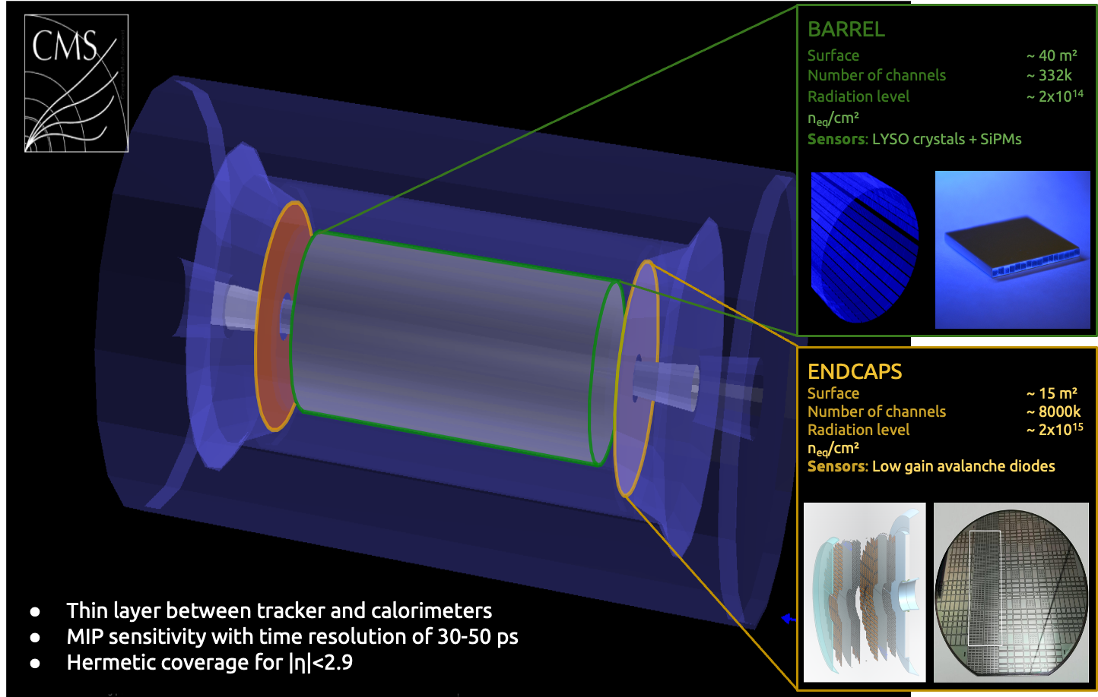
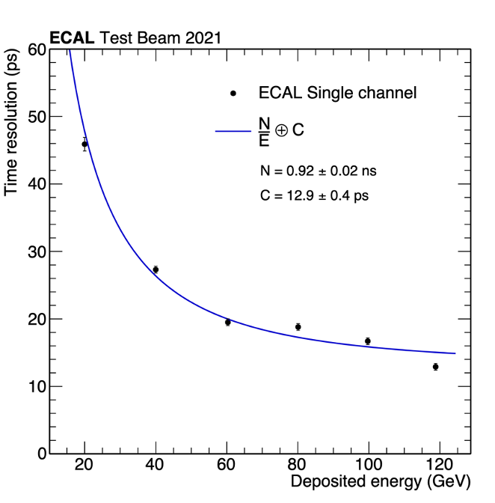
Precision timing at the HL-LHC
Precision timing usage
- for MIPs: to attribute a timing to each track (4D tracking) for vertex identification and pile-up subtraction
- for photons (E>50 GeV): triangulation and vertex identification in H->yy decay
Dedicated timing detector for MIPs
Precision timing with the CMS ECAL
Barrel: LYSO+SiPM
CMS ECAL: PbWO₄ crystals+ APD (75000 channels)
with fast electronics and oversampling at 160MHz
Endcaps: Low Gain Avalanche Diodes
The shower front is fast and sharp even for long crystals

Slide 12
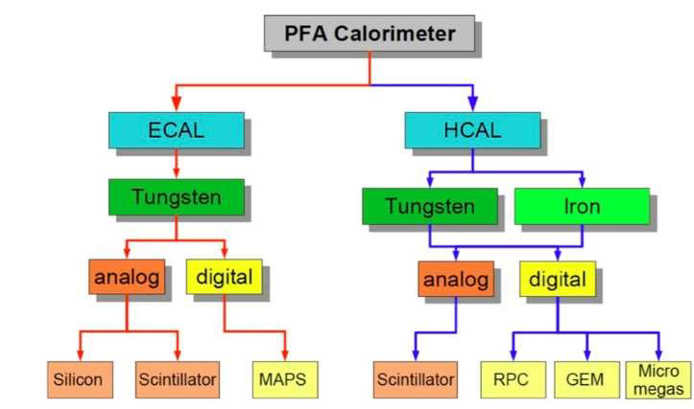
Particle flow calorimeters
Particle Flow principle
- Measure charged particle momenta with the tracker and subtract their clusters from the calorimeters
- Measure only neutral objects with the calorimeters
PF calorimeters must
be very granular (large number of channels)
small X₀ ( => small gap) such that objects do not spread and overlap.
be associated with an excellent tracker
require a smart clustering software (also for trigger)
still photons and neutral hadrons are measured by the calorimeters so good energy resolution

Slide 13
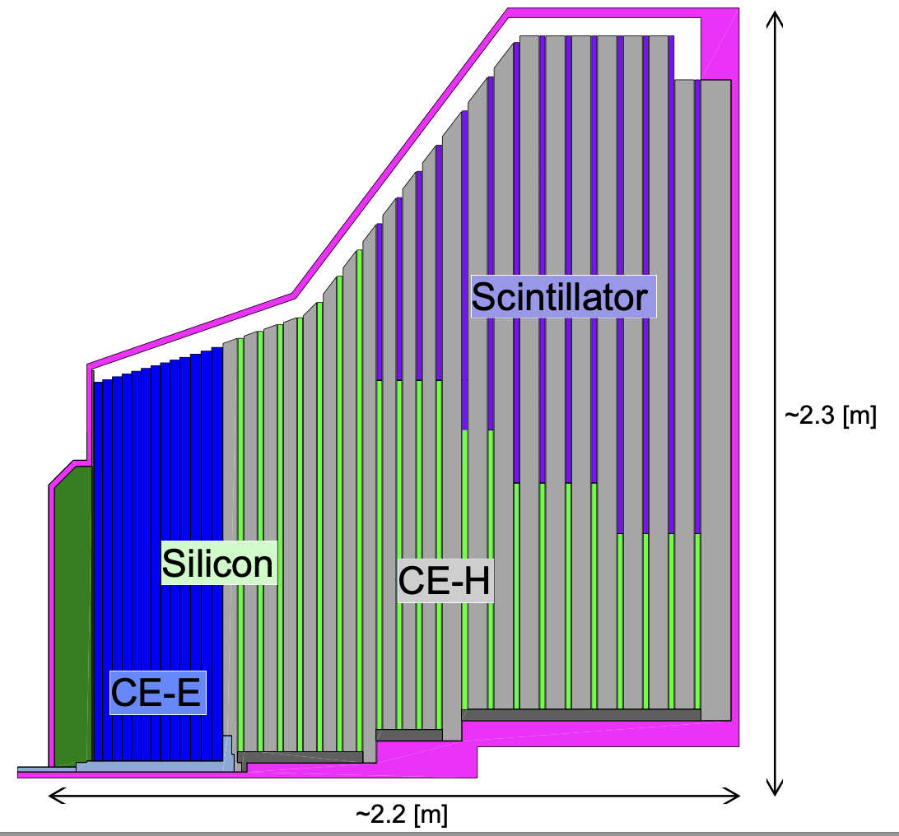
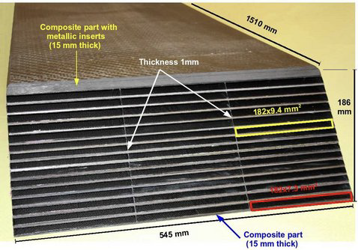
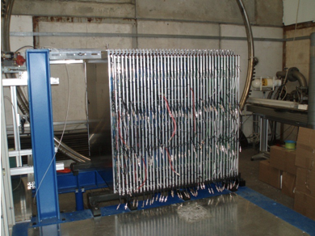
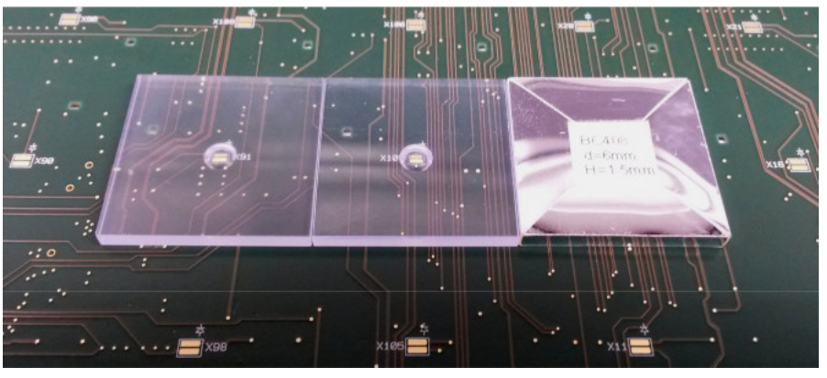
Particle flow calorimeters
Detector prototypes for Linear Collider
Upgrade of CMS Endcap calorimeters for HL-LHC
CALICE SiW ECAL (cell size 0.5x0.5cm2, 40 layers) O(100M) channels
Also proposed for CLD@FCC-ee, CEFC, EIC
CMS HGCAL:
O(6M) channels
Add a Si layer with increased gain for precision timing
CALICE was designed for operation in power pulsed mode, and triggerless, cooling and trigger must be added
CALICE DHCAL – RPC with small pads + absorber
CALICE AHCAL – SiPM on tile + absorber
HL-LHC CMS endcap e.m. and hadronic calo
e.m. : absorber+Si sensors
hadr.: absorber+Si or plastic scintillator tiles+SiPM

Slide 14
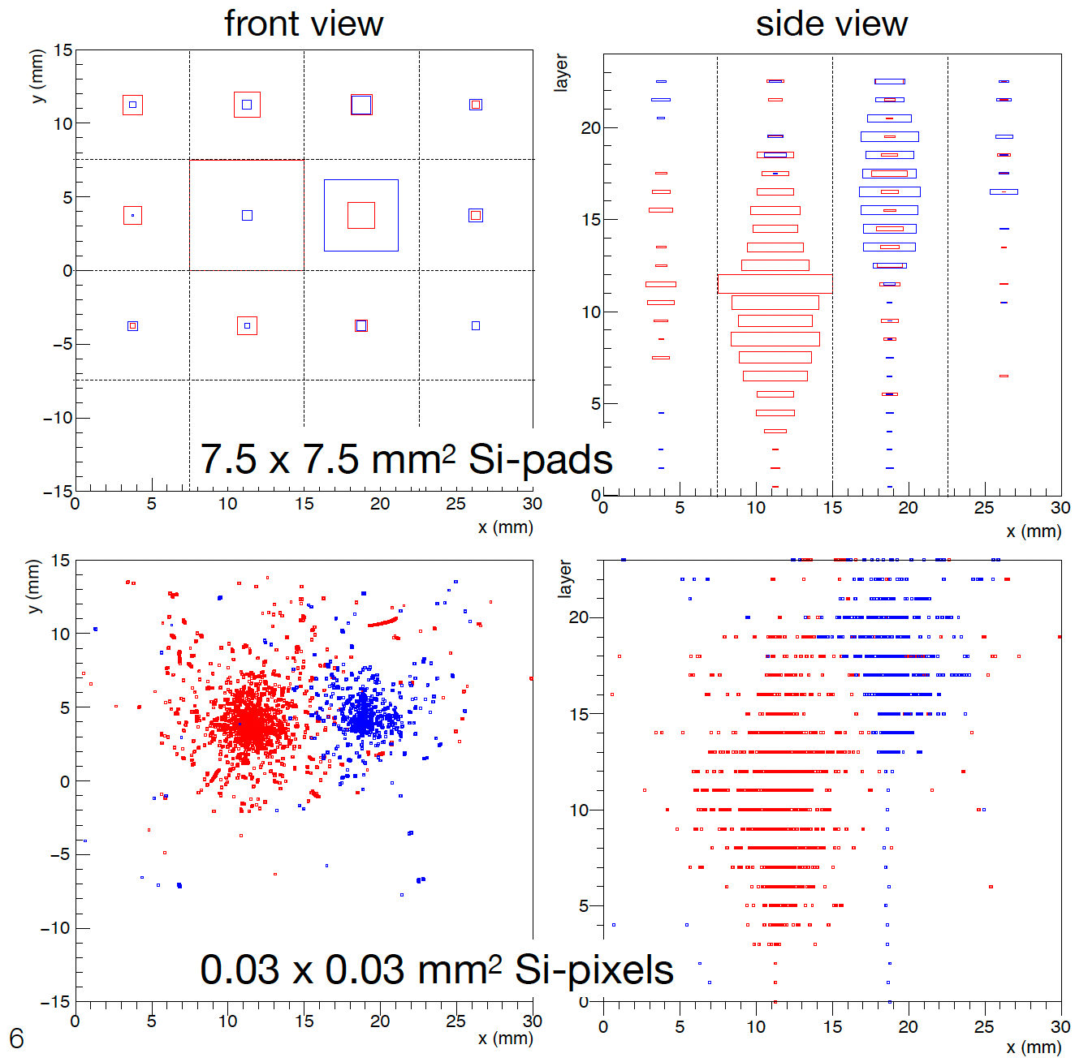
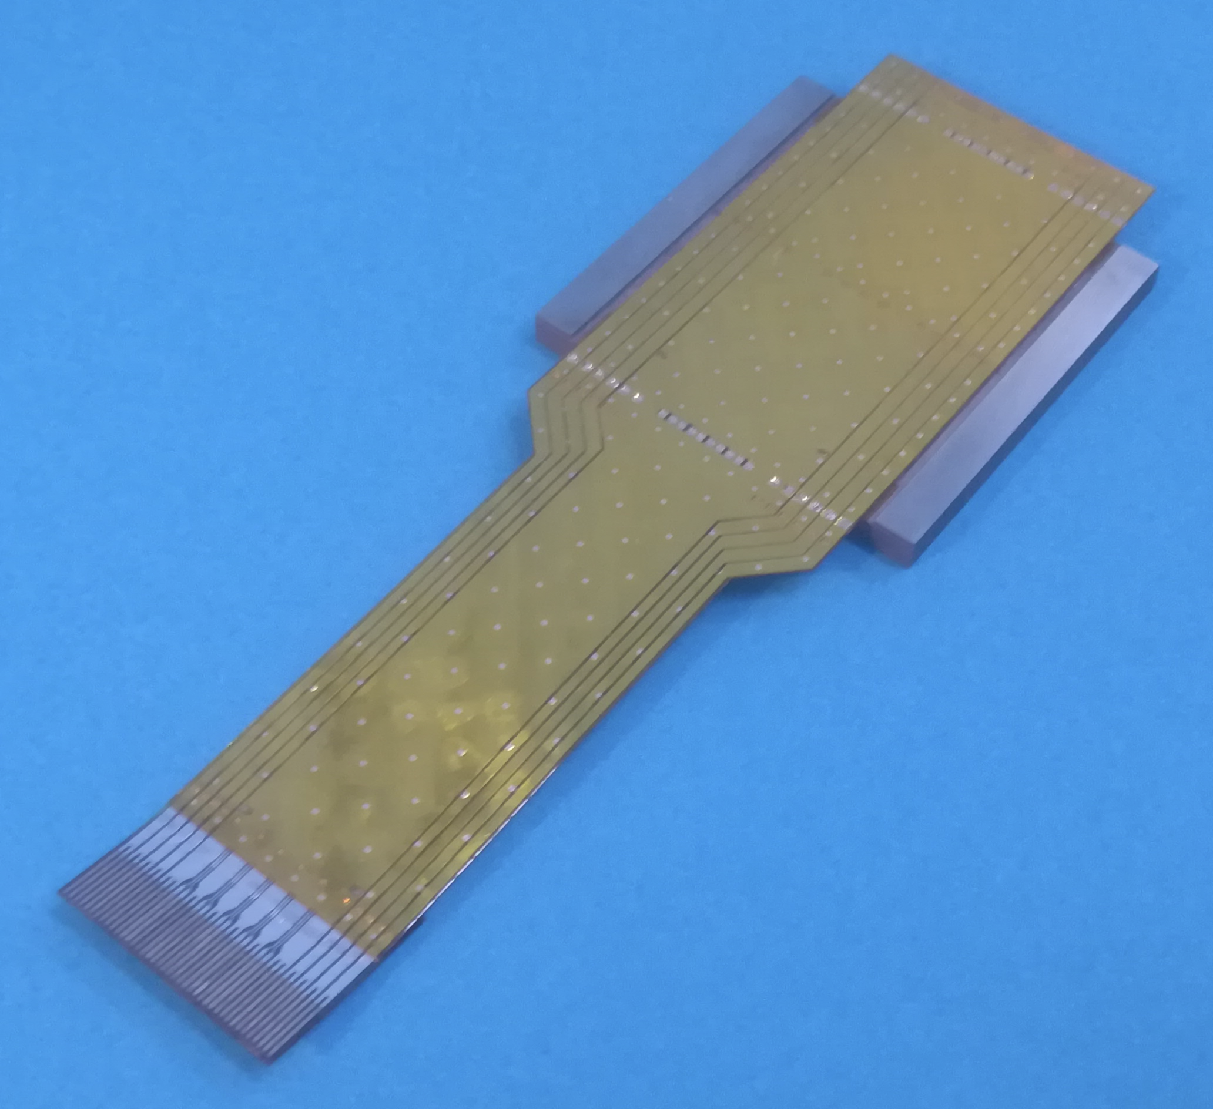
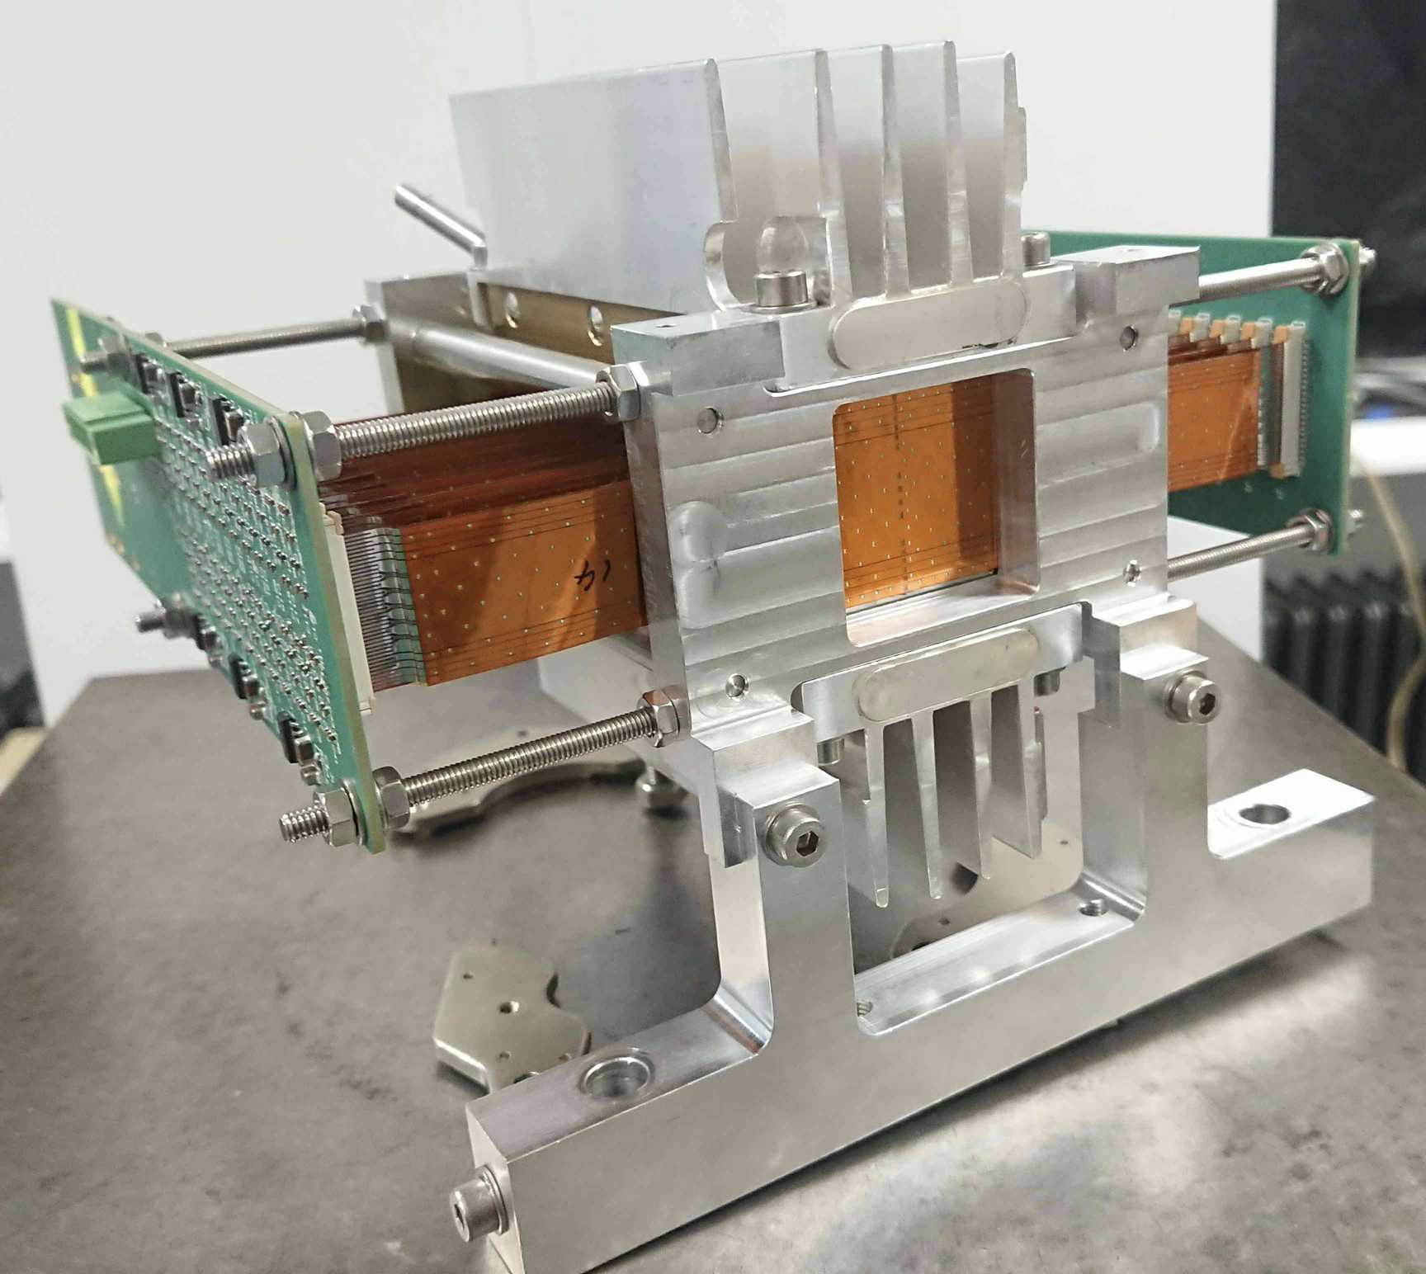
Particle flow: Upgrade of Alice, FOCAL
FOCAL calorimeter (forward e and h calorimeter), for photon-𝛑⁰ discrimination using for the electromagnetic part Si-W with 2 sections: large pads (1x1 cm²) and MAPS (30x30 μm²)
MAPS= Monolithic Active Pixel Sensors
Simultaneous measurement of an electron of 40 GeV (red) and a pion of 20 GeV (blue)
sigma(E)/E~24%/sqrt(E)+2.5%

Slide 15
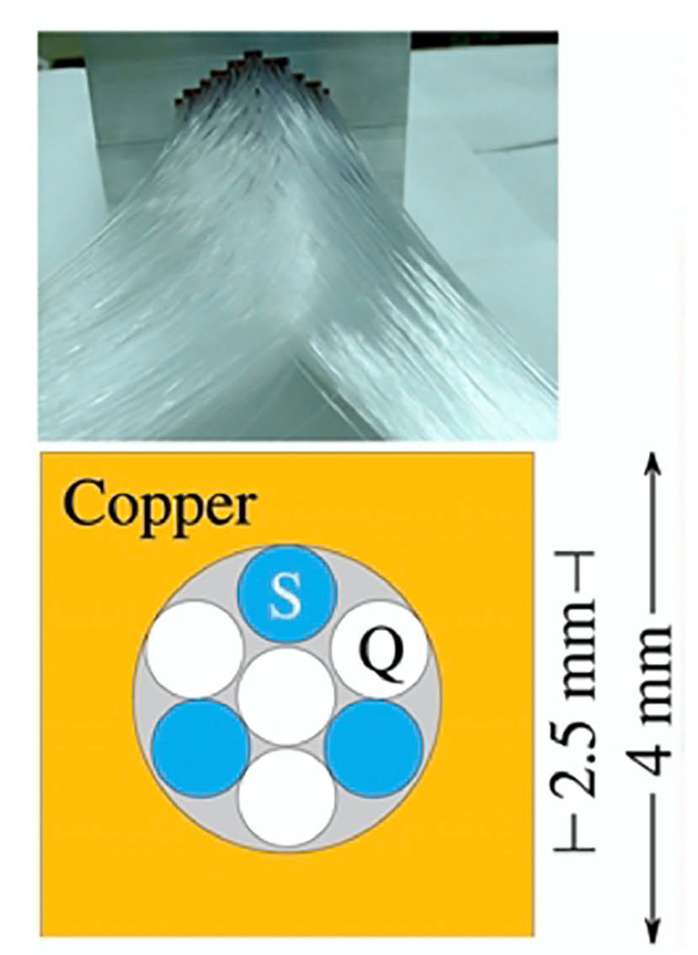
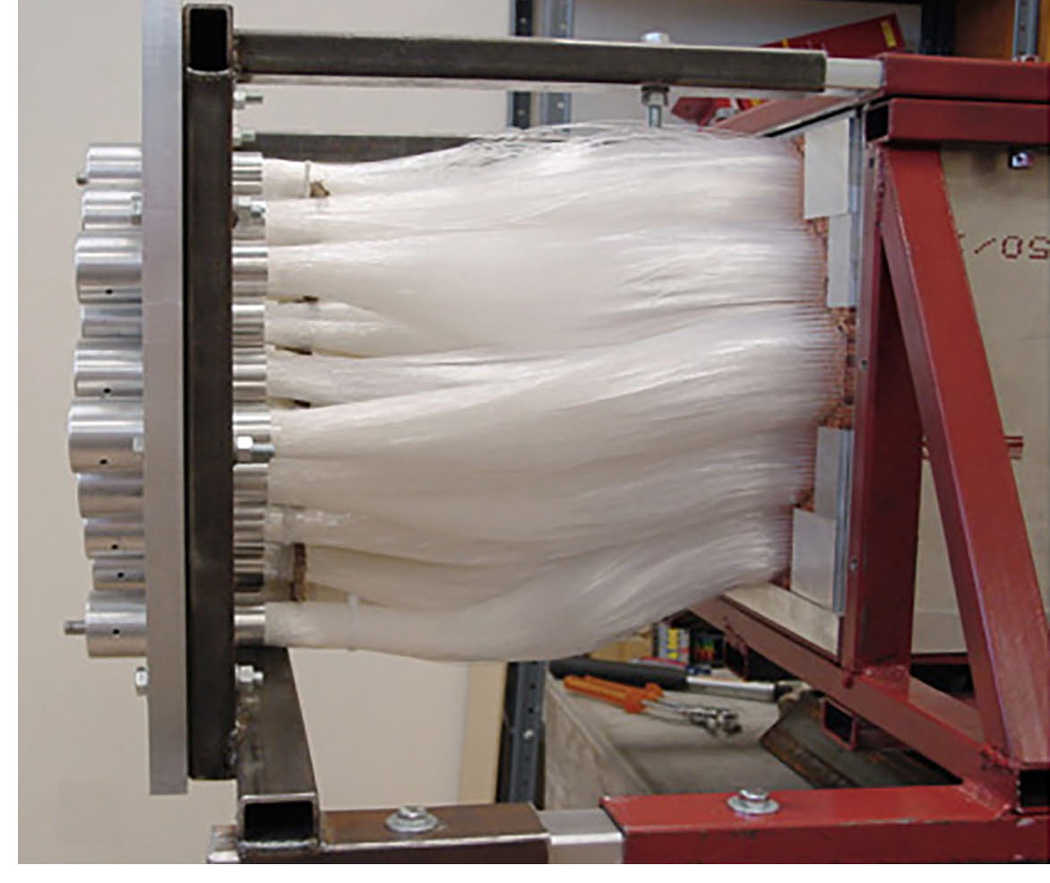
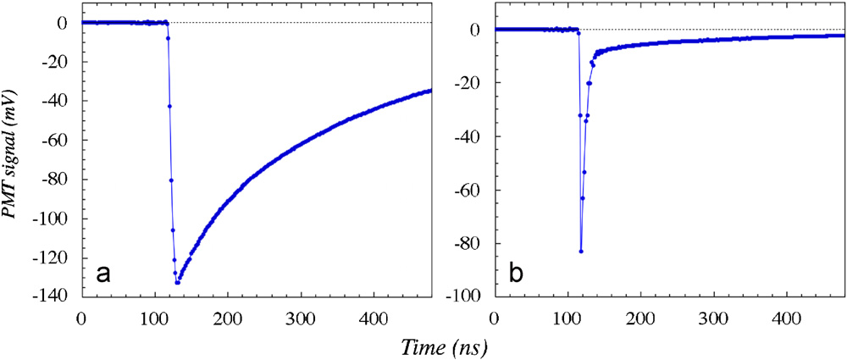
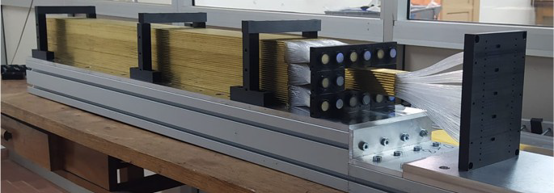
Dual Readout calorimeters
Dual readout principle
- Hadronic showers contain a hadron and e.m. component, which fluctuate very much from shower to shower
- measure hadronic and e.m. components separately in the same detector
- Cerenkov light is produced mostly by e.m. component, dE/dx signal mostly by soft hadrons
- possibly combine with an optimal e.m. calorimeter in front with dual readout as well
- and possibly a timing layer with small crystals
Dual readout and precision ECAL with scintillating crystals
Dual readout calorimeter with absorber and scintillating+quartz fibers
The e and h components can be measured in scintillating crystals exploiting:
The time of arrival
Wavelength filters
The time of arrival can be used to measure the shower depth for electron/photon id.
The fibers can be read out with SiPMs for increased granularity
Also proposed for IDEA@FCC-ee

Slide 16
Dual Readout + Crystal e.m. calorimeter

Slide 17
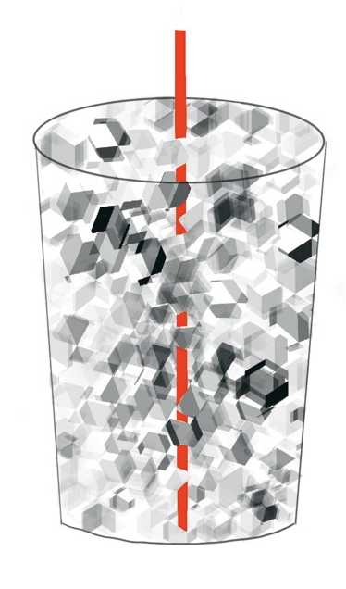
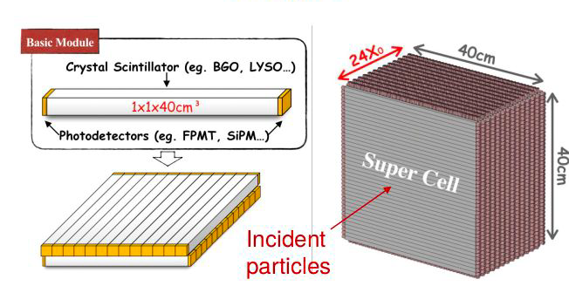
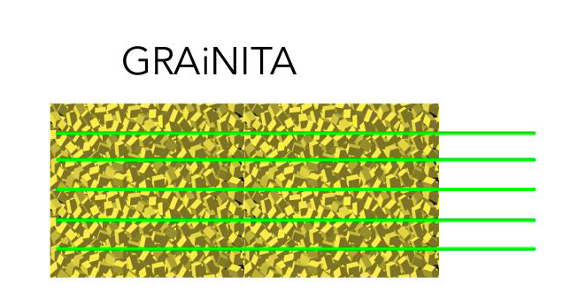
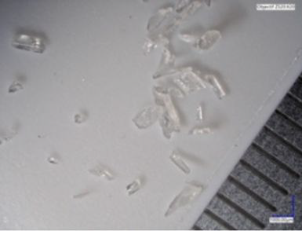
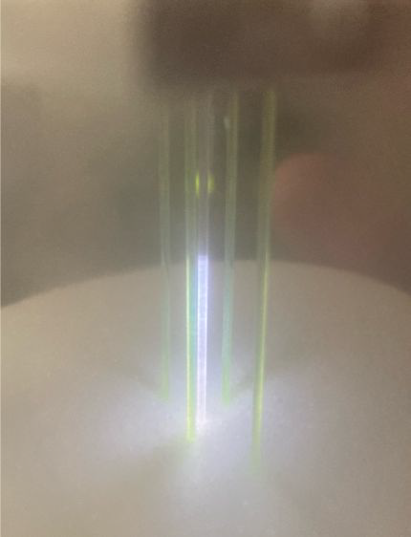
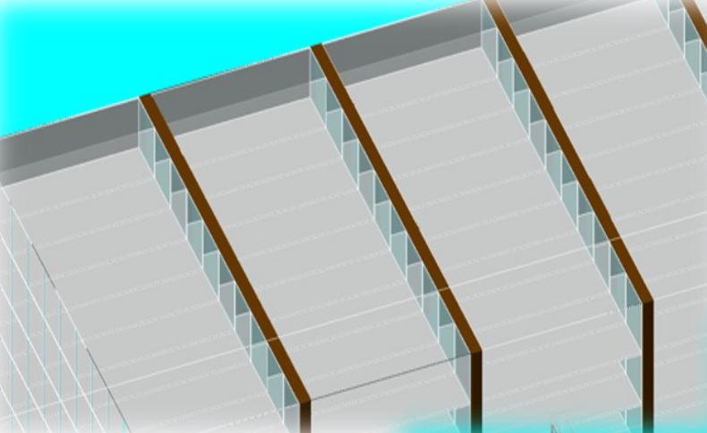
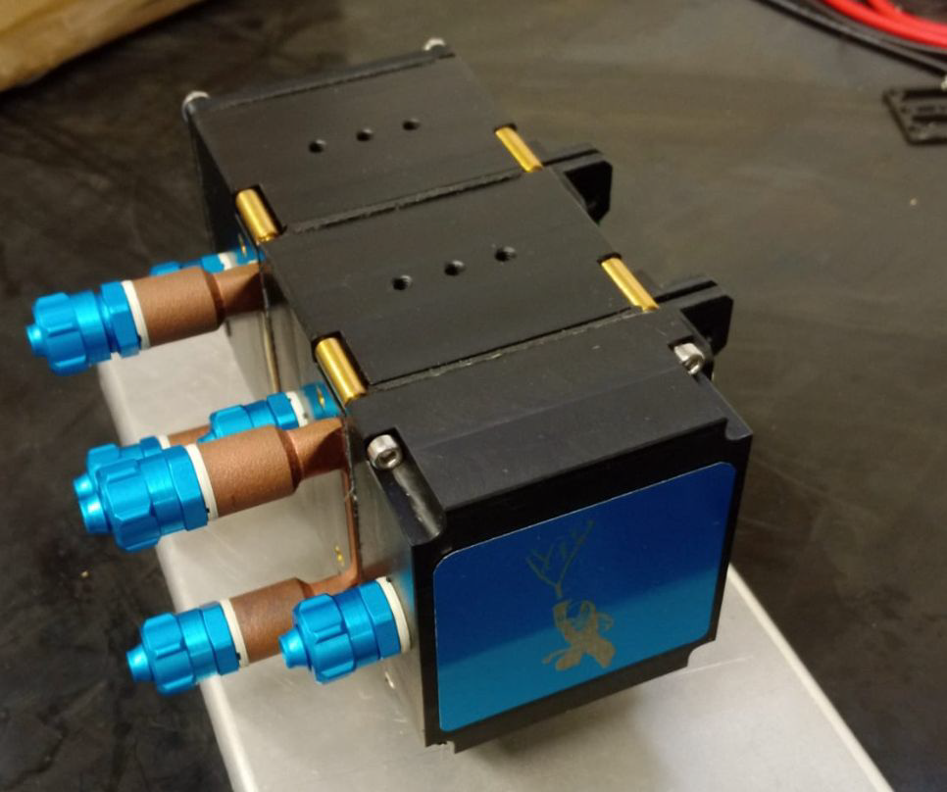
Other Crystal developments
Many new designs and solutions, here are a few personally selected ideas
For CEPC
GRAiNITA:ZnWO4 grains+propanol+WLSF
CRILIN
PbF₂ / PWO-UF
UV-extended SiPM readout
Tiny and segmented crystals
Requirement of rad-hardness
and precision timing for beam induced background subtraction
CRILIN
(Frascati)
For the muon collider

Slide 18
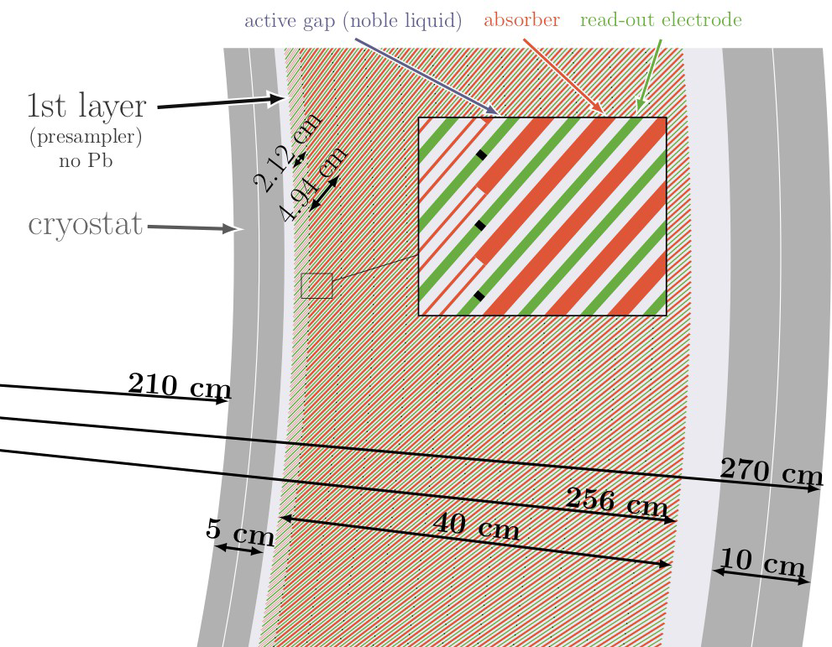
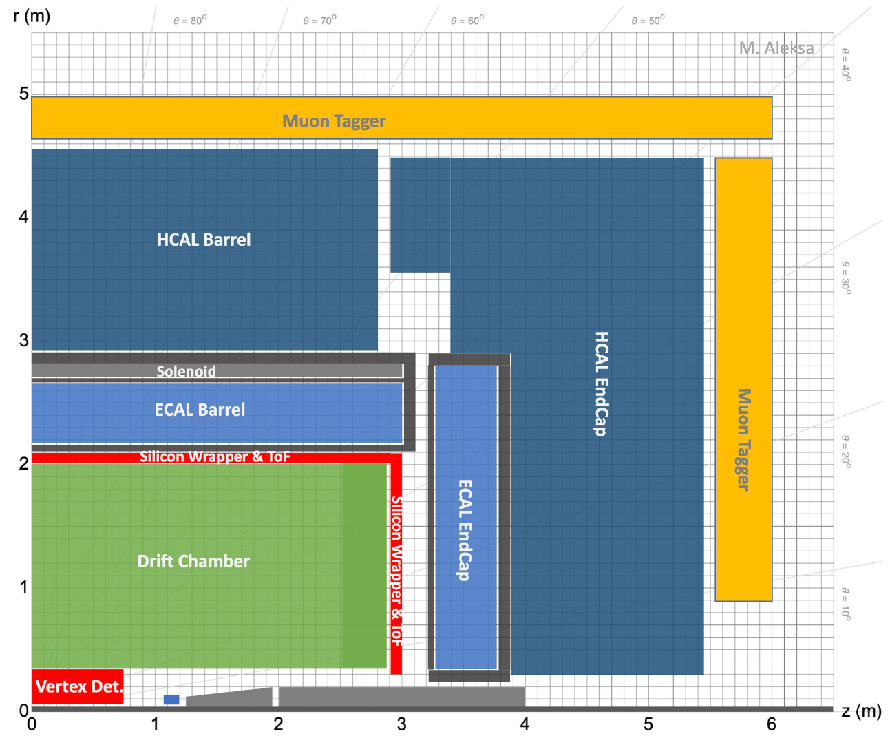
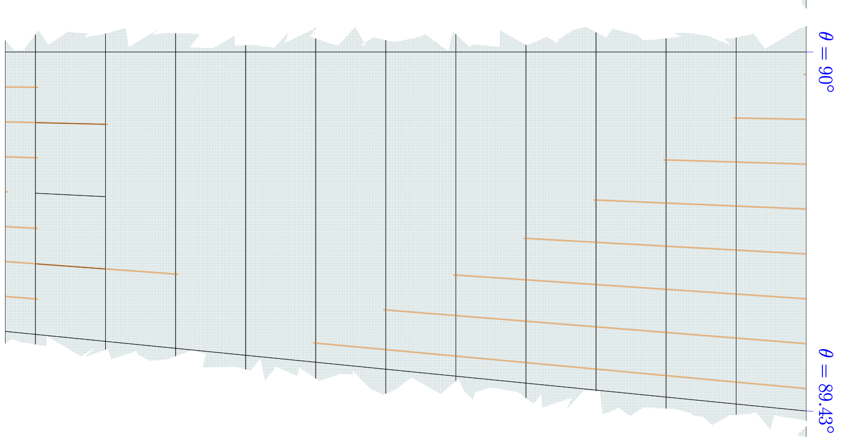
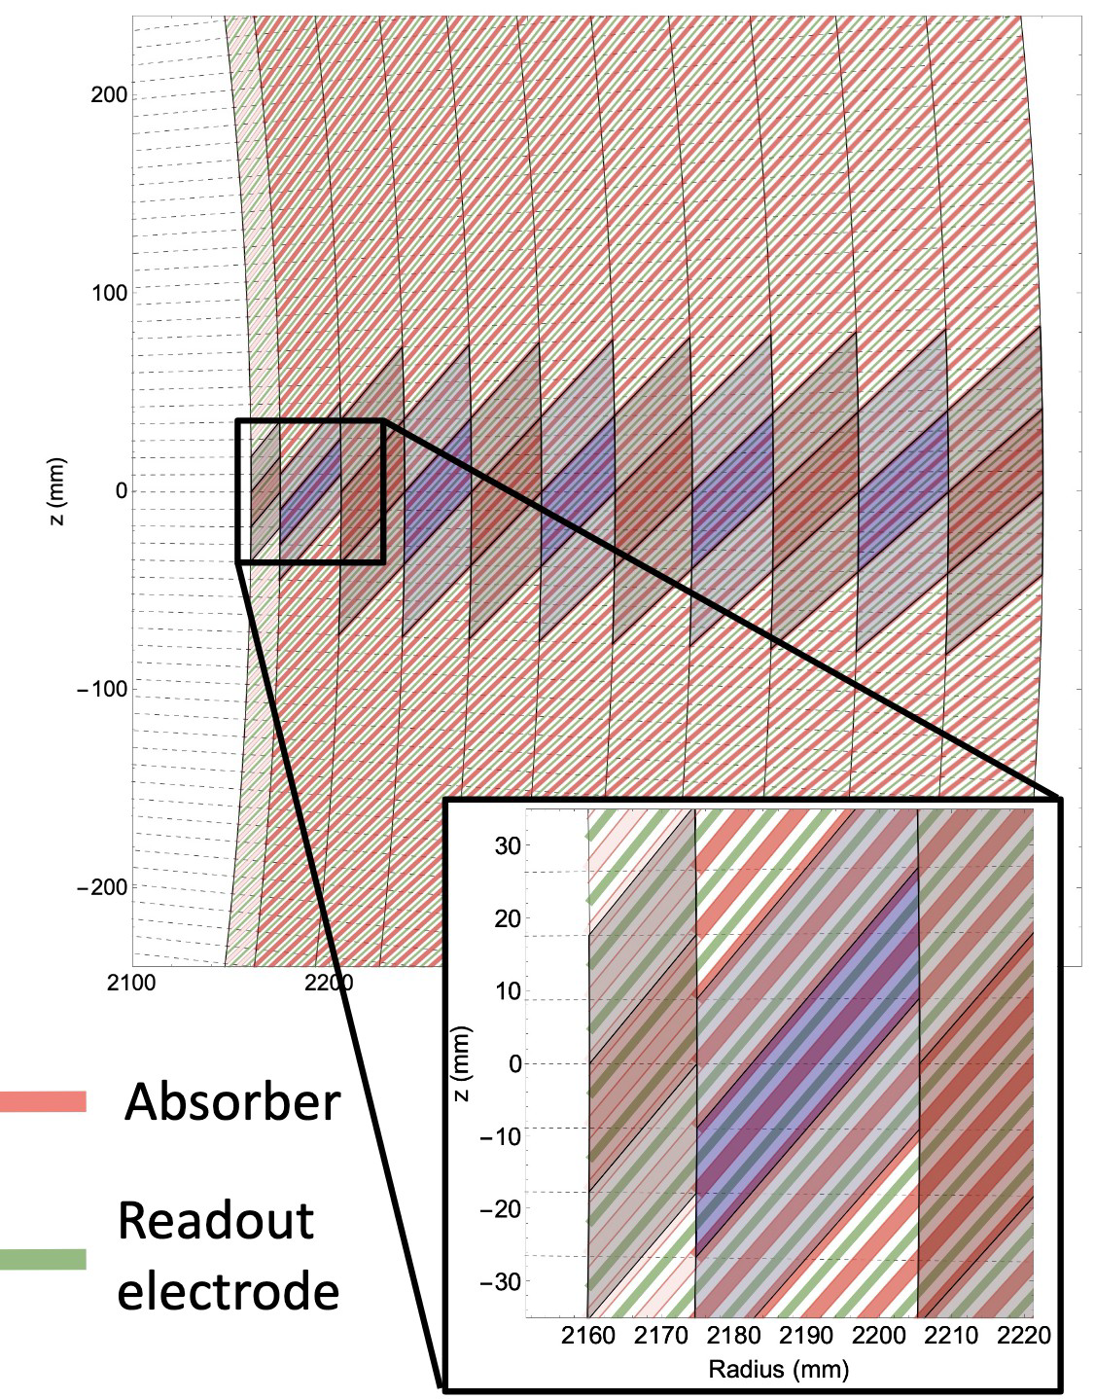
Noble liquids
Building on the Atlas LAr calorimeter know-how,
Adding desired high granularity feature and light-weight cryostat targeting FCC-ee
Could also resist high radiation and rates of FCC-hh
Addition of longitudinal granularity using multi-layer PCB, first test shows limited cross-talk
Also proposed for FCC-ee and FCC-hh

Slide 20
Important points raised at the meeting
The DRD should provide some common tools, some are existing like:
DD4HEP (detector geometry framework)
Key4HEP (simulation)
EUDAQ (common DAQ for testbeams)
Other points that were raised in the talks but not discussed:
Common testbeam requests
Common testbeam setup (moving table, lateral and back shower containment detector, hodoscope, timing detector, cold boxes, …)
Irradiation facilities
Integration, engeneering support
Interface to other task forces (electronics, trigger, photon detectors, gas detectors)
Knowledge transfer and cross-fertilization of fields

Slide 21
Outlook
Many technological solutions
Some challenging requirements
Competence in our institute on calorimeters, crystals, photon sensors, Dual Readout calorimetry, electronics and trigger, simulation, AI & software
Strong interest in particle physics at colliders
We must discuss on how to best exploit our knowledge for the future calorimeters and sign-up for the DRDs

Slide 22
Backup

Slide 24
for IFD discussion
Crystal calorimeters
achieve optimal e.m. energy resolution
require hard work to monitor and calibrate
Good calibration is needed also for trigger rate stability
Data streaming off-detector allows more flexibility and future trigger upgrades
Can achieve precision timing
Higly segmented / Particle Flow calorimeters
Are optimal for particle flow techniques combined with good tracker
Must measure the neutral hadrons and photons well
Are intrinsically redundant
Produce a lot of data
Require a dedicated, sophisticated and fast software
require some triggering logic on the front-end (today)
Full data streaming is not possible today (perhaps in the future?)
require detailed simulation effort to describe shower containment and especially for calibration
Can be equipped with a precision timing layer
Dual readout technique
Allows best resolution for hadrons through measurement of e/h fraction
Can be combined with a crystal e.m. calorimeter in front through Scintillation/Cerenkov light separation
Could be made granular
Can be equipped with precision timing measurement

Slide 25
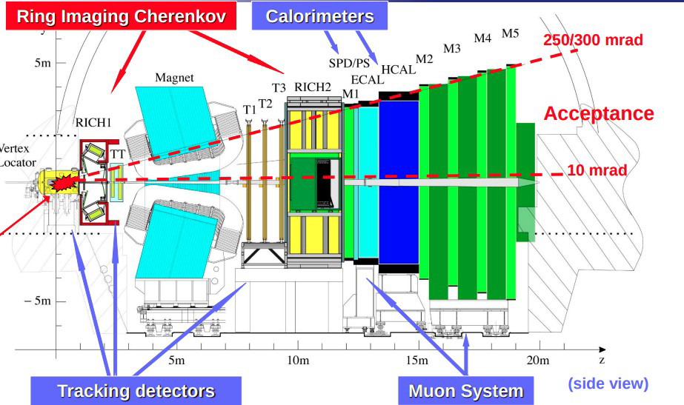
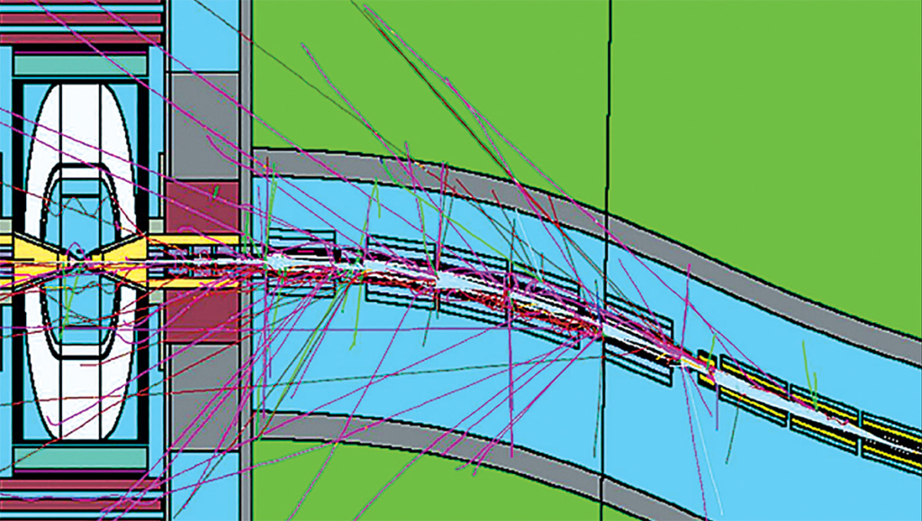
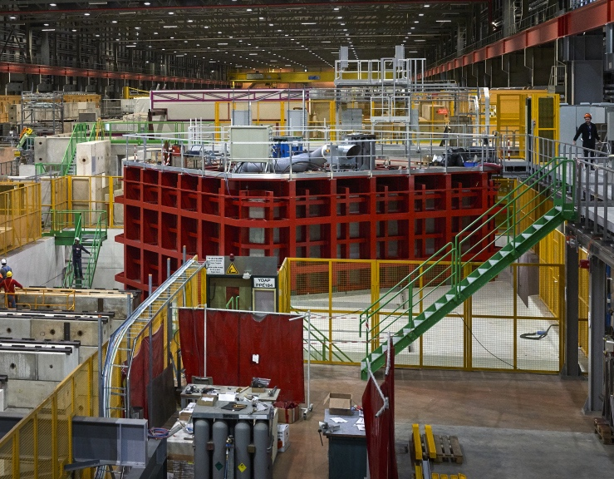
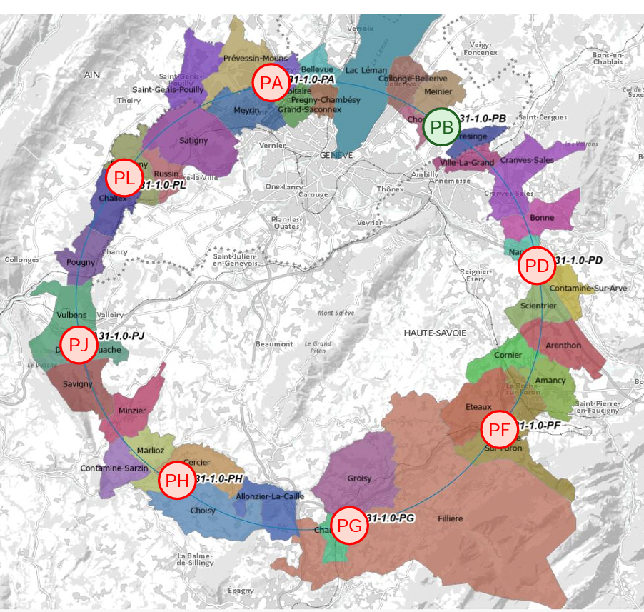
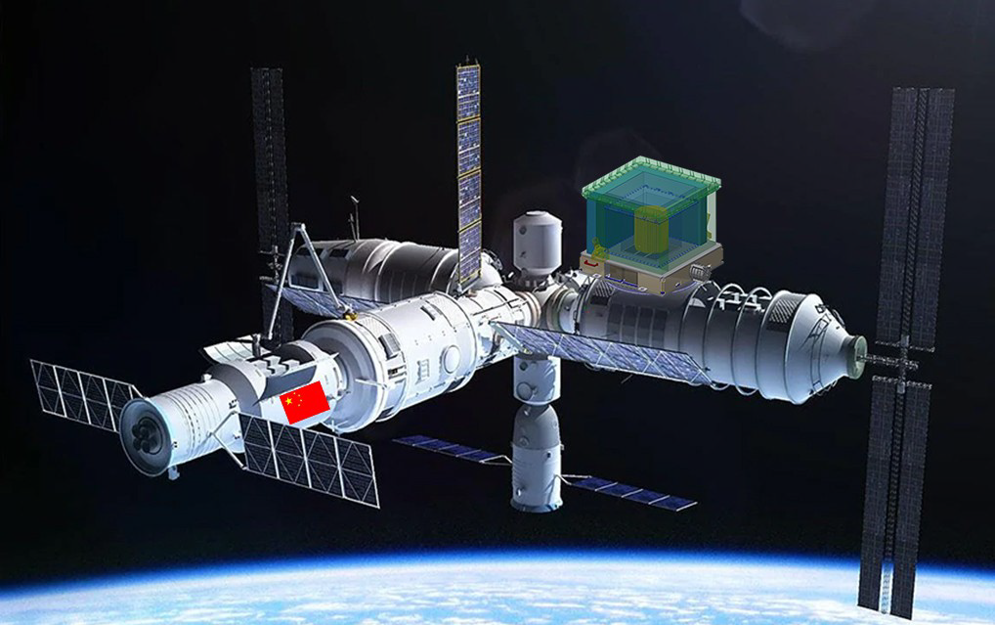
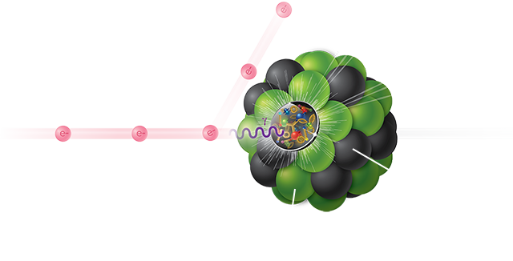
Future Experimental Facilities
μμ colliders at 10 TeV and L=10³⁵cm⁻²s⁻¹
Detector upgrades for the HL-LHC
e+e- colliders as
H-EW-top facilities (circular and linear)
hh colliders at 100 TeV and ∫L=30 ab⁻¹ and PU~1000
R&D for long baseline neutrino detectors
non-accelerator-based experiments, DM, interface with astro-particle physics
Detector R&D for rare processes, DM, and high precision at storage rings and fixed targets
Studies of partonic structure of the protons and nuclei and interface with nuclear physics, EIC

Slide 26
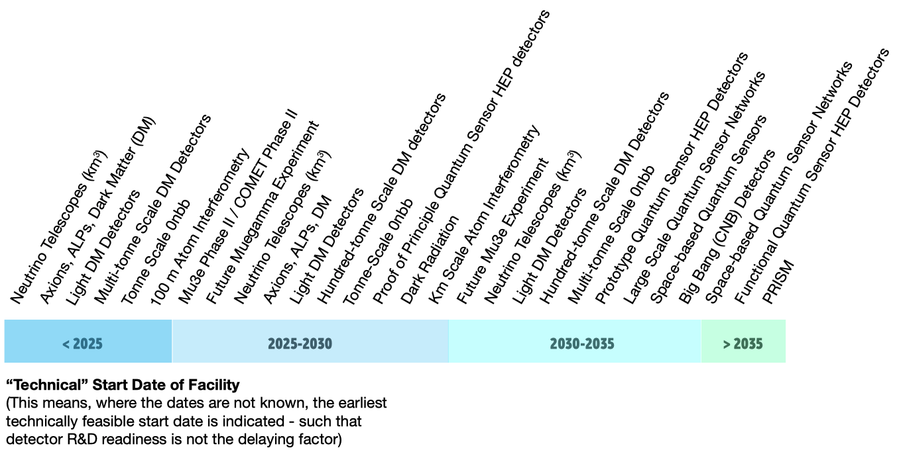

Slide 27
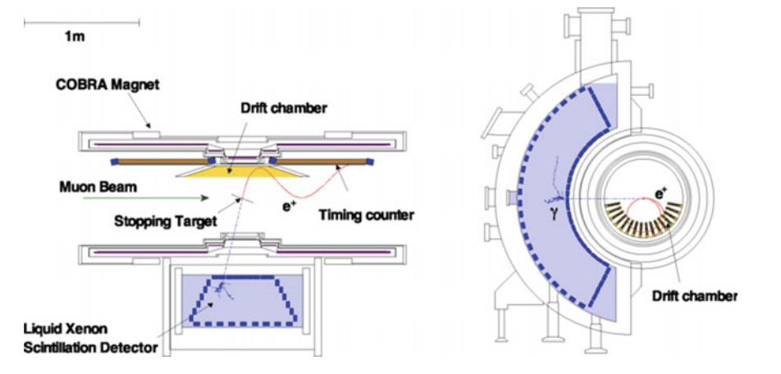
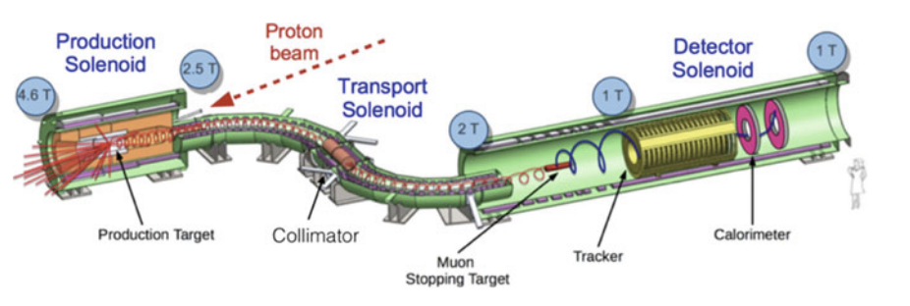
Middle energy – Intensity Frontier
Charged Lepton Flavor Violation experiments
- cLFV processes are thought to be powerful tools to investigate the physics beyond the Standard Model (SM) as all of them are extremely suppressed in the framework of SM
- There are intensive efforts ongoing to find signals of cLFV processes at high-power proton accelerator facilities in Japan, the US, and Switzerland.
MEG/MEG II (PSI, Switzerland)
Mu2e (US) / COMET (Japan)
- µ stopped on Al target @ 10 GHz then µN ➙ eN ​
- σ(E)/E of O(< 10 %) for 105 MeV electrons
- Detectors in vacuum ∼ 10⁻⁴ Torr
- Detectors in ∼ 1 Tesla magnetic field
- µ stopped on plastic film @ 30 MHz
- µ->ey (55 MeV)
- σ_{E}(E)/E of 1-2% for 55 MeV photons

Slide 28
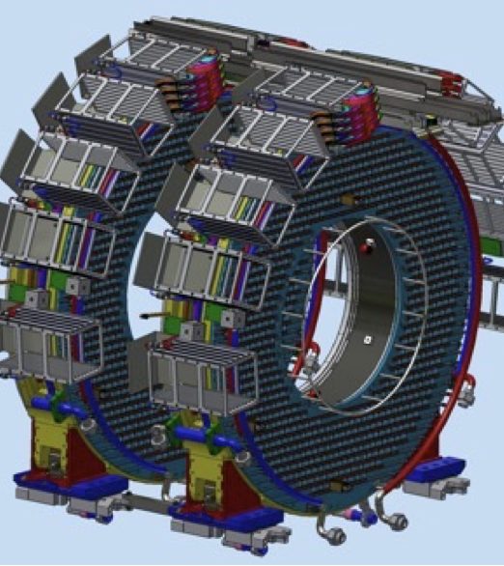
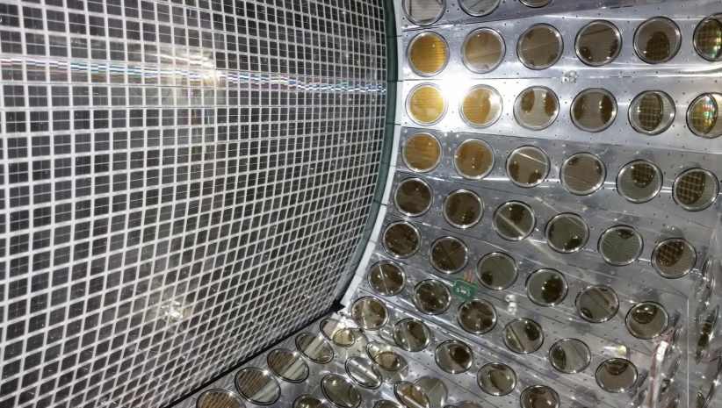
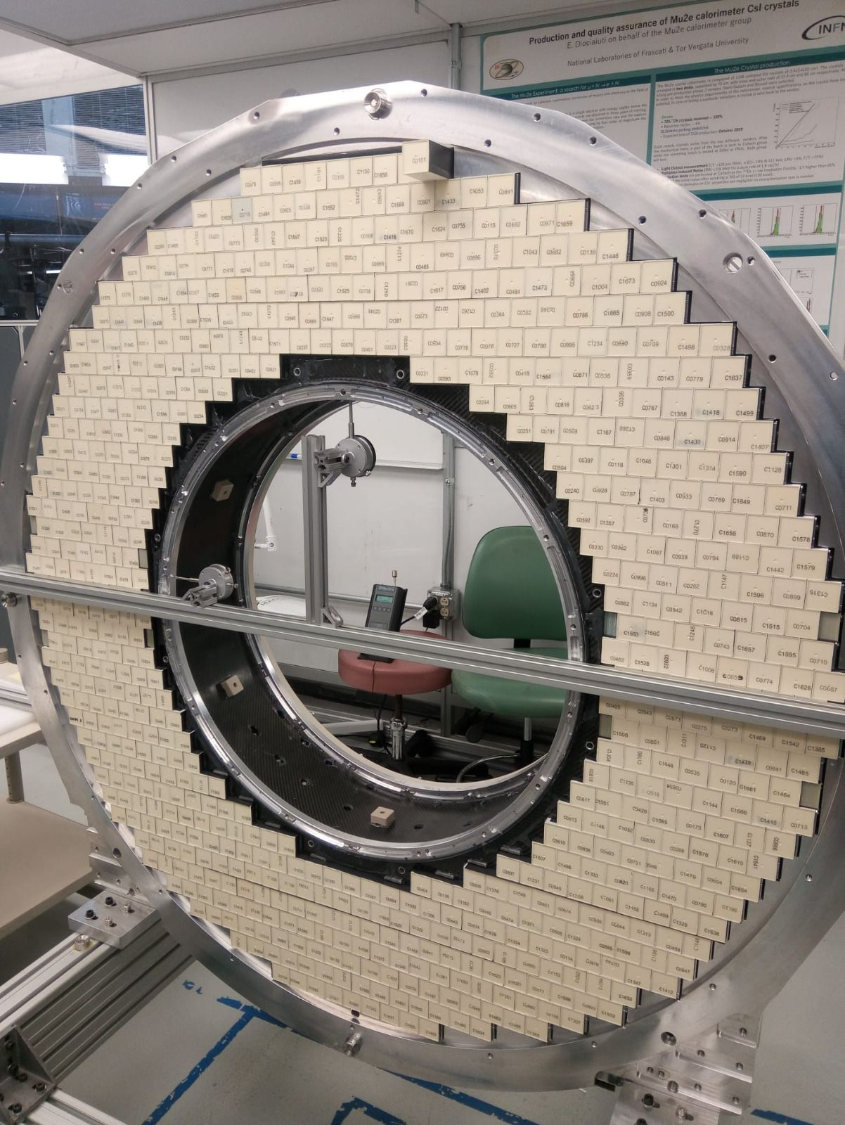
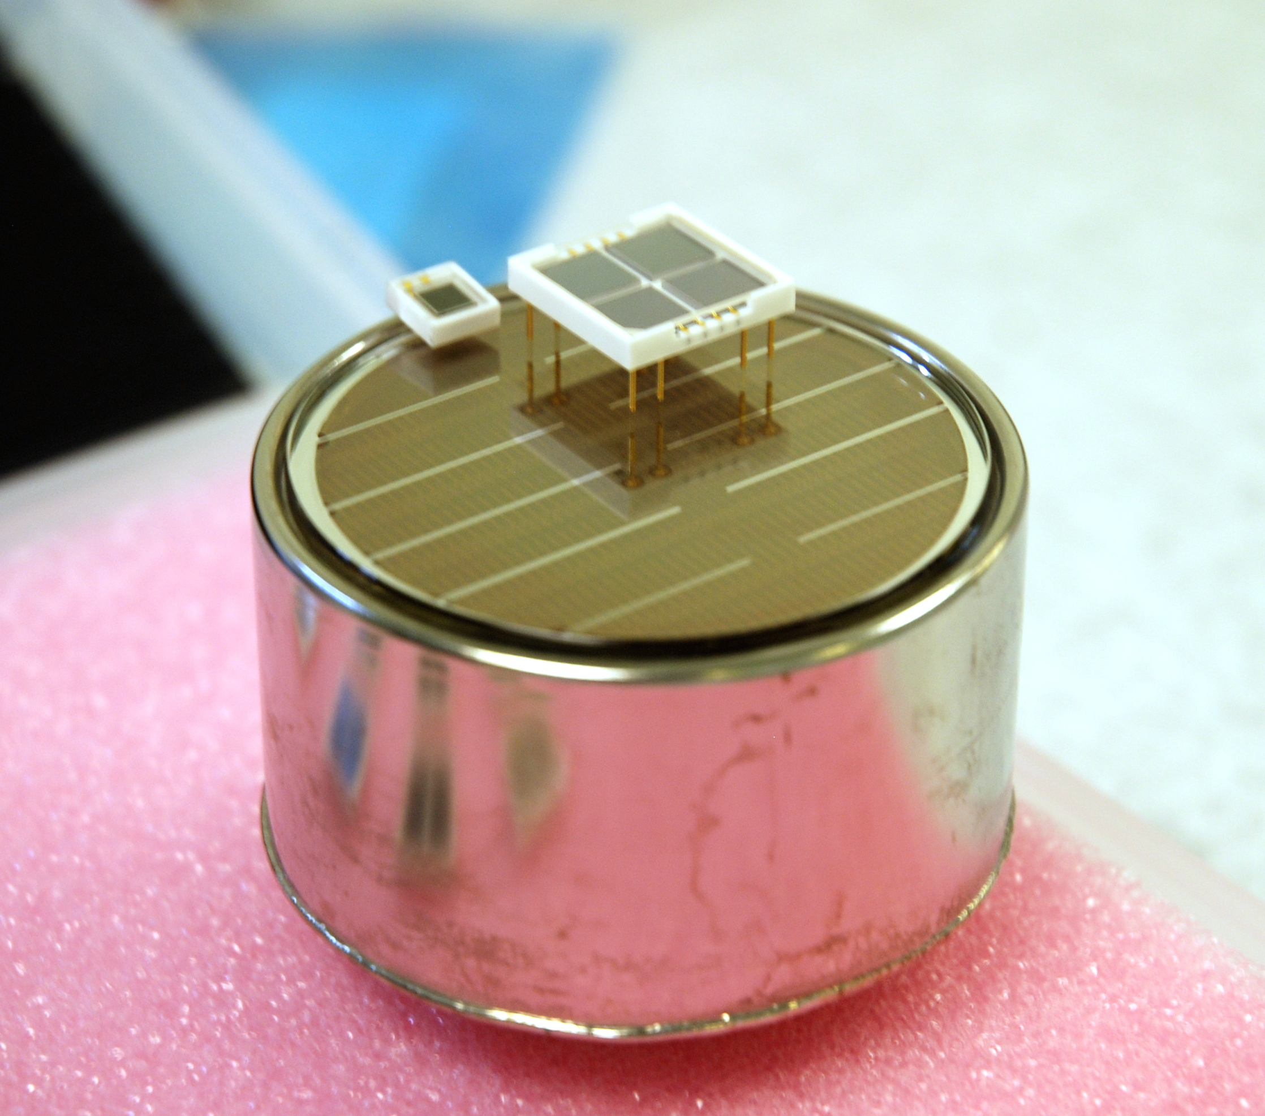
Calorimeters for cLFV experiments
Mu2e: ECAL: undoped CsI + SiPM
1500 channels
- in vacuum, 1T mag field, TID 90 krad
and fluence of 3x10¹² n/cm²
MEG II: Liquid Xe (165K) + PMT and SiPM
4700 channels
σ(E)/E ~1.1% with the SiPM, 2.4% with PMT

