Slide 1
Ion Beam Test 2022:
Some Preliminary Things for IT SCD
A. Oliva
19/12/2022

Slide 2
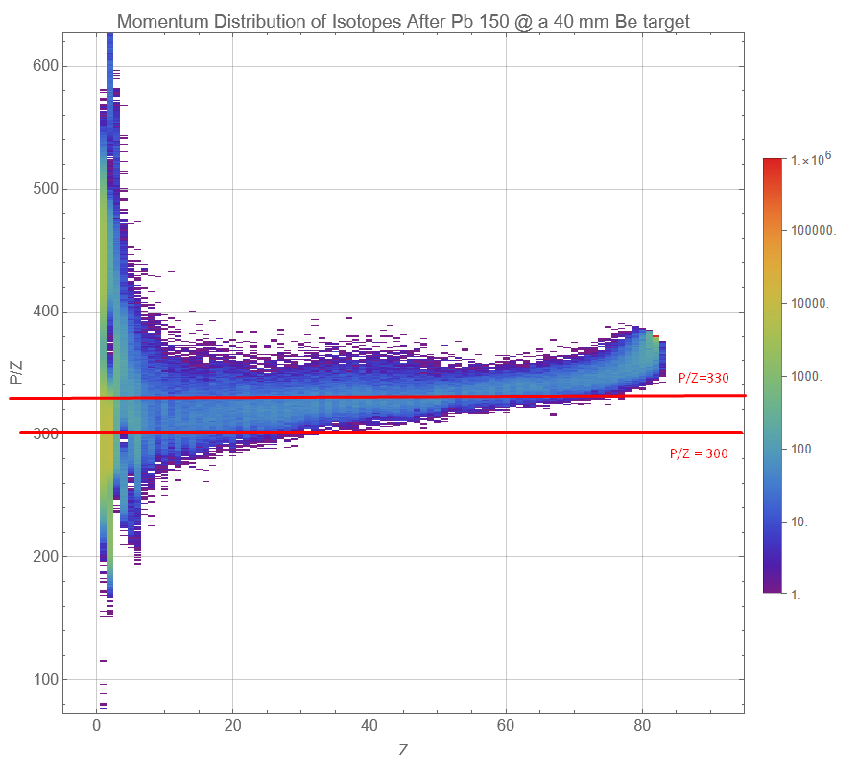
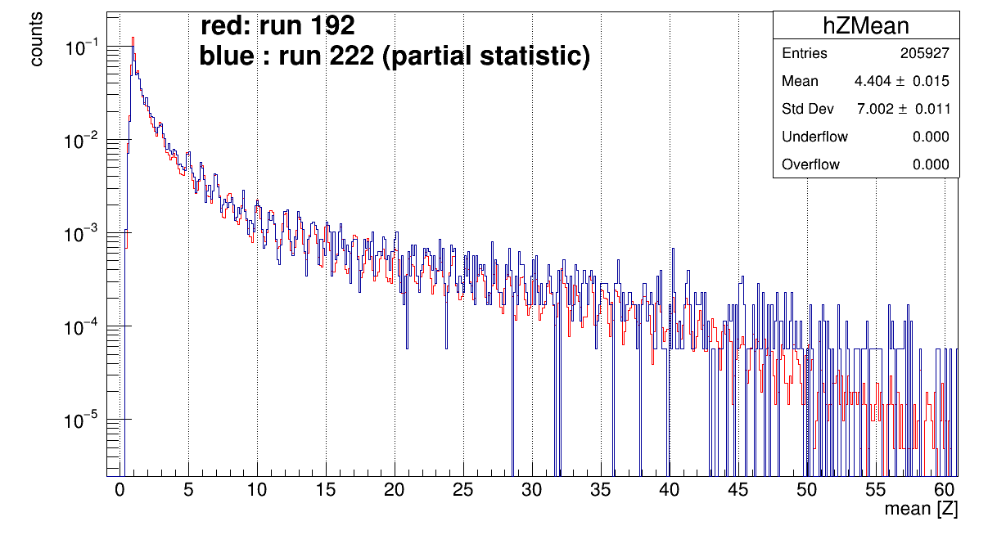
SPS Secondary Ion Beam
Pb (150 A GeV/c or 379 GV/c) + Be (40 mm) → Fragments selected magnetically.
Chosen the rigidity interval of few % around 300 GV/c.
Given straight-ahead approx. this corresponds to A/Z=2.
→ Maybe not the best configuration for high-Z.
→ However, enough to see Z=26.
Why this 10% spread?
I don’t think it is intrinsic of the beam,
should be resolution of this momentum detector (?)
Pb
primary
⁸Be hole
¹²C
Be hole
CALO PD Tower

Slide 3
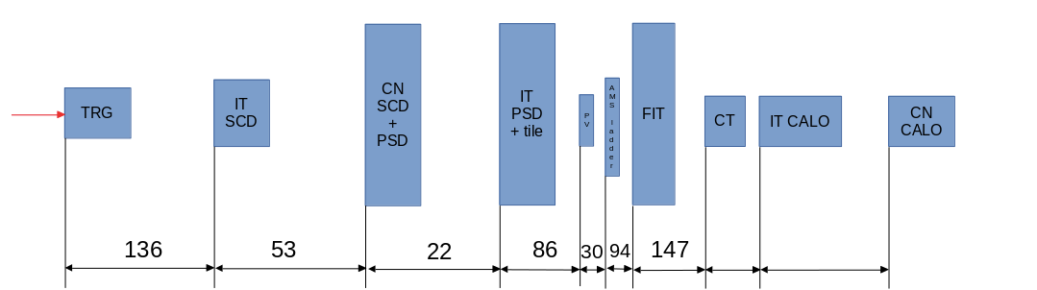
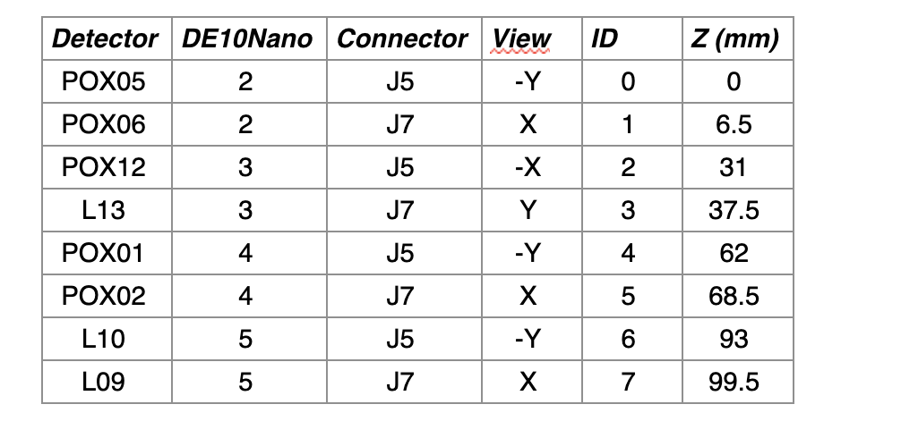
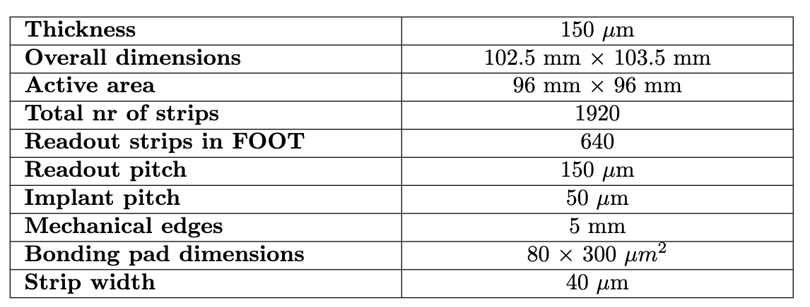
Ladder Under Test

Slide 4
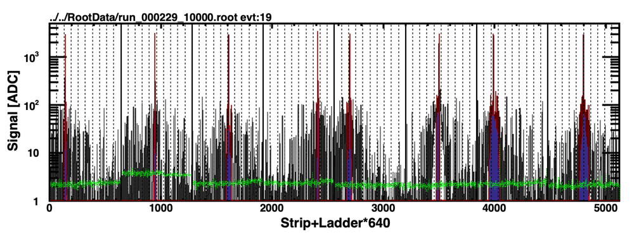
Clusterization
Run 229 (last), no finger, ~1M events
POX05 (-Y) POX06 (+X) POX12 (-X) L13 (+Y) POX01 (-Y) POX02 (-Y) L10 (+X) L09 (+X)
Hierarchical Common-Noise estimation (Ladder, ADC, VA). Large ladder-CN for POX06.
Dead strip detection to be implemented.
Very high-Z event, a lot of cluster over threshold (delta-rays inside and before sensor, beam halo, …).
Here only the selected largest cluster is displayed.

Slide 5
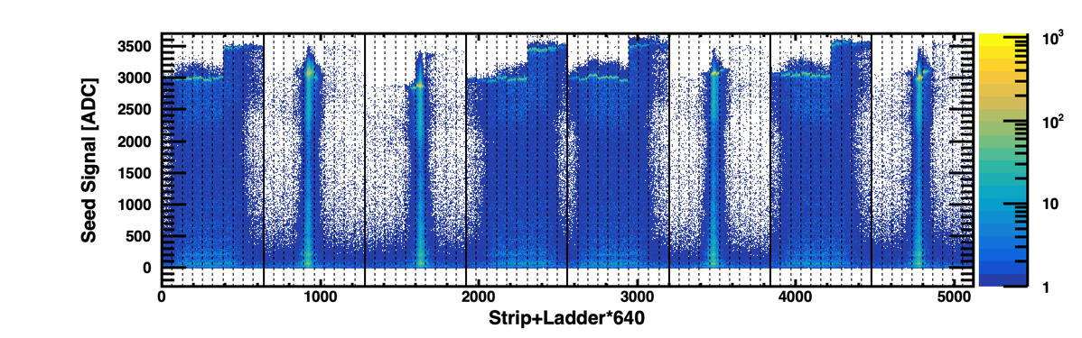
Seed Strip and Saturation
Run 229 (last), no finger, ~1M events
POX05 (-Y) POX06 (+X) POX12 (-X) L13 (+Y) POX01 (-Y) POX02 (-Y) L10 (+X) L09 (+X)
→ Broad distribution along Y and thin distribution along X (as expected from beam characteristics).
VA saturation (no ADC saturation observed for any-Z).
Gain difference still to be corrected.

Slide 6
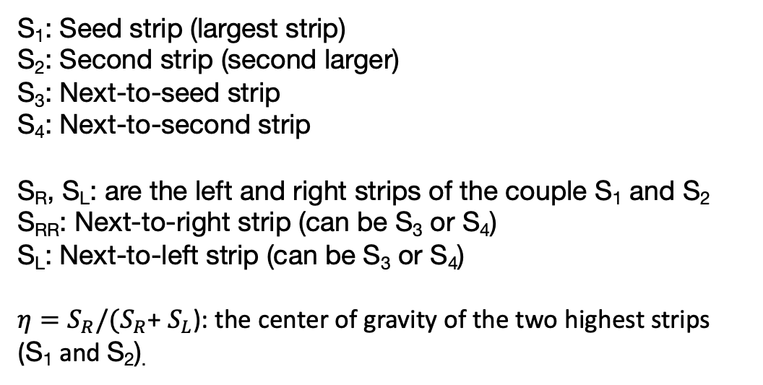
Cluster Naming
S₁
S₁
S₁: Seed strip (largest strip)
S₂: Second strip (second larger)
S₃: Next-to-seed strip
S₄: Next-to-second strip
S_{R}, S_{L}: are the left and right strips of the couple S₁ and S₂
S_{RR}: Next-to-right strip (can be S₃ or S₄)
S_{L}: Next-to-left strip (can be S₃ or S₄)
$η=S_{R}/(S_{R}$+ $S_{L}$): the center of gravity of the two highest strips (S₁ and S₂).
S₂
S₂
S₃
S₄
S₄
S₃
S_{LL}
S_{L}
S_{R}
S_{RR}
S_{LL}
S_{L}
S_{R}
S_{RR}

Slide 7
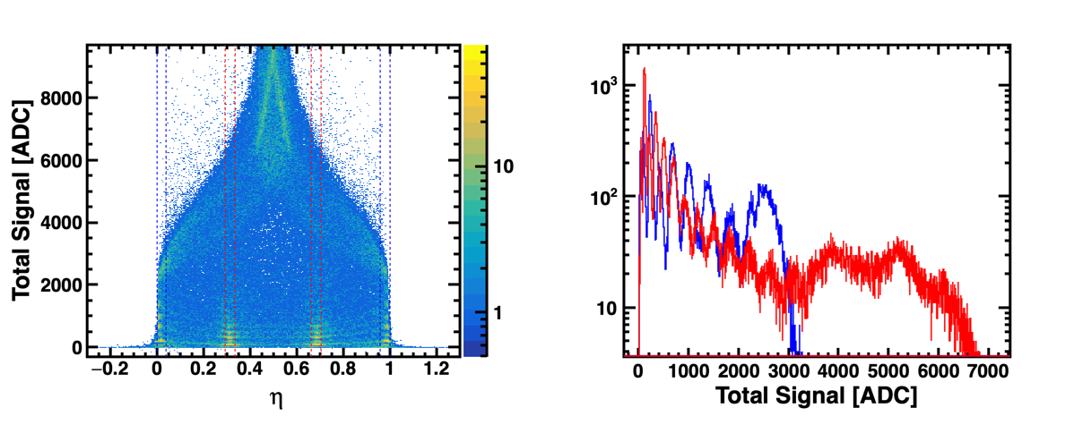
Total Signal vs 𝝶
VA04 of POX06 in run 229.
Saturation
The 𝜂-distribution shows 2 extra-peaks at about 1/3 and 2/3 as expected from the presence of 2 floating strips.
Selecting two regions profiting of the 𝜂-symmetry: readout, floating.
Basically we can see up to 6 with readout region, and up to 14 with floating using total signal (as ∼ expected).

Slide 8
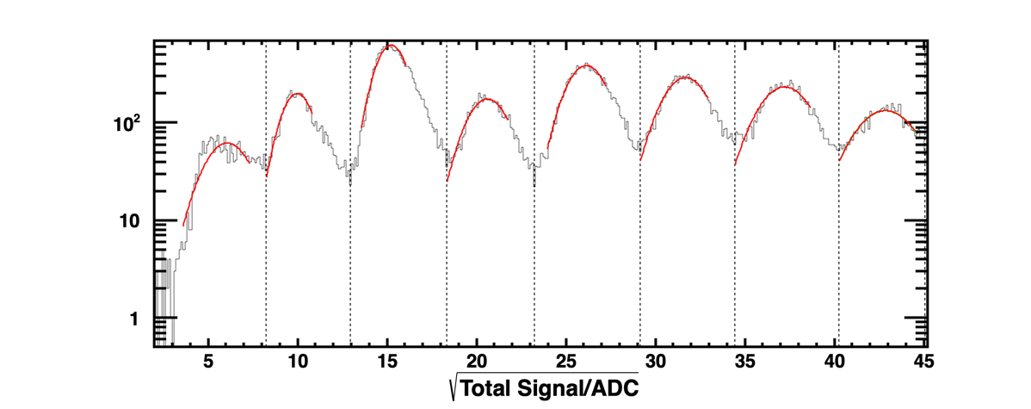
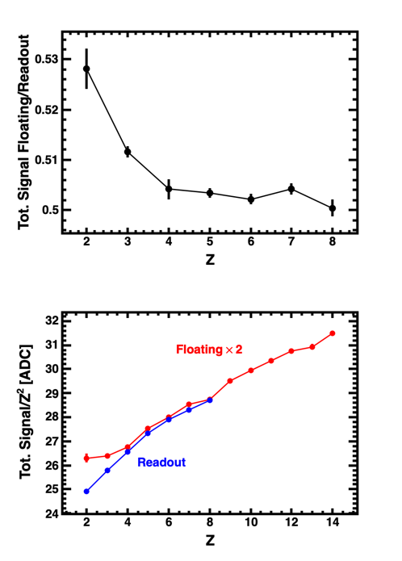
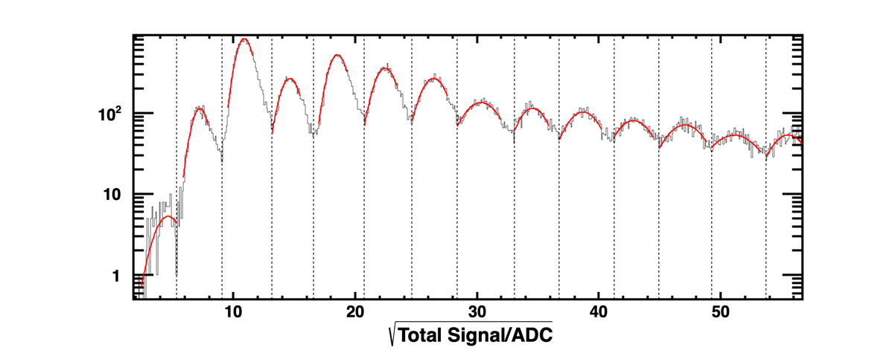
Charge Loss
Charge Loss ∼ 50%
Not a big non-linearity
Readout region
Floating region
Some non-linearity below saturation.
→ Better to use seed to study non-linearities!

Slide 9
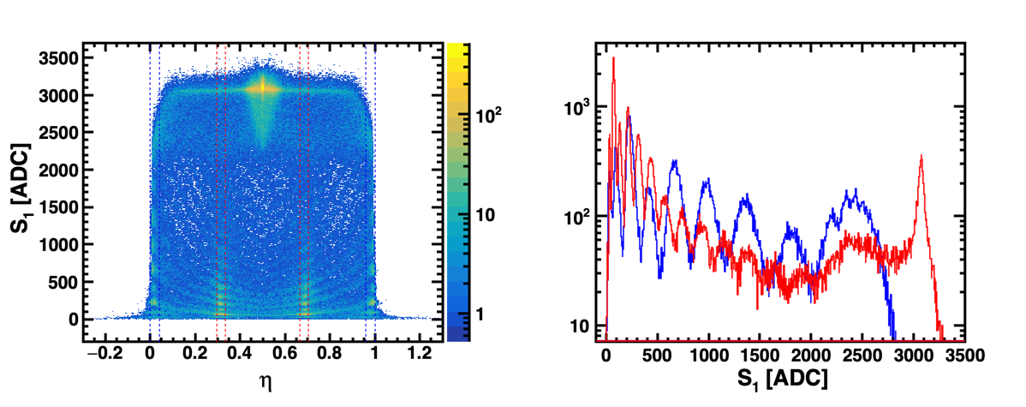
Seed Strip vs 𝝶
VA04 of POX06 in run 229.
Saturation
Seed distribution explains in full what we observe with total signal.
At moderate-Z (Z=8), seed saturates, while at high-Z (Z=14) seed strip start to saturate on floating.
Peak position of seed can be used to gain-calibrate, and verify linearity up to saturation.

Slide 10
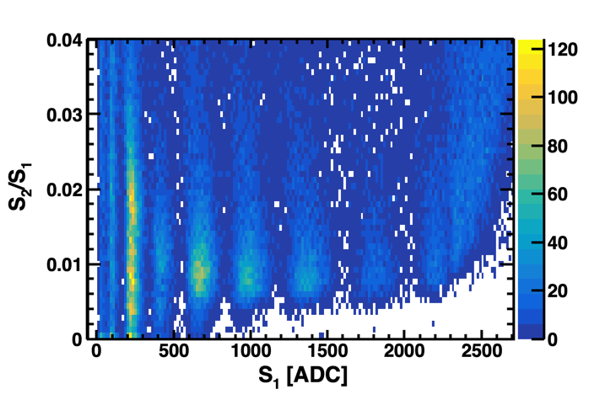
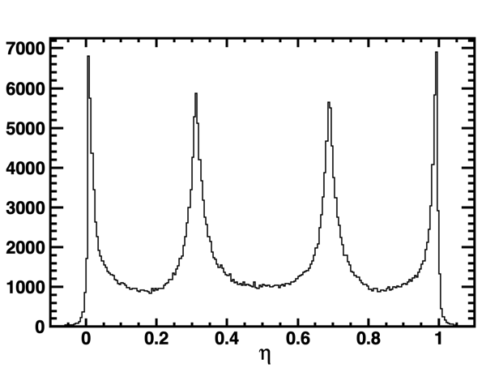
Charge Coupling
VA04 of POX06 in run 229.
No-seed-saturation, S₁ < 2000
“1/3”
“2/3”
Both 𝜂-distribution and/or S₂/S₁ ratio show a charge coupling of about 0.8%.

Slide 11
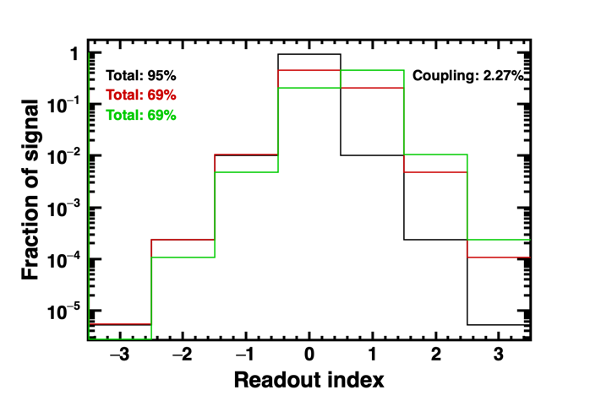
Conclusions
There is a lot of data analysis still to be done: 8 ladders, and many runs. I took a look only to one VA.
Basic properties of the VA: charge loss 50%, charge coupling 0.8%.
Observed charge peaks up to Z=8 with readout region, and up to Z=14 with floating region.
Use of external strips (S₃, S₄) to extend dynamic range is still to be tried.

