Slide 1


Dissemination and Outreach
Philip BAMBADE
IJCLab – CNRS (France)
Acknowledgements: Z. Dolezal, L. Ludovici, A. Passeri, R. Pestotnik , F. Sanchez, A. Soffer
2
EU grant n.822070

Slide 2
Dissemination of science and technology results
→ integral task of Work Packages 1-5
Following best practices using standard tools of High Energy Physics community
(1) internal report & presentation within research team, then whole collaboration
first results, progress of on-going work, cross-checks
(2) report / presentation at international workshop / conference (internal peer review)
reliable results deserving scrutiny → triggers further work within HEP community to confirm / contradict, possibly develop them
(3) high-impact journal publication (external peer review) : European Journal of Physics, Journal of High-Energy Physics, Physical
Review, Physical Review Letters, Physics Letters, Nature, Nuclear Instruments and Methods A or Journal of Instrumentation
totally solid, fully documented → all details needed to understand and reproduce the findings
Emphasizing open access and open science practices
- Preprints in open access repositories e.g. https://arxiv.org/ , https://inspirehep.net
- Open access journals always preferred for publications (although usually involves additional costs…)
- Free access to repositories for needed software and, where appropriate, simulation setups and data samples for cross-checks
Support of JENNIFER2 mentioned in Acknowledgement Section of all journal publications
2
EU grant n.822070

Slide 3
Dissemination of science and technology results
→ integral task of Work Packages 1-5
Promoting researchers’ visibility and career prospects (both junior and more senior, also tech. oriented)
- Speaker’s committee identifies relevant conferences, carefully selects speakers according to merit, competence, taking into account
career needs, properly considering under-represented groups and women
- Diversity committee monitors balance in positions of responsibility and career advancement within collaboration, keeps track of
talk demographics, aims at mentoring and grooming young researchers from under-represented communities into leadership roles
Exploitation, cross-fertilization and IPR issues
- R&D activity with CAEN & FKB members on innovative solid state sensors, photodetectors + associated state-of-the-art electronics
→ inter-sectoral transfer of knowledge transfer opportunities
→ IPR carefully covered by Consortium Agreement
- Conferences dedicated to detector technology R&D in HEP usually include significant industry participation
→ inter-mixing and interactions of academic and private sector delegates enable information flow between the communities
For improvement : conference presentations and peer-reviewed publications appear on Belle II and T2K web sites and will be listed also on JENNIFER2 web site
2
EU grant n.822070

Slide 4
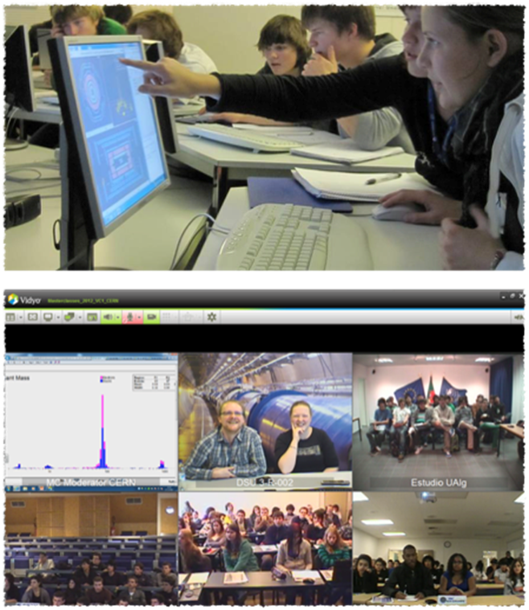
WP6 : Masterclasses for high-school students
Flagship of “International Particle Physics Outreach Group” (IPPOG)
GENERAL FRAMEWORK
- High school students (15 – 19) are “scientists for one day“
- Get invited to a research institute or university
- Introductory talks (standard model, detectors, accelerators)
- 2 h measurement with real experimental data
- International video conference ( 2 – 5 institutes + CERN/Fermilab/KEK)
Zdenek Dolezal, IPNP, Charles University, Prague
2
EU grant n.822070

Slide 5
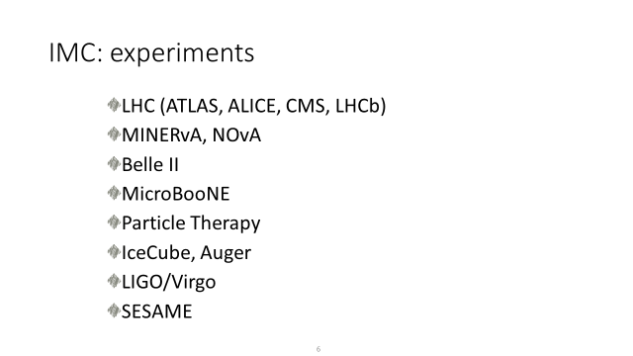
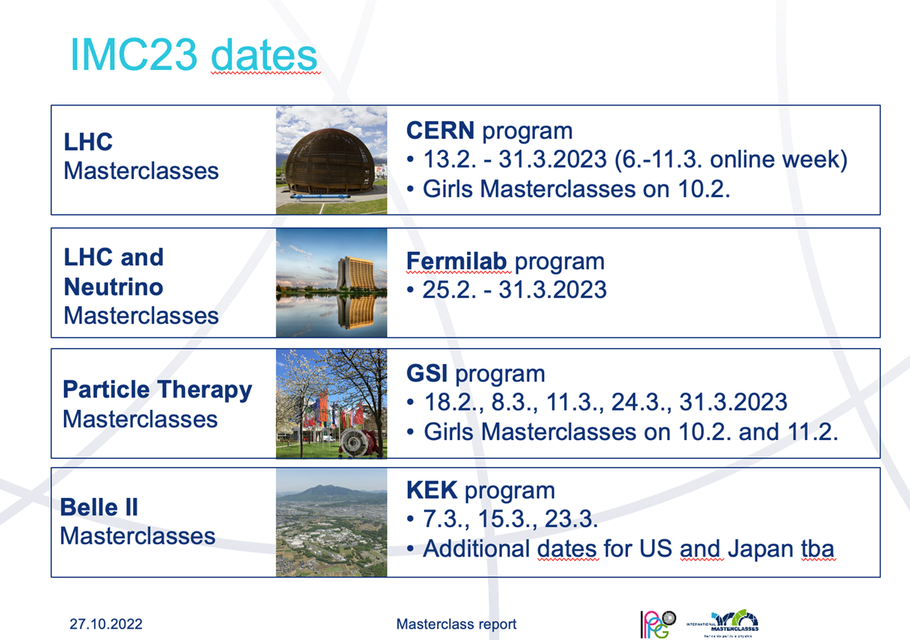
WP6 : Masterclasses for high-school students
IPPOG international masterclasses involve several experiments
Plans for 2023
Experiments
Zdenek Dolezal, IPNP, Charles University, Prague
2
EU grant n.822070

Slide 6
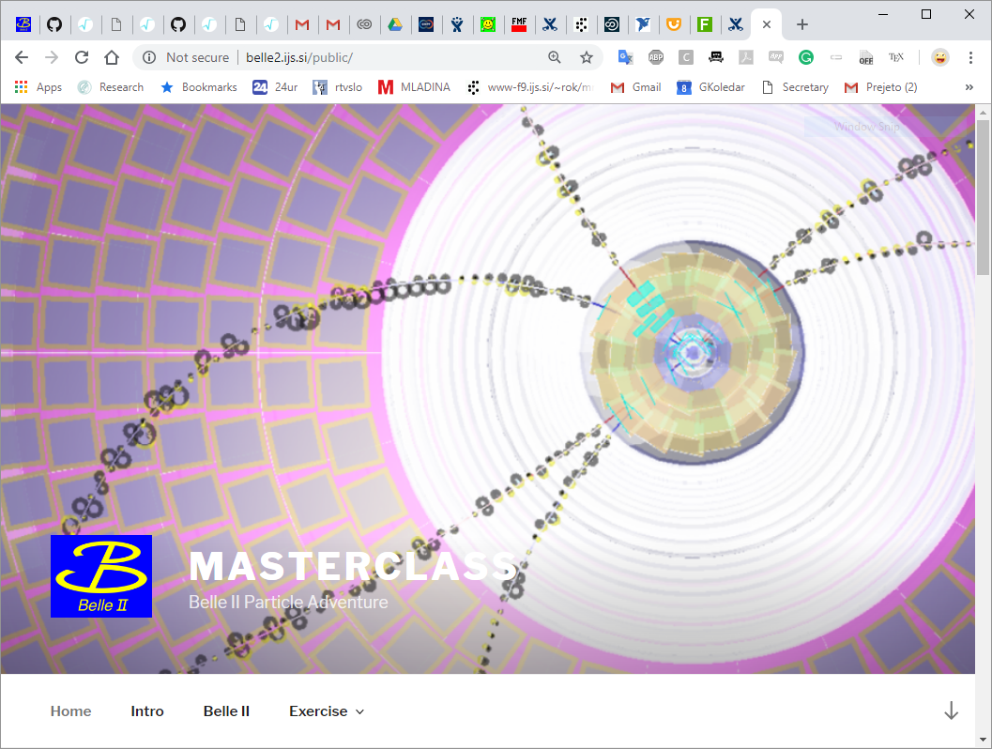
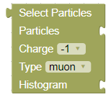
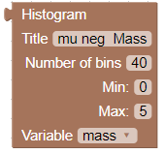
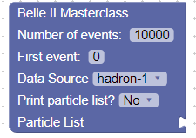
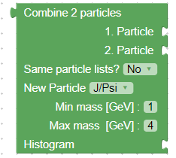


Belle II Masterclasses
Rok Pestotnik, Jožef Stefan Institute, Ljubljana
  IMC Program support - JENNIFER2 project

Slide 7


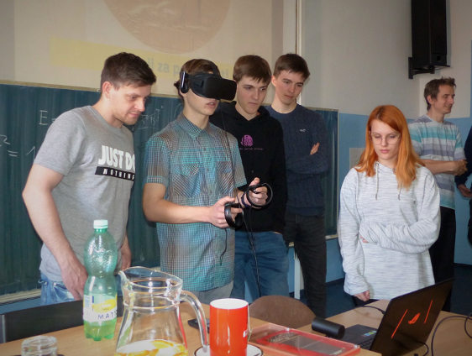
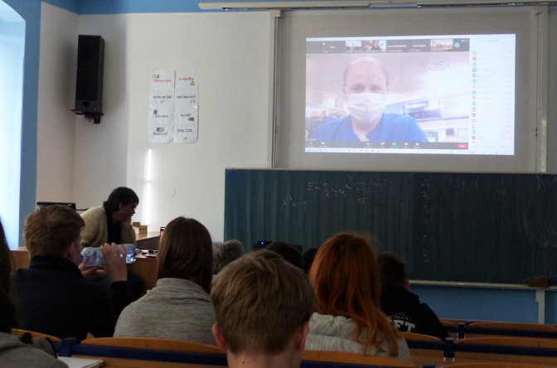
BELLE II IMC in 2022
Back to live masterclasses (1/2 still online) – 216 students
The events announced through IMC and Belle II collaboration channels
  Europe - 3 events with a final video conference
  1 planned event for Japan cancelled due to Covid
Tutorial , Jan.25 @Belle II General Meeting,
  Question time, Mar.2
Video conference with live connection to Belle II control room – live earthquake during 2nd VC.
Quiz: own application and voting system – allows group ranking.
FPCP2022 event @ Uni. Mississippi
 | Institutes | Participants
Mar. 7 2022 | 4 | 90
Mar. 16 2022 | 4 | 71
Mar. 23 2022 | 3 | 75

Slide 8
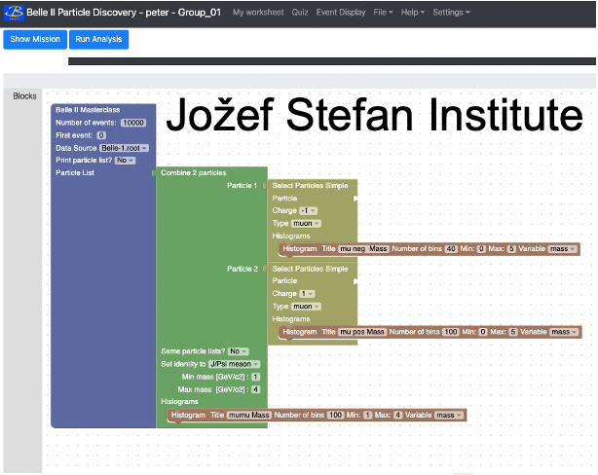
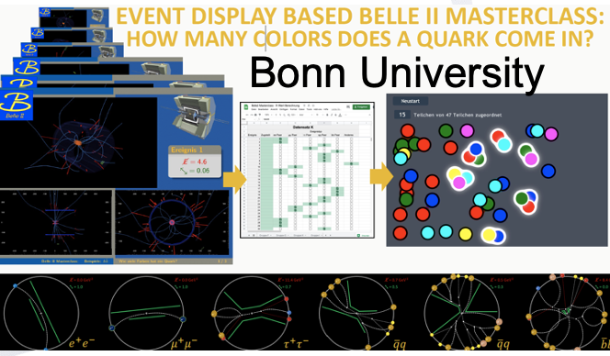
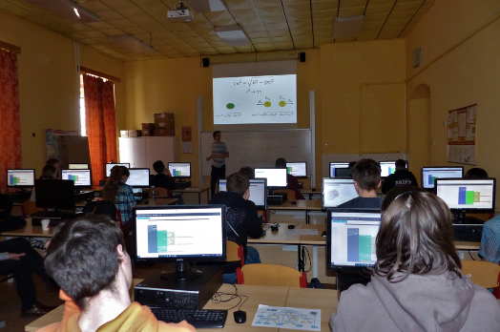
Belle II - exercises
Two exercises – Choose one or do both:
Spectroscopy – search for new particles 10 MEvents
  https://belle2.ijs.si/masterclass/
  Online server
    able to handle more than 250 parallel users
  Event display added (not used before)
New in 2022: Measure quark colors
  similar to LHC experiments
  https://belle2.ijs.si/public/home/quark-colors/
  Limited sets of events
2022:
7x exercise (old)
2x exercise 2 (new)
1x both
R. Pestotnik: J2GM Masterclass @ J2GM-WP6 ,Nov 17 2022

Slide 9
WP6 : Masterclasses for high-school students
Further plans
Plans for 2023
Experiments
T2K version
JENNIFER2
Zdenek Dolezal, IPNP, Charles University, Prague
2
EU grant n.822070

Slide 10
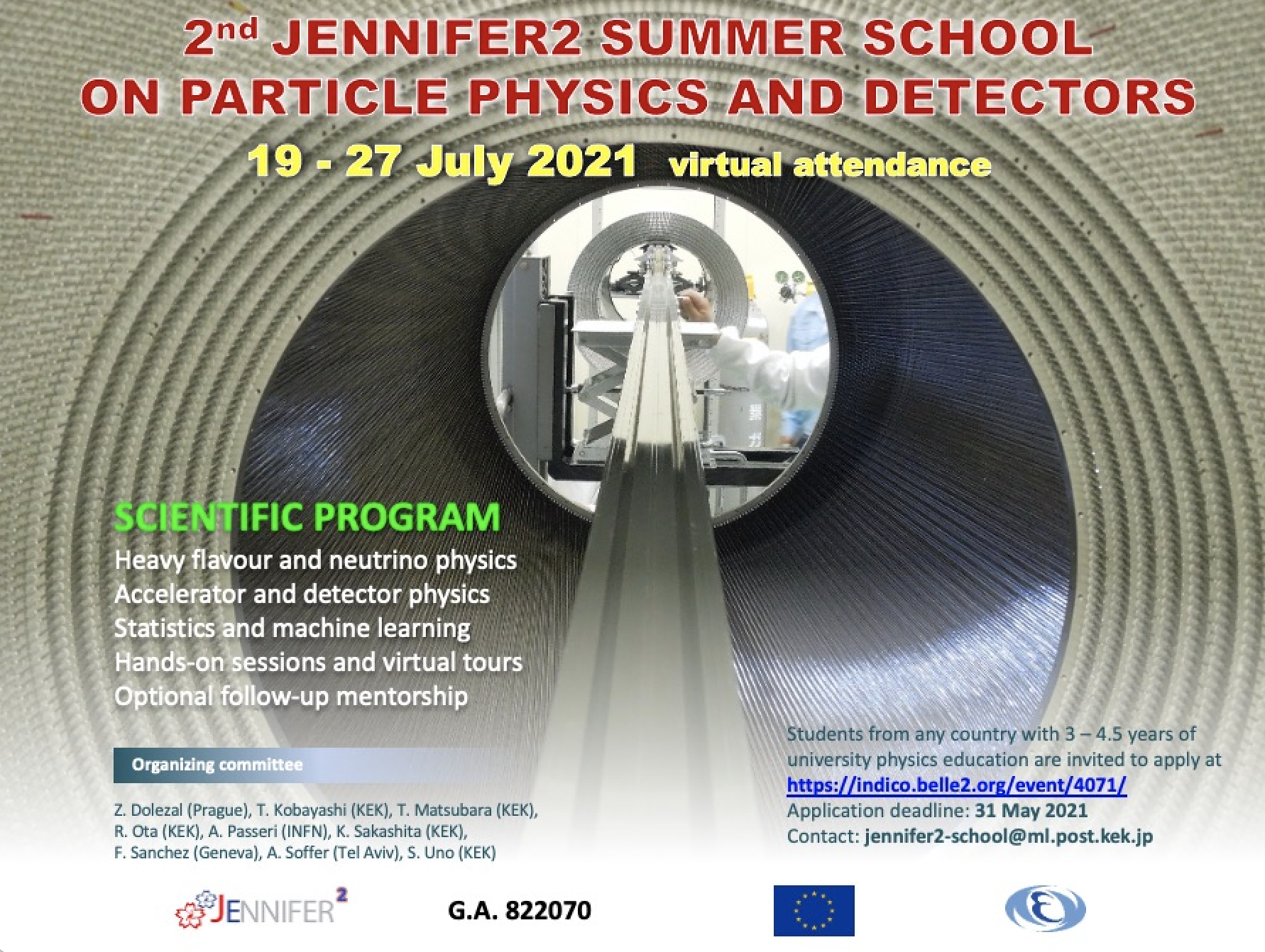
WP6 : Summer schools for physics students
1st year Master and 3rd year Bachelor students
Abi Soffer, Tel Aviv University
2
EU grant n.822070

Slide 11
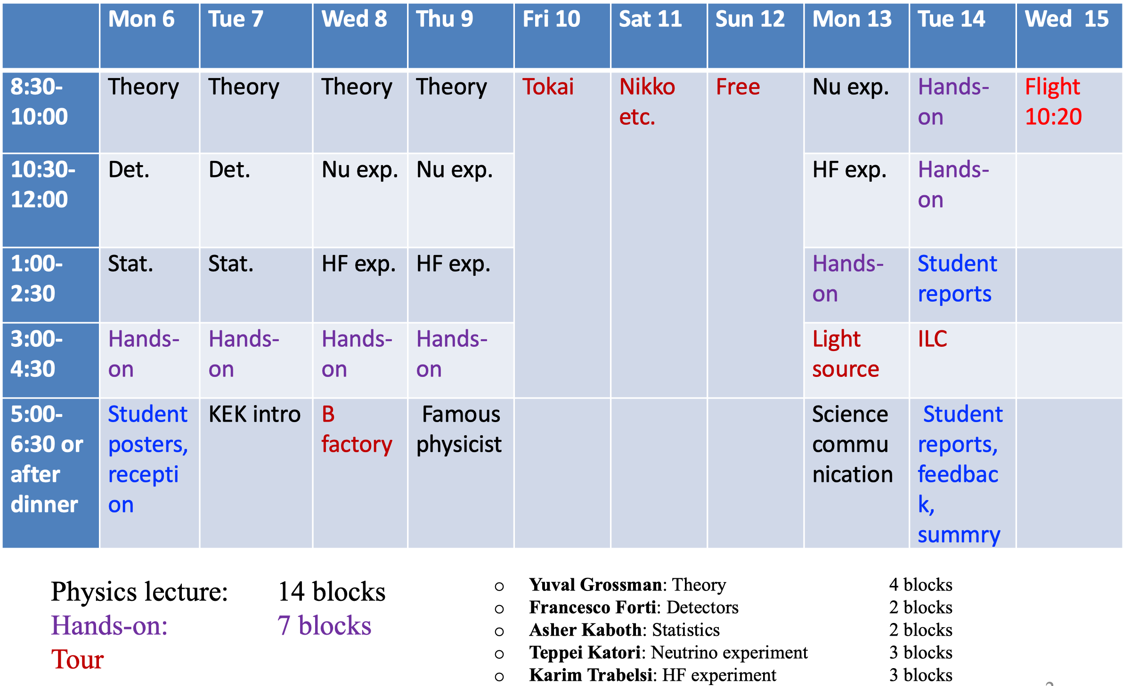
Original plan for J2SS 2020 at KEK
15 European (62 eligible applications), 5 Japanese (1 applicant) students
All expenses paid (almost €30k)

Slide 12
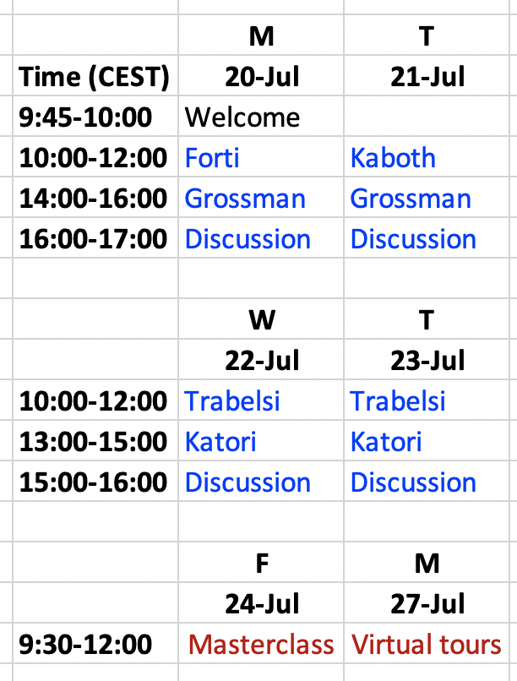
Virtual school agenda https://indico.belle2.org/event/1045
Considered online lectures more tiring
So decided to shorten the agenda from 14 lecture blocks to 8, but keep all the topics
All the speakers graciously agreed
Added an hour each day for spillover and discussion as needed – eventually used on all days
Determined that the Belle II masterclass could be done online
Converted physical KEK tours to virtual tours
Moved dates to end of July to avoid exam overlap
  (Exam date uncertainties well into June)

Slide 13
Actual participation
Screenshot from end of first day – very representative of the level of participation throughout the school
This was the most amazing thing about the virtual school:
47-51 attentive faces constantly present and listening.
There were questions, but most students were shy, as in a colloquium.
On Thursday we had the idea of having lunch together in breakout rooms
  Very successful in encouraging discussion and familiarity.
  Most important lesson for future

Slide 14
Student statistics
Australia
Bosnia (I don’t remember if attended eventually, work/exam conflict)
Czechia
France (1 student, originally from Greece)
Germany
Greece
India
Israel
Italy
Japan
Korea
Poland
Russia (1 student, originally from Zambia)
Slovenia
Spain (3 students, 1 originally from Pakistan)
Sweden
Switzerland
Turkey
UK
Ukraine
Education:
Mostly last-year undergraduates
Large portion of 1st-year masters

Slide 15
Online Belle II masterclass
36 students expressed interest
  Several more asked to join at the last minute.
  I agreed, but somewhat discouraged that, fearing too-large groups, but not a problem eventually
6 volunteers: Marko Bračko, Alberto Martini, Daniel Červenkov, Radek Žlebčík, Jakub Kandra, Ezio Torassa
  Planned on 5 groups with Ezio leading the effort
  Eventually Radek was disconnected, so Ezio stepped in as a group guide.
Some got disconnected and I reconnected them to their zoom room.
~3-4 dropped out and didn’t rejoin (too many for just connection problems)
All using the new Ljubljana server: no problems.

Slide 16
Virtual KEK tours
Tsukuba:
  Shoji Uno led a tour of Belle II and SuperKEKB
J-PARC:
  Takashi Kobayashi led the tour with Ken Sakashita, Tsunayuki Matsubara, Takeshi Komatsubara reporting from the T2K ND, K0TO
Tried to combine relatively well edited pre-shot video (higher quality) with live video (sense of being there)
Sorry, I was paying close attention and forgot to take screenshots…

Slide 17

Student satisfaction survey
Filled by 24 students (~50%) + 4 applicants who eventually didn’t attend
  How did you hear about the school?
  What were your expectations from the school?
  Relative to the option of holding the school at KEK, what are the most important disadvantages of having it online, in your experience?
  Do you see some advantages in holding the school online? What are they? How important are they relative to the disadvantages?
  To what extent do you feel that your goals for the school have been reached, given the limitation that it was held online?
  To what extent has the school attracted you to working on heavy flavor or neutrino physics for your MSc or PhD research? Have you had prior research experience in this area?
  Please provide any other criticisms or comments. In particular, what do you suggest we improve or change if the school is held online in the future?
  +16 specific questions on different aspects of the school

Slide 18
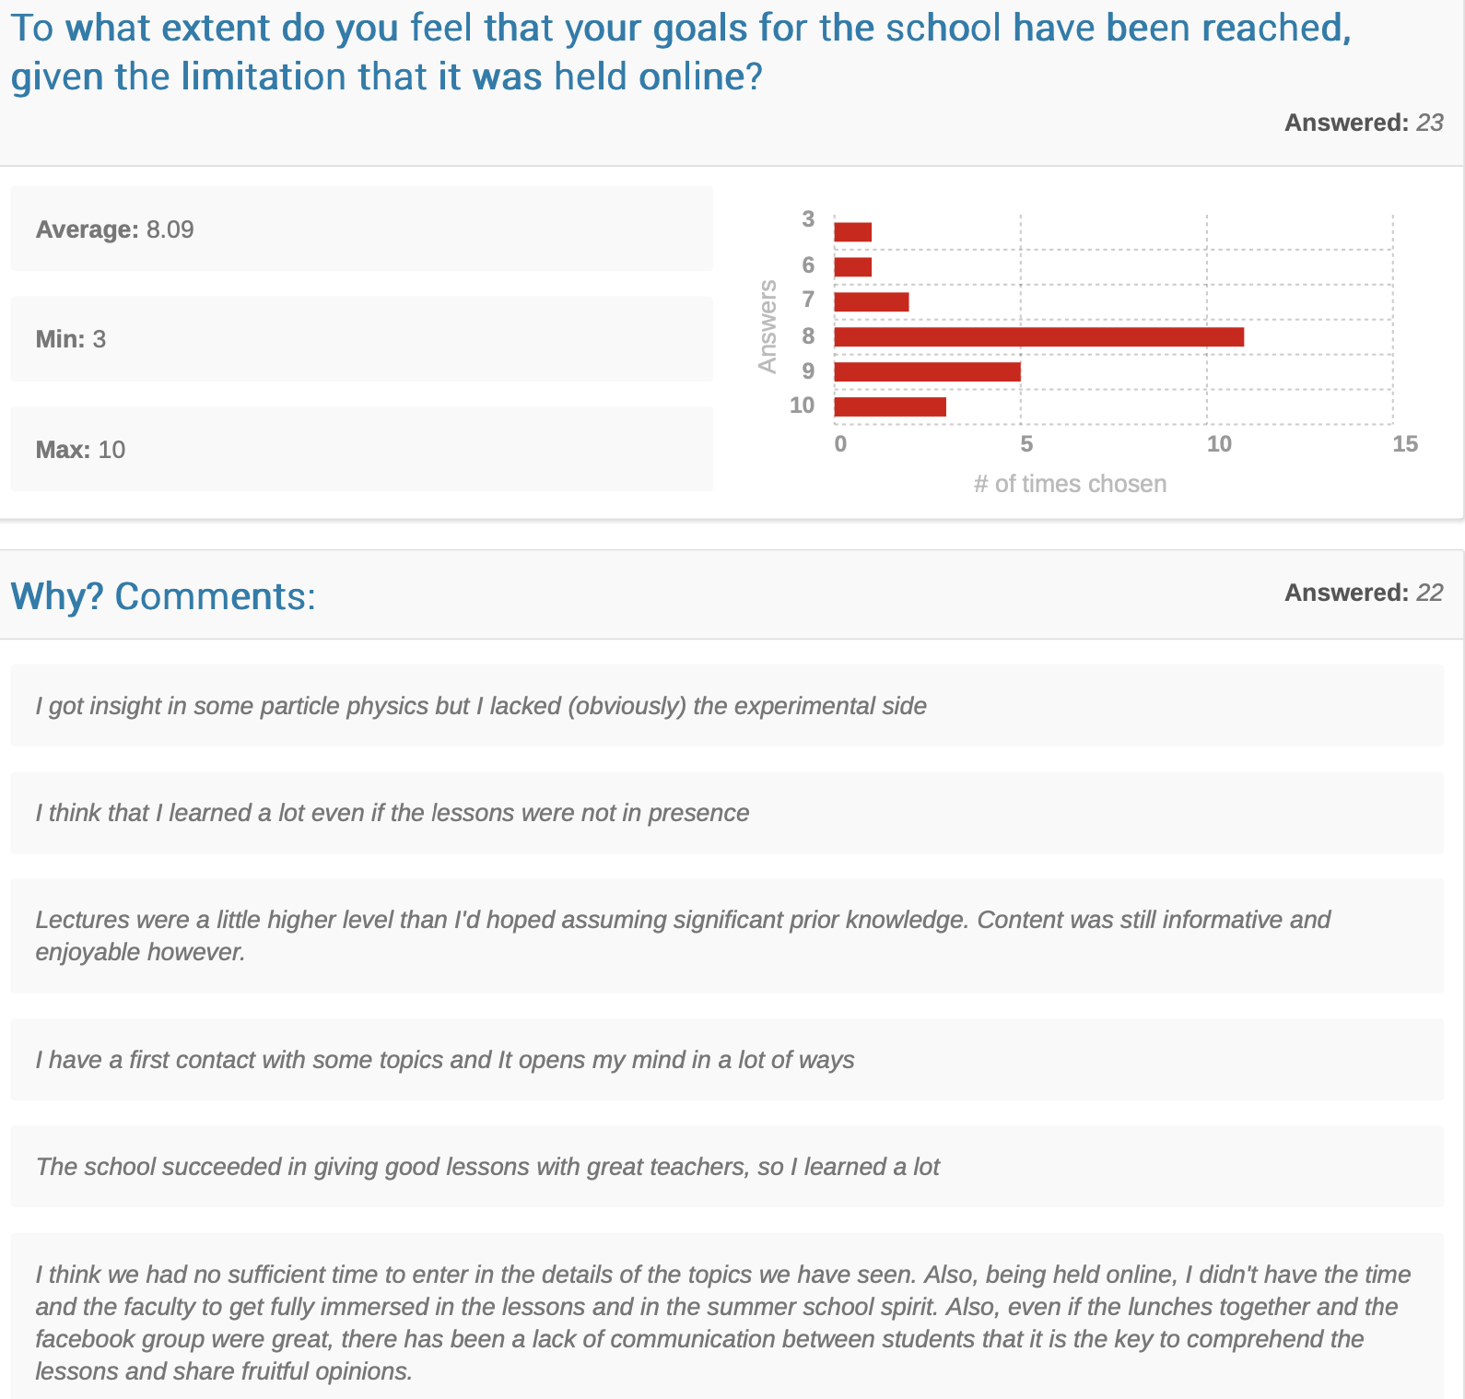

Slide 19
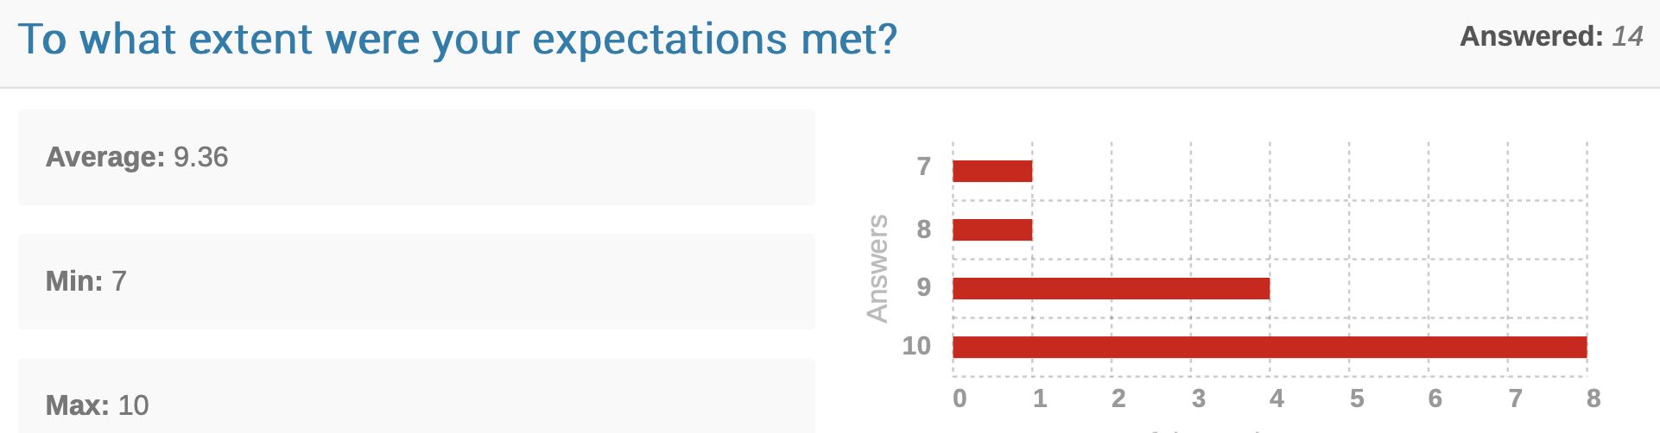
2020 Mentorship program
We got 17 volunteer mentors who worked with school students (27, I think) on a project after the school, usually remotely.
All parameters (scope, length,
expectations, etc.) defined together
by the mentor and the mentee
Thomas Kuhr
Andrzej Bozek
Francesco Terranova,
Andrea Longhin
Agnese Giaz
Stefano Lacaprara
Francesco Forti et al
Giacomo Da Pietro
Philip Bambade
Marco Bracko
Claudio Giganti
Sara Bolognesi
Federico Sanchez
Mehmet Zeyrek & Selcuk Bilmis
Peter Lewis
Diego Tonelli
Paolo Branchini

Slide 20
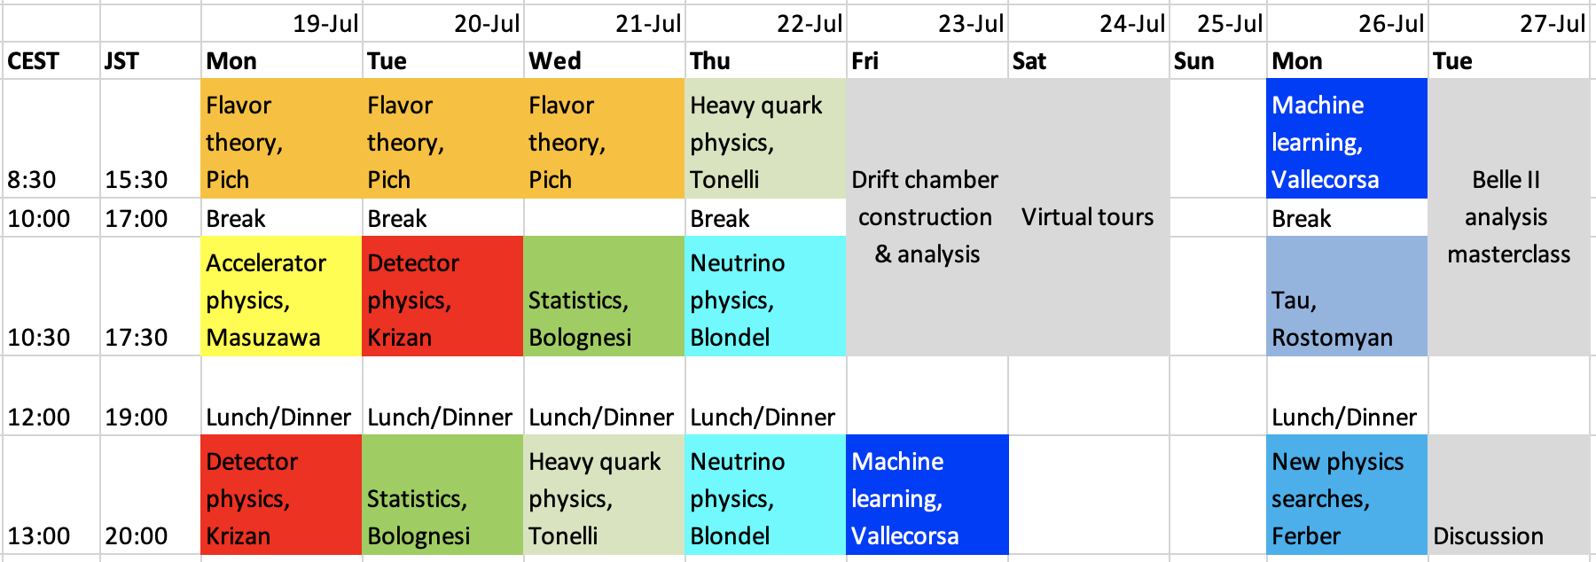
2021 school
Same format, expanded, bolder program:
The organizing committee
  Zdenek Dolezal, Tsunayuki Matsubara, Ritsuko Ota, Antonio Passeri, Kan Sakashita, Federico Sanchez, Abi Soffer, Shoji Uno
Our lecturers
  Antonio Pich, Mika Masuzawa, Peter Krizan, Sara Bolognesi, Diego Tonelli, Alain Blondel, Sofia Vallecorsa, Armine Rostomyan, Torben Ferber
Our masterclass tutors and organizers
  Antonio Passeri, Alberto Martini, Giacomo De Pietro, Radek Žlebčík, Tadeas Bilka, Karol Adamczyk, Jarek Wiechczynski
Our virtual tour and drift chamber guides
  Katsuro Nakamura, Shoji Uno, Ken Sakashita, Tsunayuki Matsubara, Takeshi Komatsubara, Guillaume Pronost

Slide 21
Students
About 150 applicants
87 admitted:
Most of those rejected didn’t meet the
criteria based on years in physics studies etc.
In 2 cases rejected lowest ranked in country:
  Had 33 applicants from India, 8 from Sri Lanka
1 Colombia
2 Ecuador
1 Honduras
3 Mexico
2 Peru
3 United States
1 Austria
1 Belgium
1 Czechia
1 Finland
1 France
1 Hungary
7 Italy
9 Japan
1 Poland
2 Russian Federation
2 Spain
3 Turkey
7 United Kingdom
14 India
3 China
2 Iran
4 S. Korea
4 Lebanon
1 Malaysia
1 Pakistan
2 Philippines
5 Sri Lanka

Slide 22
Mentorship
Antonio Passeri
Emi Kou
Giulia Casarosa
Evgueni Goudzovski
Sofia Vallecorsa
Mehmet Zeyrek, Selcuk Bilmis
Claudia Cecchi, Elisa Manoni
Kendall Mahn
Leonidas Soplin
Jan Strube
Alakhaba Datta
Tom Browder
Jim Libby
Saurabh Sandilya
Gagan Mohanty
Matsubara-san
Seema Bahinipati, Vishal Bhardwaj
Thomas Kuhr
Toni Pich
Giulia Ricciardi
Philip Bambade
Paolo Branchini
Diego Tonelli
Jake Bennett
40 students
23 mentors:

Slide 23
Next JENNIFER2 Summer Schools
There was much interest in the online schools and the mentorships
Held two successive years during suspension of JENNIFER2 contract due to Covid-19
Useful in countries that usually don’t participate in HEP
Significant outreach activity for students in the interface between Bachelor and graduate school
2024 → summer school foreseen at KEK in the original in-person format
2023 → summer school in Europe under consideration (format as in previous JENNIFER contract)

Slide 24
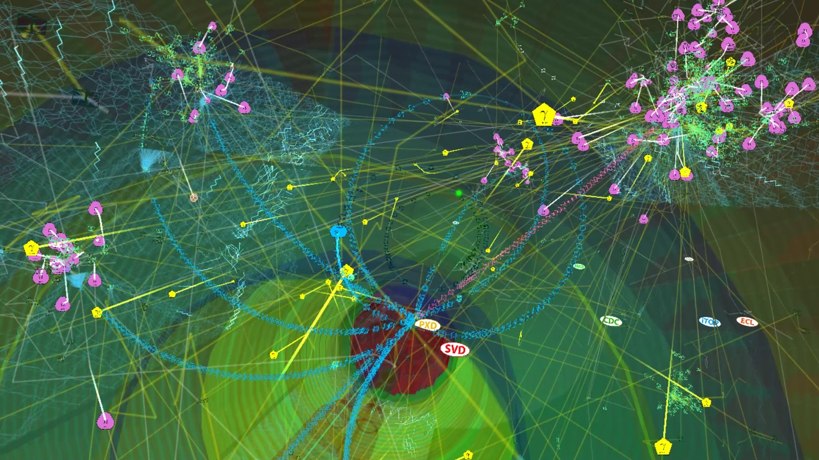
WP6 : General public science communication
→ Belle II Virtual Reality : a trip in the world of elementary particles
Antonio Passeri, INFN & Roma-3
2
EU grant n.822070

Slide 25
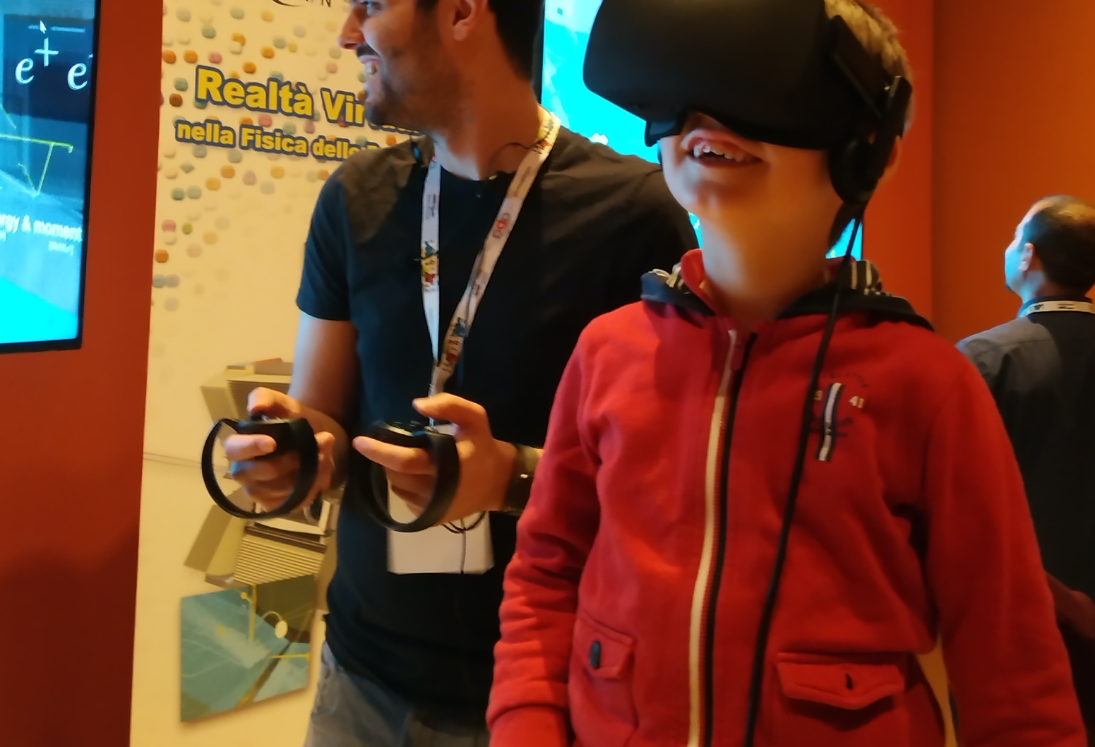
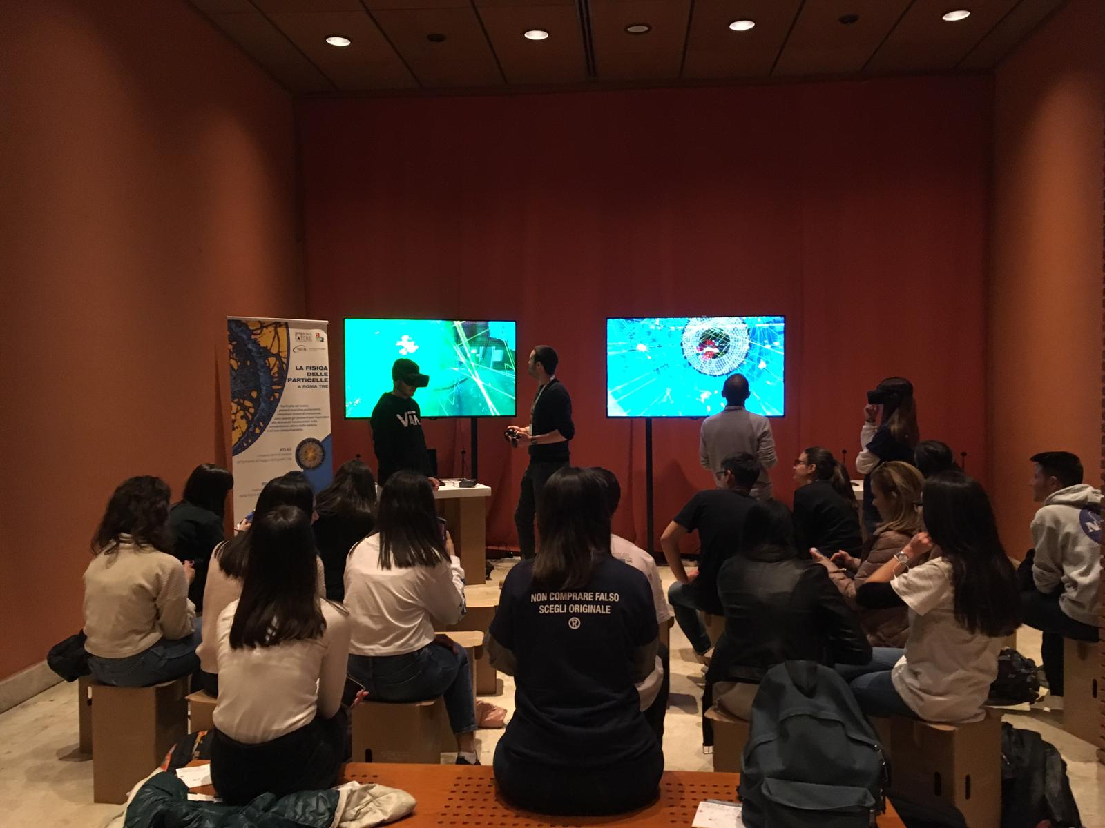
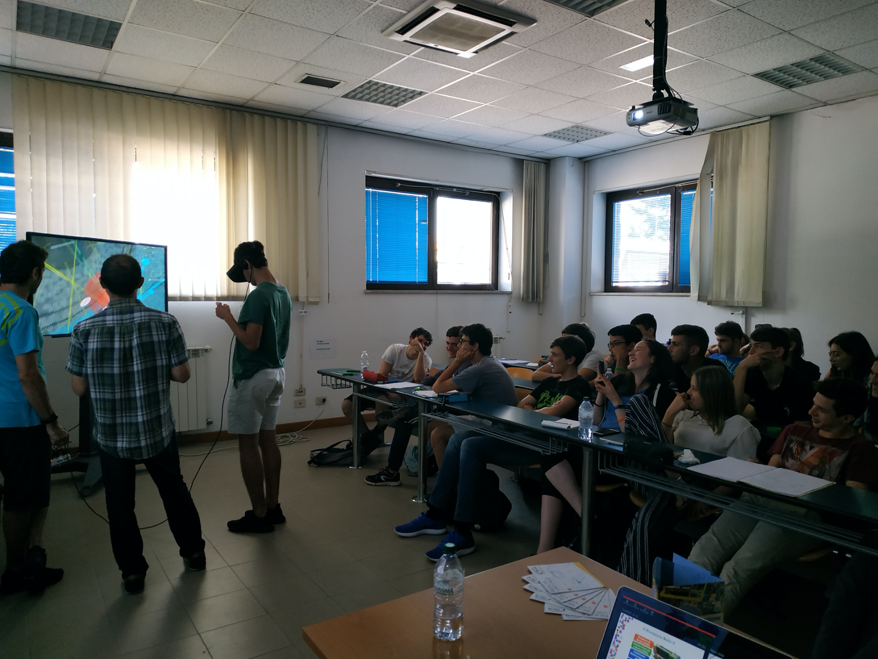
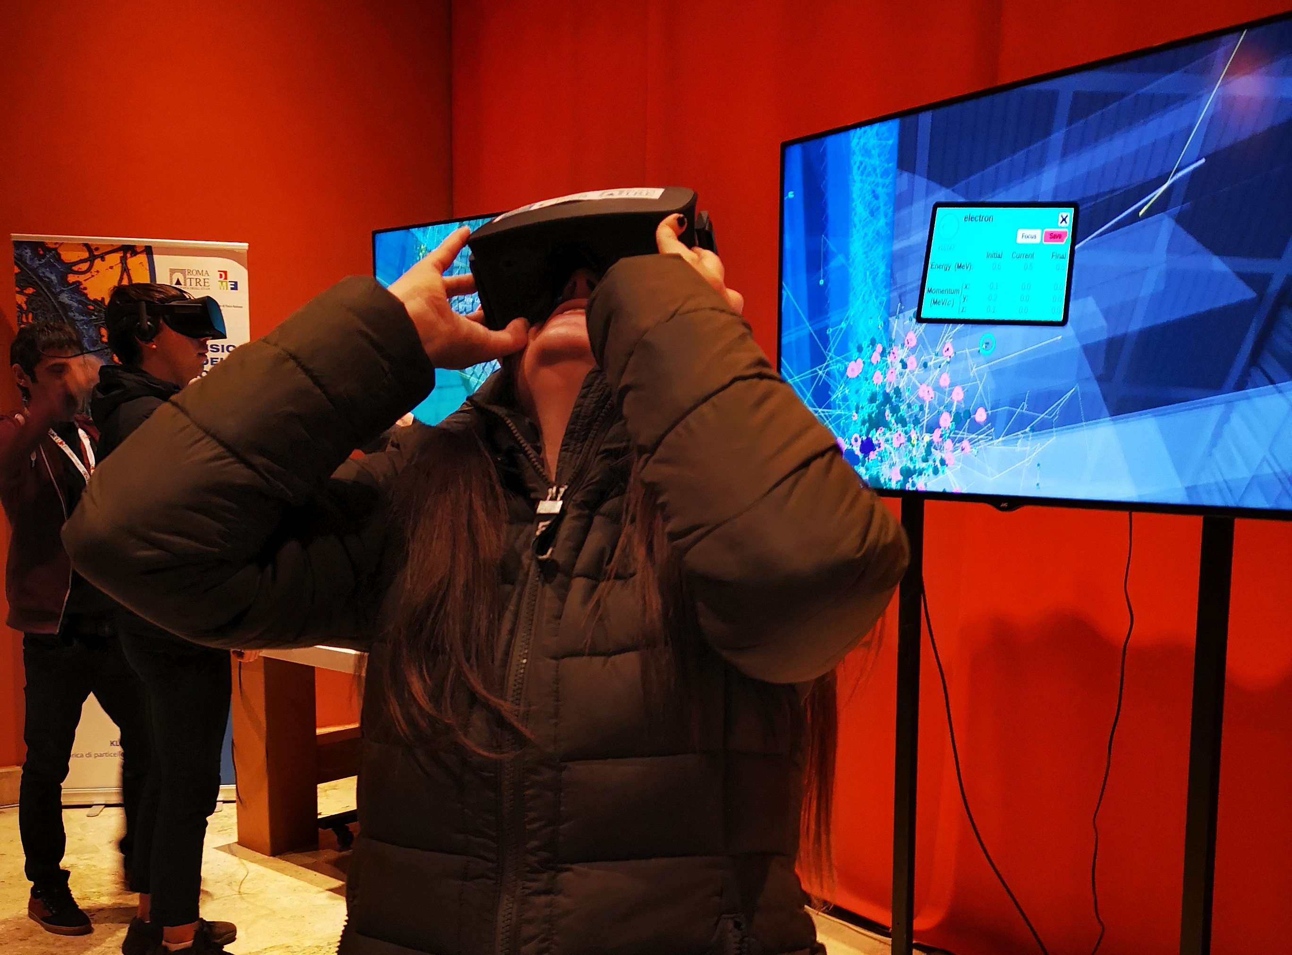
Great fun for all ages
Different kind of activities
  Schools and Masterclasses
  General Public
  Maker Faire
  National Geographic Science Festival (Genoa)

Slide 26
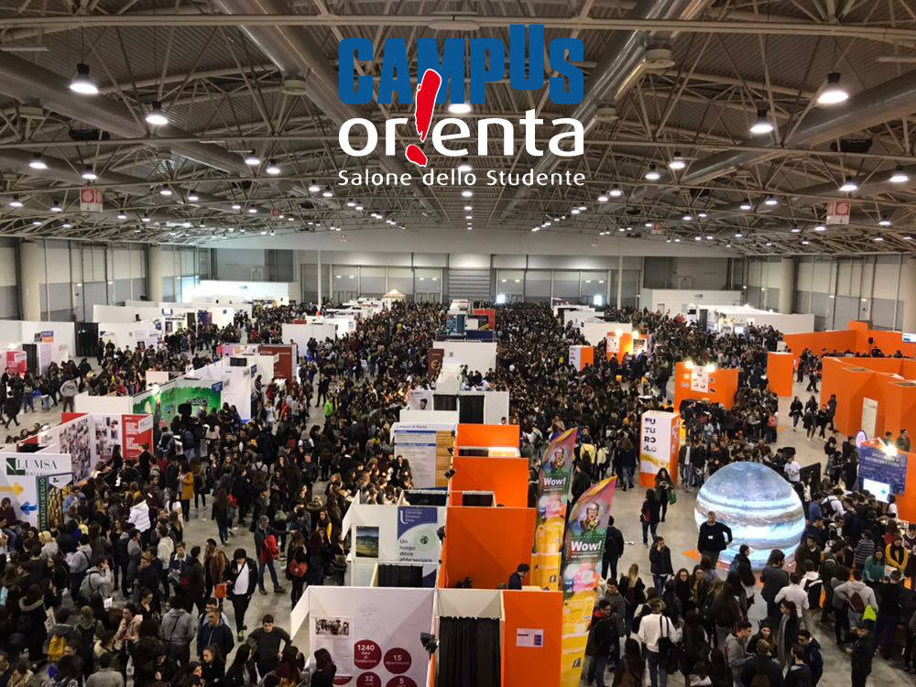


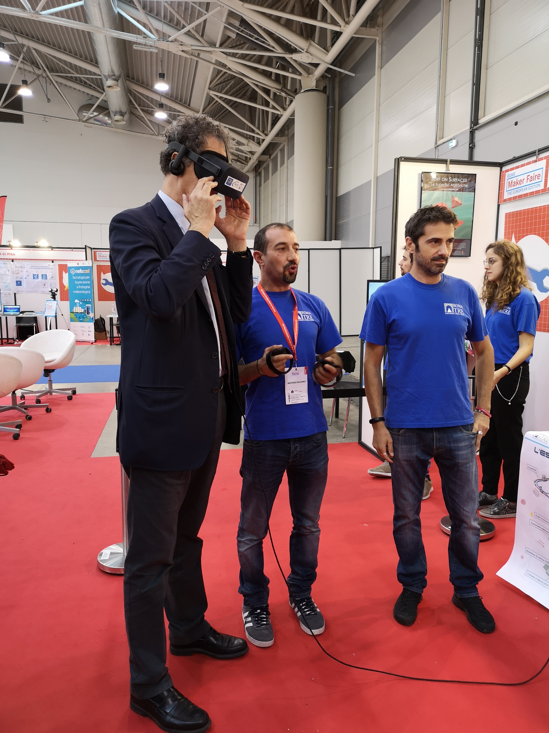
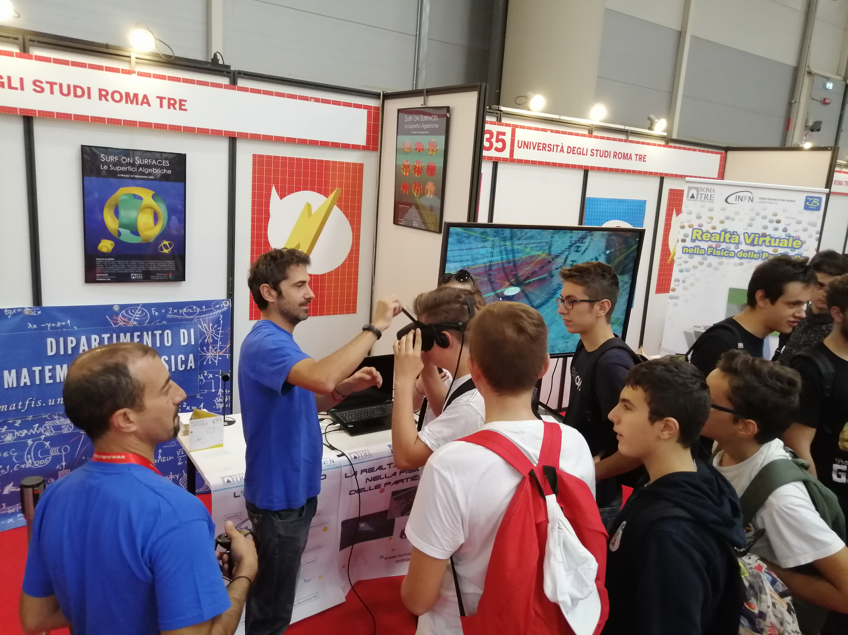

Fixed stand in large public events
  Maker Faire
  European Researcher’s Nights

Slide 27
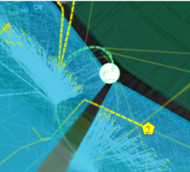
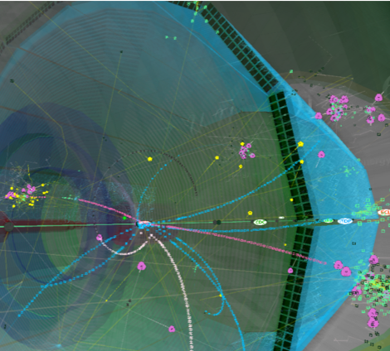
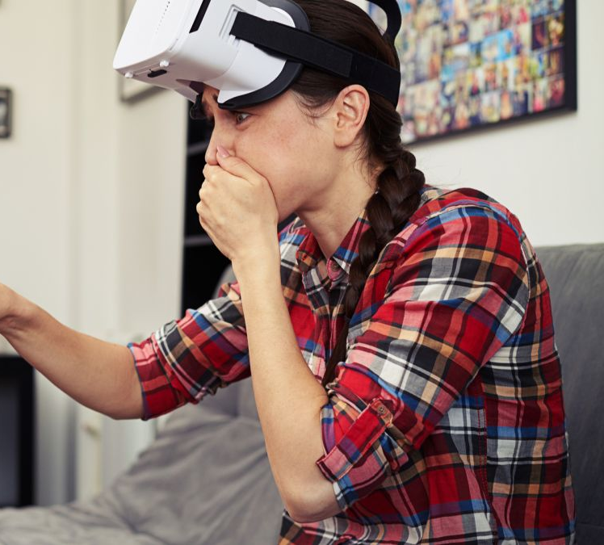
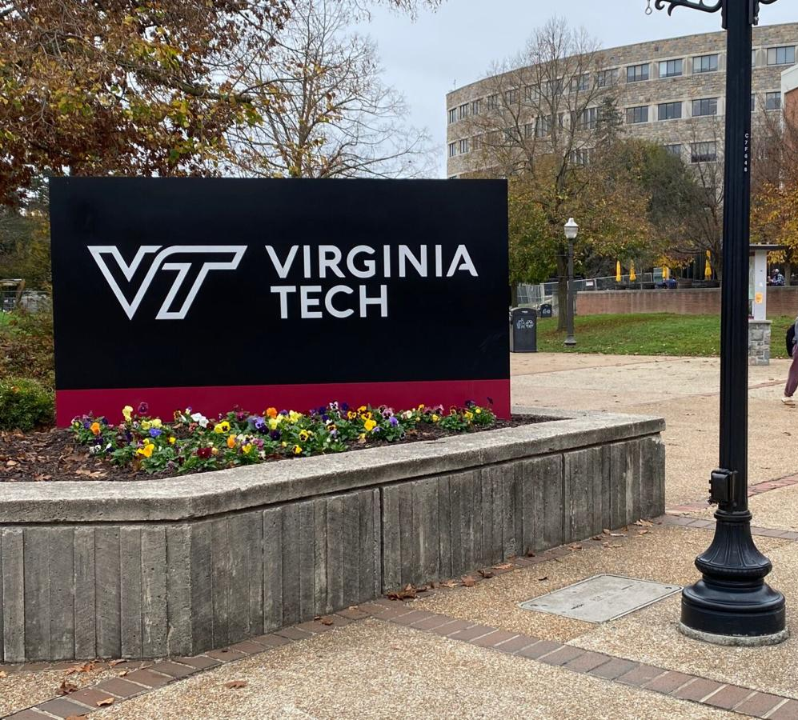
Implementation
Belle II VR graphically very engaging + continuously improving
Public usage needs some expert support to show how to move
Nice videos are produced on different physical processes to explain to broader audiences
Software property of Virginia Tech
All Belle II groups have VR
Super-Kamiokande VR available and used by neutrino groups
New VR devices are available which are stand-alone, perform better, and are quite cheap

Slide 28
WP6 : PhD co-supervision EU ↔ Japan
Administrative (JENNIFER2 + Japanese institution) → hosting arrangements during secondment (office space, computing, housing, medical insurance, transport, banking, support for language/translations, specific family/children requirement…) → usually already well covered…
Local supervision arrangements → under responsibility of applying group → important to carefully define…
Financial support to attend international conference or workshop → student talk or poster → brief report on secondment (achievements, results, future prospects, issues…) → 1200 euros / student (registration, travel + accommodation, invoice from home institution)
“JENNIFER2 Best PhD Award” in last year of JENNIFER2 → award session during final JENNIFER2 meeting.
2
EU grant n.822070

Slide 29
WP6 : PhD co-supervision – Application Form
Name of PhD student:
University / department / doctoral school of PhD student:
Period of enrollment / expected completion of PhD thesis:
PhD topic / thesis title (if already fixed):
JENNIFER2 team leader at beneficiary institution:
PhD supervisor(s) at beneficiary institution:
Co-supervisor at Japanese host institution (if identified):
Secondment project title:
Period of secondment (minimum 3 months):
Brief description of work / study to be pursued during the secondment (1/2 to 1 page):
Any additional comment / considerations (max. 10 lines):
2
EU grant n.822070

Slide 30
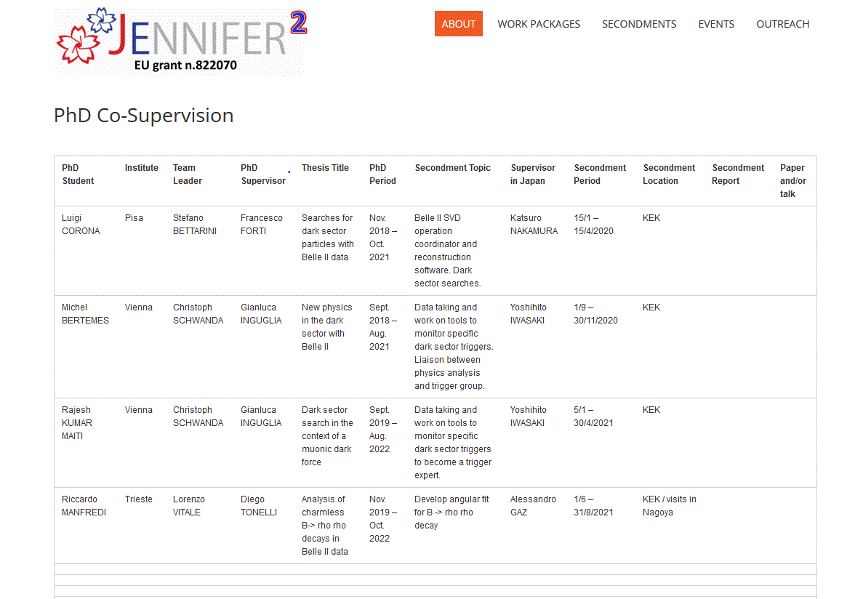

Ended early due to covid19… acknowledgment in thesis
Cancelled due to covid19…
Resuming in 2023-May2025

Slide 31
Extra slides

Slide 32
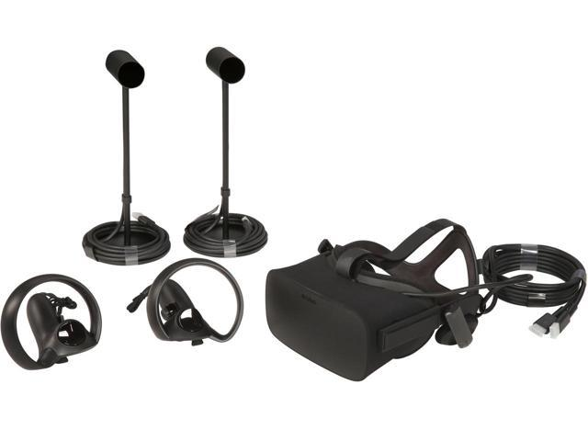
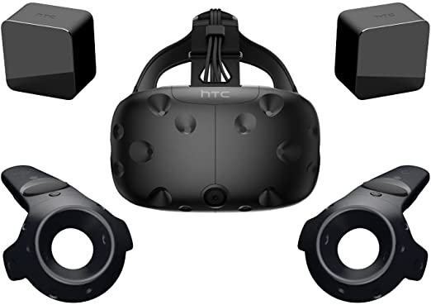
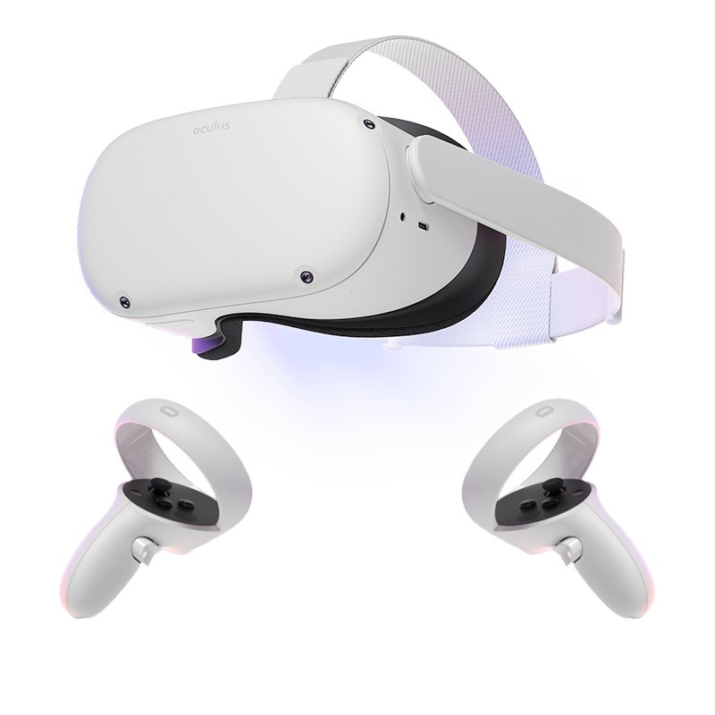
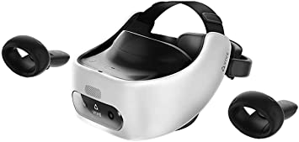
VR system evolution
Old devices needed a special graphical bord to be installed on a PC.
New VR devices are stand-alone, perform better, without PC, and are quite cheap

Slide 33
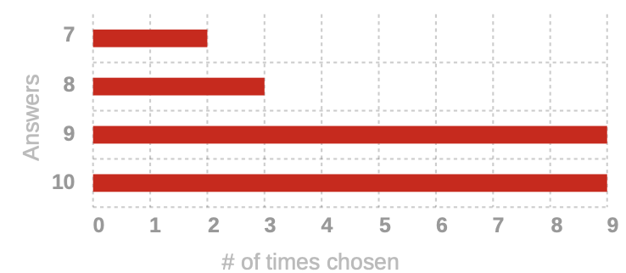
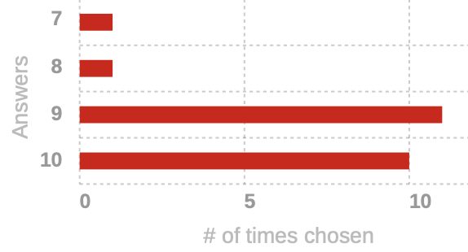
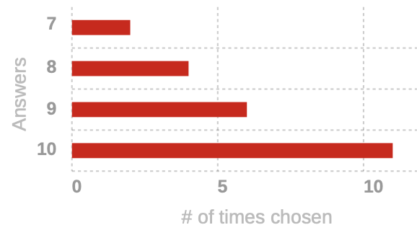
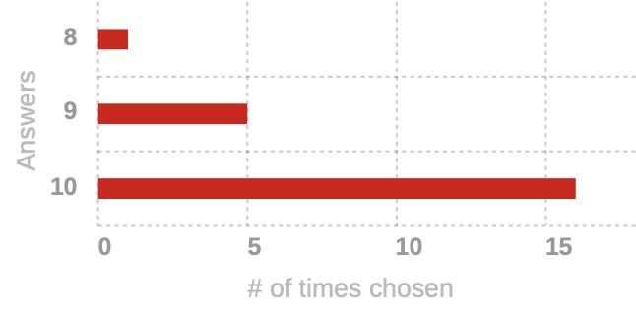
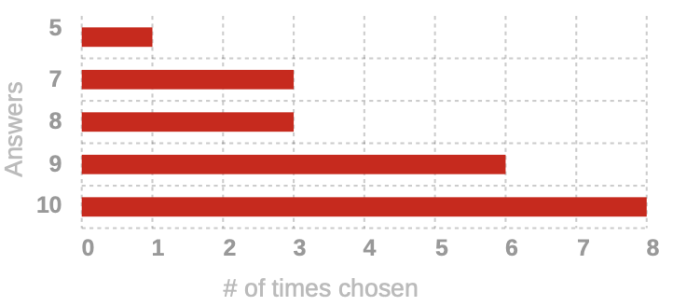
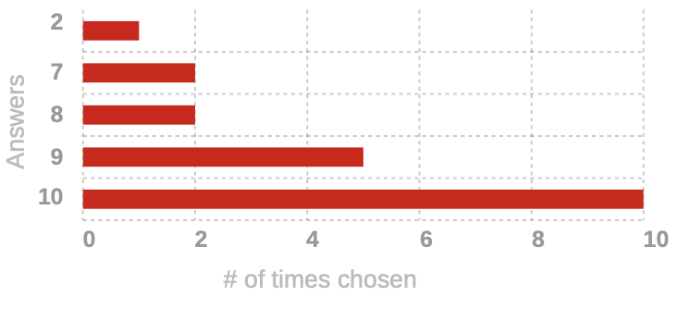
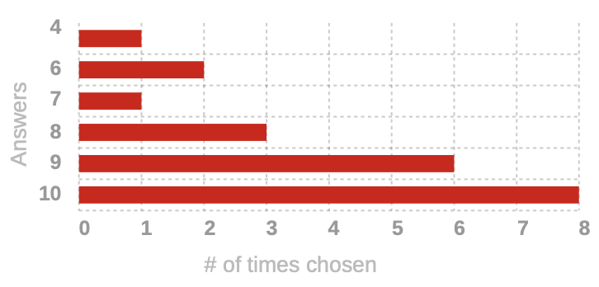
Choice and balance of topics
Lecture schedule
Detector lectures
QFT lectures
Statistics lecture
HF lectures
Neutrino lectures

Slide 34
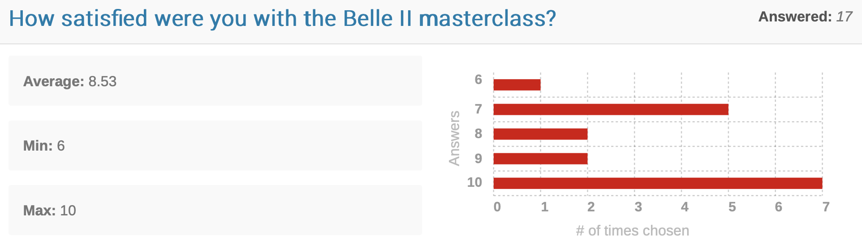
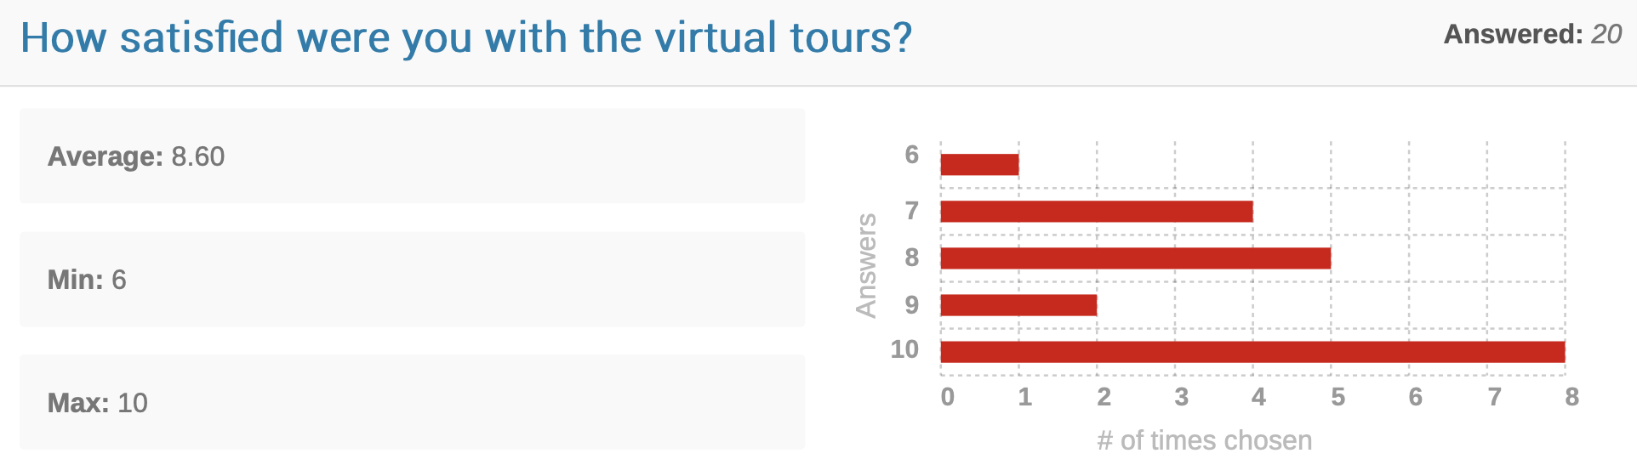

Slide 35
