Slide 1
MANG experiment
Gran Sasso Hands On school 2023
Victoria Bashu, Jiaxuan Cao, Zuke Feng, Matthias Meier, Rachana Yajur

Slide 2
Outline
Introduction of DM and how to detect them
Working principle of MANGO
Analysis method
MANGO-classic results
MANGO-keg results

Slide 3
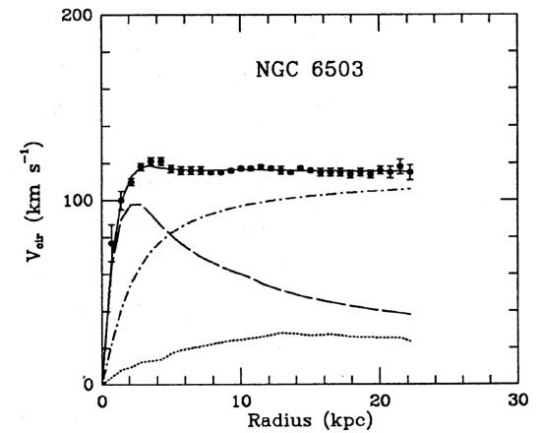
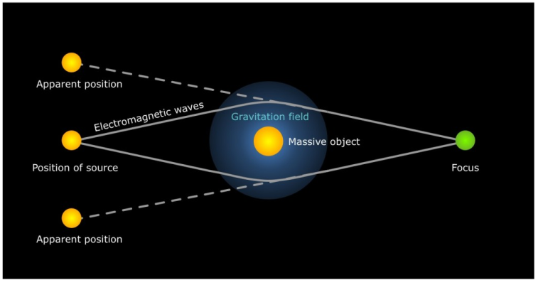
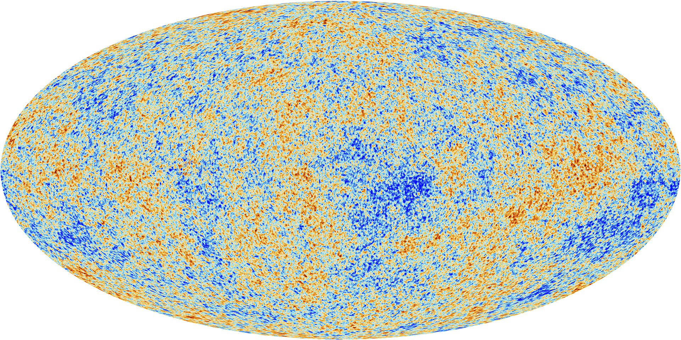
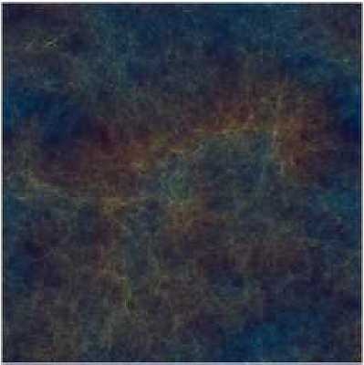
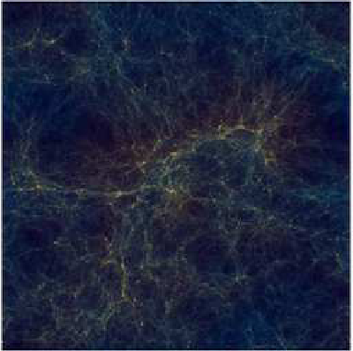
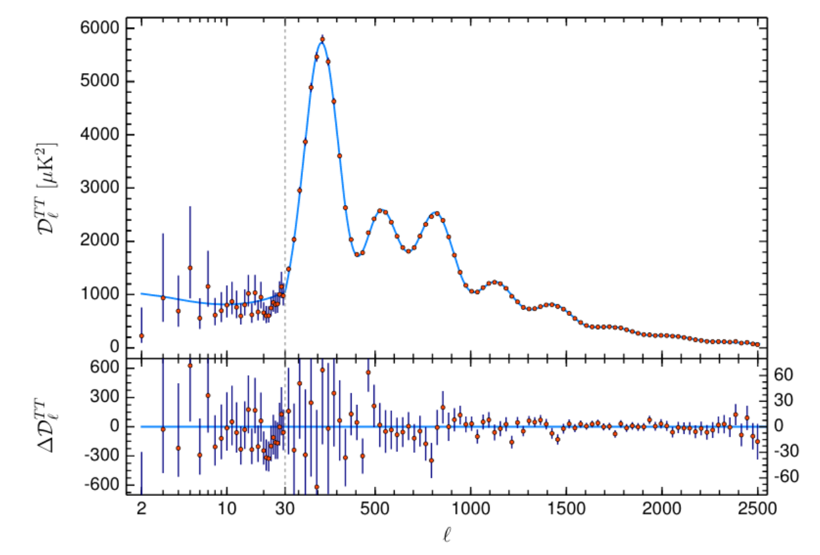
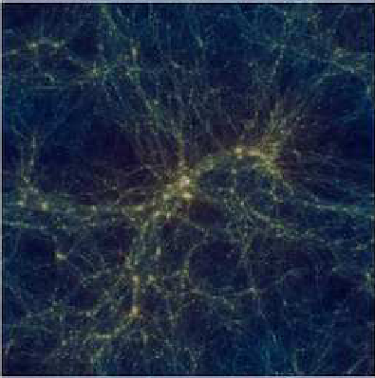
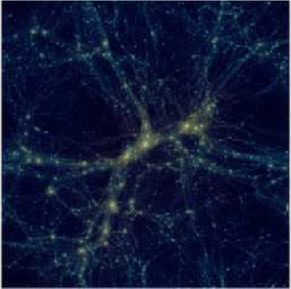
Introduction
Evidence of DM
Galactic rotation curves
Galaxy clusters velocity dispersion
X-ray emission from galaxy clusters
Gravitational lensing
Cosmic microwave background (CMB)
Structure formation

Slide 4
Introduction
Candidates for DM
Modified Newtonian Dynamics
Primordial black holes
Dark matter as a particle
WIMPs(Weakly Interacting Massive Particles)
Axions and ALPs
Sterile neutrinos
Dark sector
Characteristics of DM as a particle
Non baryonic
Abundant
Neutral and colour-free
Weakly interacting
Stable
Warm or cold

Slide 5
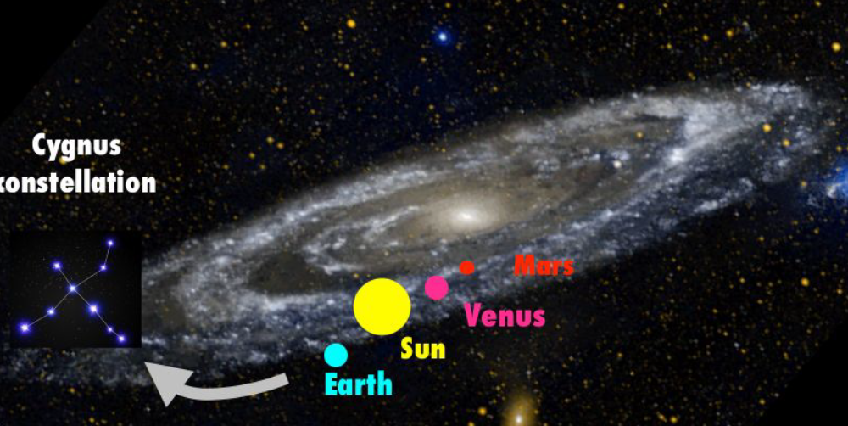
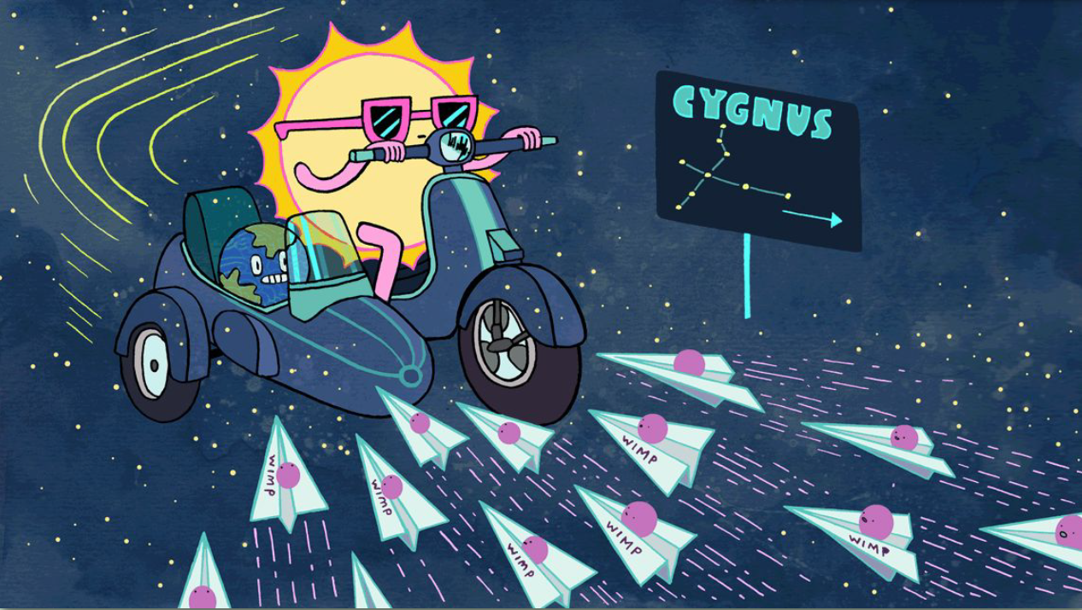
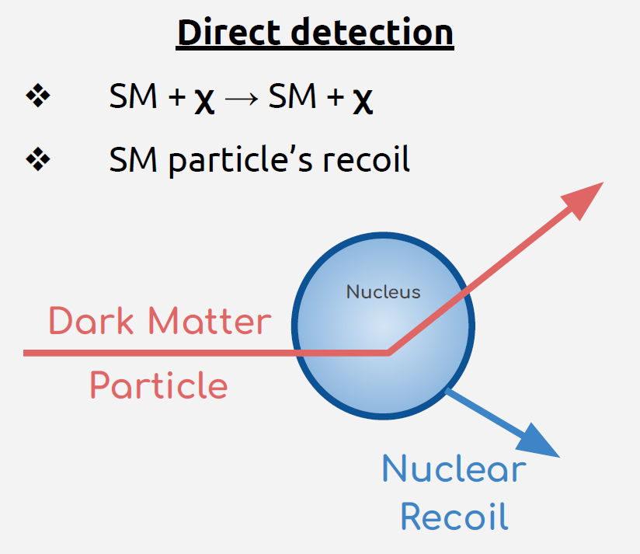
Introduction
Detect WIMPs
DM forms a halo within our galaxy.
Solar system rotates around galaxy towards Cygnus constellation.
Earth susceptible to an apparent WIMPs wind from Cygnus direction!

Slide 6
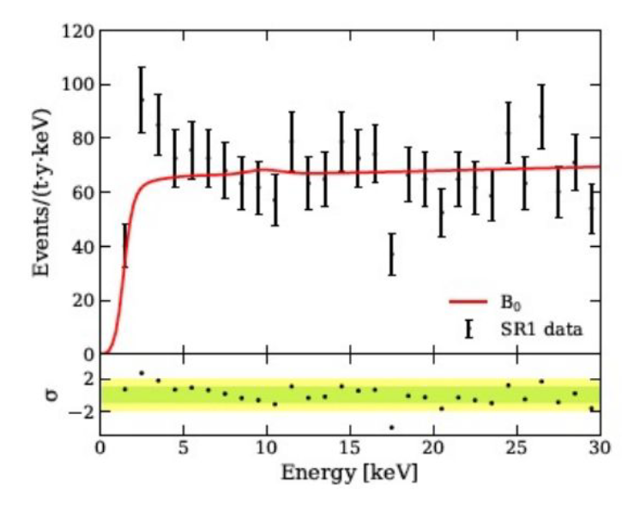
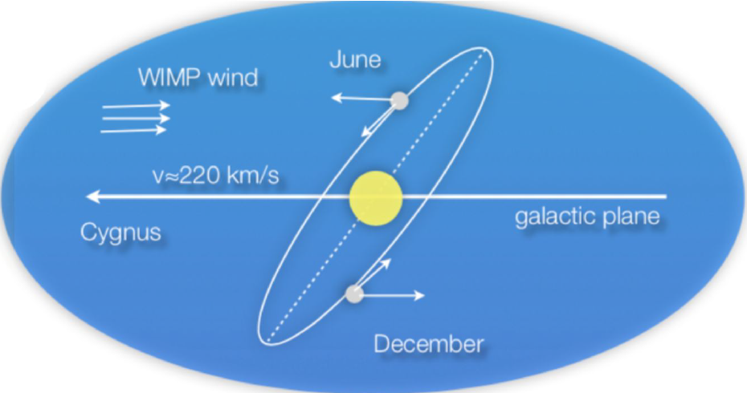
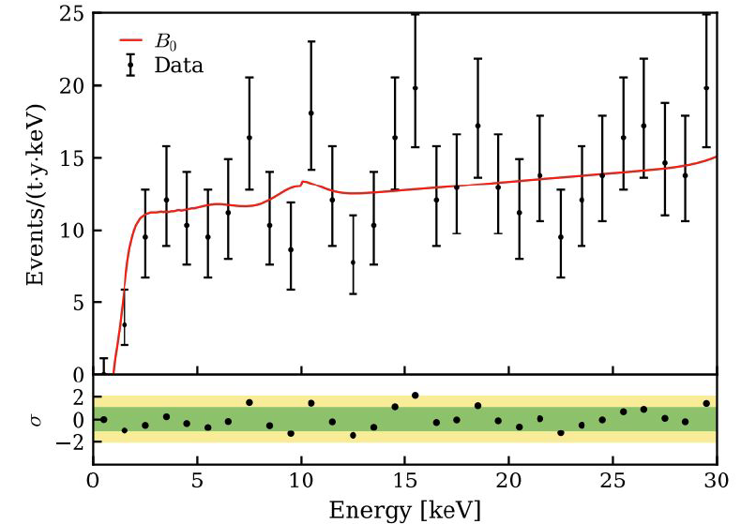
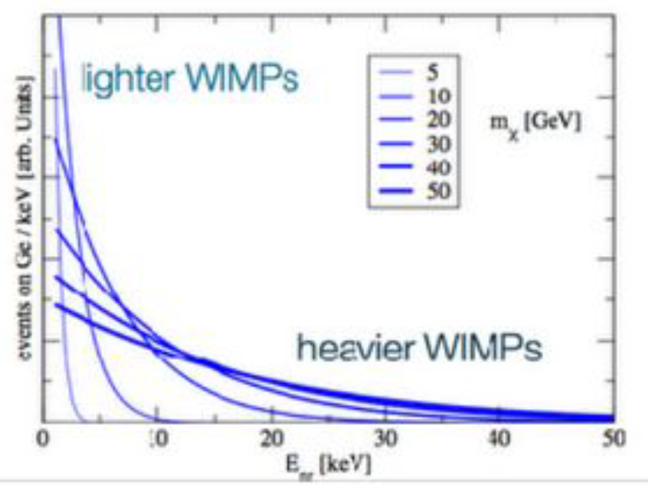
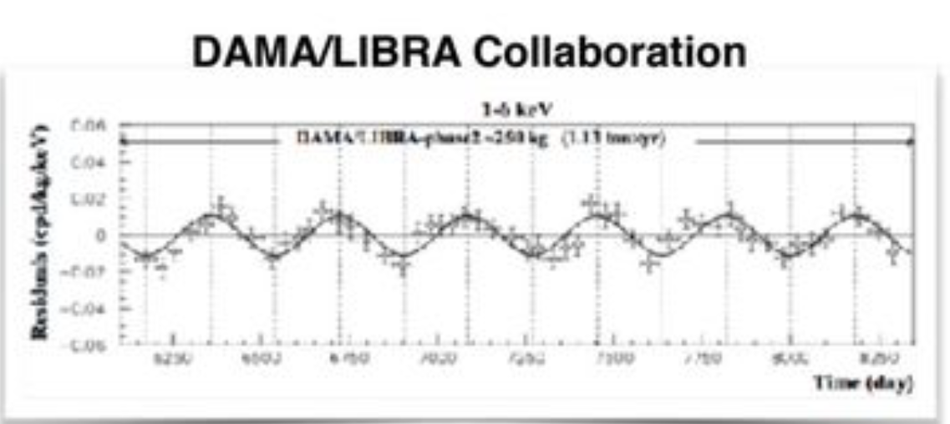
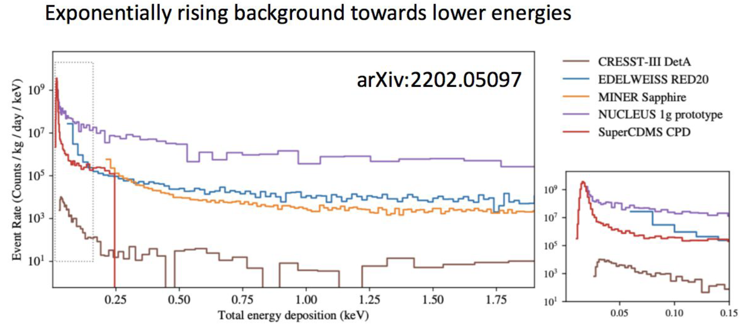
Introduction
2. Exploring the TIME dependency.
Detect WIMPs
1. Exploring the ENERGY dependency.
Results in a falling exponential with no peculiar features. The background has a similar spectrum.
Results in a few % annual
modulation.
Currently limiting the sensitivity globally !

Slide 7
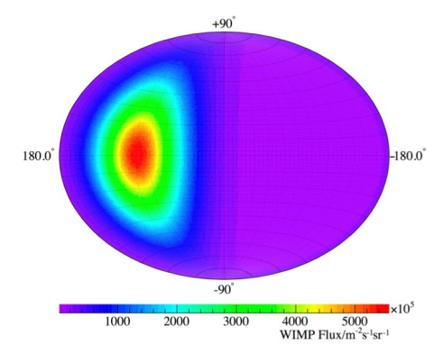
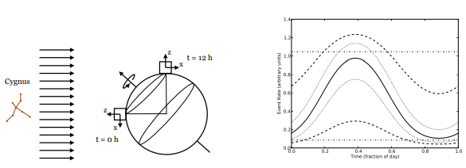
Introduction
2. Exploring the TIME dependency.
3. Exploring the DIRECTION dependency
Detect WIMPs
1. Exploring the ENERGY dependency.

Slide 8
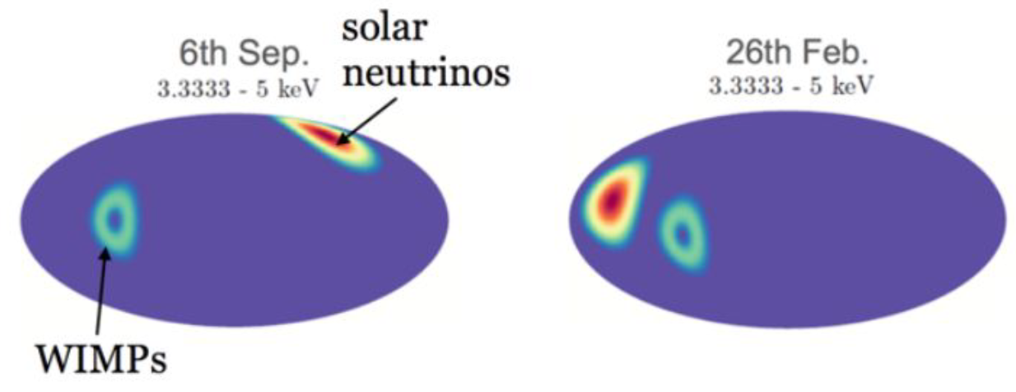
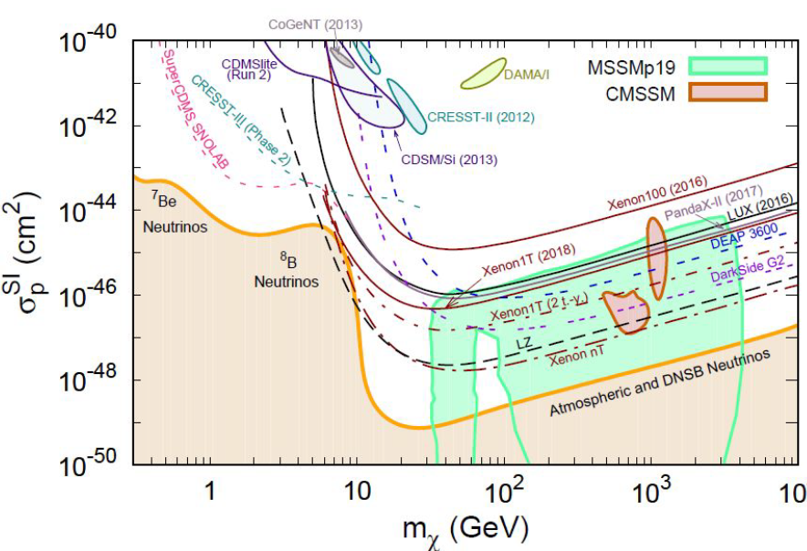
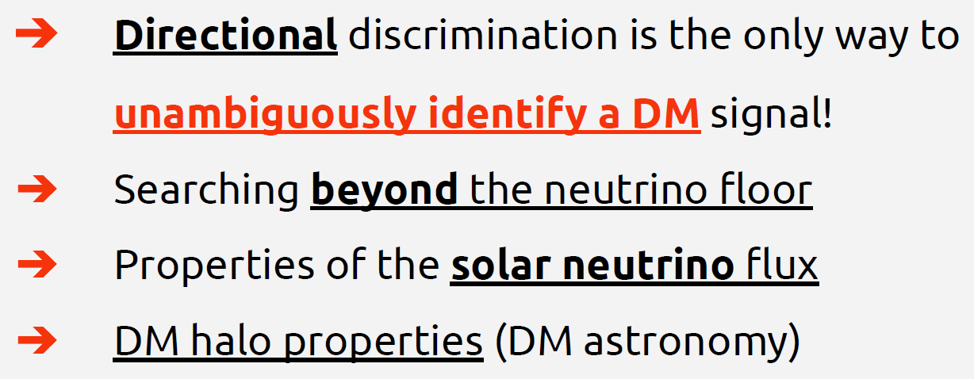
Introduction
Detect WIMPs
The coherent elastic neutrino-nucleus scattering (CE𝞶NS) produces NRs identical to the DM-induced ones.

Slide 9
Outline
Introduction of DM
Working principle of MANGO
Analysis method
MANGO-classic results
MANGO-keg results

Slide 10
Working principle of MANGO
Multipurpose Apparatus for Negative ions studies with GEM Optically readout
One of the prototypes of CYGNO
So, let’s begin with the CYGNO……

Slide 11
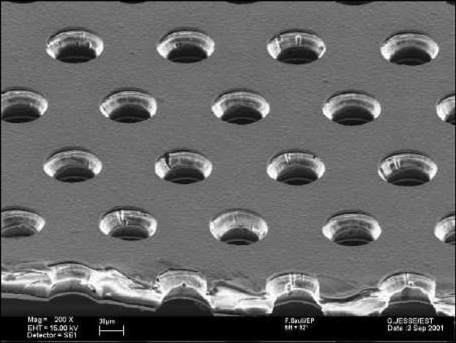
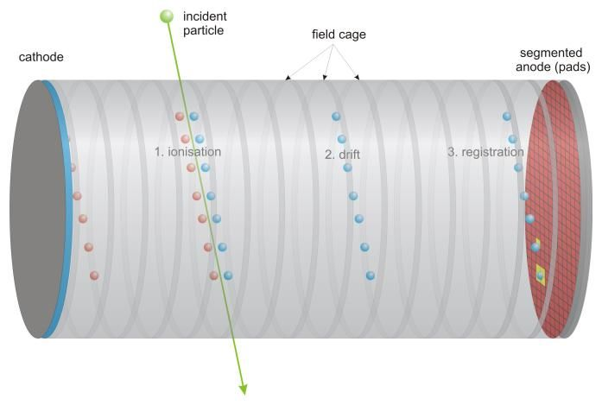
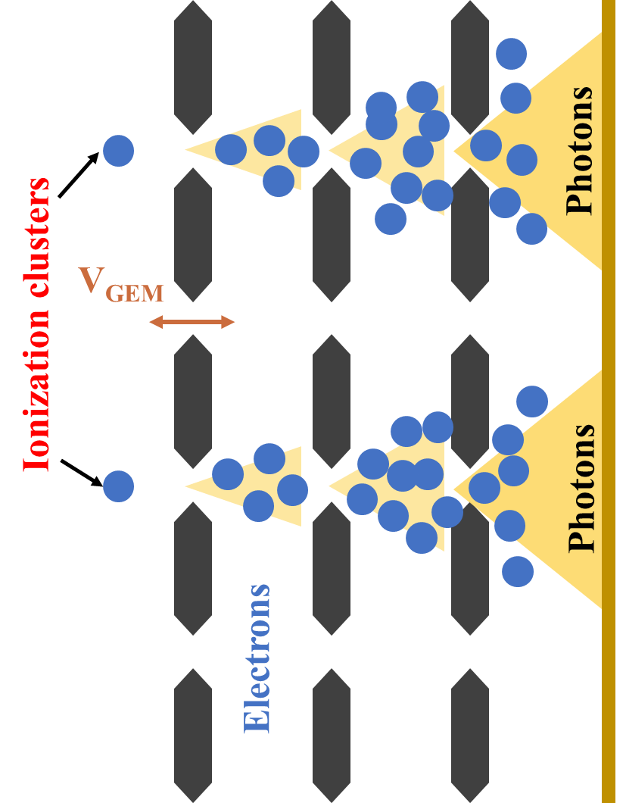
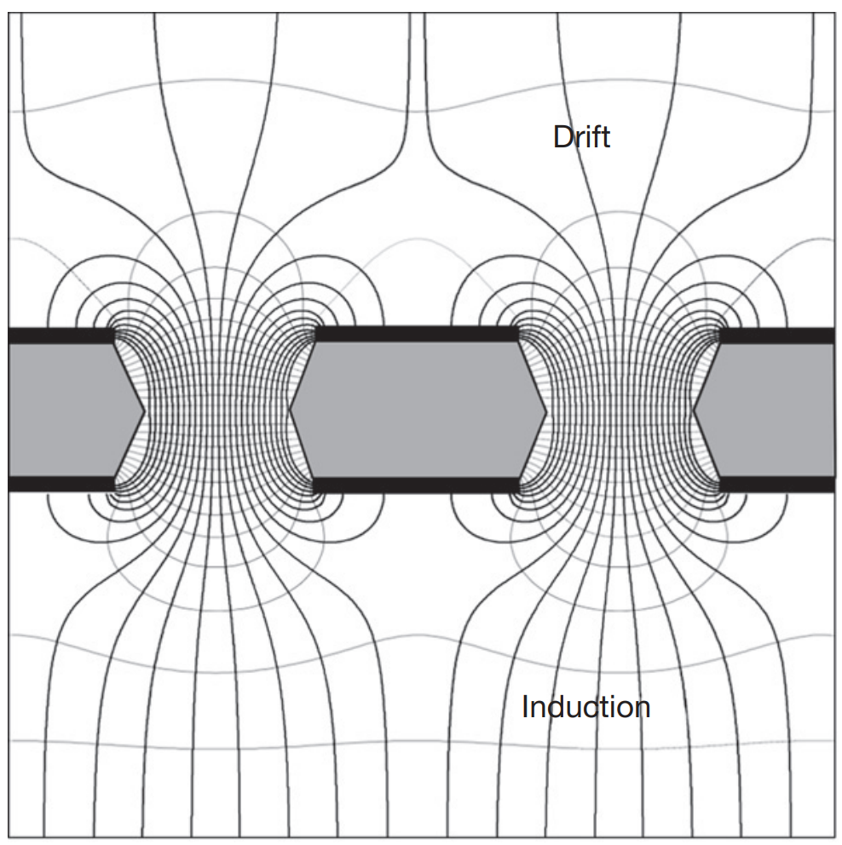
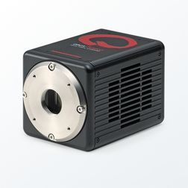
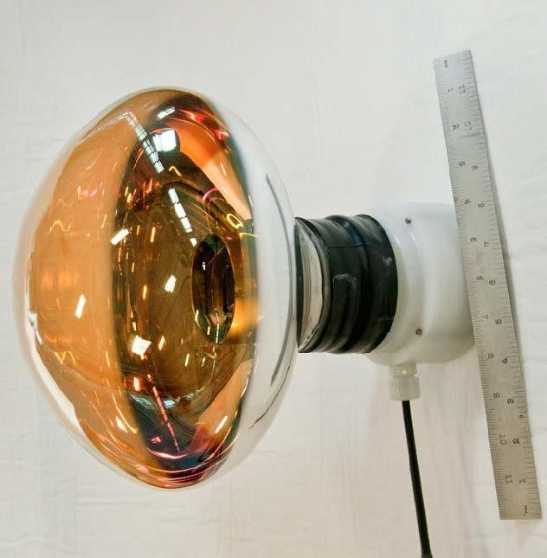
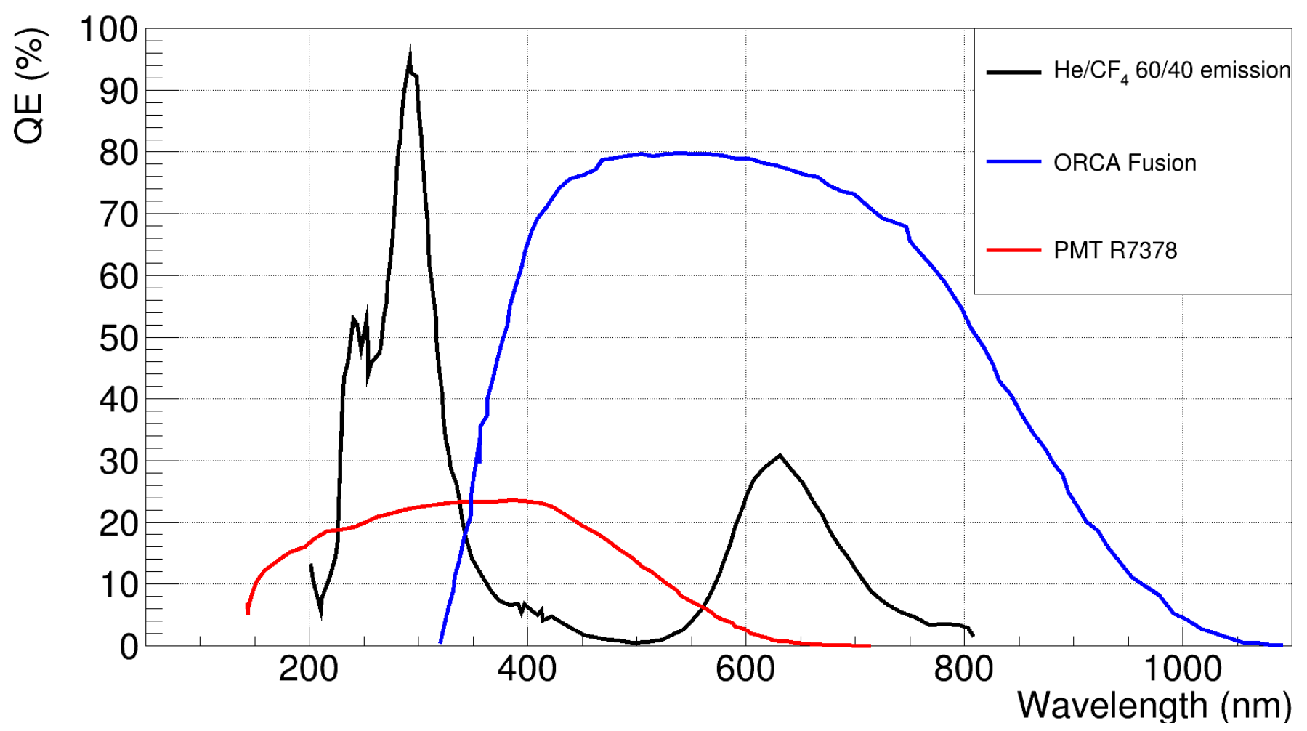
The CYGNO Concept
GEMs (Gas Electron Multipliers)
Large charge amplification
low energy thresholds
High granularity
Time Projection Chamber
GEMs
Camera and PMT
High fields in holes
Avalanches
Electric field around 1 kV/cm
prevents recombination
drifts ions and electrons to cathode & anode
scintillating properties are optimal for the optical readout

Slide 12
The CYGNO Concept
Time Projection Chamber
GEMs
Camera and PMT
High granularity of sCOMS
Measure the x & y coordinates and energy of the cluster track
Fast readout of PMT
Measure the times of arrival
Get the z coordinate
3D Reconstruction
For Hands-on, PMTs are not used

Slide 13
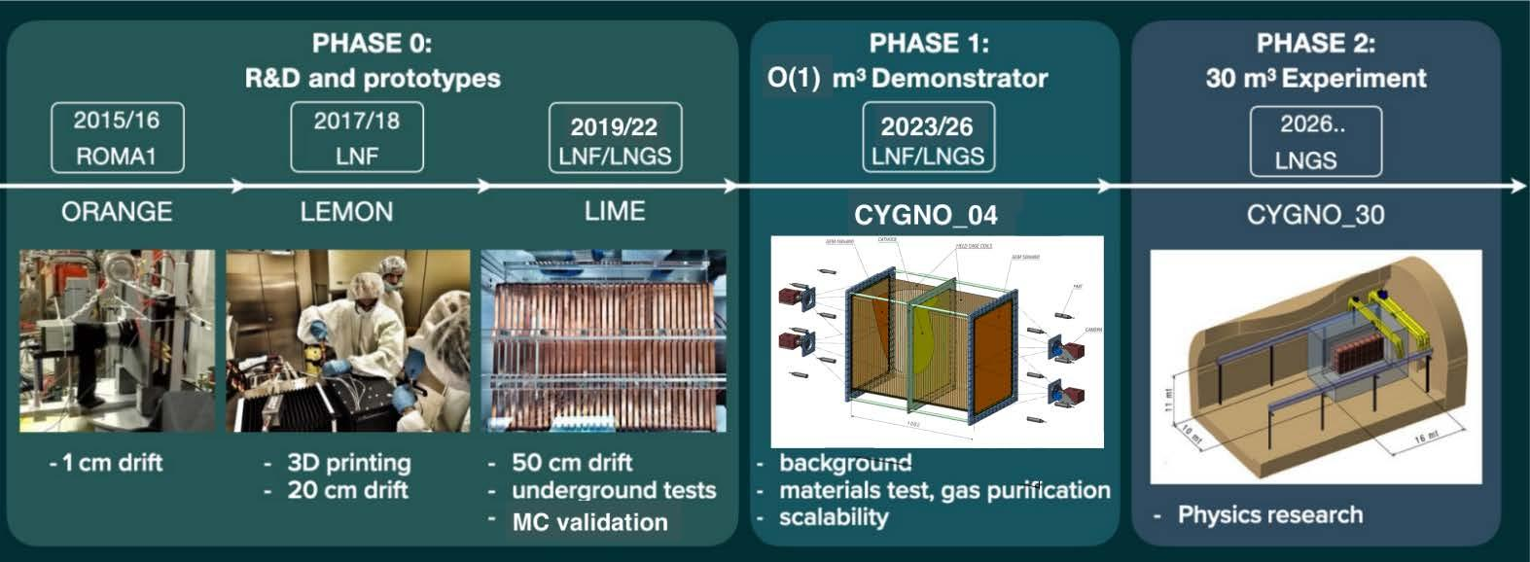
Roadmap of CYGNO

Slide 14
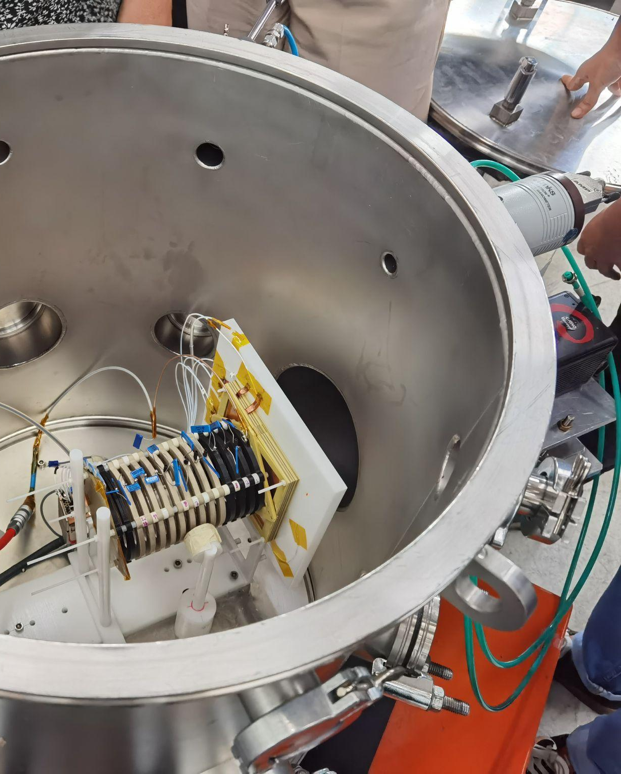
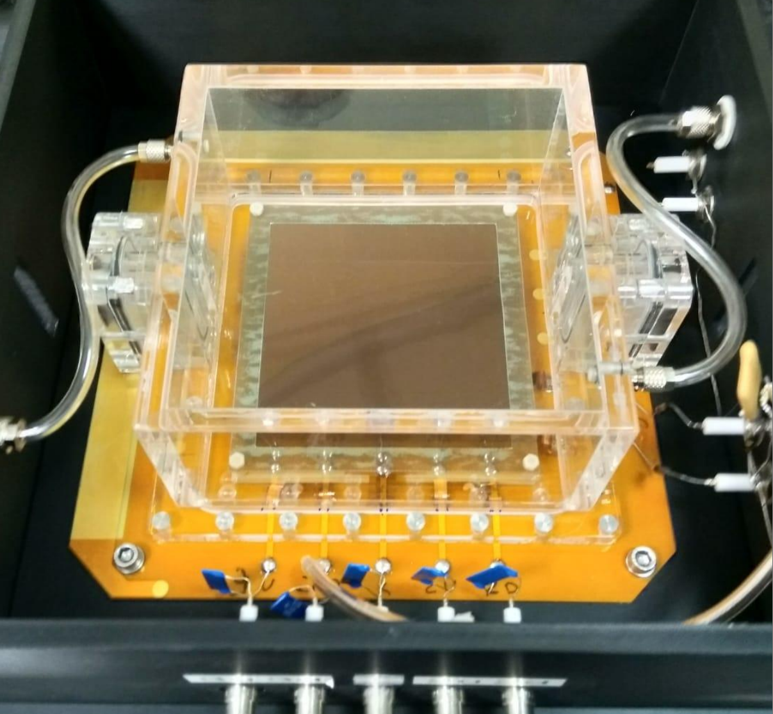
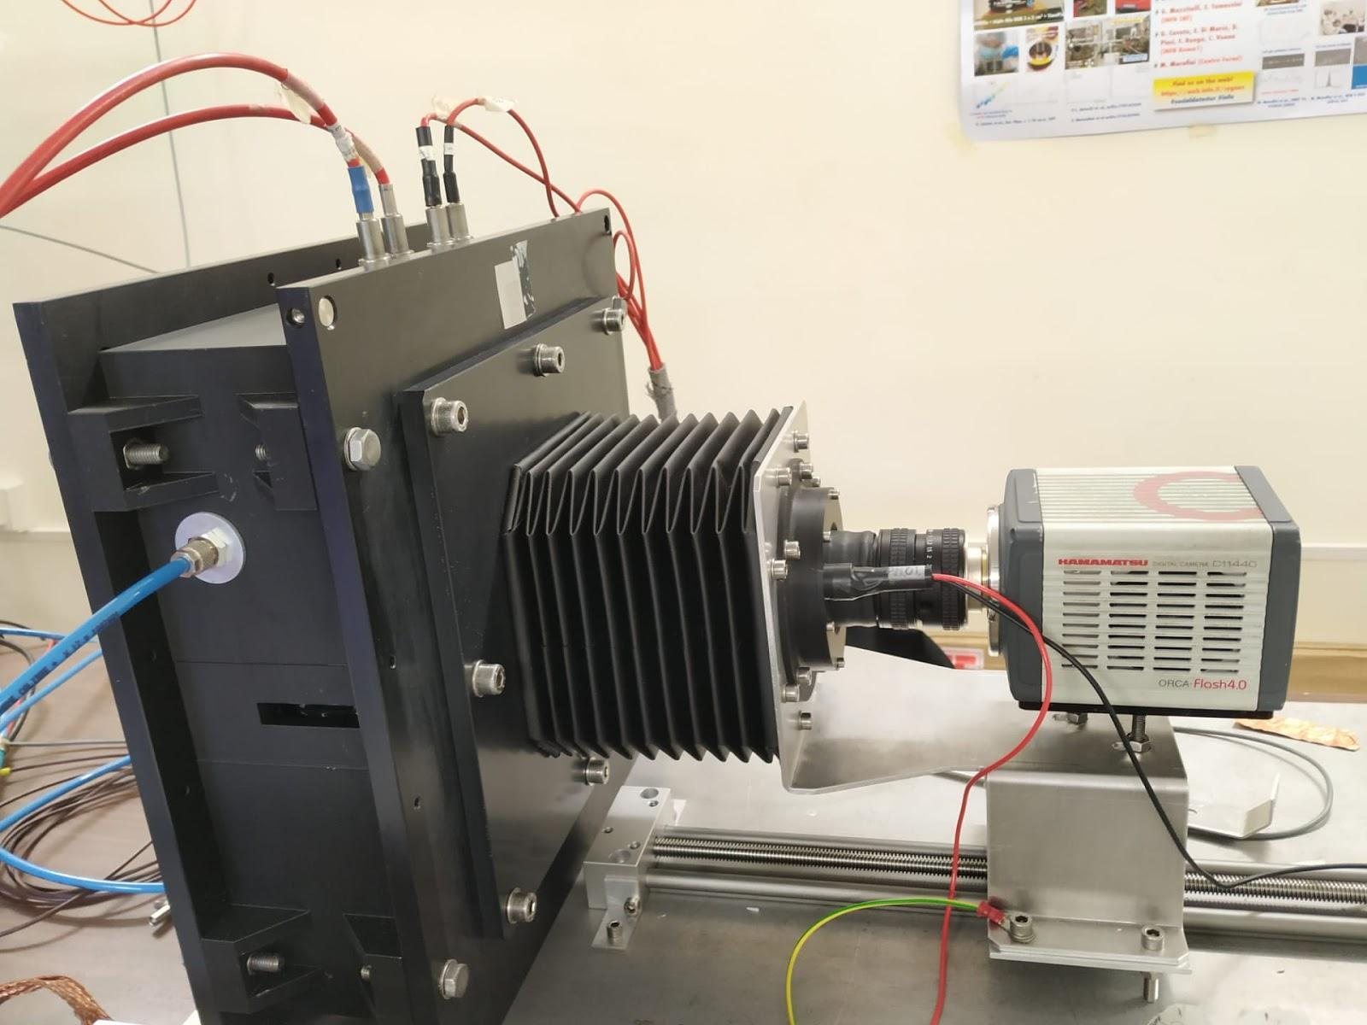
MANGO-Classic & MANGO-Keg
GEMs
&
ITO
TPC
Camera
Cathode
MANGO-Classic
MANGO-Keg

Slide 15
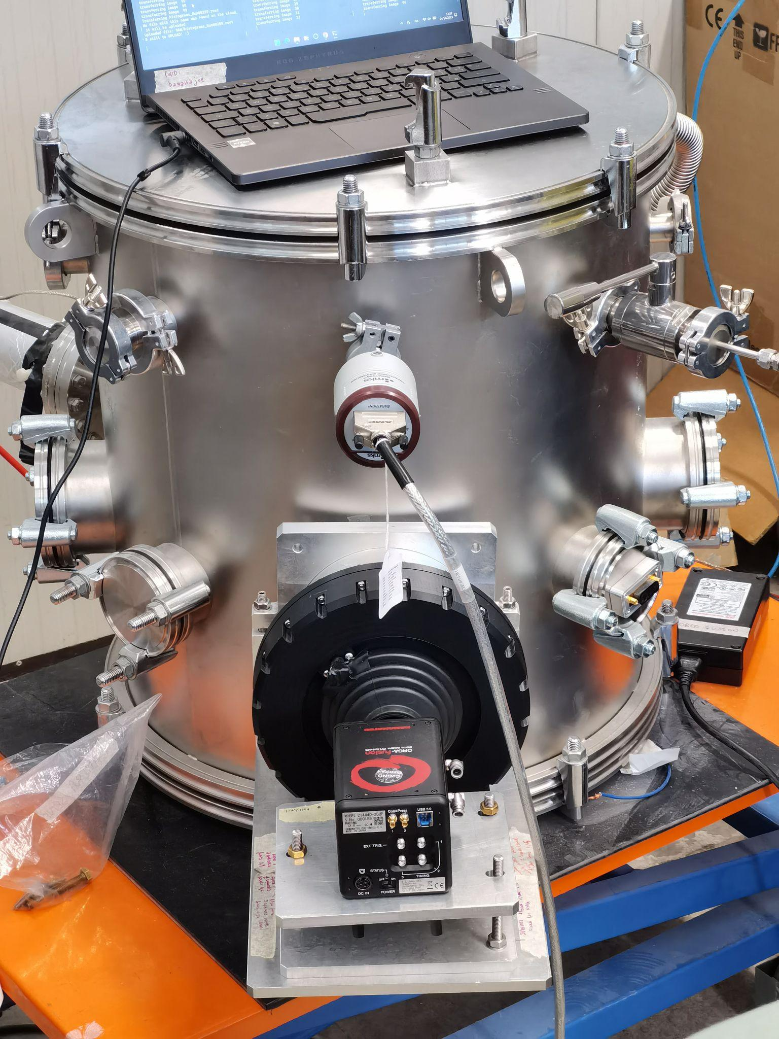
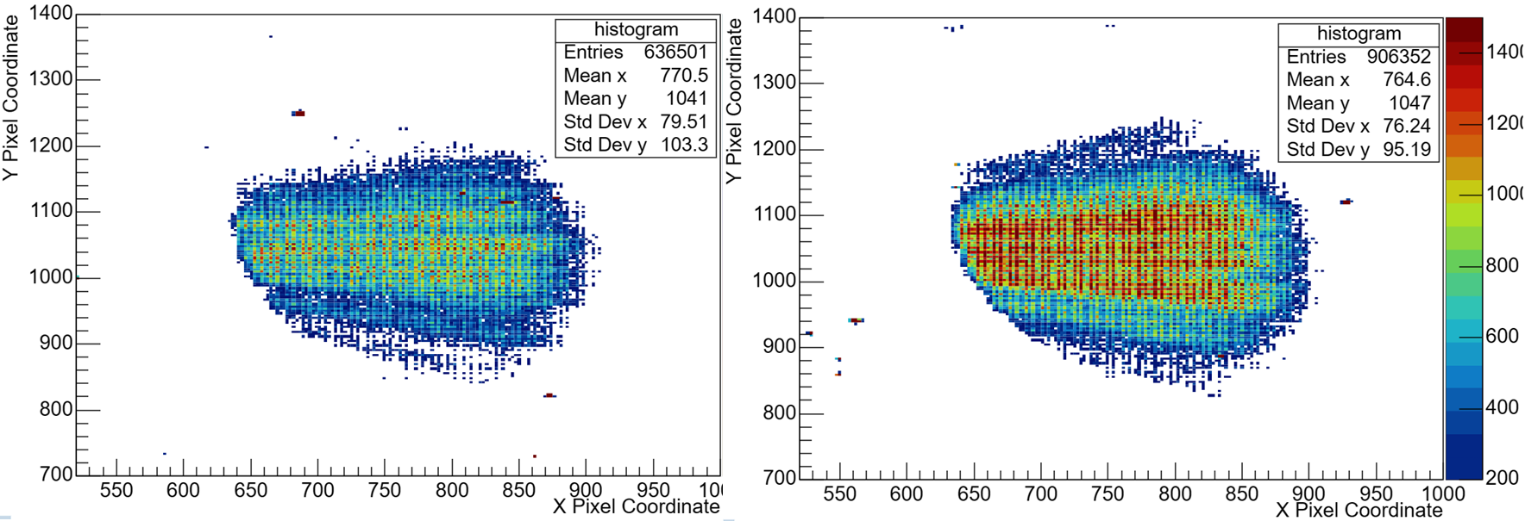
Electroluminescence on MANGO-keg
Electric field after the last GEM
Electrons are accelerated only up to the gas excitation threshold
Without charge amplification
Higher SNR without worsening of ΔE
ITO voltage off
ITO voltage on
MANGO-Keg
α shower from Am241 source
https://arxiv.org/pdf/2004.10493.pdf

Slide 16
What we have done with MANGO
MANGO-Classic
GEM voltage scan
Camera performance comparison

Slide 17
What we have done with MANGO
Source position change
Investigate the diffusion and saturation influenced by the position of incident particle
GEM voltage scan
ITO voltage scan
MANGO-Keg

Slide 18
Outline
Introduction of DM
Working principle of MANGO
Analysis method
MANGO-classic results
MANGO-keg results

Slide 19
Analysis
Characterize the noise in individual pixels
Identify tracks (clusters) and their pixel intensities
Store necessary parameters to analyze the data
Sample image with Fe55 source

Slide 20
Analysis
Pedestal images taken with GEMS voltage = 200 V for each configuration of the camera
Average pedestal value of each pixel was calculated. This gives us the average inherent noise in each pixel
The average pedestal is subtracted from the data images
Reconstruction of images – identifying super clusters
Applying selection cuts to the the reconstructed tracks

Slide 21
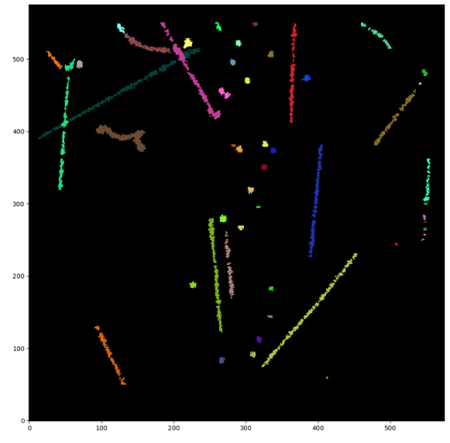
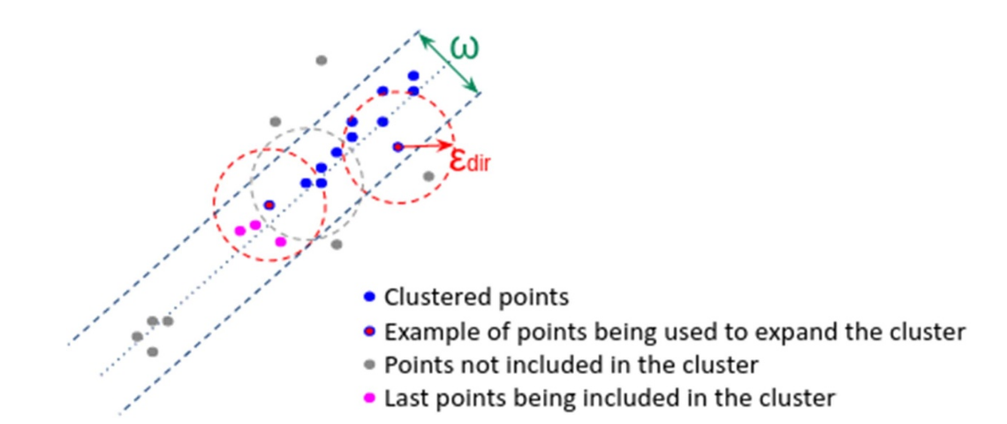
Reconstruction
DBScan clustering algorithm
“Super clusters” are selected
Cluster parameters such as the pixel coordinates, cluster integral, length, width etc. are stored
Highly depended on noise treatment
F D Amaro et al 2023

Slide 22
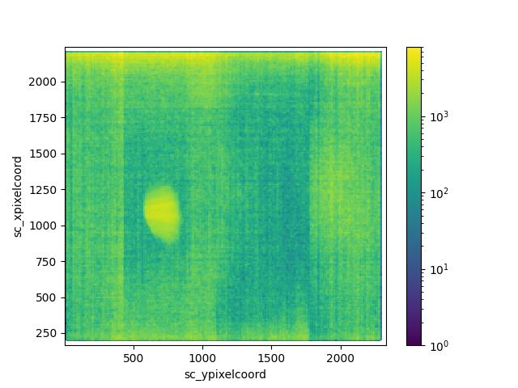
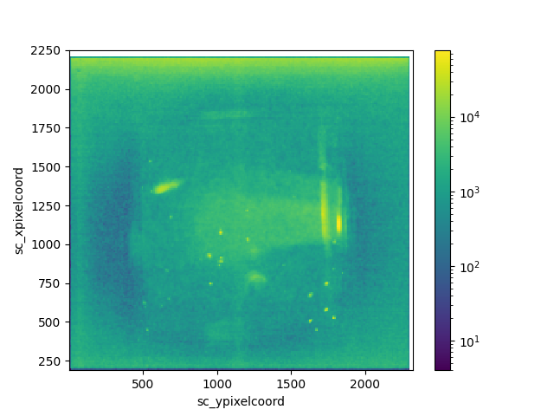
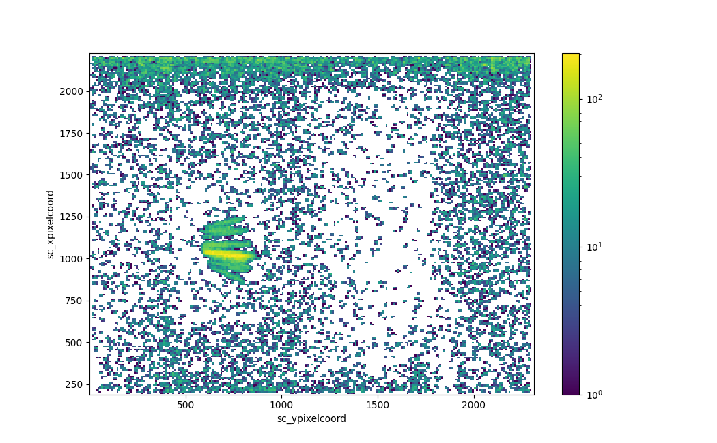
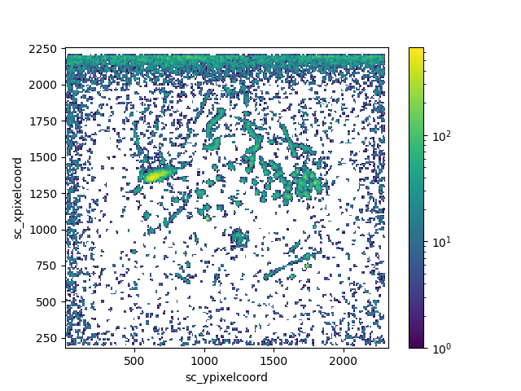
Cuts
Mango keg
Mango classic
α ➡
⬅ γ

Slide 23
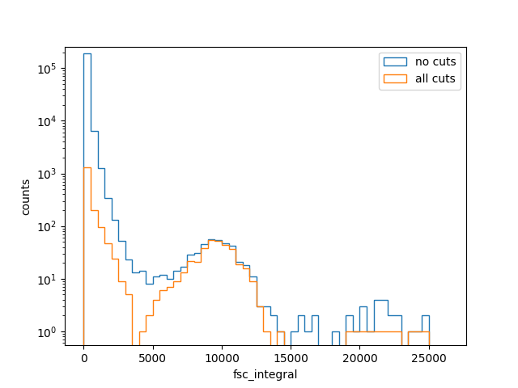
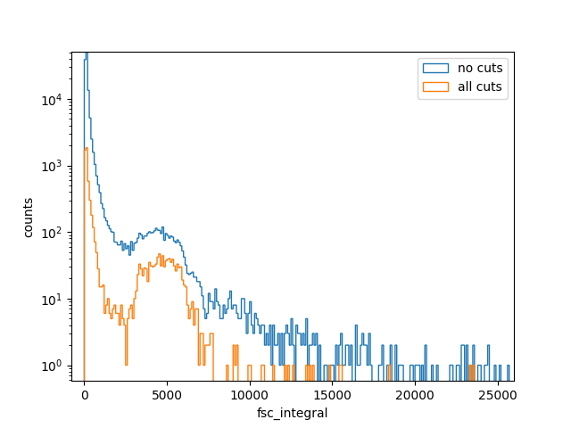
Cuts
Mango Keg
0.152 * Sc_tgaussiansigma > 0.3
Alpha → sc_width/sc_length < 0.3
650 < sc_xpixelcoord < 1400
480 < sc_ypixelcoord < 1407
Mango Classic
Sc_rms > 6
⁵⁵Fe → sc_width/sc_length > 0.8
613 < sc_xpixelcoord < 1950
478 < sc_ypixelcoord < 1885

Slide 24
Outline
Introduction of DM
Working principle of MANGO
Analysis method
MANGO-classic results
MANGO-keg results

Slide 25
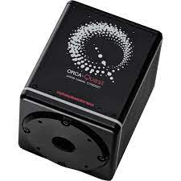
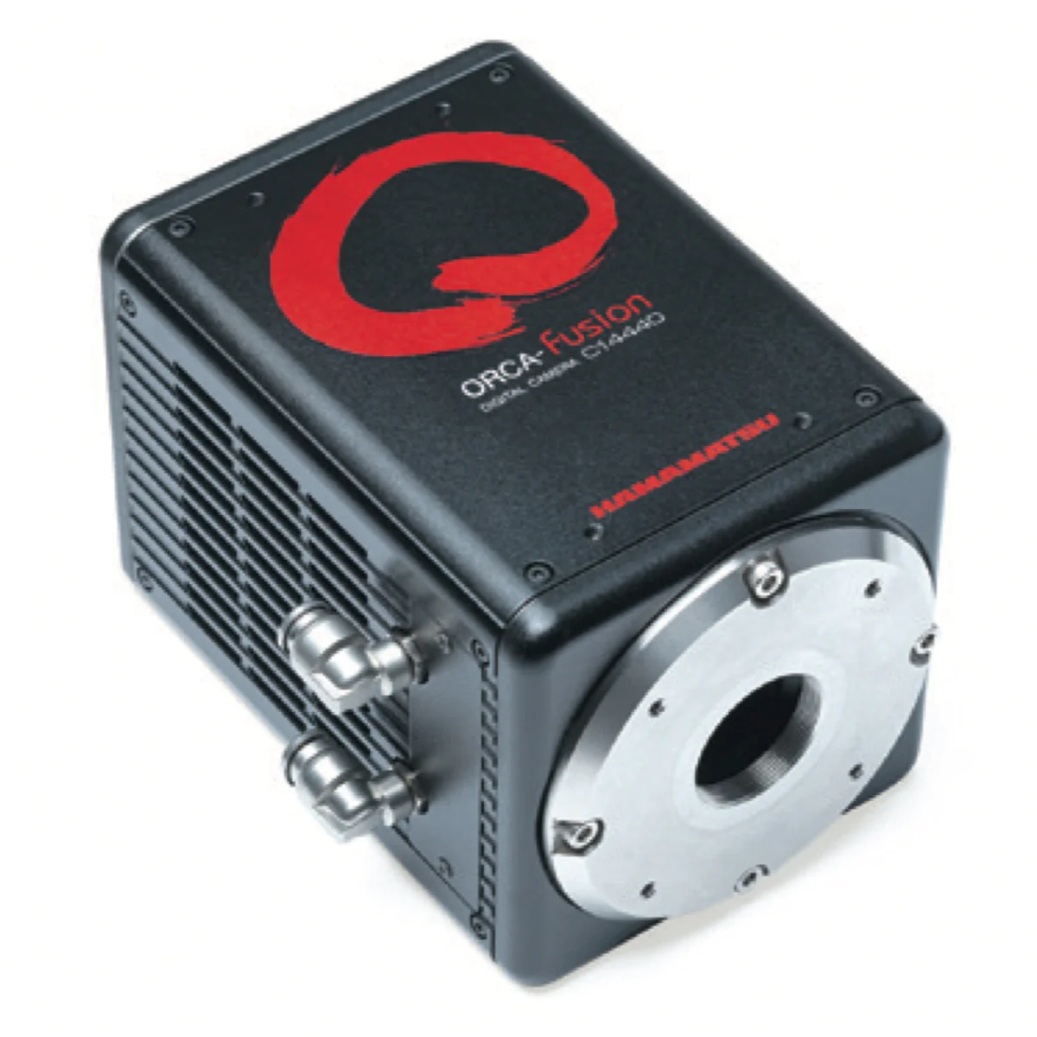
Mango classic - results
6 keV
Camera comparison
Fe55 (𝛾, ~6keV)
µ
vs.
~40 keV
ORCA Quest
ORCA Fusion

Slide 26
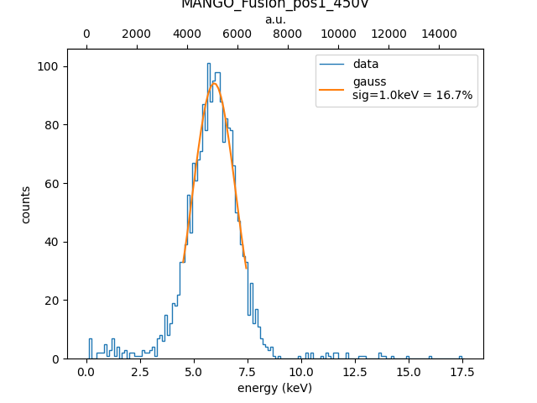
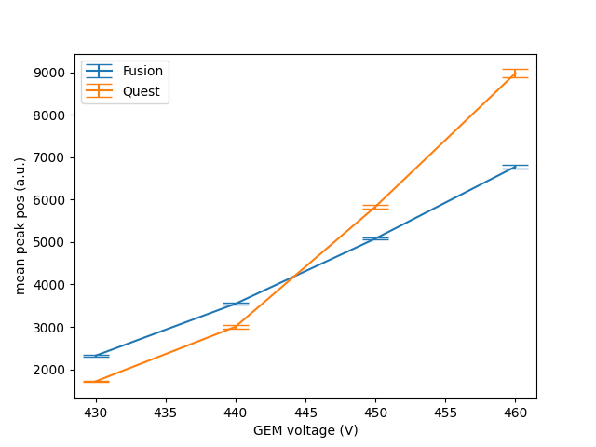
Mango classic - results

Slide 27
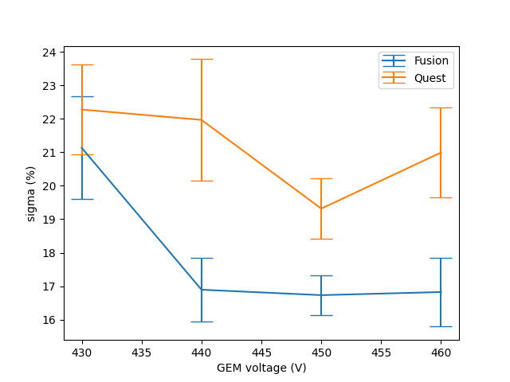
Mango classic - results

Slide 28
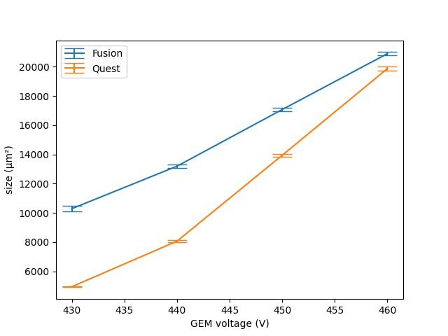
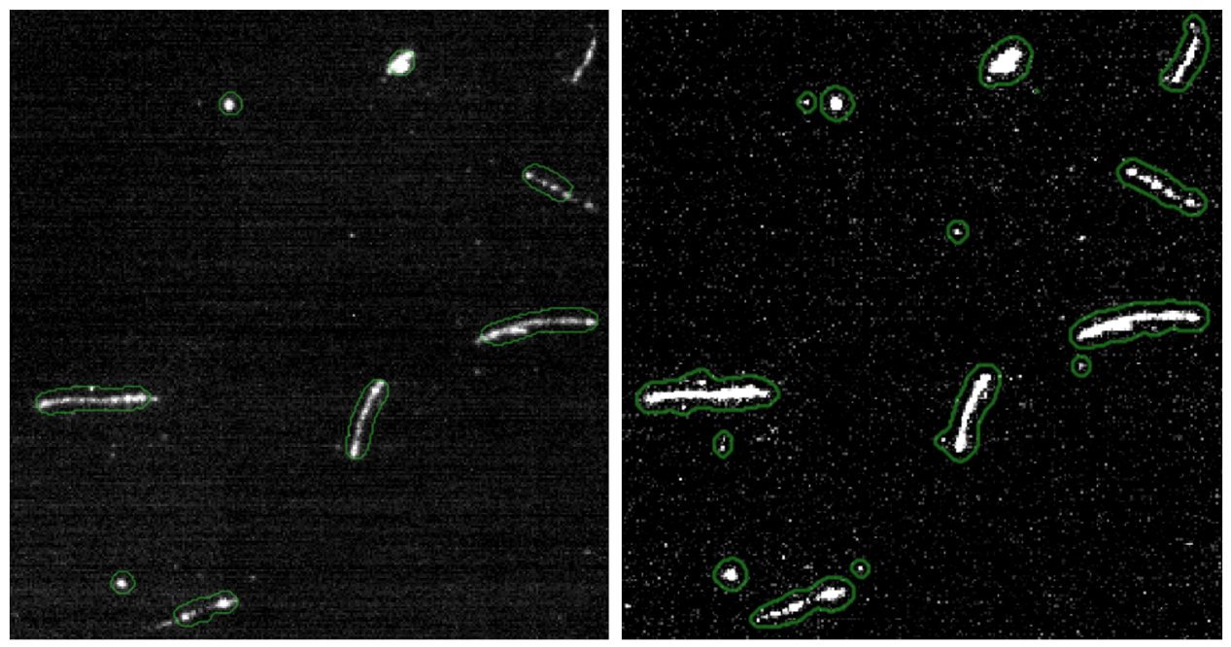
Mango classic - results
Geodesic Active Contour
Chan-Vese
PhD thesis, Giorgio Dho, Optimisation of amplication and gas mixture for directional Dark Matter searches with the CYGNO/INITIUM project, 2023

Slide 29
Camera characteristics
www.hamamatsu.com, ORCA-QUEST qCMOS ® camera C15550-20UP, 2023

Slide 30
Conclusion - Camera comparison
Better camera -> less noise
Optimized noise treatment for clustering algorithm necessary

Slide 31
Outline
Introduction of DM
Working principle of MANGO
Analysis method
MANGO-classic results
MANGO-keg results

Slide 32
Mango Keg Results

Slide 33
Position vs gain

Slide 34
Amplification

Slide 35
55Fe (𝛾, ~6keV)
241Am (α, ~5.8MeV)
Amplification
https://arxiv.org/pdf/2004.10493.pdf

Slide 36
Conclusions (MANGO KEG)
Light luminescence ✅
Position (need balance)

Slide 37
Thank you
Hands on school 2023 group 💛
Mango group

Slide 38
Backup Slides

Slide 39
Perhaps some pics if needed

