Slide 1
Modes of interest
AMS-02 Upgrade

Slide 2
Agenda
Distributed Masses
Shells
Shared Topology and its Meshing Issues
Work Around
Set Up

Slide 3
Distributed Masses

Slide 4
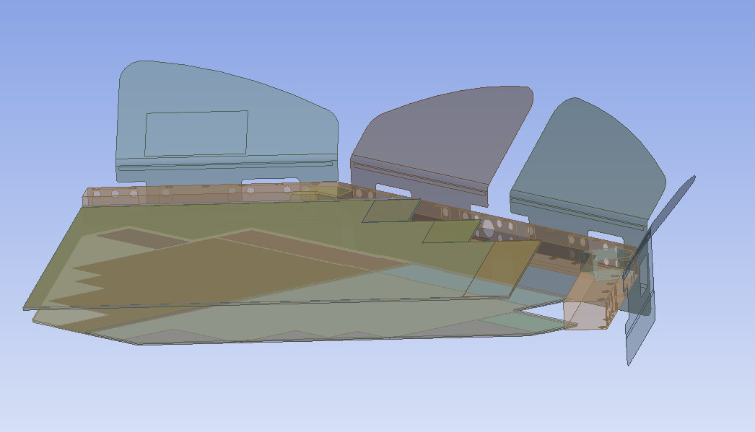
Shells
Question: Simulating with shells only at the moment
Equivalent modules approach with shells valid since we have sandwich structure,
So it is not valid for Octoframe and its fixation? Yes its okay
QLCS Units
Octoframe with Reinforcement
Radiators (but won’t be simulated)

Slide 5
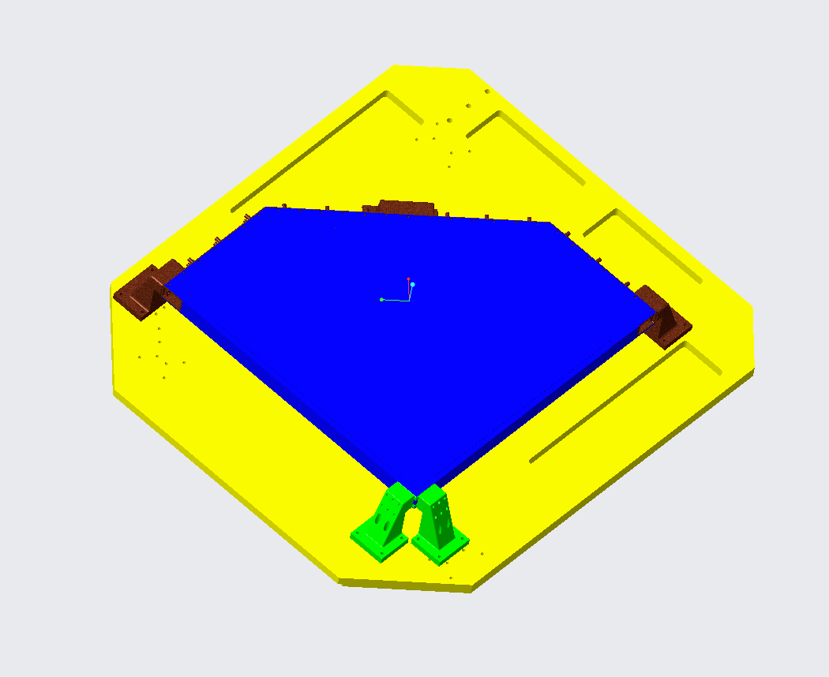
Shared Topology
Shared Topology assumes that all the selected bodies are bonded which gives them more stiffness than that they actually have
So I thought to divide it in this way:
Total Octoframe (brown)
Outer Feet Fixation (green)
Sandwich Unit (Blue)
Shaker Plate
But …

Slide 6
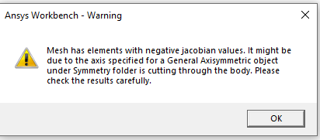
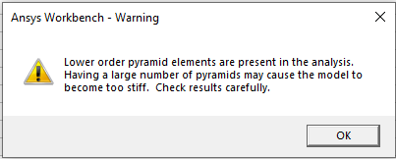
Meshing Issues
Using a shared topology prevents me often of using an hexaeder mesh due to imprinted surfaces
What I tried to do: Slice Geometry , Decrease the Element Size
Multizone (better Element Quality than Sweep) ➔ Hexdominant Mesh (really bad Element Quality) ➔ Tetraheader
Problem: too much low order pyramid elements and negative jacobian values
My maximum at the moment is at 5%
When I decrease the element size of the critical elements even an hexdominant mesh is not possible
I am trying to simplify the geometry more and more to be able to do a Hex-Multizone / prevent negative jacobian values

Slide 7
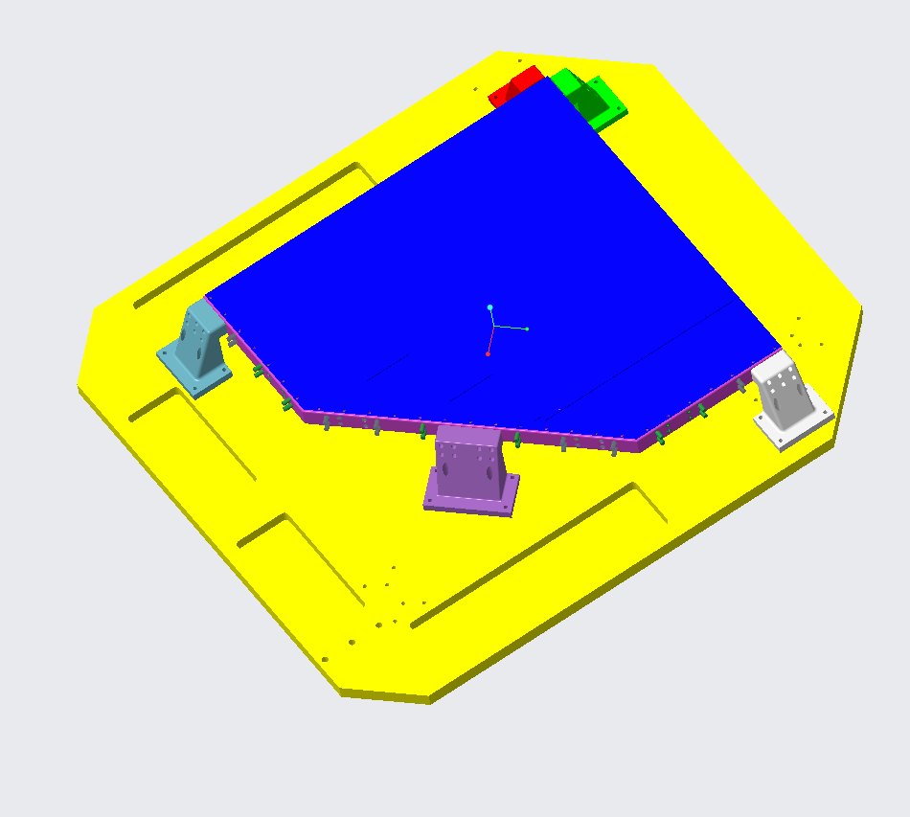
Work arounds
Simplifying the geometry more
Using more shells (Mechanical Structure, New Feet Fixation, Octoframe fixation)
Not using the Shared Topology option but only the bonded contacts
➔ Shared Topology Option only on specific Parts (smaller ones)
➔ Otherwised merge nodes of contacts via «Mesh Editor» for rest (besides solid body-shell contacts where it is unfortunatelz not working
Parts | Shared Topology | Quantity
Shakerplate | ✘ | 1
Foot | ✘ | 5
Feet Fixation | ✘ | 1
QLCS + Sandwich | ✓ | 1
Octoframe Fixations | ✘ | 11
Octoframe + Reinforcements | ✓ | 1

Slide 8
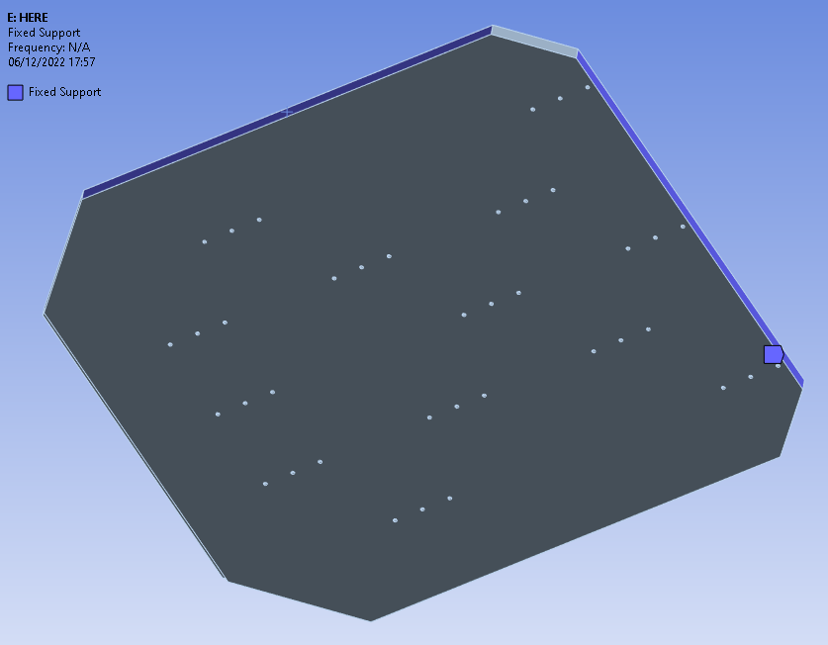
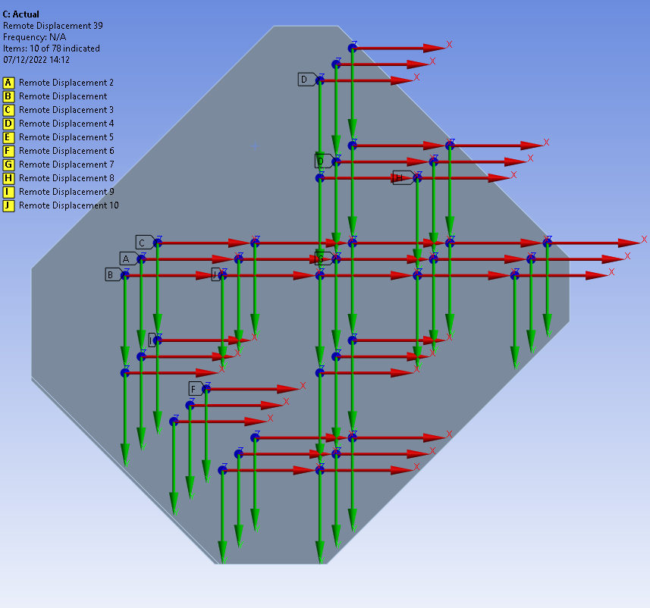
Fixation – Remote Displacement
Lateral Fixed Support of the Plate
Remote Displacement via rigid Remote Points in z/z-rot
Notes:
Simply supported approach on the bottom (Remote displacement on bottom surface just 1 fixed support! Depends on in which excitation

Slide 9
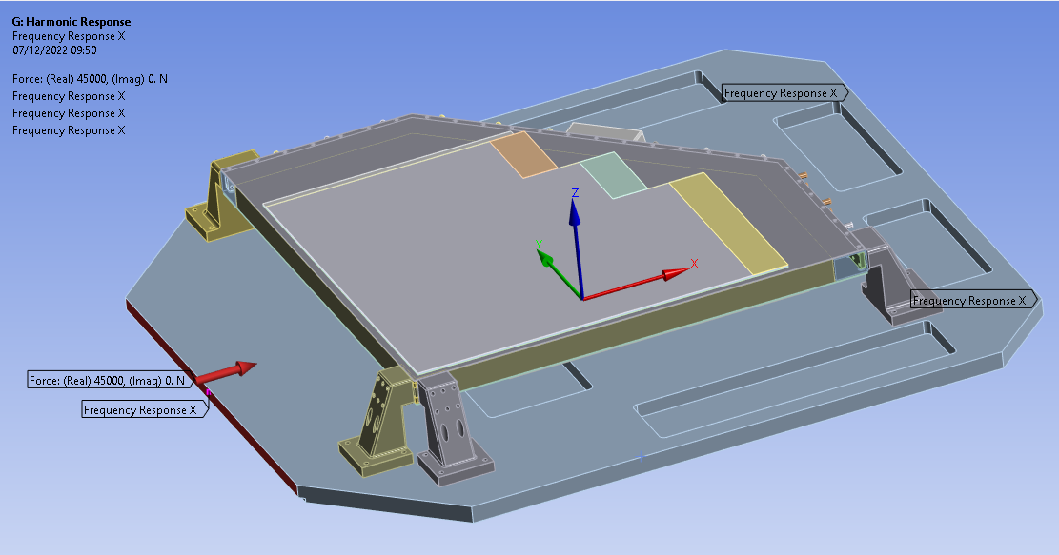
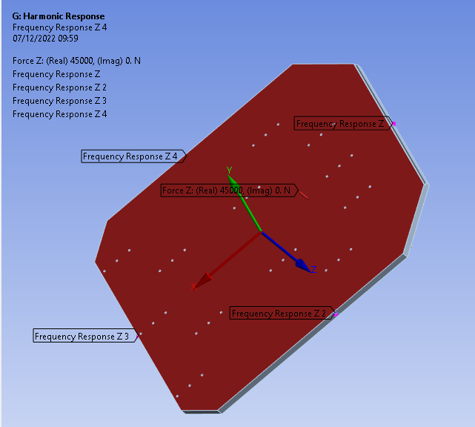
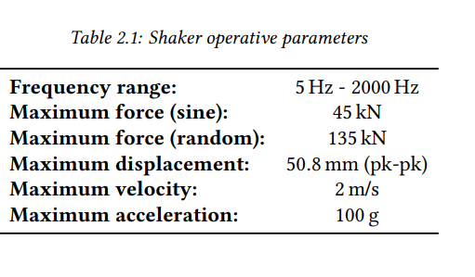
Set Up of the Analysis
This is now the Setting for the Test in x-Direction, for y-Direction it will be the same only that I will turn the plate
I want to begin with the worst case (z)
Question: I can apply the base excitation that we discussed only on an acceleration, correct? Shall I load on it the 100g or continue with the maximum force?
Notes:
1 m/s2 beschleunigung
No feet on corner , no feet fixation new radiator material, lighter maybe magnesium instead of aluminium alloy

