Slide 1
IHEP BeamTest 2022
Rui Qiao; Ke Gong; Wenxi Peng; RuiJie Wang; Bing Lu

Slide 2
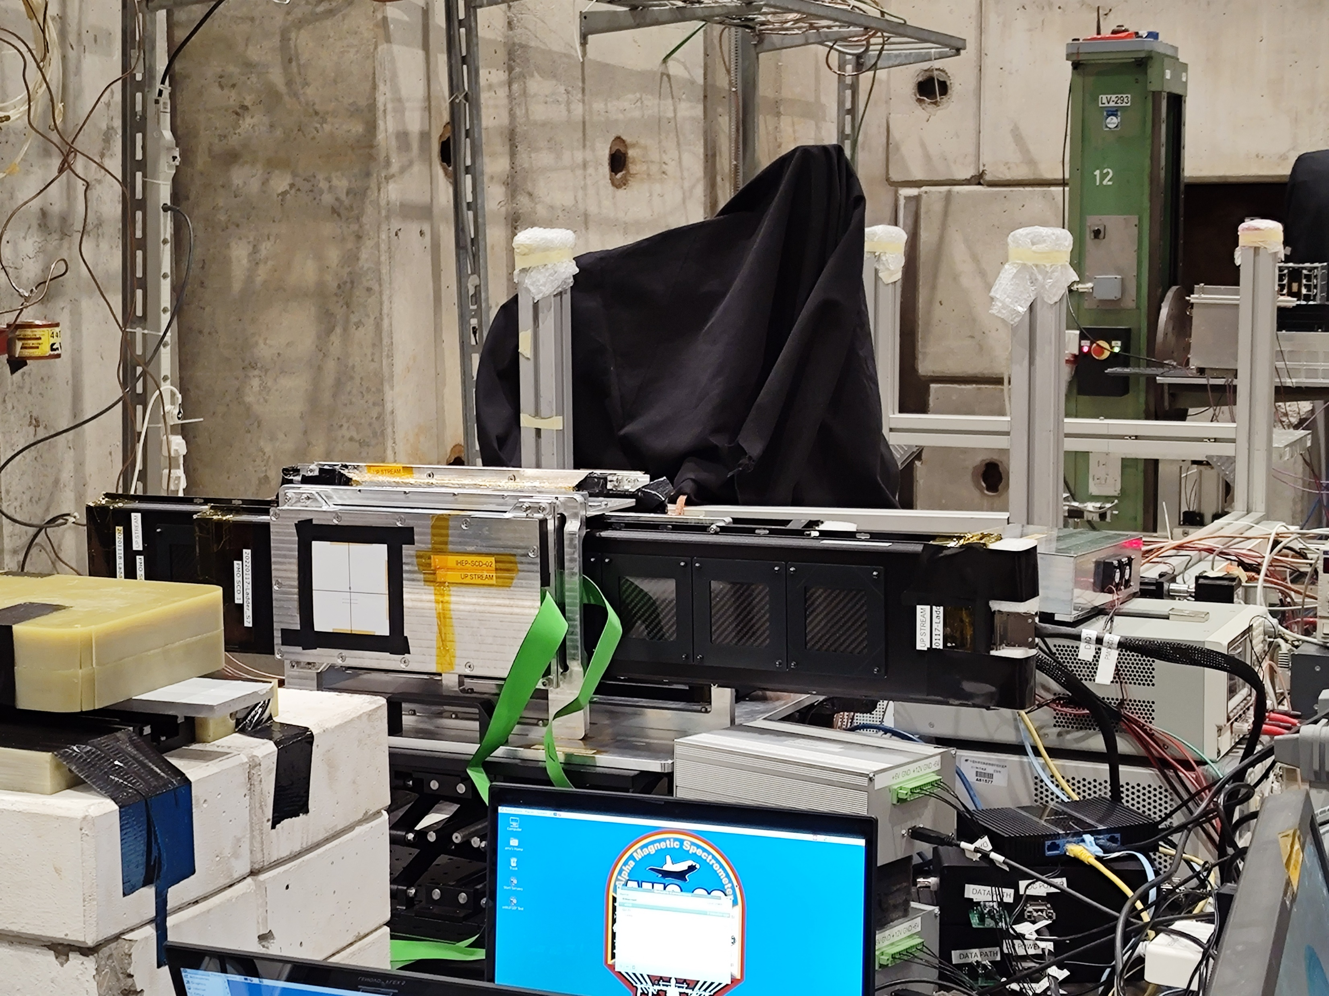
The detectors
Five detectors on a common base:
Two IHEP SCDs
Two PMO SCDs
One IHEP PSD
IHEP SCD 1&2
PSD
PMO SCD 2
PMO SCD 1
Notes:
G:\keyan\科研任务\221114_HERD束流测试\图片\来自BT2022微信群\微信图片_20221205131004.jpg

Slide 3
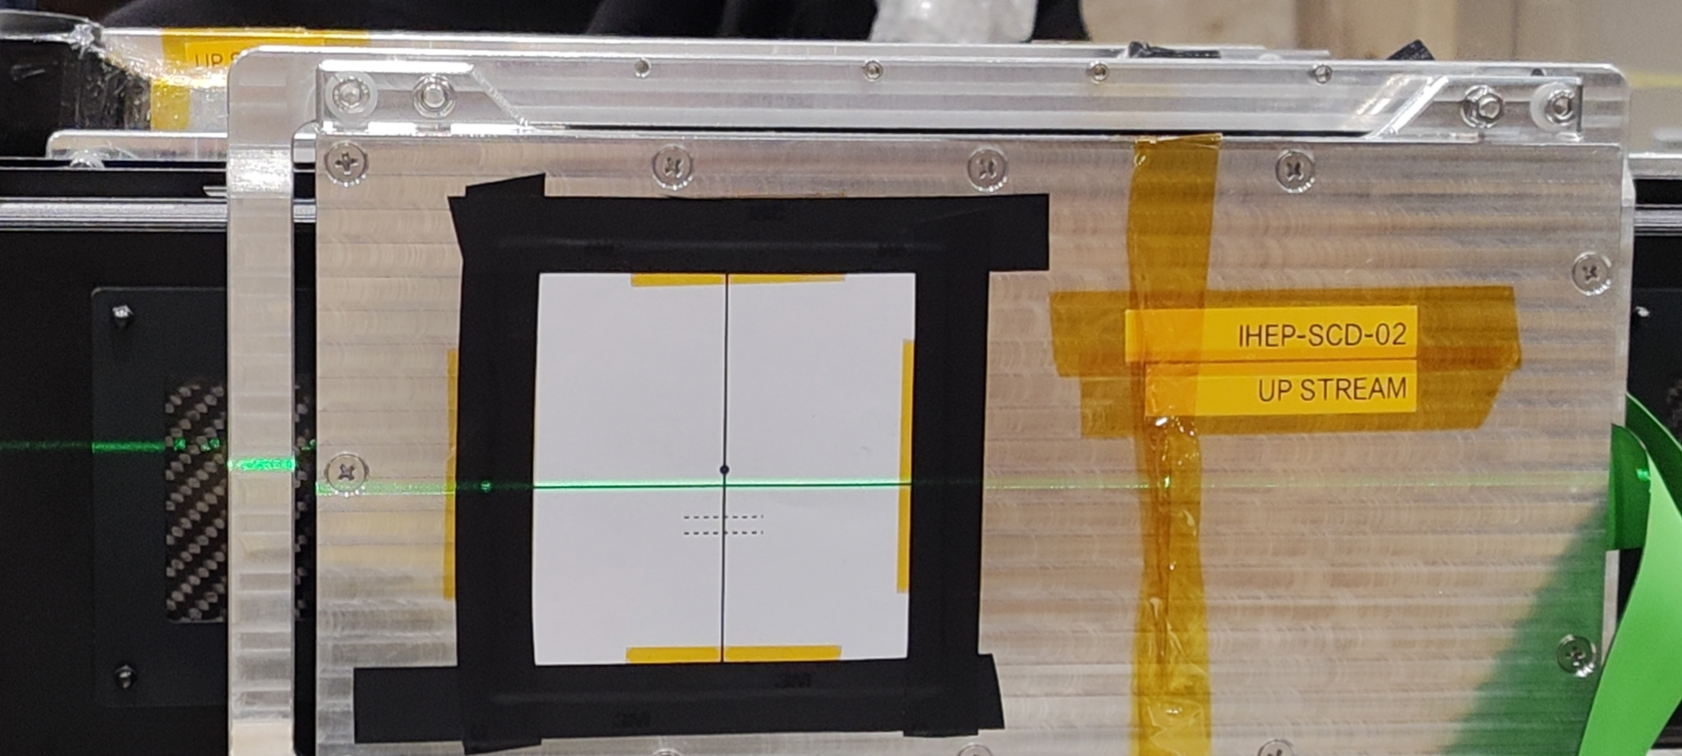
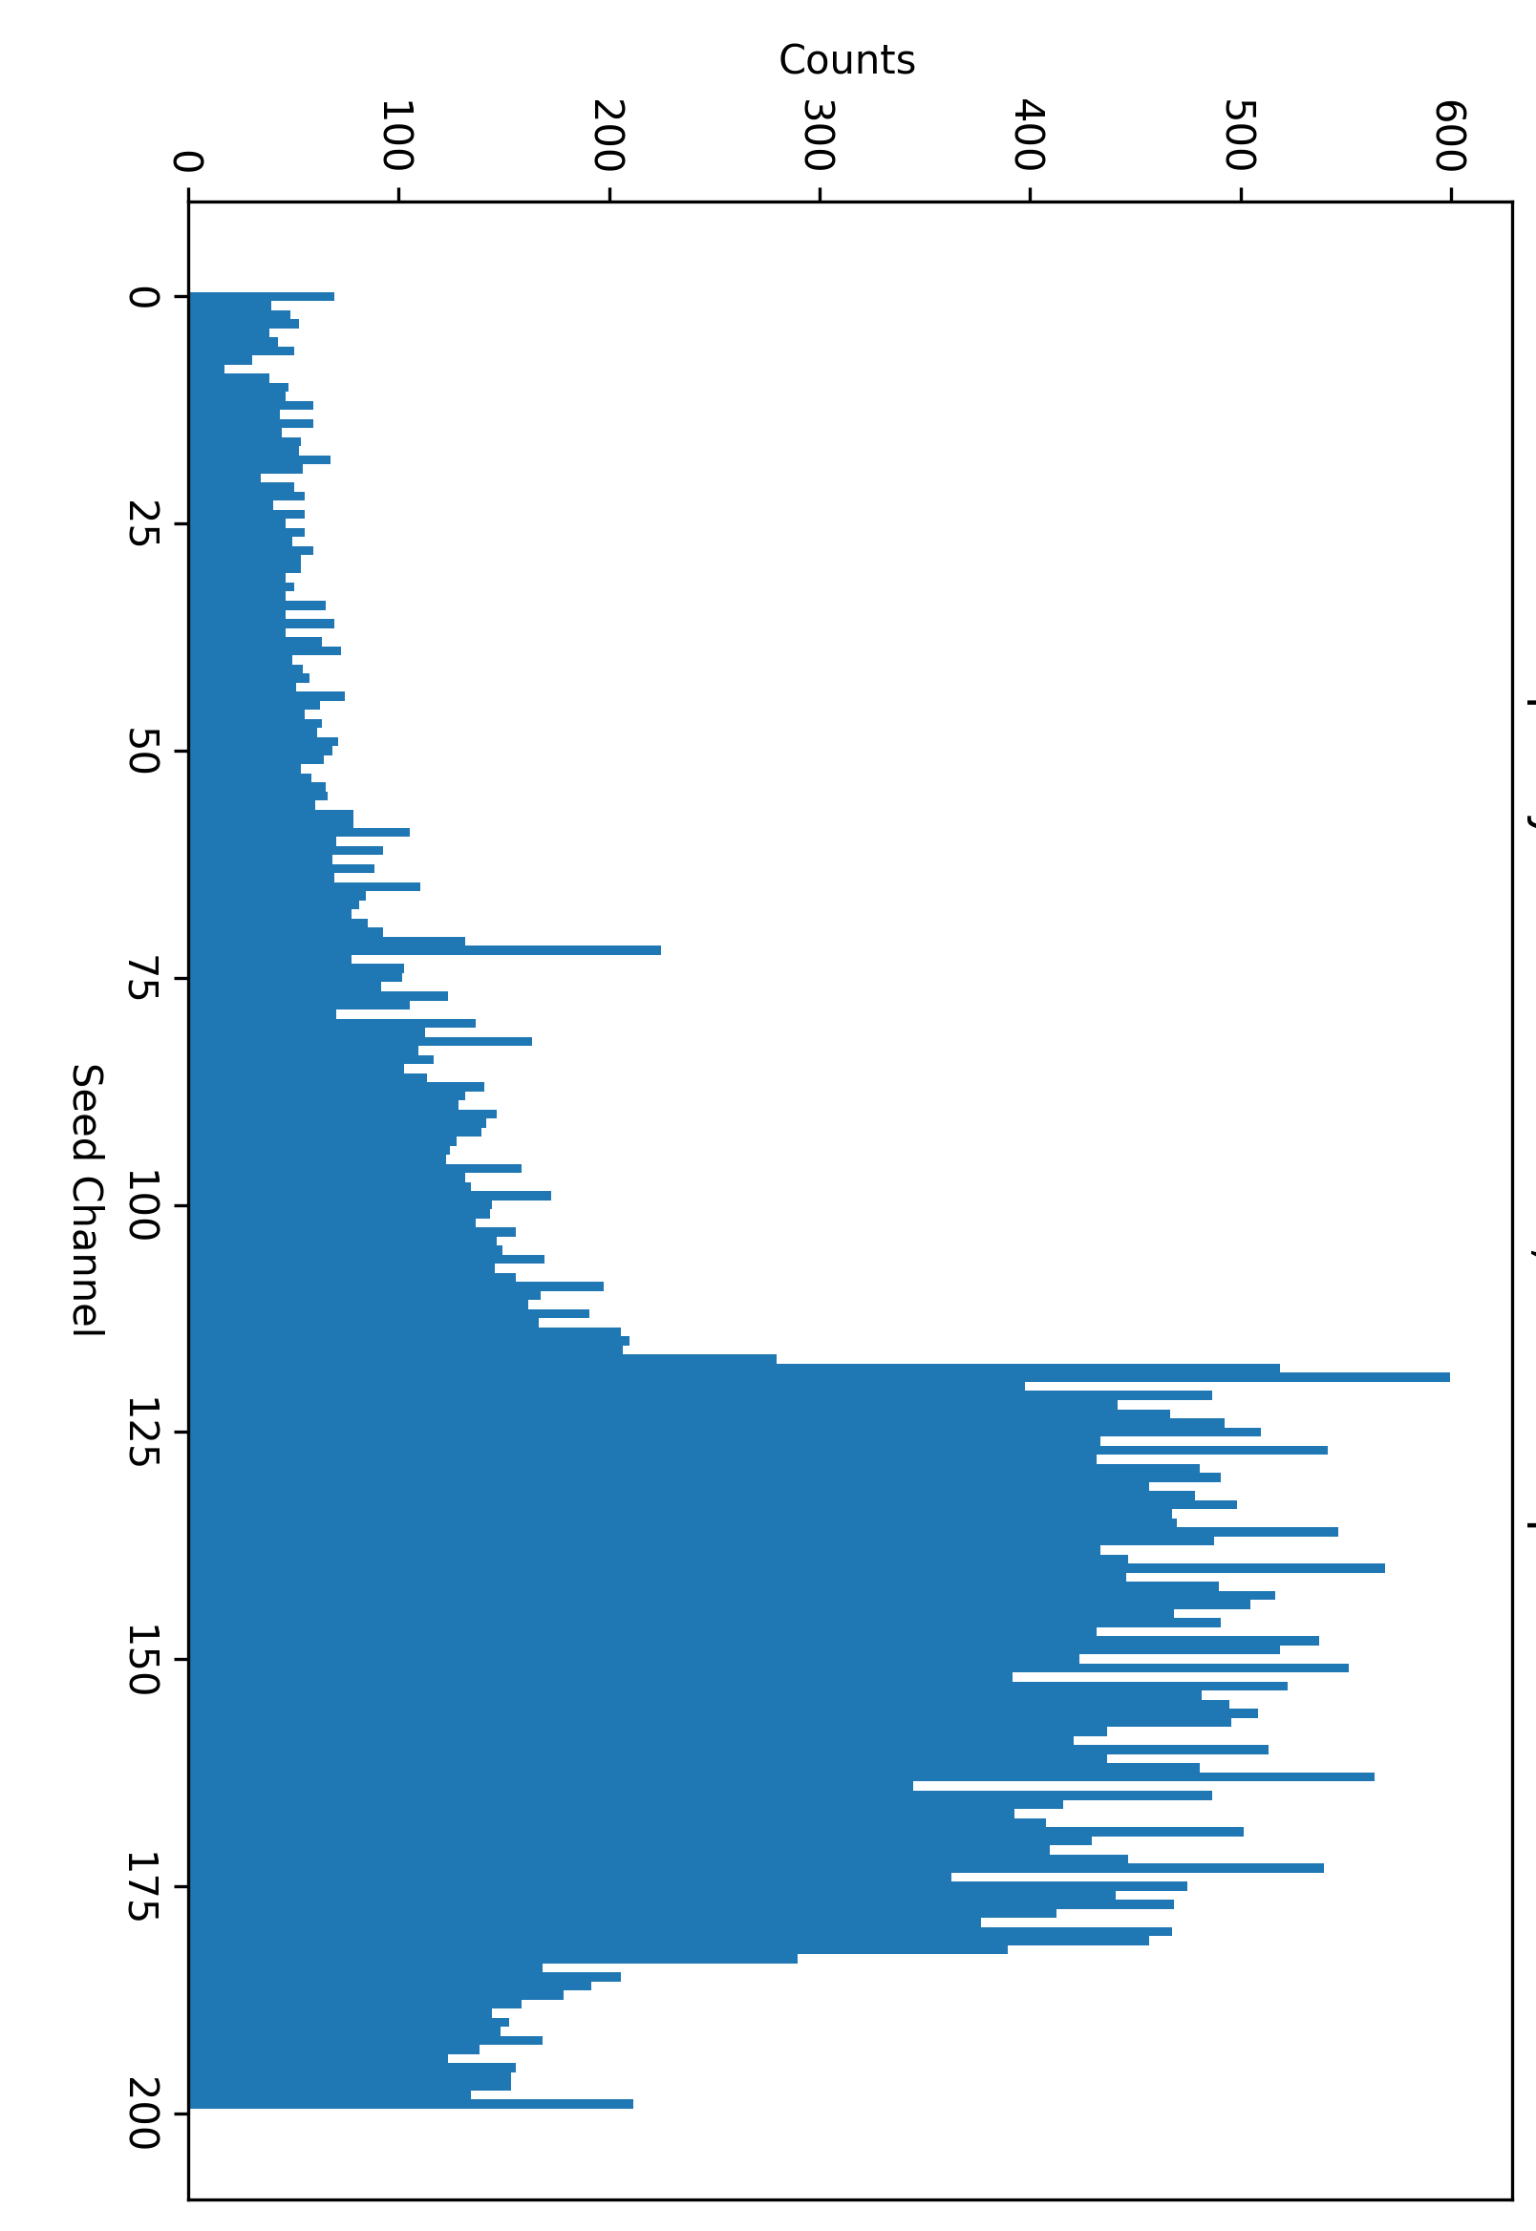
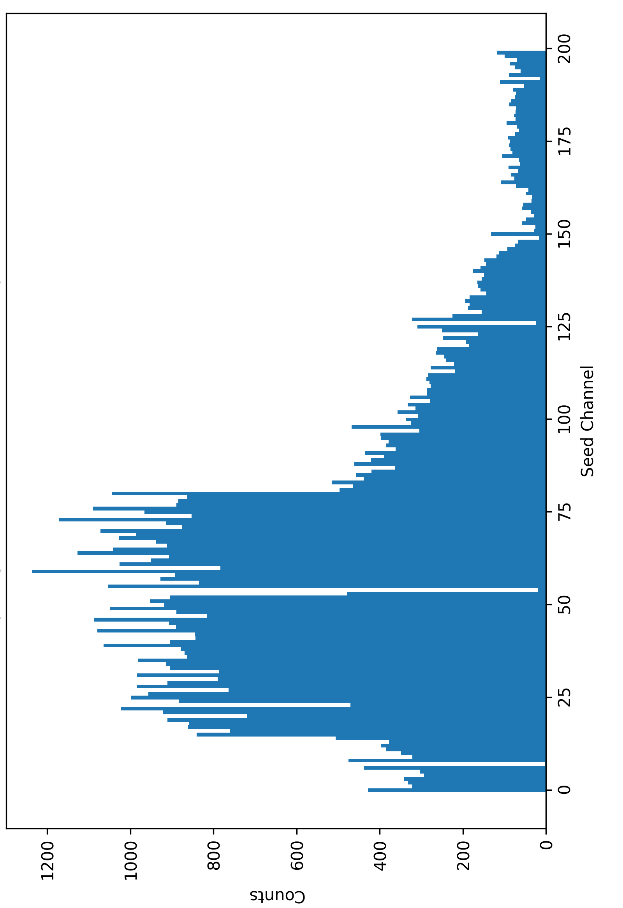
The IHEP SCDs
The beam spot was shaped by the hollow VETO. The beam spot is ~4mm below the laser.
ch0
ch199
SCD2
60um
SCD1
25um
The IHEP SCDs have width of 3.6cm, dividing into 10 sections.
As the ion beam spot is small, it was adjust to hit between section 6th & 7th .
SCD2
25um
SCD1
60um
ch199
ch0
Notes:
G:\keyan\科研任务\221114_HERD束流测试\文档\20221122_束流击中情况及调整.pptx

Slide 4
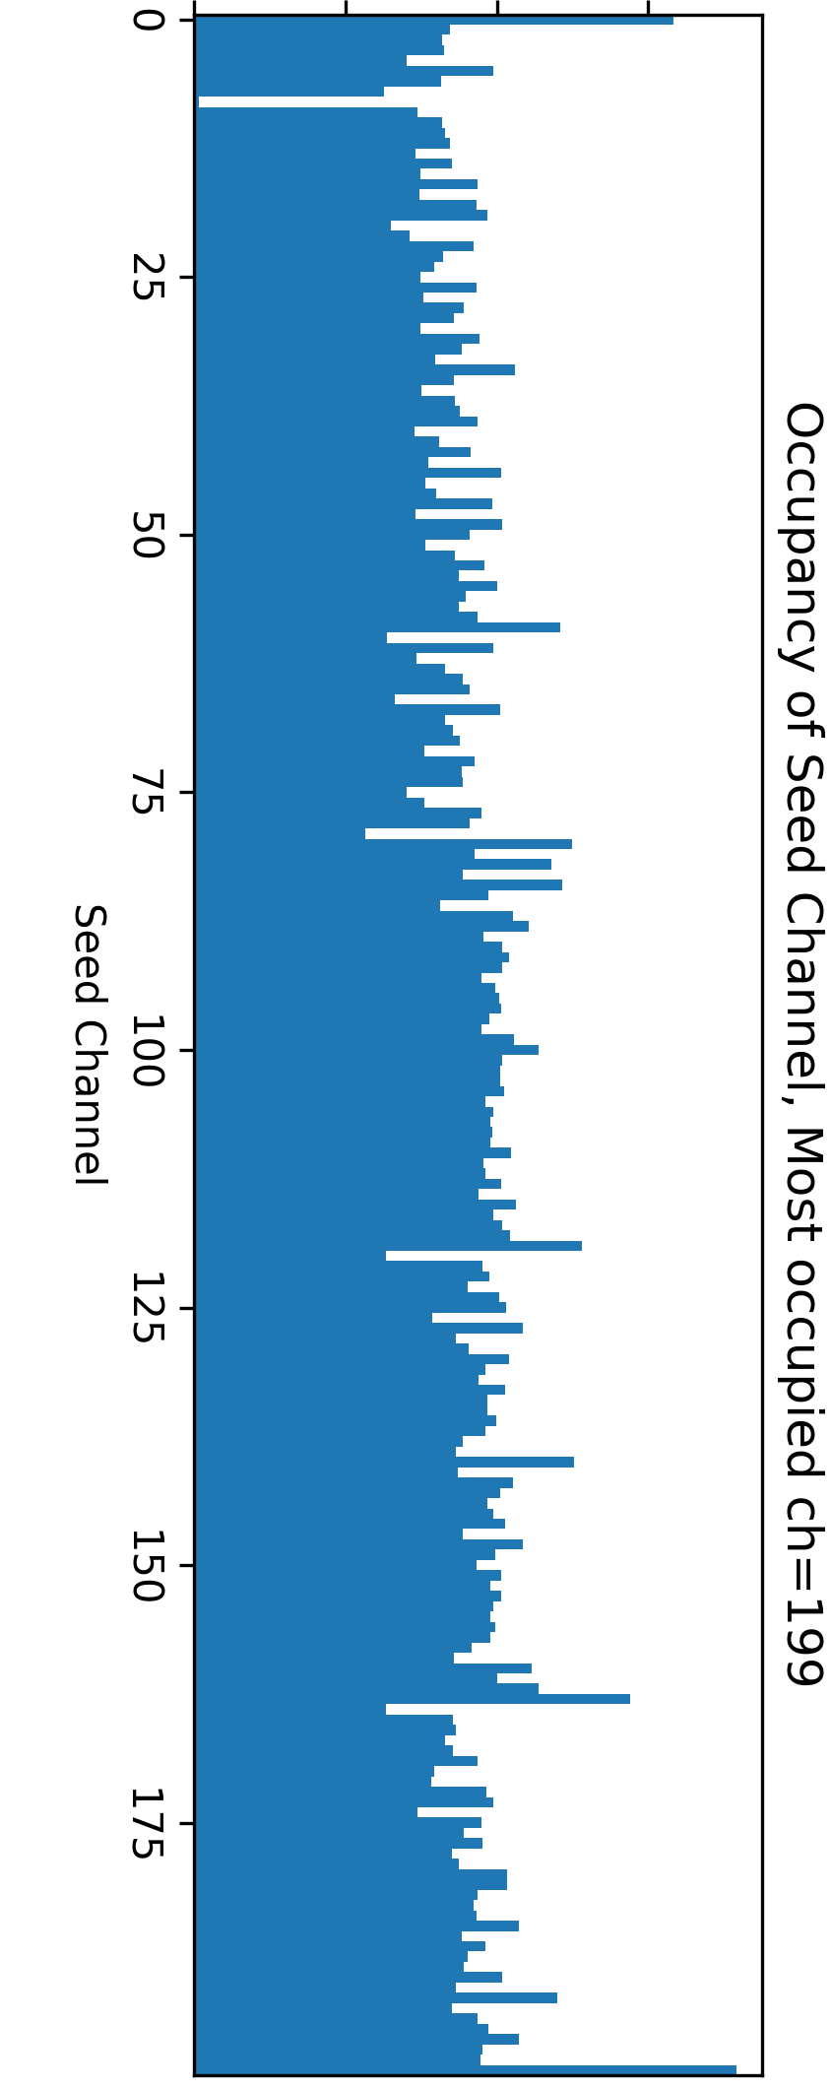
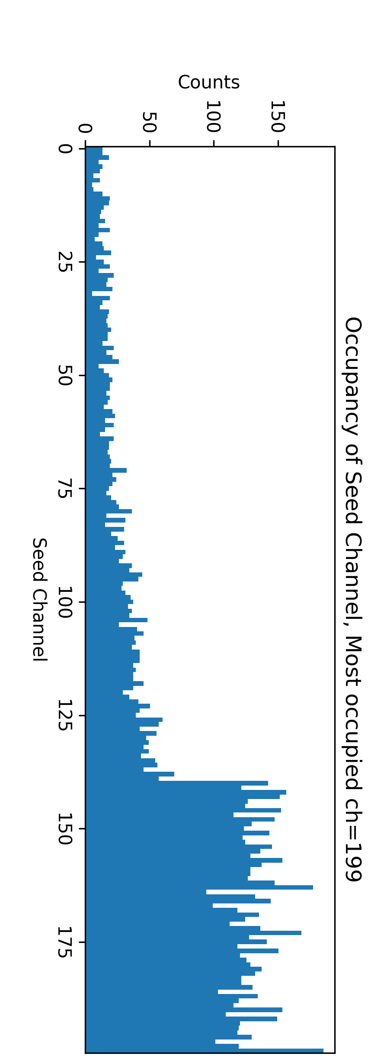
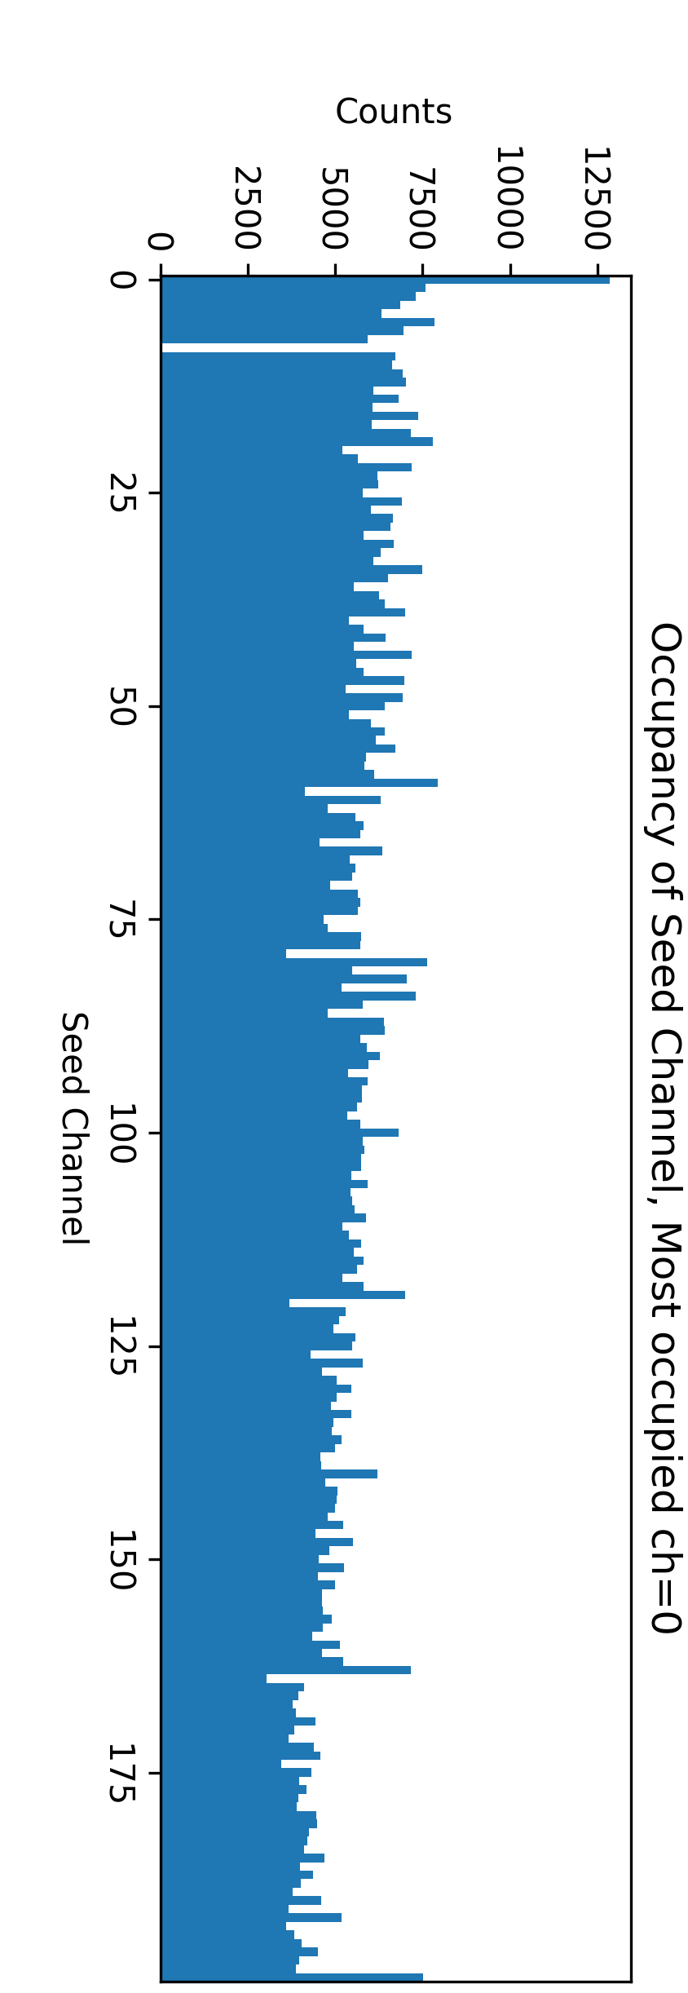
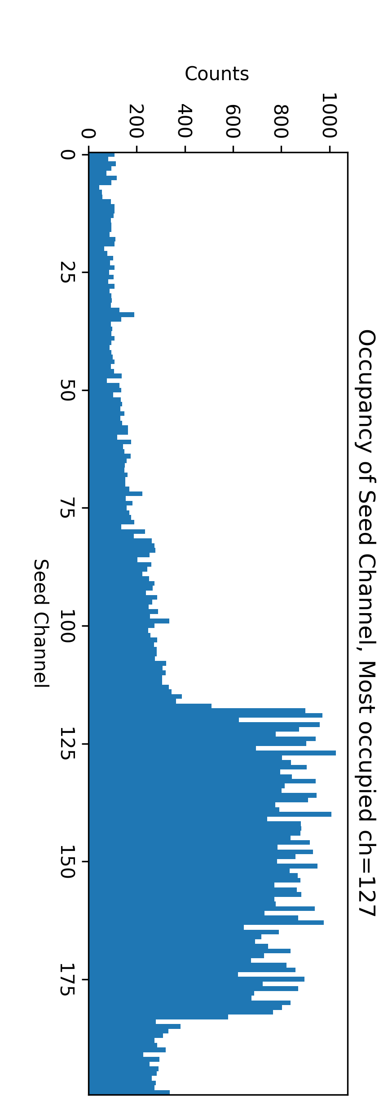
The beam spot and the height adjustment
Stage2:
3.6mm higher
Stage3:
VETO OFF
Stage1:
Initial height
Stage4:
23mm higher
Notes:
G:\keyan\科研任务\221114_HERD束流测试\png\IHEP_SCD2\cluster\

Slide 5
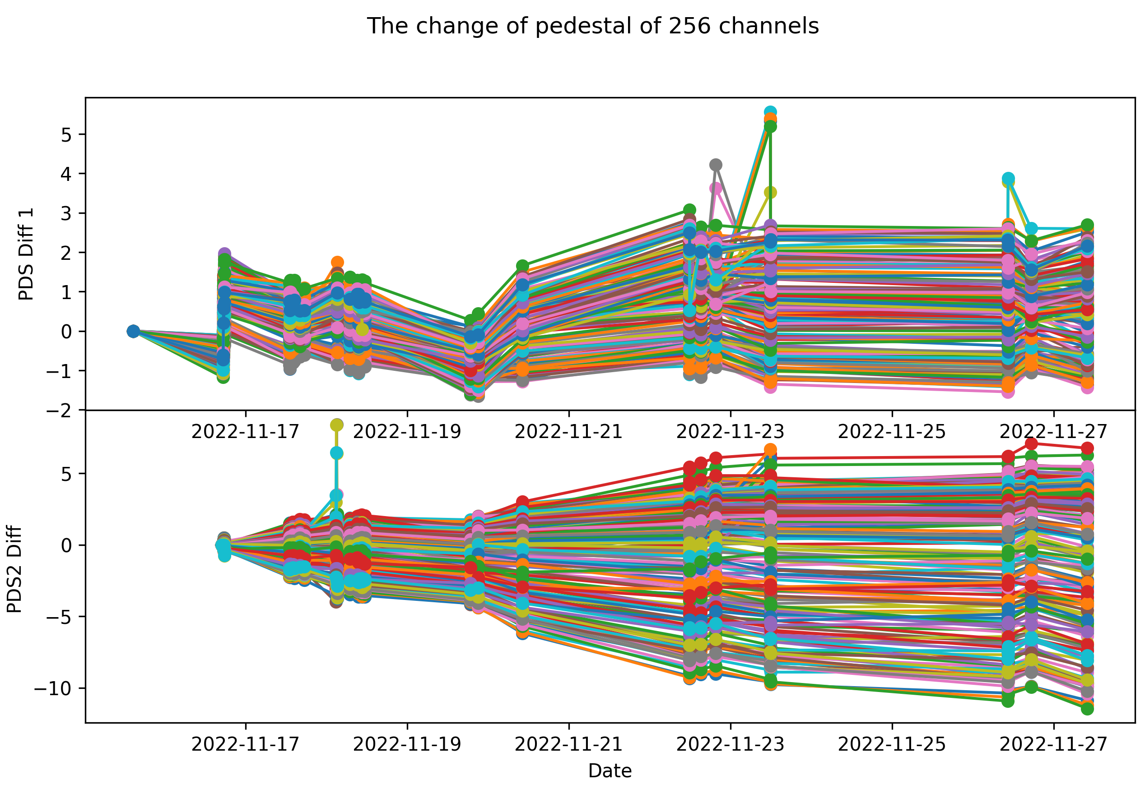
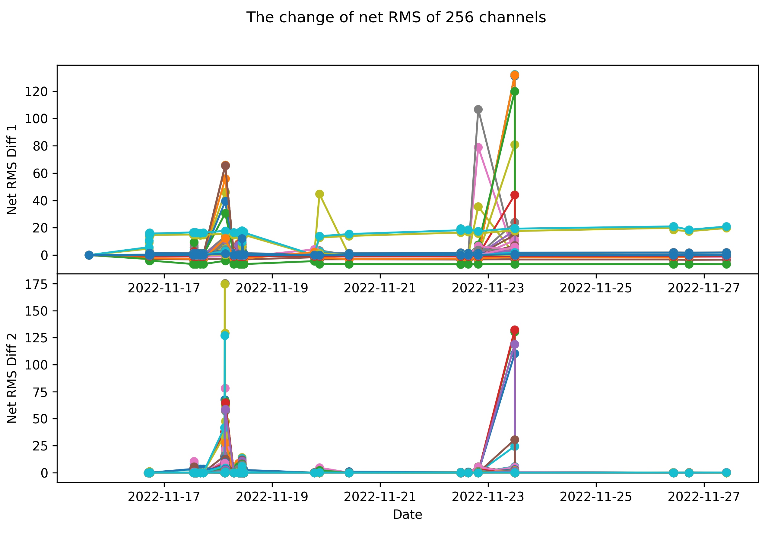
The long term detector status
We monitor the change of pedestal and net rms.
The change of pedestal(Y) of 200 channels as a function of date(X). SCD2 has pedestal change of +/- 10 ADC
The change of net rms(Y) of 200 channels as a function of date(X). SCD2 is perfect, while SCD1 has two more noisy channels

Slide 6
Data analysis framework
Raw Data Conversion
Section Selection
Pedestal analysis and subtraction
ETA correction
CN analysis and subtraction
Cluster Finding
Charge reconstruction
Charge sharing
Raw data processing
High-level data processing

Slide 7
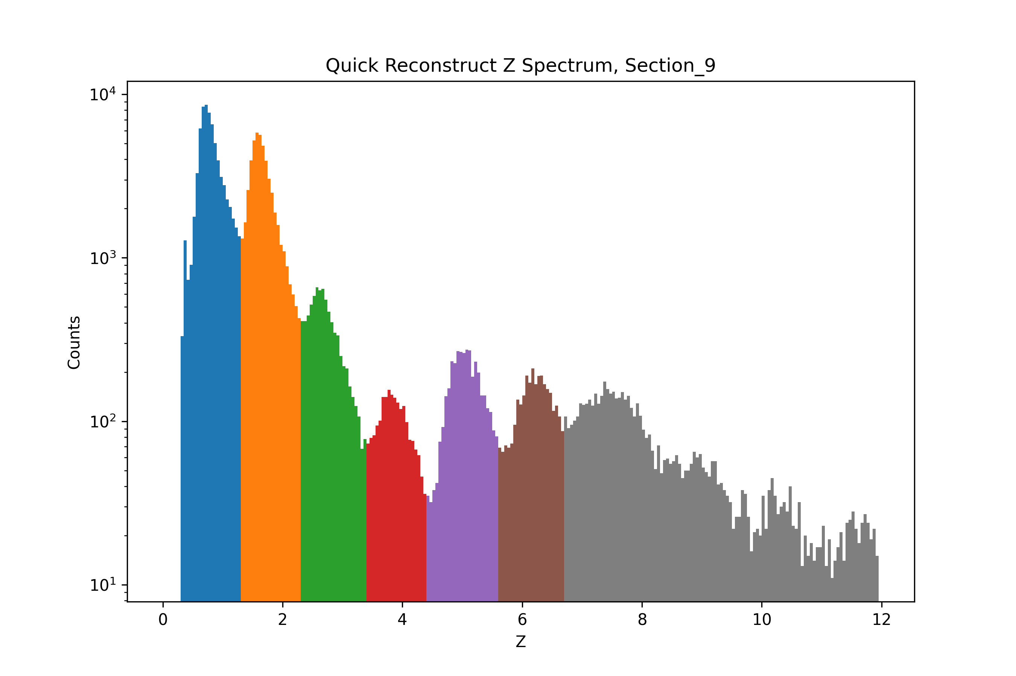
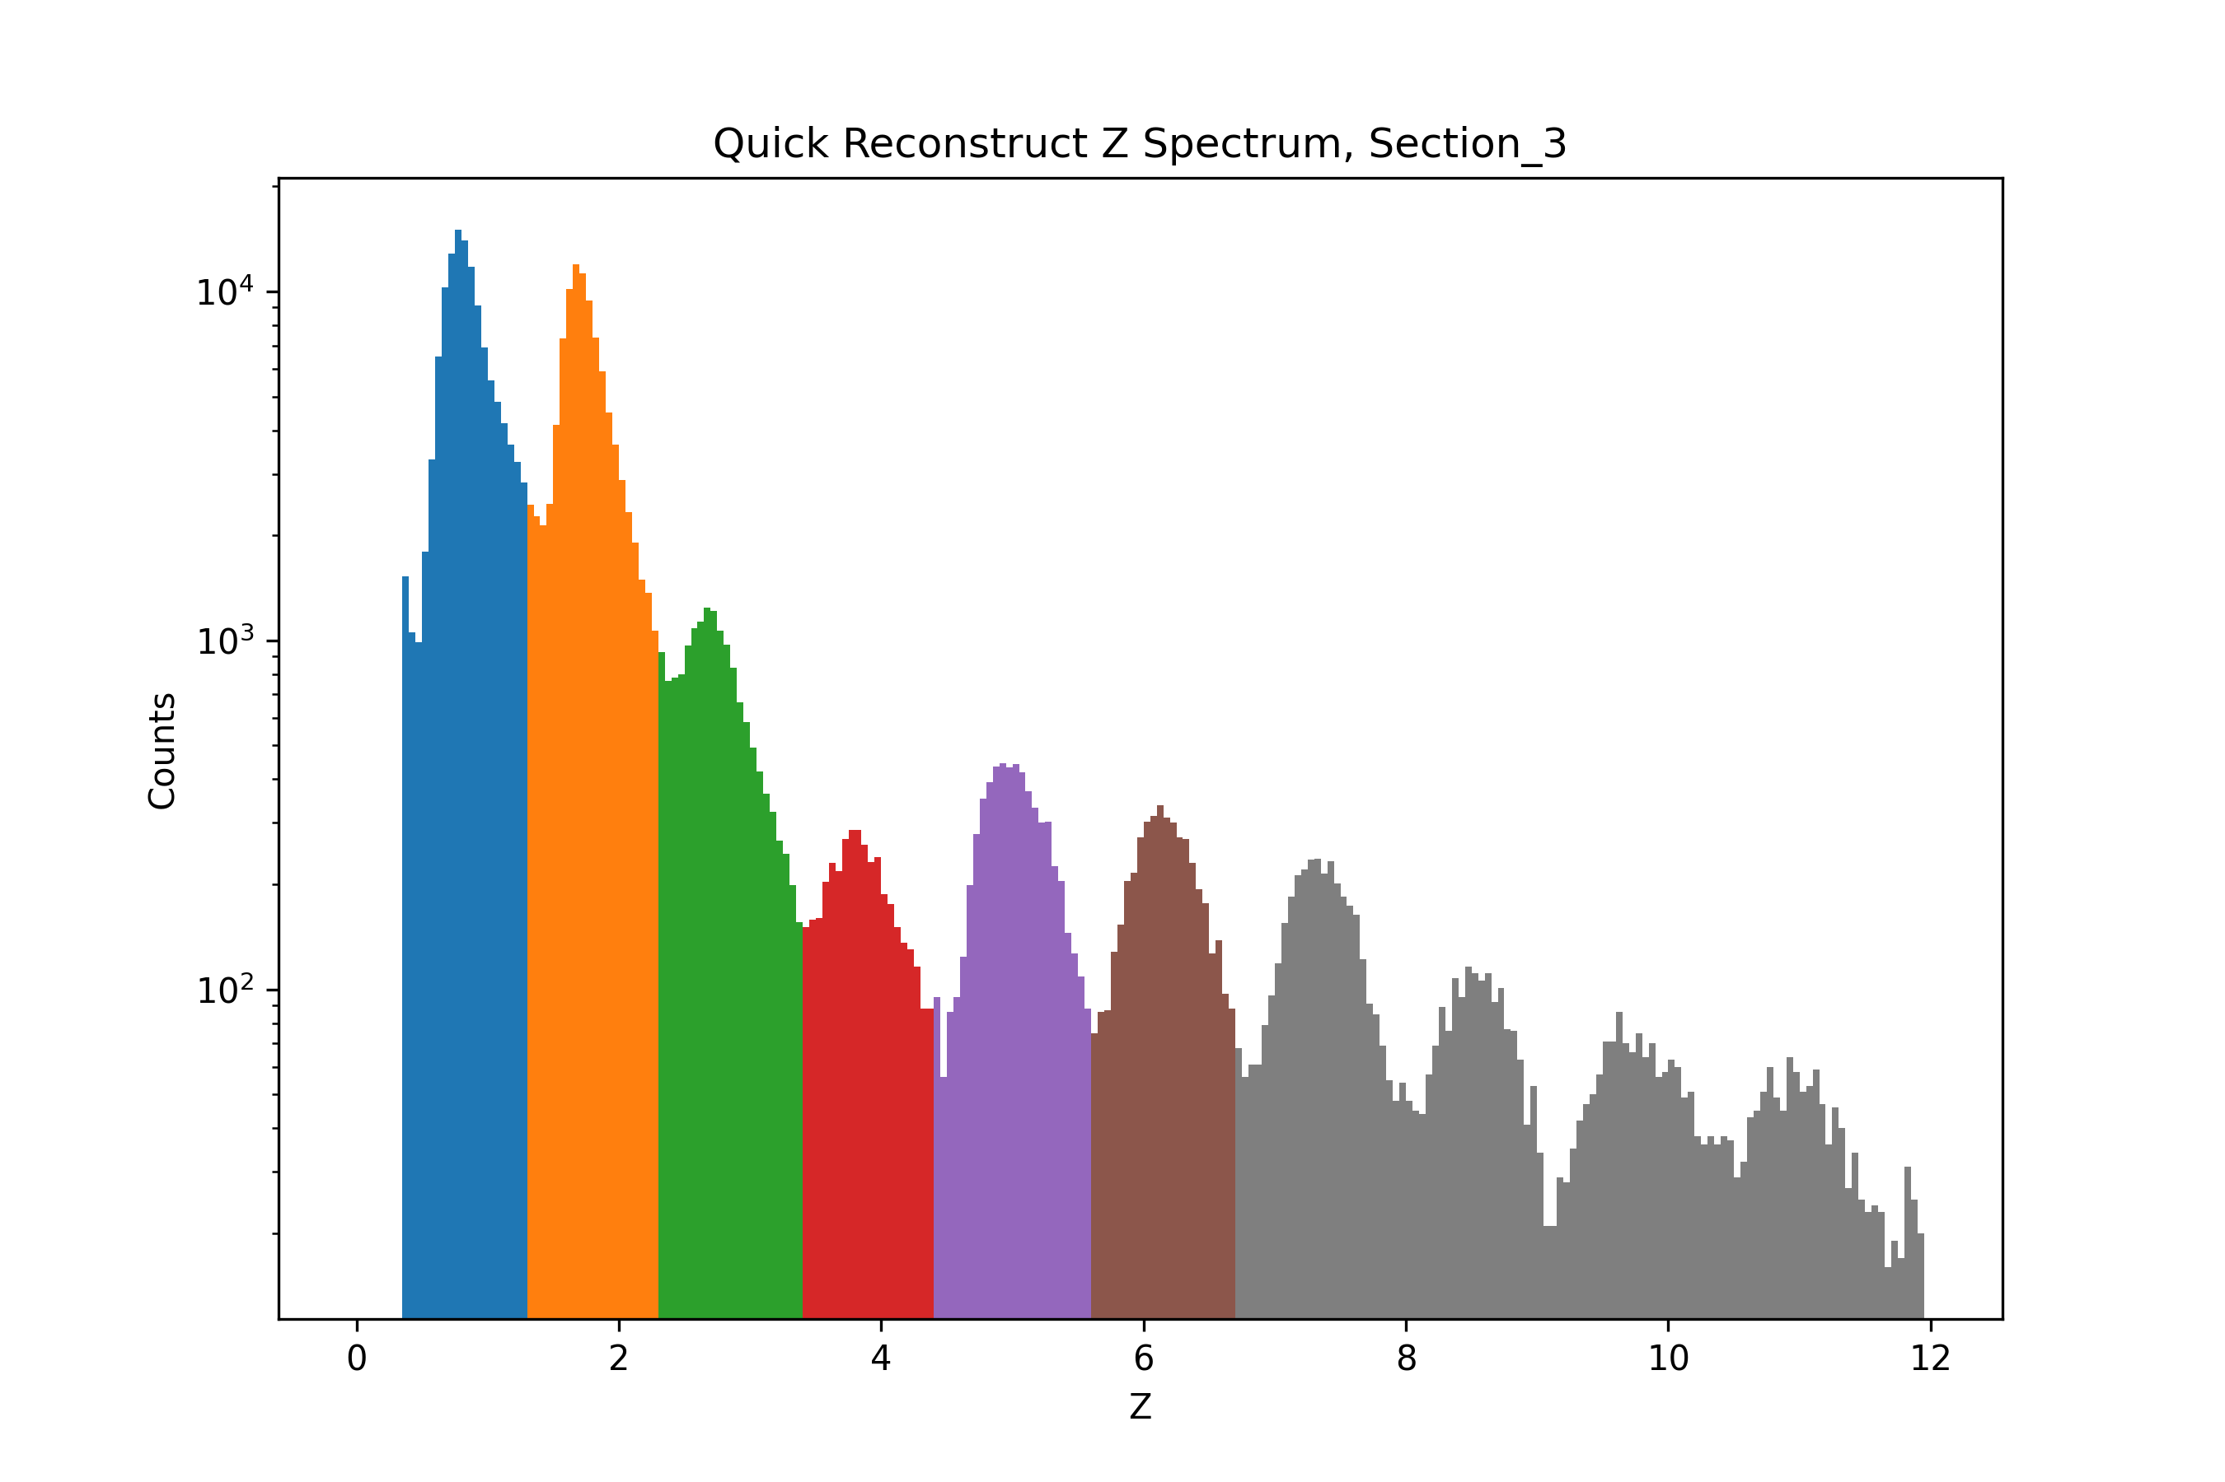
Preliminary charge response
Charge spectrum of IHEP-25um with 0 Ω. The linear range is Z=1~6.
Charge spectrum of IHEP-60um with 20 pF. The linear range is Z=1~9.
The additional 20 pF decrease the signal, or say expand the dynamic range. The SN of low-Z does not significantly decrease.
Notes:
G:\keyan\科研任务\221114_HERD束流测试\python_code\debug\快速电荷重建\step6_构造最终修正系数\*

Slide 8
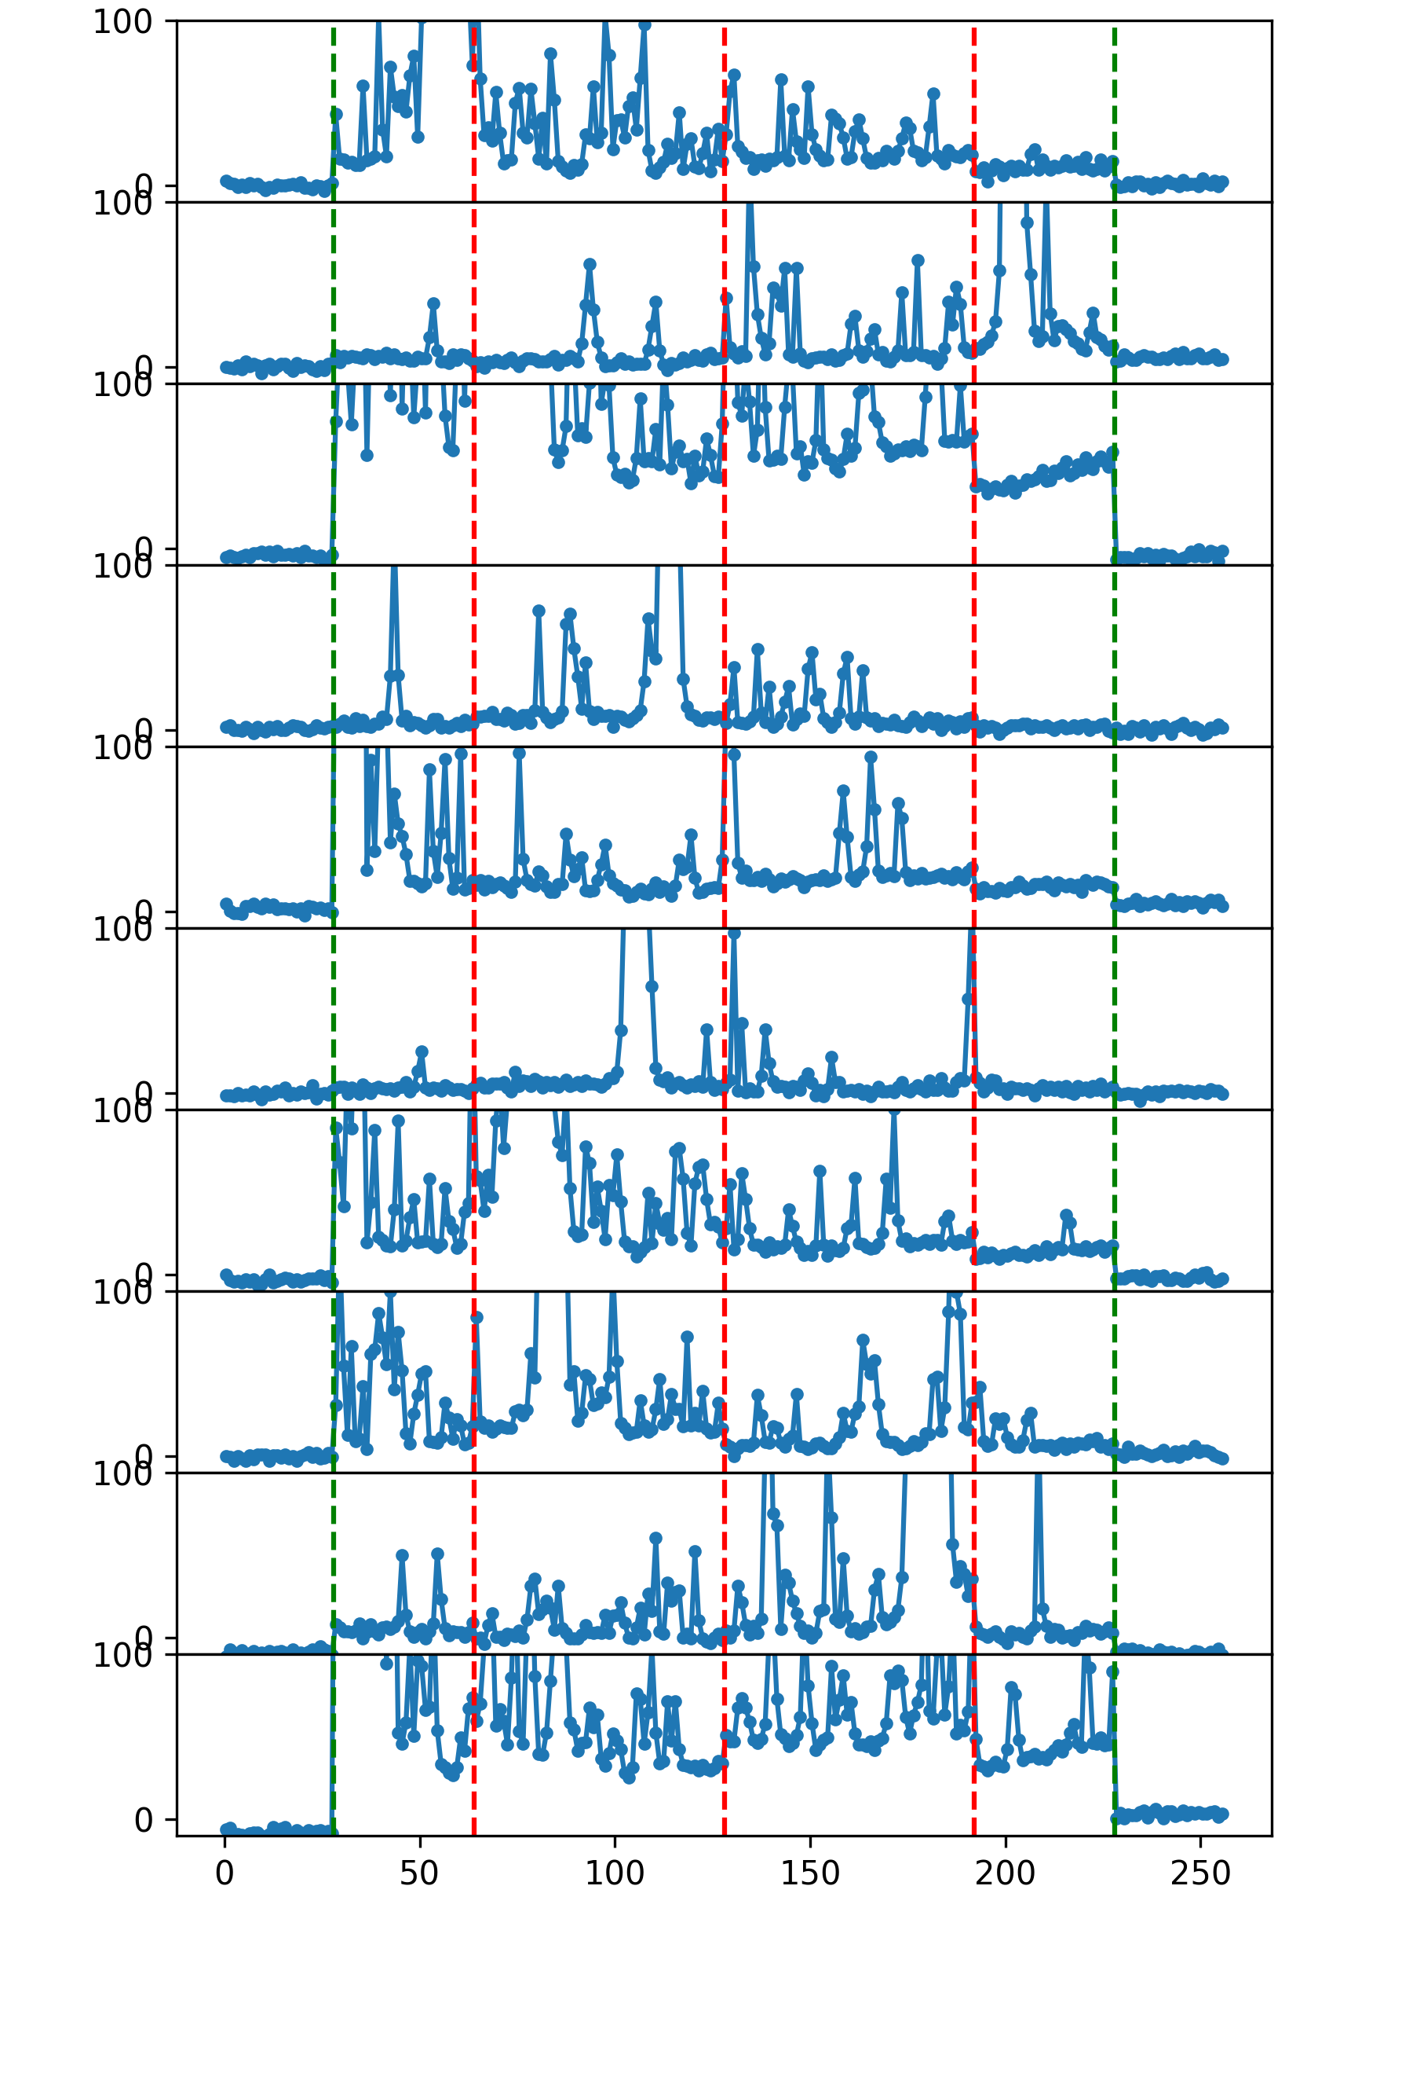
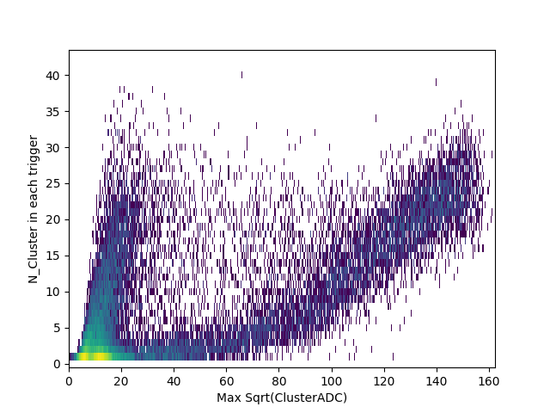
Multiplicity
The cluster multiplicity(Y) as a function of the sqrt of the maximum cluster amplitude(X). Heavy ion has larger multiplicity.
The amplitude(Y) of the 256 channels(X) in 10 heavy ions events.
Notes:
G:\keyan\HERD项目文档\周进展\资料\20221130_束流实验分析结果\*

Slide 9
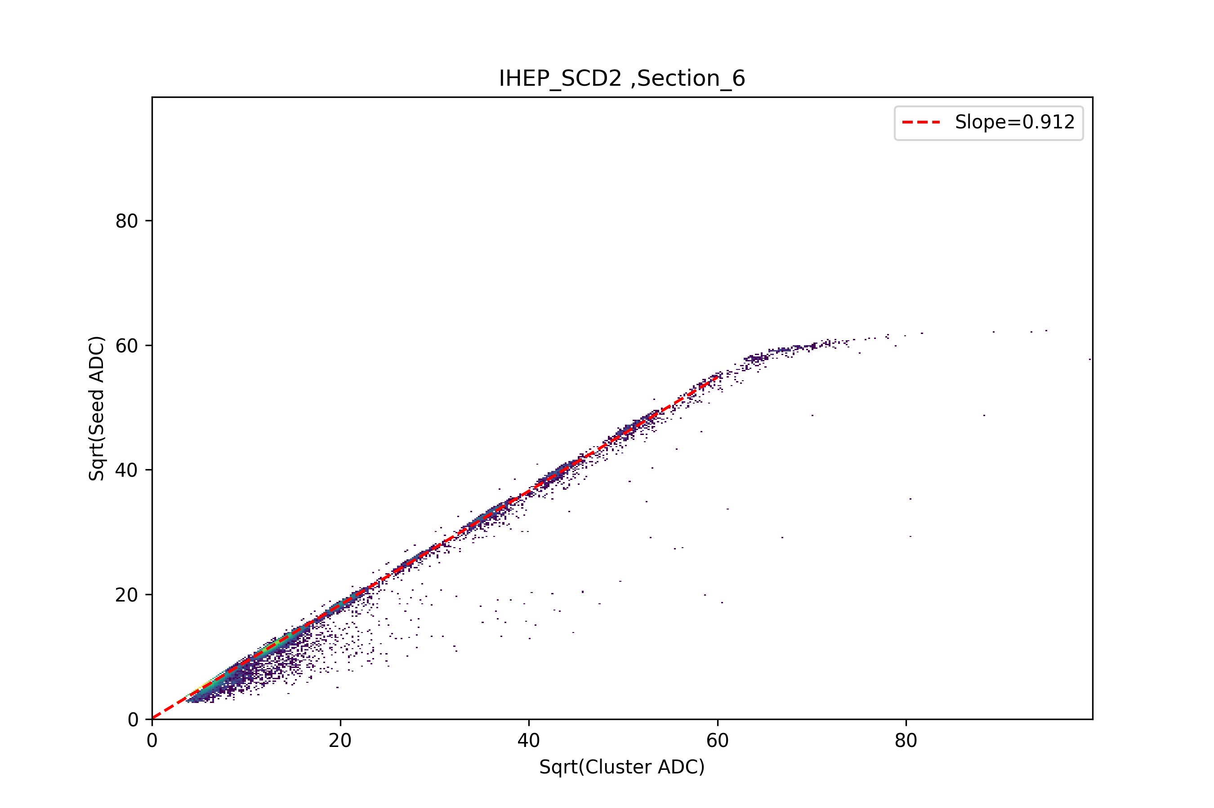
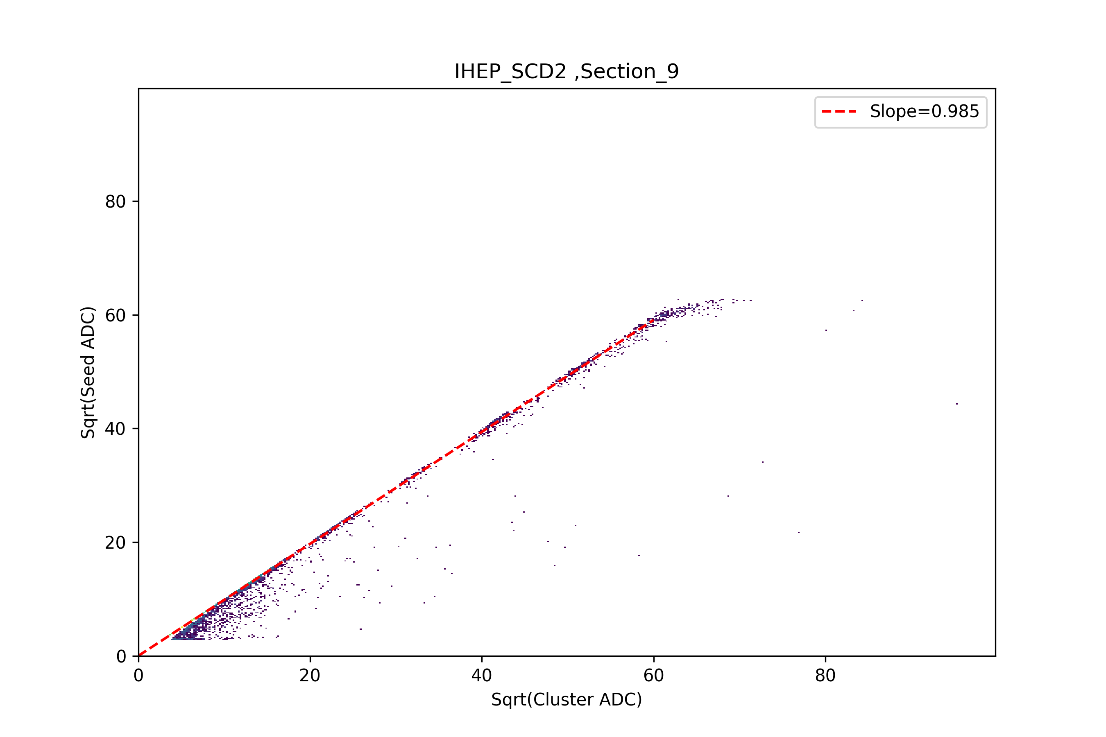
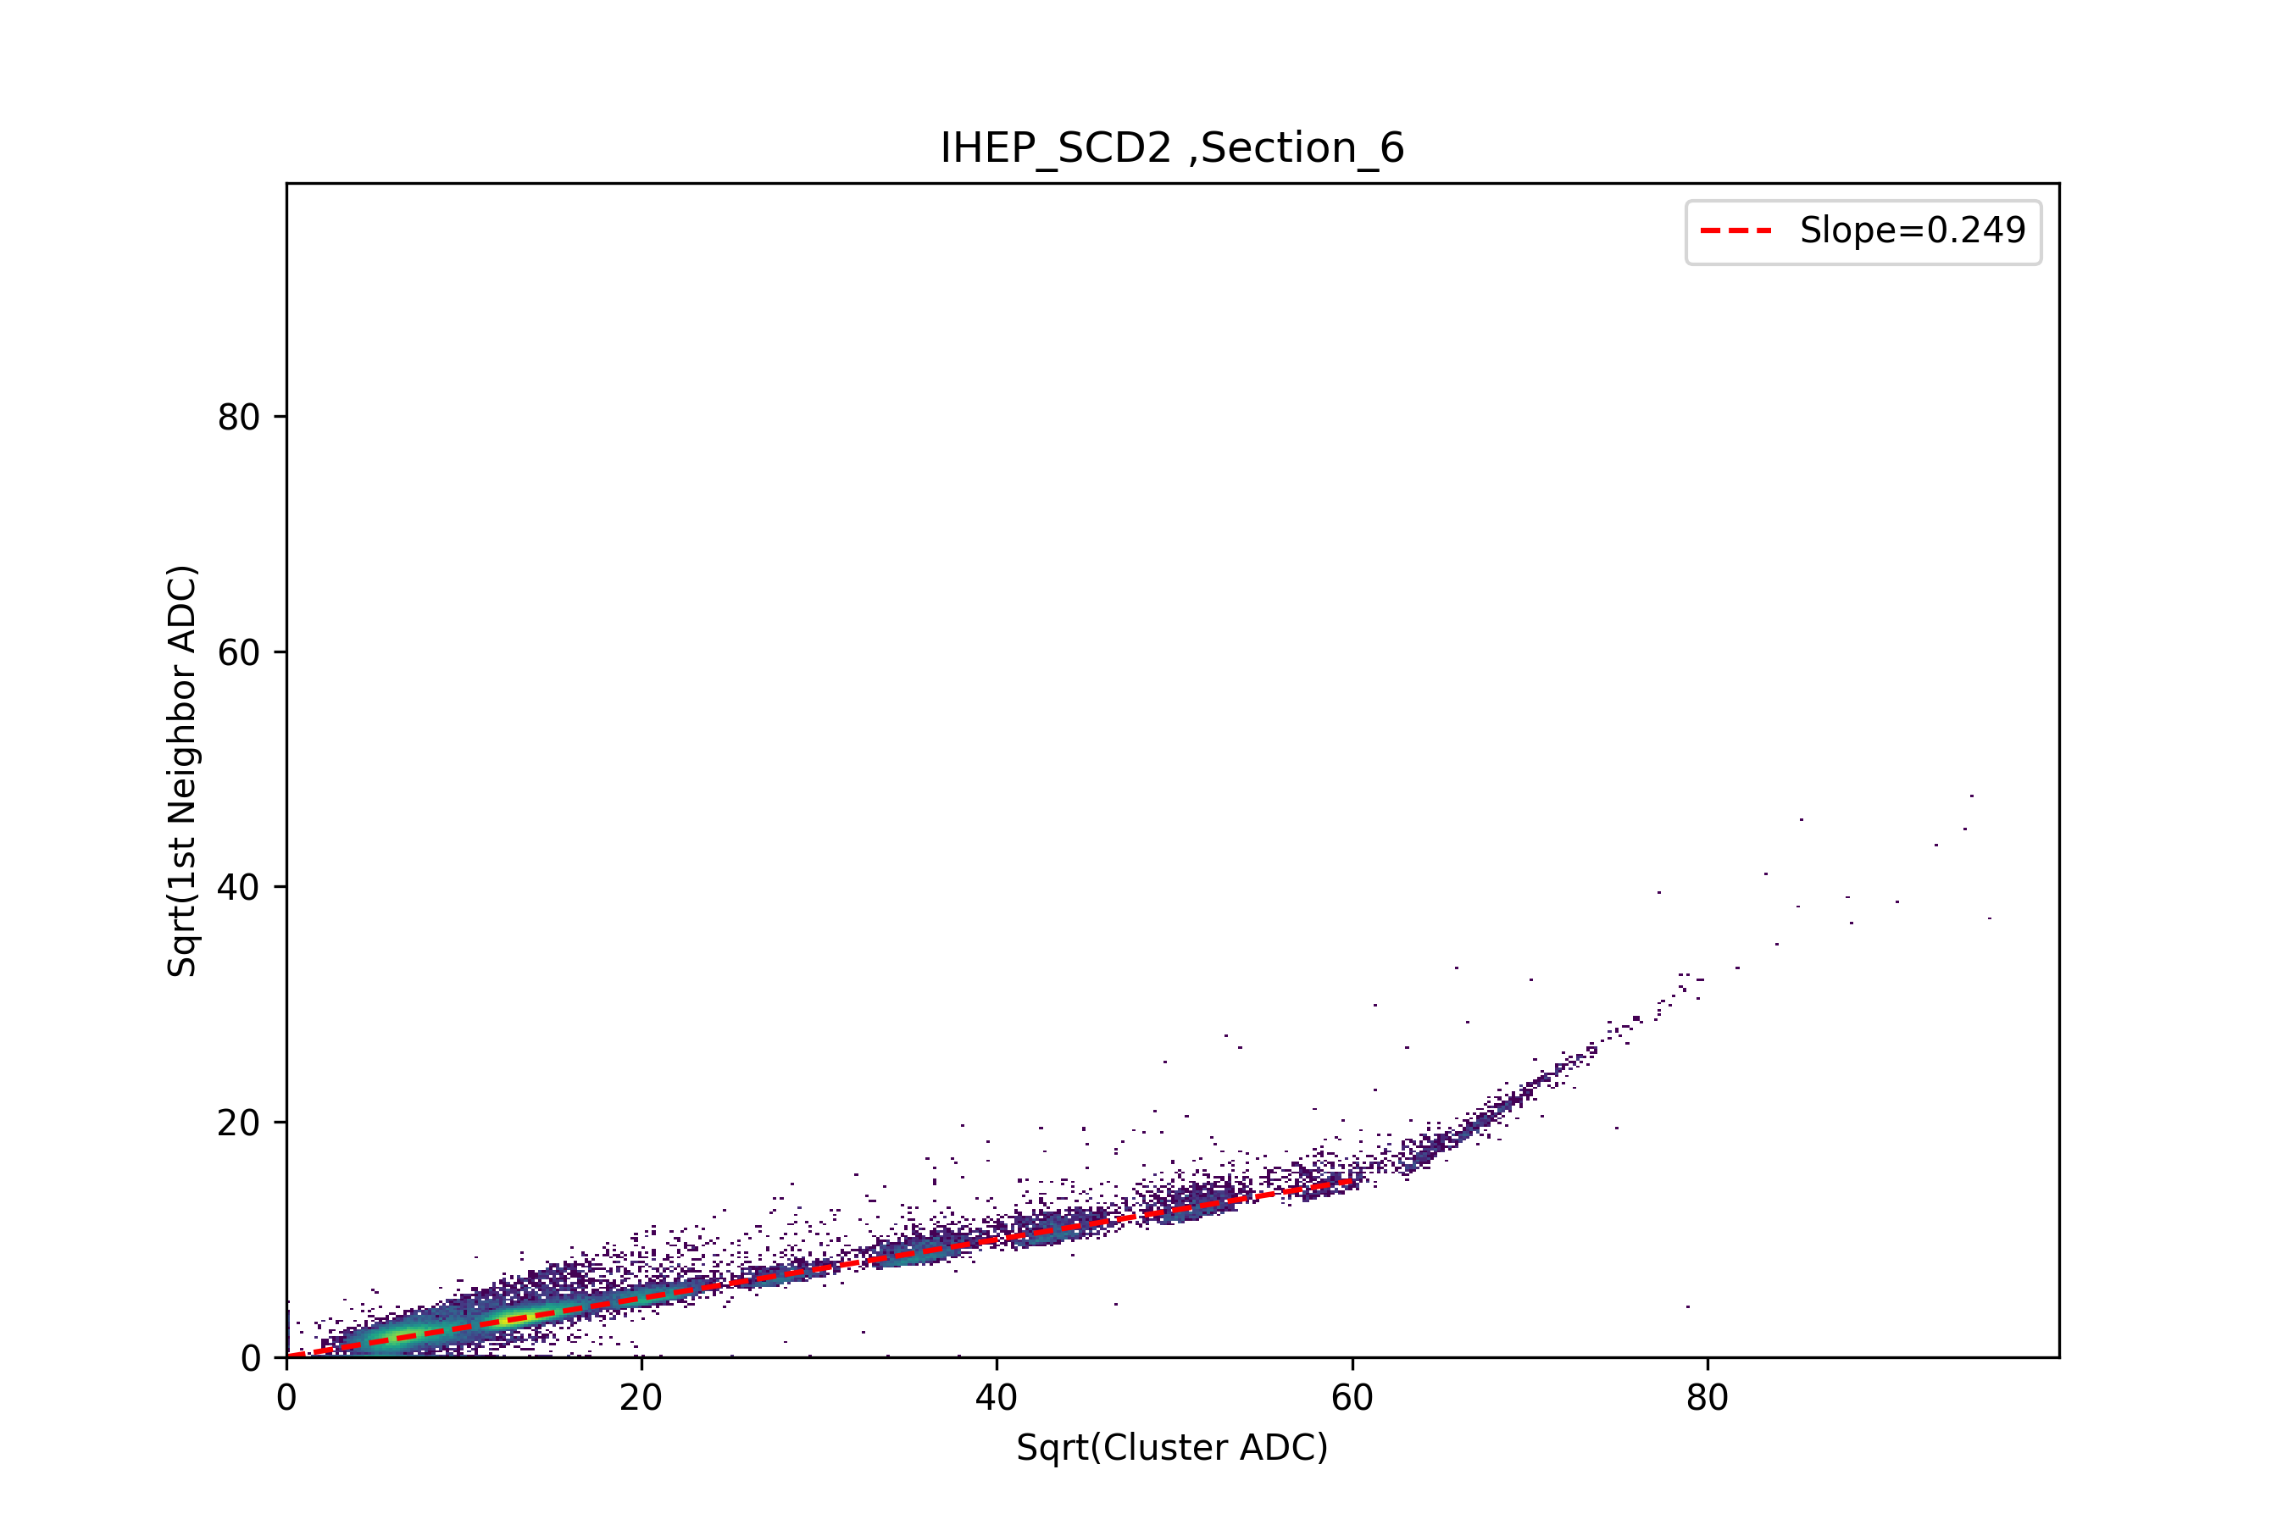
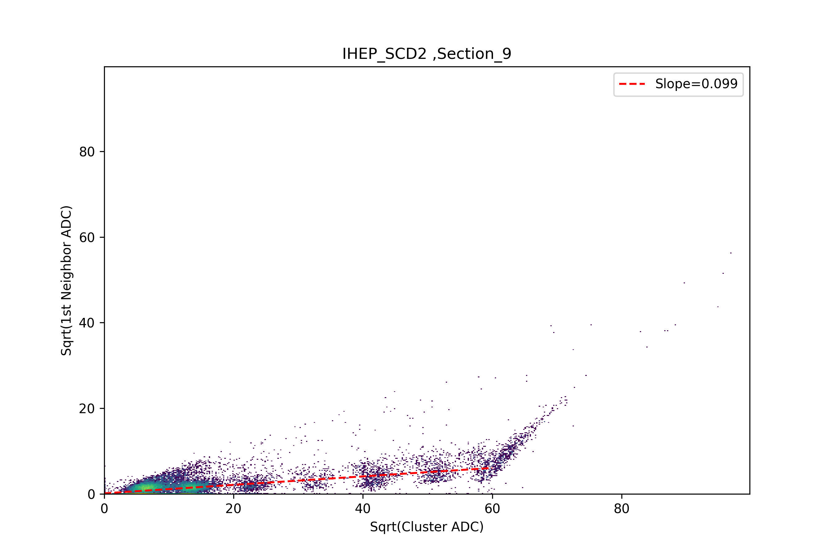
Preliminary charge sharing
Sqrt Seed ADC (Y)
Vs
Sqrt Cluster ADC (X)
Sqrt Seed ADC (Y)
Vs
Sqrt Cluster ADC (X)
Additional 20 pF cap.
0 Ω
Sqrt Neighbor ADC (Y)
Vs
Sqrt Cluster ADC (X)
Sqrt Neighbor ADC (Y)
Vs
Sqrt Cluster ADC (X)
Notes:
G:\keyan\科研任务\221114_HERD束流测试\python_code\debug\Seed通道_vs_Sum_读出条\*
G:\keyan\科研任务\221114_HERD束流测试\python_code\debug\临近通道_vs_Sum_读出条\*

Slide 10
Conclusion
The SCD performance is reviewed:
The pedestal shift max. +/- 10 ADC.
The noisly level is stable.
Ion peak clearly identified. Linear response of Z=1~6 using 0 Ω, and Z=1~9 using 20 pF.
Differenent charge sharing performance on various setup.
High multiplicity for heavy ion.

Slide 11
Future plan
ID | Mission | Person in charge
1 | Charge reconstruction (in lineary range) | WeiShuai Zhang
2 | Charge sharing | RuoSi Lu
3 | Heavy ion response | Rui Qiao
4 | Common Noise | TBD

