Slide 1
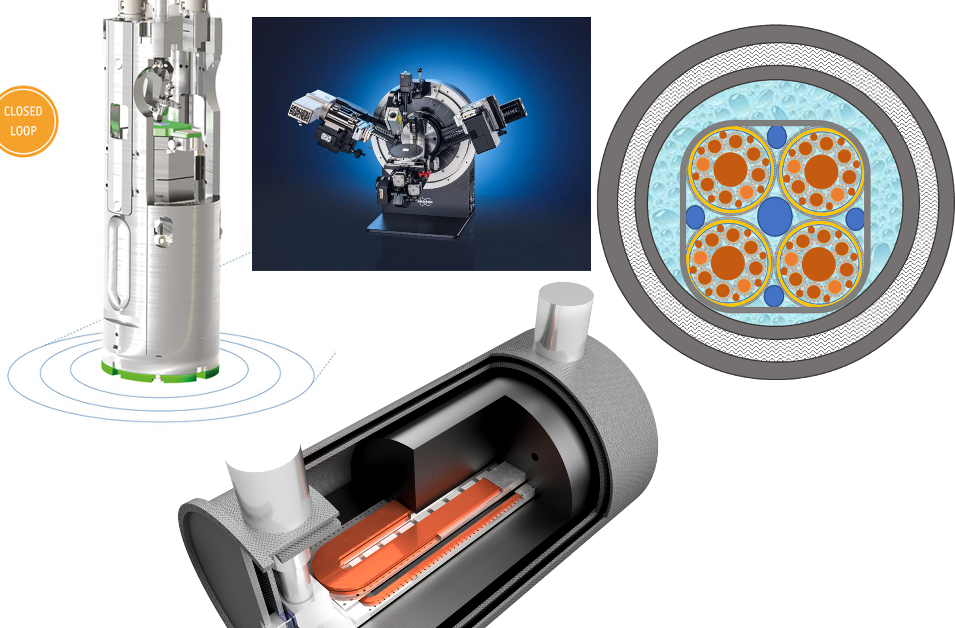
IRIS - Scope and structure
Lucio Rossi
Università di Milano
& INFN – sezione di Milano
Laboratorio LASA
24th of February 2023

Slide 2
The Program IRIS
Response to a call by the Ministry for Research under the “Recovery Funds” (PNRR)
To form a new distributed infrastructure in applied superconductivity (AS) in Italy by mutualizing existing infrastructures, competences, skills and by expanding them with new laboratories
6 poles for the new or renewed infrastructures: Frascati (INFN), Genova (INFN, CNR-Spin, Unige), Milano (INFN, Unimi – LASA lab), Napoli (Unina), Salento (Unisalento) e Salerno (INFN e Unisa)
  LASA (Milano) is the hub and coordinates the activity

Slide 3
Scope of IRIS
→ contribute to Fundamental Physics instrumentation (particle accelerators for post-LHC era) and to Societal Applications for green energy and medicine.
Superconductivity has been instrumental for the discovery of the Higgs boson and its development will be critical for future accelerators and we need of adequate infrastructure to sustain this. But the infrastructure will be devoted also to societal applications. In the domain of energy will be fundamental for a future green economy but also will allow a step toward sustainable infrastructure for fundamental physics.
Method: trying to cluster applied physicists with material scientists and magnet engineers. Therefore, we have also teams working on basic science and materials.
Industry are not allowed to be partner, rather they must be contractors.

Slide 4
IRIS timeline
Avviso MUR n. 3264 del 28-12-20221
Application on 25 February 2022
Negotiation phase with MUR: 10 June 2022 (resubmission new proposal : 17 June 2022)
Decree of approval: n. 124 of 21.06.2022
Start date of the project: 1 November 2022 (however early expenditure may be admissible for reimbursement)
End of project: 28 February 2025
→ 6 month extension to 30 October 2025 (mentioned in the call)

Slide 5
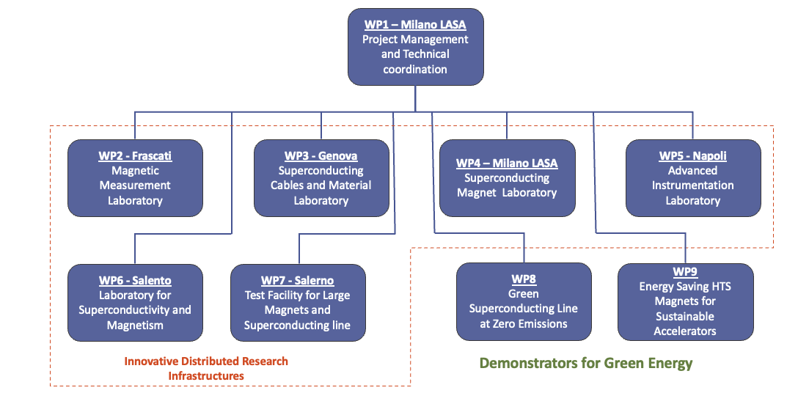
IRIS Structure

Slide 6
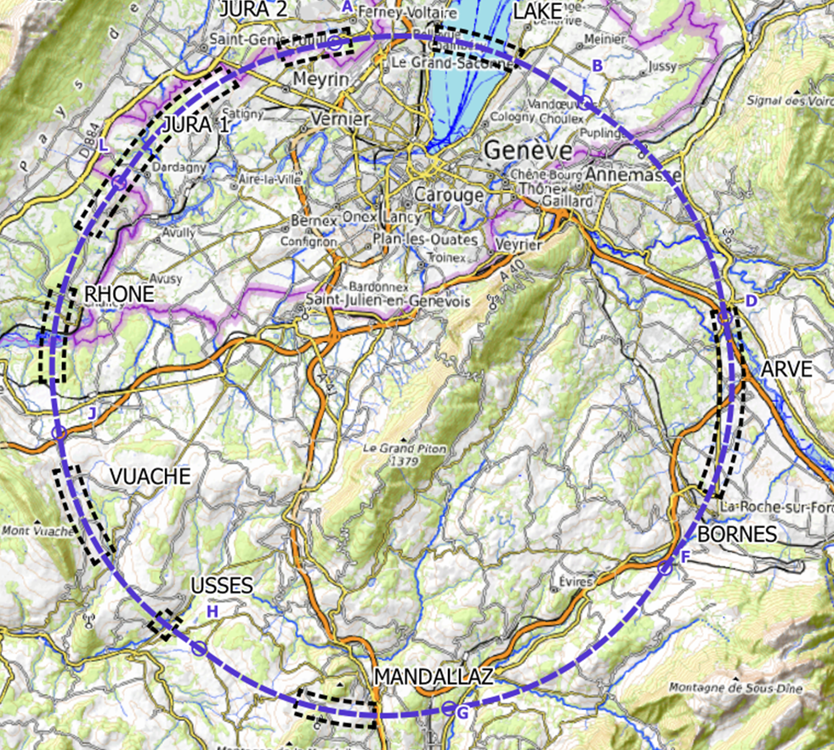
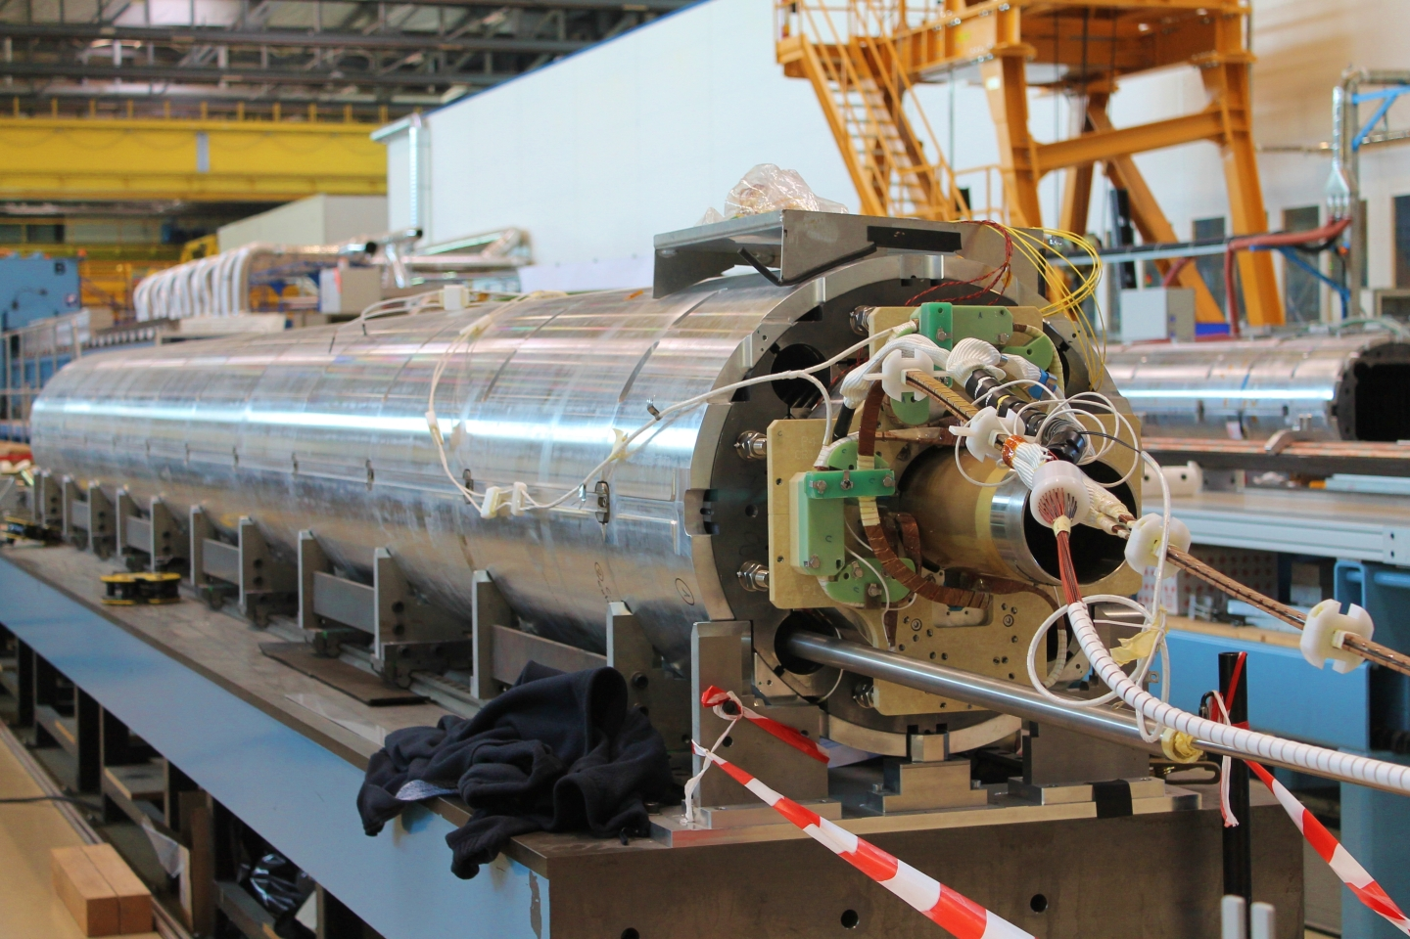
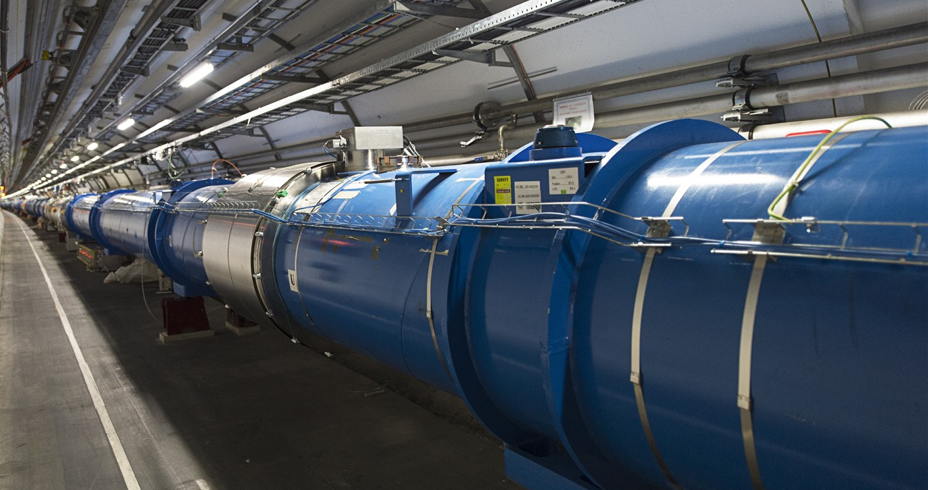
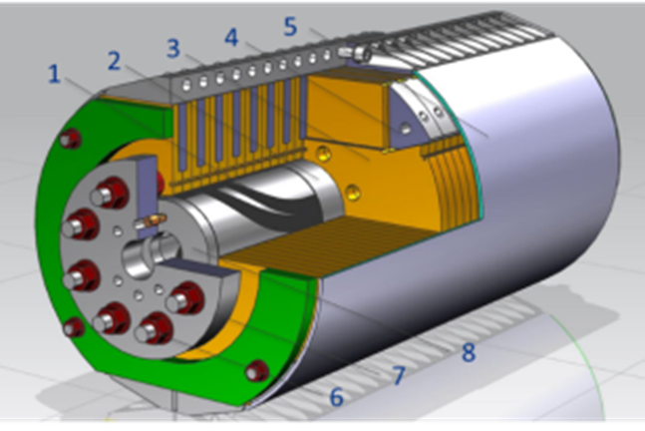
IRIS project scope -1
Fundamental Physics instrumentation
Superconductivity has been instrumental for the discovery of the Higgs boson and its development will be critical for future accelerators and we need of adequate infrastructure to sustain this.
LHC dipoles (8 T) in the tunnel
HiLumi MQXF quad (12 T)
FCC (12-16 T)

Slide 7
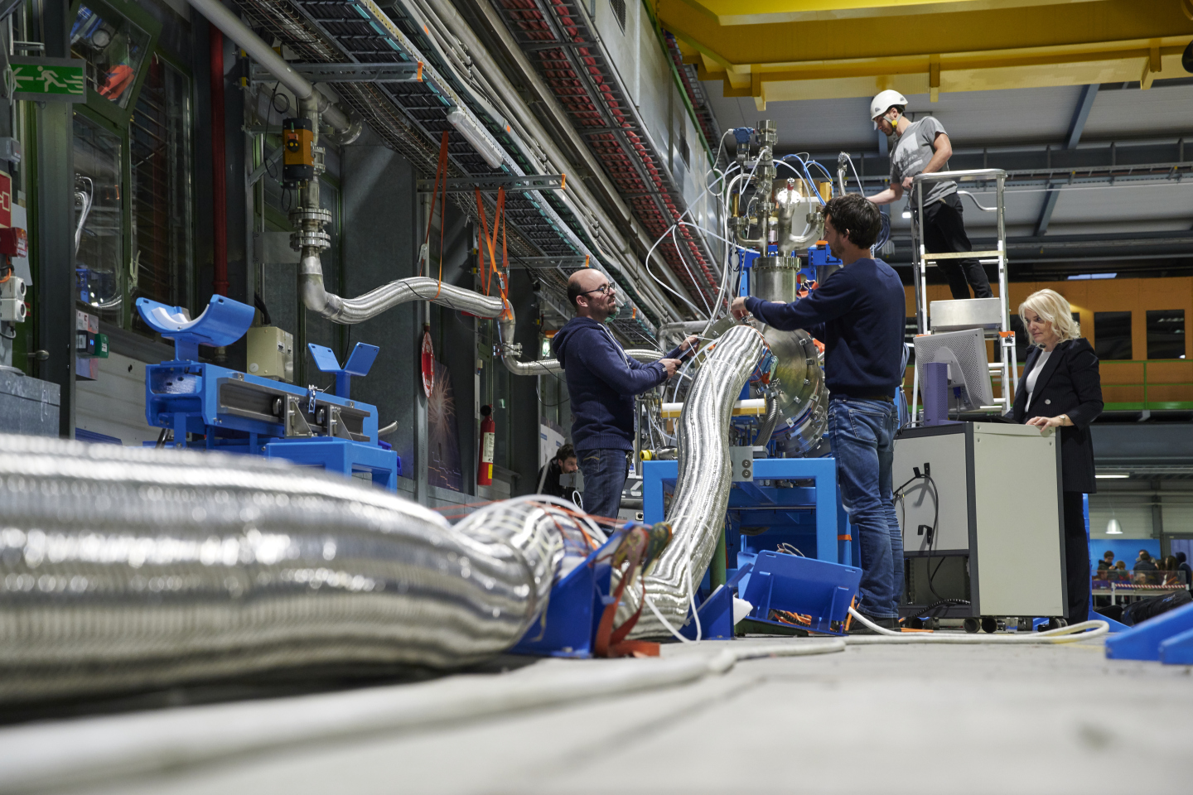
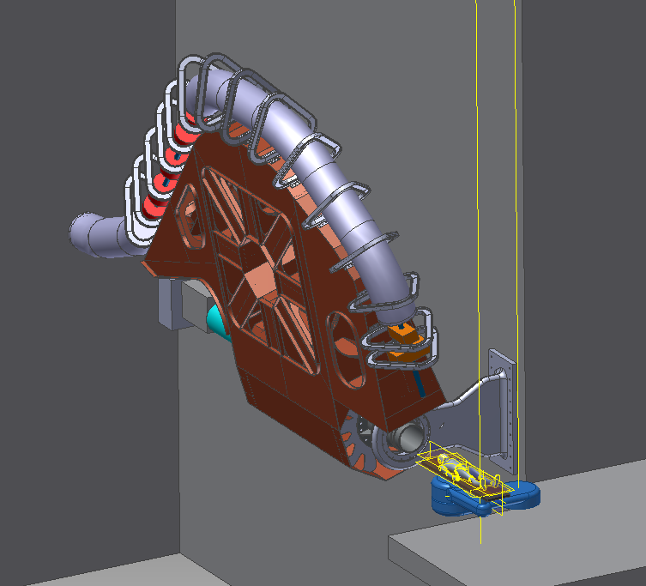
IRIS project scope -2
Societal Applications
Green Energy and Medical
Green : energy transport at zero emission and energy saving magnets.
  important for society but also for the sustainability of our research infrastructure
Medical: Superconductivity could play a key role in heavy ion therapy by enabling a rotatable gantry
Courtesy A. Ballarino - CERN
Courtesy M. Pullia (CNAO –Italy)

Slide 8
WP1 : Project Management and Technical Coordination
Management
Coordination among various poles and WPs
Remote controls and remote access to instruments
Preparation of IRIS operation (open access, sources of funding, etc…)
Training

Slide 9
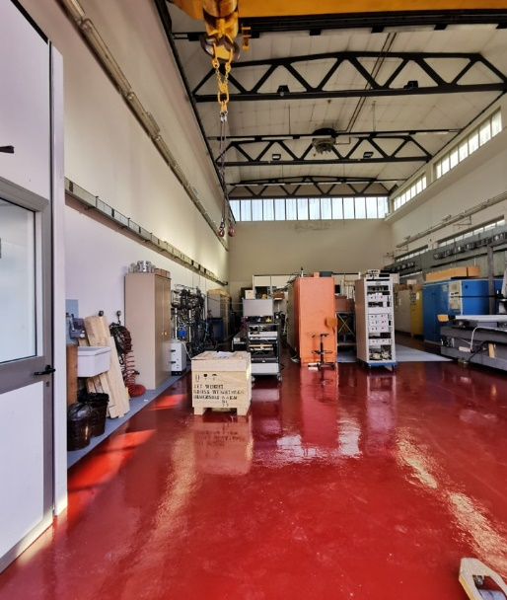
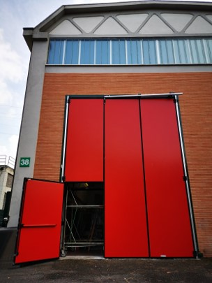
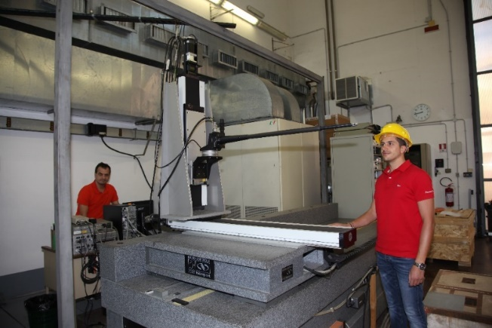
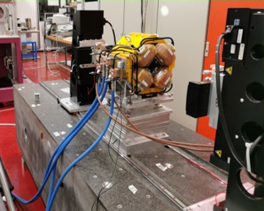
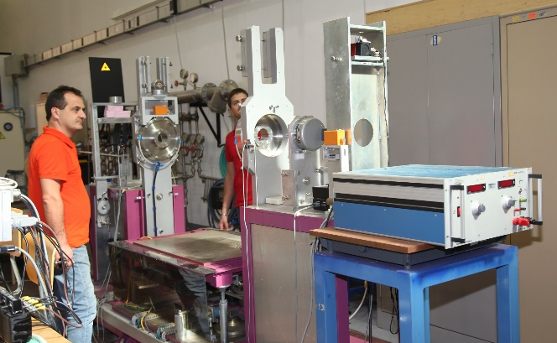
WP2 – Frascati
INFN-LNF
WP2- Magnetic Measurements Laboratory @ LNF
The INFN-LNF magnetic measurements laboratory, about 200 m², with 15 T crane has already :
a Hall effect digital teslameter with a 5-axes movement device on a granite bench;
a stretched wire bench for integral measurements of fields and mechanical fiducialization;
a rotating coil multipole measurement system; an NMR teslameter.
Several other ancillary instruments are available, such as gaussmeters, integrators, etc…
Hall probe mounted on the coordinatometer
Stretched wire bench
Rotating coil bench

Slide 10
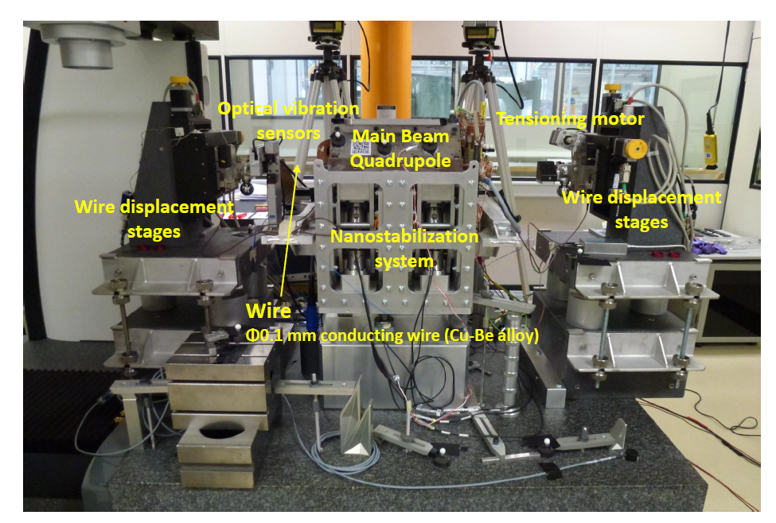
New instruments: Vibrating Wire

Slide 11
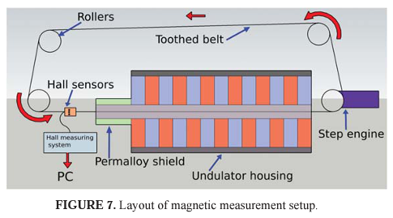
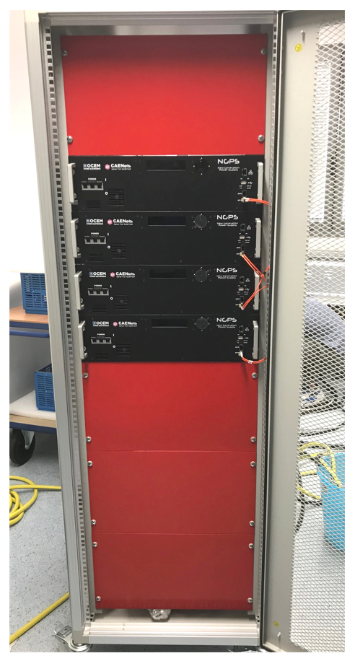
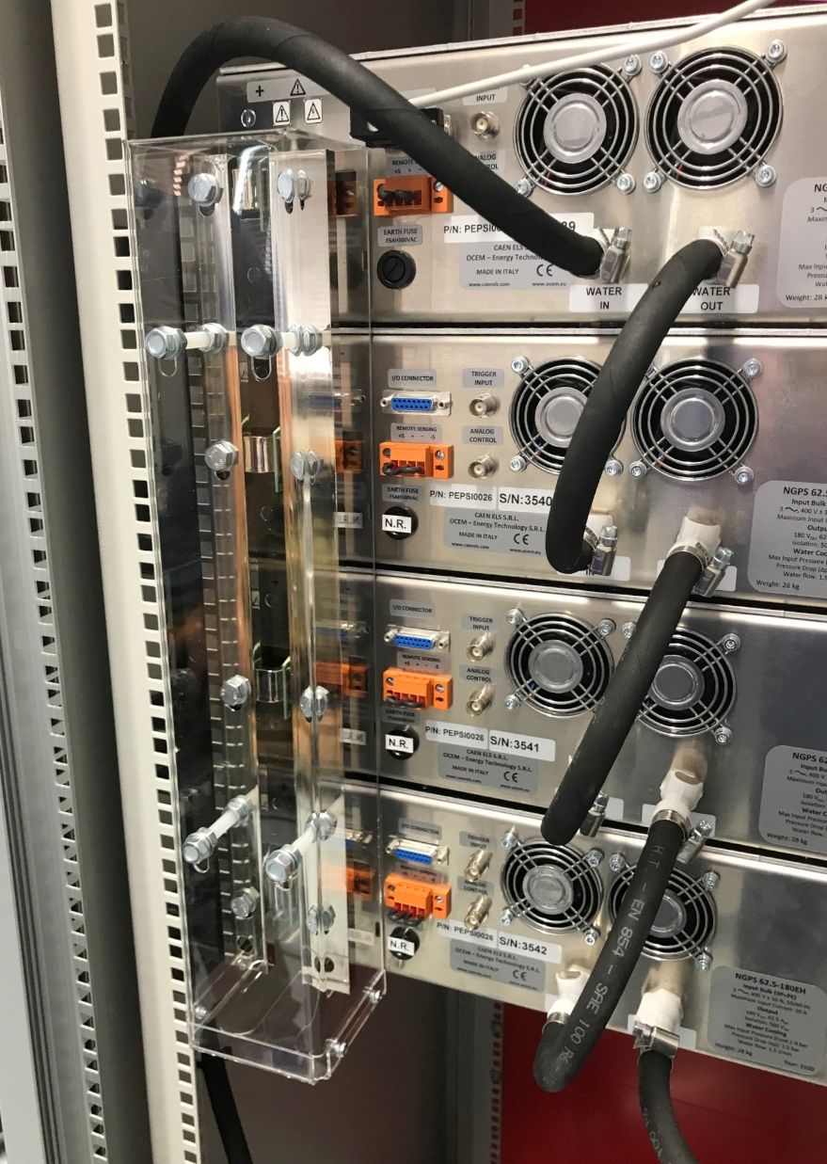
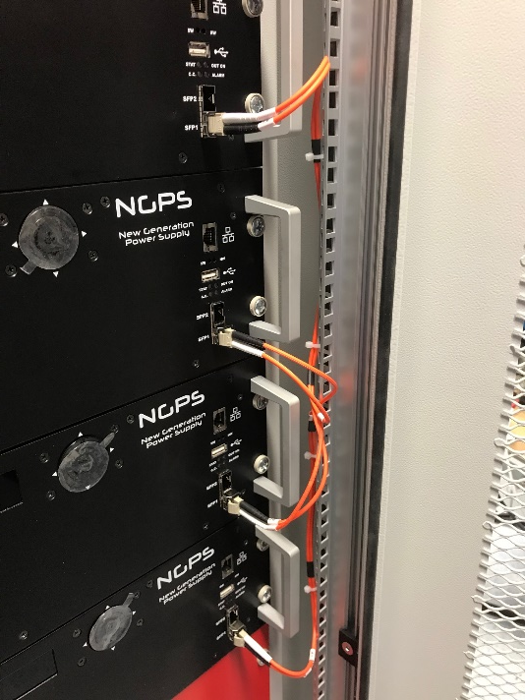
New instruments: Hall probe Mole and Modular PS

Slide 12
WP3 – Genova INFN, CNR-SPIN, UNIGE-DIFI
Collaboration among the three Insitutes ha sbeen formalized (ante-IRIS) with a new Joint Research Lab : LabCoR
INFN
  Characterization of very high current cable
  Design of SC magest for accelerators and Detectors
  Industrial Folow-ip of the SC magnets Construction
  R&D on future Magnets
CNR-SPIN
  Study of Sc materia for application
  Development of SC wires
UniGe – Phsics Dept.
  Research on SC material

Slide 13
WP3 – Genova – continue INFN, CNR-SPIN, UNIGE-DIFI
Scope
Renewal and better efficiency of the LHe plant
Renewal of part of the existing laboratory
Purchase and instlalatinof new modern equipment
Training of new researchers

Slide 14
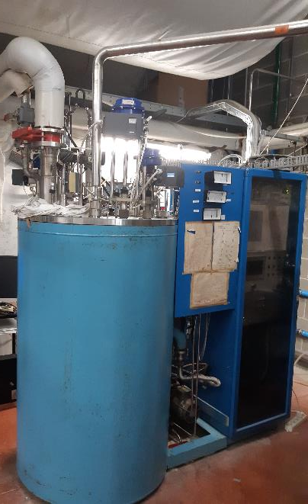
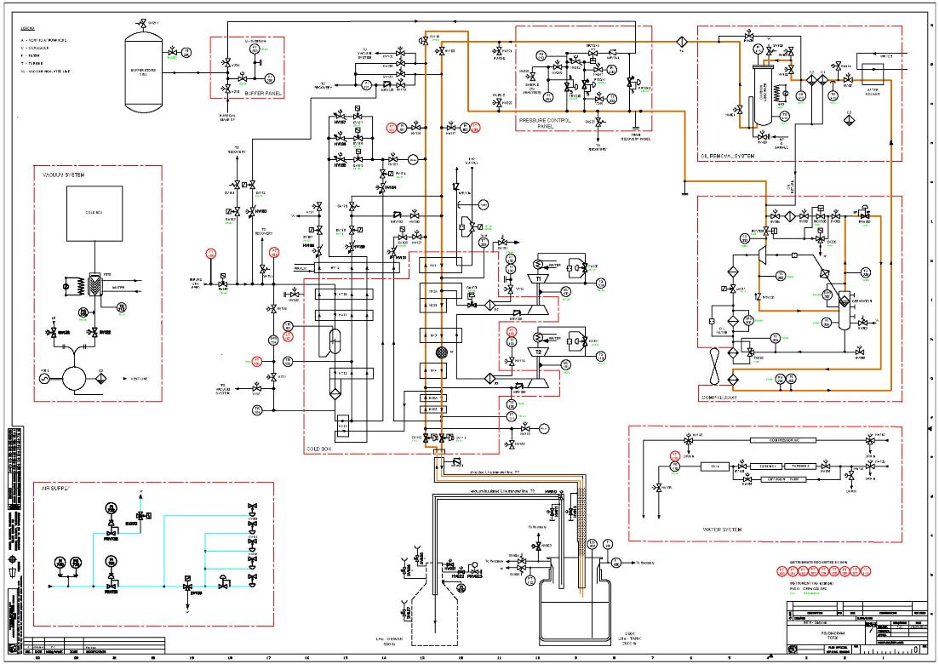
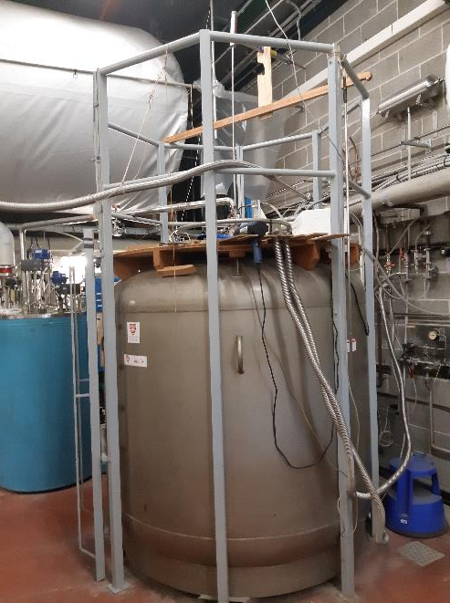
INFN-GE lab LHe plant
Pressure control panel
Buffer
Compressor
T1
T2
Purifier
Cold box
Storage
dewar

Slide 15
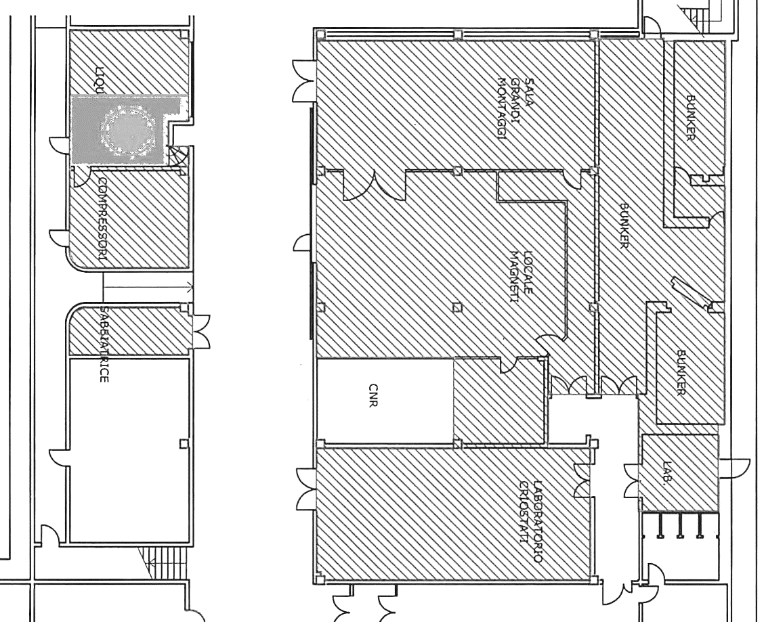
INFN-GE lab with LHe plant
Spazi criogenia
Spazi lab
Stazioni di misura
liquefattore
Cabine di controllo
Palloni di recupero

Slide 16
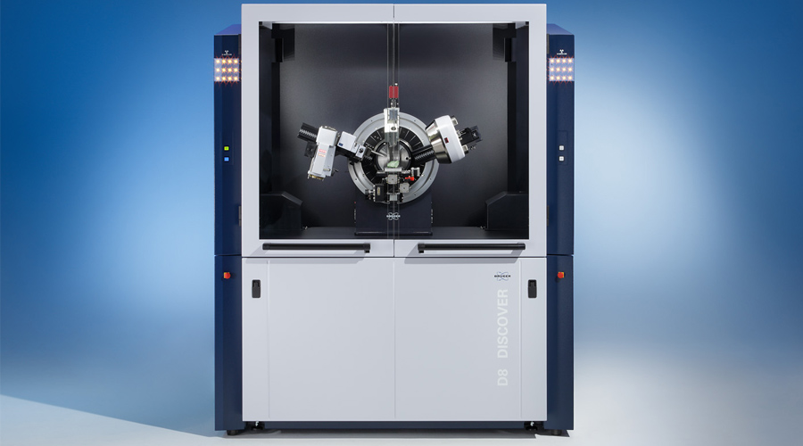
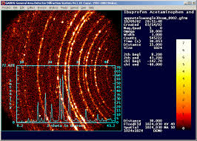
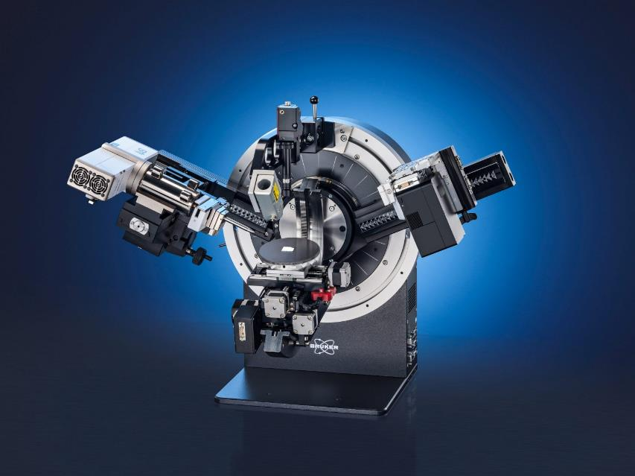
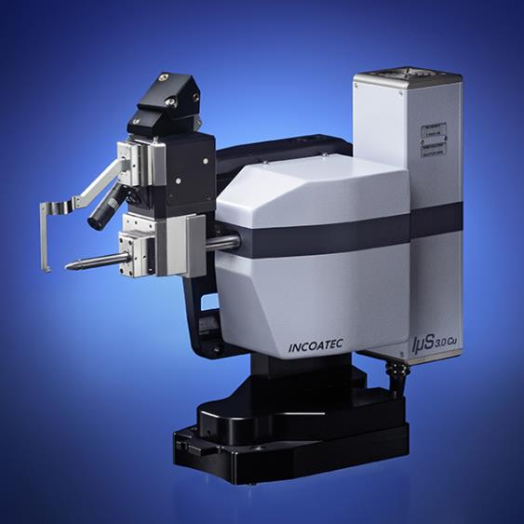
CNR-SPIN Lab
X-Ray diffractometer
Structural analysis of Superconducting materials

Slide 17
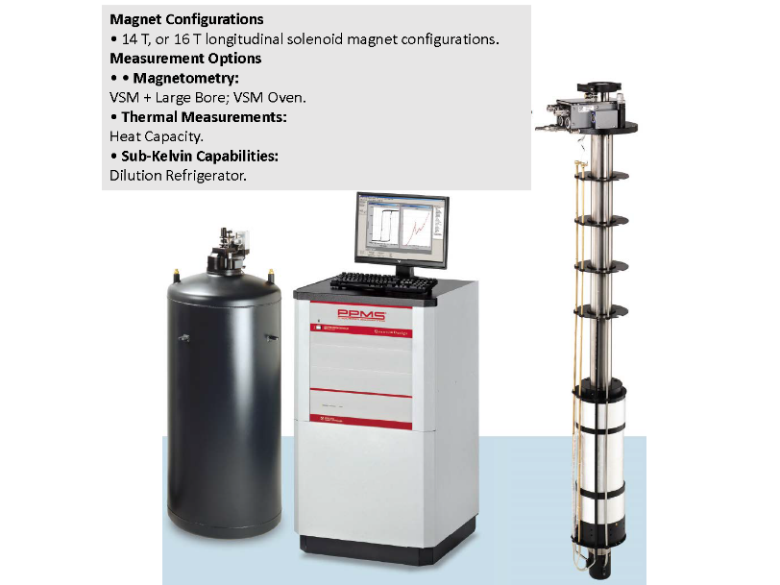
Unige - DIFI
UNIGE Physics Department:
Renewal of cryogenic plant (He gas recovery abd LN distribution)
New test station fo thermal capacity measurements in high magnetic fields for research of new SC materials

Slide 18
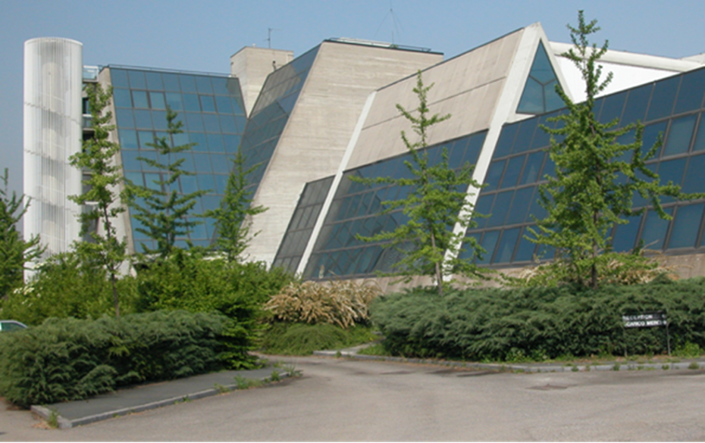
WP4 – Milano LASA - INFN-Milano, UNIMI-DIFI
Laboratorio Acceleratori & Superconduttività Applicata
  SC magnets and SRF cavities
Also photocathodes and other activities (BriXino, radionuclides studies)
(old) LHe plant to be renewed in the next 2 years
About 25 people active in applied superconductivity → 40 with IRIS
It is “only” a building, not an Institution: it belongs to Unimi, co-managed by INFN-Milano and Unimi-DIFI
It is National R.I. as INFN infrastructure (in the list of PNIR as medium priority)

Slide 19
Main activity WP4
Re-vamping of the exiting equipment in the main hall for SC magnet test
  (INFN) Revamping of the existing SC magnet test facility (for bare magnets) up to 20+ kA
  (INFN) Addition of VTI for magnet tests, new power lines, etc…
(DIFI) New building for a Superconducting Magnet Laboratory open to other labs and Industry to support new projects (FCC, MuCol, other) and novel ideas
(DIFI) Metal AD equipment to support prototypal activity
(INFN) A complete set of new equipment for manufacturing small/medium size SC magnet

Slide 20
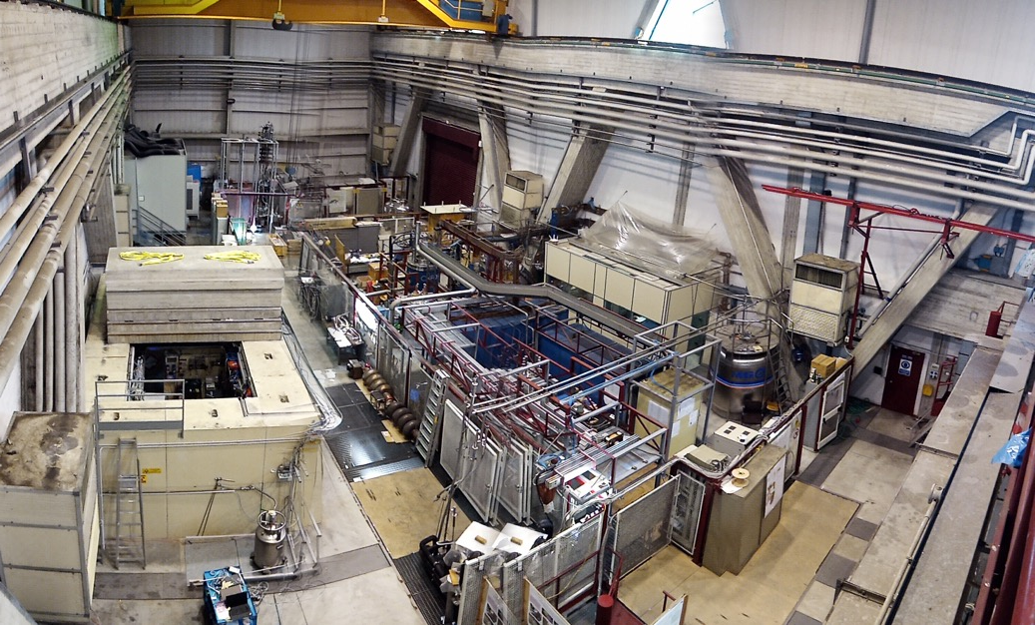
LASA Hall
High field solenoids
SC wire testing area
High current PS
Test Station for long magnets & High Current

Slide 21
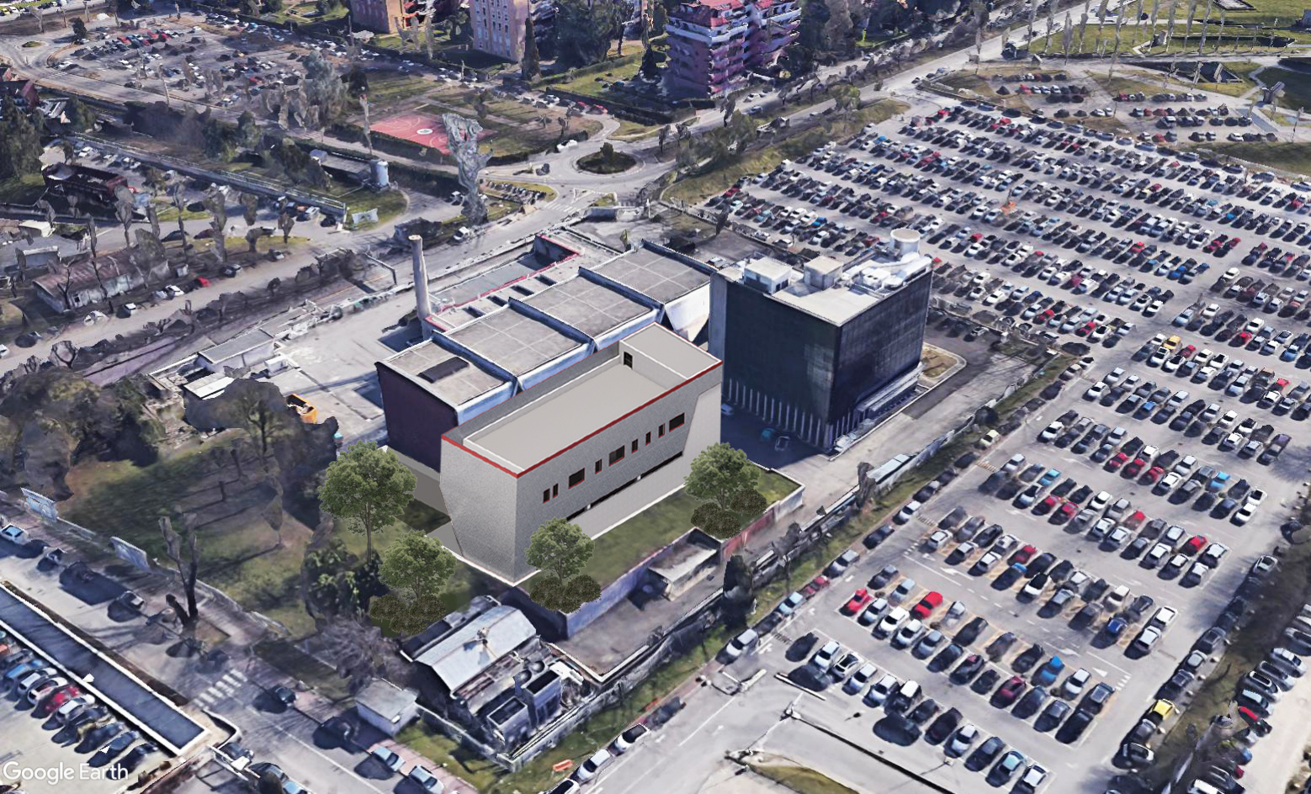
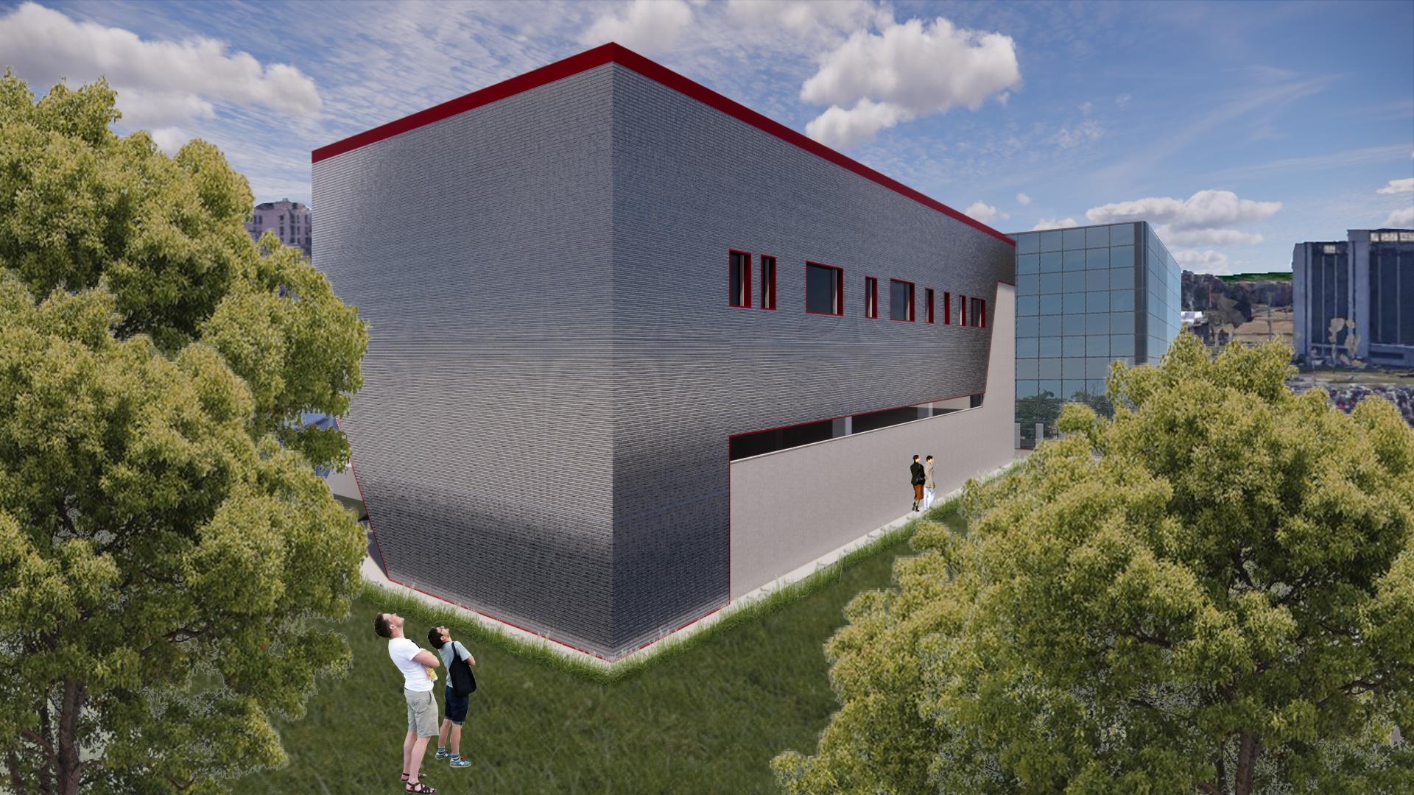
400 m2 surface building
2 floors (+ underground bunker)

Slide 22




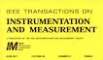


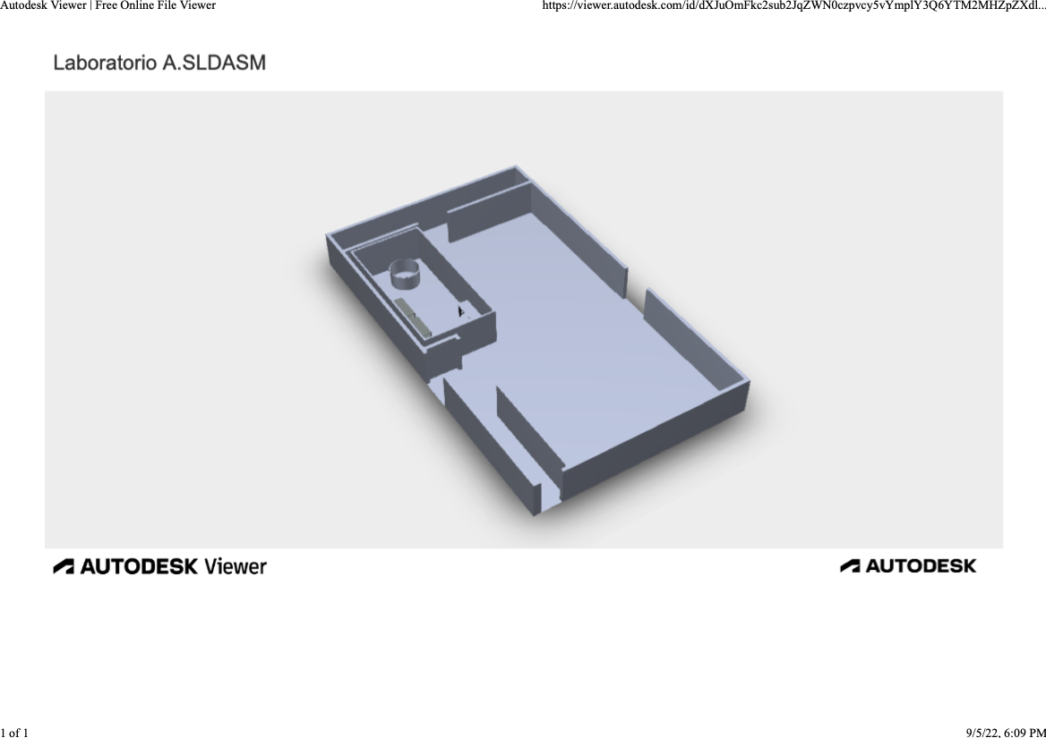
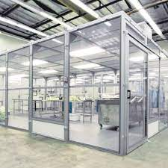
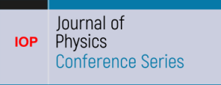






WP5 – Napoli – CIRMIS IMPALAB expertise
Magnetic measurements
Measurements on superconducting cables
Cryogenics
Aims new lab
  Extend the current instrumentation and measurement procedure for superconducting magnets and cable
  Improve the metrological feature of the measure
  Develop new procedures for facing the state of the hard challenge for LTS and HTS
2x
3x
2x
3x
7x
17.6 m
11.4 m
13x

Slide 23
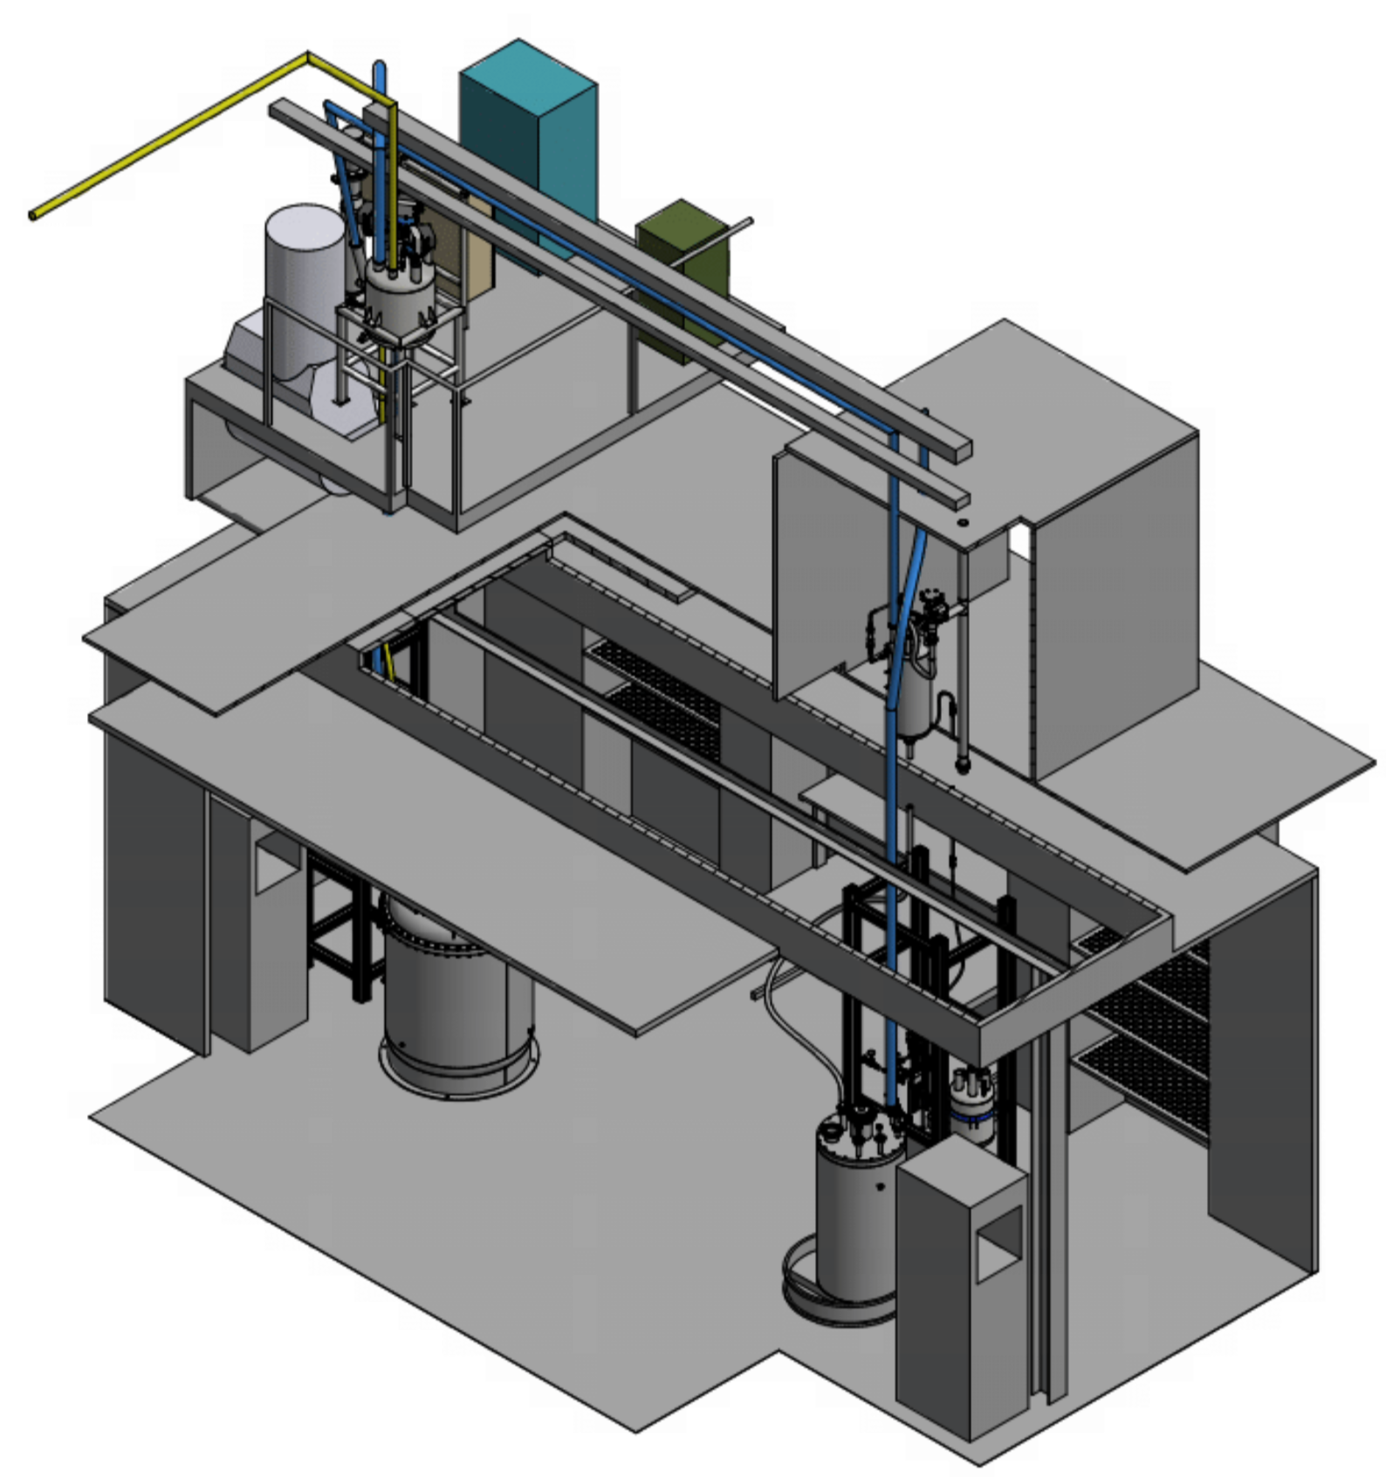
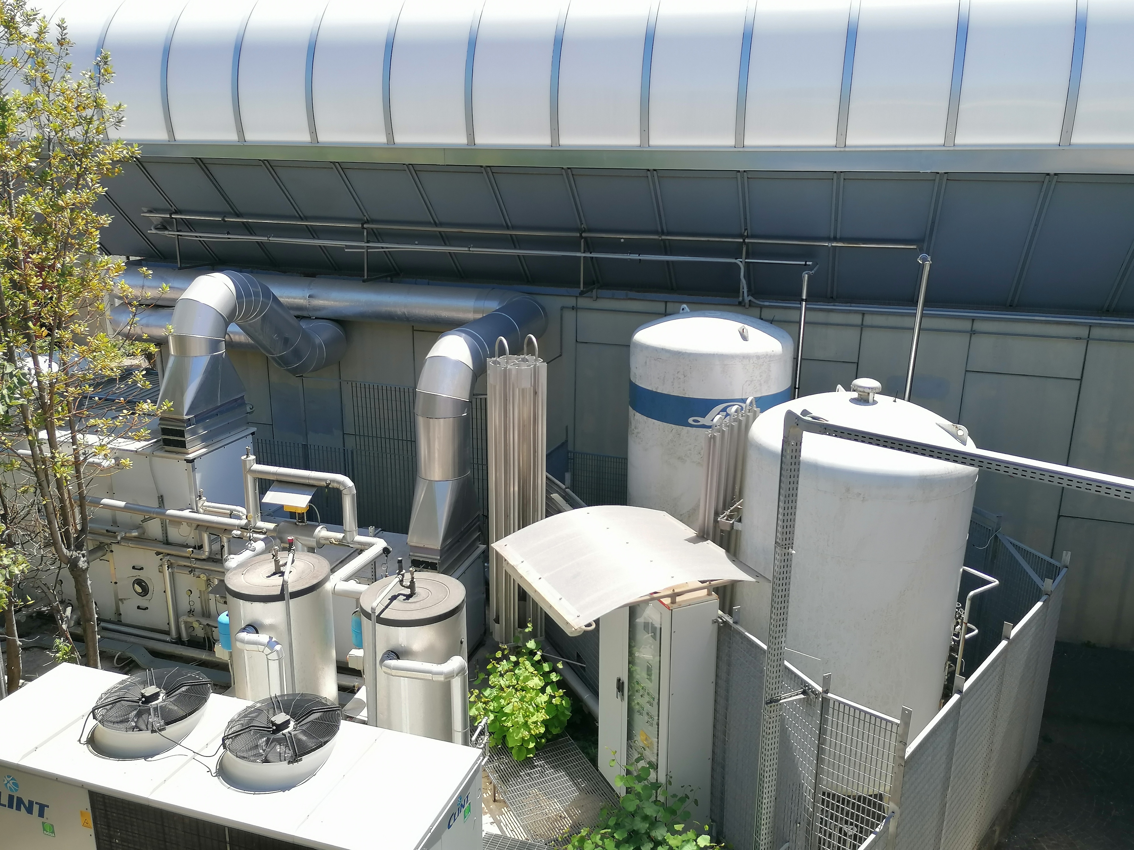
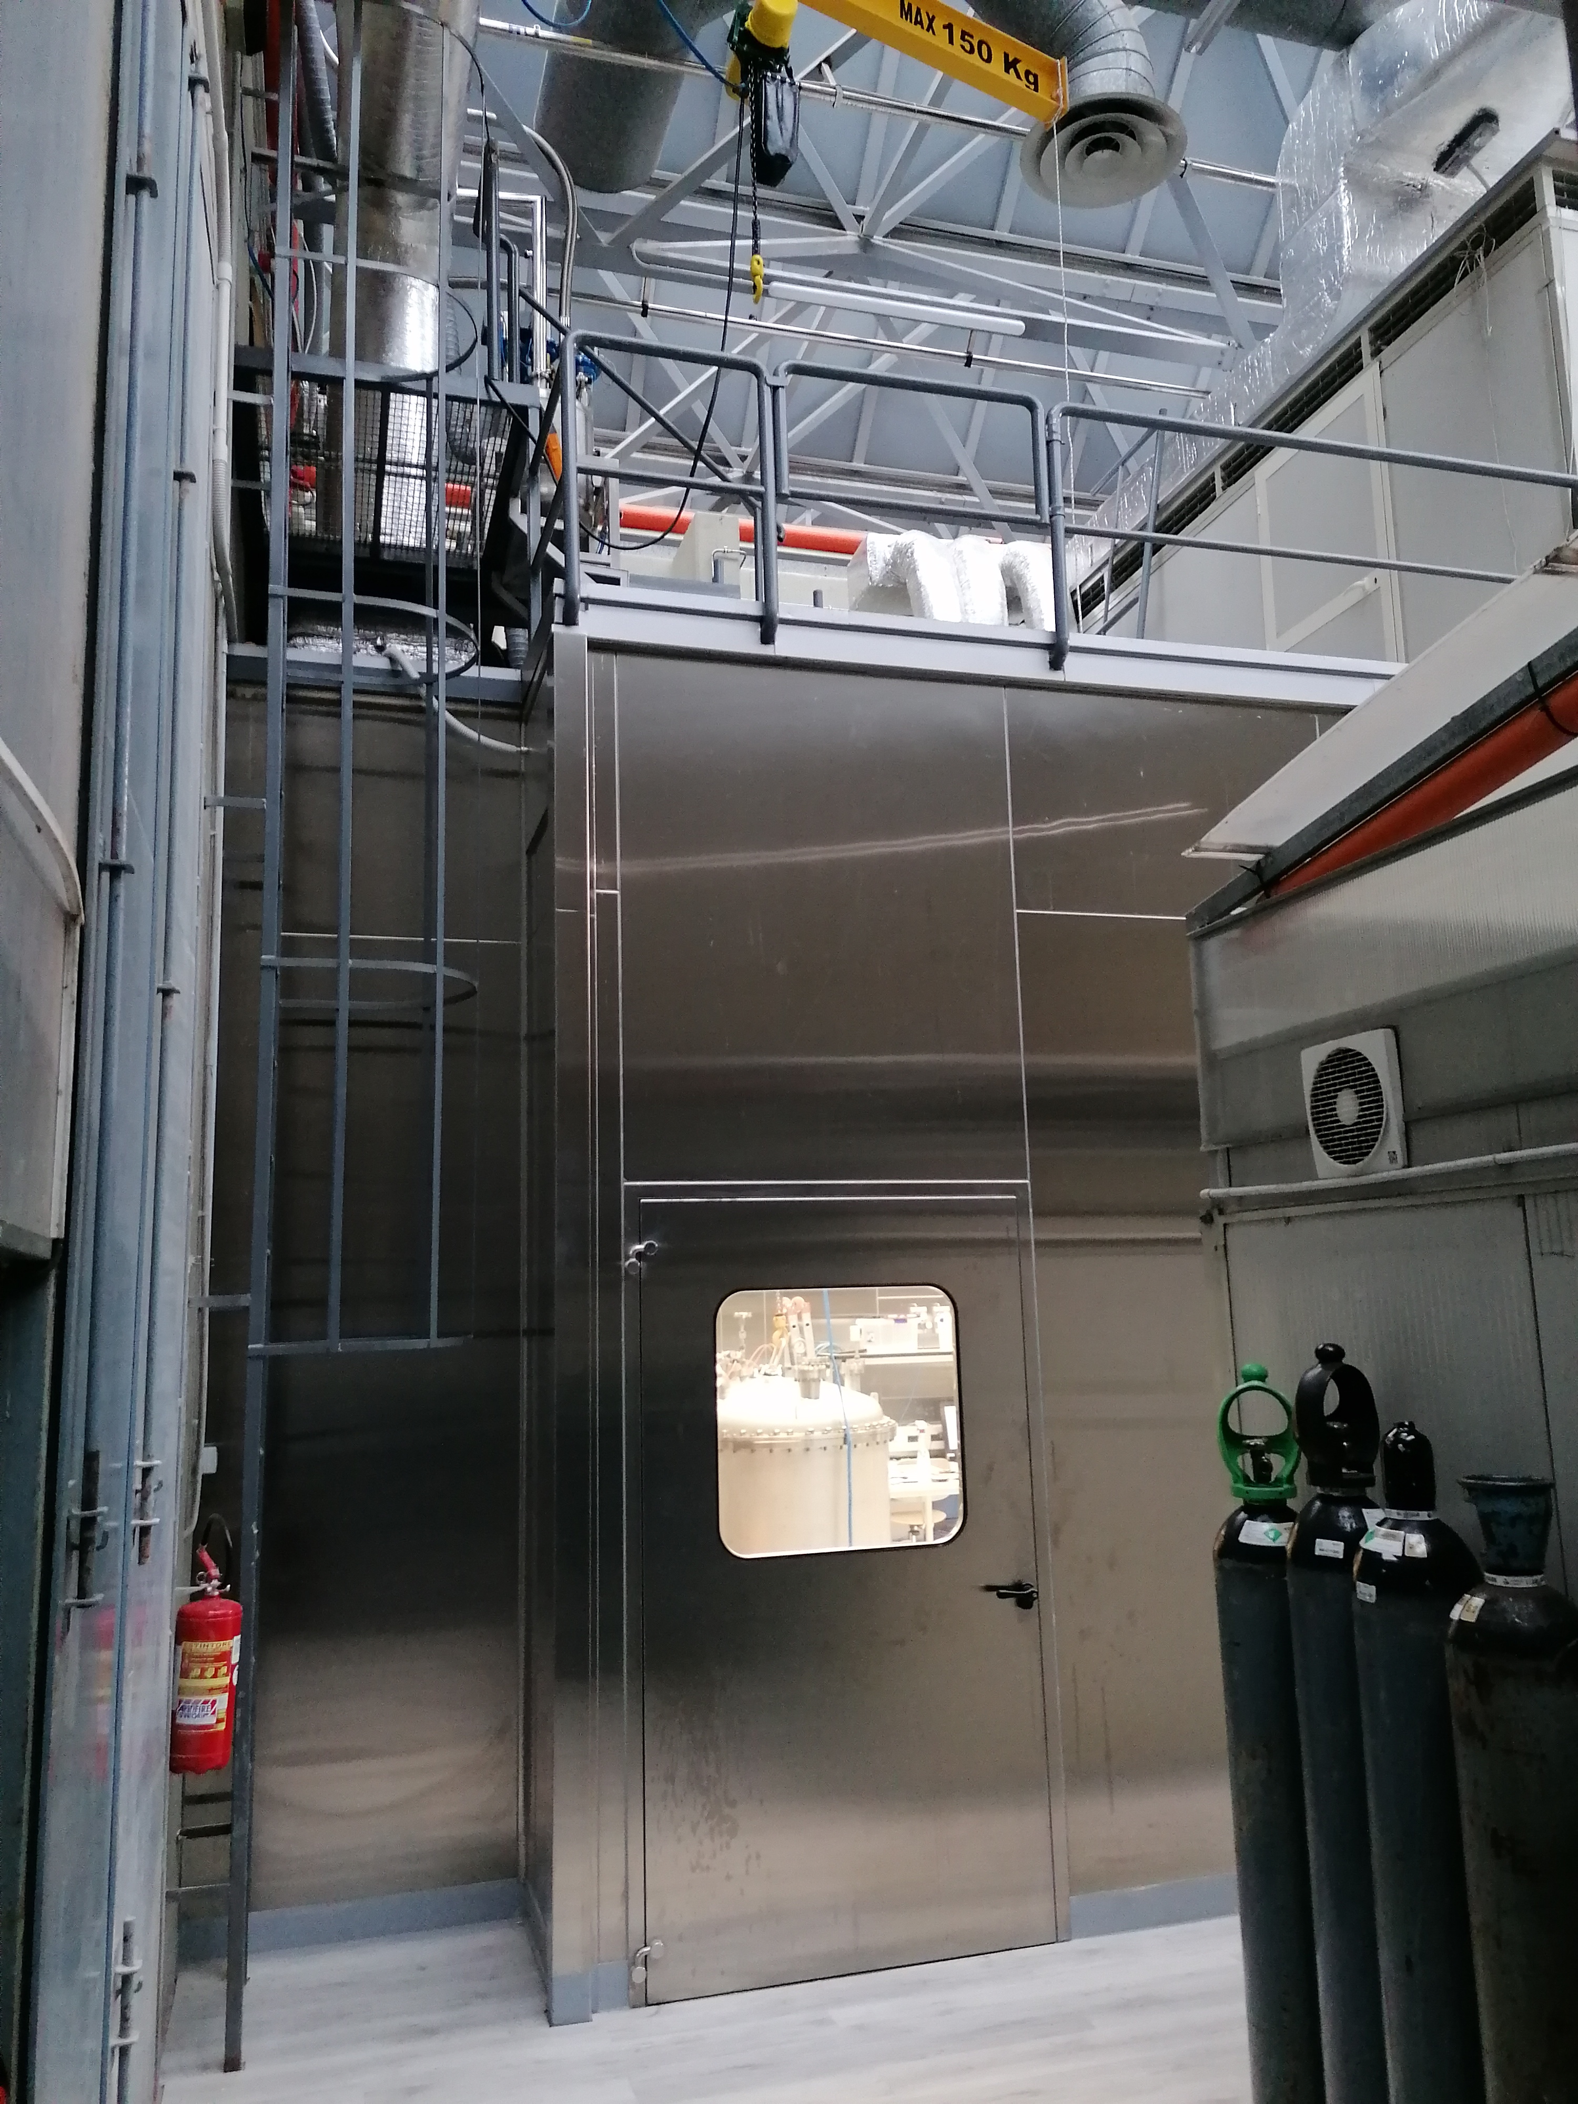
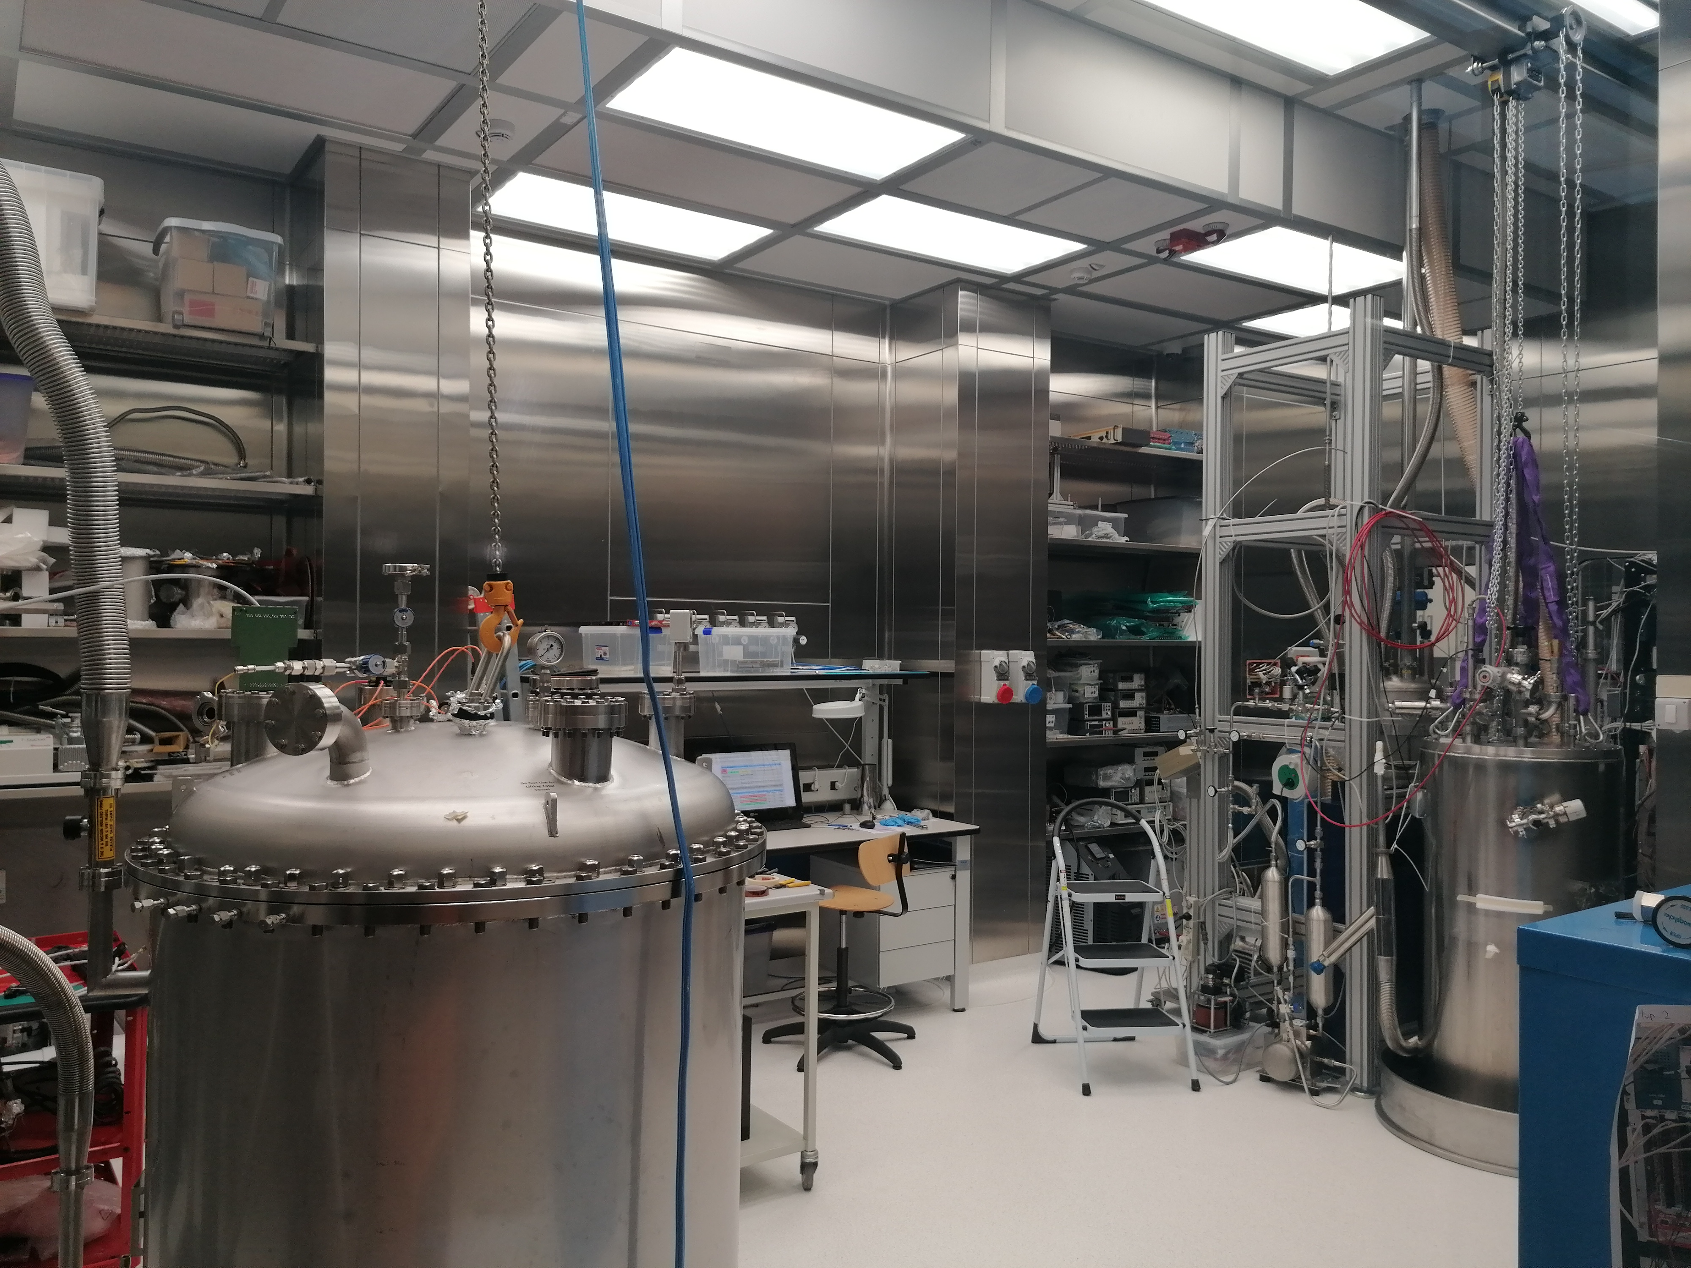
WP5 – Naples CRYOLAB
Light Detectors Test
Stand alone cryo system
Vacuum and cryogenic equipment
New
  Clean area for vacuum system and material deposition (Hardwall clean room approx. 6x4 m2)
  Liquid nitrogen cryostat
  Cryoprobe
  Low-temperature calibration system
  Dry system for low-temperature characterisation
Cryogenic liquids storage

Slide 24
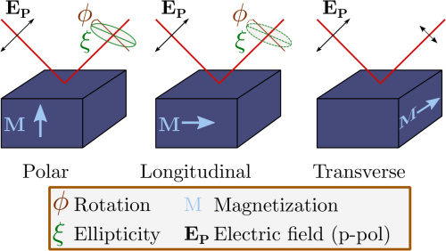
WP5- Naples CNR-SPIN – MOKE
Instrumentation for study SC with magneto-optic Kerr effect (Moke)

Slide 25
WP6 – Salento (Lecce) UNISALENTO- DMF
Magnetometry measurements under external stimuli such as light irradiation and electric fields for the characterization of innovative materials [novel setup expected to attract users working in the fields of advanced magnetic materials with controllable bistable states and investigating the interplay among magnetism and superconductivity] +50% users
Measurements of physical properties of materials (e.g. magnetotransport and measurements of critical currents) in a wide range of temperatures and magnetic fields [novel setup expected to attract users working on spintronics, superconductive devices, sensors/detectors and quantum computation] +50% users
Combined magneto-optical and ferromagnetic resonance measurements [novel setup expected to attract users working in the fields of magneto-optics, magnonics and quantum computation] +30% users
AFM, MFM and PFM microscopy measurements for the characterization of superconducting, magnetic and multifunctional materials novel setup expected to attract users working in the field of advanced functional materials, spintronics and applied superconductivity] + 30% users

Slide 26
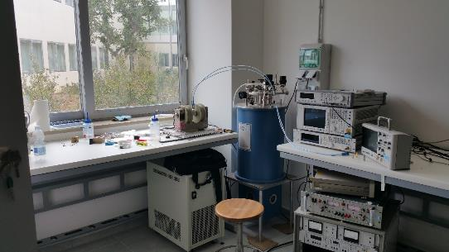
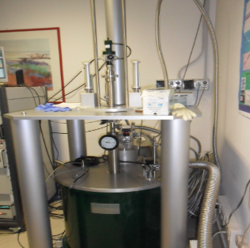
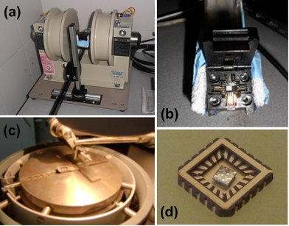
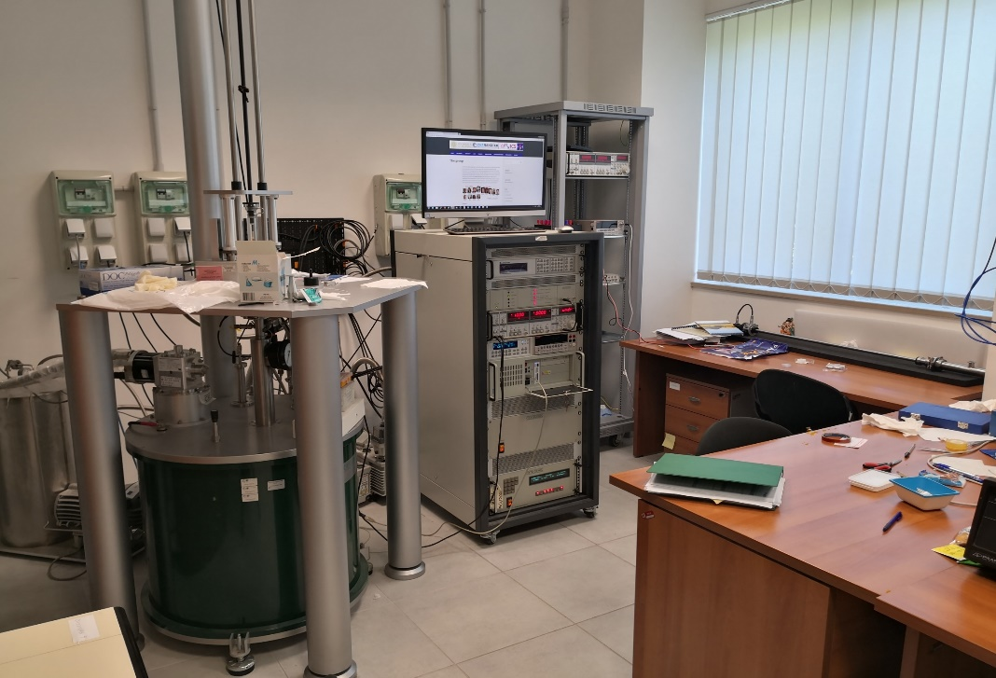
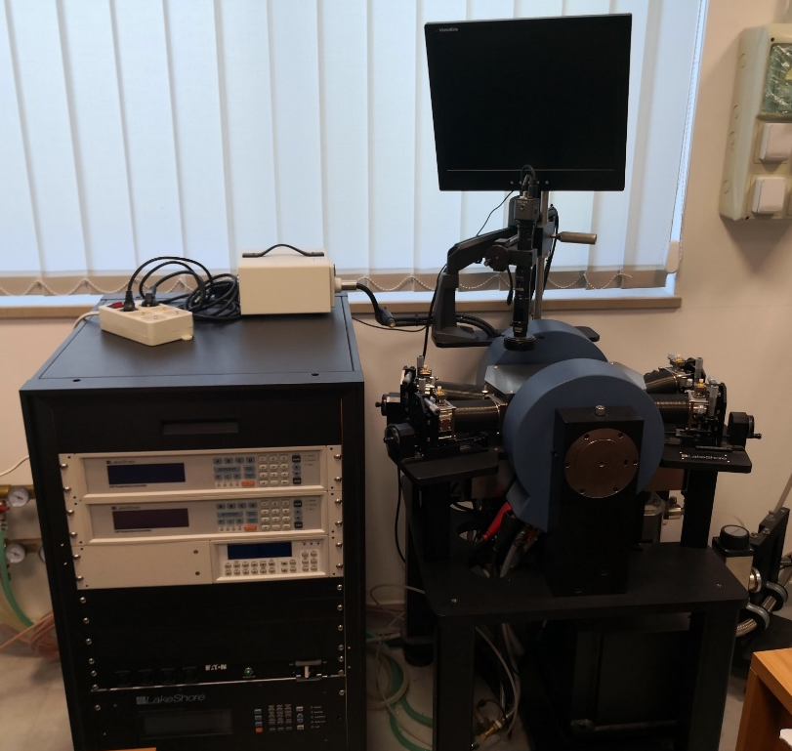
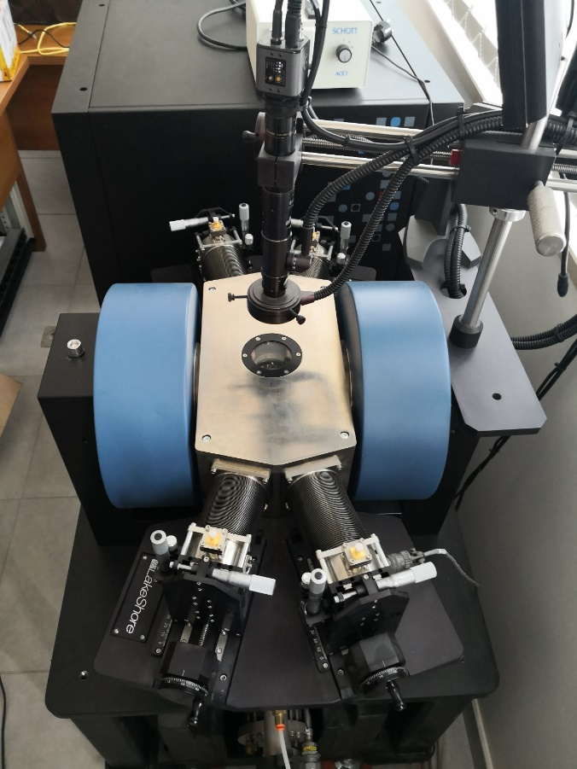
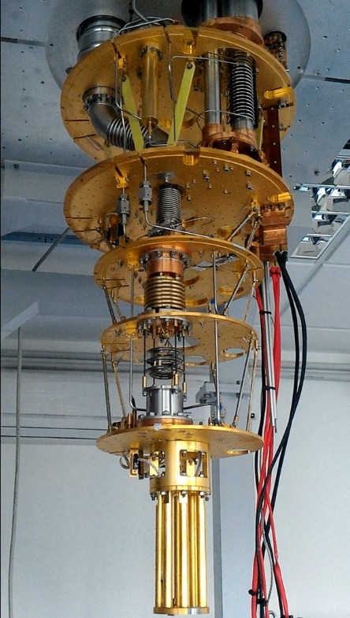
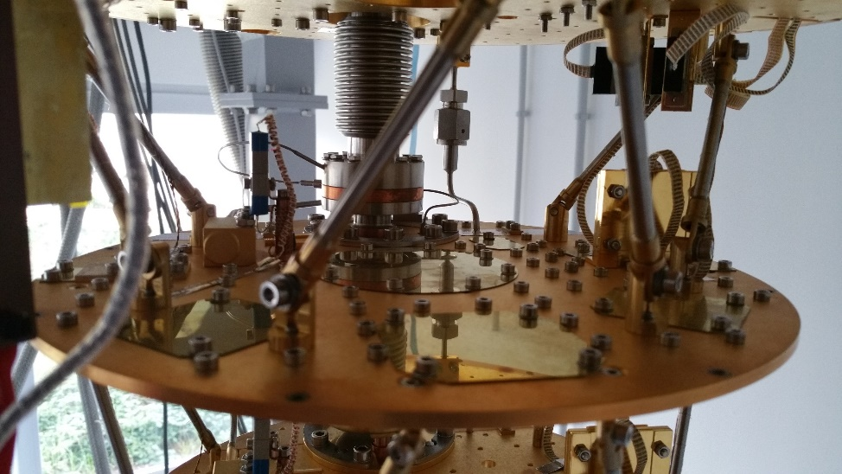
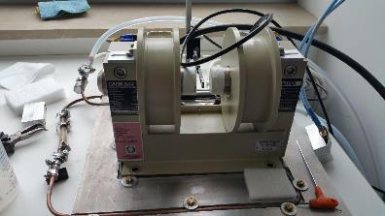
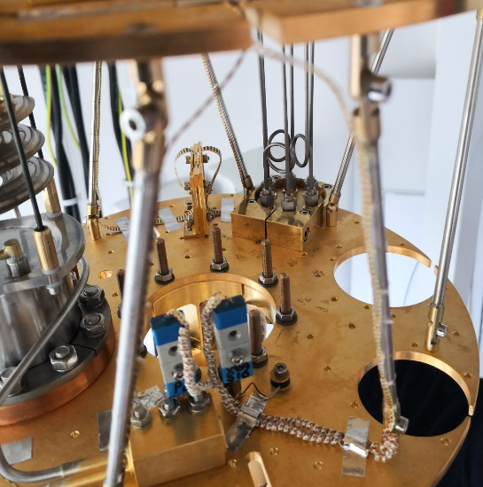



WP6 – Laboratory for Superconductivity and magnetism
Cryogenic superconducting magnet (10.5 T, 0.3-300 K)
Oxford dilution refrigerator (down to 10 mK, vector magnet 6T/1T/1T)
Lakeshore Cryogenic RF probe station (down to 8 K and up to 0.5 T and 70 GHz).
Italian node of the European Infrastructure on Magnetism EMHFL-ISABEL (funded within ISABEL project, H2020-INFRADEV-2018-2020, Grant No. 871106).

Slide 27




WP6 – Salento – Laboratory of superconductivity and Magnetism
development plan
close-cycle superconducting magnet for physical properties measurement
scanning probe microscope for material characterization
close-cycle SQUID magnetometer
split pair cryogen-free magnet system for combined magneto-optical and FMR measurements

Slide 28
WP6 – Salerno
INFN-NA-G.C.Salerno, CNR-SPIN- UNISA
INFN-Salerno with UNISA has built and commissioned a new SC Magnet test facility in the last 5 year, THOR
It is used at present for testing GSI – SIS100 SC multiplets
With IRIS the INFN/Unisa facility will evolve by:
  Increasing the cryogenic power for SC magnets
  Ability to test magnets not only at Supercritical He flow and ability to test magnets of LHC/Hilumi/FCC size (however, no HEII at te moment)
  Adding a new test facility for Green SC Lines : up to 25 kV – 40 kA (1 GW),20 K He gas, with a dugout for cable as long as 140 m

Slide 29


THOR Lab

Slide 30

WP7 – Salerno – INFN & DIFI lab : present and IRIS extension
Present
Future with IRIS

Slide 31

WP7 – Salerno CNR-SPIN
The SPIN Salerno Unit aims to acquire and setting up a magneto-transport measurement system including the application of strain and stress.
The equipment for magneto-transport (e.g. Quantum Design PPMS) consists of a variable temperature (1.9 to 300 K)-field (up to ±9 T) system, designed to perform a variety of automated measurements.
Additional elements to be acquired within IRIS are cryogenic strain and stress cells (e.g. Razorbill Instruments), which are fully compatible with the PPMS probe.
The main goal is to strengthen the capacity for investigating the role of strain/stress on the transport properties of superconducting materials.

Slide 32
We need to reduce the project in 3 days (not easy with a distributed infrastructure over 6 poles)
75 → 60 M€: keep all poles/partners, 60 M€ include taxes → 50 M€ net budget
To cope with requested reduction:
We have considered to modify part of the scope of demosntrators:
Reducing the current from 50 to 40 kA, compensated by an increase of voltage from 20 to 25 kV, which make it easier and allows for a small reduction of the budget, at constant goal of P= 1 GW
Energy saving HTS Magnets: it is a difficult goal, given the time frame. To help a budget cut we changed the scope. From 10 T - 150 mm → 8 T – 80 mm; preserving the aspect of energy saving (10-20 K)
Civil Engineering. The new constructions are in Milano and Salerno. In Milano we have re-modulated the project and considered a simple industrial building (a “hangar” ). Salerno will simplify the C.E. scope, too, with one building only instead of two.

Slide 33
Final Budget, signed with MUR
New table for ex-art. 15 agreement
I43C21000230006
IR0000003 -IRIS

Slide 34

Personnel to be hired on IRIS (Fixed Term contract, typically 30 months)
Figures to be updated…

Slide 35
IRIS project scope in addition to the poles:
2 Societal Applications
1. Green Energy
Green : energy transport at
0³ (zero cube) emission.
  Zero (almost) emission of CO₂ : consumption wil be 1% over 1000 km
  Zero emission of e.m. radiation (DC)
  Zero (almost) land consumption: a 50 cm underground pipe can carry the 5 GW power of 30 m High – 50 m wide overhead line.
Courtesy A. Ballarino - CERN

Slide 36


(courtesy of A. Ballarino, CERN, archive)
Left: Superconducting Line, in its flexible cryostat, 60 m , 100 kA – 3 kV, during successful test in 2020 at CERN for the High Luminosity LHC Project
Right: cabling a sub-element of a MgB₂ cable for High Luminosity LHC Project
Scope: Manufacturing a demonstrator capable of 1 GW DC, operated at 20 K and test it in “operative” conditions in a test facility that will then be available for other projects. 25 kV-40kA, 20 K; (50+ kV testing) - use of round wire MgB₂
Use: beside long-distance large electrical power transmission, significant place in the electric system for HVDC back-to-back system (study for placing the demonstrator in an Italian facility after the PNRR).
We will design the facility and this demo for cooling with He gas; however, in second stage after IRIS, compatibility with LH cooling will be investigated, too.

Slide 37












Manufactured with industrial cabling processes
IRIS 1GW DC 25 KV-40 kA power cable
Planetary assembling machine
for the final conductor
Lapping line for the HV insulation
and protection
Planetary cabling machine for the petal
d =1,33 mm
d =14,4 mm
d =43,2 mm
d =49 mm

Slide 38



Iris project design: 4x40 kA -25kV 20 K
Gaz He
Cryogenic
Outer Cryogenic wall ID 198/OD 220
Inner Cryogenic wall ID 127/OD 143
Characteristics
Length (m) | 75 m
Inner envelope diameter (mm) | 127/143
Outer envelope diameter (mm) | 198/220
Bending radius (m) | 2,2 m
Expected losses | 2,5 W/m at 20K (187,5 W)
P in | 20 bar
T In/T out | 18K/20K
Expected cooling power at 18 K≈330-370 W including the 2 terminaisons, cryo ends…
Mass flow: ≈15 g/s
Pressure drop ≈ 0,4 mbar.
LN₂ required for the current leads of the terminations.
Drum for envelope maximum diameter of 4,5 m
Vacuum chamber
Low thermal conduction spacer

Slide 39
Cable protototype to be installed in Salerno – IRIS WP7 station
The scope of the tender includes
test in sublements
FAT
Transport
Installation
SAT
(last three depends on WP7!)
Support by CESI (Milano) for the test protocols and procedures

Slide 40
IRIS project scope –
1. Fundamental Physics instrumentation
Superconductivity has been instrumental for the discovery of the Higgs boson and its development will be critical for future accelerators and we need of adequate infrastructure to sustain this.
LHC dipoles (8 T) in the tunnel
HiLumi MQXF quad (12 T)
FCC (12-16 T)

Slide 41





WP9 - Energy Saving HTS Magnet for Sustainable Accelerators: dipole 8 T; 80 mm; 20 K
Cable in HTS for da 10 kA, developed in the EU collaboration FP7-Eucard2 GA 312453
Courtesy of J. van Nugteren
First small demo at CERN by
J.van Nugteren, G. Kirby and T. Nes
The record field for HTS dipole (with accelerator quality) is Eucard2, 4.5 T stand alone, 16.5 T with background field (then failure)… time to explore HTS for dipoles.
Scope : a dipole rated for
8 T – 80 mm bore – 10-20 K operation as background field for cable test. Controlled Insulation.
As technology driver for 15 T – 20 K operation for FCC or Muon-C
IRIS HTS dipole: 10 T – 20 K
Aperture 80X50 mm
700 mm straight section
12 mm wide REBCO tape (stack)
1.2 MJ stored energy
10 K temperature margin
11 km of 12 mm wide HTS tape
550 A/mm² cable current density

Slide 42


Revising to a simpler design, the main scope is to test:
1) operation of dipole with cryogen-free technology
2) non-insulated (better: Controlled-Insulation) technology in dipoles
The dipole will be installed in Genova – IRIS WP3 facility

Slide 43


The optimization of the dipole’s cross section focused mainly on two configurations.
The Helmholtz-like double pancake racetracks (sketched in top-left picture) achieved the following simulated performances:
  Field quality ∆B_{y}/B_{y0}: 0.018 *
  Iron yoke volume: 0.27 m³
  Use of HTS tape ~ 12 km
0.5 m
y
x
* (along x-direction of the aperture)

Slide 44


The second X-section configuration aimed at investigating the possibility of placing the coils on the mid-plane (scheme in top-left picture).
The achieved simulated performances are the followings:
  Field quality ∆B_{y}/B_{y0}: 0.04 *
  Iron yoke volume: 0.12 m³
  Use of HTS tape ~ 14 km
0.64 m
0.34 m
y
x
* (along x-direction of the aperture)

Slide 45


Charging model (Controlled-Insulation coil)
The dipole is intended to operate between 2-10 T.
A charging model is being developed to give an estimation of the charging time of the system.
The picture shows the results of the charging model developed for the HTS magnet AMaSED-2 (300 m wide race track, peak field almost10 T) for a temperature of 20 K.
Charging model results for AMaSED-2 – Magnus Dam

