Slide 1
Madmax: Large Dipole Dectector for Dark Matter
W. Abdel Maksoud, C. Lorin, C. Berriaud, V. Calvelli, R. Correia Machado, L. Denarie, G. Dilasser, Y. Drouen, U. Duranona, P. Godon, R. Godon, Q. Guihard, S. Kassab, S. Jurie, F-P. Juster, J-P. Lottin, F. Molinie, F. Nunio, T. Pontarollo, L. Scola, L. Segrestan, N. Solenne, F. Stacci –– DRF/IRFU

Slide 2



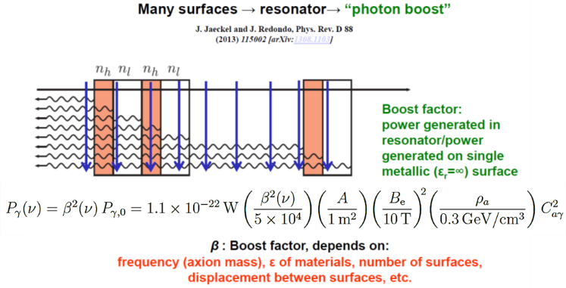

Context: innovation partnership with MPI around Dark Matter Axion physics
TARGET:
~ 100 T²m² → ~ 10 T in 1 m²
Courtesy of Max Planck Institue (B. Majorovits)

Slide 3
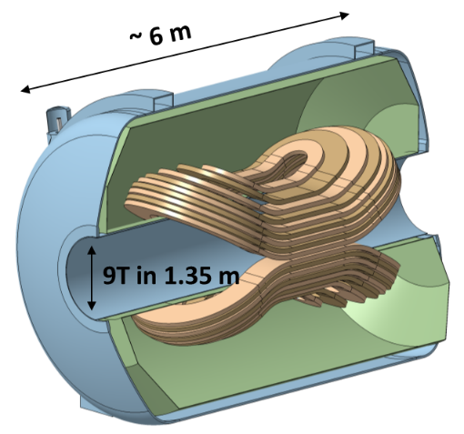
General specification of the magnet
Design Magnetic design Mechanical design Conductor design
Manufacturing aspects Winding issues Casing issues
Conductor R&D Copper profile shape Cold work
Quench propagation R&D Design Manufacturing & integration Test results
Physics specification | Value
“Ideal” FoM | ~ 100 T²m²
Booster length ‘L_{b}’ | 1.3 m
Bore diameter | 1.35 m
Dipole Field | ~ 9 T
Homogeneity (z=0) | ± 10%
Maximum overall length | 6.9 m
Maximum overall weight | 200 t
Magnet specification | Value
Superconductor | NbTi
Operating temperature | 1.8 K
Load Line margin | 10 %
Temperature margin | 1 K
Allowable VM stress | 180 MPa
Hot spot | 100 K
Discharge voltage | ± 1 kV
Maximum current | 30 kA

Slide 4
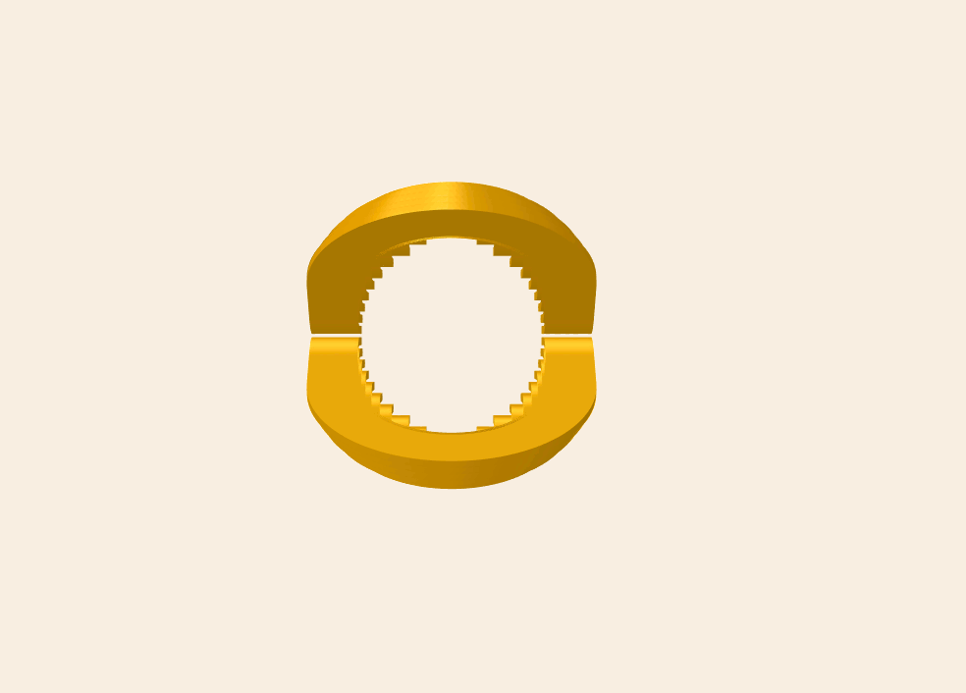
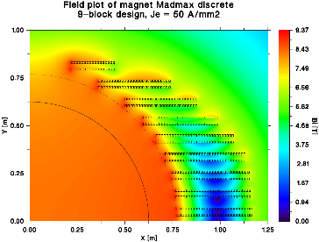
Magnetic design
Design Magnetic design Mechanical design Conductor design
Manufacturing aspects Winding issues Casing issues
Conductor R&D Copper profile shape Cold work
Quench propagation R&D Design Manufacturing & integration Test results
2 x 9 independent blocks made of one Double Pancake each
2D analytical harmonics optimization of the blocks shape to minimize peak field and volume
3D numerical optimization of the block heads to minimize peak field, volume and cost

Slide 5
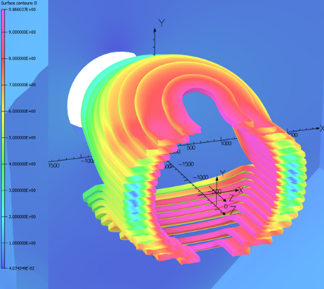
Magnetic design
Design Magnetic design Mechanical design Conductor design
Manufacturing aspects Winding issues Casing issues
Conductor R&D Copper profile shape Cold work
Quench propagation R&D Design Manufacturing & integration Test results
2 x 9 independent blocks made of one Double Pancake each
2D analytical harmonics optimization of the blocks shape to minimize peak field and volume
3D numerical optimization of the block heads to minimize peak field, volume and cost
Parameter | Results
J_{E} | 50 A/mm²
By (0,0,0) | -8.82 T
Bpeak (x,y,0) | 9.85 T
Bpeak | 9.87 T
Overfield (B_{peak}/B₀) | 11.8 %
FoM | 94.4 T²m²
H+ / H- (Z = 0.0 m) | -0.9 % / 5.0 %
Energy | 482 MJ
Volume | 4.435 m³
Length | 5.0 m

Slide 6
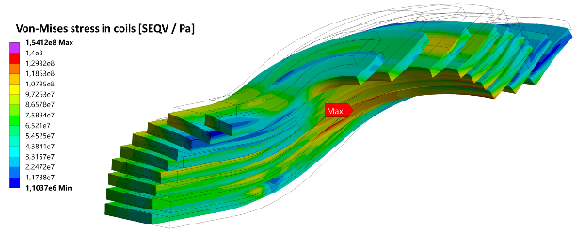
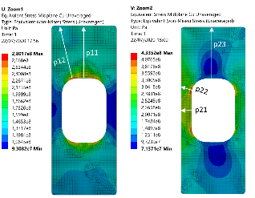
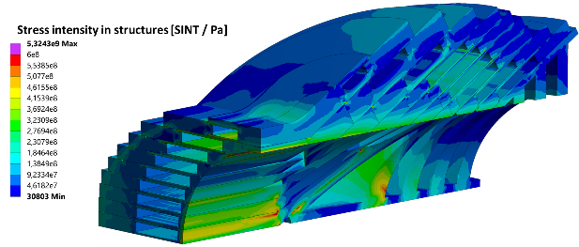
Mechanical design
Design Magnetic design Mechanical design Conductor design
Manufacturing aspects Winding issues Casing issues
Conductor R&D Copper profile shape Cold work
Quench propagation R&D Design Manufacturing & integration Test results
2 x 9 independent casings to ease manufacturing, reduce pieces weigh and cost
Mechanical stress in the conductor compatible with ITER/LHD criteria
Mechanical stress in the casings compatible with 304 L performances

Slide 7
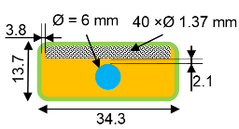
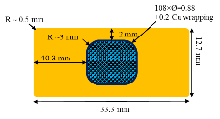
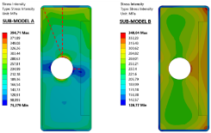
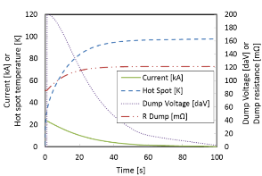
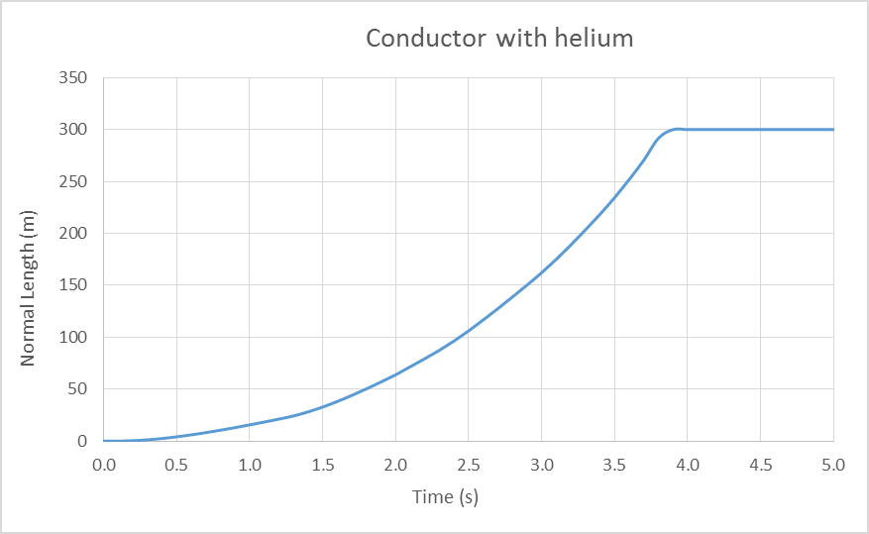
Conductor design
Design Magnetic design Mechanical design Conductor design
Manufacturing aspects Winding issues Casing issues
Conductor R&D Copper profile shape Cold work
Quench propagation R&D Design Manufacturing & integration Test results
Heat deposition by motion & cryostability
Local stress in copper
Quench velocity + 100 K hot spot + ±1 kV voltage
Parameters | Values | Units
Nominal current | 23.5 | kA
Max. field | 10.4 | T
Conductor length | 9.6 | km
Section of Cu | 362 | mm²
NbTi secion | 29 | mm²
Helium section | 28 | mm²
Cu/Sc cond. | 12,6
Coil weight | 34 | tons
Self | 1.8 | H

Slide 8
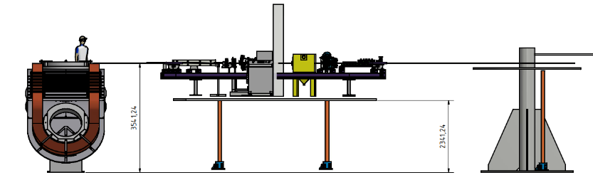
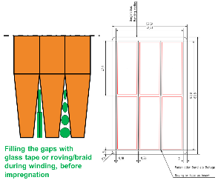
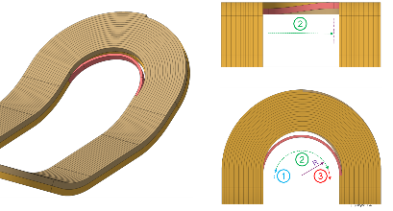
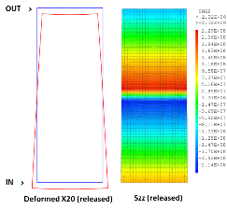
Winding issues
Design Magnetic design Mechanical design Conductor design
Manufacturing aspects Winding issues Casing issues
Conductor R&D Copper profile shape Cold work
Quench propagation R&D Design Manufacturing & integration Test results
Tooling and manufacturing process definition
Points under study: Layer jumps, key stoning, insulation, inner joints, terminals, etc.
Courtesy of Bilfinger Noell (A. Hobl)

Slide 9
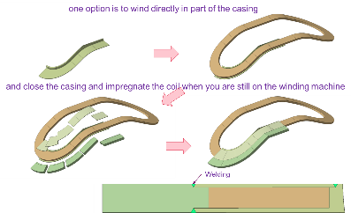
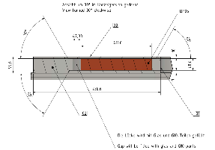
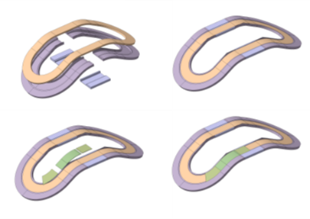
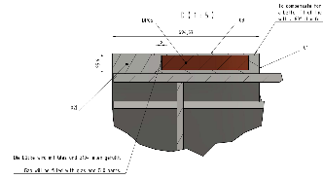
Casing insertion, closing and impregnation issues
Design Magnetic design Mechanical design Conductor design
Manufacturing aspects Winding issues Casing issues
Conductor R&D Copper profile shape Cold work
Quench propagation R&D Design Manufacturing & integration Test results
Wind the coils on a mandrel or directly on casing parts ?
Impregnate the coils on specific molds or directly in casings ?
How to close casings without damaging the coils by high heating ? TIG ? MIG ? Laser ?
Courtesy of Bilfinger Noell (A. Hobl)

Slide 10
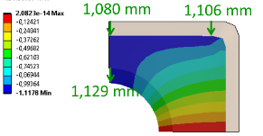
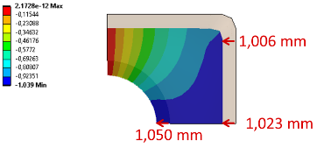
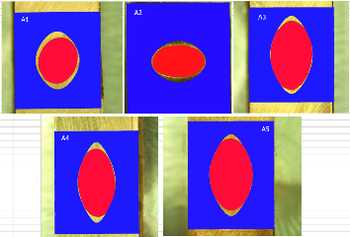
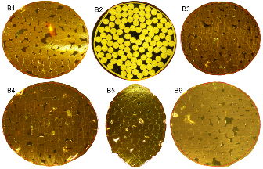
Conductor R&D: a reverse engineering problem
Design Magnetic design Mechanical design Conductor design
Manufacturing aspects Winding issues Casing issues
Conductor R&D Copper profile shape Cold work
Quench propagation R&D Design Manufacturing & integration Test results
Initial copper shape to obtain final conductor after insertion + compaction ?
FEM computations + measurements done on bare copper profile & CICC

Slide 11
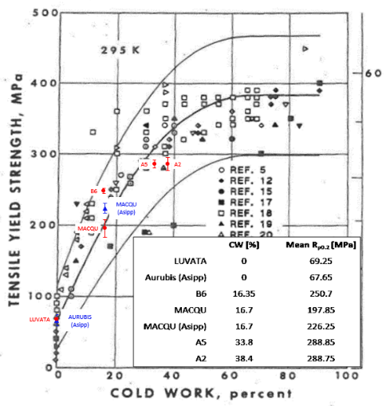
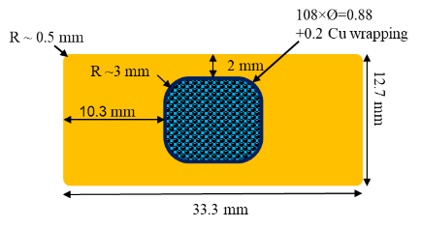
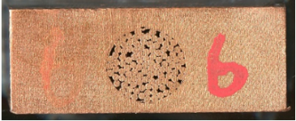
Conductor R&D: a reverse engineering problem
Design Magnetic design Mechanical design Conductor design
Manufacturing aspects Winding issues Casing issues
Conductor R&D Copper profile shape Cold work
Quench propagation R&D Design Manufacturing & integration Test results
Cold work needed to obtain the required Yield Strength on copper profile ?
Compaction trials of soft tempered profiles and mechanical measurements

Slide 12
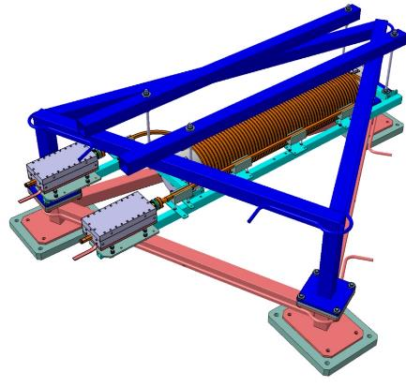
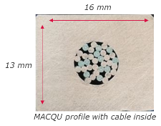
Quench propagation R&D: design
Design Magnetic design Mechanical design Conductor design
Manufacturing aspects Winding issues Casing issues
Conductor R&D Copper profile shape Cold work
Quench propagation R&D Design Manufacturing & integration Test results
No state of the art + very big uncertainties on models: Shajii ~ 3 cm/s VS THEA ~ 17-50 m/s
Design, manufacturing and experimental tests on a prototype magnet for quench studies
Parameters | Values | Units
Nominal current | 21.6 | kA
Max. field | 2.30 | T
RRR | 60
Conductor length | 50 | m
Section of Cu | 175 | mm²
Number of strands | 12 Sc / 24 Cu
Cu/Sc | 1.105
Coil weight | 100 | kg
Self | 0.19 | mH
Stored energy | 43.5 | kJ
Discharge voltage | 130 | V

Slide 13
Quench propagation R&D: manufacturing & integration
Design Magnetic design Mechanical design Conductor design
Manufacturing aspects Winding issues Casing issues
Conductor R&D Copper profile shape Cold work
Quench propagation R&D Design Manufacturing & integration Test results

Slide 14
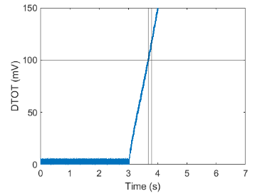
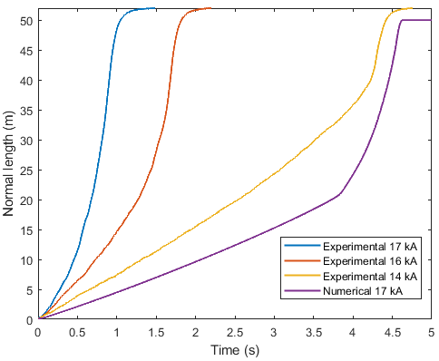
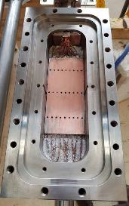
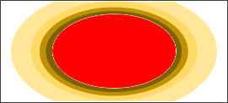
Main Quench R&D results
Design Magnetic design Mechanical design Conductor design
Manufacturing aspects Winding issues Casing issues
Conductor R&D Copper profile shape Cold work
Quench propagation R&D Design Manufacturing & integration Test results
Quench velocity order of magnitude: a few m/s up to tens of m/s → MADMAX Safety Fully OK
  Able to detect quench in less than 800 ms with a threshold of 100 mV → done 60 times
Same qualitative behavior between models and experiment but experimental quench faster
  Good deep understanding of the quench physics thanks to the code equations
  Assumption and modelling of current diffusion time in copper → increases joule effect and speed
Other important results not directly linked to quench:
  Current limitation in the W7X terminals → Lessons learned and specific design to be done for Madmax
  Thermal behavior of a static CICC 1.8 K magnet cooled with no bath
  Extra trials of 2 K forced flow in the CICC → Interesting pressure drop measurements

Slide 15
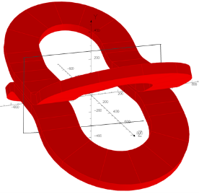
Conclusion
Conceptual design finished and validated
Open points on the manufacturing design under study and discussion with industry
1st Conductor R&D successfully demonstrated that a copper profile CICC can be manufactured in specifications
2nd Conductor R&D on going to study a “rectangular hole” behavior and unexpected issues
Quench R&D successfully demonstrated that a quench can be “classically” detected in the Madmax case
For those interested in more details: 7 papers to be published by the end of the year
Next 3 years: design, manufacture and cold test a real “skateboard shape” demonstrator coil of the Madmax magnet including:
  Demonstration of the main Madmax critical performances: 90% on the LL, mechanics, thermal cryostability
  Development of a specific optimized joint concept for Madmax
  Qualification of the main critical manufacturing issues: final conductor, winding, impregnation, casing insertion and closing impregnation process

Slide 16
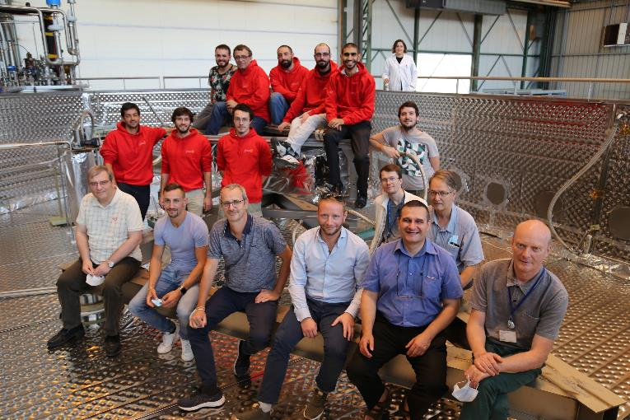

Many thanks to the Madmax team! Questions ?
W. Abdel Maksoud, C. Lorin, C. Berriaud, V. Calvelli, R. Correia Machado, L. Denarie, G.Dilasser, Y. Drouen, U. Duranona, P. Godon, R. Godon, Q. Guihard, F-P. Juster, S. Kassab, S. Jurie, J-P. Lottin, F.Molinie, F. Nunio, T. Pontarollo, L. Scola, L. Segrestan, N. Solenne, F. Stacci

Slide 17
Thank you for your attention !
Walid ABDEL MAKSOUD
Notes:
First conference
Very happy to present this work today
TY

