Slide 1
seminar
November 2022
Defects and their realization in QFT
Itamar Yaakov
This work was financially supported by the European Union’s Horizon 2020 research and innovation programme under the Marie Skłodowska Curie grant agreement No. 754496 - FELLINI

Slide 2
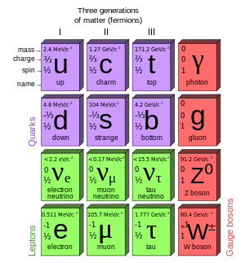
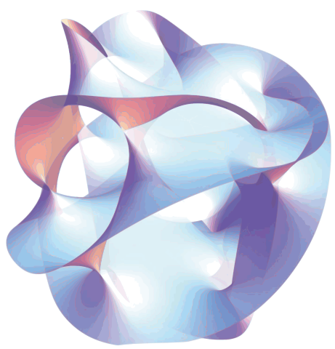
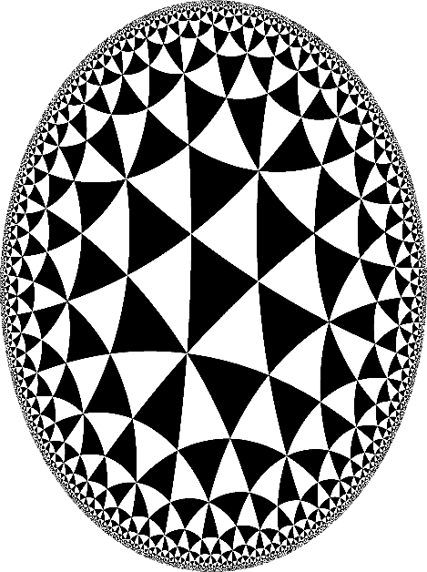
The Standard Model describes all known particle interactions.
Lattice systems are described by QFT at long distances.
image credit Wikipedia
Supersymmetric QFT
exact results and powerful
mathematical conjectures.
Holography relates quantum gravity to strongly coupled QFT.
The Quantum Field Theory universe
November 2022

Slide 3
The Standard Model:
local defects
scattering
phases
Lattice systems:
boundaries
interfaces
impurities
image credit Wikipedia
Supersymmetric QFT:
homological mirror symmetry
duality defects
defects at strong coupling
Holography:
D-branes
extremal surfaces
horizons
Ubiquitous defects
November 2022

Slide 4
important probes
clues as to local physics
a network of
0d + 1d + 2d
defects
well known versus modern
phases of gauge theories
generalized symmetries
abstract (functorial) TQFT
Geometry and networks
November 2022

Slide 5
symmetry as topological defects
gauging as topological networks
abstract
reversible
new symmetries
‘t Hooft anomalies
Generalized symmetry
obstructions to movement
new constraints
Gaiotto, Kapustin, Seiberg, and Willett (2014)
November 2022

Slide 6
group element defects
charged objects
multiplication is fusion
trivial defects are units
abelian starting at co-dimension 2
connection with higher gauge theory
higher dimension objects
constraints on expectation values
charged object
generalized Landau-Ginzburg paradigm
symmetry
defect
phases of gauge theories as breaking of one-form symmetry
refined classification of phases by Kapustin and Gukov (2013)
Higher form symmetry
November 2022

Slide 7
higher group symmetry
non-invertible symmetry
interacting topological defect networks
precursors in string theory
fusion without inverses
precursors in topological gauge theory
categories of representations rather than charges
categorical symmetry
everything at once
fusion categories?
Even more generalized symmetries
November 2022

Slide 8
historical roots
axiomatic description
Much celebrated work by Witten
Chern-Simons theory and 2d Yang-Mills
topological sigma models
twisted supersymmetric gauge theories
connection to lattice – Fukuma, Hosono, and Kawai (1992)
TQFT as a bridge between geometry and algebra
categories and functors
some shortcomings
no energy or momentum
no scattering or defects
still only a wish list, not a construction
Functorial TQFT
Atiyah (1989)
November 2022

Slide 9
fully extended TQFT
cobordism hypothesis
cutting into simple pieces
manifolds with corners
higher categories
extending upwards
classification: the value on a point
rigorous, but complicated, proof
dualizability assumptions
extensions?
Baez and Dolan (1995), Lurie (2009)
Baez and Dolan (1995), Lurie (2009)
defect TQFT
defect networks are naturally categories
generalizes open/closed TQFT
a general paradigm?
Progress in TQFT
Kapustin (2010), Davydov, Kong, and Runkel (2011)
November 2022

Slide 10
TQFT as a sub-theory
functorial QFT?
the intrinsic theory of symmetry
Symmetry Protected Topological (SPT) phases
conformal field theory - Segal (1988)
all QFT? Grady and Pavlov (2021)
Euclidean theory – Kontsevich and Segal (2021)
review by Dedushenko (2022)
gauge theory is universal
well known results about asymptotic freedom in interacting models
work of Dijkgraff and Witten on TQFT (1990)
recent work on classification of TQFT by Johnson-Freyd
Physical models
November 2022

Slide 11
Switching gears….
Defects and their realizations in gauge theory
November 2022

Slide 12
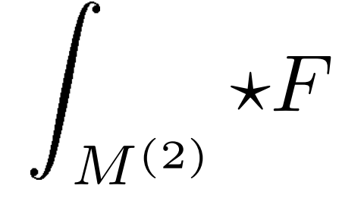
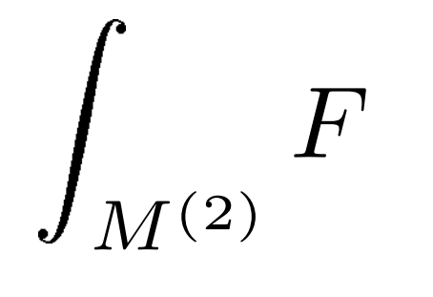
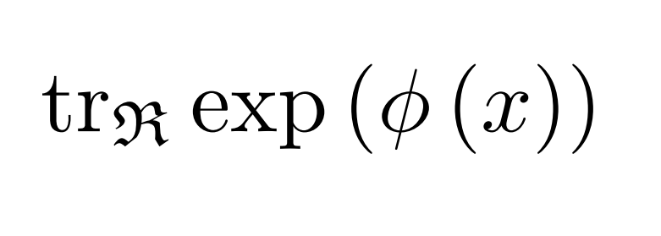
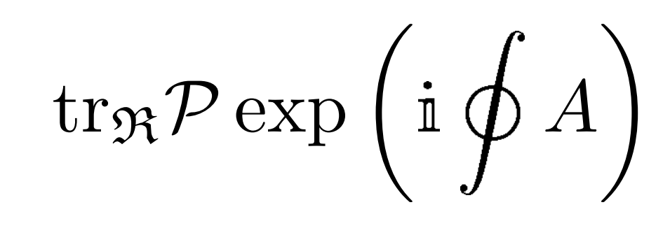
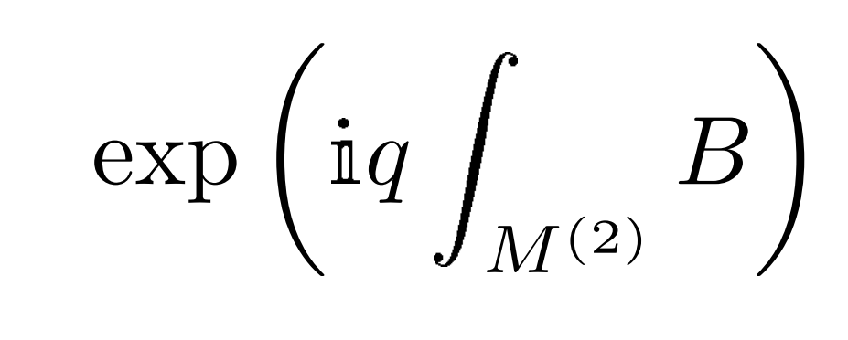
differential polynomials
Insertions
integrals of local operators
electric one-form symmetry
magnetic one-form symmetry
Wilson type
Wilson point
Wilson loop
Wilson surface…
November 2022

Slide 13
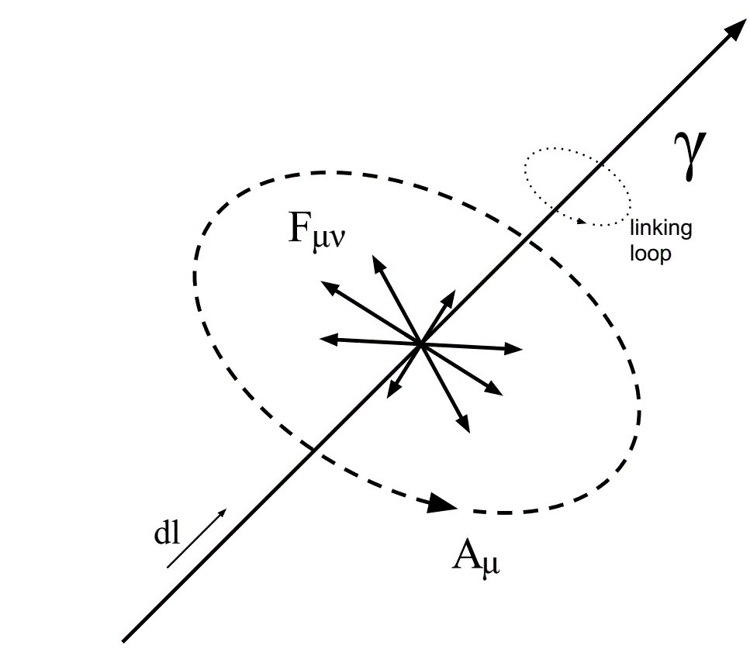
Singular
configurations
prescribed singularities
singularities in
dynamical fields
example: co-dimension 2 vortex operators
Lagrange multipliers
November 2022

Slide 14
Replica defects
November 2022

Slide 15
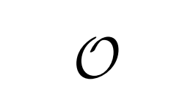
State-operator correspondence
conformal field theory
example: the monopole operator
abelian
flux
higher dimensional analogues
work of Kapustin from 2005
interpolation between dimensions
November 2022

Slide 16
Worldvolume degrees of freedom
defects as quantum objects
Witten (1988), Gukov and Witten (2008), Assel and Gomis (2015) and previous work
sigma models to flag manifolds
clues from string theory branes
alternative descriptions
using fermions or bosons
using worldvolume gauge fields
using duality walls
example: vortex-Wilson bound states
Griguolo, Guerrini, and IY (2021)
worldvolume chern-simons term
matching symmetries
November 2022

Slide 17
Research questions
Is there a systematic way to derive worldsheet degrees of freedom? D brane physics maybe?
Can we do it for all defects? Even those with topological disorder (generalized symmetries)?
Can we derive the other approaches as consequences?
What are the right mathematical tools?
November 2022

Slide 18
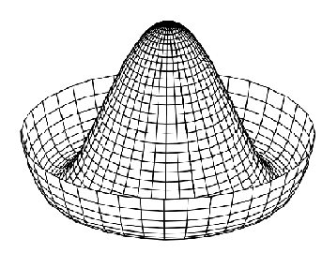
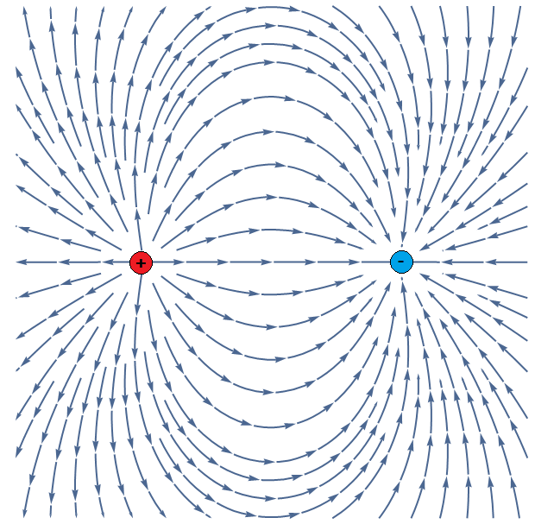
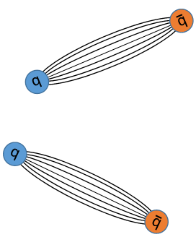
Local defects
The Polyakov model of confinement
richness of 3d physics
confinement, non-perturbative mass gap, global- and super- symmetry enhancement, quantum Coulomb branches, abelian duality, mirror symmetry, vortex soliton creation, defect networks…
Higgs
Coulomb
confining
…to study local defect operators in non-abelian gauge theory in four dimensions, with and without supersymmetry…
November 2022

Slide 19
Local defects in 4d
similar phenomenology
confinement, , non-perturbative mass gap global- and super- symmetry enhancement, abelian duality, electric magnetic duality, ‘t Hooft Polyakov monopoles, defect networks…
supersymmetry specific
Seiberg-Witten solution
BPS ray operators
problems
no obvious conserved quantities
no simple BPS states
November 2022

Slide 20
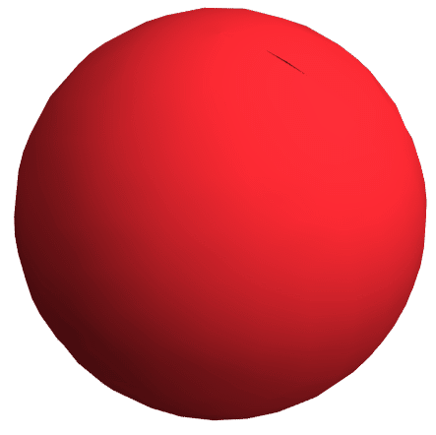
Step 1
Deform to weak coupling
Step 2
Incorporate fluctuations
fluctuations
(heavy modes)
supersymmetric moduli
(light modes)
Supersymmetric localization
Step 3
Study the finite dimensional model
[Kapustin, Willett, and IY (2009)]
Witten (1988, 1992), Nekrasov (2003), Pestun (2007) - based on - Duistermaat and Heckman (1982), Berline and Vergne (1982), Atiyah and Bott (1984)
November 2022

Slide 21
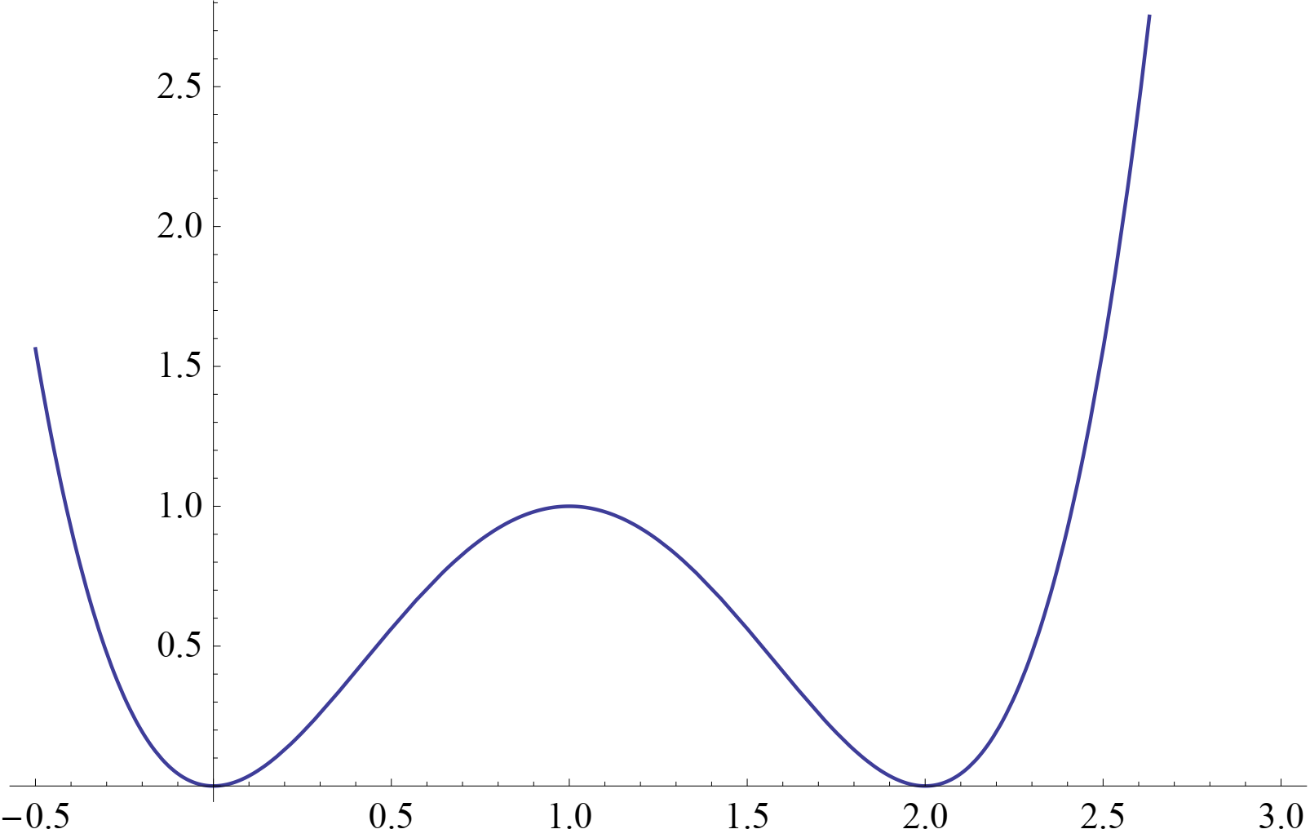
Some hints
GNO monopoles
Euclidean
action
states from infinity
GNO monopole
Work on 2d Yang-Mills by Witten.
Work on the 3d twisted index by Benini and Zaffaroni.
vector potential
Complex configurations
A strange technical detail in Benini-Zaffaroni.
A finding about electric-magnetic duality by Kapustin.
November 2022

Slide 22
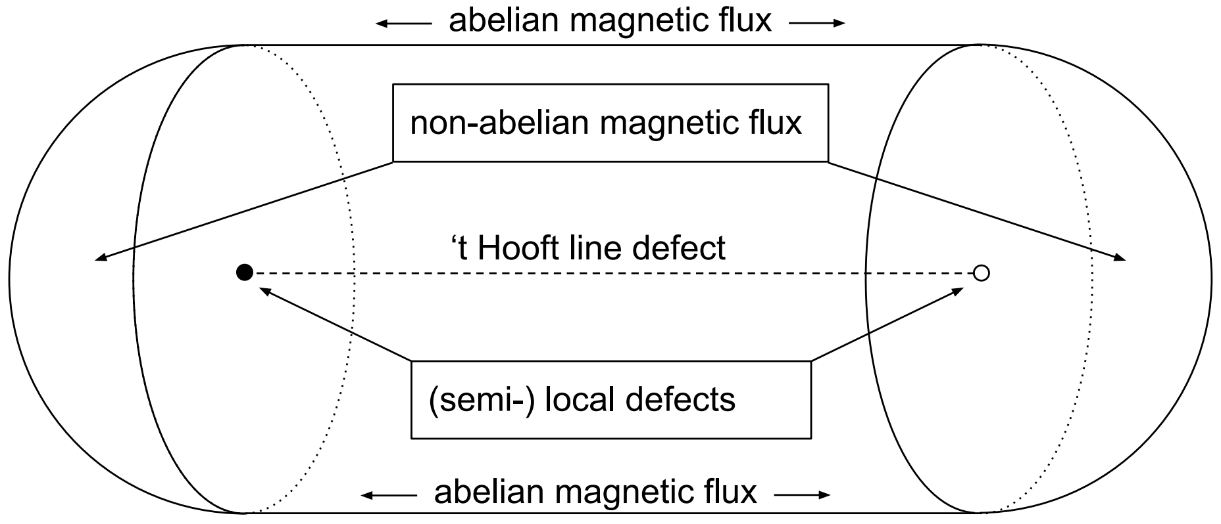
The meron
solves the equation of motions
connects with the ‘t Hooft line
rotationally symmetric
fractional topological
density
November 2022

Slide 23
Complex BPS objects
Complex BPS merons exist
Like Benini-Zaffaroni configurations
Or like Kapustin’s ‘t Hooft loops
November 2022

Slide 24
Perturbations of BPS equations
Vafa-Witten or Kapustin-Witten equations
A perturbation
leads to BPS meron
November 2022

Slide 25
Counting BPS operators
The superconformal index counts operators
The twisted index counts other BPS states
But the two sometimes agree!
November 2022

Slide 26
A non-abelian Ω background for N =4 SYM
Two versions of the twisted index
A new fugacity
Similar to the Ω deformation
November 2022

Slide 27
Thank you!
November 2022

