Slide 1
Riunione di servizio per CIF
Emiliano Dané – 28/11/2022

Slide 2
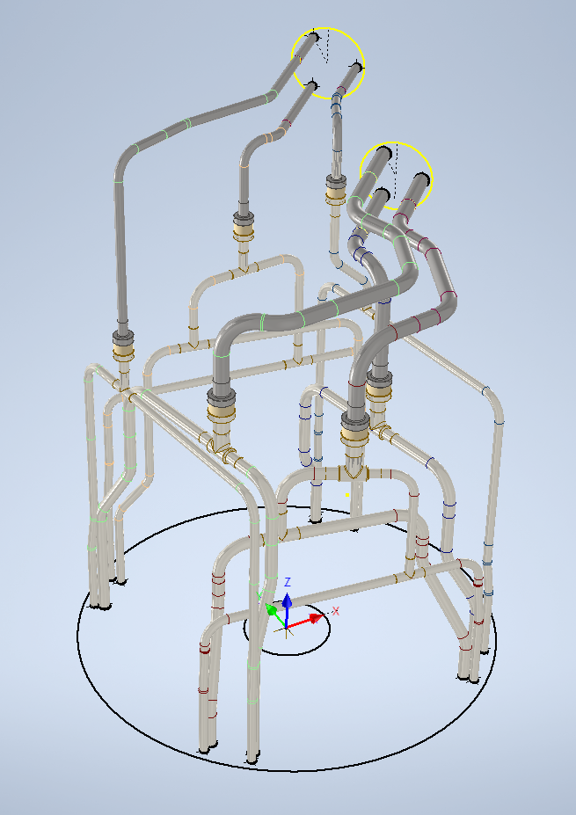
Inner System PP1 Manifold upgrade
Side A
Stainless Steel
Checked:
Pipes coordinates
Pipes diameters
Bending radius (2.5 times outer diam.)
Not final but realistic components (T, El. Breakes)
Distance between T, bendings and EB for the Welding Head for the pipe production
Assembly procedure
Everything is needed to be checked again
Do you plan to have some shieldings covering the part of stainless steel pipe? (from QL to EB)
Titanium

Slide 3
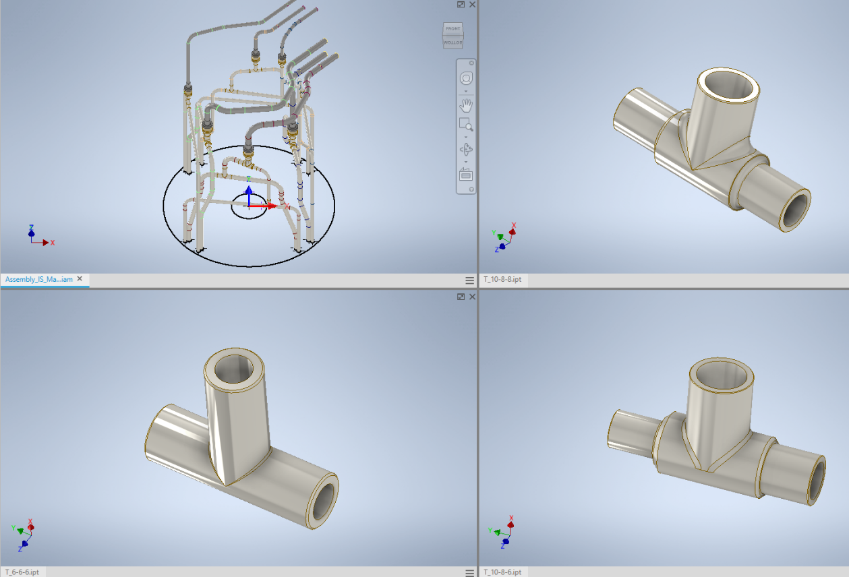
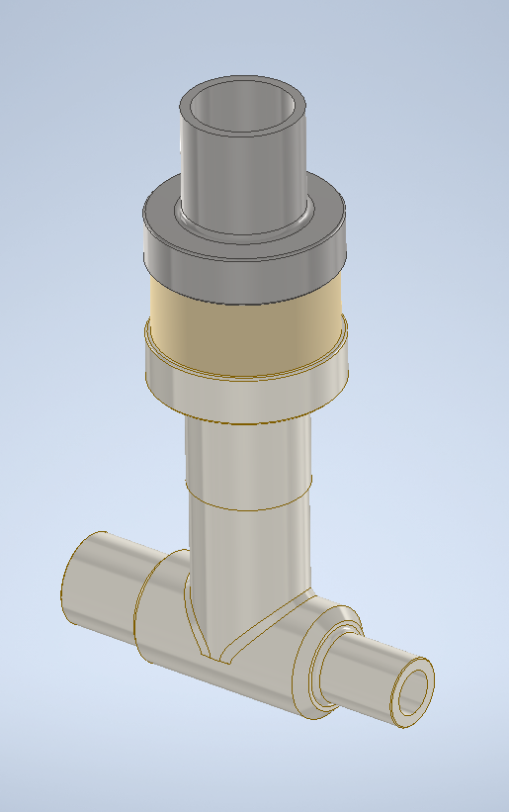
Inner System piping components: T, El. Breakes
It should be possible to weld directly the T to the El. Breake.

Slide 4
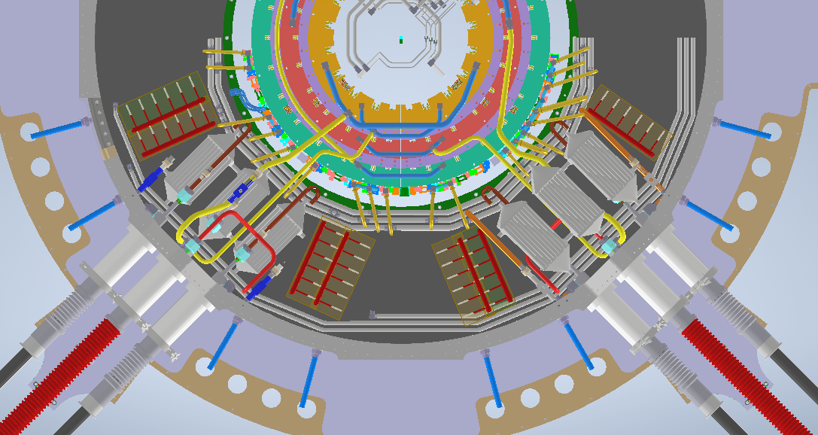
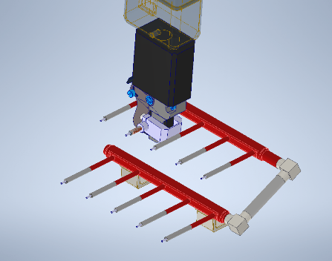
CABLES
CABLES
Outer Barrell
No interference with cabling
More space for the welding head
CG 4 -> 10
CG 8 -> 2
CG 8 -> 2
CG 2 -> 2
CG 4 -> 2
90° degree rotated
CABLES
OLD Version
Preliminary drawing
CG 7 -> 9
CG 2 -> 8
CG 4 -> 2
CG 8 -> 3

Slide 5
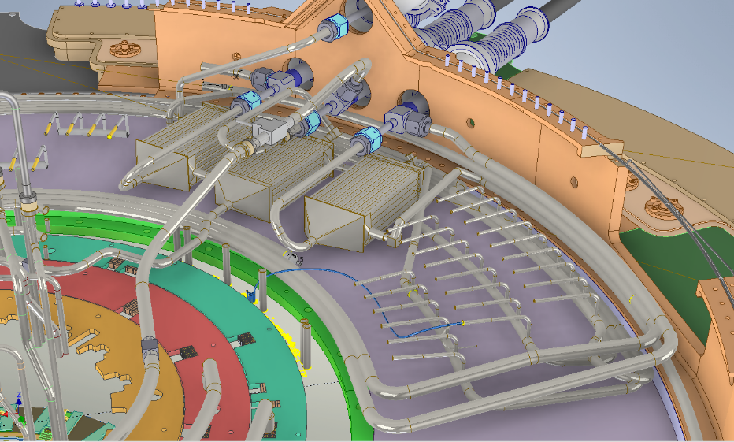
Outer Barrell distribution New Version
Shielding
New design capillary distribution
Capillary manifolds distribution
Special cap for pressure test
Protection of Capillaries

Slide 6
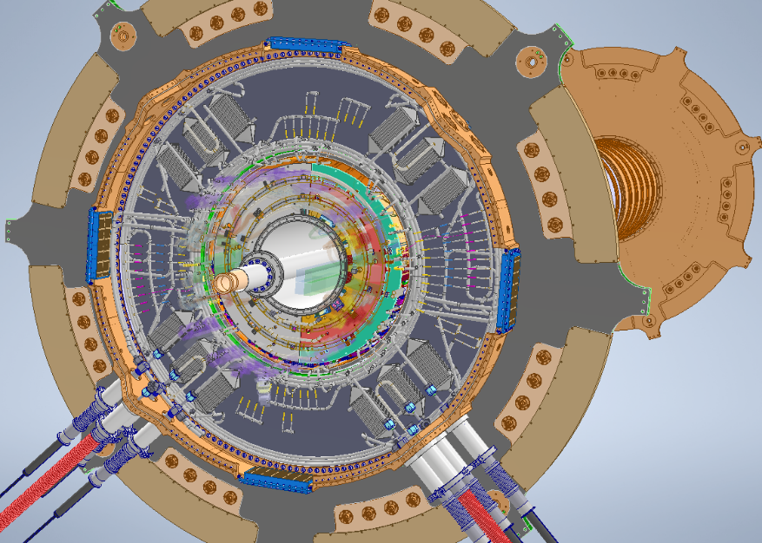
PP1 piping
SIDE A PP1 piping
Inner System Manifolds
Inner System Manifolds
End Cap Manifolds

Slide 7
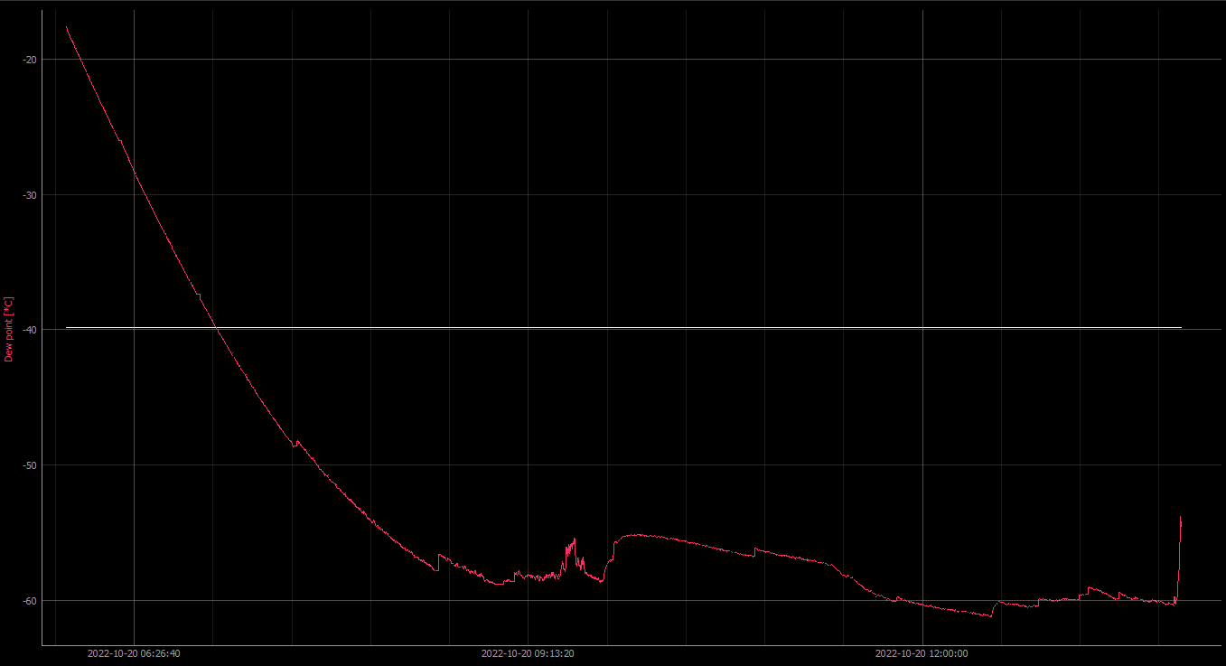
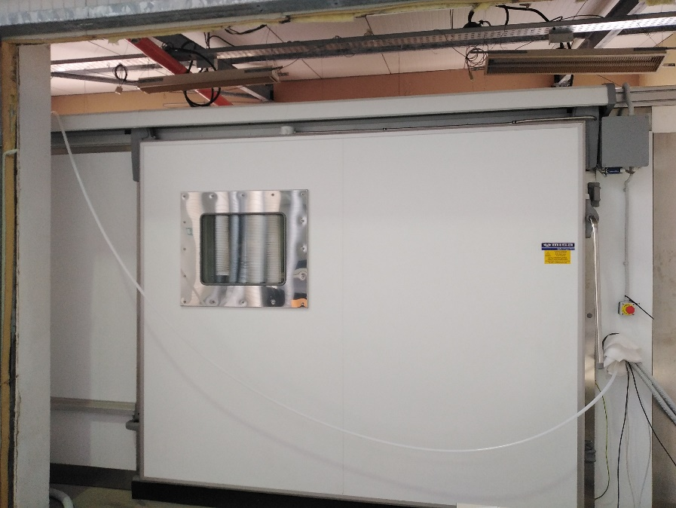
Test Camera Climatica
Dew Point [°C]
Fase di «lavaggio»
Autocalibrazione sensori
Test
temperatura
Test sovrappressione
Nuovo Ingresso Aria Secca
 | Dew Point (°C) | T_{CC} (°C)
Lavaggio Durata: 3h | -30,5 | 21,5
 | -36,1 | 21,2
 | -39,4 | 21,1
 | -45,7 | 21,0
 | -51,1 | 20,9
 | -58,1 | 20,8
3h
Tempo (minuti) | DP (°C) | T_{CC} (°C)
11:45 | -56,8 | 20
13:48 | -61,1 | 15
14:35 | -60,3 | 16
14:40 | -60,4 | 17
14:50 | -60,0 | 18
14:55 | -60,0 | 19
15:22 | -60,0 | 20
Test al variare della temperatura
TARGET

