Slide 1
SEM Meeting
INFN-LNF
Filippo Rosatelli
28/11/2022

Slide 2
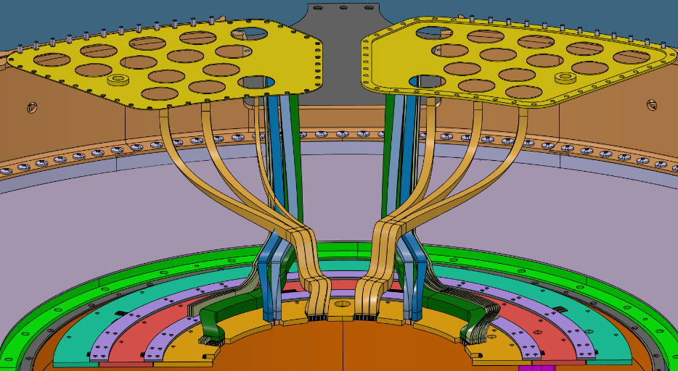
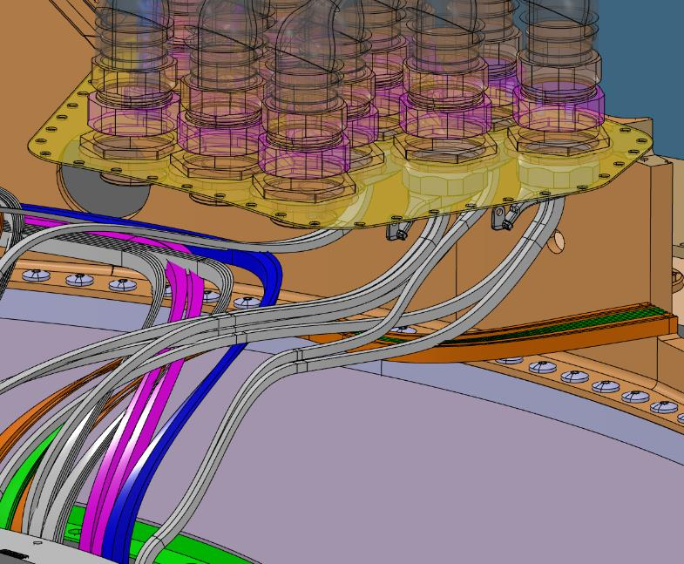
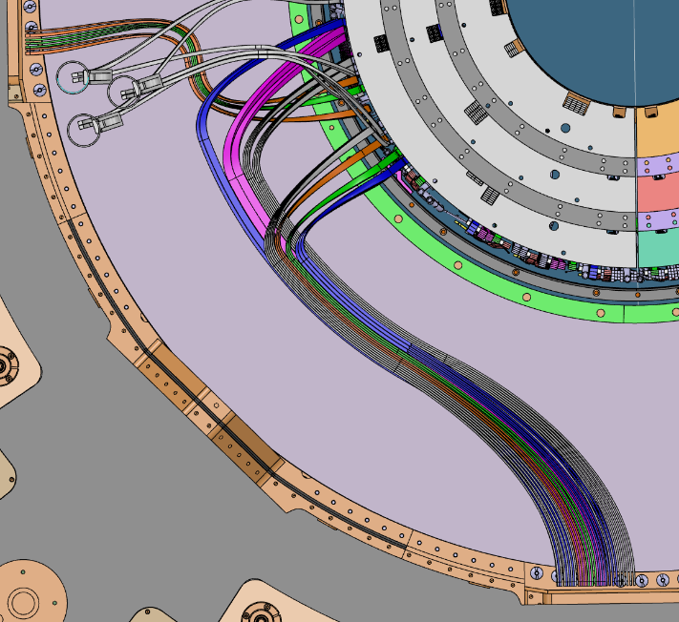
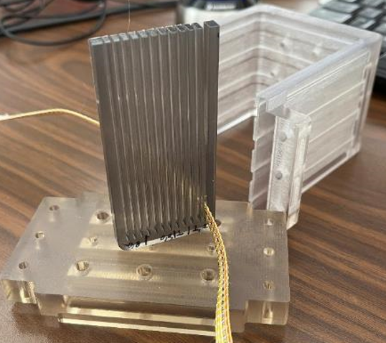
ATLAS ITk –Cabling
ENDCAP
OUTER BARREL
Activities:
Review of the cables routing inside the PP1.
Check in PP1 assembly the proposals from collaboration (e.g. Strain relief variants).
Presented at ATLAS upgrade week in Geneva.
Preparing a prototype to test the sealing with the real ribbonised data bundles.

Slide 3
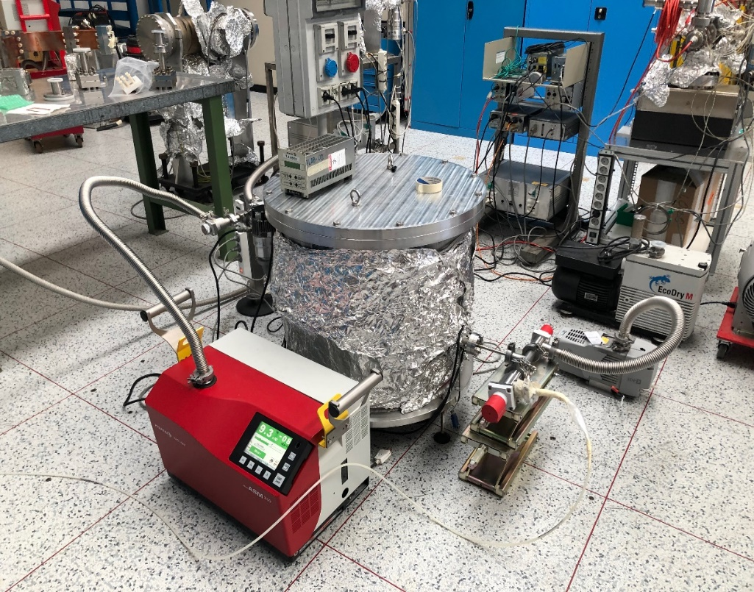
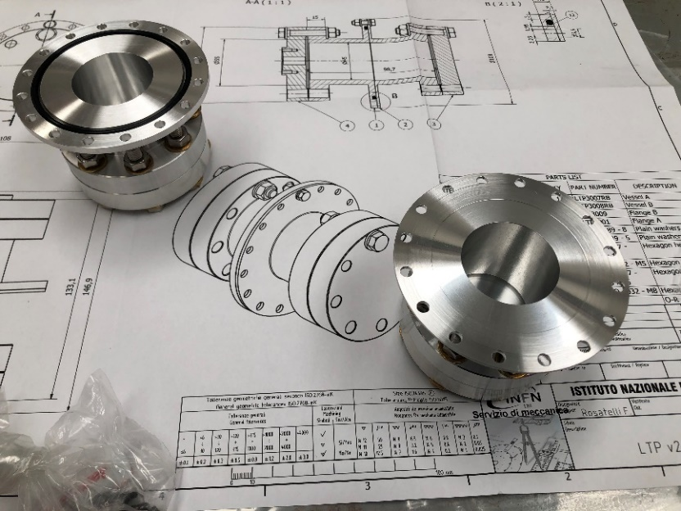
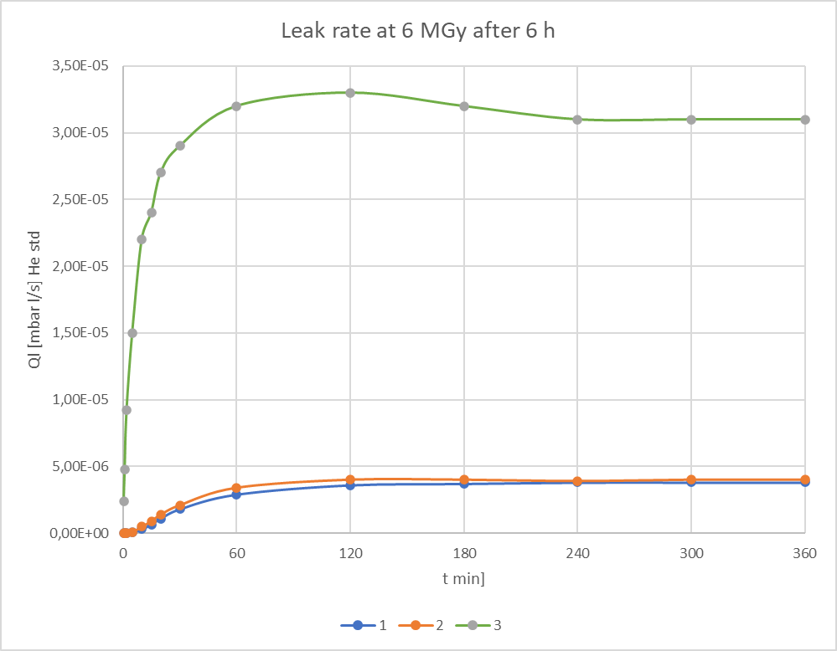
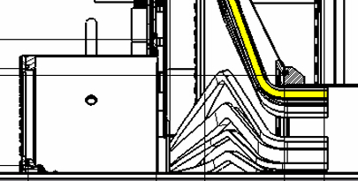
ATLAS ITk –Leak test
Thanks to Lollo & Liedl.
Prototype tested
LINE 1
LINE 2
4MGy
6MGy
4MGy
6MGy
Activities:
O-ring Leak check test finished
Material qualificated up to 6 MGy.
Writing a technical note about the results.

Slide 4
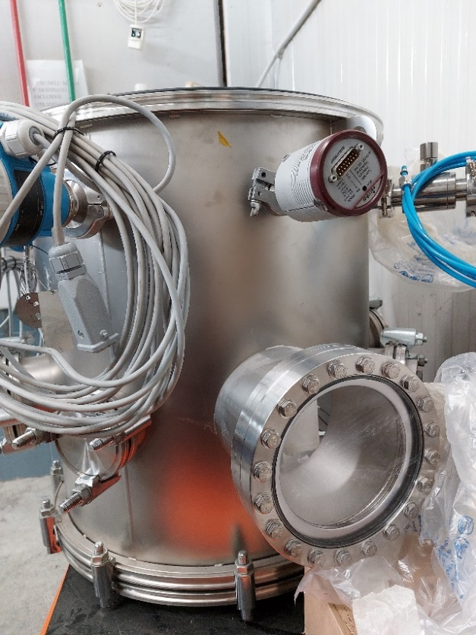
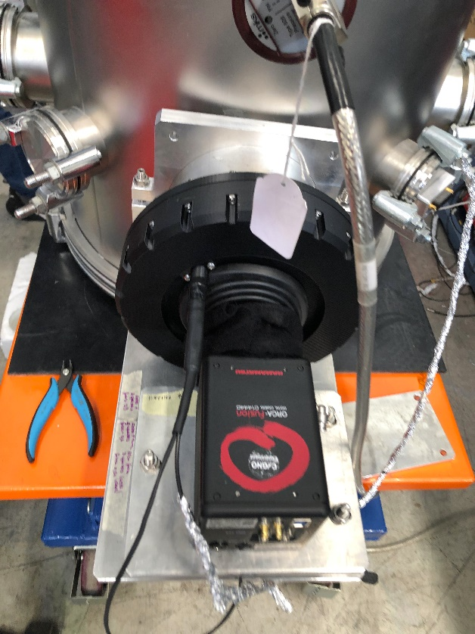
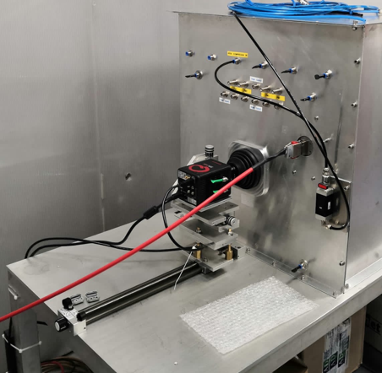
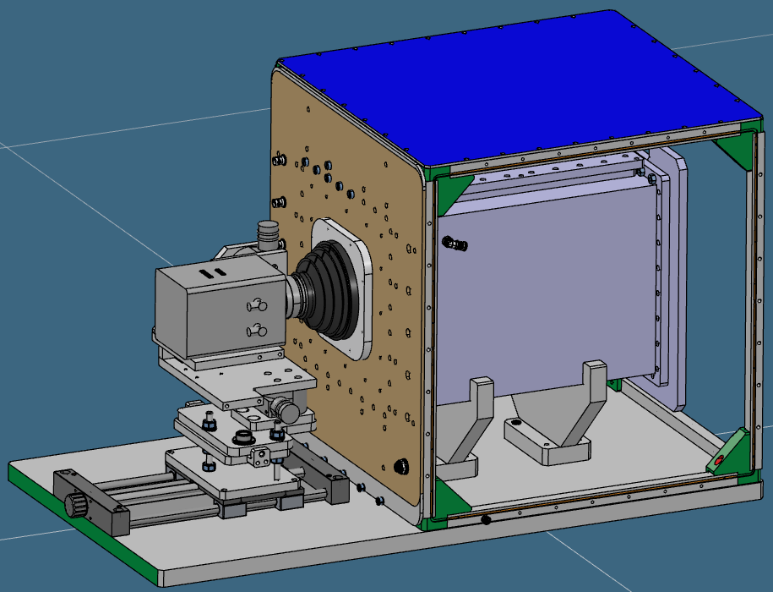
CYGNO – LIME/MANGO/GIN
Activities:
Support to the experiment.
Orders of commercial parts.
Contribution to the writing of CYGNO 04 / INITIUM TDR

