Slide 1
Calorimeter updates: crystal calibration, temperature study and data takings
A. Valetti
13/12/2022

Slide 2
Calorimeter Construction: status
110 / 320 crystals completed
SiPM:
3rd batch delivered last week
4th (last) batch delivered in feb-mar 2023
Plastic holders (helicoil insertion):
modules: 30 / 37 ready
crystal holders: 200 / 320 ready
Gluing:
on hold because technician in sick leave until Jan 9th, 2023 (broken bone)
resuming in January, about 40 crystals / working week
Equalisation before assembly:
test suite in place at CERN for cosmic rays data takings
A. Valetti
1
13/12/2022

Slide 3
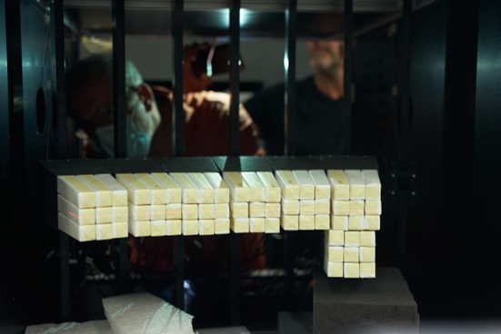
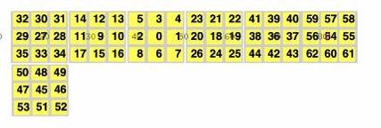
Calorimeter Calibration: HIT Setup
First night calibration setup → 1 module → 9 crystal → from 0 to 8
Last night calibration setup → 2 module → 18 crystal → from 0 to 8 and from 18 to 26
Last Night
First Night
First night calibration → Beam centered on crystal 0
Last night calibration → Beam centered on crystal 1
A. Valetti
2
13/12/2022

Slide 4
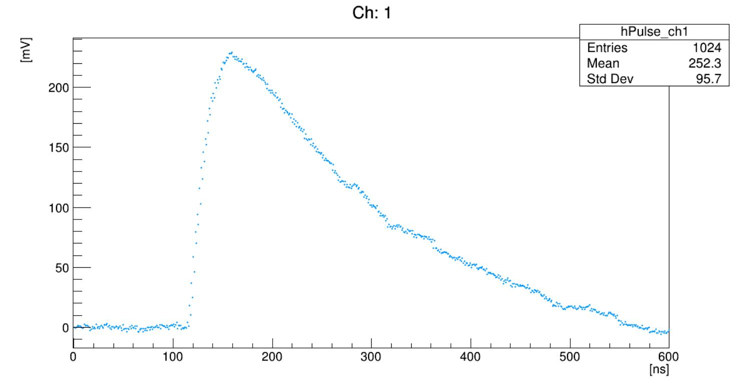
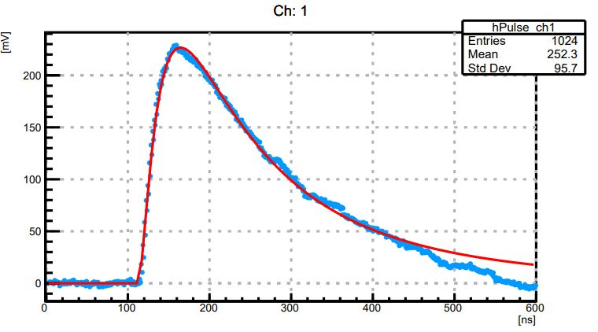
Calorimeter Calibration: Waveform
Amplitude measured in two way → Max value and Wave fitting
Proton 100 MeV/u
Wave fitting → Computationally intensive
A. Valetti
3
13/12/2022

Slide 5
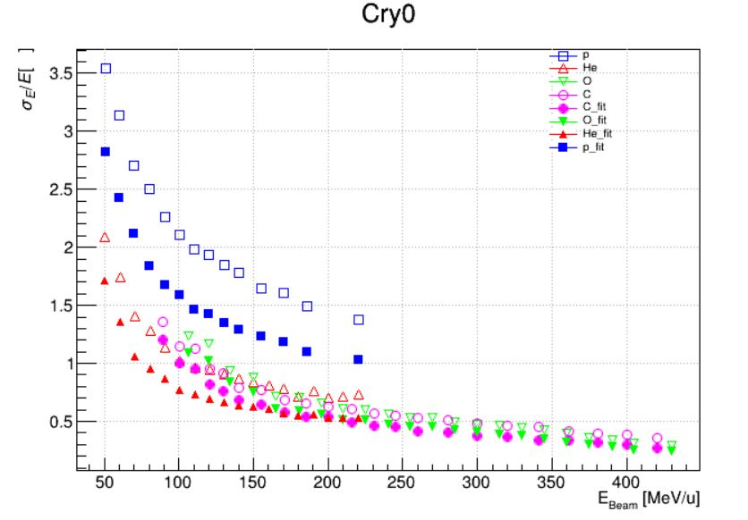
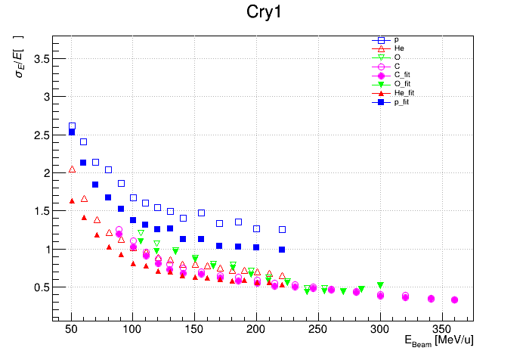
Calorimeter Calibration: Energy Resolution
%
%
Overall resolution improvement via wave fitting at lower energies → Still good performance by using max value method
A. Valetti
4
13/12/2022

Slide 6
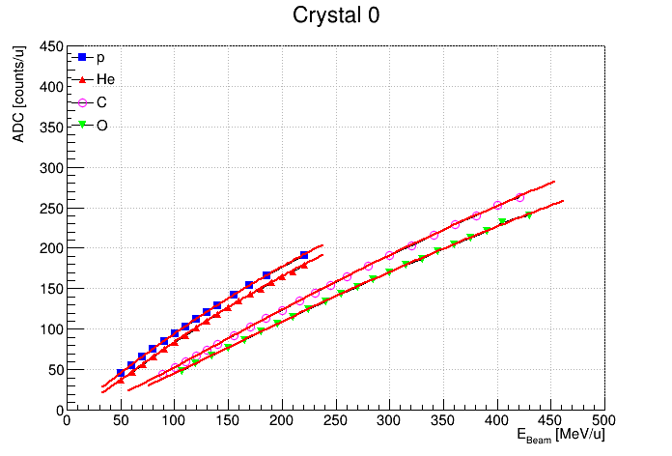
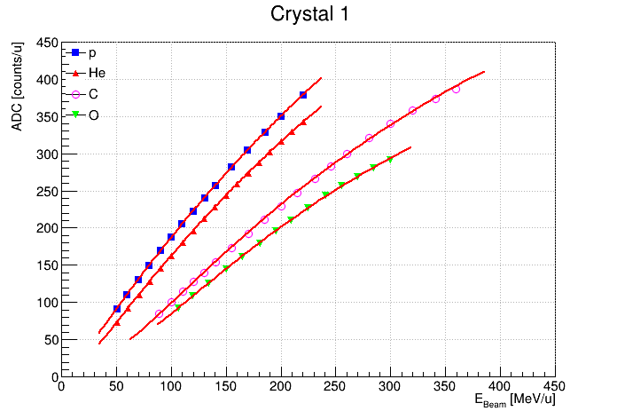
Calorimeter Calibration: Energy Calibration Function
Calibration Function → Modified Birks function is a good approximation of data
Crystals present different response → We are conducting studies to identify external contributions as, for example, difference in wrapping or bonding
A. Valetti
5
13/12/2022

Slide 7
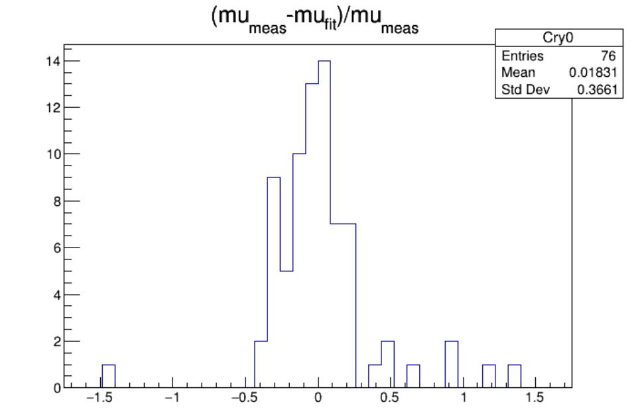
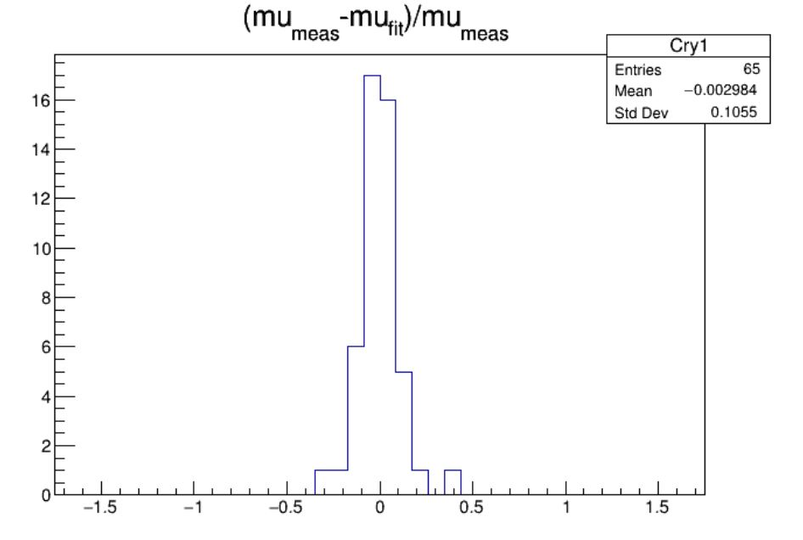
Calorimeter Calibration: Function Agreement
Difference between data and value extrapolated from the Modified Birks function
Crystal 0
Crystal 1
count
count
[%]
[%]
Good fitting of experimental data →
A. Valetti
6
13/12/2022

Slide 8
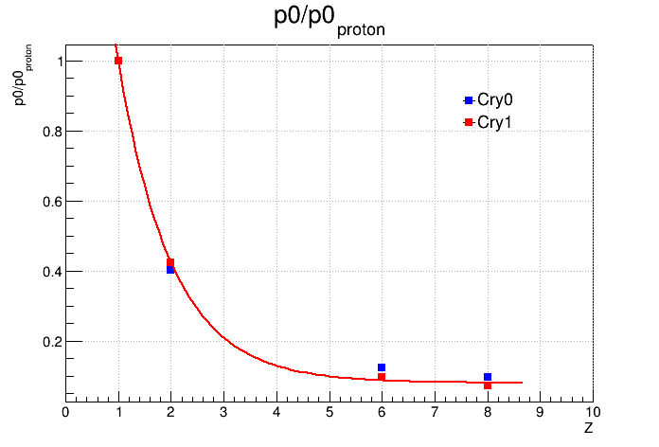
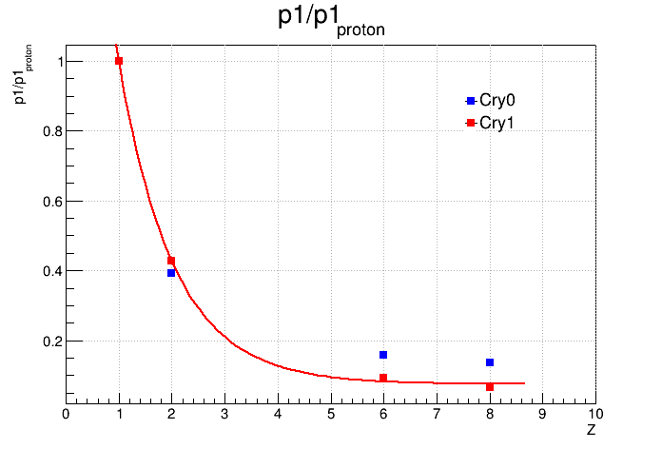
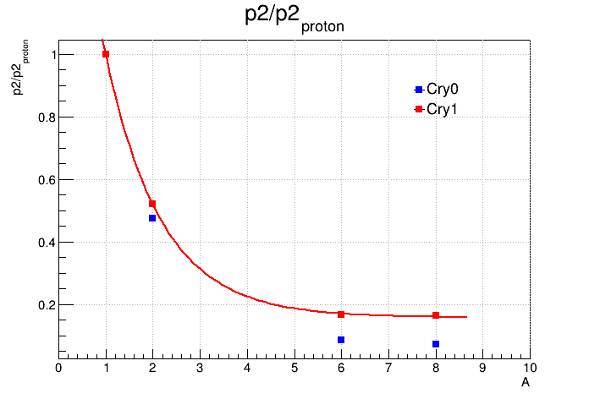
Calorimeter Calibration: Energy Equalization
Ratio of energy calibration curve parameters to proton curve parameters follow an exponential law → By measuring Z we can equalize the ADC response for different particle
A. Valetti
7
13/12/2022

Slide 9
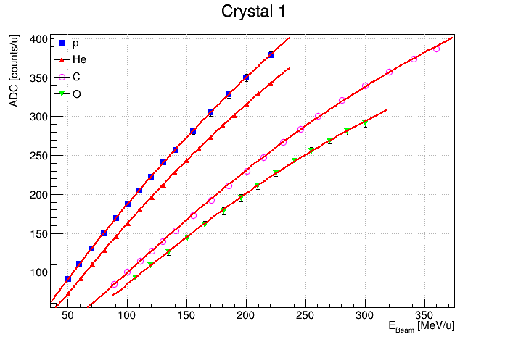
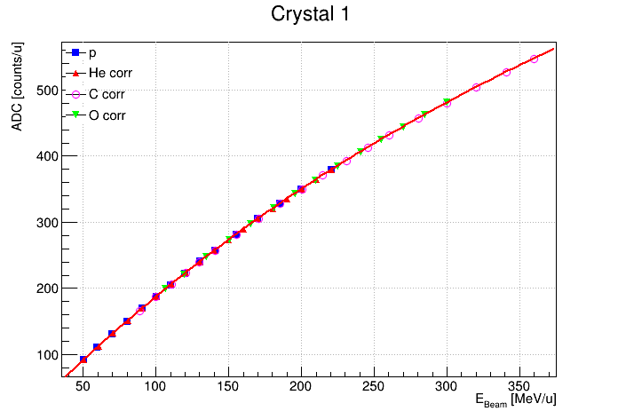
Calorimeter Calibration: Energy Equalization
p₀ | p₁ | p₂
2.10395e-01 ± 2.52608e-02 | 9.00286e-02 ± 1.22793e-02 | 1.26673e-04 ± 1.16675e-05
A. Valetti
8
13/12/2022

Slide 10
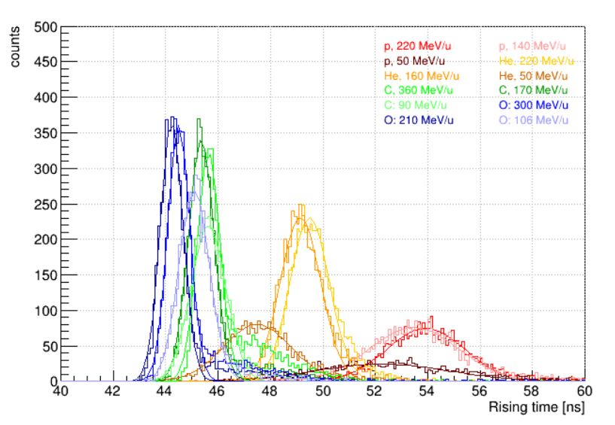
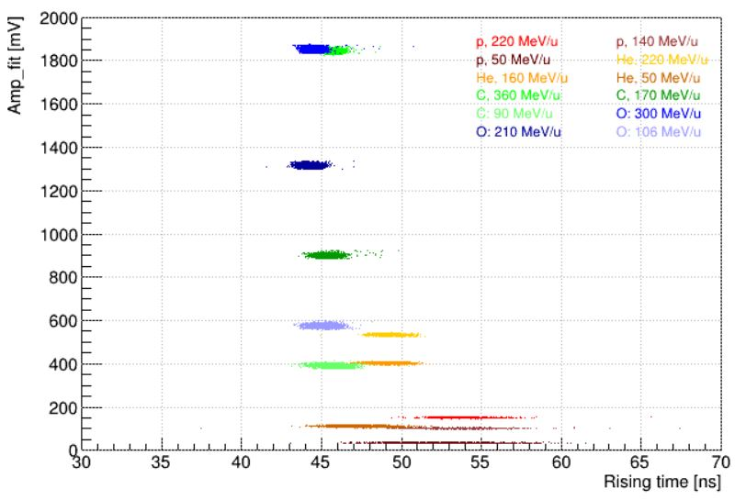
Calorimeter Calibration: PID with Rising time
Rising time → Relation between wave fit function t_{r} and particle species
[%]
[%]
A. Valetti
9
13/12/2022

Slide 11
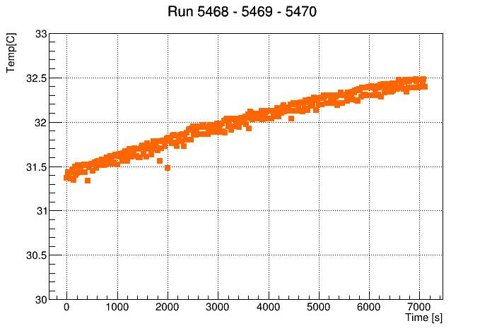
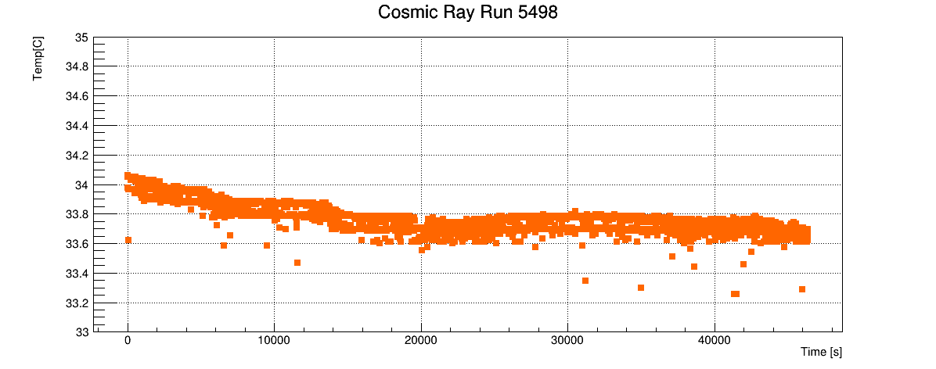
Calorimeter Calibration: Temperature Stability
Beam on
Beam off
About 17.5h
About 2h
Temperature variation during data acquisition is not negligible → Need for correction
A. Valetti
10
13/12/2022

Slide 12
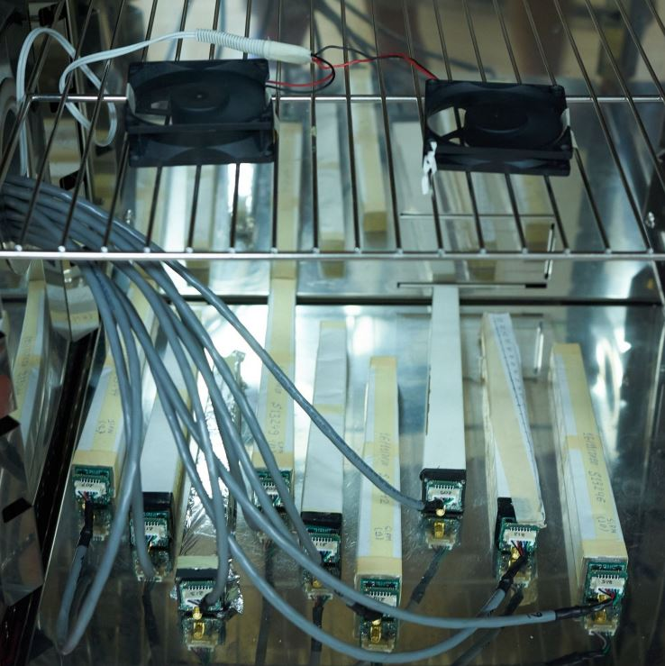
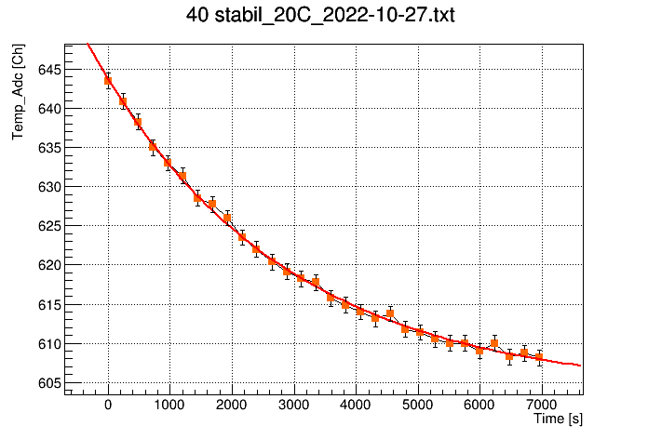
Calorimeter Calibration: Temperature Calibration Function
Every crystal has a temperature sensor which must be calibrated → Temperature measurement in Università di Torino laboratory
Climate chamber can host up to two complete modules → very time consuming due to the mass of modules → thermal equilibrium value extrapolated by fitting ADC point in a limited time
A. Valetti
11
13/12/2022

Slide 13
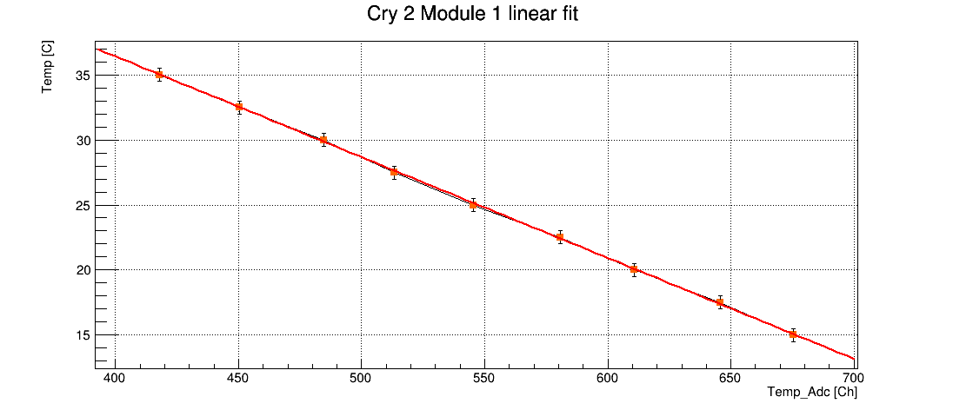
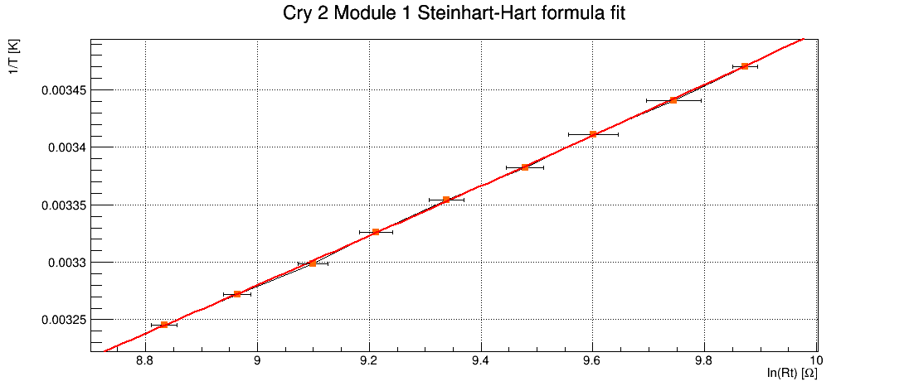
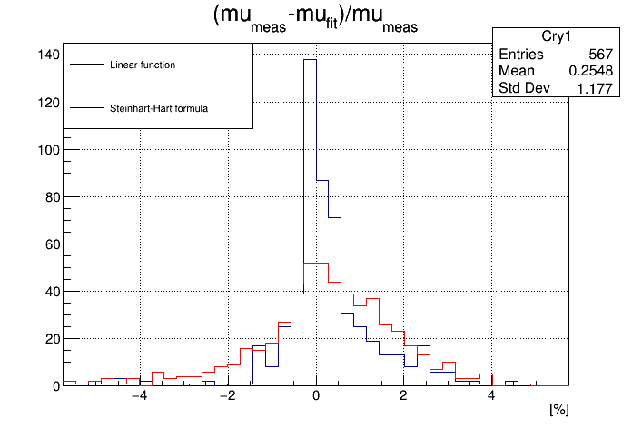
Calorimeter Calibration: Temperature Calibration Function
Two different functions have been studied → Linear and Steinhart-Hart formula
Difference between data and extrapolated value
→
Steinhart-Hart formula is better in describing data → Calibration parameter already calculated for Module from 0 to 6 → Parameters will be soon uploaded in SHOE git repository
A. Valetti
12
13/12/2022

Slide 14
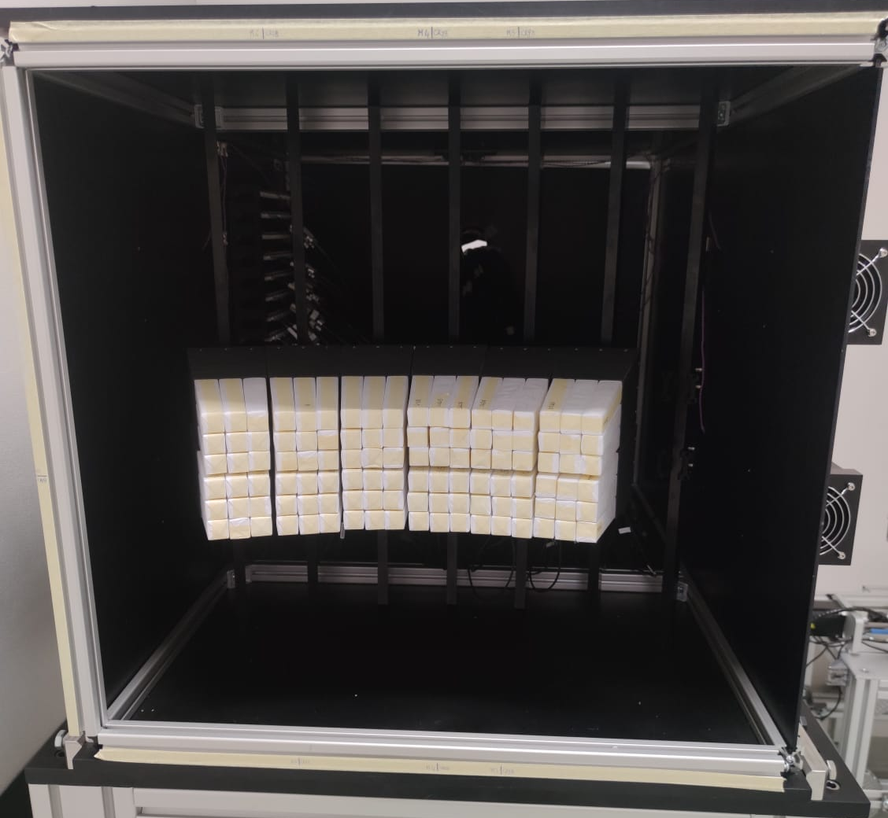
Calorimeter Calibration: CNAO 2022 Setup
Inter calibration setup → 12 module → 108 crystal → from 0 to 107
Two different maps in order to allow calo alone trigger acquisition and to scan efficiently
Second Configuration
Run 5226 - 5279
First Configuration
Run 5162-5224
A. Valetti
13
13/12/2022

Slide 15
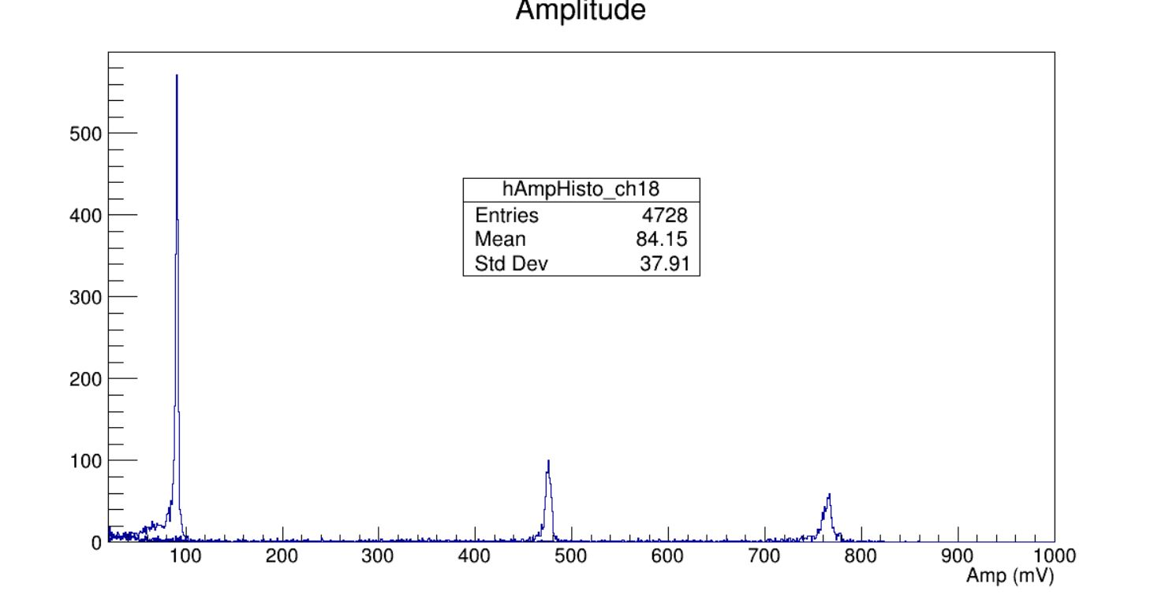
Calorimeter Calibration: Amplitude peaks
Carbon beam 300 Mev/n, same HV and LV → Wide range of amplitude response → we are studying why some crystal present such kind of behavior
Reference crystal
Crystal 18
→
Crystal 23 (Crystal 1 in HIT mapping)
→
only calibrated crystal in CNAO 2022 setup
Crystal 22
Crystal 23
We computed the ratio between all crystal amplitude peaks and the reference one → First intercalibration parameter used for fragment mass calculation
A. Valetti
14
13/12/2022

Slide 16
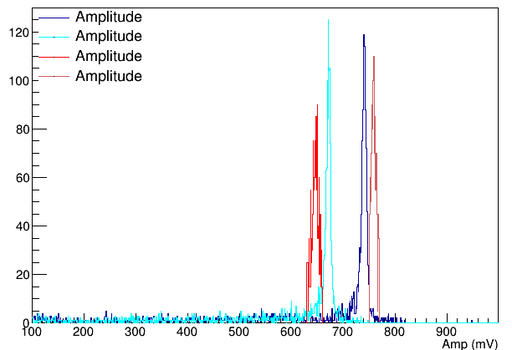
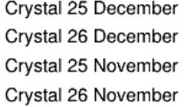
Calorimeter Calibration: Intercalibration Parameter
Problem: by comparing November and December peaks we notice a variation in the intercalibration parameter → from 6% to 15% for the crystal considered
Retrieving temperature information from November data → variation due to experimental room temperature?
Solution: Screensaver scan → routine implemented by CNAO → beam sweeps all crystal in same run → enough statistic to intercalibrate crystal in about 30 minutes allow intercalibration prior to data taking
Intercalibration prior to data taking
Rapid crystal energy calibration
A. Valetti
15
13/12/2022

Slide 17
Conclusions
Detector assembly is proceeding
Energy calibration function has been identified
Crystals temperature calibration procedure has been implemented → parameters will be soon uploaded in SHOE
“Screen saver” scan at CNAO should allow fast energy calibration of all crystal in module
A. Valetti
16
13/12/2022

