Slide 1

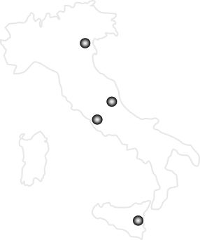

Nuclear Physics Mid Term Plan in Italy
LNF – Session
Frascati, December 1st - 2nd 2022
Summary
Nuclear Physics at DAΦNE
Charged Particle Detectors
Silicon Detectors for High Energy Experiments
Neutron Detectors
Detectors for Medical Applications
Target Development for Nuclear Physics
γ-Χ ray Detectors
New Facilities at LNF, LNL, LNS
Piergiorgio Cerello
INFN, Sezione di Torino, Torino, Italy

Slide 2
Nuclear Physics Mid Term Plan in Italy
LNF – Session
Frascati, December 1st - 2nd 2022
Charged Particle Detectors

Slide 3
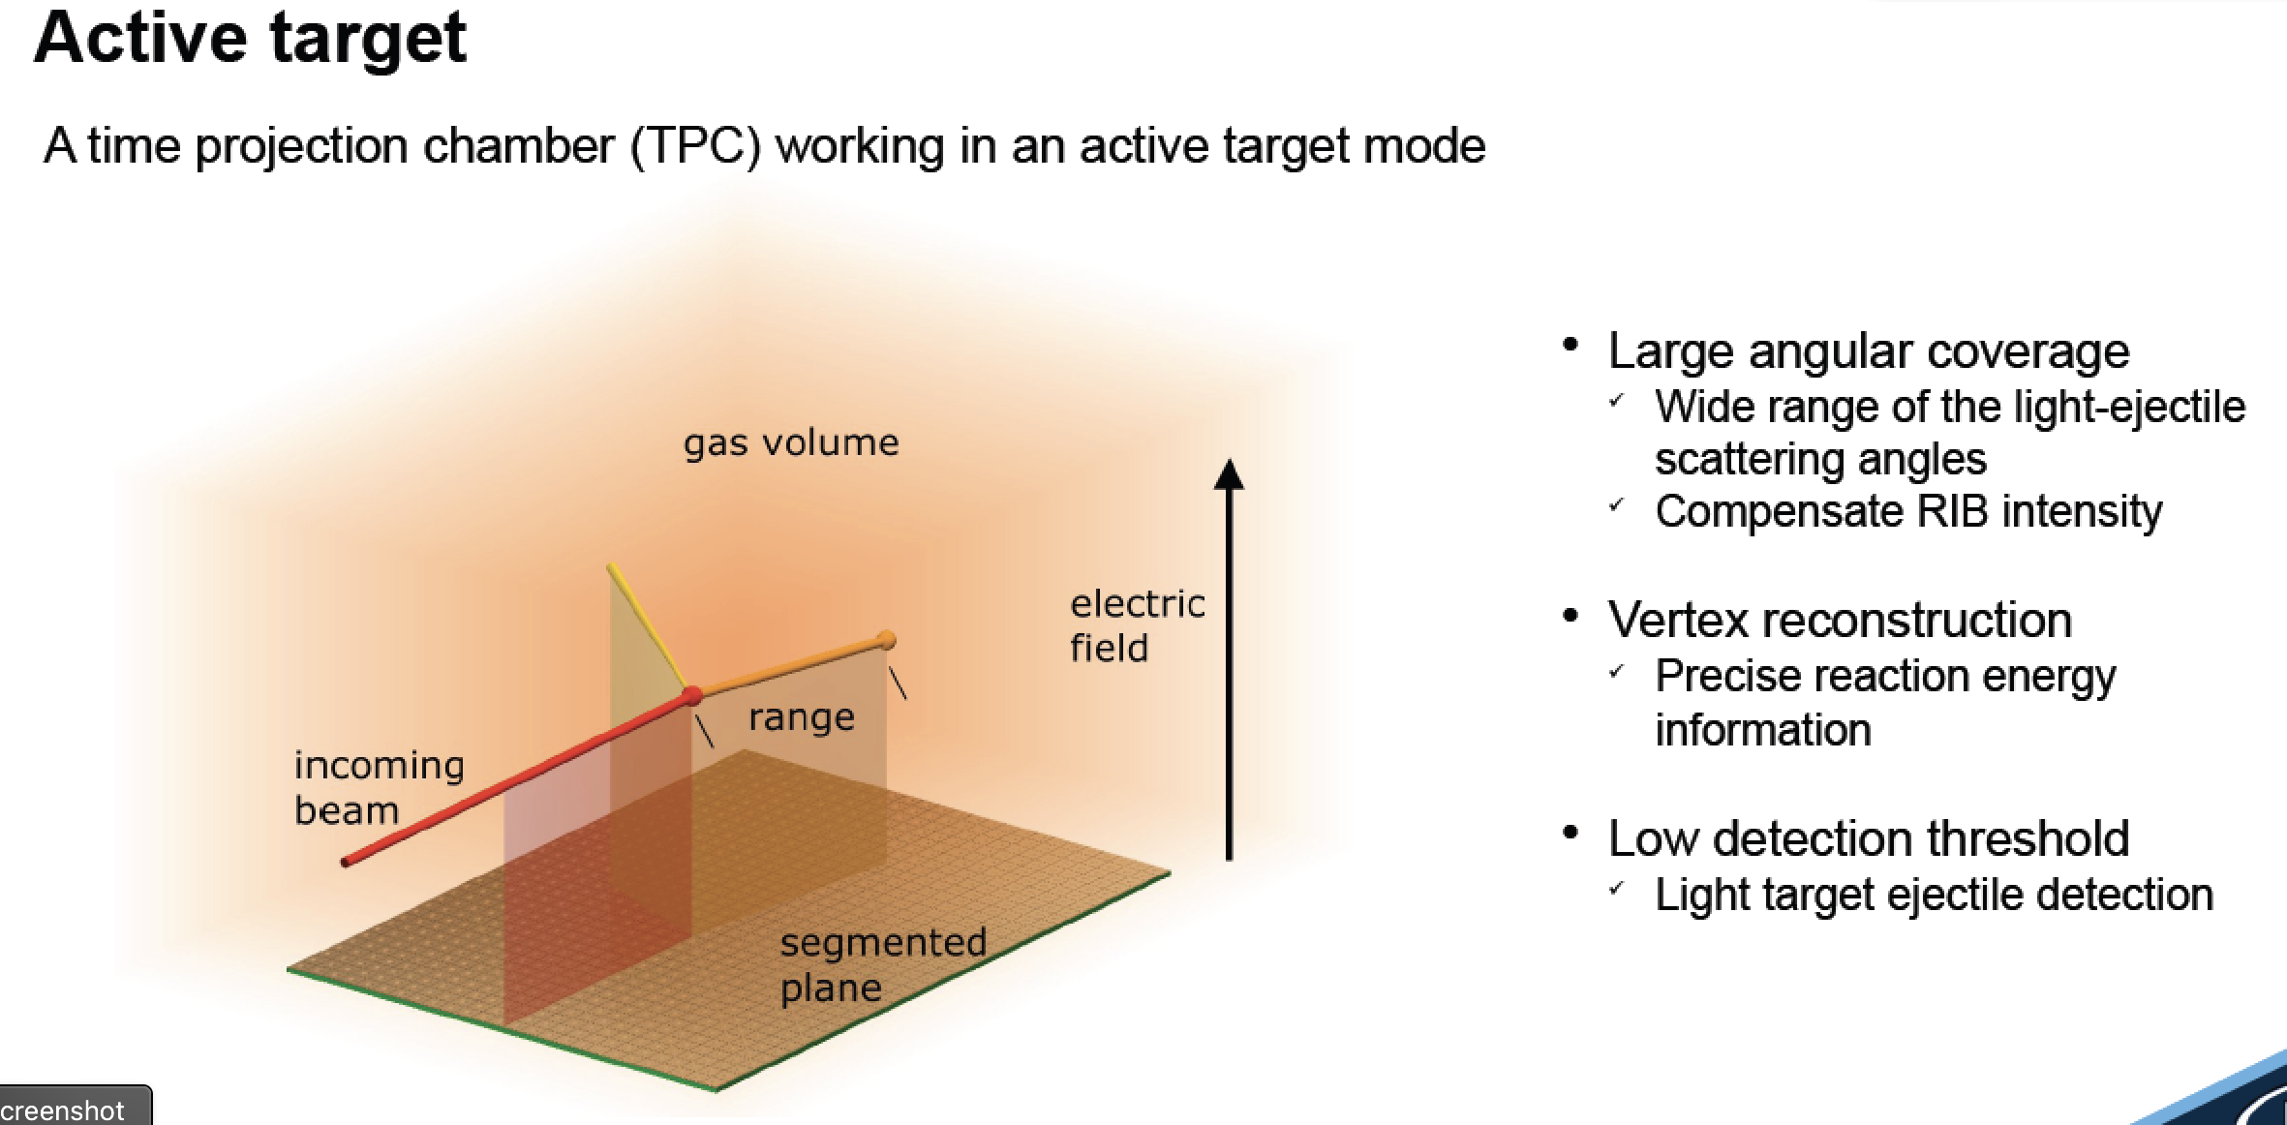


Charged Particle Detectors
Gabriele Pasquali

Slide 4
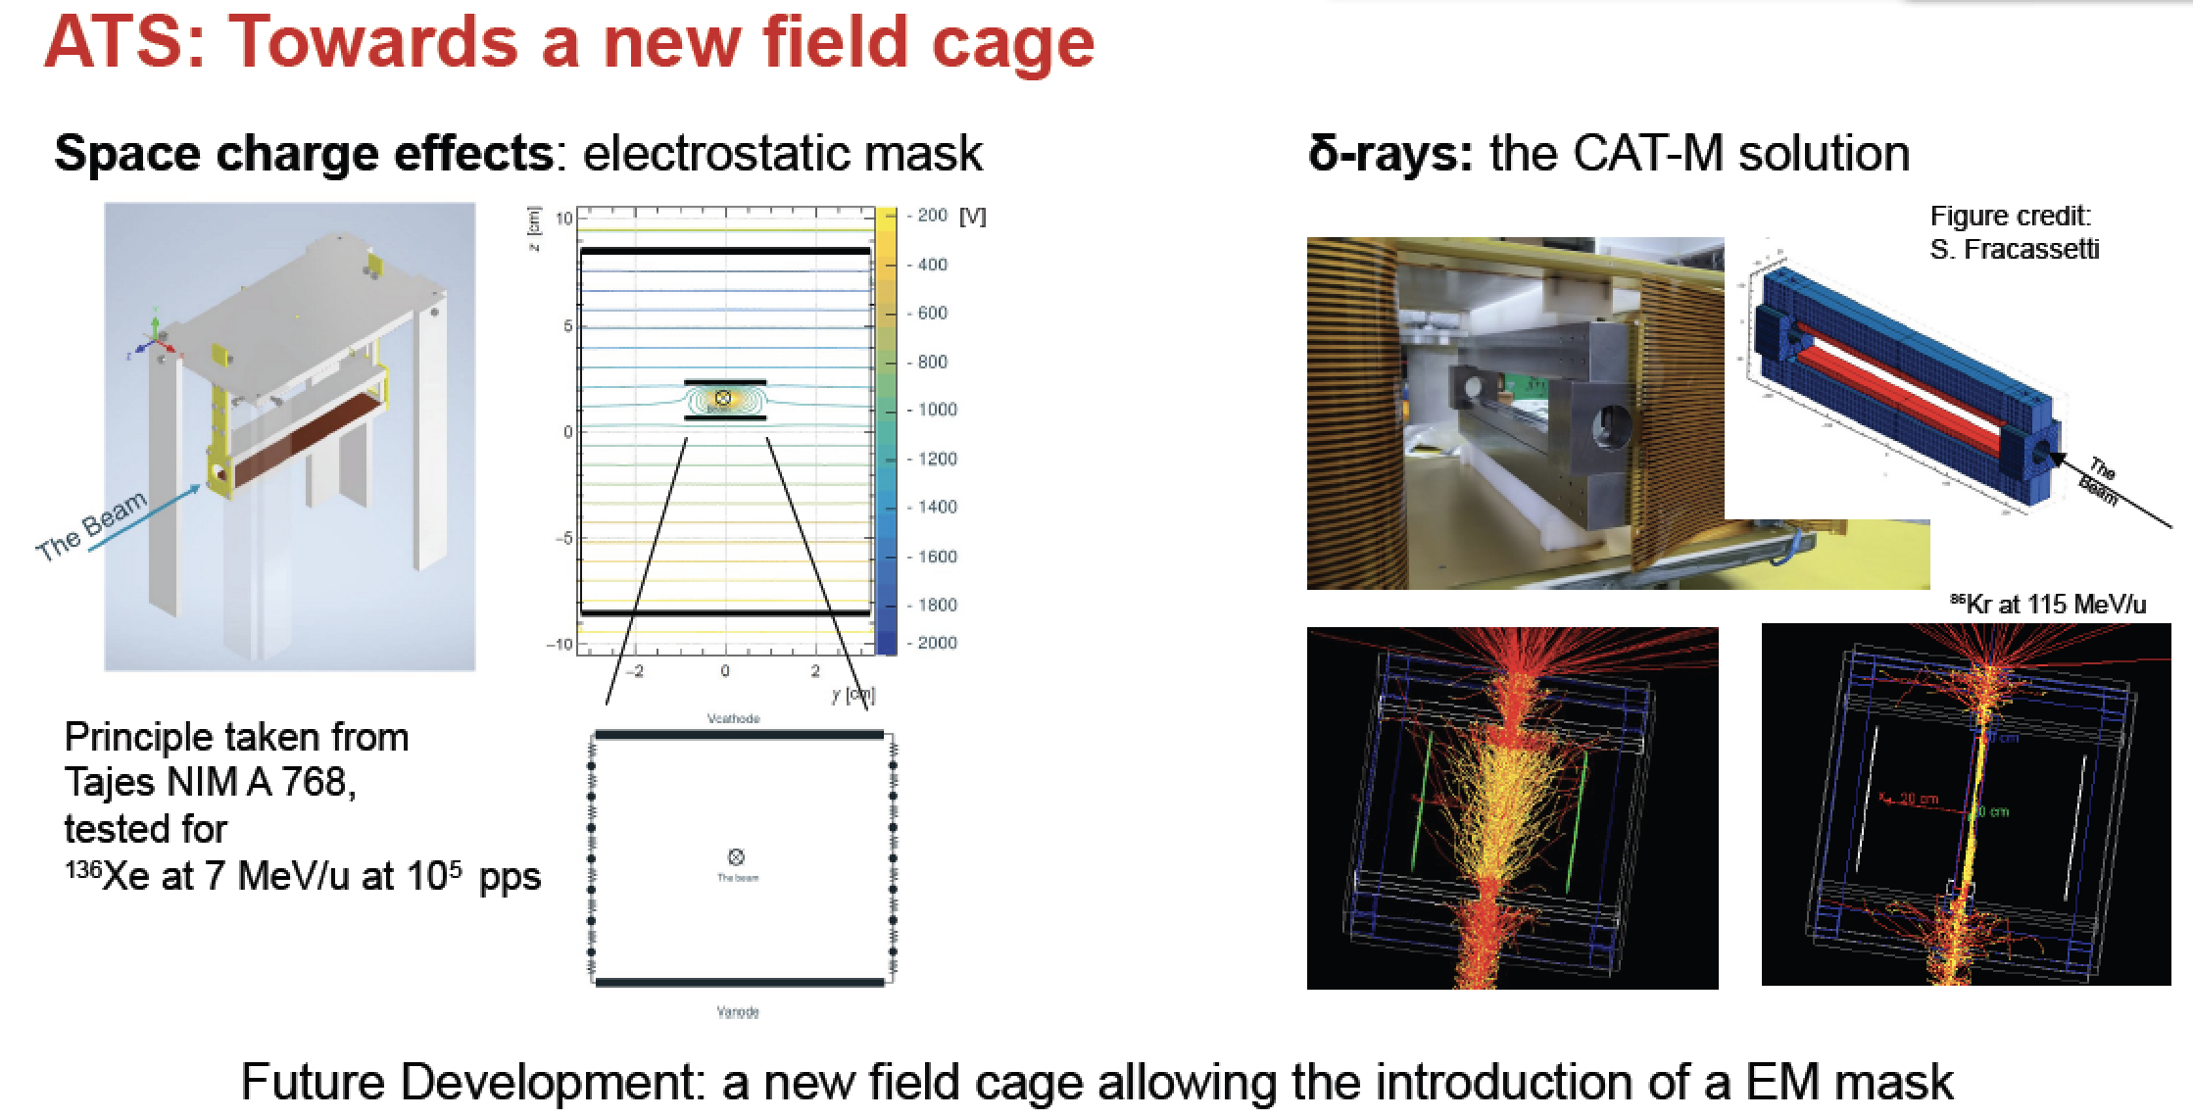
Charged Particle Detectors
Gabriele Pasquali

Slide 5
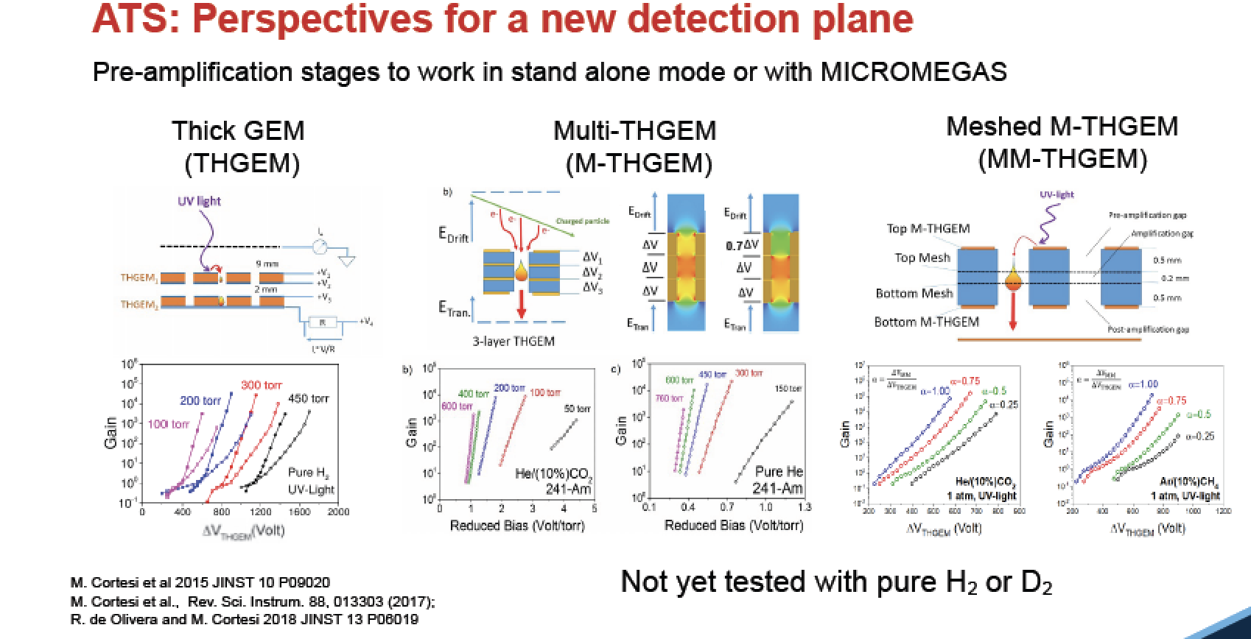
Charged Particle Detectors
Gabriele Pasquali

Slide 6


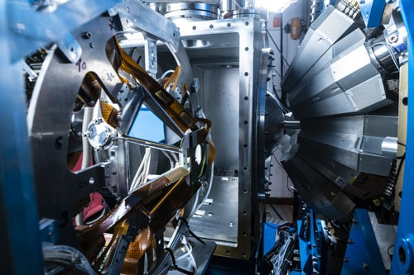
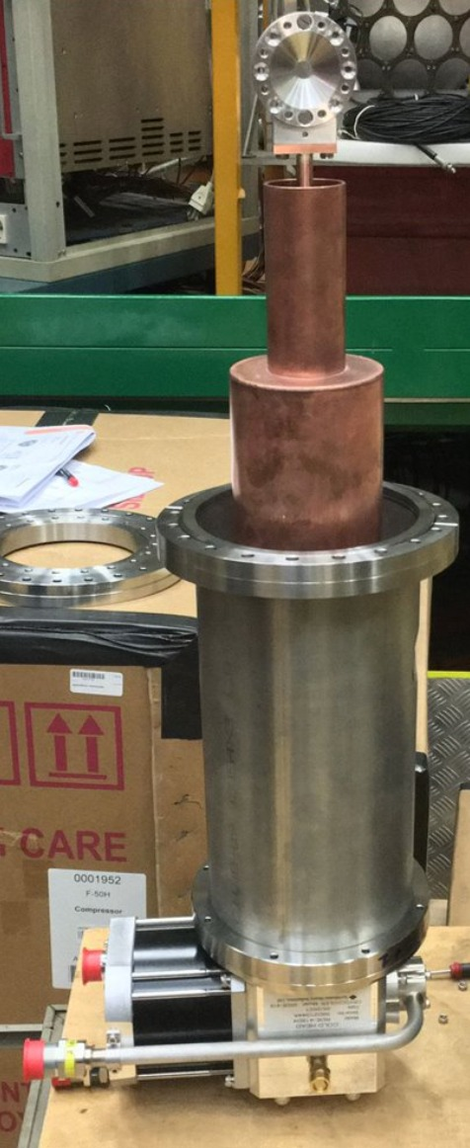
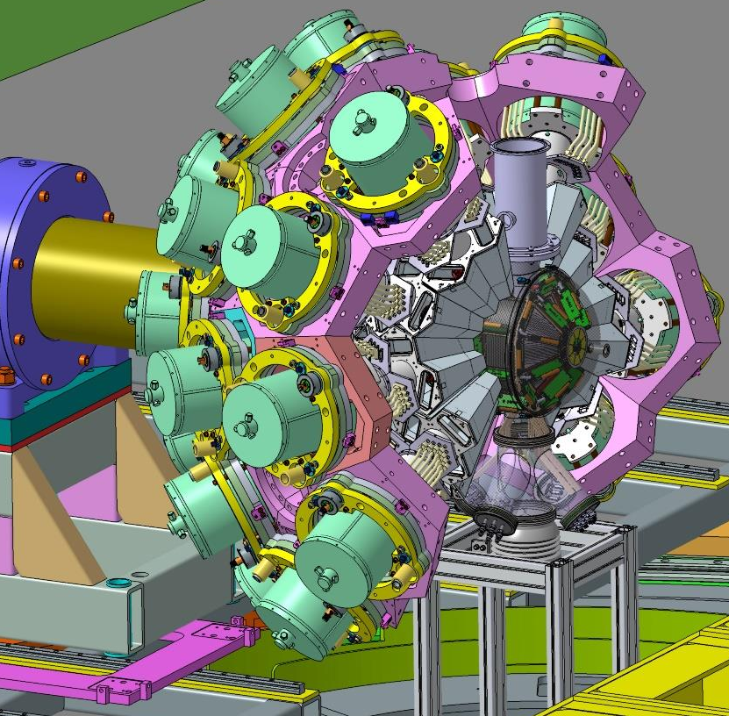



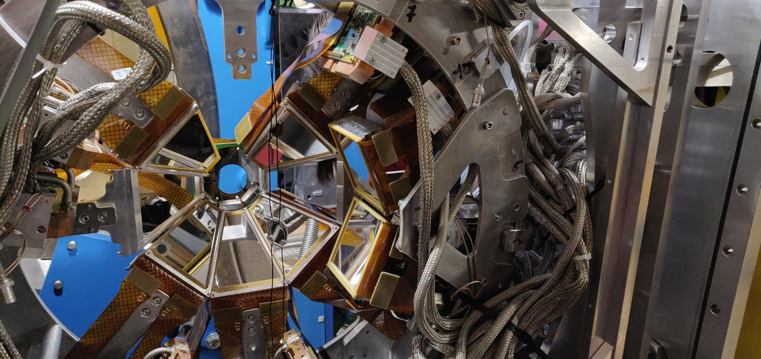
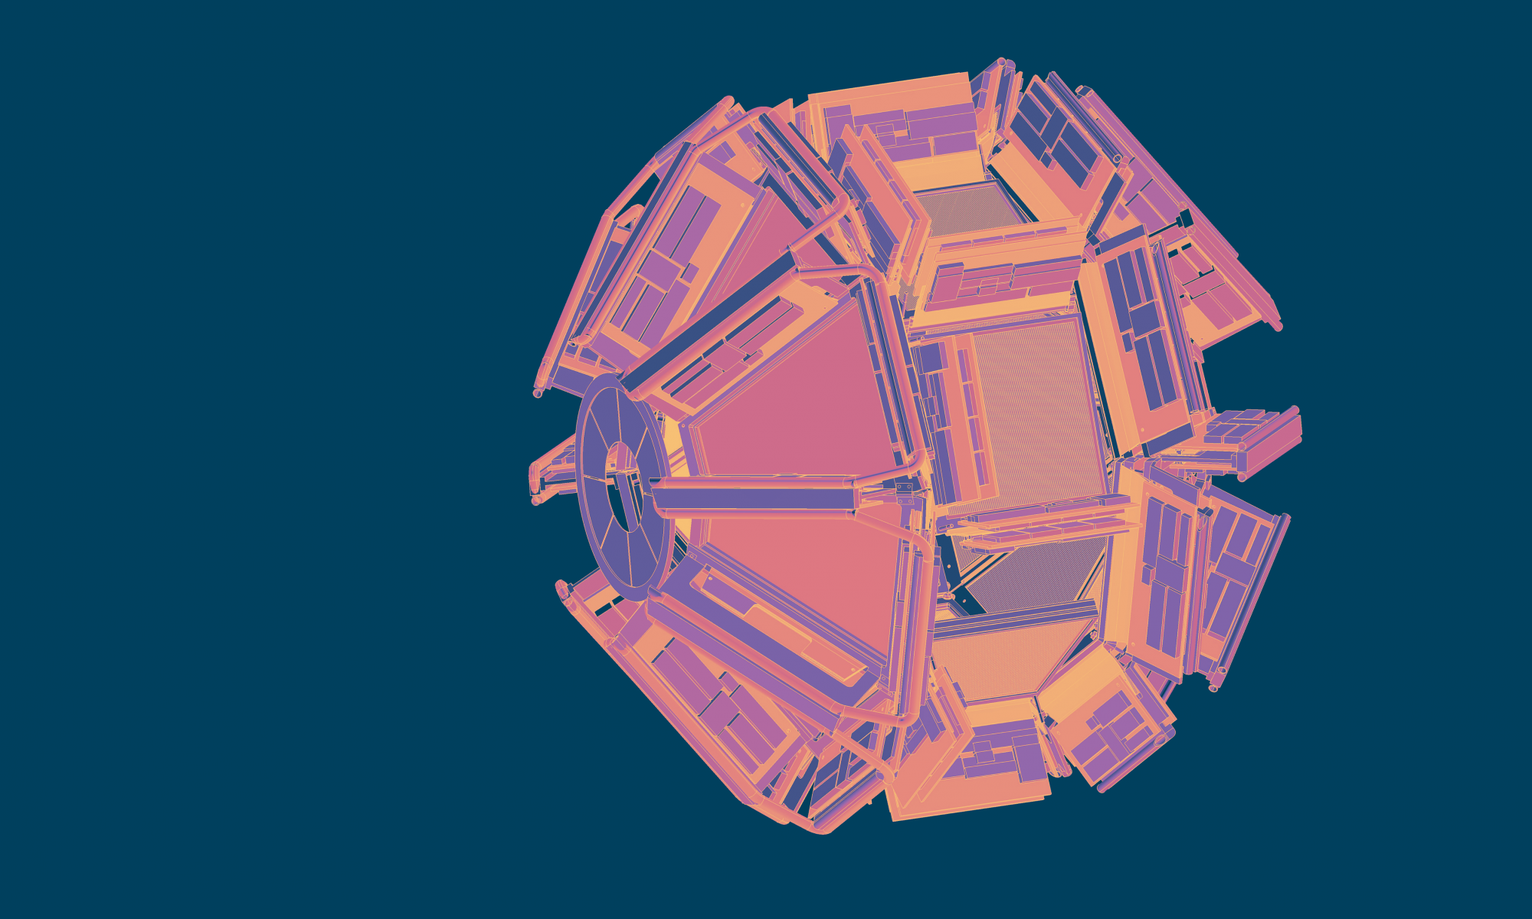
GRIT: an array of highly-segmented silicon detectors for direct reactions
Franco Galtarossa
France – Italy – UK – Spain collaboration
GRIT: Granularity, Resolution, Integration, Transparency,
+ modularity + embedded PSA + cryo target compatibility
Light ISOL RIBs @GANIL, up to early 2021 (Assié at al., NIMA 1014, 2021).
First implementation used in conjunction with AGATA and VAMOS.
To come next: LISE@GANIL and SPES@LNL

Slide 7
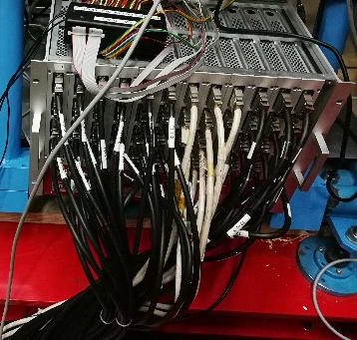
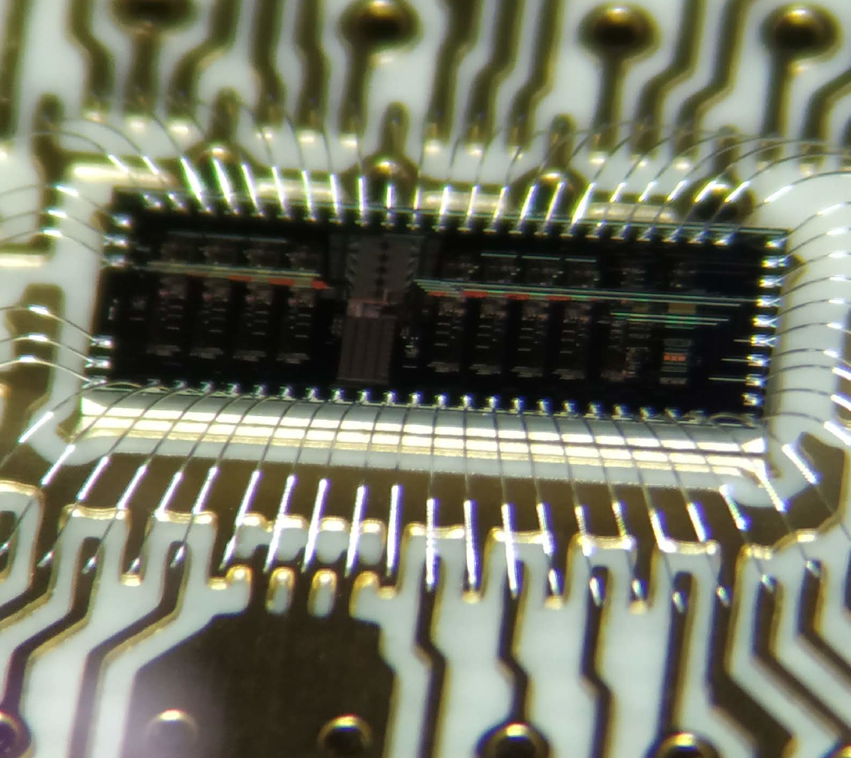
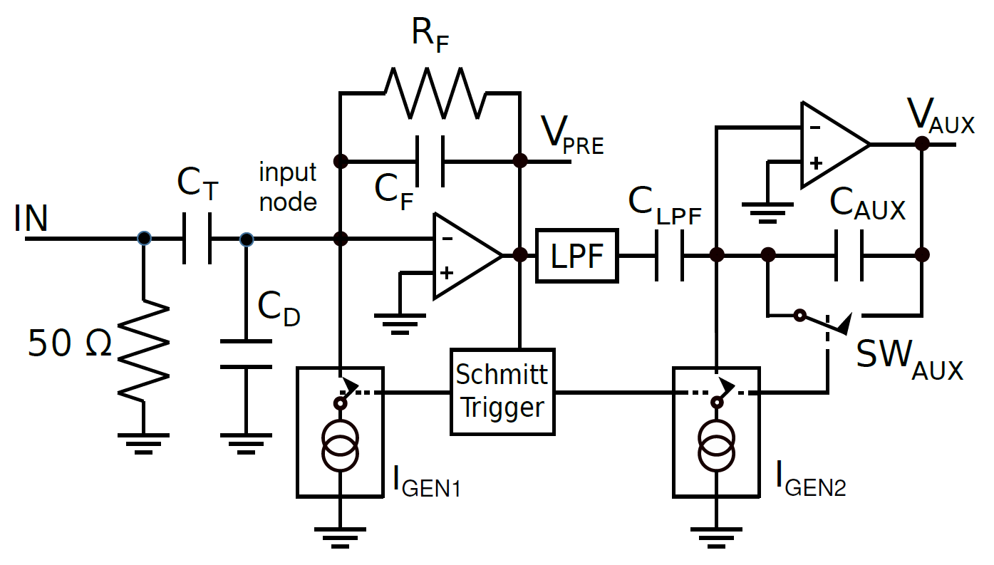
NEED FOR A MULTIPLEXING SOLUTION
PRE-AMP REDESIGN
Particle spectroscopy/discrimination with silicon detectors
Franco Galtarossa
Future developments
The read-out of several hundreds of channels without multiplexing is not practical since requires great efforts in terms of digitizing power and signal routing from detector to back-end. The GRIT collaboration is working on the PLAS analog memory that will provide a 32x multiplication factor
Main challenges:
Preserve the original resolution
Allow for PSA
Exact timestamping
Design of a non-paralyzing structure
Phase: B (3-5 years)
The ASIC pre-amplifiers are undergoing a re-design phase for spec improvement.
- Power consumption reduction (or implementation of more functions within the power budget 11mW/ch)
- Study of resistorless solutions to improve compactness and resolution
- Differential outputs
IMPLEMENTATION OF TOT-COMPATIBLE FIRMWARE FOR DIGITIZERS
Phase: A (1-3 years)
Photograph of the SeDIFF modules used to send differential signals to the digitizers rack during the 2021 test campaign.
In order to fully exploit the dynamic-range extention provided by the fast-reset technology it is mandatory to write a dedicated firmware.
This work will be carried out in sympathetic resonance with the ASIC re-design.
Phase: A (1-3 years)

Slide 8
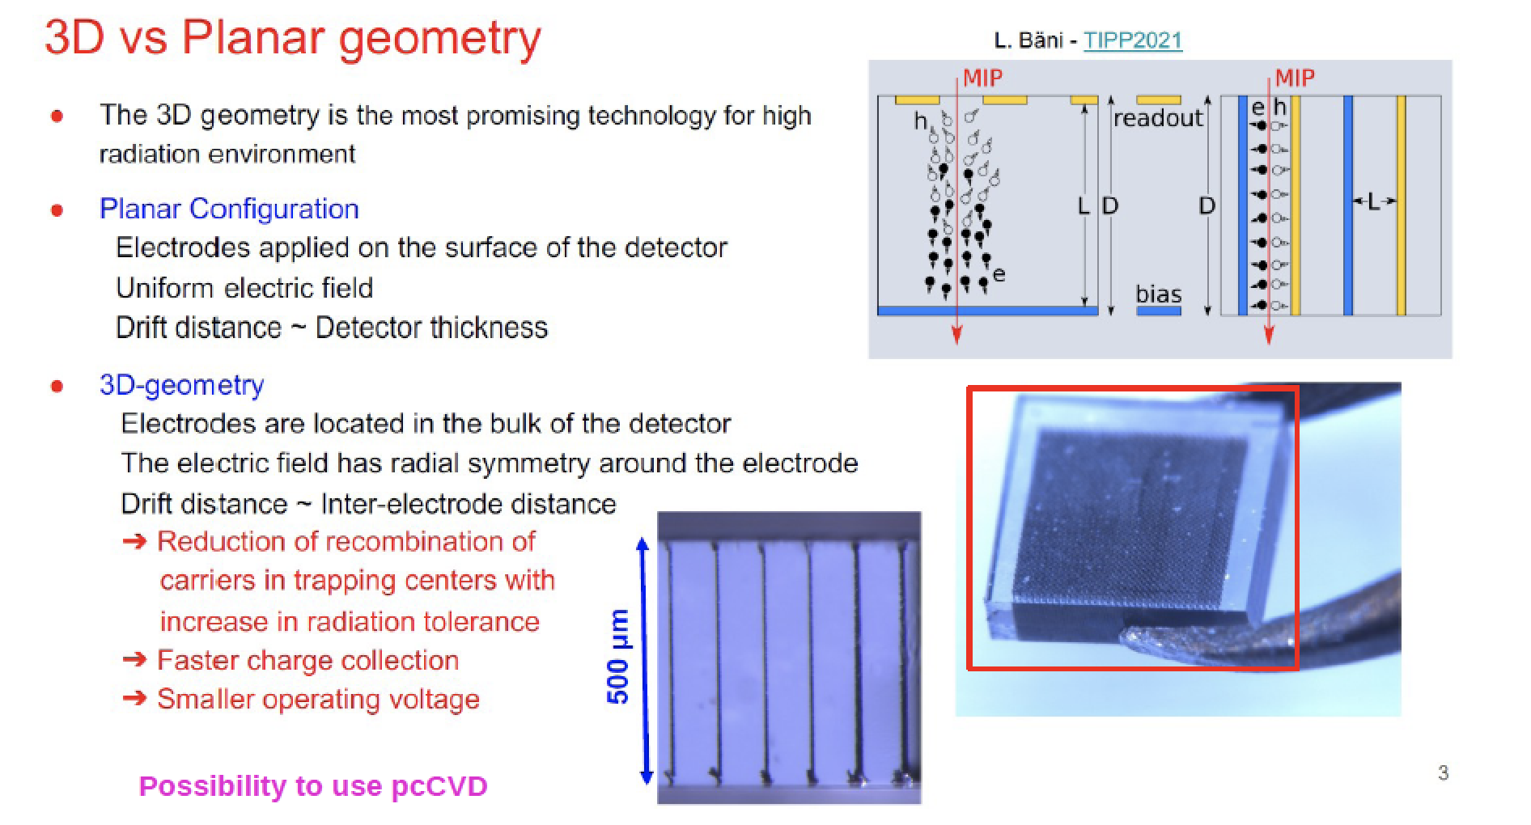
Charged Particle Detectors: Diamond detectors
Leonello Servoli

Slide 9
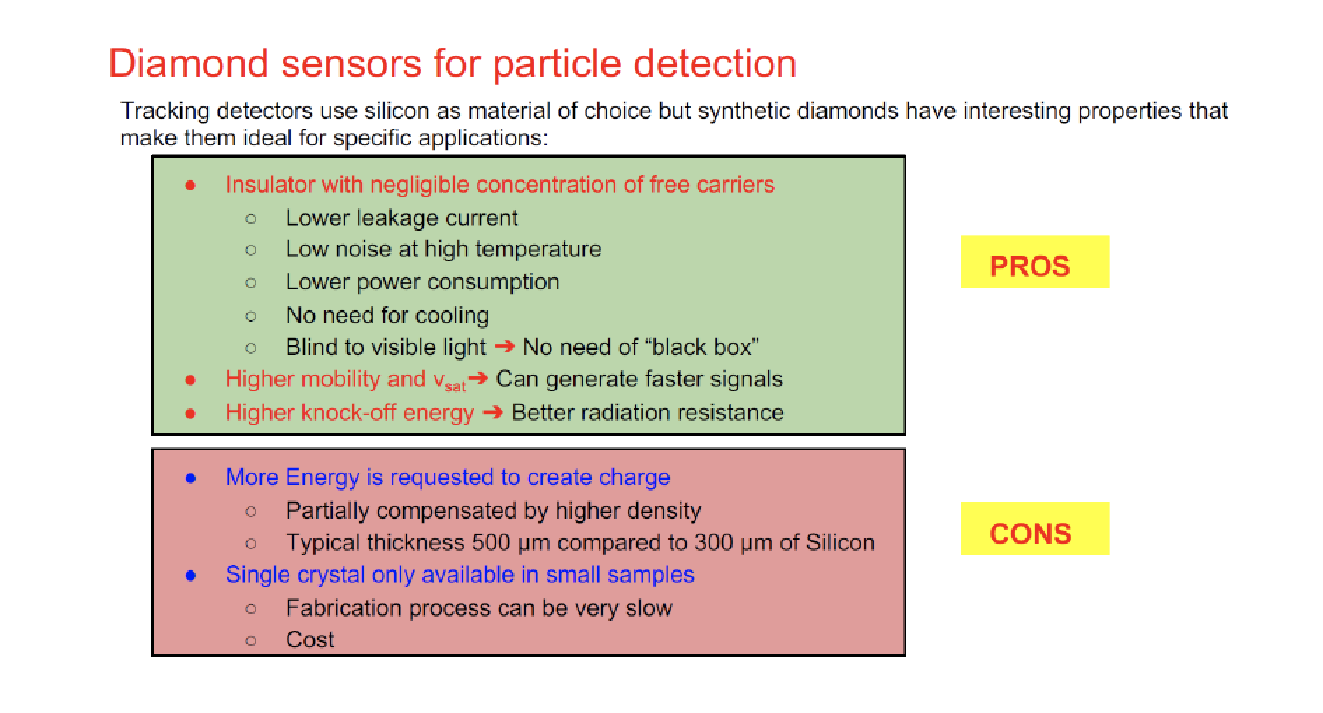
Charged Particle Detectors
Leonello Servoli

Slide 10
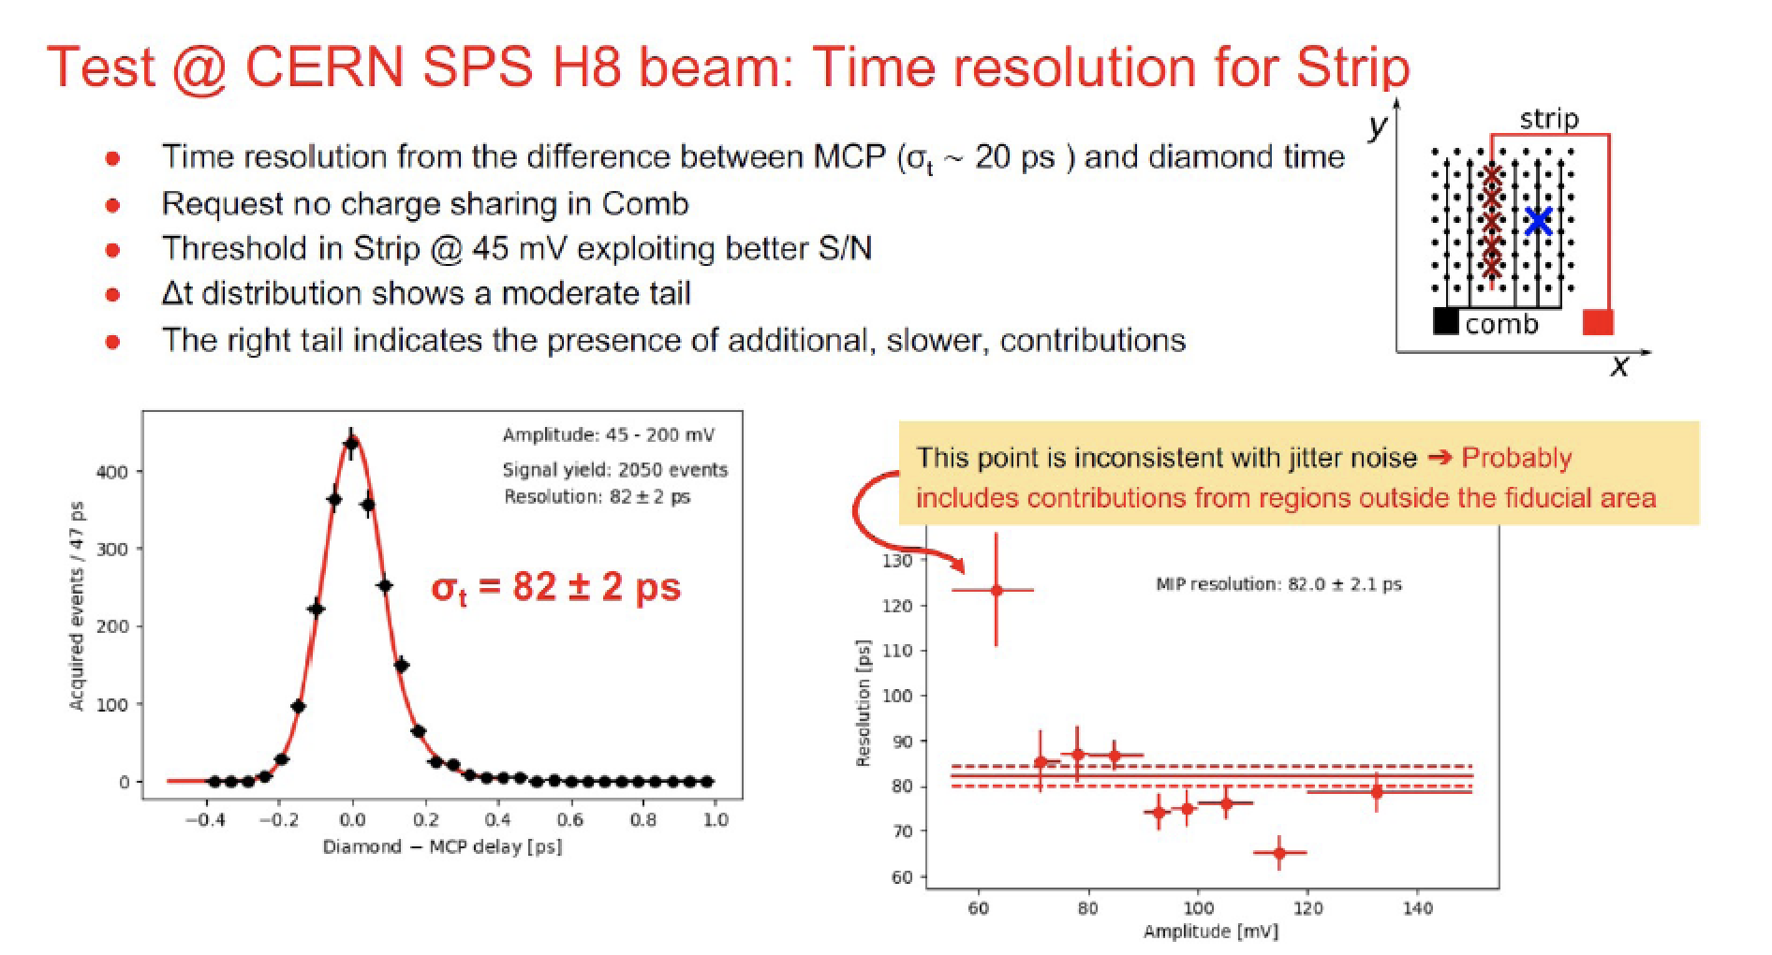
Charged Particle Detectors
Leonello Servoli

Slide 11
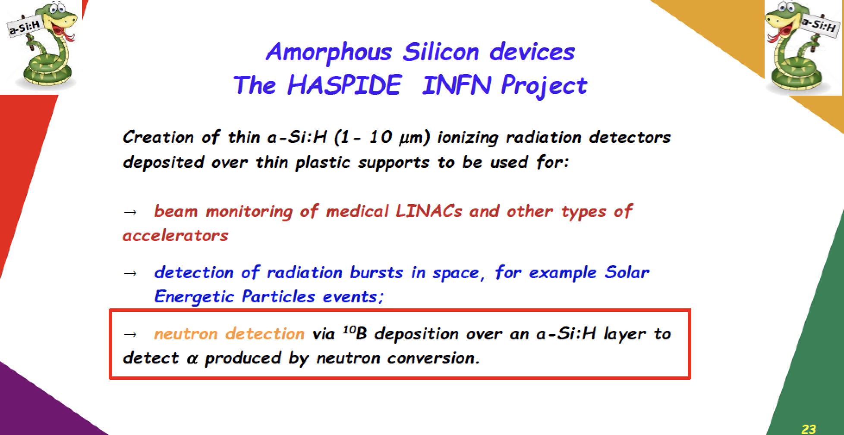
Charged Particle Detectors
Leonello Servoli

Slide 12
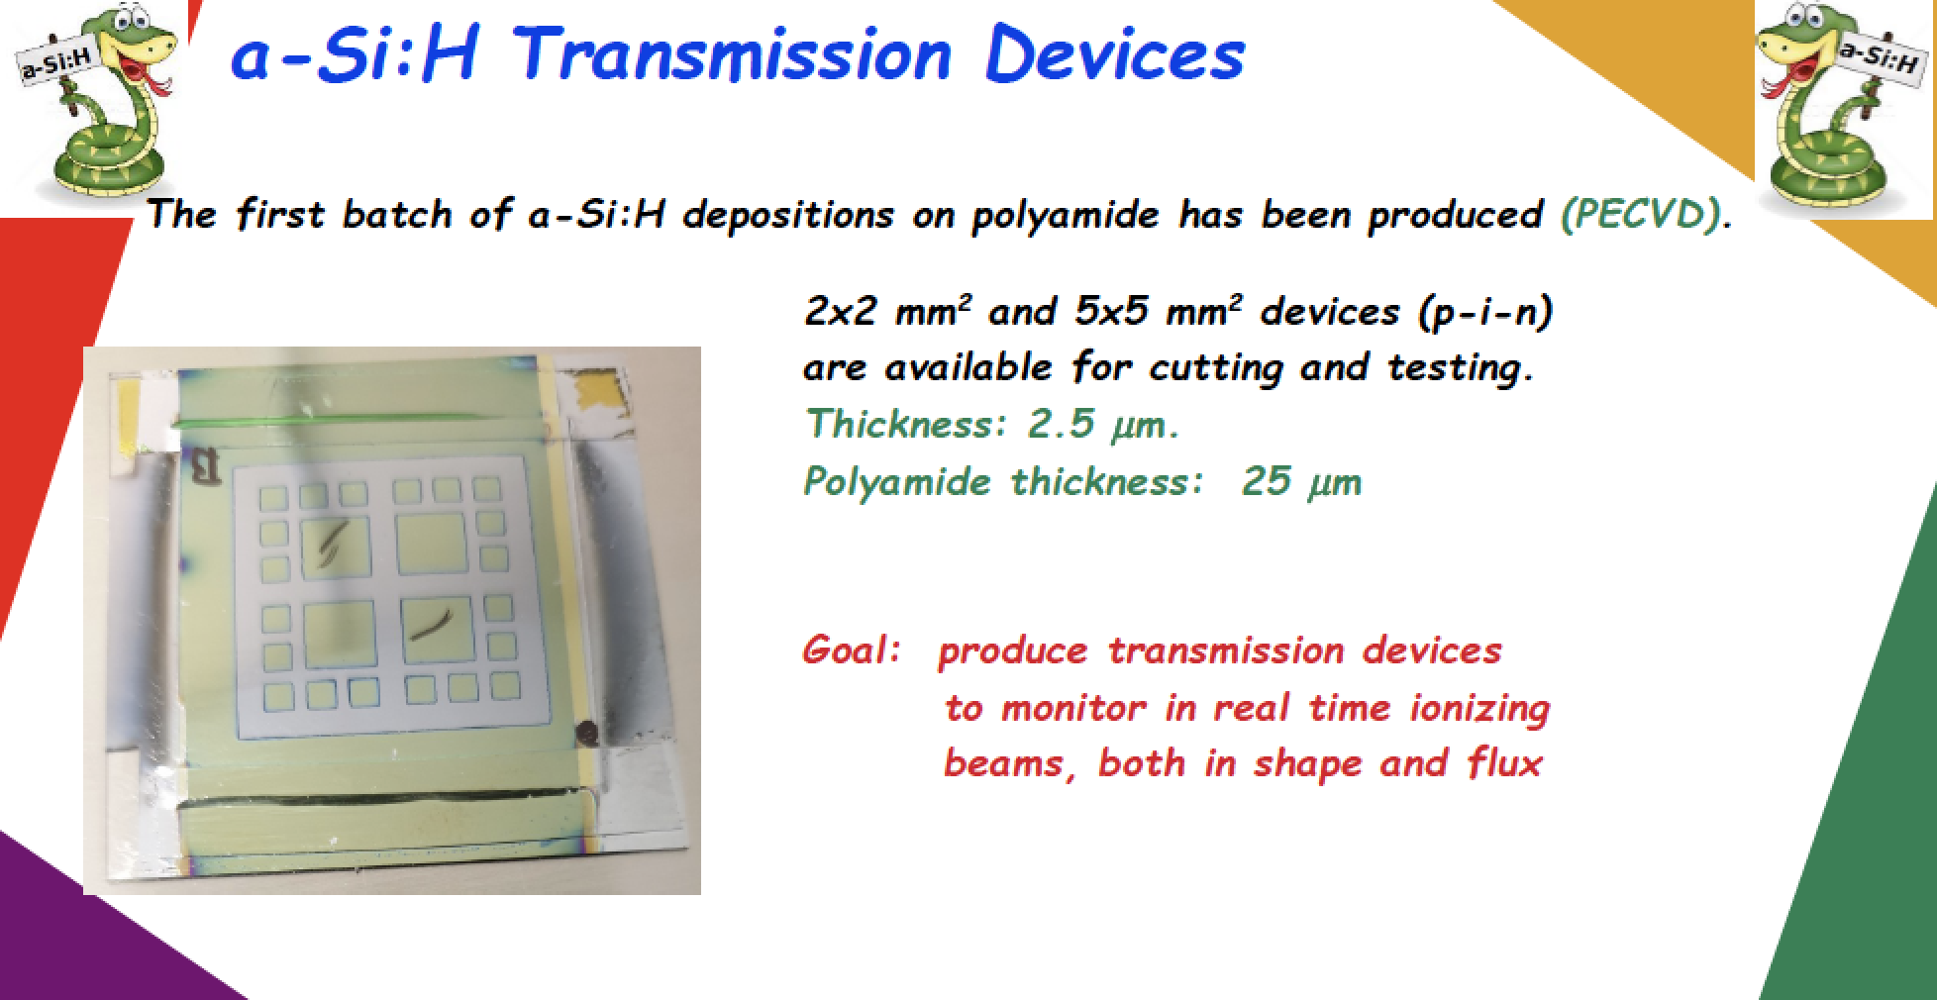
Charged Particle Detectors
Leonello Servoli

Slide 13
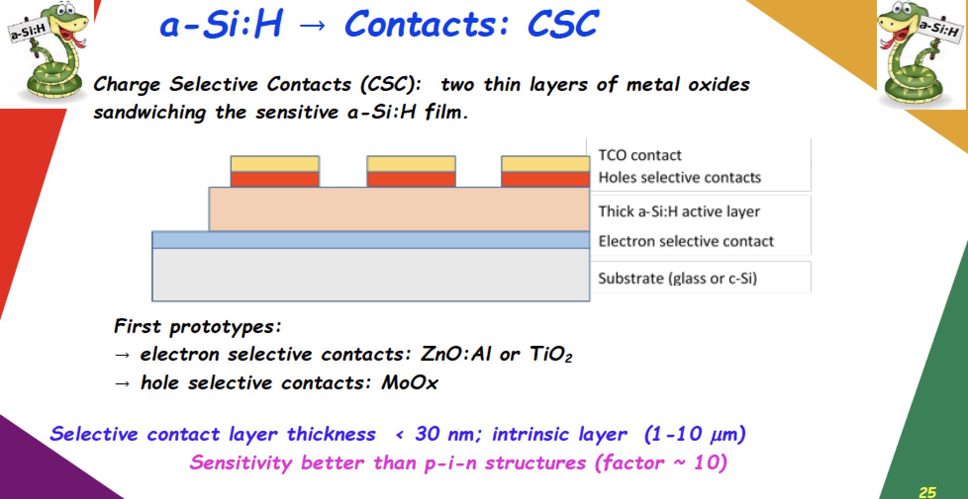
Charged Particle Detectors
Leonello Servoli

Slide 14
Nuclear Physics Mid Term Plan in Italy
LNF – Session
Frascati, December 1st - 2nd 2022
Neutron Detectors

Slide 15
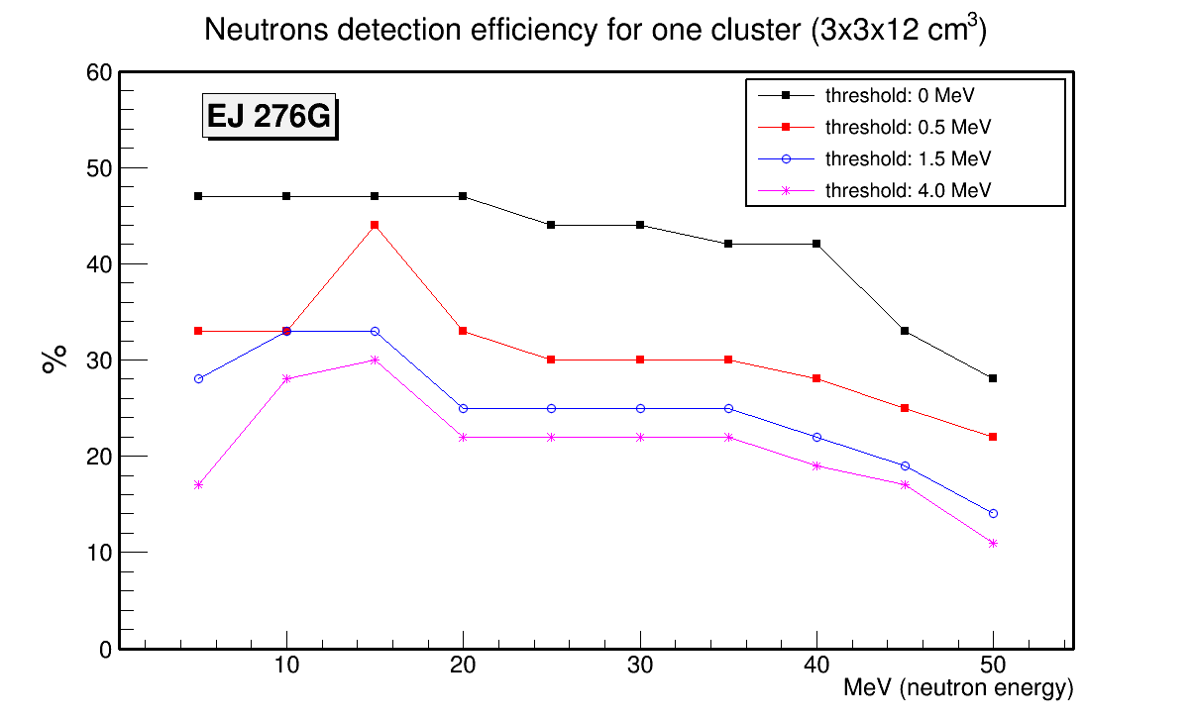
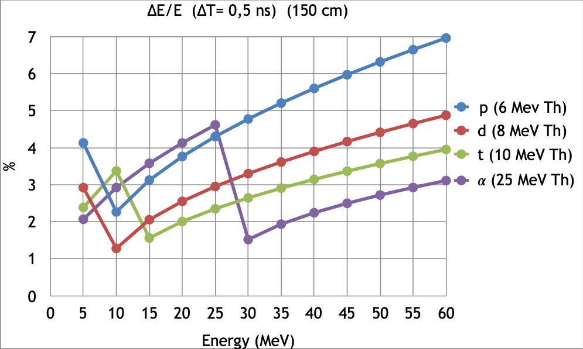
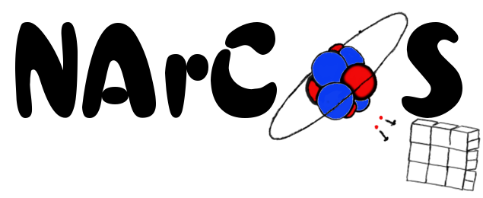
Neutron Detectors
Organic Scintillators
Andreas Best
Candidate: plastic scintillator EJ276-Green Type (ex EJ299-33) (3x3x3cm³)
1 cluster: 4 cubes -> 3x3x12 cm³
Reading the light signal: Si-PM and digitalization
Ca. 50% neutron detection eff. (for prototype)
Modular, reconfigurable
PSD of n/γ (but also light charged particles)
Energy measurement from ToF (Δt≤0.5 ns with L_{ToF}≈1÷1.5m)
TOF using RF or with ancillary MCP (low intensity exotic beams)
Energy resolution < 10%
Physic cases
Neutron-particles correlations (HBT)
Reaction Dynamics and time scale
Symmetry Energy in EoS of nuclear matter
Nuclear structure of unbound exotic nuclei
In medium nuclear interaction
Nuclear astrophysics (neutron stars and nucleosynthesis processes)
Medical applications

Slide 16
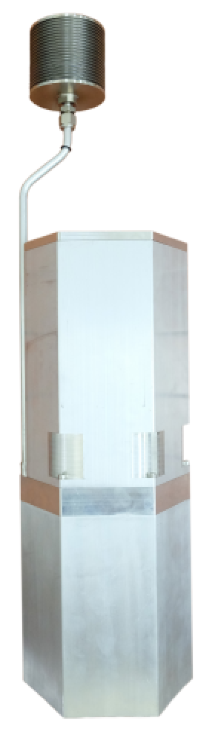
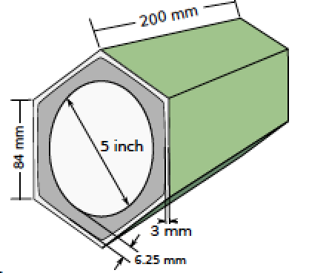
Neutron Detectors
Andreas Best
NEDA – NEutron Detector Array
Expansion chamber
Regular hexagon to tile up a surface
5” PM Hamamatsu R11833-100HA QE 33%
PSA liquid EJ301 → 3 liters
TiO₂ Reflexion paint
Expansion chamber ΔT =10-50 C
Voltage divider transistorized for large counting rates
Single to differential converter
1mm mu-metal shielding
Self produced
Flexible array – variability of focal positions (experiment dependent) or configurations (mechanics to be done)
Neutron multiplicity filter. Efficiency 1n 30%
Pulse shape discrimination – online trigger selectivity
Off-line implementation of traditional algorithms and/or Neural Networks
Angular resolution: Δθ(0.5 m) = ±7° - Δθ(1 m) = ±4°
Timing better than 1 ns. Same performance digital/analog.
Energy resolution ΔE/E: NEDA 1m – 40%, NEDA 7m – 5%

Slide 17
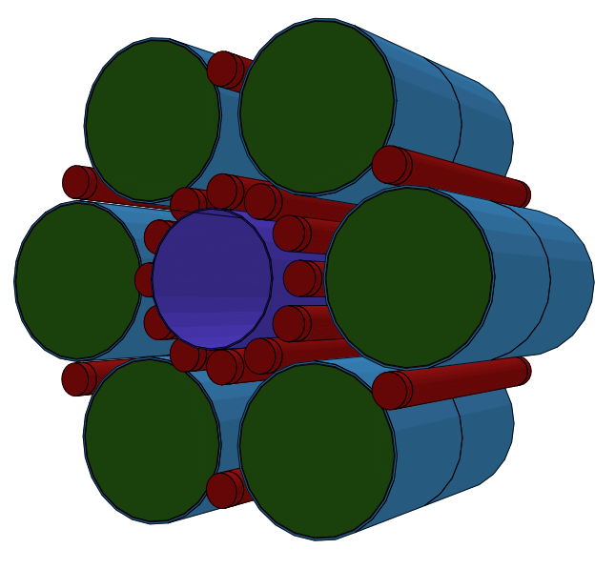
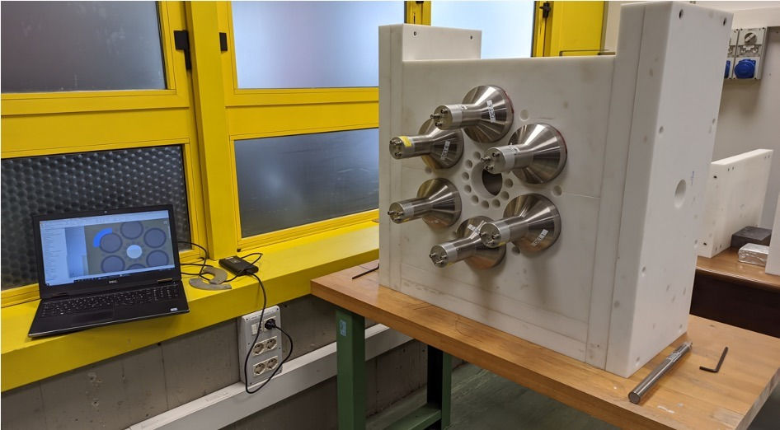

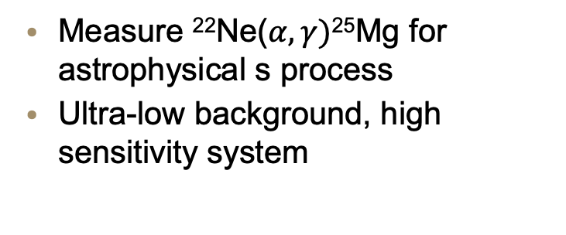
Neutron Detectors
Andreas Best
SHADES
Scintillator-3He Array for Deep-underground Experiments on the S-process
Array of 12 EJ-309 (high flash point, good PSD) and 18 ³He counters
Efficiency for low-energy neutrons ~ 20%
Coincidence ³He-Scintillator for capture-gating/energy veto
Energy resolution 20% or better (depending on E)
(First) use case: low-energy nuclear astrophysics @ LNGS
Measure ²²Ne($α,γ)$²⁵Mg for astrophysical s process
Ultra-low background, high sensitivity system
ERC-StG UniNa/INFN
A. Best, D. Rapagnani, D. Mercoligliano, C. Ananna, A. Di Leva, G. Imbriani (UniNa, INFN-Na), M. Junker (INFN-LNGS)

Slide 18
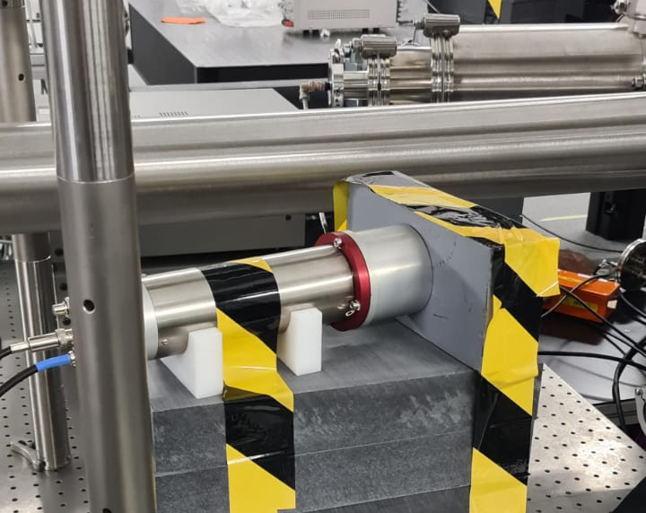
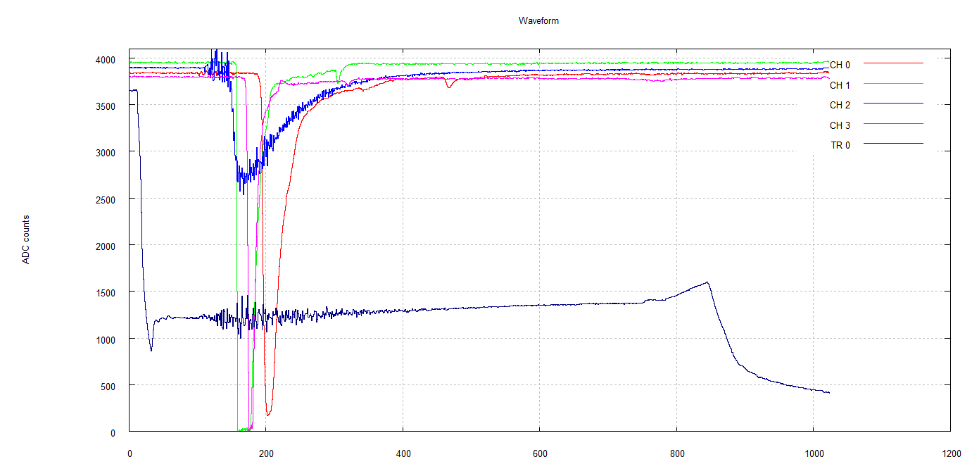
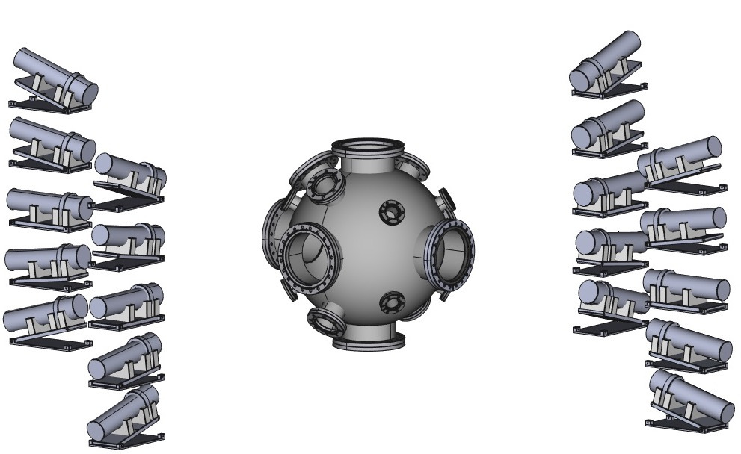
Neutron Detectors
Andreas Best
POLYFEMO (AsFin R&D)
Neutron detection in laser-driven nuclear experiments
Use case: diagnostics for plasma fusion (nuclear astrophysics - stellar plasma in laboratory)
Fast recovery from EMP and gamma flash
Tests with table-top DD fusion:
EJ-309 (liquid), EJ-232Q (plastic), Li-glass, EJ-276G (plastic)
G.L. Guardo1, M. La Cognata1, D. Lattuada1,2, G. D'Agata1,3, A.A. Oliva1,3, G.G. Rapisarda1,3, M.L. Sergi1,3
1- Laboratori Nazionali del Sud - INFN, Catania, Italy
2- Università degli Studi "Kore" di Enna, Enna, Italy
3- Università degli Studi di Catania, Catania, Italy

Slide 19
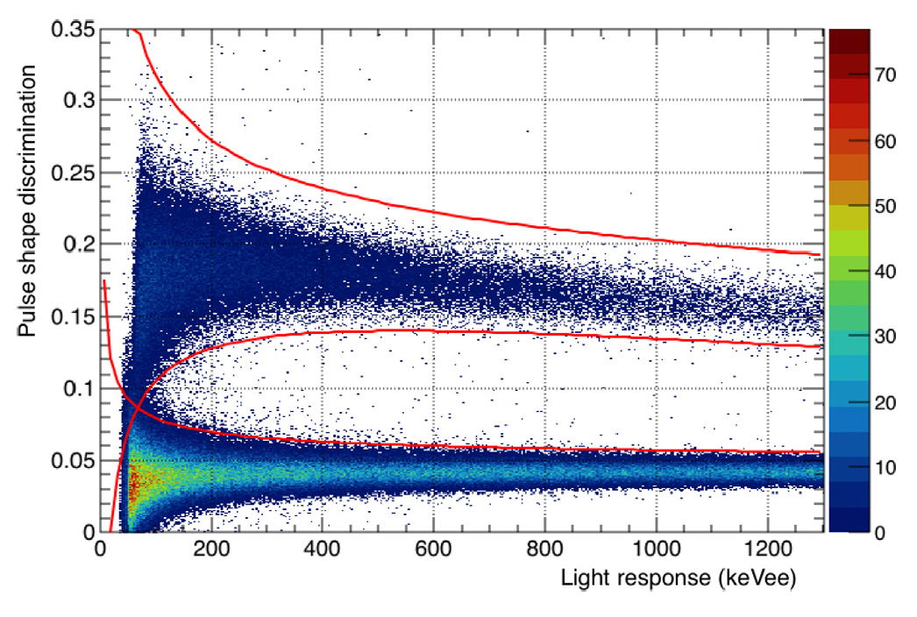
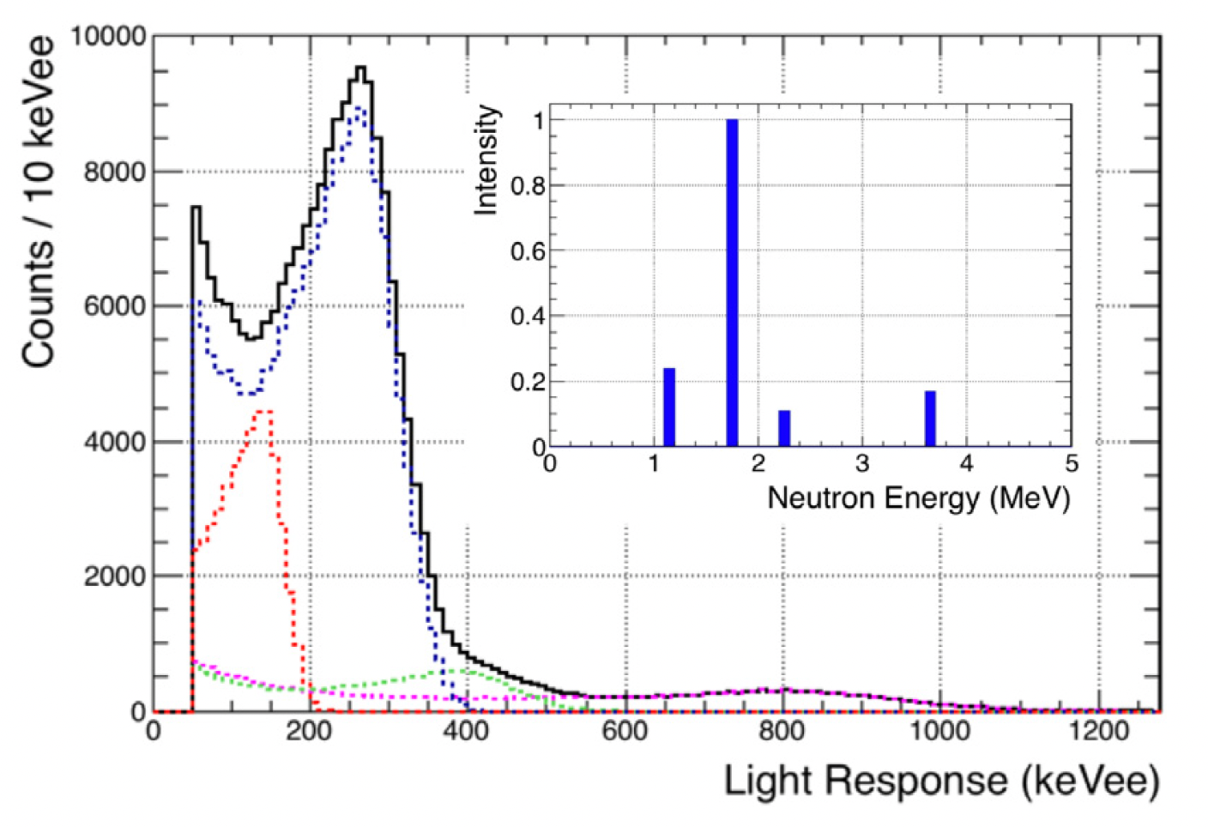
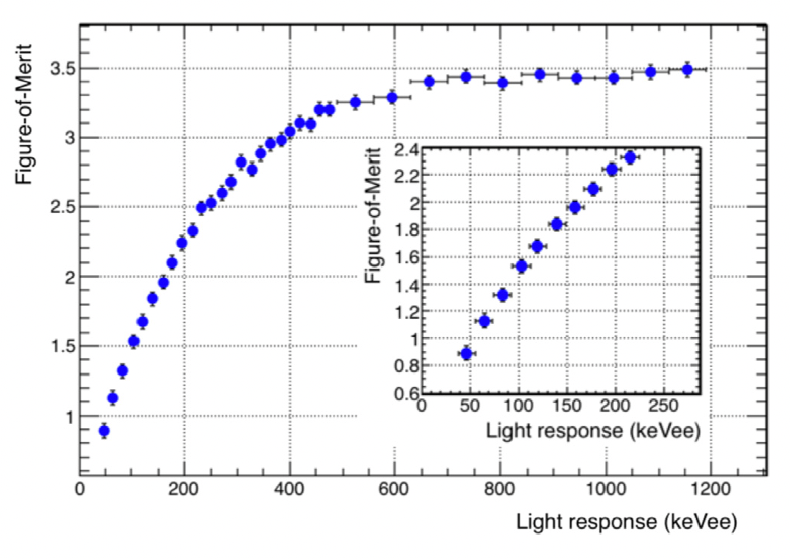
Neutron Detectors
Andreas Best
ODeSA
The ORNL Deuterated Spectroscopic Array
EJ-315 deuterated benzene-d_{6,} 10+4 detectors
Spectrum unfolding for medium energy neutrons 0.4 – 15 MeV
Use case: energy sensitivity without TOF capabilities
Intrinsic eff. ~ 30%, resolution ca. 4%
Febbraro et al. NIM A 946 (2019) 162668
Febbraro, Becker, deBoer et al. NIM A 989 (2021) 164824
Febbraro, deBoer et al. PRL 125, 062501 (2020)
On behalf of:
M. Febbraro (ORNL), R.J. deBoer (U. Notre Dame/JINA)

Slide 20
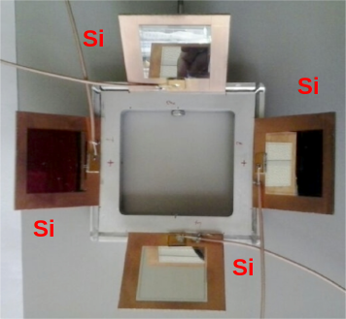
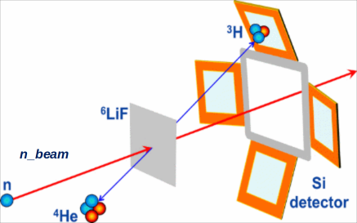

SiMon
Simone Amaducci
(n,cp) detector
Text
4x Off beam silicon detectors detecting the products of the ⁶Li(n,t) reaction from a thin (<2 μm) LiF sample on a mylar foil
Measure neutron flux from thermal to 1 MeV, very low sensitivity to γ
Acting as a permanent neutron beam monitor (SiMon and SiMon2)
Silicon -> SiC to increase rad. hardness and work in NEAR
S. Amaducci, A. Manna and the n_TOF Collaboration

Slide 21
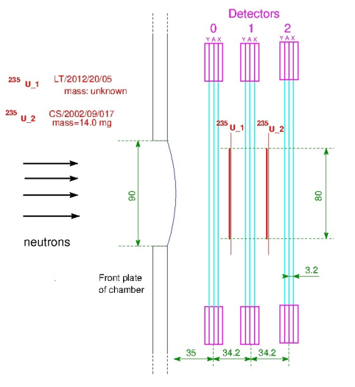
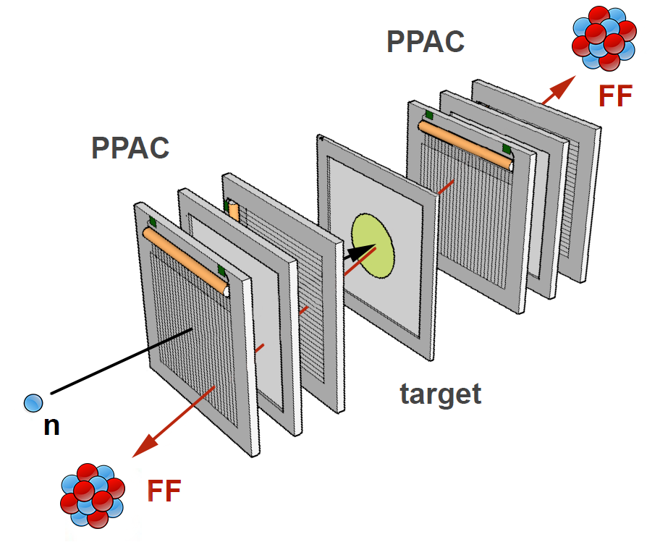
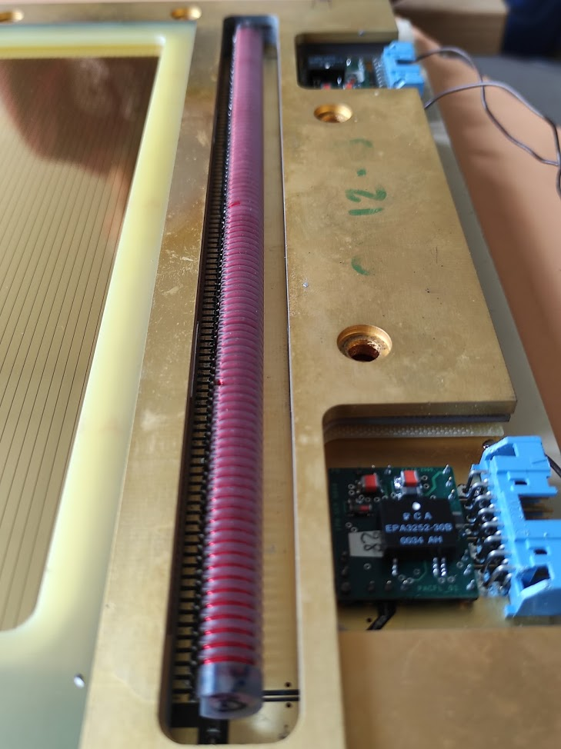
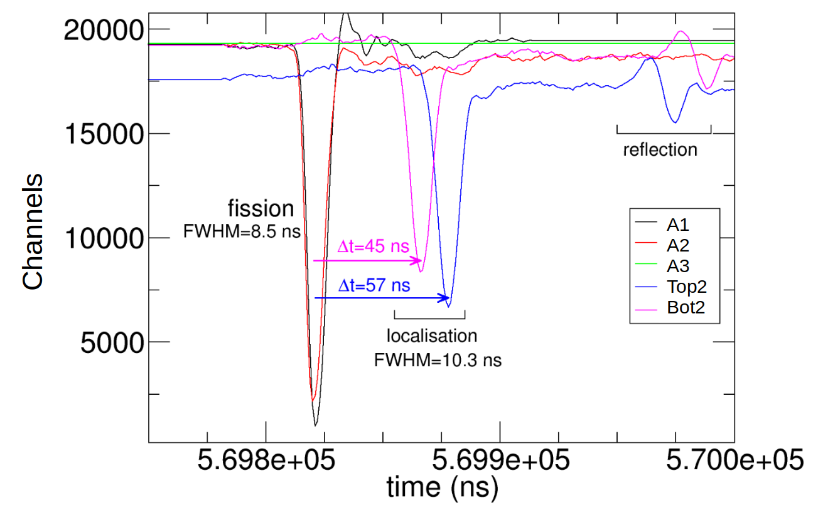
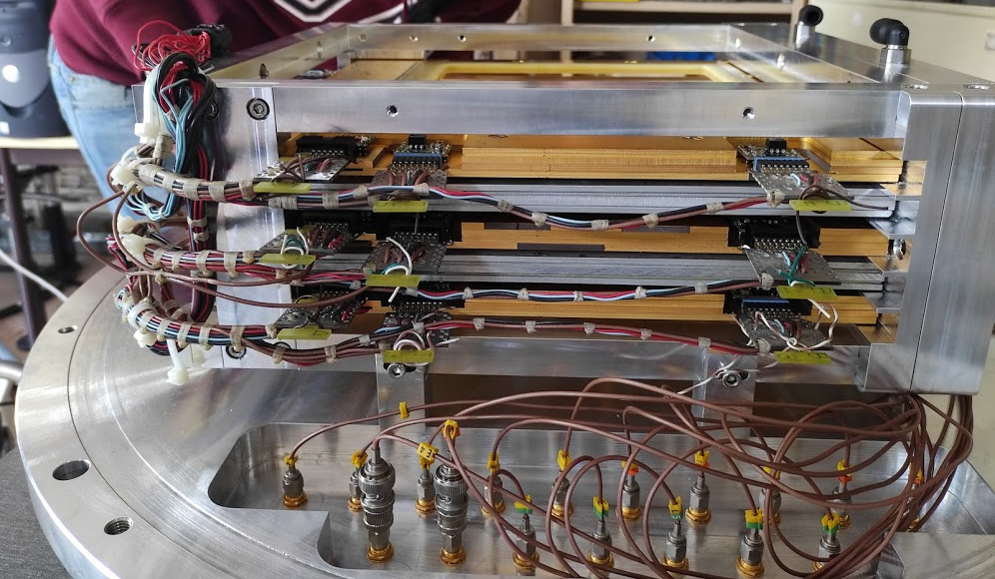
Parallel Plate Avalanche Counter (PPAC)
Simone Amaducci
Fission detector
The samples:
²³⁵U ²³⁸U
Neutron energy range:
from thermal to few GeV
The electrodes:
coated with gold, 700 nm thick
Anode:
coated gold (700 nm thick) uniform and double sided
Cathodes:
coated gold (700 nm thick)divided into 2 mm wide strips
S. Amaducci, A. Manna and the n_TOF Collaboration

Slide 22
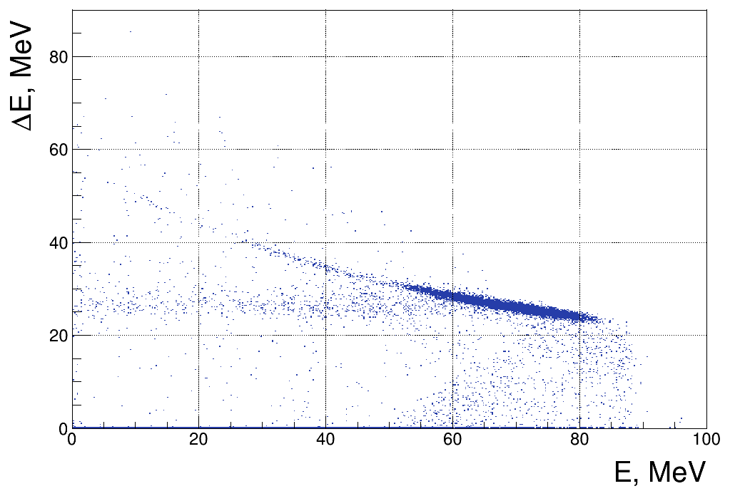
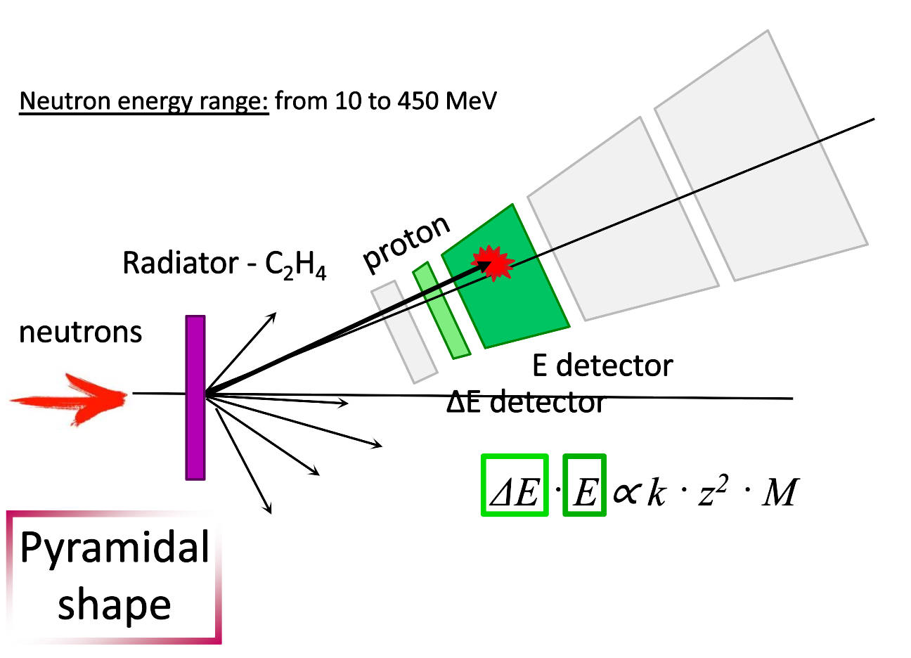
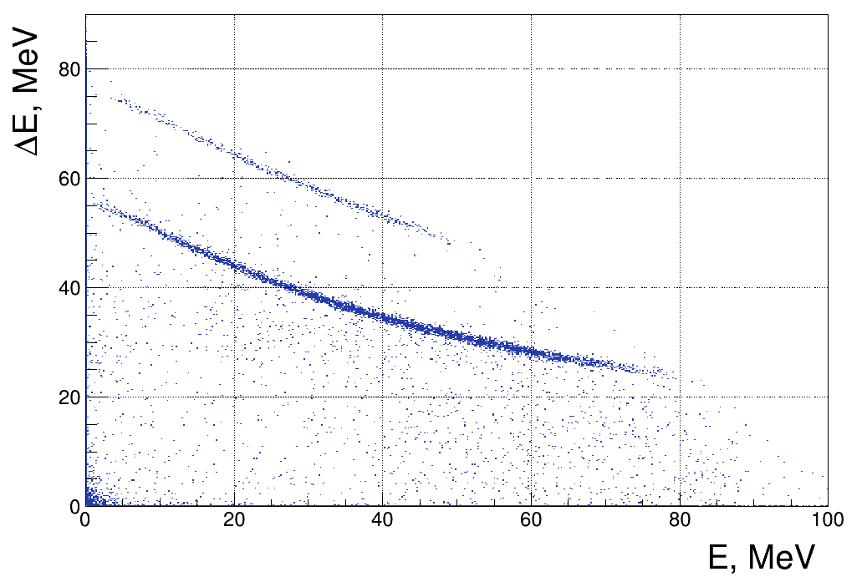
Recoil Proton Telescope (RPT)
Simone Amaducci
n-p elastic scattering
Text
C₂H₄ target, subtraction for carbon needed
2 silicon detectors: 300 μm
4 plastic scintillators:
0.5 cm, 3 cm, 6 cm, 6 cm
Hydrogen
Carbon
*non-relativistic approximation
S. Amaducci, A. Manna and the n_TOF Collaboration

Slide 23
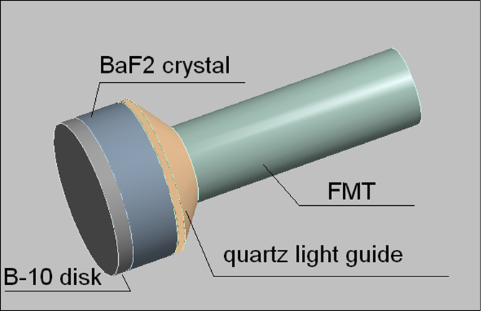
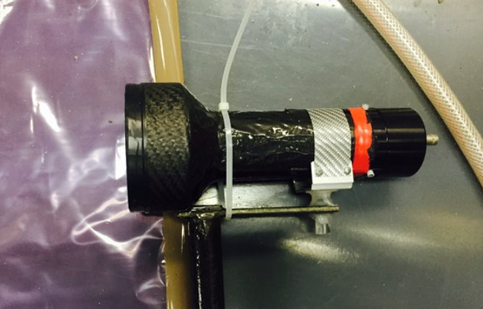
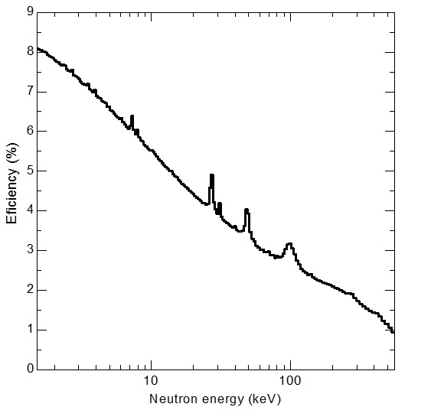
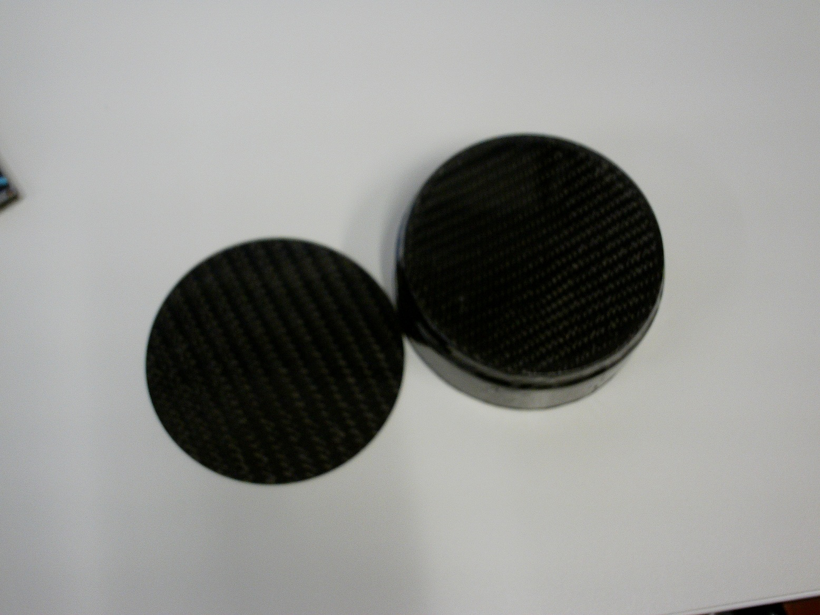
¹⁰B-BaF₂ and ¹⁰B-BGO detectors at LNL
Simone Amaducci
Text
¹⁰B-BaF₂ detector developed at LNL for low neutron energy spectra measurements with pulsed beam. Recently, upgraded with a BGO crystal instead of the BaF₂.
Detector principles: BaF2 and BGO with ¹⁰B removable capsule. Neutrons detected via 480 keV gamma from ¹⁰B(n,α) ⁷Li.
Efficiency one order of magnitude higher than Li-glass detector
Carbon fiber capsule filled with ¹⁰B powder
P. Mastinu and G. Martin Henandez​

Slide 24
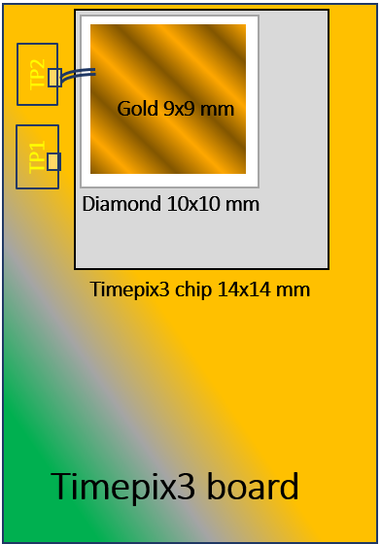
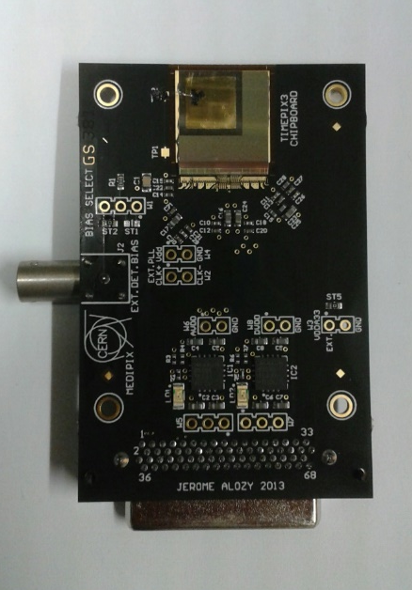

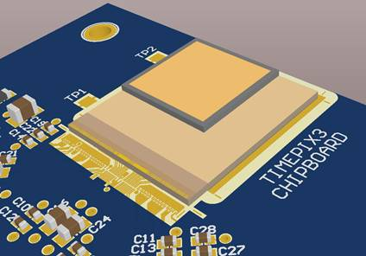
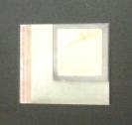



Timepix3 diamond detector for fast neutron
Simone Amaducci
Text
300 nm thick gold layer
500µm thick CVD diamond
Timepix3 board
Timepix3 chip
gamma track
A polycristalline CVD diamond with a thickness of 500 mm was bump-bonded to the Timepix3 chip on one side and a gold layer was deposited on the othe side in order to polarize the diamond.
Timepix3 board
FNG facility, ENEA Frascati, 2017
14 MeV neutrons
neutron track
A cluster Analysis Algorithm was developed to distinguish neutron tracks from gamma background.
G. Claps et al.

Slide 25









Timepix3 silicon with plastic converter (FNG, ENEA Frascati)
Simone Amaducci
Particle discrimination using ToT volume
and Cluster Height parameters
No cut
with polyethylene converter (thickness 1 mm)
Max Neutron flux @ 33 cm: 2.3×10⁶ n/s
14 MeV neutron energy
Soft-X and Hard X-rays region
Electrons and γ rays region
α, p, heavy ions region
no converter
1 mm polyethylene converter
G. Claps et al.

Slide 26
MBGEM-Pix
Simone Amaducci
Multiplication region
Gamma
Conversion region
Alpha
G. Croci et al.

Slide 27




MICADO
Simone Amaducci
Text
Main goals of the MICADO project
Measurement and Instrumentation for Cleaning And Decommissioning Operations
cost-effective solution for non-destructive characterization of nuclear waste
automatic and remote measurement instruments
uniform methodology for waste characterization and management
digitization process as a referenced standard
full traceability of waste
minimize the dose exposure for personnel
External monitoring of radioactive waste based on penetrant radiation (n or gamma)
MICADO project: SiLiF neutron detector for radwaste monitoring
G. Elio Poma

Slide 28





MICADO
Simone Amaducci
Text
Silicon enclosed between two ⁶LiF, deposited on a carbon fiber.
Plastic case to obtain a flat efficiency.
Cosentino, L.; Ducasse, Q.; Giuffrida, M.; Lo Meo, S.; Longhitano, F.; Marchetta, C.; Massara, A.; Pappalardo, A.; Passaro, G.; Russo, S.; Finocchiaro, P. SiLiF Neutron Counters to Monitor Nuclear Materials in the MICADO Project.Â SensorsÂ 2021,Â 21, 2630. https://doi.org/10.3390/s21082630
MICADO project: SiLiF neutron detector for radwaste monitoring
G. Elio Poma et al.

Slide 29

BoLAS and BoLAS_NEXT
Simone Amaducci
Text
CONTEXT:
INFN BoLAS and BoLAS_NEXT experiments
PI: G. Quarta
AIM:
study of the properties and performances of ¹⁰B layers deposited by laser ablation when coupled with different detectors.
These conversion layers have been tested in combination with:
conventional silicon detectors
a perovskite-based scintillating material (CsPbBr₃).
¹⁰B-based conversion layers combined with a silicon detector or CsPbBr₃-based scintillators for thermal neutron detection
Chiara Provenzano (1,2), Anna Paola Caricato (2,3), Marcella Marra (2,3), Paolo Finocchiaro(4), Simone Amaducci(4), Lucio Calcagnile(2,5), Maurizio Martino(2,3), Alberto Quaranta (6,7), Sandra Moretto (8), Felix Pino (8), Gianluca Quarta(2,5)
Department of Engineering of Innovation, University of Salento
INFN-Lecce Section
Department of Mathematics and Physics “E. De Giorgi”-University of Salento
INFN-Laboratori Nazionali del SUD
CEDAD-Department of Mathematics and Physics, University of Salento
Department of Industrial Engineering, University of Trento
INFN-TIFPA, Trento
University of Padova, Padova
5 cm
C. Provenzano et al.

Slide 30

Outline
Neutron Detectors
Marco Toppi
Innovative neutron detectors / measurement strategy within INFN
CLYC scintillators and Siloxane-based scintillators:
  Thermal and fast neutron spectroscopy
  γ/n separation through SPD
Ultra-fast neutrons detection:
  Tracking
  Energy measurement
  Neutron production cross section in interaction of light ions (up to ⁵⁶Fe) in the energy range 100-800 MeV/u
  γ/n separation

Slide 31




Neutron Detectors
Marco Toppi Nuclear Physics Mid Term Plan in Italy – LNF Session
CLYC (Cs2LiYCl6:Ce3+) scintillator
Good Energy resolution:
Better than NaI worse than LaBr₃:Ce
PSD possible !
Easy - γ/n discrimination
Complex - α/p discrimination
The energy of the outgoing proton or α particle scales linearly with the incident neutron energy
¹³⁷Cs
R ∼ 4.5%
Fast Neutrons
³⁵Cl(n,p)³⁵S
  - Q-value = 0.6 MeV
³⁵Cl(n,α)³²P
  Q-value = 0.9 MeV
⁶Li (n,α)t
  - Q-value = 4.78 MeV
⁶⁰Co
Thermal Neutrons:
⁶Li (n,α)t
  - Q-value = 4.78 MeV
⁶Li Enriched
⁷Li Enriched
CLYC crystal ⁷Li enriched
Fast neutrons from an Am-Be Source
with gate on the 4.4 MeV γ-ray from ¹²C
A.Giaz et al. NIM A825(2016)51
A.Giaz et al. NIM A810(2016)132
F. Camera et al private communications

Slide 32







POLIMI is developing a custom ASIC for the Pulse Shape Discrimination with a CLYC crystal readout by SiPMs
Neutron Detectors
The signal produced in some radiation detectors (e.g. CLYC scintillator) shows a time profile that changes significantly for different radiation sources.
$$V_{out}$$
Gamma ray
The charge integration approach is based on measurements of integrated charge over two different time regions:
neutron
$$t$$
$$PSD= \frac{V_{out}(t_{2})−V_{out}(t_{1})}{V_{out}(t_{2})}$$
$$t_{1}$$
$$t_{2}$$

Slide 33





Possible CLYC array for SPES
Neutron Detectors
Marco Toppi
Instead of the Ge clovers, a 4$π$ array of 3inch CLYC scintillators
5% neutron efficiency at 1 MeV
10-12% neutron energy resolution
20% $γ$-ray efficiency at 1 MeV
4% $γ$-ray energy resolution at 662 keV
Possibility to perform $β$- delayed $γ$-ray and neutron spectroscopy with the same detectors
Advantages in 2n emission detection
Drawback: low efficiency
In neutron-rich nuclei (near shell closures):
High Q-values (> 10 MeV)
Low neutron separation energies ($≲$ 4 MeV)
β-delayed neutron emission

Slide 34


Siloxane-based scintillators for neutrons
Neutron Detectors
Marco Toppi
Aim→Fabrication of siloxane-based neutrons sensors with a high light yield that can be used as compact, lightweight, rad resistant and flexible detectors in:
  monitoring neutrons as secondary radiation from high energy proton (H⁺) beam in proton therapy (APSS-Trento Hospital)
Contributors
UNIPD-DFA: Sara Maria Carturan, Sandra Moretto, Felix Pino, Jessica Delgado, Gianluigi Maggioni
INFN-LNL: Marco Cinausero, Tommaso Marchi
UNITN-DII: Alberto Quaranta, Matteo Polo
UNIBO-DFA: Laura Basiricò, Beatrice Fraboni
INFN-BO: Ilaria Fratelli
Materials design and characterization; test beam @LNL
  workers surveillance in nuclear power plant or nuclear physics experimental hall (SPES @LNL)
  revealing different impinging radiation for homeland security using common PMT or Si-PM as photosensors
INFN-TIFPA: Enrico Verroi, Francesco Tommasino
Test beam @APSS
CNR-IMM
INFN-RM3
foundry for
OPT flex
SPES cyclotron @LNL
project FIRE (INFN)
Euritrack (EU FP6) Tagged Neutron Inspection System
Notes:
At the Materials Physics Lab the synthesis of novel organic scintillators is pursued since many years in collaboration with these research units (BOX da indicare). The aim of this research topic is the fabrication…. (box da leggere) ….monitoring neutrons (clic)… workers (clic)…. revealing (clic)…

Slide 35










Neutron Detectors
Marco Toppi
Siloxane scintillators for thermal neutrons
increasing amount of dyes, fixed B conc. 3%
Addition of o-carborane →
n + ¹⁰B→ ⁷Li(0.83 MeV) +⁴He(1.47 MeV) + γ (0.48 MeV) [94%]
Transparency preserved for low dyes concentration
Optimal LY vs EJ-254 standard under Am-Be thermalized n source
Foldable siloxane-based nanocomposites
  Synthesis of nanocrystals of ⁶LiF or ⁶Li₂¹⁰B₄O₇→addition of high L.O. inorganic scintillator (ZnS:Ag)→entrapment in siloxane
⁶Li + n → ³H + ⁴He + 4.78 MeV
  Wrapping PSD organic scintillator →TRIPLE PSD
S.M. Carturan et al., Radiat Prot Dosimetry. 2011
⁷Li(p,n)⁹Be @CN-LNL
  Coupling with bendable OPT→fully FLEXIBLE n detector
MUNES @LNL
F. Pino, J. Delgado et al., submitted to Adv. Mater.
I. Fratelli, BEYOND - Grant giovani 2023
Notes:
Siloxane scintillators might also dissolve suitable organo-boron compounds, such as carborane, preserving transparency (clic). They have shown good response to thermal n from Am-Be source with LO comparable to Boron doped plastic standard (EJ-254).
Very recently (clic) the preparation of foldable siloxane scintillators for thermal n has been carried out. Nanocrystals of lithium fluoride or lithium tetraborate with isotopic enrichment have been prepared and embedded into siloxane with inorganic scintillator powder. (clic) The flexible foils were used to “dress” commercial scintillator with PSD properties , resulting in optimal triple PSD (fast n, thermal n and gamma rays). Few days ago (clic), the proposal BEYOND presented by Ilaria Fratelli has won the Grant selection for young researchers at INFN, where the research starting point is a fully flexible thermal n detector composted of organic phototransistor and the nanocomposite siloxane scintillator.

Slide 36
Detectors for fast and ultra-fast neutrons
Neutron Detectors
Marco Toppi
Fast and ultra-fast neutron detection is needed in many research fields, as nuclear, particle and astroparticle physics as well as Particle Therapy and (Space) radiation protection.
Neutron detectors able to measure energy and position and/or with tracking capability in particular will play a relevant role in nuclear and subnuclear physics as well as in applications in the next years:
Neutron detectors with tracking capability in particular will play a relevant role in nuclear and subnuclear physics as well as in applications in the next years:
n_TOF @ CERN. Neutron-neutron scattering length.
FOOT (FragmentatiOn Of Target)
BGOOD (BGO ball Open Dipole magnet)
And many others (astrophysics in space environment = solar neutrons)

Slide 37





MONDO
Neutron Detectors
Marco Toppi
Text
2015-2020: Several prototypes of fiber matrix have been built and tested [cosmic rays, BTF (LNF), APT (Trento)]. Test with different photon detectors and FBK sensors (SPADnet)
2018-2019: SBAM-I sensor built (2x2mm²). Time resolution and trigger measured with a ⁹⁰Sr source have provide its preliminary characterization
A SBAM-II sensor, larger (~1cm²) and optimized is needed. Work of the next years
SPADnet
Huge effort to produce reliable MC simulation to optimize the detector and study its performances.
Performances (MC reconstruction):
back-tracking resolution @ 20cm < 5 mm
energy resolution 4-6 % for contained protons
DES efficiency ~ 10⁻³ -10⁻⁴
SBAM-I
R.Mirabelli et al, IEEE TRANSACTIONS ON NUCLEAR SCIENCE, VOL. 65, NO. 2, 2018
E.Manuzzato et al., IEEE SOLID-STATE CIRCUITS LETTERS, VOL. 2, NO. 9, 2019
Riccardo Mirabelli PhD thesis
M.Toppi, Front. Phys. 8:567990. doi: 10.3389/fphy.2020.567990

Slide 38

RIPTIDE - RecoIl Proton Track Imaging DEtector
Neutron Detectors
Marco Toppi
Novel recoil-proton track imaging system in which the light output from a fast scintilating 6x6x6 cm³ cube is used to perform a complete reconstruction in space and time of the event
Basic requirements: (i) technological improvements in single photon counting, (ii) fast electronic readout of large amount of data
RIPTIDE concept
Need to reconstruct how the light is produced along the track:
Optical systems of lens coupled to an imaging light detection (TimePix, Mimosa28, MIMOSIS) device to perform the 3D reconstruction of the proton track (lens distance ~ 5-8 cm from the cube center, will reduce the solid angle coverage by a factor of 20)
Non imaging sensors (such as commercial SiPMs) to have a fast signal connected to the neutron scattering inside the cube for triggering purposes
A. Musumarra et al., JINST 16 (2021) C12013; 10.1088/1748-0221/16/12/C12013
C. Massimi et al., JINST 17 (2022) C09026; 10.1088/1748-0221/17/09/C09026
M. Villa, in Preparation JINST, https://arxiv.org/pdf/2210.17431.pdf

Slide 39

BGO calorimeter of BGOOD/MAMBO experiment
Marco Toppi
The experiment BGOOD@ELSA (MAMBO in CSN3) pursues a systematic investigation of non-strange and strange meson photoproduction, using polarized (and not) photon beams in the energy range of E_{γ} = (500 MeV - 3 GeV) inpinging on liquid hydrogen and deuterium targets.
The central part of the detector is done by an almost 4π acceptance BGO crystal calorimeter (polar angle 25°-155° ): 480 BGO crystals (21 radiation lenghts) each coupled to a PMT to detect both charged (protons e pions) e neutral (photons e neutrons) particles
BGO calorimeter
Barrel of 32 plastic scintillators
2 cylindrical MWPC’s
Target (HL o DL)
The 480 BGO crìystals calorimeter is a hodoscope whom granularity allows the polar and azimuthal emission angle of the detected praticle
σ(E)/E ~ 3% FWHM ( @ 1 GeV for photons )
The calorimente allow to measure proton energy up to 400 MeV kinetic energy
The PMT readout is performed through Sampling-ADC, so a time measurement can be performed with a resolution ~ 2ns.

Slide 40
Nuclear Physics Mid Term Plan in Italy
LNF – Session
Frascati, December 1st - 2nd 2022
Detectors for Medical Applications

Slide 41










Treatment Monitoring
Piergiorgio Cerello
Beam monitoring in particle therapy
Text
Space…
2.7×2.7 cm² active area (144 strips)
Time…
MOVEIT sensors
Energy…
ABACUS ASIC (24 ch)
Collaboration with INFN-EXFLU project
Courtesy of Roberto Sacchi

Slide 42









Treatment Monitoring
Piergiorgio Cerello
The Project
In-beam PET
INnovative Solutions for In-beam DosimEtry
in particle therapy
- positron emitters
- proton and carbon in-vivo verification
Dose Profiler
- secondary protons
- carbon ion in-vivo verification

Slide 43



Treatment Monitoring
Piergiorgio Cerello
Text
in-beam Positron Emission Tomography
The INSIDE clinical trial
in-beam PET image - 2 fx
In-beam PET image - 21 fx
Planning CT
Control CT
Courtesy of Elisa Fiorina
ClinicalTrials.gov NCT03662373

Slide 44





Treatment Monitoring
Piergiorgio Cerello
Dose profiler
The INSIDE clinical trial
3D emission map of fragments collected during the treatment delivery
Gamma test (9mm/10%) has been used for voxel to voxel comparison
beam
gamma map
Courtesy of Alessio Sarti
ClinicalTrials.gov NCT03662373

Slide 45





The PAPRICA project
Treatment Monitoring
Piergiorgio Cerello
Text
in-vivo monitoring of inter-fraction morphological variations
with prompt photons (E > 4MeV) detection through the pair production mechanism
Prototype design (~ 5x20 cm² total surface)
Converter: LYSO fibres, 1.5x1.5x50 mm³ each
Tracker: 3 planes of ALPIDE pixels (27x29x100 μm³)
Calorimeter: EJ-200 plastic scintillator rods, 6x6x50 mm³ each
Expected performance from FLUKA Monte Carlo simulation, on patients from the INSIDE clinical trial
PAPRICA spots morphological variations
in 2/2 replanned patients
in 0/4 not replanned patients
TRACKER
CALORIMETER
Courtesy of Ilaria Mattei

Slide 46



Treatment Monitoring
Piergiorgio Cerello
Innovative In-beam Imaging: the I3PET project
monitoring of Positron Emitters & Prompt Photons with the same PET detector
First I3PET proton beam test (June 2021):
primary-secondary radiation coincidences identified!!!
- Trigger on PET detector
- Joint DAQ
I3PET modules
MoVeIT UFSD
beam
5 ns
I3PET module
signal
Secondary radiation
UFSD
signal
Primary beam
Courtesy of Francesco Pennazio

Slide 47




Treatment Monitoring
Piergiorgio Cerello
Text
MERLINO: From PGT to stopping power!
Measurement of the EneRgy Loss for IN-vivo Optimization in particle therapy
Multi-detector approach relying on the SER-PGT reconstruction algorithm
(F. Pennazio et al., Phys Med Biol 2022)
t (ns)
The Bragg curve (in-vivo!!!)
Courtesy of Veronica Ferrero

Slide 48




Treatment Monitoring
Piergiorgio Cerello
MERLINO: From PGT to stopping power!
LaBr3 cylinder scintillator 3.81 cm diameter 3.81 cm height + PMT
Beam nozzle
UFSD 8 strips
15 x 15 x 40 cm³ PMMA target
Detector holder
LaBr3 – UFSD time coincidences
227 MeV protons on PMMA
Beam average rate 10⁷ pps
Courtesy of Veronica Ferrero
t (ns)

Slide 49




Treatment Monitoring
Piergiorgio Cerello
Text
MERLINO: From PGT to stopping power!
Courtesy of Veronica Ferrero

Slide 50

Treatment Monitoring
Piergiorgio Cerello
Text
MERLINO: From PGT to stopping power!
Courtesy of Veronica Ferrero

Slide 51


Fluorescence-based beam monitor for FLASH RT
Treatment Monitoring
Real time beam monitoring (intensity and direction) is required
Standard detectors (i.e., ionization chambers) not suitable in FLASH regime
- discharges
- dose-dependent effects
air fluorescence to detect electron current and measure its characteristics
emission of optical photons from molecular excitation with an almost constant yield over a wide energy range
air as a medium minimizes the material thickness on the beam line
arXiv:astro-ph/0409727
Courtesy of Alessio Sarti

Slide 52



Fluorescence-based beam monitor for FLASH RT
Treatment Monitoring
Proof of principle using the ElectronFlash machine, by Sordina IORT Technologies S.p.A.
air volume (2x2x60 cm³) enclosed by a thin layer of tedlar, light sensors on the edges
Courtesy of Alessio Sarti

Slide 53

Fluorescence-based beam monitor for FLASH RT
Treatment Monitoring
3 - 20 Gy/pulse
pulse duration: 4 µs
Optimize the light detection system to make it more stable and precise, and reduce the risk of saturation
Optimize design with MC simulations
Aim: monitor the intensity of typical FLASH pulses making a 2D mapping of the beam with a spatial resolution ≈mm
Integrated PMT signal
Dose: Gy / pulse
Courtesy of Alessio Sarti

Slide 54


Boron Neutron Capture Therapy (BNCT)
Treatment Monitoring
Piergiorgio Cerello
Text
- neutron flux on ¹⁰B-enriched target tissue
- high LET secondaries produced in ¹⁰B(n,α)⁷Li
- highly effective at cell level
Charged particles Range (μm)

Slide 55


Treatment Monitoring
Piergiorgio Cerello
BNCT dosimetry: the present limit
”therapeutic” dose due to ¹⁰B accumulation dD(x,y,z) ~ n10B(x,y,z) . Φ(x,y,z)dV
thermal neutron flux @ tumour site
¹⁰B distribution @ irradiation time
are presently measured indirectly - huge uncertainties on dose estimation
¹⁰B concentration from blood samples and ICP-AES or MS, coupled with pharmacokinetic models
Monte Carlo-based Treatment Planning Systems (TPS) validated through TE-phantom measurements
Courtesy of Nicoletta Protti

Slide 56




BENEdiCTE (Boron Enhanced NEutron CapTurE)
Treatment Monitoring
Piergiorgio Cerello
Text
Minimum ¹⁰B-concentration of 60ppm detected at Lena (Pavia)
Count rate
Boron concentration (ppm)
Courtesy of Carlo Fiorini

Slide 57









Treatment Monitoring
Piergiorgio Cerello
SPECT and Compton Imaging
Text
CdZnTe room-temperature semiconductor detectors:
the cutting-edge technology for small field of view scanners
DoseCapture modules for BNCT-SPECT (ENTER-BNCT project INFN + UNIPV Dipartimento di Eccellenza)
“single stage" Compton Camera
3D CZT detectors (3CaTS project)
3D-CZT prototype, 20x20x20 mm³
(i) an array of 4 Frisch Grid (FG) CZT detectors
(ii) ⁶Li-enriched neutron shield surrounding the array to reduce the (n,γ) reactions of ¹¹³Cd (~12% natural abundance)
γ-rays
drift strip detectors:
anode-cathode
orthogonal strips
to have a virtual pixel
(iii) a square 4 holes Pb collimator to select the photon direction
(iv) proprietary digital electronics for acquisition, correction and analysis
S.Fatemi et al., NIM-A 903: 134-139 (2018)
L. Abbene et al., J Synchrotron Rad 27: 1564-1576 (2020)
L. Abbene et al., Sensors 22:1502 (2022)
Courtesy of Nicoletta Protti

Slide 58

Dosimetry, QA and Radiotherapy
Giada Petringa

Slide 59

Dosimetry, QA and Radiotherapy
Giada Petringa

Slide 60

Dosimetry, QA and Radiotherapy
Giada Petringa

Slide 61

Dosimetry, QA and Radiotherapy
Giada Petringa

Slide 62

Dosimetry, QA and Radiotherapy
Giada Petringa

Slide 63

Dosimetry, QA and Radiotherapy
Giada Petringa

Slide 64

Dosimetry, QA and Radiotherapy
Giada Petringa

Slide 65

Dosimetry, QA and Radiotherapy
Giada Petringa

Slide 66

Dosimetry, QA and Radiotherapy
Giada Petringa

Slide 67

X and γ ray Imaging
Luca Brombal

Slide 68

X and γ ray Imaging
Luca Brombal

Slide 69

X and γ ray Imaging
Luca Brombal

Slide 70

X and γ ray Imaging
Luca Brombal

Slide 71

X and γ ray Imaging
Luca Brombal

Slide 72

X and γ ray Imaging
Luca Brombal

Slide 73

X and γ ray Imaging
Luca Brombal

Slide 74

X and γ ray Imaging
Luca Brombal

Slide 75

X and γ ray Imaging
Luca Brombal

Slide 76
Nuclear Physics Mid Term Plan in Italy
LNF – Session
Frascati, December 1st - 2nd 2022
γ-Χ ray Detectors

Slide 77

X-γ Rays Detectors
Alessandro Scordo

Slide 78

X-γ Rays Detectors
Alessandro Scordo

Slide 79

X-γ Rays Detectors
Alessandro Scordo

Slide 80

X-γ Rays Detectors
Alessandro Scordo

Slide 81

X-γ Rays Detectors
Alessandro Scordo

Slide 82

X-γ Rays Detectors
Alessandro Scordo

Slide 83

X-γ Rays Detectors
Alessandro Scordo

Slide 84

X-γ Rays Detectors
Alessandro Scordo

Slide 85

X-γ Rays Detectors
Alessandro Scordo

Slide 86

X-γ Rays Detectors
Alessandro Scordo

Slide 87

X-γ Rays Detectors
Alessandro Scordo

