Slide 1
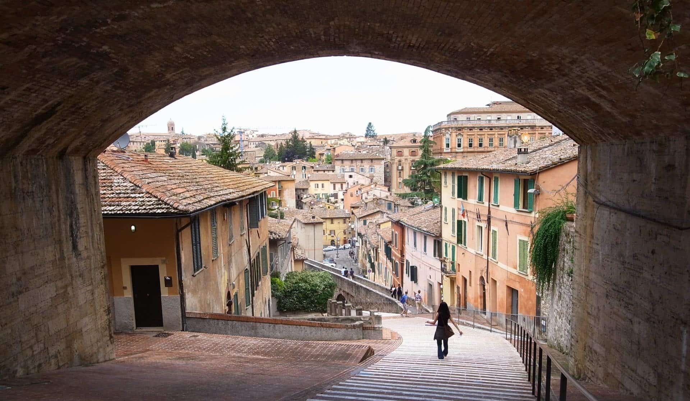
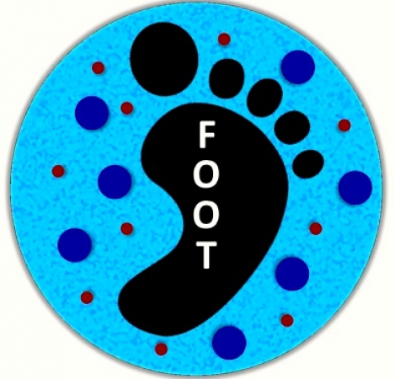
XIII FOOT meeting
Introductory remarks

Slide 2
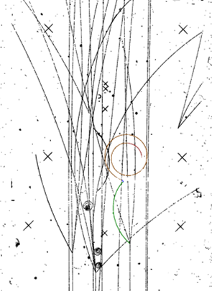
Detector status
Electronic set-up:
Good experience with: SC, BM, MSD, TW
Learning: VTX, MSD, Calo
To be completed: Calo, IT, Magnet, table mechanics
Emulsions:
Good experience with standard emulsions
NIT emulsions to be tested
Seen from outside, we do have some delay in detector completion, but we are using the time to learn to use our detector and to do some physics: positive attitude!

Slide 3
Tools
Monte Carlo:
Continuously evolving and following the different set-ups used in data takings or contributing to the definition of the set-ups!
Trigger and Data Acquisition:
Evolving with time and detectors on the beam line
More online controls; not yet finished!
Reconstruction software:
Shoe: continuously evolving with the different set-ups. More features at each release. Well developed and tuned on MC data; requires tuning at each data taking (alignment, noise, detectors on the beam line….)
Emulsions: properly running
Tools are being used to get some physics!

Slide 4
Data takings
Electronic set-up:
GSI 2021 (¹⁶O, 200-400 MeV)
HIT 2022 (⁴He, several energies)
CNAO 2022 (¹²C, 200 MeV)
Emulsions:
GSI 2019
GSI 2020
Some sample have been/are being analysed; others await volontiers!
There are plenty of possibilities for us or for newcomers!

Slide 5
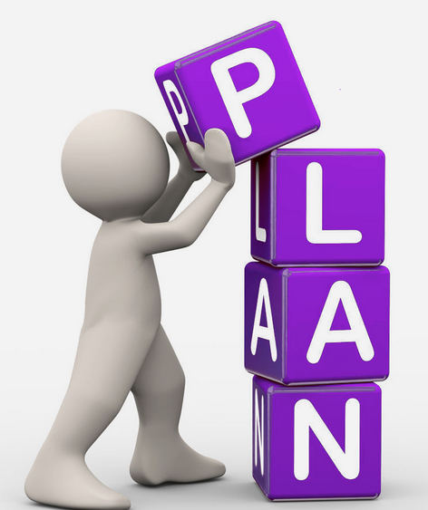
Communication
The FOOT community is active on several fronts:
Paper production
Conference partecipation
Include production of proceedings
Proposal writing
PRIN2021, PRIN 2022, CANDLER, ELFH
Agencies planning:
INFN Mid-term plan,
NuPECC Long term plan
All these activities are are signs of a healthy
and active collaboration!

Slide 6
Time to start the meeting!
Please stay in the allocated time
Please upload your presentation as soon as possible
Have a fruitfull meeting!

