Slide 1
Lattice Update
P. Raimondi,
INFN-LNF
Elba May - 29, 2011

Slide 2
Summary
Present Arc design
Present FF design
Parasitic crossing and injection
Two tunnels (Ler ½ Her) studies
Arc solutions for SR Undulator insertion:
- Concentrated
- Distributed
To do list

Slide 3
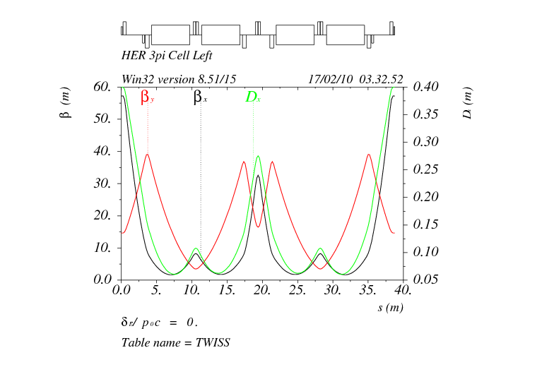
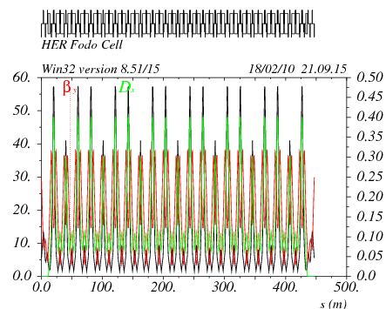
SuperB Arcs
HER and LER arcs have conceptually the same lattice. LER arc dipoles are shorter (bend radius about 3 times smaller) than in the HER in order to match the ring emittances at the asymmetric beam energies.
μ_{x} = 3π, μ_{y} = π
Cell in HER
LER
HER
μ_{x} = 1.5π, μ_{y} = 0.5π
Cell in HER

Slide 4
Layout of HER arcs
V12 Old
V12 mod
Short ring

Slide 5
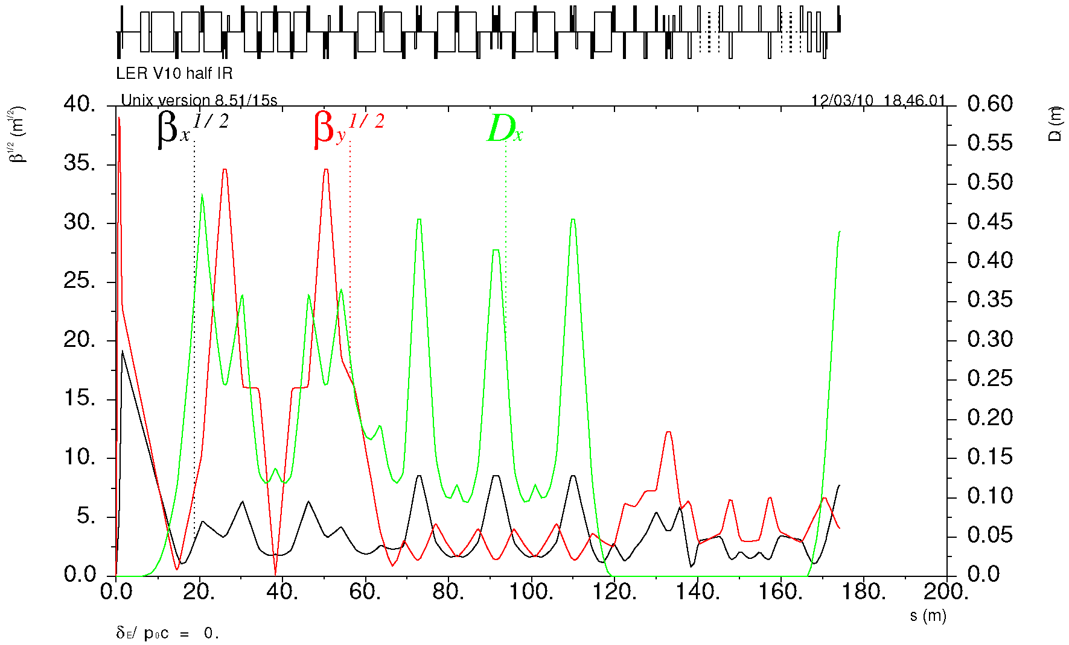
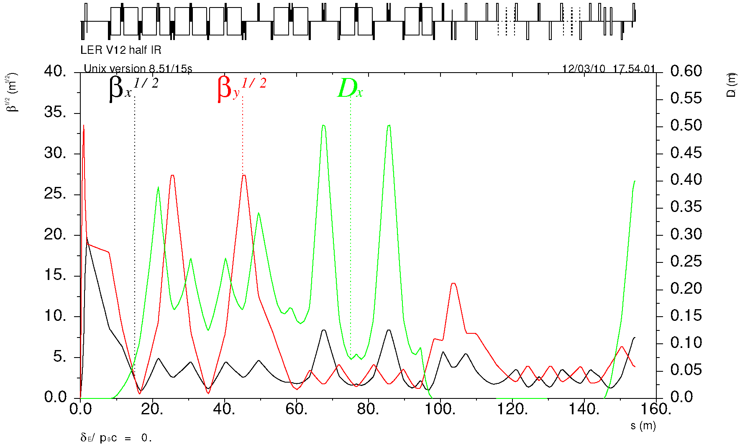
LER FF optics
IP
Y-sext
V12
Crab
Match & SR
X-sext

Slide 6
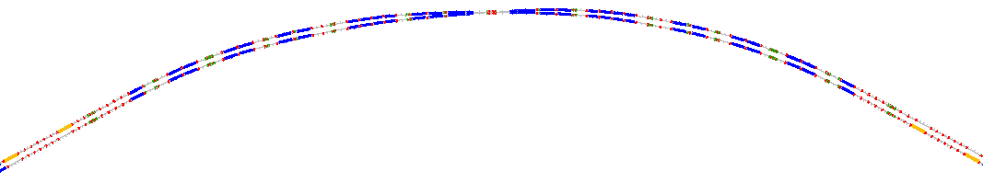
Spin Rotation
90° spin rotation about x axis
  90° about z followed by 90° about y
“flat” geometry => no vertical emittance growth
Solenoid scales with energy => LER more economical
Solenoids are split & decoupling optics added.
LER
IP
HER
S.r. dipoles
(270° spin)
HER
LER
S.r. solenoids
(90° spin)

Slide 7
“Parasitic” crossing
Doglegs have been removed and the secondary crossing (“parasitic) is made by lengthening the first 3π cell in HER by about 25 meters
This makes the two beam lines cross with and angle of about 165mrad (was about 150 with the dogleg) and there should be no interference between the two beam lines (some readjustment still needed for LER → in progress)
This longer HER cell is suitable for the injection
Lot of space remaining for utilities (RF, feedbacks, wigglers,...)

Slide 8
Injection Cell and Injection Bump

Slide 9
Ler half Her size
Rationale for half size Ler is to gain flexibility in optimizing the two rings independently.
Summary of the present studies:
- Her becomes 8% shorter and 10% less emittance
- Ler has 3nm emittance and very hard to decrease it because we need more and shorter arc cells and the quads and sextupoles get too strong
Given this and all other complications that arise (second crossing, etc…), such possibility seems unlikely to develop in a suitable one.

Slide 10
Ler Half size Her

Slide 11
Insertions for SR Undulators
We are considering Her Insertions, but it seems that Ler might as well have the same optic and layout
At the moment we have developed two possible solutions:
- 2 sections with 5 insertions in a row in the middle of the arcs. 10 lines total
6 insertions in the mux=0.75 cell distributed along the Arcs. 12 lines total

Slide 12
5 Consecutive cells

Slide 13
5 Consecutive cells

Slide 14
6 Distributed Insertions
Alternating sequence of:
Cell1 mux = 1.5, muy=0.5
Cell2 mux = 1.215, muy=0.688
Undulator insertions: length = 3.5m betax/y = 3.2m
Optic flexible to change beta’s and mu’s

Slide 15
6 Distributed Insertions
Chromatic functions

Slide 16
6 Distributed Insertions
Arcs Dynamic Aperture:
90 sigmas in X
50 sigmas in Y
dE/E > 2%
X-tracking with
dE/E=1%

Slide 17
Concentrated vs Distributed
Distributed solution seems better:
- Better D.A.
- More flexibility in the optic (for each line)
- More space for Light-Lines
- Indipendent shielding among lines

Slide 18
Arc with SL insertions summary
A solution with 12 SL insertions exists with better performances w.r.t. latest design (that has no insertions)
- emittance 10% smaller
- SR power 10% smaller
- momentum compaction 10% larger
- ARC Transverse D.A. 20 larger
- ARC energy acceptance more than doubled

Slide 19
To Do list
Need to have a team in Frascati to work out the layout, define and optimize the solutions. Such group should have all the expertises on hand (SL ones, magnets etc.)
Define the tasks for the W.B.S.

Slide 20
To Do list
In order to define the layout and the lattice there is a very long list of items:
- Iterate the layout and lattice optimization with site constraints
- Work out the injection lines.
- Make the FF H/L L/R like for the V12 (add/subtract 30mrad to the FF L/R)
- Work out the vertical separation: hopefully find the solution for the two arcs vertically displaced by about 0.5m. This will double the avalaibility for SR lines.
- Insert the Injection cells in the proper places
- Need to go to lunch…

