Slide 1

Update on HDI design and peripheral electronics in Milano
XVII SuperB Workshop and Kick Off Meeting: SVT Parallel Session
M. Citterio
on behalf of INFN and University of Milan

Slide 2
Index
Bus / Fan-out Status
HDI Status and Prototype proposal
  Hybrid structure and layout design rules
  Serializer power and low speed serializer
Data/Clock and Control Cables
  Ongoing selection on tail/cables
  Test on data rate on ~ 1m length cables
Transition card
  Data card
  Power breaking points

Slide 3
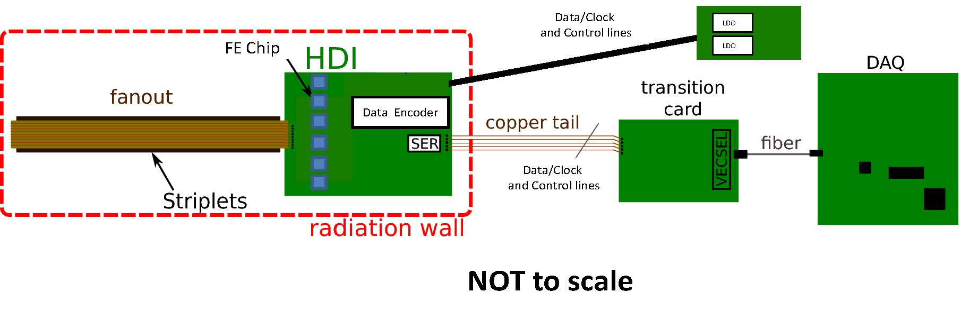
Data / Power Chain
  The baseline system has been considered
  The goal is to develop a chain which is moderately dependent from the Layer 0 “detector/FE chip” choice
    The Layer 0 chain is taken as example, the outer layer should be able to use a “similar” data/power chain

Slide 4
Bus / Fan-out status (1 of 2)
  No substantial progresses from March
    The final layout has been updated following latest CERN suggestions
      Opening on the ground/power planes have been enlarged and re-positionated
      Bonding procedure (Bus to Sensor and FE chip) needs to be reviewed with Pisa
    A sign-off meeting is planned for next week
    Production is supposed to take 4-5 weeks
      CERN under pression from LHC upgrades

Slide 5
Bus / Fan-out status (2 of 2)
  Search of commercial partner is on going
    Two possible firms have shown interest
      One firm is in France, while the other is in Italy
      Both company will start from a thin commercial Copper/Kapton tape (5 um / 25 um) and pattern the layout by etching
      They have experience with minimum lines/space resolution of 50/50 um (twice the baseline for striplets) over 10 cm lenght as a maximum
    Neither of them have ever done 25/25 um
      Only CERN shop has ventured in such a fine pitch
      Industrial experience on kapton is limited

Slide 6
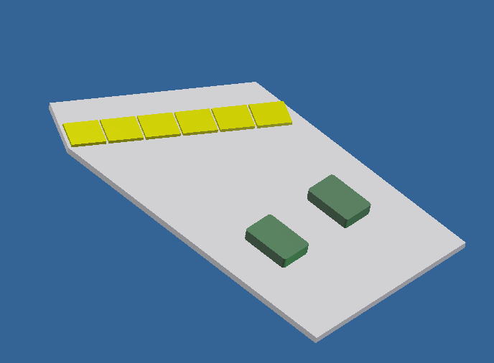
SuperB HDI (1 of 3)
Technology for SuperB HDI: AlN thick film hybrid Irregula shape is not an Issue
Detector fan-out is glued on the hybrid edge and chips inputs are wire bonded to the fan-out.
Five conductive layers (3 power/ground layers, 2 for signal) However, each additional signal layer for HDI-0 will “degrade” planarity and line resolution
New layout rules - layer thickness ~ 65 μm (5% tolerance *) (15 um conductor and 50 μm dielectric) Thickness usually decreases during oven curing Line size/space: inner signal layer >100/100 um (typical 150/150 um), 200/200 um TOP layer Pads 200 x 200 um*2 Vias 200 um, space between via ~ 250 um

Slide 7
SuperB HDI (2 of 3)
Some Open Issues
No systematic impedance control | Limited possibility to change the dielectric layer thickness with the standard process. By print screening company prefers a standard “3 pass” procedure → dielectric thickness ~ 50 um. Some avenue to be pursued: evaluate the usage of dielectric in tape (predefined thickness) → limited choices of thick film materials compatible with AlN Mix AlN and Al2O3 film materials. Possible after the first power/ground layer.
Clock lines were “qualified” by try and test in Babar | Difficult prediction of Z → dielectric constant usually not well specified by material manufacturer (ex. in next slide)
Some prototypes were produced to master the technology | Same approach to be pursued. Of particular interest is the implementation of differential lines (digital signal ~ 150-250 MHz) Prototype: small substrate (length counts), two layer (plane and one signal), array of lines of minimum size (number to be defined)

Slide 8
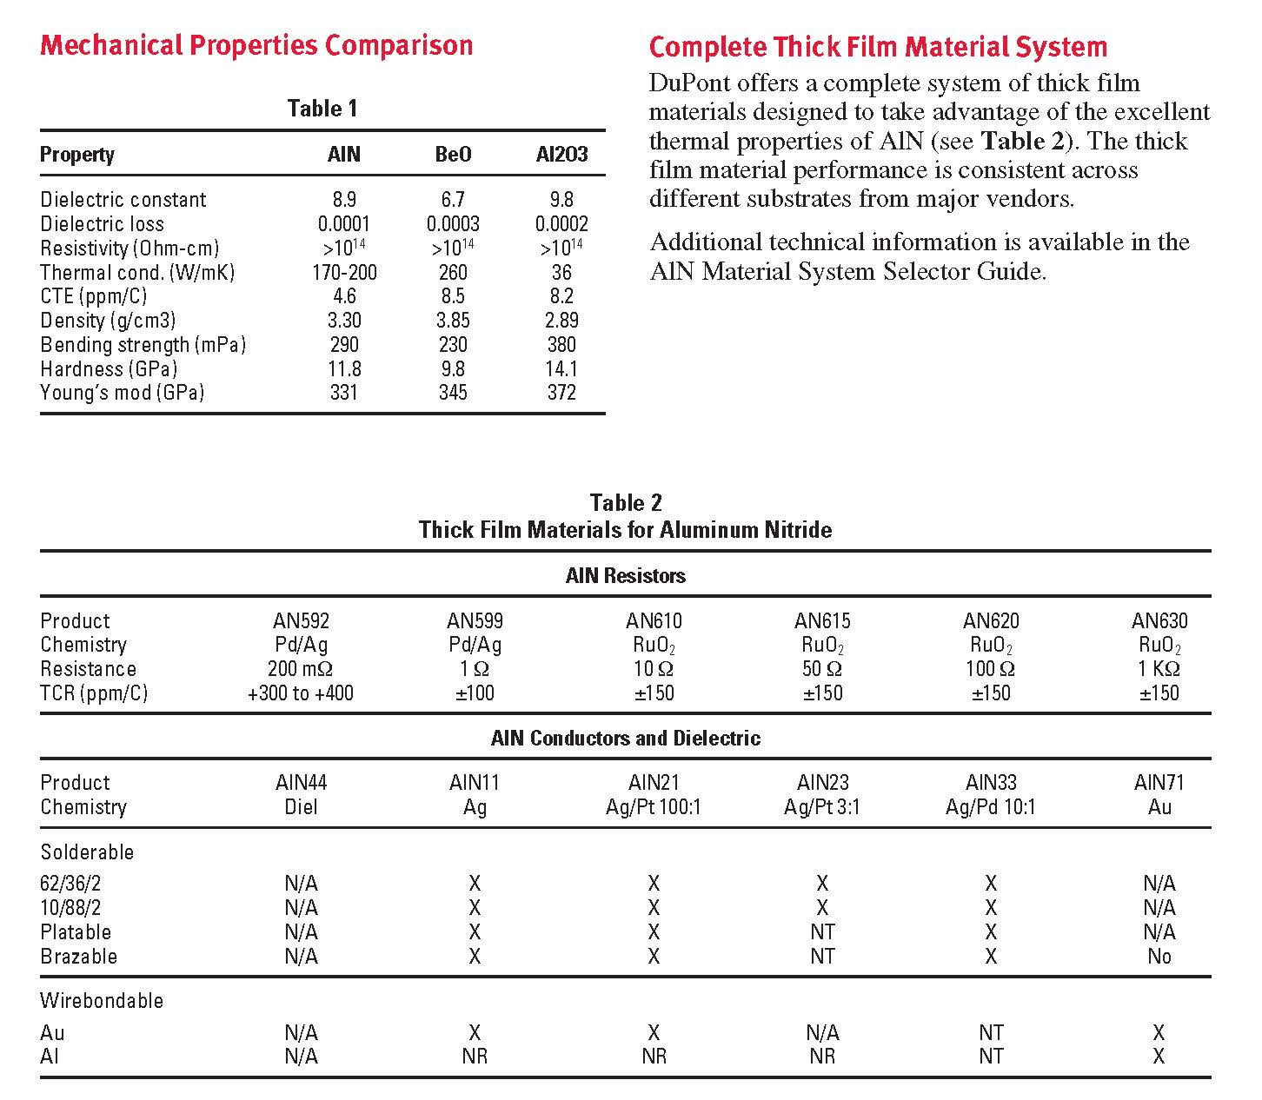
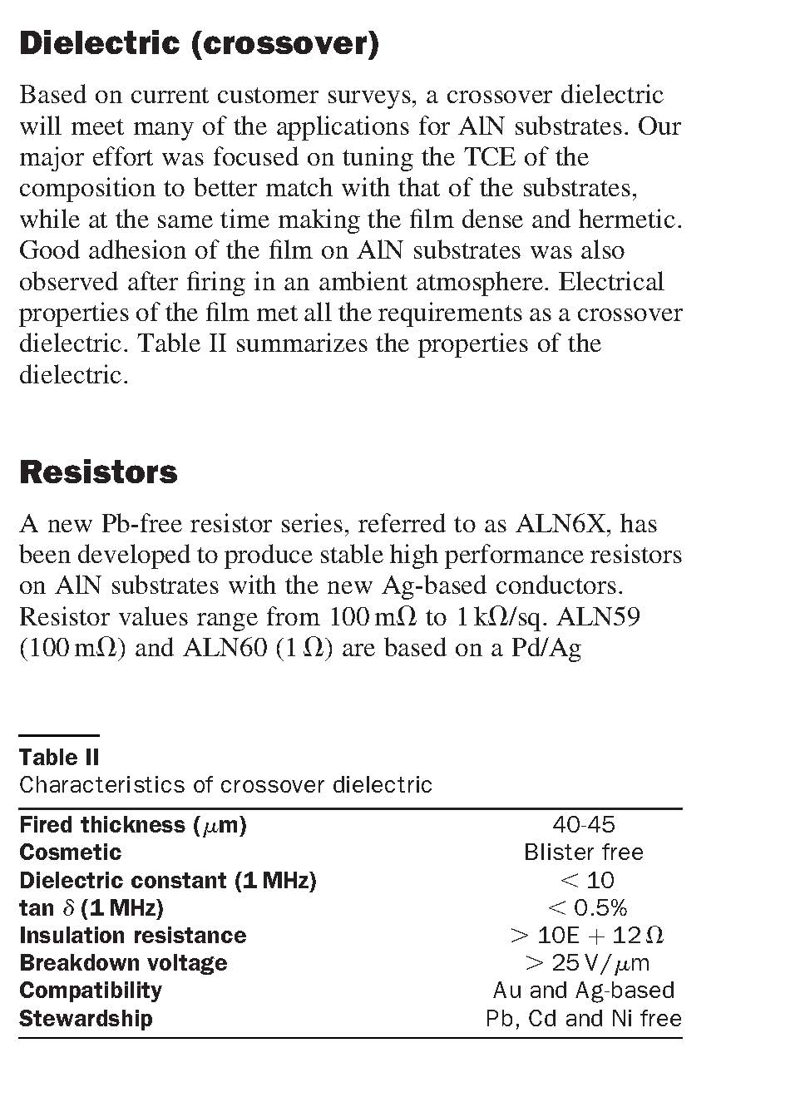
SuperB HDI (3 of 3)
The dielectric constant is specified only as an upper limit.
In the dielectric are present organic vehicles.
During the initial drying process (at ~150 C) the organic vehicle evaporates and the paste becomes a semi-solid phase mixture of dielectric and binder. Only proper curing will eliminate completely the residue.

Slide 9
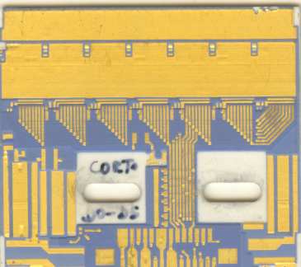
HDI … looking at Babar
The HDI must keep some/all the functionalities previously implemented:
1. Analog and digital powers. At least two different power supplies: analog and digital.
2. Two different current return, one for the digital current (DGND) and one for the analog current (AGND)
3. Each power line must be locally filtered
4. Two redundant sets of differential clock and command lines must given to all the chips and terminated so as to match with the characteristic impedance of the “tail”
5. Redundant differential data lines must be connected
6. Each HDI must host and provide connections to one resistive temperature monitor.
…. More
+ High speed data need to be transferred on the HDI
  Data formatted from FE to “Data Encoder”
  16:1 LOC 1 Serializer
High density connector should be chosen to connect power and signals to the “tail”
(Berg, Panasonics, etc…). Height after matching ~ 1.2 mm

Slide 10
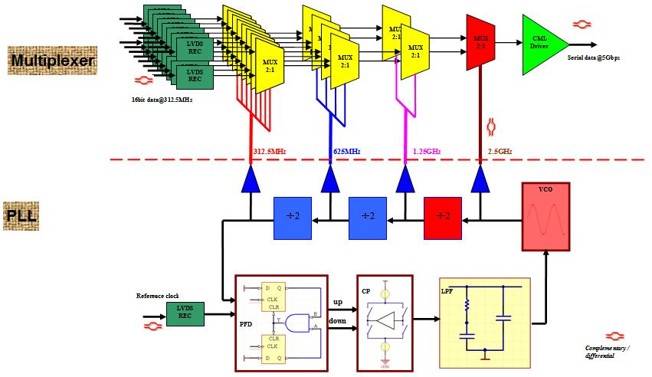
Low Speed / Low Power Serializer
The block schematic of the SMU LOC1 shows that the typical power of the chip (~ 500 mW at 5 Gbps) has a substantial contribution coming from the PLL circuit.
A “Tunable” Serializer (data rate from 2.5 to 5 Gbps) can be obtained by changing the PLL.
The goal is to reduce the power to ~ 250 mW at 2. 5 Gbps
Simulation results indicate that (courtesy of SMU) :
The final design/prototyping phase of this Low Speed /Low Power IC did not start, yet.
SMU has received expression of interest by other experiment for such a development
SMU is looking into opening a collaboration on such IC (technology is 0.25 um Silicon on Sapphire)
 | LOCs1 (mW) | low power design
CML Driver | 96 | 50%
PLL | 173 | 80%
Others | 187 | 30%

Slide 11
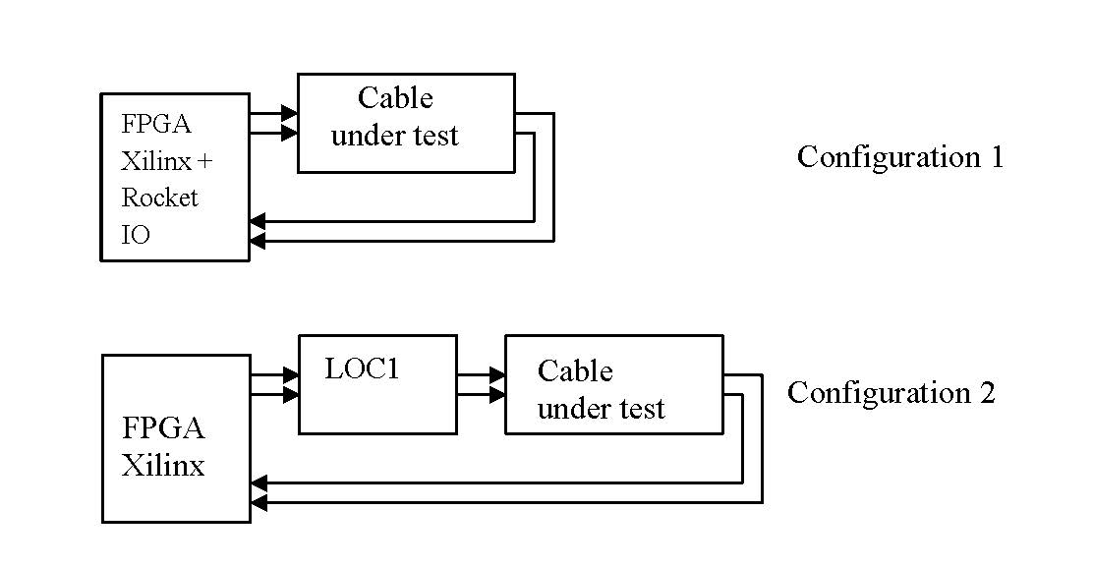
Data/Clock and Control Cables
Kapton tail is probably not a solution for SuperB
- data speed is much higher than before
- differential/coaxial lines are not usually designed in flat circuits
Some small and flexible cables have been selected and tests are on-going
Some preliminary results are shown
- the reference lenght has been chosen ~ 1m
- the test has been performed using
- Xilinx FPGA + Rocket IO as a reference
- Xilinx FPGA + LOC1 serializer as a comparison

Slide 12
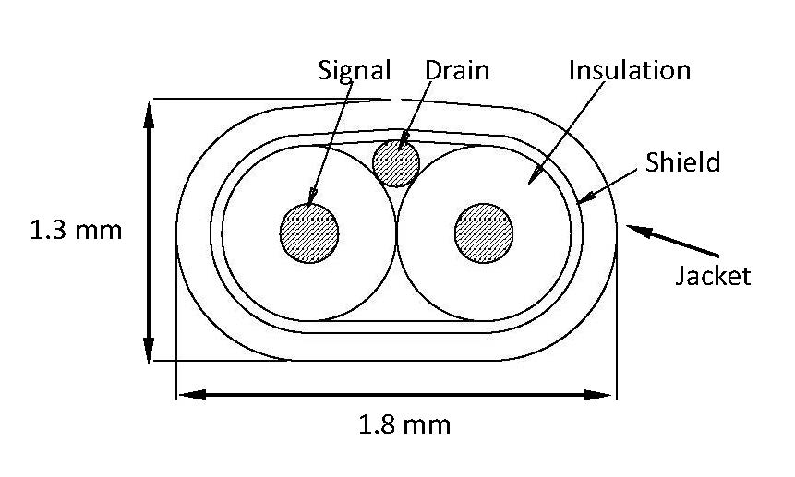
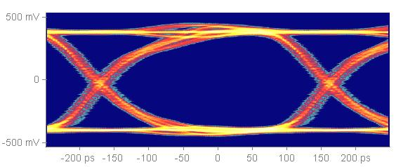
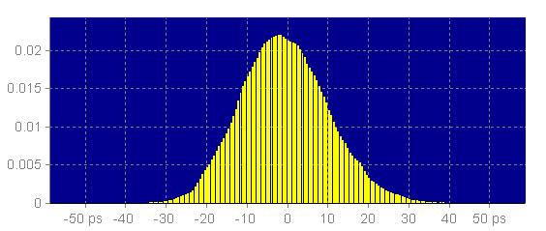
Data/Clock and Control Cables (2 of 3)
Signal: 30 AWG, Solid Copper Clad Aluminum
Differential Impedance ~ 100 Ohms +/- 5%
Capacitance: 16 pF / ft
Propagation Delay: < 2 ns/ft
The preliminary measurements show that LOC1 can drive such a cable without substantial degradation even without pre/post emphasis
Eye diagram
BER probability density function

Slide 13
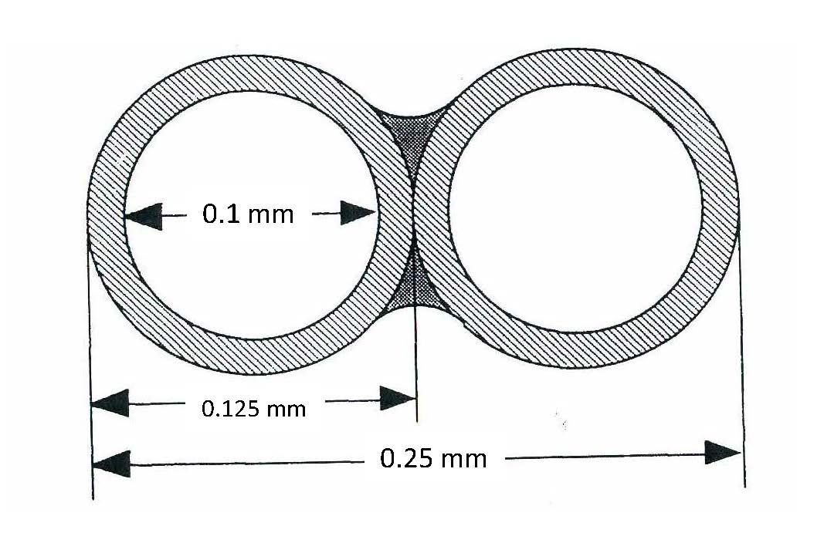
Data/Clock and Control Cables
Signal: 39 AWG, Bifilar magnet wires (Cu)
Differential Impedance: to be measured
Capacitance: 75 pF/m
Propagation Delay: to be measured
Dielectric costant: 2.1
Twisting is not needed for such a small wire
It probably can be purchased in tapes with multiple wires
- mechanical stress to be performed
- bending radius (no deformation) not known
Electric test not yet started
- difficult to make proper connection to test set-up

Slide 14
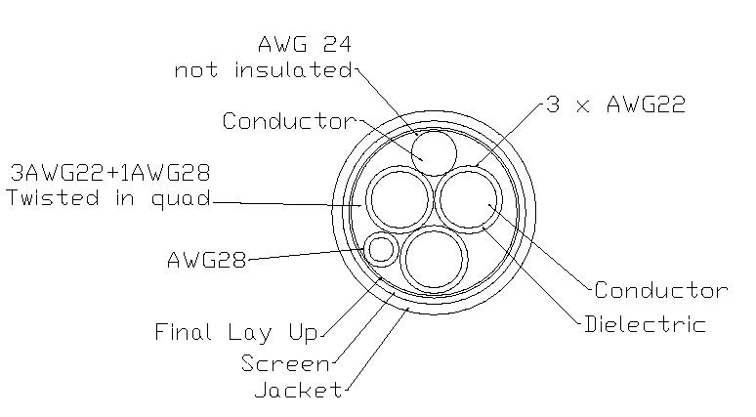
Transition card
No activities on designing the transition cards
However some preliminary study on the ”power distribution”:
micro power cables made by siltem isolated quad twist multi strands AWG22 wires has been acquired and are going to be tested
the idea is to define relatively soon the requirements for LDO regulator to be placed ”near” the HDI
such LDO will use sense lines to ”predict” exact voltage to the load.
First parameter to be defined is Max Tolerable Voltage at load to avoid FE chip damage in case of failure
Based on technology → for 0.13 um ~ 2.0 Volt
For calculation ”zero current consumption” is assumed, i.e no drop on power cables
Drop on round trip must be used
Power lines are shared on more than IC .... Worst current ....
Sense failure protection scheme must be ”fast”
AWG 22 (made of 37 x 0.114 mm individual wires)
Resistance nom.: 5.08 Ω /100 m
(or 16.25 Ω /100 m for Cu clad Al)
Diameter: 0.78 mm
Not advisable to use smaller size cables (fragile, heating)
For HV we could use AWG 30 and up.

Slide 15
Drop estimate
Recipe for calculation:
Worst current on a power cable → ?
Max drop allowed from LDO to end of sense lines → ?
Results: Size of wires and max distance from load !
Size needed for PCB ~ 5 x 8 cm, it needs moderate cooling

Slide 16
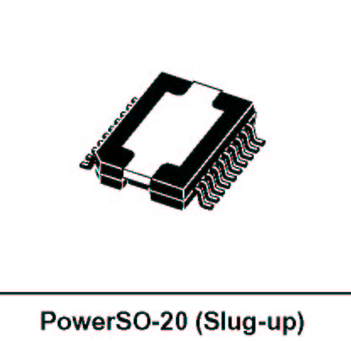
Possible radhard LDO …. from CERN
Main Features of the ST regulator:
Max current 3 A
Input Voltage < 14 V
Adjustable output voltages from 2 to 12 V
Typical dropout voltage of 0.5 V @ I= 1 A
1.5 V @ I= 3 A
Over-temperature protection
Over-voltage protection
Over-current protection
ON/OFF external control by means of a TTL signal (Inhibit line)
Short circuit control
Load regulation: better than 1%
Remote sensing operation Requires large size return wire!
Output noise voltage: < 300 μV rms (10 Hz – 10 MHz)

