Slide 1
SuperB Physics
Elba 2011

Slide 2
Evolution of the physics programme
2007: CDR (arXiv:0709.0451)
A lot of work built upon and inspired by the BaBar and Belle physics programmes.
Started to go significantly beyond the B Factory era, and also understand implications of potential measurements.
2008: Valencia (arXiv:0810.1312)
Concentrated on many areas of the new physics interplay of observables that SuperB will measure.
2010: White Papers "SuperB Progress Reports" (arXiv:1008.1541)
A coherent update of the physics programme: New physics, interplay and standard model.
2012: Physics Technical Design Report
Finalise on a timescale comparable with detector TDR.
SuperB Physics Book
Finalise shortly before data taking starts.

Slide 3
Data sample
ϒ(4S) region:
75ab⁻¹ at the 4S
Also run above / below the 4S
~75 x10⁹ B, D and τ pairs
ψ(3770) region:
500fb⁻¹ at threshold
Also run at nearby resonances
~2 x 10⁹ D pairs

Slide 4
Data sample
ϒ(4S) region:
75ab⁻¹ at the 4S
Also run above / below the 4S
~75 x10⁹ B, D and τ pairs
ψ(3770) region:
500fb⁻¹ at threshold
Also run at nearby resonances
~2 x 10⁹ D pairs
These are our priorities!

Slide 5
τLepton Flavor Violation (LFV)
νmixing leads to a low level of charged LFV (B~10⁻⁵⁴).
Enhancements to observable levels are possible with new physics.
e⁻ beam polarisation helps suppress background.
Two orders of magnitude improvement at SuperB over current limits.
Hadron machines are not competitive with e⁺e⁻ machines for these measurements.

Slide 6
τLepton Flavor Violation (LFV)
νmixing leads to a low level of charged LFV (B~10⁻⁵⁴).
Enhancements to observable levels are possible with new physics.
e⁻ beam polarisation helps suppress background.
SuperB can measure all of these channels, in the long term we should build on our existing work to provide a comprehensive picture.
Two orders of magnitude improvement at SuperB over current limits.
Hadron machines are not competitive with e⁺e⁻ machines for these measurements.
A lot more interesting topics to explore covering both Standard model and new physics scenarios

Slide 7
τLepton Flavor Violation (LFV)
Correlation between and in LTH scenario with 500GeV SUSY breaking scale (C. Tarantino)

Slide 8
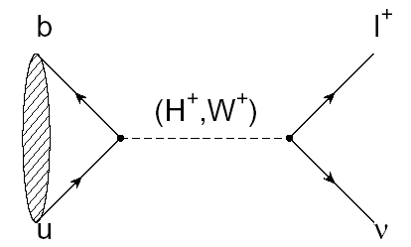
B_{u,d} physics: Rare Decays
Example:
Rate modified by presence of H⁺

Slide 9
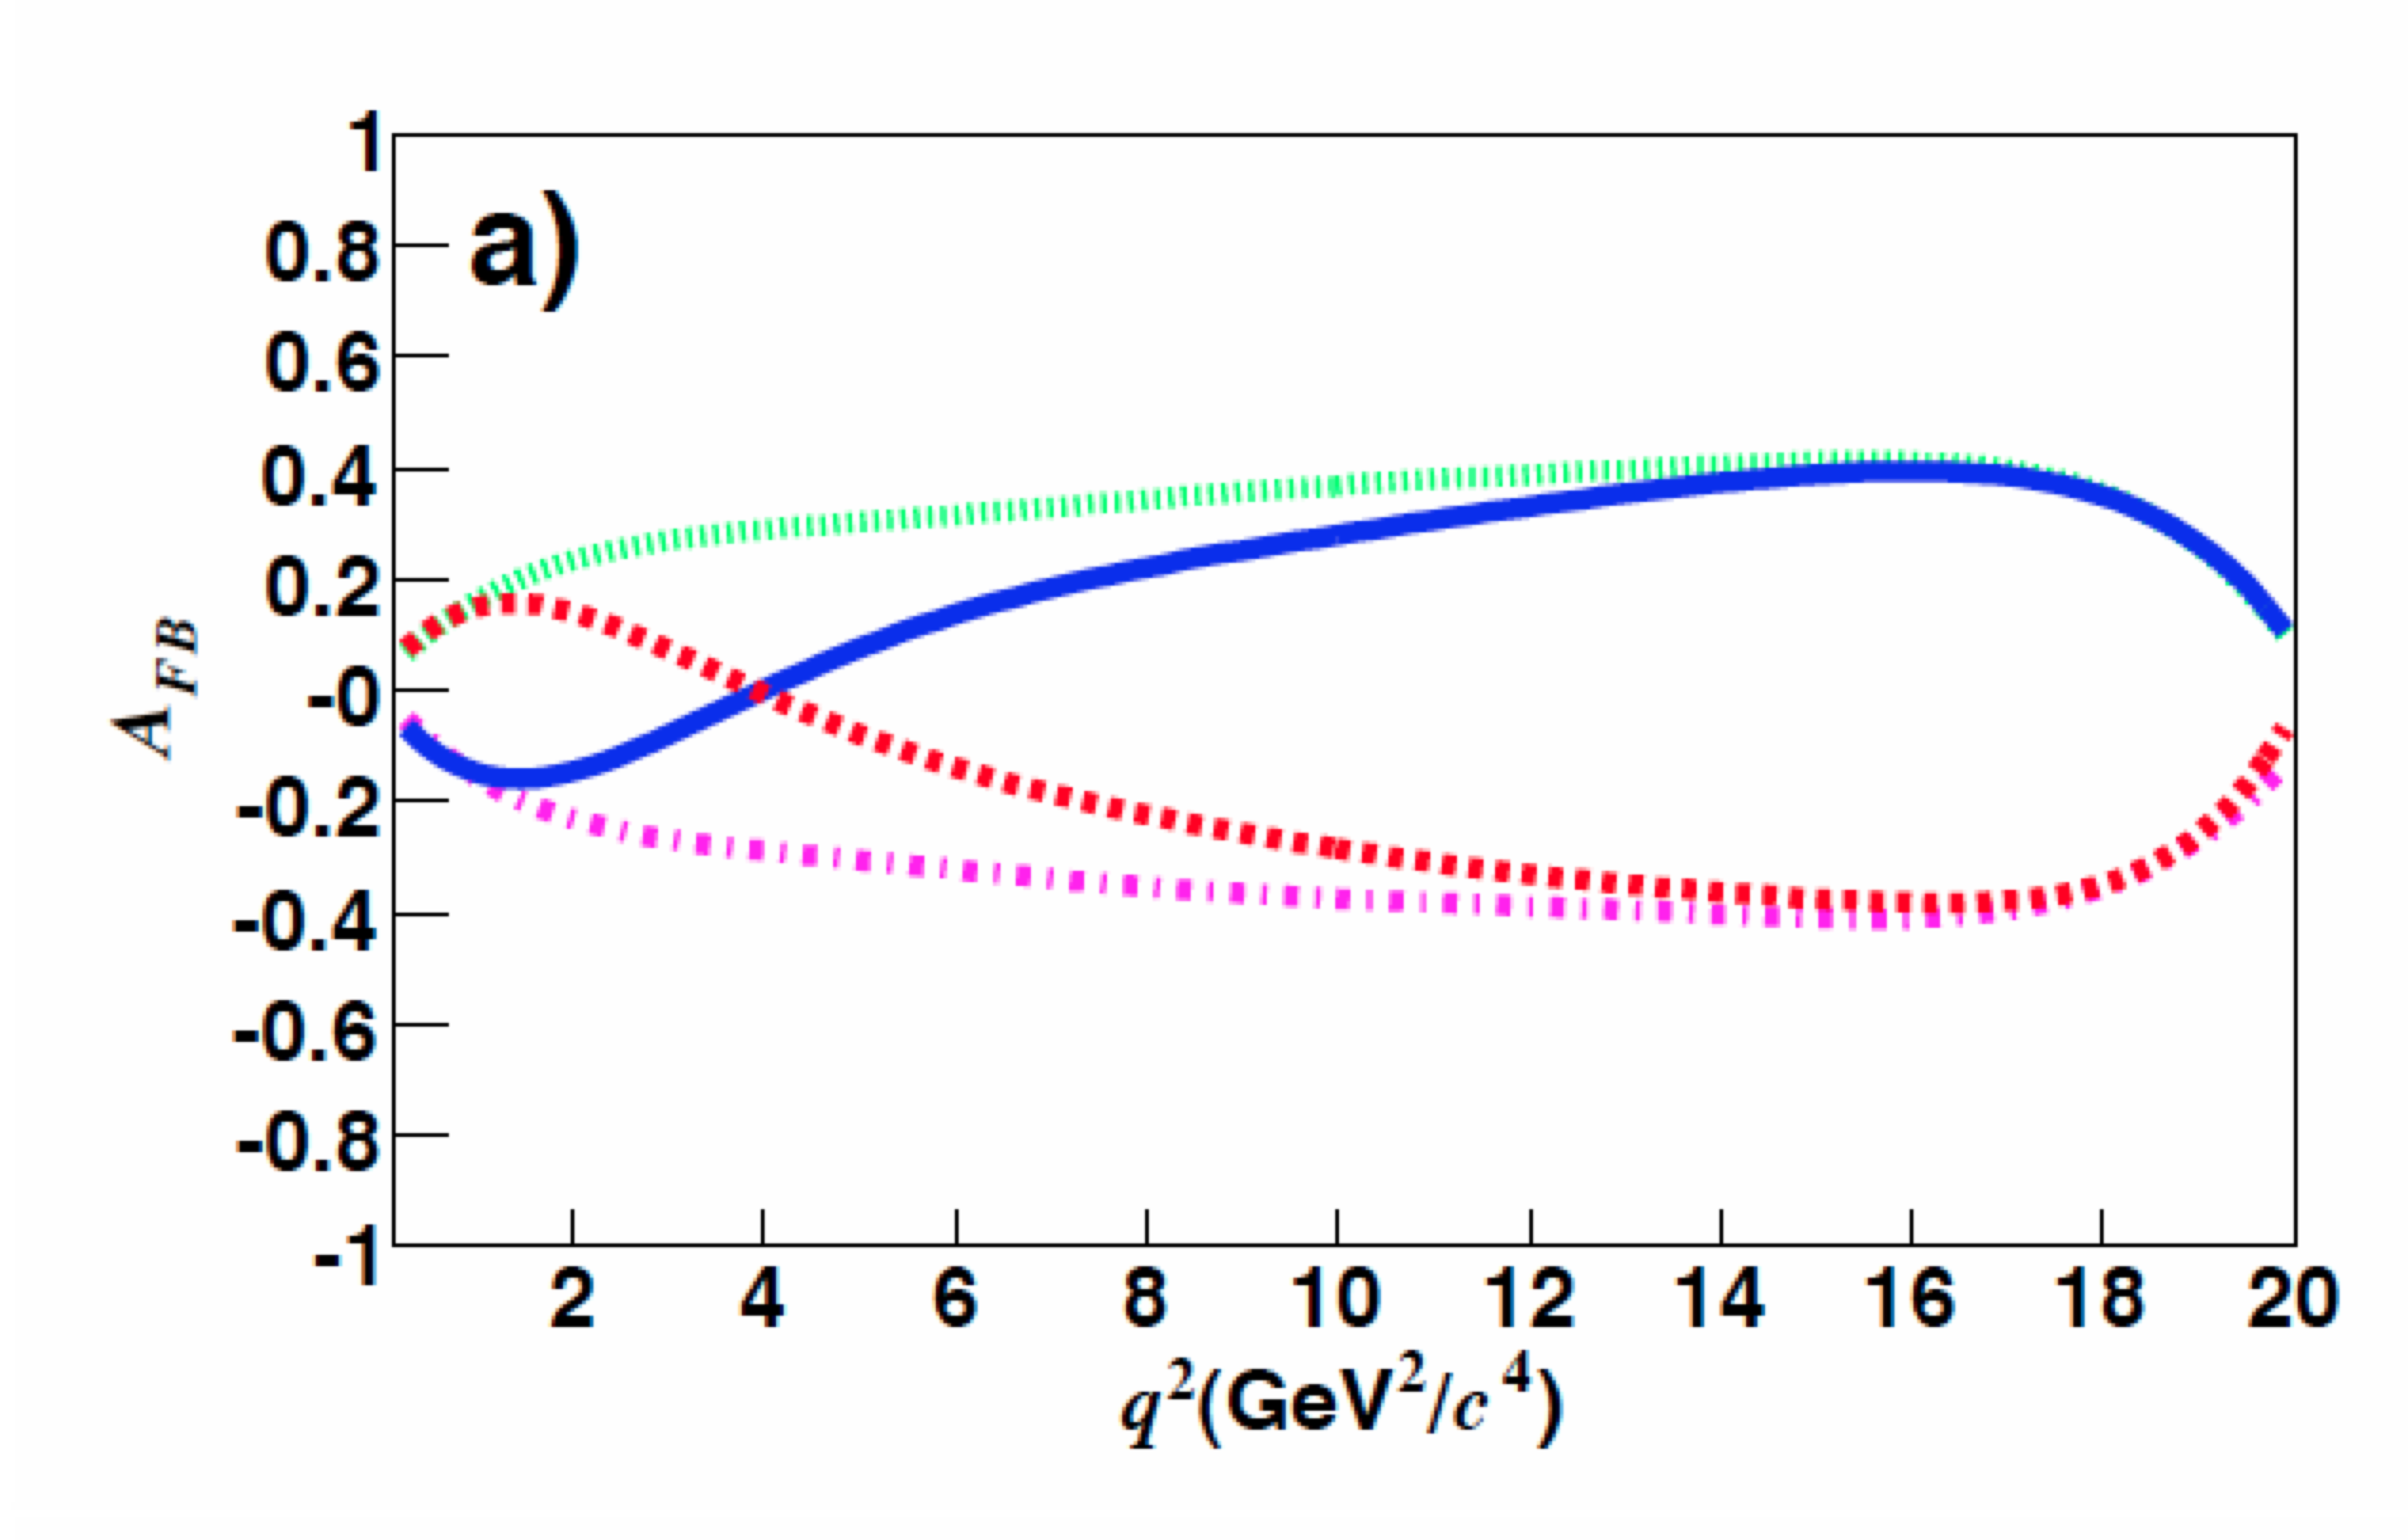
B_{u,d} physics: Rare Decays
Example:
SuperB can provide:
inclusive measurements
competitive measurement of di-muon mode (c.f. LHCb)
definitive measurement of di-electron mode
Theoretical uncertainties and how these affect interpretation of results can be non-trivial: See session on Tuesday.
We should remember that charm rare decay parallels of these B channels are also important probes for new physics.
Increasing theory error
Need SuperB to access full set of new physics sensitive observables:
FB asymmetry
Isospin asymmetry
lepton asymmetry ( )
R_{K} (K/K*)
J/ψ
ψ(2S)
Standard Model
Opposite sign C^{eff}₇
Opposite sign C^{eff}₉C^{eff}₁₀
Opposite sign C^{eff}₇ and C^{eff}₉C^{eff}₁₀

Slide 10
B_{u,d} physics: Rare Decays
Example:
Need 75ab⁻¹ to observe this mode.
With more than 75ab⁻¹ we could measure polarisation.
Sensitive to models with Z penguins and RH currents.
e.g. see Altmannshofer, Buras, & Straub
Constraint on (ε, η) with 75ab⁻¹
(Theoretical uncertainties)
(Experimental uncertainties)

Slide 11
B_{s} physics
Can cleanly measure A^{s}_{SL} using 5S data
SuperB can also study rare decays with many neutral particles, such as , which can be enhanced by SUSY.
Little Higgs (LTH) scenario

Slide 12
Charm
Collect data at threshold and at the 4S.
Benefit charm mixing and CPV measurements.
Also useful for measuring the Unitarity triangle angleγ (strong phase in D→Kππ Dalitz plot) and charm mixing phase.
)
See tomorrow's charm session for first look at TDCPV with D mesons

Slide 13
G. Inguglia (Monday)

Slide 14
G. Inguglia (Monday)
Need SuperB to measure β_{c}

Slide 15
Precision Electroweak
sin²θ_{W} can be measured with polarised e⁻ beam
√s=ϒ(4S) is theoretically clean, c.f. b-fragmentation at Z pole
Measure LR asymmetry in
at the ϒ(4S) to same precision as LEP/SLC at the Z-pole.
Can also perform crosscheck at ψ(3770).
SuperB
Plot adapted from QWeak proposal (JLAB E02-020)

Slide 16
Precision Electroweak
sin²θ_{W} can be measured with polarised e⁻ beam
√s=ϒ(4S) is theoretically clean, c.f. b-fragmentation at Z pole
Measure LR asymmetry in
at the ϒ(4S) to same precision as LEP/SLC at the Z-pole.
Can also perform crosscheck at ψ(3770).
SuperB
An important test of the SM in the electroweak sector
Plot adapted from QWeak proposal (JLAB E02-020)

Slide 17
Interplay
More information on the golden matrix can be found in arXiv:1008.1541, arXiv:0909.1333, and arXiv:0810.1312.
Combine measurements to elucidate structure of new physics.
✓
✓
✓
✓
✓
✓
✓
✓
✓
✓
✓
✓
✓
✓= SuperB can measure these modes

Slide 18
Interplay
More information on the golden matrix can be found in arXiv:1008.1541, arXiv:0909.1333, and arXiv:0810.1312.
Combine measurements to elucidate structure of new physics.
✓
✓
✓
✓
✓
✓
✓
✓
✓
✓
✓
✓
✓
✓= SuperB can measure these modes
SuperB is a very versatile tool to decode the nature of new physics using this golden matrix

Slide 19
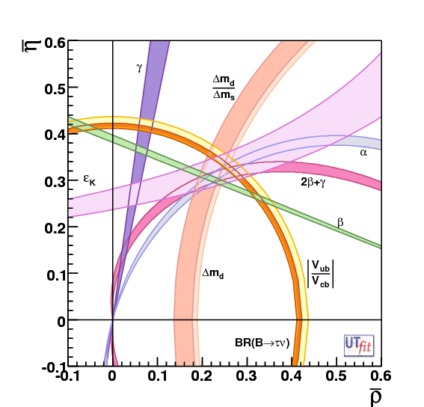
Precision CKM constraints
The "dream" scenario with 75ab⁻¹
Unitarity Triangle Angles
σ(α) = 1−2°
σ(β) = 0.1°
σ(γ) = 1−2°
CKM Matrix Elements
|V_{ub}|
Inclusive σ = 2%
Exclusive σ = 3%
|V_{cb}|
Inclusive σ = 1%
Exclusive σ = 1%
|V_{us}|
Can be measured precisely using τ decays
|V_{cd}| and |V_{cs}|
can be measured at/near charm threshold.
SuperB Measures the sides and angles of the bd unitarity Triangle
(and sides and β_{c} angle of the cu charm unitarity triangle)

Slide 20
Spectroscopy and Exotica
R. Faccini, Elba 2010
See WG5 parallel sessions on Tuesday and Wednesday

Slide 21
Golden Measurements: CKM
Comparison of relative benefits of SuperB (75ab⁻¹) vs. existing measurements and LHCb (5fb⁻¹) and the LHCb upgrade (50fb⁻¹).
LHCb can only use ρπ
βtheory error B_{d}
βtheory error B_{s}
Need an e⁺e⁻ environment to do a precision measurement using semi-leptonic B decays.
Experiment: No Result Moderate Precision Precise Very Precise
Theory: Moderately clean Clean Need lattice Clean

Slide 22
Golden Measurements: General
Experiment: No Result Moderate Precision Precise Very Precise
Theory: Moderately clean Clean Need lattice Clean
Benefit from polarised e⁻ beam
very precise with improved detector
Statistically limited: Angular analysis with >75ab⁻¹
Right handed currents
SuperB measures many more modes
systematic error is main challenge
control systematic error with data
SuperB measures e mode well, LHCb does μ
Clean NP search
Theoretically clean
b fragmentation limits interpretation

Slide 23
Physics programme in a nutshell
Versatile flavour physics experiment
Probe new physics observables in wide range of decays.
Pattern of deviation from Standard Model can be used to identify structure of new physics.
Clean experimental environment means clean signals in many modes.
Polarised e⁻ beam benefit for τ LFV searches & .
Best capability for precision CKM constraints of any existing/proposed experiment.
Measure angles and sides of the bd unitarity triangle.
Measure β_{c} and sides of the cu unitarity triangle (see charm tomorrow).
Measure other CKM matrix elements at threshold and using τ data (see tau contributions).

Slide 24
Aims of this week
Physics workshop
Focus on many areas of the programme in parallel with the general meeting.
Dedicated session on b→sll experimental and theoretical reach
Comparison document
Finalise the document, in consultation with other experiments (LHCb, Belle II etc.)
TDR
The writing starts now...
NOTE: discussion session on Wednesday morning
See outline at http://mailman.fe.infn.it/superbwiki/index.php/SuperB_Physics_TDR
December workshop
Highlight priorities and schedule dates for December physics workshop: b→sγ is already identified for discussion.

Slide 25
Charm / WG5
b→sll / WG5
Other Expts.
Lattice / tau
TDR / planning
Interplay
LHCb, Belle II, Super τ/charm

Slide 26
Charm / WG5
b→sll / WG5
Other Expts.
Unfortunately some sessions run in parallel
but there is also plenty of workshop time available this week – let's use it wisely
Lattice / tau
TDR / planning
Interplay
LHCb, Belle II, Super τ/charm/BES III

