Slide 1
Coherent Synchrotron Radiation Study
Sasha Novokhatski
SLAC National Accelerator Laboratory
XVII Super B Workshop and Kick Off Meeting
May 28 – June 2, 2011
La Biodola, Isola d’Elba, Italy

Slide 2
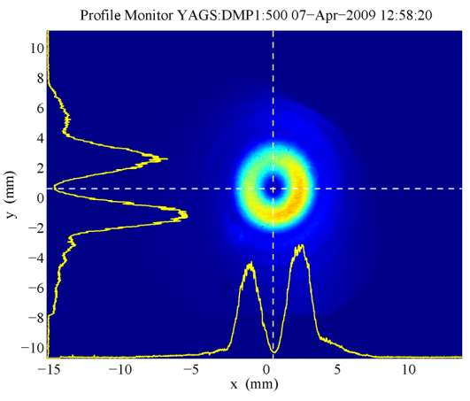
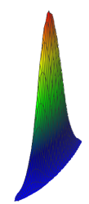
What is CSR ? Coherent Synchrotron Radiation
electro-magnetic fields
image from LCLS
in a vacuum chamber
inside a bending magnet
excited by
a short bunch

Slide 3
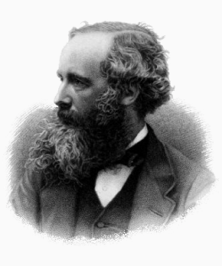
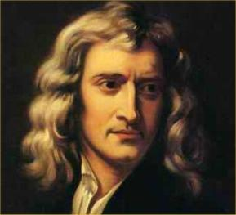
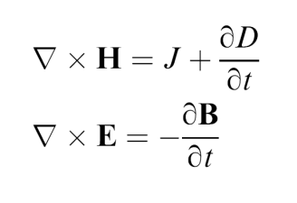
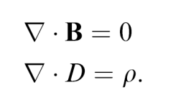
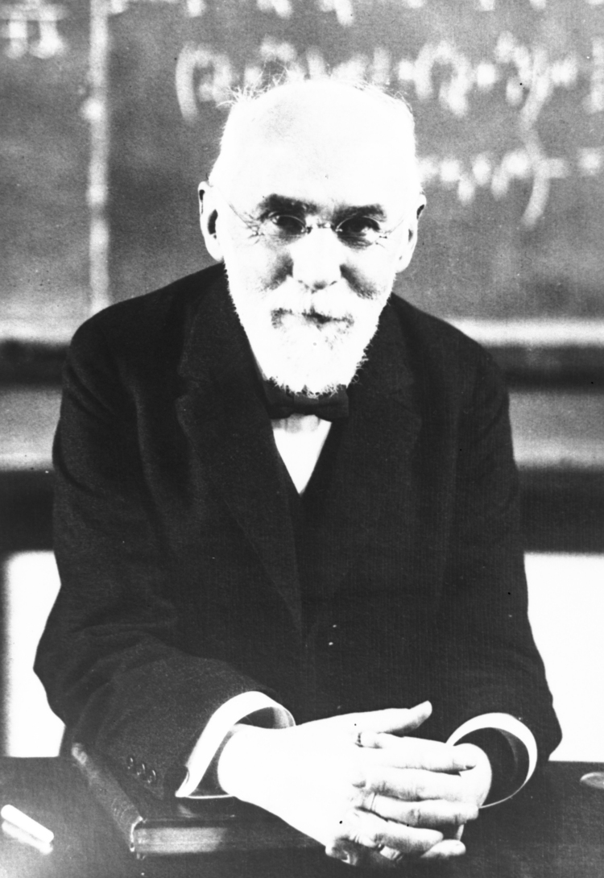
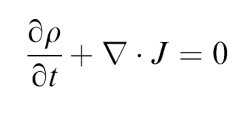
How to calculate CSR? we need to solve Maxwell's equations and Newton’s equations
Lorentz's force

Slide 4
Recently a new method was developed at SLAC
The method is based on an implicit scheme for solving the electromagnetic equations.
This algorithm is free of frequency dispersion effects which means that all propagating waves will have their natural phase velocity, completely independent of simulation parameters like mesh size or time step.
Other known methods, usually explicit, have “mesh driven” dispersion and because of this they need a much smaller mesh size which slows down calculations and can sometimes cause unstable solutions.
An implicit scheme is a self-consistent method that allows us to calculate fields of much shorter bunches.

Slide 5
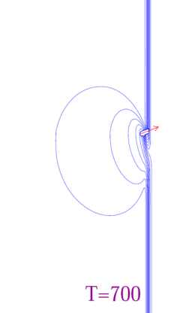
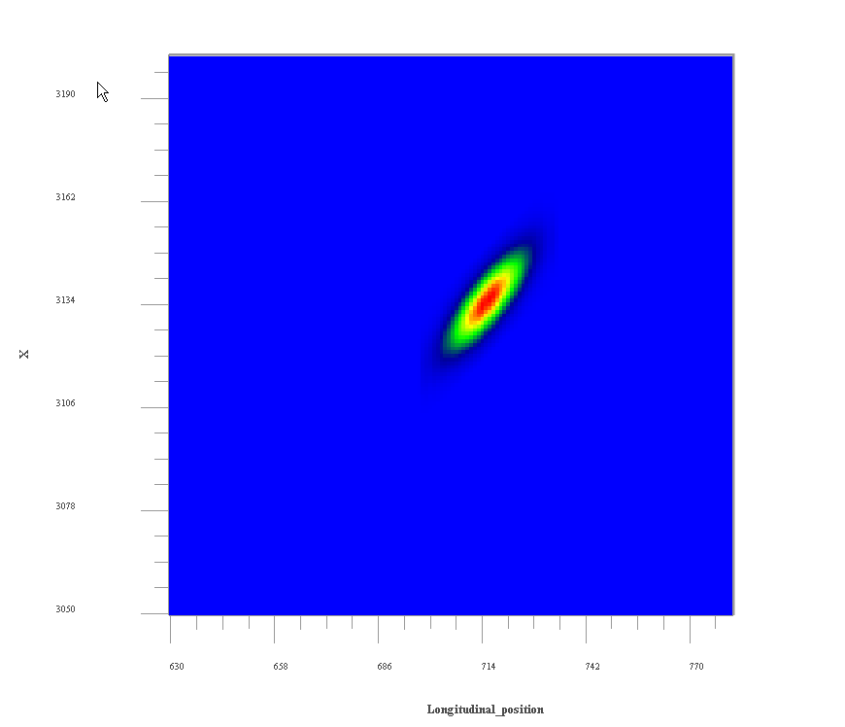
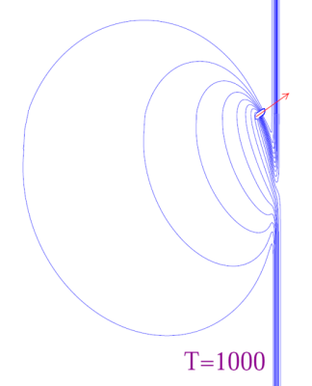
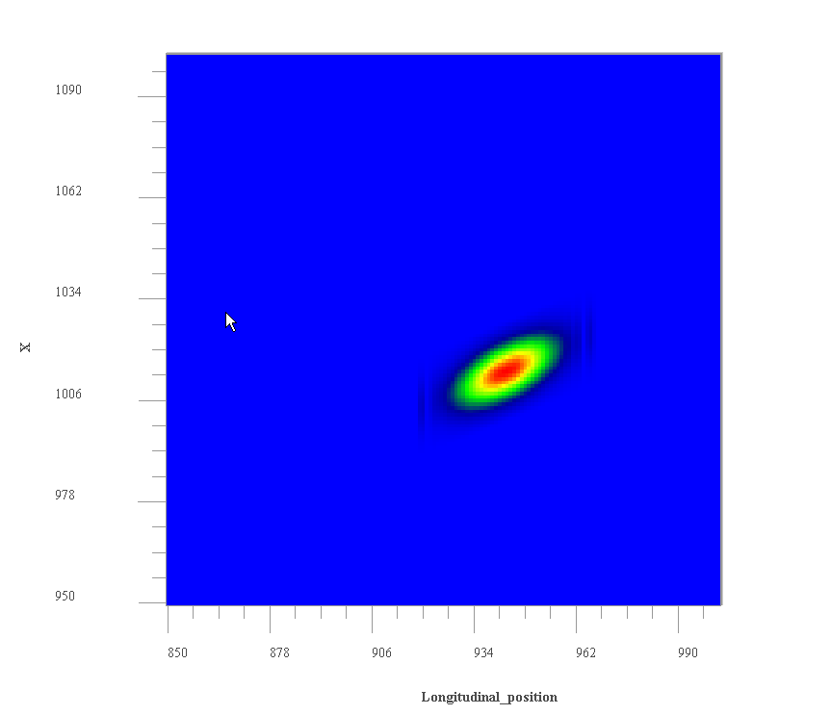
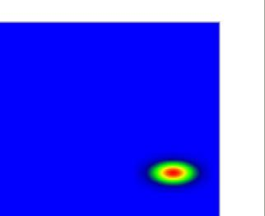
Physics of CSR: Field dynamics in a magnet

Slide 6
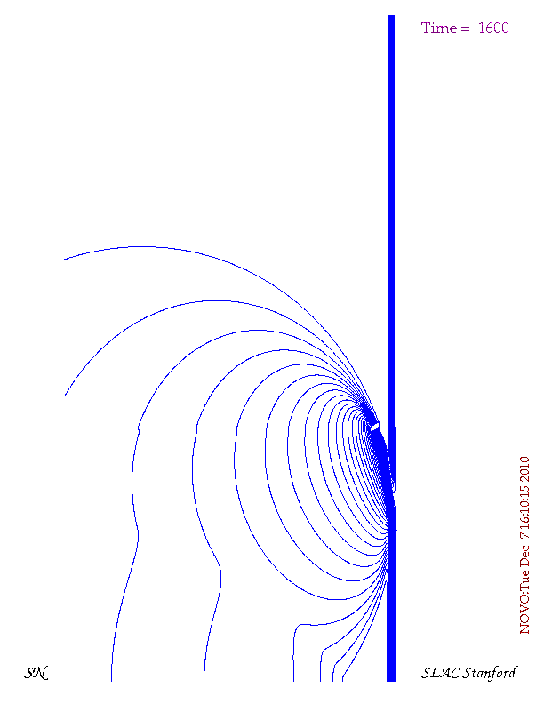
Movie show
Chamber wall
v
Initial direction
Chamber wall

Slide 7
Movie show
Chamber wall
v
Initial direction
Chamber wall

Slide 8
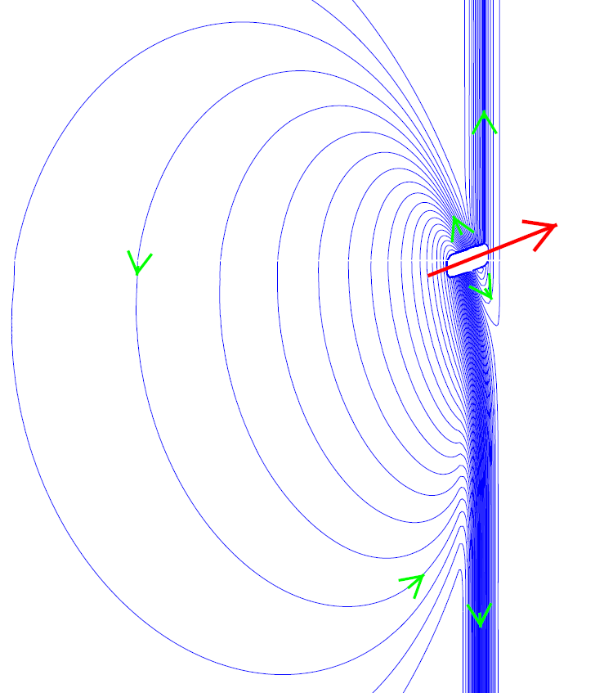
Bunch self-field remakes itself moving in a magnetic field
The upper field lines take the position of the lower lines
The white box shows the bunch location
The red arrow shows the bunch velocity vector
Green arrows show field line directions
The lower field lines take the place of the upper lines
V

Slide 9
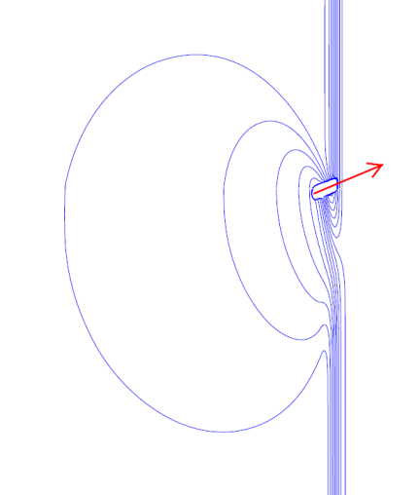
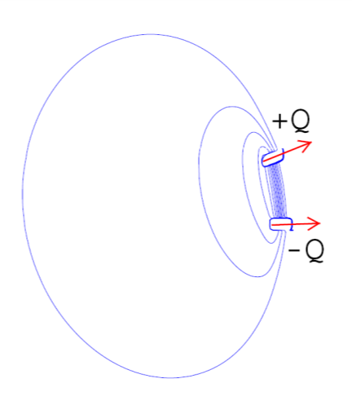
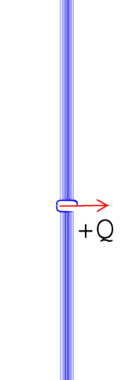
The picture becomes clear if
we decompose the field
=
+
Decomposition of the field of a bunch moving in a magnetic field into two fields:
field of a moving dipole
field of a bunch moving straight in the initial direction

Slide 10
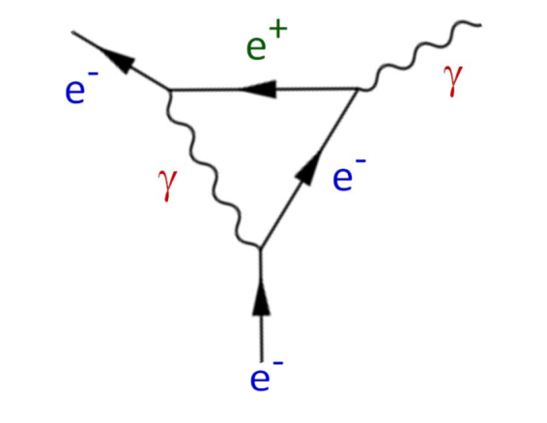
Decomposition as an analog of a Feynman diagram
There could be a close analogy between the field decomposition and the Feynman diagram.
A real electron produces a virtual photon, which decays into an electron-positron pair, corresponding to a dipole.
The positron can annihilate with the ongoing scattered electron to emit a photon. This photon corresponds to synchrotron radiation.

Slide 11
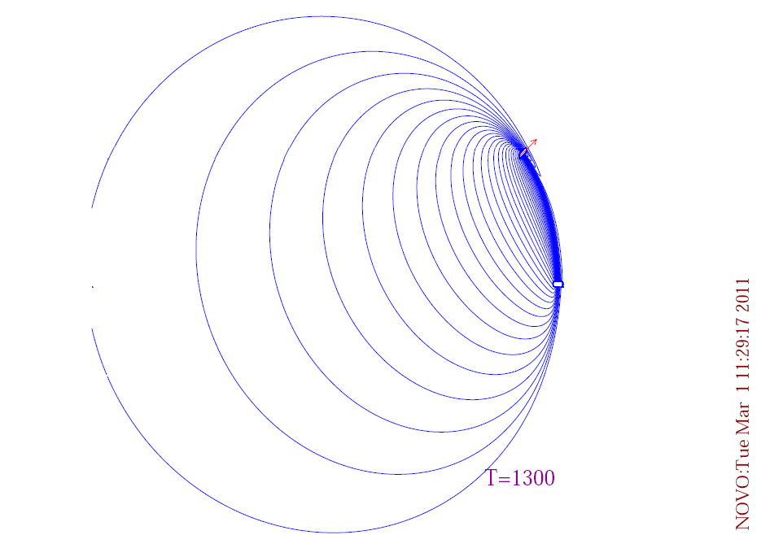
Detailed plot of a dipole field

Slide 12
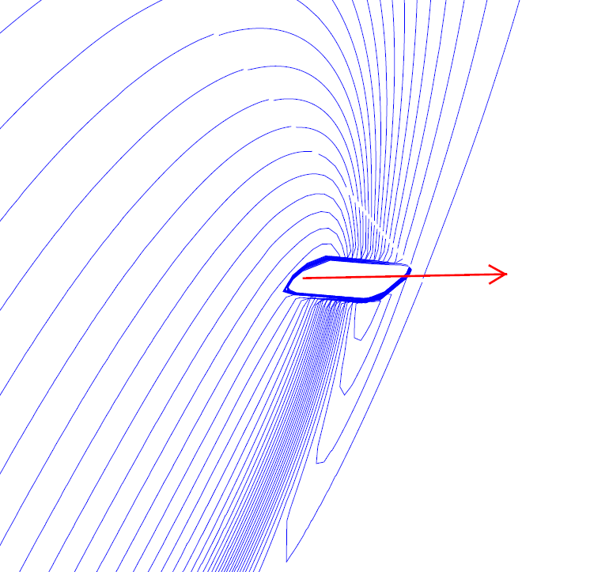
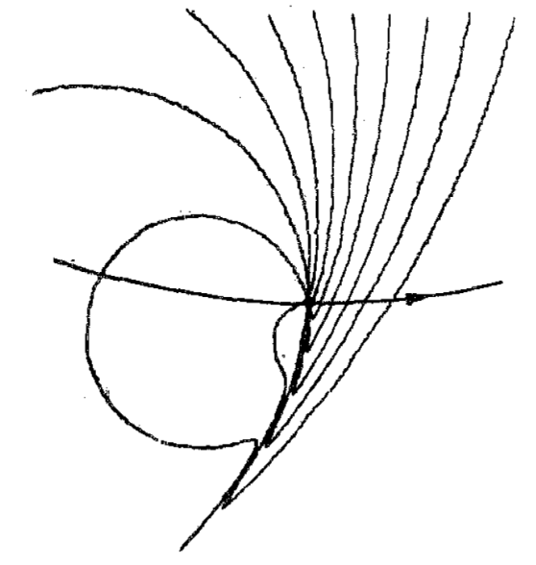
Comparison with a classical synchrotron radiation
γ - region in front of a particle
(γ=6)
equivalent bunch length
for a bending radius ρ

Slide 13
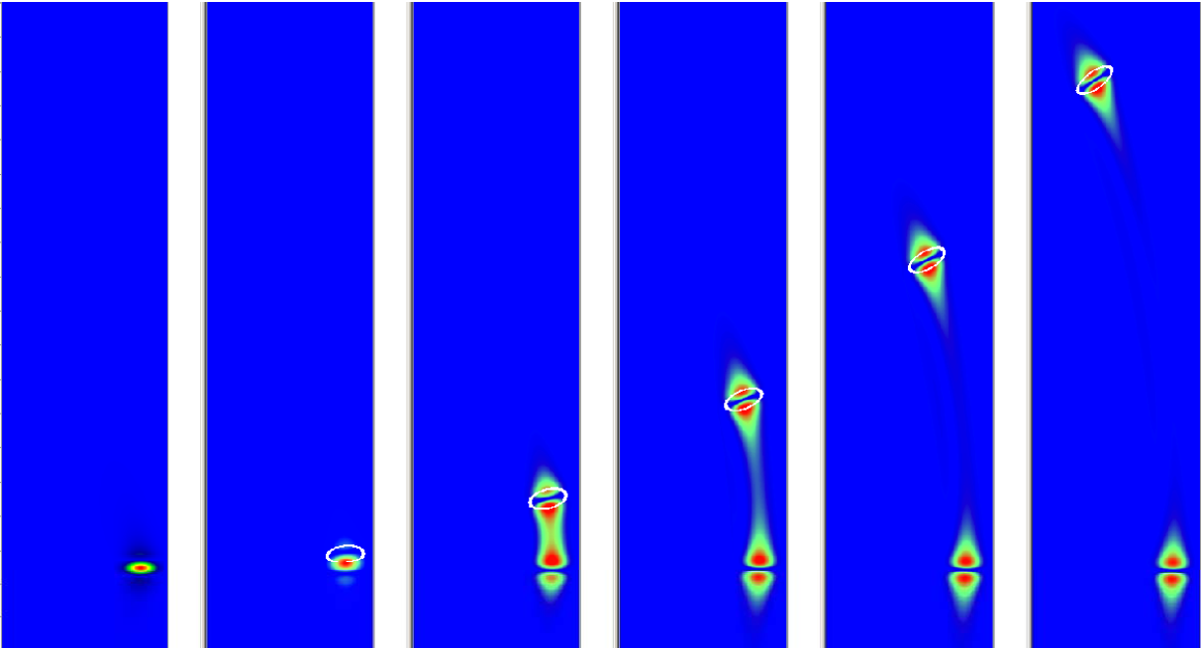
An absolute dipole electric field in time
The white oval shows the real bunch contour.
When a dipole is created an electric field appears between a real bunch and a virtual bunch. This field increases in value and reaches a maximum value when the bunches are completely separated and then it goes down as the bunches move apart leaving fields only around the bunches.

Slide 14
Electrical forces inside a bunch
Bunch shape
t
i
m
e

Slide 15
Electrical forces inside a bunch
Bunch shape
The transverse force is the well known space-charge force, which probably is compensated by a magnetic force in the ultra-relativistic case.
The collinear force is responsible for an energy gain or an energy loss. The particles, which are in the center, in front and at the end of the bunch are accelerating, whereas the particles at the boundaries are decelerating.
The total effect is deceleration and the bunch loses energy, however the bunch gets an additional energy spread in the transverse direction.

Slide 16
Coherent edge radiation?
Image of the magnetic field
Bunch trajectory
Some fields propagate along
initial beam direction
Initial beam direction

Slide 17
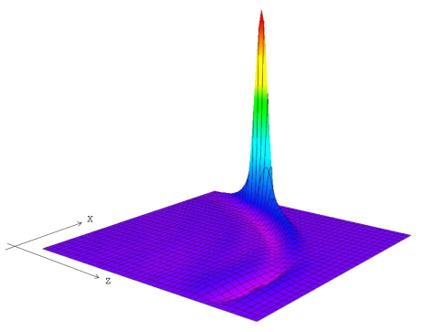
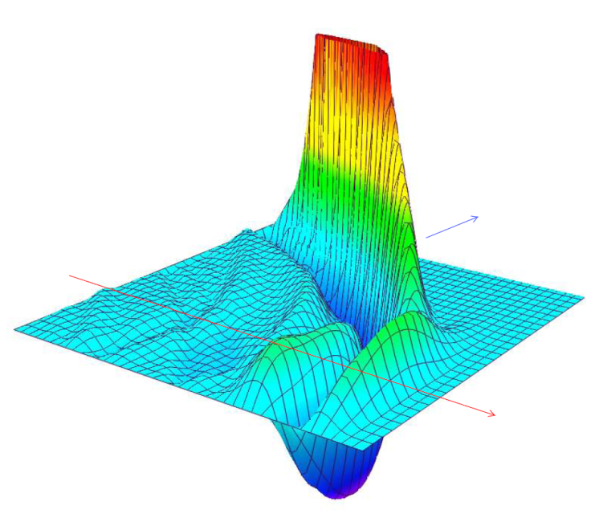
Magnetic field plots
Bunch field
Magnified
Current beam direction
Initial beam direction

Slide 18
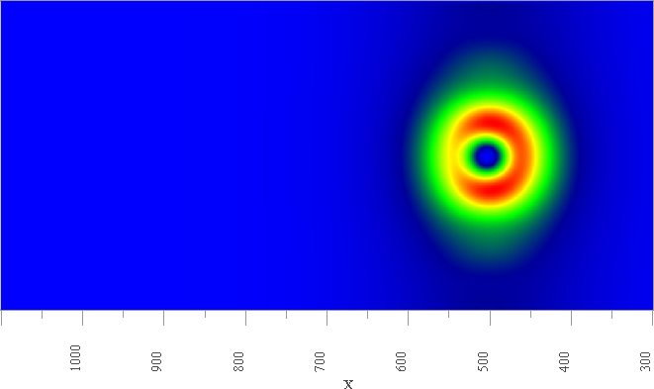
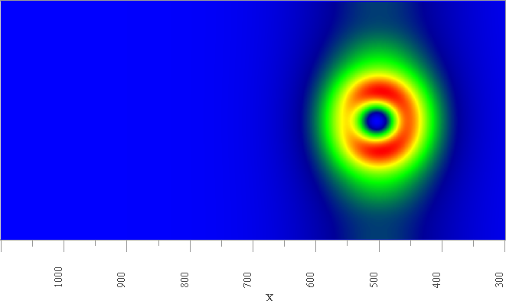
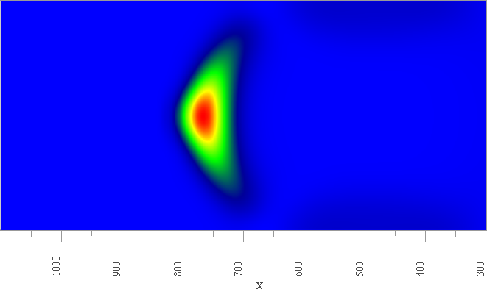
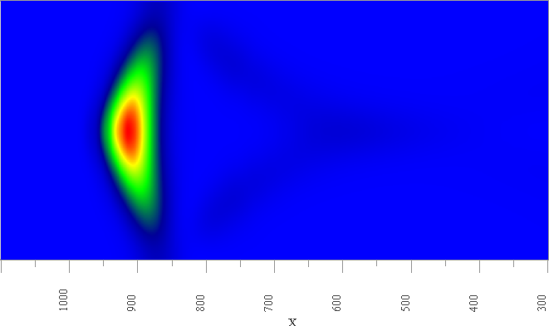
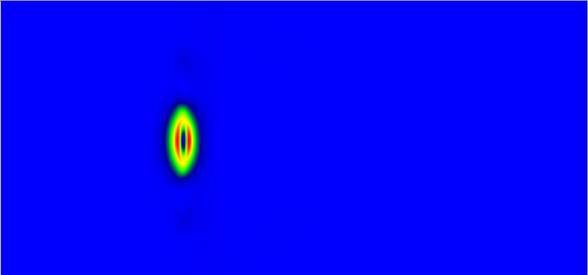
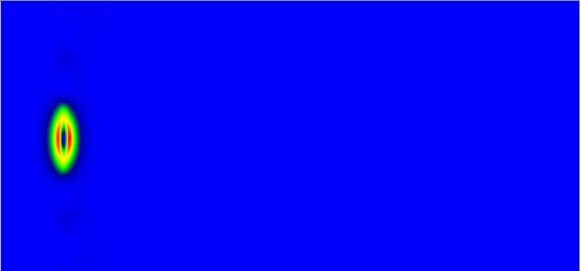
Images of radiation (transverse magnetic field)
very similar to the images, which we have seen on the YAG screen after the dump magnets, which the beam bend down at the LCLS.
Edge
radiation
Synchrotron
radiation
Bunch field
Z=0.73 m
Z=1.0 m

Slide 19
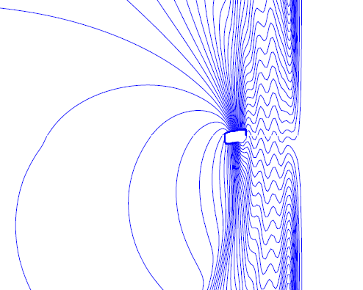
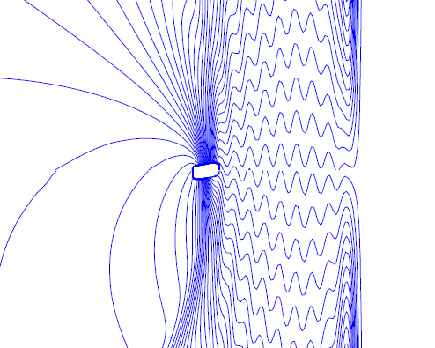
How undulator works?
Movie?
After 5 undulator periods
After 10 undulator periods
With each undulator period the bunch is delayed by one period of radiation

Slide 20
Movie show
Undulator

Slide 21
Super-B parameters. March 3, 2010
(Bold: computed values) |  | Base Line |  | Low Emittance |  | High Current |  | Tau/Charm (prelim.)
Parameter | Units | HER (e+) | LER (e-) | HER (e+) | LER (e-) | HER (e+) | LER (e-) | HER (e+) | LER (e-)
Energy | GeV | 6.7 | 4.18 | 6.7 | 4.18 | 6.7 | 4.18 | 2.58 | 1.61
Circumference | m | 1258.4 |  | 1258.4 |  | 1258.4 |  | 1258.4
Bunch length (zero current) | mm | 4.69 | 4.29 | 4.73 | 4.34 | 4.03 | 3.65 | 4.75 | 4.36
Bunch length (full current) | mm | 5 | 5 | 5 | 5 | 4.4 | 4.4 | 5 | 5
Beam current | mA | 1892 | 2447 | 1460 | 1888 | 3094 | 4000 | 1365 | 1766
N. Buckets distance |  | 2 | 2 | 2 | 2 | 1 | 1 | 1 | 1
Ion gap | % | 2 | 2 | 2 | 2 | 2 | 2 | 2 | 2
RF frequency | Hz | 4.76E+08 | 4.76E+08 | 4.76E+08 | 4.76E+08 | 4.76E+08 | 4.76E+08 | 4.76E+08 | 4.76E+08
Revolution frequency | Hz | 2.38E+05 |  | 2.38E+05 |  | 2.38E+05 |  | 2.38E+05
Harmonic number | # | 1998 |  | 1998 |  | 1998 |  | 1998
Number of bunches | # | 978 |  | 978 |  | 1956 |  | 1956
N. Particle/bunch | # | 5.08E+10 | 6.56E+10 | 3.92E+10 | 5.06E+10 | 4.15E+10 | 5.36E+10 | 1.83E+10 | 2.37E+10
Bunch current | mA | 1.935 | 2.502 | 1.493 | 1.930 | 1.582 | 2.045 | 0.698 | 0.903
Energy Loss/turn | MeV | 2.11 | 0.865 | 2.11 | 0.865 | 2.11 | 0.865 | 0.4 | 0.166
Momentum compaction |  | 4.36E-04 | 4.05E-04 | 4.36E-04 | 4.05E-04 | 4.36E-04 | 4.05E-04 | 4.36E-04 | 4.05E-04
Energy spread (zero current) | dE/E | 6.31E-04 | 6.68E-04 | 6.31E-04 | 6.68E-04 | 6.31E-04 | 6.68E-04 | 6.31E-04 | 6.68E-04
Energy spread (full current) | dE/E | 6.43E-04 | 7.34E-04 | 6.43E-04 | 7.34E-04 | 6.43E-04 | 7.34E-04 | 6.94E-04 | 7.34E-04
CM energy spread | dE/E | 5.00E-04 |  | 5.00E-04 |  | 5.00E-04 |  | 5.26E-04
Energy acceptance |  | 0.01 | 0.01 | 0.01 | 0.01 | 0.01 | 0.01 | 0.01 | 0.01
Synchrotron frequency | kHz | 3.01 | 2.8 | 2.97 | 2.77 | 3.54 | 3.26 | 2.96 | 2.77
Synchrotron tune |  | 0.0126 | 0.0118 | 0.0125 | 0.0116 | 0.0148 | 0.0137 | 0.0124 | 0.0116
SR power loss | MW | 3.99 | 2.12 | 3.08 | 1.63 | 6.53 | 3.46 | 0.55 | 0.29
RF Wall Plug Power (SR only) | MW | 12.22 |  | 9.43 |  | 19.98 |  | 1.68
Total RF Wall Plug Power | MW | 17.08 |  | 12.72 |  | 30.48 |  | 3.11
Number of cavities |  | 12 | 8 | 12 | 8 | 20 | 12 | 6 | 4
Number of Klystrons |  | 6 | 4 | 6 | 4 | 10 | 6 | 3 | 2
Total Number of klystrons |  | 10 |  | 10 |  | 16 |  | 5
RF Voltage | MV | 7.01 | 5.25 | 6.88 | 5.13 | 9.3 | 7.2 | 2.54 | 1.94
R_{s} | MΩ
Q₀
β

Slide 22
PEP-II HER dipole (measurement)

Slide 23
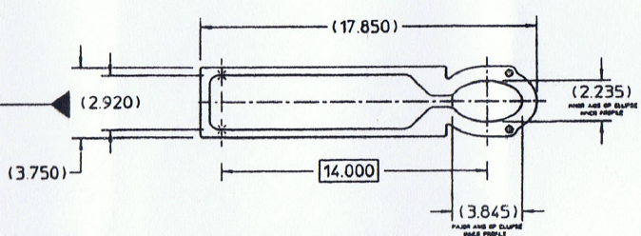
PEP-II LER pumping chamber

Slide 24
PEP-II LER dipole (a model) X beam position and magnetic field

Slide 25
SuperB LER dipole X beam position and magnetic field

Slide 26
SuperB LER dipole (a model) X beam position and magnetic field

Slide 27
Bunch CSR energy loss per turn (a model)

Slide 28
Energy loss along a bunch

Slide 29
Summary
PEP-II and Super-B factory have smaller size of the vacuum chamber than KEKB
The CSR effect is almost dammed for Super-B.
However an additional energy spread due to the beam position change inside the bending chamber has to be taken into account

Slide 30
Acknowledgments
The author would like to thank
Mike Sullivan and R. Clive Field
for help and valuable comments;
.

