Slide 1
FDIRC Simulation tools: preparing for the Prototype
Doug Roberts
University of Maryland

Slide 2
Overview
This presentation is just meant as a summary and status of the current FDIRC Geant4-based simulation and to begin thinking about what can be used for the full prototype and what still needs to be done
Simulation Status
How to get it
Options
Suitability for Prototype
Analysis Tools
Current Method
What should we be doing, and how to organize

Slide 3
Simulation Status
We have a Geant4-base standalone simulation of the FDIRC
It is in the SuperB svn system:
Repository: FDIRC
Package: fDircG4
This package has been used to study resolution vs. geometry and other options
Has also been used to create the gdml file for BRUNO
The model allows for creation and tracking of optical (Cerenkov) photons through the active materials of the detector
Also includes all of the support structure for the bar boxes.
Support around FBLOCK itself is not really correct or very detailed

Slide 4
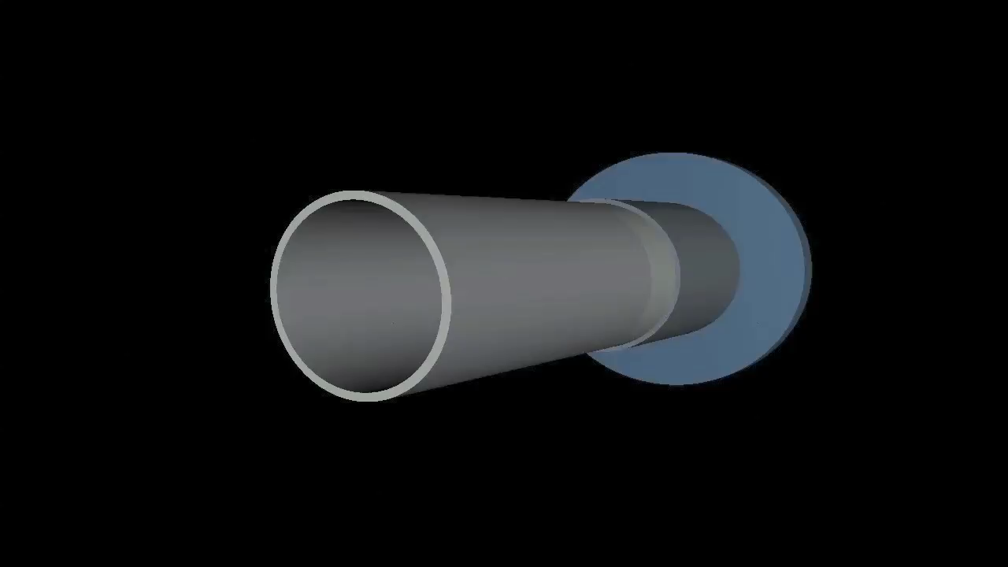
FDIRC in Bruno (all support)

Slide 5
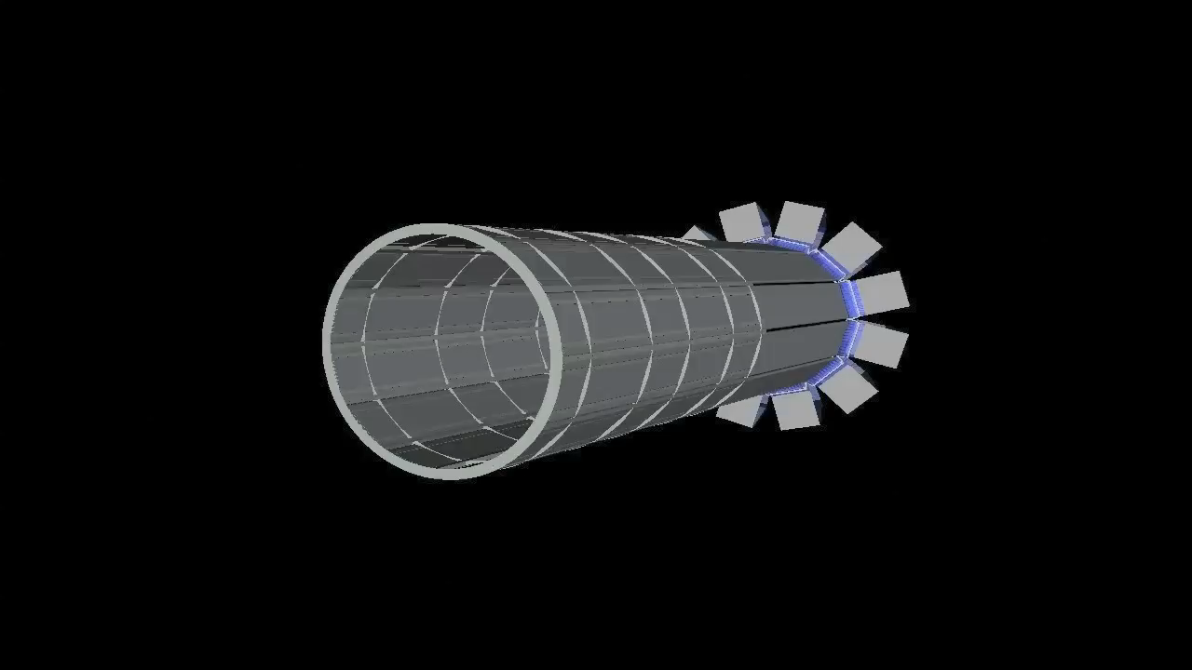
No Outer Skins

Slide 6
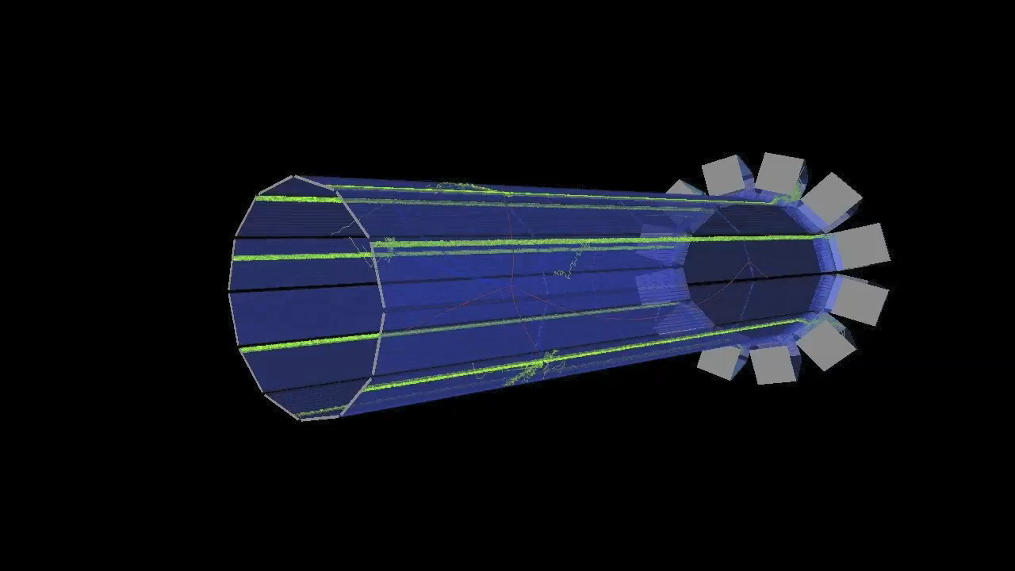
An Event

Slide 7
Options
Can be run either as full detector (all 12 sectors) or single sector
Single sector is what prototype will be
Magnetic field on or off
Single particle, di-muon-like distribution, sample of events, single photon
Like the di-muon, we could generate muons from a sample distribution for the CRT
All geometry constants are contained in a single file
For prototype, we can use a single sector, keep bar box structure but turn off other support, turn off magnetic field
Bottom Line: I think this will be very easy to adapt to the CRT prototype

Slide 8
Simulation Output
Simulation is (mostly) decoupled from specific photodetector choice or layout
One caveat: simulation can use QE of tube to speed up simulation.
Not just QE, but QE * charge collection efficiency
If we have mixed assortment of detectors on prototype, we will have to be more clever
Output is basically a ROOT file with lots of information, most of which we won’t need
What we do need:
Generated event info (track p, direction, position, time, and same info as track enters quartz bar…)
Generated optical photon info (wavelength, time, direction…)
Detected photon info (wavelength, time, position on focal plane…)

Slide 9
Analysis Tools
Currently, all of my analysis has been done within ROOT
Not sure if this is the future plan?
All of the ROOT scripts are in the fDircG4 package (“macros” directory), but there is little if any documentation at the moment
Multi-step process
Simulate Events
Generate single-photon dictionary
Process single-photon dictionary
Automatically done the first time you run the resolution calculation macro if the photon dictionary root file doesn’t exist yet
Correlate simulated events with dictionary
Analysis

Slide 10
Analysis Process
Simulate Events
Basic output is time and position of photon hits at the focal plane of the FBLOCK.
Position is in local coordinates of the focal plane
Be careful of a funny sign flip! (Do we have a coordinate sign convention, number convention…?)
Also keep original track information
Single Photon Simulation
Fixed wavelength (410 nm)
Isotropic angular distribution
Randomized over x, y, z in bar
Randomized over 12 bars in a bar box
Same output as other events
Typically using a sample of 20,000,000 generated photons
Need new sample each time we change the geometry

Slide 11
Process Single Photon Dictionary
Single Photon Dictionary is used to create a “map” from PMT pixel number to photon angles at the exit of the last quartz bar. Map also includes expected time propagation.
Multi-valued map. Depends on:
Bar hit (use track information)
Path photon takes
Lots of different paths in FBLOCK can map from a bar to a given pixel
Processing involves clustering dictionary:
Within a given pixel, try to reduce the number of dictionary entries by performing a nearest-neighbor clustering algorithm
Works in (θ_{x}, θ_{y}, t) space with some nominal resolution in these variables.
Recursive algorithm with a cutoff based on “χ²” in (θ_{x}, θ_{y}, t) space.
Persist clustered dictionary
Uses a “PixelMapper” function to go from focal plane coordinates to PMT pixel number
Includes packing efficiency, dead space around edge of tube
Would have to make a version for prototype

Slide 12
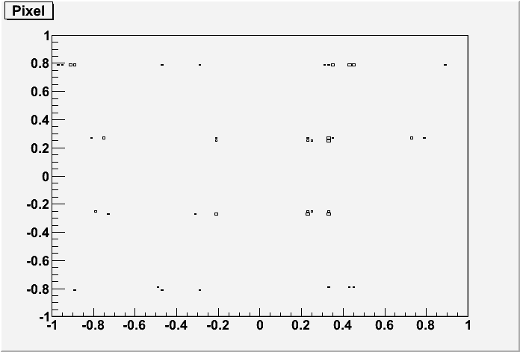
Photon Dictionary, Edge Pixel, Bar 6
θ_{Y} (radians)
θ_{X} (radians)
Pre-Clustering. Note near symmetry in |θ_{x}| and |θ_{y}|

Slide 13
Calculate Possible θ_{C} Values
For each photon hit, we calculate possible θ_{C} values with respect to the track
Several sources of ambiguity to try to go back to photon’s original direction:
Left-Right
Up-Down
Forward-Backward
Path in FBLOCK
Actually, path after leaving last quartz bar. Includes bounces in wedges.
Therefore, each photon can have many different θ_{C} “solutions”
Time resolves forward-backward in most cases
Many solutions are non-physical and are discarded
But still left with multiple solutions
Even with multiple solutions, idea is that correct one will be common to all photons from the track

Slide 14
Running in ROOT
From ROOT in “macros” directory:
run “LoadMacros.C” (root[0] .x LoadMacros.C)
Execute “run” method of DoRes.C
This needs some work to be generalized. Ideas welcome!
This will load the relevant SinglePhoton dictionary or create it if it doesn’t exist.
Determines possible θ_{C} solutions for each photon
Output will be a new ROOT file that contains all solutions for each photon in TTree “ResCalcTree”
Macro “AngleRes.C” has some examples of making plots from this TTree
I make no guarantees that this will just run OOTB!

Slide 15
What Next?
This code was primarily written for my use, and therefore not very user-friendly, or clean, or documented.
I have no attachment to this code, and would be happy to see it all scrapped. If I had to do it all over again, I would probably do some things differently based on what I’ve learned.
Would be nice to have some organized plan to build some code and structure that would be useful and easy to use for the collaboration.
I’d be more than happy to work on this with others.

