Slide 1
Update on Aging Studies
Rocky So
Supervisor: Christopher Hearty
University of British Columbia, Canada
rockyso@physics.ubc.ca
DCH Parallel Session
SuperB Collaboration Meeting
May 29th, 2011

Slide 2
Recap
Age chamber with a 100 mCi 55Fe source; measure 55Fe spectrum with a low-intensity source
Monitor current, 55Fe peak location (gain), and ratio of small pulses to 55Fe interactions
Number of small pulses increase as Malter effect sets in.

Slide 3
Recap
He:Isobutane 80:20 (no water)
Same chamber aged since Dec is still alive
2000V
1480V
1480V

Slide 4
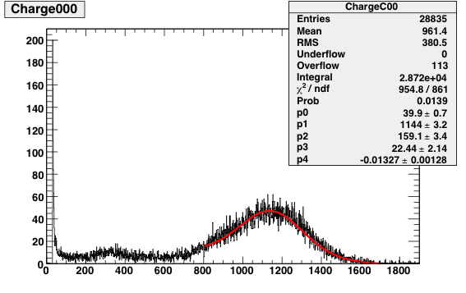
Fe55 Spectrum (Low-intensity)
Channel Number

Slide 5
Gain Correction by Density
Assume that the first 2 months of aging has no effect on Fe55 peak location
Assume linear relationship
Assume ideal gas
rms of pressure(mb)/temperature(K) is 84 channels
rms after correction is 54 channels (distance from points to line)
Still some scatter

Slide 6
Reference channel = 1160
error bars = 54 channels

Slide 7
No convincing sign of increase yet

Slide 8
Gain Drop Before Aging
Babar saw 8% drop in gain
54 rms channels/1160 channels = 5% scatter after density correction, possibly due to gas composition variation
Checked for reproducibility
Current chamber probably not sensitive enough to see the gain drop
77/23 He:Iso causes 38% increase in pulse height
Gas fluctuated up to 79.6/20.4
Build 2 new chambers using aluminum field wires
Age one but not the other to correct for gas variation and composition uncertainty
Notes:
(tndc 98-86)

Slide 9
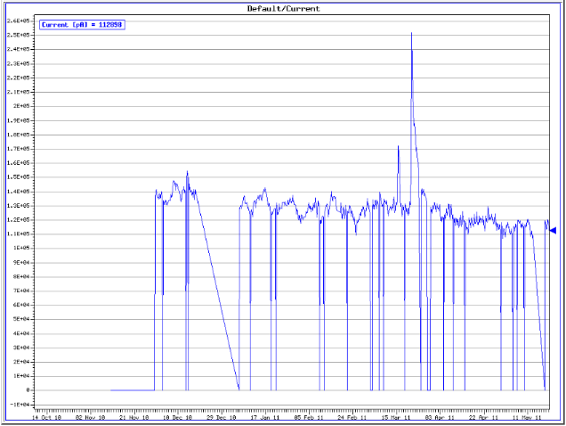
Sense Wire Current with Hot Fe55
This is before density correction
New gas bottle
Wrong voltage
No current spikes or increase observed

Slide 10
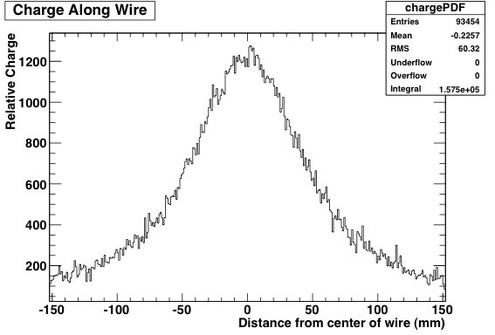
Charge Distribution along Wire
Simulated charge by throwing random photons from source to hexagonal cell
Probability of interaction inside cell is assumed to be proportional to length it traverses
Central centimeter of wire receives 7.8% of total charge (effective length = 1cm/7.8% = 13cm)
Agrees with Boyarski
Notes:
C. Lu’s papers in princeton… tndc notes…

Slide 11
Outlook
New chamber almost complete
Continue to age chamber
String dead chamber with new wires

