Slide 1

Layer0 - SVT
Mechanics update
(MDI meeting)
F. Bosi
INFN-Pisa
on behalf of the SuperB SVT Group
SuperB Workshop 4-7 April 2011, INFN-LNF

Slide 2
Outline
Work on the L0 supports (MAPS version)
(Thermal-hydraulic results on microchannel module 550 μm)
Work on the L0 supports (Striplets version)
  (Cold flanges on to the beam –pipe)
General Layout and stay clear
Conclusion

Slide 3
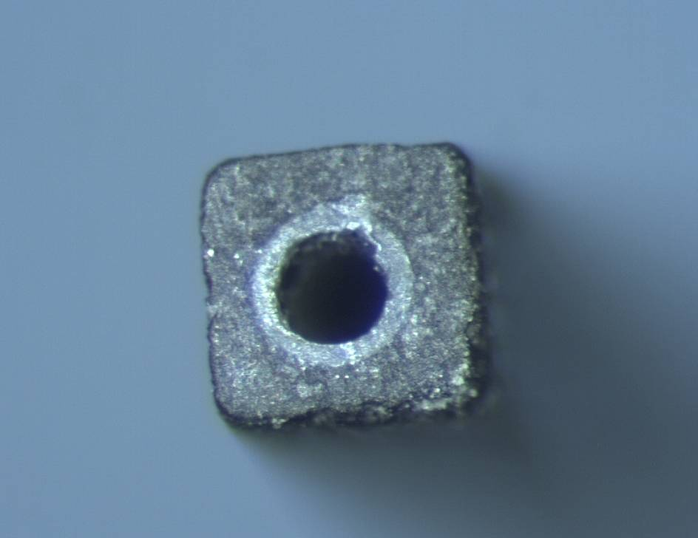
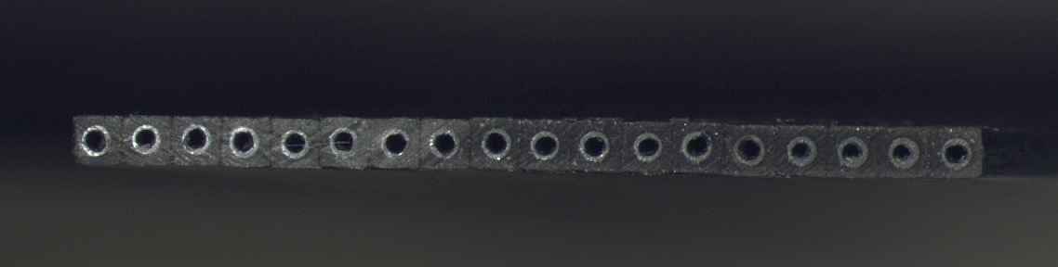
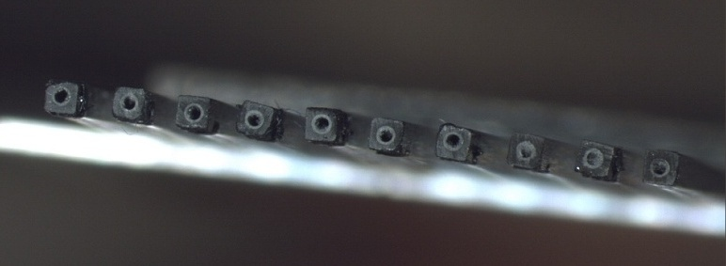
Module MAPS supports summary
Peek pipe
700 μm
The single base microchannel unit
A square CF micro-tube with an internal peek tube 50 μm thick used to avoid moisture on carbon fiber
700 μm
Dh=300 μm
Carbon Fiber Pultrusion
Full micro-channel module
The total radiation length ^{(*)} of this support is 0.28 %X₀
12.8 mm
700 μm
Support Cross Section
Net micro-channel module
Same dimensions of full micro-channel but vacancies of tubes in the structure.
The total radiation length ^{(*)} is 0.15 %X₀
^{(*)}: Material of the support structure: ( All C.F. material + peek tube + Water)
Notes:
3

Slide 4


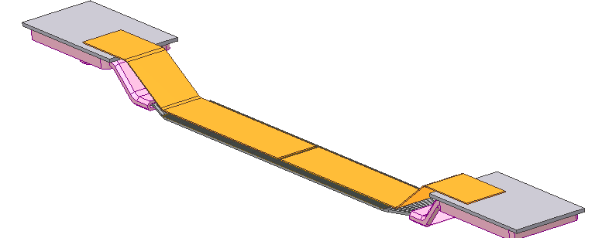
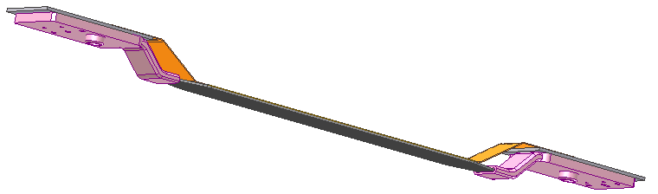
MAPS L0 module Design
Al-kapton BUS
HDI is positioned on outer radius for better radiation damage conditions
HDI
Z-piece
MAPS chips
Input coolant
Microtube support
Necessary thermal-structural simulation to verify L0 module mechanical stability
Output coolant

Slide 5
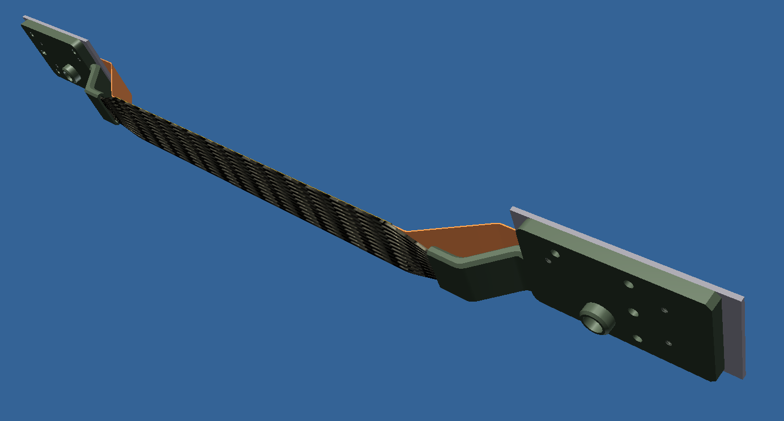
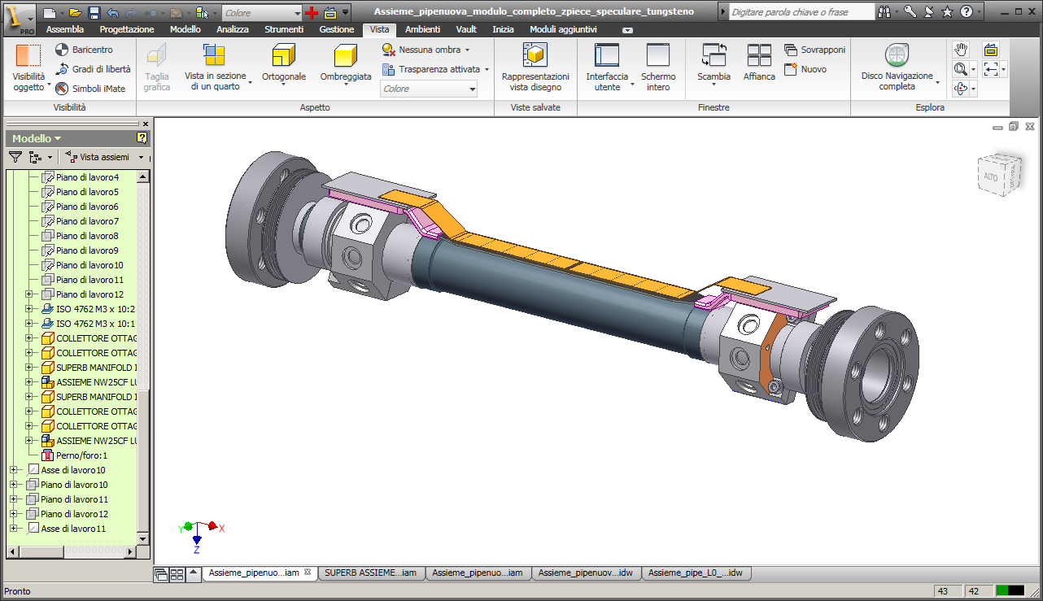
L0 on to the Beam Pipe
Microchannel support
One pixel modules positioned on the Be beam-pipe and supported by cold flange.

Slide 6
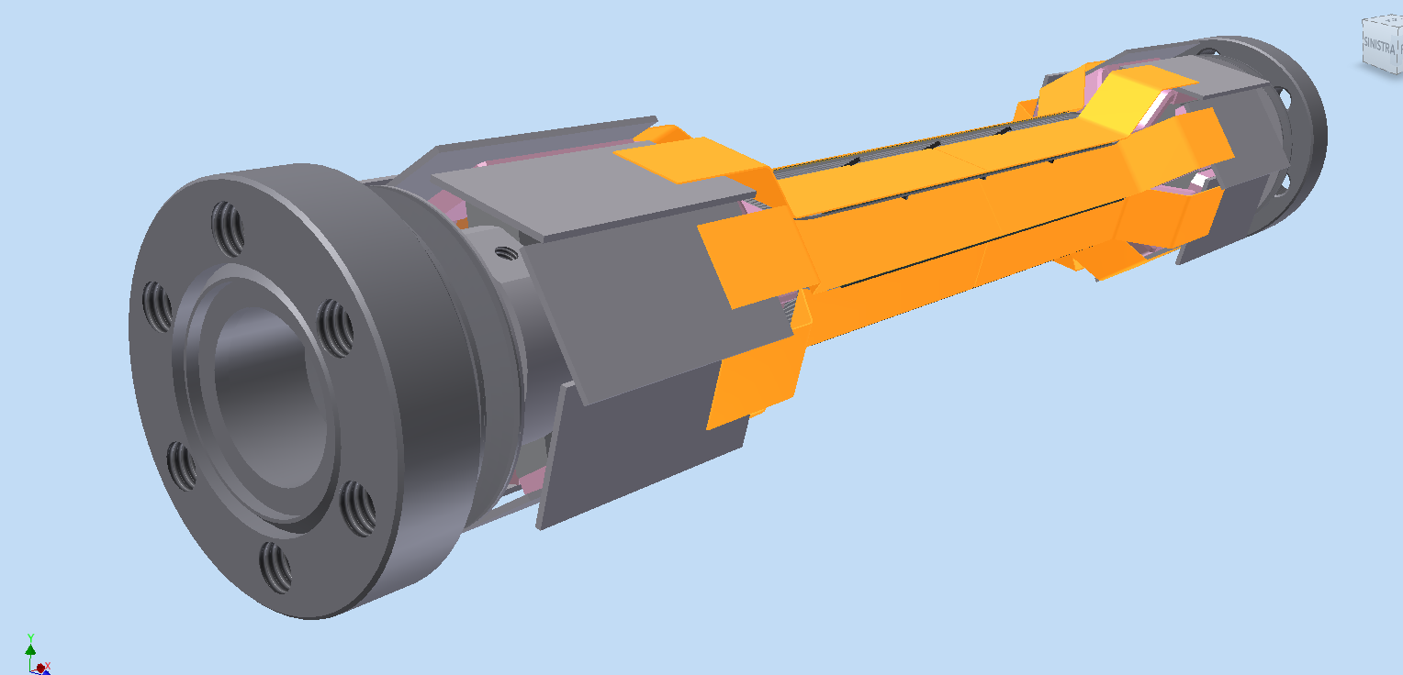
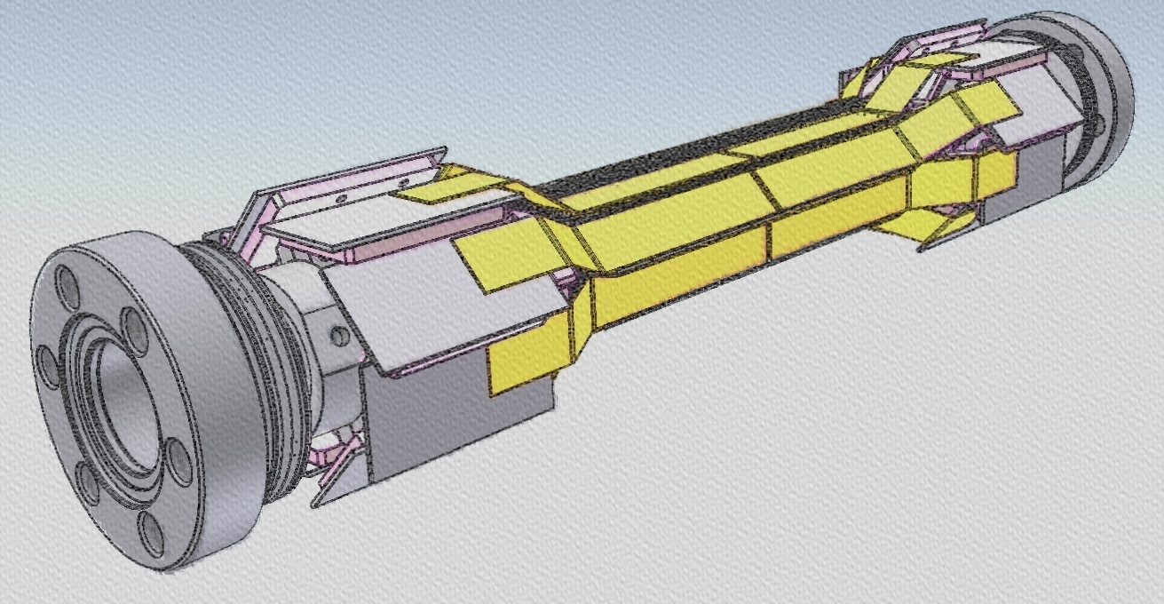
L0 on to the Beam Pipe
Complete pixel modules positioned on the Be beam-pipe and supported by cold flange.
- Further design is depending by realistic dimensions of HDI

Slide 7
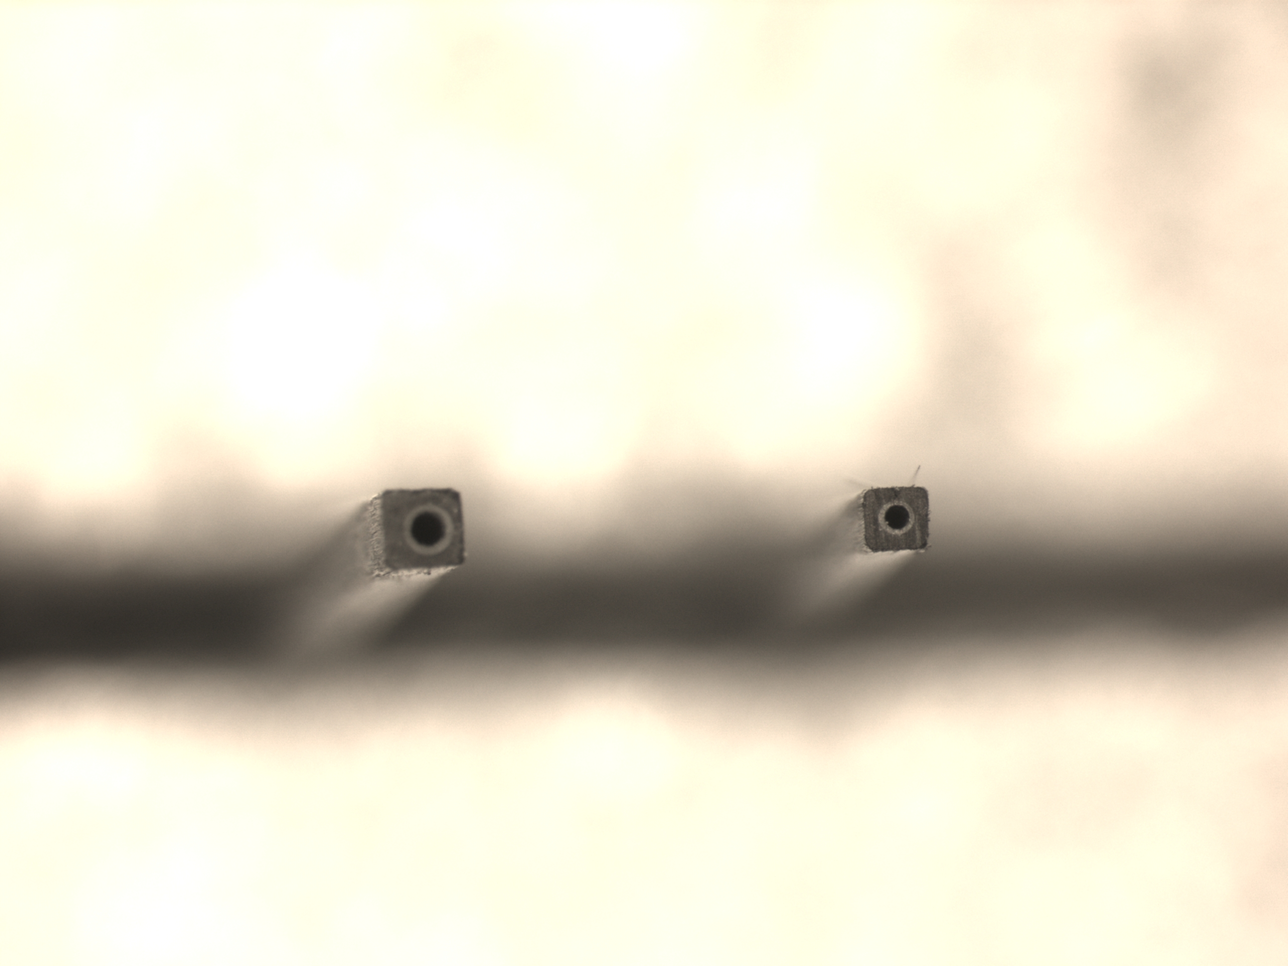
Work in progress
Further Miniaturization microtube technology
Peek pipe
Peek pipe
Dh=300 μm
Dh=200 μm
700 μm
550 μm
700 μm
550 μm
Old Carbon Fiber Pultrusion
New Carbon Fiber Pultrusion
Full Module X = 0,28 % X₀
Full Module X = 0,22 % X₀
Net Module X = 0,15 % X₀
Net Module X = 0,10 % X₀
Module Microtubes 550 μm th,Full and Net version tested at the TFD lab

Slide 8
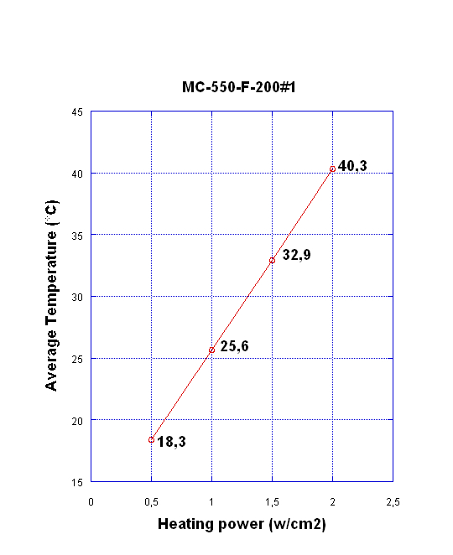
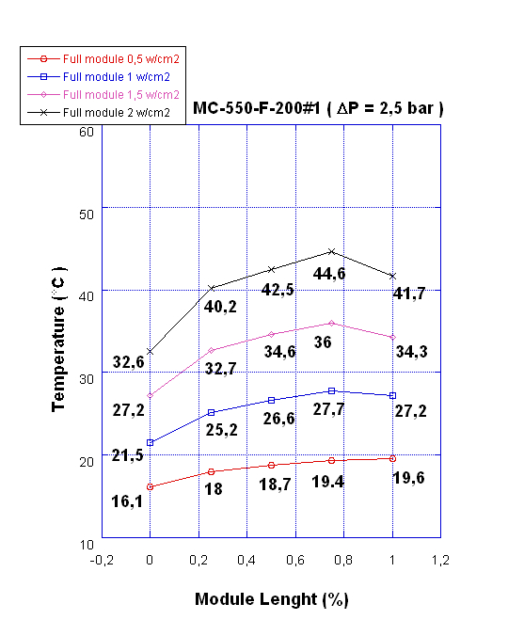
Full module H=550μm test results
Tests performed on net module sample (length = 120 mm) with water-glycol @ 10 °C as coolant (Δp =2,0 atm).
Average module Temperature vs Specific Power
Temperature along the module: ΔT = 7,1 °C at 1.5 W/cm² and Δp =2.0 atm
Notes:
8

Slide 9
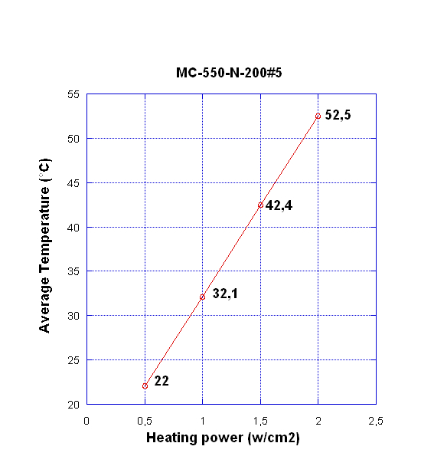
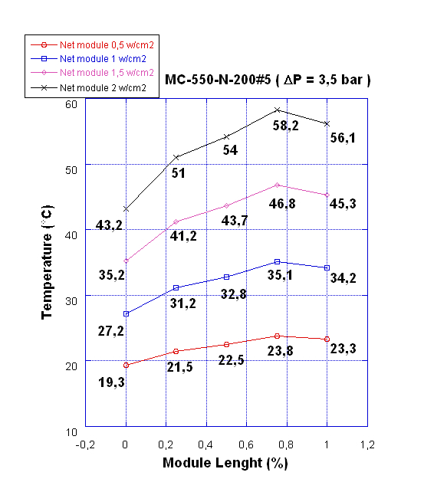
Net Module H=550μm test results
Tests performed on net module sample (length = 120 mm) with water-glycol @ 10 °C as coolant (Δp =3,5 atm).
Average module Temperature vs Specific Power
Temperature along the module:
ΔT = 7.0 °C at 1.0 W/cm² Δp =3.5 atm

Slide 10
Microchannel Module Comparison Data
Comparison List
 |  | % X0 | T max °C | Specific Power W/cm2 | Hydraulic. Diam. μm | Flow rate g/min | Δ Temperature °C
1 | Microchannel FULL Module support H=700 μm |  | 35.8 | 2.0 | 300 | 244 | 5.3
2 | Microchannel NET Module support H=700 μm | 0.15 | 38.3 | 1.5 | 300 | 128 | 6.70.28
3 | Microchannel Full Module support H=550 μm | 0.22 | 34.3 | 1.5 | 200 | 33* | 7.1*
4 | Microchannel NET Module support H=550 μm | 0.10 | 34.2 | 1.0 | 200 | 24 | 7.0
Tests performed on net module sample (length = 120 mm) with water-glycol @ 10 °C as coolant at Δp =3,5 atm ( not valid for value *).

Slide 11
Layer 0 striplets design
CDR design is being revised for TDR!
(Lab.) Geometrical acceptance: 300 mrad both in FW and BW
Distance from the i.p. : R=15 mm
V
Choosing an Octagonal shape:
  - Module active area = 12.9 x 97.0 mm2
  (includes 4% area overlap for alignment)
  - double sided Si detector, 200 μm thick with striplets (45º w.r.t det. edges)
  readout pitch 50 μm
  - multi-layer fanout circuits (similar to SVT modules, z side) are glued on each sensor, connecting Si strips to Front End Electronics
  (fanout extends twice wider than the detector, to allow a minimum of 50 μm between metal traces ~ 700 strip/readout side!).
  In a module needed ~2 fanouts/side !
A new readout chip is needed to cope with the high background rate (up to 200 MHz/cm2)
12.9 mm
U
97.0 mm
Readout Left
Readout Right
Si detector
r= 15 mm
1st fanout, 2nd fanout
HDI
HDI
Conceptual design module “flat”
z

Slide 12
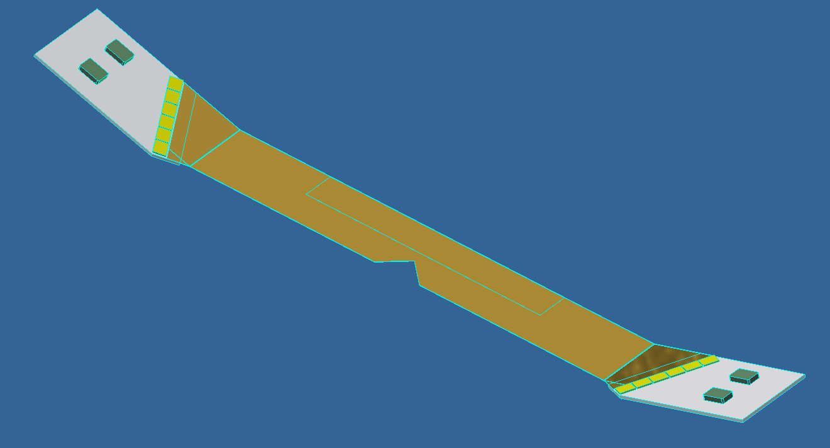
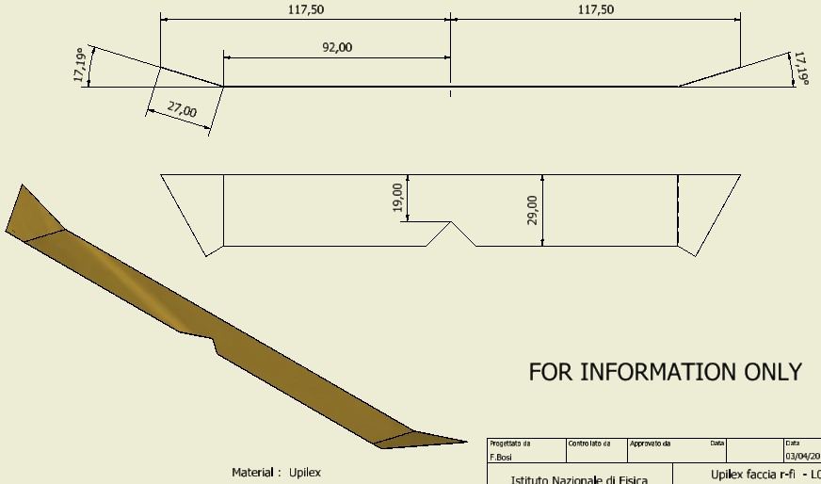
Module Striplets
Fixing buttons
Sensor position
R-fi fanout
Front-end chips
HDI
Final solution –HDI in axial direction inclinated at 300 mrad, with front-end chips 30° oriented
Notes:
12

Slide 13
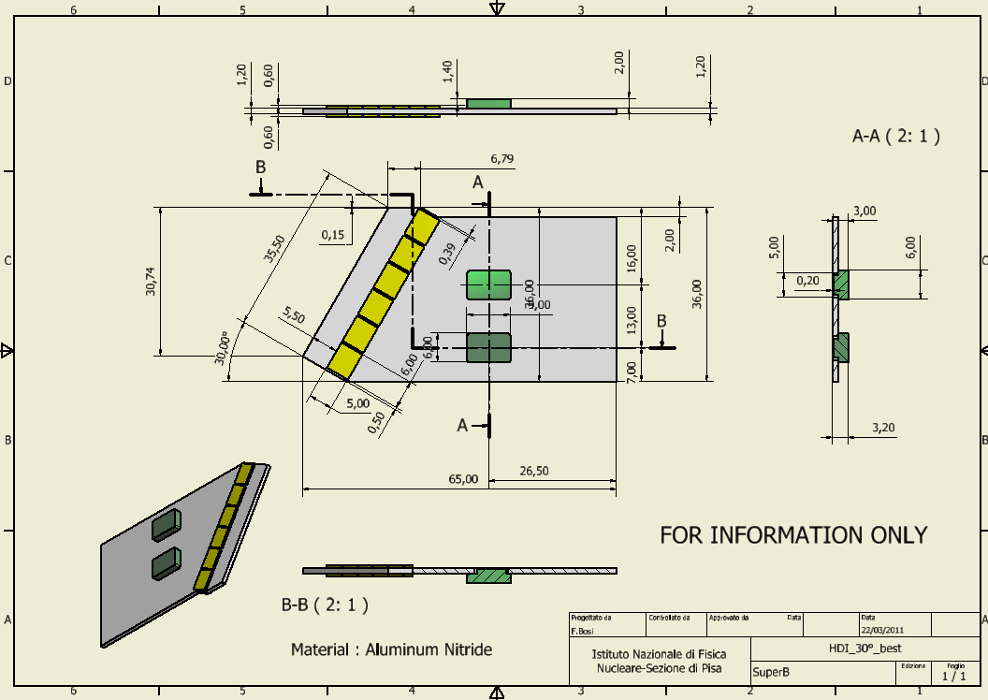
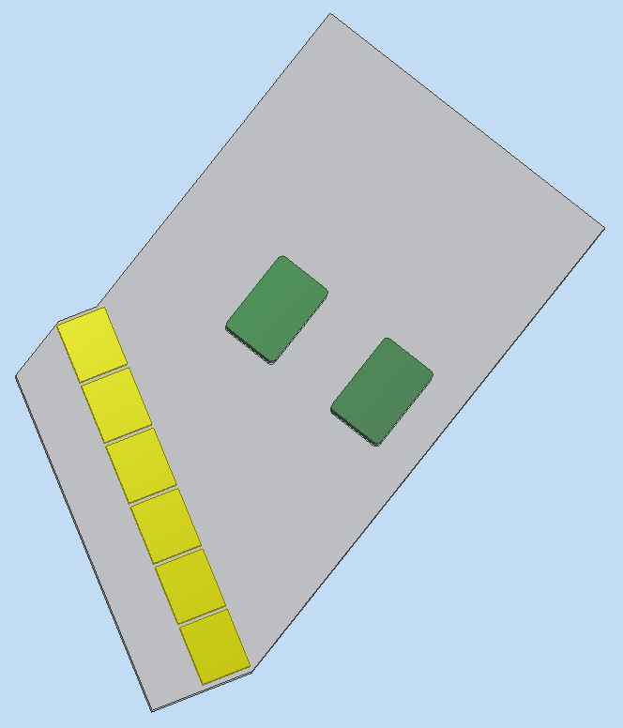
Module Striplets
Some modification about the previous HDI dimensions ; to facilitate the cold flange design, bottons positioned forward and in asymmetric position .
widht of HDI: important to limitate material in the 300 mrad envelope
Buttons positioned asymmetric and moved in forward direction
Notes:
13

Slide 14
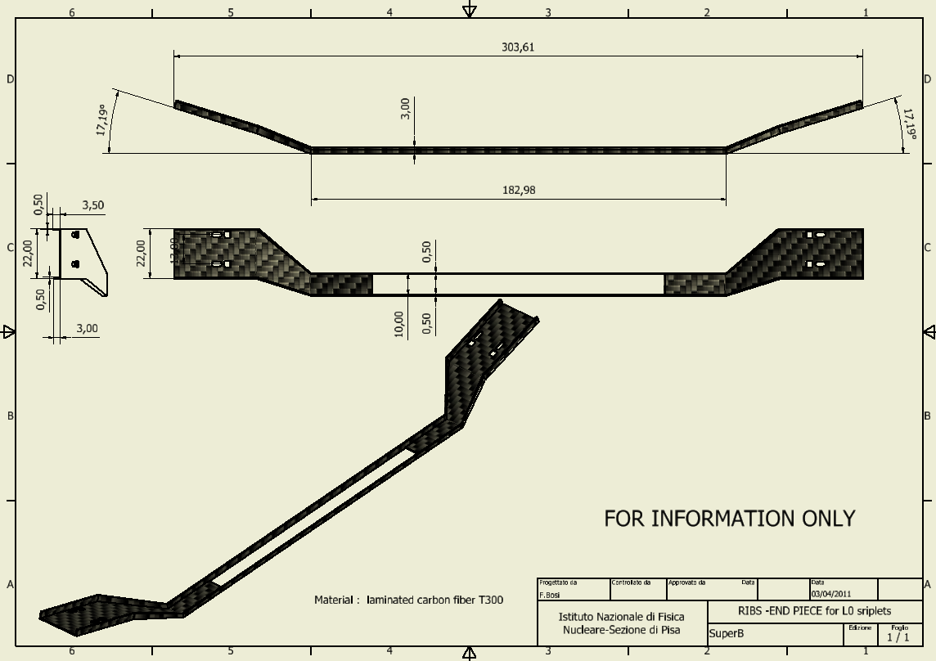
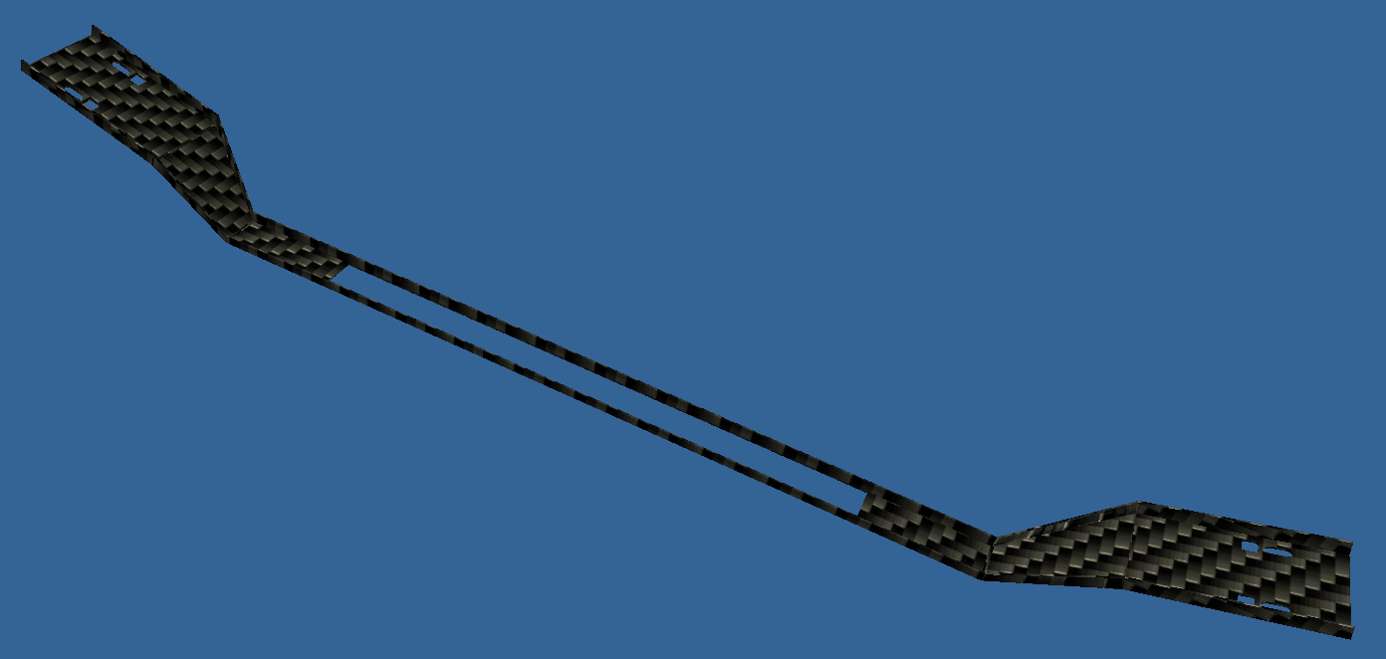
Module Striplets
Asymmetric pot for buttons glueing
Button-hole for screws and final glueing to the buttons
Low mass ribs for active region
CFRP structure , glued on the fanout-sensor and HDI buttons, that freezes the exact positions of all components.
Notes:
14

Slide 15
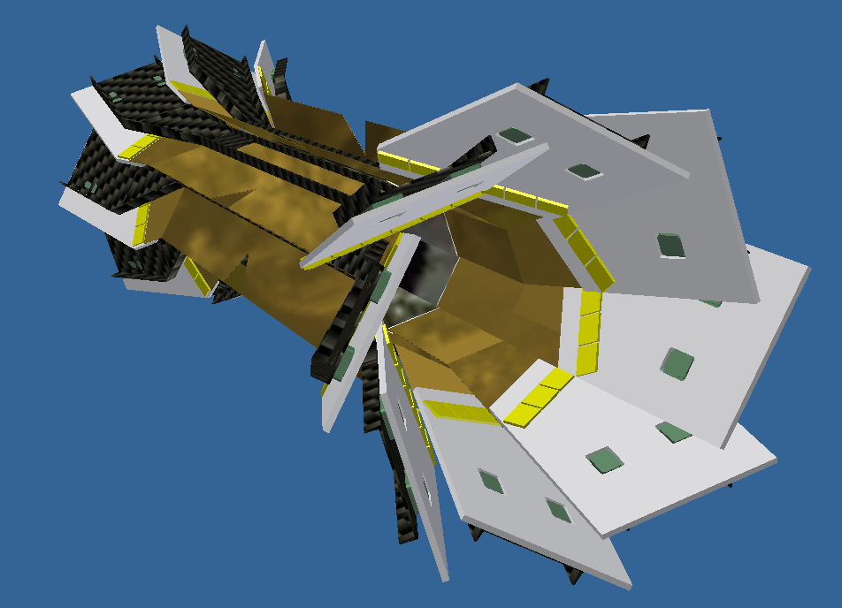
Module Striplets
Surfaces devoted to couple to the support flange fixed on the beam-pipe
Sensors
In this view missing the z fanouts in order to be able to see sensors and back side HDI
Notes:
15

Slide 16
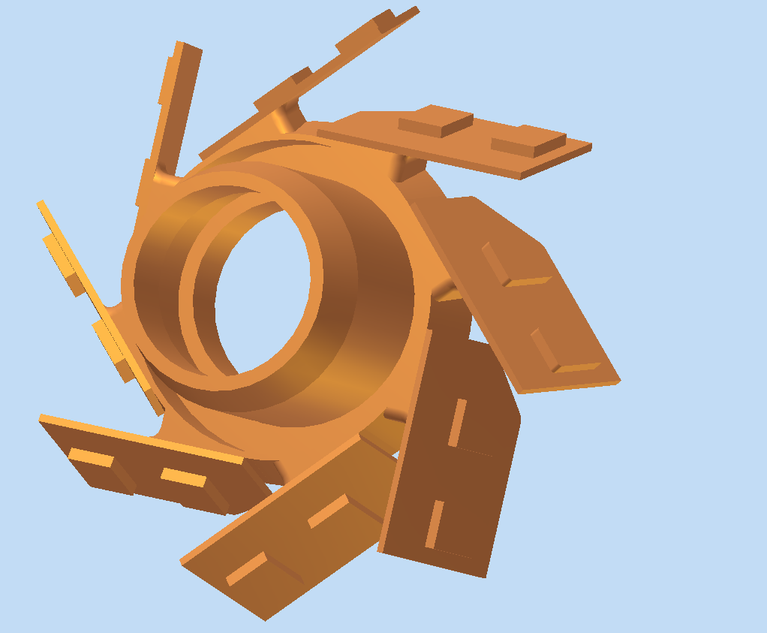
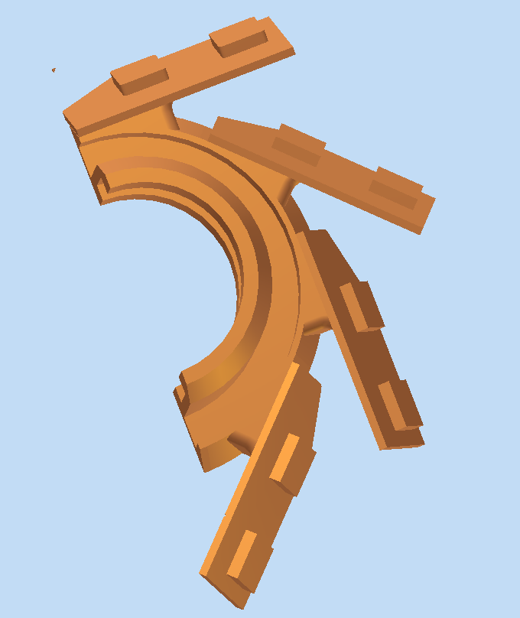
Module Striplets
Complete Cold Flanges
No too much space for cold flange between pipe-flange and HDI
Right Half Cold Flanges
Notes:
16

Slide 17
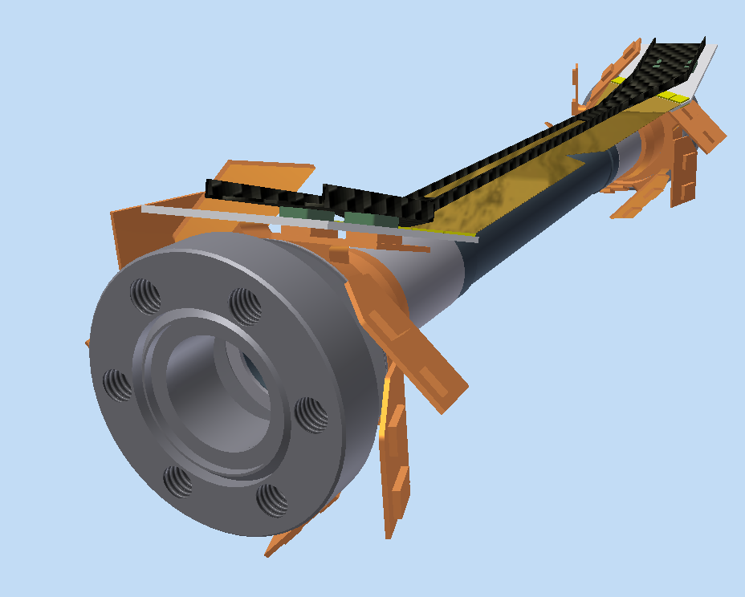
Module Striplets
One Module striplets positioned on the Be beam-pipe and on the Cold Flanges
Right Half Cold Flanges is fixed with N.4 screw-pins to the left-one and coupled to the beam pipe .
Notes:
17

Slide 18
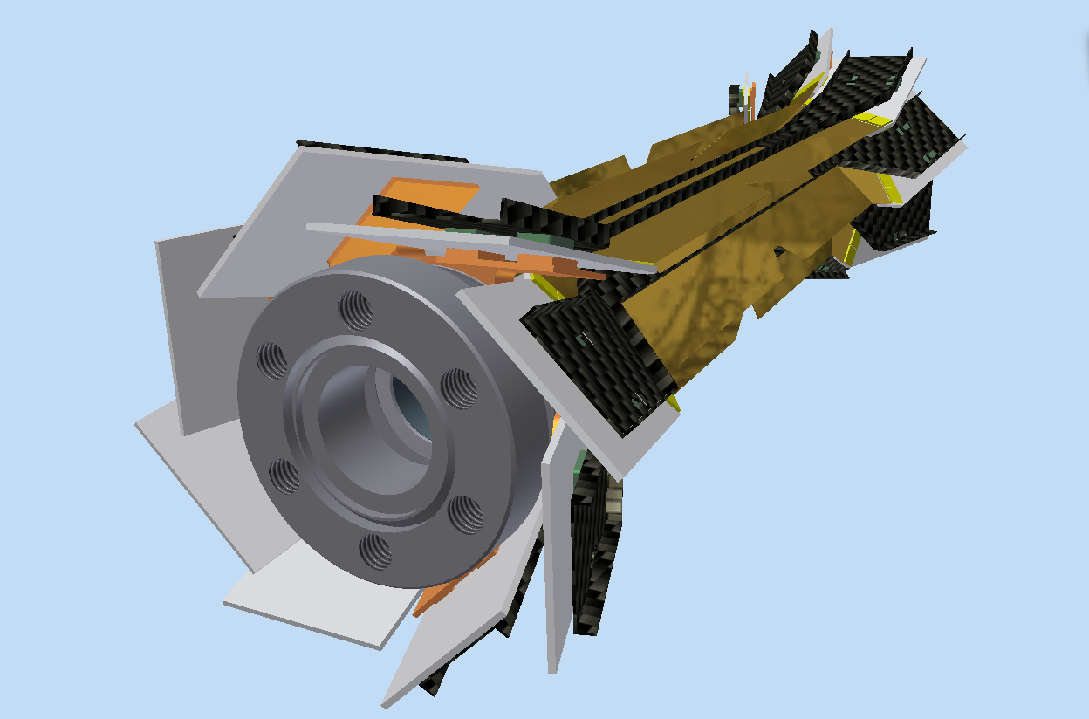
Module Striplets
Complete striplets modules, supported by Cold Flange positioned on the Be beam-pipe
.
Cold Flanges Buttons
Notes:
18

Slide 19
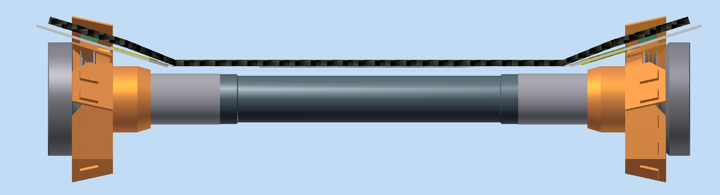
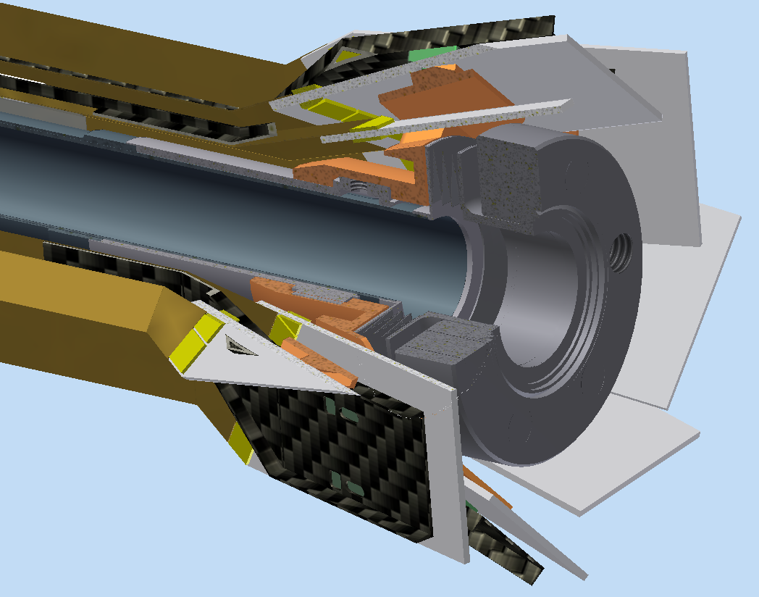
Module Striplets
Module striplets positioned on the Be beam-pipe and supported by Cold Flange.
Very complicated region for cold flanges and pipe input-output cooling connections !
Need more space in z direction or to modify the flange design in order to allow cooling in/out piping for the beam-pipe.
Notes:
19

Slide 20
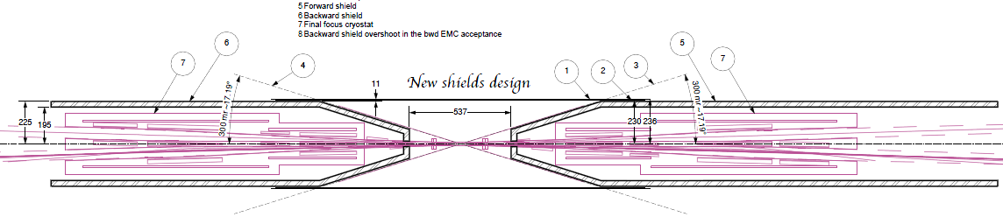
General Layout/ W Shielding
300 mrad
Dimension proposed By E. Paoloni for the new shielding design .
(shielding tangent to the 300 mrad line)
Reactions :
-L0-SVT system needs about 20 mm of clearance from the 300 mrad line for the SVT support cones, cooling service and cables ;
- Need space to place Transition-card at the end of the SVT support-cones
- Need about 20 mm of clearance between DC internal envelope and the W shielding for the SL0-SVTcables way out
- Moreover, need Space for supporting rails for quick demounting ?

Slide 21
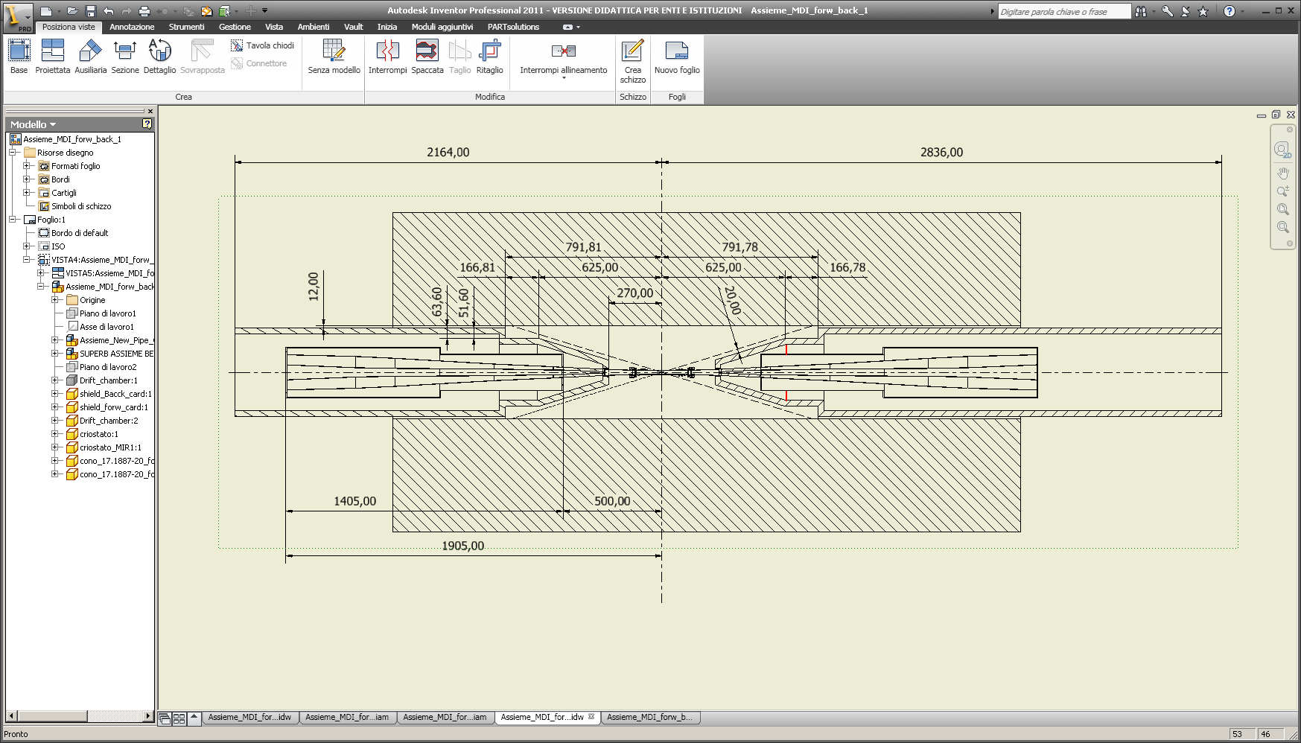
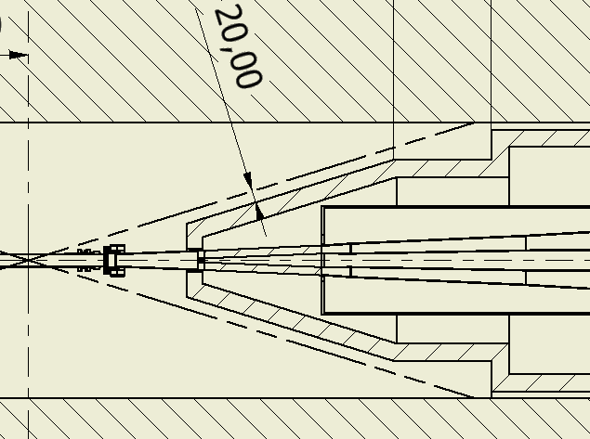
General Layout/ W Shielding
Proposed shielding shape to have space for matching card
20.00
20 mm Stay clear

Slide 22
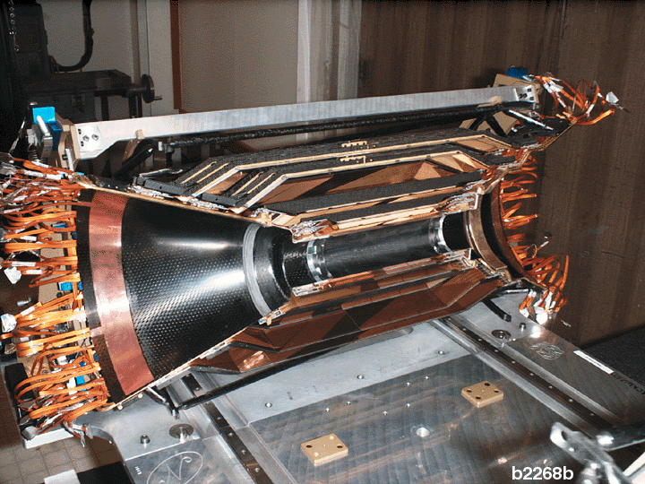
General Layout/ W Shielding
Modify external shielding diam./internal DC diam, to gain space for
SVT-L0 cables wayout
Modify the dimensions/shape conical shielding to position transition card.
Moreover, assuming for SVTa support structure with two semicone support (BaBar like), usefull to use the shielding conical part as support for the C.F. semi-cones SVT support .
20.00

Slide 23
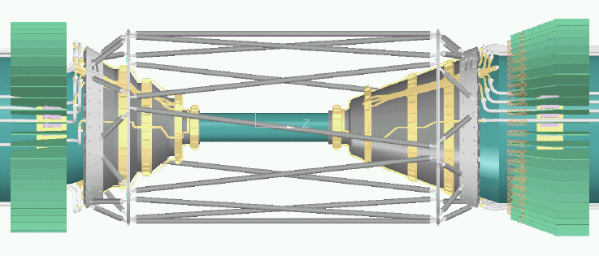
L0/SVT architecture supports
Actual constraints that force the design:
B) L0 must be mounted on the Be beam pipe to avoid any possible relative movement (low clearance from beam pipe).
A) L0 and SVT design should allow a quick demounting from the IR.
C) SVT has to be independent from beam pipe and has to be supported on the conical part of the shielding (SVT cables/services must have an independent support respect to L0 in order to allow SVT demounting without interaction with L0 cable /services );
D) Need a Gimbal ring to avoid tension on SVT structure due to movement between forward and backward components.

Slide 24
L0/SVT demounting
Actual solution:
-Gimbal-Ring fixed on conical shieding;
-L0 cables run along the conical schielding passing trough/over fixed part of the Gimbal-Ring ;
-Semicones coupled on the movable part of Gimbal-Ring and supporting SVT modules/cable&services.

Slide 25
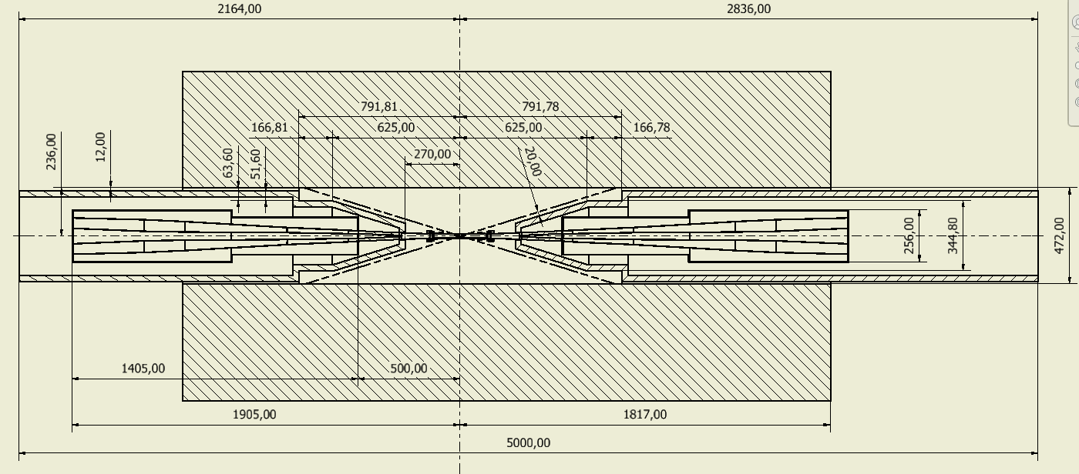
General Layout/ W Shielding
At the moment is usefull to consider backw/forw shielding, criostats, pipe and SVT-L0 as one body made rigid by:
temporary cradle structure inserted at the quick demounting time or
- cilindrical high inertia composite honeycomb beam, connecting backw/forw shielding, splittable in two side, at the SVT demounting moment, one times the entire system has been rolled-out to the barrel calorimeter.

Slide 26
Collaboration Engineering Group
General Layout/ W Shielding
Meeting in Pisa with Engineering Group of Queen Mary College :
Much interest shown on the L0-SVT mechanical design, in particular on the SVT support cones and external space frame design
N.2 Senior Engineer ready to start in fraction time on the design (J.Morris and F.Gannaway) , ready to transmit them the design file available
We are still looking for a young engineer for help in mechanical design for Pisa Engineering group , several candidates interested at this position

Slide 27
Conclusions
Test on Full and Net microchannel H=700μm module have been performed with a lot of prototypes. Now we need endurance test !
First results from Termohydraulic test on thin microchannel support microtube (base tube L=550 μm , Dh= 200 μm )
2) In good progress work to design L0 striplets components
3) Our Goal is to construct a full scale system L0 (maps-strplets) +Al. beam-pipe model to test by thermal point of view at the TFD lab.
5) Start Engineering collaboration with Queen Mary Eng. Group
4) Need adding work and engineering help to proceed on the design of SVT Layers, on the general support architecture system of I.R. and in the quick demounting of the L0 in the SuperB experiments

Slide 28
BACKUP

Slide 29
L0/SVT demounting
A quick demounting means to spilt SVT in two half around beam pipe :
SVT structure has to be very rigid to assure good stability (space frame structure needed), also it is necessary a mechanical equipments (HDMF) that is able to hold and support with high precision to decouple the two SVT halves just beside of central Be pipe.
HDMF Support
If we assume a support structure with two semicone support, (BaBar like), for SVT demounting, L0 cable routing is passing below the semicone structure
HDMF Translation rails
For an independent demounting, cooling system, cables and any SVT service has to be independent from L0 component .

Slide 30
The BaBar Silicon Vertex Tracker
5 Layers of double-sided, AC-coupled Silicon.
Custom rad-hard readout IC (the AToM chip).
Low-mass design. ( Pt < 2.7 GeV/c² for B daughters)
Stand-alone tracking for slow particles.
  Inner 3 layers for angle and impact parameter measurement.
  Outer 2 layers for pattern recognition and low Pt tracking.
20 cm
30 cm
40 cm
For the SuperB SVT L1-L5 we start from the BaBar configuration

Slide 31
SVT Geometry
Layer Radius
1 3.3 cm
2 4.0 cm
3 5.9 cm
4 9.1 to 12.7 cm
5 11.4 to 14.6 cm
Be Beam pipe
1.0 % X₀
The modules radius and the width of the sensors remain the same so this geometry do not change
10 cm
(Arched wedge wafers not shown)

Slide 32






SVT BaBar Modules
Layer
Number of
Wafers
Total Phi-Strip Length
Backward Forward
Z-Strip Length
5b 8 26.5 cm 26.5 cm 4.1 to 5.1 cm
5a 8 26.5 cm 25.1 cm 4.2 to 5.1 cm
4b 7 22.4 cm 19.9 cm 4.2 to 5.1 cm
4a 7 22.4 cm 18.5 cm 4.2 to 5.1 cm
3 6 12.8 cm 12.8 cm 7.0 cm
2 4 8.8 cm 8.8 cm 4.8 cm
1 4 8.2 cm 8.2 cm 4.0 cm

Slide 33
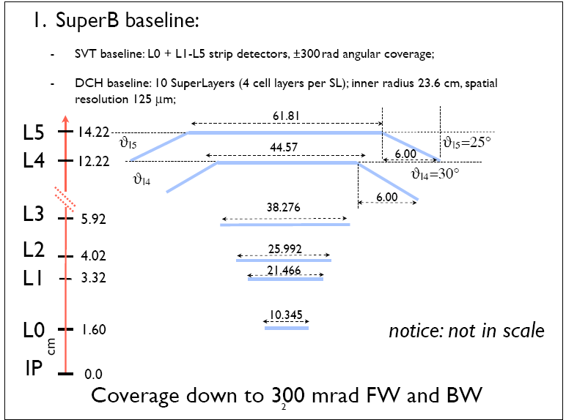
SVT SuperB Modules (first guess!)

Slide 34
SVT Mechanical Features
Brass
cooling rings
Carbon fiber
Space Frame
22 cm
B1 dipole
permanent magnet
(inside support cone)
B1 dipole
permanent magnet
(inside support cone)
Carbon fiber
support cones
109 cm

Slide 35
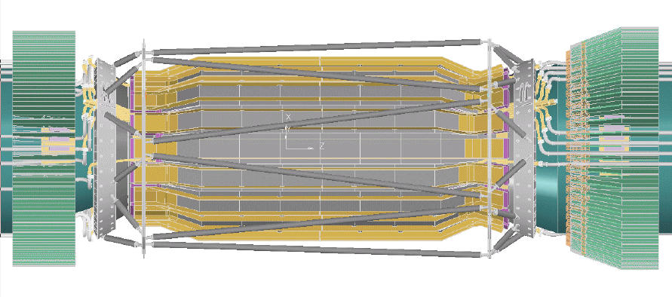
SVT Mechanical Features
Silicon wafers
Carbon & Kevlar fiber support ribs

Slide 36
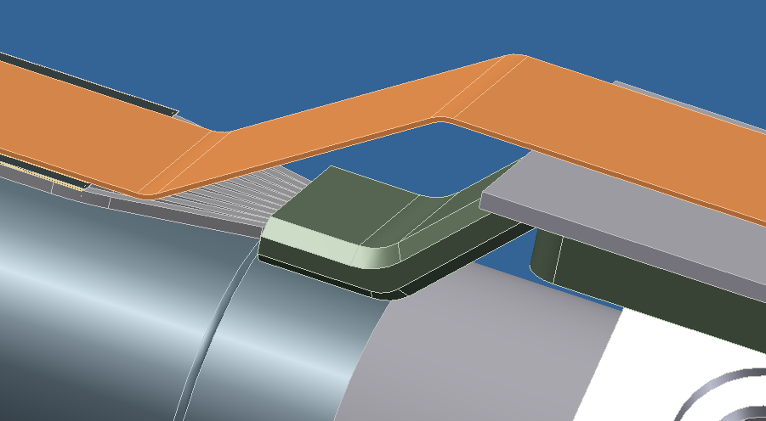
MAPS Module
Work actually in progress
Microchannel CFRP in lamination process.
Italian company ( Plyform , (NO) is producing a laminated microchannel prototype (H=700 μm and Dh=300 μm), some prototype realized, June 15 first delivery. Very important for the shaping of the microtube .
2) Microchannel CFRP in pultrusion process.
-Not yet realized this shape with poor polimerization microtube from pultrusion process .
3) Z-piece prototype
design revision for 550 μm thin microtube - rapid prototyping technology in ABS material , c/o Poggipolini (Bo) .
Notes:
36

Slide 37
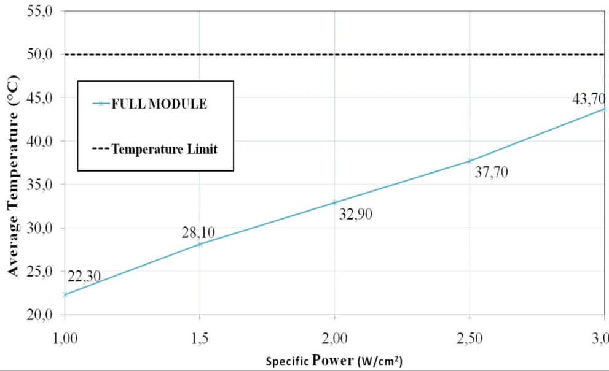
Full module H=700μm test results
Tests performed on full module sample (length = 120 mm) at Δ p =3.6 atm.
Average module Temperature vs Specific Power
Temperature along the module: ΔT = 5,3 °C at 2W/cm² and Δp =3,6 atm
Notes:
37

Slide 38
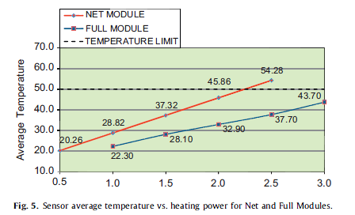
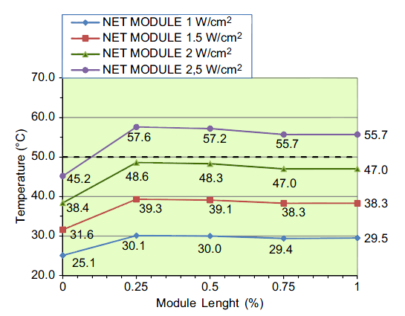
Net Module H=700 μm test results
Tests performed on net module sample (length = 120 mm) with water-glycol @ 10 °C as coolant (Δp =3,5 atm).
Data shown that Net Module is able to cool power up to about 1.5 W/cm² below the max required Temperature (50 °C).
This goal can also be achieved with a greater safety factor by reducing the inlet coolant temperature.

Slide 39
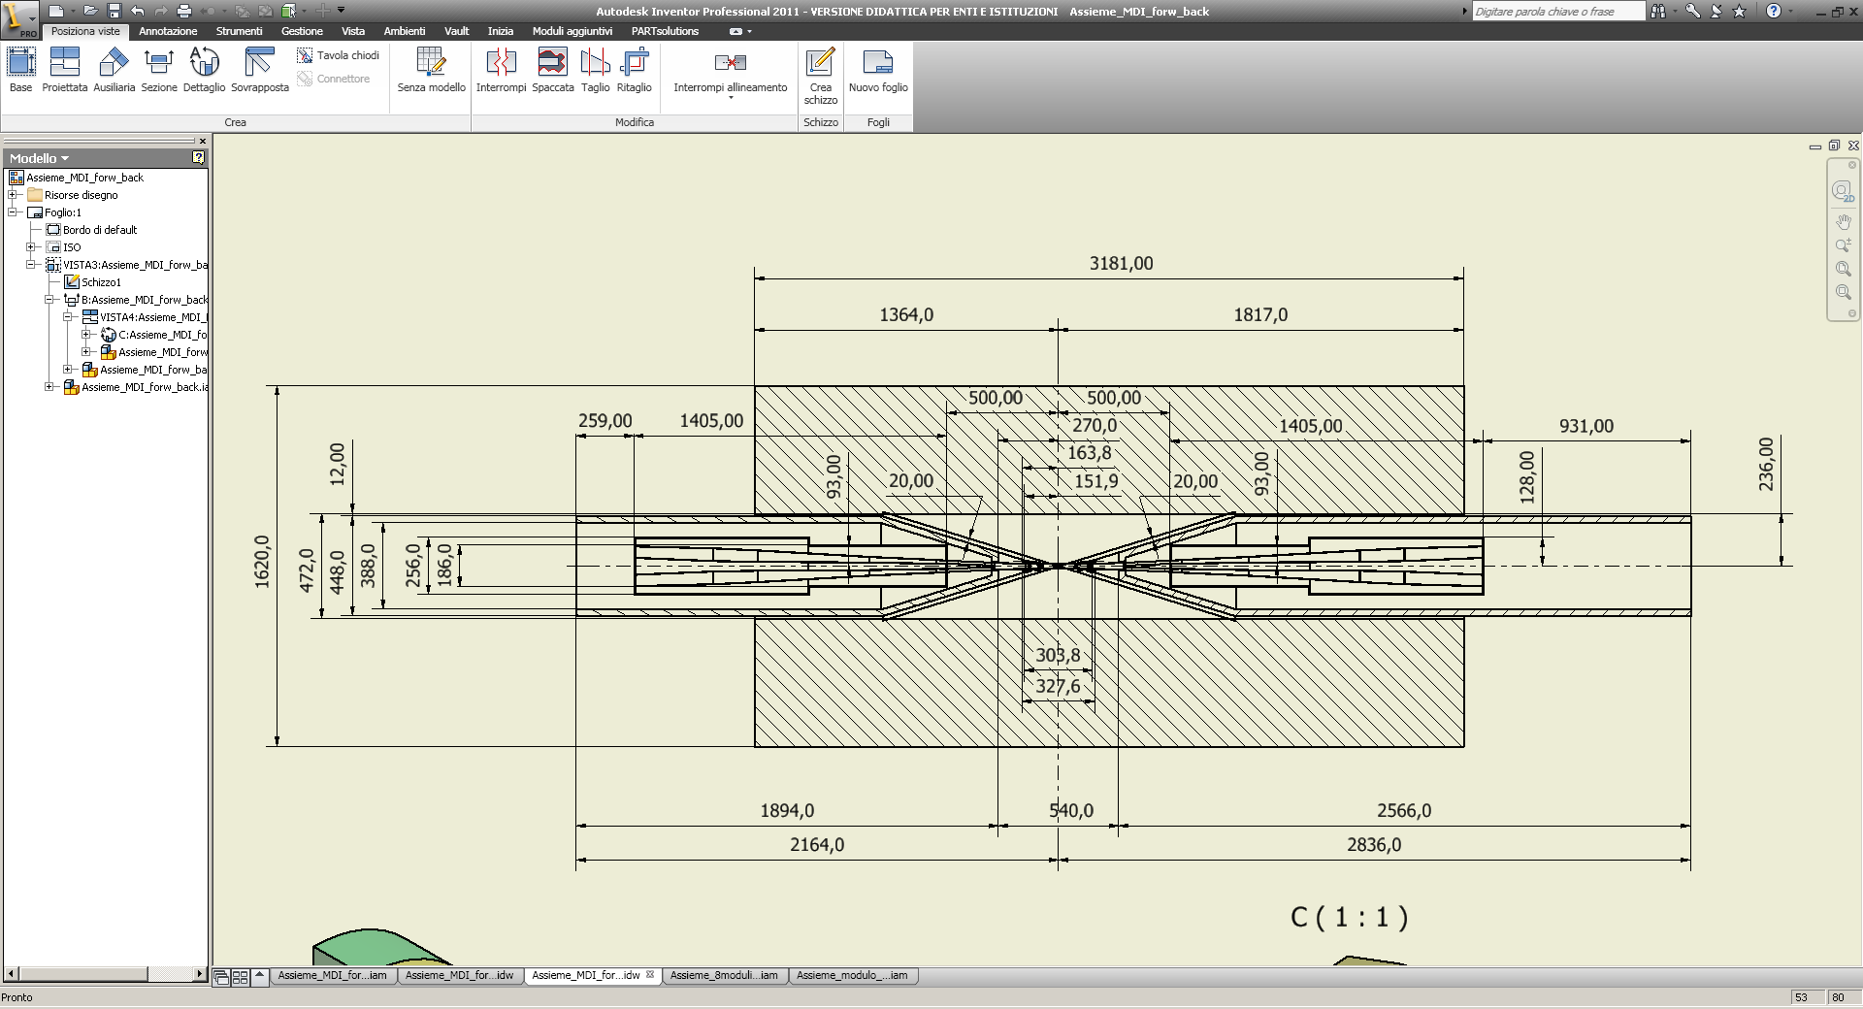
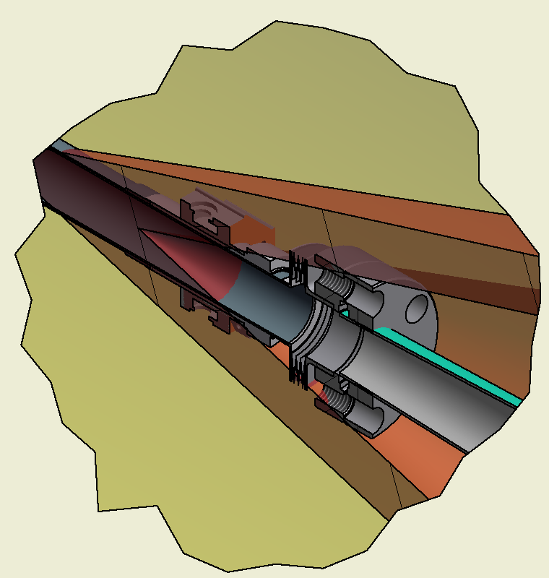
General Layout/ W Shielding
20mm stay clear requested for SVT-L0 cables and services
Need more space for SVT-L0 cable (20 mm)!
20 mm Stay clear

