Slide 1
Reuse of Babar sc coil components
(impressions gotten after a visit to SLAC and discussion with W.Craddock)
List of the items
Solenoid
Ancillary equipment
Refrigerator and Compressors
Controls

Slide 2
List of the items
The superconducting coil
1.1 Cold mass (7.8 t)
1.2 Cryostat (3.0 t)
1.3 Valve box (0.8 t)
Dump resistor (1.2 t)
Power supply (5 kA, 20 V)
Two racks with controls (0.3 t)
Vacuum pumps and related systems
Transferline and Quench line
Breaker for 5 kA
Cables amd misc. Hardware
The cold box
Compressors
Refrig. controls

Slide 3
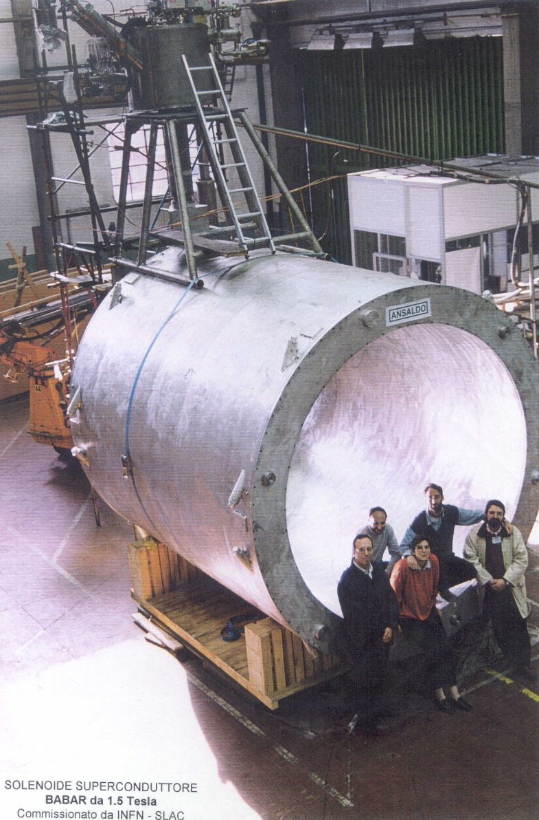
The superconducting coil

Slide 4
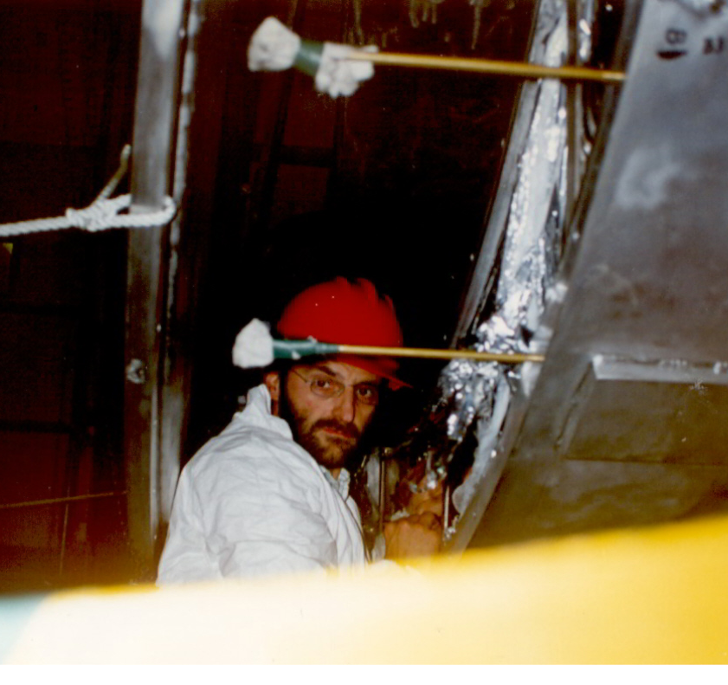
Status of the sc coil
The coil has been dis-assembled and it is now mounted inside the transportation tool. There is a point to be fixed with relation to the cold mass blockage in the cryostat. Though the supporting system should be able to hold the transportation loads (3g vertical , 2g axial and 1.5 g lateral), the cold mass was blocked wrt the cryostat. This is documented by photo, not by drawings or engineering reports.
Human memory does not help!
Same considerations apply for the valve box. Blocking elements not found

Slide 5
Reuse of the sc solenoid and its controls
The solenoid can be reused. Some care for the transportation (the system for blocking the cold mass, the shield and the valve box shall be reviewed). Sensors on tie rods (strain gages and thermometers) are no more working. The re-assembly on site shall include a replacement of the sensors, a re-alignment of the cold mass, a re-connection of the current leads (with restoration of the electrical insulation).
The hardware of the control system includes old instruments (voltmeter, scanner,..). The software is based on an early version of LabView (however SLAC did not use this software). Software and hardware shall be updated by replacing components and implementing new software.
My position would be to give a contract to ASG for transporting the magnet, re-assembly it and updating the control system.

Slide 6
Reuse of other ancillaries
Dump resistor (0.068 Ω) . No problem for its reuse
Breakers . No problem
Quench detection. To be re-checked and re-used
Pumps. Not checked by me. In principle could be reused
Power supply. This component shall be reviewed before deciding its re-use. I would consider to buy a new one. The required ramp rate is max 1.7 A/s (4.3 V + resistive voltage drop). A 10 V - 5 kA power supply (preferably 2 quadrants) would be optimal (200 k€?)

Slide 7
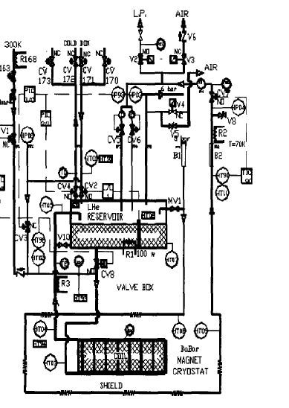
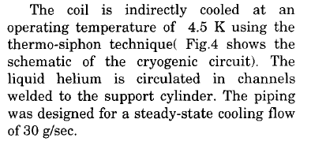
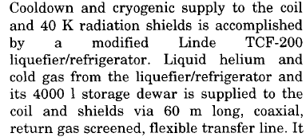
Cooling system
Solenoid heat loat@ 4.5 K 50W

Slide 8
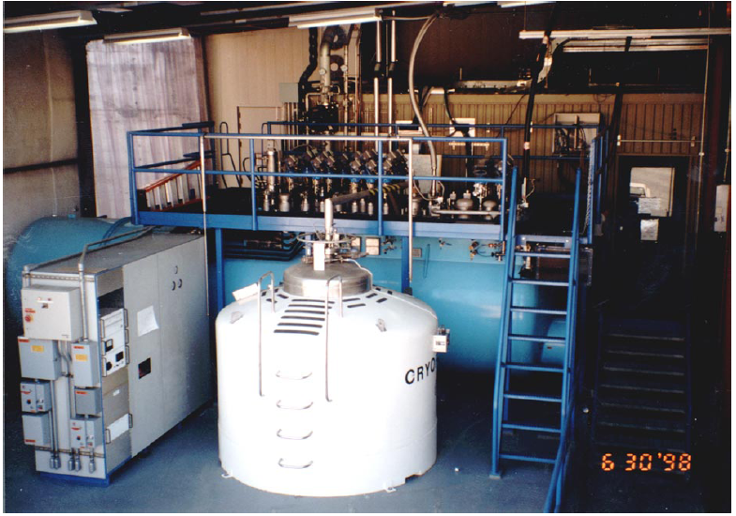
Refrigerator (Liquifier)

Slide 9
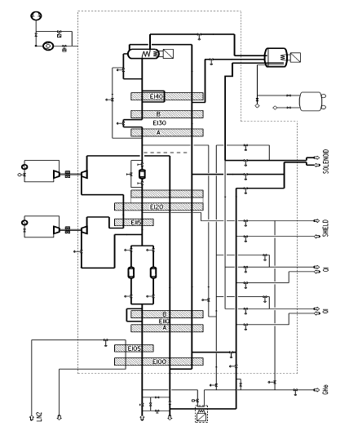
Schematic and working modes
Considering the over all heat loads, the cooling capacity exceeds the need of a factor 2.5. Too much?
However the presence of further sc devices (IR doublets, spin rotators) suggests to consider this size for the refrigerator.

Slide 10
Refrigerator reuse
In principle the refrigerator could be reused, but its re-installation and commissioning in Italy would require the involvement of Linde and of the SLAC personnel, who operated the system (the control system was developed at SLAC ). The cost of this operation is presently unclear and involves a lot of expert manpower (I can guess 300-400 k€). There are risks for using a machine now 15 years old, to be operative for further 15 years. The screw compressors shall be replaced (300 k€).
Alternative is a new refrigerator of similar size (2.5 M€). May be a factor 3-4 on cost but limited or no risks.
Advice: Set up a small group of experts for evaluating these options asap.

Slide 11
A late comment from Wes Craddock
There are lots of spare parts for the liquefier including 3 sets (6 total) of spare turbine expanders.
The graphical user interface is LabView 7. The PLC programming is RSLogix (ladder logic) from Rockwell software (Allen Bradley) The interface between LabView 7 and RsLogix is RSLinx OEM.
For converting and/or update the software the following could be done. 1) Convert LabView 7 to the most recent version or completely rewrite the user interface. 2) Keep the PLC as it is and update the RSLogix and RsLinx. 3) Or replace the PLC with some newer system and rewrite the ladder logic.
Much much time and effort was put into constantly revising this logic so it provides a safe operating system with lots of backups and redundancy..

Slide 12
Many components of SC solenoid and refrigerator systems can be reused. Problem (specially for the liquifier) stays in the limited number still available of the expert persons , who designed, built and commissioned the device 13 years ago.
The superconducting solenoid group on March 1998

