Slide 1
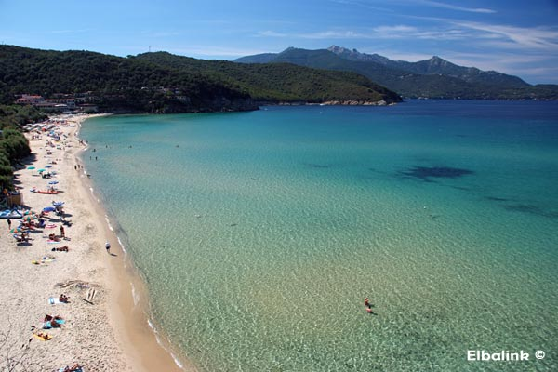

Physics Prospects @KLOE-2
A. Passeri
XVII SuperB Workshop and Kick-Off Meeting – La Biodola june 1st 2011

Slide 2
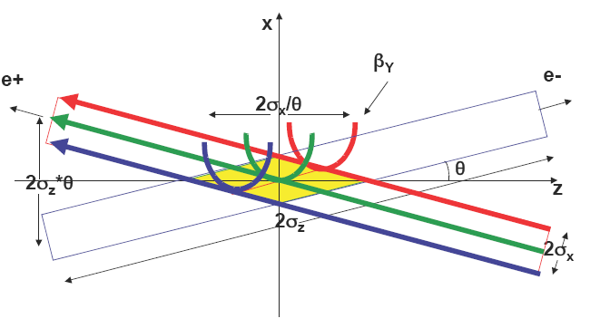
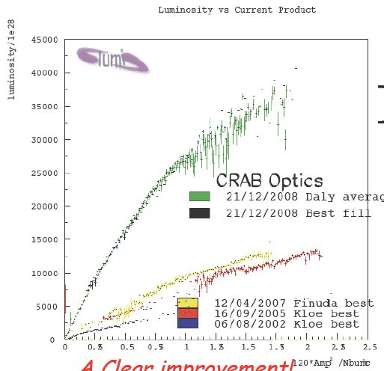
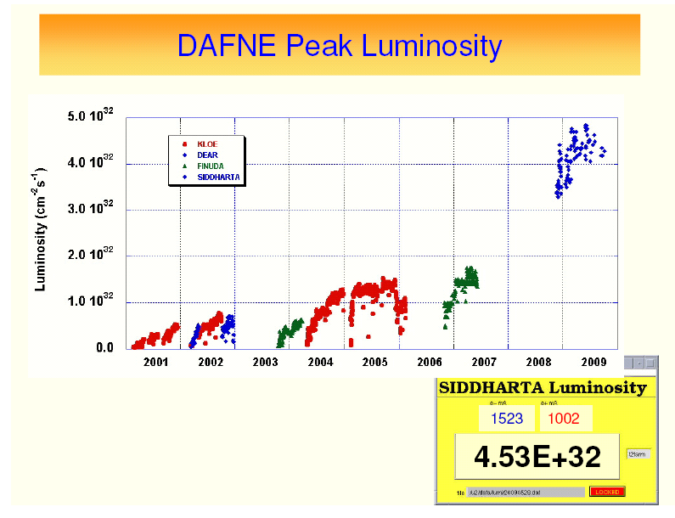
DAFNE upgrade
New interaction scheme
implemented: large beam
crossing angle + sextupoles
for crabbed waist optics
L_{new} ~ 3 × L_{old}
∫Ldt = 1 pb⁻¹/hour
Still space for improvements

Slide 3
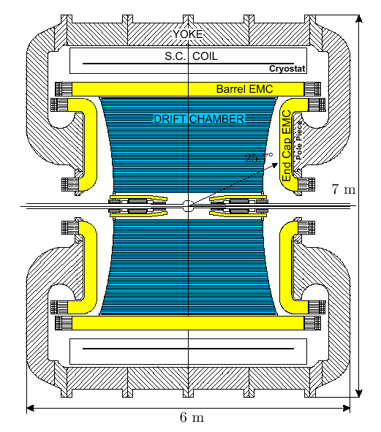
Just to remind you: the KLOE detector
Large volume Drift Chamber (13K cells, He mixt.)
  4m-∅, 3.75m-length, all-stereo
  σ_{p}/p = 0.4 % (tracks with θ > 45°)
  σ_{x}^{hit} = 150 μm (xy), 2 mm (z)
  σ_{x}^{vertex} ~1 mm σ_{Mππ} ~ 1 MeV
QCal
Pb-SciFi Calorimeter : 15 X₀ depth, 98% solid angle
σ_{E}/E = 5.7% / √E(GeV)
σ_{T} = 54 ps / √E(GeV) ⊕ 50 ps
PID capabilities mostly from TOF
σ_{L}(γγ) ~ 1.5 cm (π⁰ from K_{L} → π⁺π⁻π⁰)
Β=0.5 Τ
Data taking ended on March 2006
2.5 fb⁻¹ on tape @ √s = M_{f} (8×10⁹ f)
~10 pb⁻¹ @ 1010, 1018, 1023, 1030 MeV
250 pb⁻¹ @ 1000 MeV

Slide 4
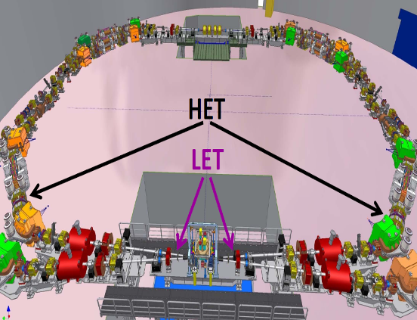
KLOE-2 Step-0 upgrade
Minimal detector upgrade for first KLOE-2 run (≈5 fb⁻¹ in 1 year):
taggers to detect momentum of leptons in e⁺e⁻→e⁺e⁻g*g*→e⁺e⁻X
LET: E=160-230 MeV
Inside KLOE detector
LYSO+SiPM
σ_{E}<10% for E>150 MeV
HET: E > 400 MeV
11 m from IP
Scintillators + PMTs
σ_{E} ~ 2.5 MeV
σ_{T} ~ 200 ps

Slide 5
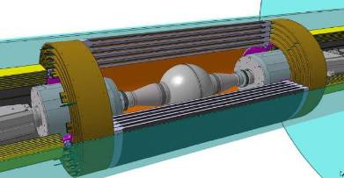
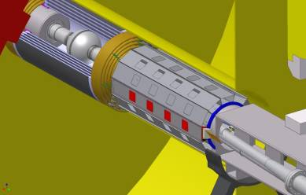
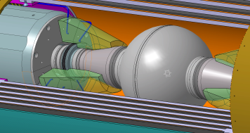
KLOE-2 full upgrade
Major detector upgrades for second KLOE-2 run (2012):
INNER TRACKER
4 layers of cylindrical triple GEM
Better vertex reconstruction near IP
Larger acceptance for low p_{t} tracks
QCALT
W + scintillator tiles + SiPM/WLS
QUADS coverage for K_{L} decays
CCAL
LYSO + APD
Increase acceptance for γ’s from IP (21°→10°)

Slide 6

i.e. “A Series of Unfortunate Events” ?
KLOE-2 now
KLOE-2 detector is ready for data taking since september 2010
After curing serious cryogenics problems, KLOE solenoid was switched
on nov 15 th.
December spent in trying to get collisions and minimizing machine bckgr.
in january a sever fault in e+ septum prevented DAFNE to deliver positrons. New septum installed in march.
electron beam used anyhow to complete e detailed background study. New shielding inserted around KLOE IR
in march linac gun cathode died. DAFNE borrowed a gun from SLAC, which allowed to have some more beam in april: bckgr conditions much improved, detector fully calibrated, tracking ok.
repeated linac gun faults finally stopped beams end of may. KLOE is (actively) waiting for new gun asap !

Slide 7
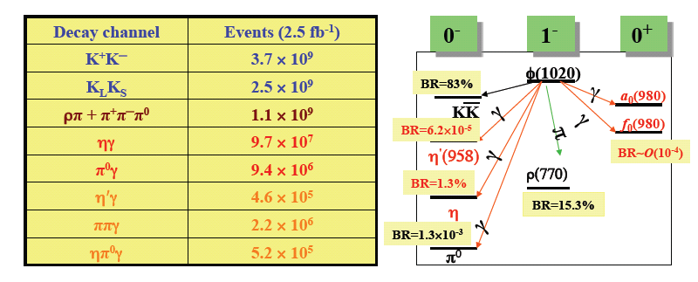
KLOE / KLOE-2 particle fluxes
Decay channel | Events (5 fb⁻¹)
K⁺K─ | 7.4 × 10⁹
K_{L}K_{S} | 5.0 × 10⁹
ρπ + π⁺π─π⁰ | 2.2 × 10⁹
ηγ | 1.9 × 10⁸
π⁰γ | 1.9 × 10⁷
η′γ | 9.2 × 10⁵
ππγ | 4.4 × 10⁶
ηπ⁰γ | 1.0 × 10⁶

Slide 8
KLOE-2 Physics Program
Goal: ~20 fb⁻¹ in the next 3 ─ 4 years to extend the KLOE physics program at
DAΦNE upgraded in luminosity (approved) and energy up to 2.4 GeV (under discussion):
KLOE-2 physics paper :
G.Amelino-Camelia et al., Eur.Phys.J. C (2010) 68:619-681
γγ physics
Light meson spectroscopy
Kaon physics
Dark forces searches
Hadronic cross section
  Existence (and properties) of σ(600)
  Study of Γ(S/PS→γγ)
  PS transition form factor
  Properties of scalar/vector mesons
  Rare η decays
  η′ physics
  Test of CPT (and QM) in correlated kaon decays
  Test of CPT in K_{S} semileptonic decays
  Test of SM (CKM unitarity, lepton universality)
  Test of χPT (K_{S} decays)
  Light bosons @ O(1 GeV)
  α_{em}(M_{Z}) and (g_{μ}-2)
I will focus only on few items strongly pointing
towards New Physics

Slide 9
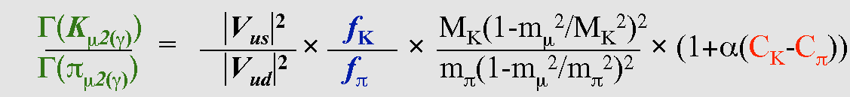
KLOE-1 core bussiness : V_{us}
C_{K}² G_{F}²M_{K}⁵
S_{EW} |V_{us}|² | f₊ (0)|² I_{Kℓ}(λ_{+,0}) (1+δ^{K}_{SU(2)}+δ^{Kℓ}_{em})²
Γ(K _{l3(γ)}) =
K⁰π⁻
192π³
Precise determination of V_{us}
Test of Lepton universality Ke3 vs Kμ3
Most precise test of CKM unitarity
Lepton-Quark universality of weak int.
Precise determination of V_{us}/V_{ud}
Test of Physics beyond the SM
  right-handed contributions to
  charged weak currents
  charged Higgs exchange
  (2 Higgs doublet scenarios)
Lepton Flavor Violation test with Γ(K_{e2})/Γ(K_{μ2})
Γ(K_{μ2})/Γ(π_{μ2})
Helicity suppressed: enhanced sensitivity to NP
Notes:
Only 2nd order corrections in (m_strange – m_up,down) (su3) – ad es iperoni hanno anche termine assiale e a-gatto non vale – non vale neanche in kl2
in kl3 nei k contrib teorico su f+0 da reticolo e’ il maggiore nelle incertezze
in kl2 entra fk/fpi perche’ misuri rappporto delle loro gamma, g kmu2/g kpi2, e fk / fpi si misura su reticolo con incertezza pari a f+0 . Non misurando il rapporto fk/fpi ma le singole, l’incertezza sarebbe maggiore peerche’ su3 entra al 1 ordine

Slide 10
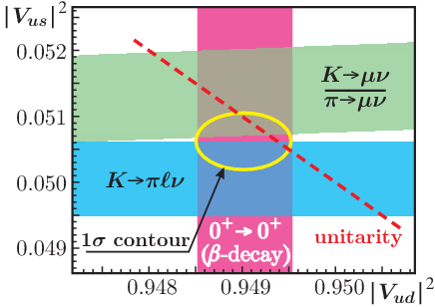
By measuring all relevant BR’s, lifetimes, FFs for
charged and neutral kaons, KLOE-1 obtained:
KLOE average |V_{us}|f₊(0) = 0.2157(6) χ2/ndf=7/4 (13%)
World Average 0.2163(5)
|V_{us}| = 0.2237(13)
f₊ (0)=0.964(5)
PRL 100 (2008)
BR(K± → μ ± ν) = 0.6366(17)
PLB 632 (2006)
|V_{us} /V_{ud}|= 0.2323(15)
f_{K} /f_{π}= 1.189(7)
PRL 100 (2008)
|V_{us}| = 0.2237(13) from Kl3 decays
|V_{ud}| = 0.97418(26)
PRC 77 (2008)
Fit to |V_{ud} | ², |V_{us} | ² and |V_{us} /V_{ud}|²
JHEP 04 (2008)
|V_{ud} | ² = 0.9490(5)
|V_{us} | ² = 0.0506(4)
χ² = 2.3/1 (13%)
Agreement with unitarity
1-V_{ud} ² -V_{us} ² = 4(7)x10⁻⁴ @0.6σ
Universality of lepton and quark weak coupling to W±
G_{F} = 1.166371(6) x10⁻⁵ GeV⁻²
G_{CKM} = 1.16604(40) x10⁻⁵ GeV⁻²
Notes:
At present, the sensitivity of the quark–lepton universality
test through the GCKM measurement is competitive and
even better than the measurements from decays and the
electroweak precision tests [92]. Thus unitarity can also be
interpreted as a test of the universality of lepton and quark
weak couplings to the W boson, allowing bounds to be set
on extensions of the SM leading to some kind of universality
breaking. For instance, the existence of additional Z0
gauge bosons, giving different loop-contributions to muon
and semileptonic decays, can break gauge universality [12].
The measurement of GCKM can set constraints on the Z0
mass which are competitive with direct search at the colliders.
When considering supersymmetric extensions, differences
between muon and semileptonic decays can arise
in the loop contributions from SUSY particles [13,14]. The
slepton-squark mass difference could be investigated improving
present accuracy on the unitarity relation by a
factor of 2-3.

Slide 11
Current fractional errors on Vus inputs
and possible improvements @KLOE-2 step-0 (7.5pb⁻¹ overall stat)
Most KLOE systematic uncertainties are partially statistical,
as efficiencies are normally measured on data, so they will also scale.
 |  | % err | BR | τ | δ | I_{Kℓ}
K_{L}e3 | 0.2155(4) | 0.20 | 0.09 | 0.13 | 0.11 | 0.06
K_{L}μ3 | 0.2167(4) | 0.21 | 0.10 | 0.13 | 0.11 | 0.08
K_{S}e3 | 0.2153(7) | 0.32 | 0.30 | 0.03 | 0.11 | 0.06
K±e3 | 0.2152(10) | 0.47 | 0.25 | 0.05 | 0.40 | 0.06
K±μ3 | 0.2132(10) | 0.48 | 0.27 | 0.05 | 0.39 | 0.08
 |  | % err | BR | τ | δ | I_{Kℓ}
K_{L}e3 | 0.2163(6) | 0.26 | 0.09 | 0.20 | 0.11 | 0.06
K_{L}μ3 | 0.2166(6) | 0.29 | 0.15 | 0.18 | 0.11 | 0.08
K_{S}e3 | 0.2155(13) | 0.61 | 0.60 | 0.03 | 0.11 | 0.06
K±e3 | 0.2160(11) | 0.52 | 0.31 | 0.09 | 0.40 | 0.06
K±μ3 | 0.2158(14) | 0.63 | 0.47 | 0.08 | 0.39 | 0.08

Slide 12
V_{us} perspectives for step-0 :
KLOE-2 can significantly improve the accuracy on the measurement of K_{L} , K± lifetimes and K_{S}e3 branching ratio with respect to present world average with data from the first year of data taking, at KLOE-2/step-0.
The present 0.23% fractional uncertainty on |Vus| × f+(0) can be reduced to 0.14% using KLOE present data set together with the KLOE-2/step-0 statistics.
Detector upgrades have not been considered in this evaluation
To improve the accuracy on the V_{us} determination and then its contribution to the total uncertainty on the unitarity relation, a more precise estimate of f₊ (0) is needed.
 | f₊ (0)V_{us}
KLOE today (World Average) | 0.28% (0.23%)
KLOE + Step-0 + WA | 0.14%
With f₊ (0) @ 0.5% the accuracy on the unitarity relation of the first row is
σ (1-V_{ud} ² -V_{us} ² ) = 6 x10⁻⁴
V_{us} @ 0.4% from fit
V_{ud} @ 0.026%

Slide 13

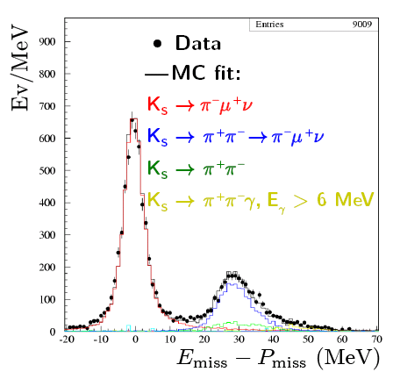
CPT violation in Ke3 decays
CPT invariance ⇒ A_{S} = A_{L} = 2 Reε ≈ 3x10⁻³
If A_{S} ≠ A_{L} CPT is violated either in the mass matrix (δ) or in
the ΔS ≠ΔQ decay amplitude (x₋):
A_{S} – A_{L} = 4 (Re δ + Re x₋)
pure KS sample selected by KL crash
TOF technique allows signal selection with unambiguous charge assignment
acceptance limited by spiralizing tracks not reaching the calorimeter surface
13000 signal events selected in 410 pb⁻¹ sample

Slide 14
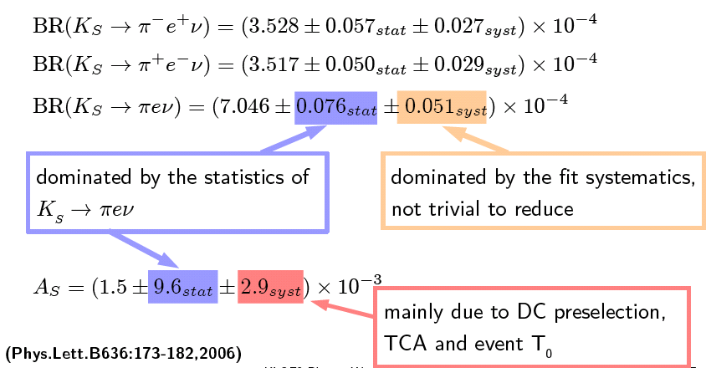
KLOE-1 result :
A_{L} = (3.322 ±0.058±0.047) x 10⁻³ KTEV ‘02
Step-0 : fractional error on BR 0.8% → error on A_{S} 4 x 10⁻³
Step-1 : systematics can be pinned down by inner tracking:
expected BR fract. error 0.3%
K_{S}→πμν channel also affordable

Slide 15

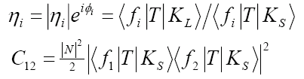
Quantum interference in the neutral kaon system
f₁
t₁
K_{S,L}
t₂
φ
K_{L,S}
K_{S} and K_{L} are entangled states: φ-factory is a unique environment to study quantum interference
Δt=t₁- t₂
f₂
interference pattern I(Δt) for different final
states f₁,f₂ give access to the different parameters: Γ_{S}, Γ_{L}, Δm, |η_{i}|, φ_{i}
several QG models predict CPTV terms in the
interference time evolution. Lorentz
invariance violation is also possible.
a good vtx resolution is required: σ(Δt)<τ_{S}
quest for an improvement of inner tracking!

Slide 16
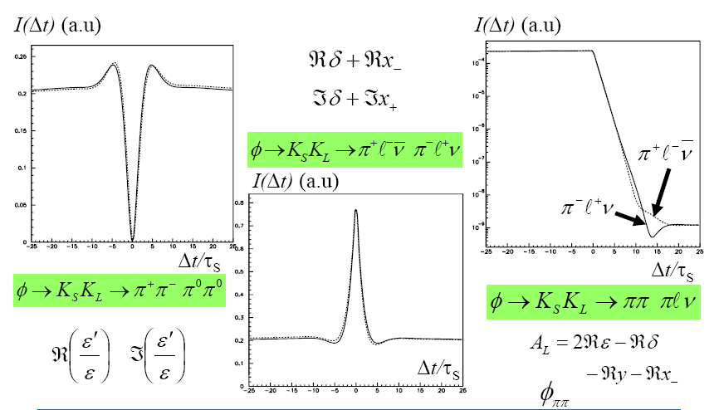
Interference patterns and observables

Slide 17
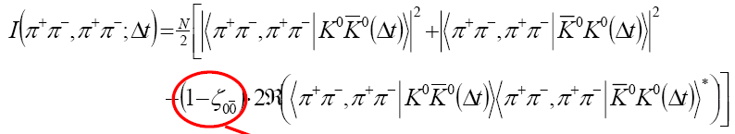
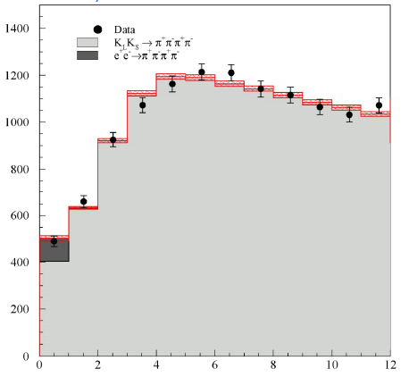





Quantum decoherence
EPR forbids simultaneous decays (Δt=0) for identical final states
decoherence signal concentrated at small Δt
sensitivity depends on vertex resolution
KLOE final (1.5 fb-1):
CPLEAR :

Slide 18




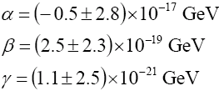

CPTV from decoherence :
Decoherence is represented by an extra term in the Liouville’s equation for the density matrix of the kaon system
+ L (ρ)
Phenomenological model: L(ρ) = L(ρ,λ) , λ simply related to ζ_{SL}
KLOE
1.5 fb⁻¹
( CPLEAR: )
Quantum gravity effects: EHNS model (NP B241 (1984) 381)
3 parameters α, β, γ ∼ o (M_{K}²/M_{Planck}) ∼ 10⁻²⁰ GeV
CPLEAR:
KLOE-1 cannot do better without constraints
Complete positivity constraint (α=γ,β=0) guarantees positivity of correlated kaons density matrix eigenvalues:
KLOE 1.5 fb⁻¹

Slide 19

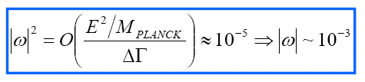
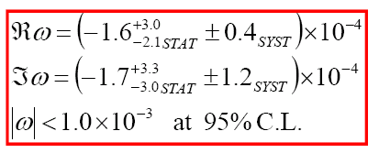
CPTV induced by QG modifies the particle-antiplarticle definition and breaks the BE statistics correlation in the kaon system (Bernabeu et al.)
Maximal expectations :
KLOE final 1.5 fb⁻¹
Best sensitivity for f₁=f₂=π⁺π⁻ :
α,β,γ,ω can be simultaneously fit
from interference pattern

Slide 20
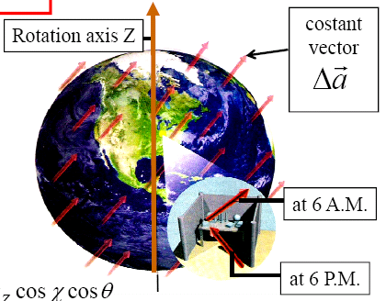
CPT and Lorentz invariance violation in SM extension
Spontaneous breaking of CPT and Lorentz symmetry may happen in some QG models.
Such phenomena are described by an effective model (Standard Model Extension)
SME predicts CPT violation in kaon mixing, but not in decay.
CPTV parameter δ depends on kaon momentum:
Δa_{μ} is a 4-vector parameter related to CPT and Lorentz violation in SME lagrangian
a_{μ} is a constant vector while lab frame rotates with earth
depends on sidereal time
azimuthal and polar angle of kaon momentum in lab frame must also be taken into account

Slide 21


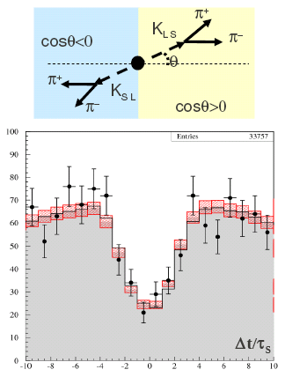

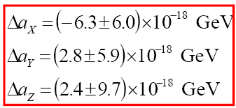

KLOE made first evaluation of Δa₀ thanks to cancellations occurring in a symmetric collider
The study of
as a function of polar angle and sidereal time
yields the distribution
from which we fitted:

Slide 22
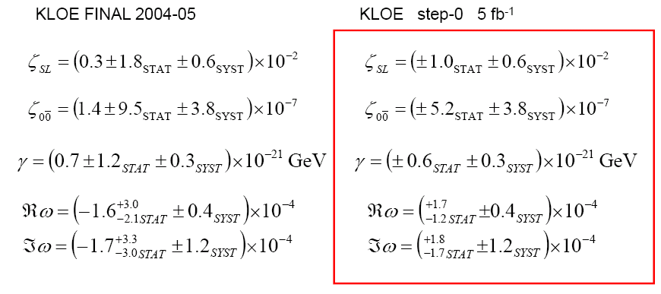
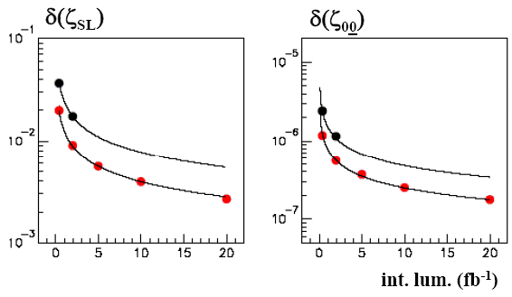



KLOE-2 perspectives:
Simple statistics scaling for step-0
Real improvement will be insertion of inner tracker for step-1

Slide 23
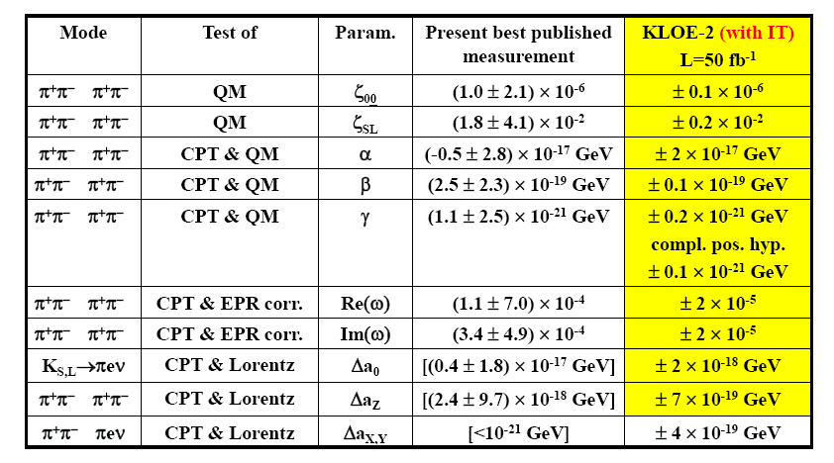
Great benefits on almost all sensitivities !

Slide 24
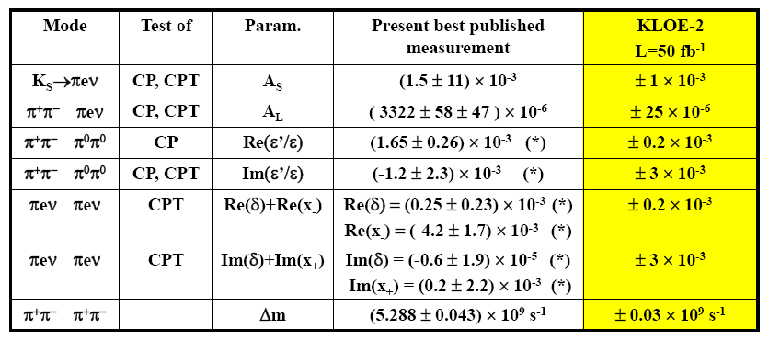

Slide 25
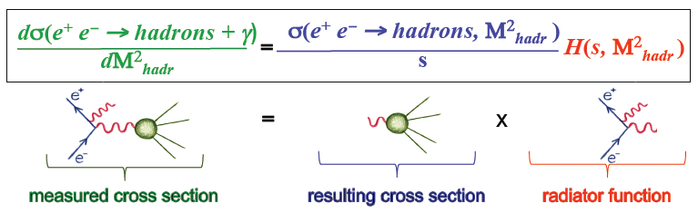

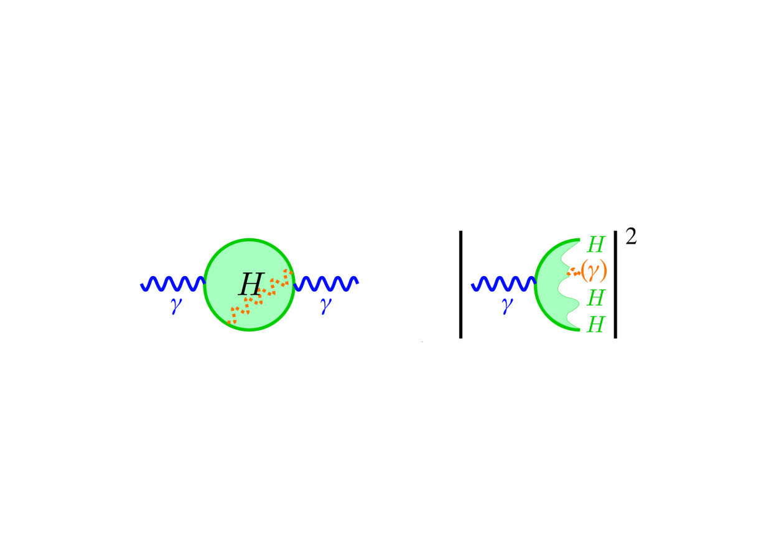
Measurement of σ → π⁺π⁻(γ) from threshold to m_{φ}
ππ contribution to muon anomaly
•
•
hadrons
Cross section measurement exploits ISR process:

Slide 26

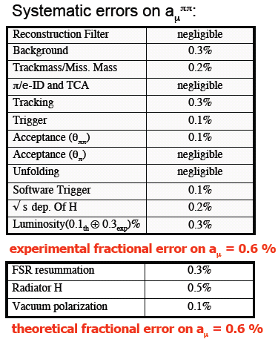
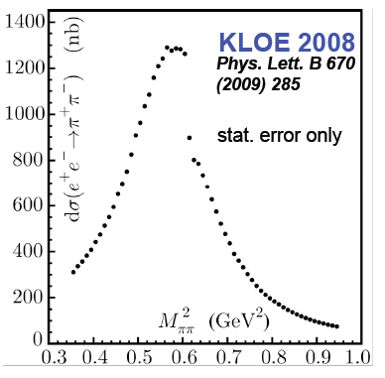

KLOE measurement for small angle (undetected) photons
Backgrounds removed by kinematics and PID
MC shapes fitted to data

Slide 27
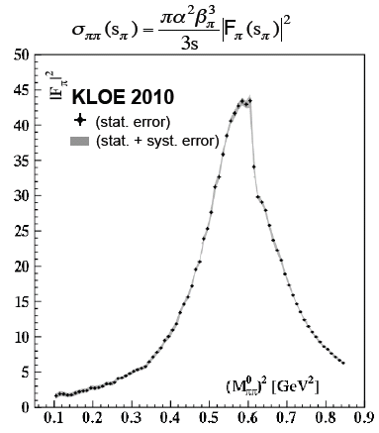
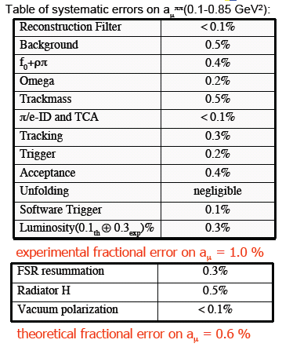
KLOE measurement for large angle (detected) photons
Use 233 pb⁻¹ off peak data (√s = 1 GeV) to minimize resonant background
Large FSR contribution specially in threshold region
Interference unknown, estimated by MC using phenomenological models

Slide 28

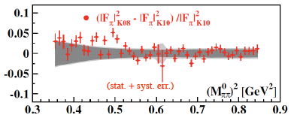
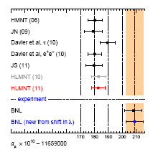
KLOE08-KLOE10 fractional difference
overall 1% error !
Results confirm 3.3 σ discrepancy with BNL direct a_{μ} measurement
KLOE08 + KLOE10
included
In progress:
σ → π⁺π⁻(γ) measurement from ππγ/μμγ ratio
FSR model validity test via fw-bw asymmetry
measurement in e⁺e⁻→π⁺π⁻ process
still ~ 1.5 fb⁻¹ to be analized from 2004-2005 data
arXiv:1105.3149
(Teubner et al.)

Slide 29
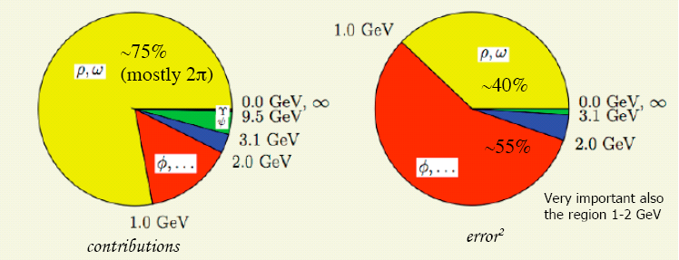
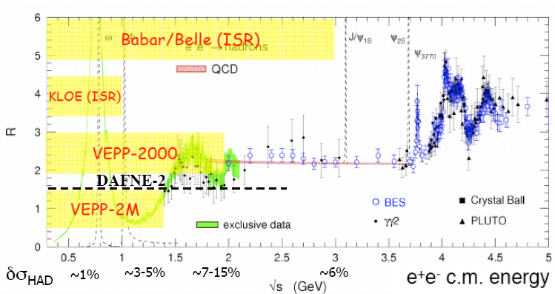
What about σ_{had} @KLOE-2 ?
Hard to improve region
below 1 GeV
1 GeV<√s < 2 GeV is the critical region for a_{μ} error !
σ_{had} poorly measured
just above 1 GeV:
DAFNE may perform an energy scan !

Slide 30
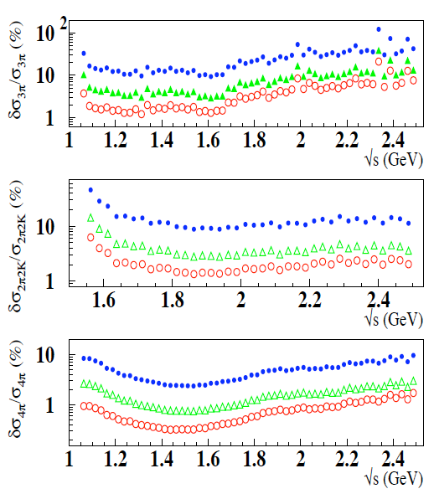
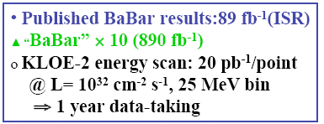
Energy scan at DAΦNE ?
Statistical errors only
Such measurements may pin down a_{μ} error from hadronic loop by a factor of 2: (2.6 x10⁻¹⁰)
For comparison: light-by-light theoretical error is ~3 x10⁻¹⁰ , while experimental error from new BNL experiment to directly measure a_{μ} is at the level of 1.6 x10⁻¹⁰ !

Slide 31
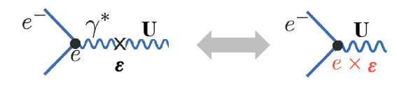
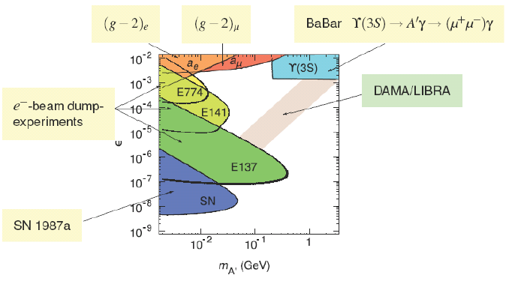
Dark Forces @KLOE ?
Recent astrophysical observations by various experiments (PAMELA, ATIC, Integral,DAMA, Egret,WMAP) could be explained by a secluded gauge sector:
low mass mediator U-boson ( m_{U} ∈ 1 MeV÷ few GeV)
weakly coupled to SM: ε ≤10⁻³
Present limits in ε – m_{U} plane:
Best channels @KLOE / KLOE-2:
φ→ η U
higgs’strahlung: e⁺e⁻→h’ U
e⁺e⁻→ Uγ

Slide 32


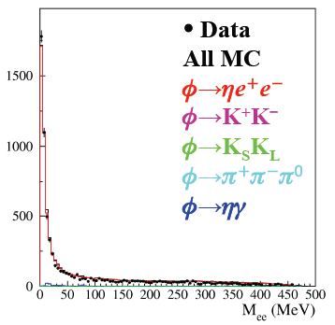
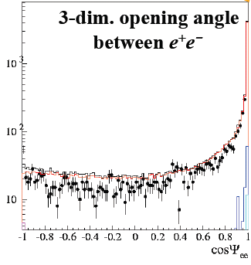

Expect:
KLOE looked for:
results available !
in progress (tougher bckgr)
analysis on 739 pb⁻¹
Main bckgr from γ conversions and from neutral kaons decays:
beated by topological and tof cuts
good agreement with MC
M_{ee} background shape fitted from data
use CL_{s} technique to exclude signal regions

Slide 33

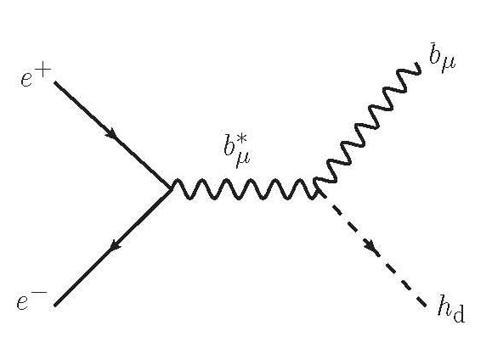
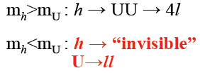

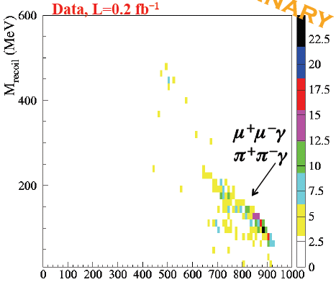
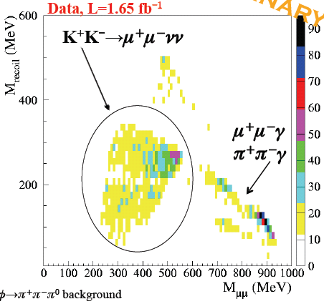
Higgs’strahlung
τ_{h} > 10 μs for ε=10⁻³, increasing with decreasing ε
U→e⁺e⁻ not selected by evt classif algorithm
look only for U→μ⁺μ⁻
Backgrounds from:
K⁺K⁻ early decays, φ→π⁺π⁻π⁰, π⁺π⁻γ, μ⁺μ⁻γ
Signal selection via kinematics and PID
Efficiency 15÷40% depending on m_{h}, m_{U}
off peak 2006 data
Signal would show up as a sharp 2D peak (~10 evts) … not found (yet?)
Quite bad K⁺K⁻ bckgr disappears running off peak
KLOE-2 off peak run under discussion
Analysis would profit a lot from improved tracking with IT

Slide 34
Conclusions
KLOE-2
KLOE-2 has a rich physics program, which can open various windows on new physics processes
KLOE-1 data are still providing new interesting analyses
DAFNE collider group and KLOE-2 collaboration are making best effort to start a new stable high luminosity data taking

Slide 35
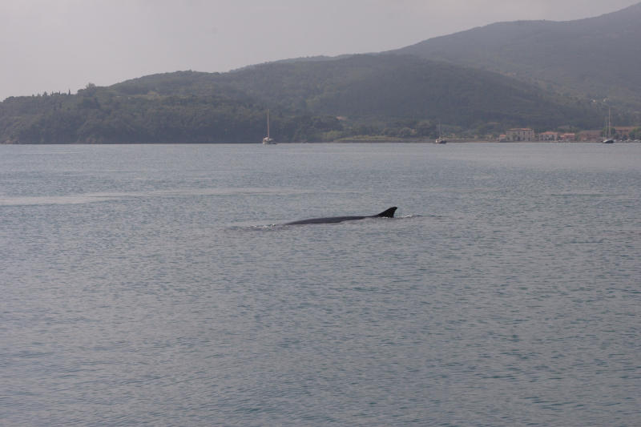
Shall we see some emerging new objects ?

Slide 36
SPARES

Slide 37
To extract V_{us} from K_{L},K_{S} and K±
PLB 632 (2006)
PLB 632 (2006)
BR(K_{Le3}) = 0.4008(15)
BR(K_{Lμ3}) = 0.2699(14)
0.37%
0.52%
BR(K⁺ → μ ⁺ν) = 0.6366(17)
0.27%
JHEP 01 (2008)
PLB 626 (2005)
τ± = 12.347(30)
τ_{L} = 50.92(30) ns
0.58%
0.24%
PLB 636 (2006)
BR(K_{S} → πeν) = 7.046(91) × 10⁻⁴
JHEP 02 (2008)
1.3%
BR(K± → π⁰e±ν) = 0.04965(53)
BR(K± → π⁰μ±ν) = 0.03233(39)
1%
1.2%
PLB 636 (2006)
PLB 666 (2008)
JHEP12(2007)
0.43%
λ₊′ = (25.6 ± 1.5_{stat} ± 0.9_{syst} )×10⁻³
λ₊″ = ( 1.5 ± 0.7_{stat} ± 0.4_{syst} )×10⁻³
λ₀ = ( 15.4 ± 1.8_{stat} ± 1.3_{syst} )×10⁻³
BR(K⁺ → π⁺ π⁰ (γ)) = 0.2065(9)

Slide 38
K_{S}→ πeν decay – Test of CPT
Sensitivity to CPT violating effects through charge asymmetry:
_
G(K_{S,L} → π⁻e⁺ν) - G(K_{S,L} → π⁺e⁻ν)
A_{S,L} =
_
G(K_{S,L} → π⁻e⁺ν) + G(K_{S,L} → π⁺e⁻ν)
⟨π⁺ε⁻υ|Η_{W}|Κ⁰⟩ = a + b
⟨π⁻ε⁺υ|Η_{W}|Κ⁰⟩ = a∗− b∗
⟨π⁻ε⁺υ|Η_{W}|Κ⁰⟩ = c + d
⟨π⁺ε⁻υ|Η_{W}|Κ⁰⟩ = c∗− d∗
b=d=0 if CPT holds
K → πeν amplitudes
c=d=0 by ΔS=ΔQ rule
A_{S} = 2(Re ε_{Κ} +Re δ_{Κ} +Re b/a −Re d*/a)
A_{L} = 2(Re ε_{Κ} −Re δ_{Κ} +Re b/a +Re d*/a)
A_{S} − A_{L} ≠ 0
implies
CPT
CP
CPT in
mixing
CPT in
decay
ΔS≠ ΔQ
and CPT
Notes:
SM predictions: GammaS = GammaL, As = AL = 2Re epsilon

Slide 39
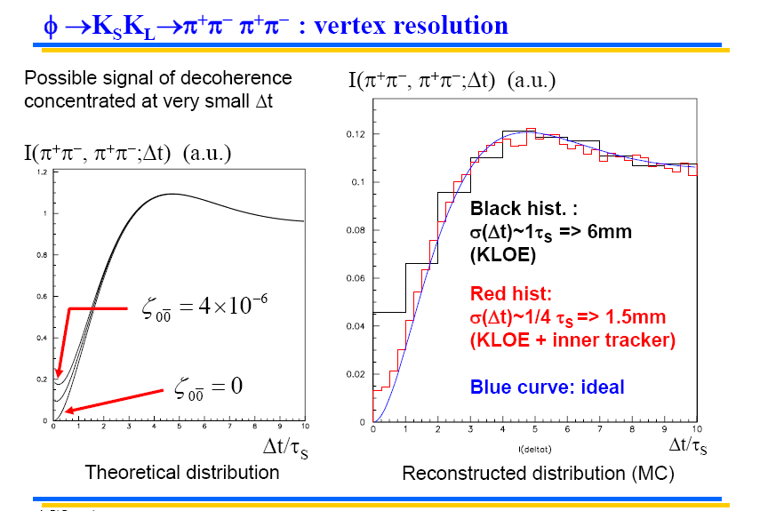

Slide 40
η→π⁺π─e⁺e─
Plane asymmetry ⇒ test of CP violation
Constraints from Br(η→π⁺π─): expt. A_{CP} < 10⁻⁴
  th. (SM) A_{CP} < 10⁻¹⁵
Non conventional CP violation mechanism
(non CKM) proposed ⇒ A_{CP} up to 2×10⁻²
[D.N.Gao MPLA17(2002)]
A_{CP} = (-0.6 ± 2.5 ±1.8) × 10⁻²
[PLB675(2009)283]
KLOE-2
with O(10 fb⁻¹) ⇒ δBr ∼ 1.4% (stat.)
δA_{CP} ∼ 1.2 % ( “ )
reduce systematics
O(20 fb⁻¹) with IT ⇒ δA_{CP} < 1%
40

