Slide 1
Preliminary Trigger view
P. Branchini (INFN Roma 3)
Involved Group:
INFN-LNF G. Felici,
INFN-NA A. Aloisio,
INFN-Roma1 V. Bocci,
INFN-Roma3

Slide 2
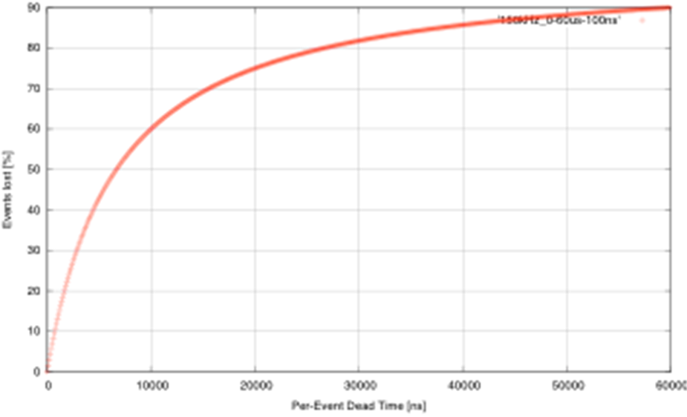
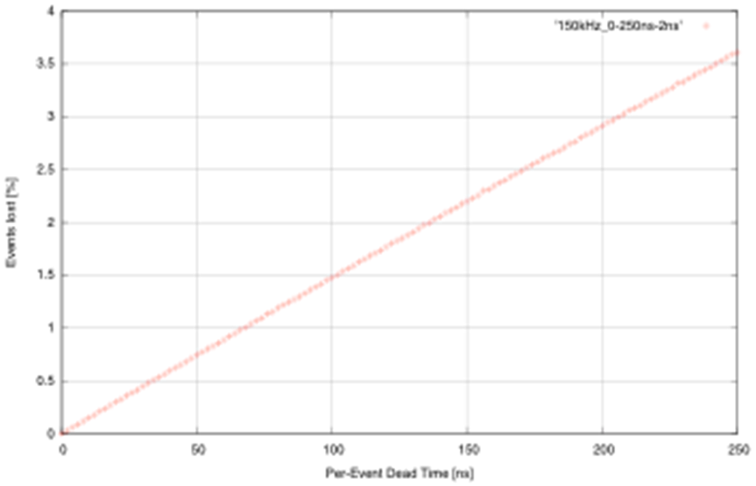
Let’s remember the specs in SuperB
Baseline:
re-implement BaBar L1 trigger with some improvements
  Shorter latency (~6us instead of 12us)
  Higher sampling frequencies (DCH and EMC)
  2-d map for calorimeter
Possible additions
SVT trigger
What about the TOF ? (in DELPHI we used it in the trigger)
Bhabha Veto
Do we need an absolute time stamp at the trigger level?
Challenge
To keep the event loss due to dead time below 1% => a maximum of ~70ns “per-event dead time” is allowed in trigger and FCTS
Other considerations
What goes in L1, what in L3, what’s the optimum?
150kHz
Exponential Inter-arrival time pdf.
Luitz 2010

Slide 3
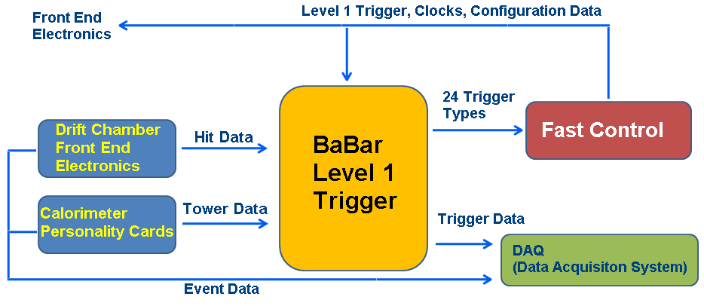
BaBar: Trigger Layout
J. C. Andress et Al., “BaBar Calorimeter Level 1 Trigger Design” , BaBar Note (1998)

Slide 4
Latency in the EMC Barrel
ADC conversion time.
Depends on
Shaping, can
it be changed?
J. C. Andress et Al., “Babar Calorimeter Level 1 Trigger Design” , BaBar Note (1998)
Can we improve latency here?

Slide 5
Latency in DC
Latency in BaBar :
  DC event processing about 6 μs +
  GLT event processing 3 μs +
  trigger data movement 3,8 μs
  Total: 12.8 μs
How to reach about 6 μs ?
Latency of the system is dominated by DC processing. It depends on how fast data processing is.
We should be able to be faster with new FPGAs.

Slide 6
Triggered event apple pie
The original BaBar trigger time resolution was about 100 ns.
Can we improve it?
100 ns good for BaBar running@2.2 μs dead time.
We should aim at 30 ns since SuperB dead time is estimated to be 70 ns.
P. D. Dauncey et Al., “Design and performance of the level 1 calorimeter trigger for the BABAR detector” (2001)

Slide 7
Systems under study
EMC Forward
EMC Barrel
DC

Slide 8
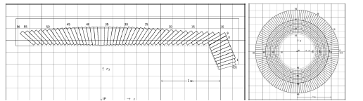
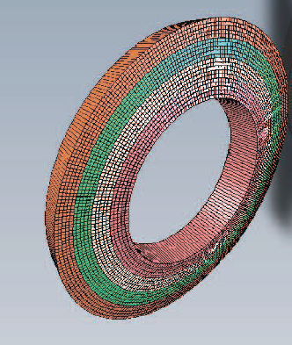
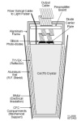
SuperB EMC
  EMC Barrel :
  5760 CsI(Tl) Crystals
EMC Forward =
4400 Lyso Crystals
(176 modules)

Slide 9
Forward Lyso signal
The Lyso has been read out by a PMT (signal lasts 150 ns)
we should not have problems here. Moreover a resolution on 1 ns has been reached
on the peak charge distribution at CERN test beam.

Slide 10
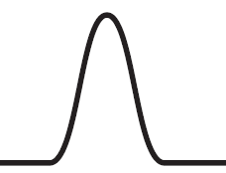
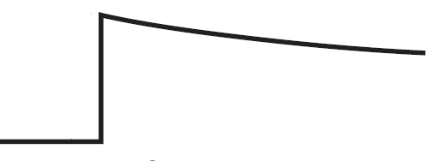
EMC fast trigger path and energy one
Energy accurate measurement path
Double
Range
shaper
Range (0,1)
CSP
X N_{cryst}
Trigger Fast Path
Analog
Σ
n
Pulse
Encoder
LVDS

Slide 11
EMC forward tentative implementation
Double
Range
shaper
X5
Range
CSP
X5
X5
5
input
Σ
VME Range
Shaper
VFE
New Circuit Analog Sum
over 5 input.
Analog
Σ
Pulse
Encoder
5
input
LVDS
Trigger Tower module

Slide 12
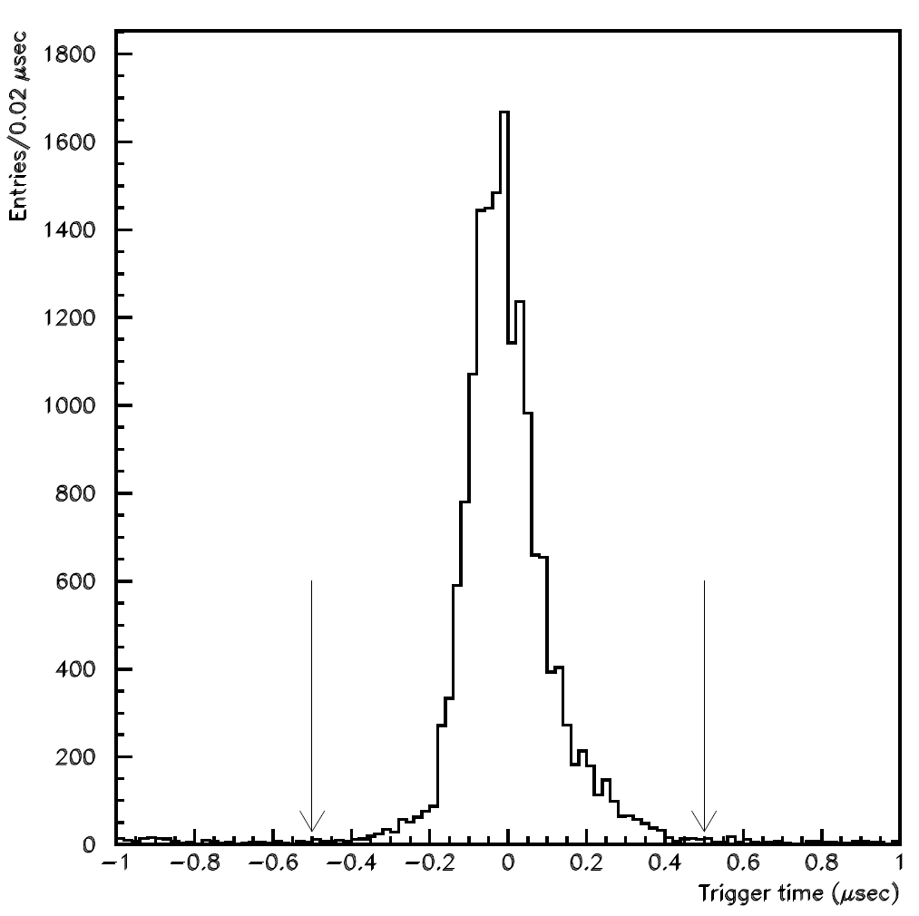
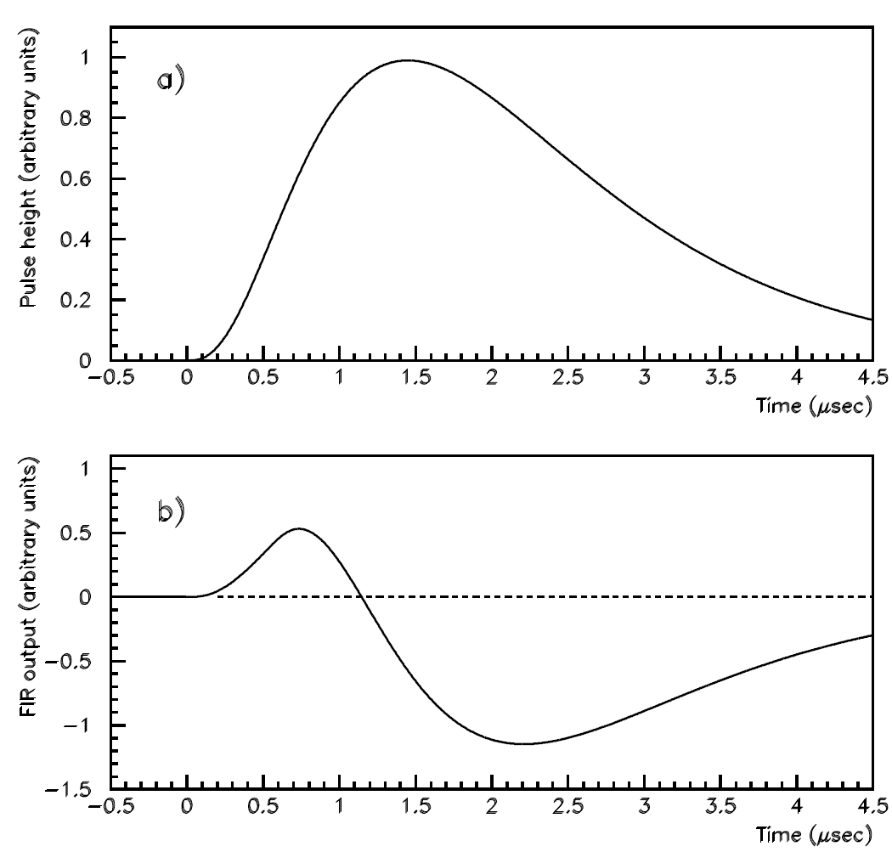
Barrel CsI (Tl doped) original BaBar
P. D. Dauncey et Al., “Design and performance of the level 1 calorimeter trigger for the BABAR detector” (2001)
3 thresholds applied to the signal of the tower.
The plot shows the difference between the EMC trigger time and the DC trigger time.
μ+μ- events used to select good resolution in DC.
A FIR Filter with 8 parameters was applied to the signal. Its zero crossing occurred
at roughly a fixed time distance from the start of the signal, it was used to gate
the threshold information. Due to this mechanism the time resolution was about 100 ns.

Slide 13
Comments I
The afore mentioned strategy worked fine for BaBar.
Unfortunately latency is dominated by
adc conversion and peak finding.
Peak finding determined time jiitter too.
We really should try to improve this part.

Slide 14
Comments II
At the moment we could immagine to assert a trigger signal using only a part of the energy deposit in the CsI.
Resolution could be worse by the
sqrt(energy fraction collected).
But we do not have any crystal to play with.
We are waiting for a small sample of BaBar crystals
From Bill

Slide 15
SuperB DC trigger
Following BaBar strategy we would like to implement fast tracking but why?
For background reduction in L3 trigger(see picture below)
For event classification
Real time data quality check and detector monitoring
…………..
Z0 distrib. of triggered events
before zed measurement upgrade

Slide 17
Track finder

Slide 18
DC track finder algorithm
Faster sampling means better precision
(if the gas mixture is the same) do we need it?
Chai 2004

Slide 19
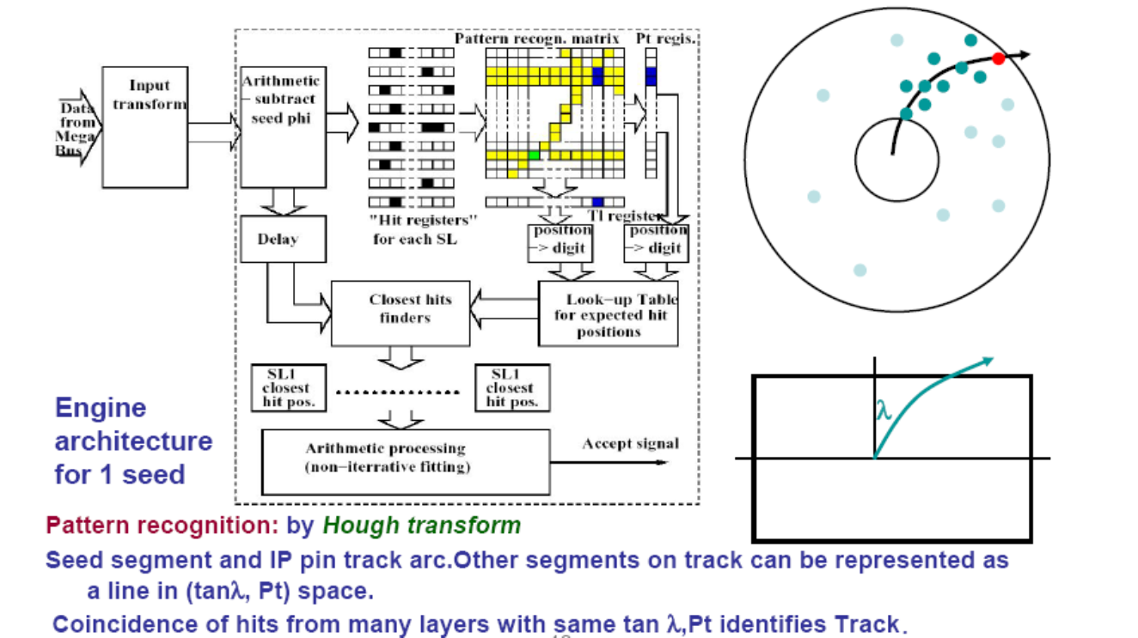
Zed@IP track finder algorithm
Zed@IP track finder algorithm

Slide 20
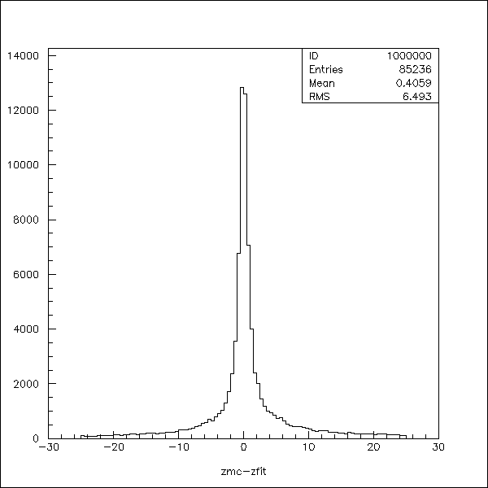
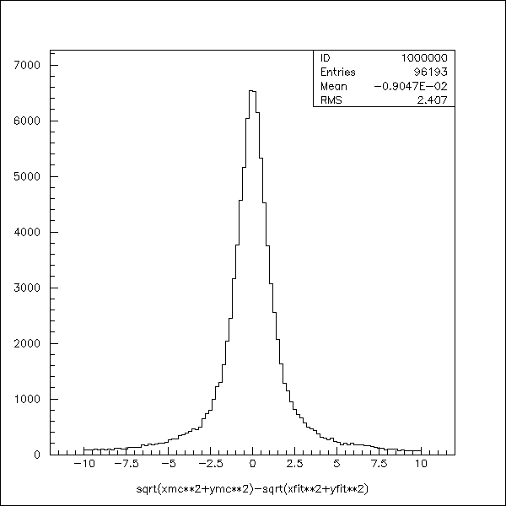
What we get in the B-> D* K sample
Zed resolution RMS=6.5 cm
R resolution RMS = 2.4 cm
Hypothesis: error on x coordinate = error on y coordinate : gaussian, sigma 0.8 mm
error on z coordinate : gaussian, sigma = 1.5 cm

Slide 21
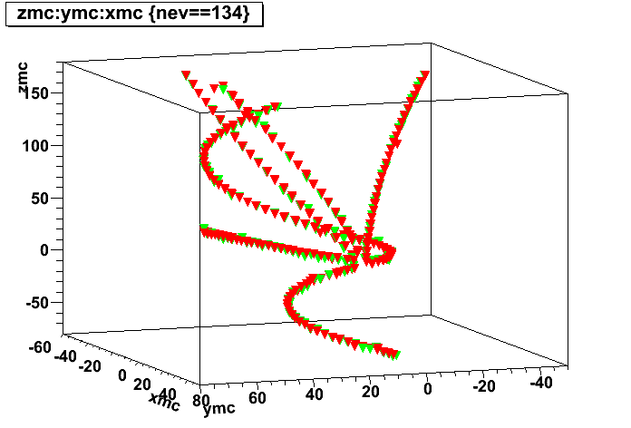
τ sample
Red: fast reconstruction , green MC

Slide 22
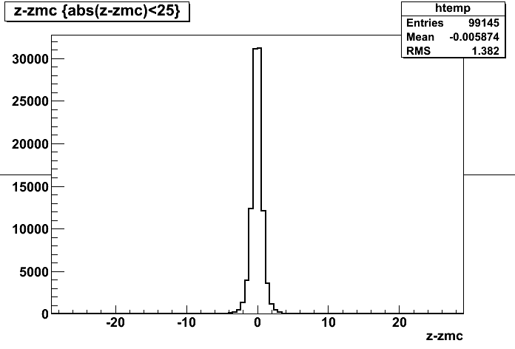
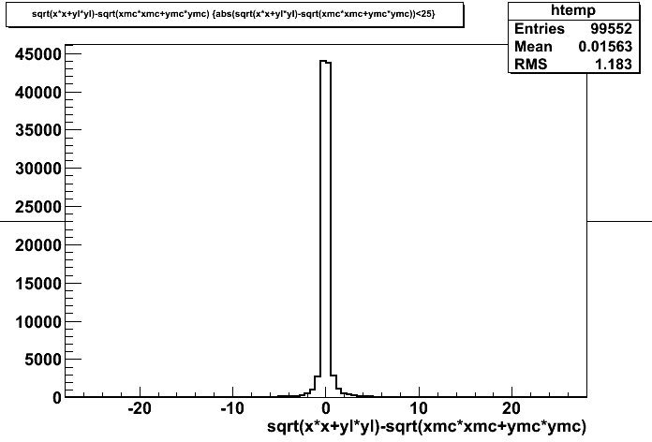
What we get in the τ sample
Zed resolution RMS=1.4 cm
R resolution RMS = 1.2 cm

Slide 23
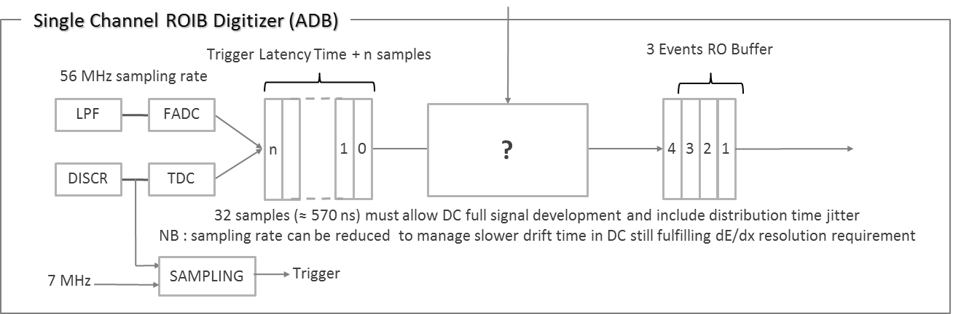
How?
A dedicated path for the trigger is already foreseen for the DC.

Slide 24

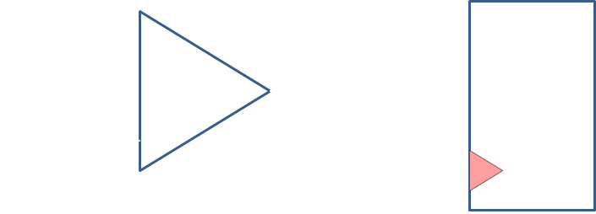
Trigger Path
Thr
LUT
Clk

Slide 25
dedicated trigger path
The information from the fast path feeds a 1 bit flash adc (a prototype is being drawn by Roma3).
The sampling frequency should be optimised
Possible range:(from 3.5 to 56 MHz).
In the prototype we would like to be able to vary the
sampling frequency.
We would like to test prototype and strategy on the LNF DC prototype.
These bits (one for each wire) are delivered to a FPGAs via LVDS links (EMC like).

Slide 26
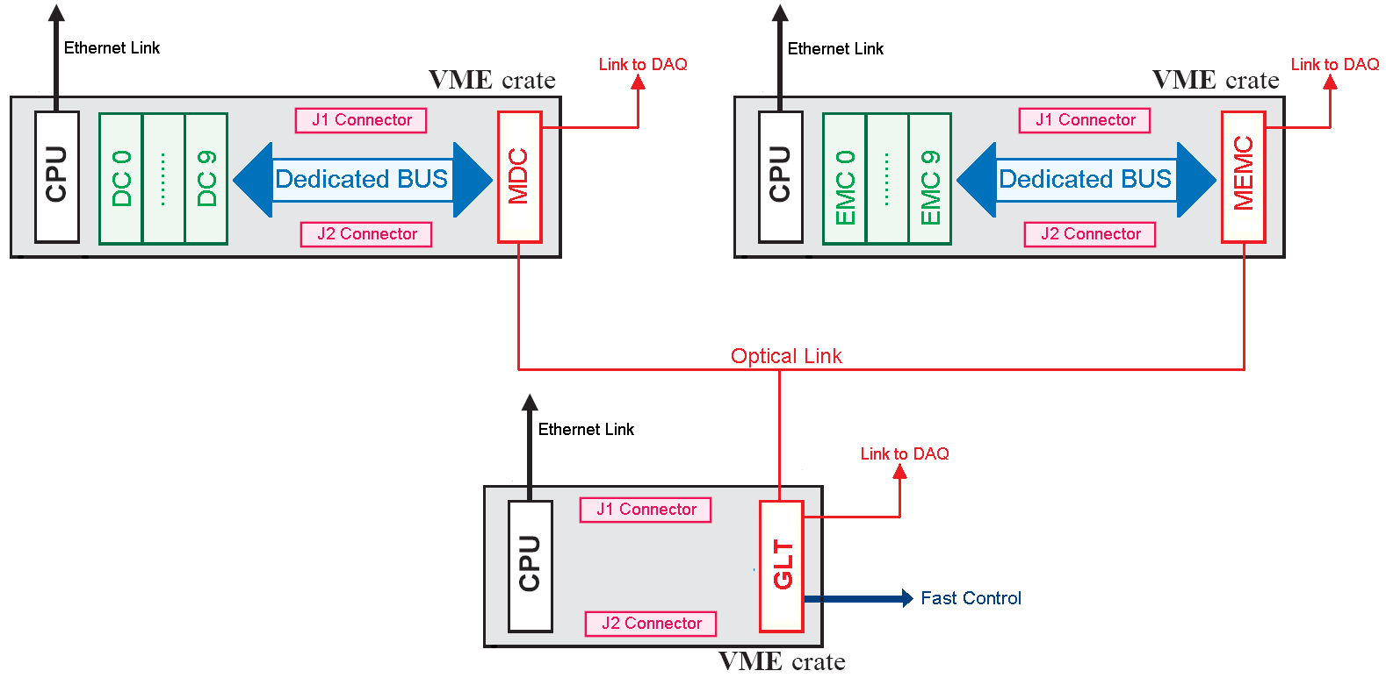
A possible sketch of trigger system in SuperB
To be noticed: in this scheme input links to DC0-DC9 ad EMC0-EMC9 can be LVDS

Slide 27
Do we need rad hard equipment?
I’m not completely convinced.
We could extensively make use of protocol correction error,
thus avoiding to use real rad hard equipment
if not strictly necessary.
Moreover we could also think to house the most critical part of the radiation sensitive hardware in a shielded zone.

Slide 28
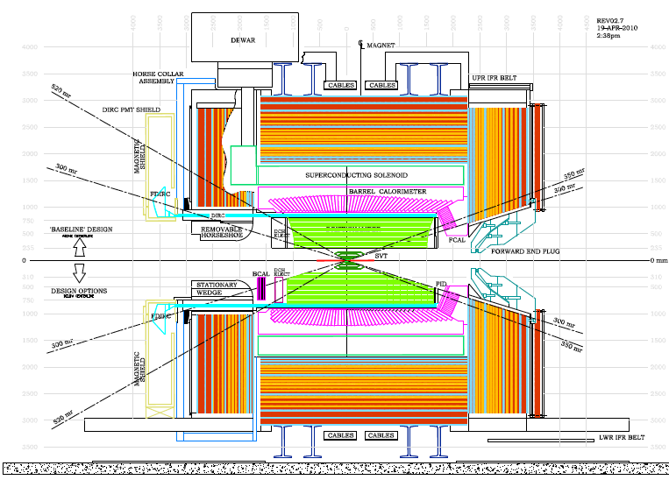
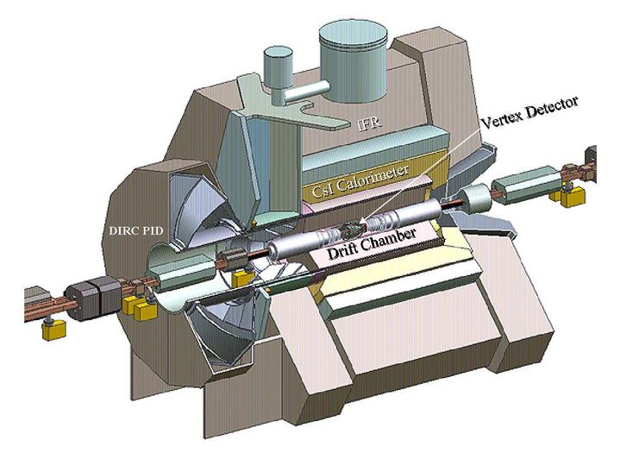
For instance…

Slide 29
Thank you for your kind attention !

