Slide 1
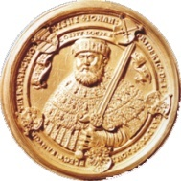
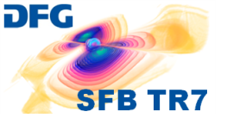
Materials 2
G. Cole (Vienna) – Crystalline Coatings
S. Koker (Jena) – Waveguide Coatings
R. Nawrodt (Jena) – Silicon research
GWADW 2011 – La Biodola, Isola d‘Elba

Slide 2
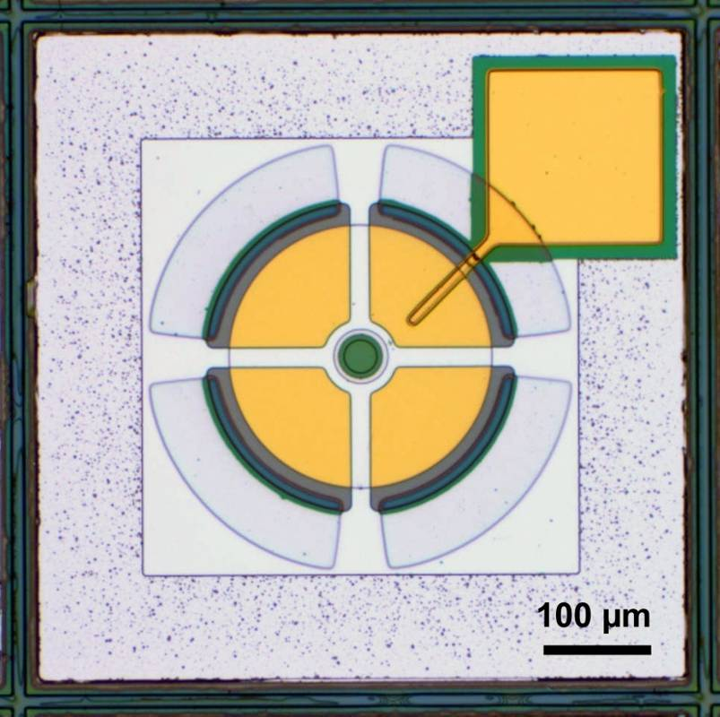
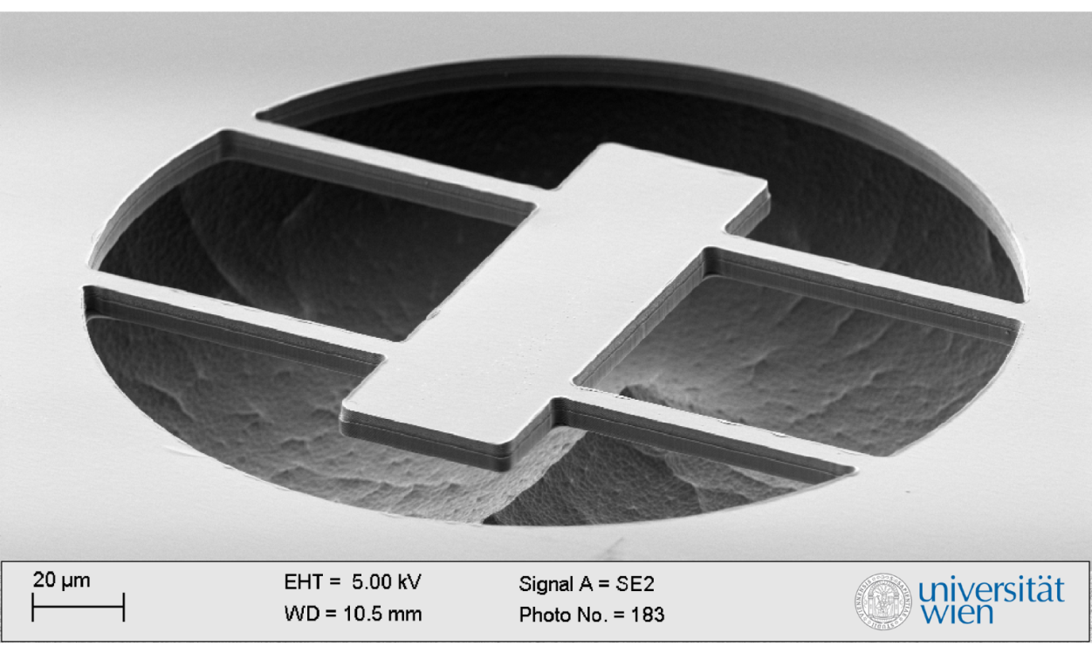
Garrett Cole, University of Vienna
PhD in Materials Science, UC Santa Barbara, 2005
Dissertation: micromechanically tunable laser-amplifiers
subsequent positions in industry (Aerius Photonics, LLC) and at Lawrence Livermore Nat. Lab. continued this path of research
Current focus: resonators for radiation-pressure cooling
extension of tunable laser work—simply a suspended mirror
design and fab. of high R, high Q optomechanical resonators
studies of fundamental damping mechanisms

Slide 3
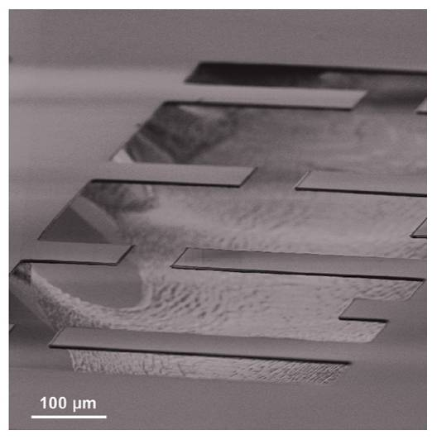
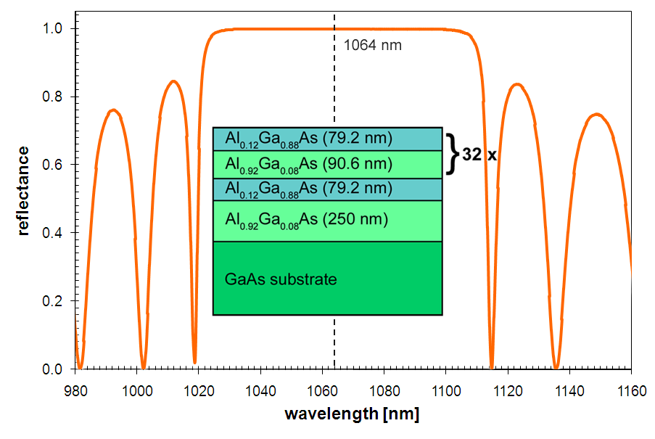
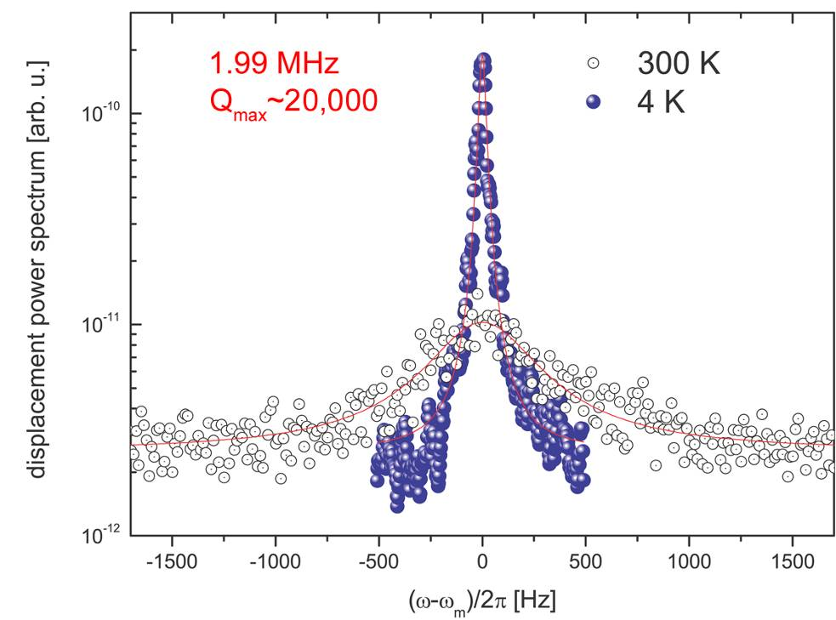
Monocrystalline Optomechanics
fabricated at Lawrence Livermore National Lab.
32.5 period undoped Al_{x}Ga_{1-x}As distributed Bragg reflector (MBE)
high index layers contain 12% Al for substrate etch selectivity
8% Ga incorporated in low index film to slow oxidation in ambient
Single- and doubly-clamped beams, dimensions: 100s x 50 x 5.5 μm³
eigenfrequencies up to 2 MHz (sideband resolved κ/ω_{m}~0.2), Q~10⁴
G. D. Cole, S. Gröblacher, K. Gugler, S. Gigan, M. Aspelmeyer, Applied Physics Letters (2008)

Slide 4
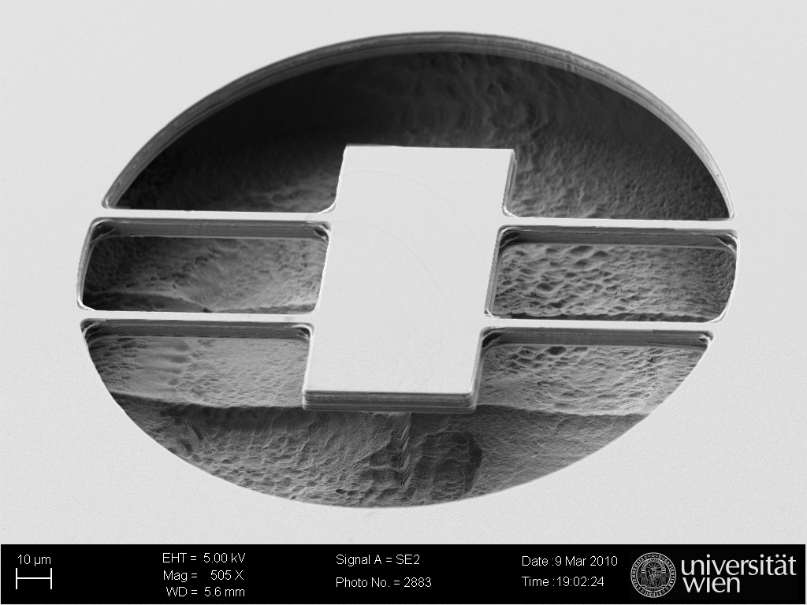
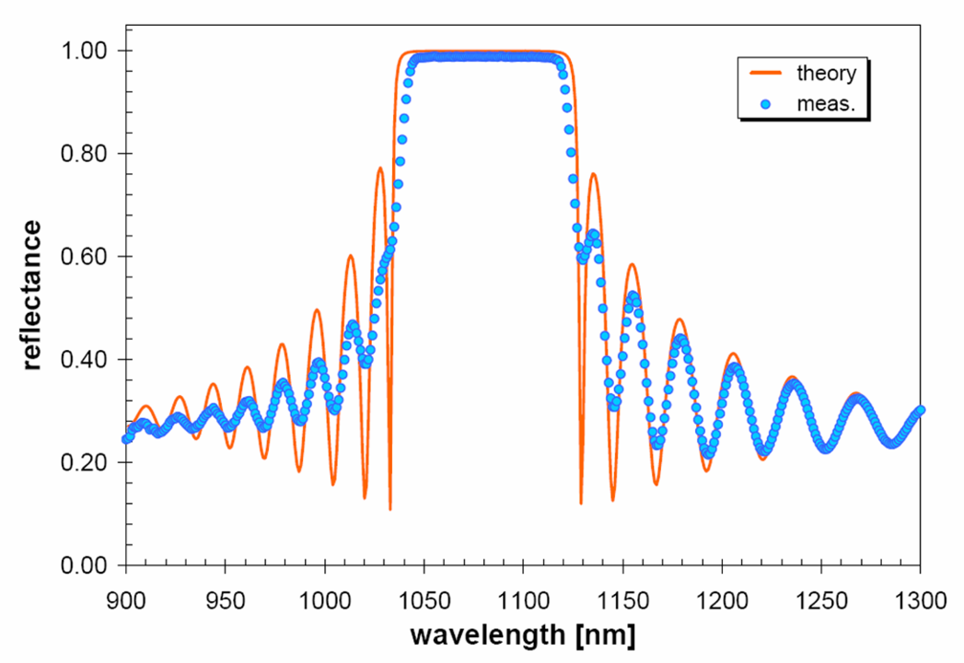
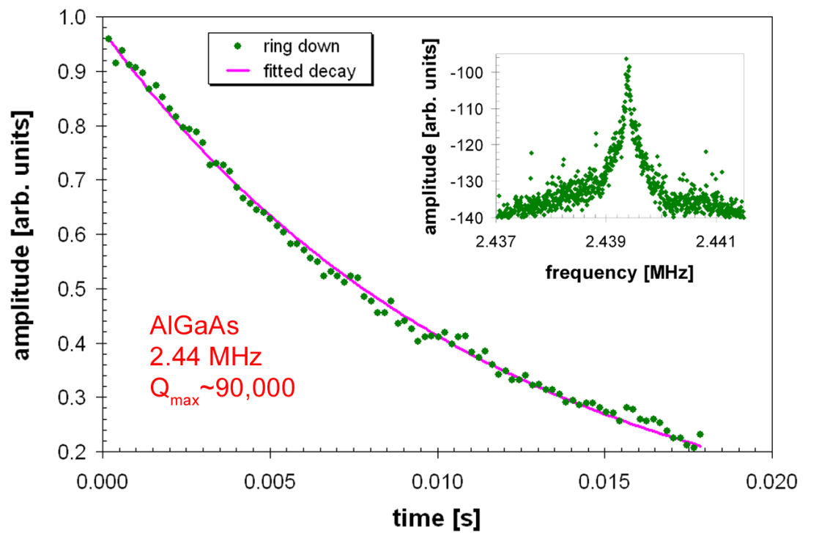
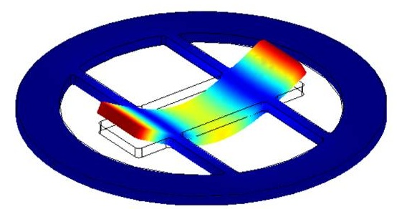
Monocrystalline Optomechanics
40.5 period undoped Al_{x}Ga_{1-x}As distributed Bragg reflector (MOCVD)
nominally identical to previous structure, more layer pairs to boost R
Support-induced losses were found to limit quality factor in cantilevers
free-free design employed to minimize phonon-tunneling loss
eigenfrequencies from 1-4 MHz with Q~10⁵ at cryogenic temperatures
G. D. Cole, et al., IEEE MEMS Conf. (2010) | G. D. Cole, et al., Nature Communications (2010)

Slide 5
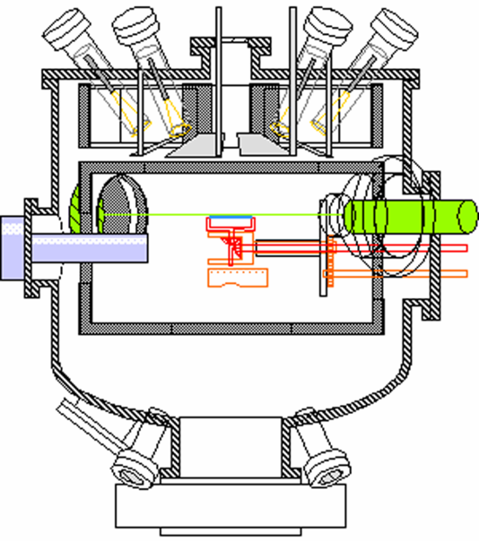
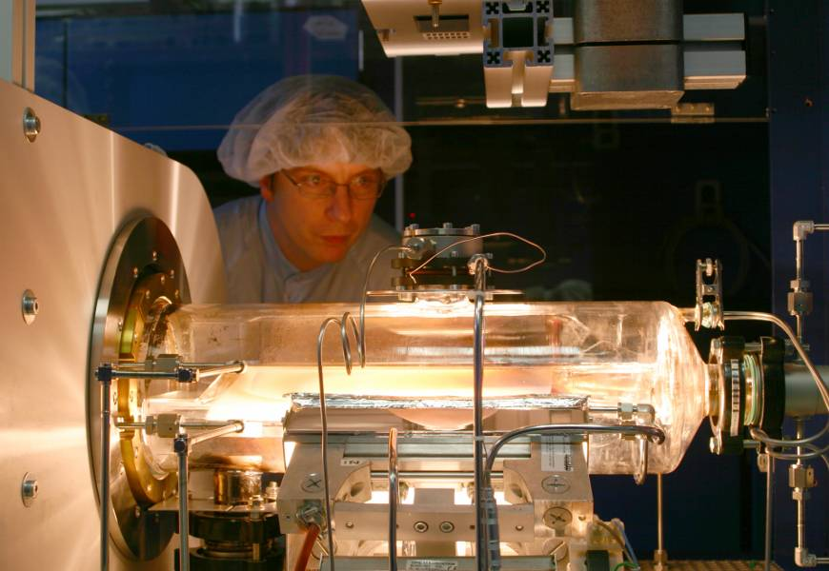
Crystal Growth Techniques
molecular beam epitaxy
metal organic chemical vapor deposition
effusion cells
sample
RHEED
cryopanels
vacuum chamber
Material | Crystal structure | Lattice const. (A) | Modulus (GPa) | Density (kg/m³) | CTE (x10⁻⁶ K⁻¹) | Refractive index
GaAs | zinc blende | 5.6455 | 85.3 | 5320 | 5.73 | 3.4804
AlAs | zinc blende | 5.6533 | 83.5 | 3760 | 5.20 | 2.9383
Al₂O₃ | hexagonal | 4.785 (a) | 345 | 3980 | 5.50 | 1.76

Slide 6
Summary of AlGaAs DBR Properties
MBE grown 32 period mirror showed the best surface quality with an AFM-measured roughness of 2 Å
current best MOCVD samples exhibit roughness of 5-6 Å
Absorption has been measured for both MOCVD and MBE grown DBR structures at 1064 nm
MOCVD: ~70 ppm (α=2 cm⁻¹), MBE: <10 ppm (α=0.2 cm⁻¹)
best results from literature yield α=0.15 cm⁻¹
Reflectivity >99.99% measured on wafer (40.5 pairs)
allows for an impedance matched finesse of 1.75×10⁴
Q-values exceeding 90k at 2.4 MHz (>2×10⁵ at 300 Hz)
maximum Q∙f product of 3.2×10¹¹ Hz (84k @ 3.84 MHz)
literature: 4 MHz shear res. Q∙f = 2.3×10¹² Hz (300 K in air)

Slide 8
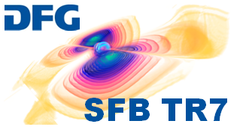
Optical components based on resonant
waveguide gratings
Introduction – Enhanced bandwidth of RWGs – Experimental tests
S. Kroker, T. Käsebier, E.-B. Kley, A. Tünnermann
Institute of Applied Physics, FSU Jena
GWADW 26/05/2011

Slide 9
Introduction
Realization of highly-reflective mirrors
Multilayer stacks
Resonant waveguide gratings (RWGs)
non-monolithic
monolithic
high index
…
low index
reduce effective layer thickness reduce coating thermal noise
Bunkowski et al., CQG, 2006
Brückner et al., Opt. Express, 2008
Brückner et al., PRL, 2010

Slide 10
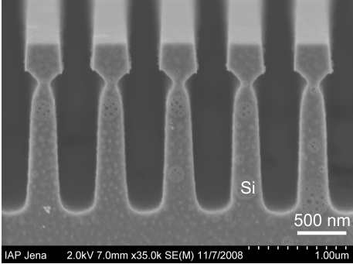
Starting point: Monolithic T-shaped mirror
R=99.8% @ 1550 nm
Highest resonant reflectivity ever realized!
Questions:
further improvement of reflectivity?
- > what reflectivities can be principally achieved with T-shaped gratings?
2. use RWGs for other things
monolithic (silicon)
non-monolithic (silicon-diamond, silicon-SiO₂)
Brückner et al., PRL, 2010
Liu et al., Mat. Sc. Eng., 2004
Notes:
Can we even do more with RWGs than reflecting light at a certain angle and wavelength?

Slide 11
The answer: stack of RWG’s
RWG 2
RWG 1

Slide 12
Feature I: Wavelength dependence
Higher bandwidth for
less critical to meet design wavelength (larger fabrication tolerances)
Enhancement of reflectivity!
Notes:
Achtung: double ist twin-konfiguration und nicht das vorher gezeigte!

Slide 13
Feature II: Angular Dependence @ 1550 nm

Slide 14
The use of it
built all-reflective diffractive components based on RWGs
high angular acceptance helps to limit transmission
superpose larger period to subwavelength structures to get
diffraction orders
Possibilities for superposition:
- depth modulation
- width/period modulation
Effective
layer
thickness
< 1.5 µm

Slide 15
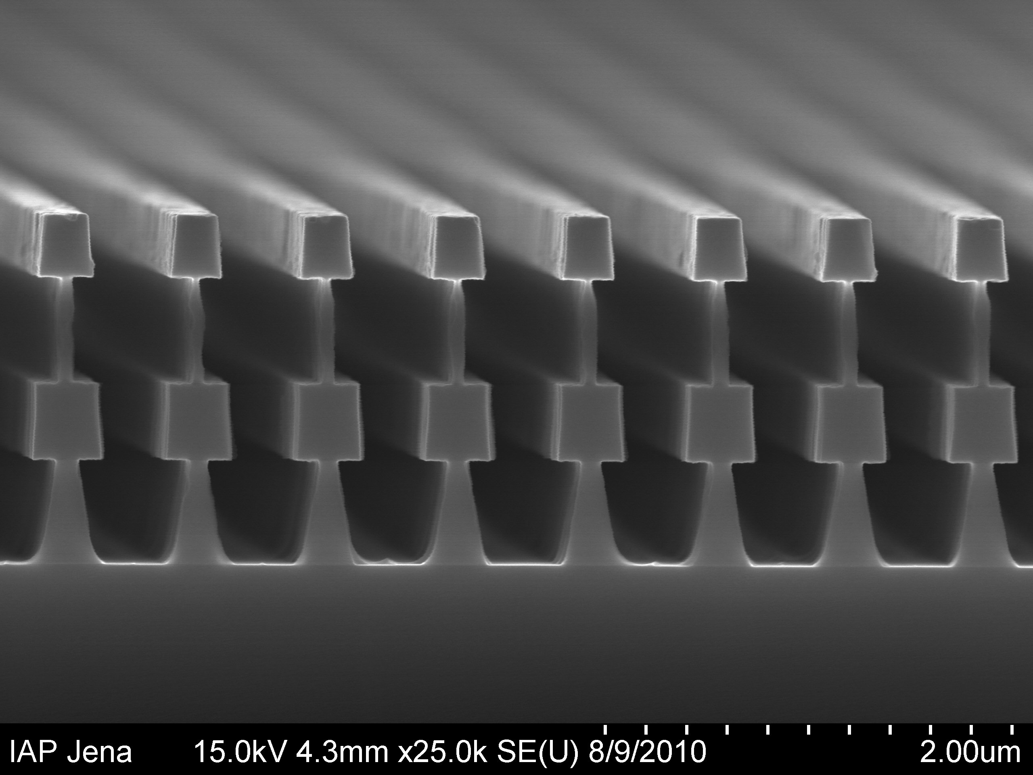
First experimental steps
Si-SiO₂ double T structures
anisotropic etching
selective isotropic etching by means of HF
Despite wrong grating parameters:
- layers too thin
silicon duty cycle too low
exact refractive index unkown (design for bulk values)
Output from FIRST processed wafer!

Slide 16
Summary
Increase reflectivity of
resonant reflectors:
improve technology
use double-T-shape gratings
Realization of resonant
diffractive components:
depth modulation
width modulation
First experiment:
double T‘s feasible
R=87%

Slide 17
Thank you for your attention!

Slide 19
Silicon as a test mass material
R. Nawrodt¹, N. Beveridge² , G. Hammond², K. Haughian² , G. Hofmann¹, J. Hough², B. Kley³, J. Komma¹, S. Kroker³, I. Martin², P. Murray², S. Reid², S. Rowan², R. Schnabel⁴,
P. Seidel¹, C. Schwarz¹, J. Steinlechner⁴, A. Tünnermann³
¹ Friedrich-Schiller-Universität Jena, Institute for Solid State Physics
² SUPA University of Glasgow, Institute for Gravitational Research
³ Friedrich-Schiller-Universität Jena, Institute for Applied Physics
⁴ Albert-Einstein-Institut Hannover

Slide 20
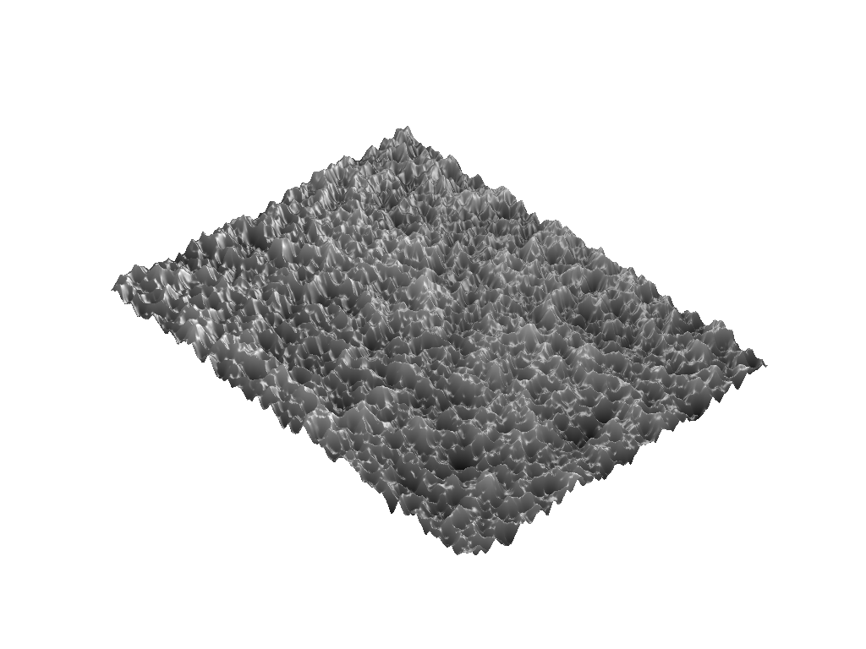
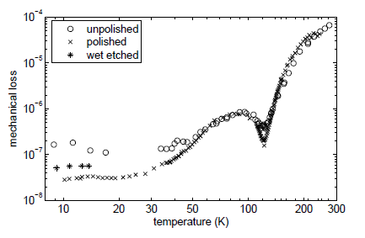
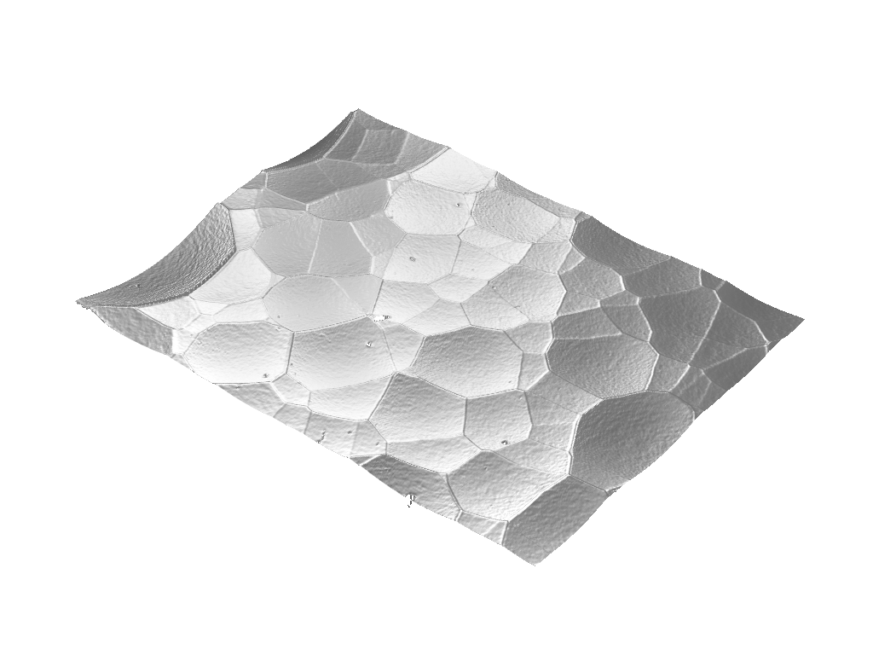
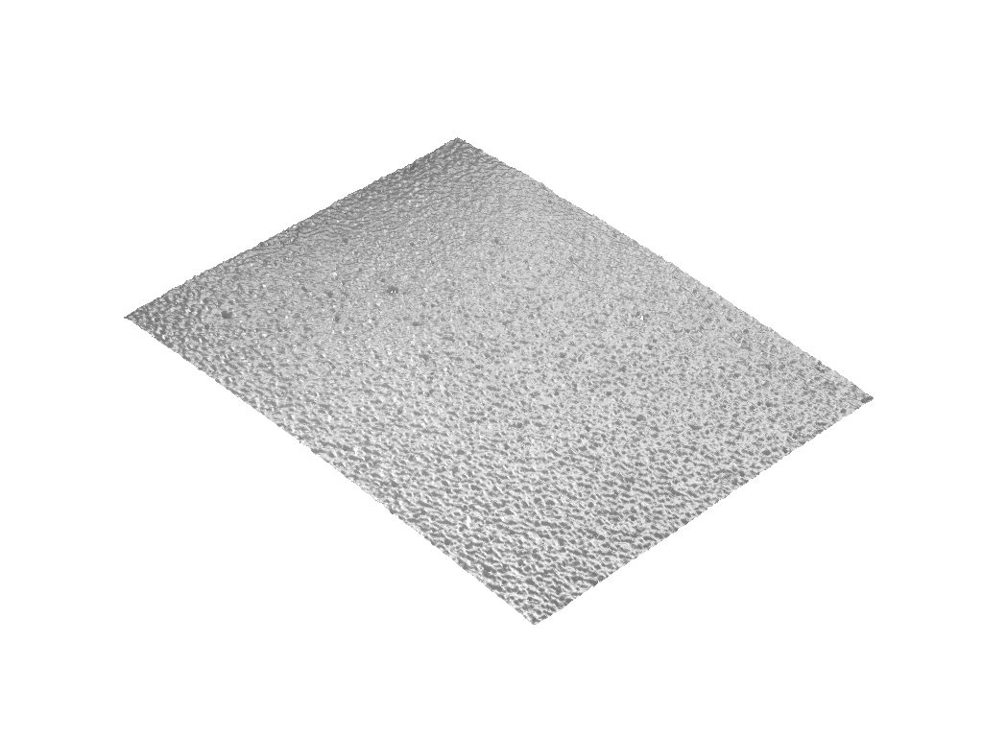
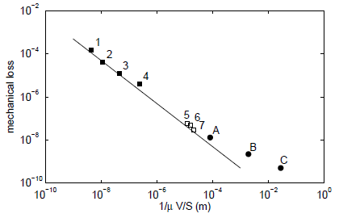
Surface Loss of Silicon
last GWADW: surface loss in Si
α_{s} = 0.5 pm

Slide 21
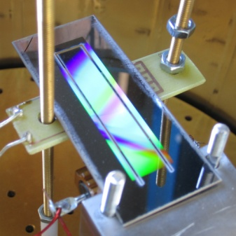
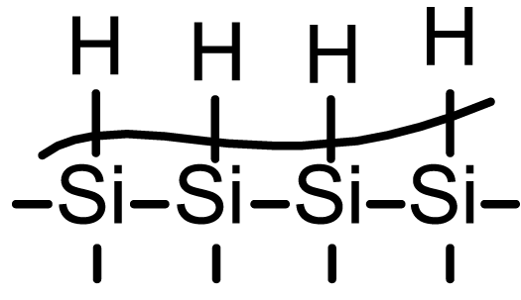
Surface Loss of Silicon
experimental observation:
mechanical loss decreases if grating is etched into cantilever
→ etching removed „bad“ surface
so far: impossible to attribute any
measured loss directly to
the grating
detailed study of surface losses needed
understanding the origin of losses
find ways to passivate surfaces
open bonds
terminating layers

Slide 22
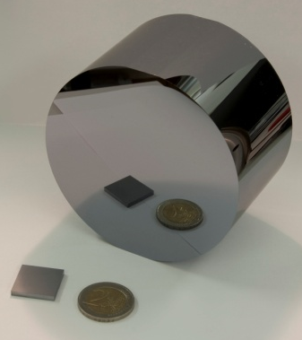
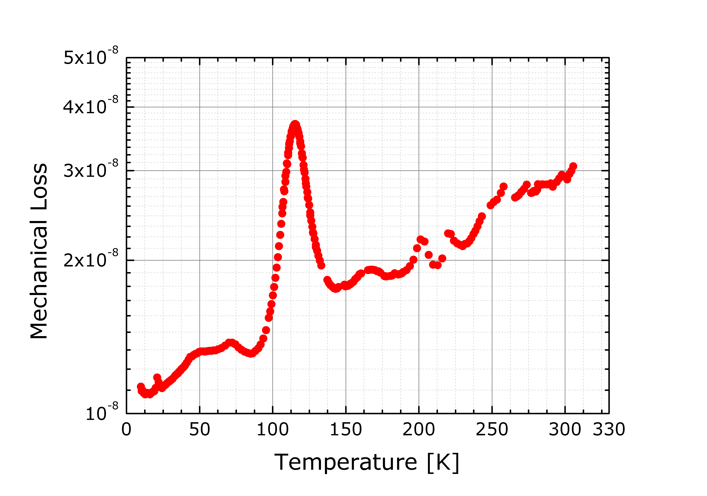
Bulk loss of Silicon
ET-LF: end mirror Si(111), dia. >45 cm
lowest impurities in FZ silicon ↔ currently available in smaller diameters → impact of impurities on the mechanical loss?
understanding loss peaks
correlate them with impurities
main impurity:
oxygen
(electronically not active)
[Si(111), CZ grown, dia. 65 mm, length 50 mm, 68 kHz]

Slide 23
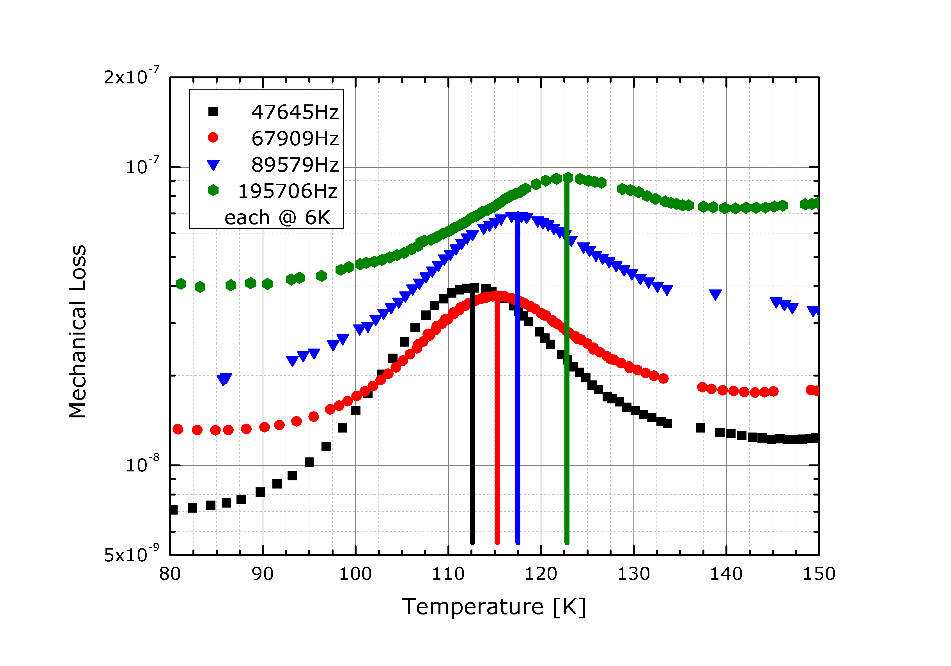
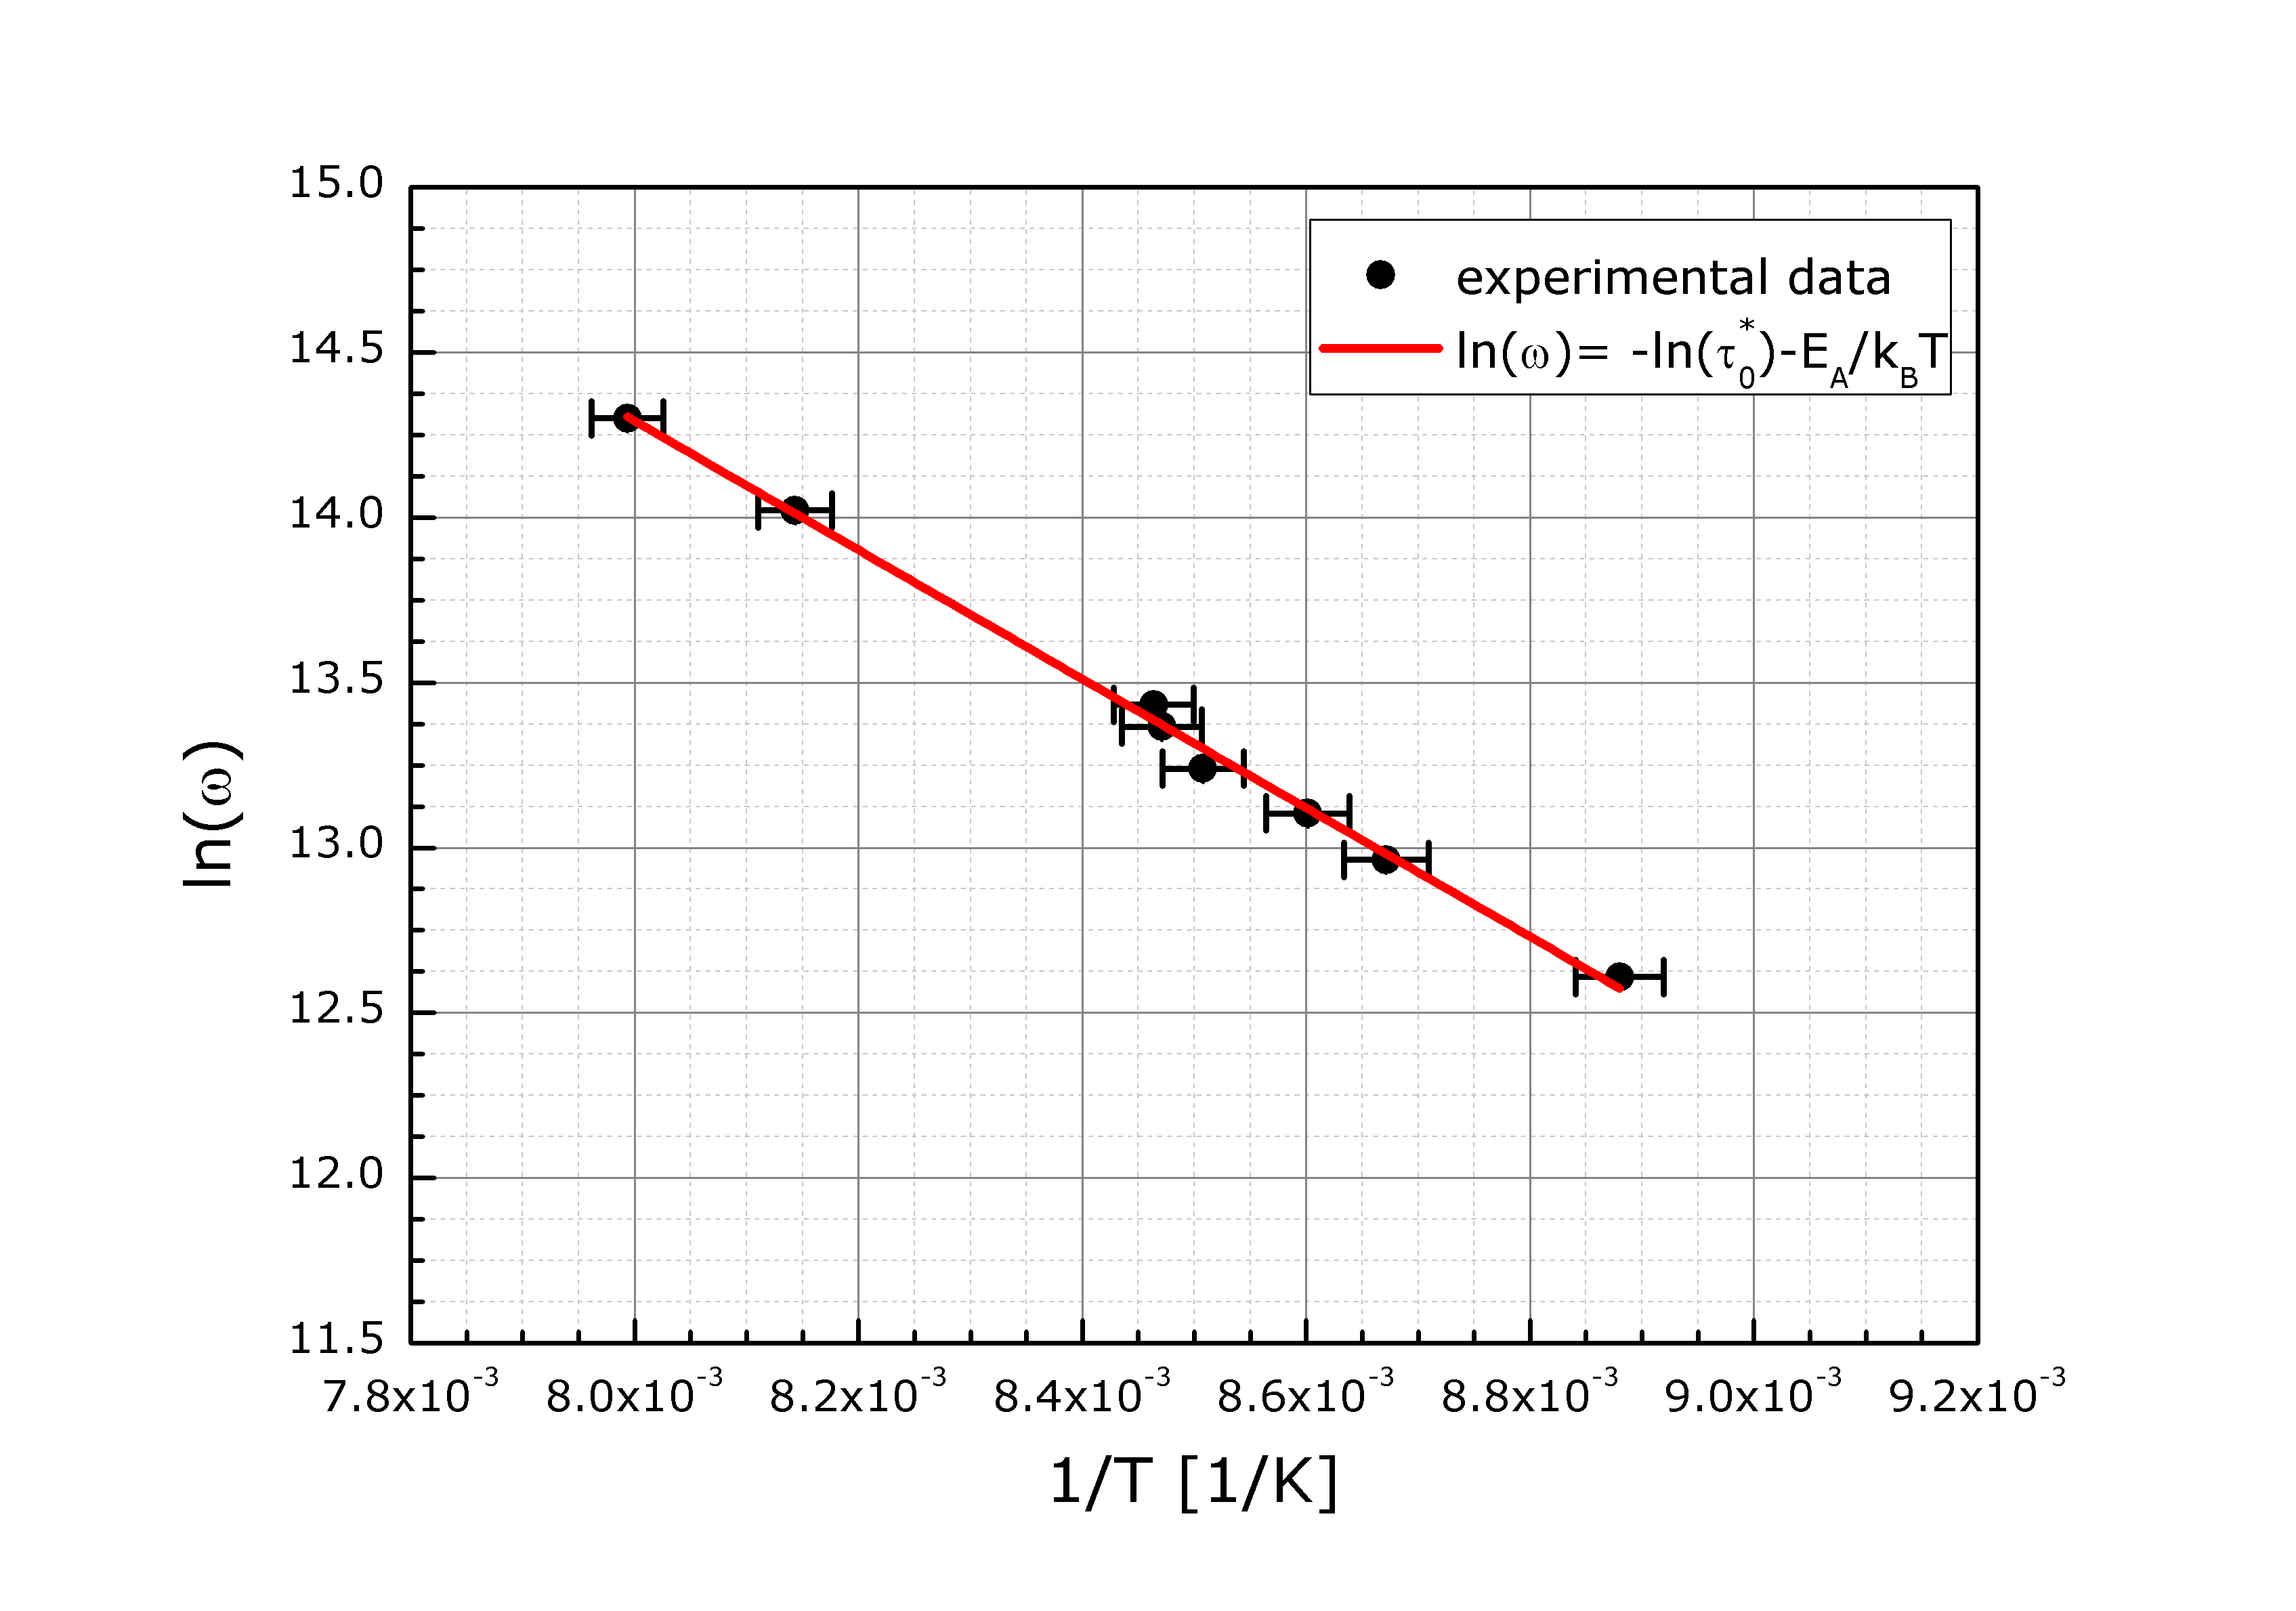
Bulk loss of Silicon
thermally activated process → transition in an energy level system
activation energy around 169 meV → oxygen impurity

Slide 24
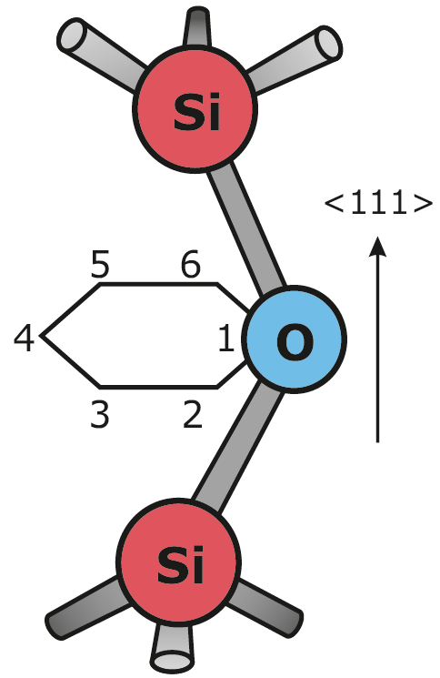
Bulk loss of Silicon
oxygen is bound in a siloxane-complex in Si
Si-O-Si complex similar to a molecule
→ different energy levels and transitions
mechanical loss should be dependent on
direction of stress/strain → mode dependent
drum modes: large effect in Si(111)
no effect in Si(100)
→ anisotropic loss effects

Slide 25
Optical properties of silicon
bad knowledge of optical properties at around 1550 nm and low temperatures
focus on:
optical absorption (heating)
thermo-optical coefficient dn/dT (thermo-refractive noise in transmittive components)

Slide 26
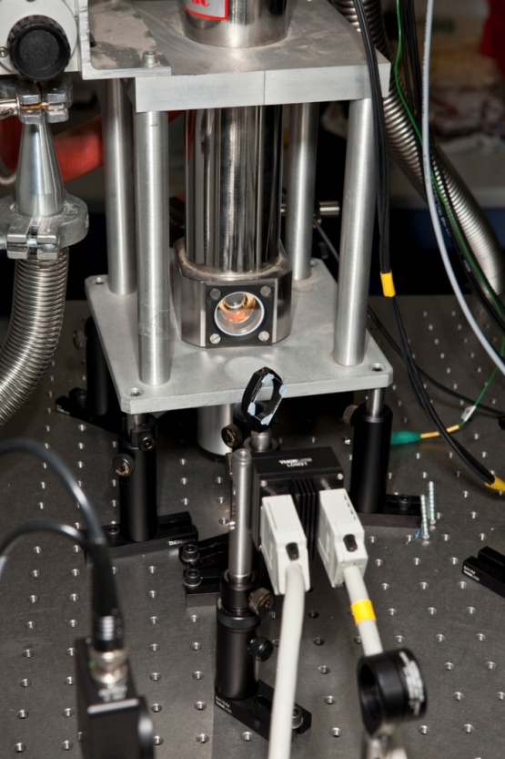
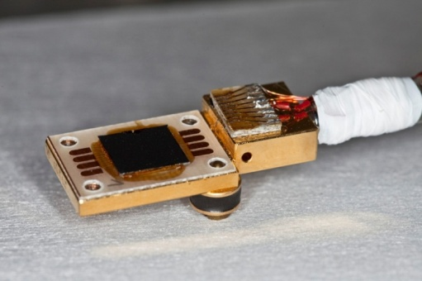
Optical properties of silicon
initial tests
standard optical setup for operation
between 2 and 400 K
simple transmission measurement
to obtain dn/dT
change in T
length change
through CTE
(known)
change in optical
pathlength through
change in n via dn/dT
(unknown)
sample thickness: 2 mm

Slide 27
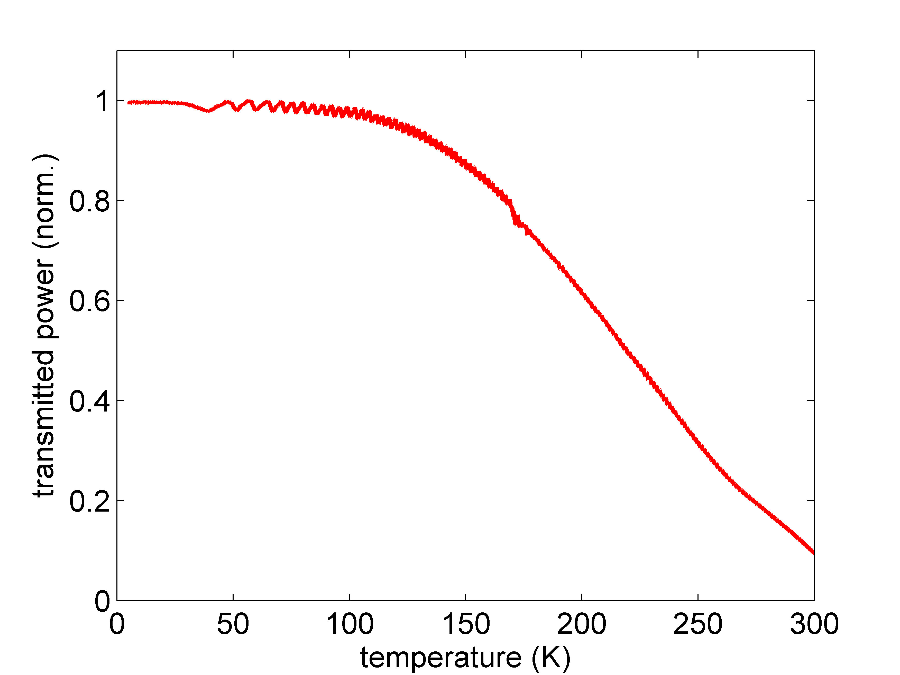
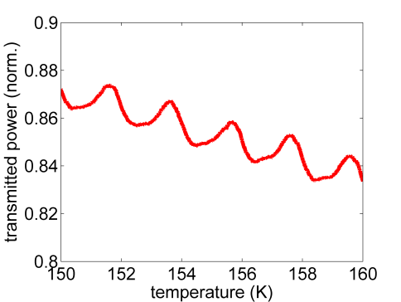
Optical properties of silicon
strong temperature
dependence of optical
absorption
1064 nm

Slide 28
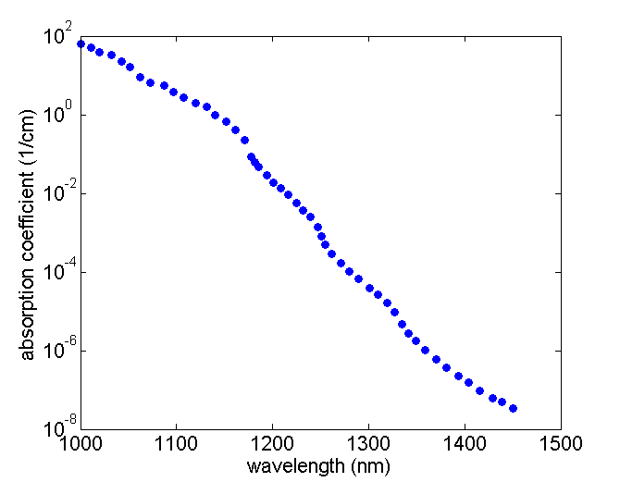
Optical properties of silicon – optical absorption
Si = indirect semiconductor → absorption needs phonons to be involved
(conservation of momentum)
conduction band
1 phonon
2 phonons
phonon
3 phonons
photon
valence band
300 K
[Keeves et al., J. Appl. Phys.]
phonon density strongly temperature dependent → optical absorption strongly
temperature dependen
remaining process: free carrier absorption (freeze out in Si – doping!)

Slide 29
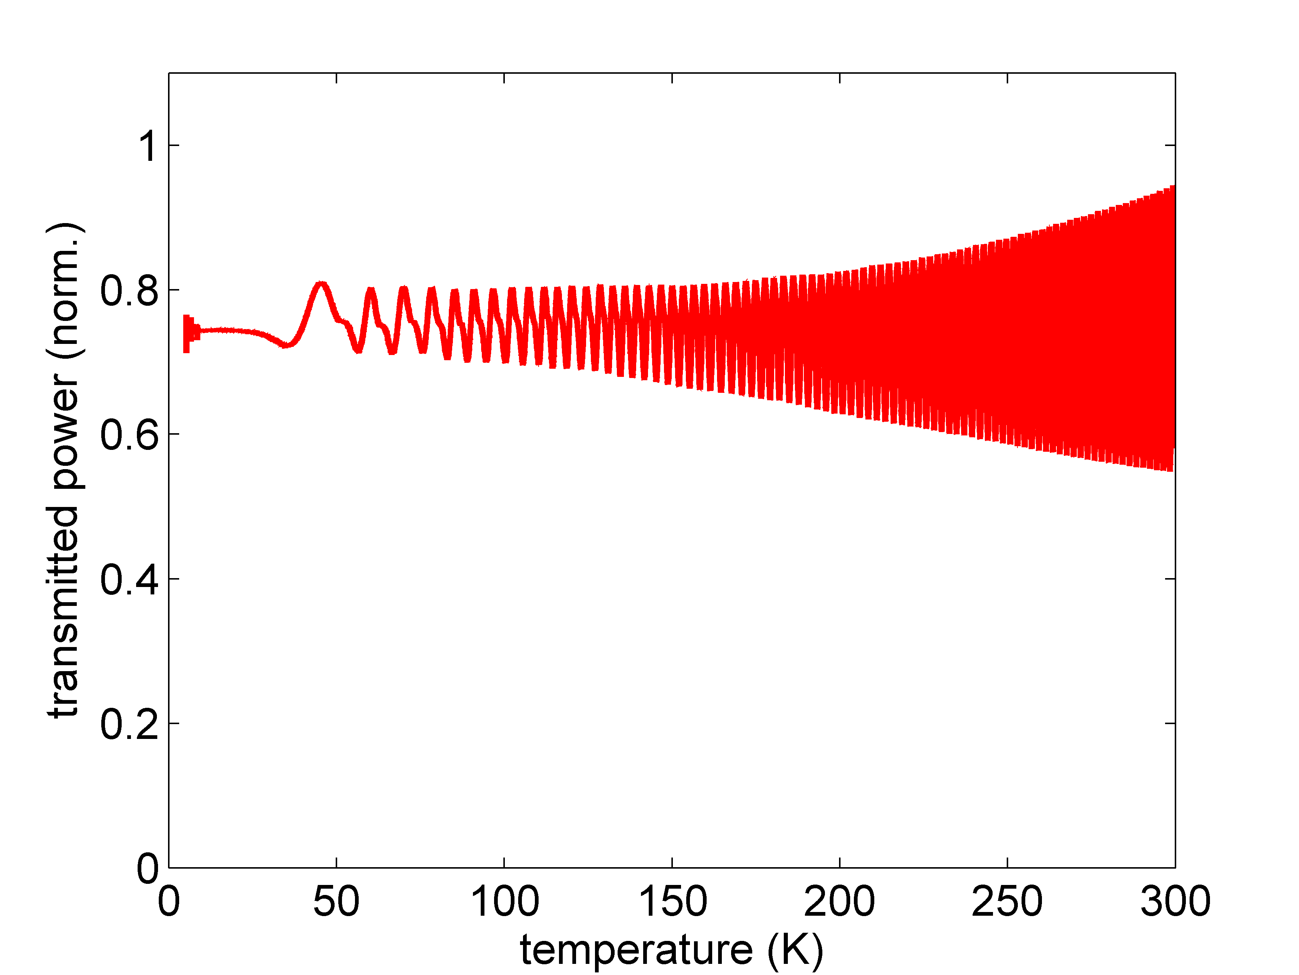
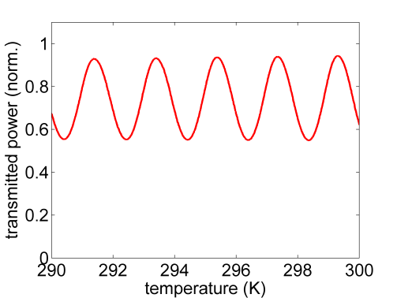
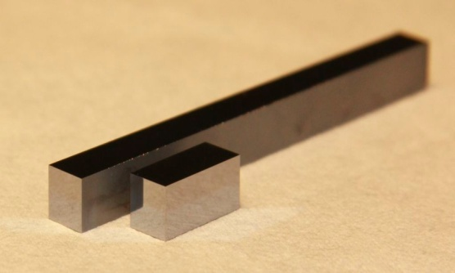
Optical properties of silicon
1550 nm
already high transmission at 300 K
and 1550 nm
very small dn/dT → larger interaction
length of light and matter needed
new samples: CZ samples, length 6 – 70 mm

Slide 30
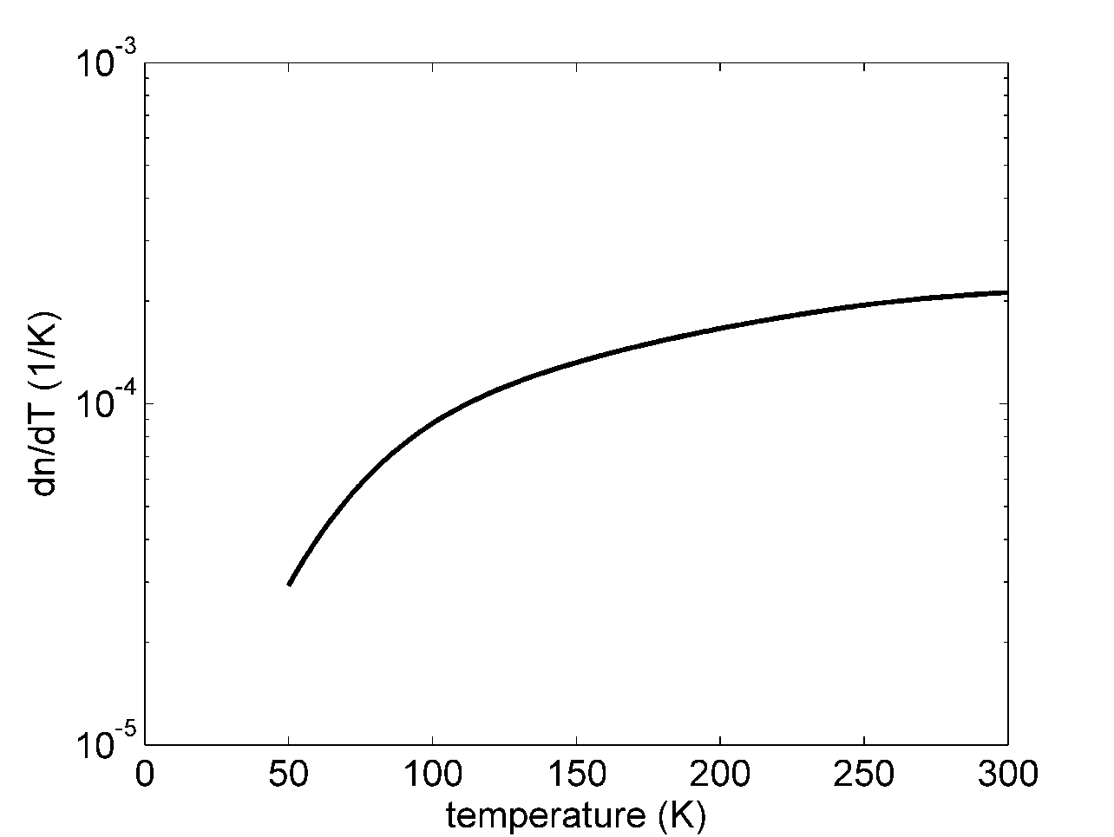
Optical properties of silicon
1550 nm
obtained values of a thin sample (0.5 mm) agree with literature values
(only 1 reference available)
[Frey - Temperature-dependent refractive index of silicon and germanium]

Slide 31
Summary
surface loss important for small scale devices (suspension, MEMs)
passivation technique needed to obtain low loss devices
oxygen causes optical and mechanical loss
study of oxygen induced losses in order to set upper limits for the O-concentration in test masses
measurement of missing optical properties
dn/dT
aim: absorption measurement on high purity silicon at low temperatures

