Slide 1



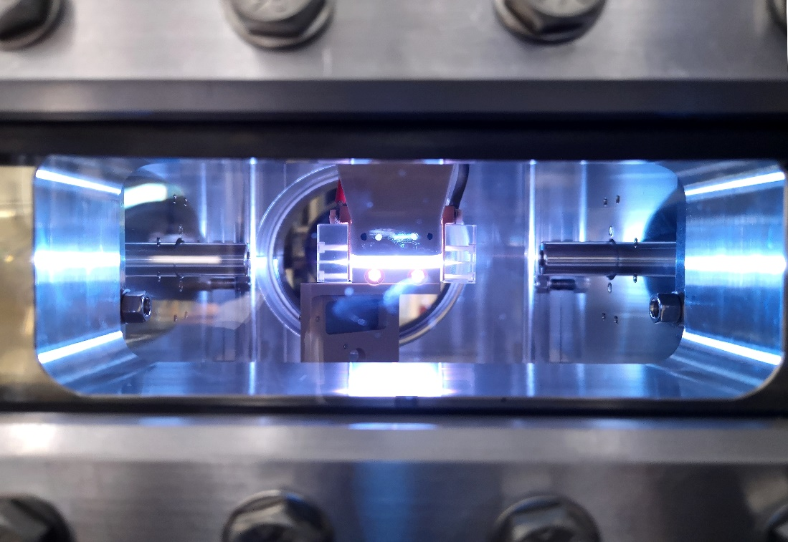
TDR Review Committee meeting
Plasma section
30th November-2nd December 2022
A. Biagioni, R.Pompili
Angelo.Biagioni@lnf.infn.it

Slide 2

Plasma section – RC comments
2.8 Plasma Section
Very good progress was made with the plasma source for the ∼500MeV energy gain. An ∼40 cm capillary discharge now operates at the plasma laboratory. It is similar to the ∼3 cm discharge, also occurring in a 3D-printed capillary, but with six gas inputs, instead of two. It produces a plasma with density varying.
longitudinally between ∼1.5 and 3×1017 cm−3. Surprisingly, the plasma density variation is comparable to that observed with the 3-cm-long capillary and also occurs over the entire half length of the discharge. The hypothesis is that the variation in plasma density over the length of the discharge can be compensated by varying the diameter of the discharge tube.
Vacuum measurements show that operating at 100 Hz requires an almost continuous gas flow. Operating at 400 Hz requires a continuous flow, posing a challenge for maintaining good vacuum before and after the plasma source.
Measurements also show that the density of the discharge in a 3D-printed capillary decreases as a function of the number of discharges, e.g., 30% over one hundred thousand events. On the contrary, it remains constant over that number of discharges in a sapphire capillary. A cheaper, 3D-printed glass capillary may offer the same lifetime as a sapphire capillary.
A plasma length allowing for 5 GeV energy gain, longer but also with a larger transformer ratio acceleration maybe possible by stacking three 40-cm-long discharges.
The use of a laser pulse to decrease time jitter of the discharge with respect to the electrical trigger and reduce variations of plasma density from event to event was presented at previous meetings. Is this method applicable to the longer discharge and will it be implemented (if needed)?
The RC recommends that capillaries with tapered radius to compensate for the (non constant) longitudinal plasma density profile measured in the constant-radius capillaries be tested very soon. This test can be done with the short capillary. For consistency, requirements in terms of uniformity of the longitudinal plasma density should be determined from simulation studies. Alternatively, numerical simulations may be performed to determine the effect of the observed non-uniformity on the beam and FEL parameters. Density ramps at the plasma entrance and exit of the capillary should also be carefully characterized and included in numerical simulations.
2
30th November – 2nd December 2022
TDR review committee

Slide 3
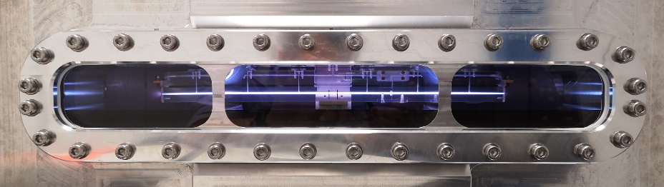
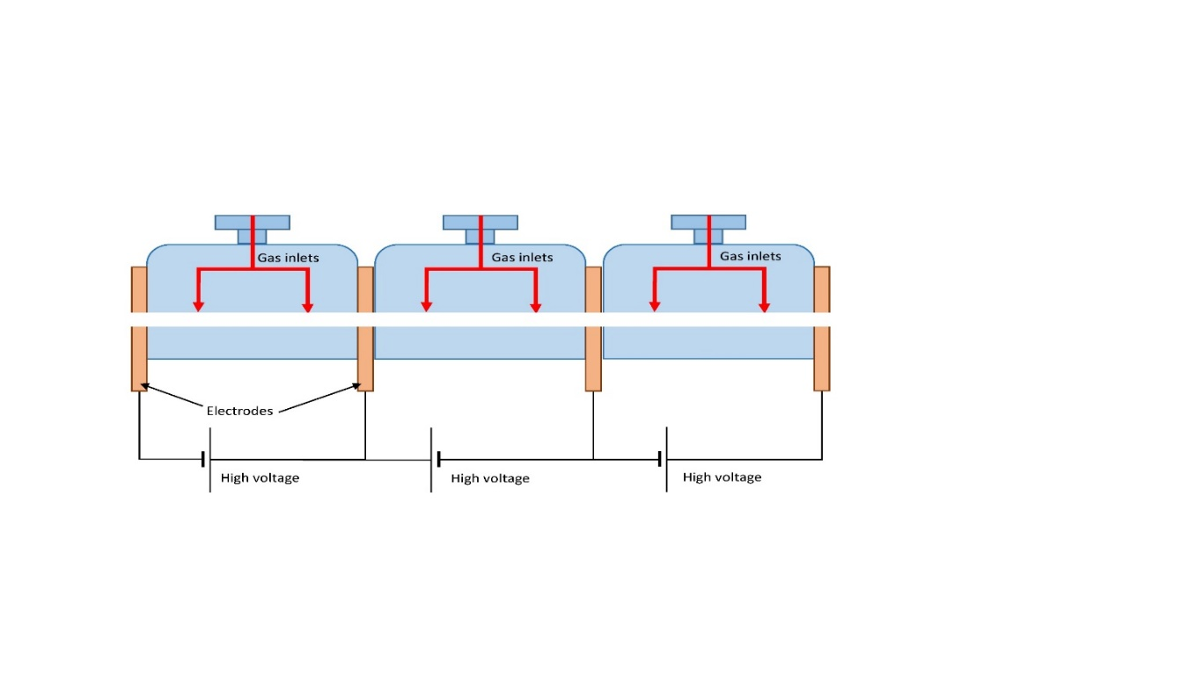
Plasma module developments: summary
Plasma module for EuPraxia project
1.1 GeV (1.5 GV/m 40cm capillary - density 10¹⁶ cm-3)
  Direct plasma discharge for 40cm long capillary
    Stability
    Longitudinal profiles
  Plasma sources operating at 100 – 400 Hz
    Vacuum system
    Study on materal science to increase capillary’s longevity
    High-voltage sources for plasma formation
Segmented capillary
    Plasma sources larger than 40 cm (m-scale)
    Longitudinal density modulation
    5 GeV case for EuPRAXIA (1.5 GV/m m-scale capillary - density 10¹⁶ cm-3)
40cm capillary is working
3
30th November – 2nd December 2022
TDR review committee

Slide 4
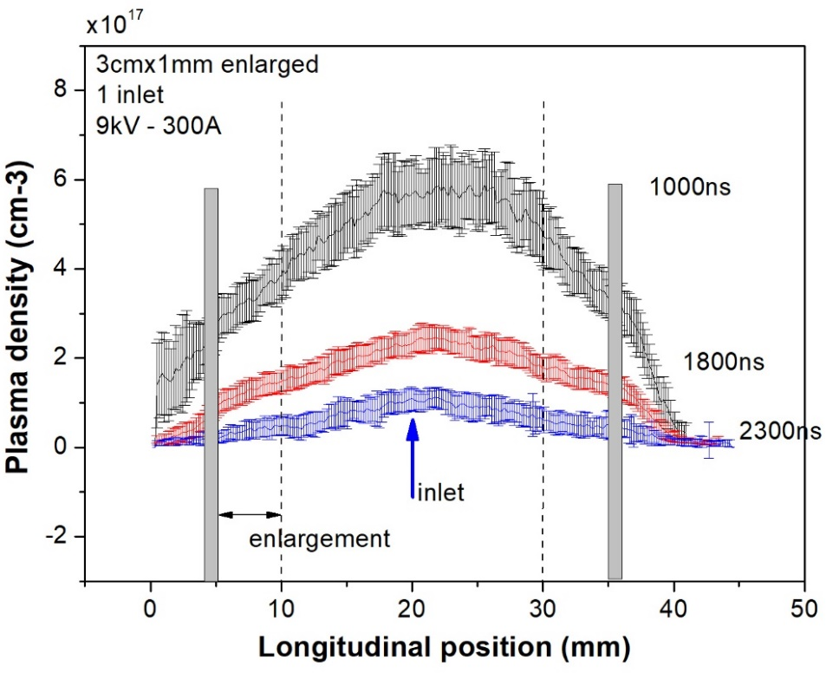
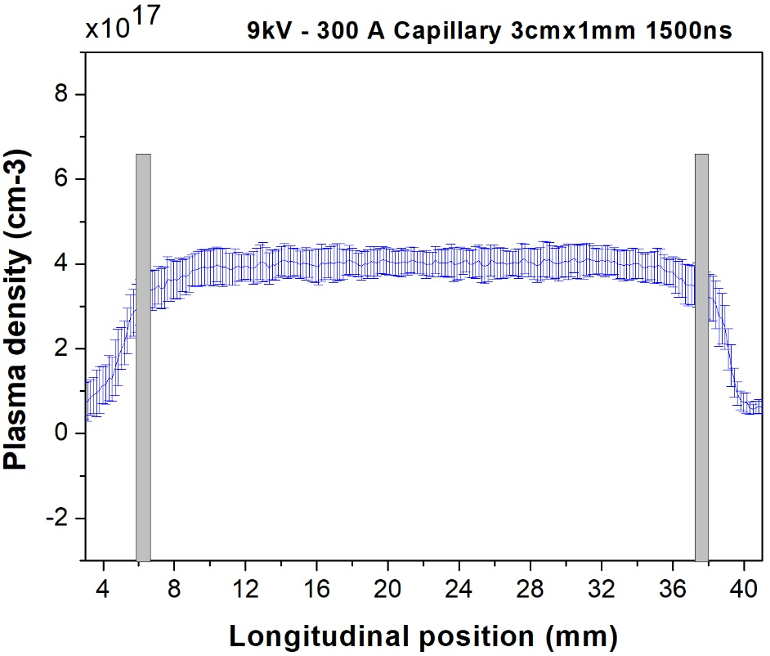
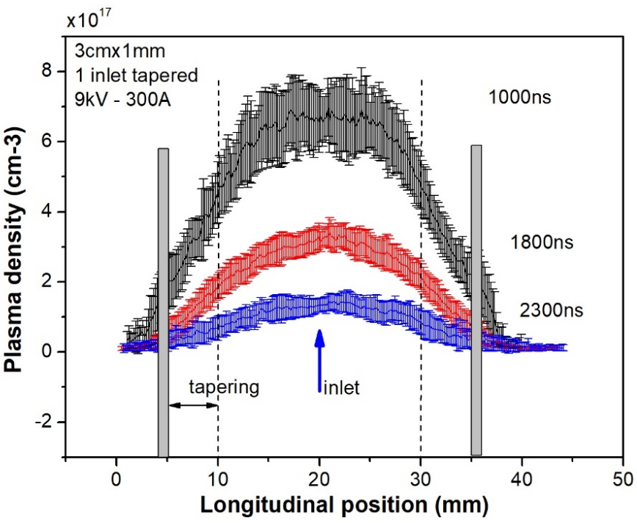
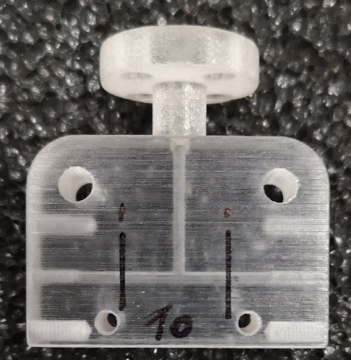
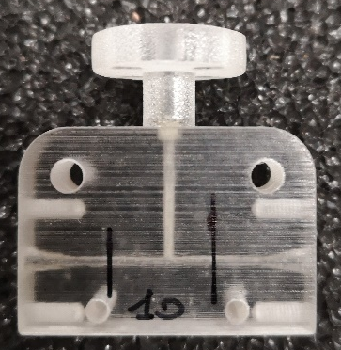
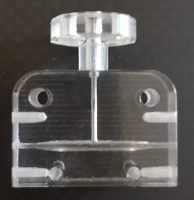
Plasma module developments: channel shaping
Presented in the previous RC 26 - 27th October 2021
Cigar-shape
inlet
Laser trigger and
Cigar-shape capillary
4

Slide 5
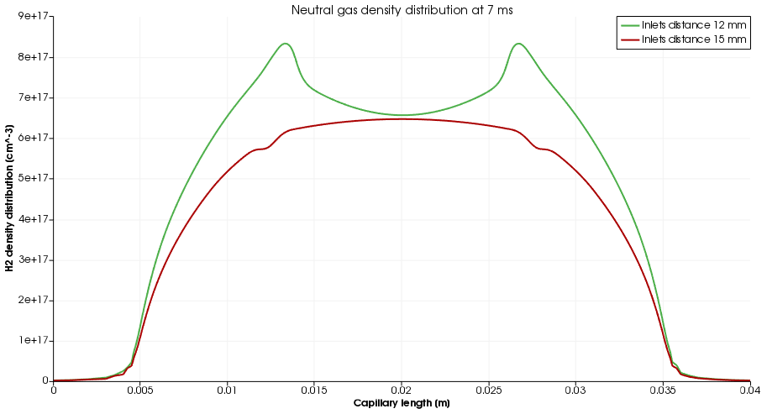
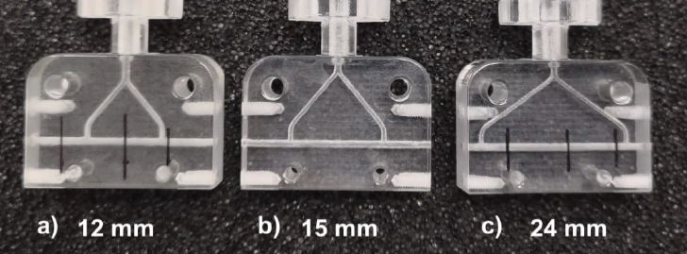
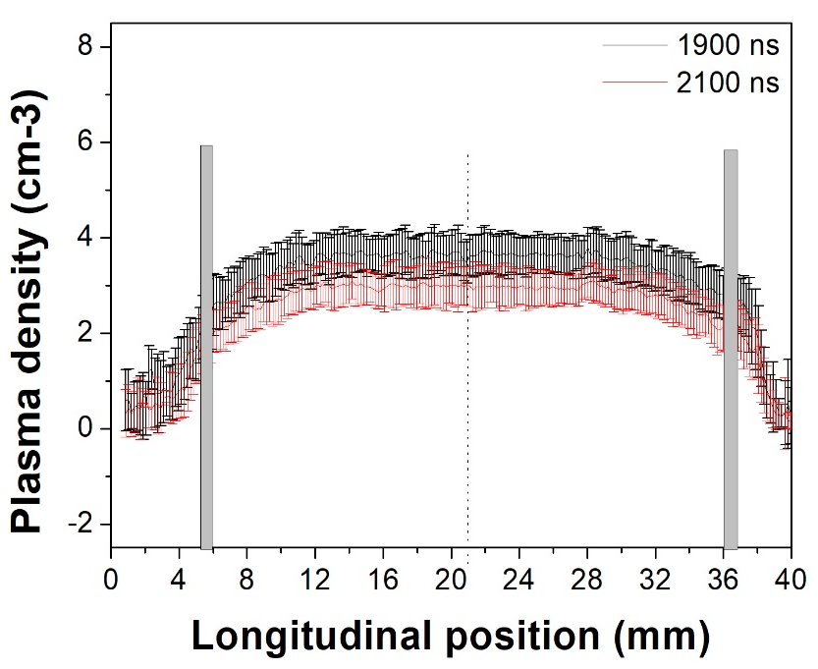
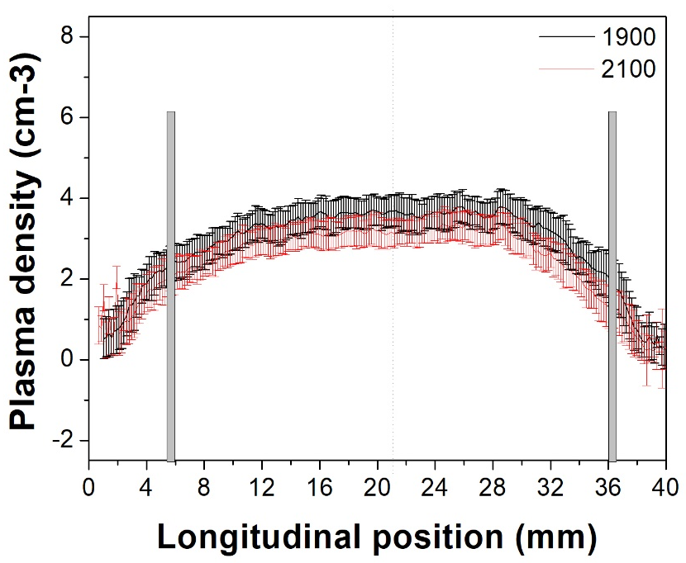
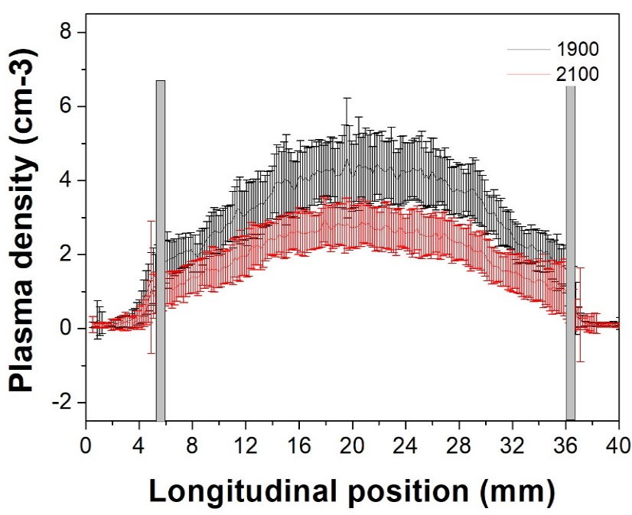
Plasma module developments: channel shaping
8E17
6E17
Neutral gas density
12kV 300 A
10¹⁷
Longitudinal position (mm)
18 mm/30mm
14 mm/30mm
1
1.5
2
inlet
inlet
inlet
5
30th November – 2nd December 2022
TDR review committee

Slide 6
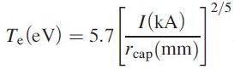
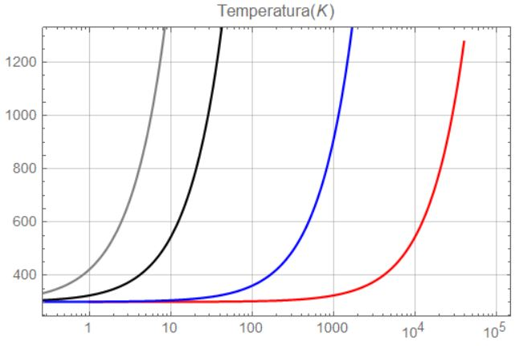


Plasma section developments: erosion of walls capillary
Mitigation of erosion of the capillary walls can be achieved by reducing the heat flux
PWFA
5x10¹⁶cm⁻³ Pgas=20mbar
Ip=300A Rcap=500um
Lcap=30mm Δt=600ns
the energy deposited into the capillary per shot:
≈ 4.6 eV
E = Rp Ip² Δt = 50 mJ/shot
Spitzer plasma resistance
Wall temperature (K)
Conductive heat transfer law:
Plastic
400K
k=0.2
T2=300K
r2 =5mm
Glass
1700K
k=1-3
Sapphire
2300K
k=40
q
Discharge
hating
300A, 100Hz
Cylinder geometry
T1,r1
Diamond
3800K
k=1000
Discharge
Heating
300A, 400Hz
Water
Cooling
300K
A. Gonsalves, et al, Demonstration of a high repetition rate capillary discharge waveguide, JAP, 119,10.1063/1.4940121
Dissipated P(W)
30th November – 2nd December 2022
20W
6
Angelo.Biagioni@lnf.infn.it

Slide 7
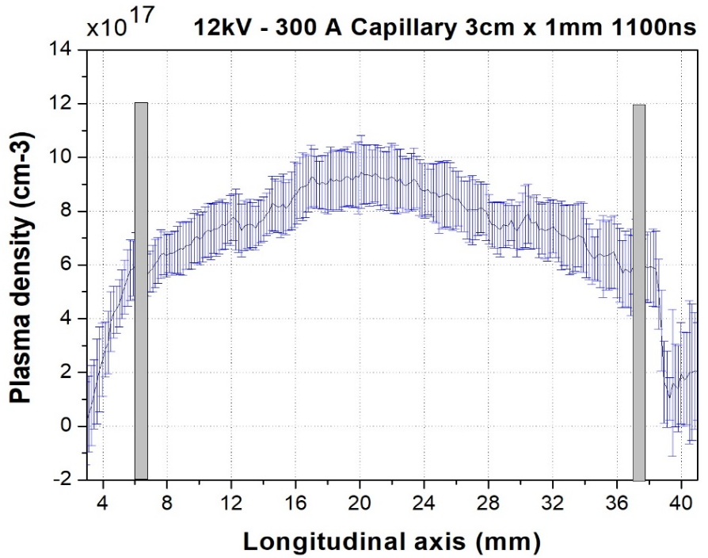
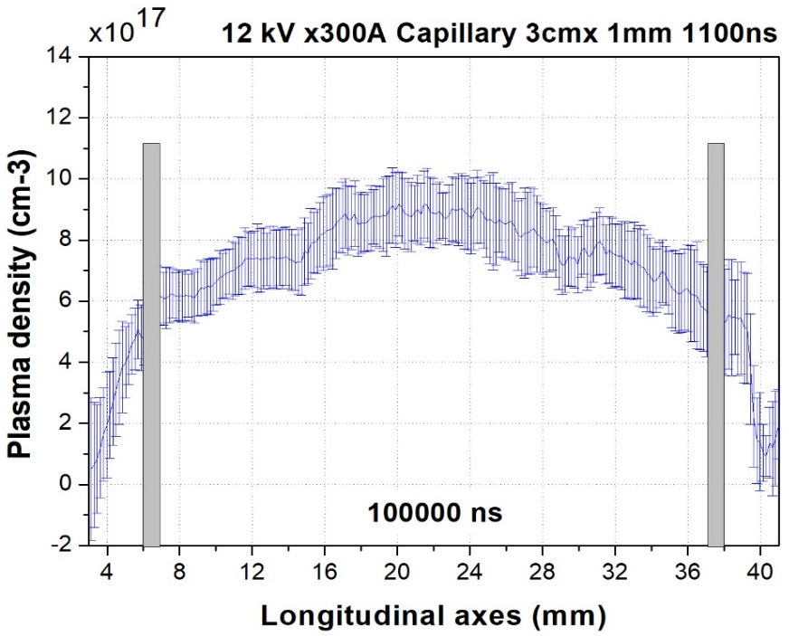
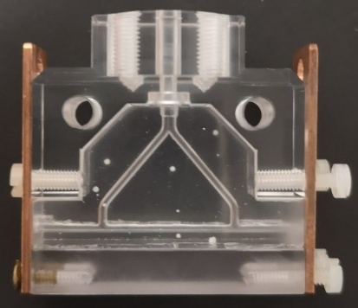
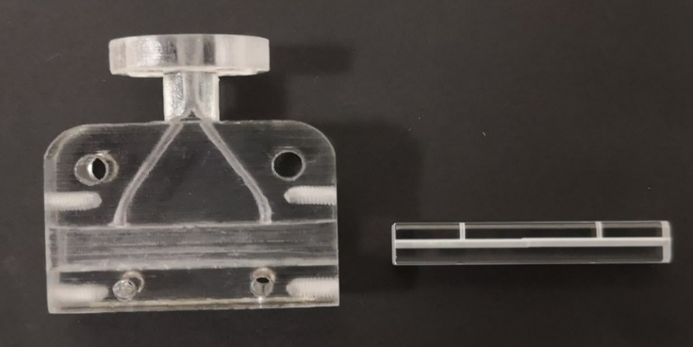
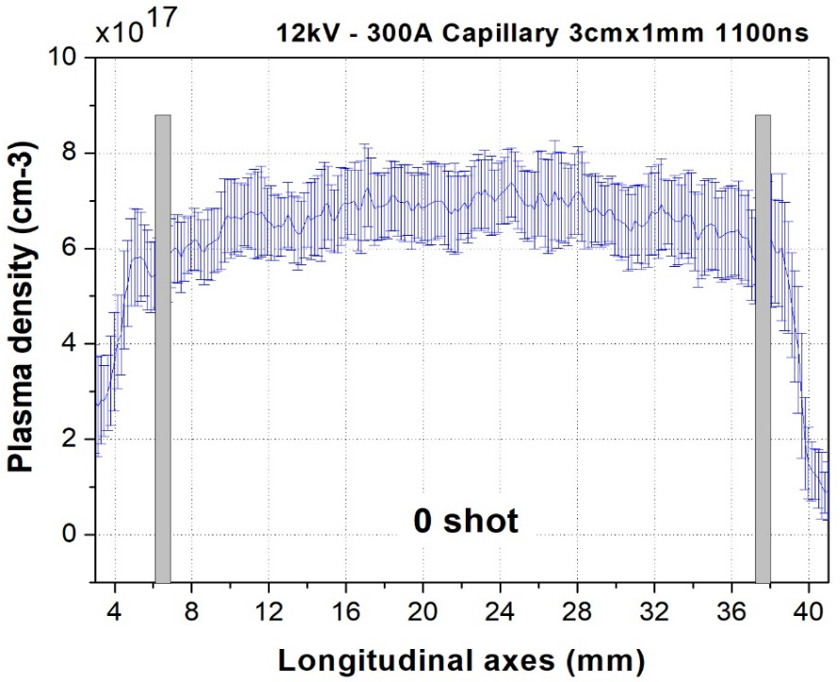
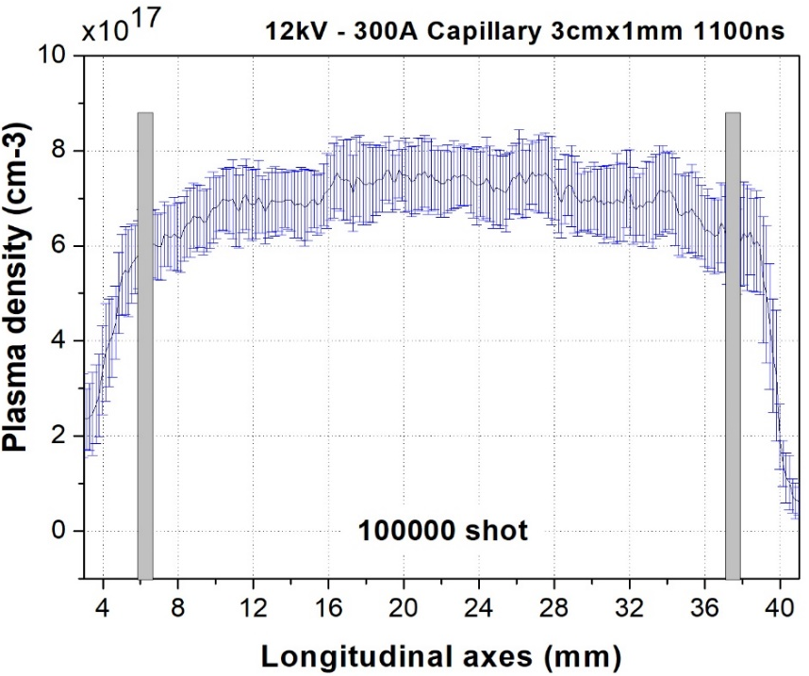
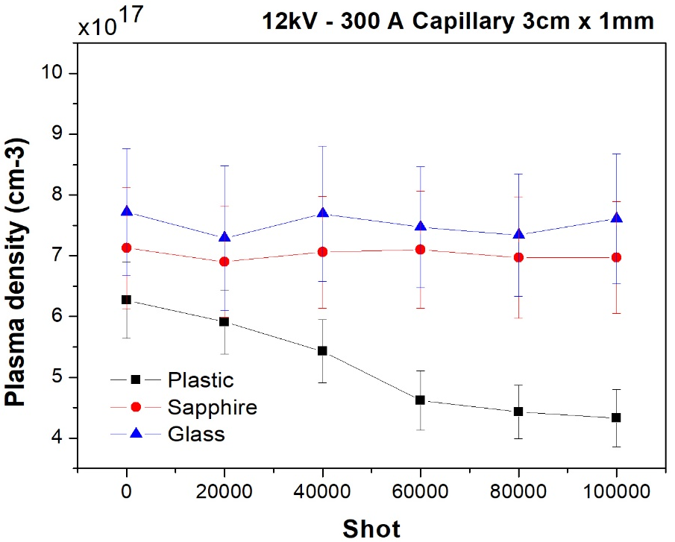
Plasma section developments: erosion of the walls capillary
1Hz repetition rate
Presented in the previous RC 6 - 7th June 2022
glass
3D-printed glass capillary
Sapphire
0 shot
100000 shot
Sapphire capillary
Comparison
7

Slide 8
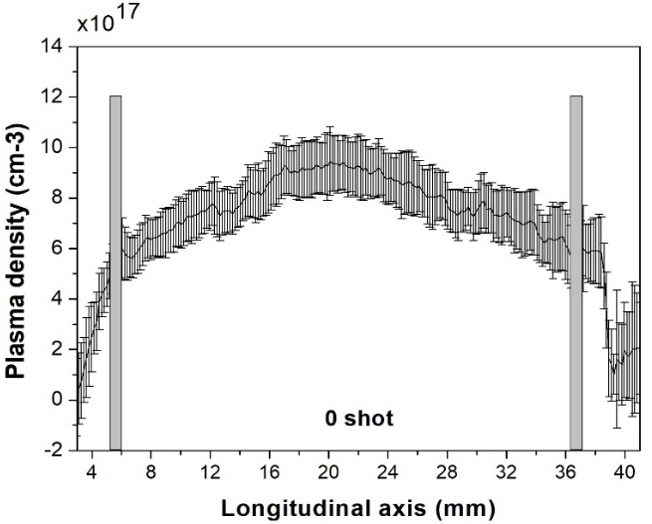
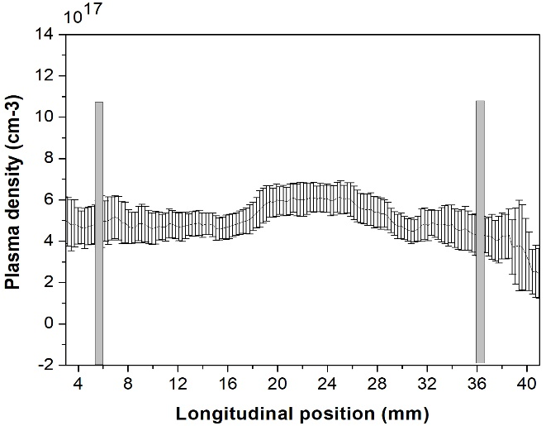
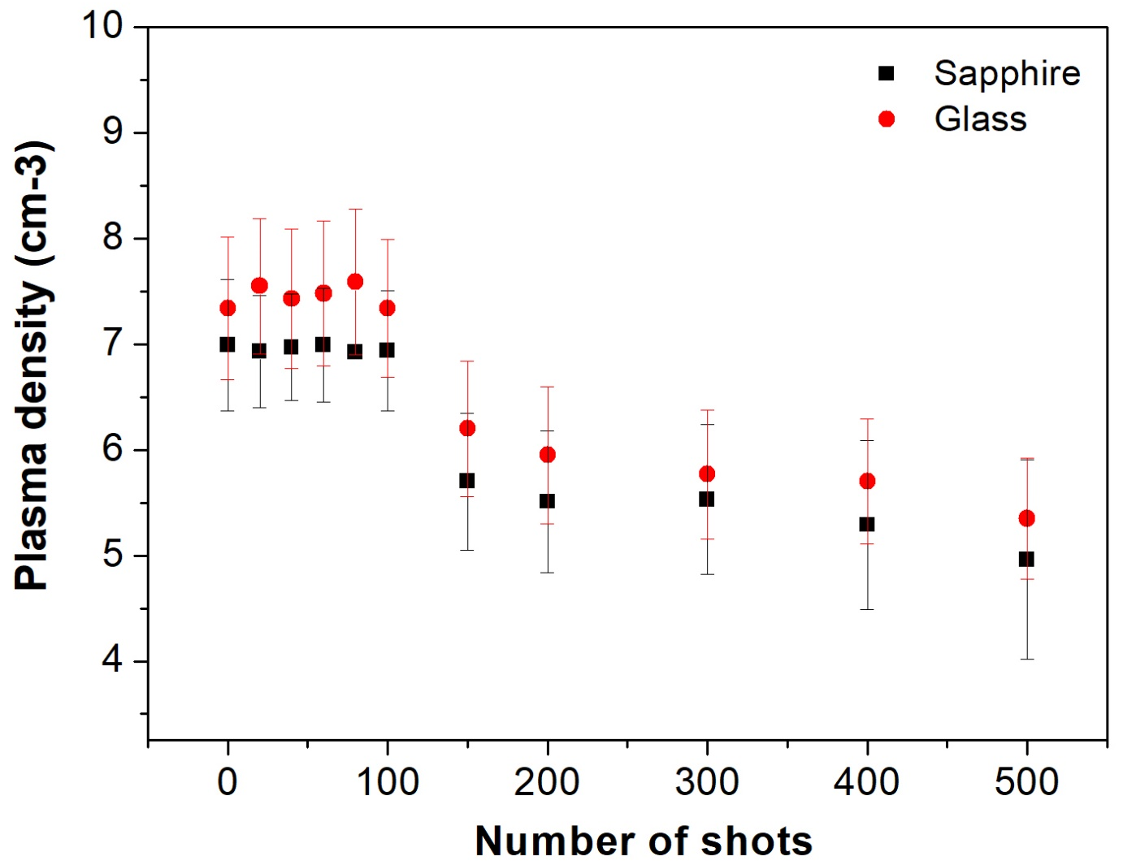
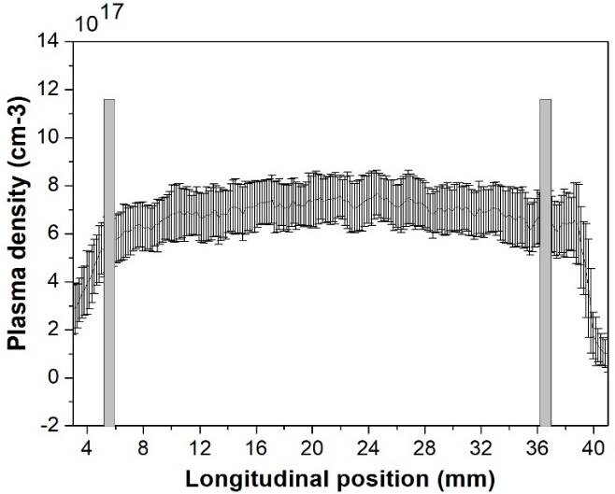
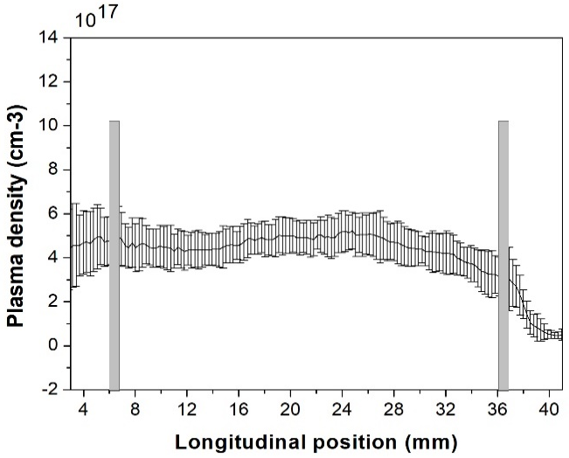
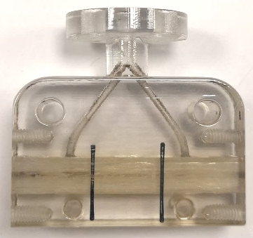
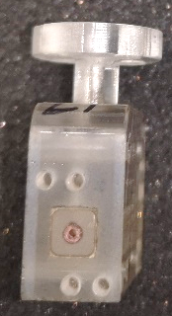
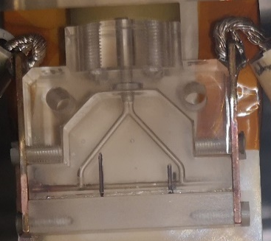
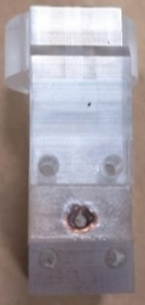
Plasma section developments: erosion of walls capillary
1-5 Hz repetition rate
Glass capillary
Starting
5 Hz
0 shot
500000 shot
Sapphire capillary
Rep rate 1 Hz
0 shot
500000 shot
Sapphire
Glass
Stronger materials as sapphire or Glass can support a larger number of shots at 1 Hz but higher repetition rates produce a deformation of the channel that in turn changes the longitudinal density profile
8
Angelo.Biagioni@lnf.infn.it

Slide 9
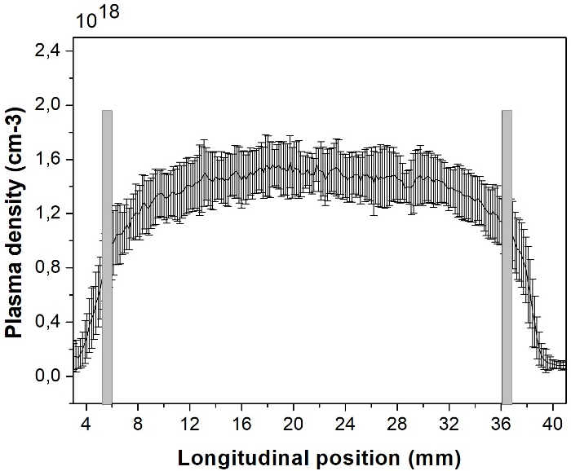
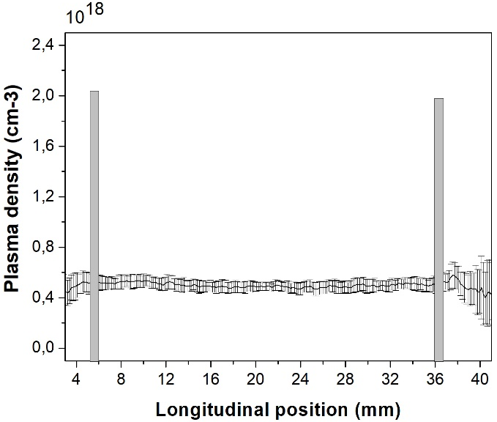
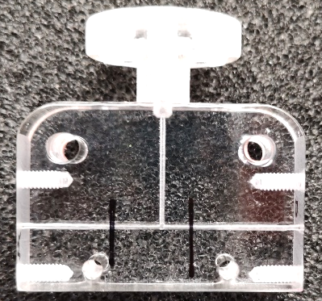
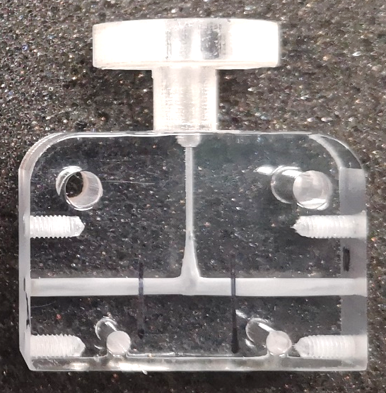
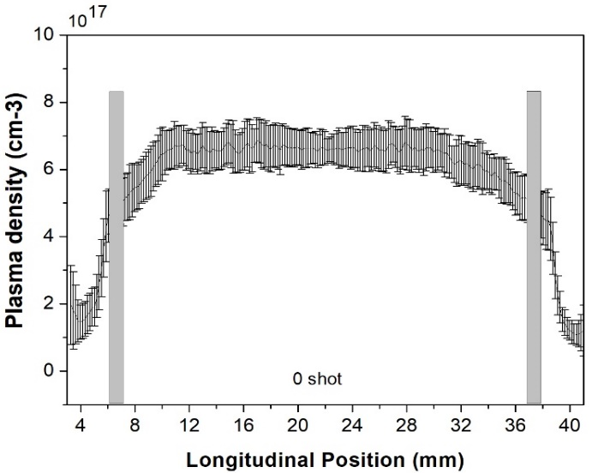
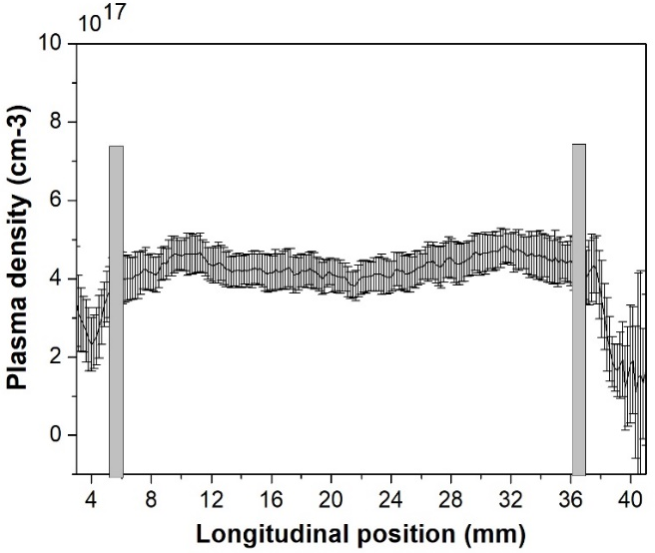
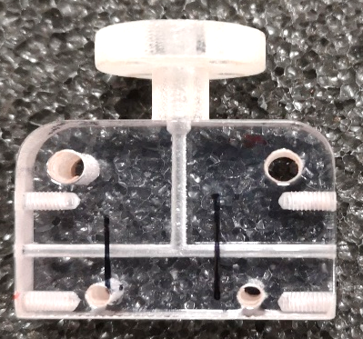
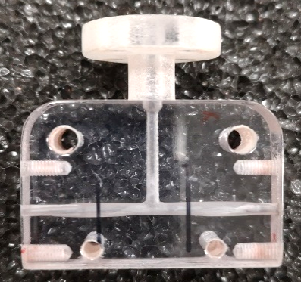
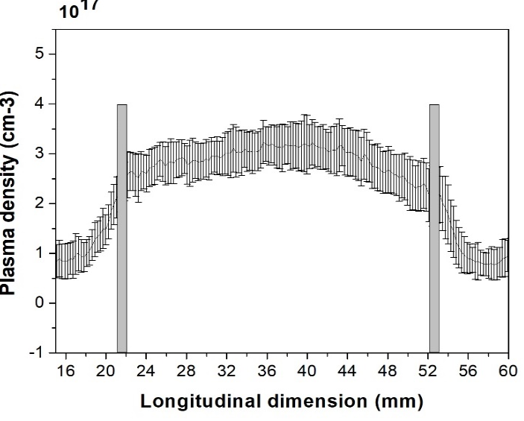
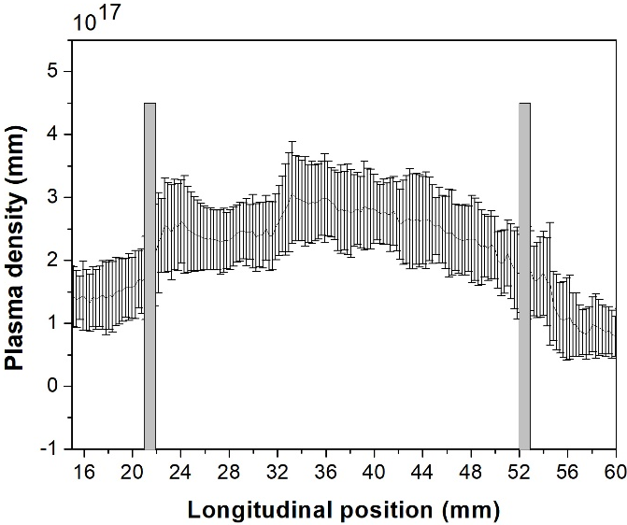
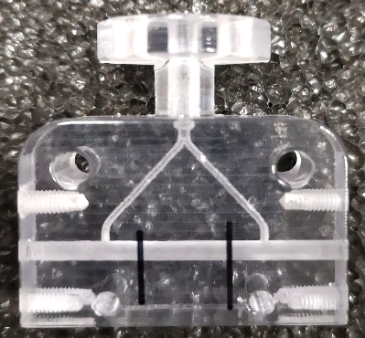
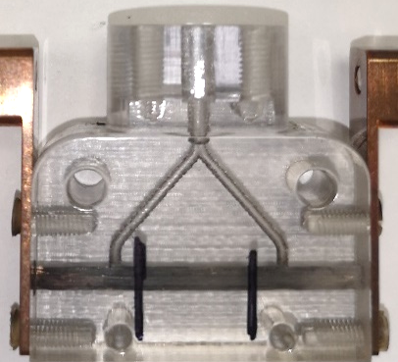
Plasma section developments: erosion of walls capillary
3cmx0.5mm capillary
Ip = 300 A
Te ≈ 6,1 eV
1Hz repetition rate
0 shot
50000 shot
The larger is the current density, the stronger is the damaging of the plasma channel, because the thermal energy to be dissipated by the capillary walls will increase
3cmx1mm capillary
Ip = 300 A
Te ≈ 4.6 eV
0 shot
100000 shot
3cmx2mm capillary
Ip = 300 A
Te ≈ 3,5eV
0 shot
100000 shot
9
30th November – 2nd December 2022
TDR review committee

Slide 10
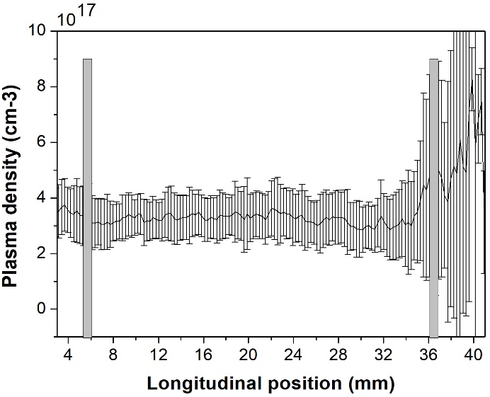
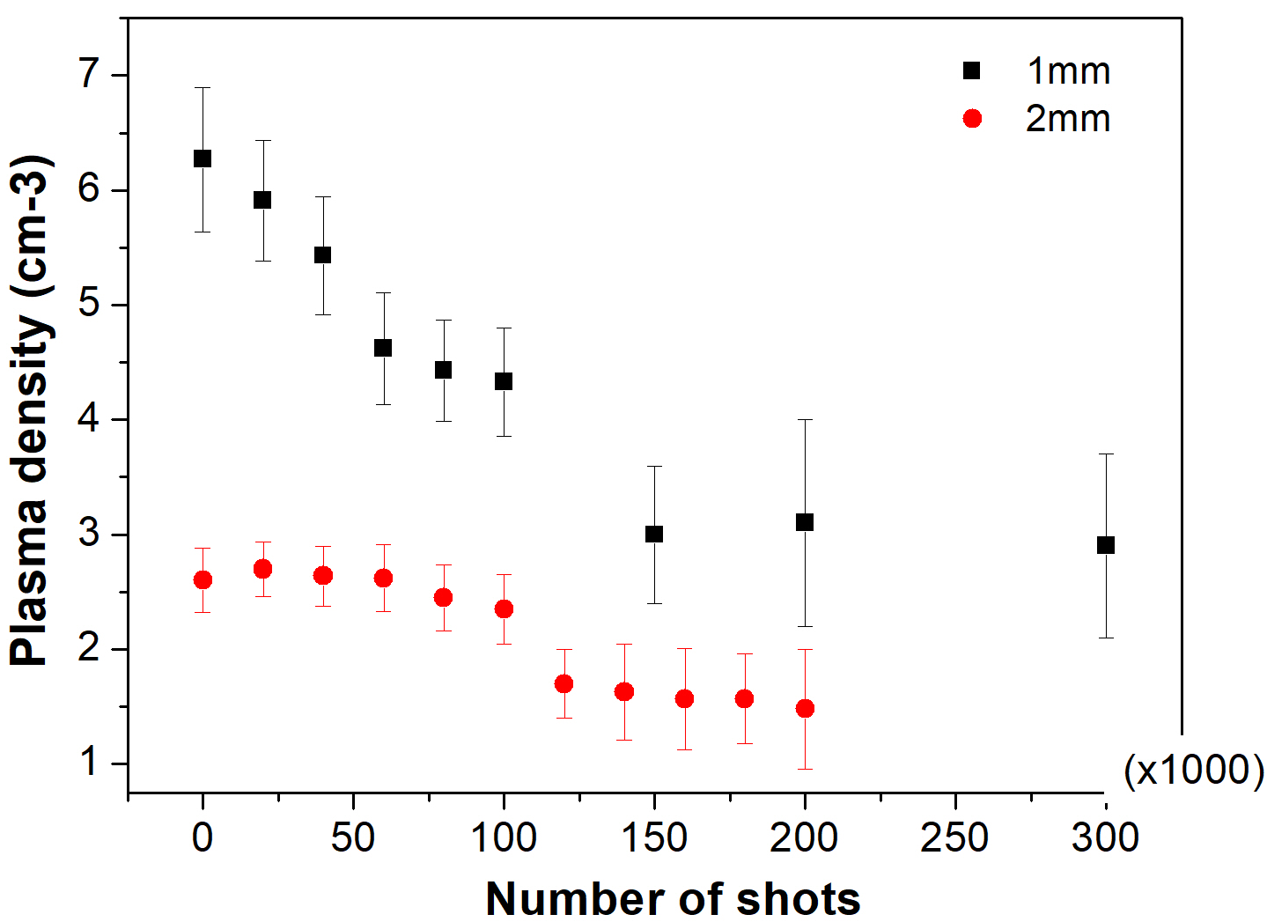

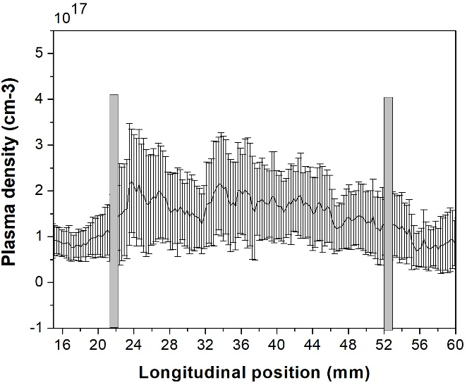
Plasma section developments: erosion of walls capillary
1-5 Hz repetition rate
1 mm
300 A
0 shot
300000 shot
Starting
5 Hz
Rep rate 1 Hz
2 mm
300 A
0 shot
200000 shot
The damaging of the capillary depends on the plasma current density and also on the repetition rate of the discharge, since the higher is the repetition frequency the larger is the thermal energy accumulated on the capillary walls
10
30th November – 2nd December 2022
TDR review committee

Slide 11
Plasma section developments: erosion of walls capillary
Glass 3D printer
Sapphire
3cmx0.5 mm and 3cmx1mm show a strong deformation but no blackened parts
Sapphire and glass materials do not show a deformation along the longitudinal coordinate like the plastic capillary composed of plastic but have a blackened parts on the positive electrode
Also the 3cmx2mm channel does not show a strong deformation but it is completely blackened
Plastic 3D printer
3cmx0.5mm capillary
Ip = 300 A
3cmx1mm capillary
Ip = 300 A
3cmx2mm capillary
Ip = 300 A
11
30th November – 2nd December 2022
TDR review committee

Slide 12
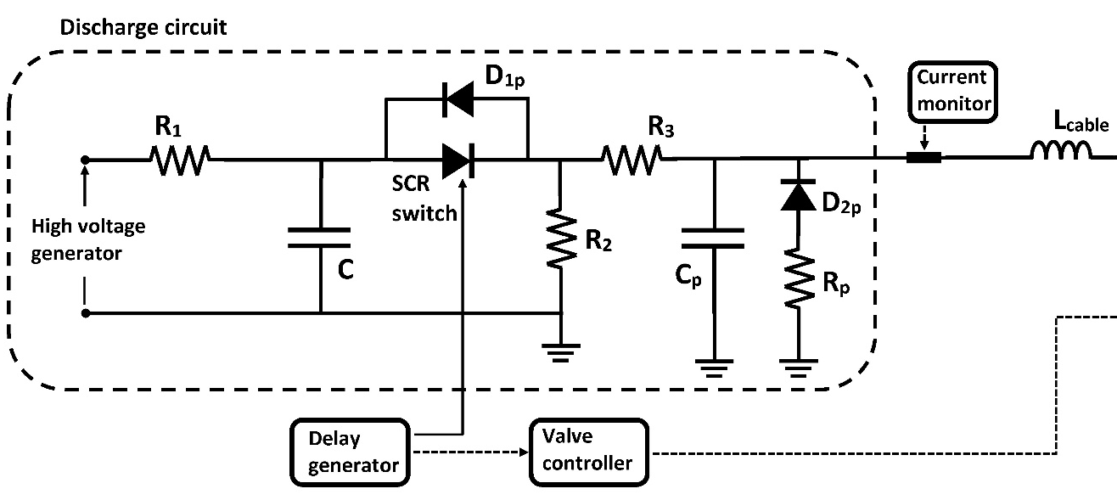
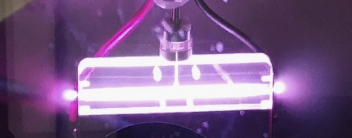
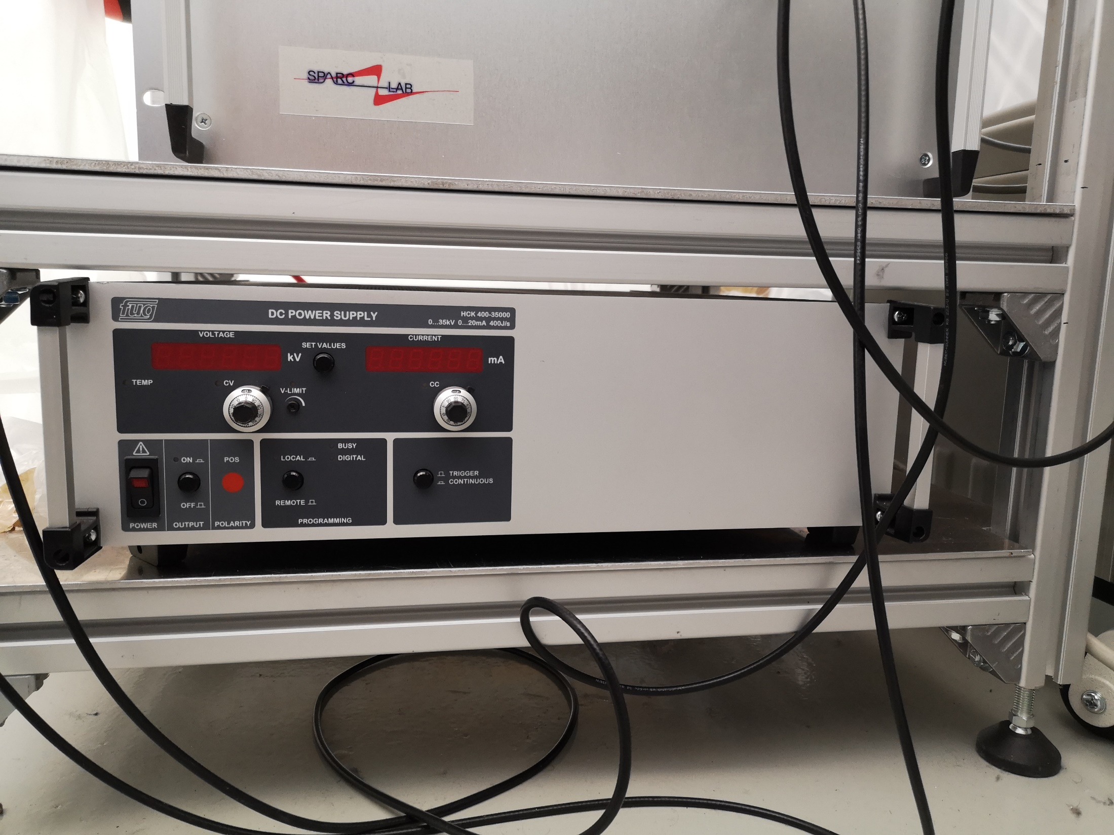






Plasma section developments: high voltage source for plasma formation
HV gen
3cmx1mm
6kV – 500A
HVpulser
20/40 Hz Rep rate
(measured) is
the current limit
Due to HV gen
τ =RC=1us
1.2 kA
2.5 kA
In priciple, the HV pulser is able to support
400 Hz RepRate, heating issues can limit the
RepRate, but the primary electric source could represent a limit to operate at High rep rate:
5kV
Vc
t_{trig}=35ms
Q=CV=10kV x 40nF = 0.4x10⁻³ C
t_{c} = dQ/I_{c} = 20 ms per pulse (with I_{c}=20 mA)
Max Rep rate 50 Hz with the current HV gen
tc=20ms
12

Slide 13

EuPRAXIA plasma sources: 40cm long capillary
Presented in the previous RC 6 - 7th June 2022
Operating conditions:
Rep rate at 1 Hz
10 kV – 380 A minimum values to have the ionization (3 kV – 140 A for 3cmx2mm)
Aperture time E-valve/Voltage delay is 8ms/12 ms (3-4 ms/5-6 ms for 3cmx2mm)
6 inlets of 1 mm in diameter separated by 60mm/80mm (1 or 2 inlets for 3cmx2mm)
13
30th November – 2nd December 2022
TDR review committee

Slide 14




EuPRAXIA plasma sources: 40cm long capillary
Presented in the previous RC 6 - 7th June 2022
Long. Traslation of optics
Density measurements
All mirrors and lenses have been mounted on movable breadboards In order to scan the entire lenght of the capillary
Blind area where there is windwow supports (could be reduced)
10¹⁶ - 10¹⁷ cm-3 range (EuPRAXIA goal)
Long. Traslation to cover
the entire capillary
Spectrometer
Controller
20cm
Spectrometer
Controller
Spectrometer
Spectrometer
14

Slide 15



EuPRAXIA plasma sources: 40cm long capillary
3cmx2mm 6kV - 300A Plastic
Elctrode
0.7x10¹⁷ cm-3
related to 15mm
inlet
Elctrode
0.6x10¹⁷ cm-3
related to 200mm
Inlets
15
30th November – 2nd December 2022
TDR review committee

Slide 16


EuPRAXIA plasma sources: segmented capillary
Segmented capillary
The critical point is the electrode insertion to avoid gas leaks (two prototypes already produced)
Elongation of the maximum length of plasma sources up to m-scale with HV pulses less tahn 10 kV
Longitudinal density modulation by changing voltage or delay time
Transition area of the plasma density around the electrical gorund has to be characterized
Electrical
ground
n_{e}
8 cm
16
30th November – 2nd December 2022
TDR review committee

Slide 17




EuPRAXIA plasma sources: segmented capillary
5.5E16
inlet
HV₁
HV₂
electrical ground
electrode
electrode
17
30th November – 2nd December 2022
Angelo.Biagioni@lnf.infn.it

Slide 18

Conclusions
All sections of the Plasma module for EuPraxia project are ongoing
1.1 GeV (1.5 GV/m 40cm capillary - density 10¹⁶ cm-3)
  Direct plasma discharge for 40cm long capillary
    Stability
    Longitudinal profiles
  Plasma sources operating at 100 – 400 Hz
    Vacuum system
    Study on materal science to increase capillary’s longevity
    High-voltage sources for plasma formation
Segmented capillary
    Plasma sources larger than 40 cm (m-scale)
    Longitudinal density modulation
    5 GeV case for EuPRAXIA (1.5 GV/m m-scale capillary - density 10¹⁶ cm-3)
40cm capillary is working
Design of Segmented capillary
18
30th November – 2nd December 2022
TDR review committee

Slide 19
Thank you for your
attention
Angelo.Biagioni@lnf.infn.it

