Slide 1
EuPRAXIA@SPARC_LAB
General Introduction and Project Overview
at SPARC_LAB
M. Ferrario, INFN
IV EuPRAXIA@SPARC_LAB Review Committee Meeting, LNF November 30, 2022

Slide 2
AGENDA
30/11 Wednesday
14:30 General introduction and project overview - M.Ferrario
15:15 Scientific Case – F. Stellato
16:00 Layout & Infrastructure – A.Ghigo
16:45 Coffee Break
17:15 Sparc_Lab latest results – R.Pompili / V.Shpakov
18:00 Closed Session
01/12 Thursday
9:00 Beam dynamics S2E simulations – C.Vaccarezza
9:45 Plasma module development – A.Biagioni
10:30 FEL & Undulators – L.Giannessi
11:15 Coffee Break
11:45 RF sections & RF Power – D.Alesini
12:30 Electron beam Diagnostics – A.Cianchi
13:15 Lunch Break
14:30 Photon Beam-lines and Diagnostics – F. Villa
15:15 TDR structure and Performance Baseline Structure
16:00 Coffee Break
16:30 Closed Session
02/12 Friday
9:00 Q&A and Outlook of the next meeting
10:00 Closed Session
12:00 Report back

Slide 3
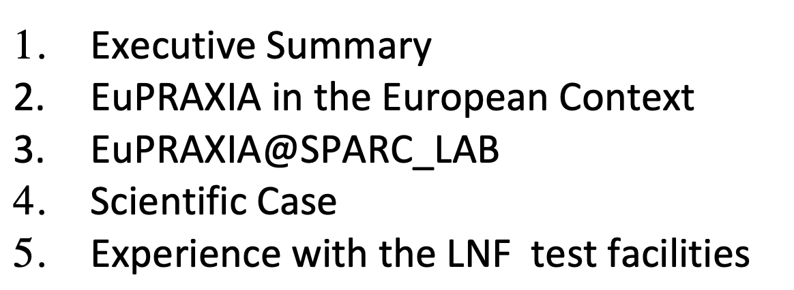
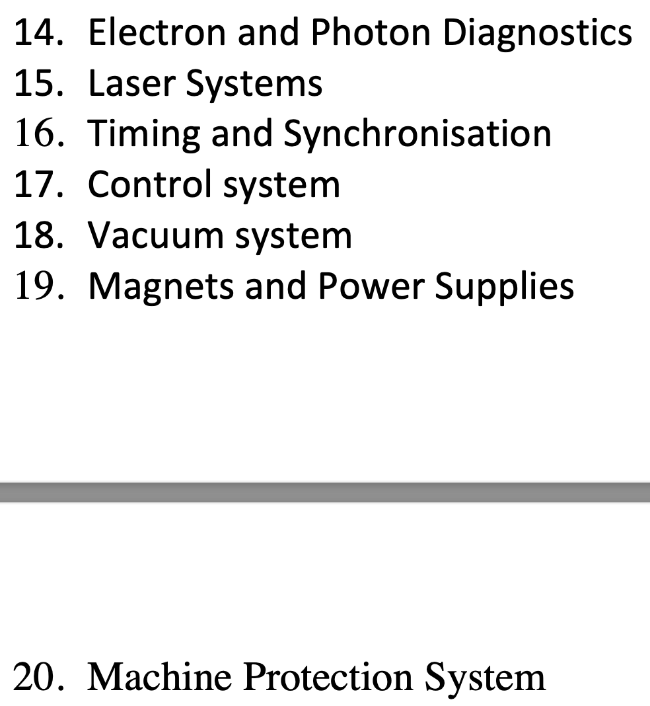
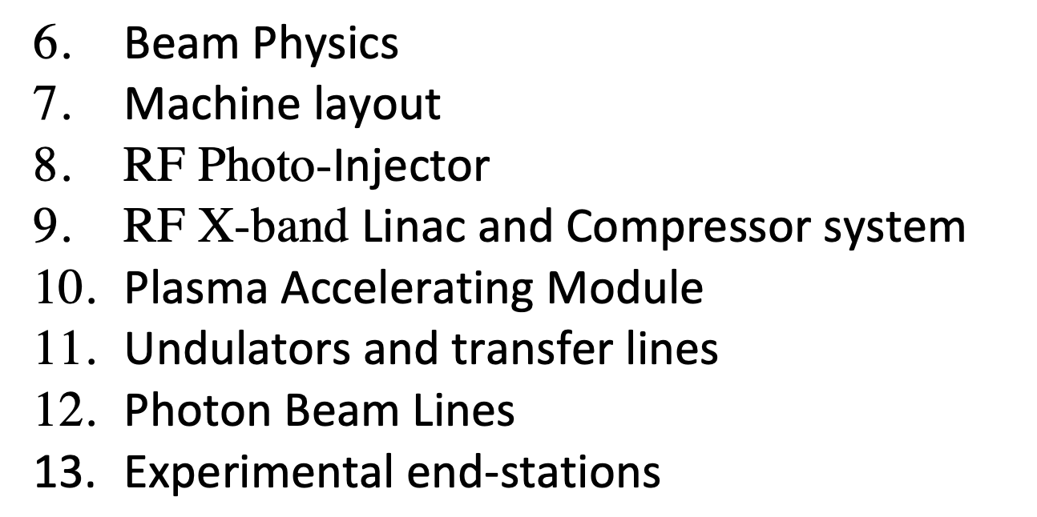
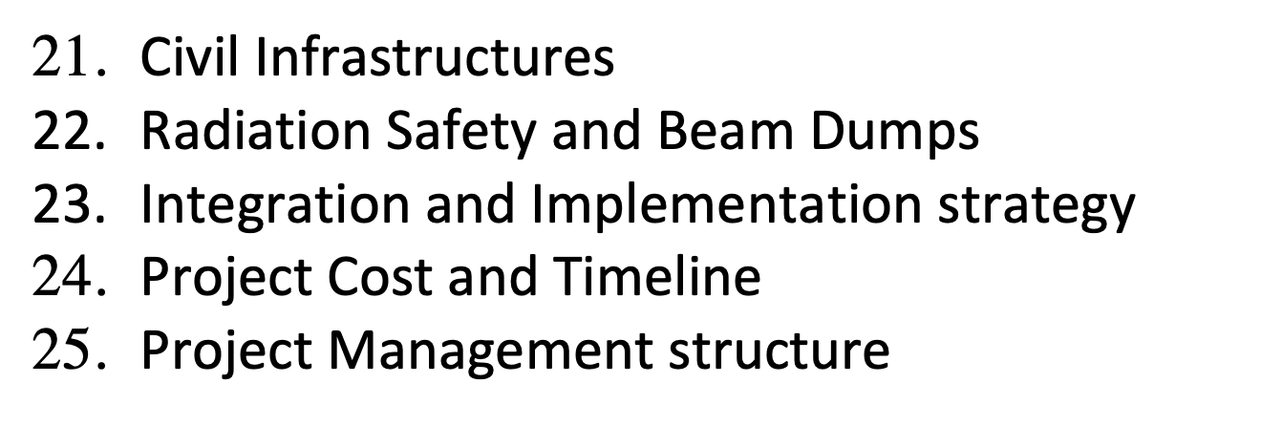
TDR Draft Index

Slide 4
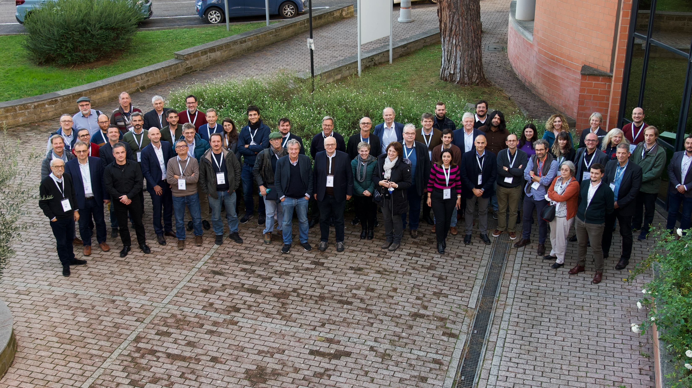
EuPRAXIA_PP Kickoff meeting, LNF, November 24-25, 2022
116 participants = > 63 attendance + 53 remote

Slide 5

EuPRAXIA-Preparatory Phase Consortium
34 Institutes from 12 Countries → to be merged with ESFRI Consortium
Preparatory Phase
Complemented by institutes in EuPRAXIA ESFRI consortium: additional 17 institutes from France, Germany, Poland, Sweden, United Kingdom, China, Japan, United States. Russian institutes presently suspended.

Slide 6
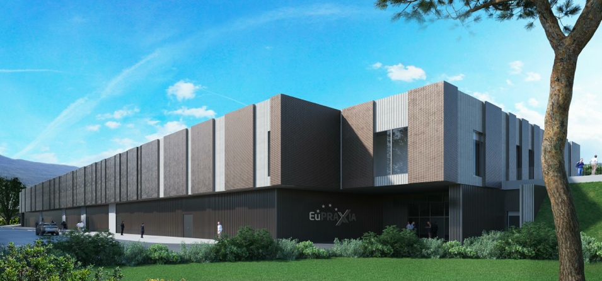
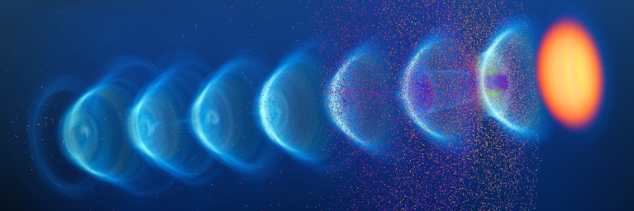
EuPRAXIA-PP (Preparatory Phase) Key Facts
Prepares the implementation of the full RI in Europe
Total project volume (including in-kind): 8.3 M€
  EU funding: 2.49 M€ (EU without in-kind)
  Outside EU 0.69 M€ (Switzerland)
  0.51 M€ (UK)
Work organized in 16 Work Packages
Project dates: 1 Nov 2022 – 31 Oct 2026
Coordinator and location of headquarters: INFN
34 participating organizations from 12 countries
Will establish a “Board of Financial Sponsors“ with representatives of funding agencies.
So far ~ 25% of total M&P funding (569 M€) secured. Site 1 is essentially financed.

Slide 7
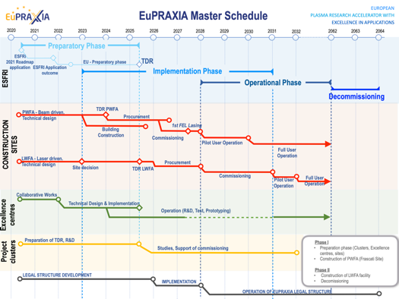
Preparatory Phase Main Goals
Managerial WP`s
  Outreach to public, users, EU decision makers and industry
  Define legal model (how is EuPRAXIA governed?), financial model, rules, user services and membership extension for full implementation
  Works with project bodies and funding agencies → Board of Financial Sponsors
Technical WP‘s (correspond to Project Clusters):
  Update of CDR concepts and parameters, towards technical design (full technical design requires more funding)
  Specify in detail Excellence Centers and their required funding: TDR related R&D, prototyping, contributions to construction
  Help in defining funding applications for various agencies
Output defined in milestones & deliverables with dates

Slide 8
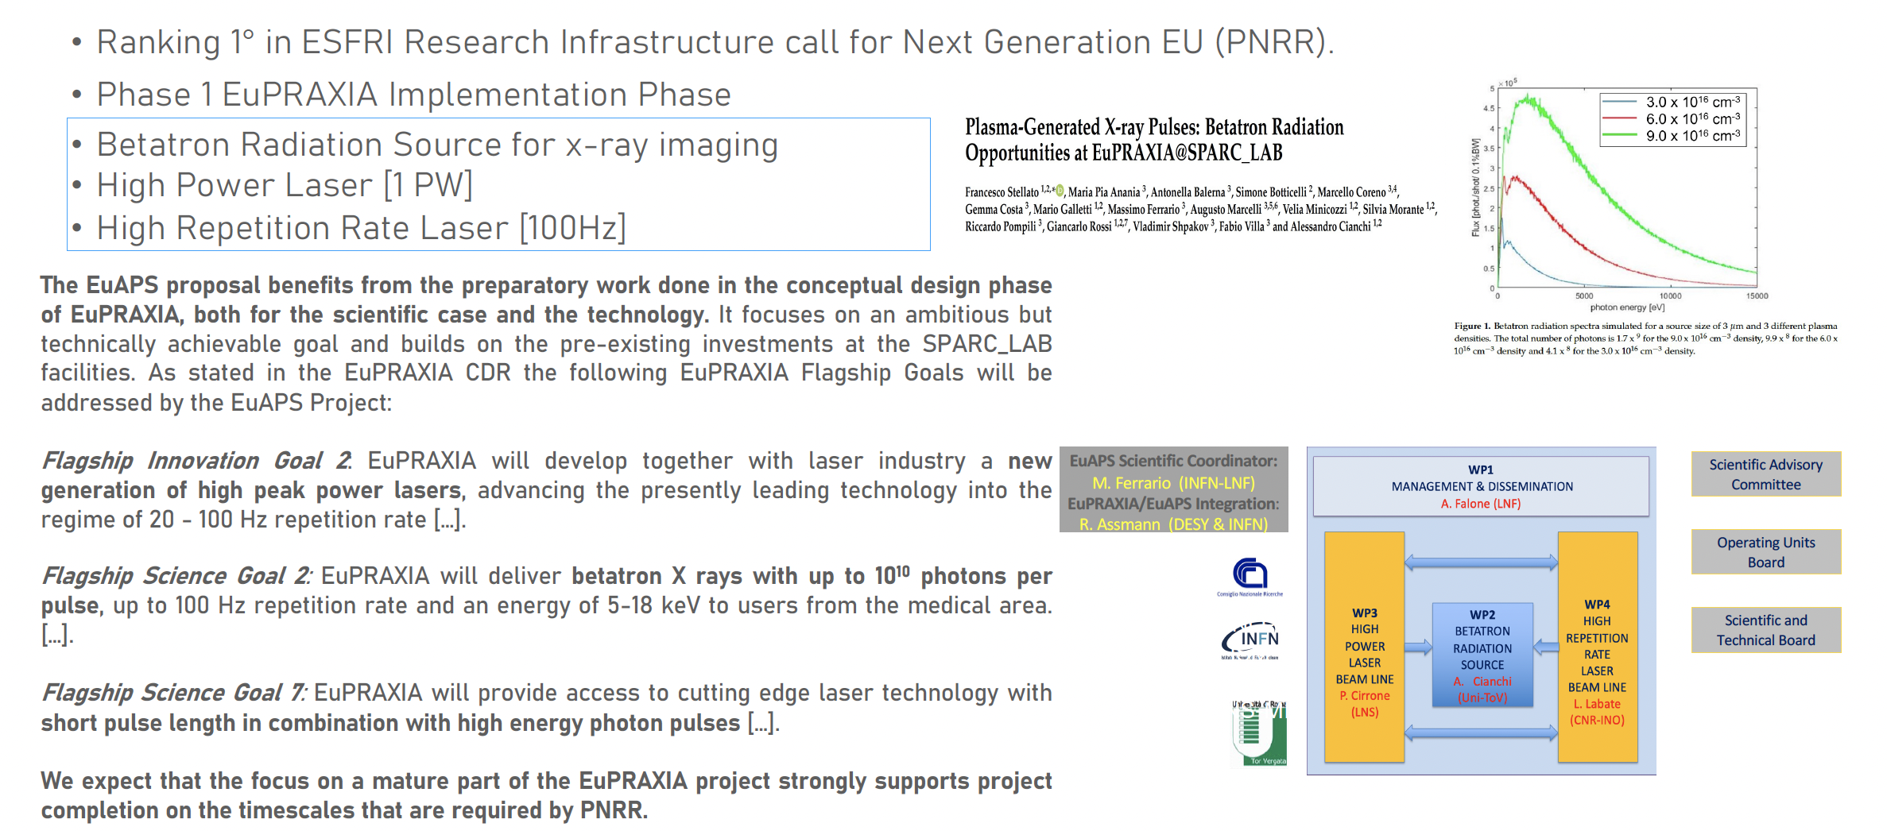
EuPRAXIA Advanced Photon Sources
Project Starting Date : December 1^{rst}

Slide 9


EXIN / EuPRAXIA / EuAPS
Compressor
EuAPS source
Photon line
EuAPS
user area
COMB/EXIN

Slide 10
Recruitment strategy
Several position will be opened soon due essentially thanks to the Next-Generation EU related projects.
There will be:
Plasma Scientists
Laser engineer
Senior scientists in plasma accelerator based as EuAPS infrastructure manager.
Additional positions covering other areas will have to be opened in 2023 → Difficulties in finding candidates.
Welcome 2 new Beam Dynamics Staff members:
Stefano Romeo
Alessio Del Dotto

Slide 11
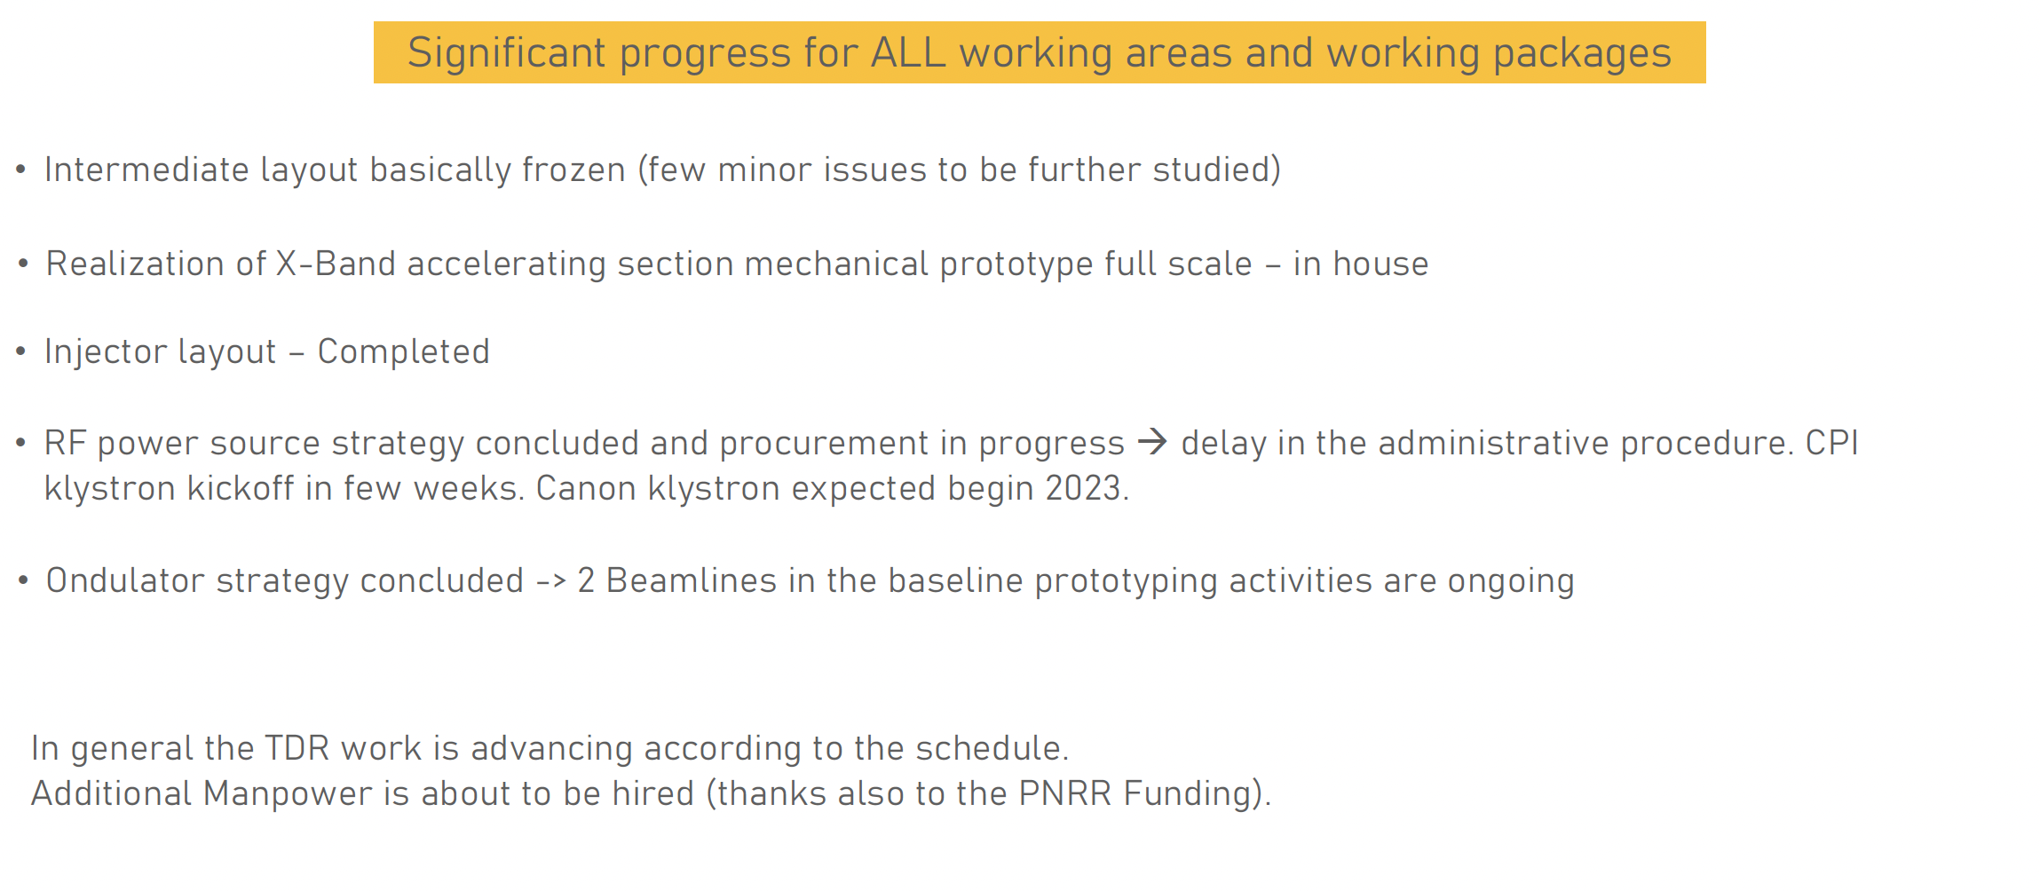
Progress on the EuPRAXIA@SPARC_LAB TDR
Significant progress for ALL working areas and working packages:
Intermediate layout basically frozen (few minor issues to be further studied)
Realization of X-Band accelerating section mechanical prototype full scale – in house
Injector layout – Completed
RF power source strategy concluded and procurement in progress → delay in the administrative procedure. CPI klystron kickoff in few weeks. Canon klystron expected begin 2023.
Ondulator strategy concluded -> 2 Beamlines in the baseline prototyping activities are ongoing
In general the TDR work is advancing according to the schedule.
Additional Manpower is about to be hired (thanks also to the PNRR Funding).

Slide 12
Milestones Delivered

Slide 13
R&D Cost Baseline follow up.
The spending rate for R&D has increased as expected since the definition and the design have reached a more mature level.
In particular the procurement of the most significant items are highlighted below:
X-Band high efficiency tube
X-Band high repetition rate RF station (modulator + canon klystron).
Prototype of X-Band accelerating section

Slide 14
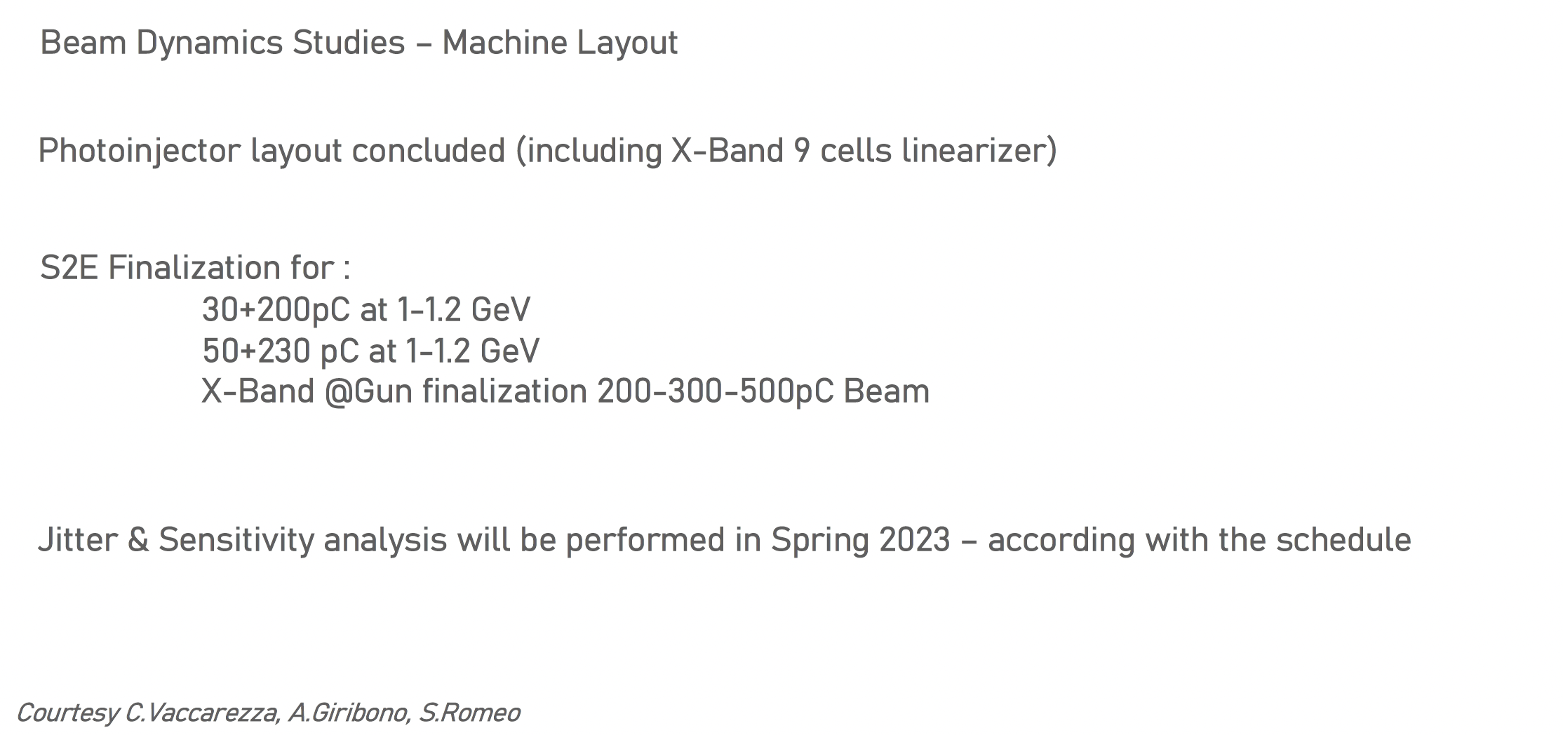
TDR – Beam Dynamics | Machine Layout

Slide 15
EuPRAXIA@SPARC_LAB Parameter List update 2
Electron Beam parameters from CDR
Electron Beam Parameters Nov 22
Parameter | Unit | PWFA | Full X-band
Electron Energy | GeV | 1 | 1
Bunch Charge | pC | 30 | 200
Peak Current | kA | 1-2 | 1-2
RMS Energy Spread | % | 1.1 | 0.1
RMS Bunch Length | 𝜇m | 6-4 | 24-20
RMS norm. Emittance | 𝜇m | 1 | 1
Slice Energy Spread | % | 0.03 | 0.02
Slice norm Emittance | mm-mrad | 0.5 | 0.3
Parameter | Unit | PWFA | Full X-band
Electron Energy | GeV | 1-1.2 | 1
Bunch Charge | pC | 30-50 | 200-500
Peak Current | kA | 1-2 | 1-2
RMS Energy Spread | % | 0.1 | 0.1
RMS Bunch Length | 𝜇m | 6-3 | 24-20
RMS norm. Emittance | 𝜇m | 1 | 1
Slice Energy Spread | % | ≤0.05 | ≤0.05
Slice norm Emittance | mm-mrad | 0.5 | 0.5

Slide 16
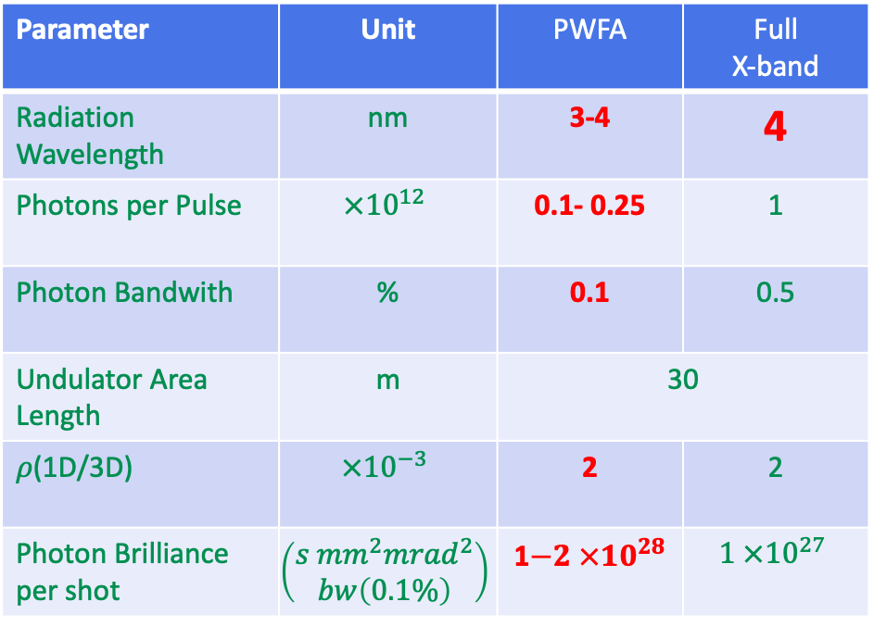
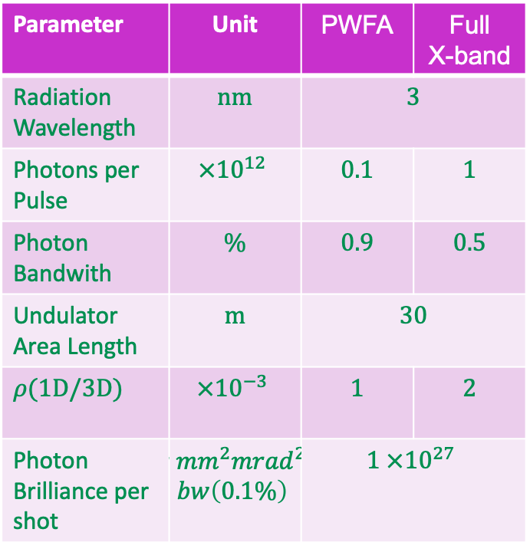
EuPRAXIA@SPARC_LAB Parameter List update 1
Nominal FEL parameters from CDR
FEL Parameters Nov 2022
Parameter | Unit | PWFA | Full X-band
Radiation Wavelength | nm | 3 | 3
Photons per Pulse | $$×{10}^{12}$$ | 0.1 | 1
Photon Bandwith | % | 0.9 | 0.5
Undulator Area Length | m | 30 | 30
𝜌(1D/3D) | $$×{10}^{−3}$$ | 1 | 2
Photon Brilliance per shot | $$\left(\begin{aligned}s {mm}^{2}{mrad}^{2} \\ bw\left(0.1\%\right)\end{aligned}\right)$$ | $$1 ×{10}^{27}$$ | 1
Parameter | Unit | PWFA | Full X-band
Radiation Wavelength | nm | 3-4 | 4
Photons per Pulse | $$×{10}^{12}$$ | 0.1- 0.25 | 1
Photon Bandwith | % | 0.1 | 0.5
Undulator Area Length | m | 30 | 30
𝜌(1D/3D) | $$×{10}^{−3}$$ | 2 | 2
Photon Brilliance per shot | $$\left(\begin{aligned}s {mm}^{2}{mrad}^{2} \\ bw\left(0.1\%\right)\end{aligned}\right)$$ | 1$−2 ×{10}^{28}$ | $$1 ×{10}^{27}$$

Slide 17
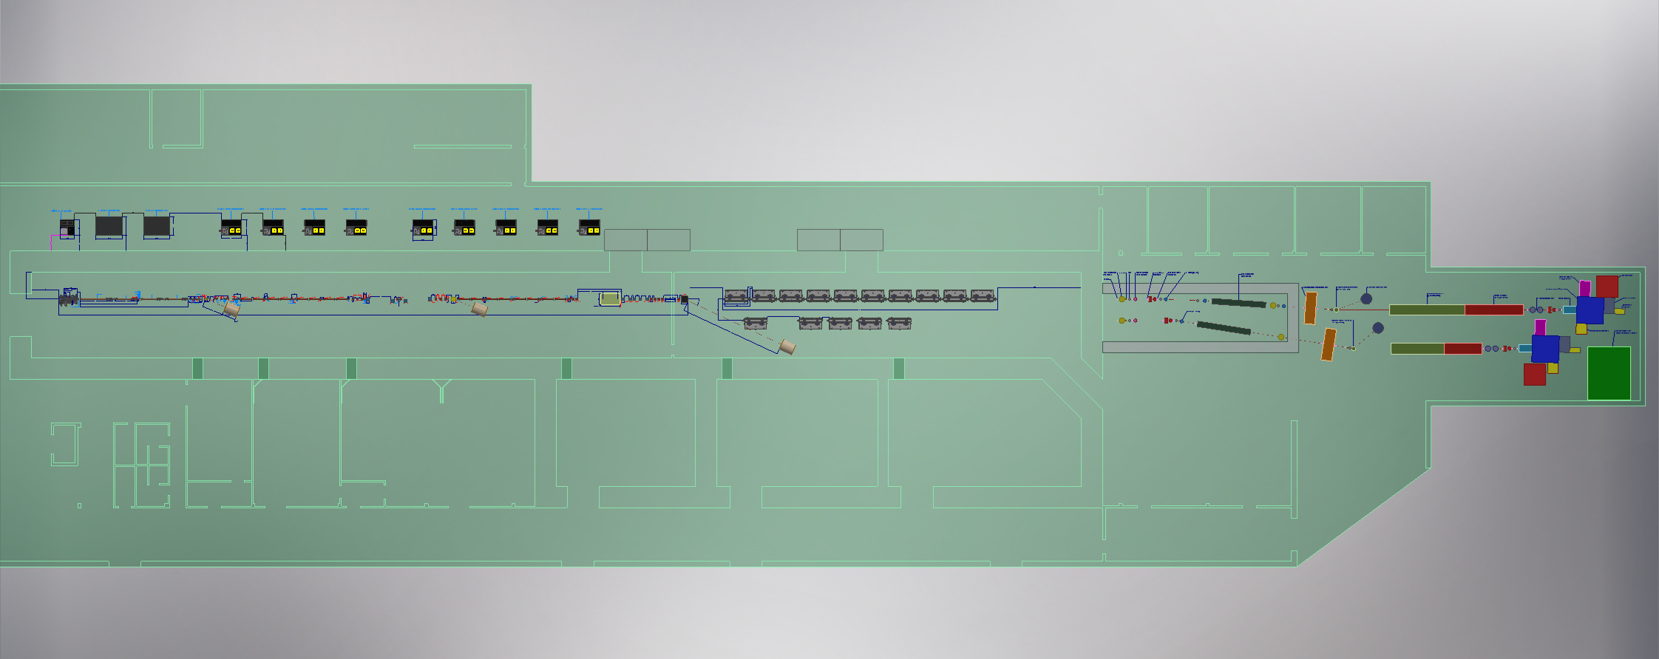
Machine Layout
Courtesy F.Cioeta & E.Di Pasquale , A.Ghigo

Slide 18
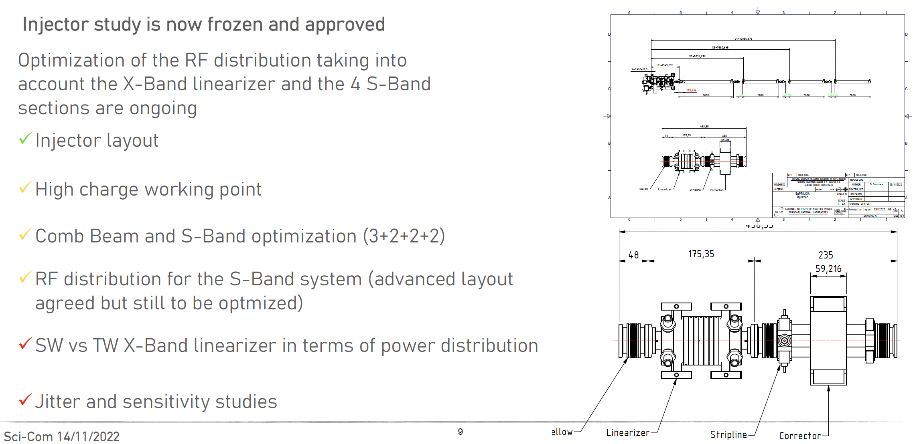
Injector

Slide 19
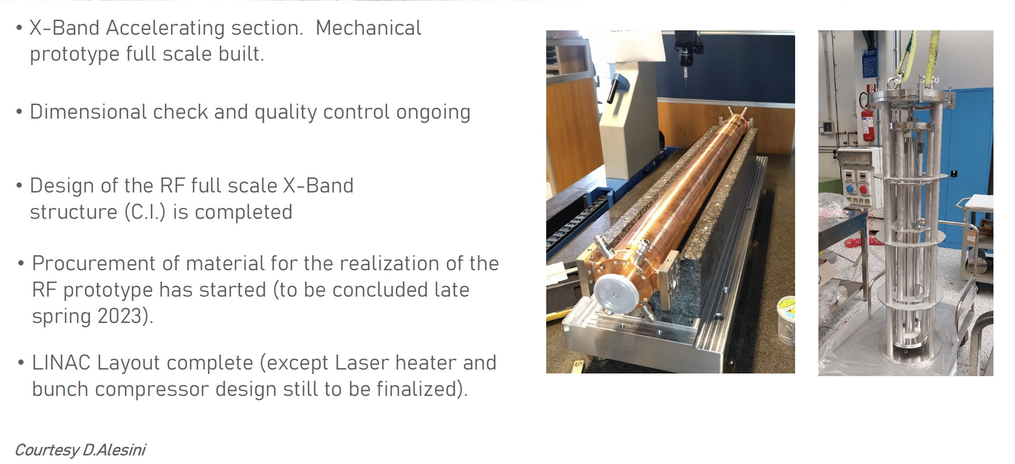
Linac

Slide 20
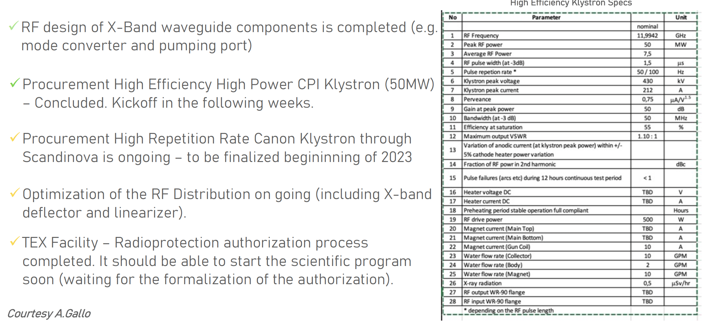
RF Power Sources

Slide 21
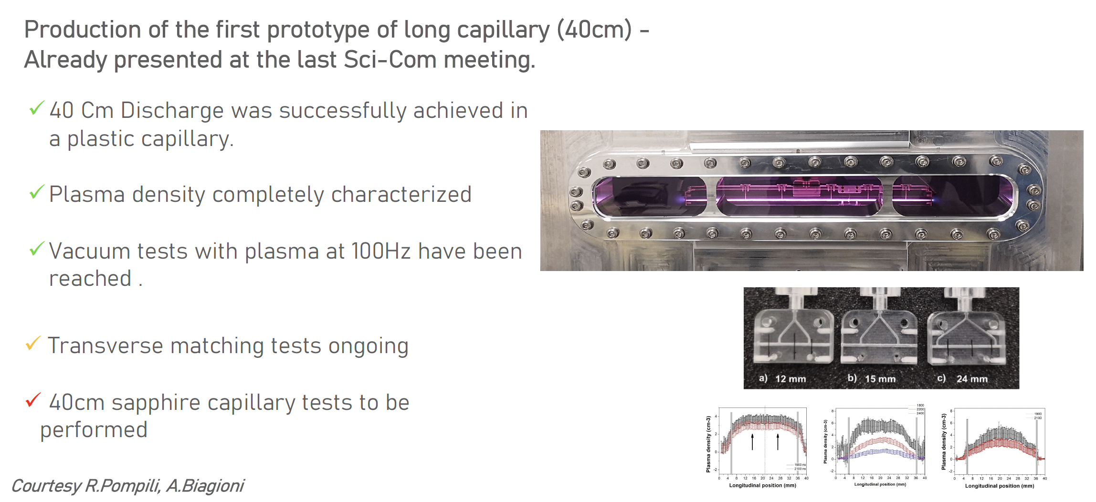
Plasma Module

Slide 22
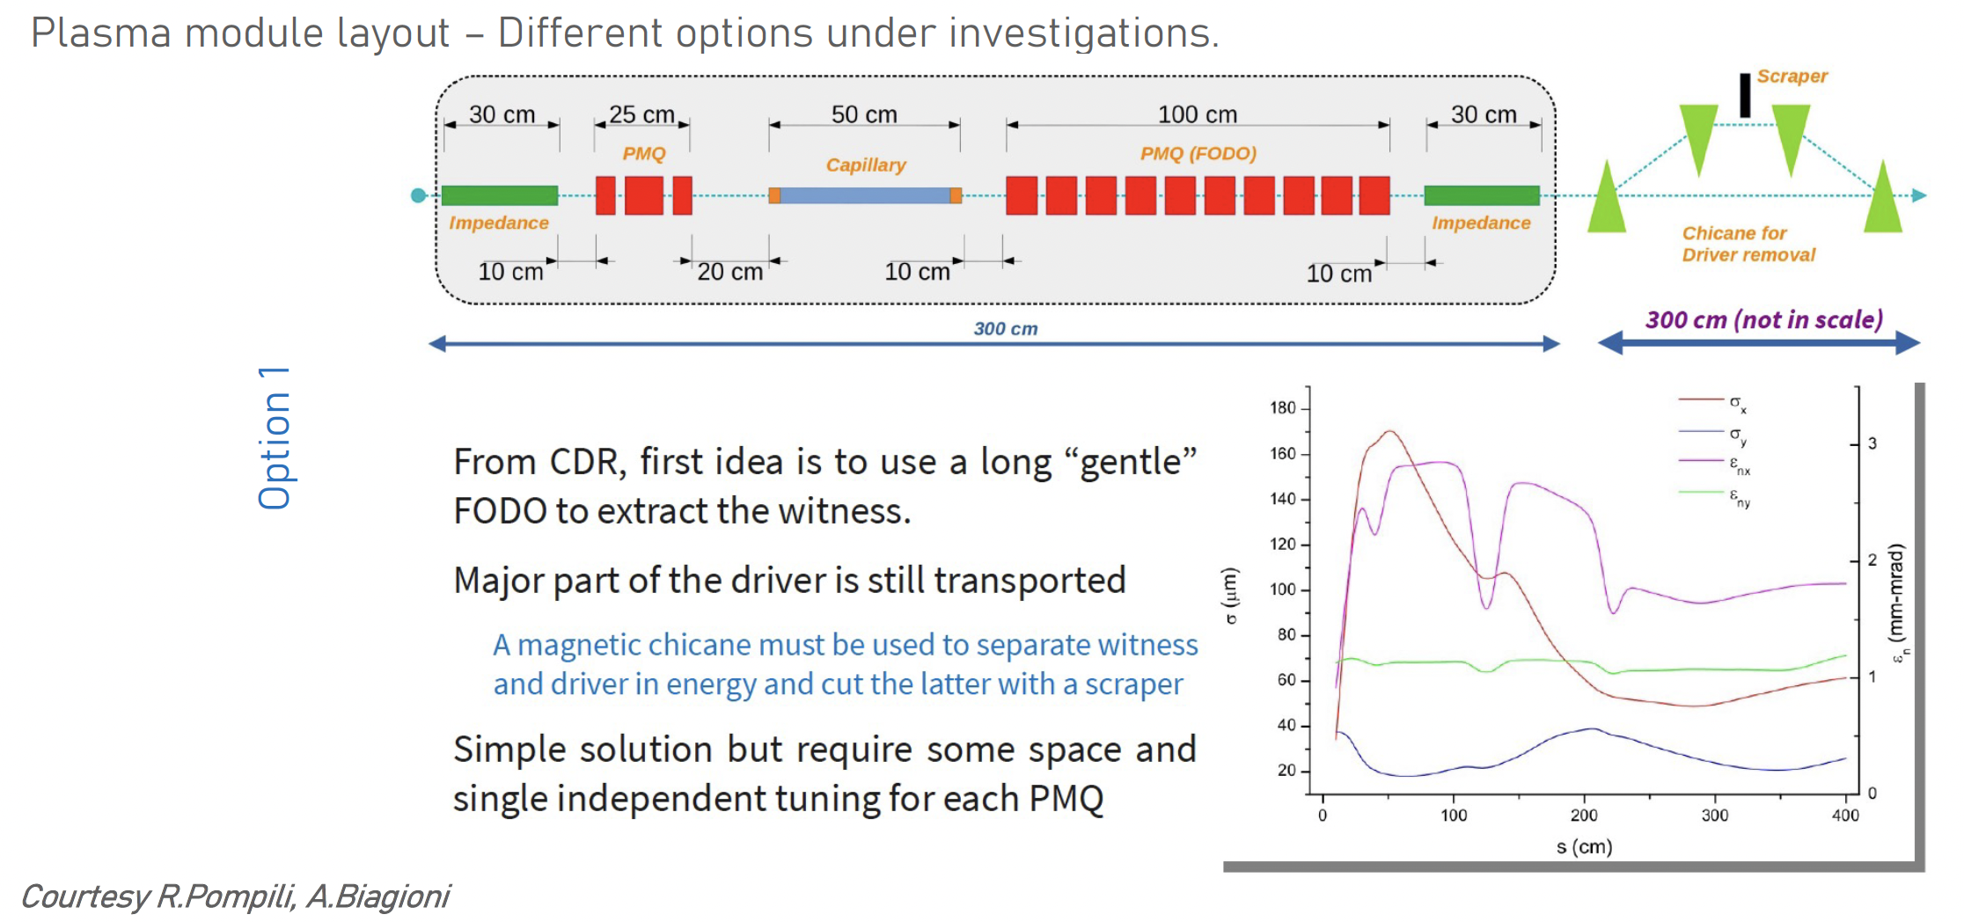
Plasma Module

Slide 23
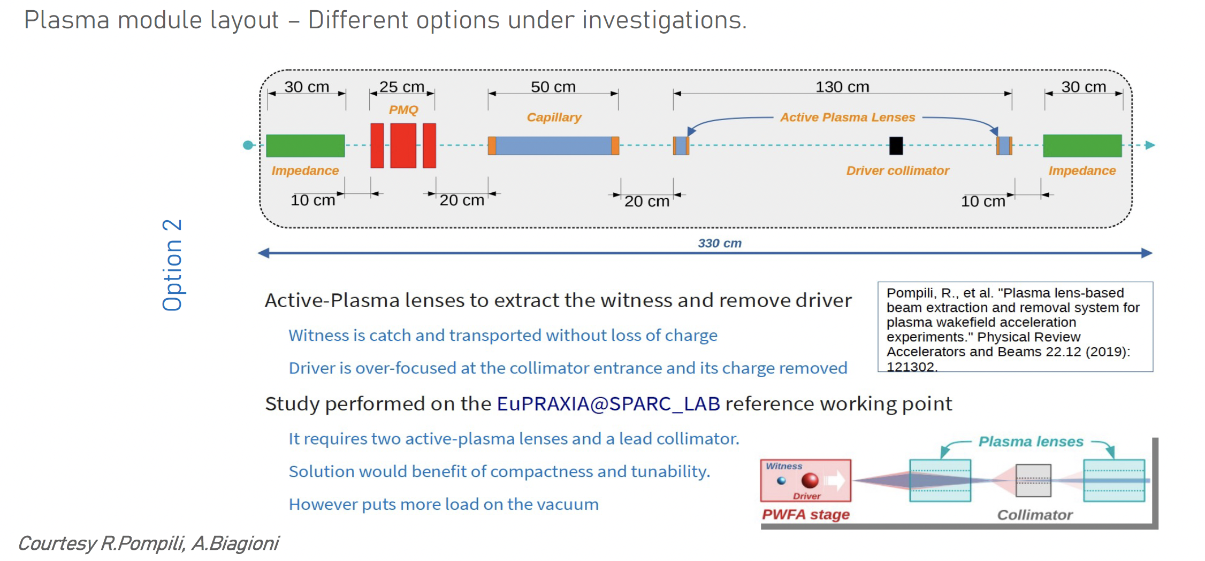
Plasma Module

Slide 24
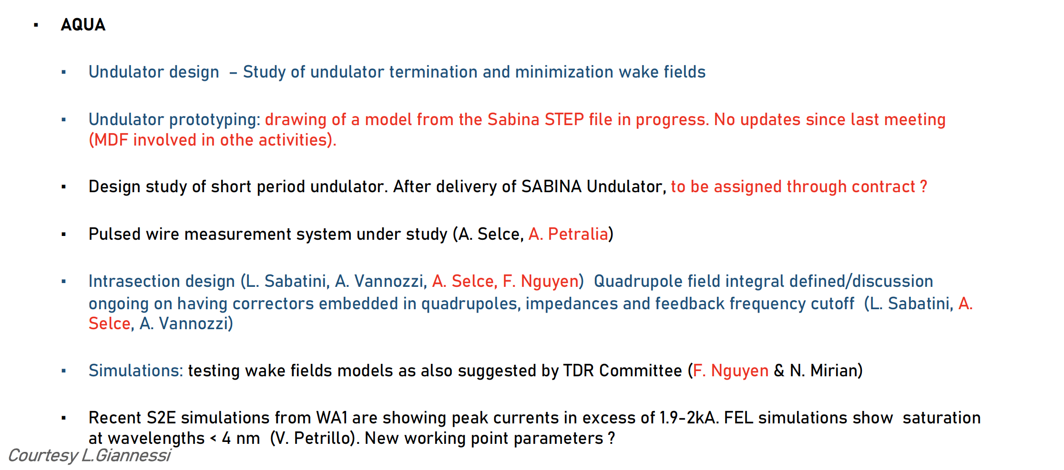
FEL and Undulators

Slide 25
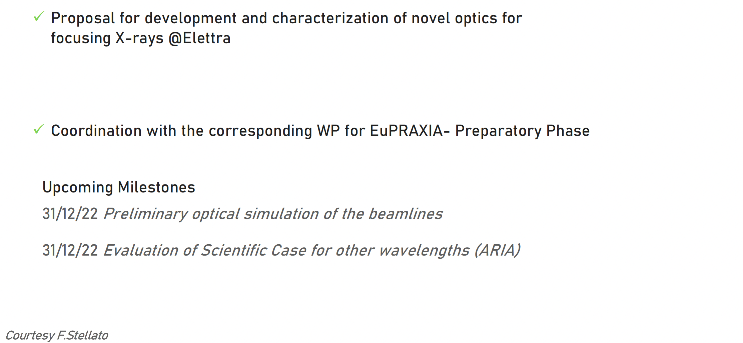
Users and Beam Lines

Slide 26
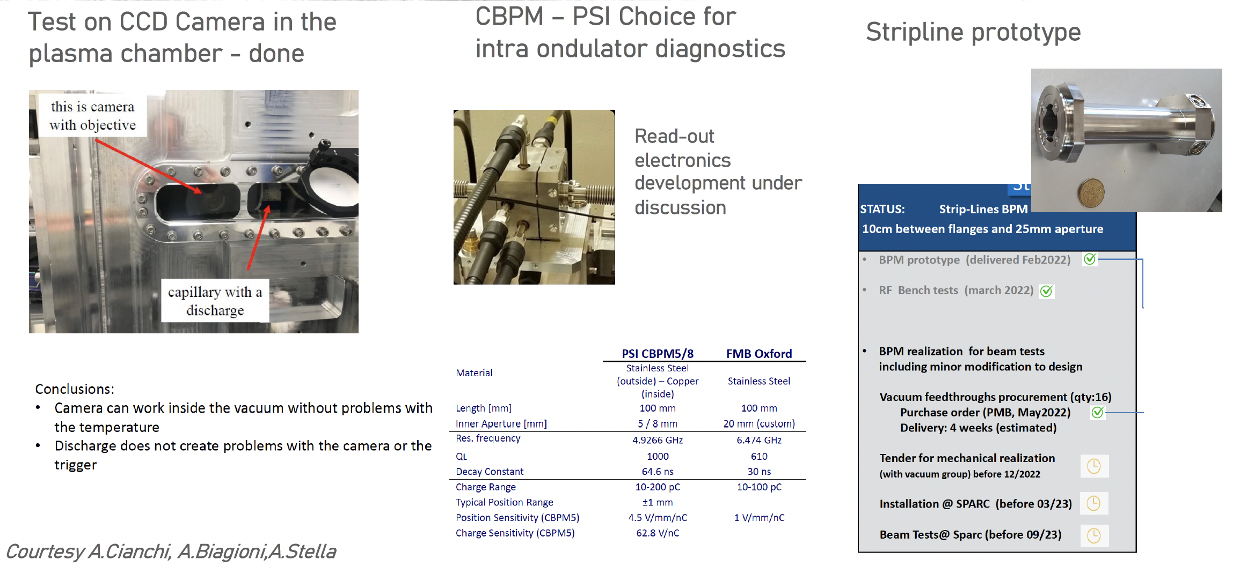
Diagnostics
Courtesy Cianchi, Biagioni, Stella, Shpakov, Franzini

Slide 27
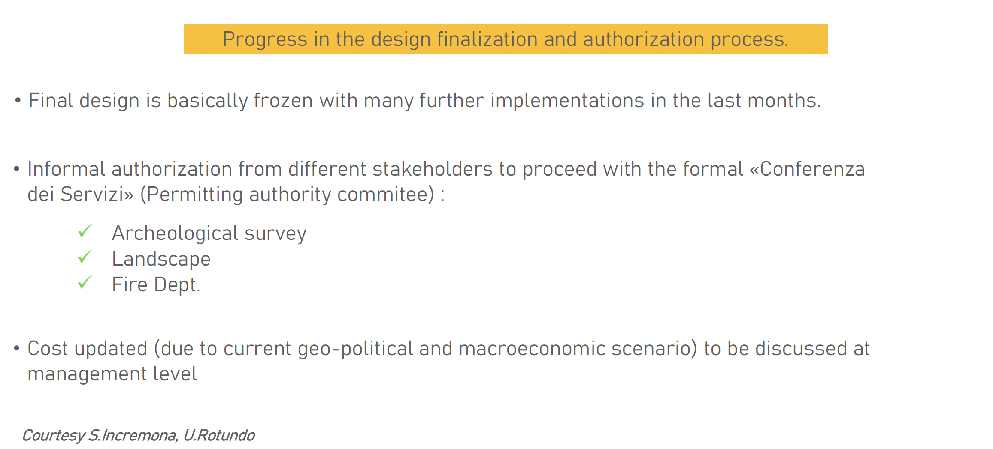
Building Status

Slide 28
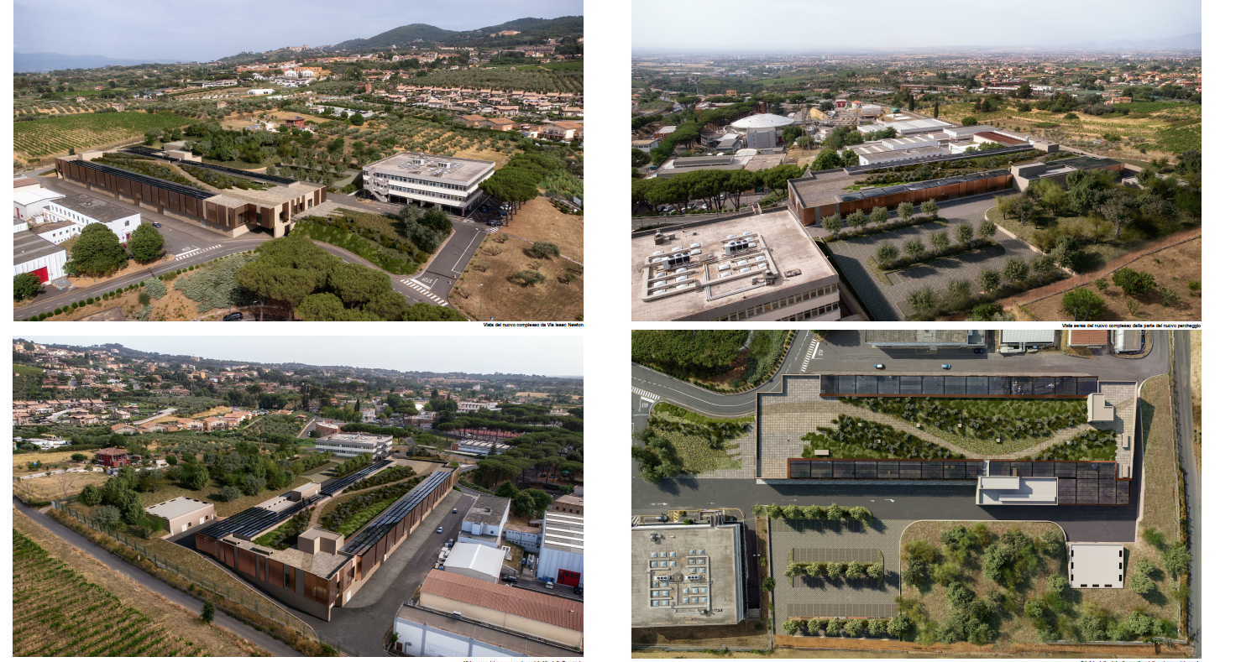
Building Rendering

Slide 29
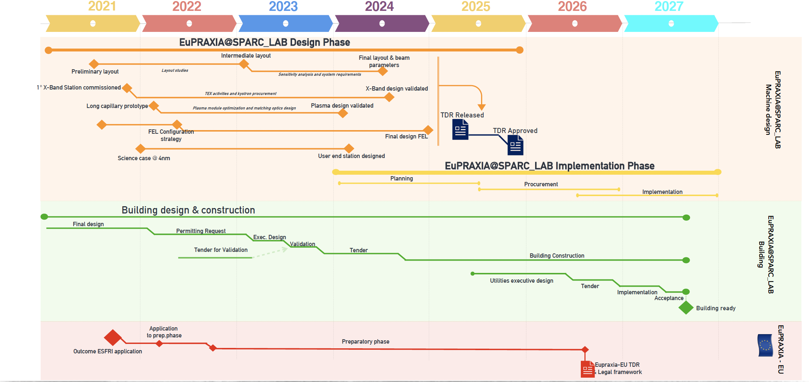
Schedule Update

Slide 30
Milestones work in progress

Slide 31
Project Office Status
The Project Management activities has been carried out as expected. A lot of effort has been put in defining parallel projects devoted to the consolidation of EuPRAXIA iniative in particular EuAPS, EuPRAXIA Preparatory Phase.
The project office of the whole EuPRAXIA iniative is increasing its momentum. One additional resource has been hired specifically for the management of the EuPRAXIA Preparatory Phase Project. A scientific secretary is about to be hired beginning of 2023.
A comprehensive project management plan has been set up for EuAPS project which is quite demanding from management perspective (bimestral monitoring and a remarkable amount of tender to be issued in a very short time frame).
In the next semester the major effort will be put in the definition of a comprehensive configuration and project breakdown structure. This will help in the estimation of the implementation cost.
By the end of 2023 we expect to start the activities for the planning of the Implementation phase and to start the redaction of the TDR itself.

Slide 32
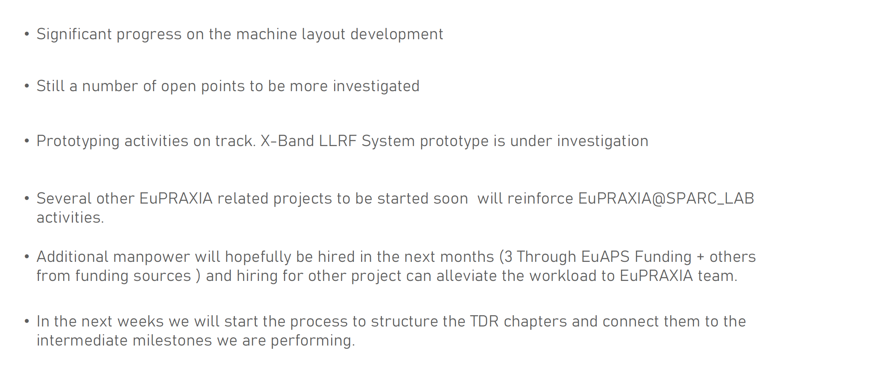
Conclusions

