Slide 1
Communications & Schedule IBL
3D-FBK Sensors
G. Darbo - INFN / Genova
Indico agenda:
http://agenda.infn.it/conferenceDisplay.py?confId=3350

Slide 2
When Shut-downs? Speed-up?
LHC and Experiments discussed the plans in Chamonix (24-28 January 2011)
http://indico.cern.ch/conferenceDisplay.py?confId=103957
LHC will run 2 years (2011 and 2012). Then a long shutdown (15÷19 months)
The SD foreseen for IBL in 2016 will likely move away
ATLAS Management has requested IBL to look at installation in 2013.
IBL Technical Coordinator has prepared an aggressive schedule for installation in July 2013.
Specification for sensors maintained that of IBL TDR (5x10¹⁵ n/cm²)
Sensor pre-production:
Decided to go ahead (need to be approved by the Institute Board) with 2 batches of n-on-n planar from CiS and 2 batches from CNM and FBK. Both CNM and FBK agreed to have a second batch in parallel
230µm wafer bought.
In case of decision of 3D we should have 100 wafer produced
The IBL would need 40 wafers with 100% good yield.
If need more FBK may produce additional 2 batches? By when?
Competition is strong. But is worth to compete!

Slide 3
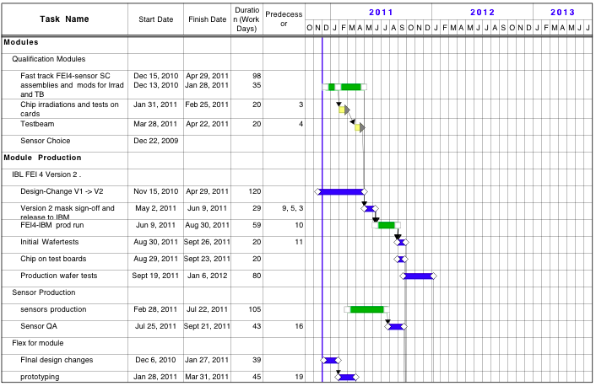
Schedule: FE-I4 & Module Pre-prod
vx
Submission of FE-I4
Very Aggressive!
Sensor production

Slide 4
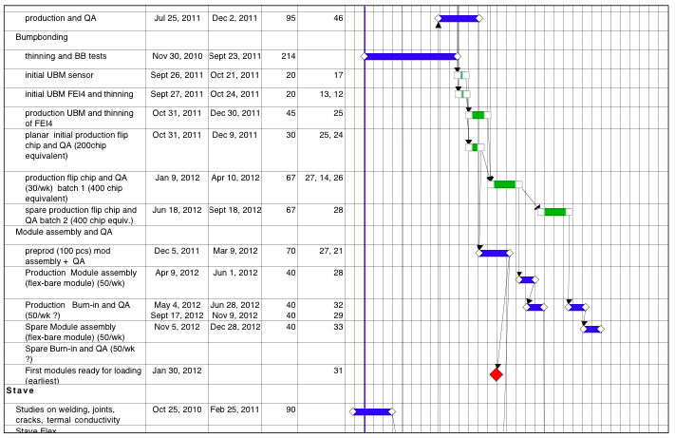
Schedule: Module Prod
20% of modules
40% of modules
40% of modules

