Slide 1

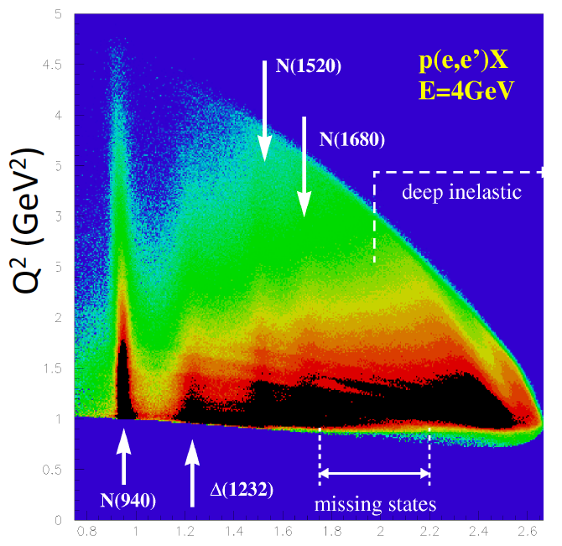
Baryon spectroscopy: new results and perspectives
Annalisa D’Angelo
University of Rome Tor Vergata & INFN Rome Tor Vergata
for the CLAS Collaboration
Outline:
Motivation for light baryon spectroscopy
Establishing N* states – polarized photoreactions
Identifying the effective degrees of freedom: mesons electro-production
Signature for hybrid baryons
Outlook & conclusions
W (GeV)

Slide 2
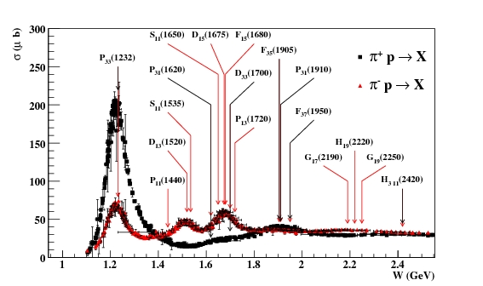
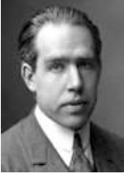
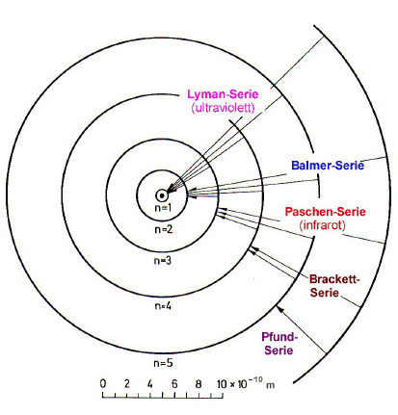
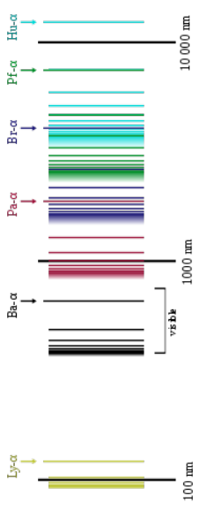
Why N* ? From the Hydrogen Spectrum to QCD
Niels Bohr (1922)
Spectral series of hydrogen
Understanding the hydrogen atom’s ground state requires understanding its excitation spectrum.
Understanding the proton’s ground state requires understanding its excitation spectrum.
From Bohr model of the atom to QED.
From the Constituent Quark model to QCD.

Slide 3
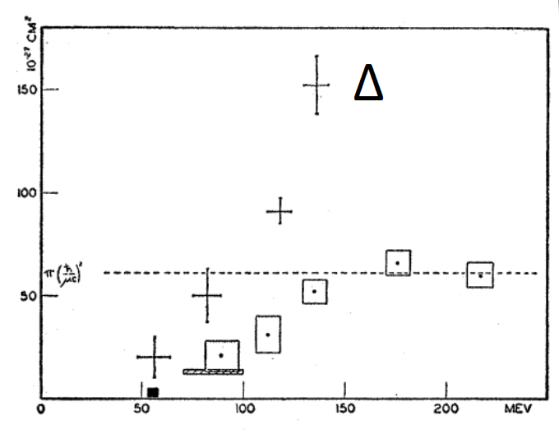
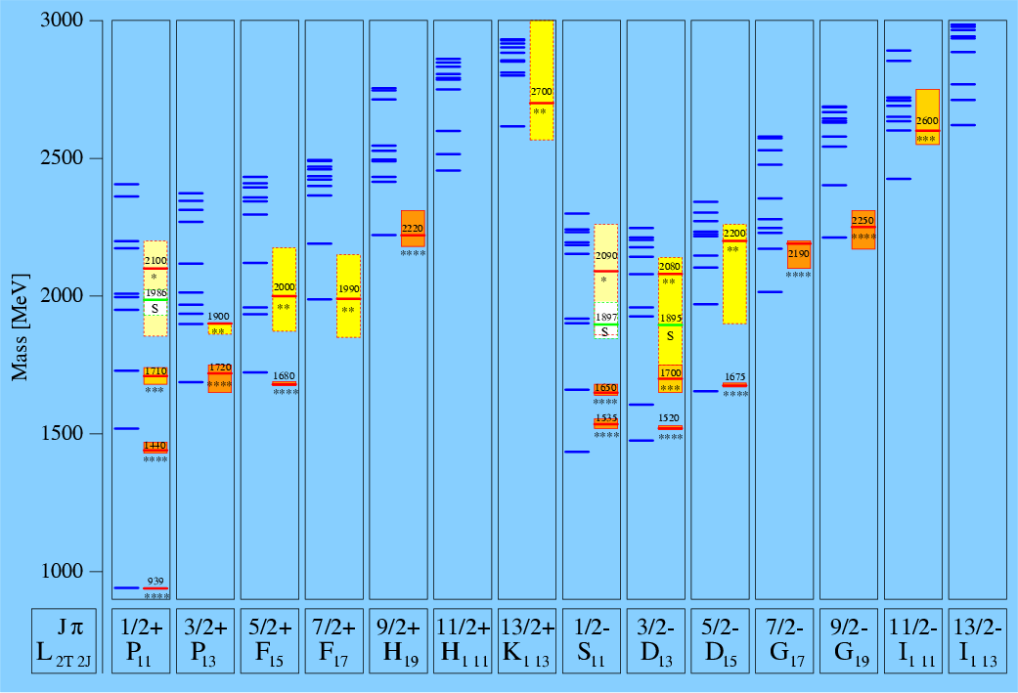
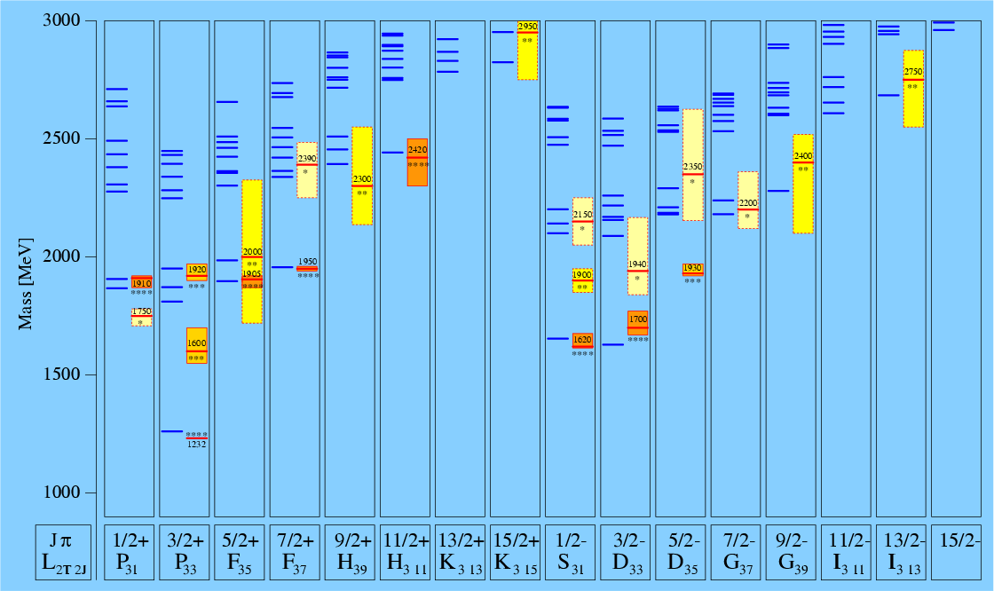
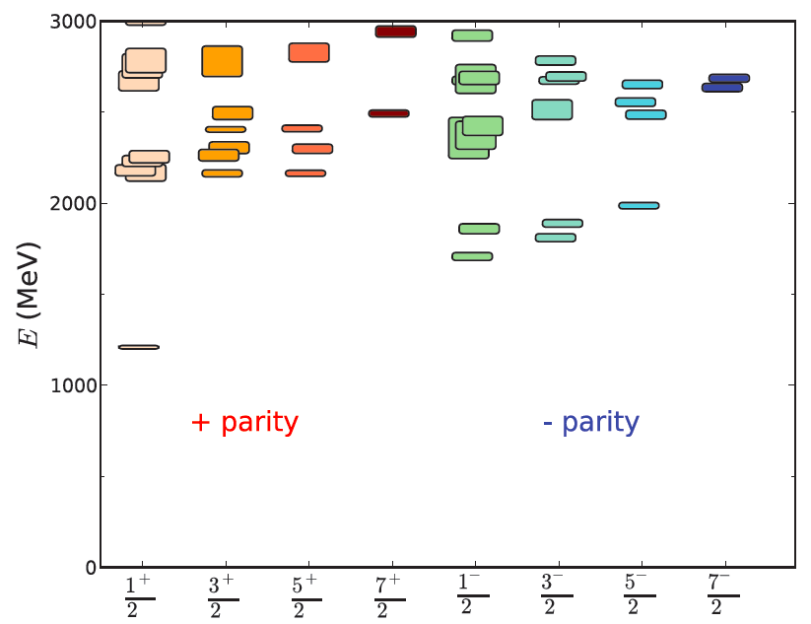
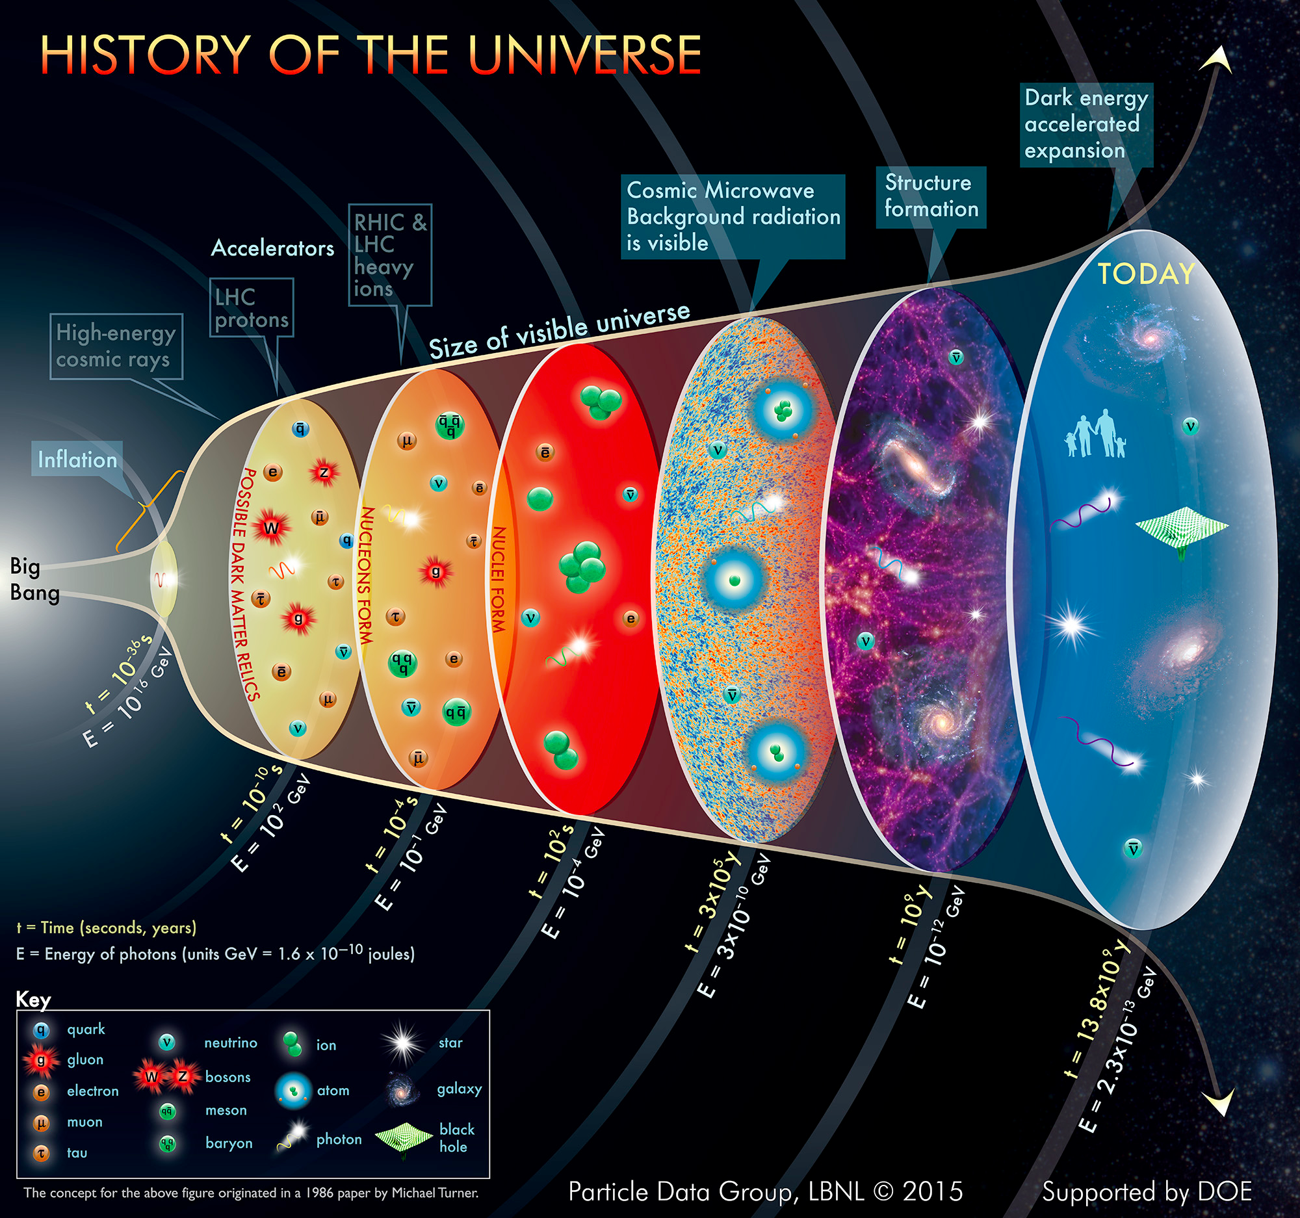
Historical Markers
1952: First glimpse of the Δ(1232) in πp scattering shows internal structure of the proton.
1964: Baryon resonances essential in establishing the quark model and the color degrees of freedom.
1989: Broad effort to address the missing baryon puzzle.
N*
Δ
2010: First successful attempt to predict the nucleon spectrum in LQCD.
2015: Understanding of the baryon spectrum is needed to quantify the transition from QGP to the confined phase in the early universe.

Slide 4
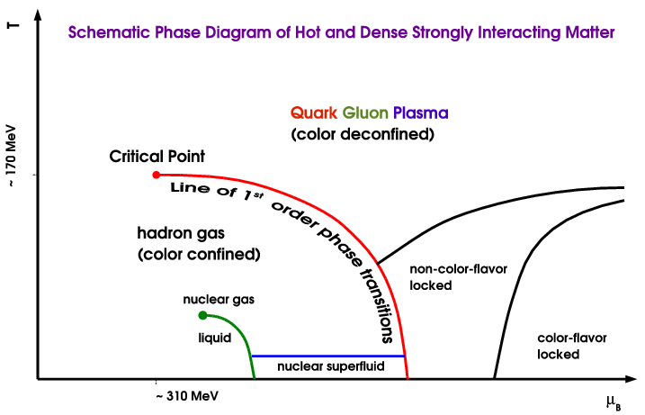
Strong QCD is born ~ 1μsec after the Big Bang
T ~ 700, 000, 000 yrs: Galaxies
T ~ 400, 000 yrs: Atoms
T ~ : 10² s: Nuclei
T ~ 10⁻⁶ s: Nucleons
T~ 10⁻⁹ s: QGP
Quark Gluon Plasma
(color deconfined)
N*
Hadron Gas
(color confined)
T ~ 10⁻⁶ s: Transition from
the QGP to Nucleons
Dramatic events occur in the microsecond old Universe.
The transition from the QGP to the baryon phase is dominated by excited baryons.
A quantitative description requires more states than found to date => missing baryons.
During the transition the quarks acquire dynamical mass and the confinement of color occurs.

Slide 5
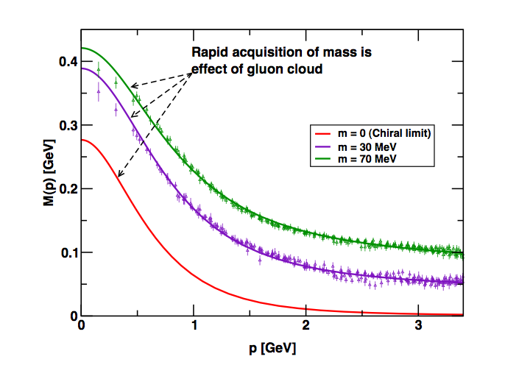
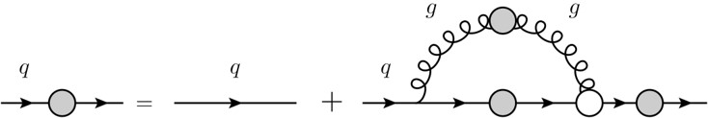
Critical QCD Questions Addressed
How do massless quarks acquire mass?
Effective quark mass depends on its momentum
numerical simulations
of unquenched lattice QCD
(Bowman et al.)
M=M(p)
m₀=m_{HM}
Dyson-Swinger equation
(Bhagwat et al.)
dressed quark
bare quark
dressing kernel
mass composition
<2% Higgs mechanism
>98% non-perturbative strong interaction
Measure the Q² dependence of electrocoupling amplitudes

Slide 6
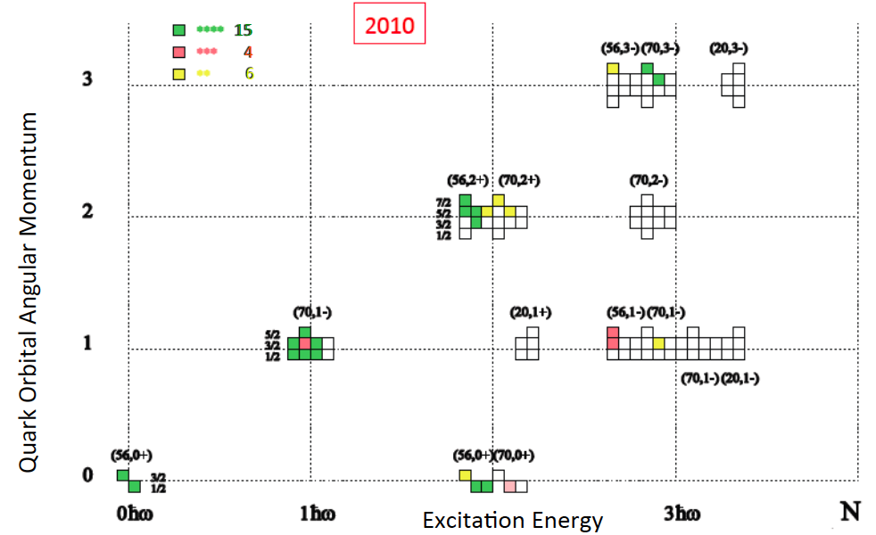
Constituent quark models and SU(6)xO(3)
Current-quarks of perturbative QCD evolve into constituent quarks at low momentum Connection between constituent and current quarks.
Courtesy: D. Menze
numerical simulations
of unquenched lattice QCD
(Bowman et al.)
Dyson-Swinger equation
(Bhagwat et al.)
Missing Baryons
QCD-inspired Constituent Quark models: states classified by isospin, parity and spin within each oscillator band. Many projected q³ states are still missing or uncertain.

Slide 7
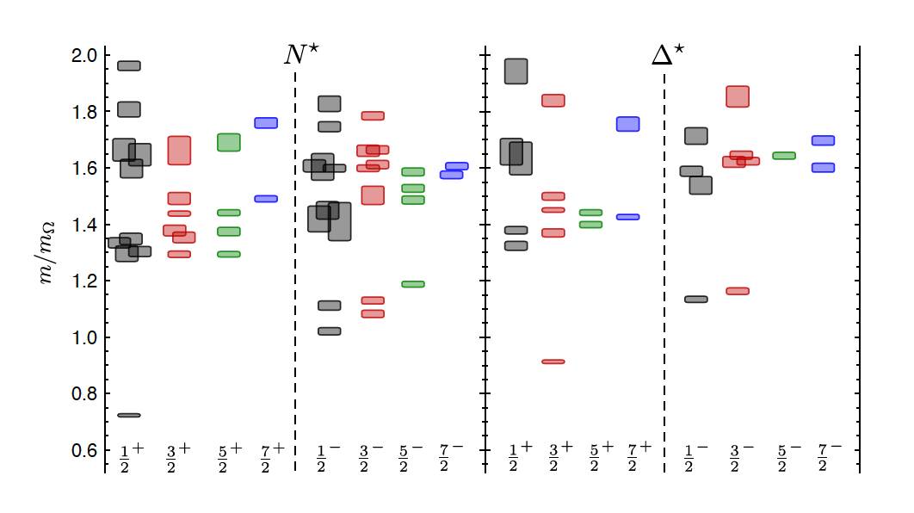
LQCD N* & Δ Spectra
Exhibit the SU(6)×O(3)-symmetry features
Counting of levels consistent with non-rel. quark model
Striking similarity with quark model
No parity doubling
4
5
3
1
2
3
2
1
1
1
2
2
1
Δ(1232)
N(938)
Problems are not solved!
Robert G. Edwards, Jozef J. Dudek, David G. Richards, Stephen J. Wallace
Phys.Rev. D84 (2011) 074508

Slide 8
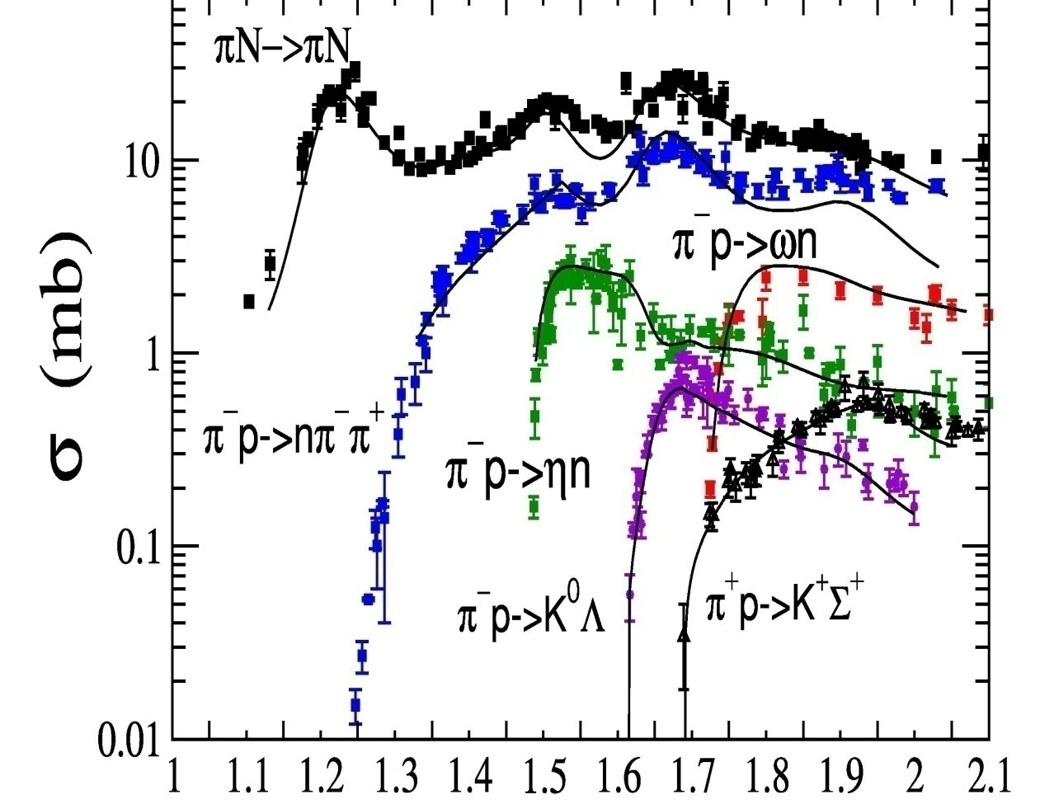
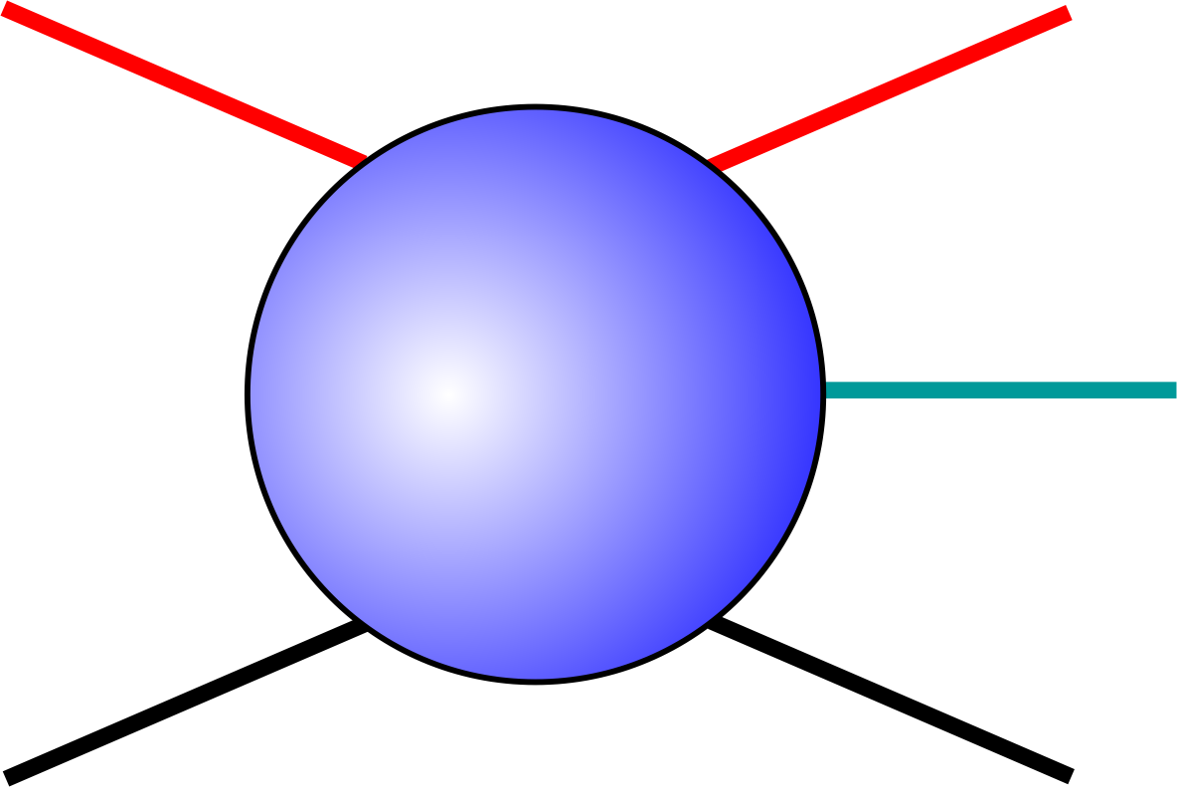
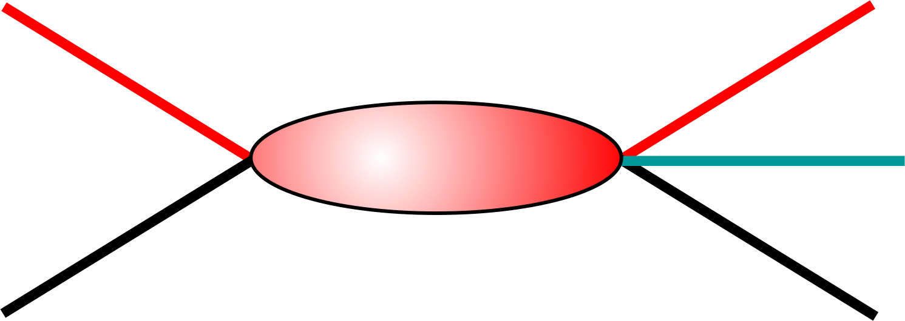
Establishing the N* and Δ Spectrum: πN scattering
M₁
π
M₂
B
N
π
L_{2I 2J 2J}
M₁
W GeV
M₂
N
B

Slide 9
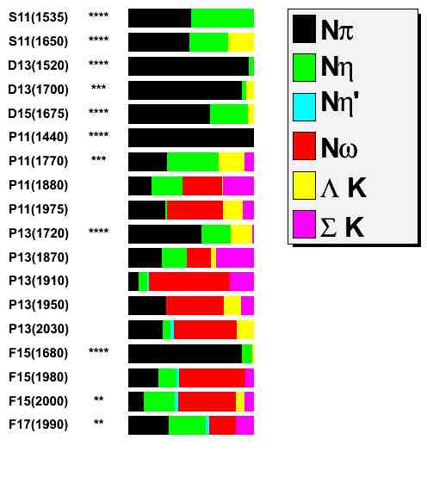
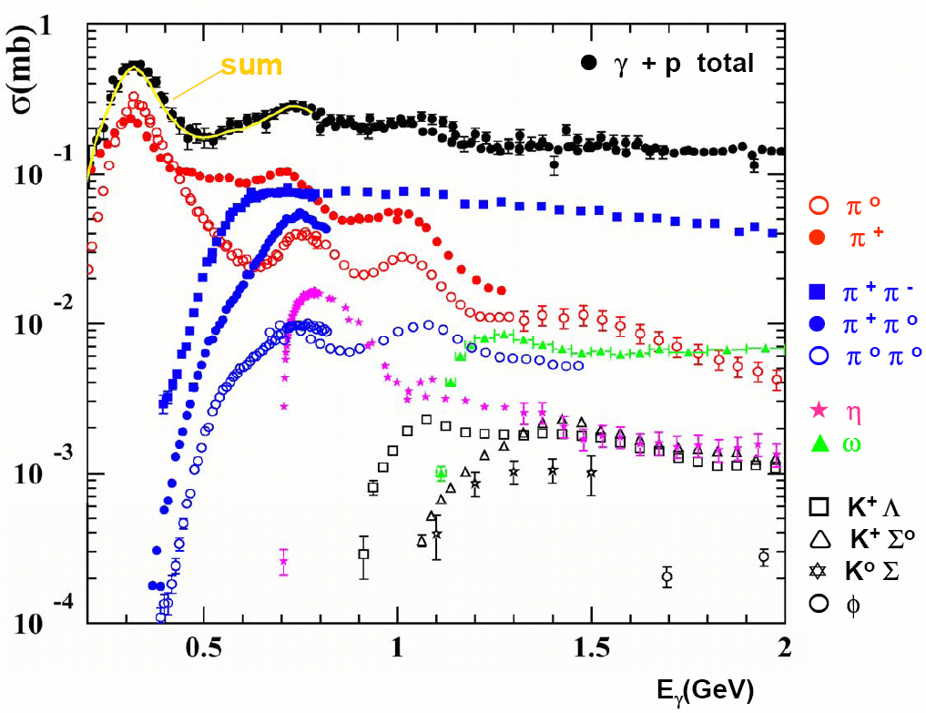

Establishing the N* and Δ Spectrum
Search all channels: not just πN
Photonuclear cross sections
(1/2)⁻
(1/2)⁻
(3/2)⁻
(3/2)⁻
(5/2)⁻
(1/2)⁺
(1/2)⁺
(1/2)⁺
(1/2)⁺
(3/2)⁺
(3/2)⁺
(3/2)⁺
(3/2)⁺
(3/2)⁺
(5/2)⁺
(5/2)⁺
(5/2)⁺
(7/2)⁺
Nπ
Nη
Nη`
Nω
ΛK
ΣK

Slide 10
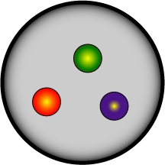
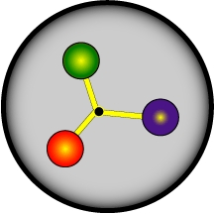
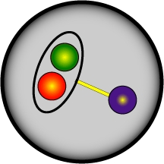

N* Program – photo- & electro-production of mesons
The N* program is one of the key physics foundations of CLAS@JLab, A2@MAMI, CB@ELSA, BGOOD
Detectors have been designed to measure cross sections and spin observables over a broad kinematic range for exclusive reaction channels:
πN, ωN, φN, ηN, η’N, ππN, KY, K*Y, KY*
- N* parameters do not depend on how they decay
- Different final states have different hadronic decay parameters and different backgrounds
- Agreement offers model-independent support for findings
CLAS12@JLAB
The program goal is to probe the spectrum of N* states and their structure
- Probe the underlying degrees of freedom of the nucleon through studies of photoproduction and the Q² evolution of the electro-production amplitudes.
N* degrees of freedom??

Slide 11
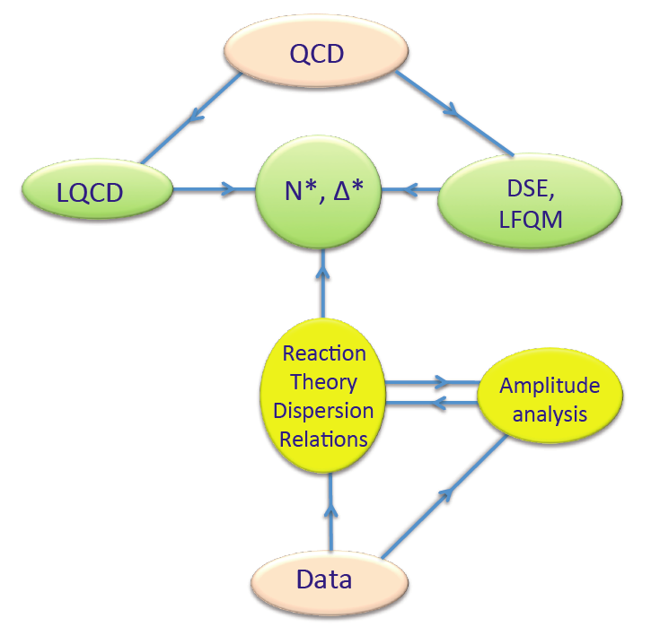
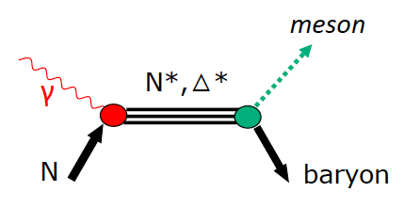
Establishing the N* and Δ Spectrum
Experimental requirements:
Precision measurements of photo-induced processes in wide kinematics, e.g.
γp→πN, ηp, KY, .., γn→πN, K⁰Y⁰, ..
More complex reactions, e.g. γp → ωp, pφ, ππp, ηπN, K*Y, .. may be sensitive to high mass states through direct transition to ground state or through cascade decays
Polarization observables are essential
Engaging theoretical groups
Extract s-channel resonances
Hadronic
production
Electromagnetic
production
&

Slide 12
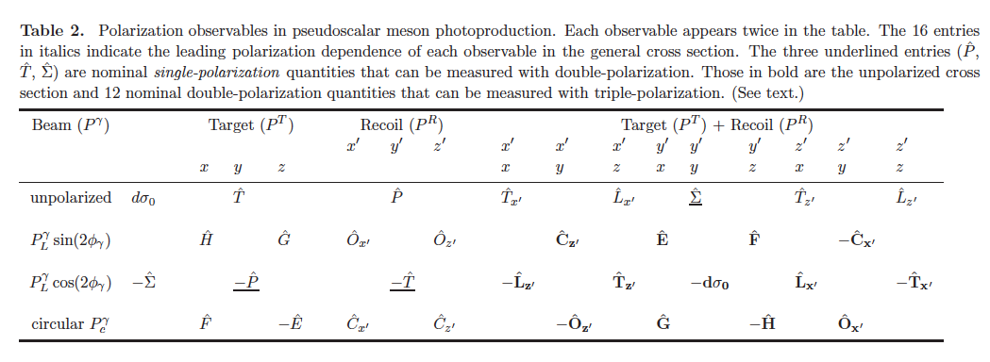
Polarization Observables: Complete Experiment
The holy grail of baryon resonance analysis
Process described by 4 complex, parity conserving amplitudes
8 well-chosen measurements are needed to determine amplitude.
Up to 16 observables measured directly
3 inferred from double polarization observables
13 inferred from triple polarization observables
Λ weak decay has large analyzing power
A. Sandorfi, S. Hoblit, H. Kamano, T.-S.H. Lee, J.Phys. 38 (2011) 053001

Slide 13
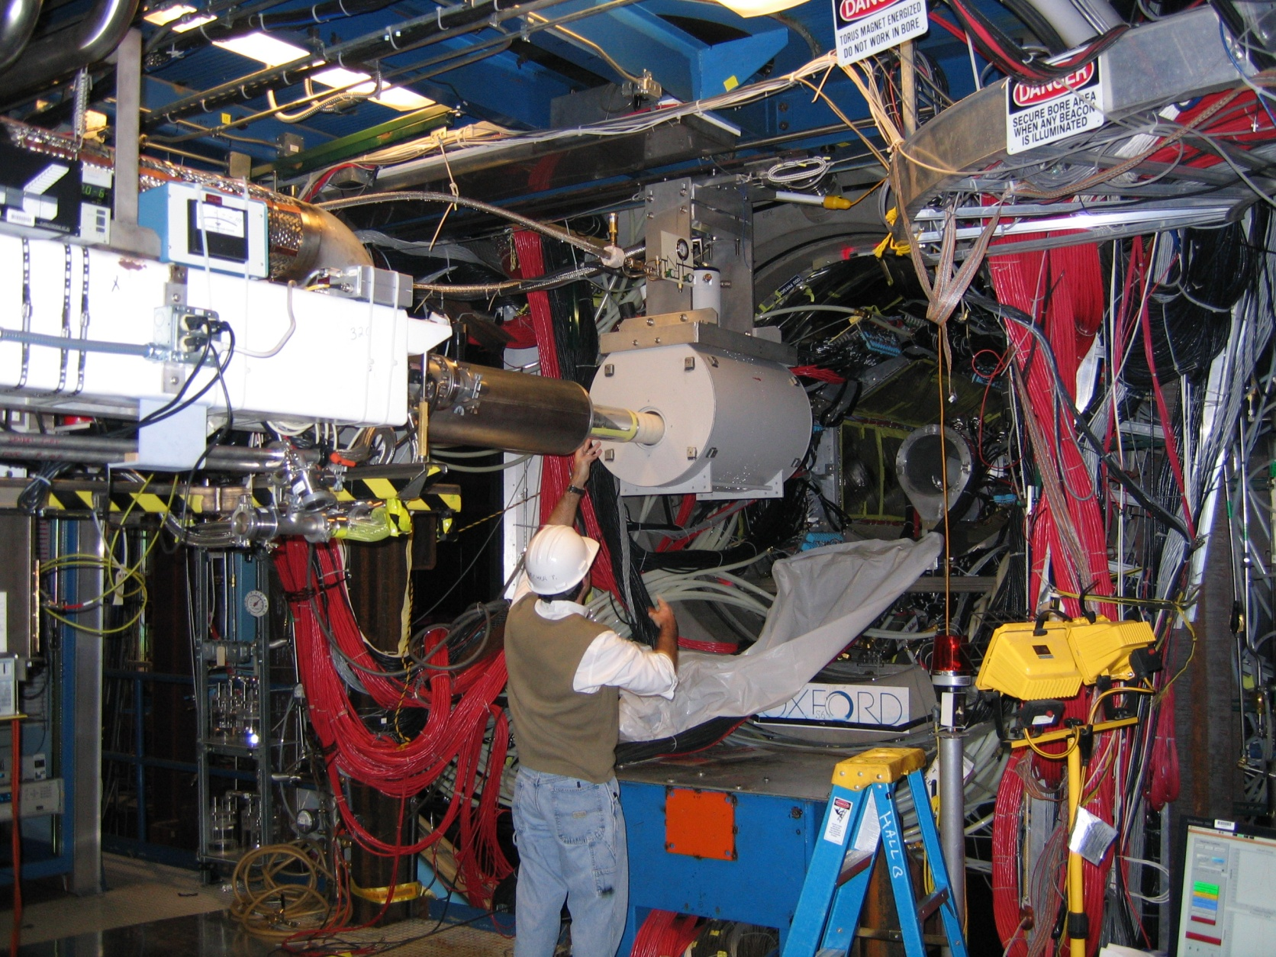
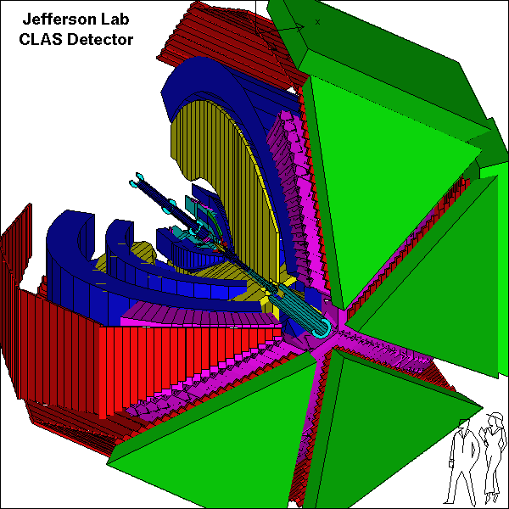
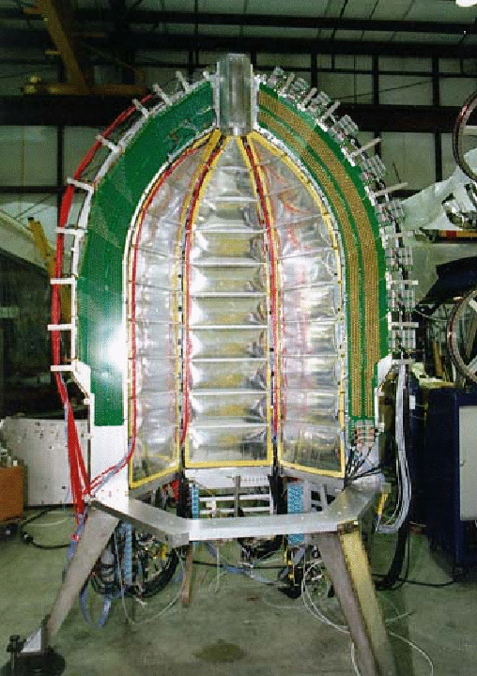
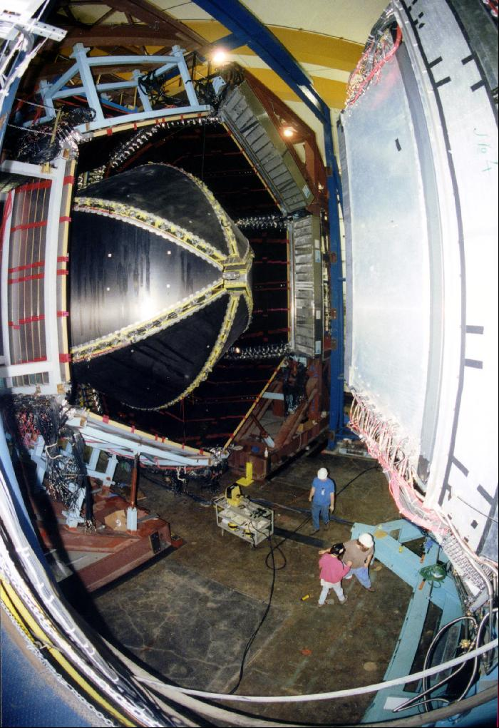
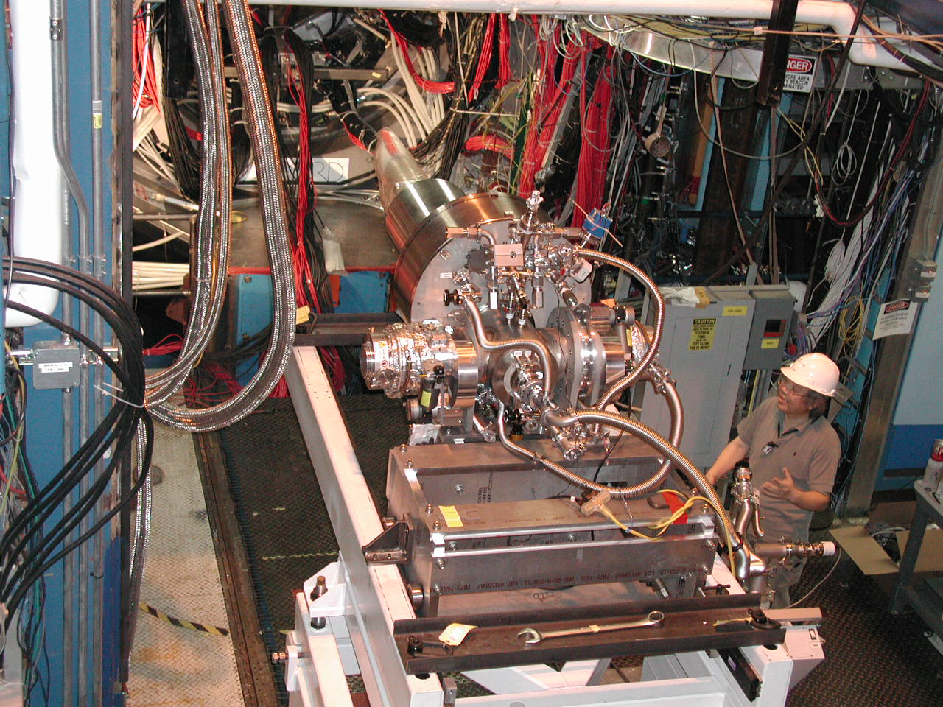
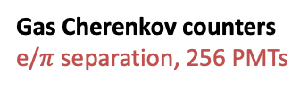
Experimental set-up
Polarized Frozen-spin Targets & CEBAF Large Acceptance Spectrometer
Torus magnet
6 superconducting coils
Electromagnetic calorimeters
Lead/scintillator, 1296 photomultipliers
FROST (Butanol)
start counter
Open CLAS detector
or
+
Drift chambers
35,000 cells
HD -ice
Time-of-flight counters
plastic scintillators,
684 photomultipliers
Gas Cherenkov counters e/$π$ separation, 256 PMTs

Slide 14
CLAS N* Experimental Program
 | σ | Σ | T | P | E | F | G | H | T_{x} | T_{z} | L_{x} | L_{z} | O_{x} | O_{z} | C_{x} | C_{z}
pπ⁰ | ✓ | ✓ | ✓ |  | ✓ | ✓ | ✓ | ✓
nπ⁺ | ✓ | ✓ | ✓ |  | ✓ | ✓ | ✓ | ✓
pη | ✓ | ✓ | ✓ |  | ✓ | ✓ | ✓ | ✓
pη’ | ✓ | ✓ | ✓ |  | ✓ | ✓ | ✓ | ✓
Νππ | ✓ | ✓ | ✓ |  | ✓ | ✓ | ✓ | ✓
p ω/φ | ✓ | ✓ | ✓ | ✓ | ✓ | ✓ |  | ✓ | ✓SDME
K⁺Λ | ✓ | ✓ | ✓ | ✓ | ✓ | ✓ | ✓ | ✓ | ✓ | ✓ | ✓ | ✓ | ✓ | ✓ | ✓ | ✓
K⁺Σ⁰ | ✓ | ✓ | ✓ | ✓ | ✓ | ✓ | ✓ | ✓ | ✓ | ✓ | ✓ | ✓ | ✓ | ✓ | ✓ | ✓
K^{0*}Σ⁺ | ✓ | ✓ |  |  |  |  |  |  |  |  | ✓ | ✓
K^{+*}Λ | ✓ | ✓ |  | ✓ |  |  |  |  | ✓SDME
pπ⁻ | ✓ | ✓ |  |  | ✓ | ✓ | ✓
pρ⁻ | ✓ | ✓ |  |  | ✓ | ✓ | ✓
K⁺Σ⁻ | ✓ | ✓ |  |  | ✓ | ✓ | ✓
K⁰Λ | ✓ | ✓ |  | ✓ | ✓ | ✓ | ✓ |  |  |  | ✓ | ✓ | ✓ | ✓ | ✓ | ✓
K⁰Σ⁰ | ✓ | ✓ |  | ✓ | ✓ | ✓ | ✓ |  |  |  | ✓ | ✓ | ✓ | ✓ | ✓ | ✓
K^{0*}Σ⁰ | ✓ | ✓
✔-published, ✔-acquired
Proton targets
Neutron targets

Slide 15

Establishing the N* spectrum – Precision & Polarization are essential
Hyperon photoproduction γp→K⁺Λ→K⁺pπ⁻
Fit by BnGa group
A.V. Anisovich et al, EPJ A48, 15 (2012)
γ->Λ Polarization transfer
M. Mc Cracken et al.(CLAS), Phys.RevC81,025201,2010
D. Bradford et al. (CLAS), Phys.Rev. C75, 035205, 2007
Notes:
This shows an example of very precise K-Lambda cross section and polarization data published by the CLAS collaboration.
The Bonn-Gatchina group found strong evidence for the N(1900)3/2+. An excellent fit is achieved in both cross section and polarization observables.
Several new states and states with low * rating were needed to fit the data with acceptable chi^2.

Slide 16
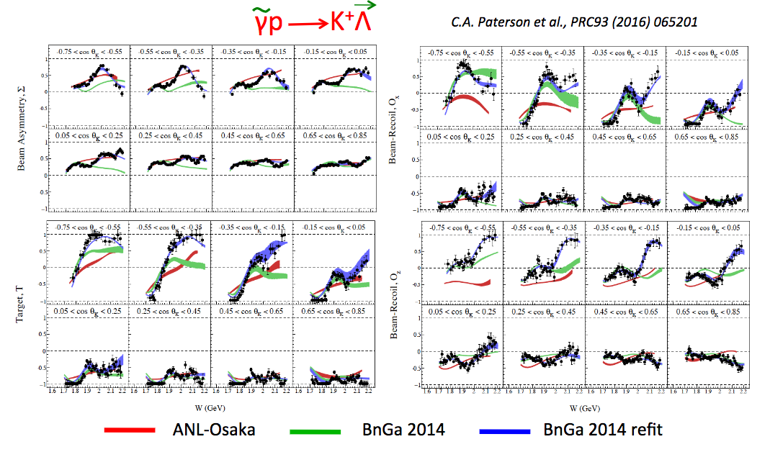

More N* from polarized K⁺ Λ photoproduction?
$$\tilde{γ}p→K^{+}\vec{Λ}$$
New Multipole Extraction
PRC96,055202 (2017)

Slide 17
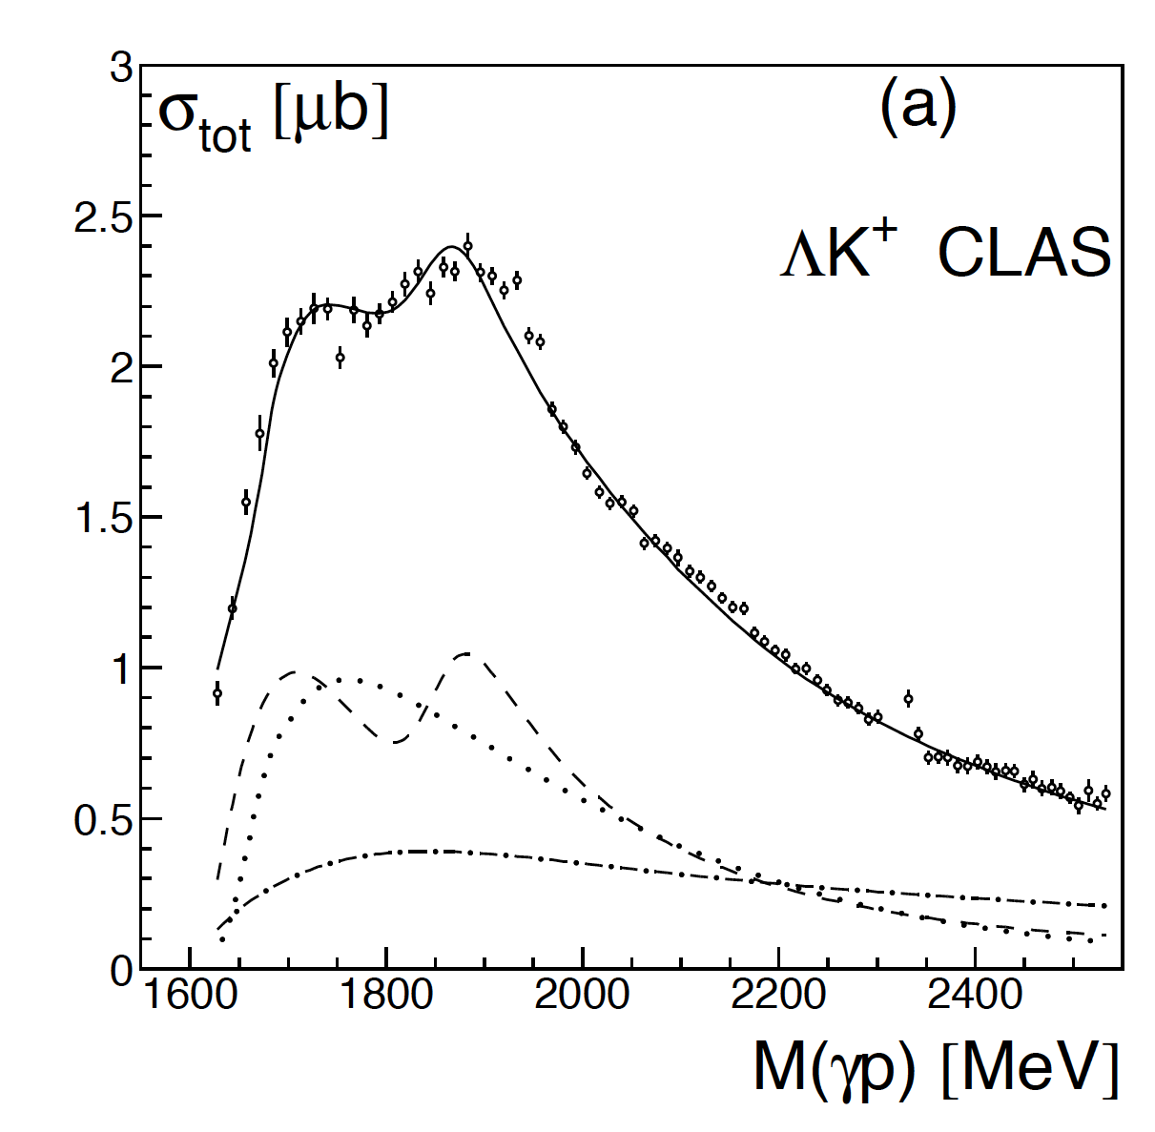
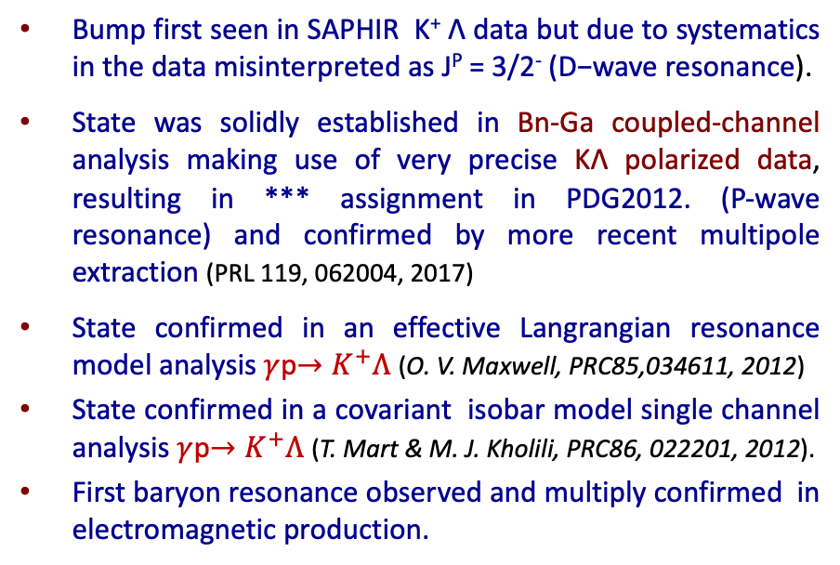
The N(1900)3/2⁺ State
Bump first seen in SAPHIR K⁺ Λ data but due to systematics in the data misinterpreted as J^{P} = 3/2⁻ (D−wave resonance).
State was solidly established in Bn-Ga coupled-channel analysis making use of very precise KΛ polarized data, resulting in *** assignment in PDG2012. (P-wave resonance) and confirmed by more recent multipole extraction (PRL 119, 062004, 2017)
State confirmed in an effective Langrangian resonance model analysis $γ$p$→K^{+}Λ$ (O. V. Maxwell, PRC85,034611, 2012)
State confirmed in a covariant isobar model single channel analysis $γ$p$→K^{+}Λ$ (T. Mart & M. J. Kholili, PRC86, 022201, 2012).
First baryon resonance observed and multiply confirmed in electromagnetic production.
Bonn-Gatchina fit
P₁₃
          Promoted to **** state in 2021 RPP

Slide 18
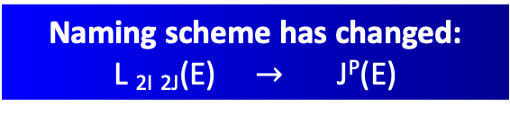
Updated Spectrum of Baryon Resonances
From 2000 to 2010 no new Baryon resonances in PDG. πN- scattering data and π-photoproduction only.
Multi-channel models now include many photoproduction data. e.g. Bonn-Gatchina PWA analysis
A. Anisovich et al. EPJ A 48, 15 (2012)
PRL 119, 062004, 2017)
State N(mass)J^{P} | PDG pre 2010 | PDG 2012 | PDG 2021
N(1710)1/2⁺ | *** | *** | ****
N(1880)1/2⁺ |  | ** | ***
N(1895)1/2⁻ |  | ** | ****
N(1900)3/2⁺ | ** | *** | ****
N(1875)3/2⁻ |  | *** | ***
N(2120)3/2⁻ |  | ** | ***
N(2000)5/2⁺ | * |  | **
N(2060)5/2⁻ |  | ** | ***
Naming scheme has changed:
L _{2I} _{2J}(E) $→$ J^{P}(E)
Results from photoproduction now add to the PDG tables and determine properties of baryon resonances

Slide 19
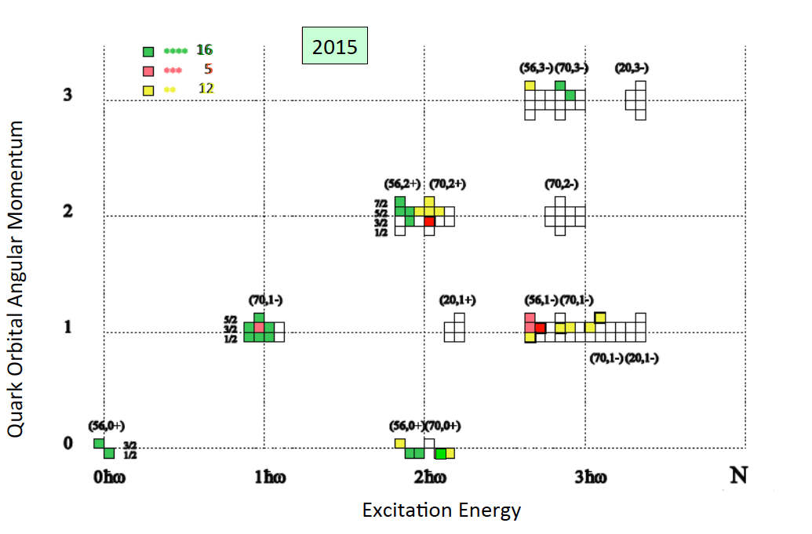
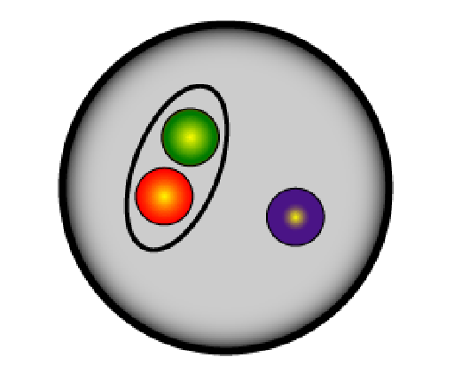
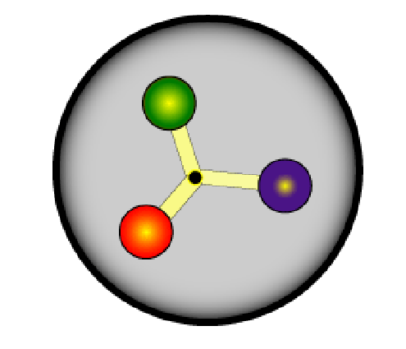
Do New States Fit into Q³ QM ?
SU(6)xO(3)
“Hard” quark-diquark models ruled out.
“Soft” quark-diquark models remain viable.
e.g. G. Eichmann et al. Phys. Rev. D 94, 094033 (2016)
vs

Slide 20
Do New States Fit into LQCD Projections ?
Robert G. Edwards, Jozef J. Dudek, David G. Richards, Stephen J. Wallace Phys.Rev. D84 (2011) 074508
N(1900)3/2⁺
N(1880)1/2⁺
N(2060)5/2⁻
N(2120)3/2⁻
N(1875)3/2⁻
N(1895)1/2⁻
Ignoring the mass scale, new candidates fit the J^{P} values predicted from LQCD.
The field would really benefit from more realistic Lattice masses for N* states.
Known states:
N(1675)5/2⁻
N(1700)3/2⁻
N(1520)3/2⁻
N(1650)1/2⁻
N(1535)1/2⁻
m_{π} = 396 MeV
Lowest J⁺ states
500 – 700 MeV high
Lowest J⁻ states
200 – 300 MeV high

Slide 21
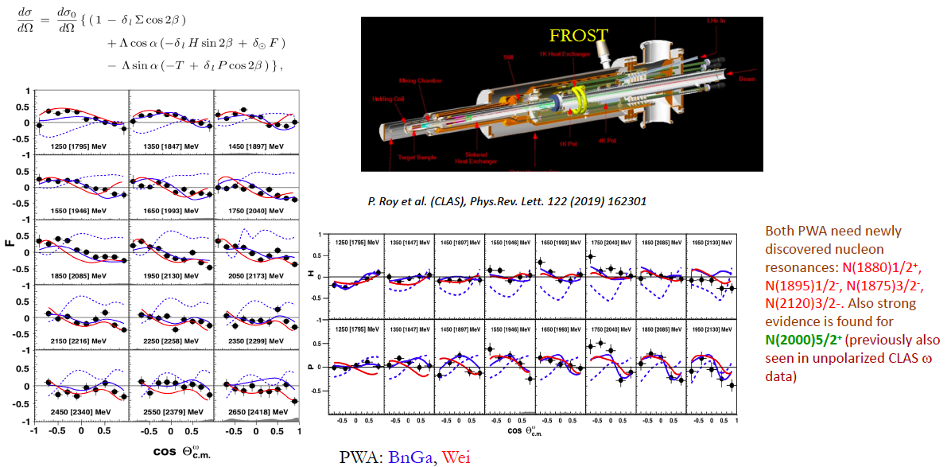
Beam-target asymmetries γ p $→$ p ω

Slide 22
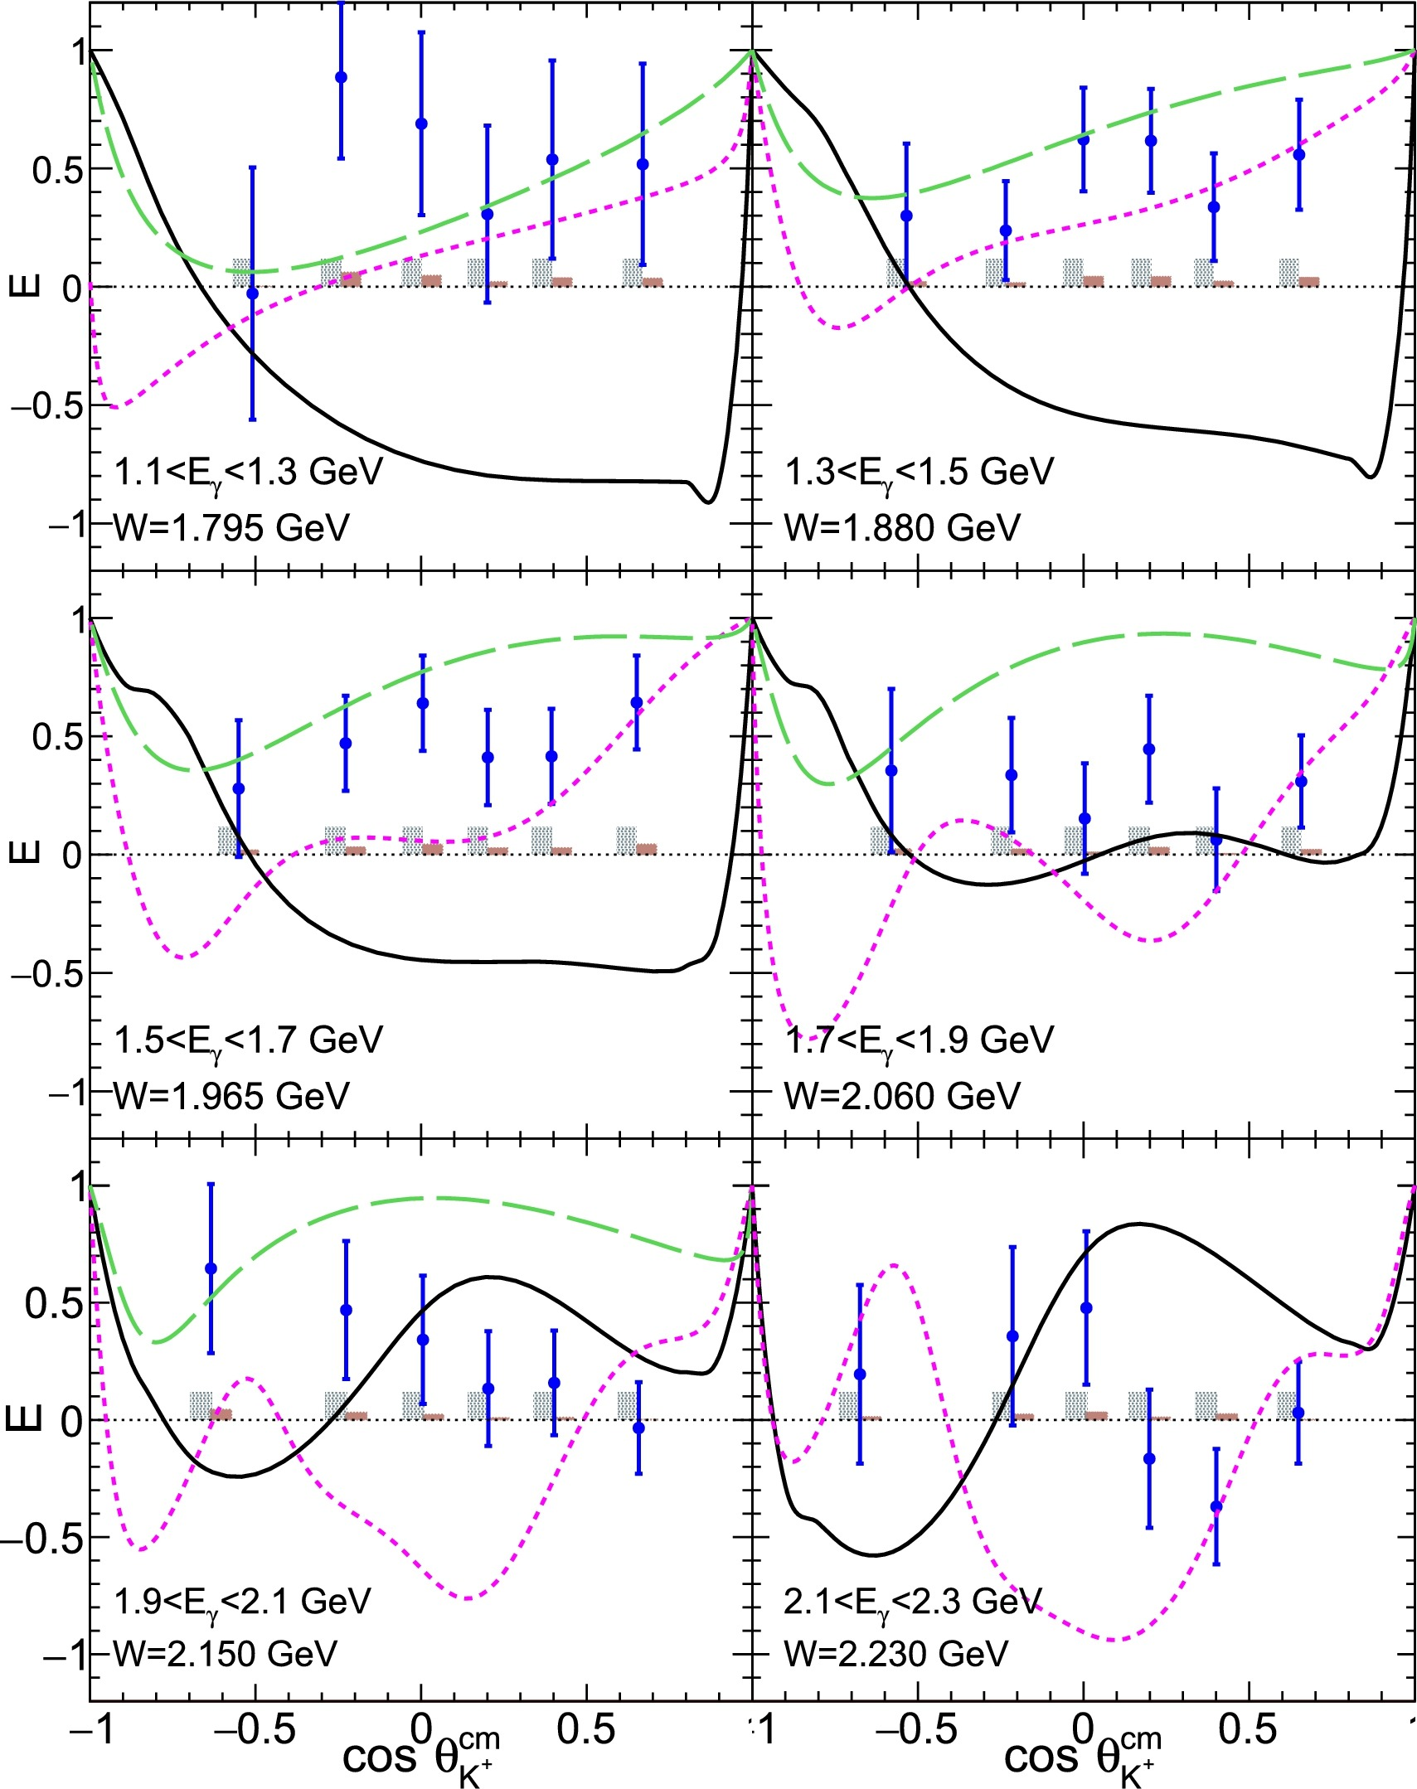
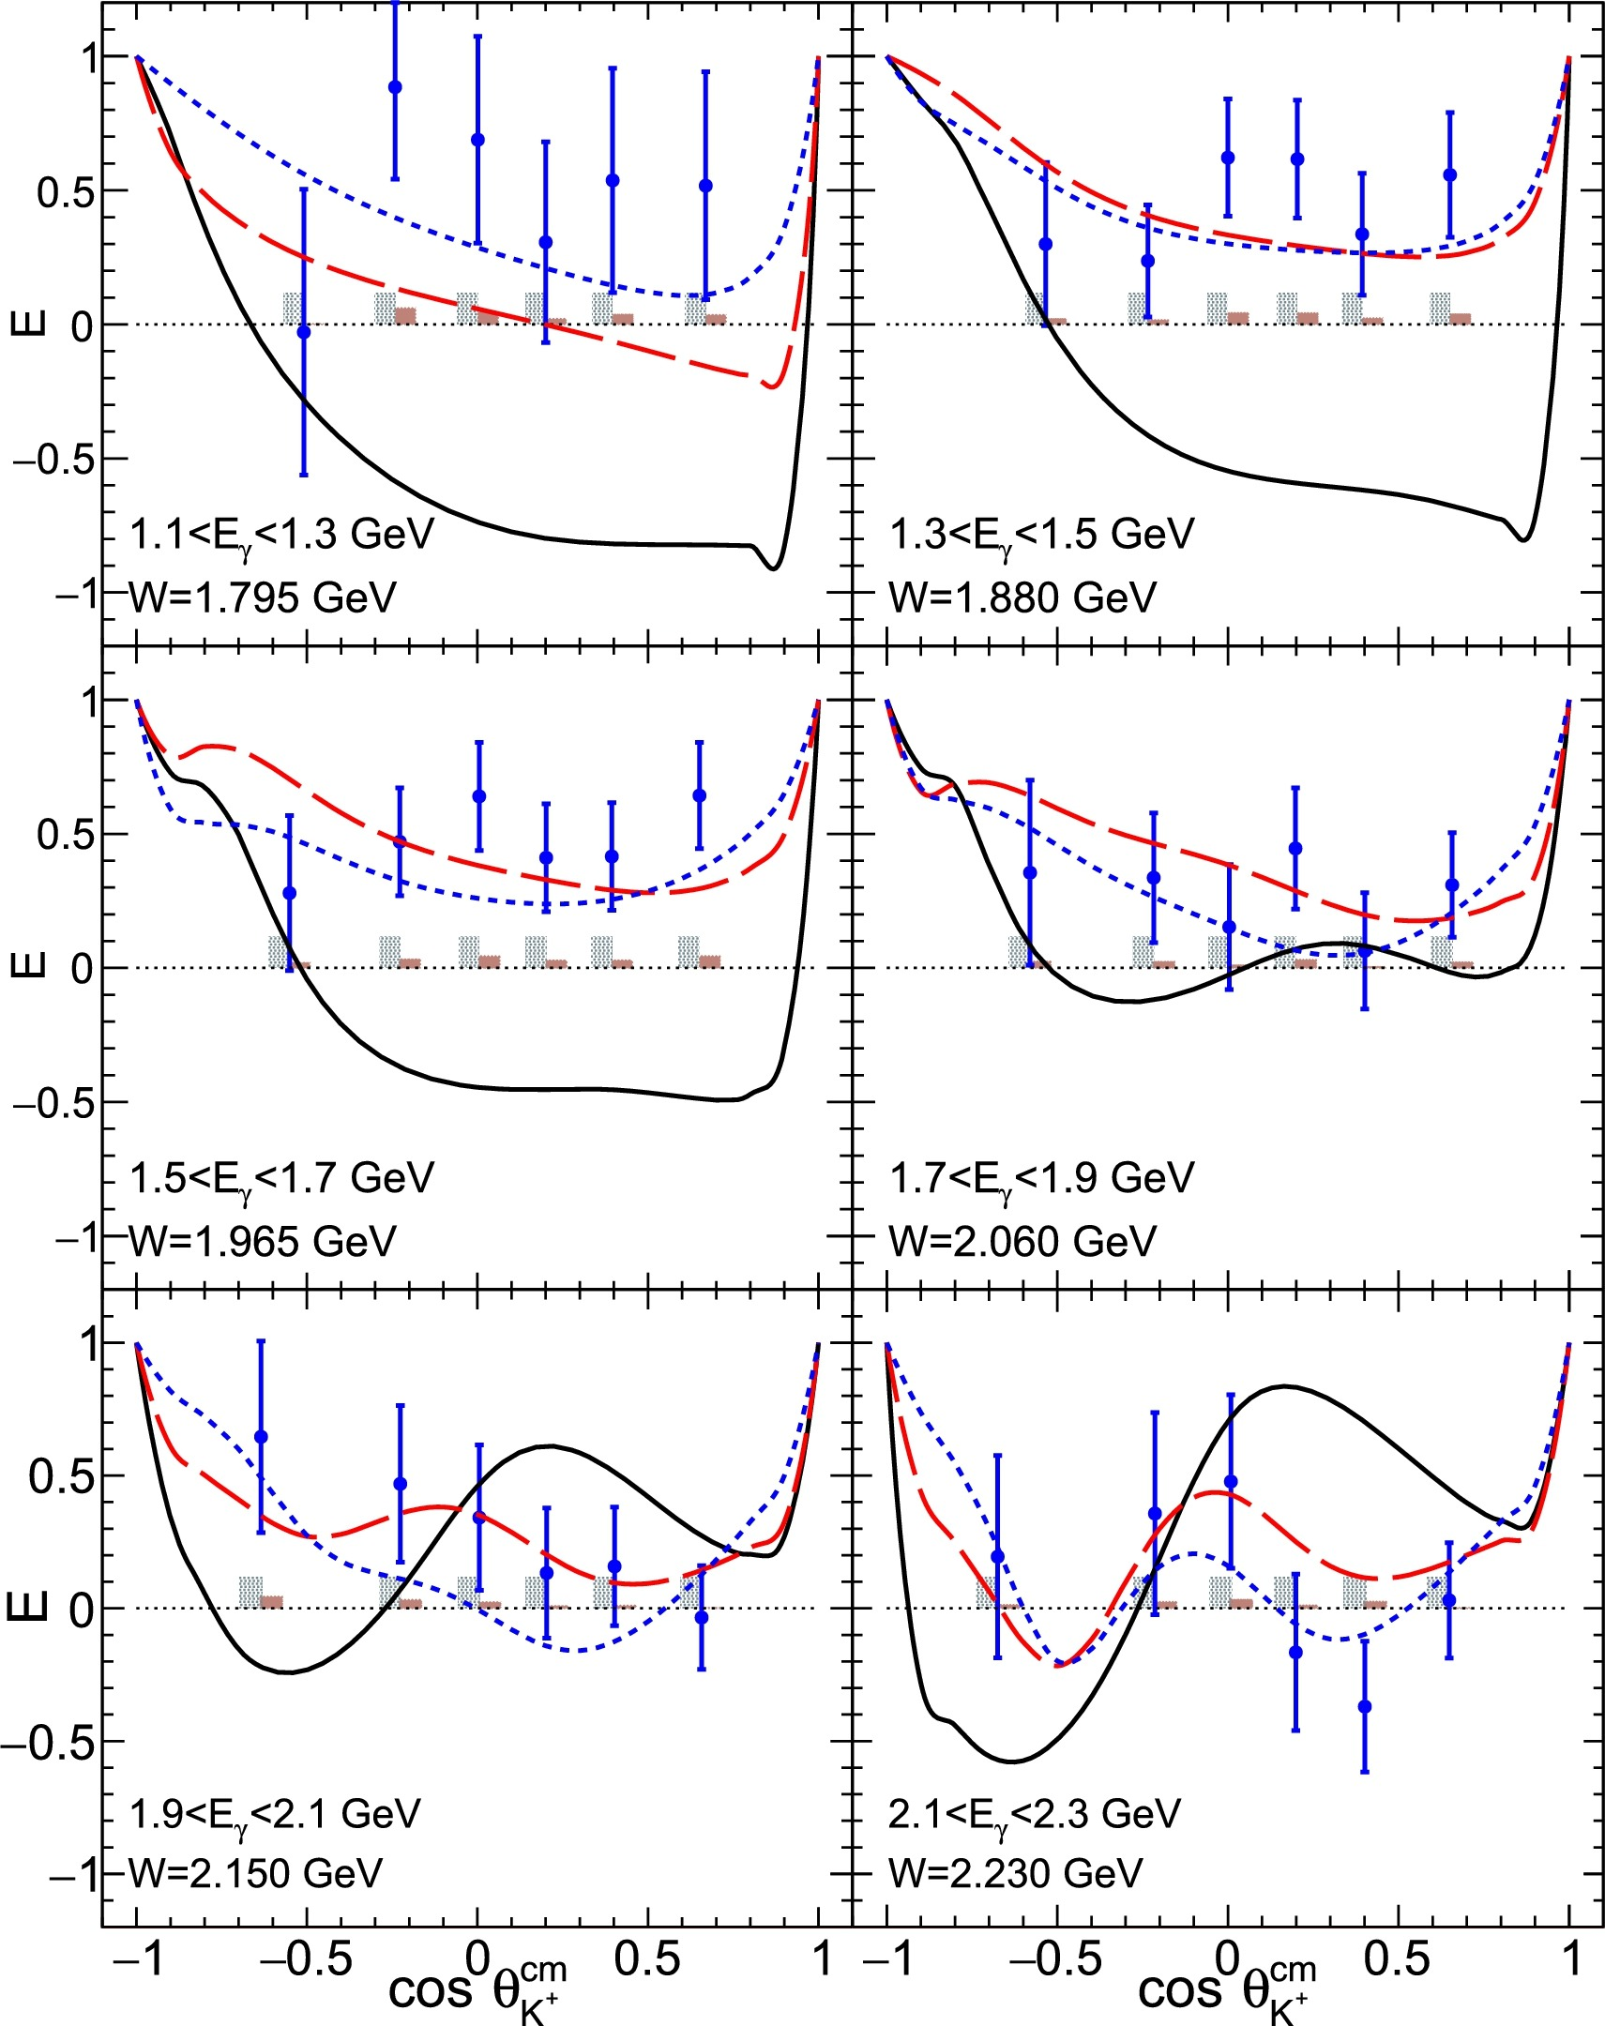

Search for Neutron States: γ n $→$ K⁺ Σ⁻
Beam-Target
helicity asymmetry E
Kaon-Maid2000
Kaon-Maid2017
Bonn-Gatchina 2017
Bonn-Gatchina 2019
N(1895)1/2⁻ N(1720)3/2⁺
N(1900)3/2⁺
modified photo-couplings
Bonn-Gatchina 2019
+ N(2170) 3/2⁺
N. Zachariou et al Phys lett B 808 (2020) 135662

Slide 23
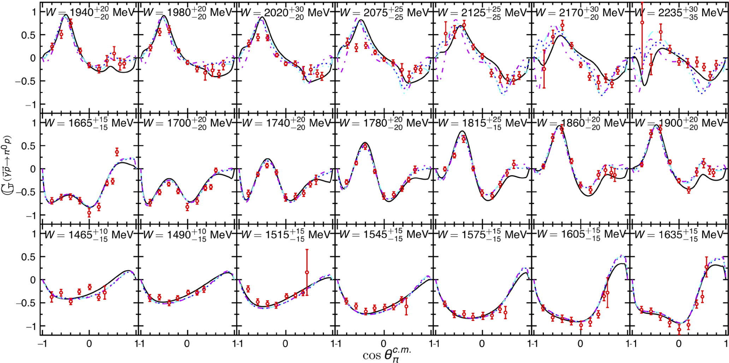
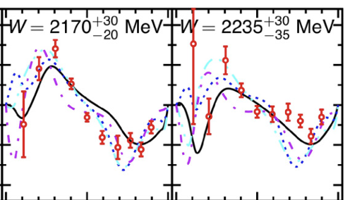
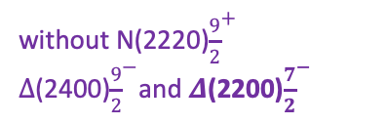
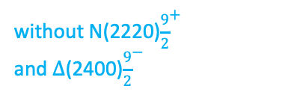
Beam-target asymmetry G in $\vec{γ}+\vec{p}$ $→$ $π^{0}$+ p
N. Zachariou et al Phys lett B 817 (2020) 136304
SAID ZA19
BoGa
BoGa
without N(2220)${\frac{9}{2}}^{+}$
and $Δ$(2400)${\frac{9}{2}}^{−}$
BoGa 3
without N(2220)${\frac{9}{2}}^{+}$
$Δ$(2400)${\frac{9}{2}}^{−}$and $Δ$(2200)${\frac{7}{2}}^{−}$

Slide 24
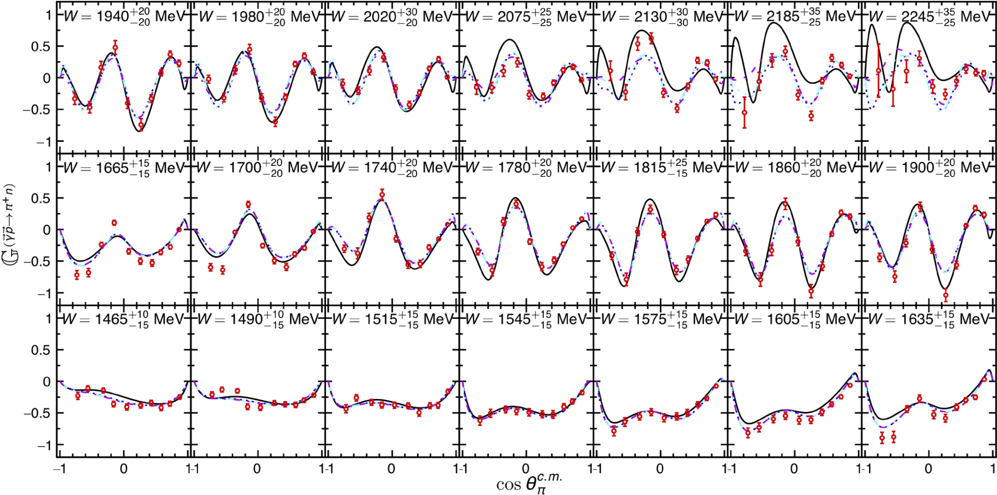
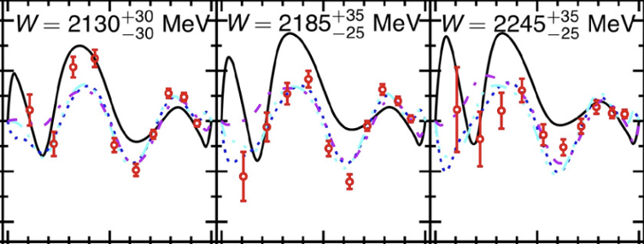
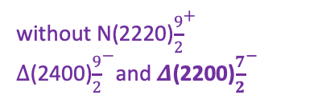
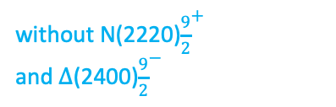
Beam-target asymmetry G in $\vec{γ}+ \vec{p}$ $→$ $π^{+}$ +n
SAID ZA19
BoGa
BoGa
without N(2220)${\frac{9}{2}}^{+}$
and $Δ$(2400)${\frac{9}{2}}^{−}$
BoGa 3
without N(2220)${\frac{9}{2}}^{+}$
$Δ$(2400)${\frac{9}{2}}^{−}$and $Δ$(2200)${\frac{7}{2}}^{−}$
N. Zachariou et al Phys lett B 817 (2020) 136304

Slide 25

Search for Neutron States: γ n $→$ π⁻ p

Slide 26




$$π^{+}π^{−} photoproduction −polarized p target$$
Measurements of polarization observables
HD-ice frozen-spin
polarized target
$I^{⊙}$is expected to be odd
Preliminary results by: A. Filippi (g14 data-set)

Slide 27


$$π^{+}π^{−} photoproduction −polarized p target$$
Measurements of polarization observables
HD-ice frozen-spin
polarized target
polarized p
$P_{z}is$ expected to be even
Preliminary results by: A. Filippi (g14 data-set)

Slide 28


$$π^{+}π^{−} photoproduction −polarized p target$$
Measurements of polarization observables
HD-ice frozen-spin
polarized target
polarized p
$P_{z}^{⨀} is$ expected to be even
Preliminary results by: A. Filippi (g14 data-set)

Slide 29

Electroexcitation of N*/Δ resonances
Central question in hadron physics:
what are the relevant degrees of freedom at varying distance scale?
[56,2⁺]
2
N(1680)5/2⁺
N(1720)3/2⁺
Probe resonance strength vs photon virtuality Q
L_{3q}
[70,1⁻]
N(1675)5/2⁻
N(1520)3/2⁻
N(1535)1/2⁻
1
[56,0⁺]
0
Δ(1232)3/2⁺
N(940)
N(1710)1/2⁺
N(1440)1/2⁺
[70,0⁺]
0
1
N [ħω]
2

Slide 30

Total cross section at W < 2.1 GeV
γ* + p π⁺ + n
Different states respond differently to changes in Q²
Data: K. Park et al. PRC 77 (2008) 015208; K. Park et al. PRC 91 (2015) 045203
Analysis with UIM & fixed-t DR; Recent review: I. Aznauryan, V. Burkert, Prog. Part. Nucl. Phys. 67 (2012) 1.

Slide 31




Excited Nucleon Structure
Nucleon structure is more complex than what can be described accounting for quark degrees of freedom only
  - Low Q²:
  High Q²:
  structure well described by adding an external meson cloud to inner quark core
  quark core dominates; transition from confinement to pQCD regime
(Q² < 5 GeV²)
3q core + meson cloud 3q core pQCD
low Q² high Q²
(Q² > 5 GeV²)
Calculations of form factors and electrocoupling amplitudes are sensitive to the underlying quark mass distribution
e’
M
γ_{v}
e
N*,△*
Q²
N
B
A_{1/2}, A_{3/2}, S_{1/2}
helicity amplitudes
DSE calculations
A_{1/2} , A_{3/2} – transverse
S_{1/2} - longitudinal
CLAS results vs. QCD expectations with running quark mass

Slide 32

Roper - 1st nucleon radial excitation?

Slide 33

MB Contribution to electro-excitation of N(1535)1/2⁻
N(1535)1/2⁻
is consistent
with the 1st
orbital excitation
of the nucleon.
Meson-baryon cloud may account for discrepancies at low Q².

Slide 34

MB Contribution to electro-excitation of N(1675)5/2⁻
Measures the meson-baryon contribution to the γ* p N(1675)5/2⁻ directly.
Can be verified on γ* n N(1675)5/2⁻ which is not suppressed

Slide 35


π⁺π⁻p CLAS data - Newly Discovered N’(1720)3/2⁺
π⁺π⁻p photoproduction
π⁺π⁻p electroproduction
V.I. Mokeev et al., Phys. Lett. B 805, 135457 (2020)
N(1720)3/2⁺
Resonant part
N’(1720)3/2⁺
N’(1720)3/2⁺
Resonant part w/o
N’(1720)3/2⁺,
& N(1720)3/2⁺
N(1720)3/2⁺
Evidence of a new N’(1720)3/2⁺ resonance from the combined analysis of CLAS photo- and electroproduction of the π⁺π⁻p channel
First result on Q² evolution of the new resonance electrocoupling
35

Slide 36
Hybrid Hadrons: Hadrons with Explicit Gluonic Degrees of Freedom
Hybrid hadrons with dominant gluonic contributions are predicted to exist by QCD.
Experimentally:
Hybrid mesons |qqg> states may have exotic quantum numbers J^{PC} not available to pure |qq> states GlueX, MesonEx, COMPASS, PANDA ….
Hybrid baryons |qqqg> have the same quantum numbers J^{P} as |qqq> electroproduction with CLAS12 (Hall B).
Theoretical predictions:
        MIT bag model - T. Barnes and F. Close, Phys. Lett. 123B, 89 (1983).
        QCD Sum Rule - L. Kisslinger and Z. Li, Phys. Rev. D 51, R5986 (1995).
        Flux Tube model - S. Capstick and P. R. Page, Phys. Rev. C 66, 065204 (2002).
        LQCD - J.J. Dudek and R.G. Edwards, PRD85, 054016 (2012).

Slide 37

Hybrid Baryons in LQCD
J.J. Dudek and R.G. Edwards, PRD85, 054016 (2012)
regular states
clustered
in mass
hybrid states
LQCD
1.3GeV
The nucleon mass is shifted ~300 MeV to higher masses
Hybrid states have same J^{P} values as qqq baryons. How to identify them?
Overpopulation of N 1/2⁺ and N 3/2⁺ states compared to QM projections. ?
A_{1/2} (A_{3/2}) and S_{1/2} show different Q² evolution.

Slide 38


Separating q³g from q³ states ?
CLAS results on electrocouplings clarified nature of the Roper.
Will CLAS12 data be able to identify gluonic contributions ?
q³
q³
q³g
q³g
q³
For hybrid “Roper”, A_{1/2}(Q²) drops off faster with Q² and S_{1/2}(Q²) ~ 0.

Slide 39

Hybrid Baryon Signatures
Based on available knowledge, the signatures for hybrid baryons consist of:
• Extra resonances with J^{p}=1/2⁺ and J^{p}=3/2⁺, with masses > 1.8 GeV and decays into Nππ or KY final states.
•A drop of the transverse helicity amplitudes A_{1/2}(Q²) and A_{3/2}(Q²) faster than for ordinary three quark states, because of extra glue-component in valence structure.
•A suppressed longitudinal amplitude S_{1/2}(Q²) in comparison with transverse electro-excitation amplitude (J^{P}=1/2⁺).
Candidate reaction channels are:
e p $→$ e p π⁺ π⁻
e p $→$ e K⁺Λ, e K⁺Σ⁰

Slide 40

CLAS12 and the JLab 12 GeV Upgrade
The JLab 12 GeV upgrade project started 20 years ago…
2000-2004: Science case
2004-2008: R&D
2006-2009: Design and Engineering
2009-2015: Construction
2012-2017: Installation
CHL
Hall B with CLAS12 spectrometer
CLAS Collaboration:
~200 scientists
55 institutions
12 countries
Scope of the 12 GeV upgrade project:
Double the accelerator beam energy
New Hall D
Upgrades to existing Halls A, B, C

Slide 41

CLAS12
Forward Detector (FD)
  - TORUS magnet
  HT Cherenkov Counter
  Drift chamber system
  LT Cherenkov Counter
  Forward TOF System
  Pre-shower calorimeter
  E.M. calorimeter
Central Detector (CD)
  SOLENOID magnet
  Silicon Vertex Tracker
  Central Time-of-Flight
Beamline
  Cryo Target
  Moller polarimeter
  - Shielding
  Photon Tagger
Upgrade to the baseline
- Central Neutron Detector
  MicroMegas
  Forward Tagger
  RICH detector
  Polarized target
MM
CND
FT
RICH

Slide 42
CLAS12 Spectrometer
beam

Slide 43



Electroexcitation kinematics
Measured σ are decomposed using UIM or fixed-t DR to extract N* & Δ helicity amplitudes.

Slide 44



Beam-Recoil Transferred Polarization in K⁺Y Electroproduction
6.535 GeV and 7.546 GeV electrons on LH₂ target
Extract beam-recoil transferred polarization from longitudinally polarized beam electron to final state hyperon vs. Q², W, cos q_{K}^{c.m.}
Part of program to study spectrum and structure of excited nucleon states
D.S. Carman, A. D., L. Lanza, V. I. Mokeev et al., Phys Rev C105, 065201 (2022)
K⁺Λ
K⁺Σ⁰
Kaon-Maid
RPR 2011
RPR 2011
No resonances
Bydžovský-Skoupil Model

Slide 45
Summary
Major progress made in the last years in the search for N* and Δ states.
Polarization observables in photo-production have provided crucial constraints
New states have been found and can be accommodated in CQM and LQCD schemes.
Naïve (non-dynamical) di-quark models are ruled out.
Knowledge of Q²-dependence of electrocouplings is necessary to understand the nature ( the internal structure) of the excited states.
Roper is the first radial excitation of the q³ core, obscured at large distances by meson-cloud effects.
Leading electrocoupling amplitudes of prominent low-mass states (e.g. N(1535)1/2⁻ ) is well modeled by DSE/QCD, LC SR and LF RQM for Q²> 2 GeV.
Search for hybrid baryons with explicit gluonic degrees of freedom is possible investigating the low Q² evolution of high-mass resonance (2-3 GeV) electrocoupligs:
Looking for suppressed A^{1/2}, A^{3/2}, S^{1/2} at low Q²

Slide 46
BACKUP SLIDES

Slide 47

Run Group K Production
Fall 2018
E=6.5GeV
CHARGE
E=7.5GeV
Energy Change
FT-OFF
15.6 G EVENTS
RUN CONDITIONS – FALL 2018
Torus Current | 100% (3375 A) - negative outbending
Solenoid | -100 %
FT | ON @ 7.5 GeV -> OFF @ 6.5 GeV
Beam/Target | Polarized electrons, unpolarized LH₂ target
Luminosity | ~ 5 10 ³⁴ cm⁻²s⁻¹ @ 7.5 GeV 10 ³⁵ cm⁻²s⁻¹ @ 6.5 GeV FULL LUMINOSITY
Beam Energy | Beam Current | Tgt | Trigger | Collected Events
7.5 GeV | 35 nA | LH₂ | e in CLAS e in FT + 1 Fwd Hadron | 3.5 G
7.5 GeV | 45 nA | LH₂ | e in CLAS - prescaled e in FT + 1 Fwd Hadron | 4.3 G
6.5 GeV | 60 nA | LH₂ | e in CLAS | 7.8 G

Slide 48

Critical QCD Questions Addressed
The light N* spectrum: what is the role of glue?
“Nucleons are the stuff of which our world is made.
As such they must be at the center of any discussion of why the world we actually experience has the character it does.”
Nathan Isgur, NStar2000, Newport News, Virginia
Derek B. Leinweber – University of Adelaide
Search for new baryon states

Slide 49


Establishing the N* and Δ Spectrum: πN Scattering
dσ/dΩ
P
π⁺ p π⁺ p
π⁻ p π⁻ p
π⁻ p π⁰ n
π⁺ p π⁺ p
π⁻ p π⁻ p
π⁻ p π⁰ n
1234 MeV
1449 MeV
1678 MeV
1900 MeV
θ
θ
θ
θ
θ
θ

Slide 50

Establishing the N* and Δ Spectrum: πN Amplitudes
S₁₁
P₁₁
P₁₃
D₁₃
D₁₅
F₁₅
F₁₇
Isospin 1/2
Imaginary T
Julia-Diaz, Lee, Matsuyama, Sato

Slide 51


Establishing the N* and Δ Spectrum: γ + p ➔ π⁰ + p
Differential cross section
Σ Beam Asymmetry
Kamano
Nakamura
Lee &
Sato, 2012
T single
G E F double
polarization observables
also available

Slide 52




Event Reconstruction
β
β
π⁻
π⁺
K⁺
p
positives
negatives
p (GeV)
p (GeV)
ep → e'π⁺X
10.6 GeV
2.2 GeV
6.4 GeV
Δ⁰(1232)
Δ⁰(1232)
neutron
neutron
neutron
neutron
2nd N* region
3rd N* region
M_{x} (GeV)

