Slide 1
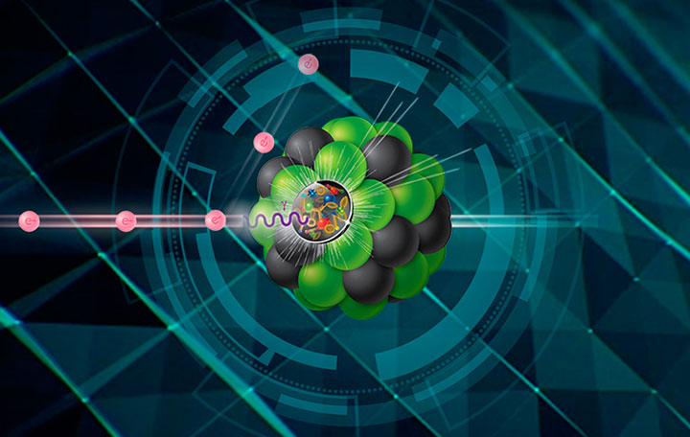
Design Philosophy
ePIC
(electron-Proton/Ion Collider)
Detector and Collaboration
Bernd Surrow (surrow@temple.edu)
DOE NP contract: DE-SC0013405

Slide 2
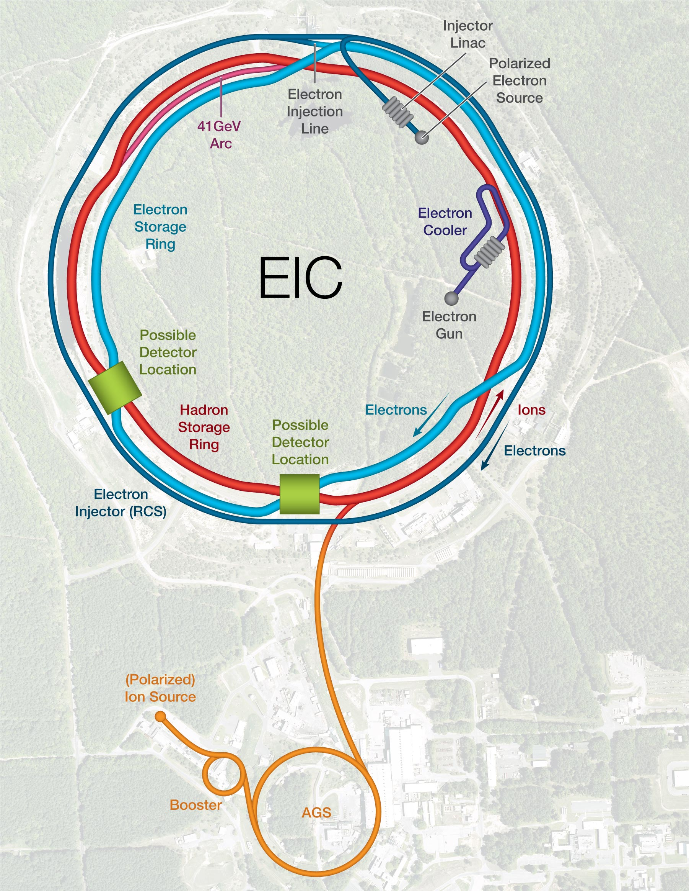
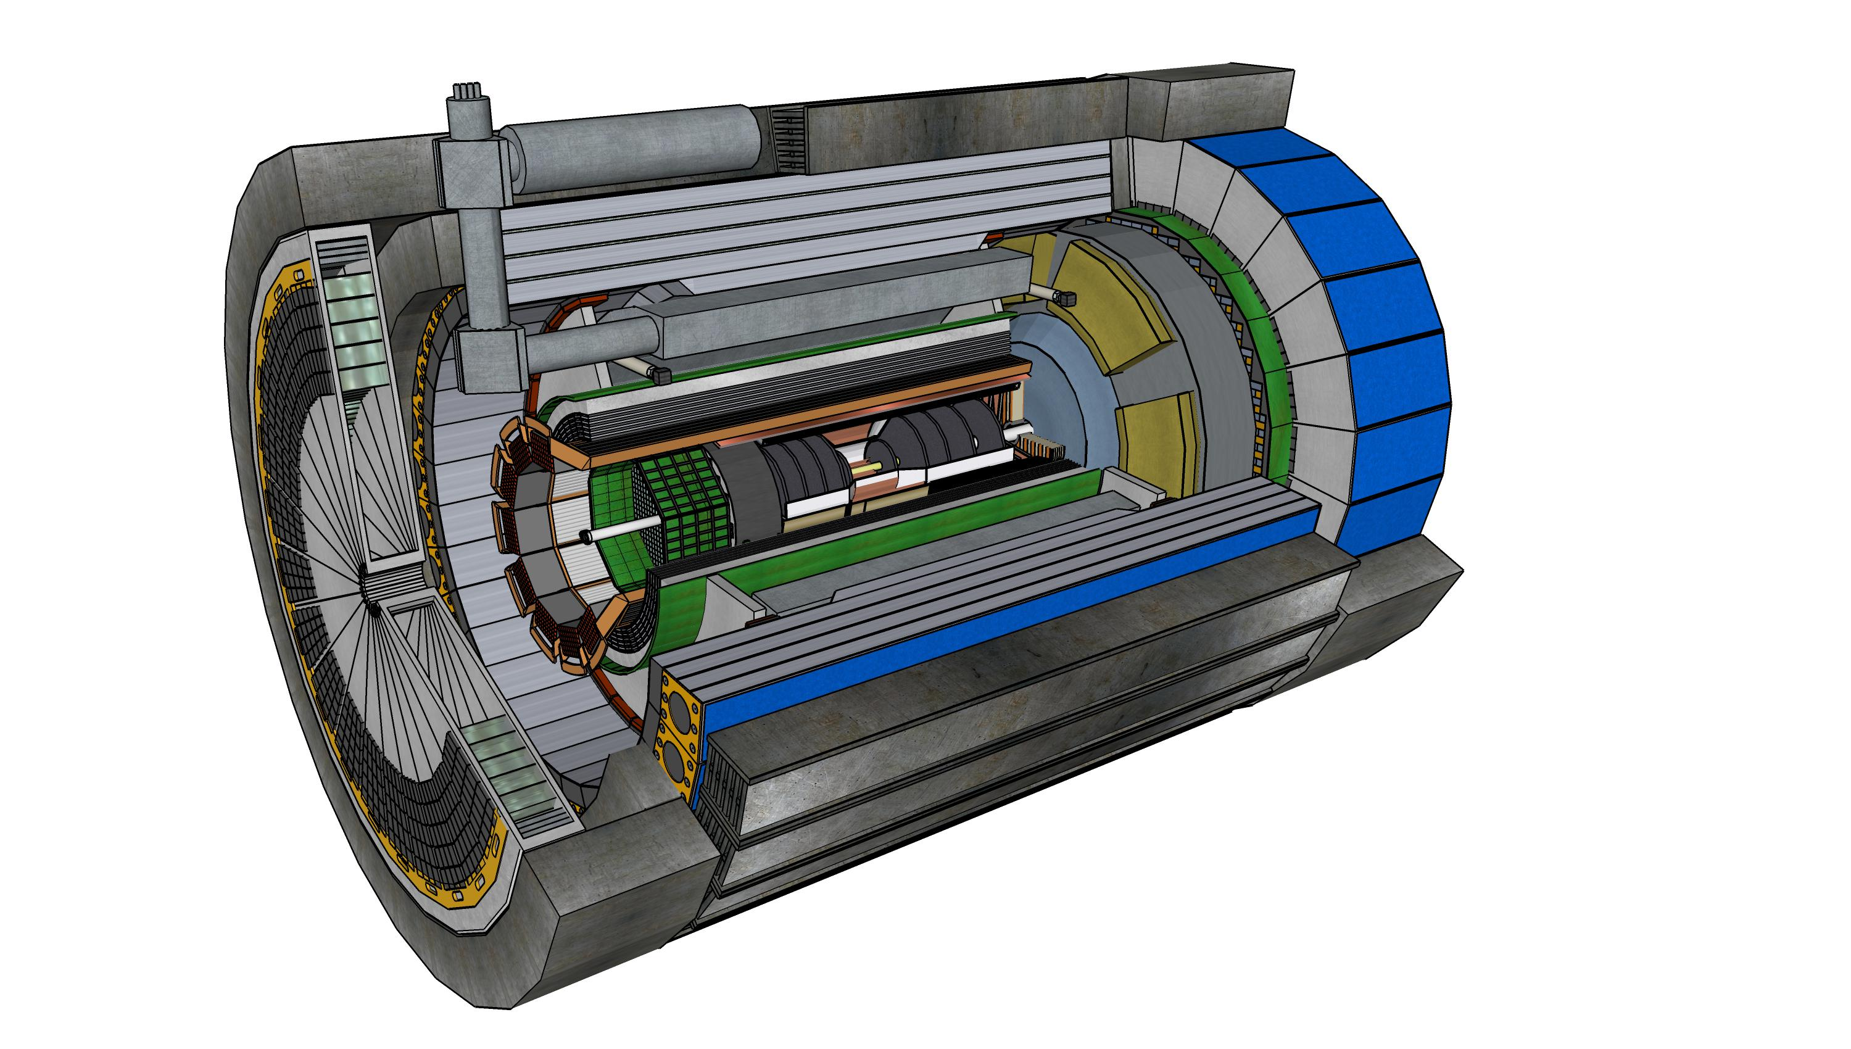
Outline
EIC Project Development
ePIC Detector Design Philosophy
ePIC Collaboration
Summary And Next Steps
15th European Research Conference EINN 2023
Paphos, Cyprus, October 31 - November 4, 2023
Bernd Surrow

Slide 3
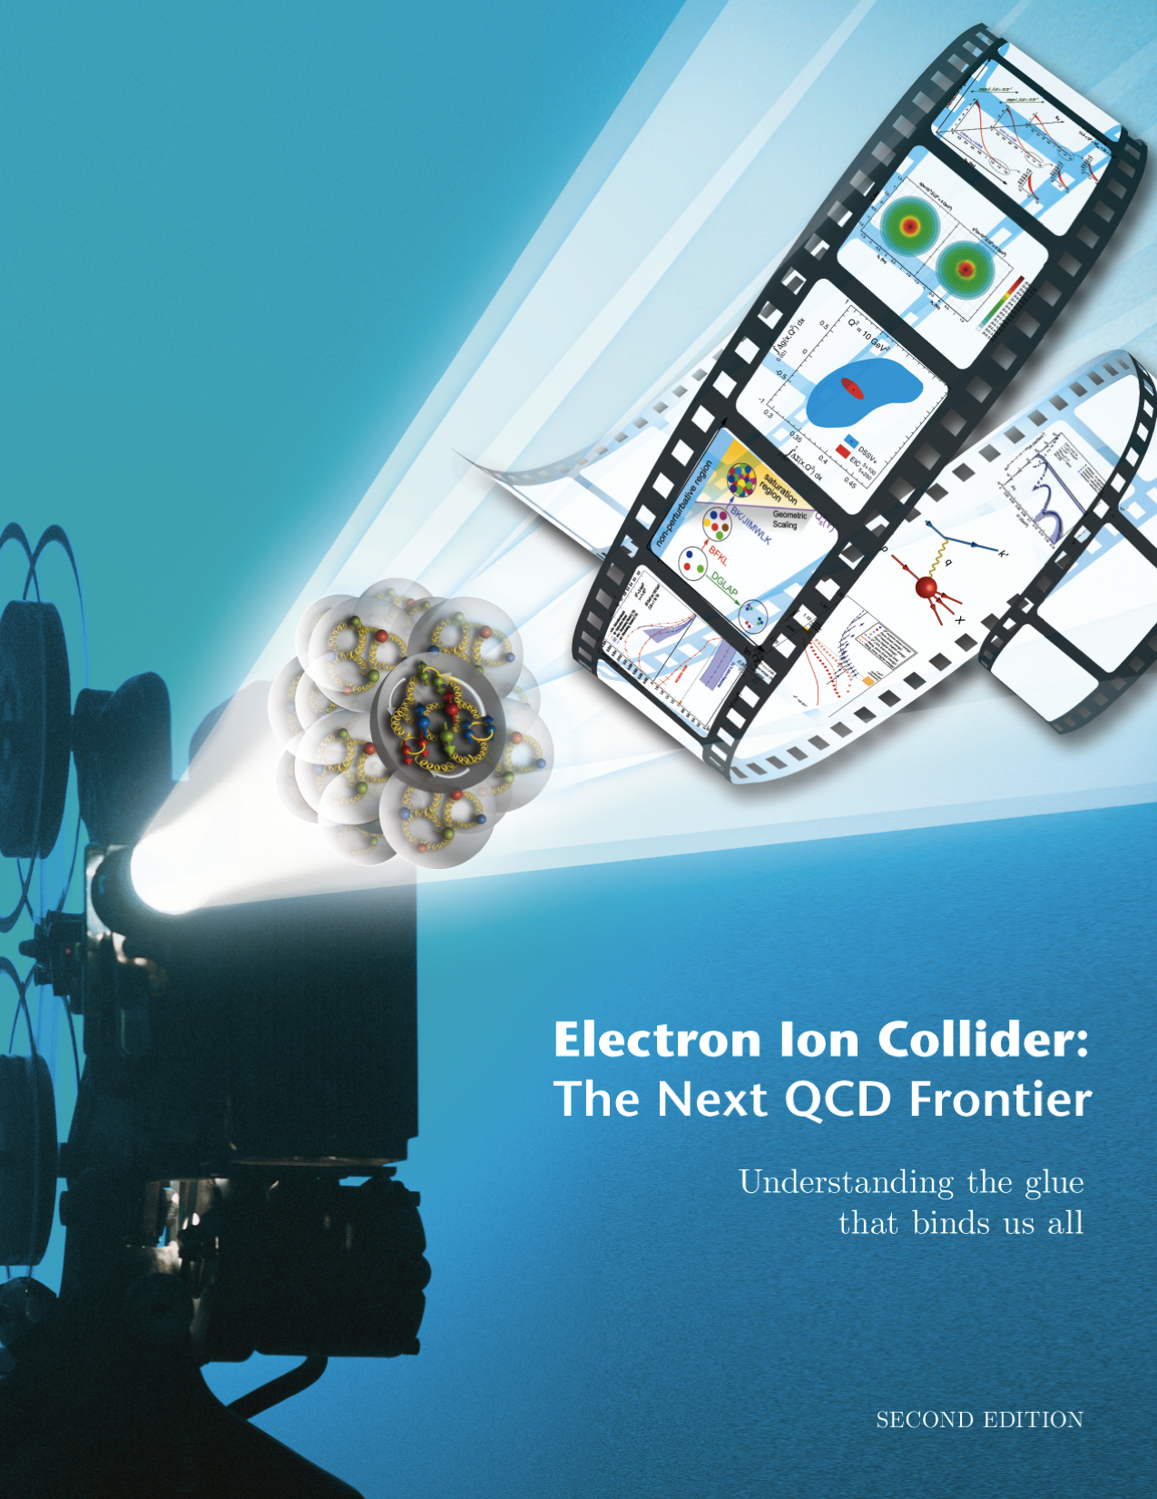
Spinning Glue: QCD and Spin
EIC Project Development
EIC: Study structure and dynamics of matter at high luminosity, high energy with polarized beams and wide range of nuclei
Whitepaper:
10³⁴
Tomography (p/A) Transverse Momentum Distribution and Spatial Imaging
100
Luminosity (cm⁻² sec⁻¹)
Integrated Luminosity (fb⁻¹/yr)
10³³
Spin and Flavor Structure of the Nucleon and Nuclei
10
arXiv:1212.1701
Parton Distributions in Nuclei
QCD at Extreme Parton Densities - Saturation
10³²
1
Understanding the glue that binds as all!
40
80
120
$$\sqrt{s}$$
(GeV)
15th European Research Conference EINN 2023
Paphos, Cyprus, October 31 - November 4, 2023
Bernd Surrow

Slide 4
Spinning Glue: QCD and Spin
EIC Project Development
Requirements
Machine:
High luminosity: 10³³cm⁻²s⁻¹ - 10³⁴cm⁻²s⁻¹
Flexible center-of-mass energy : Wide kinematic range
Highly polarized electron (0.8) and proton / light ion (0.7) beams: Spin structure studies
Wide range of nuclear beams (d to Pb/U): High gluon density
Detector:
Wide acceptance detector system including particle ID (e/h separation & π, K, p ID - flavor tagging)
Instrumentation for tagging of protons from elastic reactions and neutrons from nuclear breakup: Target / nuclear fragments in addition to low Q² tagger / polarimetry and luminosity (abs. and rel.) measurement
$$\sqrt{s}=\sqrt{4E_{e}E_{p}}$$
$$Q^{2}=sxy$$
non-perturbative
perturbative
HERMES, COMPASS, JLab6, JLAB12
HERA
EIC
Q²(GeV²)
10⁻¹
1
10
10²
10³
10⁴
10⁵
15th European Research Conference EINN 2023
Paphos, Cyprus, October 31 - November 4, 2023
Bernd Surrow

Slide 5
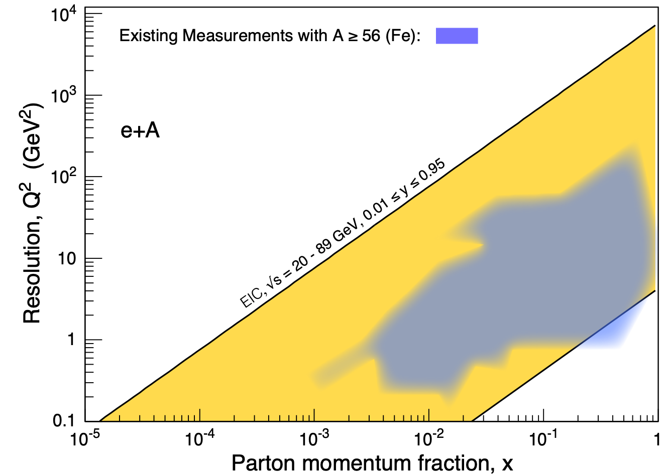
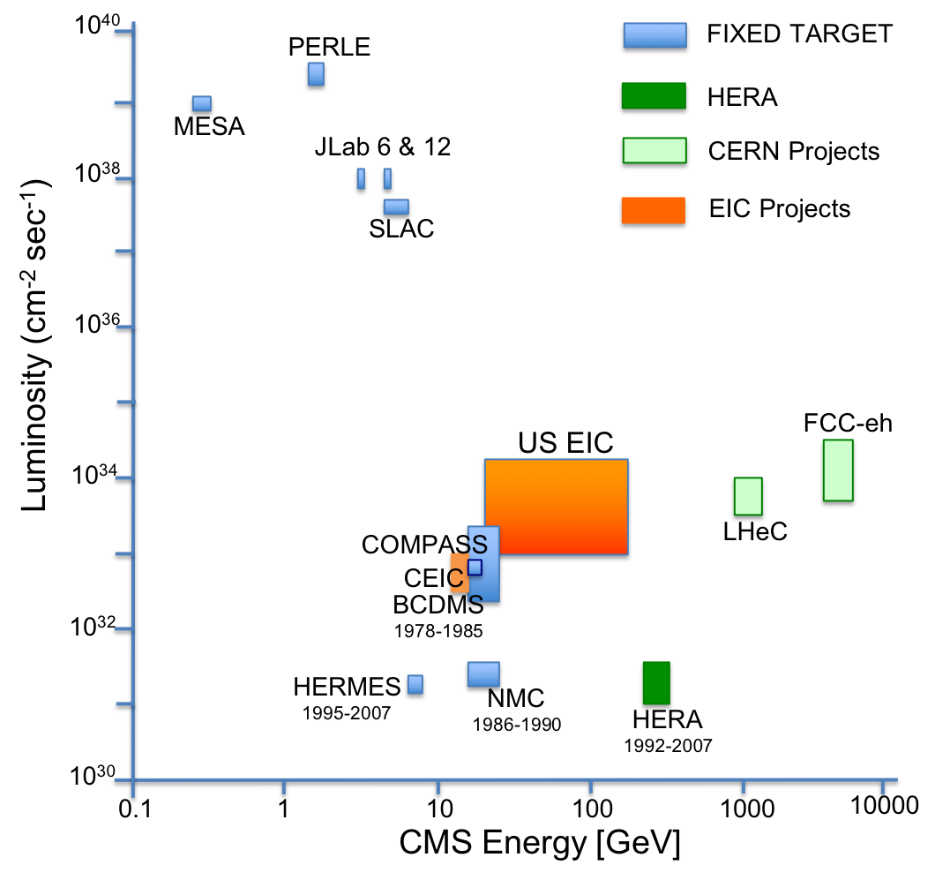
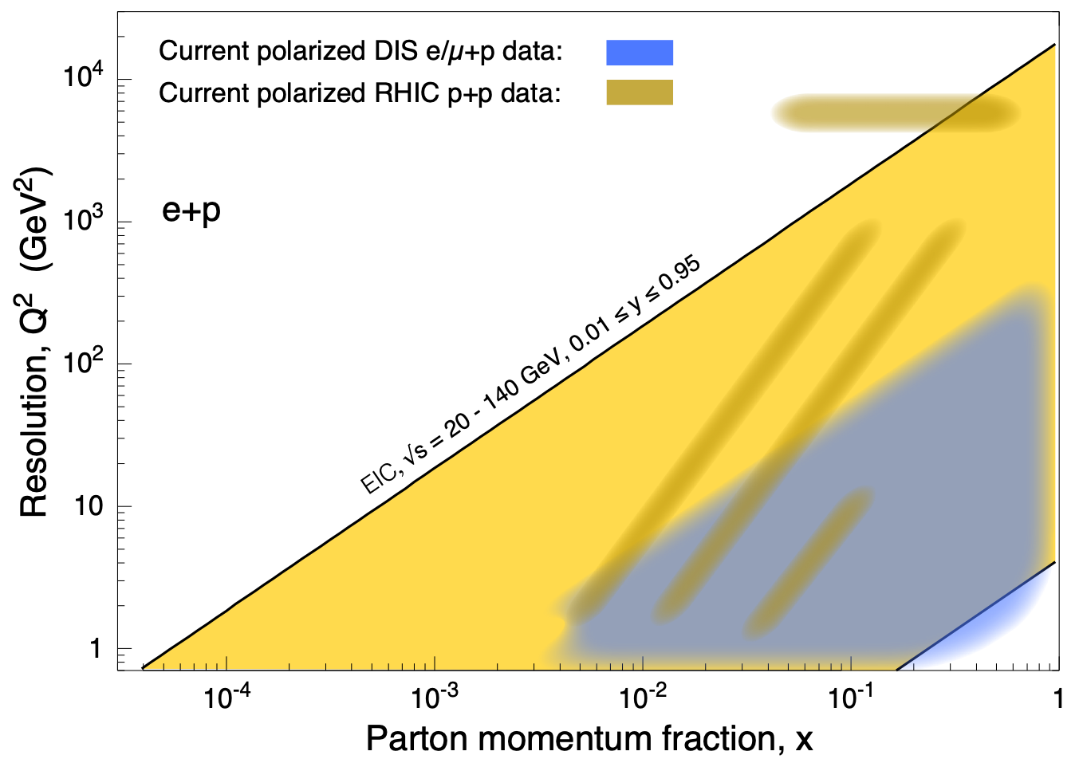
Spinning Glue: QCD and Spin
EIC Project Development
Luminosity / / Kinematic coverage
$$\sqrt{s}$$
eA
ep
15th European Research Conference EINN 2023
Paphos, Cyprus, October 31 - November 4, 2023
Bernd Surrow

Slide 6
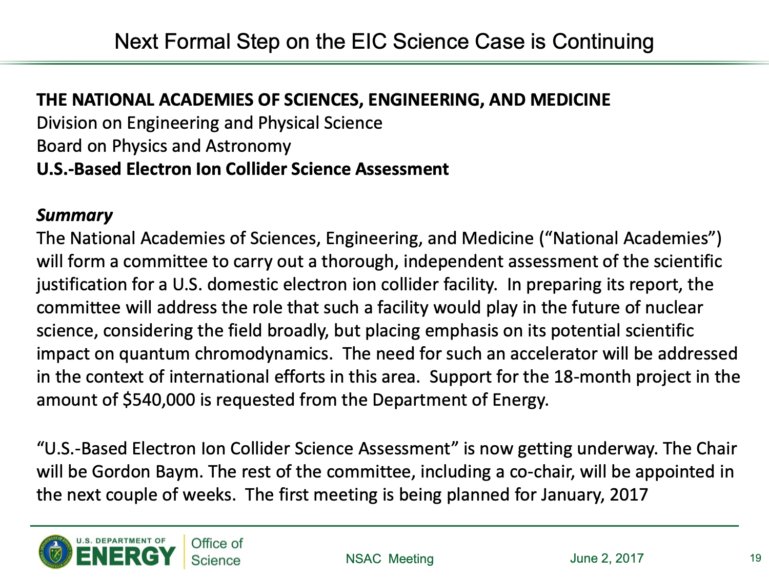
EIC Project Development
Critical steps over the last couple of years
INT Workshop series / Documentation of Physics Case - Whitepaper: “Understanding the glue that binds us all!”
INT Workshop: 2010
WP: 2012, updated in 2014 for LRP
2015 Long-range plan (LRP):
Request to review EIC Science Case by National Academy of Sciences, Engineering, and Medicine (NAS)
arXiv:1212.1701
Understanding the glue that binds as all!
T. Hallman
T. Hallman
15th European Research Conference EINN 2023
Paphos, Cyprus, October 31 - November 4, 2023
Bernd Surrow

Slide 7
Spinning Glue: QCD and Spin
EIC Project Development
NAS Webinar and NAS report release: 07/24/2018
https://www.nap.edu/catalog/25171/an-assessment-of-us-based-electron-ion-collider-science
Download pdf-file of final report!
Webinar on Tuesday, July 24, 2018 - Public presentation and report release
Gordon Baym (Co-chair): Webinar presentation
Slides from Webinar: https://www.nap.edu/resource/25171/eic-public-briefing-slides.pdf
Glowing” report on a US-based EIC facility!
“The committee finds that the science that can be addressed by an EIC is compelling, fundamental and timely.”
15th European Research Conference EINN 2023
Paphos, Cyprus, October 31 - November 4, 2023
Bernd Surrow

Slide 8
EIC Project Development
Site Selection and award of DOE Critical Decisions 0 (CD-0) and 1 (CD-1)
https://www.energy.gov/articles/us-department-energy-selects-brookhaven-national-laboratory-host-major-new-nuclear-physics
WASHINGTON, D.C. – Today, the U.S. Department of Energy (DOE) announced the selection of Brookhaven National Laboratory in Upton, NY, as the site for a planned major new nuclear physics research facility. The Electron Ion Collider (EIC), to be designed and constructed over ten years at an estimated cost between $1.6 and $2.6 billion, will smash electrons into protons and heavier atomic nuclei in an effort to penetrate the mysteries of the “strong force” that binds the atomic nucleus together.
EIC
Critical Decision-0 (CD-0), “Approve Mission Need”, approved for the EIC on December 19, 2019.
Operating* Funds
Project Engineering and Design (PED) Funds
Construction & PED
Funds
Operating Funds
Initiation
Definition
Execution
Closeout
Critical Decision-1 (CD-1), “Approve Alternative Selection and Cost Range”, was awarded for the EIC on June 29, 2021.
Conceptual Design
Preliminary Design
Final Design
Construction
Critical
Decisions
CD-0
Approve Mission Need
CD-1
Approve Alternative Selection
and Cost
Range
CD-2
Approve Performance Baseline (PB)
CD-3
Approve Start of Construction or Execution
CD-4
Approve
Start of Operations or Project Completion
15th European Research Conference EINN 2023
Paphos, Cyprus, October 31 - November 4, 2023
Bernd Surrow

Slide 9
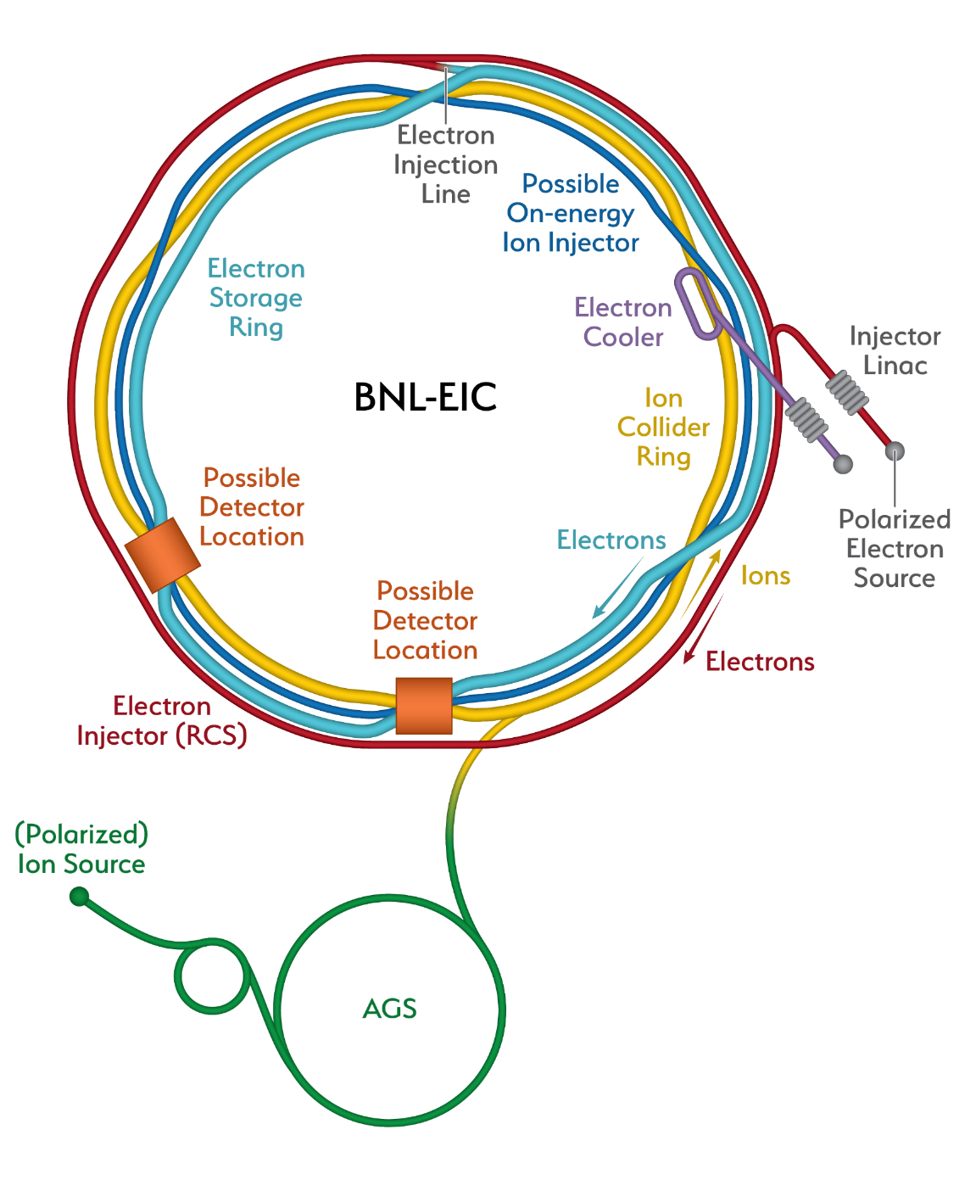
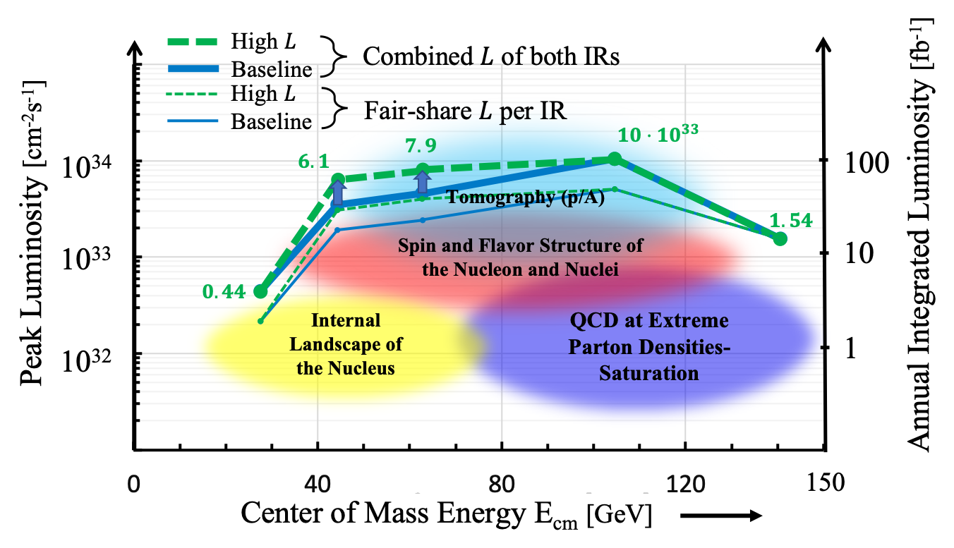
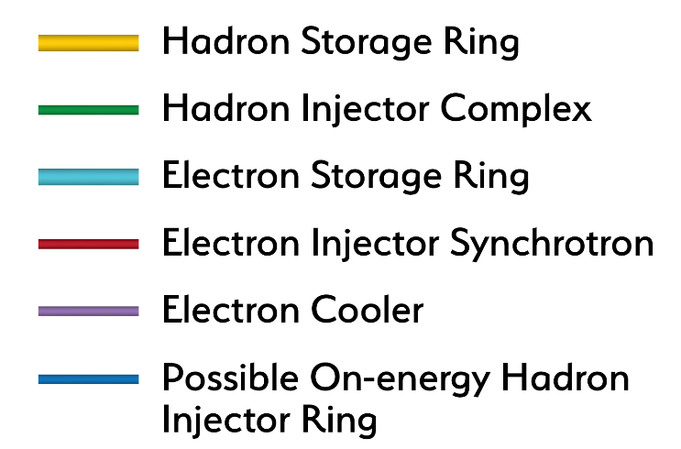
EIC Project Development
EIC accelerator design
Center of Mass Energies: | 20GeV - 140GeV
Luminosity: | 10³³ ⁻ 10³⁴ cm⁻²s⁻¹ / 10-100fb⁻¹ / year
Highly Polarized Beams: | 70%
Large Ion Species Range: | p to U
Number of Interaction Regions: | Up to 2!
2nd detector
15th European Research Conference EINN 2023
Paphos, Cyprus, October 31 - November 4, 2023
Bernd Surrow

Slide 10
EIC Project Development
Yellow Report Activity - Critical EIC Community activity for CD-1
R.~Khalek et al. [EIC Users Group], BNL-220990-2021-FORE, arXiv e-Print: 2103.05419, Accepted for publication in Nuclear Physics A
~400 authors / ~150 institutions / ~900 pages with strong international contributions!
Review: Community review within EICUG and external readers (~30) worldwide covering physics and detector expert fields!
Available on archive: Nucl. Phys. A 1026 (2022) 122447 / https://arxiv.org/abs/2103.05419
15th European Research Conference EINN 2023
Paphos, Cyprus, October 31 - November 4, 2023
Bernd Surrow

Slide 11
EIC Project Development
Open Call for Detector Proposals
ATHENA: A Totally Hermetic Electron-Nucleus Apparatus
Concept: General purpose detector inspired by the YR studies based on a new central magnet of up to 3T
WWW-page: https://www.athena-eic.org
CORE: COmpact detectoR for the Eic
Concept: Nearly hermetic, general-purpose compact detector, 3T baseline
WWW-page: https://userweb.jlab.org/~hyde/EIC-CORE/
ECCE: EIC Comprehensive Chromodynamics Experiment
Concept: General purpose detector based on 1.5T BaBar magnet
WWW-page: https://www.ecce-eic.org
15th European Research Conference EINN 2023
Paphos, Cyprus, October 31 - November 4, 2023
Bernd Surrow

Slide 12
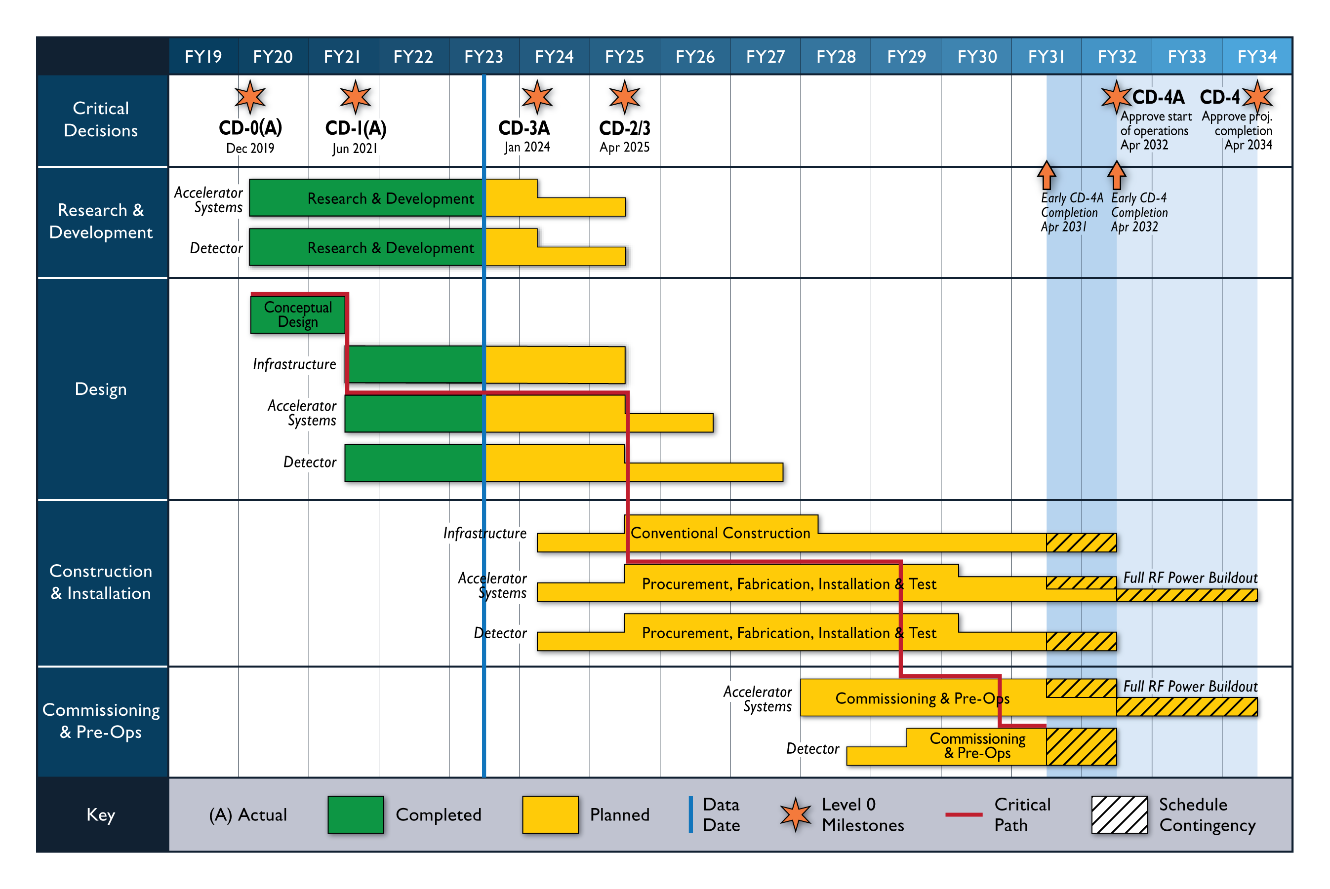
EIC Project Development
Schedule: EIC Project Detector at IP 6 / ePIC
15th European Research Conference EINN 2023
Paphos, Cyprus, October 31 - November 4, 2023
Bernd Surrow
Notes:
A critical path in project management is the longest sequence of activities that must be finished on time in order for the entire project to be complete. Any delays in critical tasks will delay the rest of the project.

Slide 13
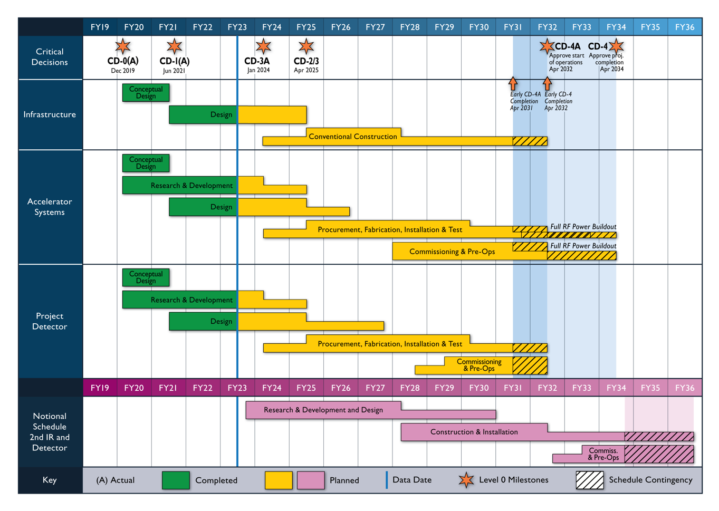
EIC Project Development
Reference Schedule for 2nd IR and Detector
Talk by Abhay Deshpande / TR 03:00 PM: Case for the 2nd detector
Talk by Pawel Nadel-Turonski / TR 03:30 PM: Designing the 2nd IR and detector
15th European Research Conference EINN 2023
Paphos, Cyprus, October 31 - November 4, 2023
Bernd Surrow

Slide 14
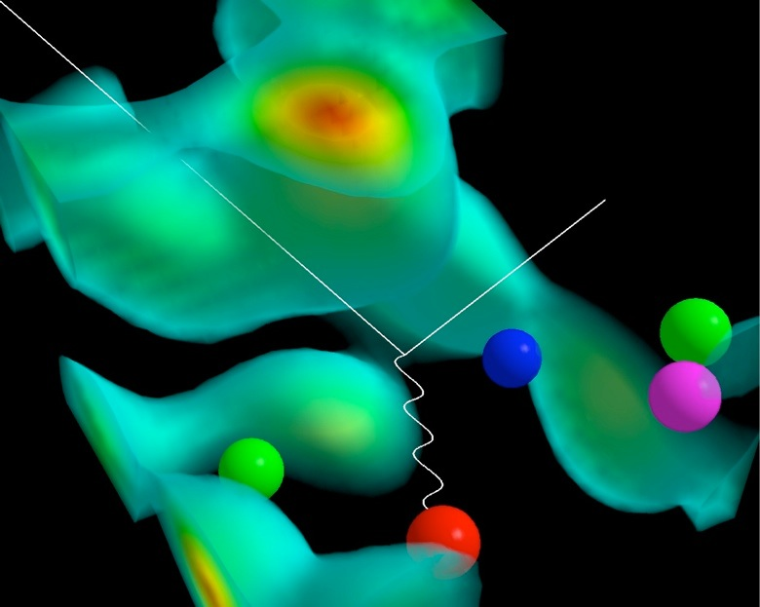
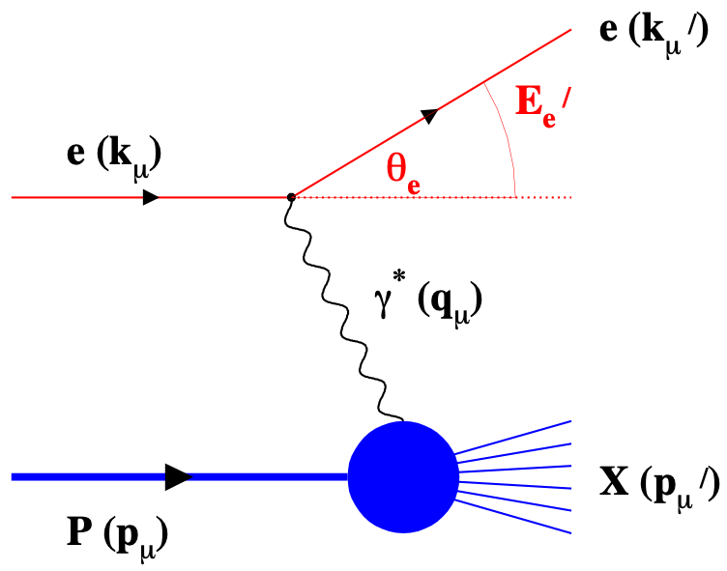
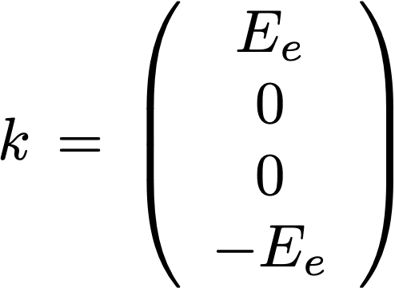
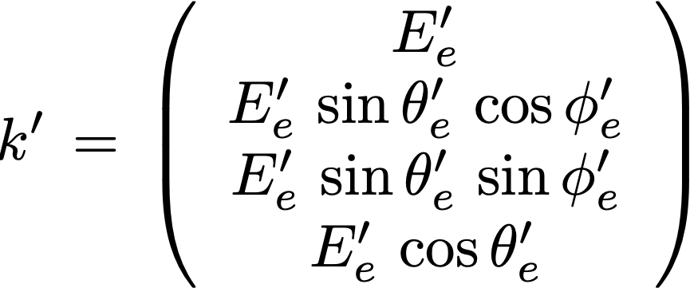
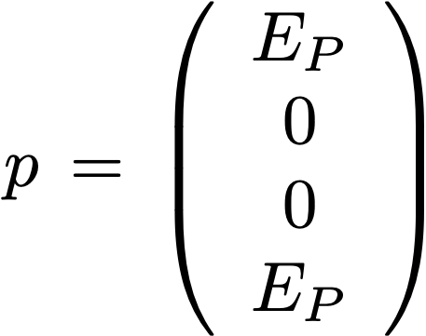
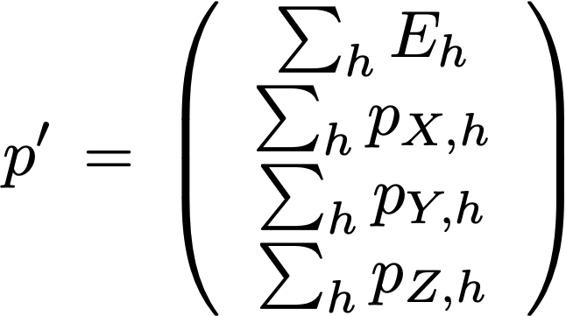
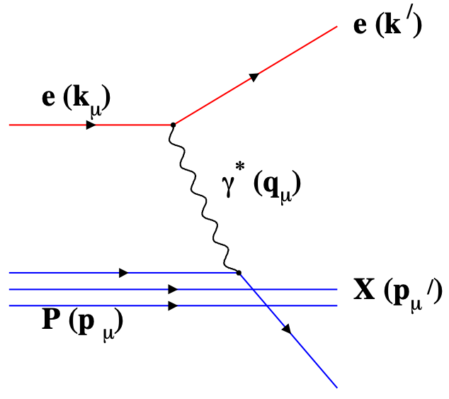
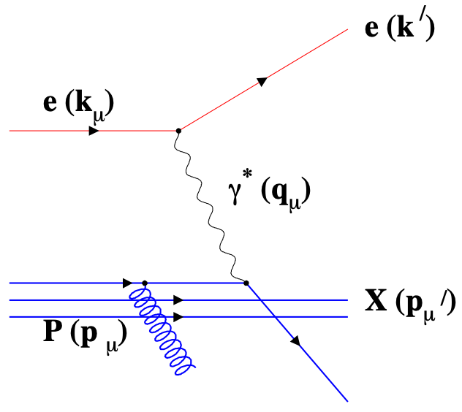
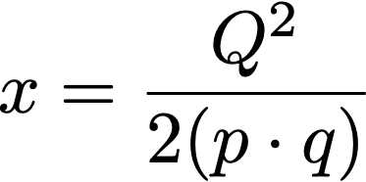
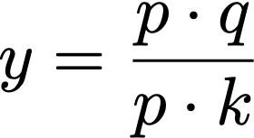
ePIC Detector Design Philosophy
DIS - Kinematics
Measure of resolution power
Measure of momentum fraction by struck quark
Measure of inelasticity
15th European Research Conference EINN 2023
Paphos, Cyprus, October 31 - November 4, 2023
Bernd Surrow

Slide 15
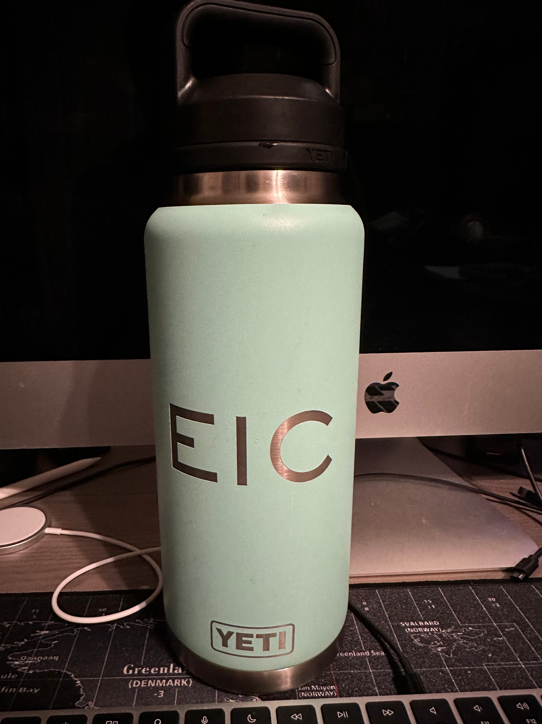
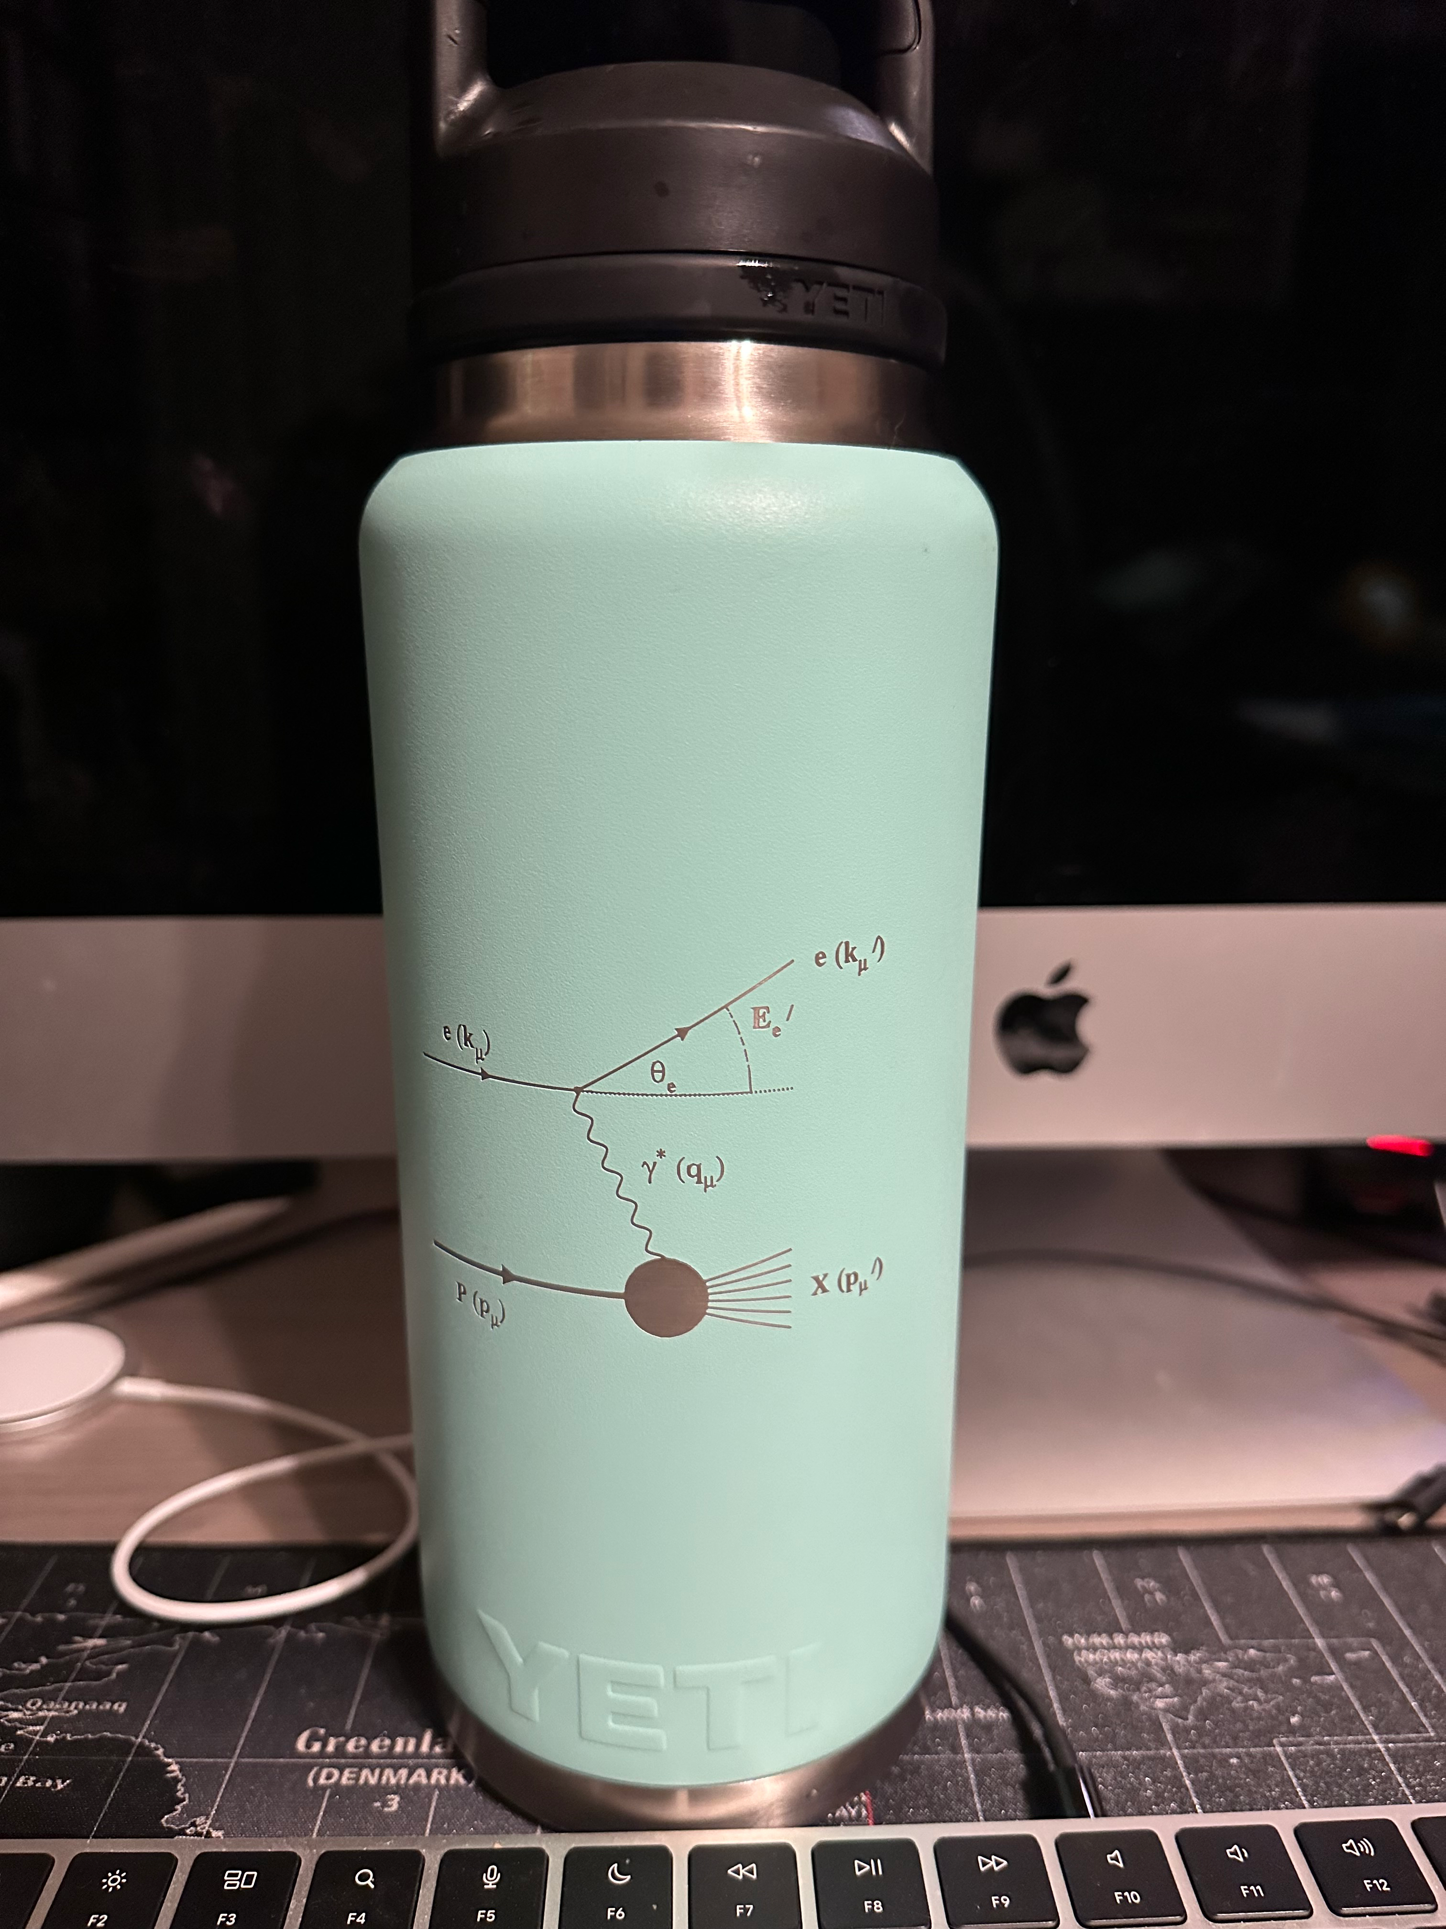
ePIC Detector Design Philosophy
Importance of EIC / Kinematics found On every-day products…
15th European Research Conference EINN 2023
Paphos, Cyprus, October 31 - November 4, 2023
Bernd Surrow

Slide 16
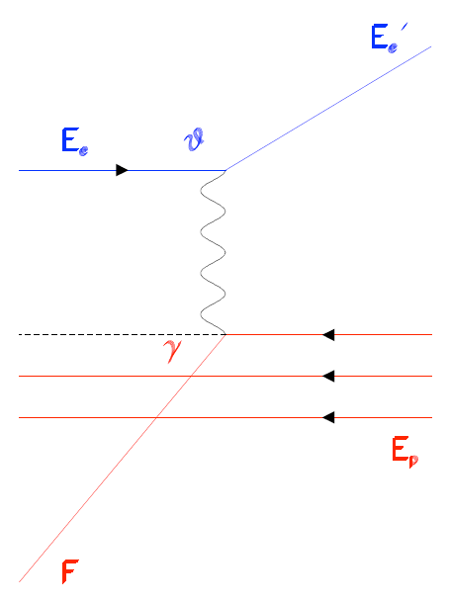
Spinning Glue: QCD and Spin
ePIC Detector Design Philosophy
EIC kinematic considerations: Ee=10GeV X Ep=250GeV (√s=100GeV)
15th European Research Conference EINN 2023
Paphos, Cyprus, October 31 - November 4, 2023
Bernd Surrow

Slide 17
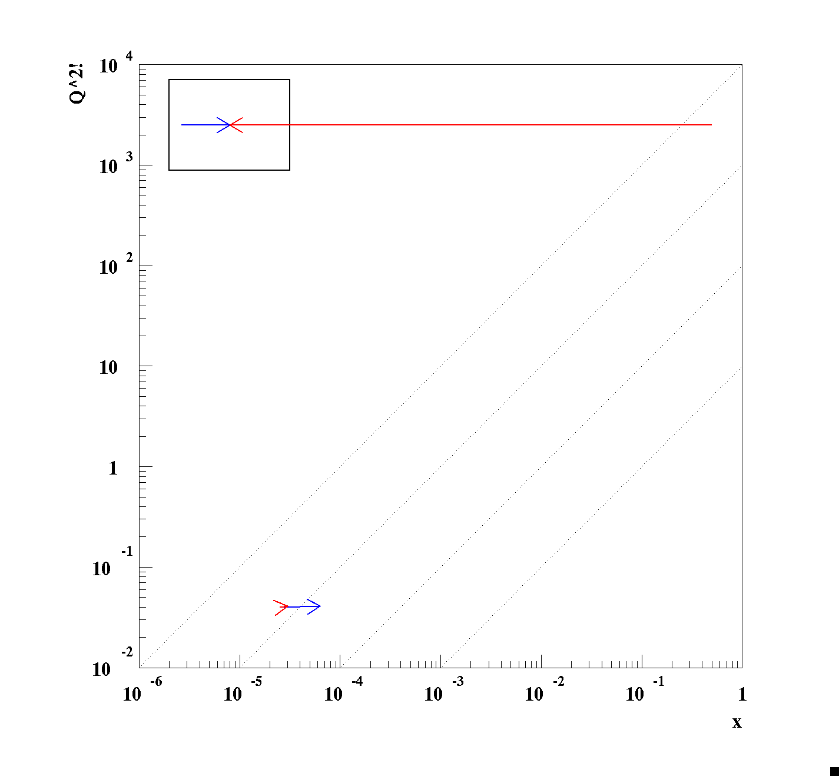
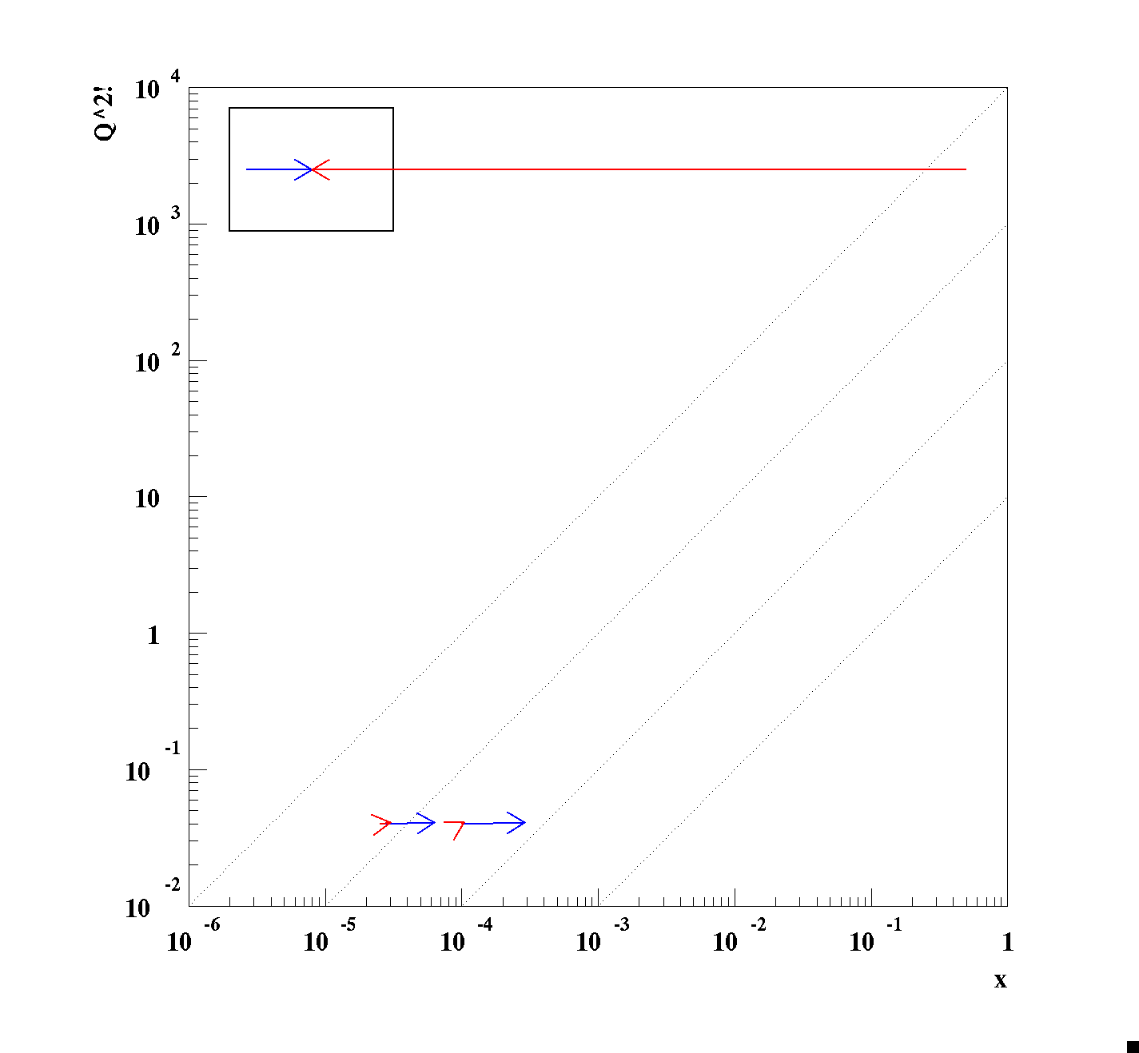
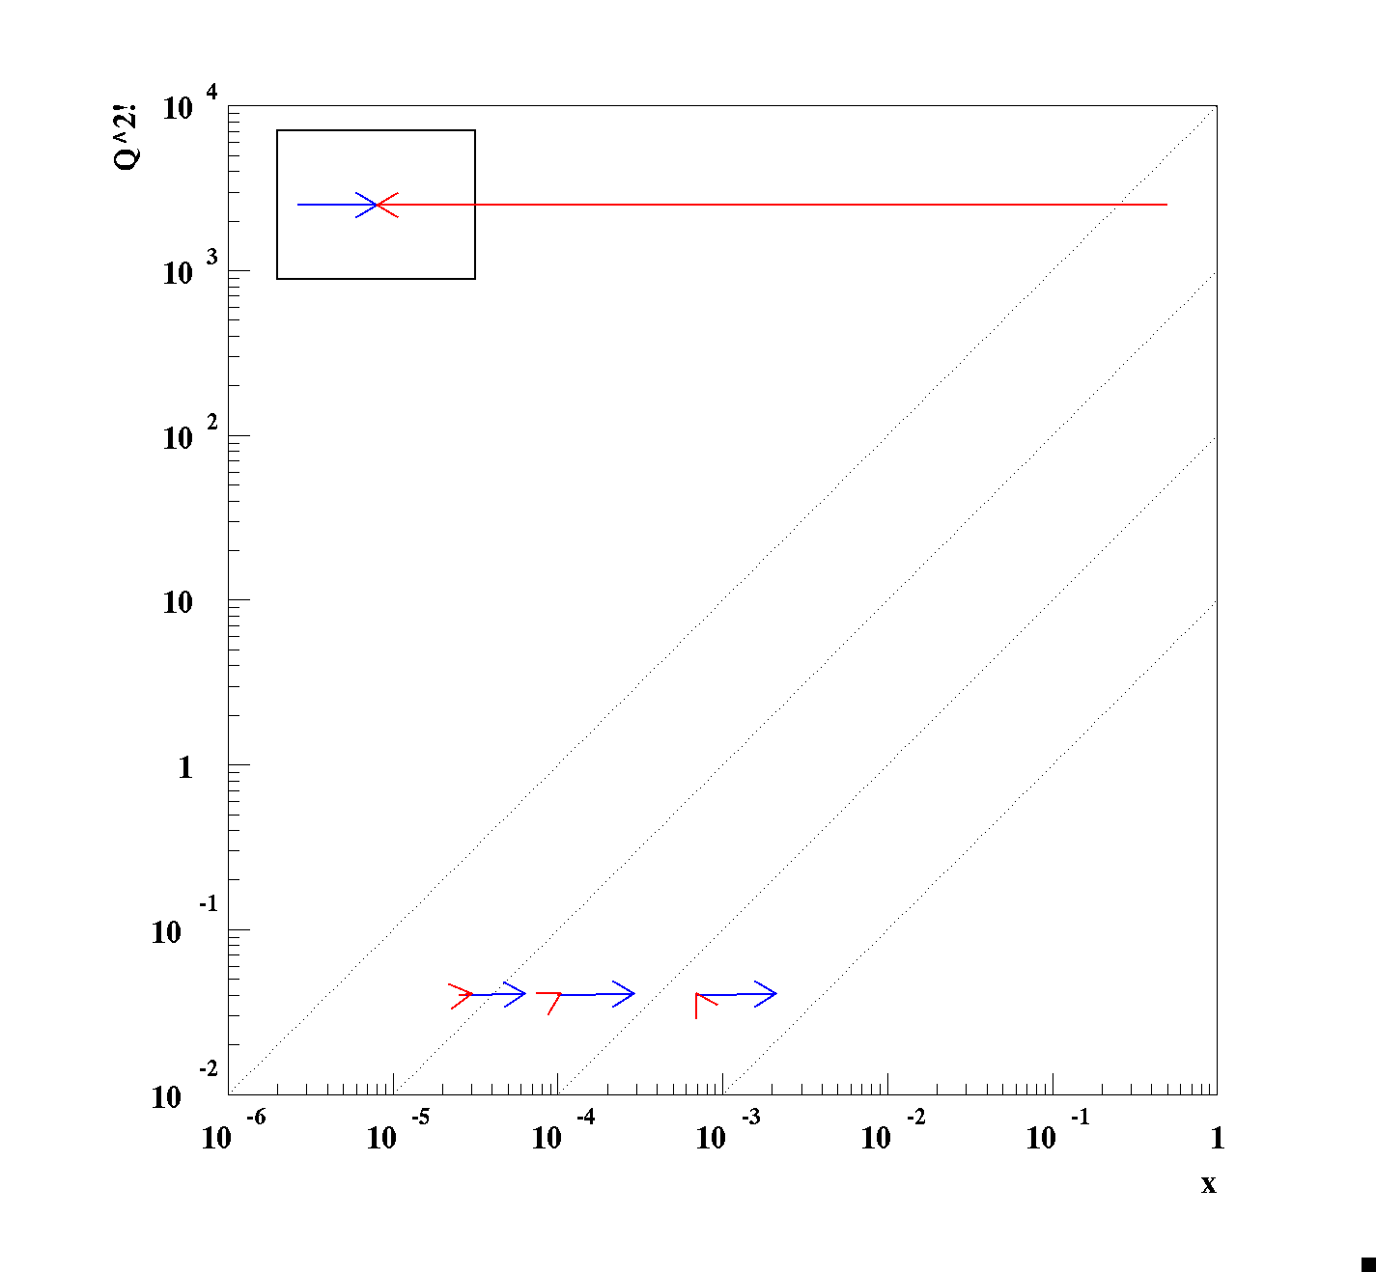
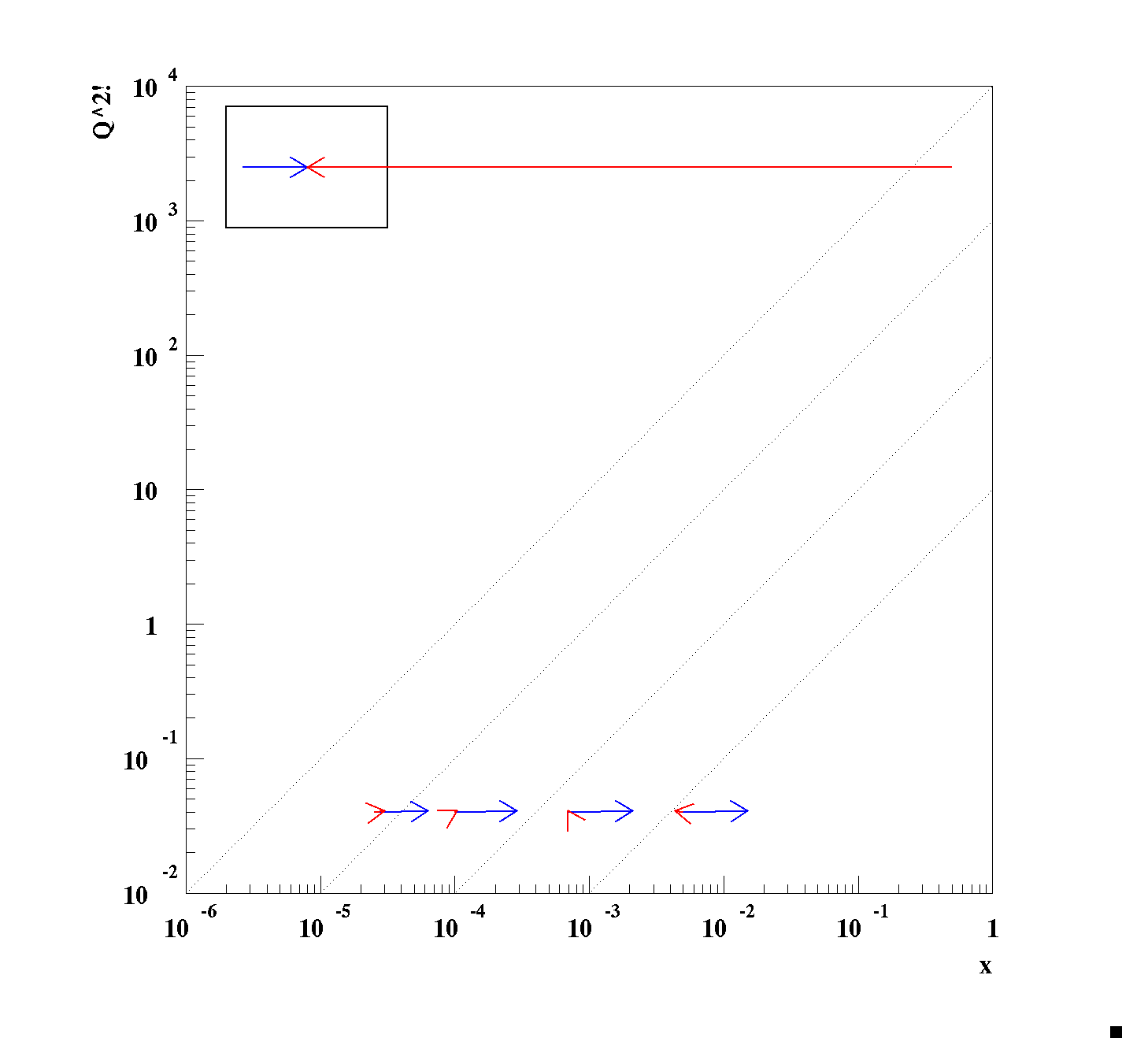
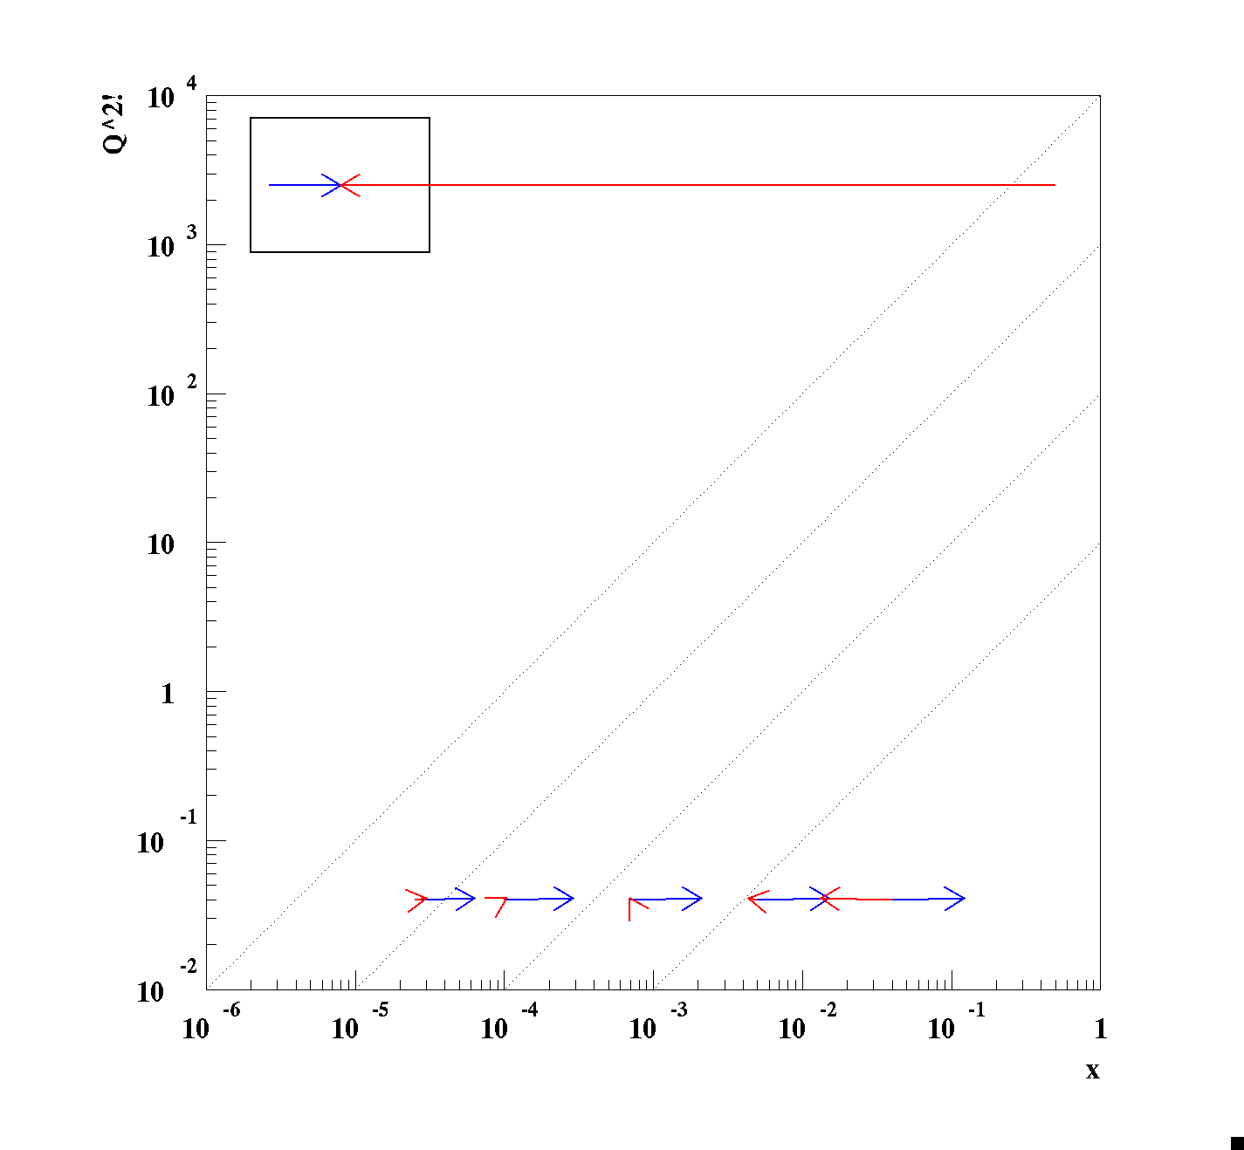
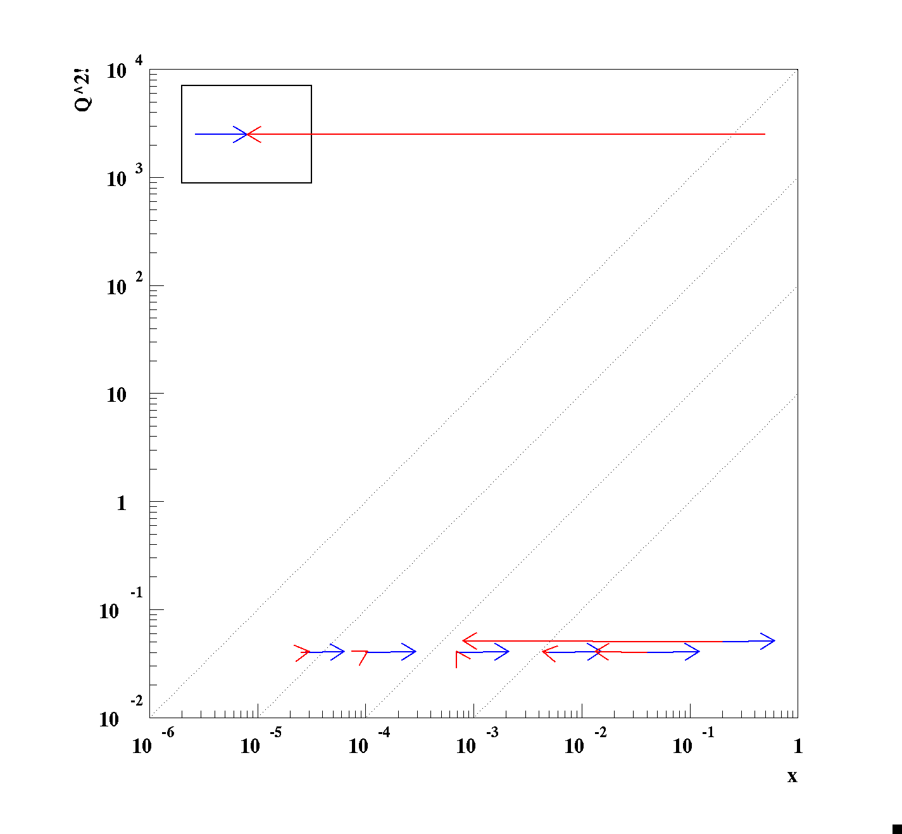
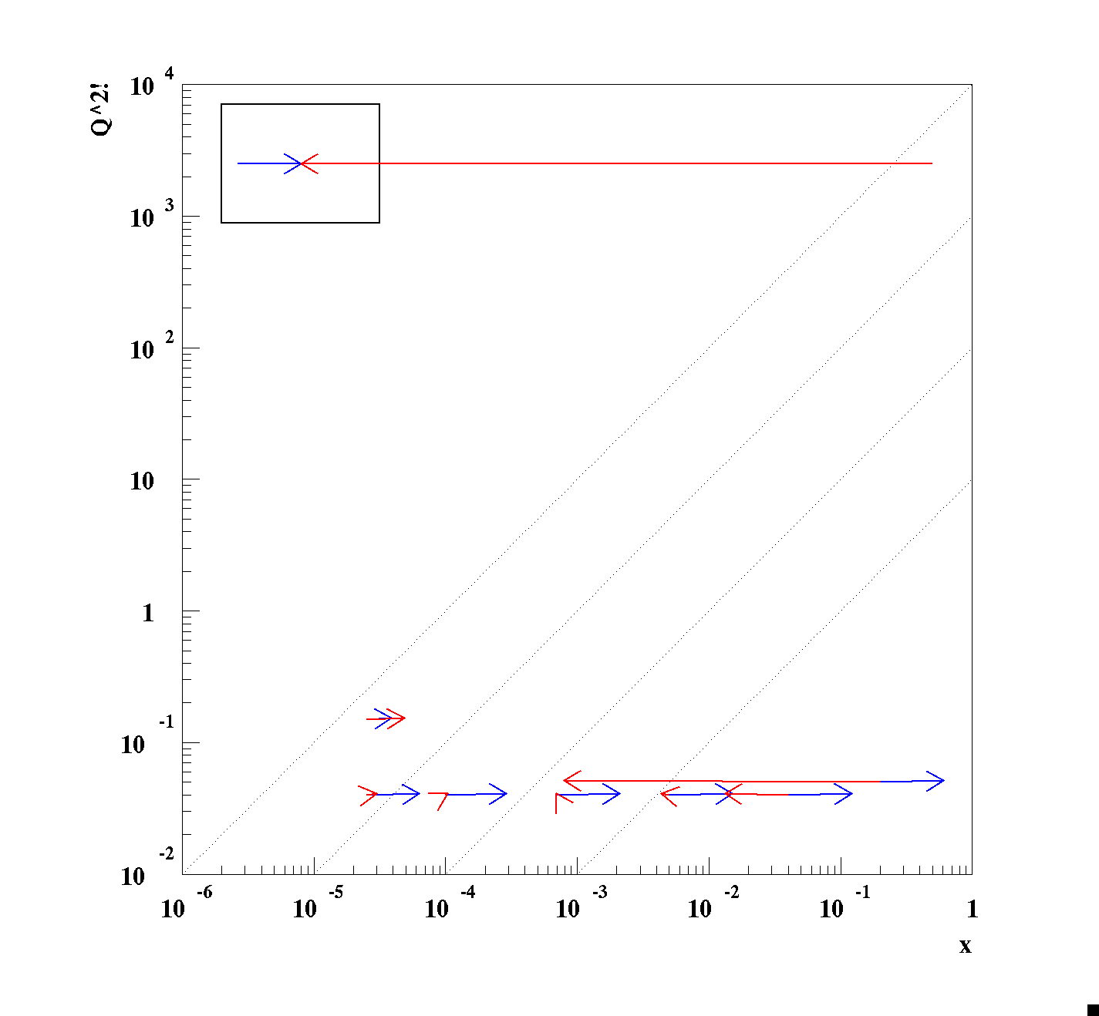
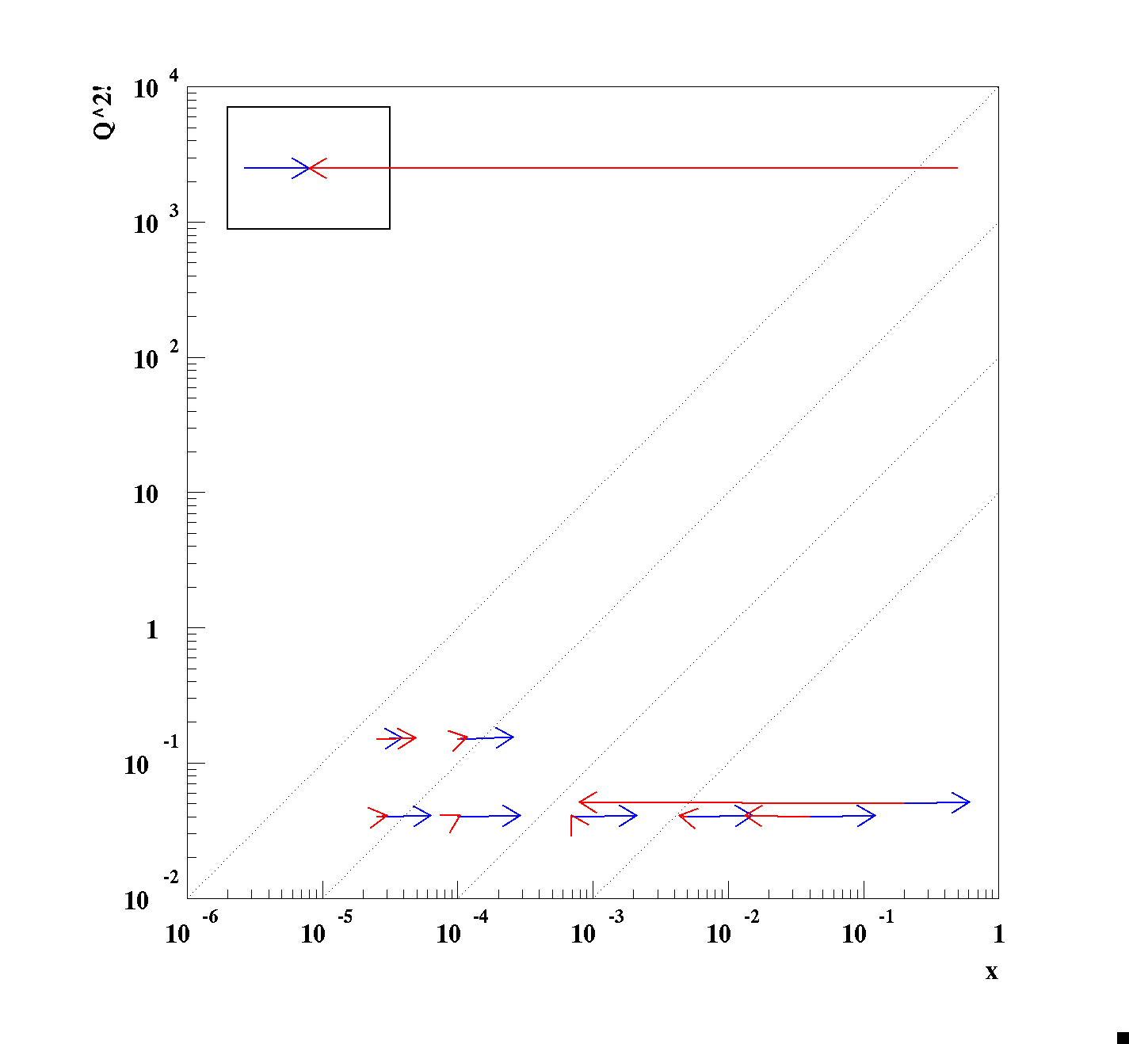
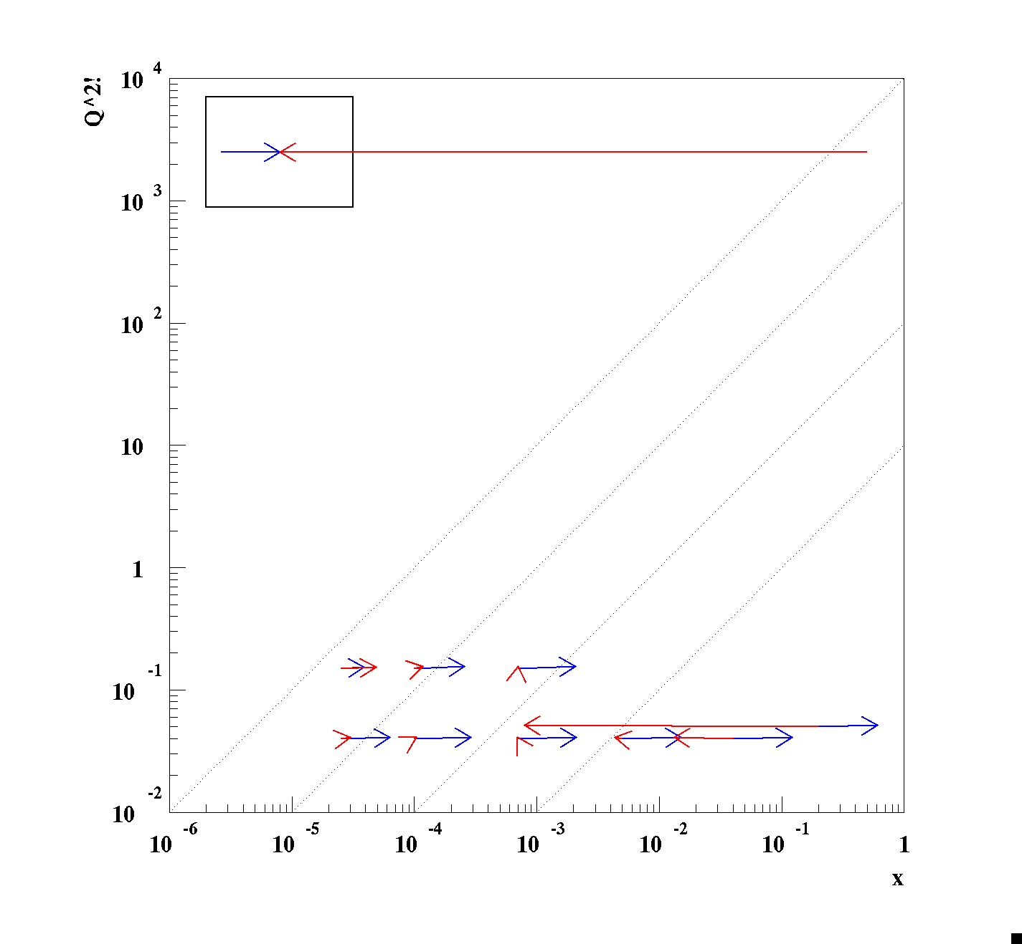
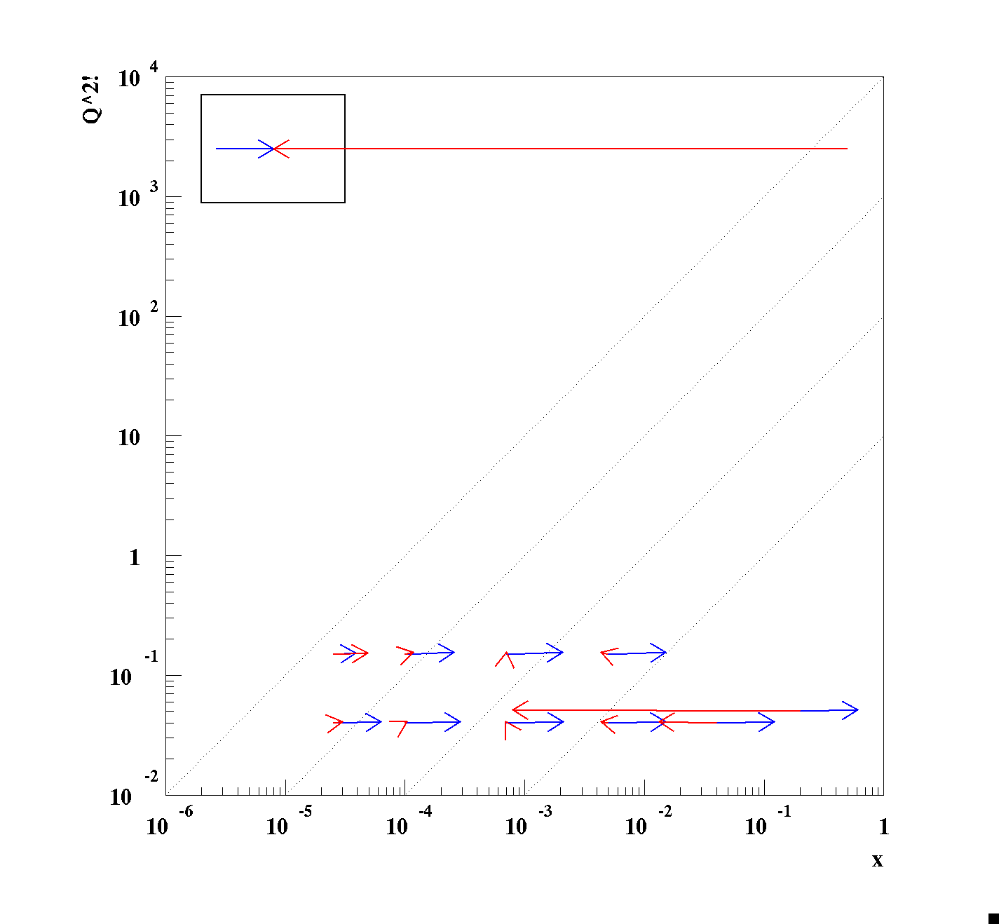
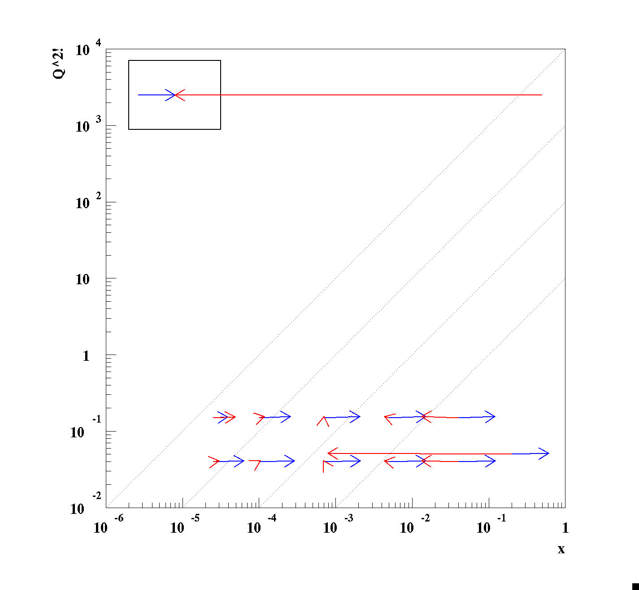
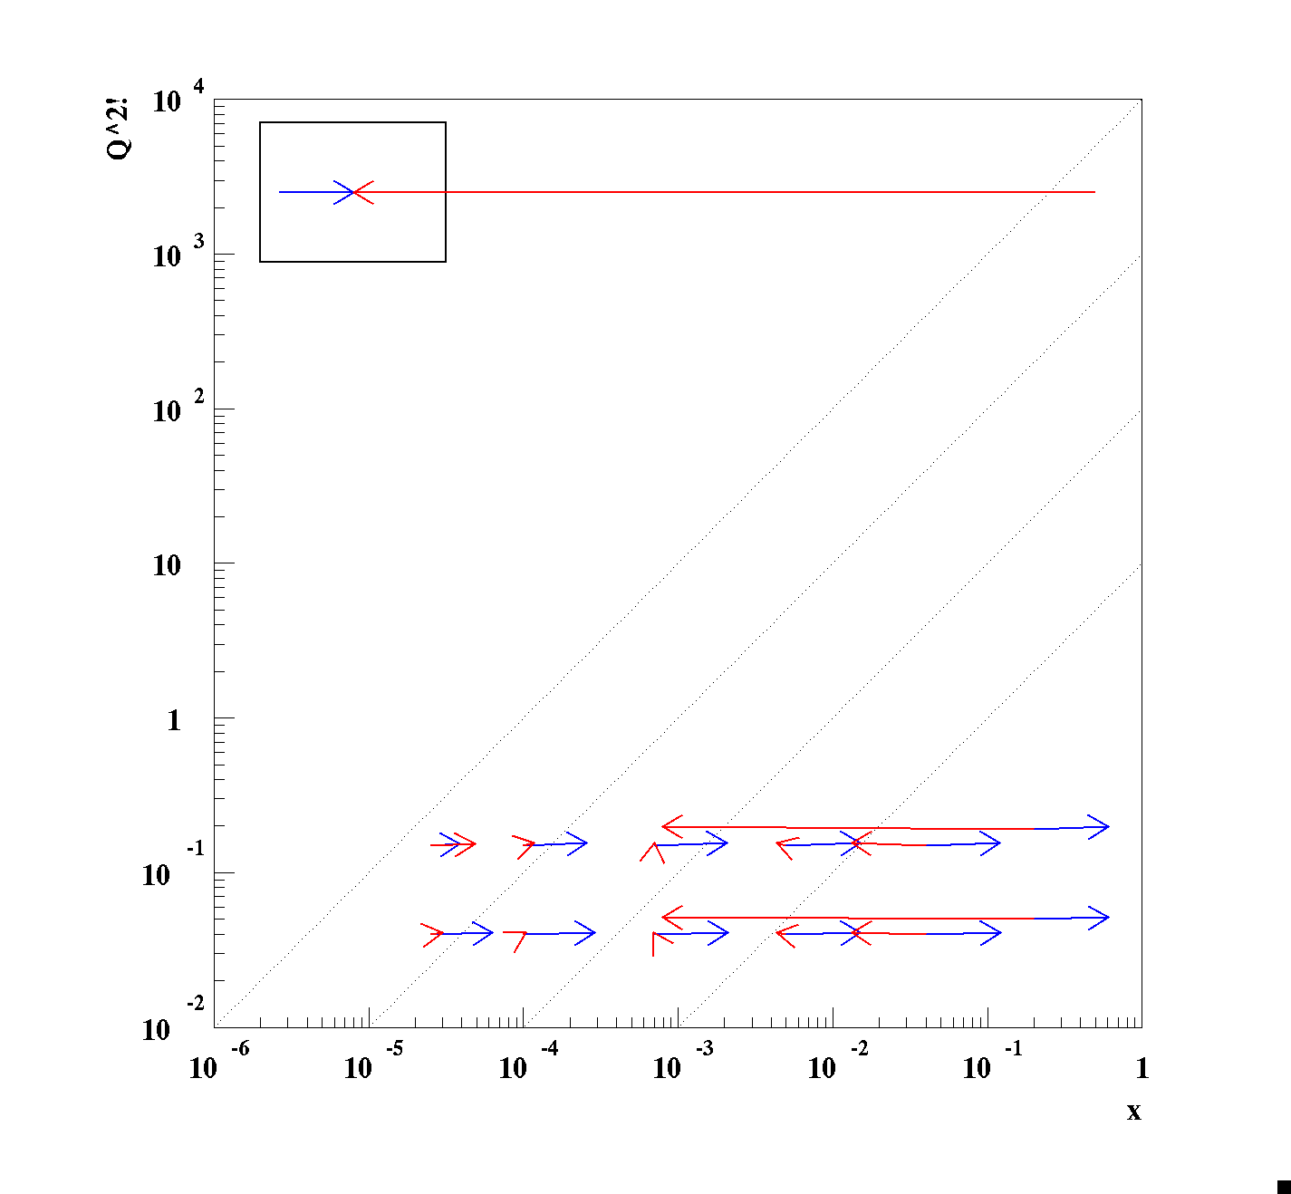
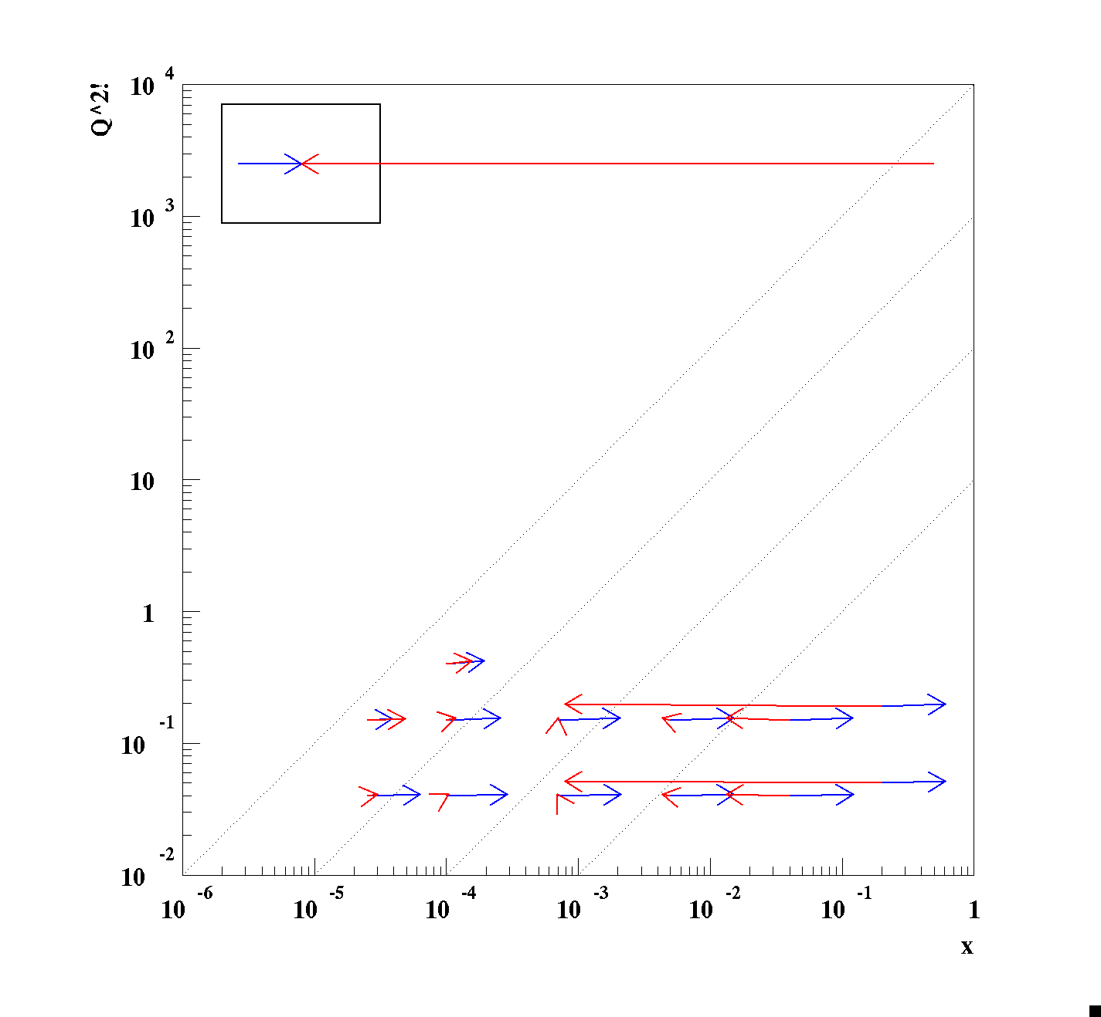
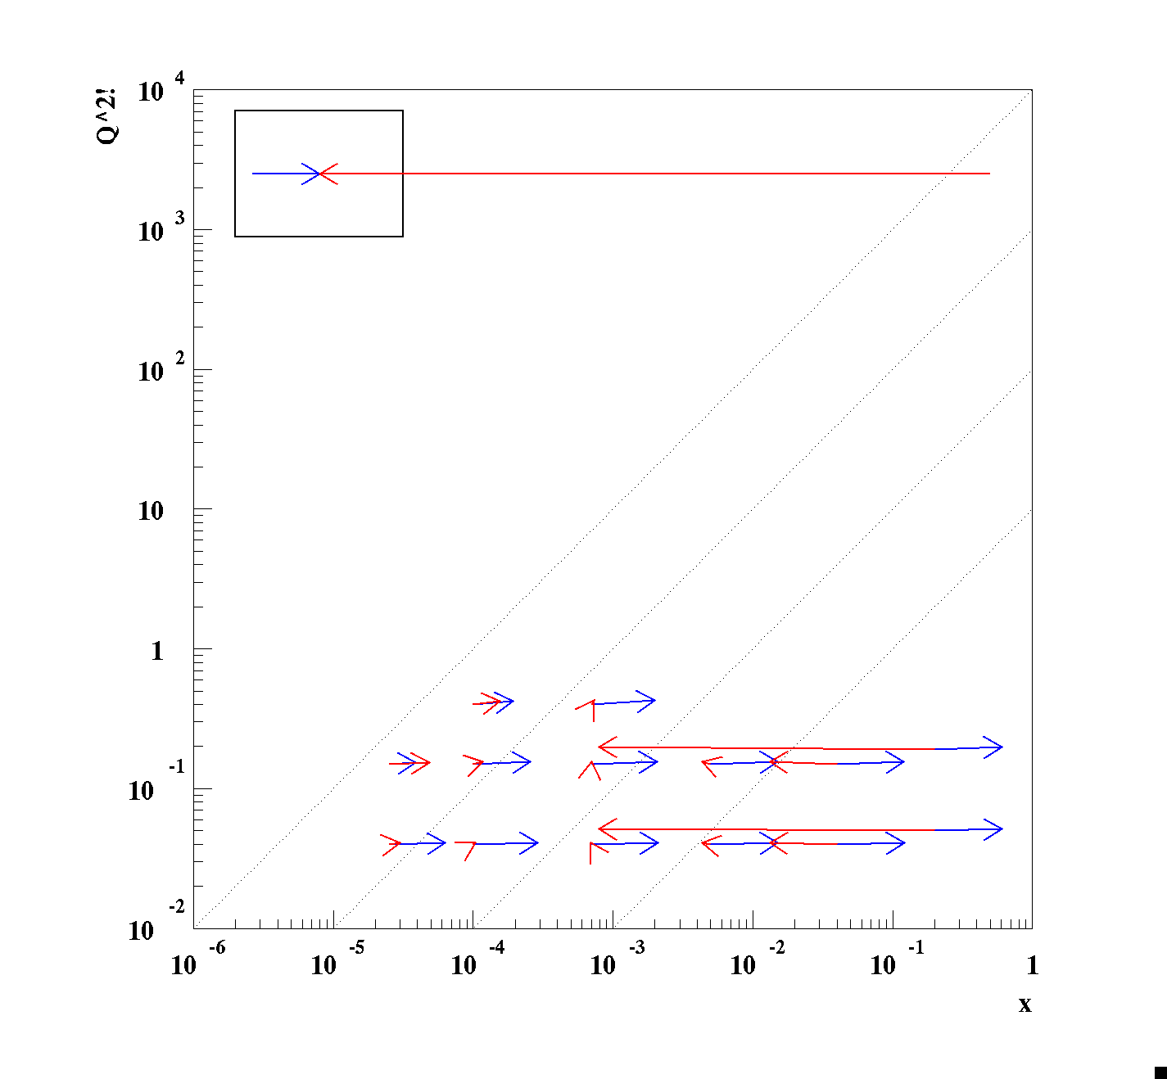
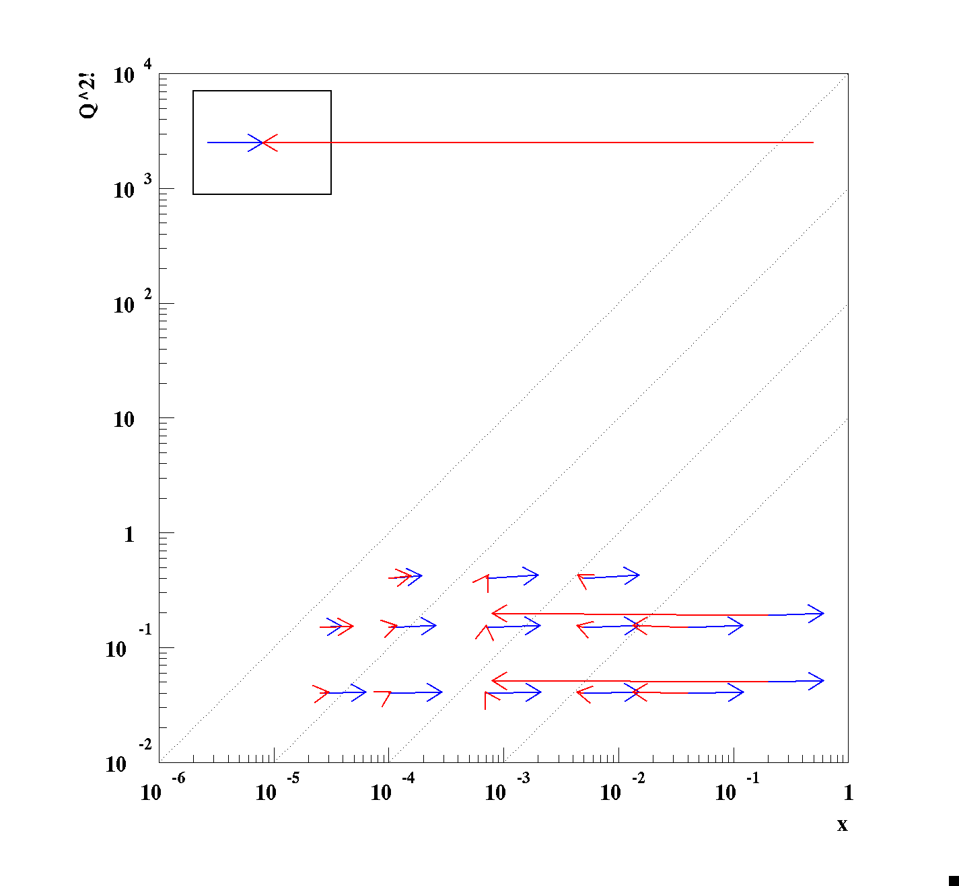
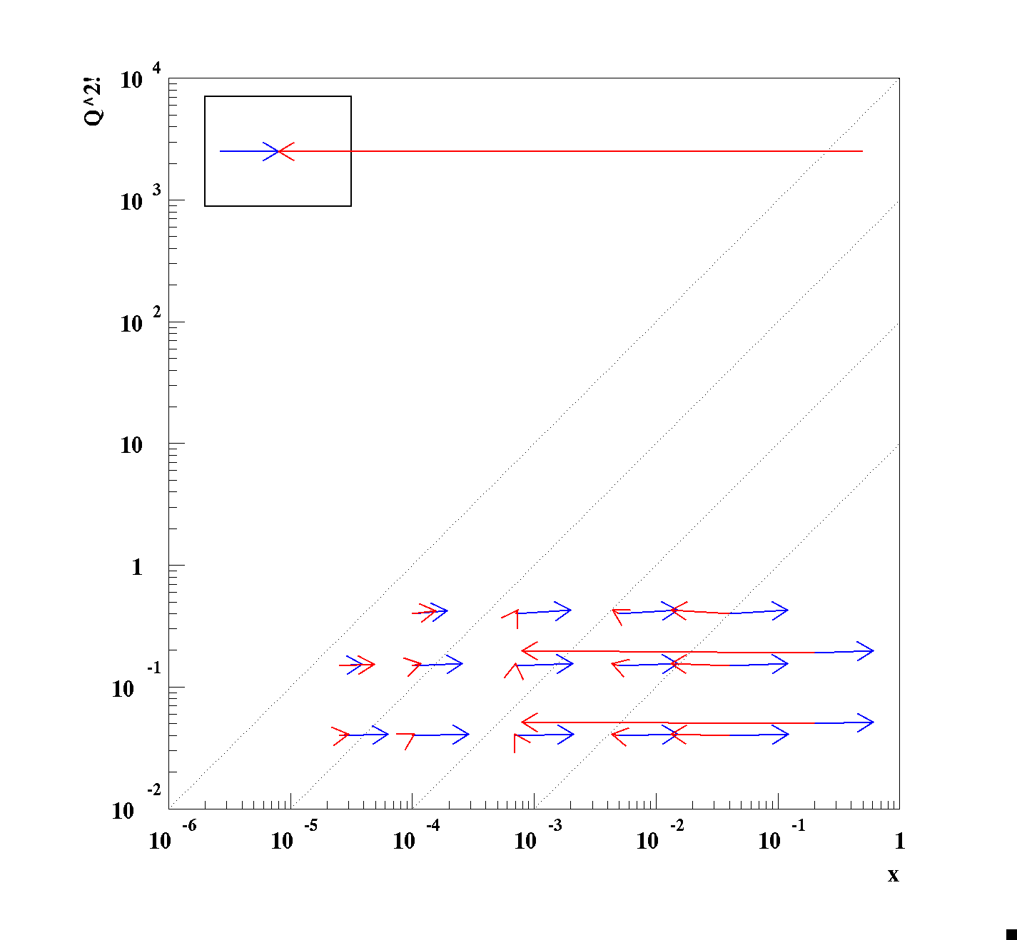
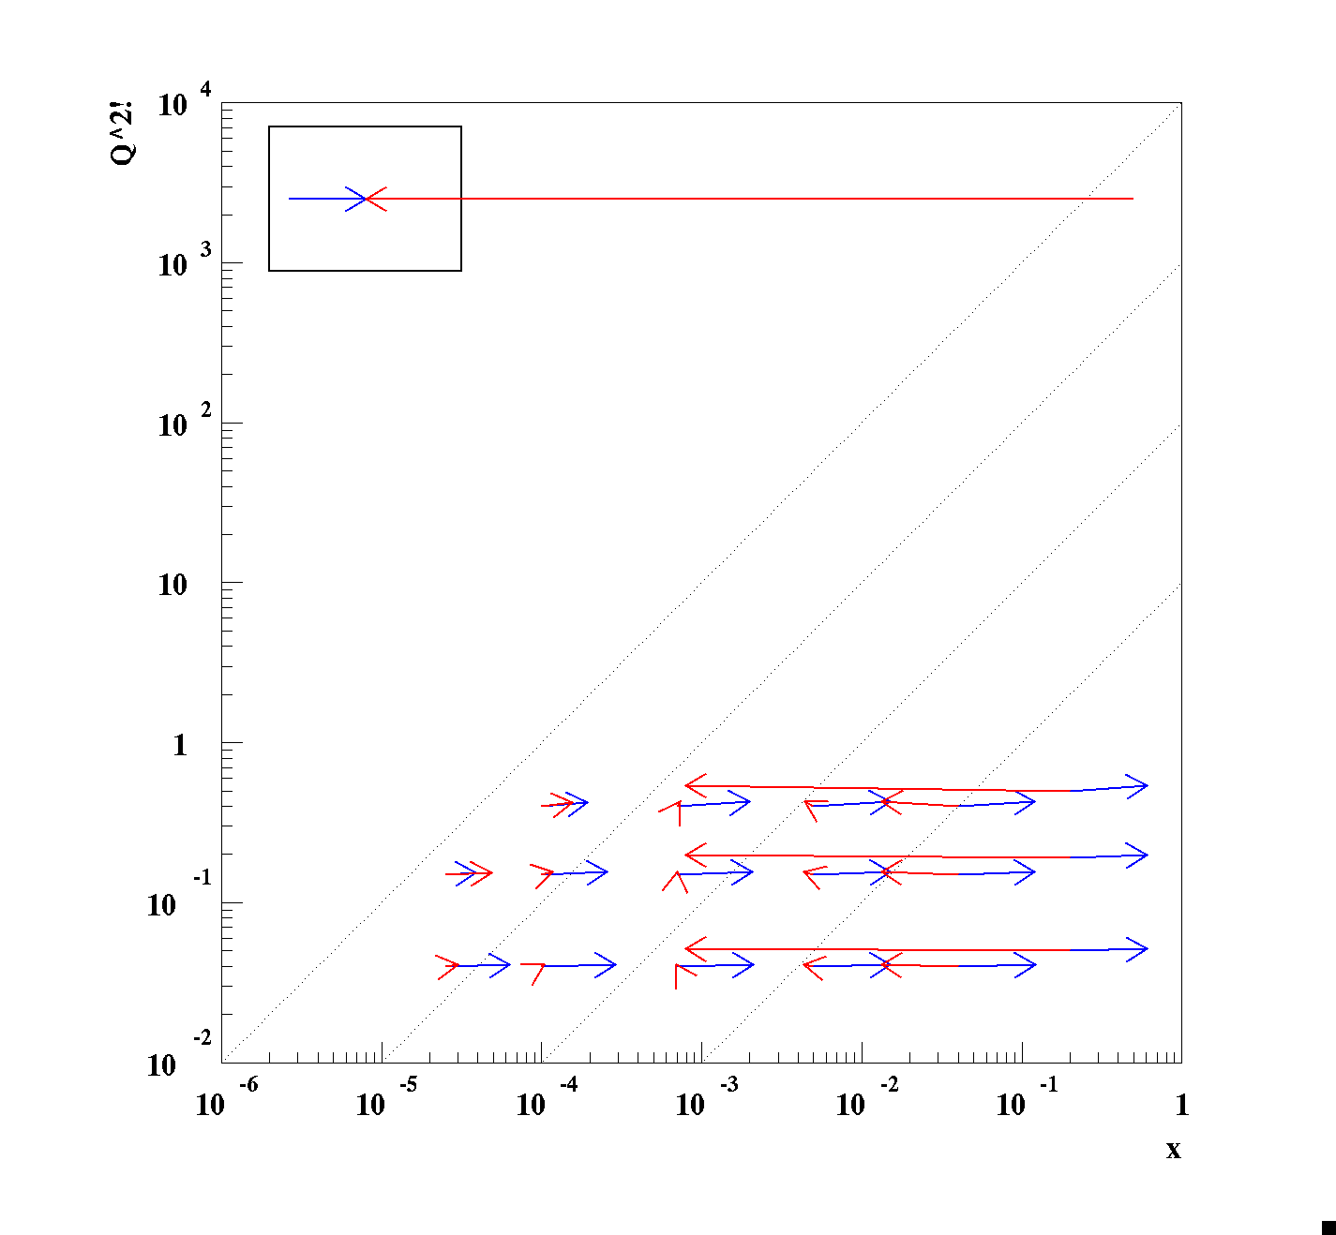
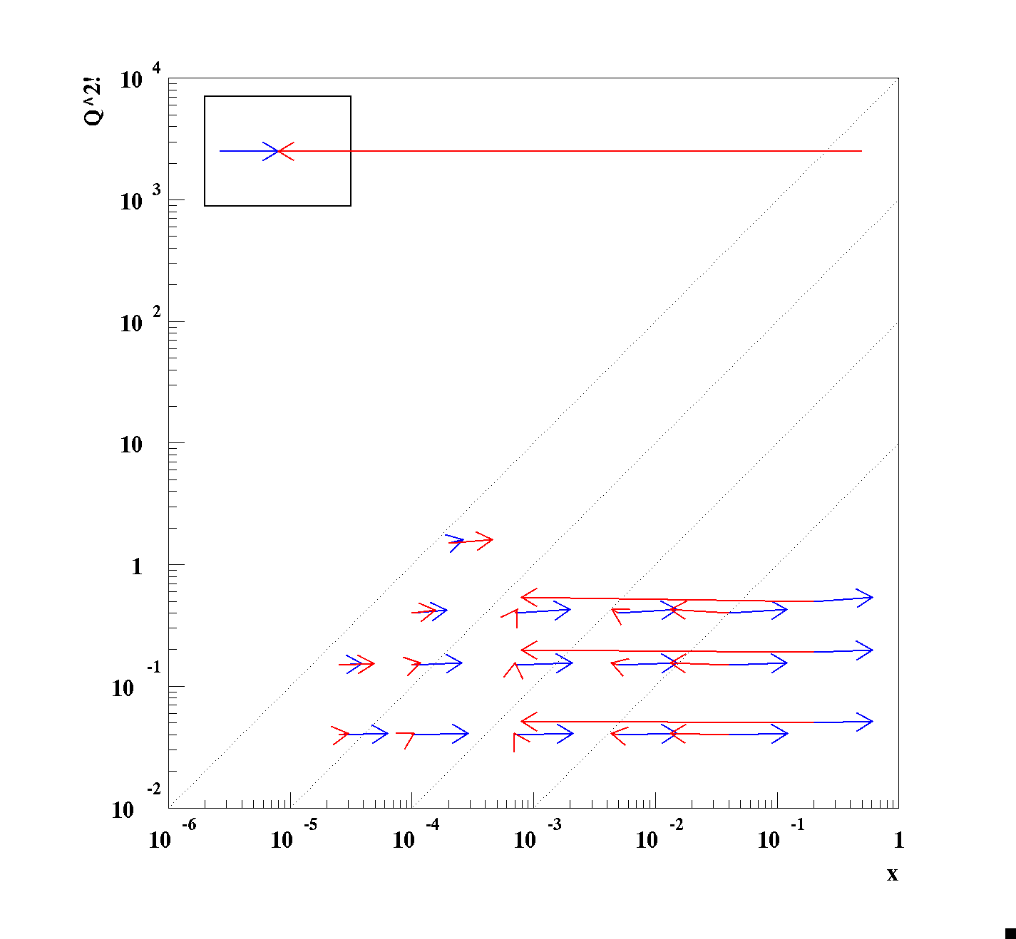
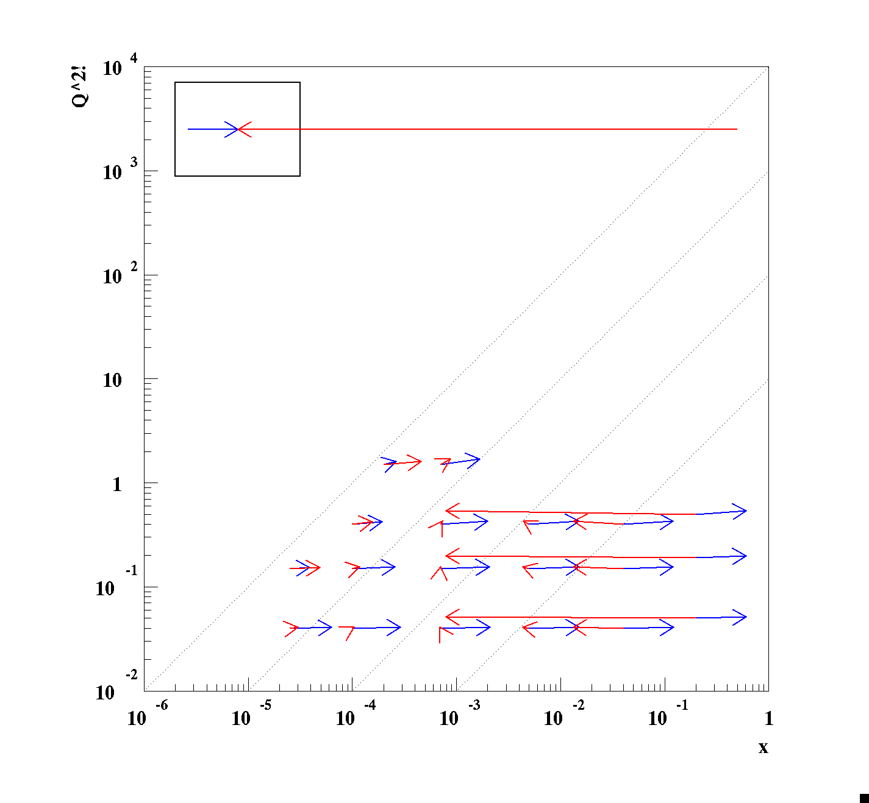
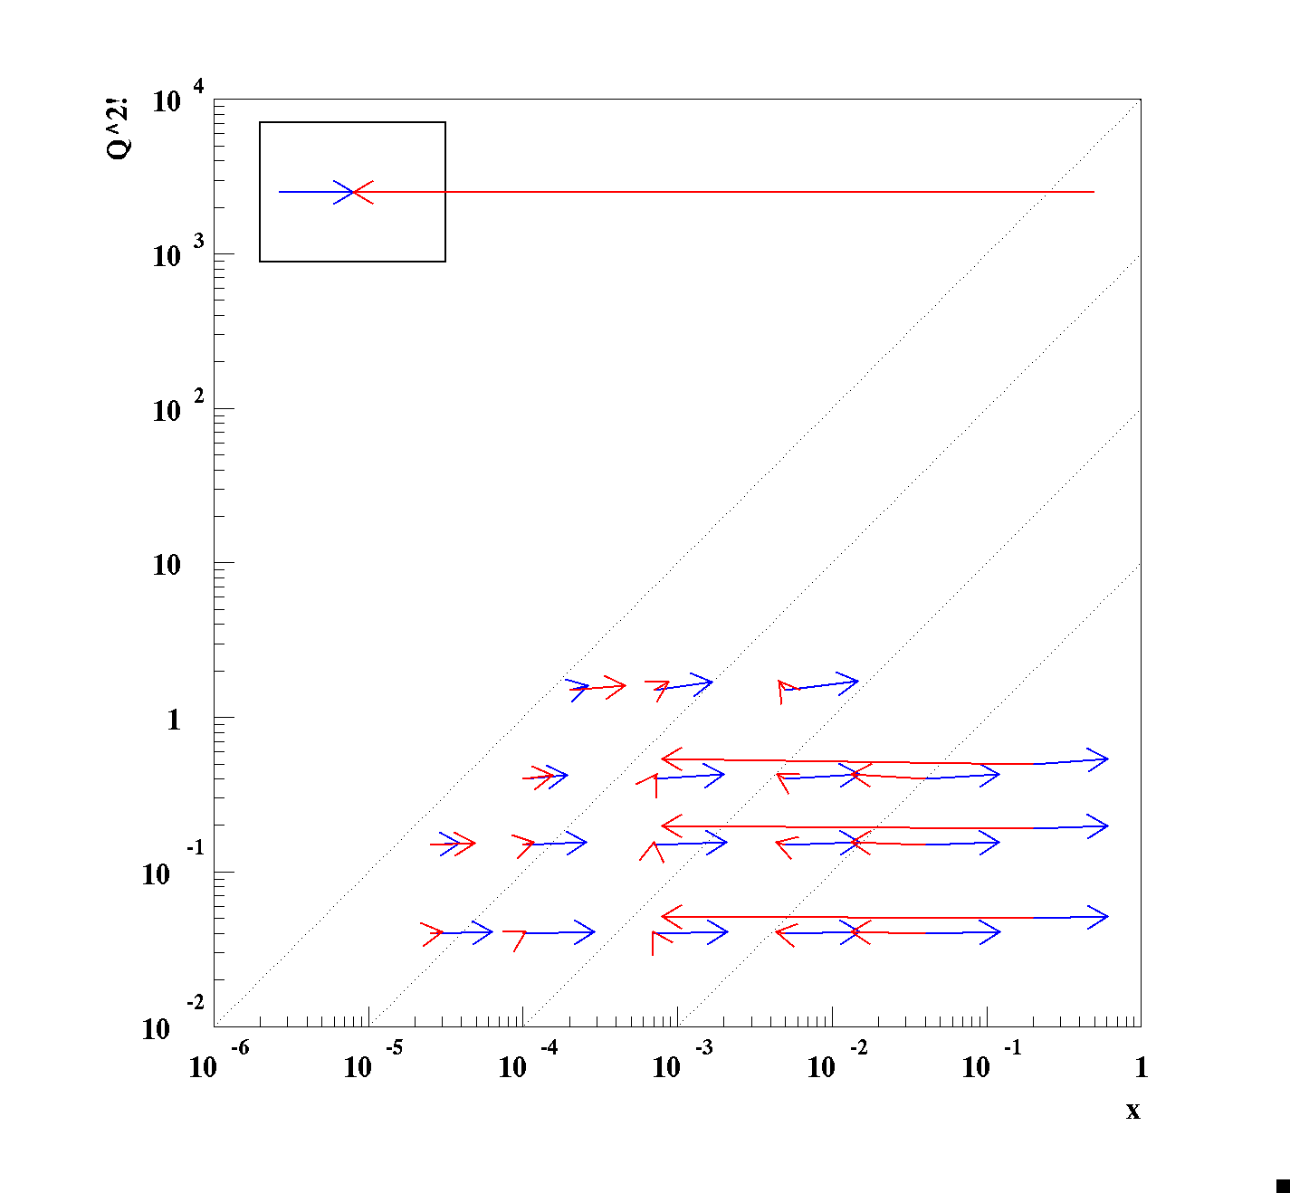
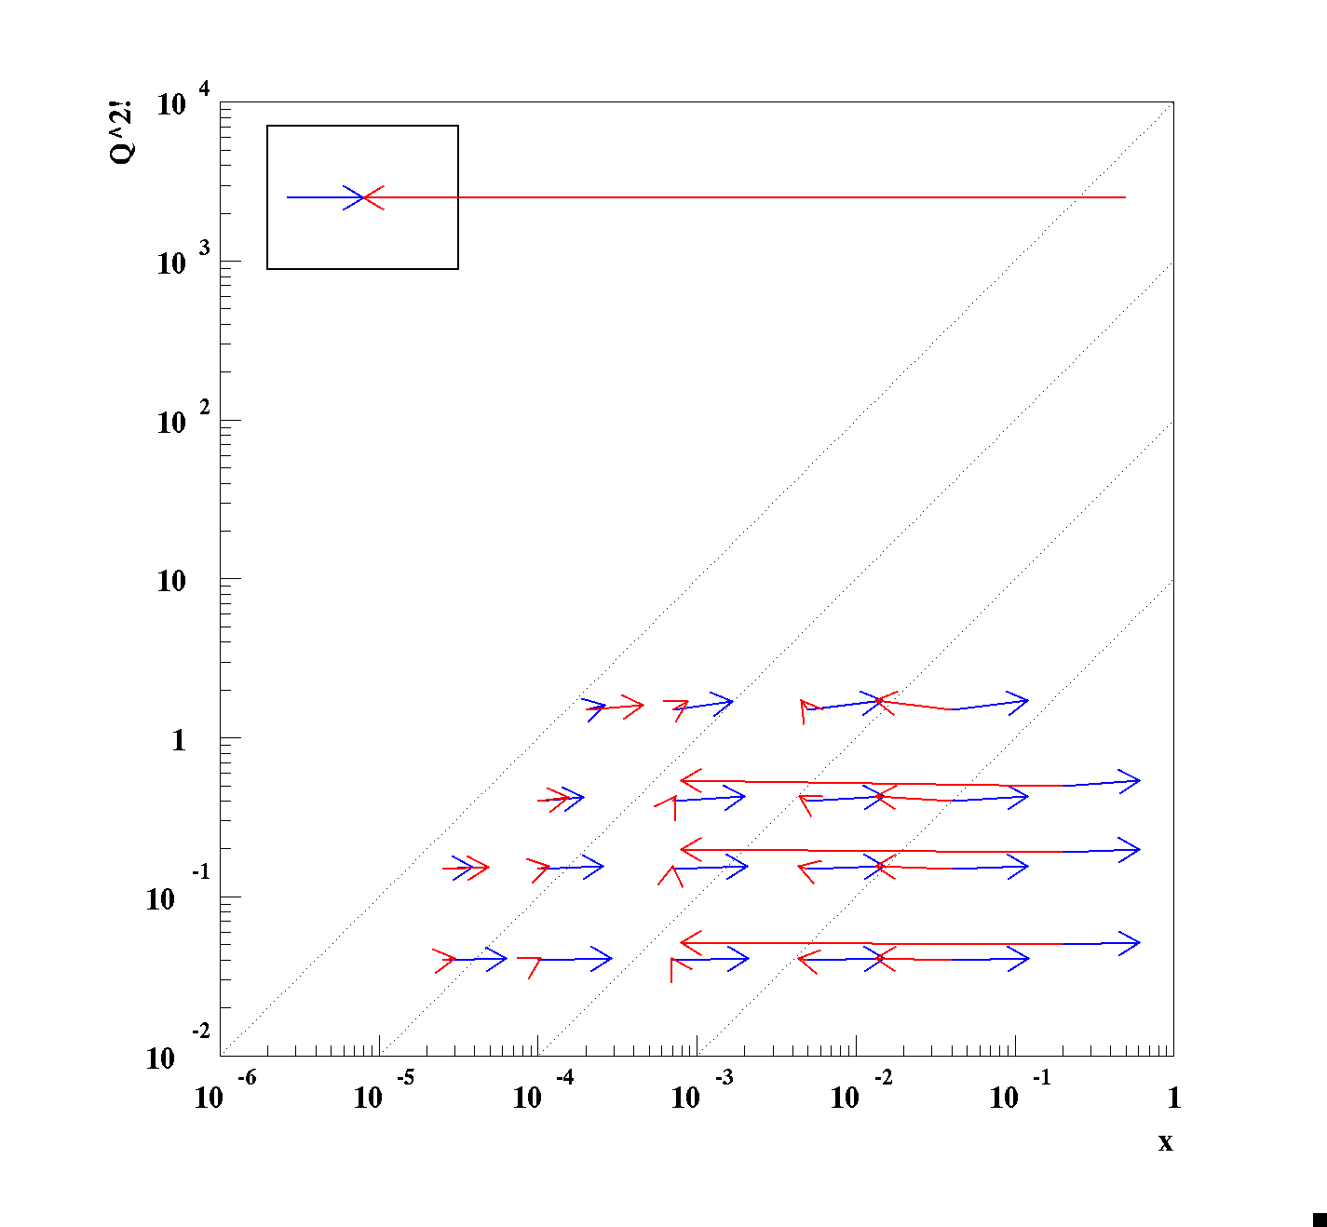
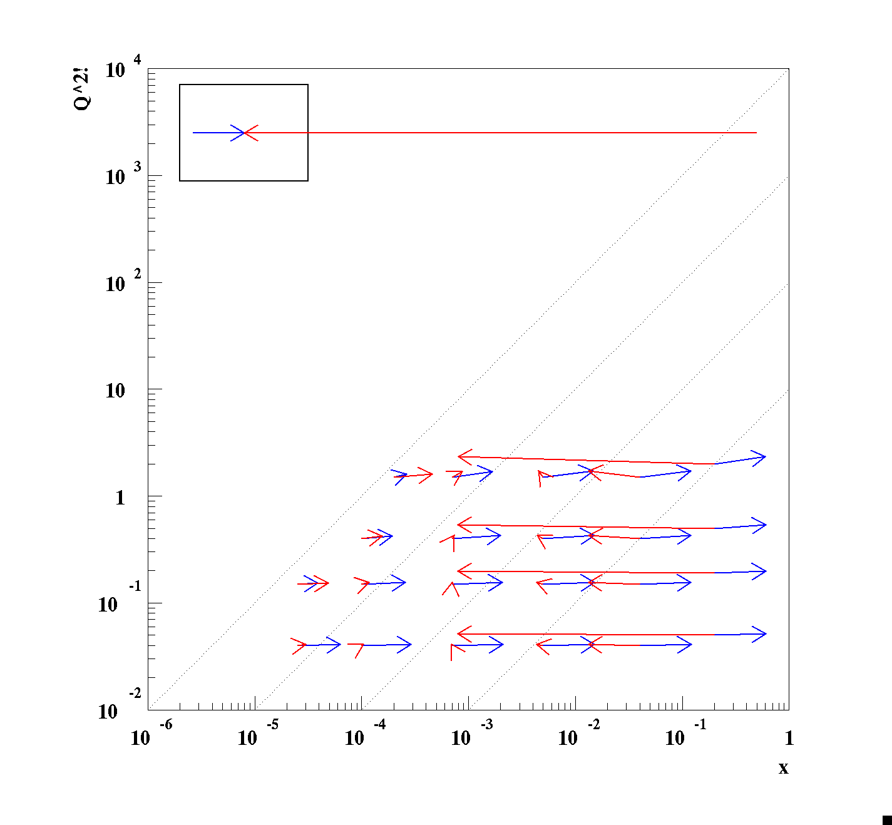
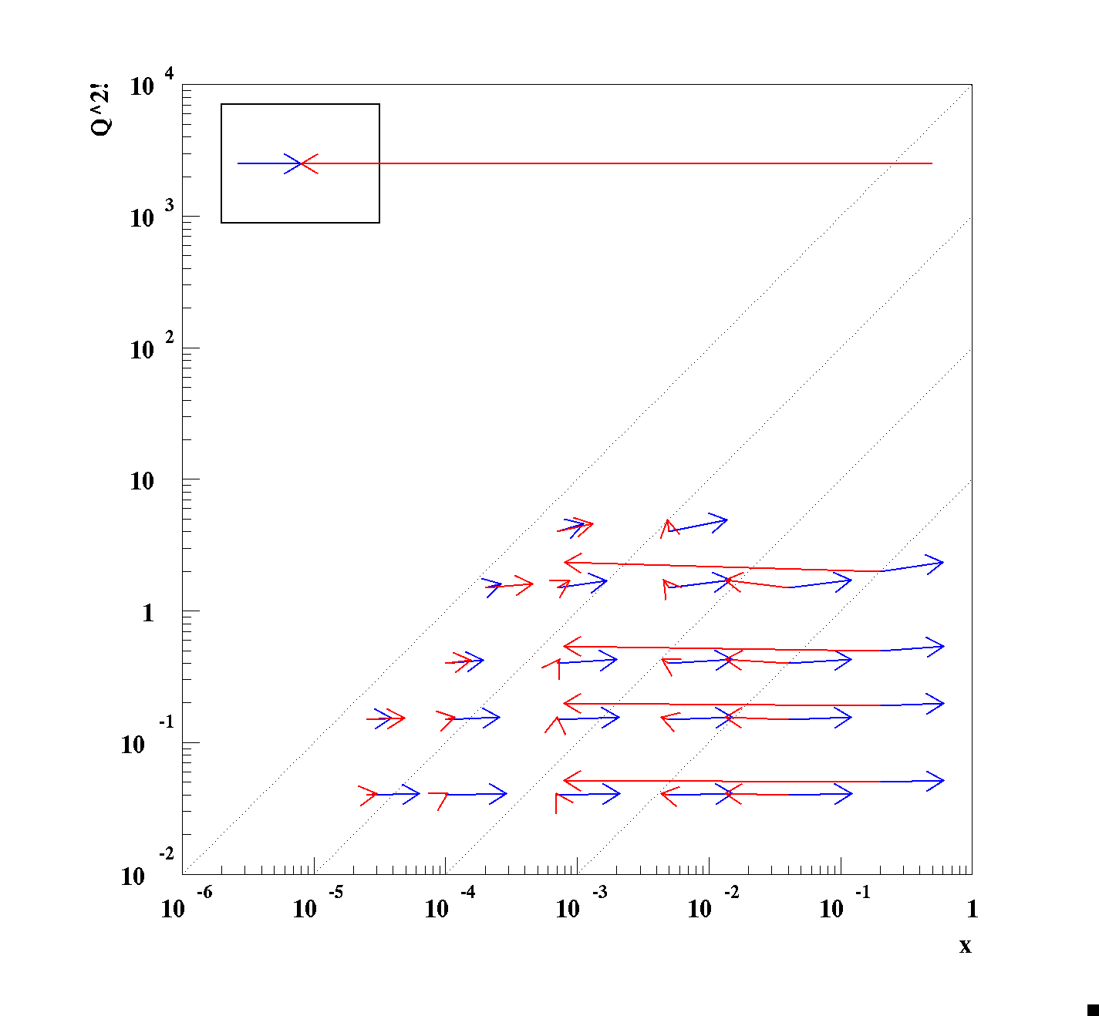
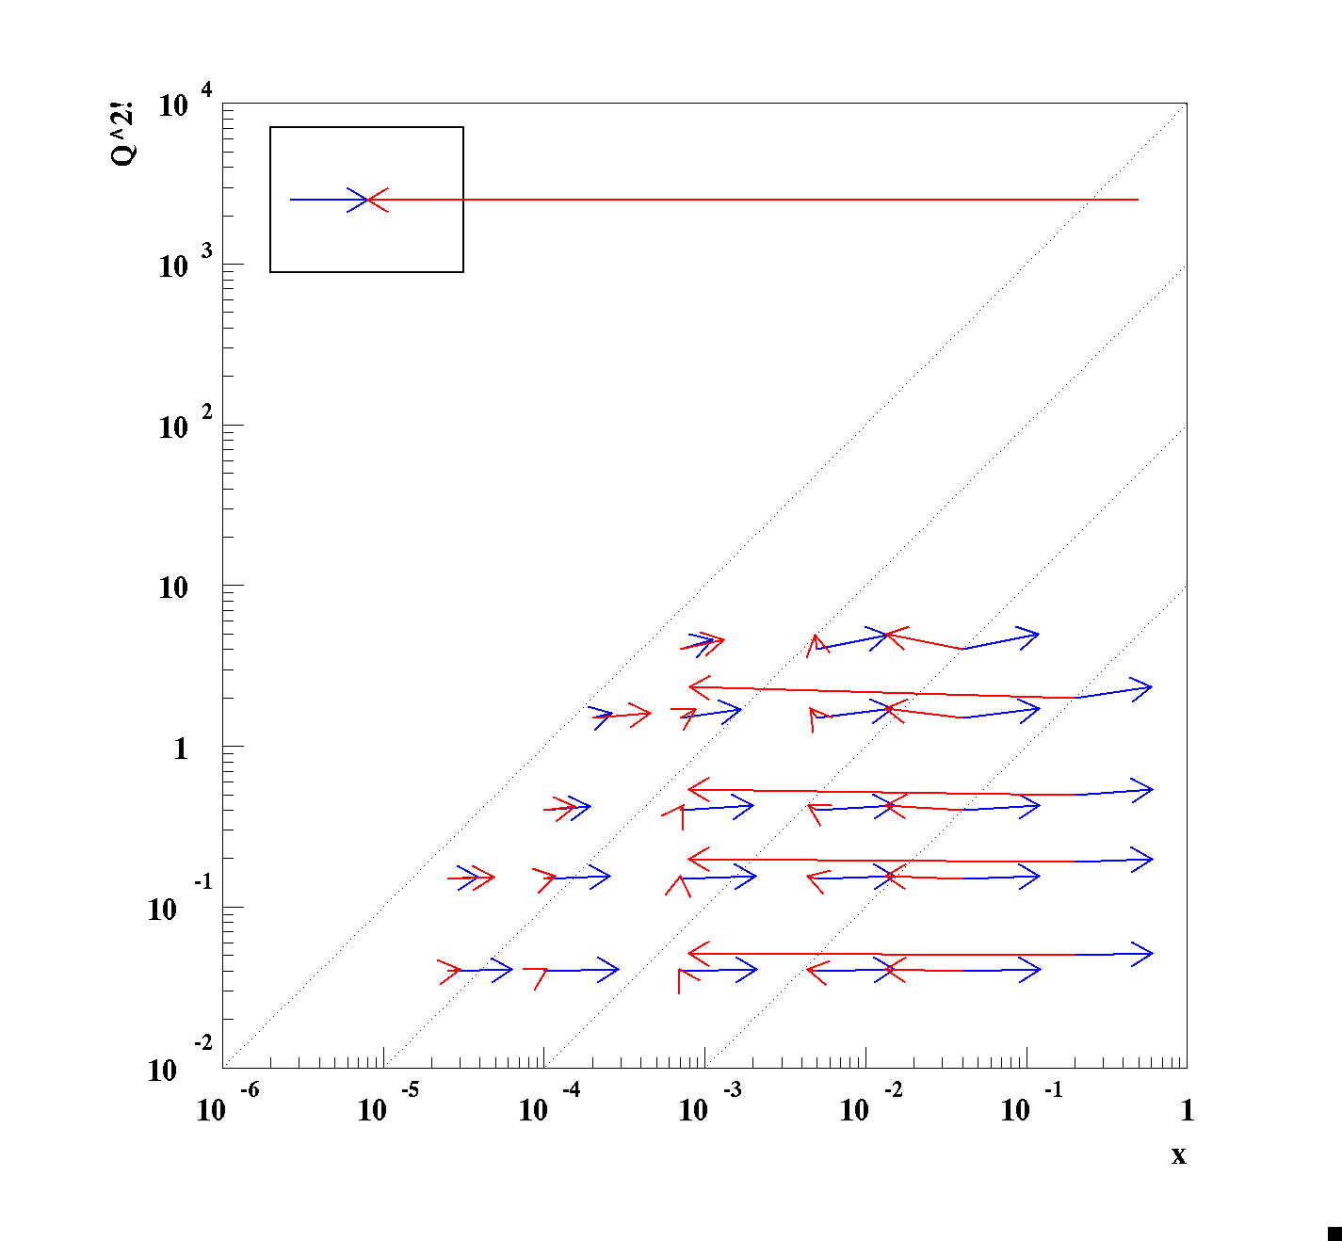
Spinning Glue: QCD and Spin
ePIC Detector Design Philosophy
EIC kinematic considerations: Ee=10GeV X Ep=250GeV (√s=100GeV)
forward
rear
barrel
15th European Research Conference EINN 2023
Paphos, Cyprus, October 31 - November 4, 2023
Kinematic peak location!
Bernd Surrow

Slide 18
Spinning Glue: QCD and Spin
ePIC Detector Design Philosophy
EIC kinematic considerations: Ee=10GeV X Ep=250GeV (√s=100GeV)
Fixed $E_{e}^{′}$
Fixed $θ_{e}^{′}$
2GeV steps: 2GeV-100GeV
5º steps: 4º-179º
Fixed F
Fixed $γ$
2GeV steps: 2GeV-100GeV
5º steps: 4º-179º
15th European Research Conference EINN 2023
Paphos, Cyprus, October 31 - November 4, 2023
Bernd Surrow

Slide 19
Spinning Glue: QCD and Spin
ePIC Detector Design Philosophy
Overview of processes and final states
Inclusive: Unpolarized fi(x,Q²) and helicity distribution Δfi(x,Q²) functions through unpolarized and polarized structure function measurements (F2, FL, g1)
Define kinematics (x, y, Q²) through electron (e-ID and energy+angular measurement critical) / hadron final state or combination of both depending on kinematic x-Q² region
Inclusive DIS
Semi-Inclusive DIS (SDIS)
SDIS: Flavor tagging through hadron identification studying FF / TMD’s (Transverse momentum, kT, dependence) requiring azimuthal asymmetry measurement - Full azimuthal acceptance
Heavy flavor (charm / bottom): Excellent secondary vertex reconstruction
Deeply-Virtual Compton Scattering (DVCS)
Exclusive: Tagging of final state proton using Roman pot system studying GPD’s (Impact parameter, bT, dependence) using DVCS and VM production
eA: Impact parameter determination / Neutron tagging using Zero-Degree Calorimeter (ZDC)
15th European Research Conference EINN 2023
Paphos, Cyprus, October 31 - November 4, 2023
Bernd Surrow

Slide 20
Spinning Glue: QCD and Spin
ePIC Detector Design Philosophy
Overview of general requirements
arXiv:1212.1701
1: Scattered electron
2: Fragmented particles (e.g. π, K, p) of struck quark
3: Nuclear and nucleonic fragments / scattered proton
1
Talk by Dave Gaskell / W 03:30 PM: Electron and Hadron Beam Polarimetry
2
3
Acceptance: Close to 4π coverage with a η-coverage (η = -ln(tan(θ/2)) of approximately η < |3.5| combined calorimetry (EM CAL and hadron CAL at least in forward direction) and tracking coverage
Low dead material budget in particular in rear direction (~10% X/X0)
Good momentum resolution Δp/p ~ few %
Electron ID for e/h separation varies with θ / η at the level of 1:10⁴ / ~2-3%/√E for η<-2 and ~7%/√E for -2<η<1
Particle ID for π/K/p separation over wide momentum range (Forward η up to ~50GeV/c / Barrel η up to ~4GeV/c / Rear η up to ~6 GeV/c)
High spatial vertex resolution ~ 10-20μm for vertex reconstruction
Low-angel taggers:
Forward proton / A fragment spectrometer (Roman pots)
Low Q² tagger
Neutrons on hadron direction
Luminosity (Absolute and relative) and local polarization direction measurement
15th European Research Conference EINN 2023
Paphos, Cyprus, October 31 - November 4, 2023
Bernd Surrow

Slide 21
ePIC Detector Design Philosophy
Global ePIC design overview
Far-Backward
Central
Detectors
Far Backward Detectors
PbW04 EMCAL
Far Forward Detectors
15th European Research Conference EINN 2023
Paphos, Cyprus, October 31 - November 4, 2023
Bernd Surrow

Slide 22
ePIC Detector Design Philosophy
FarForward detector system
FarForward detector system to measure very forward neutral and charged particle production: 4 detector systems
B0 system: Measures charged particles in the forward direction and tags neutral particles
Off-momentum detectors: Measure charged particles resulting from decays
Roman pot detectors: Measure charged particles near the beam
Zero-degree calorimeter: Measures neutral particles at small angles
15th European Research Conference EINN 2023
Paphos, Cyprus, October 31 - November 4, 2023
Bernd Surrow

Slide 23
ePIC Detector Design Philosophy
FarBackward system
High precision luminosity measurement at 1% level for absolute luminosity and 0.01% for relative luminosity measurement using several methods based on the Bremsstrahlung process:
Counting photons converted in thin exit window using dipole field and measuring e⁺e⁻ pairs
Energy measurement of unconverted photons
Counting of unconverted photons
Low Q2 taggers - PHP tagger
Talk by Krzysztof Piotrzkowski / W 04:00 PM: EIC Luminosity Measurement
15th European Research Conference EINN 2023
Paphos, Cyprus, October 31 - November 4, 2023
Bernd Surrow

Slide 24
ePIC Detector Design Philosophy
ePIC Detector Design
Tracking:
New 1.7T solenoid
Si MAPS Tracker
MPGDs (μRWELL/μMegas)
PID:
hpDIRC
pfRICH
dRICH
AC-LGAD (~30ps TOF)
Calorimetry:
Imaging Barrel EMCal
PbWO4 EMCal in backward direction
Finely segmented EMCal +HCal in forward direction
Outer HCal (sPHENIX re-use)
Backwards HCal (tail-catcher)
3.5m
3.2m
5.0m
5.34m
h=0
protons
electrons
15th European Research Conference EINN 2023
Paphos, Cyprus, October 31 - November 4, 2023
Bernd Surrow

Slide 25
ePIC Detector Design Philosophy
ePIC Tracking Detectors: Layout
MAPS Tracker:
Small pixels (20 μm), low power consumption (<20 mW/cm²) and material budget (0.05% to 0.55% X/X₀) per layer
Based on ALICE ITS3 development
Vertex layers optimized for beam pipe bake-out and ITS-3 sensor size
Forward and backward disks
MPGD Layers:
Provide timing and pattern recognition
Cylindrical μMEGAs
Planar μRWell’s before hpDIRC - Impact point and direction for ring seeding
AC-LGAD TOF and AstroPix (BECAL):
Additional space point for pattern recognition / redundancy
Fast hit point / Low p PID
MAPS Barrel + Disks
Talk by Matt Posik / 05:00 PM: ePIC Tracking System Overview and Performance
MPGD Barrels + Disks
AC-LGAD based ToF
15th European Research Conference EINN 2023
Paphos, Cyprus, October 31 - November 4, 2023
Bernd Surrow

Slide 26
ePIC Detector Design Philosophy
ePIC PID Detectors: Layout
Dual-Radiator RICH (dRICH)
High-Performance DIRC
Quartz bar radiator (BaBAR bars)
light detection with MCP-PMTs
Fully focused
π/K 3б separation at 6 GeV/c
Proximity Focused (pfRICH)
Long proximity gap (~40 cm)
Sensor: LAPPDs
up to 9 GeV/c 3б π/K sep.
C₂F₆ Gas Volume and Aerogel
Sensors tiled on spheres (SiPMs)
π/K 3σ sep. at 50 GeV/c
AC-LGAD TOF (~30ps)
Talk by Roberto Preghenella / 05:30 PM: Particle Identification with the ePIC detector at the EIC
Accurate space point for tracking / Low p PID
Forward disk and central barrel
15th European Research Conference EINN 2023
Paphos, Cyprus, October 31 - November 4, 2023
Bernd Surrow

Slide 27
ePIC Detector Design Philosophy
ePIC Calorimeter Detectors: Layout
Backwards HCal
Steel/Sc Sandwich
tail catcher
High granularity W/SciFi EMCal
Longitudinally separated HCAL with high-η insert
Backwards EMCal
PbW04 crystals, SiPM photosensor
Talk by David Hornidge / 06:00 PM: Calorimetry with the ePIC Project
Barrel HCAL (sPHENIX re-use)
15th European Research Conference EINN 2023
Paphos, Cyprus, October 31 - November 4, 2023
Barrel BECAL
Bernd Surrow

Slide 28
ePIC Detector Design Philosophy
ePIC Streaming DAQ system
No External trigger
All collision data digitized, but zero suppressed at FEB
Low / zero dead-time
Event selection can be based on full data from all detectors (in real-time, or later)
Collision data flow is independent and unidirectional ➜ no global latency requirements
Avoiding hardware triggers avoids complex custom hardware and firmware
Data volume is reduced as much as possible at each stage
15th European Research Conference EINN 2023
Paphos, Cyprus, October 31 - November 4, 2023
Bernd Surrow

Slide 29
Spinning Glue: QCD and Spin
ePIC Collaboration
World Map - Institutions
15th European Research Conference EINN 2023
Paphos, Cyprus, October 31 - November 4, 2023
Bernd Surrow

Slide 30
Spinning Glue: QCD and Spin
ePIC Collaboration
Number of Institutions
15th European Research Conference EINN 2023
Paphos, Cyprus, October 31 - November 4, 2023
Bernd Surrow

Slide 31
Summary and Next Steps
Over two decades, the nuclear physics community has developed the scientific and technical case for the Electron-Ion Collider, to push the frontiers of human understanding of the fundamental structure and dynamics of matter ➜ Emergent phenomena in QCD!
Enormously profit from a diverse set of experiences among experimentalists and theorists at numerous institutions worldwide ➜ Critical for a broad EIC scientific program
Successful merging of several proposal efforts, forming a new collaboration in 2022/2023: ePIC collaboration
A very exciting time is ahead of us to explore the structure and dynamics of matter at a new ep/eA collider facility following years of preparation - Join us!
15th European Research Conference EINN 2023
Paphos, Cyprus, October 31 - November 4, 2023
Bernd Surrow

Slide 32
Summary and Next Steps
Schedule: EIC Project Detector at IP 6 / ePIC
15th European Research Conference EINN 2023
Paphos, Cyprus, October 31 - November 4, 2023
Bernd Surrow

