Slide 1
Measurements of Transverse Spin Dependent $π^{+}π^{-}$ Azimuthal Correlation Asymmetry and Unpolarized $π^{+}π^{-}$ Cross Section in p+p Collisions at STAR at RHIC
Bernd Surrow
(On behalf of the STAR Collaboration)
DOE NP contract: DE-SC0013405

Slide 2
Outline
Theoretical Foundation
RHIC Collider and STAR experiment
Analysis Details - $π^{+}π^{-}$ Asymmetry
$π^{+}π^{-}$ Asymmetry Results
Analysis Details - $π^{+}π^{-}$ Cross-Section
$π^{+}π^{-}$ Cross-Section Results
Summary
$${\overset{⃗}{p}}_{h,1}$$
$${\overset{⃗}{p}}_{h}$$
$$X$$
$${\overset{⃗}{p}}_{h,2}$$
$$H_{1}^{∢}$$
$$k$$
$$h_{1}$$
$$\overset{̂}{σ}$$
$$j$$
$$i$$
$$f_{1}$$
$${\overset{⃗}{p}}_{a},\overset{⃗}{s_{a}}$$
$${\overset{⃗}{p}}_{b}$$
$$l$$
= parton polarization $i,j,k,l$ = parton flavors
$$D_{1}$$
$$X$$
15th European Research Conference EINN 2023
Paphos, Cyprus, October 31 - November 4, 2023
Bernd Surrow

Slide 3
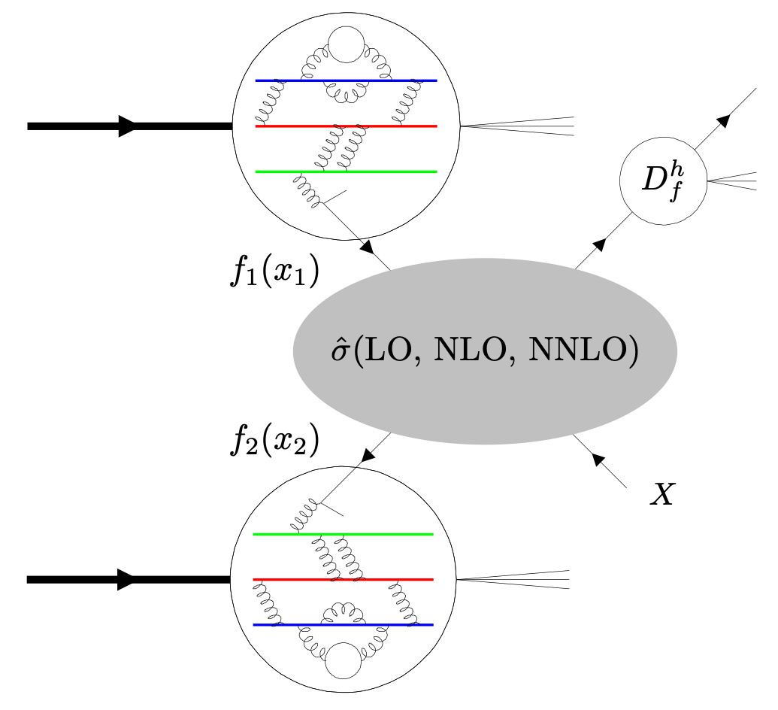
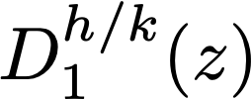
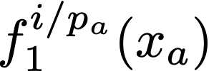
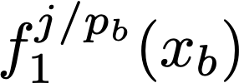
Theoretical foundation
Probe transverse proton spin structure using high-energy polarized p+p collisions
Important new insight into the transverse proton spin structure at STAR in polarized p+p collisions at high energies using well established processes both theoretically and experimentally involving jets / hadrons
Transversity-related measurements: Important insight into transverse spin structure - Need coupling of transversity (h1) to chiral-odd transverse spin dependent fragmentation function (FF):
Collins TMD FFs: Azimuthal single-spin asymmetries of charged pions in jets
Di-hadron FFs: Azimuthal correlations of charged pion pairs
Deepen our understanding concerning universality, factorization and evolution!
long-range
short-range
long-range
FF Review: A. Metz and A. Vossen, Prog. Part. Nucl. Phys. 91 (2016) 136.
15th European Research Conference EINN 2023
Paphos, Cyprus, October 31 - November 4, 2023
Bernd Surrow

Slide 4
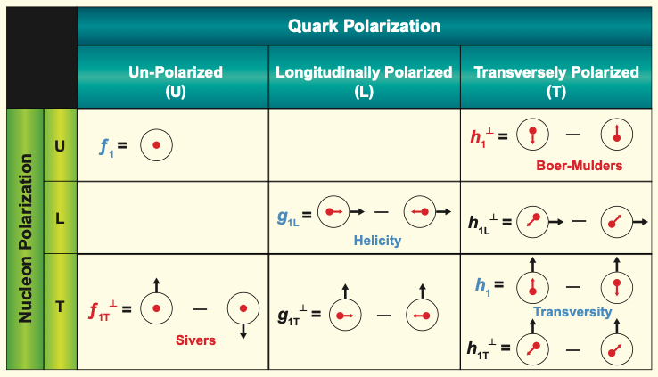
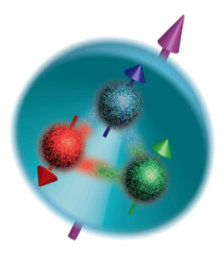
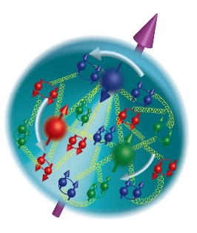
Theoretical Foundation
Proton spin structure
Proton spin structure in terms of parton distribution functions (PDFs)
Three leading twist collinear PDFs, integrated over parton transverse momentum $k_{T}$:
$f_{1}(x)=$Unpolarized PDF
$g_{1}(x)=$ Helicity PDF
$h_{1}^{q}(x)=$Transversity PDF
Motivation: Measurement of observable to constrain $h_{1}^{q}(x)$ in collinear framework in polarized p+p collisions employing chiral-odd di-hadron fragmentation function (DiFF)!
15th European Research Conference EINN 2023
Paphos, Cyprus, October 31 - November 4, 2023
Bernd Surrow
Motivation: Measurement of observables to constrain $h_{1}^{q}(x)$ in the collinear framework in pp collision.

Slide 5
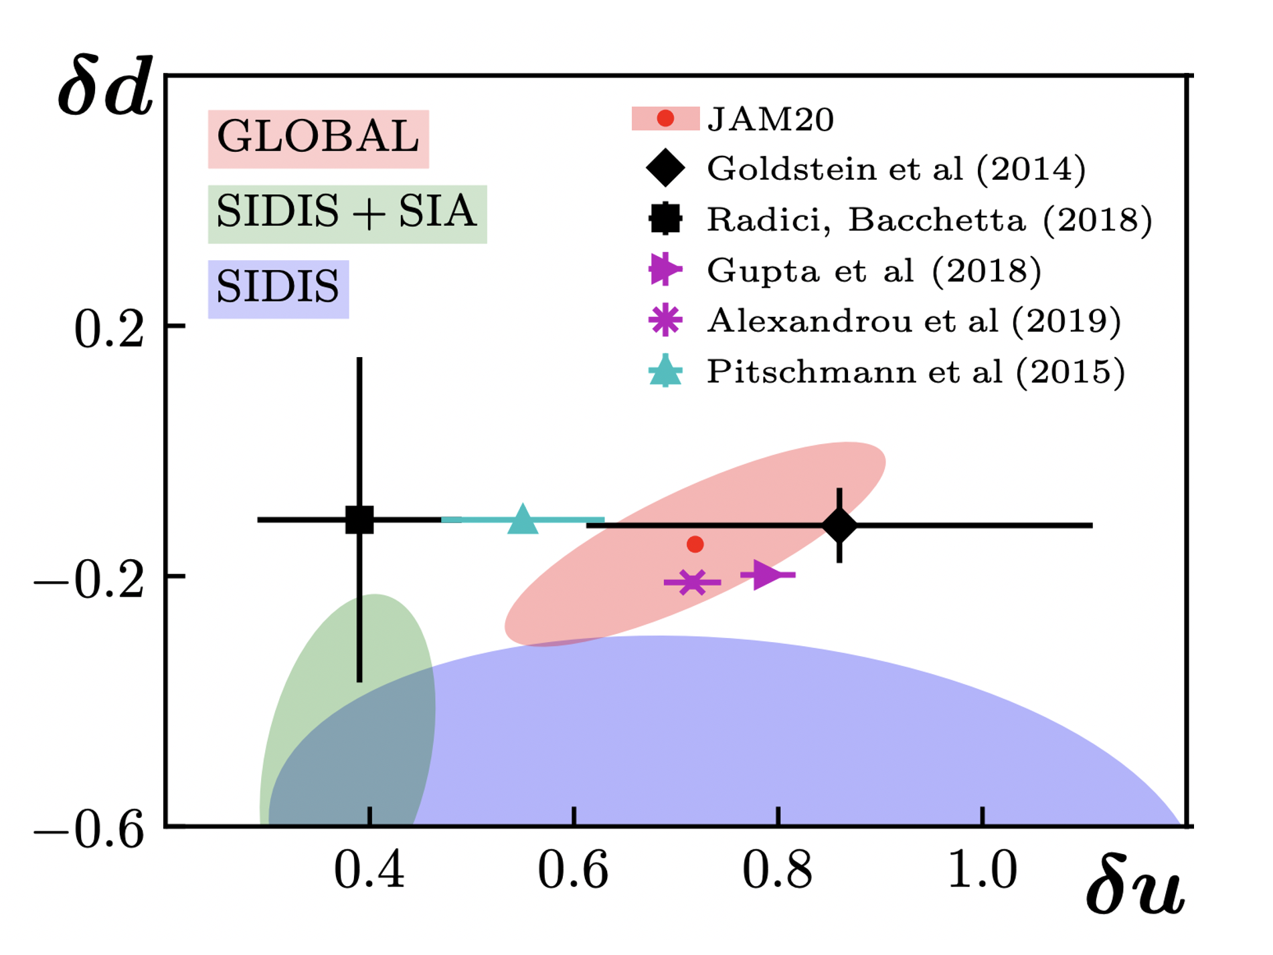
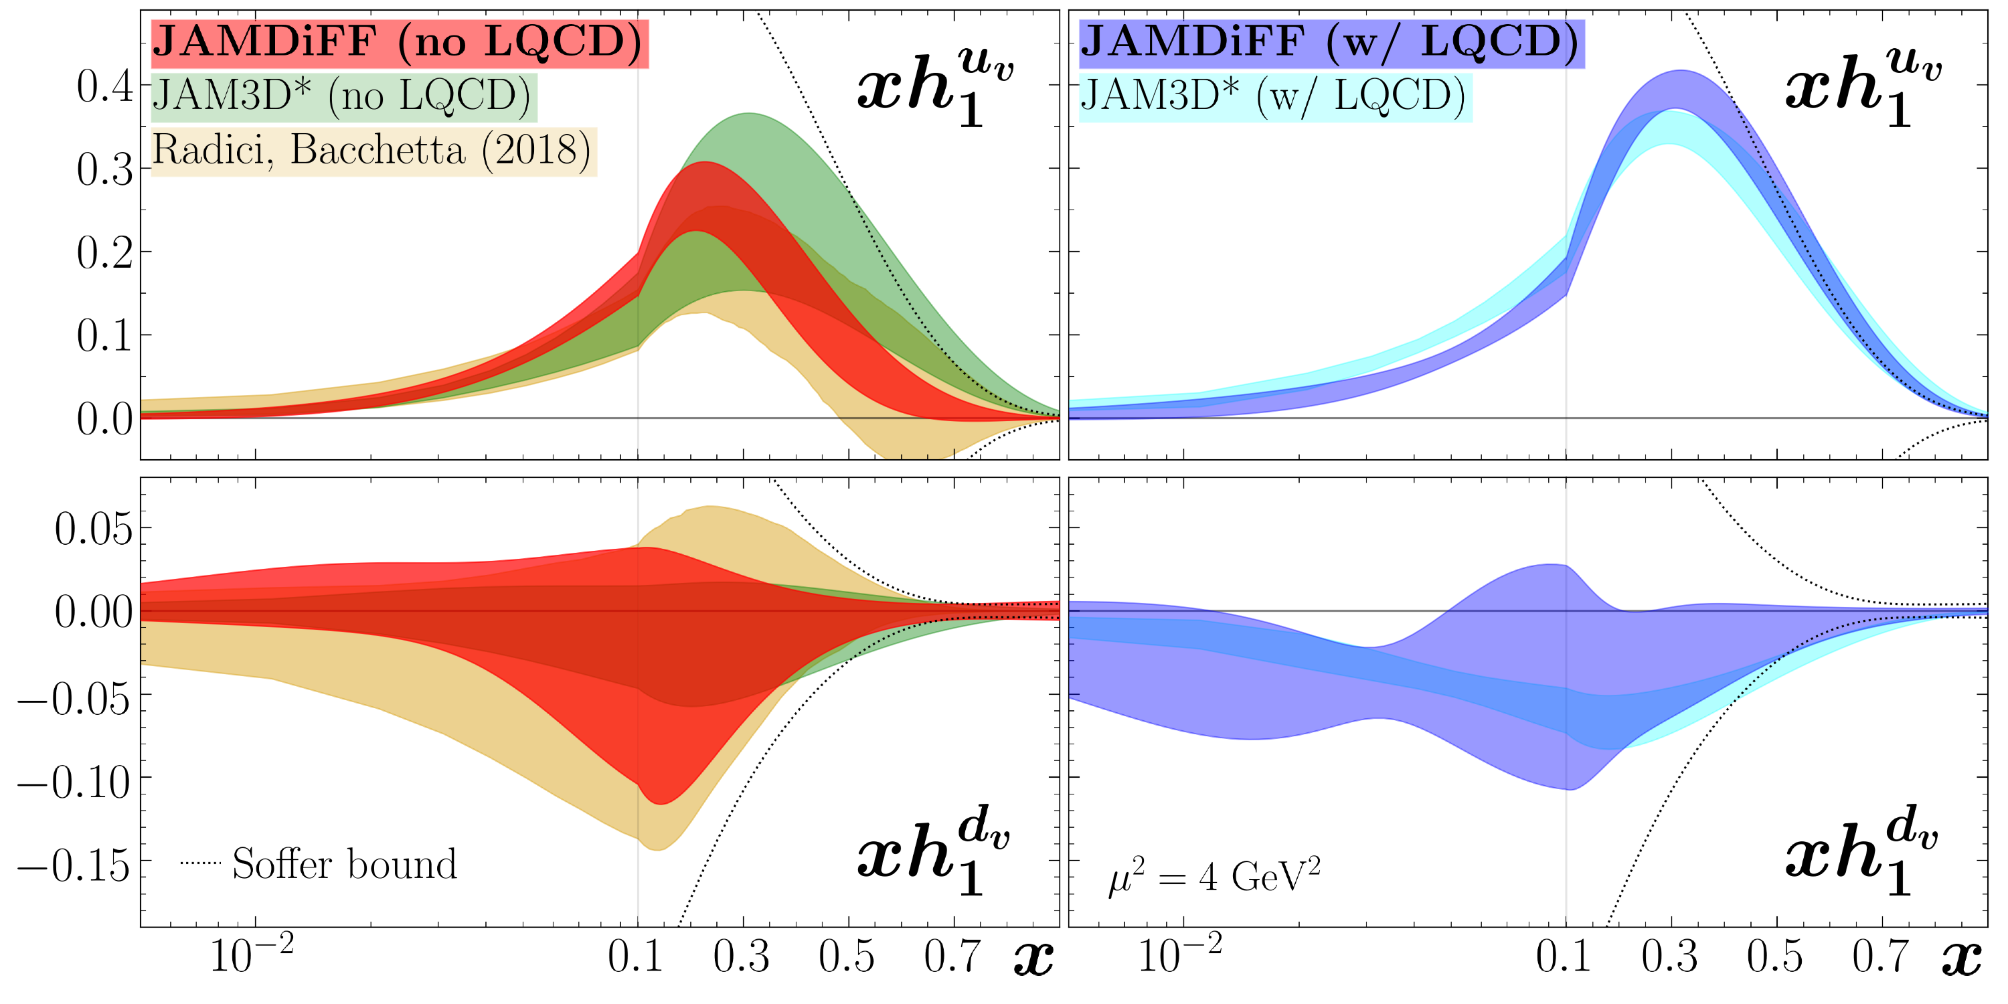
Theoretical Foundation
Transversity
Correlation between nucleon transverse polarization and transverse polarization of quarks - no gluon transversity!
First transversity global analysis by M. Radici and A. Bacchetta (Phys. Rev. Lett. 120, 192001 (2018))
New global analysis by JAM global analysis (arXiV 2308.14857)!
Important connection to Lattice QCD!
15th European Research Conference EINN 2023
Paphos, Cyprus, October 31 - November 4, 2023
Bernd Surrow

Slide 6
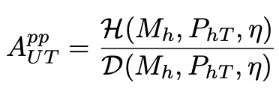
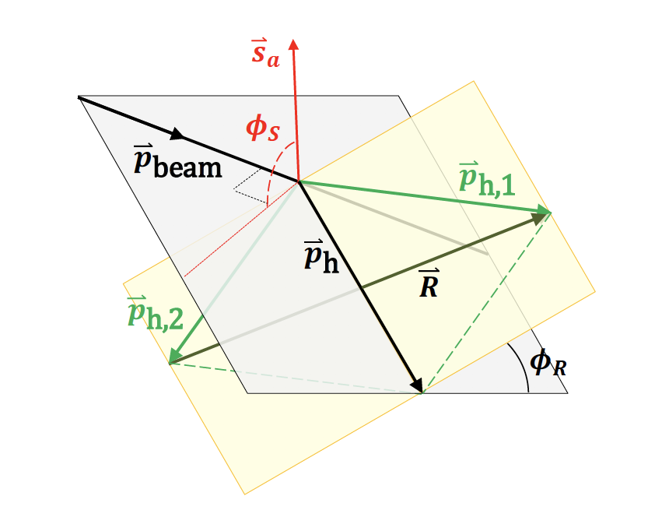
Theoretical Foundation
$${\overset{⃗}{p}}_{h,1}$$
$${\overset{⃗}{p}}_{h}$$
Observables for transversity - Theoretical formulation
$${\overset{⃗}{p}}_{h,2}$$
$$X$$
Di-hadron channel: $p↑+p→h^{+}h^{-}+X$
$$H_{1}^{∢}$$
$$h_{1}$$
$$k$$
$$i$$
$$\overset{̂}{σ}$$
$$j$$
$$f_{1}$$
Asymmetry:
$${\overset{⃗}{p}}_{a},\overset{⃗}{s_{a}}$$
$${\overset{⃗}{p}}_{b}$$
$$l$$
Transversity:
$$D_{1}$$
= parton polarization $i,j,k,l$ = parton flavors
$$X$$
$$h_{1}↔f_{1},H_{1}^{∢}↔D_{1}$$
Unpolarized cross-section:
15th European Research Conference EINN 2023
Paphos, Cyprus, October 31 - November 4, 2023
Bernd Surrow
Notes:
Reference

Slide 7
Theoretical Foundation
Observables for transversity - Experimental measurement
Di-hadron azimuthal correlation asymmetry, $A_{UT}$ , for $p↑+p→h^{+}h^{-}+X$ :
$$A_{UT}=\frac{dσ_{UT}}{dσ_{UU}}=\frac{dσ^{↑}-dσ^{↓}}{dσ^{↑}+dσ^{↓}}$$
$$∝\frac{∑_{i,j,k}h_{1}^{i/{p_{a}}}(x_{a})f_{1}^{j/{p_{b}}}(x_{b})H_{1}^{∢h_{1}h_{2}/k}(z,M_{h})}{∑_{i,j,k}f_{1}^{i/{p_{a}}}(x_{a})f_{1}^{j/{p_{b}}}(x_{b})D_{1}^{h_{1}h_{2}/k}(z,M_{h})}$$
Independent measurement of $H_{1}^{∢}$ is required from $e^{+}e^{-}$ experiments (e.g. BELLE!)
$D_{1}^{h_{1}h_{2}}$ is least known, specifically for gluon fragmentation (New constrain from STAR!)
Unpolarized di-hadron cross-section, $dσ_{UU}$ , for $p↑+p→h^{+}h^{-}+X$ :
$dσ_{UU}$ is crucial for $D_{1}^{h_{1}h_{2}}$ providing access to quarks and gluons
$dσ_{UU}$ and $A_{UT}$ allow model-independent extraction of transversity, $h_{1}^{q}(x)$!
15th European Research Conference EINN 2023
Paphos, Cyprus, October 31 - November 4, 2023
Bernd Surrow

Slide 8
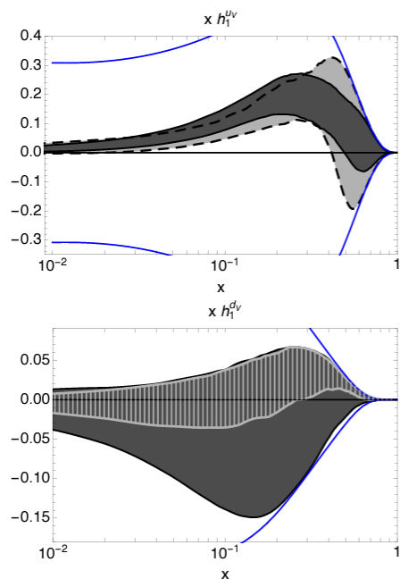
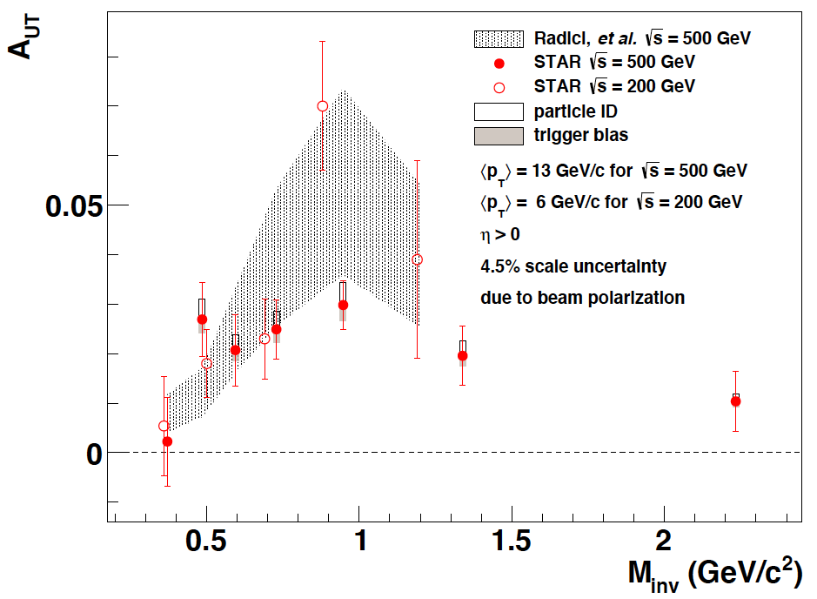
Theoretical Foundation
First proof-of-principle measurements at 200GeV and 510GeV
Radici et. al. Phys. Rev. Lett. 120 (2018), 19 192001
STAR observed significant $π^{+}π^{-}$ correlation asymmetry, $A_{UT}$, using 200 GeV and 500 GeV
$$A_{UT}∝h_{1}^{q}(x)H_{1}^{∢π^{+}π^{-}}(z,M_{h}^{2})$$
$A_{UT}$ enhanced around $ρ$-mass region.
STAR, $e^{+}e^{-}$, HERMES, COMPASS
Significant impact on $h_{1}^{q}(x)$ from STAR data at $\sqrt{s}=200GeV$
$e^{+}e^{-}$, HERMES, COMPASS
STAR, Phys. Lett. B 780 (2018) 332
STAR Phys. Rev. Lett. 115 (2015) 242501
$e^{+}e^{-}$, HERMES, COMPASS
STAR, $e^{+}e^{-}$, HERMES, COMPASS
15th European Research Conference EINN 2023
Paphos, Cyprus, October 31 - November 4, 2023
Bernd Surrow
Notes:
Reference

Slide 9
RHIC Collider and STAR Experiment
Polarized p+p collider facility at BNL
Siberian Snakes
RHIC pC Polarimeter
Absolute Polarimeter
(H jet)
PHENIX/sPHENIX
STAR
Siberian Snakes
Spin Rotators
Partial Snake
Helical Partial
Siberian Snake
Pol. Proton Source
200 MeV Polari-meter
AGS polarimeters
Rf Dipole
Strong AGS snake
15th European Research Conference EINN 2023
Paphos, Cyprus, October 31 - November 4, 2023
Bernd Surrow

Slide 10
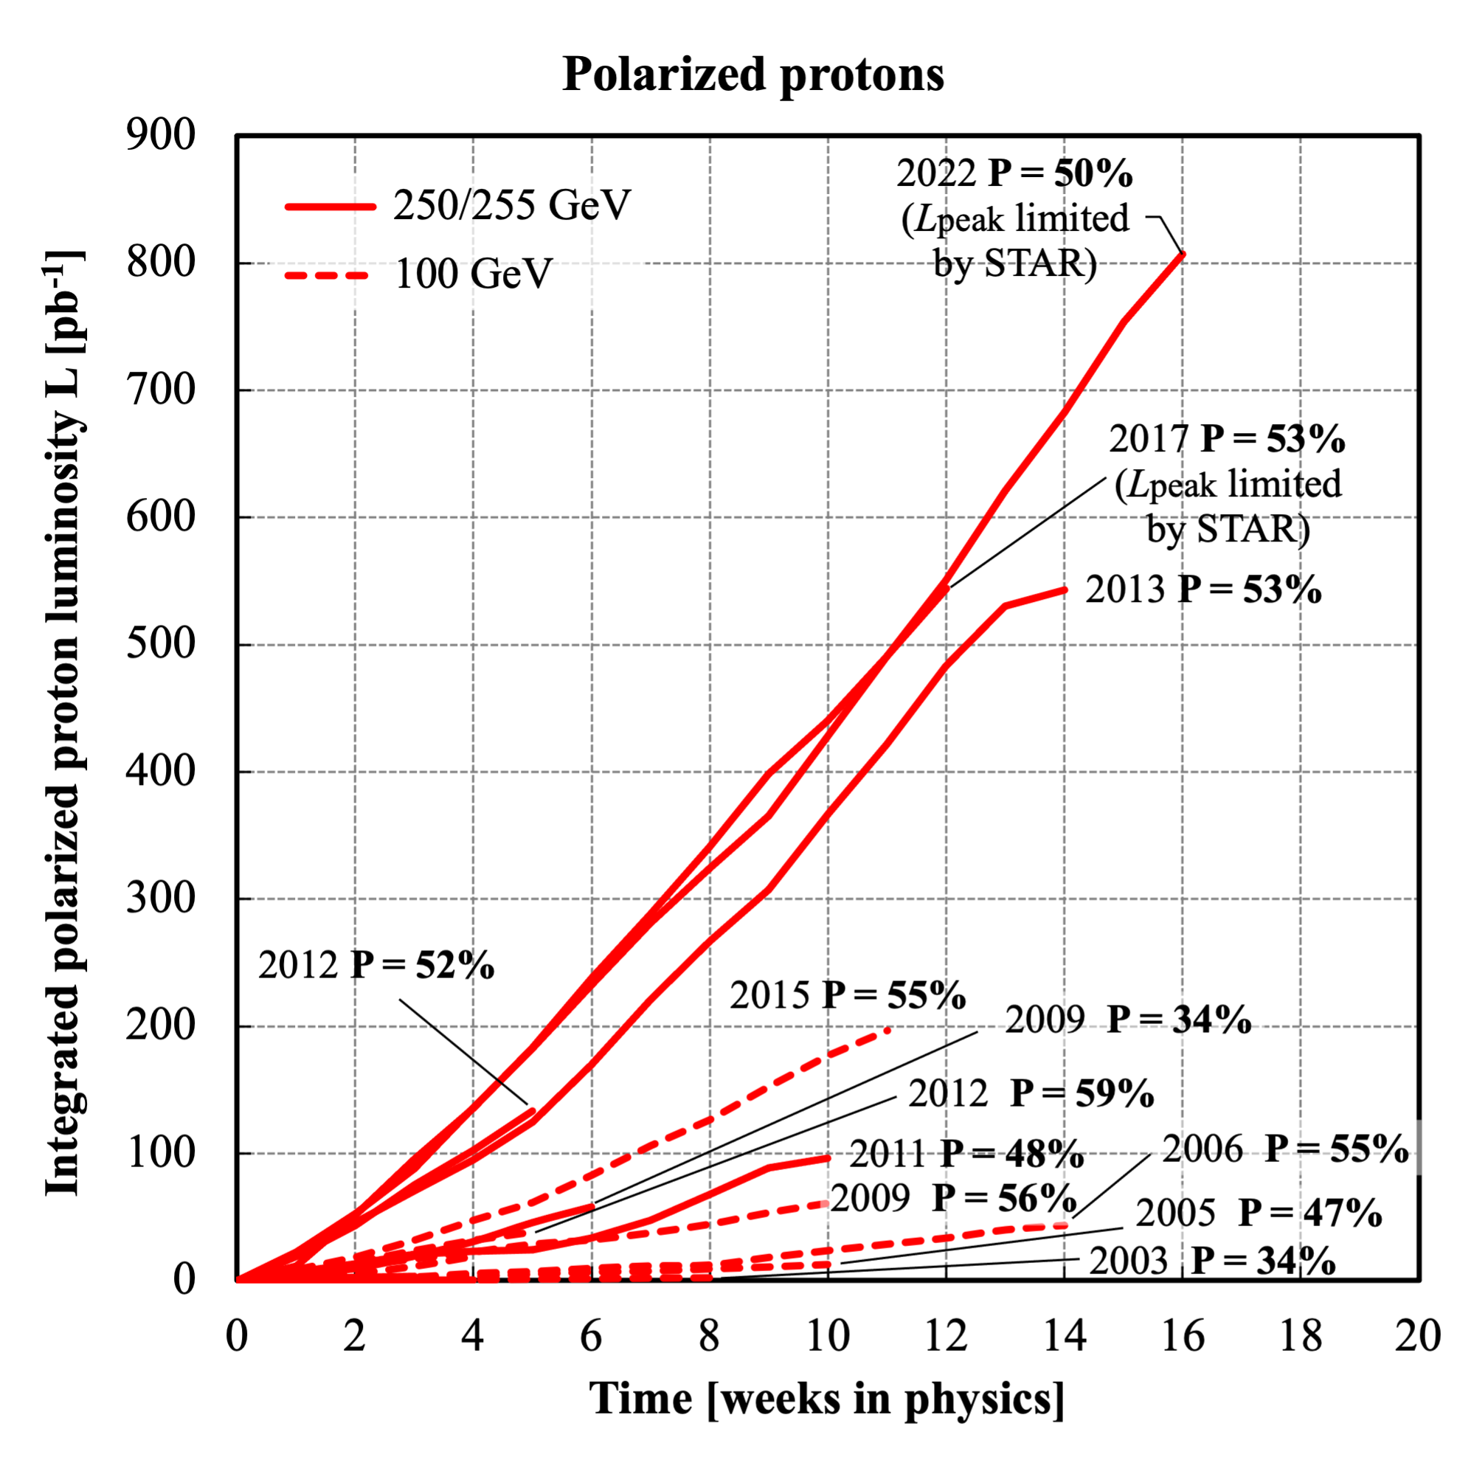
RHIC Collider and STAR Experiment
Transverse spin-polarized p+p production runs
Di-hadron FFs: 2006 at 200GeV and 2011 at 500GeV measurements and updates presented here!
TMD Collins FFs: 2012 / 2015 at 200GeV and 2011 at 500GeV measurements
Large data samples in 2015 at 200GeV and 2017 / 2022 at 510GeV!
15th European Research Conference EINN 2023
Paphos, Cyprus, October 31 - November 4, 2023
Bernd Surrow

Slide 11
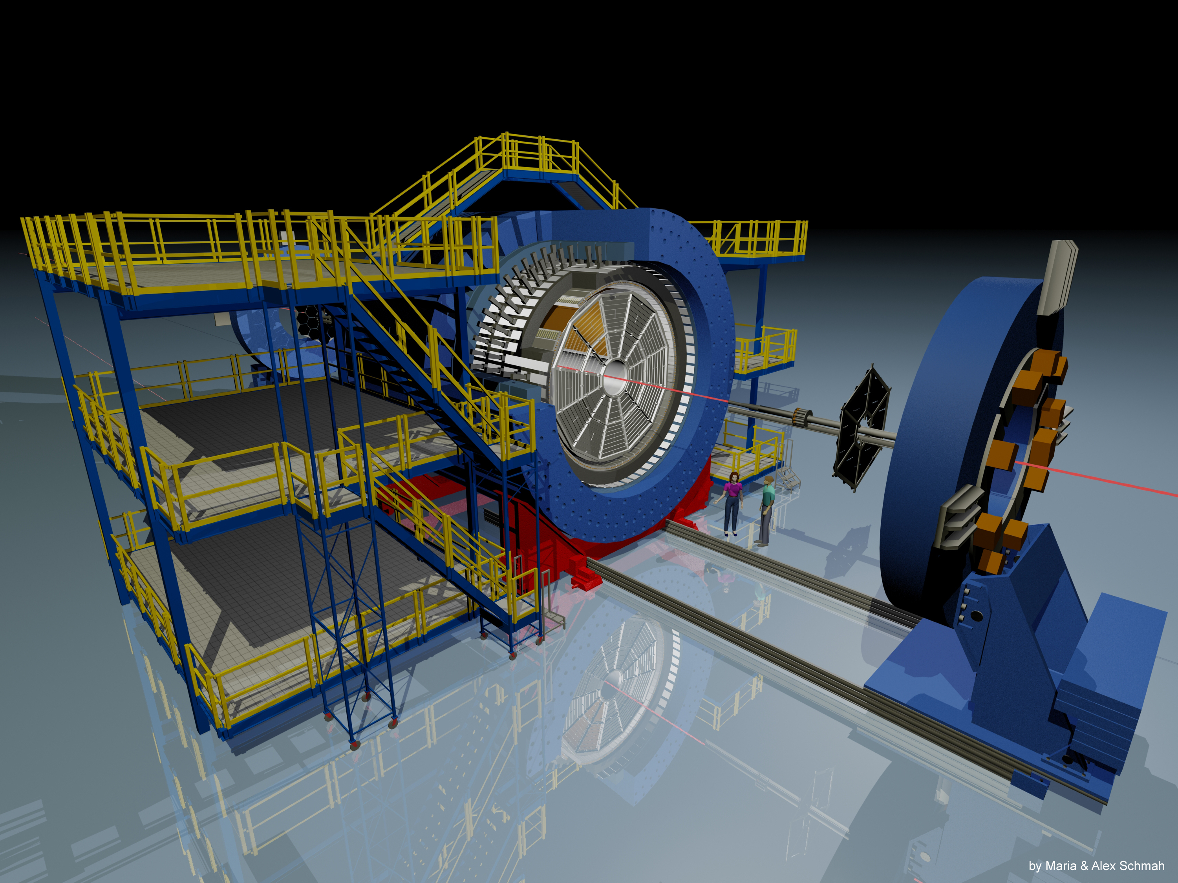
RHIC Collider and STAR Experiment
Overview of STAR experiment
EEMC
Magnet
TPC
TOF
BEMC
VPD
BBC
Sub-Detector | Acceptance | Function
TPC | -1 < 𝞰 <1, 0 < 𝟇 < 2𝞹 | Tracking, PID
BEMC | -1 < 𝞰 <1, 0 < 𝟇 < 2𝞹 | Event triggering
TOF | -1 < 𝞰 <1, 0 < 𝟇 < 2𝞹 | PID
15th European Research Conference EINN 2023
Paphos, Cyprus, October 31 - November 4, 2023
Bernd Surrow

Slide 12
RHIC Collider and STAR Experiment
Polarized p+p data samples and kinematic coverage
Collision mode | proton-proton
Polarization type | transverse
Year | 2006 | 2011 | 2012 | 2015 | 2017 | 2022 | 2024
 | 200 | 500 | 200 | 200 | 510 | 508 | 200
 | ~ 1.8 | ~ 25 | ~ 22 | ~ 52 | ~ 320 | ~ 400 | ~ 190
 | ~ 60 | ~ 53 | ~ 57 | ~ 57 | ~55 | ~52
$$\sqrt{s}(GeV)$$
$$L_{int}({pb}^{-1})$$
$$⟨P_{beam}⟩(\%)$$
STAR Preliminaries @ $\sqrt{s}$ = 200 GeV
Unpolarized $π^{+}π^{-}$ Cross Section (2012)
IFF Asymmetry (2015)
Published IFF $A_{UT}$
STAR, Phys. Lett. B 780 (2018) 332
STAR, Phys. Rev. Lett. 115 (2015) 242501
STAR IFF Preliminary @ $\sqrt{s}$ = 510 GeV
Planned IFF and Cross Section Measurements
15th European Research Conference EINN 2023
Paphos, Cyprus, October 31 - November 4, 2023
Bernd Surrow

Slide 13
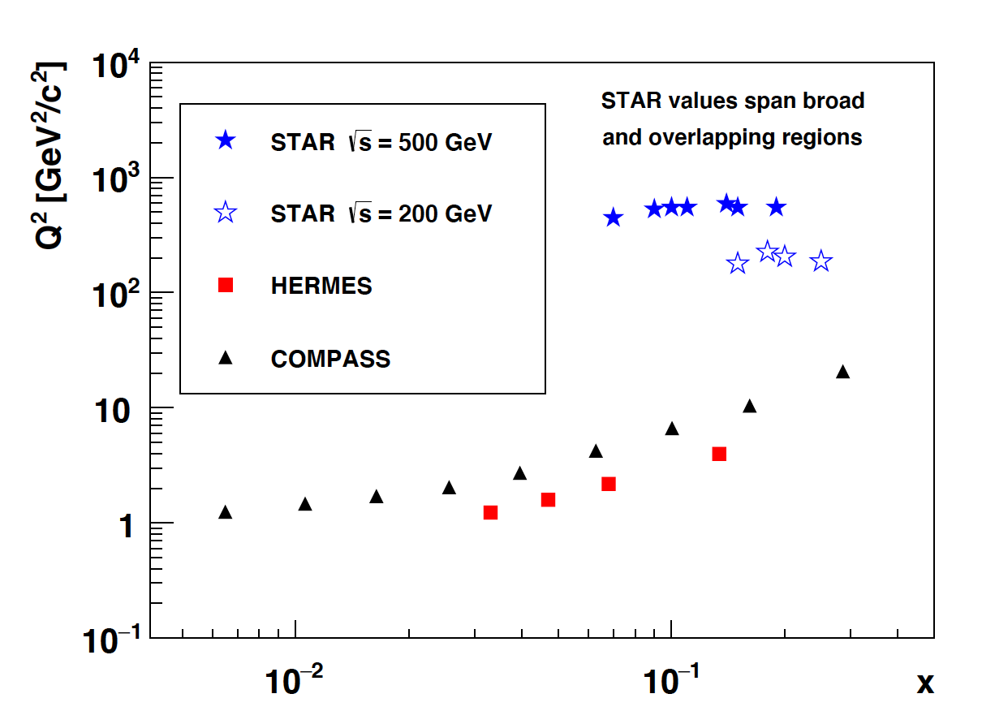
RHIC Collider and STAR Experiment
Kinematic coverage
Collision mode | proton-proton
Polarization type | transverse
Year | 2006 | 2011 | 2012 | 2015 | 2017 | 2022 | 2024
 | 200 | 500 | 200 | 200 | 510 | 508 | 200
 | ~ 1.8 | ~ 25 | ~ 22 | ~ 52 | ~ 320 | ~ 400 | ~ 190
 | ~ 60 | ~ 53 | ~ 57 | ~ 57 | ~55 | ~52
$$\sqrt{s}(GeV)$$
$$L_{int}({pb}^{-1})$$
$$⟨P_{beam}⟩(\%)$$
STAR Kinematic Coverage:
Covers larger $Q^{2}$ values compared to HERMES and COMPASS.
Intermediate x coverage, probing predominantly valence quark region.
15th European Research Conference EINN 2023
Paphos, Cyprus, October 31 - November 4, 2023
Bernd Surrow
Notes:
Reference

Slide 14
Analysis details - $π^{+}π^{-}$ Asymmetry
Kinematic variables and selection cuts
$$π^{+}$$
$${\overset{⃗}{p}}_{h_{1}}$$
Polarized parton fragments to $π^{+}π^{-}$ :
$$\overset{⃗}{s}$$
$${\overset{⃗}{p}}_{h}$$
$${\overset{⃗}{p}}_{beam}$$
$$π^{-}$$
$${\overset{⃗}{p}}_{h_{2}}$$
$$\overset{⃗}{R}$$
Two crucial vectors: ${\overset{⃗}{p}}_{h}={\overset{⃗}{p}}_{h_{1}}+{\overset{⃗}{p}}_{h_{2}}$ and $\overset{⃗}{R}=\frac{1}{2}({\overset{⃗}{p}}_{h_{1}}-{\overset{⃗}{p}}_{h_{2}})$
Access to the quark polarization via correlation: $\overset{⃗}{S}⋅\overset{⃗}{R}×{\overset{⃗}{p}}_{h}$
Scattering plane
Pion identification by measuring the ionization energy loss (dE/dx) with $p_{T}^{π}>1.5$ GeV/c and $|η|<1$
Oppositely charged pion pairs, $π^{+}π^{-}$
Direction of $\overset{⃗}{R}$ always points from $π^{-}$ to $π^{+}$ $A_{UT}$ gets otherwise diluted
$$π^{+}$$
$$π^{-}$$
$π^{+}π^{-}$ reaction plane
15th European Research Conference EINN 2023
Paphos, Cyprus, October 31 - November 4, 2023
Bernd Surrow

Slide 15
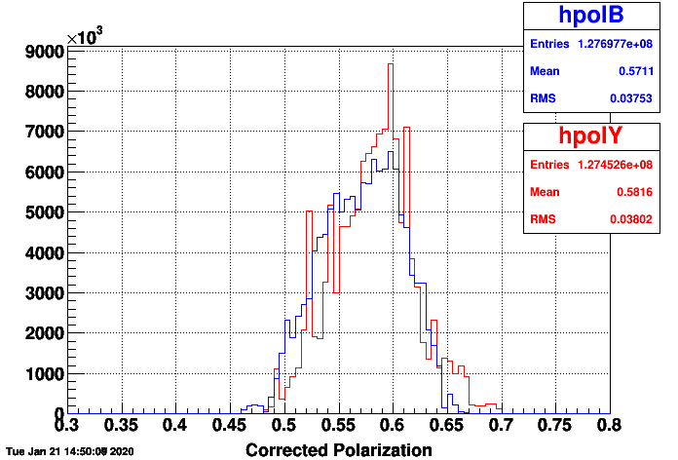
Analysis details - $π^{+}π^{-}$ Asymmetry
P $≡$ Average beam polarization
Asymmetry determination
Cross-ratio formula: $ϕ_{RS}$ binning in $A_{UT}$ extraction
Run 15
$$A_{UT}sin(ϕ_{RS})=\frac{1}{P}\frac{\sqrt{N^{↑}(ϕ_{RS})N^{↓}(ϕ_{RS}+π)}-\sqrt{N^{↓}(ϕ_{RS})N^{↑}(ϕ_{RS}+π)}}{\sqrt{N^{↑}(ϕ_{RS})N^{↓}(ϕ_{RS}+π)}+\sqrt{N^{↓}(ϕ_{RS})N^{↑}(ϕ_{RS}+π)}}$$
Free from relative luminosity terms (cancels out in symmetric detector system!)
Two transverse polarization states: $↑$, $↓$
16 $ϕ_{RS}$ bins of uniform widths over [$-π,π$].
Symmetry between [$-π,0$] and [$0,π$] hemispheres.
Count $π^{+}π^{-}$ yields in each 16 $ϕ_{RS}$ bins for each polarization states: $N^{↑}(ϕ_{RS})$, $N^{↓}(ϕ_{RS})$.
$$π$$
$$ϕ_{RS}$$
$$0$$
$$ϕ_{RS}+π$$
$ϕ_{RS}$ binning scheme
15th European Research Conference EINN 2023
Paphos, Cyprus, October 31 - November 4, 2023
Bernd Surrow

Slide 16
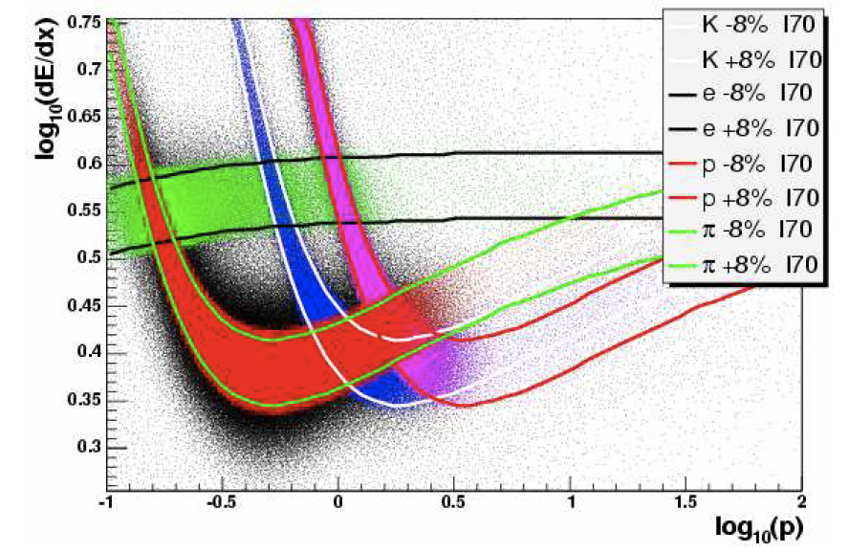
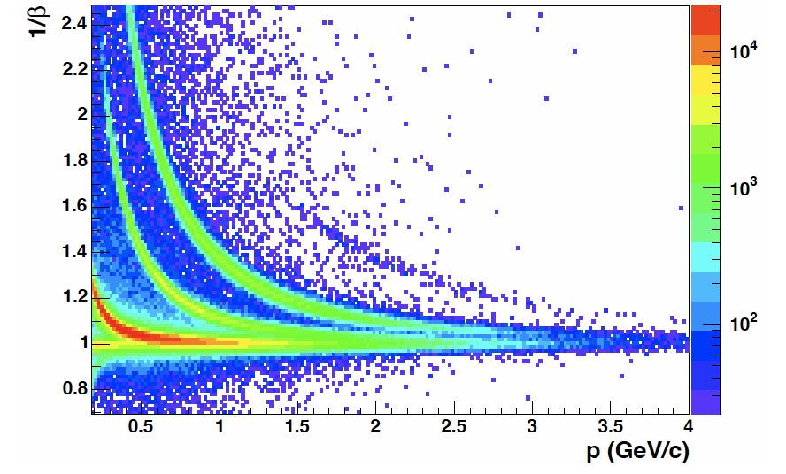
Analysis details - $π^{+}π^{-}$ Asymmetry
Systematic uncertainties
STAR PID relies on the measured ionization energy loss (dE/dx) by the TPC at low $p_{T}$.
Time of Flight (TOF) helps to improve the STAR PID, in conjunction with the TPC via dE/dx
The fraction of proton, kaon, and electron (backgrounds) in the pion signal region estimates the PID systematic uncertainty
TPC PID
TOF PID
15th European Research Conference EINN 2023
Paphos, Cyprus, October 31 - November 4, 2023
Bernd Surrow

Slide 17
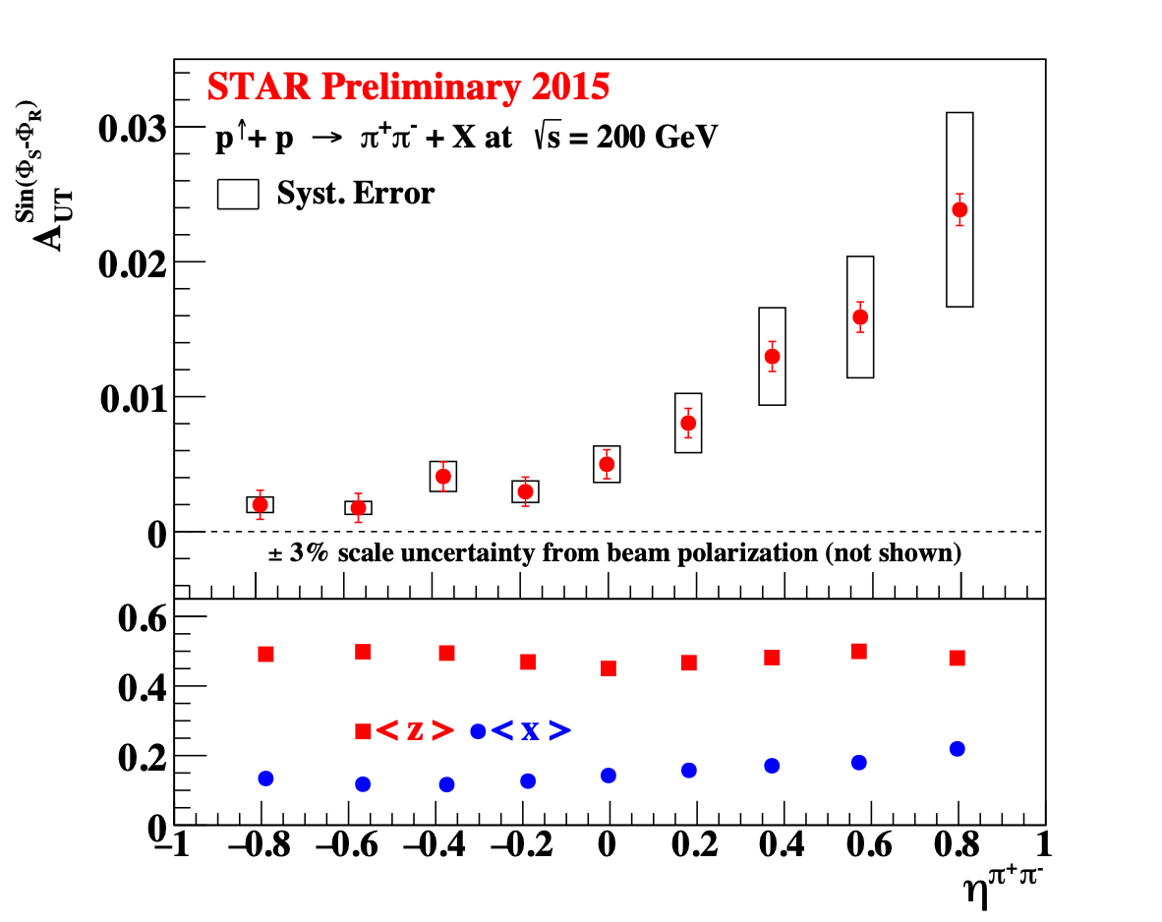
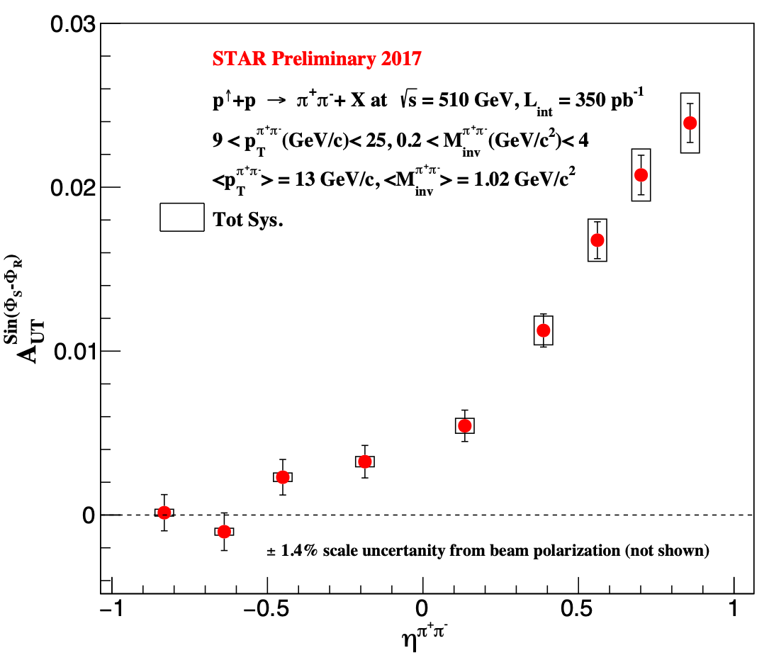
$π^{+}π^{-}$ Asymmetry Results
Asymmetry vs. pseudo-rapidity $η^{π^{+}π^{-}}$ at 200GeV and 510GeV
$A_{UT}$ increases with $η$ at 200GeV (Run 15) and 510GeV (Run 17) - Sizable $h_{1}^{q}(x)$ expected for $η>0$, i.e., large $x$!
Improved PID treatment for 510GeV (Run 17) using TPC/TOF, whereas 200GeV (Run 15) based on TPC PID only so far, TOF PID incl. for final result for 200GeV (Run 15)
Systematic uncertainties: PID and Trigger bias
15th European Research Conference EINN 2023
Paphos, Cyprus, October 31 - November 4, 2023
Bernd Surrow
Notes:
Reference

Slide 18
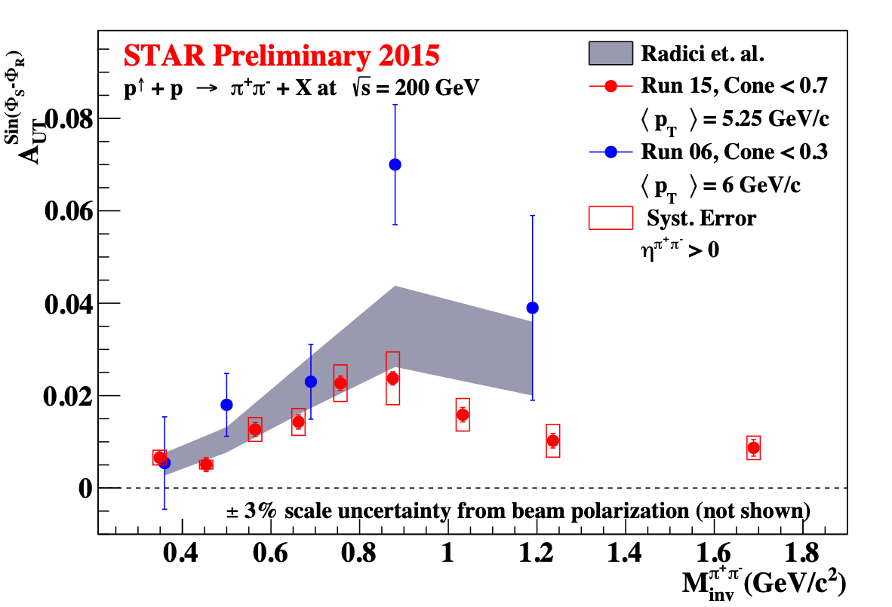
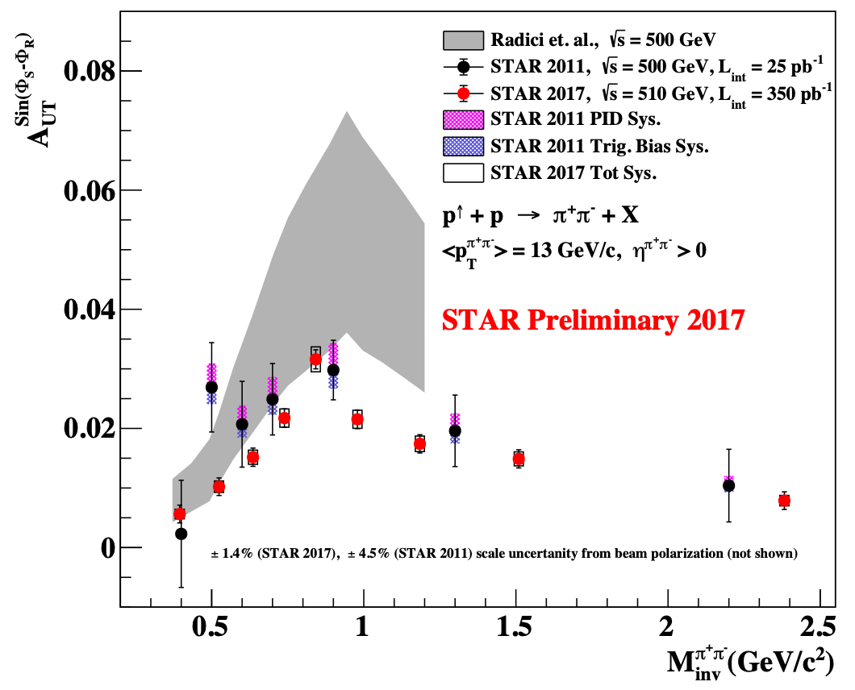
$π^{+}π^{-}$ Asymmetry Results
Asymmetry vs. invariant mass $M_{inv}^{π^{+}π^{-}}$ integrated in $p_{T}$ at 200GeV and highest $p_{T}$ bin at 510GeV
$A_{UT}$ asymmetry is enhanced around $M_{inv}^{π^{+}π^{-}}$ ~ 0.8, consistent with the previous measurement and theory prediction
Theory calculations overshoots the new measurement beyond the $ρ$ resonance peak
Statistical precision is significantly improved by the new result
15th European Research Conference EINN 2023
Paphos, Cyprus, October 31 - November 4, 2023
Bernd Surrow
Notes:
Reference

Slide 19
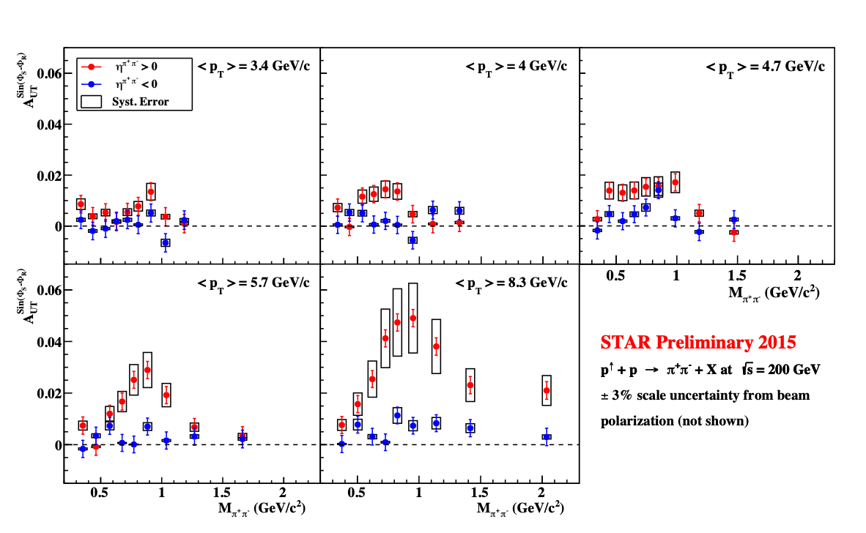
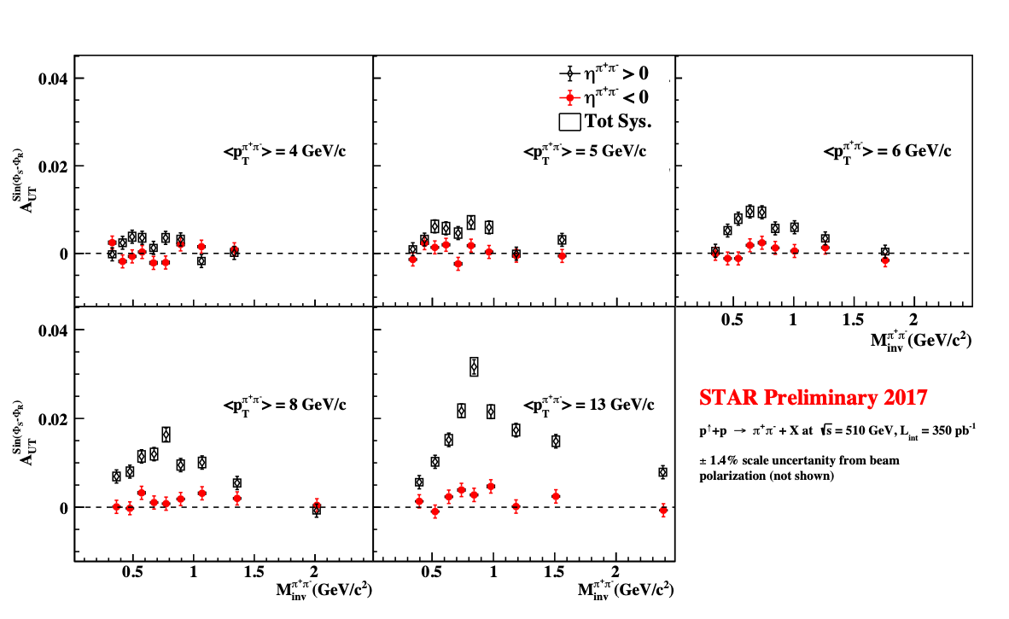
$π^{+}π^{-}$ Asymmetry Results
Asymmetry vs. invariant mass $M_{inv}^{π^{+}π^{-}}$ in $p_{T}$ bins at 200GeV and 510GeV
$A_{UT}^{sin(ϕ_{RS})}$ vs $M_{inv}^{π^{+}π^{-}}$ in different $p_{T}$ and $η^{π^{+}π^{-}}$bins
Signal grows stronger at higher $p_{T}$ in forward $η^{π^{+}π^{-}}$region / Resonance peak around $M_{inv}^{π^{+}π^{-}}∼0.8GeV/c^{2}$ ~ $M_{ρ}$.
Backward $η^{π^{+}π^{-}}$signal is small, mainly from low x quarks from polarized beam
15th European Research Conference EINN 2023
Paphos, Cyprus, October 31 - November 4, 2023
Bernd Surrow
Notes:
Reference

Slide 20
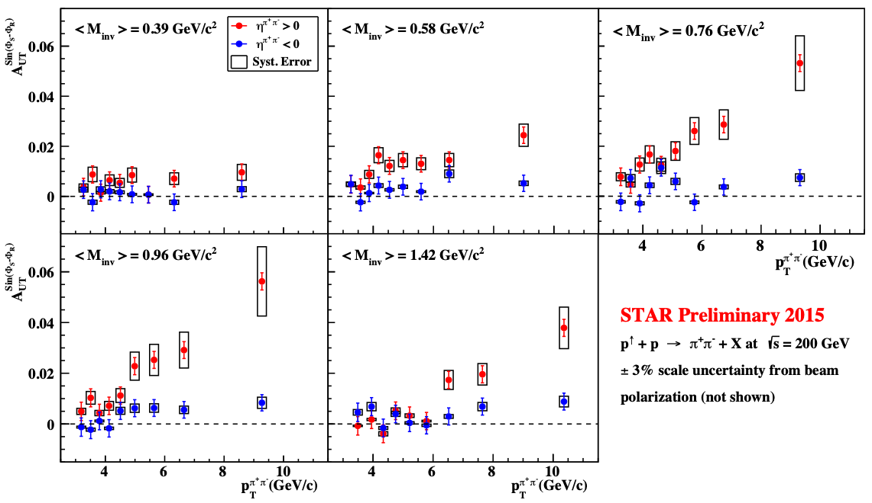
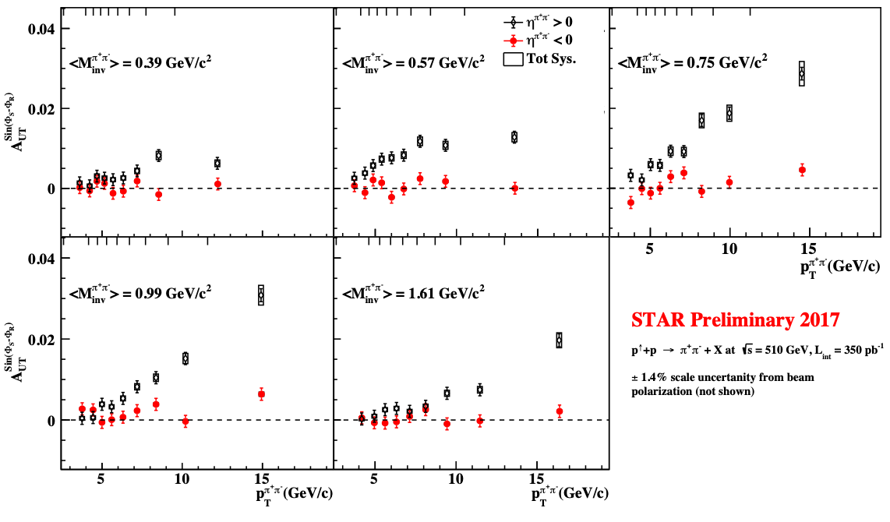
$π^{+}π^{-}$ Asymmetry Results
Asymmetry vs. transverse momentum $p_{T}$ in $M_{inv}^{π^{+}π^{-}}$ bins at 200GeV and 510GeV
Large asymmetry signal at higher $p_{T}$ in forward $η^{π^{+}π^{-}}$region. Stronger signal when $⟨M_{inv}⟩∼M_{ρ}$ .
Backward $η^{π^{+}π^{-}}$signal ($η^{π^{+}π^{-}}<0$) is small, mainly from low x quarks from polarized beam.
15th European Research Conference EINN 2023
Paphos, Cyprus, October 31 - November 4, 2023
Bernd Surrow
Notes:
Reference

Slide 21
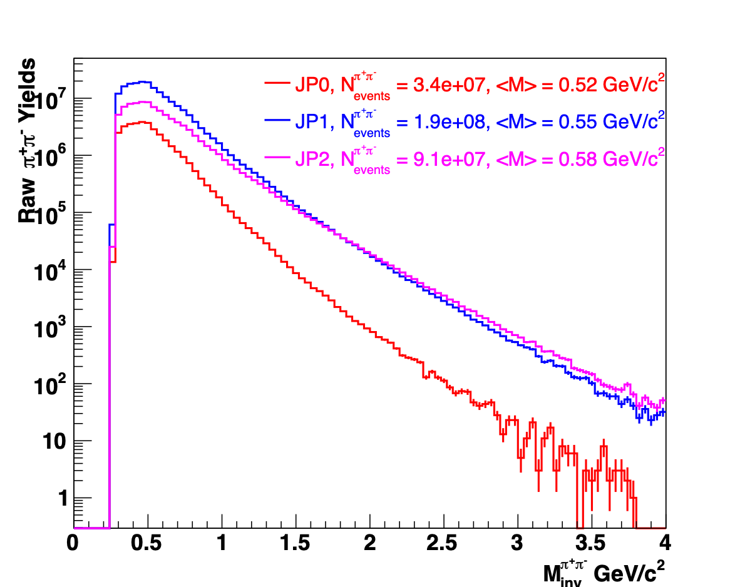
Analysis details - $π^{+}π^{-}$ Cross-Section
Selection criteria
$$π^{+}$$
Di-hadron channel, $p+p→π^{+}π^{-}+X$ :
$${\overset{⃗}{p}}_{h_{1}}$$
$$π^{-}$$
$${\overset{⃗}{p}}_{h}$$
Inclusive $π^{+}π^{-}$ differential cross section:
As a function of invariant mass, $M_{inv}^{π^{+}π^{-}}$, in |$η$|<1 .
Much needed for the $D_{1}^{h_{1}h_{2}}$ extraction.
Access to $D_{1}^{h_{1}h_{2}/g}$.
STAR Run 2012 dataset @ $\sqrt{s}=200$ GeV
Triggers: JP0, JP1, JP2
Lower trigger threshold provides better gluon sensitivity than Run 2015.
$π^{+}π^{-}$ construction is same as in the IFF analysis, except for the track $p_{T}>0.5$ GeV/c.
$${\overset{⃗}{p}}_{beam}$$
$${\overset{⃗}{p}}_{h_{2}}$$
$$\overset{⃗}{R}$$
15th European Research Conference EINN 2023
Paphos, Cyprus, October 31 - November 4, 2023
Bernd Surrow
Notes:
Reference

Slide 22
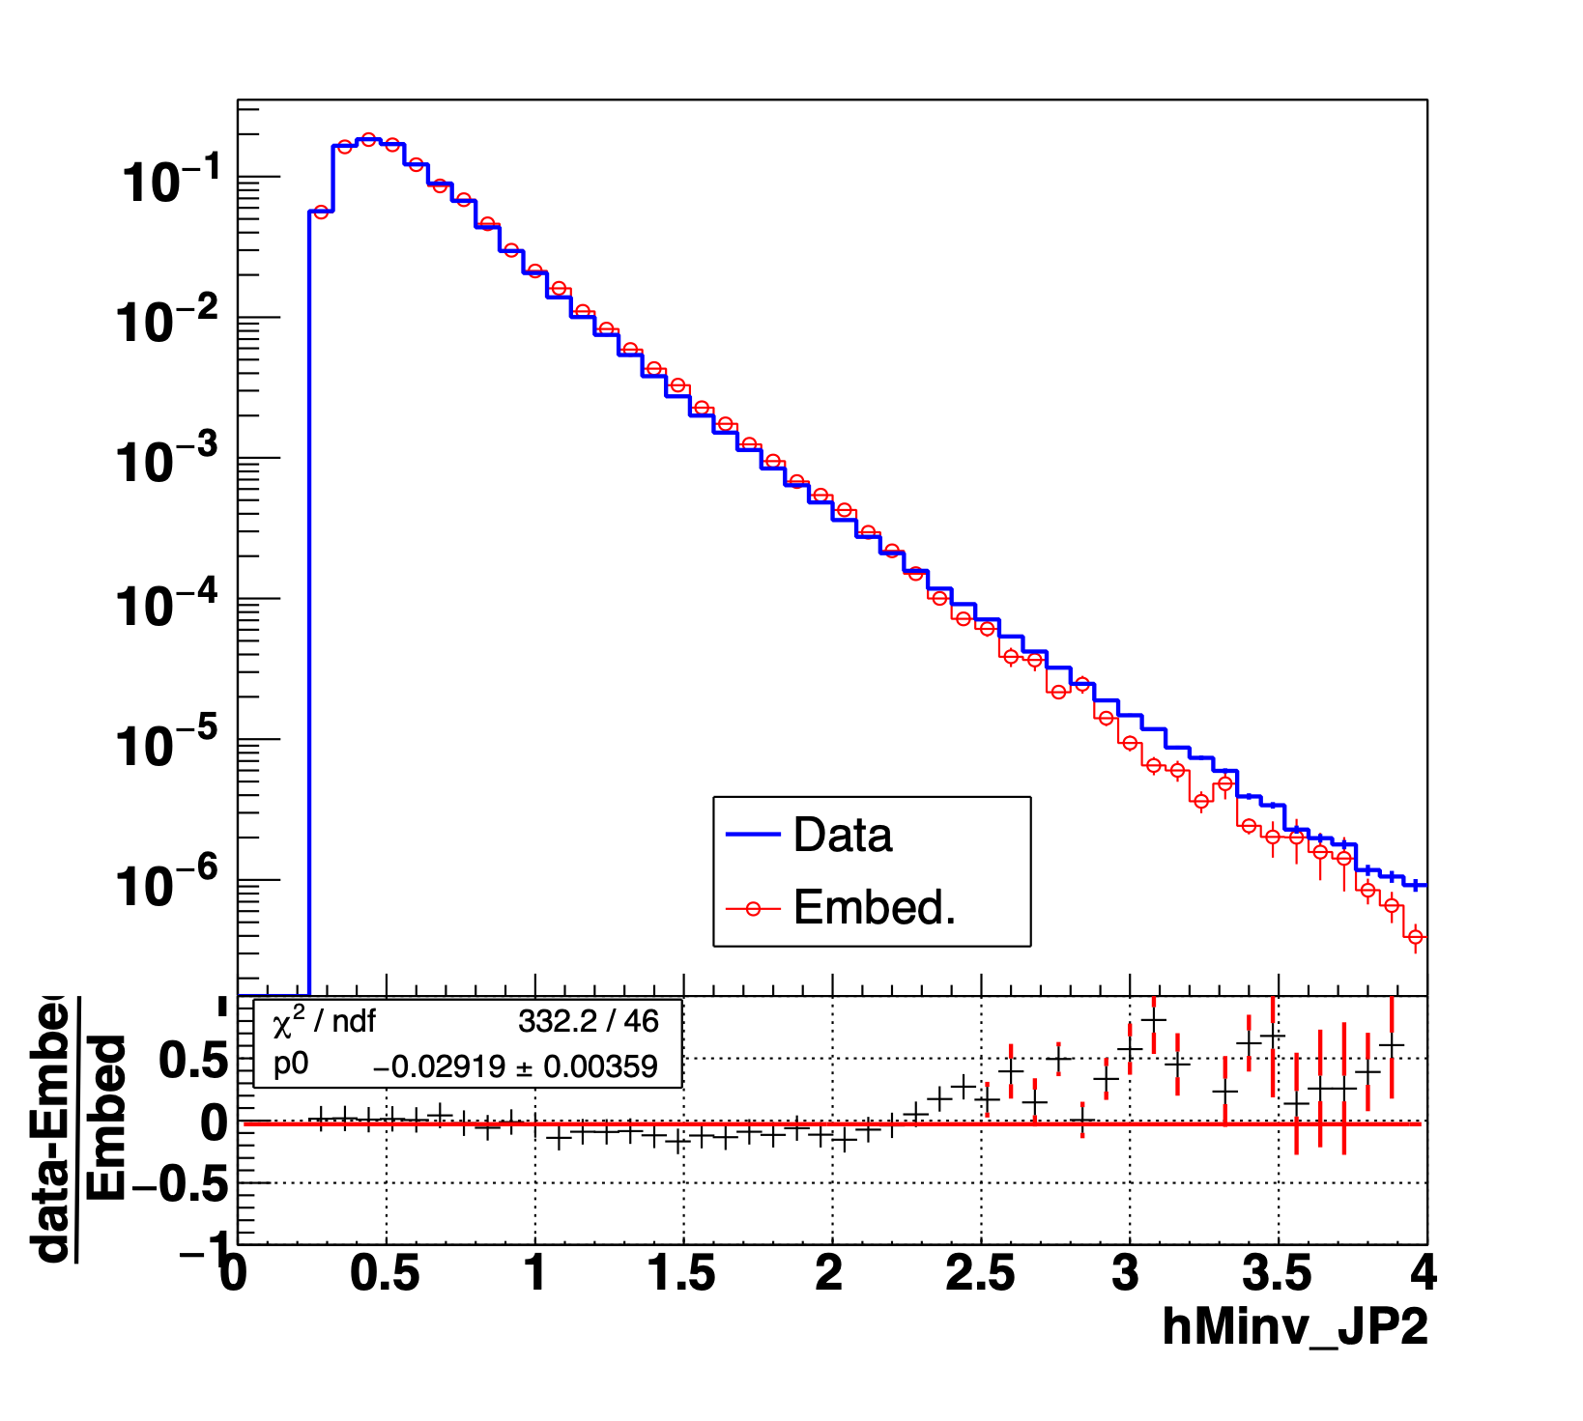
Analysis details - $π^{+}π^{-}$ Cross-Section
Cross-section determination and systematic uncertainties
PYTHIA simulated events, reconstructed through GEANT package embedded with real collision events to effectively reconstruct STAR detector responses (Embedding)
Unfolding accounts for the bin migration effect and backgrounds
Unfolding is performed for each trigger, allowing independent measurement of triggered cross-section
15th European Research Conference EINN 2023
Paphos, Cyprus, October 31 - November 4, 2023
Bernd Surrow
Notes:
Reference

Slide 23
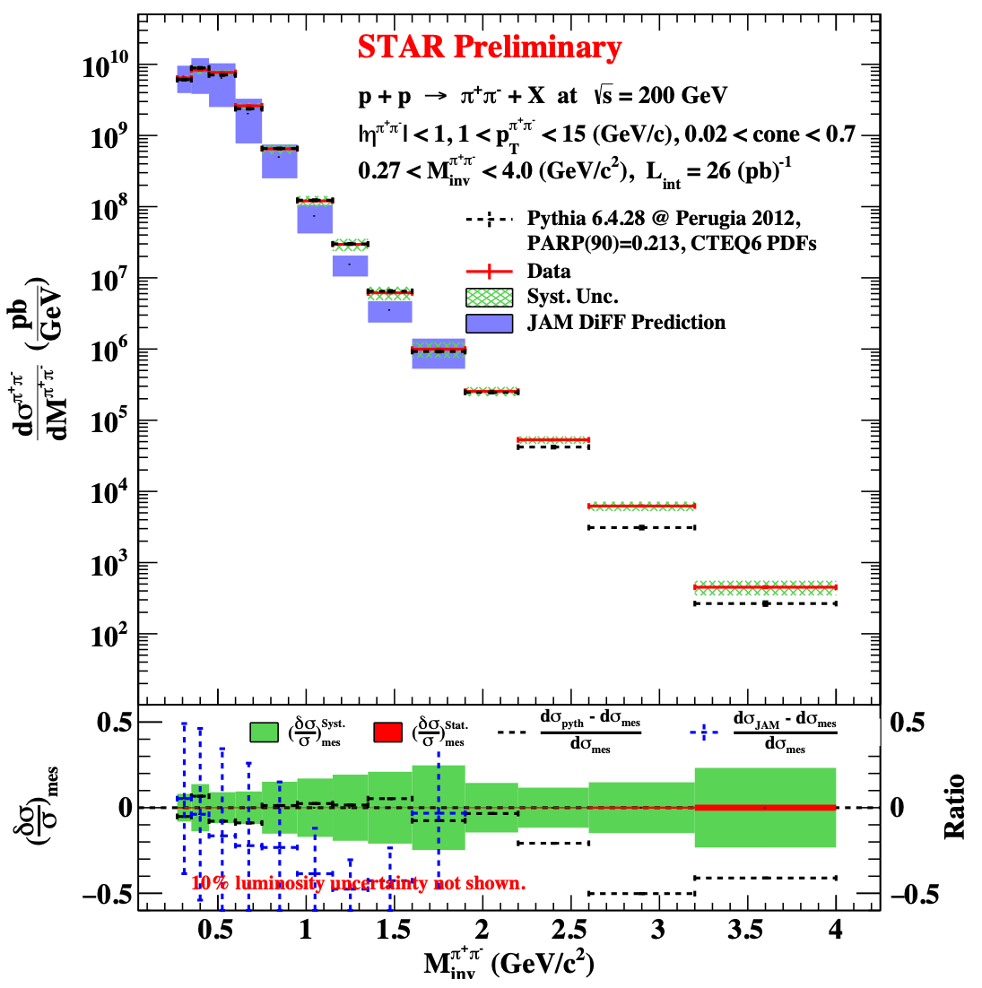
Analysis details - $π^{+}π^{-}$ Cross-Section
Preliminary di-hadron cross-section result
Top Panel:
First unpolarized $π^{+}π^{-}$ cross-section measurement
Good agreement in comparison to PYTHIA simulation and JAMDiFF preduction
Bottom Panel:
Systematic uncertainties (Green band!)
Statistical uncertainties (Red band!)
Relative difference to PYTHIA / JAMDiFF shown in black/blue
Access to $D_{1}^{h_{1}h_{2}}$ for gluons
Path to model-independent extraction of $h_{1}(x)$
15th European Research Conference EINN 2023
Paphos, Cyprus, October 31 - November 4, 2023
Bernd Surrow
Notes:
Reference

Slide 24
Summary and Outlook
Summary
New measurements of IFF di-pion asymmetries at 200GeV (2015) and 510GeV (2017)
First di-pion cross-section measurement at 200GeV (2012)
Improved PID systematics (Combination of TPC+TOF) for Run 17 data at 510GeV, to be applied to 200GeV measurement
Publication of 200GeV and 510 di-pion measurements: Input to global analysis for transversity extraction!
15th European Research Conference EINN 2023
Paphos, Cyprus, October 31 - November 4, 2023
Bernd Surrow
Notes:
Reference

Slide 25
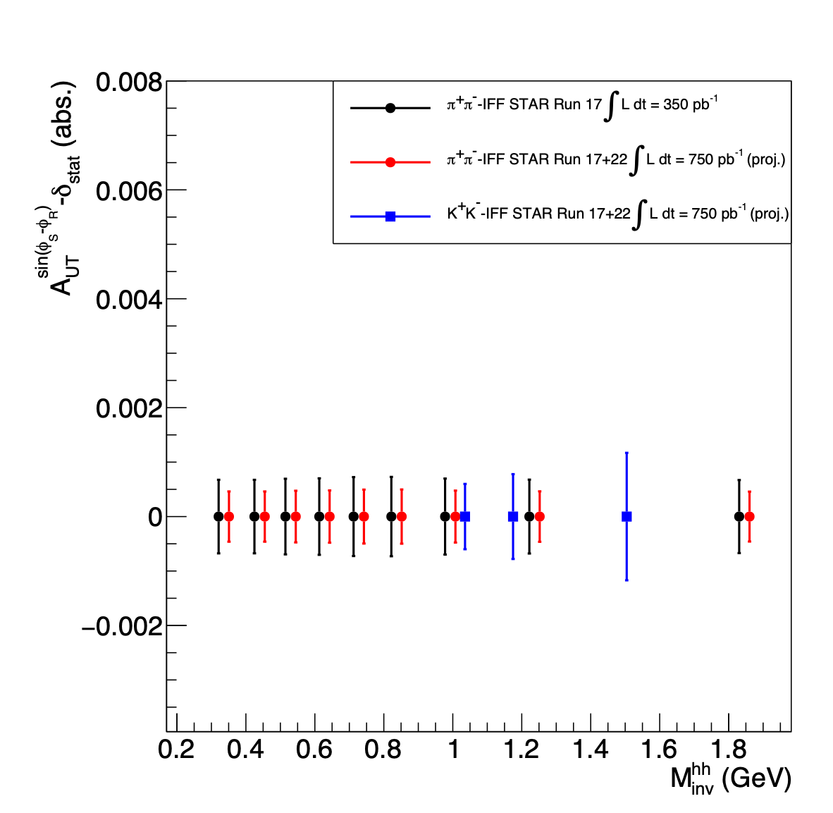
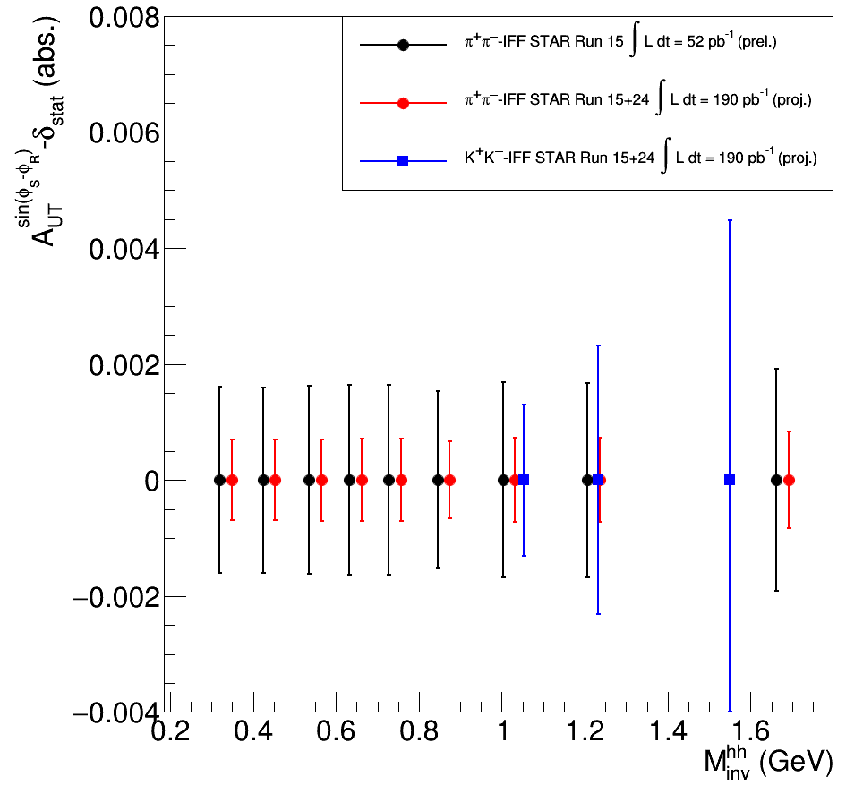
Summary and Outlook
Outlook
Precision measurement of IFF asymmetries for pions / kaons from 2015+2024 at 200GeV and 2017+2022 at 510GeV
Planned cross-section measurements for pions at 510GeV and Kaons at 200/510GeV
15th European Research Conference EINN 2023
Paphos, Cyprus, October 31 - November 4, 2023
Bernd Surrow

