Slide 1
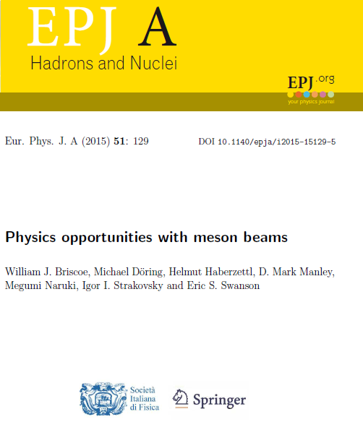
Experimental Opportunities in for Meson Beams at EIC
W.J. Briscoe and Igor Strakovsky
Department of Physics
The George Washington University
Virginia Science and Technology Campus
Ashburn, VA 20147
2015 White Paper
135 endorsers from 77 labs worldwide

Slide 2
The Need for New Meson Factories
In recent years, electron facilities have measured meson photo- and electro-production data of excellent quality and quantity.
Much of the outdated meson-beam data for corresponding hadronic final states are of poor quality or non-existent and provide inadequate input to interpret, analyze, and exploit the full potential of the EM data..
To exploit the high-precision EM data, high-statistics data from measurements with meson beams with good angle and energy coverage are needed to advance the field in baryon and meson spectroscopy and related areas of hadron physics.
Here we summarize unresolved issues in hadron physics and outlines the opportunities and advances only possible with such a facility.
To connect this with the EIC we show the inroads we made in developing a conceptual justification for JLEIC with the hopes that we can develop a similar effort for the EIC at BNL.

Slide 3
A Little History: What was a Meson Factory in the mid 20th Century?
“Meson factories are medium-energy accelerators (300-1000 MeV), capable of producing proton beams of much greater intensity than other types of existing machines.” – The Ramsey Panel: Hans A. Bethe, chairman, Herman Feshbach, Harry Gove, W. W. Havens, Jr., Robert Christy, Gerald Phillips and Robert R. Wilson. Physics Today 17, 68 (1964).
“Accelerators that will produce 500—1000 MeV nucleons and mesons in beams thousands of times more intense than existing machines will be able to do experiments never before possible, increase precision of others and reveal processes now unknown”. Louis Rosen Physics Today 19, 21 (1966)
→ LAMPF (USA), TRIUMF (Canada), SIN (Switzerland)

Slide 4
What Would a Modern Meson Facility Be?
It would have a CM energy range of at least 2.5 GeV to exploit the physics opportunities with pion and kaon beams complementary to EM programs at facilities: JLab, MAMI, ELSA, SPring-8, and BEPC.
New higher energy and intensity meson facilities can contribute to the fuller understanding of recent high-quality EM data.
This is not a competing effort, but an experimental program that
  provides the hadronic complement of ongoing EM programs and
  provides common ground for better, more reliable, phenomenological and theoretical analyses. [1,2]
  Refs available online with supplemental.

Slide 5
Hyperon Spectrum is Important
This program well-aligned with a goal found in the 2015 Long Range Plan for Nuclear Science: “...a better understanding of the role of strange quarks became an important priority.” [3]
Knowledge of the low-lying spectra of mesons and hyperons is very poor in comparison with that of the nucleon.
Better determination of pole positions and decays are needed.
Determination of hyperon spectra combined with measurements of spectra of charmonia and B particles at LHCb at CERN allows for clearer understanding of soft QCD matter and the approach to heavy quark symmetry. [4]
Recent studies that compare LQCD calculations of thermodynamic,
statistical Hadron Resonance Gas models, and ratios between measured yields of different hadron species in heavy ion collisions provide indirect evidence for presence of ”missing” resonances in these contexts.
Contribution order:
• Hyperons
• Non-strange Baryons
• Mesons
• Light Nuclei

Slide 6
Spectroscopy of Baryon and Hyperon Resonances
Pion Beams are Needed
Most current knowledge about the bound states of three light quarks comes from PWAs of πN → πN scattering performed at Meson Factories.
More recant measurements of πN elastic scattering are required to determine absolute πN branching ratios.
Without that information it is impossible to determine the absolute branching ratios for other decay channels.
Summary of resonance properties is provided in Review of Particle Physics.[5]
Comparison of experimental results and models → “missing resonances”.[6]

Slide 7
Spectroscopy of Baryon and Hyperon Resonances
Pion and Kaon Beams
Most existing Meson data on πN ηN, KΛ, KΣ are 30 - 40 years old. [7]
In many cases, systematic uncertainties were not reported or underestimated.
While analyses agree on 4-star resonances visible in elastic πN scattering; poor pion-induced data led different analyses to claim inconsistent resonance content.
No conclusive agreement on resonances that couple weakly to πN channel. [8]
First determinations of pole position for Λ(1520) obtained only recently. [9]
Intense kaon beams would provide opportunities to locate missing resonances and establish properties of decay channels for higher excited states.

Slide 8
Spectroscopy of Baryon and Hyperon Resonances
Pion and Kaon Beams
Results of current EM facilities would be enhanced by high-quality hadron-beam data.
A new program in hadronic physics requires both pion and kaon beams.
A facility in which a “complete program” of πN→ πN, π⁻p → K⁰Λ, π⁻p → K⁰Σ⁰, π⁻p → K⁺Σ⁻, and π⁺p → K⁺Σ⁺ can be measured is essential;
N.B. hyperons - self analyzing - get spin information for free.
Full solid angle coverage to study inelastic reactions e.g., π⁻p → ηn, π⁺p → π⁰π⁺p.
Should be able to perform baryon spectroscopy measurements to W ≥ 2.5 GeV; this requires pion beams ≥ 2.85 GeV/c.
The 2 GeV/c pion beam at J-PARC only allows measurements to W ≈ 2.15 GeV.

Slide 9
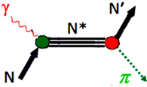
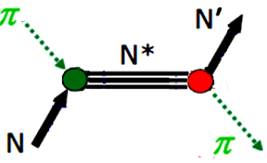
Status of Studies with Pion Beams
Measurements of final states involving a single pseudoscalar meson and spin-1/2 baryons are important.
Reactions involving πN channels include:
γp → π⁰p, π⁻p → π⁰n,
γp → π⁺n, π⁻p → π⁻p,
γn → π⁻p, π⁺p → π⁺p,
γn → π⁰n.
Data bases for these reactions larger than for other reactions.

Slide 10
Why More Studies with Pion Beams are Needed
Figures 1, 2, and 3 summarize current data W < 2.5 GeV for π⁺p → π⁺p, π⁻p → π⁻p, and π⁻p → π⁰n, respectively.
πN elastic scattering data[11] allowed establishment of 4-star resonances[12].
πN→ πN data are old, have large systematic uncertainties and are incomplete.
Few data A and R exist for π⁻p → π⁻p and π⁺p → π⁺p at few energies and angles.
No A and R data for π⁻p → π⁰n few P data.
These observables needed to construct unbiased partial-wave amplitudes.
Improvement in statistics recently shown with EPECUR (Fig. 4).

Slide 11
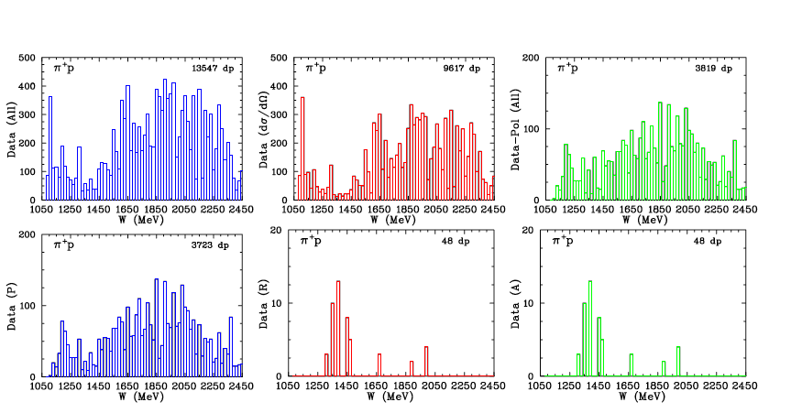
Fig 1 Data available for π⁺p → π⁺p W ≤ 2.45 GeV.[10] Row 1: (blue) total data for all observables, (red) dσ/dΩ data, (green) polarization data. Row 2: (blue) P spin data, (red) R spin data, (green) A spin data.
Studies with Meson Beams

Slide 12
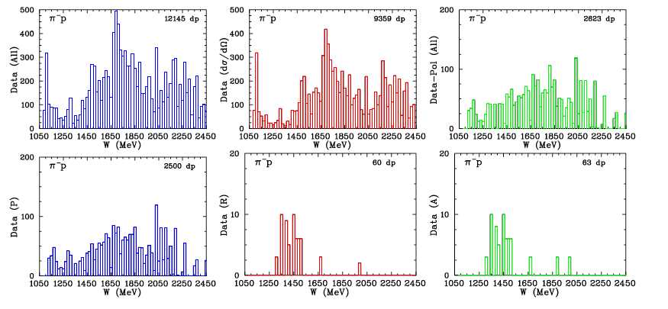
Fig 2 Data available for π⁻p → π⁻p for W ≤ 2.45 GeV. [10] Row 1: (blue) data available for all observables, (red) dσ/dΩ data, (green) polarization data. Row 2: (blue) P spin data, (red) R spin data, (green) A spin data.
Studies with Meson Beams

Slide 13
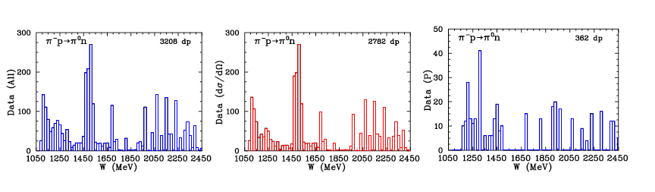
Fig 3 Data available for π⁻p → π⁰n W ≤ 2.45 GeV[10]. (blue) total data available for all observables, (red) shows dσ/dΩ) data, (blue) shows the amount of all polarization data.
Studies with Meson Beams

Slide 14
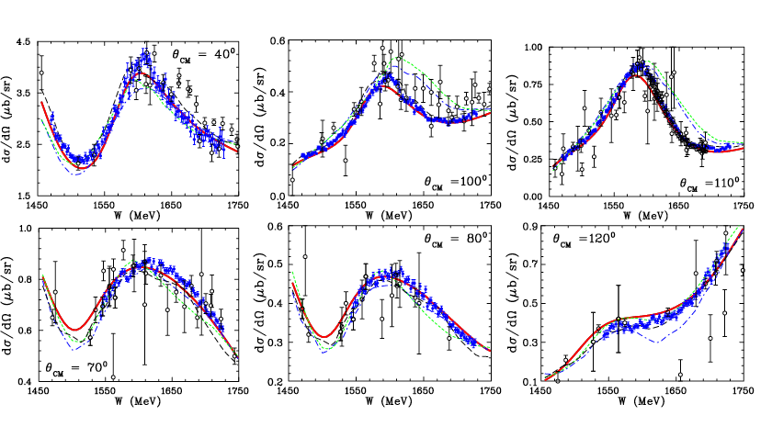
Fig 4 dσ/dΩ for π−p (top) and π+p (bottom) elastic scattering. EPECUR data (blue) [13] previous measurements [14] black. Data from earlier experiments within bins of ∆θ_{CM} = ±1⁰. GWU SAID fit, WI08 [11] red solid curve, older KH80 [15], KA84 [16], and CMB [17] fits blue dash-dotted, green short dashed, and black dashed curves, respectively.
Improved Cross Section Measurements from EPECUR

Slide 15
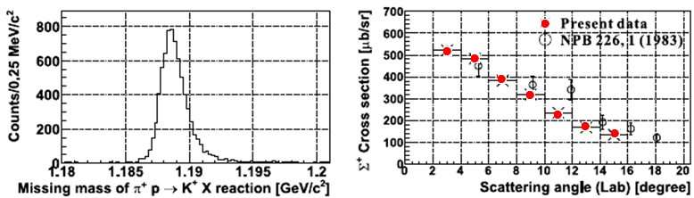
Fig. 5 dσ/dΩ of π⁺p → K⁺Σ⁺ at p_{lab} =1.37 GeV/c from J-PARC experiment [18], compared older data. [19]
Newer Measurements from J-PARC
Fig. 5 shows measurements of I = 3/2 K⁺Σ⁰ final state by J-PARC E19 Collaboration, compared older data; note improvement in uncertainties and angular range!
Similar measurements would improve PWAs of KΣ final state and help extract S-wave contributions needed in approaches based on unitary chiral perturbation theory.

Slide 16
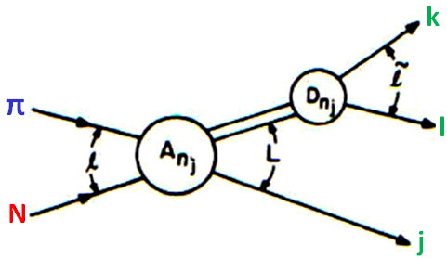
Other Studies with Pion Beams
Other measurable inelastic reactions include ππN final states:
  γp → π⁰π⁰p, π⁻p → π⁰π⁰n,
  γp → π⁰π⁺n, π⁻p → π⁰π⁻p,
  γp → π⁺π⁻p, π⁻p → π⁺π⁻n,
  γn → π⁰π⁰n, π⁺p → π⁰π⁺p,
  γn → π⁰π⁻p, π⁺p → π⁺π⁺n,
  γn → π⁺π⁻n.
Analysis/interpretation more complicated −> involve 3-body final states.
πN → ππN reactions have lowest energy threshold of the inelastic hadronic channels and some of the largest cross sections.
For most established N ∗ and ∆∗ resonances, dominant inelastic decays that go to ππN final states.
Much of the πN → ππN data come from old bubble-chamber data analyzed in isobar-model PWA at W = 1320 to 1930 MeV [20].
We need high-quality, high-statistics data for πN → ππN data that can be analyzed together with complementary data for γN → ππN channels. (Planned for E45 at J-PARC)

Slide 17
The K-Long Experiment at Jefferson Lab
The K-Long project is approved to install a secondary K_{L} beam line in Hall D at Jefferson Lab with a flux three order of magnitude higher than SLAC.
Scattering experiments on both proton and neutron targets.
First hadronic facility at Jefferson Lab.
We will measure differential cross sections and (self) polarization of hyperons with GlueX detector to enable precise PWA to determine all resonances up to W=2500 MeV.
We will perform strange meson spectroscopy to locate pole positions in I = 1/2 and 3/2 channels.

Slide 18

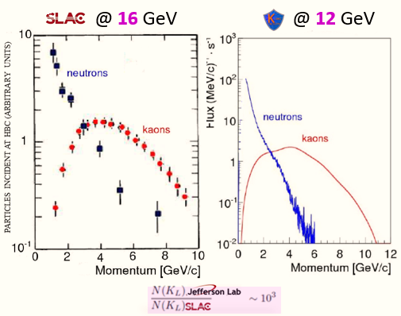
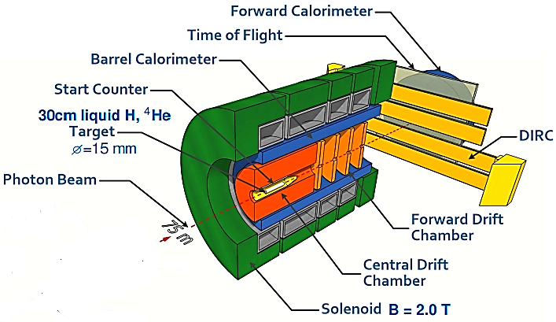

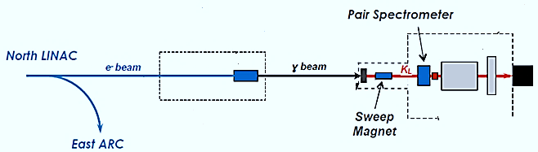
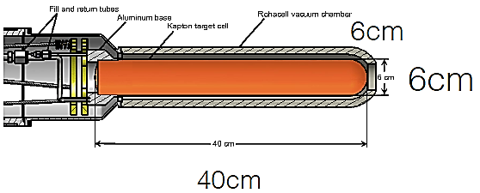
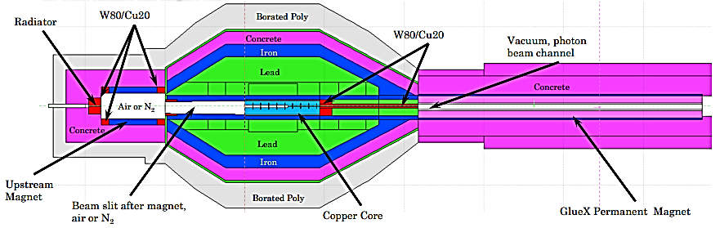
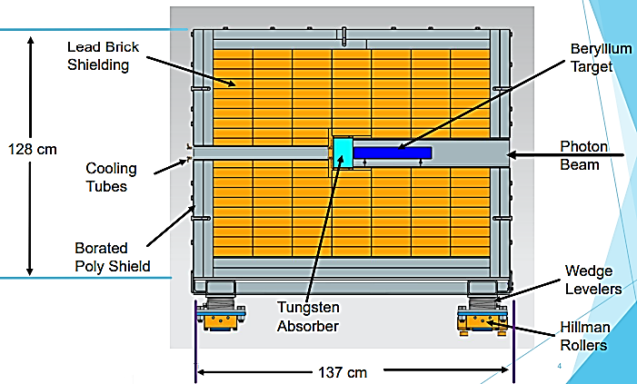
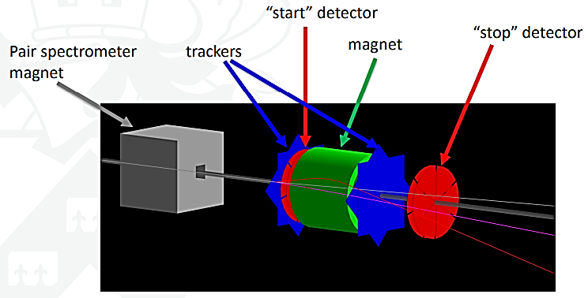
.
Hall D Beam Line for
GlueX
Spectrometer
K_{L}-beam
We will not use
KFM
12 GeV 5 μA
Bunch spacing 128 ns
No need in
tagging
photons
CPS
KPT
n/γ Beam Dump
LH₂/LD₂-target
.
Compact Photon Source
Kaon Production Target
Kaon Flux Monitor
e-beam
γ-beam
K_{L}-beam
γ-beam
K_{L}-beam
D. Day et al. Nucl Instrum Meth A 957, 163429 (2020)

Slide 19
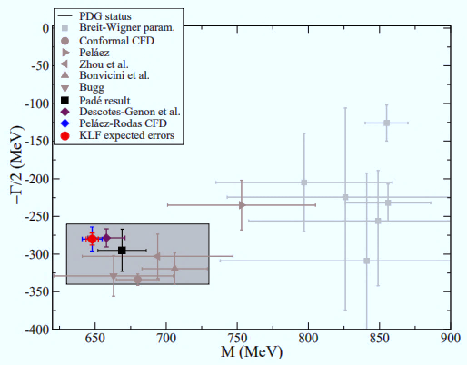
.
Summary of Meson Spectroscopy
K_{L} will have significant impact on our knowledge of Kp scattering amplitudes.
Improve conflicting determinations of heavy K* parameters.
Help to settle tension between phenomen-ological determination of scattering lengths from data vs ChPT & LQCD.
For K*(700), it will reduce:
  uncertainties in mass by factor of two and
  uncertainties in width by factor of five. .
Help to clarify debated of its existence, and therefore, long standing problem of existence of the scalar meson nonet.
K*(700)
.
• Roy-Steiner dispersion approach
M – iΓ/2 = (648 ± 4) – i(280 ± 8) MeV
100 days
J.R. Pelaez et al Phys Rev D 93, 074025 (2016)

Slide 20
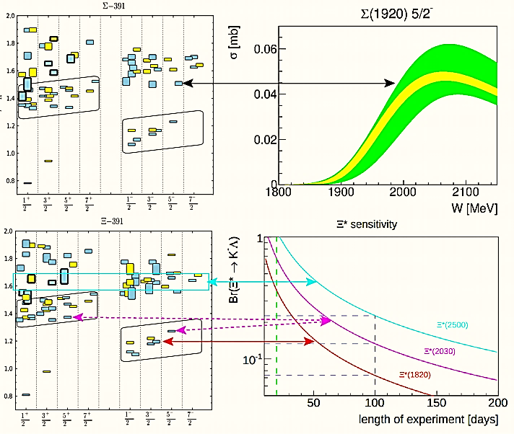

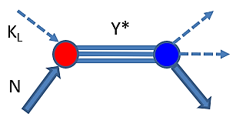
.
Summary of Hyperon Spectroscopy with K_{Long} Beam
K_{L} sensitivity with 100 days of running will allow observation of hyperons with good precision.
Why should it be done with K_{L} beam ?
Only realistic way to observe s-channel resonances
having all momenta of K_{L} together “tagged’’ kaons.
Why should it be done at Jefferson Lab?
Because there are no other existing facilities where this
can be done.
Why should we care about dozens of missing states ?
Because is is a goal of the LRP!
100 days
20 days
Σ
.
R. G. Edwards et al, Phys Rev D 87, 054506 (2013)
…The new capabilities of the 12-GeV era facilitate a detailed study of baryons containing two and three strange quarks. Knowledge of the spectrum of these states will further enhance our understanding of the manifestation of QCD in the three-quark arena.
2015 LRP for Nuclear Science.

Slide 21
Meson Beam at EIC?
Let’s Look at Example of Previous Work Done
We spent much time developing a preliminary conceptual design of a Meson Facility at JLEIC.
This was published in a White paper[1] just before the decision was made to build EIC at BNL.
Design we had produced only works at JLEIC, but may give us an insight as to what may be possible at BNL EIC in conjunction with the second detector.
We present this as a “learning by example” moment with the hopes of interesting new blood in this project.

Slide 22
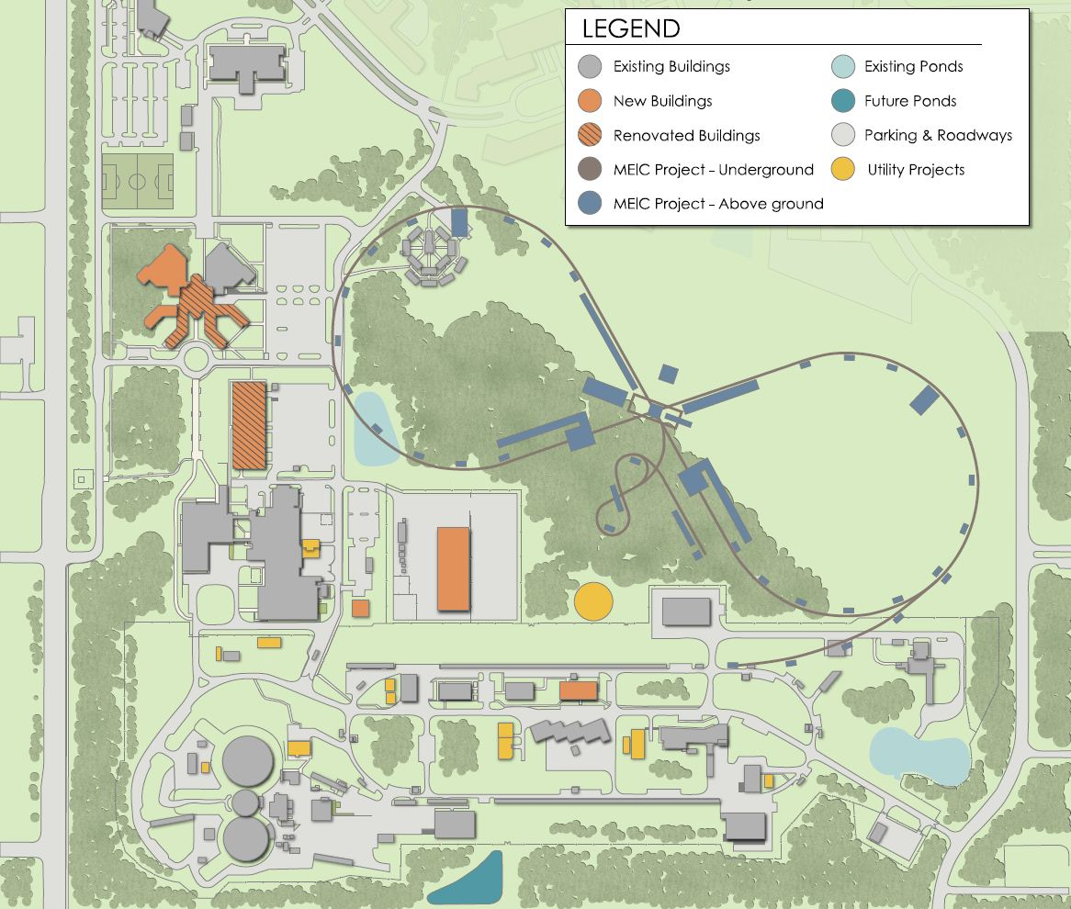
JLab Campus Layout
JLEIC:
• W = 15 – 65 GeV.
• Protons: 20 − 100 GeV.
• Luminosity:
10³³ to 10³⁴ cm⁻²s⁻¹ per IP.
• 2.2 km.
Ion Booster:
• Protons: 8 GeV.
• Booster design based on
super-ferric magnet
technology.
• 313.5 m.
It would have gone here!
Meson Hadron Facility :
• Pions:
< 3 GeV.
10⁷ s⁻¹.
Δp/p < 2%.
• Kaons:
< 2 GeV.
10⁵ s⁻¹.
CEBAF center
?
IP
JLEIC
IP
CEBAF
10/26/23
22

Slide 23
Conceptional Development of Meson Facility for JLEIC
Based 8 GeV booster design: 313.5 m, 260 ns spill, 2 s ramp up/down cycle, synchrotron magnets.
Design intensity 1×10¹² protons (160 nC/spill) ~ 0.6 kW,
  two orders of magnitude below BNL/AGS meson beamlines,
  three orders of magnitude less than J-PARC.
  The time-averaged current ~ 80 nA.
Assumed 8 GeV booster parameters were frozen as in Ref. [21]
What is needed to modify design to produce useful π and K beams.
JLEIC booster would inject into main ring only a fraction each day; it would be available for π/K physics remainder of the time.

Slide 24
Conceptional Development of Meson Facility for JLEIC
JLEIC booster had short duty factor – unsuitable for proposed physics due to detector instantaneous rate limit.
Need beam particles delivered at lower rate over a longer period.
Booster modified for slow extraction would be cost-effective but would require major redesign.
A solution to that did not involve design change: add stretcher ring.
Simplest stretcher design providing ~ 100% duty factor was to extract booster beam into and fill one turn of ring over 260 ns spill.
  Required ring of radius of 12.3 m with 39 1m long fixed dipoles of 4.3 T.

Slide 25
Conceptional Development of Meson Facility for JLEIC
A more compatibe and less costly option was
  double the stretcher diameter,
  fill half circumference each spill,
  halve the field to 2.16 T and
  use resistive magnets of simular design to booster magnets.
This plan allowed ~ CW beam extraction with good duty factor using resonant slow extraction while booster magnets were ramping.
Time-average beam ~ 5 × 10¹¹ p/s extracted from stretcher into transfer line to production target for secondary particles (π/K) into dedicated hadron hall.
We look to see what π/K fluxes might be achieved.

Slide 26
Pion and Kaon Intensity Estimates for
Meson Facility for JLEIC
Given 80 nA CW, 8 GeV/c protons, we estimated the fluxes of pions and kaons as a function of secondary particle momentum and channel production angle.
Used parametrizations of Sanford & Wang (SW) to estimate number of πs [22] and Ks [23] generated at production target /GeV/c /steradian /interacting proton.
Used this as input to procedure of Yamamoto [24] that includes effects of
  secondary particle production efficiency
  nuclear absorption cross sections of protons on different production targets,
  solid angle and momentum acceptance, and
  decay factors for typical secondary-particle channels.
Yields π± and K± fluxes at end of secondary beamline as function of production angle for given production target and secondary-particle beamline.
N.B. Yamamoto described design of KEK K2 line with similar conditions
  1 × 10¹² protons at 12 GeV.

Slide 27
Pion and Kaon Intensity Estimates for
Meson Facility for JLEIC
The π/K yields Y are determined from the
  SW rates d²N/(dΩdp) = (1/σ_{a}) d²σ/(dΩdp),
  the proton flux F_{i} on the production target,
  the production efficiency η for secondary particles per incident proton,
  the nuclear absorption cross section σ_{a} associated with the protons on the production target,
  the secondary channel characteristics: solid angle dΩ, momentum bite ∆p/p, momentum p, and decay factor d using:
Y = F_{i} η/σ_{a} d²σ/dΩdp ∆Ω (∆p/p) pd

Slide 28
Pion and Kaon Intensity Estimates for
Meson Facility for JLEIC
Used a proton flux F_{i} = 5 × 10¹¹ protons/s CW at 8 GeV, a 6 cm platinum target σ_{a} = 1798 mb, η = 0.365.
Scaled σ_{a} and η from SW rates for Be target (σ_{a} = 227 mb and η = 0.14).
Channel 30 m long with 3.125 msr and ∆p/p=2%.
Decay factor d is probability that a secondary particle of mass M, mean life τ , and momentum p survives a distance x = 30 m:
d(x) = exp (−M x/(p cτ ))
Using Yamamoto, we determine production efficiency from absorption lengths in Ref. 25 for protons, pions, and kaons.

Slide 29
8 GeV/c Protons on Be Production Target
Pion and Kaon production rates on beryllium per steradian per GeV/c per interacting proton for 5×10¹¹ protons/s CW at 8 GeV. The legend denotes different assumptions for the production angle

Slide 30
Incident Proton Momentum 8 GeV/c
Pion and Kaon rates that could be expected at the end of a 30 m-long channel with a solid angle of 3.125 msr and a momentum bite of 2% ∆p/p. The production target is assumed to be 6 cm Platinum. Decay along the length of the channel, as well as secondary particle production efficiency and nuclear absorption cross sections of the protons on the Platinum target are also factored into this prediction. The legend denotes different assumptions for the production angle.

Slide 31
Summary – What is Needed Today
Goals of EM facilities enhanced by hadron-beam data of quality similar to EM data.
Vigorous program in hadronic physics requires modern facility with π and K beams.
A Meson Factory where πN and KN elastic and inelastic scattering (including hyperon production) is measured with high precision and full solid angle is very useful.
Such a facility ideally should allow measurements W ≥ 2.5 GeV, which would require pion beams with momenta ≥ 2.85 GeV/c.
The 2 GeV/c pion beam at J-PARC only allow measurements to W ≈ 2150 MeV.
We encourage work on a conceptual design of a “Meson Factory” for the BNL EIC that ideally could be compatible with the future second detector.

Slide 32
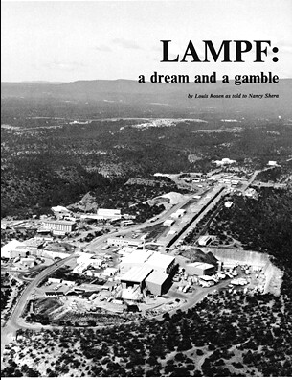
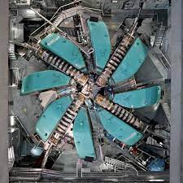
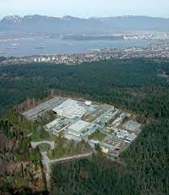
Thanks for Listening

Slide 33
References
Physics Opportunities with Meson Beams for EIC, William J. Briscoe (GWU), Michael Doring (GWU), Helmut Haberzettl (GWU), D. Mark Manley, (KSU), Megumi Naruki (Kyoto University), Greg Smith (JLab), Igor Strakovsky (GWU), Eric S. Swanson (University of Pittsburg—https://doi.org/10.48550/arXiv.2108.07591
Physics Opportunities with Meson Beams, William J. Briscoe (GW), Michael Döring (GW), Helmut Haberzettl (GW), D. Mark Manley (KSU), Megumi Naruki (Kyoto Univ.), Igor I. Strakovsky (GW), Eric S. Swanson (Univ. of Pittsburgh)—Eur. Phys. J. A 51, 129 (2015).
A. Aprahamian et al., Reaching for the horizon: The 2015 long range plan for nuclear science, http://science.energy.gov/np/nsac/
N. Isgur and M.B. Wise, Phys. Rev. Lett. 66, 1130 (1991).
R.L. Workman et al. [Particle Data Group], Prog. Theor. Exp. Phys. 2022, 083C01 (2022).
R Koniuk and N. Isgur, Phys. Rev. Lett. 44, 845 (1980).
R.A. Khalek et al. “Science requirements and detector concepts for the Electron-Ion Collider: EIC Yellow Report,” [arXiv:2103.05419 [physics.ins-det]].
R A. Arndt, W.J. Briscoe, I.I. Strakovsky, and R.L. Workman, Phys. Rev. C 74, 045205 (2006).
9. Y. Qiang, Y.I. Azimov, I.I. Strakovsky, W.J. Briscoe, H. Gao, D.W. Higinbotham, and V.V. Nelyubin, Phys. Lett. B 694, 123 (2011).
W.J. Briscoe, D. Schott, I.I. Strakovsky, and R. L. Workman, Institute of Nuclear Studies of the George Washington University Database; http://gwdac.phys.gwu.edu/.
11. R.A. Arndt, W.J. Briscoe, I.I. Strakovsky, and R.L. Workman, Phys. Rev. C 74, 045205 (2006).
12. K.A. Olive et al. [Particle Data Group], Chin. Phys. C 38, 090001 (2014).

Slide 34
References
13. I.G. Alekseev et al. [EPECUR Collaboration], Phys. Rev. C 91, 025205 (2015).
14. R.A. Arndt, I.I. Strakovsky, R.L. Workman, and M.M. Pavan, Phys. Rev. C 52, 2120 (1995).
15 G. Höhler, Pion-Nucleon Scattering, Landoldt-Börnstein, Vol. I/9b2, edited by H. Schopper (Springer-Verlag, Berlin1983).
16. R. Koch, Z. Phys. C 29, 597 (1985).
R.E. Cutkosky, C.P. Forsyth, R.E. Hendrick, and R.L. Kelly, Phys. Rev. D 20, 2839 (1979).
K. Shirotori et al., Phys. Rev. Lett. 109, 132002 (2012).
D.J. Candlin et al., Nucl. Phys. B 226, 1 (1983).
D.M. Manley, R.A. Arndt, Y. Goradia, and V.L. Teplitz, Phys. Rev. D 30, 904 (1984).
E. Nissen and T. Satogata, “Revised Optics Design for the JLEIC Ion Booster,” Proc. of IPAC’18, Vancouver,BC, Canada, paper THPAK126.
J. R. Sanford and C. L. Wang, BNL 11299 and BNL 11299, (1967). http://server.c-ad.bnl.gov/esfd/JRS-CLW-1.pdf.
J. R. Sanford and C. L. Wang, BNL 11479, (1967). http: //server.c-ad.bnl.gov/esfd/JRS-CLW-2.pdf.
A. Yamamoto, “Study On Low-energy Intense Kaon Beam,” KEK-81-13. https://inis.iaea.org/collection/NCLCollectionStore/_Public/14/758/14758681.pdf
S. P. Denisov, S. V. Donskov, Y. P. Gorin, R. N. Krasnokutsky, A. I. Petrukhin, Y. D. Prokoshkin, and D. A. Stoyanova, Nucl. Phys. B 61, 62 (1973).

