Slide 1
The EIC Accelerator – Design Highlights and Project Status
Christoph Montag, BNL
EINN 2023
Paphos, Cyprus
October 31 – November 4, 2023

Slide 2
EIC Requirements
High luminosity: L = 10³³ to 10³⁴ cm⁻²sec⁻¹ - factor 100 to 1000 beyond HERA
Large range of center-of-mass energies E_{cm}= 29 to 140 GeV
Polarized beams with flexible spin patterns
Favorable condition for detector acceptance such as p_{T} =200 MeV/c
Large range of hadron species: protons ….Uranium
Collisions of electrons with polarized protons and light ions (h³He, hd,…)
➔EIC meets or exceeds the requirements formulated in the
White Paper

Slide 3
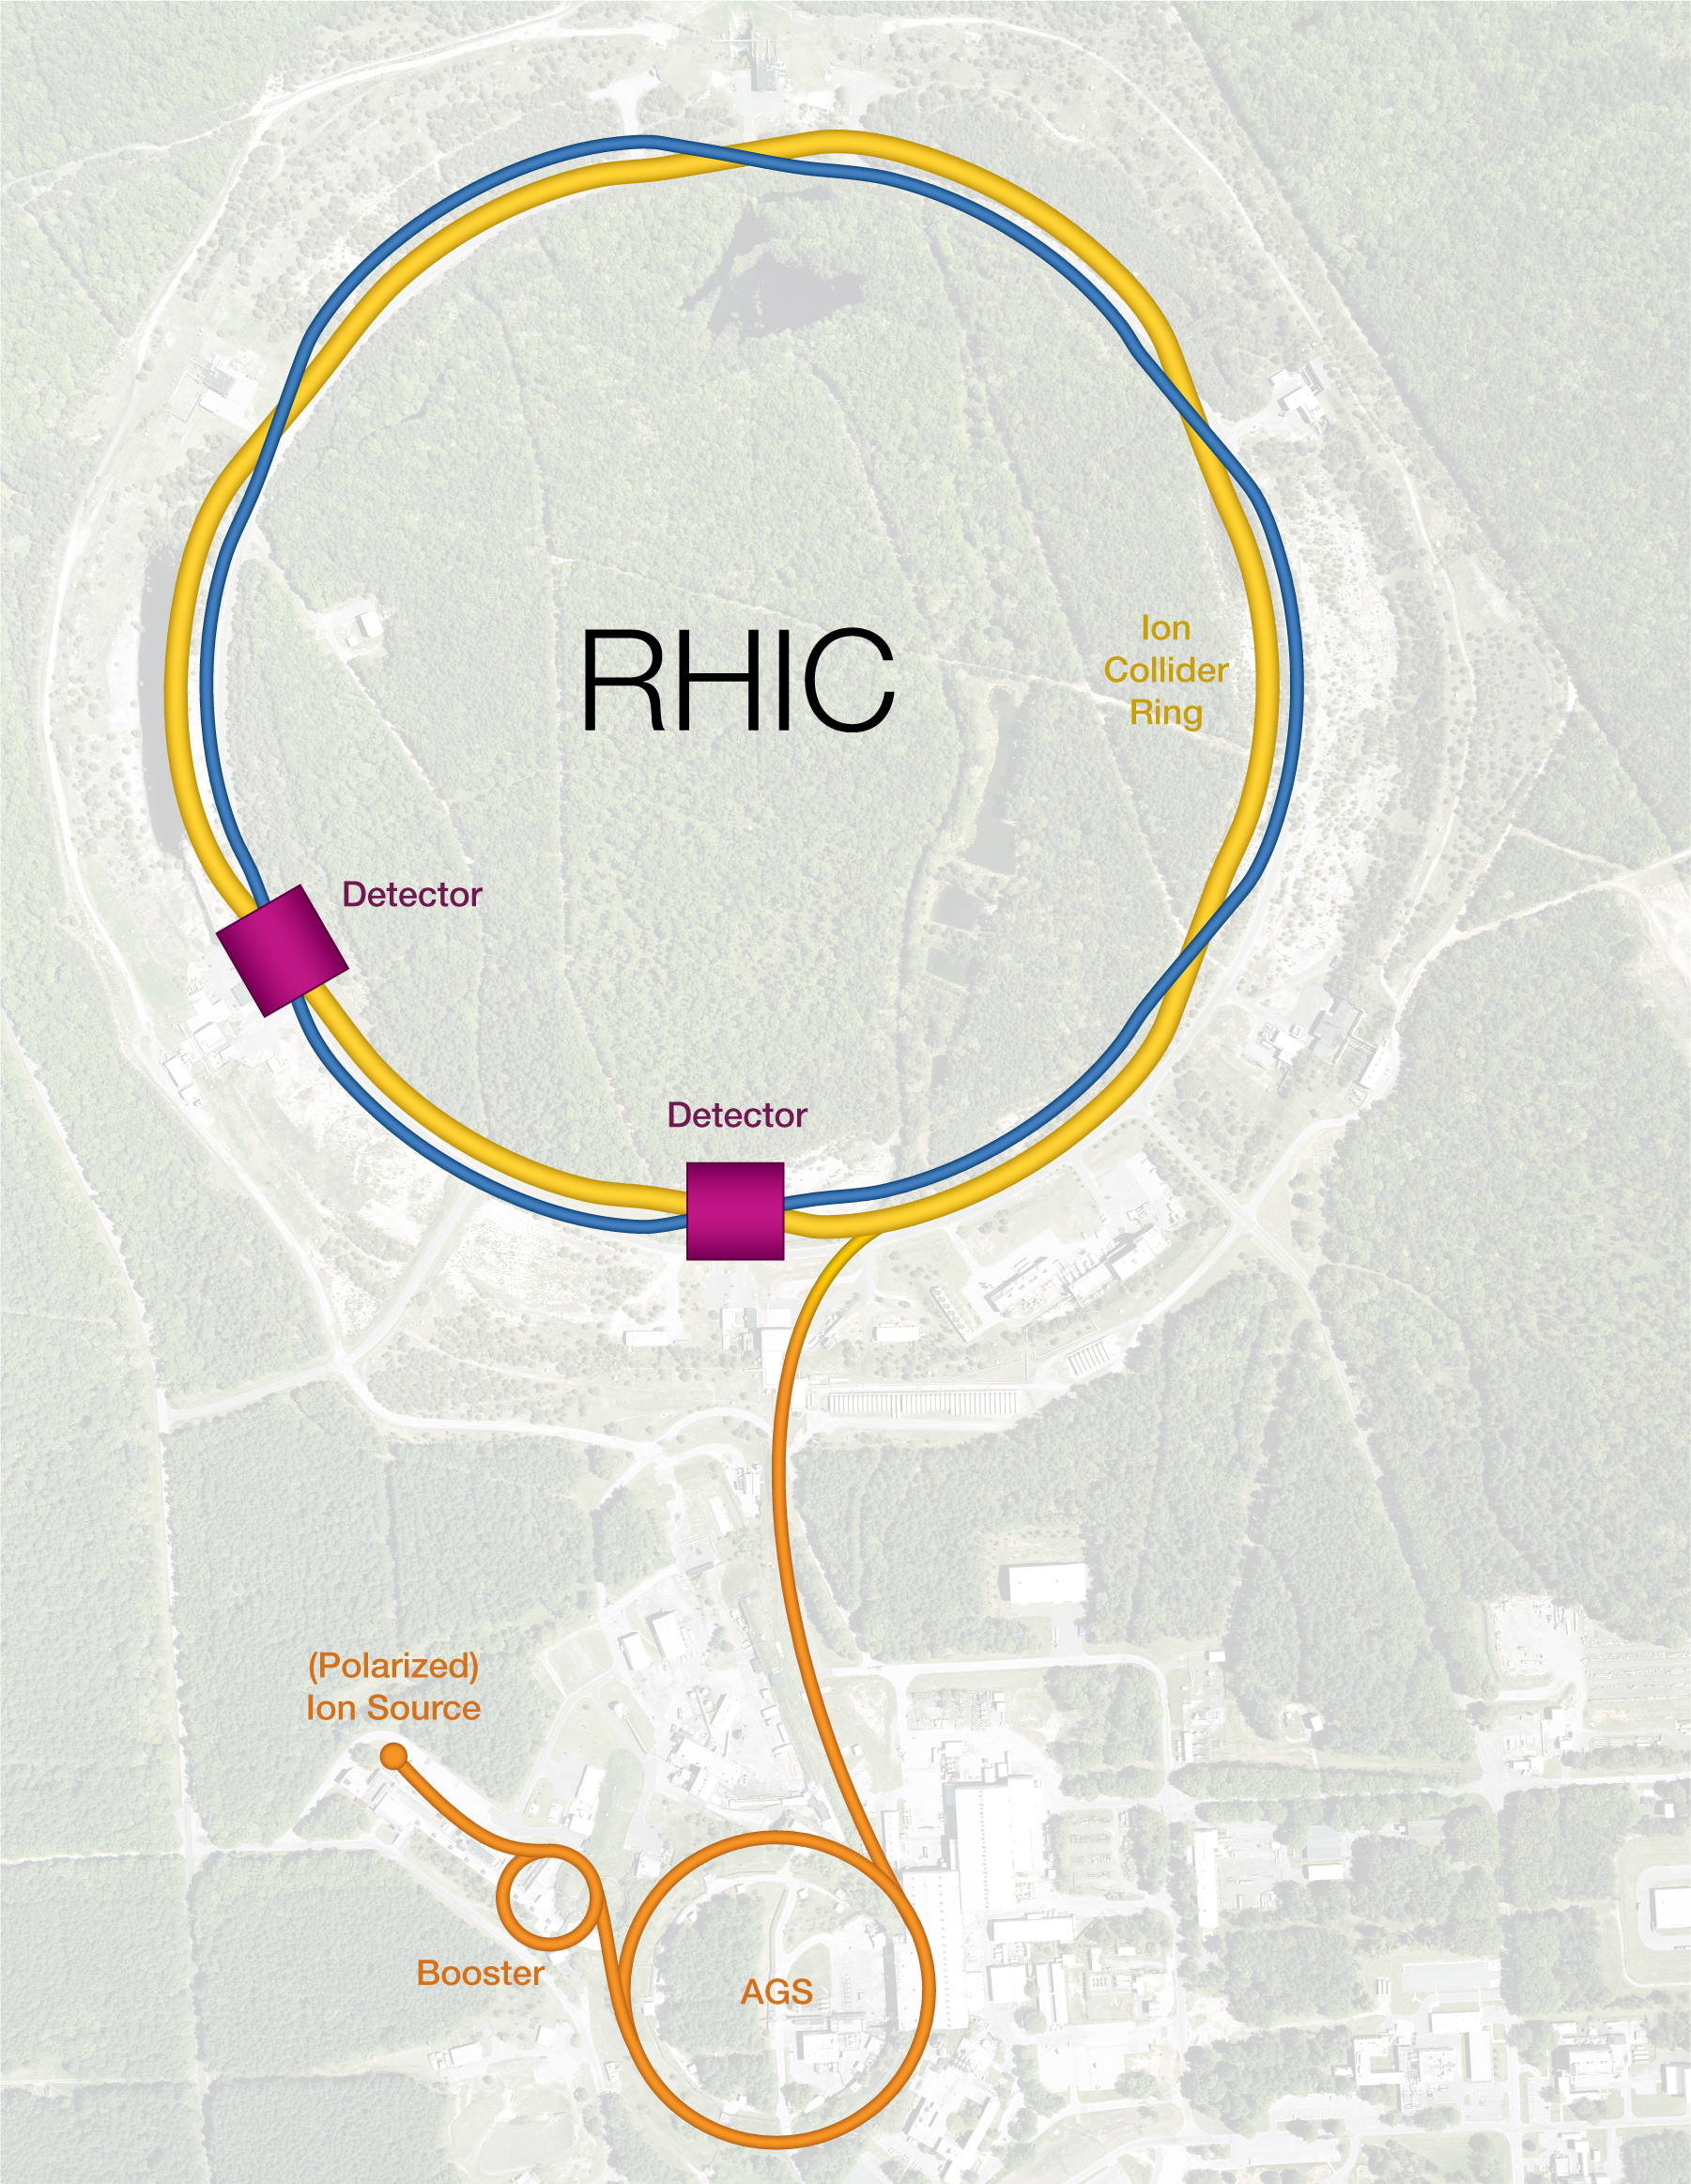
Relativistic Heavy Ion Collider (RHIC)
Two superconducting storage rings
3.8km circumference
Energy up to 255GeV protons, or 100GeV/n gold
110 bunches/beam
Ion species from protons to uranium
60% proton polarization – world’s only polarized proton collider
Exceeded design luminosity by factor 44 - unprecedented
6 interaction regions, 2 detectors
In operation since 2001
EIC is based on existing RHIC facility

Slide 4
EIC Design Concept
EIC is based on the RHIC complex: Hadron Storage Ring (HSR), injectors, ion sources, infrastructure; needs only relatively few modifications and upgrades
Today’s RHIC beam parameters are close to what is required for EIC (except number of bunches, 3 times higher beam current, and vertical emittance)
Add a 5 to18 GeV electron storage ring & its injector complex to the RHIC facility ➔ E_{cm} = 29-141 GeV
Design and built a suitable interaction region

Slide 5
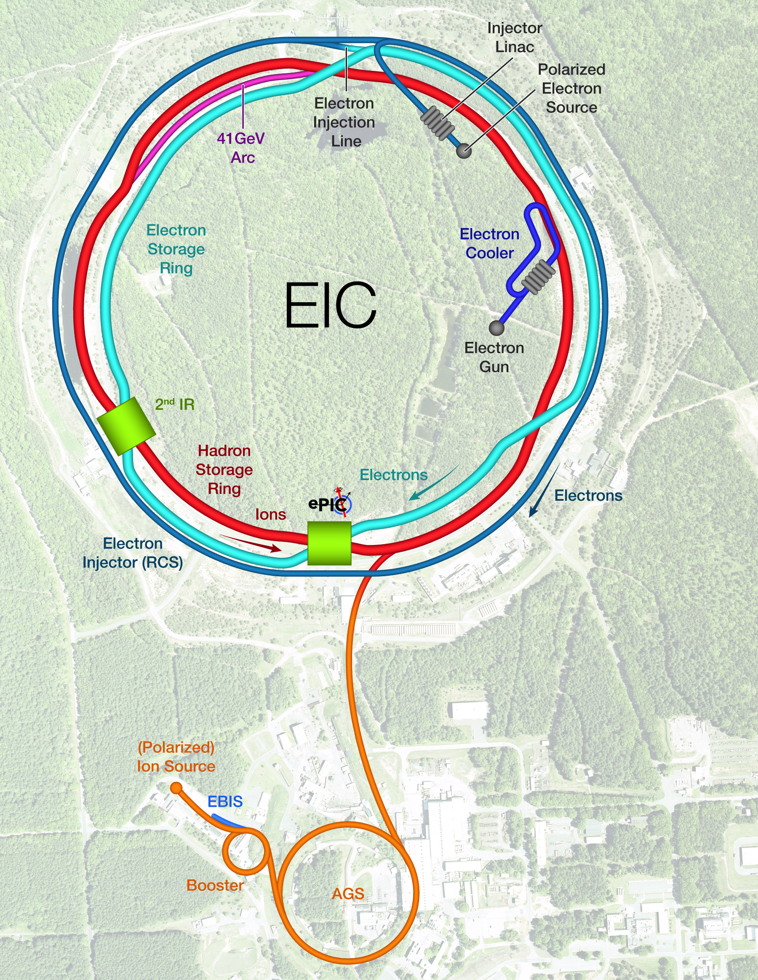
Facility layout
Hadron Storage Ring comprised of “Blue” and “Yellow” RHIC arcs
Retaining RHIC injector chain
Electron complex to be installed in existing RHIC tunnel – cost effective

Slide 6
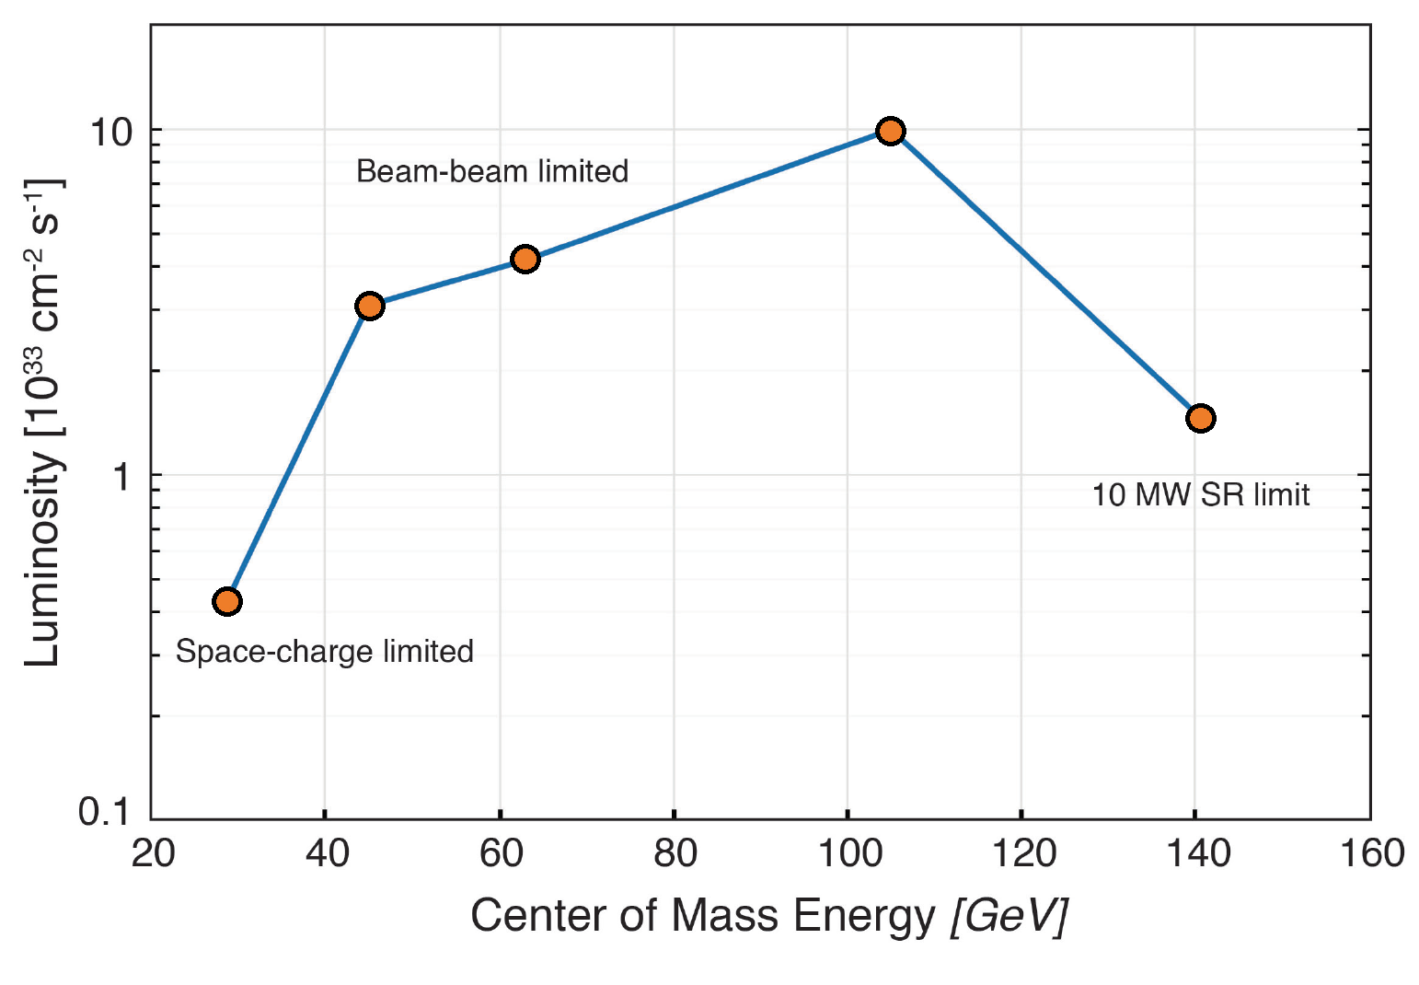
e-p Luminosity versus Center-of-Mass Energy
Electron-nucleon luminosities in e-A collisions are similar within a factor of 2 to 3

Slide 7
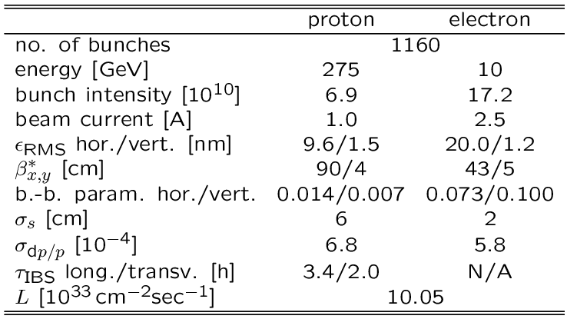
Parameters for Highest e-p Luminosity
Hadron beam parameters similar to present RHIC, but smaller vertical emittance and many more bunches
2 hour IBS growth time requires strong hadron cooling
Electron beam parameters resemble a B-Factory

Slide 8
Luminosity Sharing with two IRs
Both electrons and hadrons are at the beam-beam limit with one collision point – they would not “survive” a second IR
To enable two collision points, both electron and hadron bunch intensity would have to be reduced by a factor two – resulting luminosity at each IR would be factor 4 smaller
Instead, we modify the fill pattern such that half the bunches collide in IR6, while the other half collides in IR8
As a result, total luminosity is preserved, and each detector gets half of the total

Slide 9
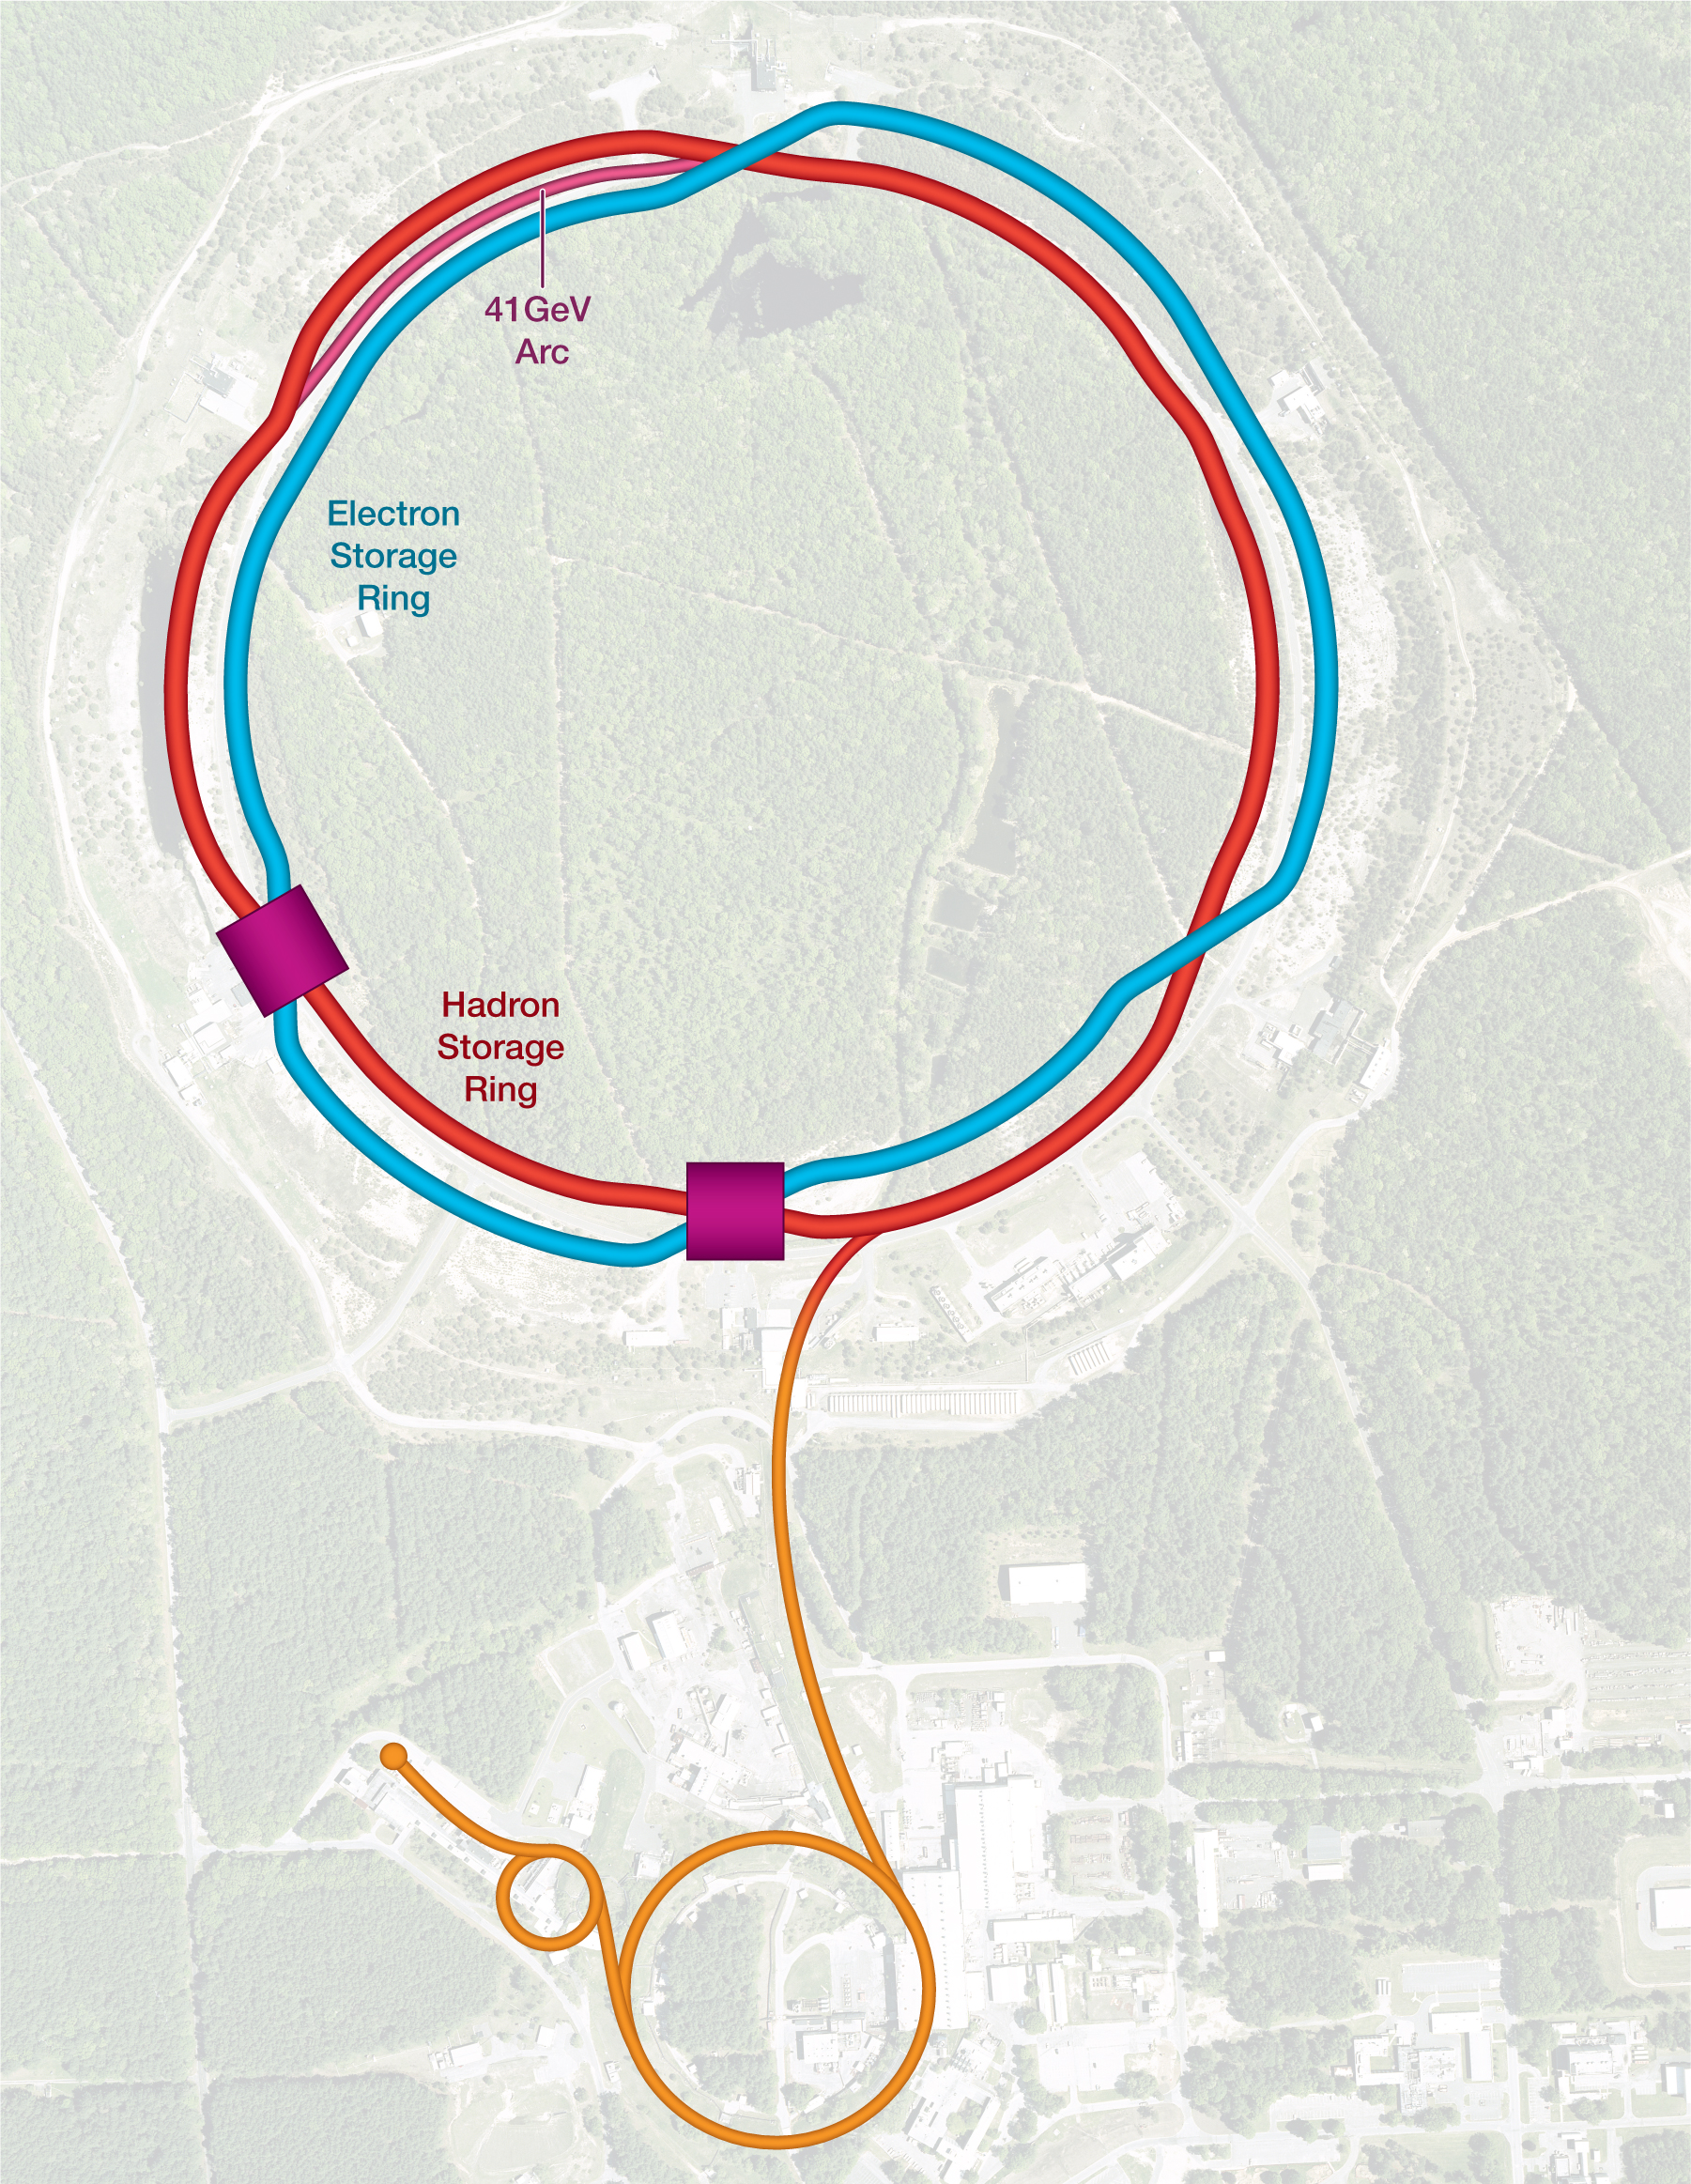
Collision Synchronization
HSR needs to operate over a wide energy range
Changing the beam energy in the HSR causes a significant velocity change
To keep the two beams in collision, they have to be synchronized so bunches arrive at the detector(s) at the same time
Synchronization accomplished by path length change
Between 100 and 275 GeV (protons), this can be done by a small radial shift – there is enough room in the beampipe
For lower energies, use an inner instead of an outer arc as a shortcut. 90 cm path length difference corresponds to 41 GeV proton beam energy

Slide 10
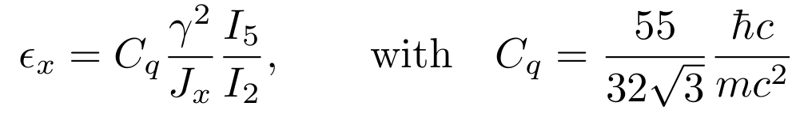
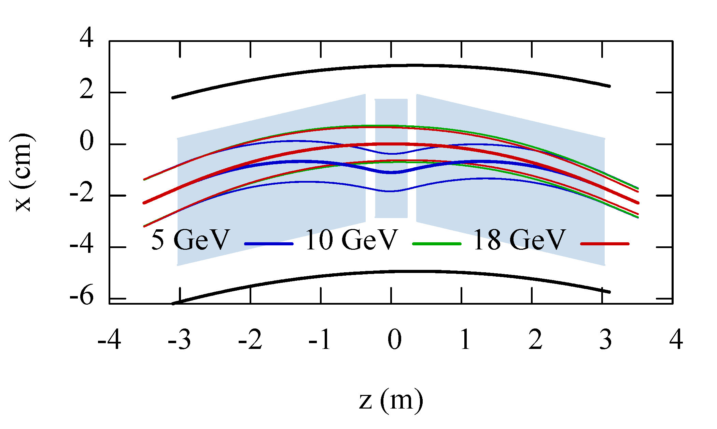
Emittance Control in the ESR
EIC needs 24 nm emittance from 5 to 18 GeV for optimum luminosity, but equilibrium emittance in an electron storage ring depends on beam energy:
Betatron phase advance μ per FODO cell is the “knob” to adjust the emittance
60 degrees at 10 GeV and 90 degrees at 18 GeV both yield ~24 nm
“super-bends” for emittance generation below 10 GeV

Slide 11
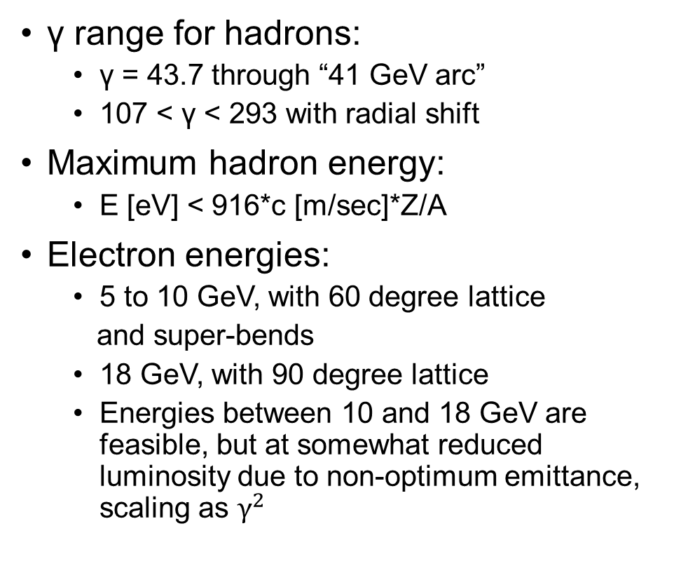
Beam Energies
γ range for hadrons:
  γ = 43.7 through “41 GeV arc”
  107 < γ < 293 with radial shift
Maximum hadron energy:
  E [eV] < 916*c [m/sec]*Z/A
Electron energies:
  5 to 10 GeV, with 60 degree lattice
  and super-bends
  18 GeV, with 90 degree lattice
  Energies between 10 and 18 GeV are feasible, but at somewhat reduced luminosity due to non-optimum emittance, scaling as $γ^{2}$

Slide 12
EIC Electron Polarization
Physics program requires bunches with spin “up” and spin “down” (in the arcs) to be stored simultaneously
Sokolov-Ternov self-polarization would produce only polarization anti-parallel to the main dipole field
Only way to achieve required spin patterns is by injecting bunches with desired spin orientation at full collision energy
Sokolov-Ternov will over time re-orient all spins to be anti-parallel to main dipole field
Spin diffusion reduces equilibrium polarization
Need frequent bunch replacement to overcome Sokolov-Ternov and spin diffusion

Slide 13
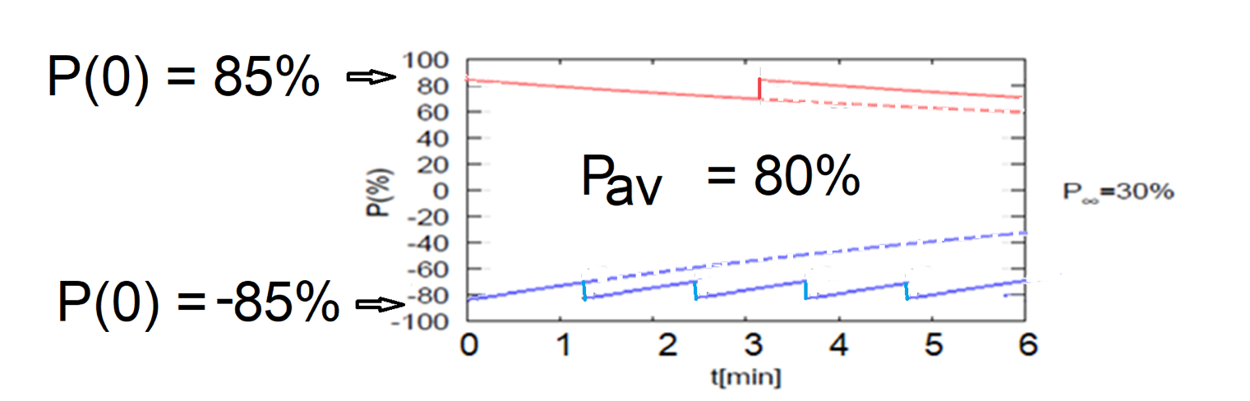
High Average Electron Polarization
Frequent injection of bunches with high initial polarization of 85%
Initial polarization decays towards P∞
At 18 GeV, every bunch is replaced (on average) after 2.2 min with RCS cycling rate of 1Hz
B P
B P
Refilled every 3.2 minutes
Refilled every 1.2 minutes
Re-injection
P_{av}=80%
P∞= 30%
(conservative)
P_{av}=80%
Re-injections

Slide 14
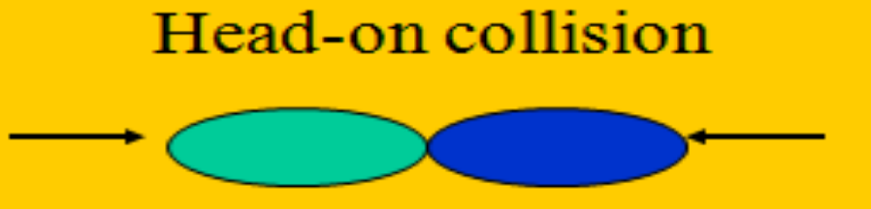
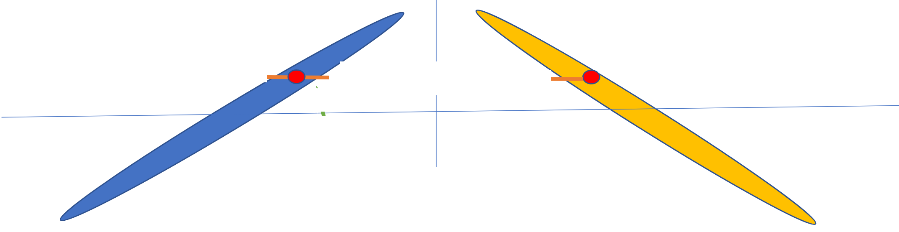
Crossing Angle and Luminosity
EIC interaction region is based on a 25 mrad crossing angle for beam separation and luminosity maximization
In head-on collisions, every beam particle in one beam can potentially interact with every particle in the other beam
Long (~+/-6 cm), skinny (100 um) bunches colliding at an angle have very little overlap
With 25 mrad crossing angle, each electron can only interact with a thin slice of the +/-6 cm long oncoming hadron bunch

Slide 15
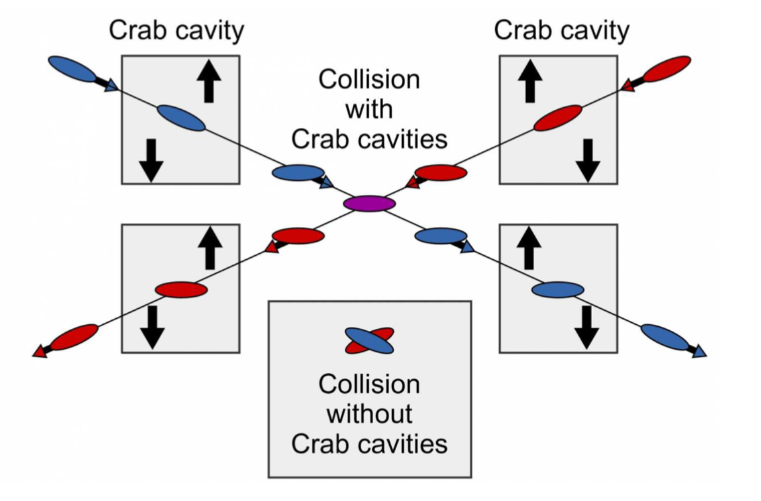
Crab Crossing
Head-on collision geometry is restored by rotating the bunches before colliding (“crab crossing”)
Bunch rotation (“crabbing”) is accomplished by transversely deflecting RF resonators (“crab cavities”)
Actual collision point moves laterally during bunch interaction – to be taken into account in analysis

Slide 16
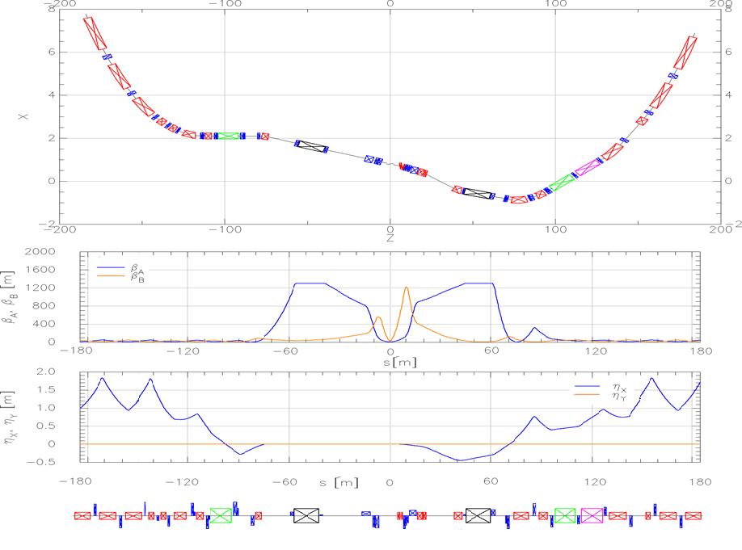
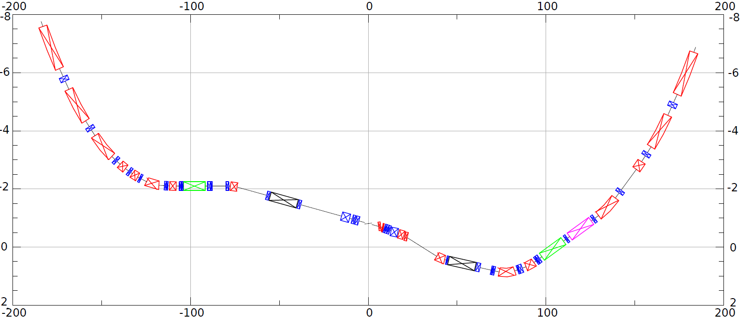
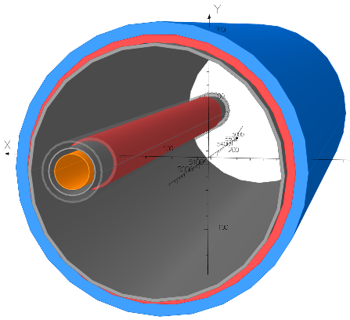
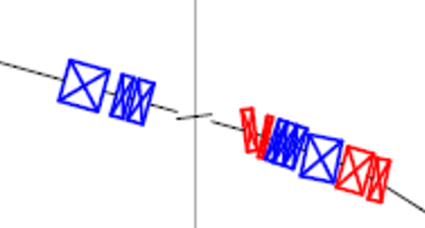
HSR layout in IR6
Forward and rear hadron lattice matched into RHIC
  Snake at correct angle
  Beta = 1300m at crab cavities
    Hor. phase advance 90º
  Matching Magnets
    Mostly repurposed RHIC magnets
    few additional magnets required (some SC)
    Some need re-cryostating
h
HSR Arc
Crab–in
Crab –out
HSR Arc
Spin
Rotator
Snake
matching
Off momentum Detectors
Spin Rotator
ESR Lumi-Monitor
matching
Approximate ESR path
Zero Deg Calorimeter
Detector region
B0pF spectrometer
Nov 2021 layout
3 Dipoles and 3 Quadrupoles in one shared cryostat

Slide 17
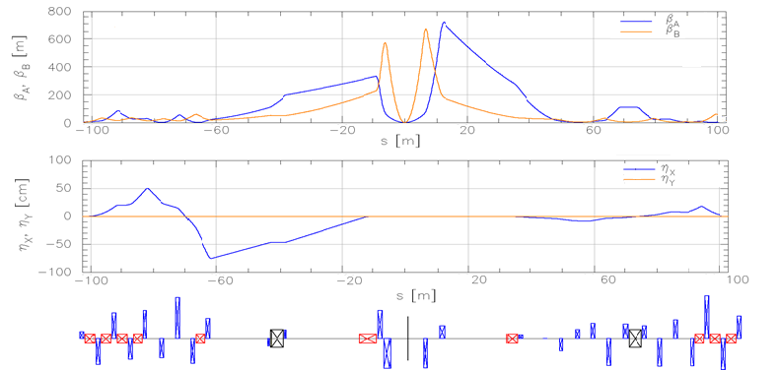
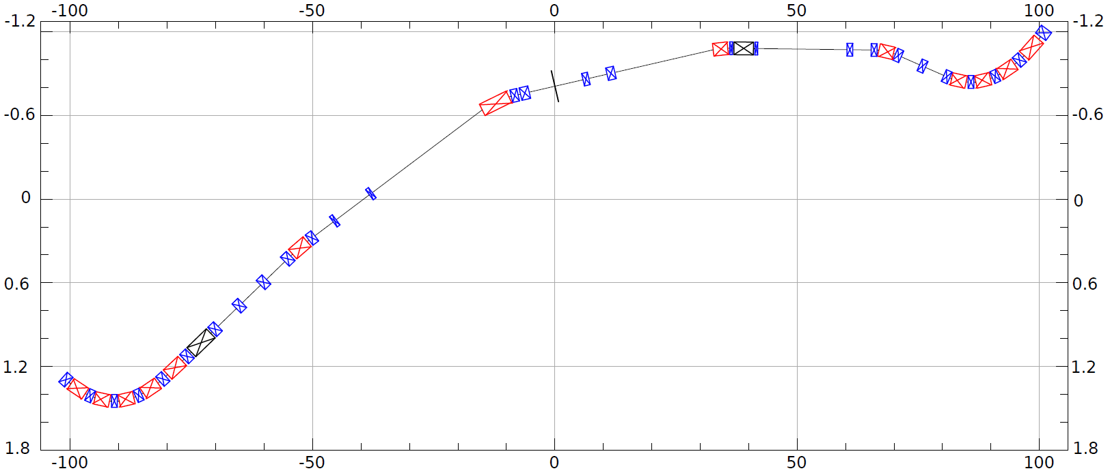
ESR layout in IR6
Design to:
Provide room for detector components
Mitigate synchrotron radiation issues
Provide longitudinal spin (new spin rotators)
Match into the arcs
Provide conditions for crabbing
Allow 3 rings and beam elements
e
~130m
Spin Rotation Solenoids
6GeV
Crab –in
IP Focusing
18GeV
Lumi-Monitor
B2eR
~130m
Spin Rotation Solenoids
E-taggers
Polarimeter Laser
Detector region
Longitudinal spin
B1eF
Crabbed beam.
Crab–out

Slide 18
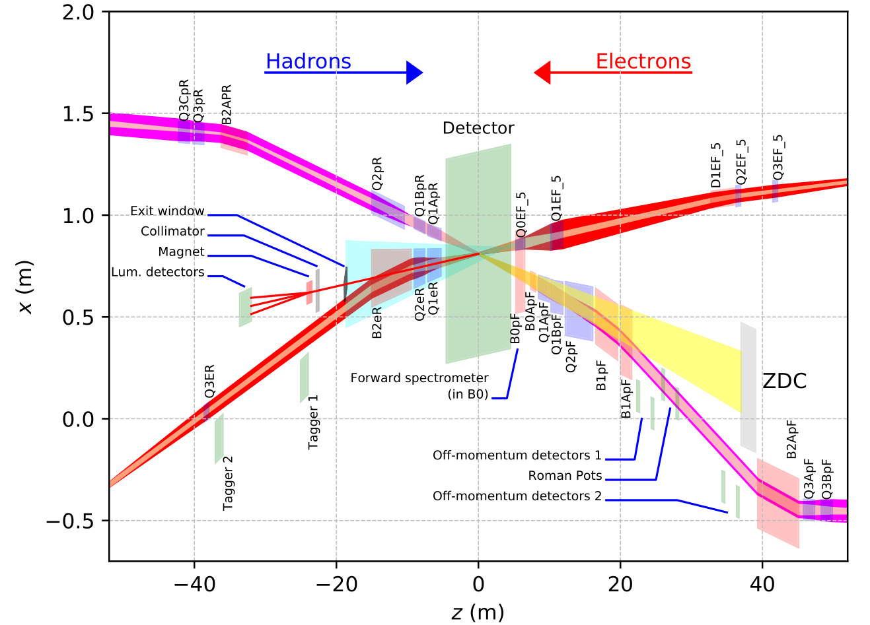
EIC IR Layout
High luminosity:
  Small β* for high luminosity
  Limited IR chromaticity contributions
  Large final focus quadrupole aperture
  Physics requirements:
  Large detector acceptance
  Forward spectrometer
  No machine elements within +/- 4.5m from the IP
  Space for luminosity detector, neutron detector, “Roman Pots”
Multi-stage separation:
Electrons from protons
Protons from neutrons
Electrons from Bethe-Heitler photons (luminosity monitor)

Slide 19
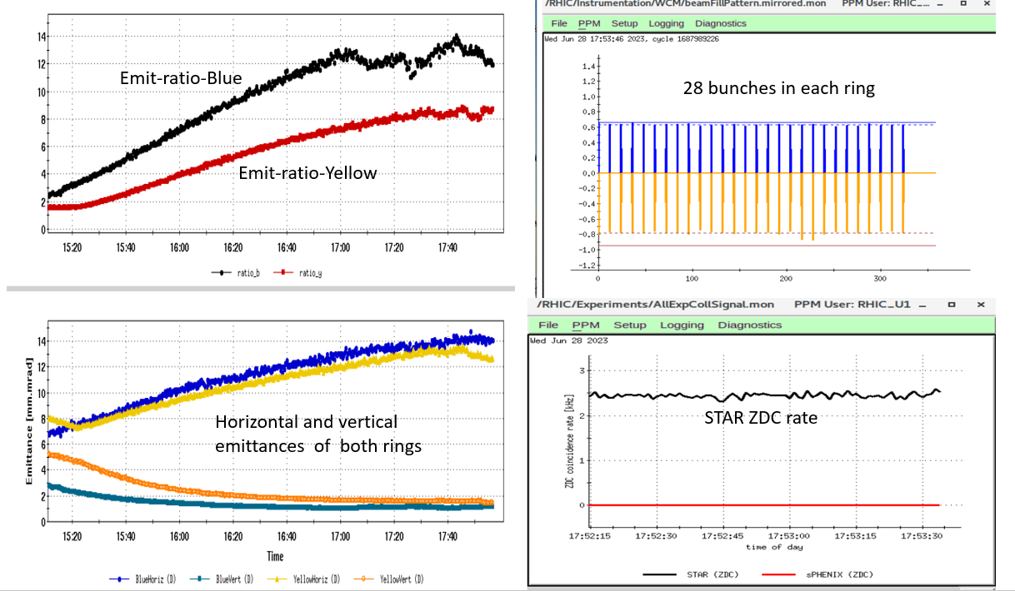
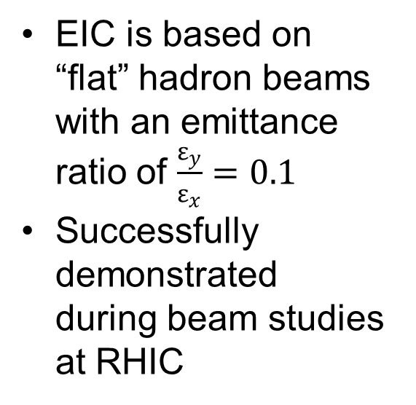
Latest Highlight #1 – Flat Hadron Beam Collisions
EIC is based on “flat” hadron beams with an emittance ratio of $\frac{ε_{y}}{ε_{x}}=0.1$
Successfully demonstrated during beam studies at RHIC

Slide 20
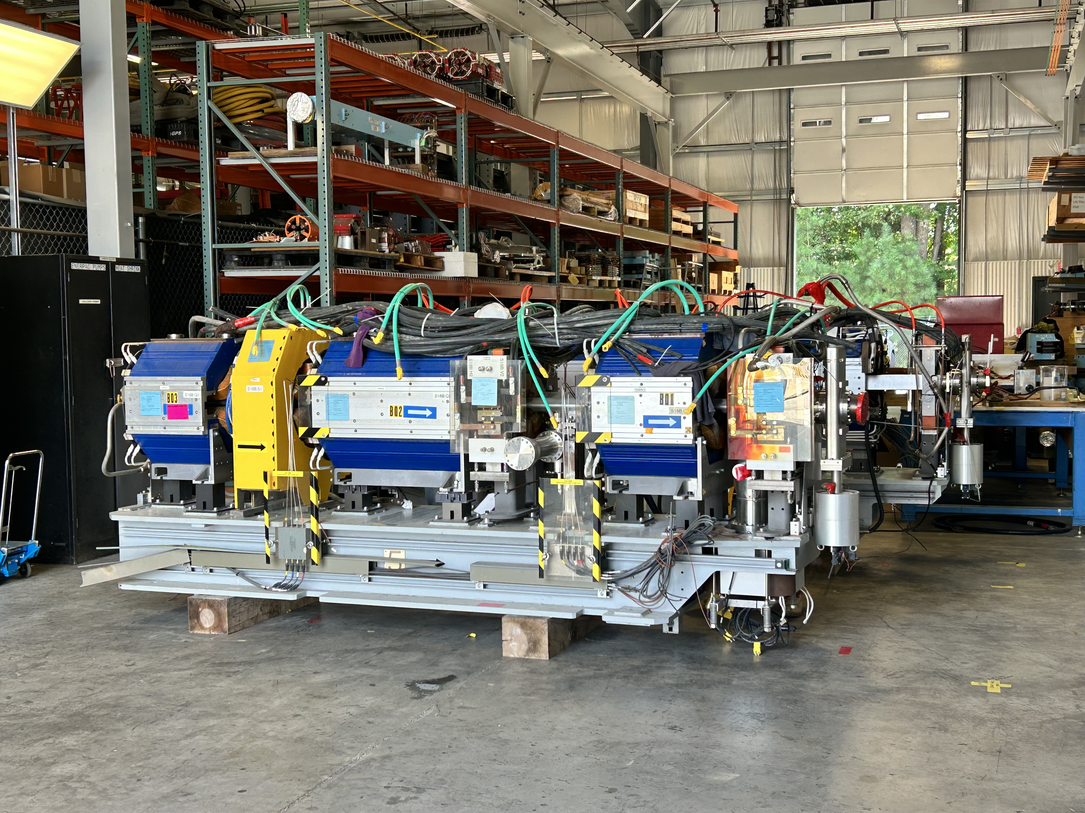
Latest Highlight #2 – Magnets for the ESR
400 Quadrupoles and 280 Sextupoles from the Advanced Photon Source at ANL to be repurposed for ESR
~ $7M cost savings
Received first girders on September 13

Slide 21
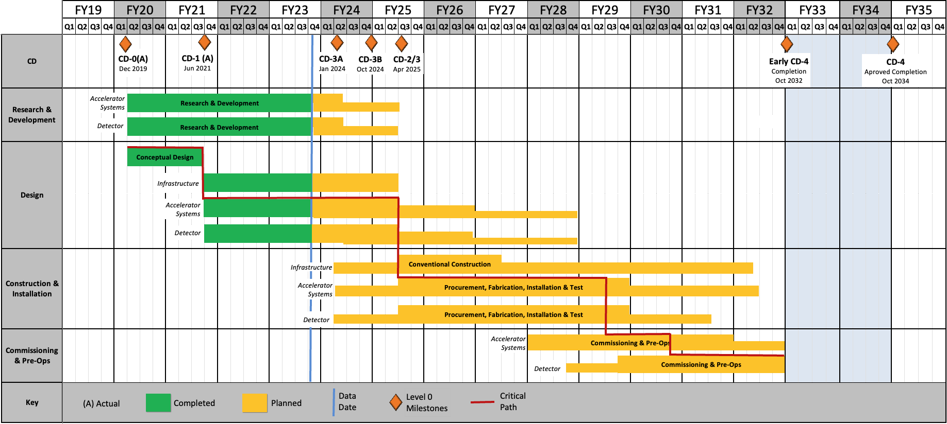
Project Status and Schedule
Project milestones:
CD-0: mission need
CD-1: alternative selection, cost range
CD-2: project baseline
CD-3: start of construction
CD-4: project completion, start of operations
CD-3A, CD-3B: early procurements

Slide 22
Summary
The EIC will be the next large nuclear physics facility, starting operations ~2032
It fulfills all the requirements listed in the White Paper, facilitating a rich physics program
These requirements make it a very challenging machine – high beam currents, polarization, novel hadron cooling technique, large energy range, …

