Slide 1
TeVPa
Napoli, September 11-15, 2023
The LHAASO PeVatron bright sky:
what we learned
Martina Cardillo
IAPS-INAF
martina.cardillo@inaf.it
M. Cardillo & A. Giuliani
Appl. Sci. 2023, 13(11), 6433; https://doi.org/10.3390/app13116433

Slide 2
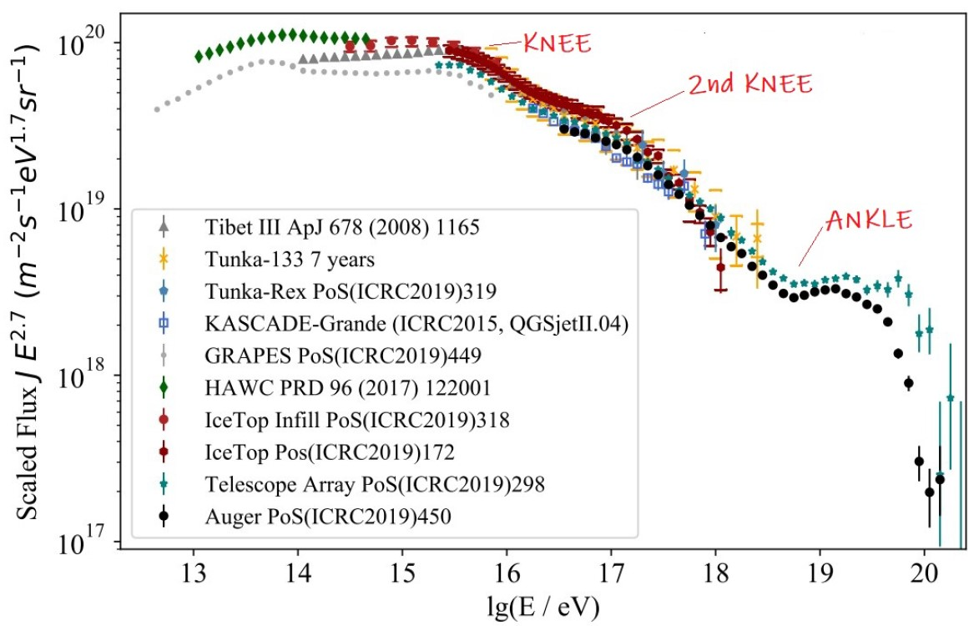
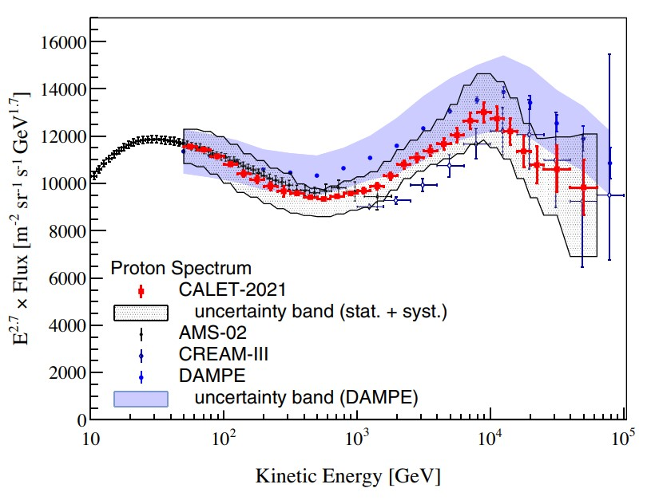
Cosmic Ray Overview
Schroder+19
Between the knee and the second knee (~10¹⁷ eV) should be the transition from Galactic to extragalactic component.
Extra-Galactic component
Limited information
Extra-Galactic magnetic field
Origin connected to transition region
But also the Galactic Component is not so bright and clear
Recent results by CALET/DAMPE show that the region below 1 PeV may not be as featureless as we
thought, showing hardening and steepening between 100 GeV and 100 TeV
Adriani+22

Slide 3
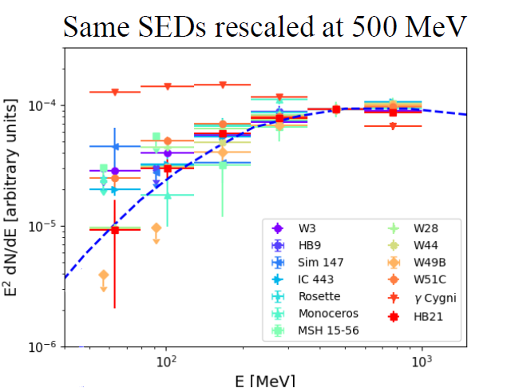
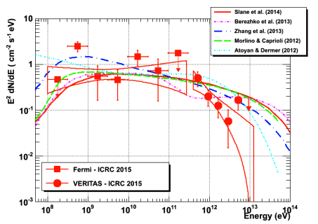
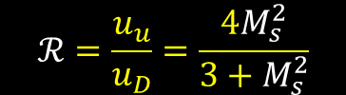
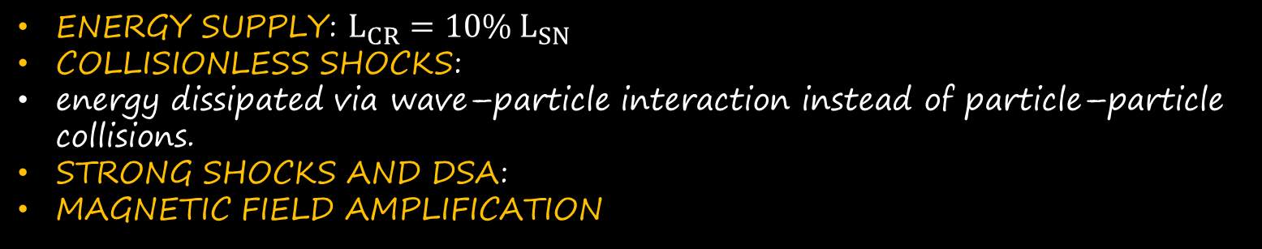

Galactic Cosmic Ray origin
GENOLINI talk
The main candidates: Supernova Remnants
ENERGY SUPPLY: $L_{CR}=10\% L_{SN}$
COLLISIONLESS SHOCKS:
energy dissipated via wave–particle interaction instead of particle–particle collisions.
STRONG SHOCKS AND DSA:
MAGNETIC FIELD AMPLIFICATION
$$ℛ=\frac{u_{u}}{u_{D}}=\frac{4M_{s}^{2}}{3+M_{s}^{2}}$$
$M_{s}→∞$ , $ℛ→4$
Direct evidences
Pion bump detection: distinction leptonic/hadronic only at E<200 MeV
Pevatrons → g-ray at E>100 TeV only of hadronic origin (maybe…)
Low-Energies
High-Energies
Confrimation of the presence of CRs but not of fresh acceleration (likely RE-accelerated or D suppression)
[MC+ 2016, Celli+ 2019]
Possible Detection problem → PeVatrons only in the first 100 years
[MC+2015]
Lemoine-Goumard talk Gamma2022
10 TeV
Nahee 2015

Slide 4
Theory
Where do most CRs come from?
Observations
Energetics
  P_{CR} ∼ 10⁴⁰ − 10⁴¹ erg/s
Power-law injected spectrum
  Required from DSA theory
Maximum energy
  They must explain the PeV proton energies
Anisotropy
  Source distribution has to be correlated with CR anisotropy (at PeV, ~10⁻³)
Composition
  They must explain CR composition and its energy dependence
Detected VHE-UHE Emission
Spectral curvature
  Signature of Emax, KN, spectral breaks
Spatially-resolved emission
Correlation with target material
  Not perfect: i.e. emission is convolution of CR distribution with gas
Energy-dependent morphology
  Expected in general due to energy dependence of transport and/or cooling
A multi-wavelength counterpart!
Receipt to be a CR source
MC&Giuliani 2023
Notes:
HE: >100 MeV
VHE: 100 GeV-100 TeV
UHE: E>100 TeV
From a theoretical point of view, the hadronic PeVatron requirements can be summarized in the following way [66]:
• Energetics - Hadronic PeVatrons must explain the CR power of the Galaxy, estimated to be about PCR ∼ 1040 − 1041 erg/s [10];
• Power-law injected spectrum - According to DSA, the accelerated spectrum at the source must follow a power-law that, after correction for transport effects and CR anisotropy, has to be ∝ E−2.1÷2.3 [9,10];
• Maximum energy - The acceleration efficiency at the source must be such as to explain PeV particle energies;
• Anisotropy - The source distribution must be correlated with the CR anisotropy in their arrival direction predicted by any diffusive model for CRs [10,75];
• Composition - Galactic CR sources must explain their composition that is slightly different with respect to the Solar CR one (e.g. large overabundance of light elements, overabundance of metals with respect to H and He) [9,10]. Moreover, the composition varies over energy (e.g. different elements have different spectral indices), and also this energy dependence needs to be reproduced.
From an observational point of view, a candidate hadronic PeVatron must have some precise features [76]:
• Evidence of UHE γ-ray emission (E > 100 TeV) - If we have CR acceleration, we expected protons accelerated at least up to 1 PeV and consequently, γ-ray emission well above 100 TeV without a cut-off in the spectrum;
• Spectral curvature - The parent particle power-law is modified by the existence of a maximum energy and/or to some break due to losses;
• Correlation with target material - The p-p interaction is most favoured in presence of a dense target in the source surroundings [75,77]
• Extended emission with likely energy-dependent morphology - CRs diffuse through the media surrounding the source and diffusion (as like as cooling) is energy dependent;
• Multi-wavelength counterpart - Secondary non-thermal electrons produced in the p-p interaction emit in radio/X-ray bands.

Slide 5
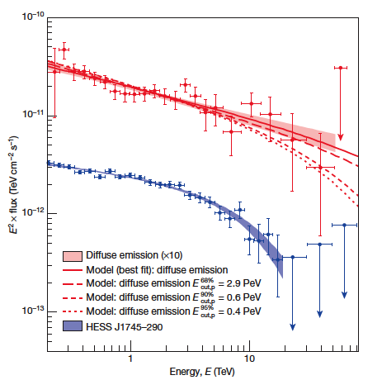
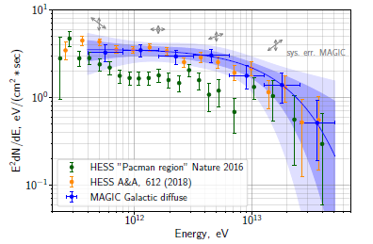
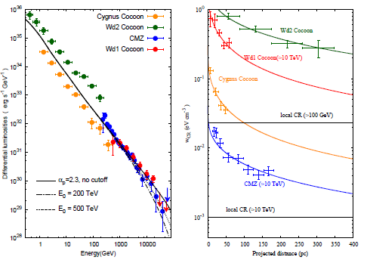
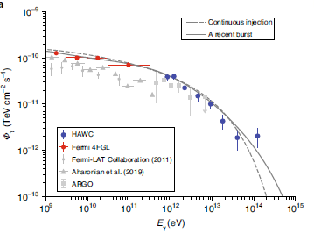
Other sources - Before LHAASO
Galactic Center Region
Correlation molecular gas and gamma-ray
CR energy density 10 CR sea
CR spectrum → γ_{E} =2.3-2.4 up to 100 TeV (large error bars)
Spatial distribution → 1/r
First spectro-morphological analysis on-going (Devin talk Gamma 2022)
HESS collaboration 2016
HESS collaboration 2018
MAGIC collaboration 2020
APEX+Planck: Dust
(ATLASGAL-Konsortium/Csengeri+ 2016)
Vieu thesis 2023
Superbubbles
Hot and rarefied extended cavities (OB stars winds and SNRs [Bykov 1992]:
Multiple shocks and winds
No radiative phase
Low-energy spectrum slope similar to the one measured by Voyager
Explanation of some CR composition anomalies[ Higdon+ 2003, Tatischeff 2018]
Spatial and spectral behavior similar to the GC one [Aharonian 2018]
HAWC collaboration 2021
Aharonian et al. 2018
Notes:
GC:
Collegamento con i Superbubbles
Sito per Immagine APEX+Planck → https://www.mpifr-bonn.mpg.de/pressreleases/2016/3#
Three areas of the Galactic plane as seen by the APEX LABOCA camera merged with large-scale images from the Planck satellite. Above: 6 x 3 degree field centered on the Galactic centre (constellation: Sagittarius).
APEX, the Atacama Pathfinder EXperiment telescope, is located at 5100 metres altitude on the Chajnantor Plateau in Chile’s Atacama region.

Slide 6

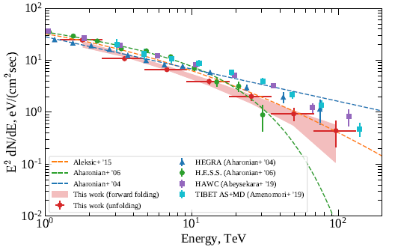

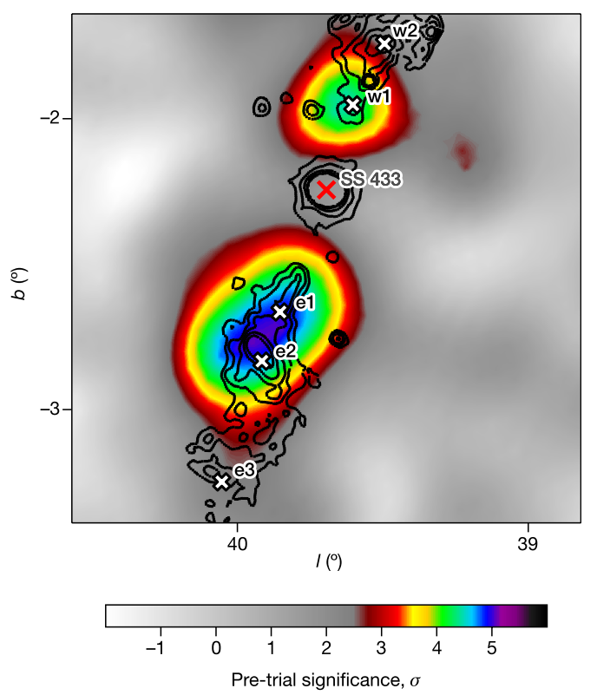
Other sources - Before LHAASO
Crab Nebula & the others
Detection
above 1 PeV!!!
but…
MAGIC collaboration 2020
LHAASO collaboration 2021
Crab is a PWN
(leptonic source)
so…
Leptonic origin of gamma-rays possible!!
There is a hadronic component?
Cyg X-1, Cyg X-3 and
SS 433 (emitting X-rays) show HE emission up to TeV.
Binaries & Microquasars
HESS
Olivera-Nieto Gamma2022
Notes:
Crab:
…ci ricolleghiamo alla questione sezione d'urto e Klein Nishina.
Gamma-ray emission from Crab Nebula discovered by the Whipple telescope in 1989
Microquasar
DA non molto, nel mondo del TeV si sono inseriti i Microquasars.
Microquasars are binary stellar systems where the remnant of a star that has collapsed to form a dark and compact object (such as a neutron star or a black hole) is gravitationally linked to a star that still produces light, and around which it makes a closed orbital movement. In this cosmic dance of a dead star with a living one, the first sucks matter from the second, producing radiation and very high energetic particles (Fig. 1). These binary star systems in our galaxy are known under the name of “microquasars” because they are miniature versions of the quasars (‘quasi-stellar-radiosource’), that are the nuclei of distant galaxies harboring a super massive black hole, and are able to produce in a region as compact as the solar system, the luminosity of
100 galaxies like the Milky Way. Nowadays the study of microquasars is one of the main scientific motivations of the space observatories that probe the X-ray and γ-ray Universe.
[Mirabel 2011]
SS 433 (broad MWL emission) is a key target to understand particle acceleration in XRB jets. The jet produces two bright TeV spots (e1 and w1). HESS conferma quanto visto da HAWC ed è il primo IACT ad avere questi risultati. Il TeV è in coincidenza dell'X mentre al GeV, come evidenzia Fermi, la situazione è più complessa.

Slide 7
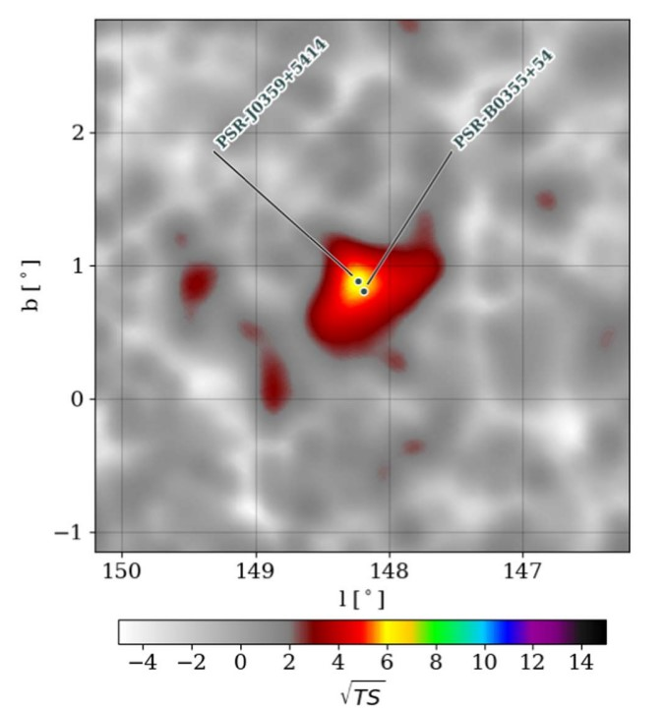

And for the propagation: TeV HALOS
VELA
HESS 2020
Both pulsar and extended emission evaded detection for a long time
Escaping electrons and positrons (due to RS that disrupts PWN) form an extended halo of GeV and TeV gamma-rays
Geminga
HAWC 2017
TeV Halos as new source class
TeV halo candidate near the Galactic plane in a non-crowded region.
This TeV halo candidate shares similar characteristics to others, suggesting that TeV halos could be a general feature of middle-age pulsars.
Propagation study
PSR J0359+5414
HAWC (Albert+23)
Notes:
Non sono sorgenti di accelerazione ma…

Slide 8
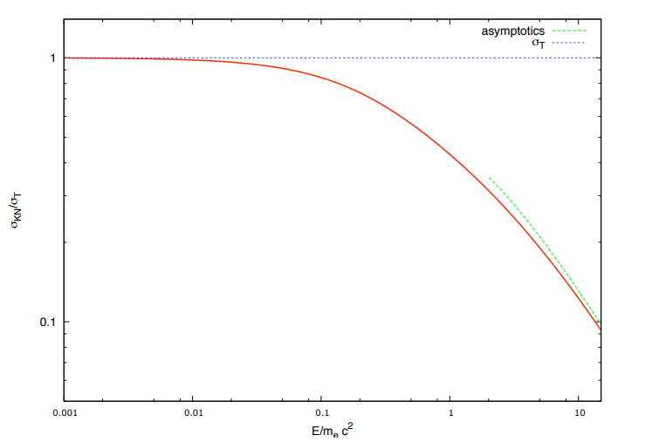

Pevatrons
HIGH-ENERGY ASTROPHYSICS
PEVATRON = an object capable of accelerating PARTICLES (hadrons or leptons) up to the PeV (=10¹⁵ eV) range
INVERSE COMPTON (leptonic)
Thomson scattering ($hν_{i}≪m_{e}c^{2}$)
transfer small,
scattering almost elastic,
Thomson cross-section applied
Klein-Nishina scattering ($hν_{i}≫m_{e}c^{2}$)
transfer large,
scattering deeply inelastic,
need to use cross-section derived from QED.
COSMIC RAY CONTEXT
PEVATRON= an object capable of accelerating HADRONS up to the PeV (=10¹⁵ eV) range

Slide 9

Ok…
We have some hints of emission around 100 TeV…
but just one PeVatron (the Crab)…
And it could be a leptonic one...
…when suddenly…

Slide 10
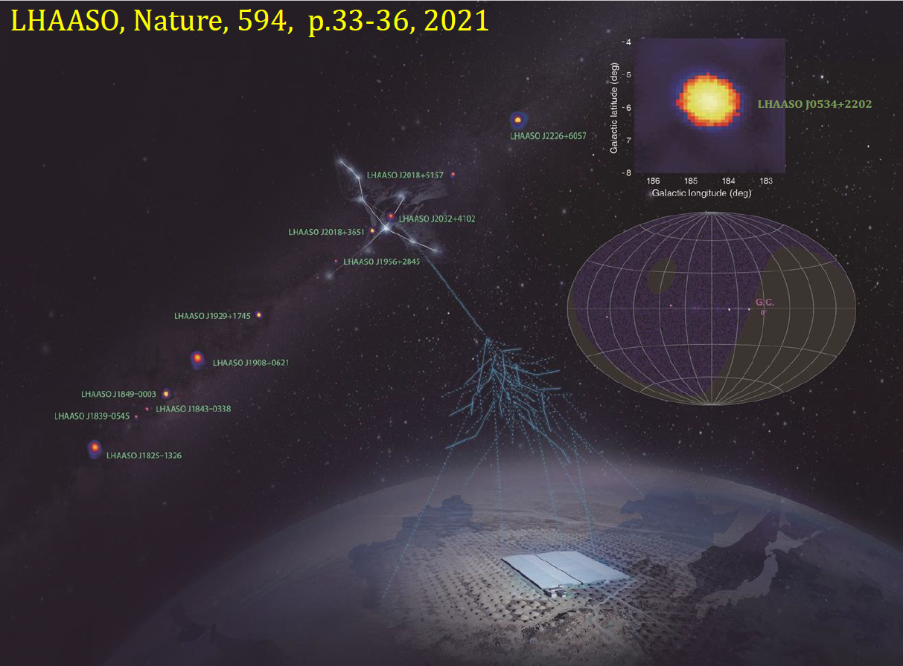

"PeVatrons" storm from LHAASO
OUR GALAXY IS FULL OF "PEVATRONS"!!!!!!
12 "PeVatrons" discovered with high significance (>7σ)!!
LEPTONIC
Or
HADRONIC?
Cao ICRC 2021
Notes:
…Da qui chiaramente è iniziato il putiferio tra gli altri strumenti, presenti e futuri, per capire meglio cosa LHAASO sta osservando e in generale per riuscire a selezionare i candidati pevatroni della nostra Galassia
We acknowledge the significant results obtained by HAWC and recognize that they hinted at what LHAASO saw successively
However, we think LHAASO results were a breakthrough for two main reasons, the extension by an order of magnitude of energy range and the relatively large number of sources.
Despite the fact the portion of the Galaxy observable by the LHAASO site is smaller than that by the HAWC site (and it doesn’t include the Galactic center) LHAASO tripled the number of known sources emitting above 100 TeV, demonstrating that this feature is quite common on galactic sources. The number of sources for which a hadronic scenario is almost excluded increased similarly.
Moreover, the detection of photons near (in some cases above) 1 PeV challenge an astrophysical explanation of what we are observing (both assuming hadronic or leptonic origin)
Let us also note that LHAASO obtained these results with only 10 months of observations, suggesting these 12 sources are only the top of the iceberg of what will be detected by future observations of both LHAASO and other instruments based on the same technology (i.e. SWGO at the south).

Slide 11
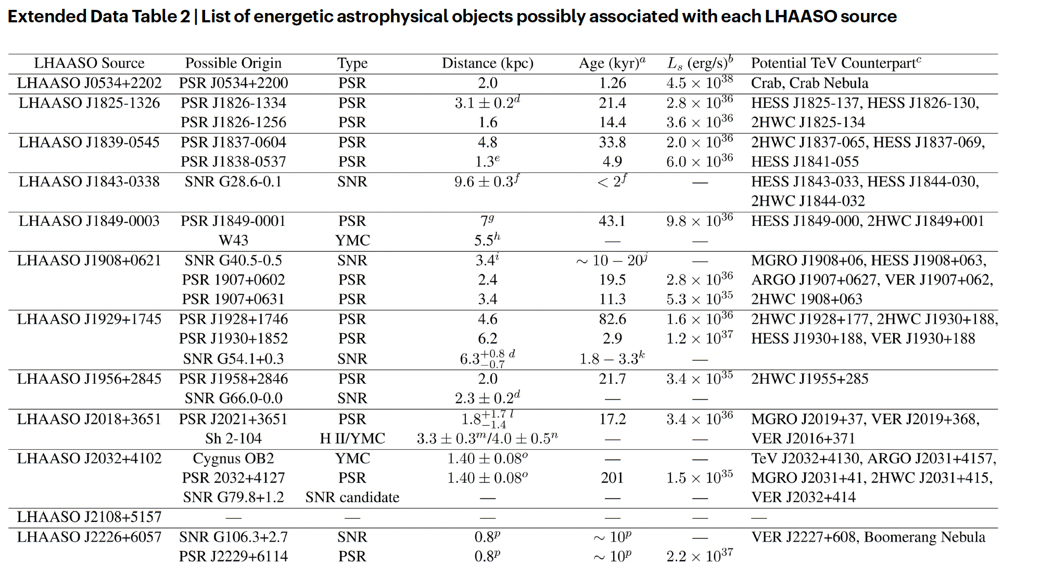
Notes:
Ma non c'è solo la questione adronico/leptonico: qui non sappiamo proprio a cosa associare la loro emissione
- Have a look to the columns "Possible origin" and "Potential TeV Counterpart" → spiegare la problematica della risoluzione angolare

Slide 12
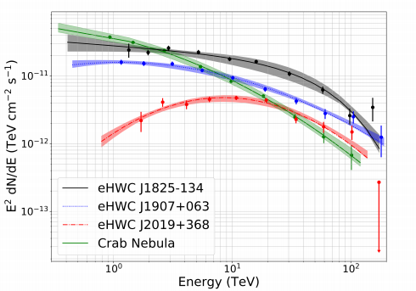
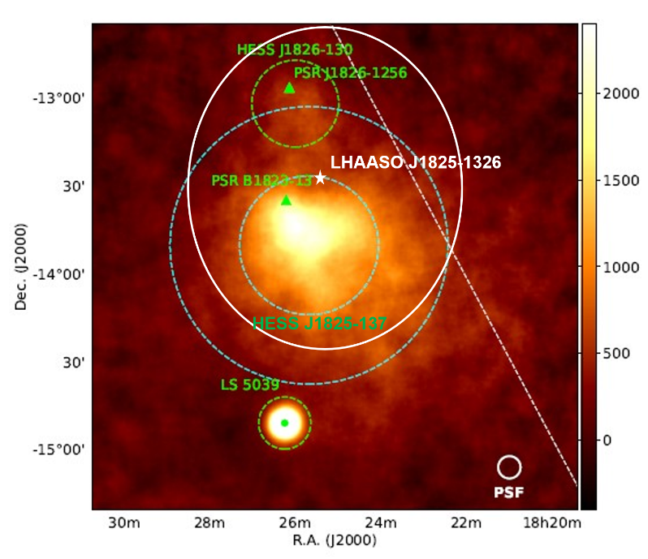
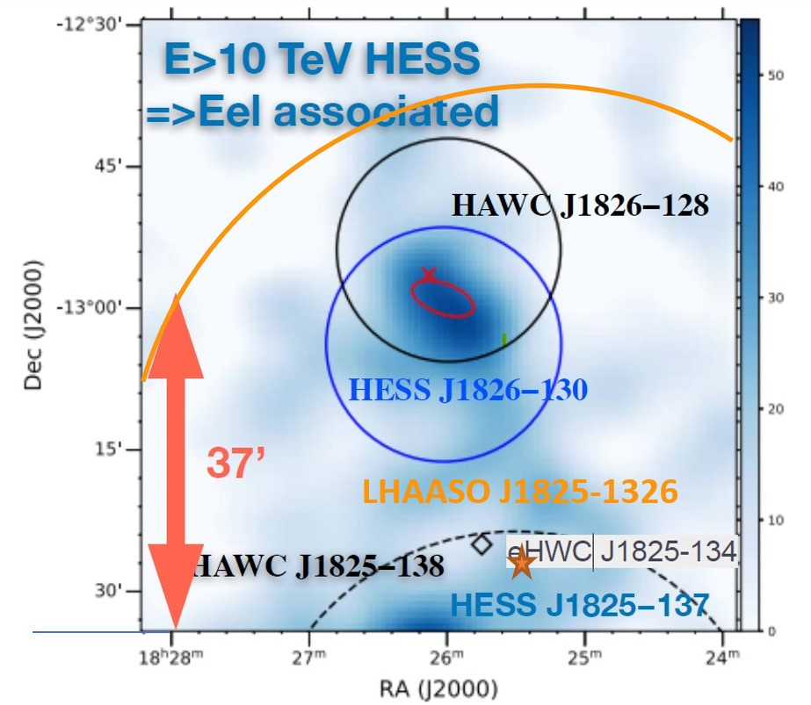
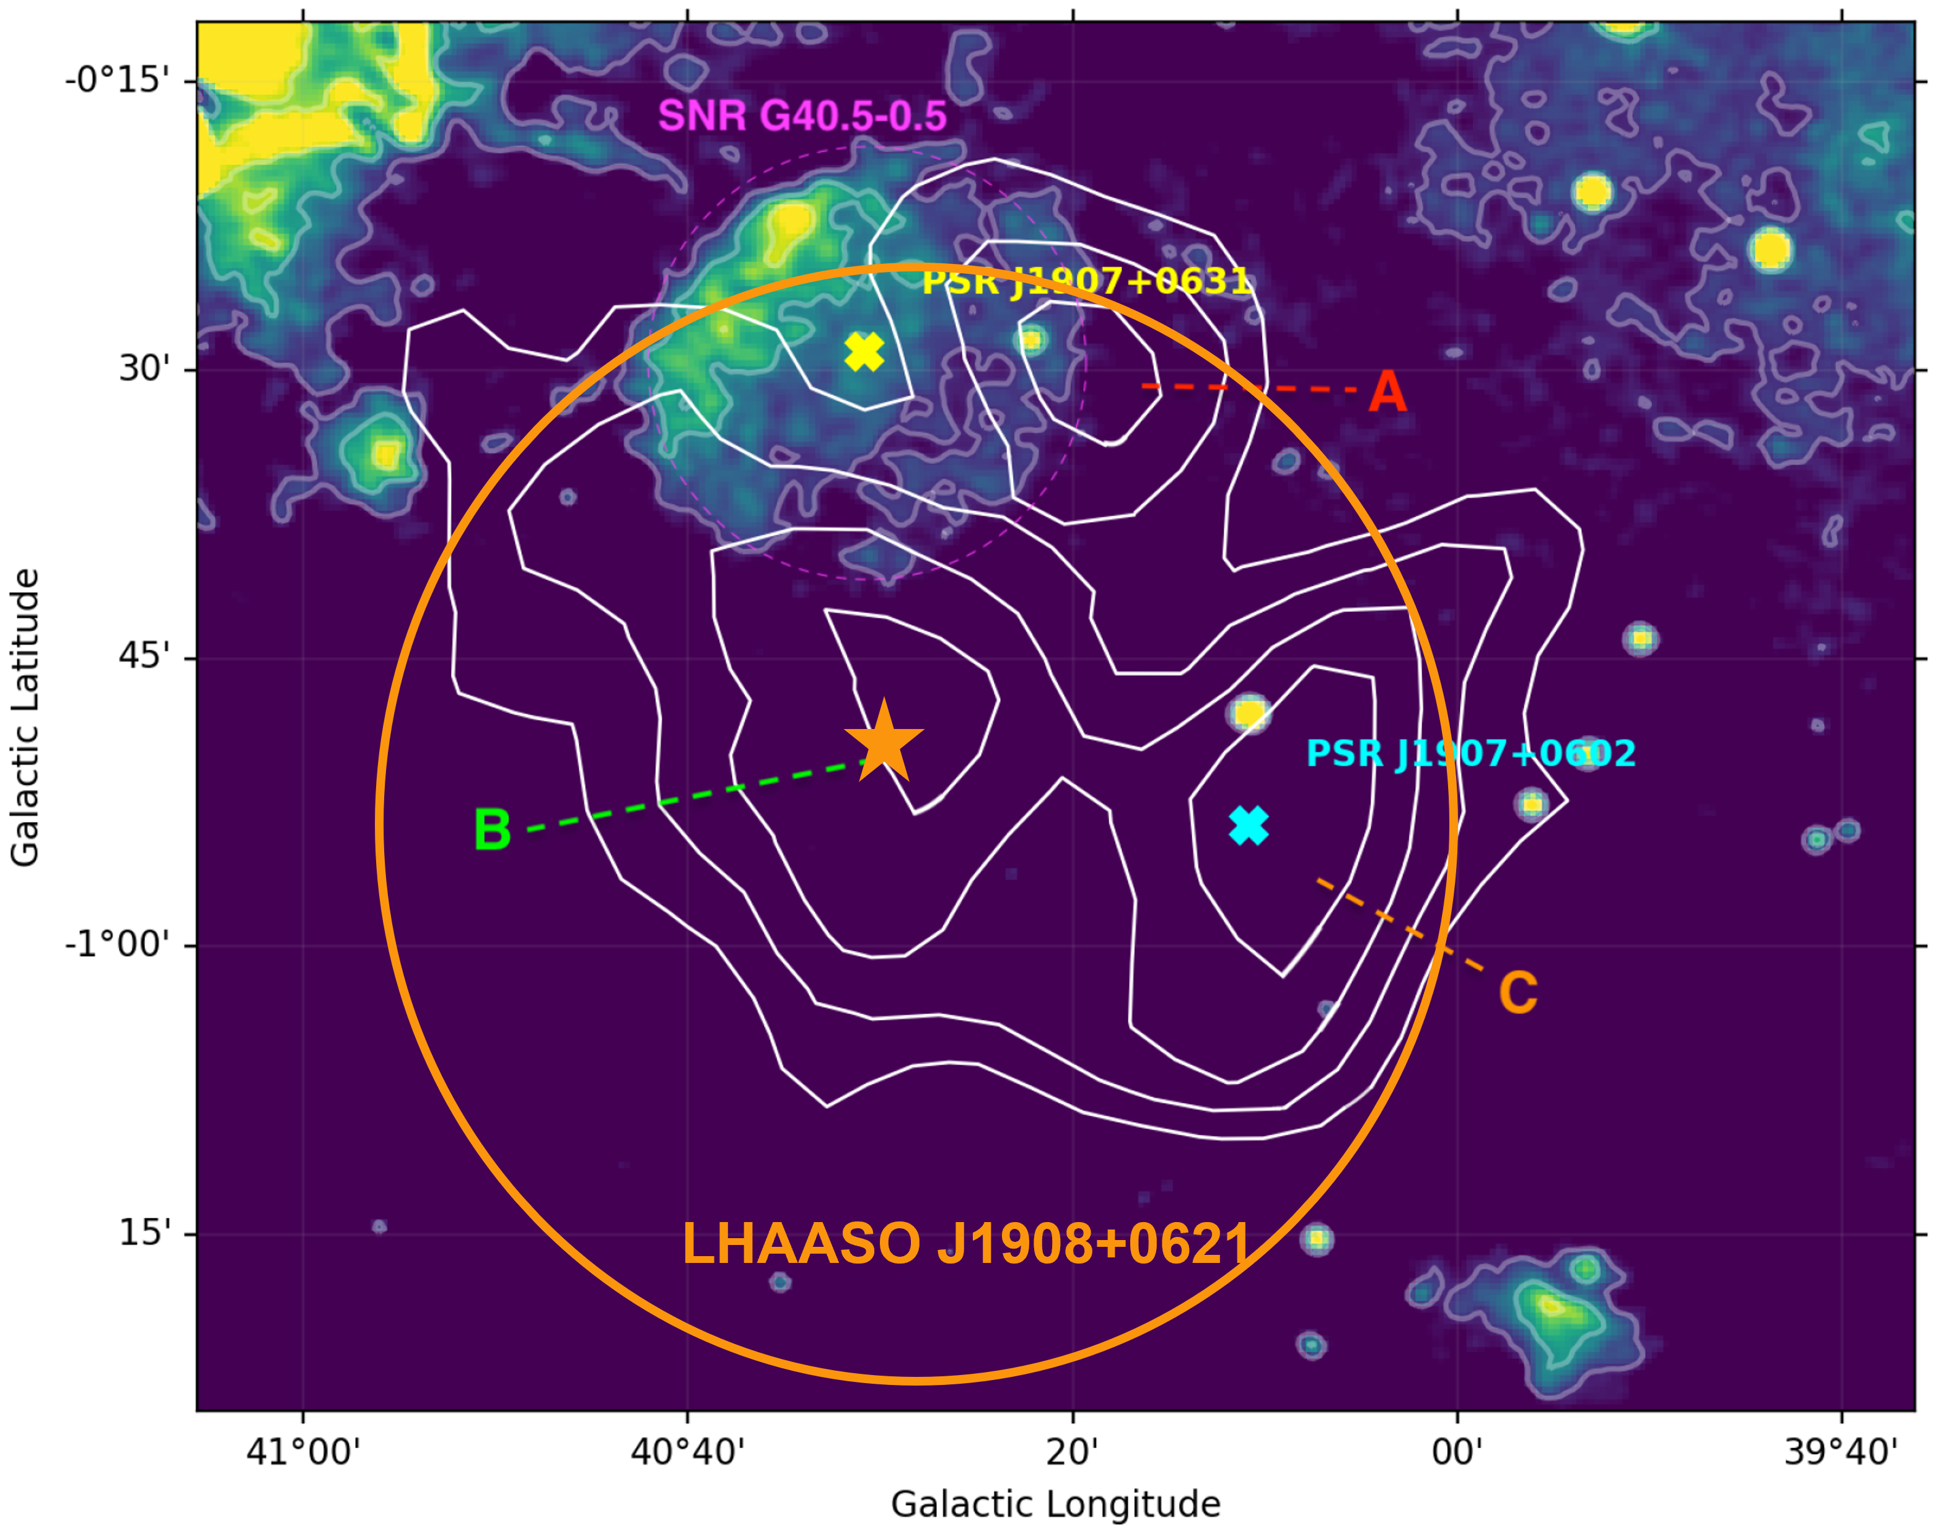
Pulsar Wind Nebulae
HAWC
The majority could be PWN!!!
(statistics: more numerous and long last)
Cao et al. 2021
Abeysekara et al. 2020
LHAASO J1825-1326
PWN? SNR?
[MC&Giuliani 2023]
LHAASO J1908+621
PWN?SNR?
[MC&Giuliani 2023]
Very Complex
Environment and low angular resolution
HESS coll. 2019
Burgess+ 2022
Crestan+ 2021
Notes:
Complex enviroinment traducibile come "un gran casino"
Two of the sources with the highest significance
J1825: HAWC risolve tre sorgenti, HESS 2 e ci sono sia PSR ma anche SNRs
J1908: 2 PSR e una SNR nei dintorni (interagente con le MCs)
PWNe should be the most numerous between the different kinds of Galactic sources 328
[48] and their γ-ray emission is estimated to last a very long time (∼ 100 kyrs)

Slide 13
Pulsar Wind Nebulae
Vercellone+ 2022
Leptonic origin of gamma-rays > 100 TeV is possible
  → IC on BKG photon field (no KN effect due to an increase of the cooling time in radiation dominated environments [low B]) [Breuhaus+ 2022]
Protons:
γ = 10⁵
χp = 15%
Acceleration is limited by the maximum potential drop (not in the Crab)
500h
CARIBELLA talk
MOHRMANN talk
GOKSU talk
Protons:
γ = 5 × 10⁶,
χp = 4%;
If there are protons (hadrons):
~few % of the total energy (Guepin+ (2020))
pp emission may show up in the high energy tale of IC emission
DeOnaWilhelmi+ 2022

Slide 14
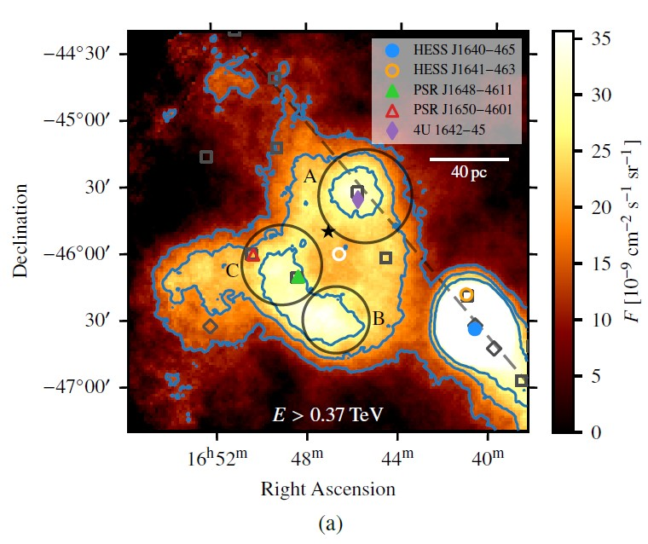
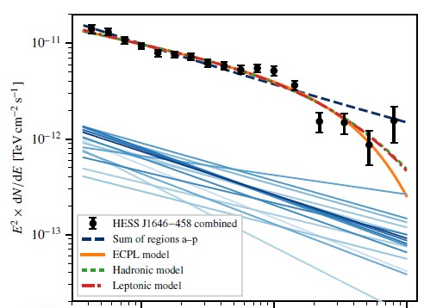
Young Massive Star Clusters (inside superbubbles)
Clusters with age < few Myrs that can reach M up to 6x10⁴ Solar masses
Acceleration at 1 PeV possible at Wind Termination Shocks [Morlino 2021, Vieu et al. 2022]
Collective effects in the most compact clusters (size of a few pc) can generate a collective ourflows (right amount of power [Vink 2022])
Several physical ingredients to a deep analysis (cluster population, stellar population inside, stellar wind, cluster wind, PA model, gas distribution) [Morlino CTAO general meeting]
MOHRMANN talk
MENCHIARI talk
Abeysekara+ 2021 (HAWC coll)
HAWC collaboration 2021
Cygnus Region
Aharonian+2022
Low-energy break
Banik 2022
Lemoine-Goumard
talk Gamma2022
Westerlund 1
E [TeV]
Notes:
Dopo LHAASO sono stati fatti degli studi più approfonditi che hanno capito meglio cosa sia necessario.
The power injected by a single stellar wind is between 10-50% of the power generated by a SNR shock [67] with an average energy per massive star of about 1048 erg
Dalla presentazione di Vieu:
Massive star cluster = a bounded group of stars which contains SN progenitors (ZAMS >~ 8 Msol).
I superbubble sono i contenitori degli YMSCs
Can massive star clusters produce PeV photons?
Fast SN exploding within young compact massive star clusters can account for the UHE GCR up to 100 PeV.
Very few of these events are required (~ 1/10 000 yr) and UHE particles escape within 1kyr => O(1), or possibly O(0) gamma-ray counterpart!
> Can massive star clusters produce ɣ-rays up to 100 TeV?
Young compact clusters can accelerate particles at the WTS up to 1 PeV and produce detectable photons up to 100s TeV.nded group of stars which contains SN progenitors (ZAMS >~ 8 Msol).

Slide 15
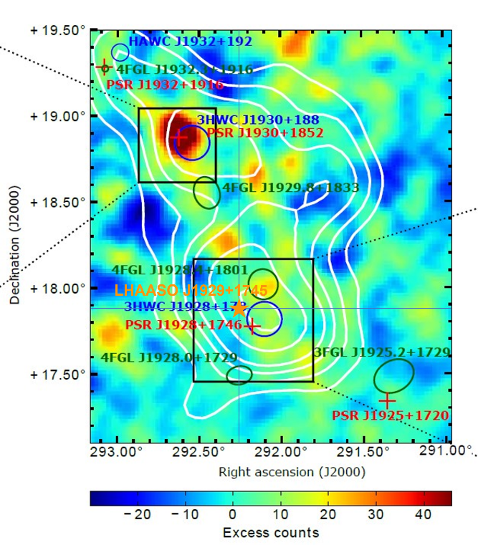
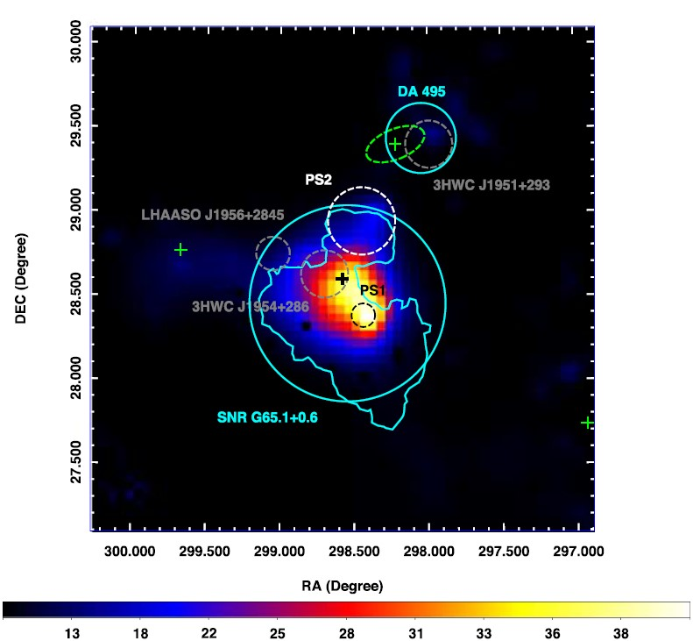
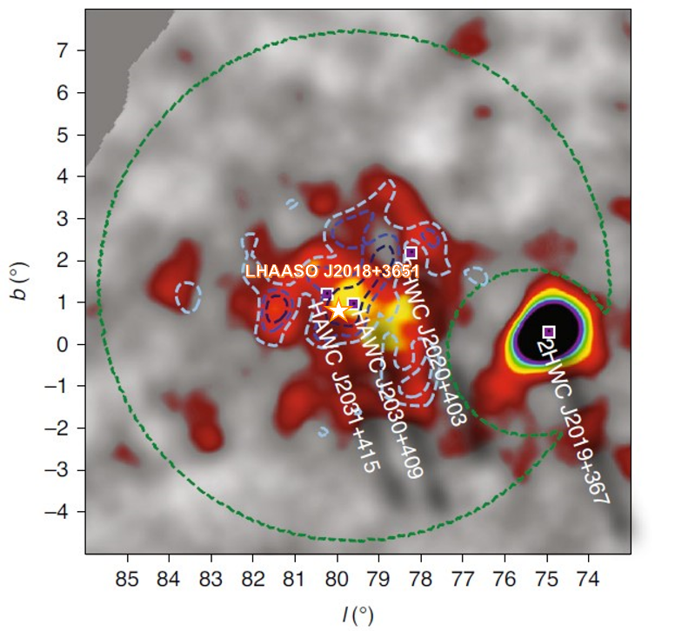
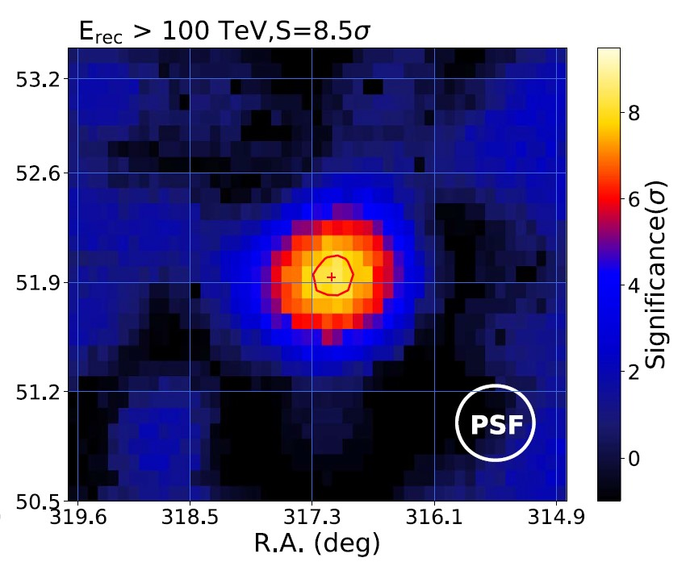
LHAASO J1825-1326
TeV HALOS
Albert+2023,HAWC coll.
LHAASO J1929+1745
Several LHAASO sources could be TeV halos!
HESS coll. 2019
[MC&Giuliani 2023]
PINETTI talk
LINDEN talk
LHAASO J1956+2845
LHAASO J2032+4102
LHAASO J2108+3651
Xing+ 2022
Cao, Aharonian+21
Abeysekara+ 2021
(HAWC coll)
First source discovered at UHE
Notes:
The main problem related to TeV halo detection is the possibility of confusing them with extended SNRs [118]. In order to verify the TeV halo origin of a
source, beyond the co-location of the bulk of its emission with a pulsar, this pulsar needs to have a spin-down luminosity sufficient to generate a halo and needs to be enough old to allow electrons to diffuse in the ISM (bow-shock nebula [70]). Furthermore, the extension of the halo has to be larger than the possible PWN X-ray emission, otherwise the emission
could be a γ-ray PWN, and its morphology must be explained by slow-diffusion, otherwise this could indicate a hadronic accelerator
*J1825 → HESS J1825: The extraordinary extension of this source makes it a possible candidate TeV halo [146], even because it is not possible to explain it within the standard dynamics of the PWN [147].
*J1929 → HAWC: Actually, the estimated age of the PSR (∼ 80000 yrs) and the lack of X-ray detection in its correspondence open the chance that 3HWC J1928+178 could be another TeV halo → però studi più approfonditi del proper motion non convincono
*J1956 → Dall'analisi dei dati Fermi-LAT he authors estimated a possible TeV halo generated from this source (based on Geminga one parameter), suggesting that this is the VHE/UHE emission source.
*J2032 → According to [118], it is a candidate TeV halo because it is associated with a pulsar >100 kyrs and has a TeV halo-expected-flux ma Nessun altra analisi lo conferma
*J2108 → prima sorgente rivelata alle UHE! but the absence of X-ray emission implies a weak magnetic field, favoring a TeV Halo scenario over that the
PWN one. Ma comunque non ci sono PSR vicine

Slide 16
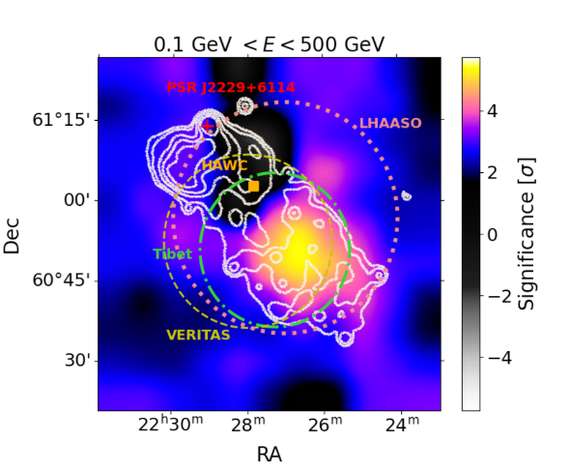
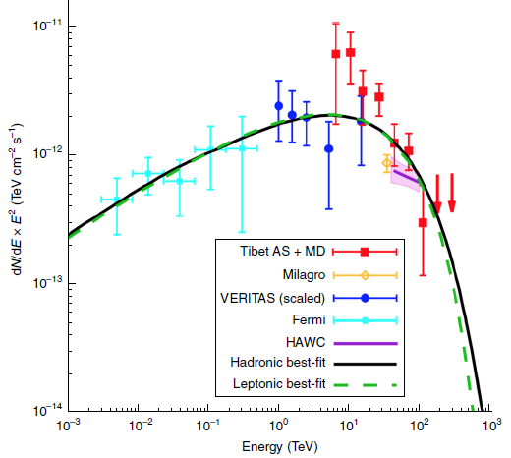
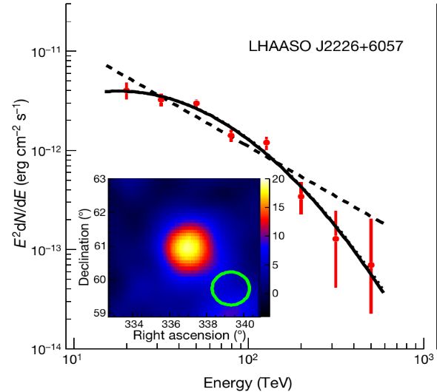
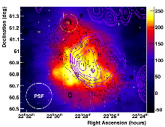
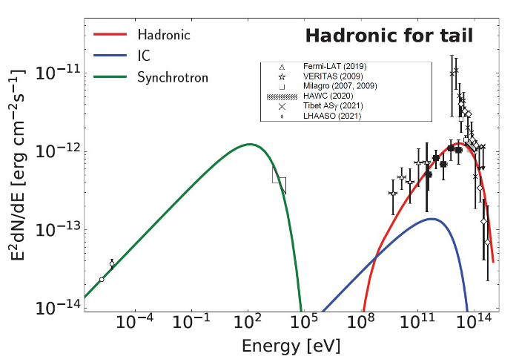
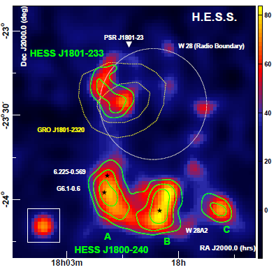
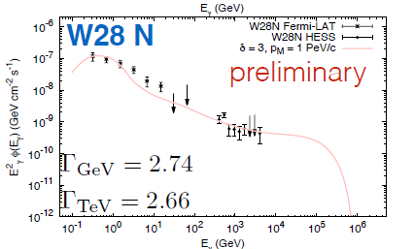
And finally… The Supernova Remnants
Almost all the talks in this session
LHAASO J2226+6057
MAGIC coll. 2023
Fang+ 2022
Tibet AS collaboration 2021
Cao+ (LHAASO coll) 2021
Fermi-LAT and MAGIC detection favoured hadrons from SNR/MC interaction
Propagation study
Gamma Cygni (MAGIC collaboration 2019)
Celli Talk Gamma2022
W28 (Aharonian et al. 2008)
Notes:
Le SNR sono fondamentali anche per lo studio sulla propagazione dei raggi cosmici ma non ho tempo di parlarvene quindi credetemi sulla fiducia o andatevi a guardare qualche seminario/presentazione/articolo
MAGIC: evidenzia come la morfologia cambia con l'energia (ad alte energie solo la coda come anche al GeV) → modello adronico favorito

Slide 17
More kinds of source is better than one
Vieu&Revill 2023

Slide 18
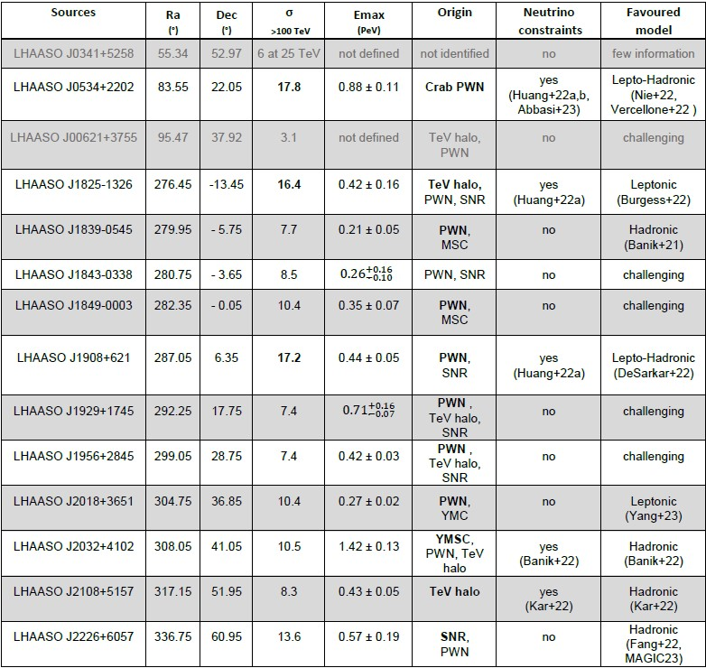
HIGHEST ENERGY SENSITIVITY
WIDE BAND SENSITIVITY
GOOD ANGUKAR RESOLUTION
NEUTRINOS
MC&Giuliani 2023

Slide 19

Very recent results (especially from ICRC 2023)
Yao talk,
LHAASO Highlight ICRC2023,
Lemoine-Goumard GA highlights ICRC2023
12 PeVatrons studied with LHAASO-WCDA [Chuandong ICRC23]
    LHAASO J1908+621 shows a break in the spectrum
    LHAASO J2032+4102 shows a possible Cut-Off
First LHAASO catalog with a total of 43 candidate PeVatrons! (WCDA+KM2A) https://arxiv.org/abs/2305.17030
    LHAASO J2002+3238 coincident with SNR G69.7+1.0 [Hou et al. ICRC23]
    LHAASO J1959+2850 coincident with PSR J1958+2845 and
    SNR G66.0-0.00 + associated MC [Yu et al. ICRC23]
    LHAASO J1740+1000: could be a bow-shock pulsar tail [Xu et al. ICRC23]
    LHAASO J1922+1403: W51c up to 300 TeV! [Chen et al ICRC2023]
    SNR G150.3+4.5: coincident with 4FGL J0426.5, could be a PWN or a SNR/MC [Zeng et al ICRC23]
    GAMMA CYGNI: KM2A detected PeV emission! [Feng et al. ICRC23]
Further studies from the other instruments (see ICRC23 presentations)
→ the most analysed:
    LHAASO J2108+5157 (VERITAS&HAWC [Kumar et al. ICRC23] and MC [Toledano-Juarez ICRC23] )
    LHAASO J2226+6057 (HAWC [Son et al. ICRC23] and VERITAS [Park et al. ICRC23])
    LHAASO J1825-1326 (HAWC [Goksu talk])
A lot of work to do → we need more specific and "focused" information (taking into account the Observatory role of CTA→ 40% of time for KSPs):
  choice of a few LHAASO "hadronic PeVatrons" candidates → possibly of different kinds (e.g. SNR, YMSC)
  estimation of exposure time necessary for these sources
  simulation of observation from the two sites and combination of the results → focus on the morphology reconstruction
Importance to combine GeV-TeV energies
A lot of SNRs!
(young but als middle aged)
Importance of cross-correlation

Slide 20

What we need in the next future?
Wide FoV with almost homogeneous off-axis acceptance
  Multi-target fields, surveys, and extended sources (GC, SNRs, TeV halos)
  Enhanced chance for serendipitous discoveries
Sensitivity: better than current IACTs (E > 10 TeV):
  Extended spectra for PeVatron confirmation and lepto/hadro origin discerning (SNRs, Micro-quasars, PWN)
  Diffusion coefficient constraints (Gamma-Cygni, SNRs, TeV halos)
Energy/Angular resolution: ≤ 10% / ≤ 0.1° (E ≤ 10 TeV)
  Characterize extended sources morphology
    Energy dependence
    Identification acceleration regions
  MW association
  Spectral Shape (hadrons vs leptons)
                And we would like also
                a neutrino detection, thanks!
Several Talks in the TeVPa neutrino sessions
Li et al. ICRC23 (Neutrino/ LHAASO diffuse emission)
Burley et al. ICRC23 (Neutrino promising target and SNRs)

Slide 21


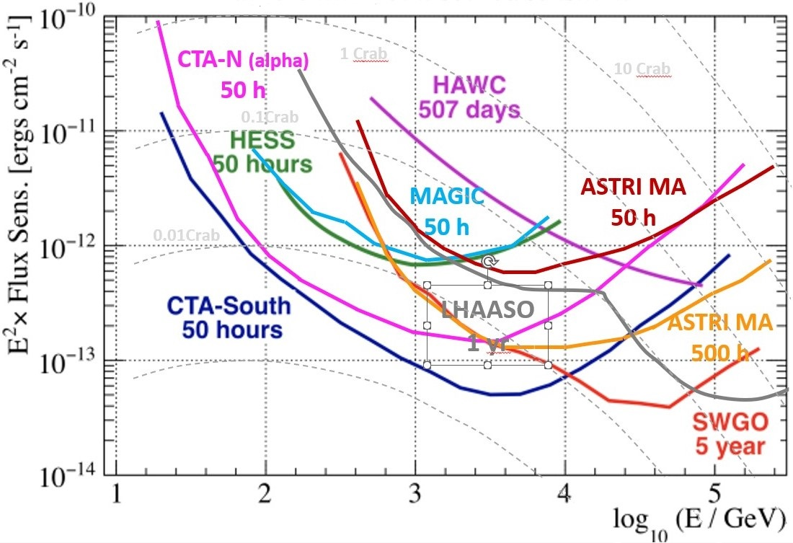
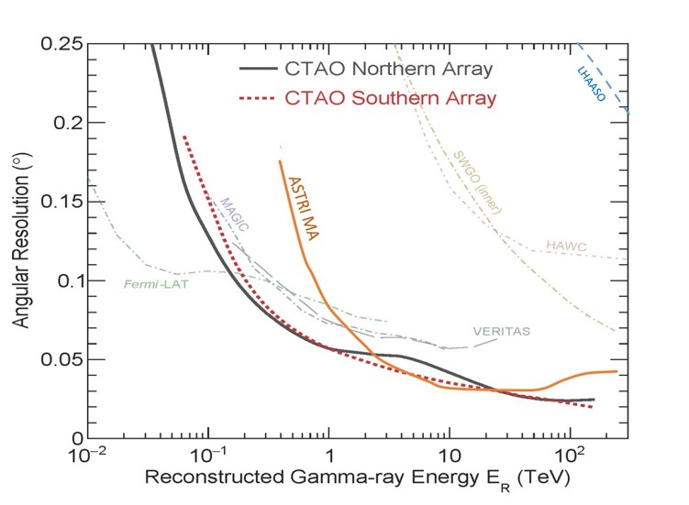
ASTRI Mini-Array and CTA
Angular
resolution
Sensitivity
Vercellone+ 2022,
Scuderi+ 2022,
CTA website,
MC&Giuliani 2023
Sensitivity: better than current IACTs (E > 10 TeV):
  Extended spectra and cut-offs contsraints
Energy/Angular resolution: ≤ 10% / ≤ 0.1° (E ≤ 10 TeV)
  Characterize extended sources morphology
Tutone talk

Slide 22
IMPORTANT MESSAGES
Cosmic-ray origin: a Very Hot Topic since 1912!!
The three main candidate hadronic PeVatrons are Pulsar Wind Nebulae, Supernova Remants and Massive Star Clusters
The future in the VHE domain is related to LHAASO, ASTRI-MA and CTA and their synergy with other instruments
The collaboration between gamma-ray and neutrino communities will be fundamental in order to solve the CR origin issue → importance of VODF (Very-high-energy Open Data Format [Khelifi+2023 ICRC23 proc., Unbenhaum+23])
Look at the ICRC2023 and TeVPa presentations and proceedings with a lot of new observations and modeling of PeVatron candidate sources
A lot of work to do: from simulation and software to data analysis to theoretical interpretation
Notes:
Accennare al lavoro combinato CTA-IceCube Ubernhaum 2023

Slide 23


Thank you
very much!

