Slide 1
Monte Carlo Event Generators for EIC

Slide 2
Introduction

Slide 3
What the use of MCEGs in experiments?
Study of observables and their dilution while going from the hard process to the generated particles
Optimization of the experimental apparatus
Calculation of acceptance corrections
Corrections in general
They are developed to fulfill experimental needs and are fundamental tools of our research.
Models are a fundamental ingredient, e.g. the LUND hadronization model based on string (not on fragmentation functions).

Slide 4
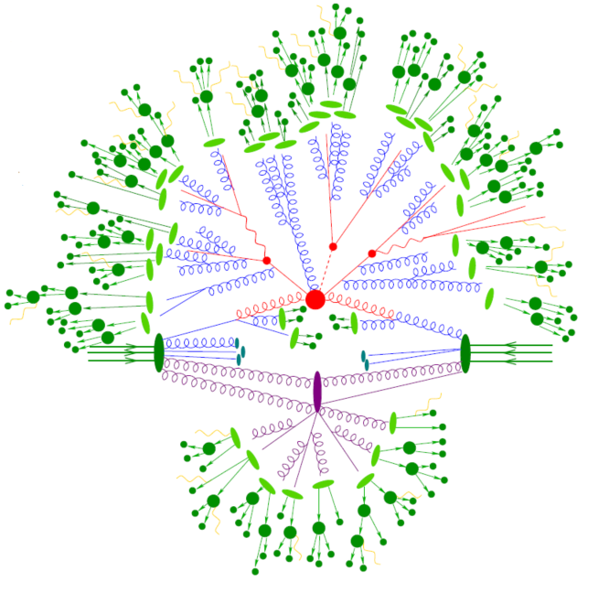
The Role of Monte Carlo Event Generators
Their scope is to simulate the physics we are interested in (both in terms of signals and background) that are happening in the interaction of the particles
Need of inputs (i.e. things that cannot be simulated) as e.g. PDFs.
PDFs are fitted by different groups; they are provided to MCEG trough library LHAPDF (Les Houches Accord PDF) introduced in 2002 in view of the LHC. Since version 6 LHAPDF is written in more modern C++ language)
TMD PDFs?

Slide 5
(GP-)MCEG Philosophy
Generate exclusive hadronic final states
Input as much theory as possible
Add phenomenological models where there is no theory
Parameters should correspond to physical properties of the model
Tune the parameters to data globally, i.e. try to avoid different tuning for different experiments (keep in mind: most of the tuning is done for LHC at least for modern GPEG)
Open software
QCD is central

Slide 6
Monte Carlo Event Generators (MCEG) for EIC
General Purpose MCEG:
PYTHIA8
HERWIG7
SHERPA
(old) PYTHIA6
Dedicated MCEG:
BeAGLE (eA)
DJANGOH (DIS ep, eA with RCs)
MILOU (DVCS)
RAPGAP (DIS and Diffractive ep)
elSpectro (spectroscopy)
EpIC (exclusive processes ep)
TOPEG (DVCS eA)
eSTARlight (coherent VM photo- and electro-production)
https://eic.github.io/software/mcgen.html

Slide 7
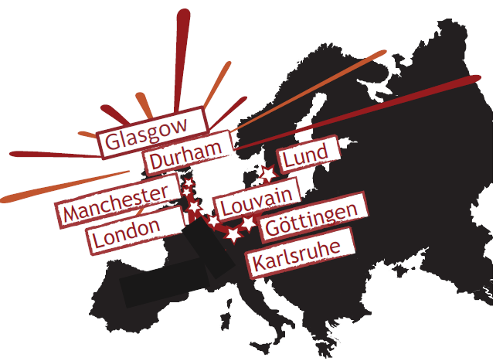
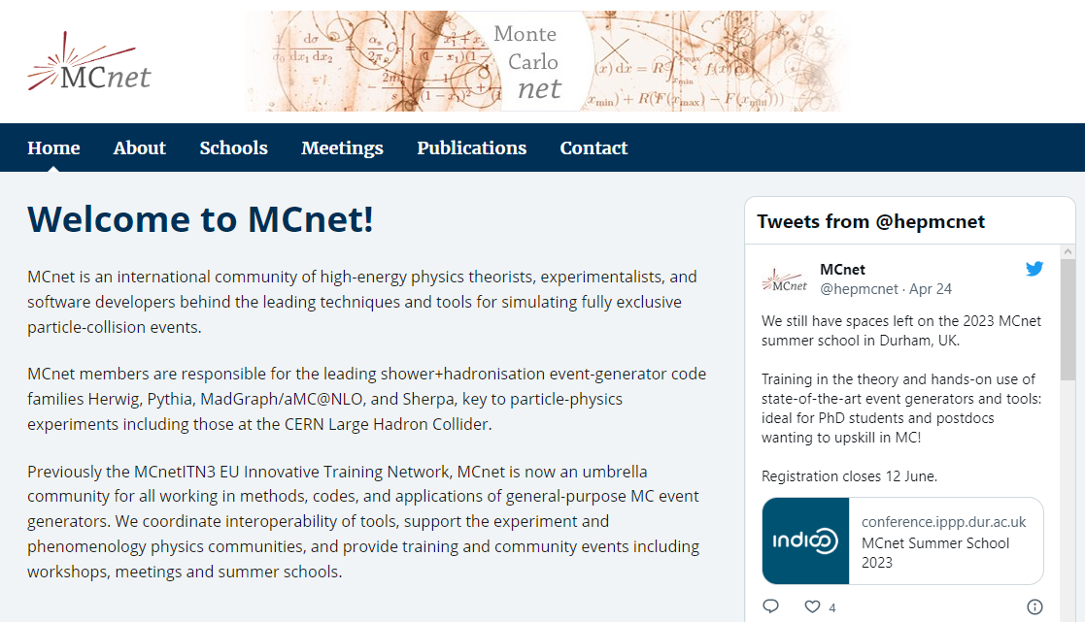
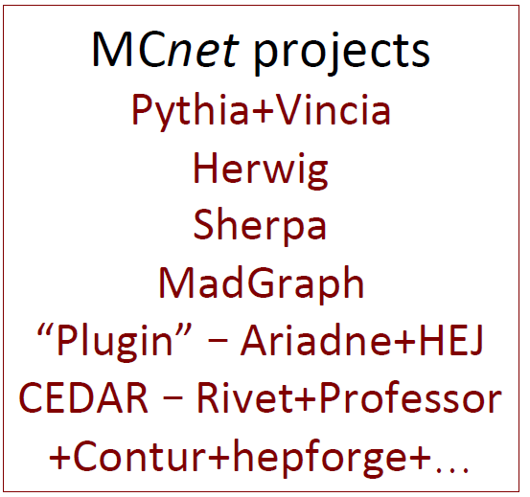
MCnet
https://montecarlonet.org

Slide 8
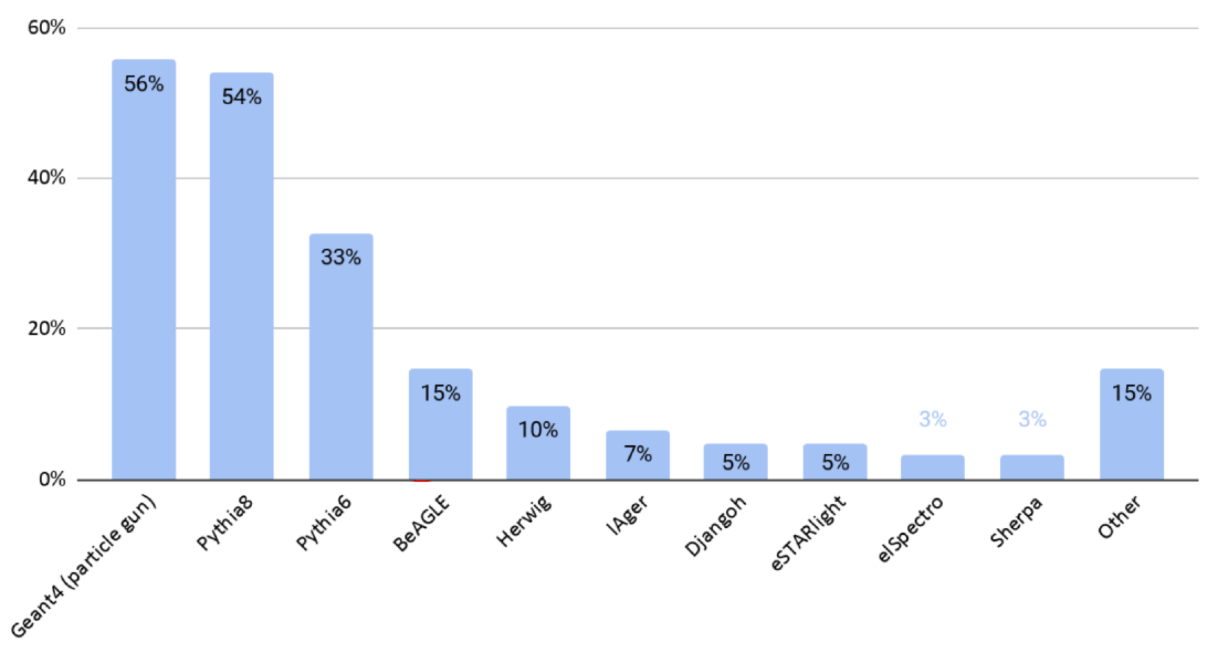
Usage for the Yellow Report
Talk of M. Diefenthaler: https://indico.cern.ch/event/1200496/

Slide 9
GP-MCEG vs DP-MCEG
We need event generators to model our data, but also to model the theory (for both GP and DP).
With GP-MCEG you may (in principle) simulate all the process, not only the one of your interest, and therefore study background leaks in your selections
For GP-MCEG it’s not enough to tune for one analysis/experiment, but one need to tune to everything.
  e+e− ⇒ Hadronisation and FSR
  ep ⇒ ISR and remnant jets.
  pp ⇒ UE and MPI
  pA ⇒ small dense systems, flow
  AA ⇒ large dense systems, jet quenching
  eA ⇒ cold dense nuclear matter
For very specific processes, the need of DP will remain, since it will be difficult to push authors to model them in.

Slide 10
PYTHIA

Slide 11
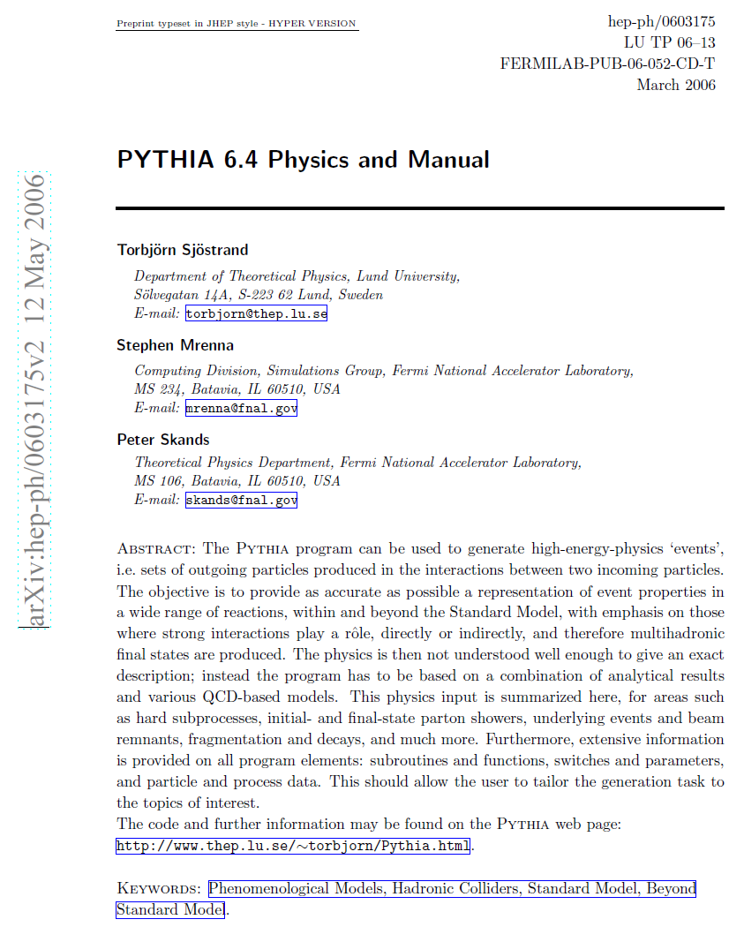
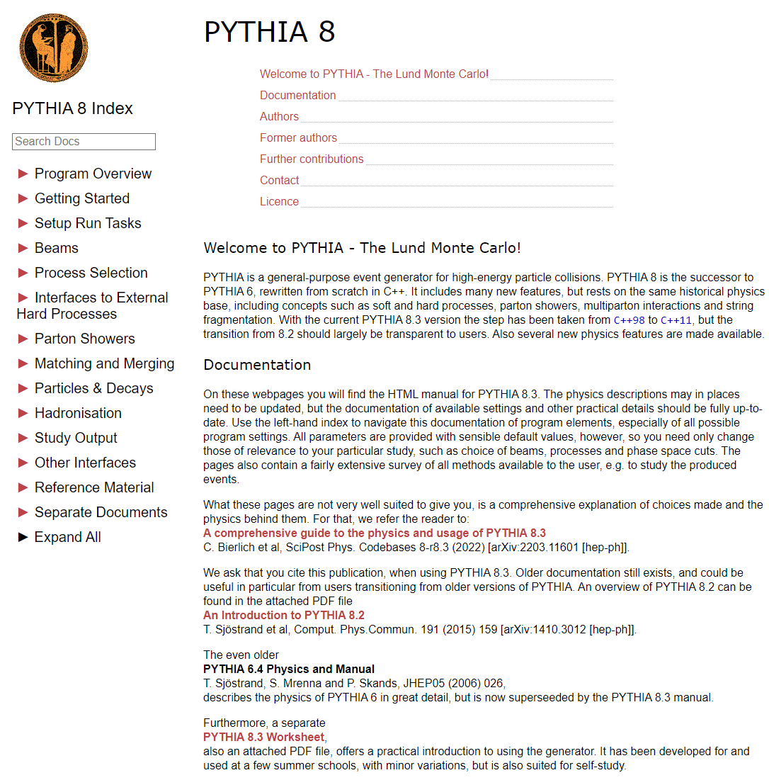
PYTHIA
574 PAGES

Slide 12
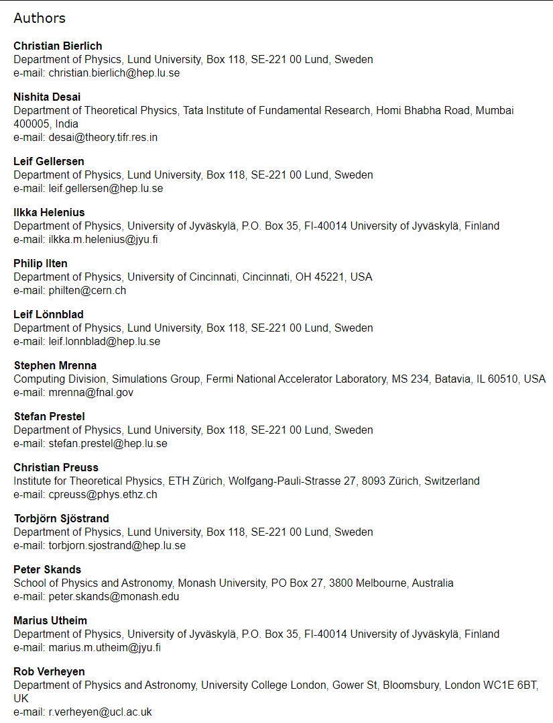
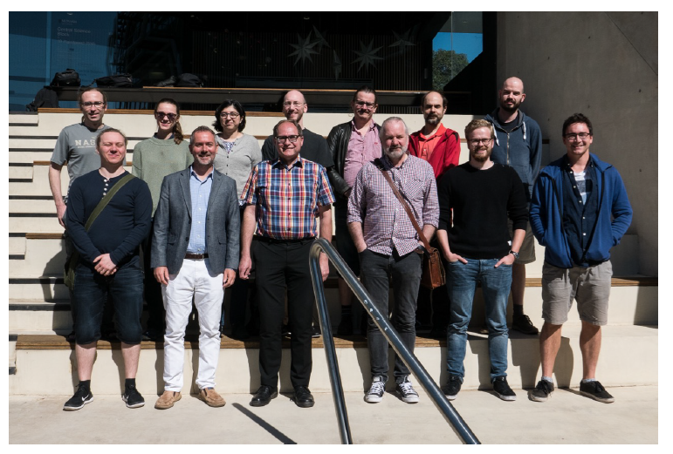

Slide 13
Pythia8(.3)
Pythia went from version 6 (used also for DIS) to version 8 in view of LHC. Major upgrade: from FORTRAN to C++ and interfaced with other codes for hard process at higher order (e.g. MC@NLO, POWHEG, KrKNLO)
Pythia 8 was devoted to LHC. No DIS at the beginning, i.e. one cannot have ep interactions)
It changed with Pythia 8.3, triggered by the EIC community, but also LHeC, even if those communities are small.
Already in Pythia 8.2 there was something present (DIRE patches)
Work is also ongoing for AA, and can be used/extended to eA (Angantyr)

Slide 14
Event generation in DIS with PYTHIA 8
Hard scattering
  Convolution between PDFs and matrix element (ME) for partonic scattering
Parton shower
  Final state radiation (FSR)
  Initial state radiation (ISR) for hadron
  QED emissions from leptons
  ME corrections for the hardest splitting
  Matching of high-multiplicity MEs and PS
Hadronization
  String hadronization with color reconnections
  Decays to stable hadrons

Slide 15
Need of precision: improved matching
All general purpose event generators have facilities for (semi-) automatic matching of NLO matrix elements for (almost) any (B)SM process, using
  MC@NLO
  POWHEG
  KrKNLO

Slide 16
Matching fixed-order NLO to PS
MC@NLO
Use parton-shower splitting kernel as infrared subtraction term
Multiply LO event weight by Born-local K-factor including integrated subtraction term and virtual corrections
Add hard remainder function consisting of subtracted real-emission correction
[Frixione,Webber] hep-ph/0204244
POWHEG
Use matrix-element corrections to replace parton-shower splitting kernel by full real-emission matrix element in rst shower branching
Multiply LO event weight by Born-local NLO K-factor (integrated over real corrections that can be mapped to Born according to parton-shower kinematics)
[Nason] hep-ph/0409146

Slide 17
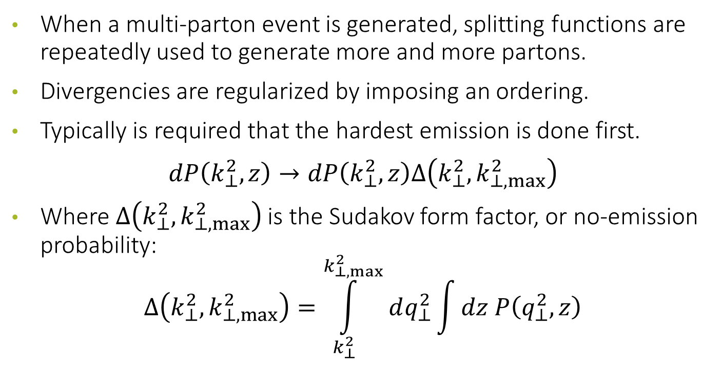
Parton shower
When a multi-parton event is generated, splitting functions are repeatedly used to generate more and more partons.
Divergencies are regularized by imposing an ordering.
Typically is required that the hardest emission is done first.
$$dP\left(k_{⊥}^{2},z\right)→dP\left(k_{⊥}^{2},z\right)Δ\left(k_{⊥}^{2},k_{⊥,max}^{2}\right)$$
Where $Δ\left(k_{⊥}^{2},k_{⊥,max}^{2}\right)$is the Sudakov form factor, or no-emission probability:
$$Δ\left(k_{⊥}^{2},k_{⊥,max}^{2}\right)=\int_{k_{⊥}^{2}}^{k_{⊥,max}^{2}}{dq_{⊥}^{2}}\int{dz P\left(q_{⊥}^{2},z\right)}$$

Slide 18
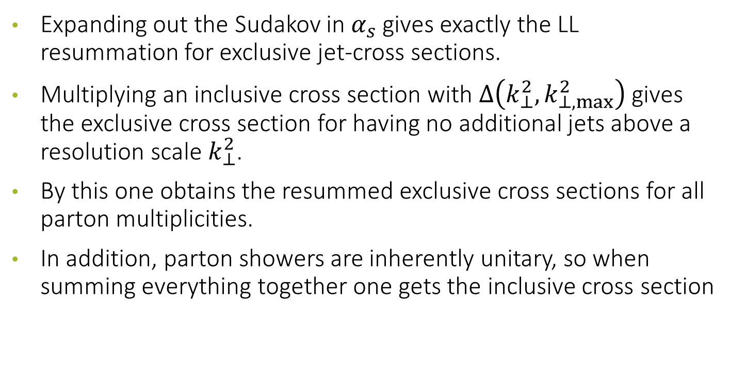
Comments
Expanding out the Sudakov in $α_{s}$ gives exactly the LL resummation for exclusive jet-cross sections.
Multiplying an inclusive cross section with $Δ\left(k_{⊥}^{2},k_{⊥,max}^{2}\right)$gives the exclusive cross section for having no additional jets above a resolution scale $k_{⊥}^{2}$.
By this one obtains the resummed exclusive cross sections for all parton multiplicities.
In addition, parton showers are inherently unitary, so when summing everything together one gets the inclusive cross section

Slide 19
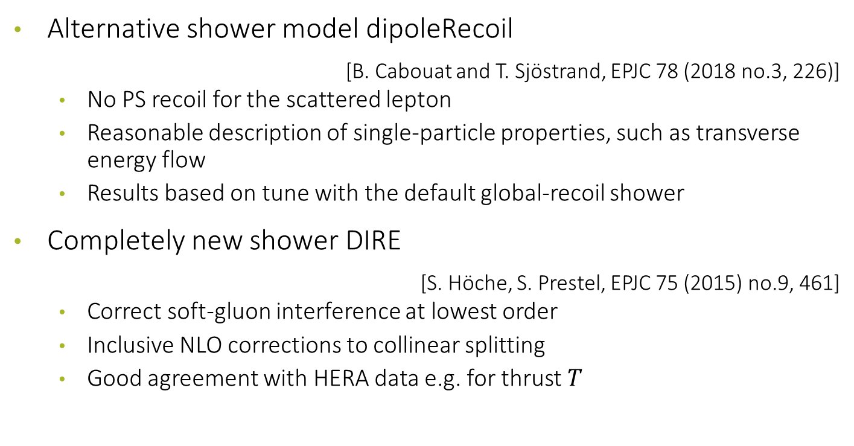
Parton Shower in PITHIA8
Alternative shower model dipoleRecoil
[B. Cabouat and T. Sjöstrand, EPJC 78 (2018 no.3, 226)]
  No PS recoil for the scattered lepton
  Reasonable description of single-particle properties, such as transverse energy flow
  Results based on tune with the default global-recoil shower
Completely new shower DIRE
[S. Höche, S. Prestel, EPJC 75 (2015) no.9, 461]
  Correct soft-gluon interference at lowest order
  Inclusive NLO corrections to collinear splitting
  Good agreement with HERA data e.g. for thrust $T$

Slide 20
mode PartonShowers:model
option 1 : Simple Showers. This is the "old" shower framework that has its roots in PYTHIA 6 and has been distributed with PYTHIA 8 since the beginning. It also has some special features that the other two don't.
option 2 : VINCIA Showers. Based on sequences of pT-ordered 2→3 branchings, the VINCIA shower model is similar to that of ARIADNE, which it resembles strongly for final-state evolution while VINCIA adopts a different (backwards-evolution) picture for initial-state radiation. The branching kernels, known as antenna functions, treat coherent sums of parton pairs without requiring a separation into "radiators" and "spectators". The current PYTHIA implementation includes QCD and QED 2→3 branchings with full mass dependence and, for the latter, multipole interference effects.
option 3 : Dire Showers. Dire (short for Dipole resummation) implements a transverse-momentum ordered dipole shower in which radiator-spectator particle pairs evolve simultaneously. The emission phase space is fully symmetric between radiator and spectator, while the overall emission probability is separated into two pieces corresponding that are enhanced (suppressed) in region collinear (anti-collinear) to the radiator or the spectator, respectively. Dire includes QCD and QED emissions, a detailed treatment of (quark/lepton) mass effects, and is set up to include higher-order corrections, such as triple-collinear or double-soft parton emissions.
There are some differences between the showers to be aware of
  The Dire shower comes with a nontrivial variable weight. It is therefore important that results for each event are weighted by the event weight in pythia.info.weight()/
  While all three shower models do ordinary QCD and QED radiation, beyond that the capabilities vary.
  Tuned parameter values for PYTHIA's modeling of nonperturbative physics are normally only valid for the specific shower model they were tuned with,

Slide 21
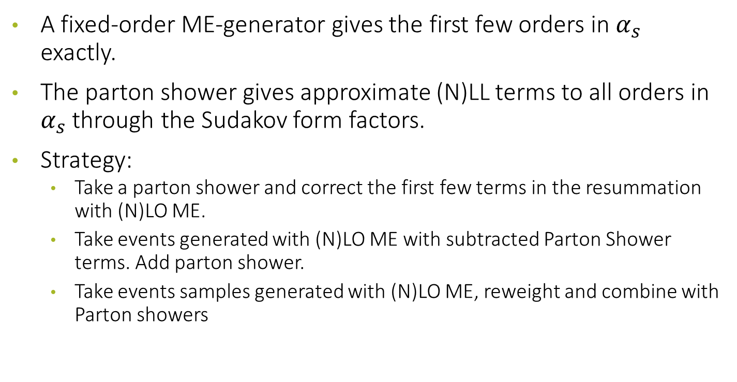
Matching and Merging — The Basic Idea
A fixed-order ME-generator gives the first few orders in $α_{s}$ exactly.
The parton shower gives approximate (N)LL terms to all orders in
$α_{s}$ through the Sudakov form factors.
Strategy:
  Take a parton shower and correct the first few terms in the resummation with (N)LO ME.
  Take events generated with (N)LO ME with subtracted Parton Shower terms. Add parton shower.
  Take events samples generated with (N)LO ME, reweight and combine with Parton showers

Slide 22
Tree-level Merging
Combines samples of tree-level (LO) ME-generated events for different jet multiplicities. Reweights with proper Sudakov form factors.
Needs a merging scales to separate ME and shower region and avoid double counting. Only observables involving jets above that scale will be correct to LO.
Typically the merging scale dependence is beyond the precision of the shower

Slide 23
Phenomenological modelling
PDFs: DGLAP-based fitted to data
Particle Decays: measured and modelled
Hadronization: Non-perturbative modelling
Multi-parton interactions: (Non-)perturbative modelling

Slide 24
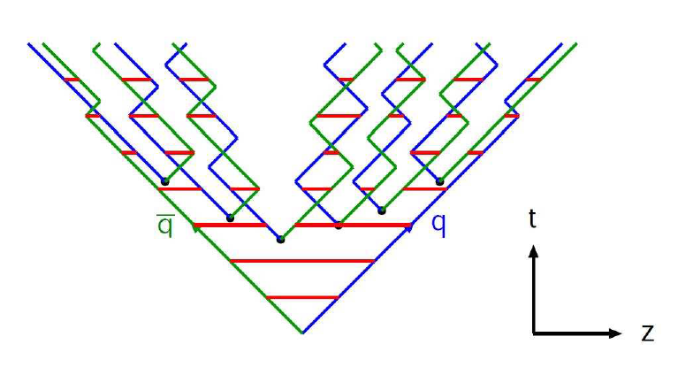

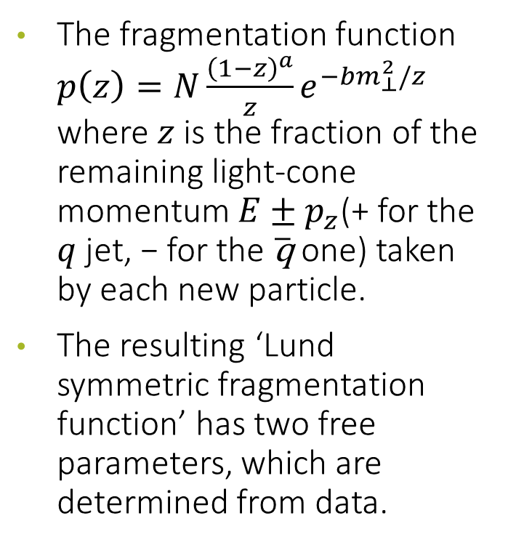
Hadronization: the Lund Model
The fragmentation function $p\left(z\right)=N\frac{{\left(1−z\right)}^{a}}{z}e^{−bm_{⊥}^{2}/z}$ where $z$ is the fraction of the remaining light-cone momentum $E±p_{z}$(+ for the $q$ jet, − for the $\overline{\text{q}}$ one) taken by each new particle.
The resulting ‘Lund symmetric fragmentation function’ has two free parameters, which are determined from data.
The tunneling function
$$𝒫=e^{−\frac{πm_{q⊥}^{2}}{κ}}≡e^{−\frac{πm_{q}^{2}}{κ}}e^{−\frac{πp_{⊥}^{2}}{κ}}$$
$κ$, the string tension, $≈1\frac{GeV}{fm}≈0.2 {GeV}^{2}$.

Slide 25
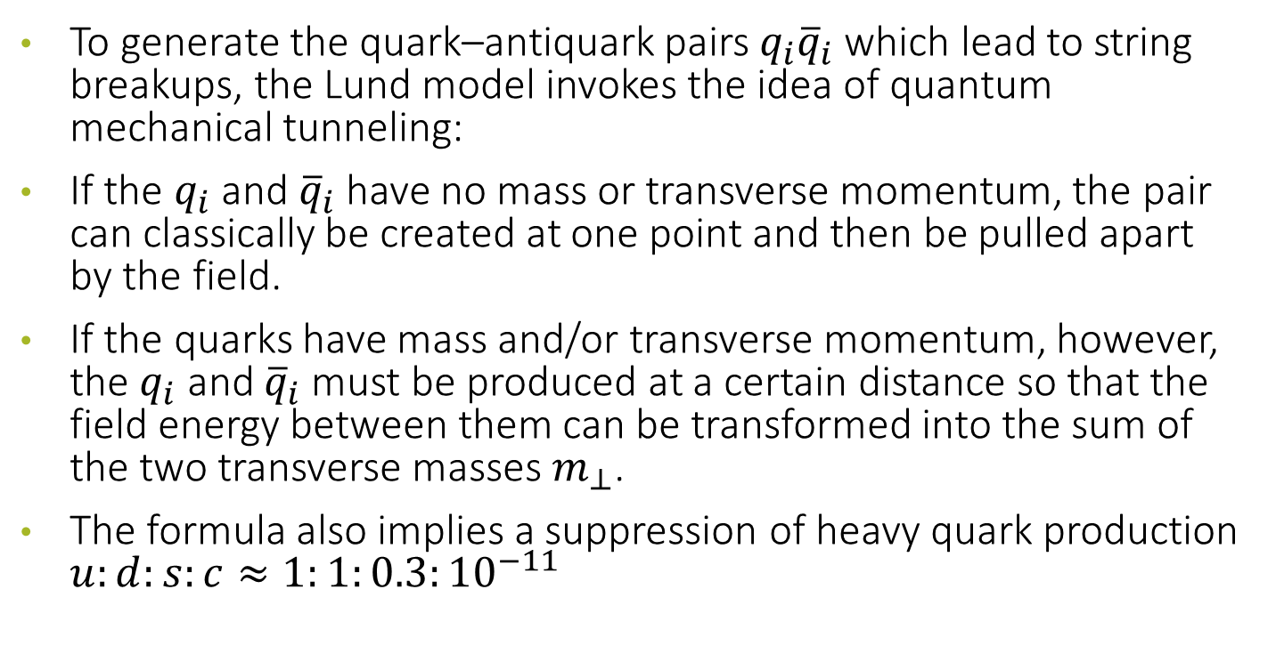
Tunneling
To generate the quark–antiquark pairs $q_{i}{\overline{q}}_{i}$ which lead to string breakups, the Lund model invokes the idea of quantum mechanical tunneling:
If the $q_{i}$ and ${\overline{q}}_{i}$ have no mass or transverse momentum, the pair can classically be created at one point and then be pulled apart by the field.
If the quarks have mass and/or transverse momentum, however, the $q_{i}$ and ${\overline{q}}_{i}$must be produced at a certain distance so that the field energy between them can be transformed into the sum of the two transverse masses $m_{⊥}$.
The formula also implies a suppression of heavy quark production $u:d:s:c≈1:1:0.3:{10}^{−11}$

Slide 26
Hadronization for low energy collisions:
The Lund String model is non-perturbative, but it requires high energy.
In the process one can chop off hadrons from either end randomly, but in the end we are left with a tiny string piece which we don’t know how to treat.
As soon as the string mass goes below ∼ 10 GeV it is forced the decay into two hadrons.

Slide 27
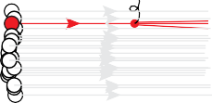

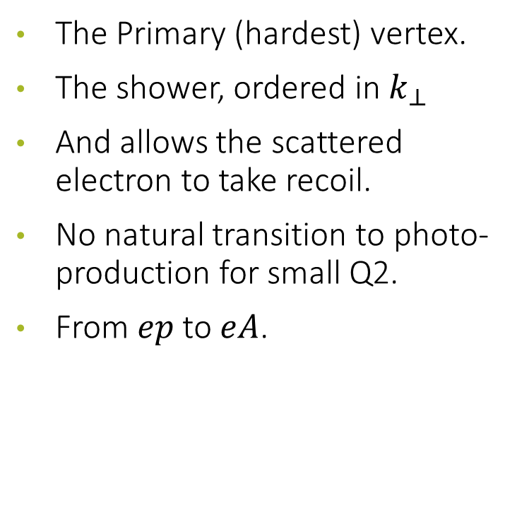


DIS as view from MCEG
The Primary (hardest) vertex.
The shower, ordered in $k_{⊥}$
And allows the scattered electron to take recoil.
No natural transition to photo-production for small Q2.
From $ep$ to $eA$.
_{e}−
$$k_{1,⊥}<Q$$
HADRONISATION
$$k_{2⊥}<k_{1⊥}$$
$$k_{3⊥}<k_{2⊥}$$
p
A

Slide 28


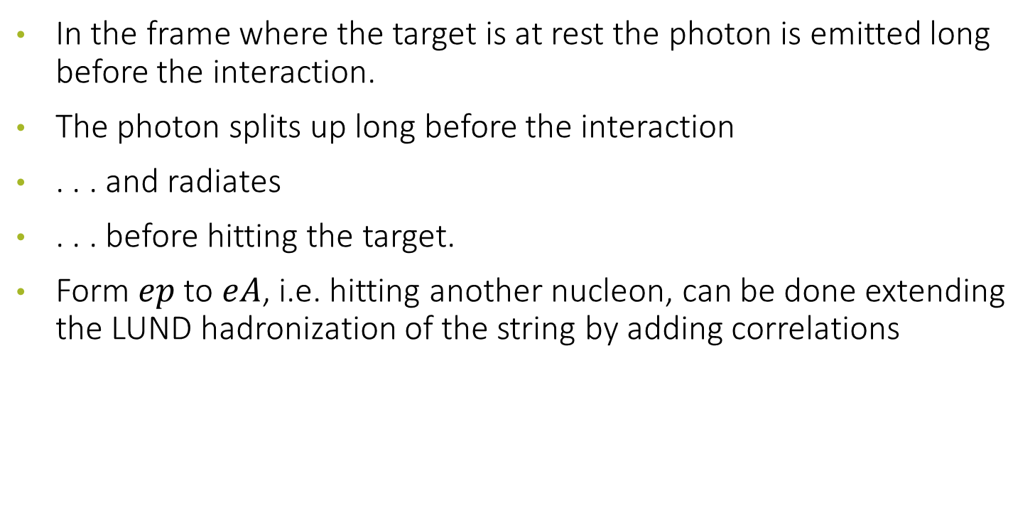

The dipole picture for DIS
In the frame where the target is at rest the photon is emitted long before the interaction.
The photon splits up long before the interaction
. . . and radiates
. . . before hitting the target.
Form $ep$ to $eA$, i.e. hitting another nucleon, can be done extending the LUND hadronization of the string by adding correlations
$$z$$
$$R\sim 1/Q$$
$$1−z$$

Slide 29
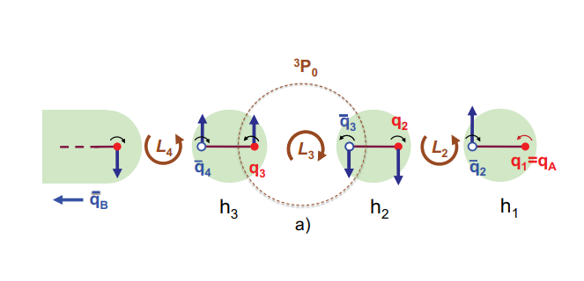



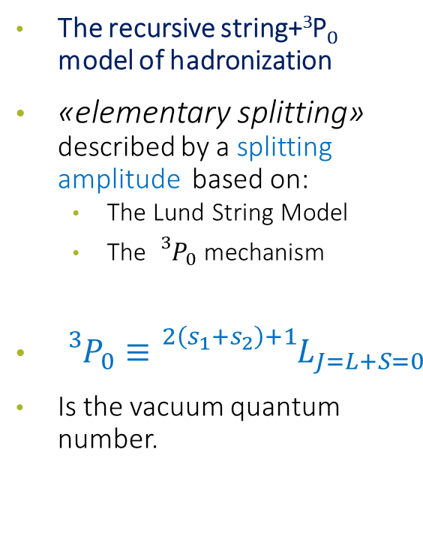















StringSpinner: polarized quarks in PYTHIA
StringSpinner [Kerbizi, L$\ddot{o}$nnblad, CPC 272 (2022) 108234]
The recursive string+³P₀ model of hadronization
«elementary splitting» described by a splitting amplitude based on:
  The Lund String Model
  The ${}_{}^{3}{P_{0}}$ mechanism
${}_{}^{3}{P_{0}≡}{}_{}^{2\left(s_{1}+s_{2}\right)+1}{L_{J=L+S=0}}$
Is the vacuum quantum number.
$$l′$$
$$l$$
$$γ^{∗}$$
$$q$$
$$\hat{σ}$$
$$π$$
$$q_{2}$$
$$K$$
from PYTHIA
$$ρ$$
$$π$$
$$π$$
$$ω$$
$$π$$
PDF
beam remnants
$$π$$
$$h_{N}$$
$$π$$
$f_{1}^{q}(x,Q^{2})$
$h_{1}^{q}\left(x\right)$ from parametrizations

Slide 30


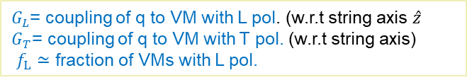


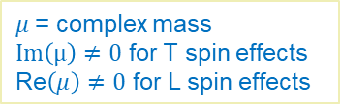
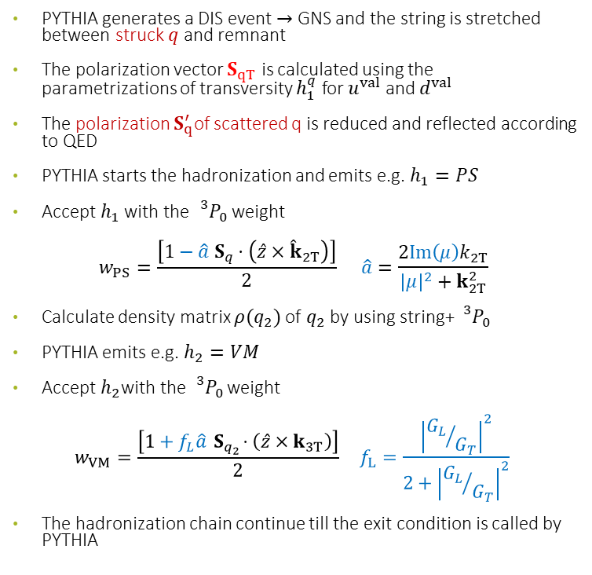







Spin effects in PYTHIA
PYTHIA generates a DIS event $→$ GNS and the string is stretched between struck $q$ and remnant
The polarization vector $S_{qT}$ is calculated using the parametrizations of transversity $h_{1}^{q}$ for $u^{val}$ and $d^{val}$
The polarization $S_{q}^{′}$of scattered q is reduced and reflected according to QED
PYTHIA starts the hadronization and emits e.g. $h_{1}=PS$
Accept $h_{1}$ with the ${}_{}^{3}{P_{0}}$ weight
$$w_{PS}=\frac{\left[1−\hat{a} S_{q}⋅\left(\hat{z}×{\hat{k}}_{2T}\right)\right]}{2} \hat{a}=\frac{2Im\left(μ\right)k_{2T}}{{\left|μ\right|}^{2}+k_{2T}^{2}}$$
Calculate density matrix $ρ(q_{2})$of $q_{2}$ by using string+ ${}_{}^{3}{P_{0}}$
PYTHIA emits e.g. $h_{2}=VM$
Accept $h_{2}$with the ${}_{}^{3}{P_{0}}$ weight
$$w_{VM}=\frac{\left[1+f_{L}\hat{a}{ S}_{q_{2}}⋅\left(\hat{z}×k_{3T}\right)\right]}{2} f_{L}=\frac{{\left|{G_{L}}/{G_{T}}\right|}^{2}}{2+{\left|{G_{L}}/{G_{T}}\right|}^{2}}$$
The hadronization chain continue till the exit condition is called by PYTHIA
$$h_{n}$$
$$h_{2}(p_{2})$$
$$h_{1}(p_{1})$$
$$q_{3}(S_{q_{3}},k_{3T})$$
$$q_{2}(S_{q_{2}},k_{2T})$$
$$(qq)$$
$$q{(S}_{q}^{′},0_{T})$$
γ*
$$S_{qT}=\frac{h_{1}^{q}}{f_{1}^{q} }S_{T}^{Nucl.}$$
$$q$$
$$l$$
Nucleon
$$l′$$
$G_{L}$= coupling of q to VM with L pol. (w.r.t string axis $\hat{z}$)
$G_{T}$= coupling of q to VM with T pol. (w.r.t string axis)
$f_{L}≃$ fraction of VMs with L pol.
$μ$= complex mass
$Im\left(μ\right)≠0$ for T spin effects
Re$\left(μ\right)≠0$ for L spin effects

Slide 31
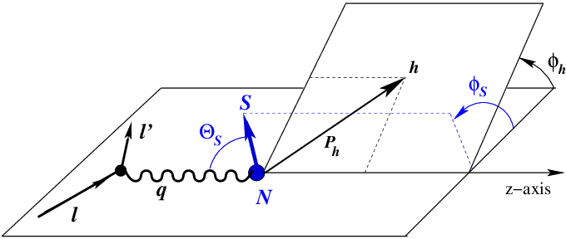
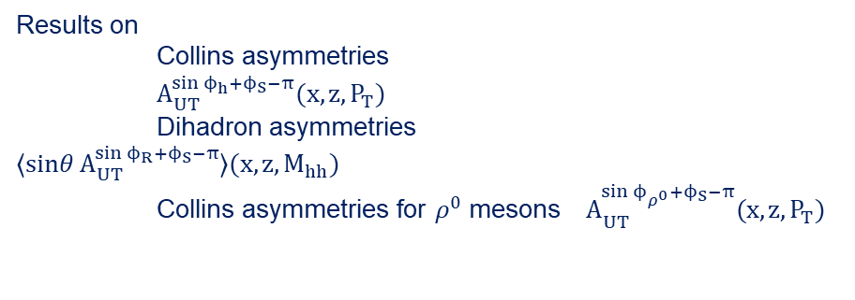


Simulations of SIDIS with transversely polarized protons
COMPASS and HERMES kinematics
$$γ^{∗}$$
$$P_{T}$$
Results on
Collins asymmetries $A_{UT}^{\sin{ϕ_{h}+ϕ_{S}−π}}(x,z,P_{T})$
Dihadron asymmetries $⟨sinθ A_{UT}^{\sin{ϕ_{R}+ϕ_{S}−π}}⟩(x,z,M_{hh})$
Collins asymmetries for $ρ^{0}$ mesons $A_{UT}^{\sin{ϕ_{ρ^{0}}+ϕ_{S}−π}}(x,z,P_{T})$

Slide 32
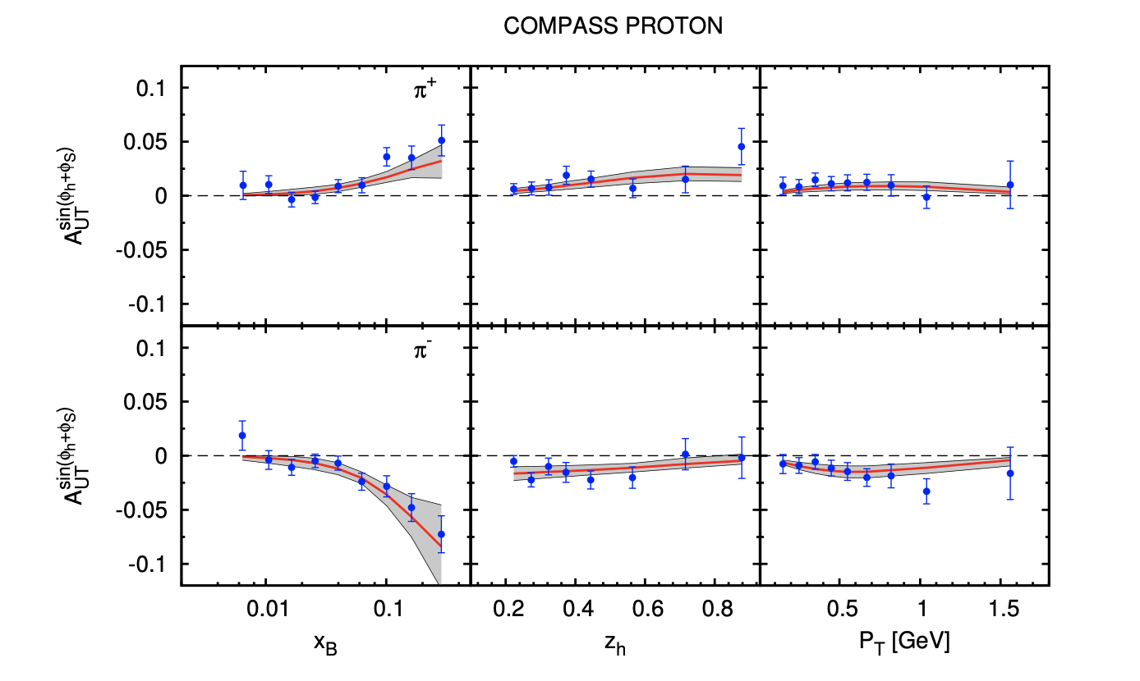


Collins asymmetries for $π$ and $K$ @ COMPASS
$$π^{+}$$
$$π^{−}$$
Anselmino et al, PRD 92 (11) (2015) 114023
Satisfactory description
Kang et al., PRD 93 (1) (2016) 014009

Slide 33
Collins asymmetries for $π$ and $K$ @ COMPASS
Satisfactory description also for kaons

Slide 34


Collins asymmetries for $π$ and $K$ @ HERMES
Smaller $π^{−}$asymmetries for x>0.2 in simulations
$π^{0}$ in simulations as expected by isospin

Slide 35
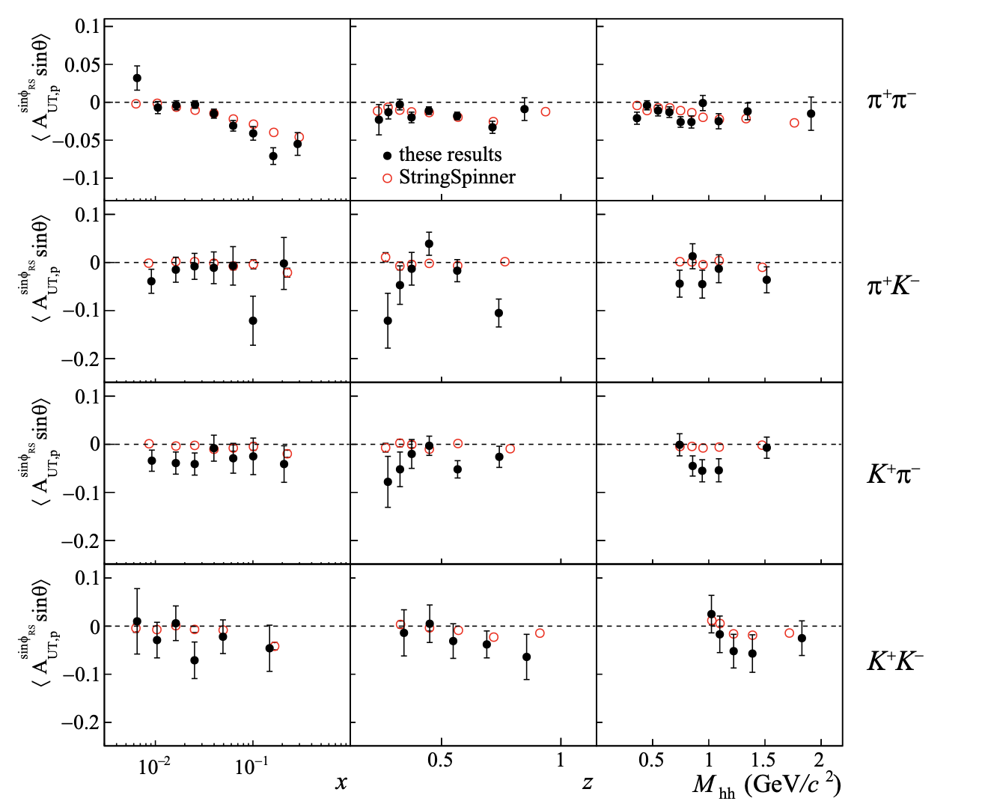
Dihadron asymmetries

Slide 36
What was learn from HERA
First point: no GPEG can reproduce small-x final states at HERA, why should we believe the small-x ISR modelling at LHC.
  Complex interplay with MPI
  Deficiencies circumvented by ME matching/merging.
  Formal precision more important than accuracy.
  At high energies non-perturbative effect are small.
Electron–Ion Collider
  Extrapolate HERA to lower energies
  Extrapolate HI@LHC/RHIC to lower energies
  Non-perturbative effect no-longer small.

Slide 37
herwig

Slide 38
HERWIG
https://herwig.hepforge.org
Simon Platzer @ MCEGs for future ep and eA facilities, Wien 2019

Slide 39
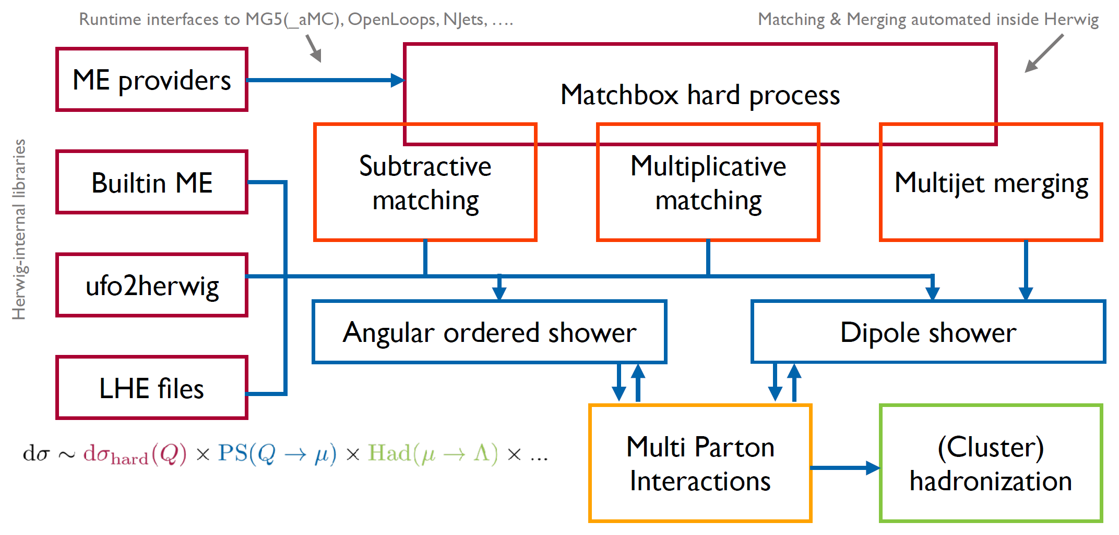
Herwig flow chart

Slide 40
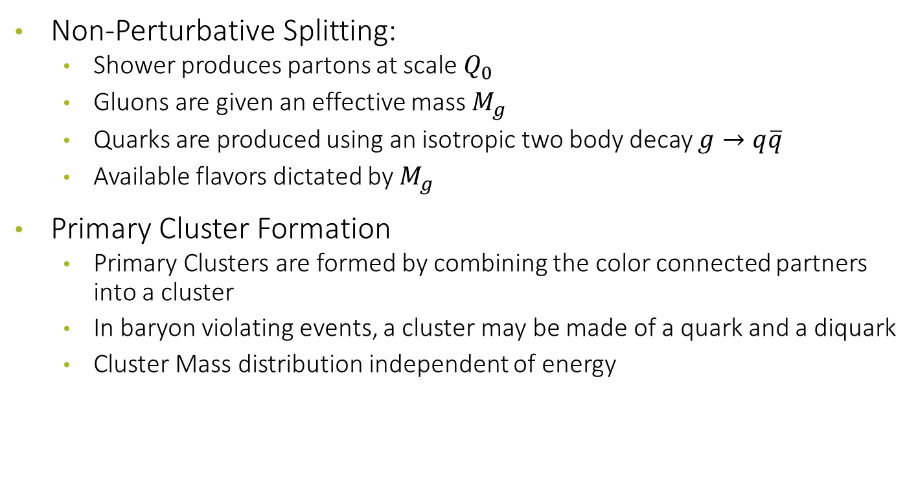
Herwig Cluster Model for Hadronization
Non-Perturbative Splitting:
  Shower produces partons at scale $Q_{0}$
  Gluons are given an effective mass $M_{g}$
  Quarks are produced using an isotropic two body decay $g→q\overline{q}$
  Available flavors dictated by $M_{g}$
Primary Cluster Formation
  Primary Clusters are formed by combining the color connected partners into a cluster
  In baryon violating events, a cluster may be made of a quark and a diquark
  Cluster Mass distribution independent of energy

Slide 41
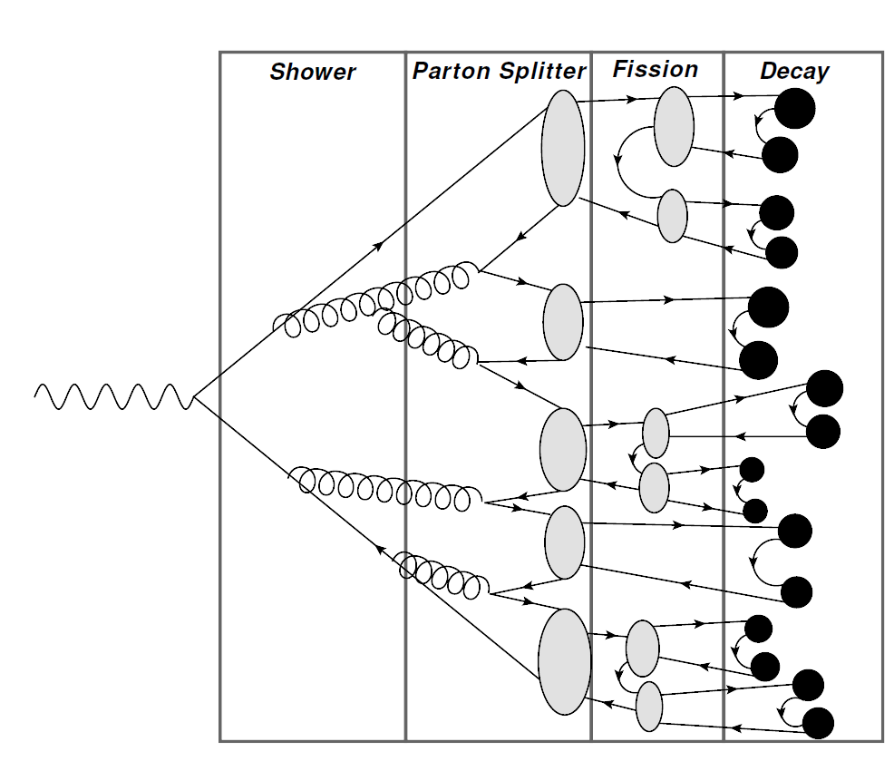
Hadronization Steps

Slide 42
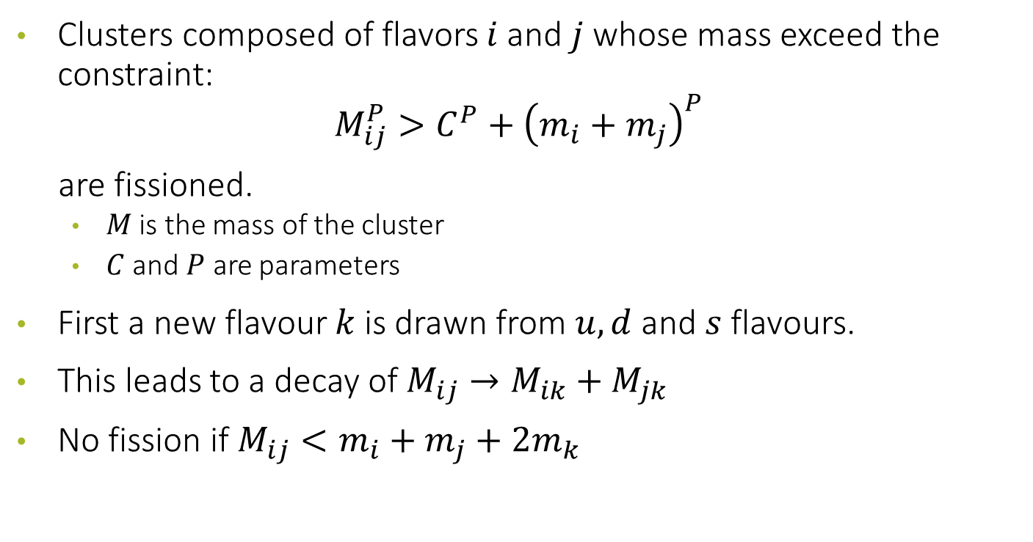
Cluster Fission
Clusters composed of flavors $i$ and $j$ whose mass exceed the constraint:
$$M_{ij}^{P}>C^{P}+{\left(m_{i}+m_{j}\right)}^{P}$$
are fissioned.
  $M$ is the mass of the cluster
  $C$ and $P$ are parameters
First a new flavour $k$ is drawn from $u,d$ and $s$ flavours.
This leads to a decay of $M_{ij}→M_{ik}+M_{jk}$
No fission if $M_{ij}<m_{i}+m_{j}+2m_{k}$

Slide 43
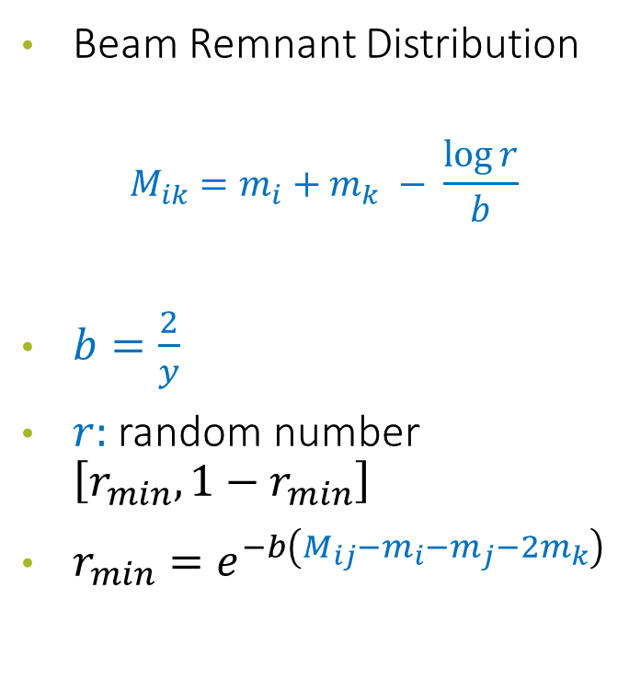
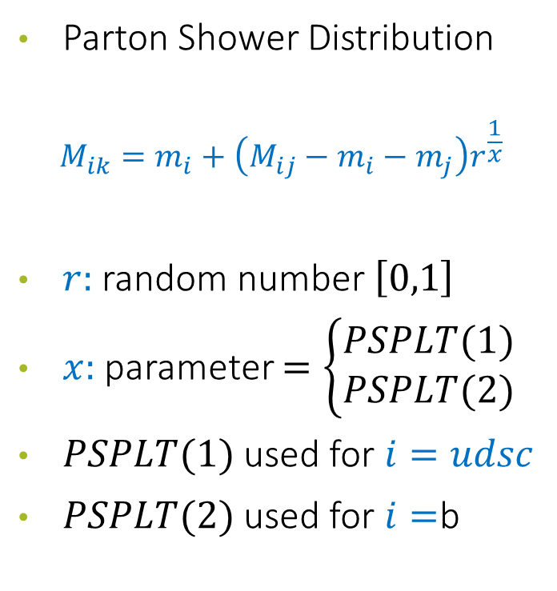
Mass Distribution for current and remnant
Parton Shower Distribution
$$M_{ik}=m_{i}+\left(M_{ij}−m_{i}−m_{j}\right)r^{\frac{1}{x}}$$
$r:$ random number $\left[0,1\right]$
$x:$ parameter $=\left\{\begin{matrix}PSPLT(1) \\ PSPLT(2)\end{matrix}\right.$
$PSPLT(1)$ used for $i=udsc$
$PSPLT(2)$ used for $i=$b
Beam Remnant Distribution
$$M_{ik}=m_{i}+m_{k} − \frac{\log{r}}{b}$$
$b=\frac{2}{y}$
$r:$ random number $\left[r_{min},1−r_{min}\right]$
$r_{min}=e^{−b\left(M_{ij}−m_{i}−m_{j}−2m_{k}\right)}$

Slide 44
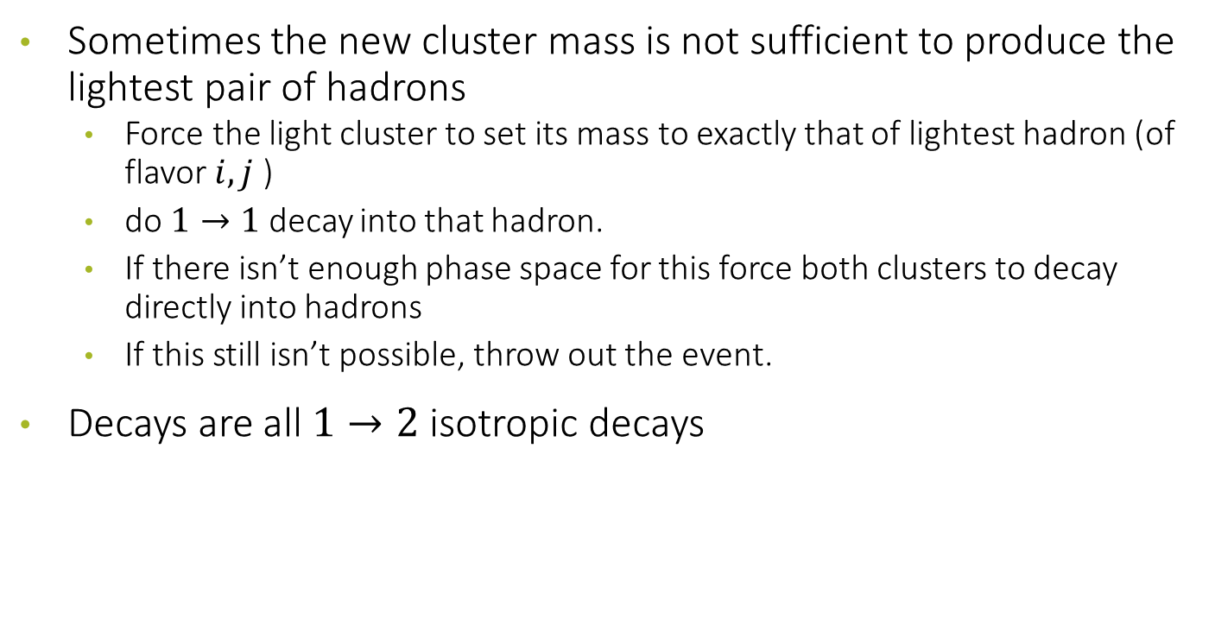
Cluster Fission
Sometimes the new cluster mass is not sufficient to produce the lightest pair of hadrons
  Force the light cluster to set its mass to exactly that of lightest hadron (of flavor $i,j$ )
  do $1→1$ decay into that hadron.
  If there isn’t enough phase space for this force both clusters to decay directly into hadrons
  If this still isn’t possible, throw out the event.
Decays are all $1→2$ isotropic decays

Slide 45
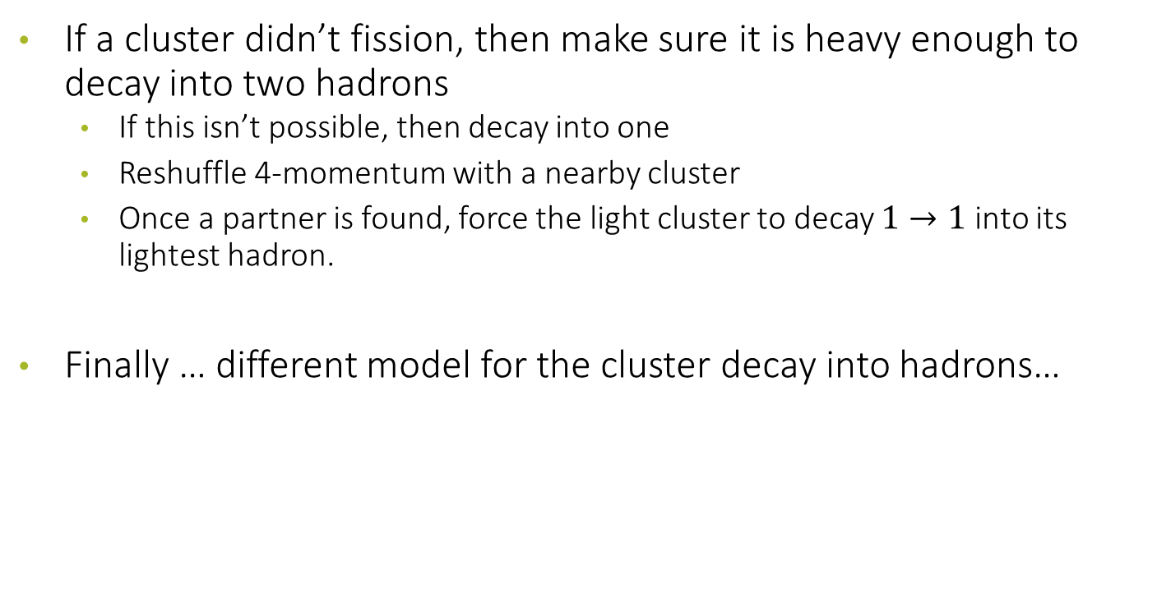
Light Clusters
If a cluster didn’t fission, then make sure it is heavy enough to decay into two hadrons
  If this isn’t possible, then decay into one
  Reshuffle 4-momentum with a nearby cluster
  Once a partner is found, force the light cluster to decay $1→1$ into its lightest hadron.
Finally … different model for the cluster decay into hadrons…

Slide 46
DedicateD MCEG: BEAGLE

Slide 47
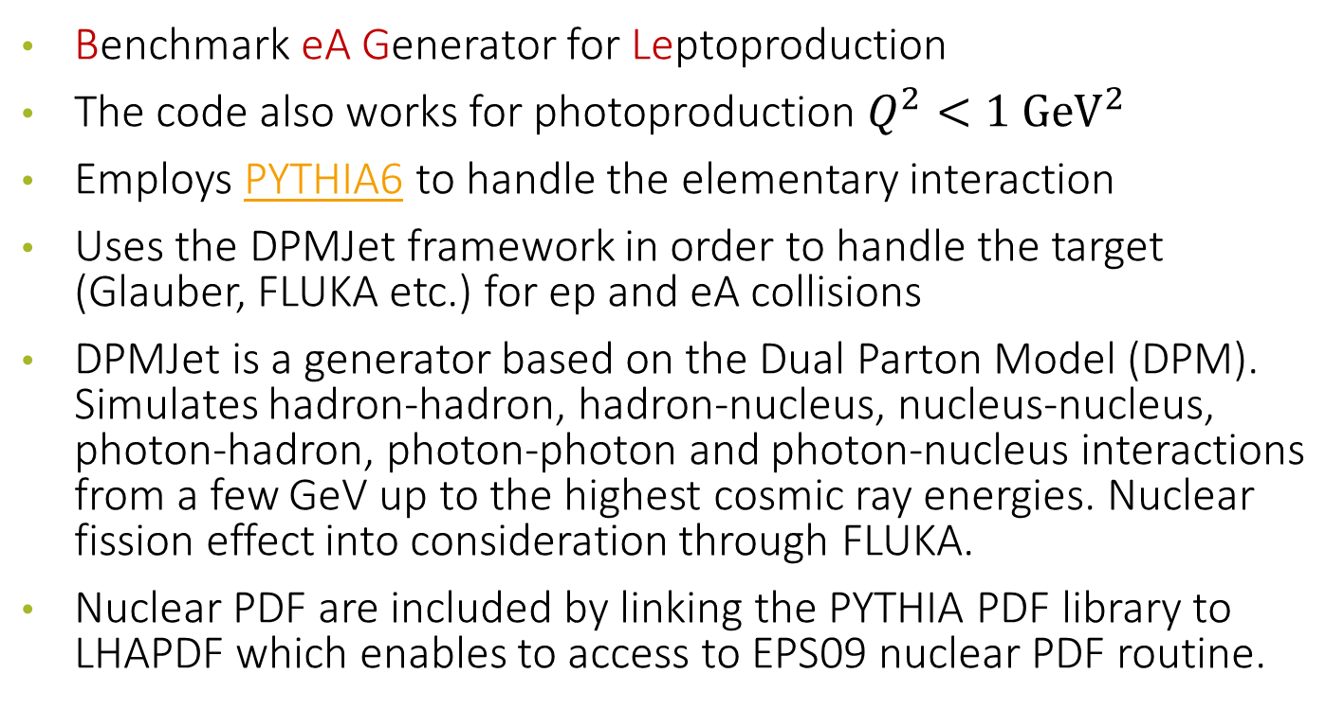
BeAGLE
Benchmark eA Generator for Leptoproduction
The code also works for photoproduction $Q^{2}<1 {GeV}^{2}$
Employs PYTHIA6 to handle the elementary interaction
Uses the DPMJet framework in order to handle the target (Glauber, FLUKA etc.) for ep and eA collisions
DPMJet is a generator based on the Dual Parton Model (DPM). Simulates hadron-hadron, hadron-nucleus, nucleus-nucleus, photon-hadron, photon-photon and photon-nucleus interactions from a few GeV up to the highest cosmic ray energies. Nuclear fission effect into consideration through FLUKA.
Nuclear PDF are included by linking the PYTHIA PDF library to LHAPDF which enables to access to EPS09 nuclear PDF routine.
https://eic.github.io/software/beagle.html

Slide 48
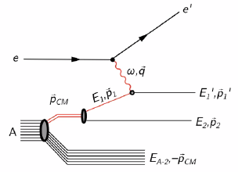
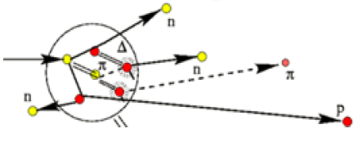
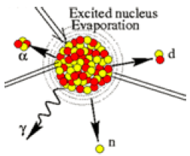
BeAGLE Structure
Primary interaction
Hadronization
Intra-nuclear cascade
Nuclear remnant evaporation & breakup
Done with PYTHIA6, while Glauber is handled by BeAGLE, PyQM: Nuclear Geometry + optional gluon radiation in medium
Handled by PYTHIA6
Cascade process handled by DPMJET
Nuclear remnant evaporation and break up by FLUKA

Slide 49
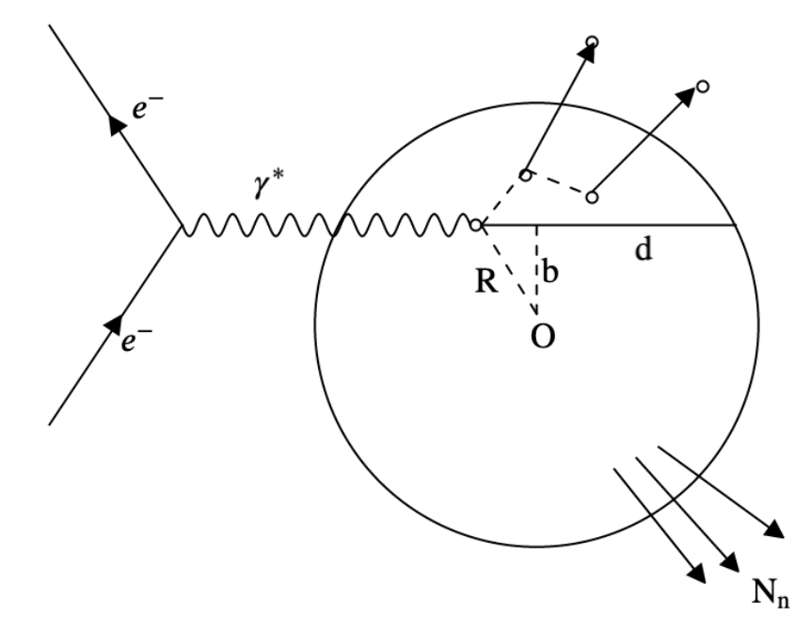

Schematics
Experimental handle:
  Use the total (neutron) energy deposited in Zero-Degree Calorimeter
  Forward neutron emissions, or evaporated neutrons, are correlated with the following parameters:
Impact parameter $b$
Travelling distance $d$
Nuclear thickness $T\left(b\right)$
$$\frac{T\left(b\right)}{ρ_{0}}=\int_{−∞}^{+∞}{dz\frac{ρ\left(b,z\right)}{ρ_{0}}}$$

Slide 50
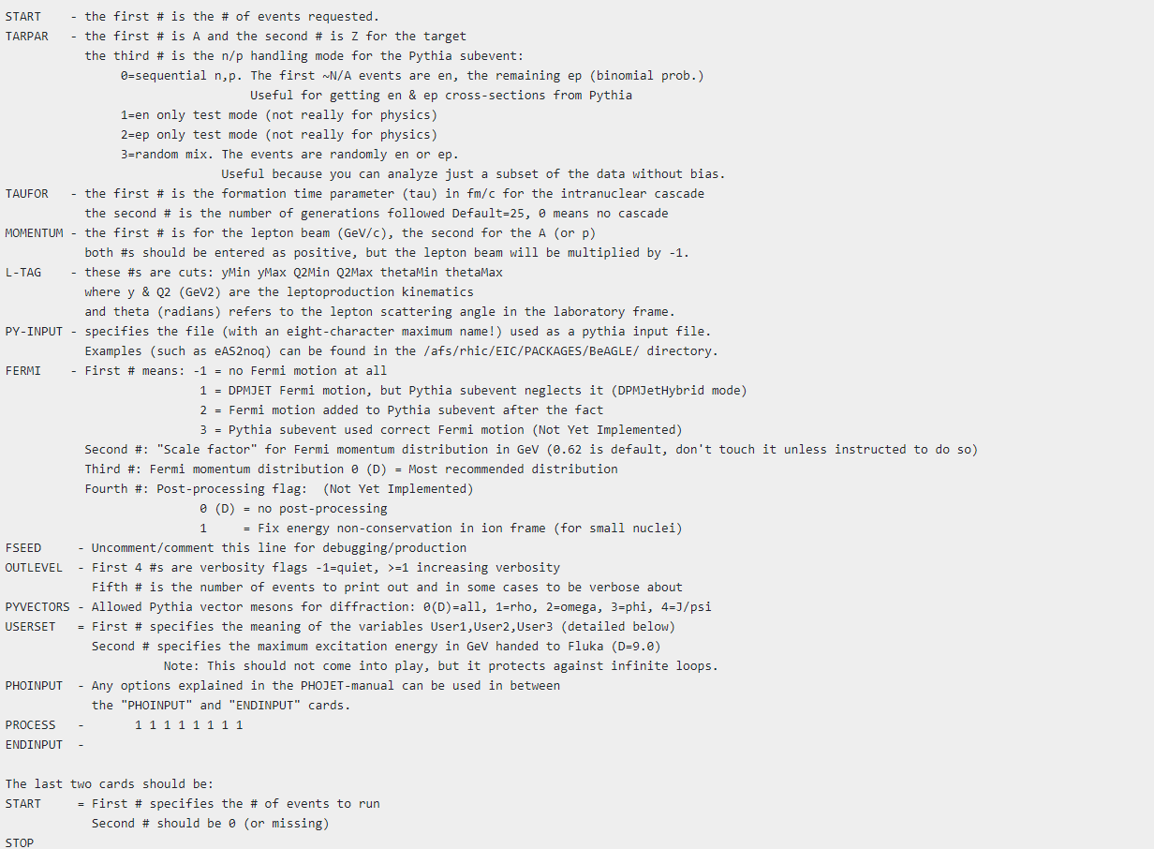
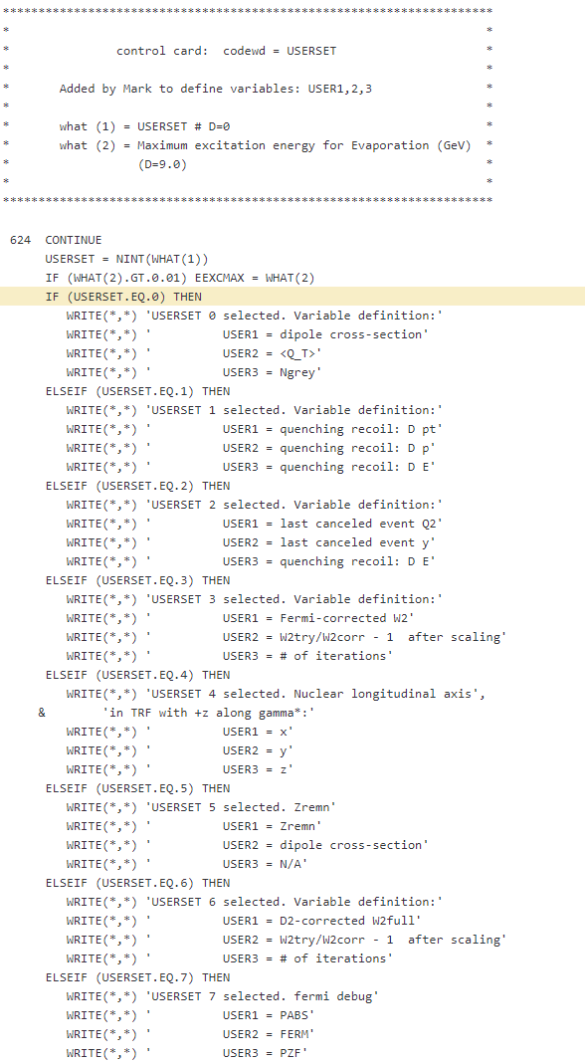
BeAGLE Control Card

Slide 51
DedicateD MCEG: EPIC
Exclusive processes

Slide 52
EpIC: MCEG for exclusive processes
Generic
→ to be used at CERN, JLab, EIC, … (no more “home-made” generators)
Multichannel (DVCS, TCS, DVMP, …) capability
→ what is available in PARTONS will be available in new MC generator
Modularity
→ for flexibility and simplicity
Well developed
→ good coding practices, use modern programming language (c++) and paradigms
Easy to maintain
→ we expect at least 20 years of lifetime, project must be well designed and properly established, must have useful documentation
Robust
Multithreaded
https://pawelsznajder.github.io/epic/

Slide 53
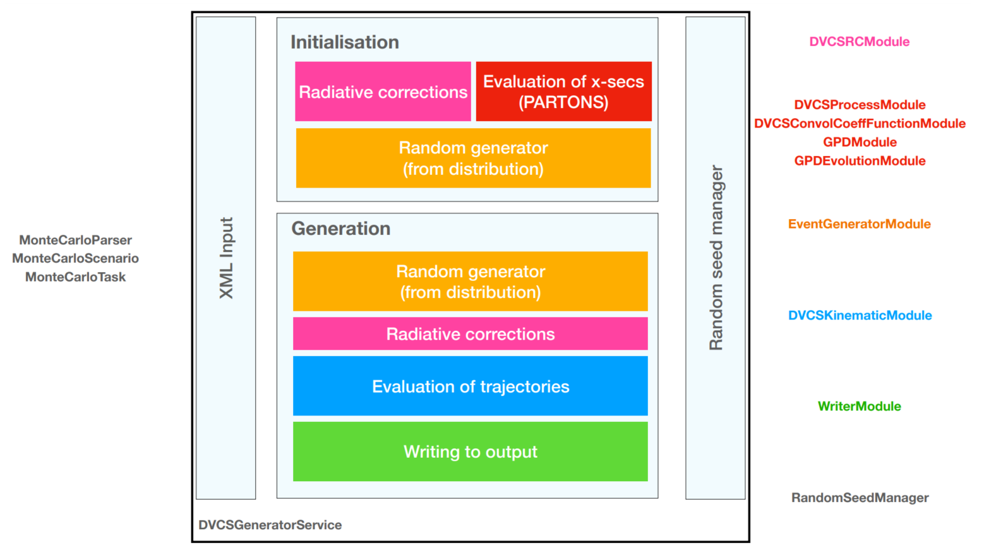
EpIC Scheme

Slide 54
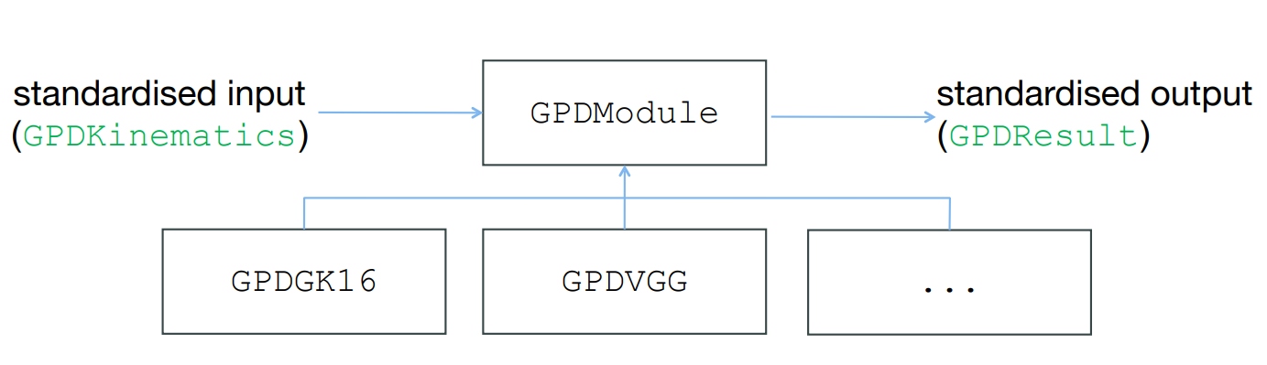
GPDModule
benefiting from C++ inheritance and polymorphism mechanisms
reduction of mistake probability
adding new modules as easy as possible

Slide 55
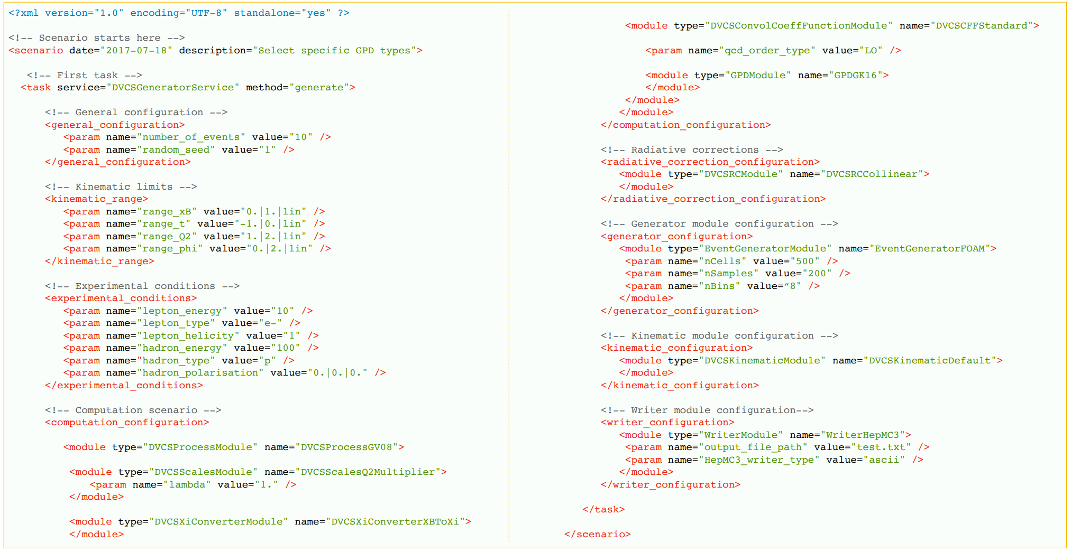
XML input

Slide 56
DedicateD MCEG: estarlight
Exclusive processes

Slide 57
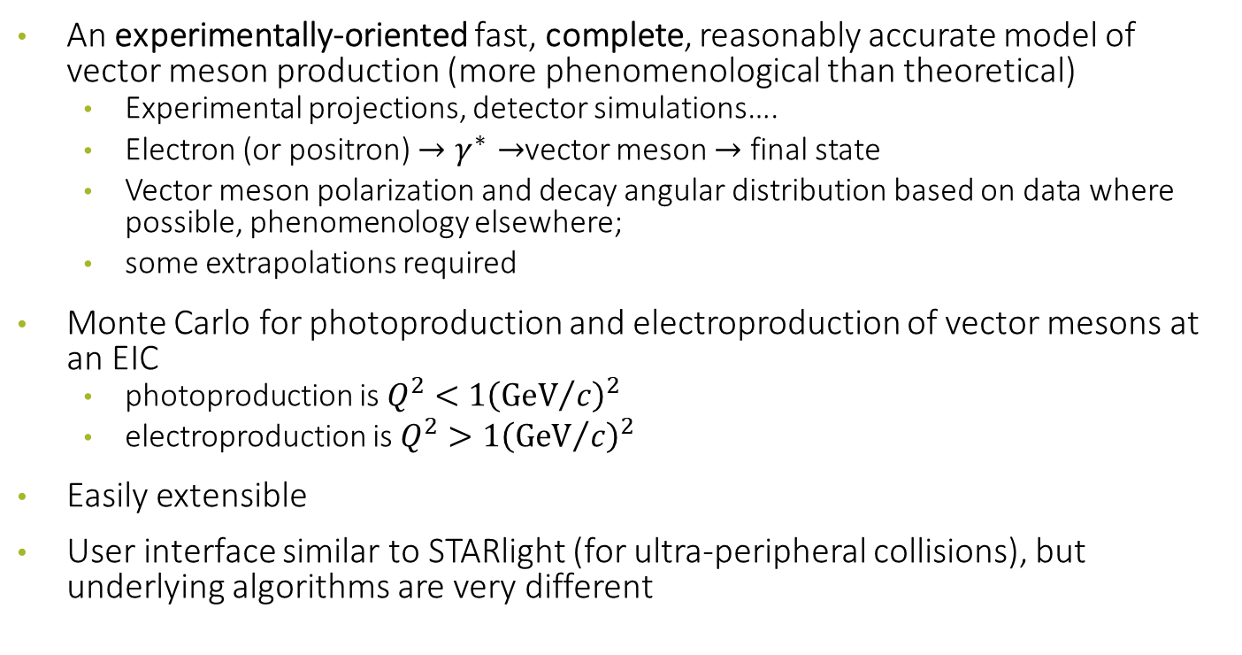
eSTARlight
An experimentally-oriented fast, complete, reasonably accurate model of vector meson production (more phenomenological than theoretical)
  Experimental projections, detector simulations….
  Electron (or positron) $→γ^{∗}→$vector meson $→$ final state
  Vector meson polarization and decay angular distribution based on data where possible, phenomenology elsewhere;
  some extrapolations required
Monte Carlo for photoproduction and electroproduction of vector mesons at an EIC
  photoproduction is $Q^{2}<1{\left({GeV}/c\right)}^{2}$
  electroproduction is $Q^{2}>1{\left({GeV}/c\right)}^{2}$
Easily extensible
User interface similar to STARlight (for ultra-peripheral collisions), but underlying algorithms are very different
M. Lomnitz & S. Klein, Phys. Rev. C99, 015203 (2019) 2

Slide 58
Initial states
Electron (or positron)
Protons
Light ions (Z<7), modelled with a Gaussian distribution
Heavy ions, modelled with a Woods-Saxon distribution
For protons, lead, gold, zirconium, ruthenium, xenon or copper parameters are from electron scattering data
  No neutron halo
For other nuclei, radii are determined from simple formulae
Nuclear properties are easy to change if desired
Arbitrary beam energies…

Slide 59

Final states
$ρ, ω, φ, ρ′$, $ρ$ + direct $ππ$, with interference
  Simple states decayed in STARlight
  Complex final states via PYTHIA interface
  Easily extensible
Incoherent photonuclear interactions performed with DPMJET
eSTARlight tracks: outgoing electron & proton/nucleon
eSTARlight outputs: photon 4-vector
HEPMC3 format available
PS: very useful to calculate SIDIS contamination…Example for COMPASS with HEPgen++ later on

Slide 60

Cross section for electronuclear interaction
Comes as a convolution of the photon flux from the electron with the cross section, both depending on $Q^{2}:$
$$σ\left(eX→eX+V.M.\right)=\int{dQ^{2}}\int{dE_{γ}\frac{dN_{γ}\left(E_{γ},Q^{2}\right)}{dE_{γ}dQ^{2}}}σ_{γX}\left(W,Q^{2}\right)$$
Photon flux depends on virtuality:
$$\frac{dN_{γ}\left(E_{γ},Q^{2}\right)}{dE_{γ}dQ^{2}}=\frac{α}{π}\frac{1}{E_{γ}Q^{2}}\left[1−\frac{E_{γ}}{E_{e}}+\frac{1}{2}{\left(\frac{E_{γ}}{E_{e}}\right)}^{2}−\left(1−\frac{E_{γ}}{E_{e}}\right)\frac{Q_{min}^{2}}{Q^{2}}\right]$$
Parametrization from HERA data:
$$σ_{γp}={\left(\frac{1}{1+\left(\frac{Q^{2}}{M_{VM}^{2}}\right)}\right)}^{c_{1}{+c}_{2}\left(Q^{2}+M_{VM}^{2}\right)}σ_{γp}\left(W\right) where σ_{γp}\left(W\right)=σ_{P}W^{ε}+σ_{M}W^{η}$$

Slide 61




Vector Meson decays
Vector mesons retain the spin of the incident photon
For $Q^{2}→0$, s-channel helicity conservation means that the vector mesons are transversely polarized to the beam direction
As $Q^{2}$ rises, longitudinal polarization rises
The $Q^{2}$ dependence of the transverse to longitudinal polarization ratio is not well known
HERA data (COMPASS data as well) are parametrized in terms of spin-matrix elements
Only known for some mesons; use most similar meson where needed
$$R^{VM}=\frac{1}{ε}\frac{r_{00}^{04}}{1−r_{00}^{04}}$$

Slide 62


Nice comparison to HERA data

Slide 63


From $γp$ to $γ$A
One can model the $γ$A cross section using a quantum Glauber calculation, generalized vector meson dominance and the optical theorem:
$$σ_{tot}\left(VA\right)=\int{d^{2}b\left[2\left(1−e^{−σ_{tot}\left(Vp\right)T_{AA}\left(b\right)/2}\right)\right]}$$
$$σ_{γA→VA}={\left.\frac{dσ_{γA→VA}}{dt}\right|}_{t=0}\int_{t_{min}}^{∞}{dt{\left|F\left(t\right)\right|}^{2}}$$
For heavy mesons: ${\left.\frac{dσ}{dt}\right|}_{t=0}\sim A^{2}$; for the $ρ^{0}$, ${\left.\frac{dσ}{dt}\right|}_{t=0}\sim A^{4/3}$

Slide 64
Dedicated MCEG: DJANGOH
Radiative effects in SIDIS

Slide 65

The problem for SIDIS
Photon radiation from the muon lines changes the DIS kinematics on the event by event basis
The direction of the virtual photon is changed with respect to the one reconstructed from the muons
  This introduces false asymmetries in the azimuthal distribution of hadrons calculated with respect to the virtual photon direction
  Smearing of the kinematic distributions (f.i. $z$ and $P_{hT}$)
Due to the energy unbalance, in the lepton plane the true virtual photon direction is always at larger angles with respect to the reconstructed one
In SIDIS, having an hadron in the final state, only the inelastic part of the radiative corrections plays a role

Slide 66



Smearing of variables DIS

Slide 67


Smearing of variables SIDIS

Slide 68

RADIATIVE CORRECTIONS
Measure FFs, PDFs, etc. by comparing data with theoretical predictions:
$$σ_{exp}=σ_{theory}\left[PDFs, TMDs…\right]$$
High precision requires knowledge of higher-order corrections
$$σ_{theory}=σ^{\left(0\right)}\left[≡σ_{Born}\right]+α_{em}σ^{\left(1\right)}+α_{em}^{2}σ^{\left(2\right)}+…$$
Emission of real photons
  experimentally often not distinguished from non-radiative processes: soft photons, collinear photons
  ➔ ”radiative corrections”
Virtual corrections: loop diagrams
  needed to cancel infrared divergences

Slide 69




LEPTONIC RADIATION
Observed cross section: convolution of true cross section $⊗$ radiator function
$$dσ^{obs}\left(p,q\right)=\int_{exp {cond}^{′}s}{\frac{d^{3}\vec{k}}{2k^{0}}R\left(ℓ,ℓ^{′},k\right)dσ^{true}\left(p,q−k\right)}$$
Shifted kinematics: $q→ q−k$, e.g., $Q^{2}=−{\left(ℓ−ℓ′\right)}^{2}⟹{\tilde{Q}}^{2}=−{\left(ℓ−ℓ^{′}−k\right)}^{2}$
but integration may be restricted by experimental conditions, also indirectly:
  leptonic variables: measure $E$ and $θ$ of scattered lepton ➔ and $Q^{2}$
  real photon detection: possibility to reject radiative events by detecting the radiated photon
➔ expect strong dependence on experimental prescriptions for measuring kinematic variables
NOTE the ${\tilde{Q}}^{2}≪Q^{2}$ is possible: ${\tilde{Q}}_{min}^{2}=\frac{x^{2}}{1−x}M_{N}^{2}$
➔ Difficult to treat radiative and detector effects separately (acceptance cuts, efficiencies, ...)
need full Monte-Carlo treatment
$$k^{μ}$$
$$γ^{∗}\left(q^{μ}\right)$$

Slide 70


RADIATIVE CORRECTIONS
Three basic channels contribute to lepton-nucleus $ℓA$ scattering at different $Q^{2}$ and $ν$
These are the
  Elastic scattering $\left(ν={Q^{2}}/{2M_{A}}\right)$
  Quasi elastic scattering $\left(ν\sim {Q^{2}}/{2M_{N}}\right)$
  Inelastic scattering$\left(ν>{Q^{2}}/{2M_{N}}+m_{π}\right)$
At Born level, $Q^{2}$ and $ν$ are fixed by measuring energy and scattering angle of the lepton and the we can distinguish between the three processes.
In case of an extra (radiated) photon the fixing of $Q^{2}$ and from $θ$ and $E^{′}$ is removed and the photon has to be included in the kinematic calculation.

Slide 71

MC USED TO CHECK RC IN TMD SIDIS
DJANGOH (J. Kripfganz, H.-J. Möhring, A. Kwiatkowski, G. Schuler, K. Charchula, T. Martini, H. Spiesberger, djangoh)
  universal leptonic corrections at $ℴ\left(α_{E}\right)$,
  interface to QCD-based event generation: parton showers, jets, hadronic final state: LEPTO
  includes models for low $Q^{2}$ behavior:
    elastic tail,
    SOPHIA for low-mass hadronic final states
  includes option for polarized proton / heavy nuclei

Slide 72


DJANGOH (COMPASS version)
Main routines
  djanoh_h.f (main steering code, contains calculation of cross sections)
  djangoh_l.f (LEPTO part, used for the $γ^{∗}N$ in the DIS region)
  djangoh_p.f (polarized part)
  djangoh_u.f (user access/control)
  sophia_dj.F (hadronization of low-$W$ final states; we have used it up to $W<2.7$ GeV
Djangoh is written in fortran
In COMPASS we have modified in order to have $μN$
In COMPASS we have introduced Cahn and Sivers modulations to study the impacts of RCs
In COMPASS we have modified to interface it with ROOT (same DISevent class)
Both xml and standard input steering files

Slide 73



Cahn and Boer-Mulder effects in the MC
We have parametrised the $k_{⊥}$ dependence of the SIDIS cross section.
This parametrization, applied in Djangoh, is in accordance with [A. Kerbizi et al., Phys. Rev.D100 (2019) 014003.]
$$\left\langle k_{⊥}^{2}\right\rangle =1.43x^{0.75}\left(1−x\right) {\left(GeV/c\right)}^{2}$$

Slide 74


DJANGOH (COMPASS version)

Slide 75




Slide 76

Cahn and Sivers

Slide 77
EXAMPLE
CORRECTION FOR DIFFRACTIVE VECTOR MESONS

Slide 78



Diffractive vector mesons in SIDIS TMDs
not a DIS process!
Hadrons from the decay of exclusive diffractive vector mesons (exclusive hadrons), very interesting per se, constitute a relevant source of background for the SIDIS measurement.
Most important contributions cone from $ρ^{0}→π^{+}π^{−}$ and $φ→K^{+}K^{−}$
These processes are visible (when you detect both decay particles) in the missing energy
These processes shows nice azimuthal modulations (per se)
$$E_{miss}=\frac{M_{X}^{2}−M_{p}^{2}}{2 M_{p}}$$

Slide 79



SDMEs

Slide 80


Diffractive vector mesons in SIDIS

Slide 81

For SIDIS
We do have these events in the SIDIS sample
Hadrons produced in the decay of diffractively produced vector mesons inherit an azimuthal modulation from the parent vector meson (modeled via SDMEs), so that
  Exclusive hadrons distort the distribution of the azimuthal angle of the hadrons produced in SIDIS
  Modify the $P_{hT}$ distribution, being mostly present at small $P_{hT}$ (and small $x$, high $z$).
  Some of them may be cut by the exclusivity cut (but not all)
  These are not SIDIS process and we need to correct our measurements to remove them

Slide 82

Strategy:
Generate vector mesons with SDME modulations (COMPASS generator HEPgen++). Samples of $ρ^{0}$, $ω$ and $φ$
Normalize the HEPgen++ samples with the data:
  Use the information from the visible exclusive events, that is: events in which both hadrons are observed, with opposite charge and large fraction of energy ($z_{tot}>0.5$).
  Select the events in which (exactly) 2 hadrons with opposite charge are observed in the DATA, in LEPTO and in HEPgen++ with the same selections.
The normalization of HEPGEN to the data is done in steps:
  The missing energy spectrum for exclusive events (2h with opposite charge) from LEPTO is normalized to that of the data: their integral in $10<E_{miss}<20$ GeV are required to match.
  The data are subtracted of the normalized LEPTO, obtaining an exclusive peak.
  The exclusive peak in HEPgen++ is normalized to that from the data: their integrals are required to match in $−2.5<E_{miss}<2.5$ GeV.

Slide 83


Normalization

Slide 84


Azimuthal modulations of VMs
Here we see the exclusive hadrons contamination in 3D, obtained as the sum of visible component (from the data) and nonvisible component (from the Monte Carlo).

Slide 85


Visible VM modulations

Slide 86
Full procedure
The full procedure to correct the data is then:
  We start from the raw asymmetries
  We discard all the visible exclusive component from the data (by cuts)
  We subtract the non-visible exclusive component from the normalized Monte Carlo
  Correct for the apparatus acceptance modulations
  Correct for the kinematic prefactors

Slide 87



Also $P_{hT}$ distributions are contaminated

Slide 88
EXAMPLE
CORRECTION FOR RADIATIVE EFFECTS

Slide 89



Phase space for a $\sqrt{s}\sim 22$ GeV
Simulation done for an EIC at $\sqrt{s}\sim 22$ GeV, i.e. close to the $\sqrt{s}\sim 17$ GeV of COMPASS
This was done in order to use already prepared binning for both unpolarized azimuthal asymmetries and $P_{hT}$ distributions
Only MC data here.

Slide 90

RC Corrections for Multiplicities:
Hadron multiplicities in SIDIS are defined by the ratio of the SIDIS over DIS cross sections i.e.:
$$M^{h}\left(x, Q^{2},z, P_{hT}^{2},φ_{h}\right)=\frac{d^{5}σ/dxdQ^{2}dzdP_{hT}^{2}dφ_{h}}{d^{2}σ/dxdQ^{2}}≡\frac{d^{5}σ}{d^{2}σ}$$
Experimentally this is obtain by dividing the phase space in bins of the relevant variable and counting the rate of events in this interval for a given time for a given beam flux and for a given number of proton per unit surface in the target; i.e. :
$$N^{DIS}\left(x, Q^{2}\right)=Φ_{Beam}∙N_{CD}∙\frac{d^{2}σ}{dxdQ^{2}}∙∆x∆Q^{2}∆Time$$
$$N^{h}\left(x, Q^{2},z, P_{hT}^{2},φ_{h}\right)=Φ_{Beam}∙N_{CD}∙\frac{d^{5}σ}{dxdQ^{2}dzdP_{hT}^{2}dφ_{h}}∙∆x∆Q^{2}∆z∆P_{hT}^{2}∆φ_{h}∆Time$$
Which allows to write the measured multiplicities as:
$$M_{exp}^{h}\left(x, Q^{2},z, P_{hT}^{2},φ_{h}\right)=\frac{N^{h}\left(x, Q^{2},z, P_{hT}^{2},φ_{h}\right)/∆x∆Q^{2}∆z∆P_{hT}^{2}∆φ_{h}}{N^{DIS}\left(x, Q^{2}\right)/∆x∆Q^{2}}$$

Slide 91

Corrections for Multiplicities:
To express the theoretical, Born level, multiplicities $M_{th}^{h}$ we define the radiative corrections starting from pure Monte Carlo multiplicities calculated at $α_{em}^{2}$ (Born) and up to $α_{em}^{4}$
$$M_{MC\left(α_{em}^{2}\right)}^{h}\left(x, Q^{2},z, P_{hT}^{2},φ_{h}\right)=\frac{N_{MC\left(α_{em}^{2}\right)}^{h}\left(x, Q^{2},z, P_{hT}^{2},φ_{h}\right)/∆x∆Q^{2}∆z∆P_{hT}^{2}∆φ_{h}}{N_{MC\left(α_{em}^{2}\right)}^{DIS}\left(x, Q^{2}\right)/∆x∆Q^{2}}$$
$$M_{MC\left(α_{em}^{4}\right)}^{h}\left(x, Q^{2},z, P_{hT}^{2},φ_{h}\right)=\frac{N_{MC\left(α_{em}^{4}\right)}^{h}\left(x, Q^{2},z, P_{hT}^{2},φ_{h}\right)/∆x∆Q^{2}∆z∆P_{hT}^{2}∆φ_{h}}{N_{MC\left(α_{em}^{4}\right)}^{DIS}\left(x, Q^{2}\right)/∆x∆Q^{2}}$$
To obtain:
$$M_{th}^{h}\left(x, Q^{2},z, P_{hT}^{2},φ_{h}\right)=M_{exp}^{h}\left(x, Q^{2},z, P_{hT}^{2},φ_{h}\right)∙\frac{M_{MC\left(α_{em}^{2}\right)}^{h}\left(x, Q^{2},z, P_{hT}^{2},φ_{h}\right)}{M_{MC\left(α_{em}^{4}\right)}^{h}\left(x, Q^{2},z, P_{hT}^{2},φ_{h}\right)}$$
Or
$$η_{RC}=\frac{M_{MC\left(α_{em}^{2}\right)}^{h}\left(x, Q^{2},z, P_{hT}^{2},φ_{h}\right)}{M_{MC\left(α_{em}^{4}\right)}^{h}\left(x, Q^{2},z, P_{hT}^{2},φ_{h}\right)}$$

Slide 92






Examples of Radiative Corrections (No Cahn&BM):

Slide 93





Examples of Radiative Corrections (Cahn&BM):

Slide 94





$\cos{φ}$ distribution and corrections for hadrons
$$P_{hT}^{2}$$
$$0.10 0.30 0.50 0.64 1.00$$
$$z$$
$$0.20 0.25 0.32 0.40 0.55 0.70 0.85$$

Slide 95



$\cos{2φ}$ distribution and corrections for hadrons
$$P_{hT}^{2}$$
$$0.10 0.30 0.50 0.64 1.00$$
$$z$$
$$0.20 0.25 0.32 0.40 0.55 0.70 0.85$$

Slide 96





Distributions and corrections for $0.2<z<0.3$
$$7.0 16 81$$
$$1.0 1.7 3.0 7.0$$
$$Q^{2} {\left(GeV/c\right)}^{2}$$
$$0.003 0.008 0.013 0.02 0.032 0.055 0.10 0.21 0.40$$
$$x$$

Slide 97



Distributions and corrections for $0.3<z<0.4$
$$7.0 16 81$$
$$1.0 1.7 3.0 7.0$$
$$Q^{2} {\left(GeV/c\right)}^{2}$$
$$0.003 0.008 0.013 0.02 0.032 0.055 0.10 0.21 0.40$$
$$x$$

Slide 98



Distributions and corrections for $0.4<z<0.6$
$$7.0 16 81$$
$$1.0 1.7 3.0 7.0$$
$$Q^{2} {\left(GeV/c\right)}^{2}$$
$$0.003 0.008 0.013 0.02 0.032 0.055 0.10 0.21 0.40$$
$$x$$

Slide 99



Distributions and corrections for $0.6<z<0.8$
$$7.0 16 81$$
$$1.0 1.7 3.0 7.0$$
$$Q^{2} {\left(GeV/c\right)}^{2}$$
$$0.003 0.008 0.013 0.02 0.032 0.055 0.10 0.21 0.40$$
$$x$$

