Slide 1
Status EIC_NET initiative and EIC project
The Italian Contribution to the Electron Ion Collider
P. Antonioli
INFN-Bologna

Slide 2
Why this talk?
We are in Italy ;-)
We will have Giornate Nazionali since this afternoon (an introduction)
If you are not from Italy (or you are not working currently with INFN) is however good thinking about "your future": how your country community is contributing/will contribute to the EIC?
We want to grow a new "EIC generation" → know your "space"
How I can/want to contribute?
CAVEAT: some information here are "old" on purpose: last updates on R&D during "Giornate Nazionali"
CAVEAT: I take advantage of nice ePIC presentation made by Silvia Dalla Torre on Tuesday

Slide 3
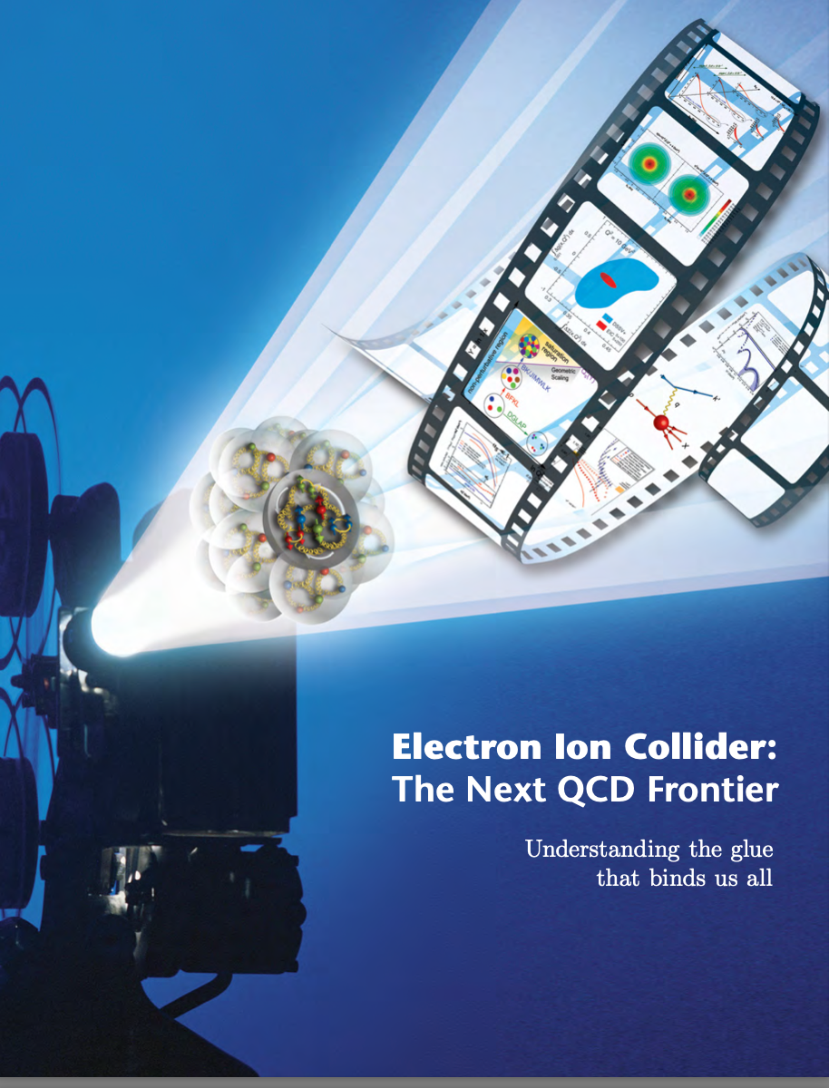
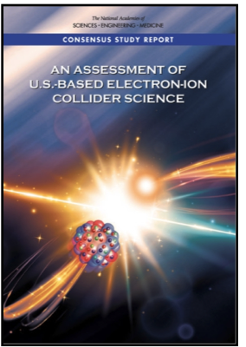
A long story is becoming reality
https://www.bnl.gov/eic/
2012 White paper
The Electron-Ion Collider: the next QCD frontier
2015 NP LRP
“We recommend a high-energy high-luminosity polarized EIC as the highest priority for new facility construction following the completion of FRIB.”
2018 National Academy Science report
“The committee finds that the science that can be addressed by an EIC is compelling, fundamental and timely.”

Slide 4
A long story is becoming reality
https://www.bnl.gov/eic/
Dec 2019/Jan 2020
CD-0 ("mission need") status achieved
BNL site selection
Jun 2021
Following CDR presented, CD-1 passed

Slide 5
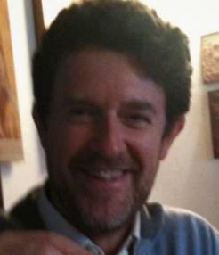
A little bit of (Italian) history
Italian groups first interested to EIC physics are from HERA diaspora (HERMES in particular), from COMPASS (DIS @ CERN SPS program), from JLab ("hadron physics") and from a strong theoretically community (Pavia, Perugia, Cagliari, ...)
Some Italian groups participated to early R&D efforts for EIC (funding from DoE) and EIC User Group acted as the first "engine" to coalesce groups...
Marco is now EICUG chair

Slide 6
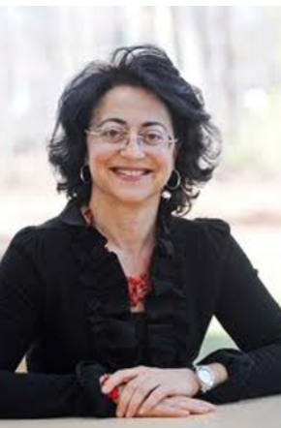
2016 Nuclear Physics INFN community meeting
2016
Patrizia is Associate Director at JLab
https://agenda.infn.it/event/10586/contributions/3969/attachments/2968/3258/Rossi_INFN2016.pptx
One of the first presentations to the largest INFN community
Check the slides!

Slide 7
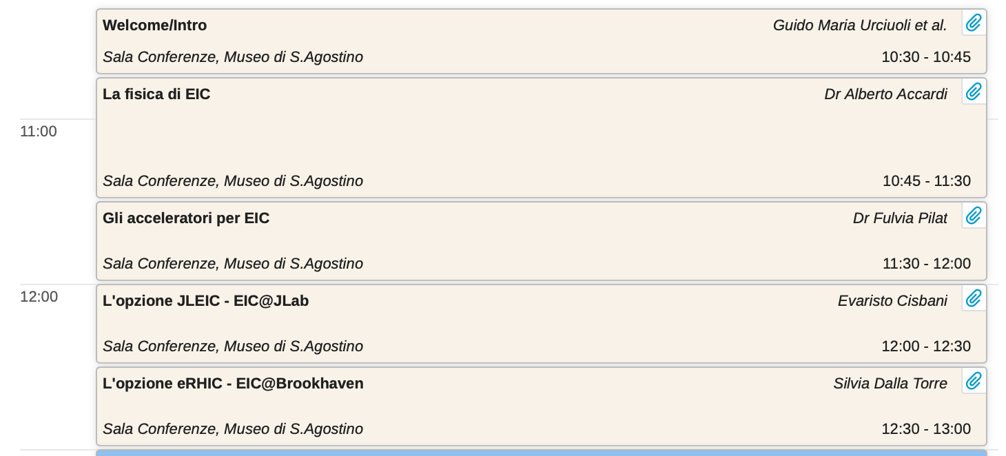
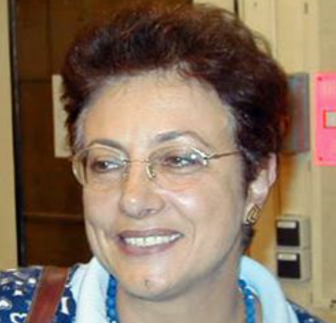
A little bit of (Italian) history (II)
https://agenda.infn.it/event/12368/?ovw=True
2017
Silvia is now ePIC deputy spokesperson
Marco is now dRICH sub-system leader
(Note: Google is unable to find a photo of Marco, apparently)

Slide 8
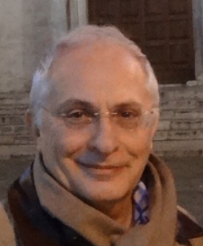
EICUG meeting in Italy...
2017
“INFN consider EIC an important opportunity for the hadronic physics community and encourage partnerships and collaborations with the other Institutions involved in the project’’
E. Nappi,
then INFN vicepresident
Groups coalesced in a formal proposal of an INFN initiative to explore EIC opportunities in May 2018
EIC_NET initiative approved by INFN Nuclear Physics committee in September 2018
EIC_NET started operations beginning of January 2019

Slide 9
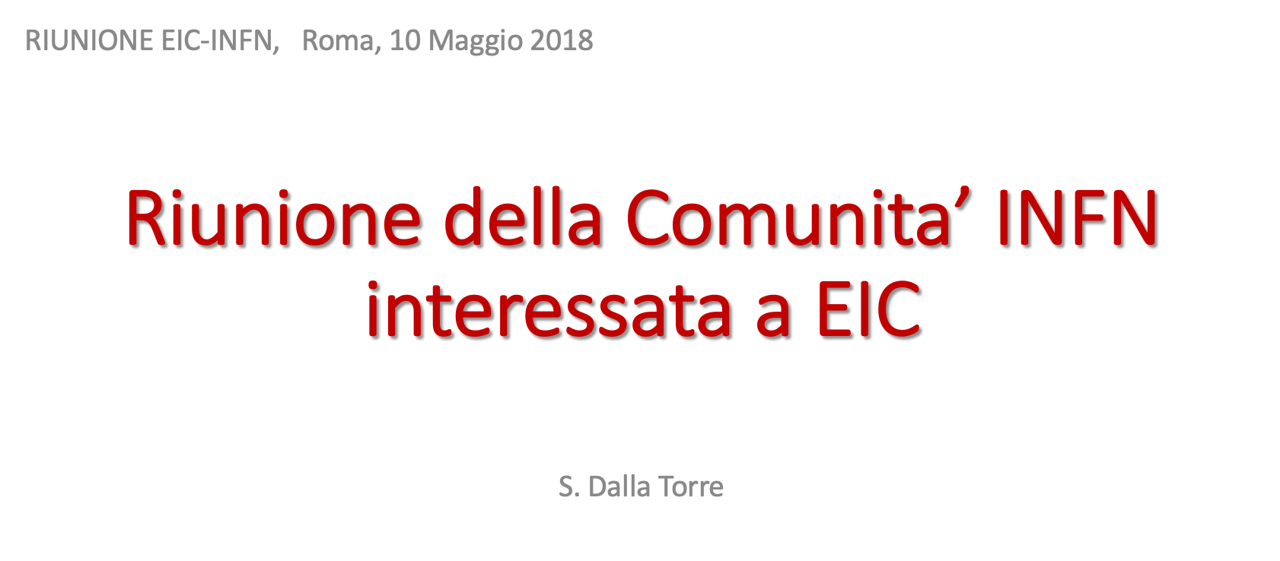
and INFN "EIC_NET" initiative
Groups coalesced in a formal proposal of an INFN initiative to explore EIC opportunities in May 2018,
EIC_NET initiative approved by INFN Nuclear Physics committee in September 2018
EIC_NET started operations beginning of January 2019
https://indico.ectstar.eu/event/29/timetable/?view=standard

Slide 10
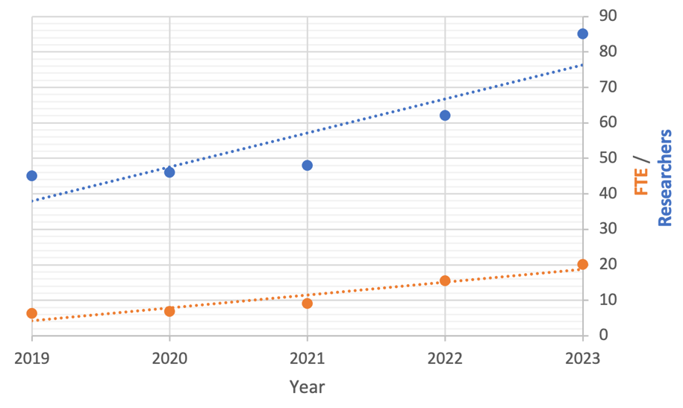
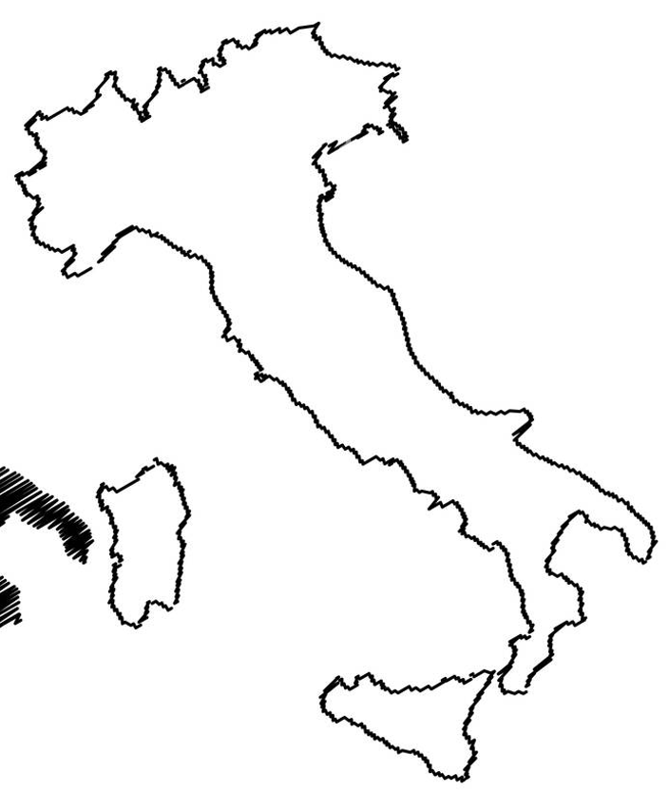
EIC_NET status: a growing community
PV
PD
TS
TO
FE
BO
GE
RM1 RM2
SA
BA
A growing community with different background: COMPASS, JLAB/CLAS12, ALICE, ATLAS, CMS, STAR, DARK SIDE, ...
CS
LNS/CT

Slide 11
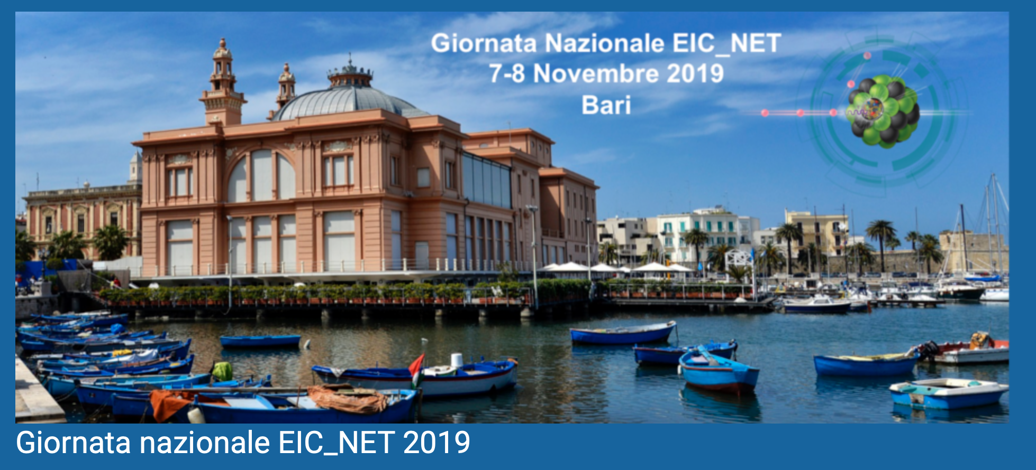
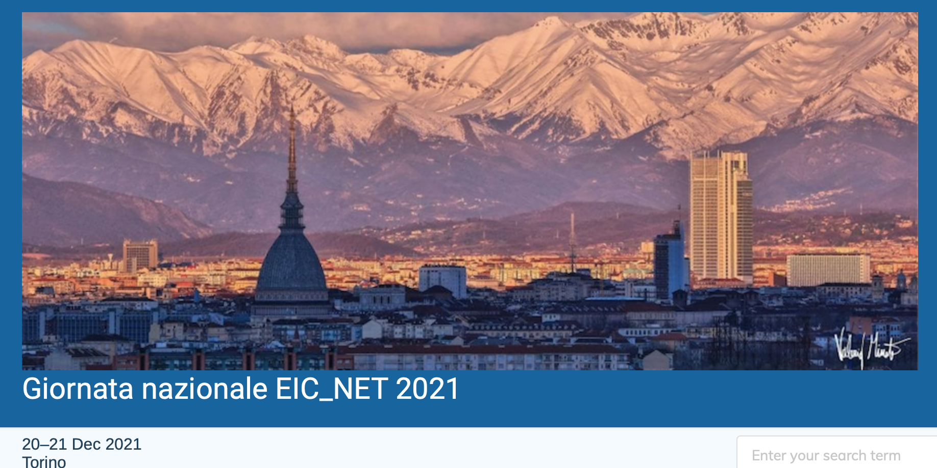
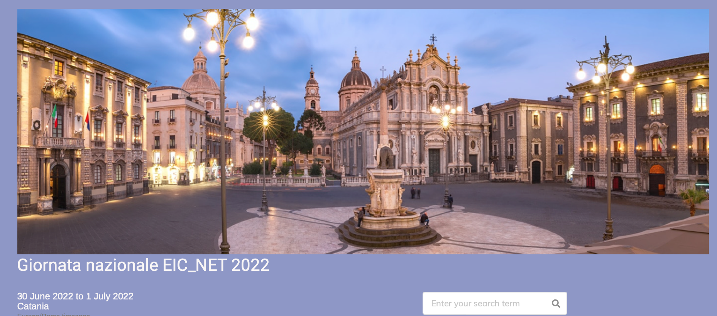
https://agenda.infn.it/category/1561/

Slide 12
from this year first RRB meeting (April 2023)
RRB = Resource Review Board →
meeting of funding agencies representatives of different countries

Slide 13
Not only the detector: the accelerator
Many developments in critical R&D for accelerator design
https://indico.bnl.gov/event/15342/contributions/64650/attachments/42380/70993/2022-07-26-EICUG-Satogata-AcceleratorDesign.pdf
T. Satogata@EICUG meeting – July2022
design consolidation of different components needed
no show stoppers
R&D needed in different areas but not critical
HSR Vacuum upgrade needed due to higher current and shorter bunch length:
resistive-wall impedance
e-cloud buildup
Solution identify in copper-clad (to reduce resistivity) and aC (amorphous Carbon) thin film to reduce secondary electron yield

Slide 14
EIC accelerator: international contributions (& INFN)
T. Satogata@EICUG meeting
"INFN acceleratori" involvement!

Slide 15
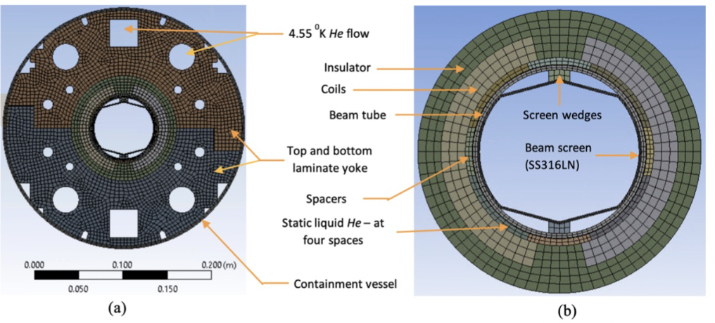
Some more details
SEY Characterization of coated surfaces at LNF
Development of a system ("turn-on key") for SEY measurements to be performed on site at BNL

Slide 16
Not only the detector: the magnet ?

Slide 17
Not only the detector: the magnet ?

Slide 18
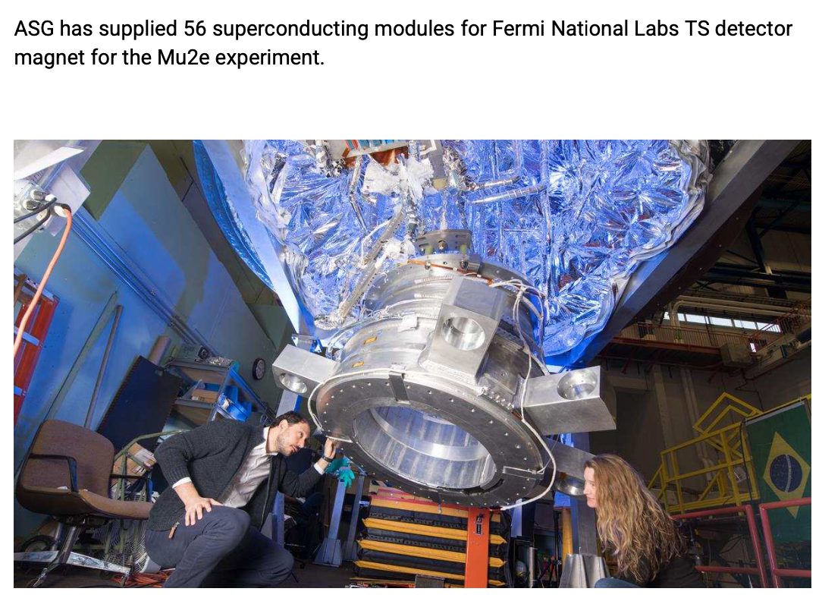
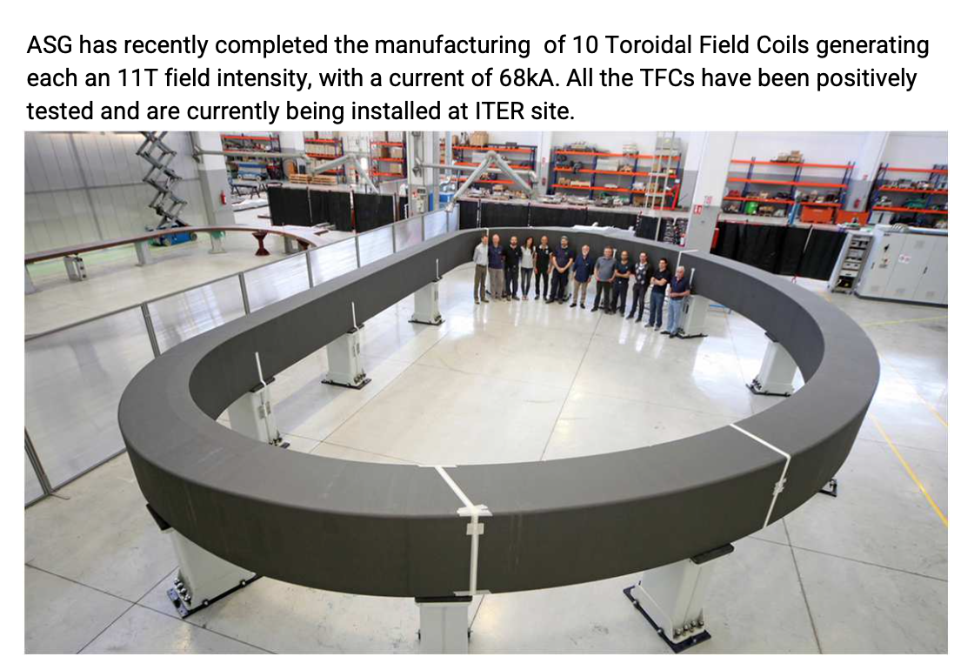
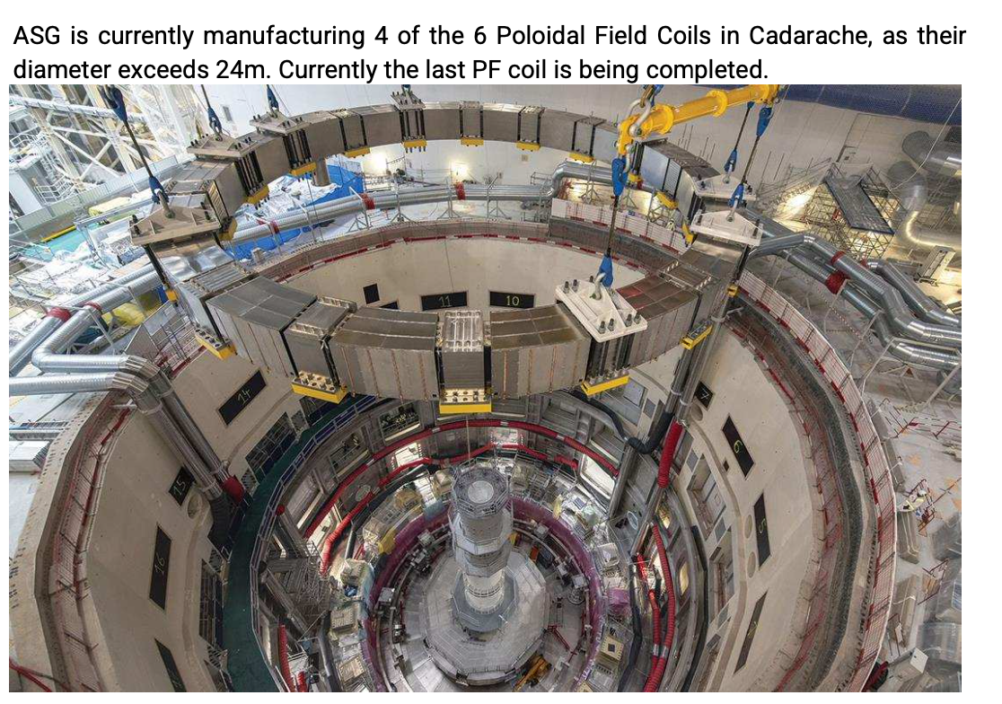
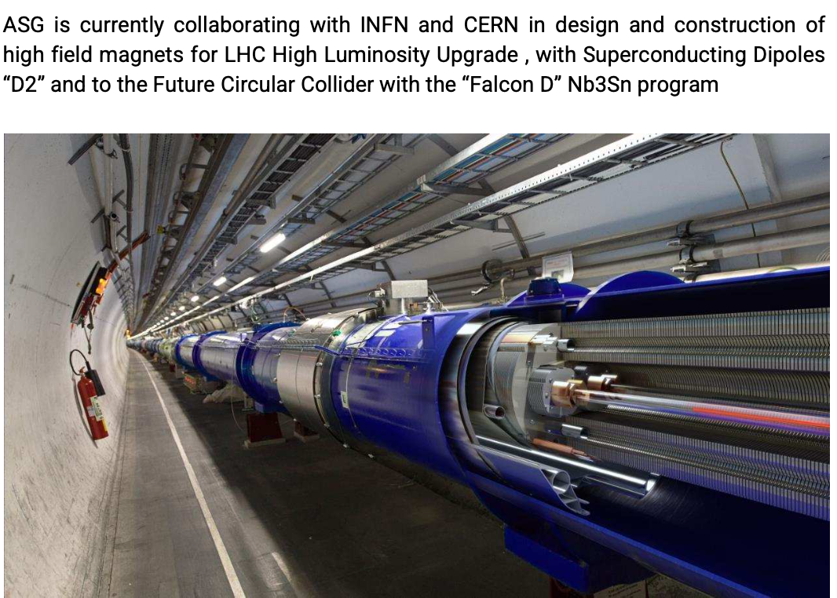
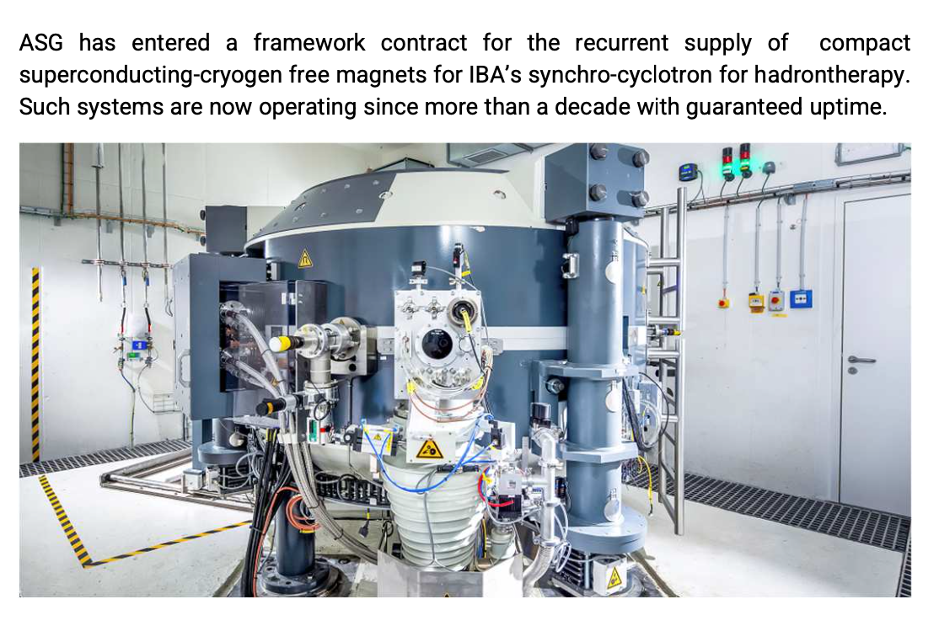
Potential involvement of an Italian excellence: ASG semiconductors

Slide 19
What are doing INFN groups?
dRICH
SiTracker
streaming readout
BA TS PD
GE RM2
FE TS LNF (RM1)
optics
mechanics
radiators
photosensors
MAPS 65 nm technology
El. cal. @JLAB + TRIDAS
BO FE
CS-SA-CT
aerogel
pressurized Argon vs C₂F₆
SiPM
LAPPD
DAQ for dRICH
FE BA
FE LNS + BNL/JLab
GE TS
Toward detector definition and optimization, simulation capacity will be key: a big working space for all our groups
ALCOR
TO
TS BA LNS SA + Duke + NISER
PV CS TO
Simulation & computing
Physics (SIDIS, Exclusive tagging, diffractive, hadron spectroscopy and hadronization, ...)
TS CT CS BA

Slide 20
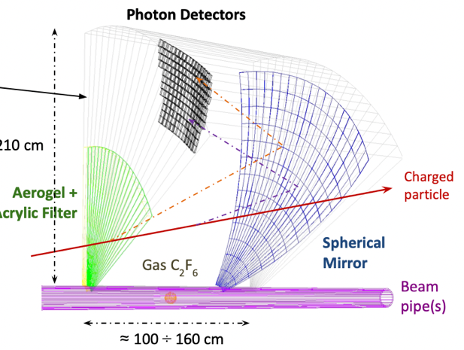
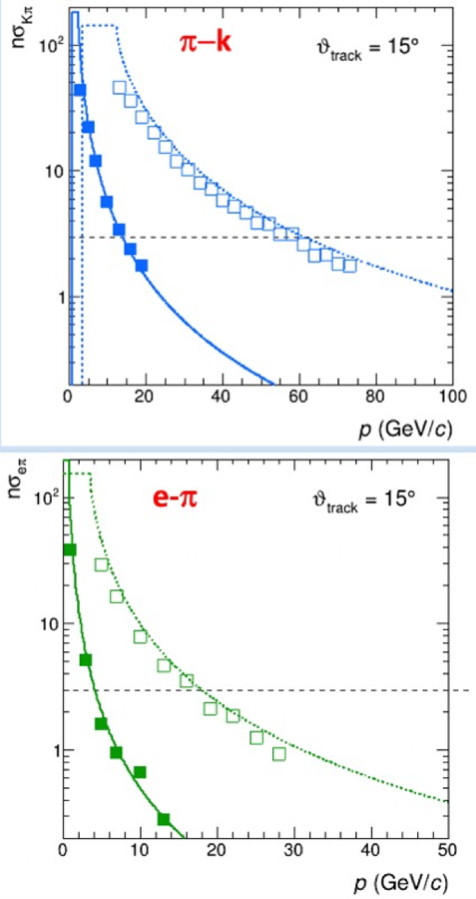
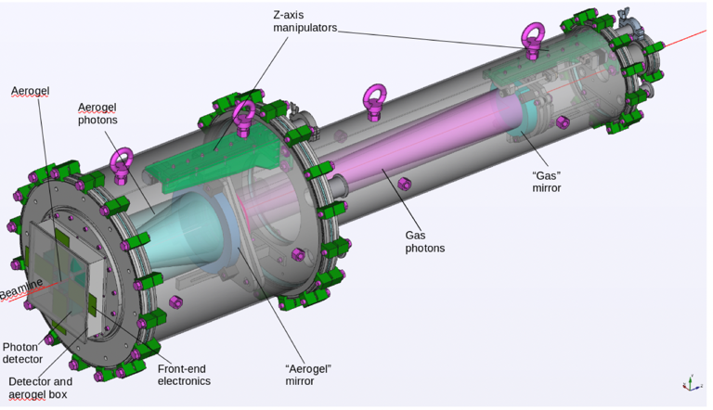
dRICH R&D: the idea and the main prototype
hadron identification crucial for SIDIS
radiators: Aerogel (n=1.02)/ Gas (n=1.008)
3 m² area, 3x3 mm² pixel
SiPM (LAPPD) option for photosensors
dRICH “prototype” to study performance
Building dRICH Collaboration
one of the 2023 tasks
2021 test beam

Slide 21
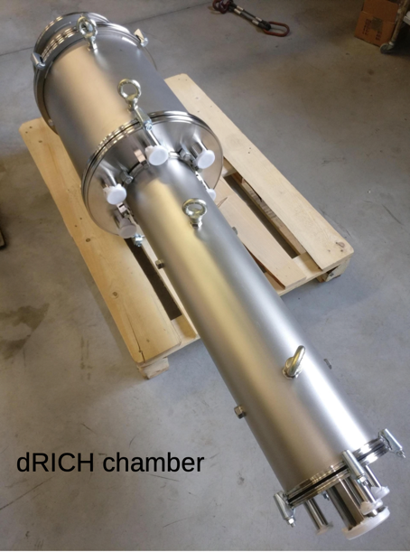
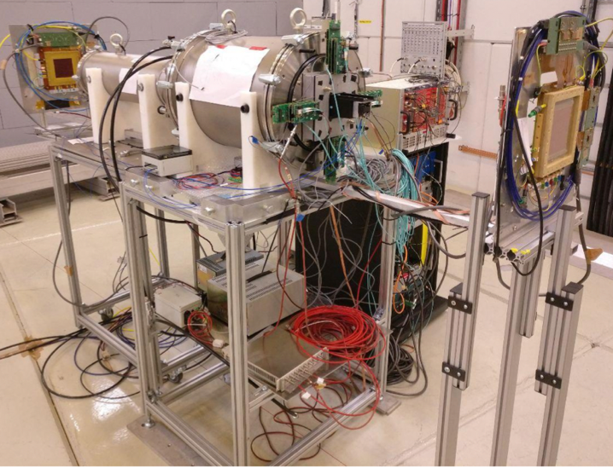
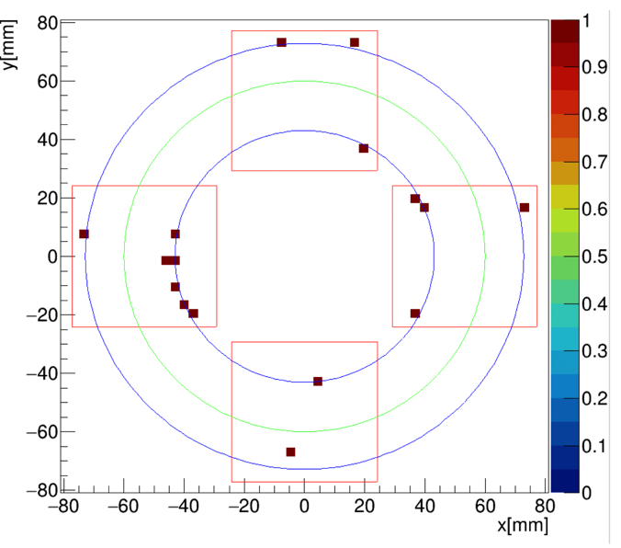
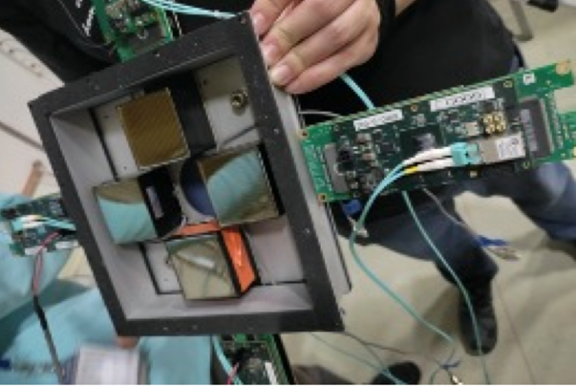
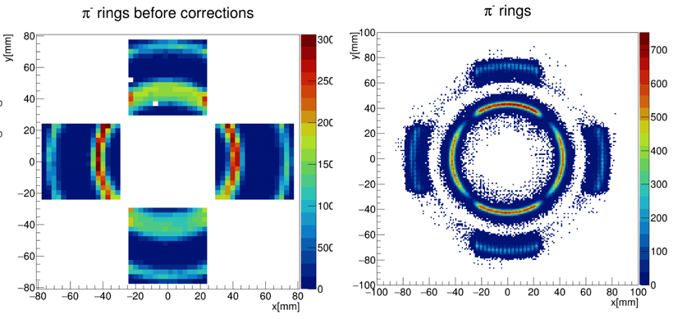
dRICH prototype 2021 @ test beams
aerogel
gas
Tracking with GEM
Preliminary results on σ_{θ} resolution with aerogel and gas
MAPMT detector box

Slide 22
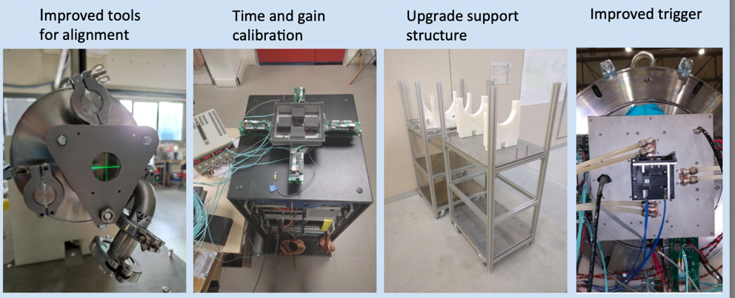
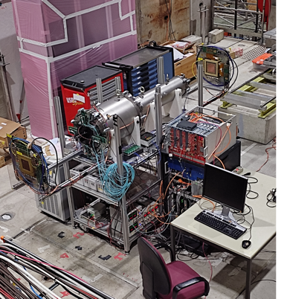
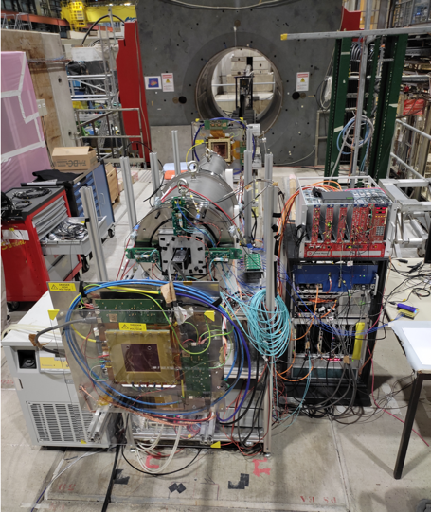
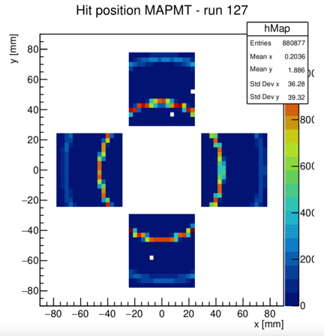
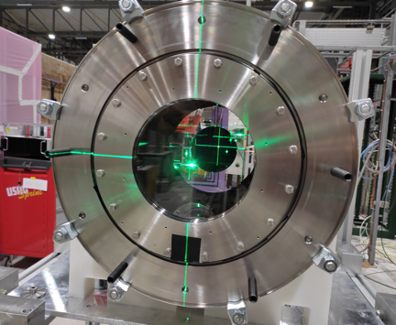
dRICH 2022 test beam campaign
FE
Test @SPS and PS
direct comparison between MAPMT and SiPM readout
Finalize resolution studies (in better controlled beam conditions)

Slide 23
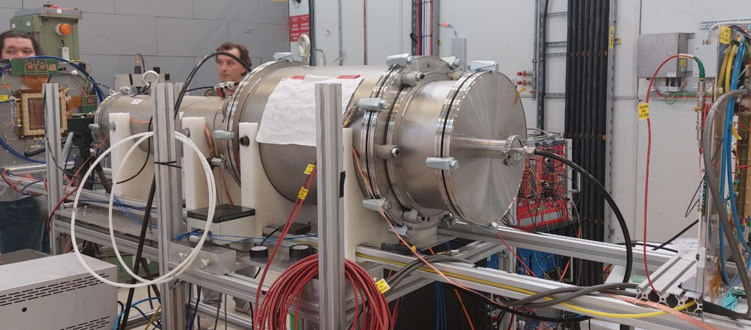
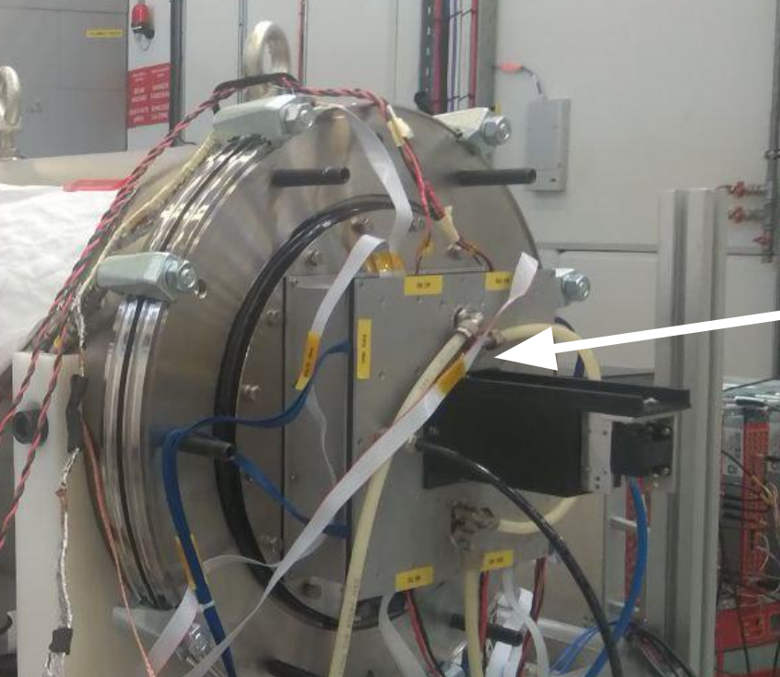
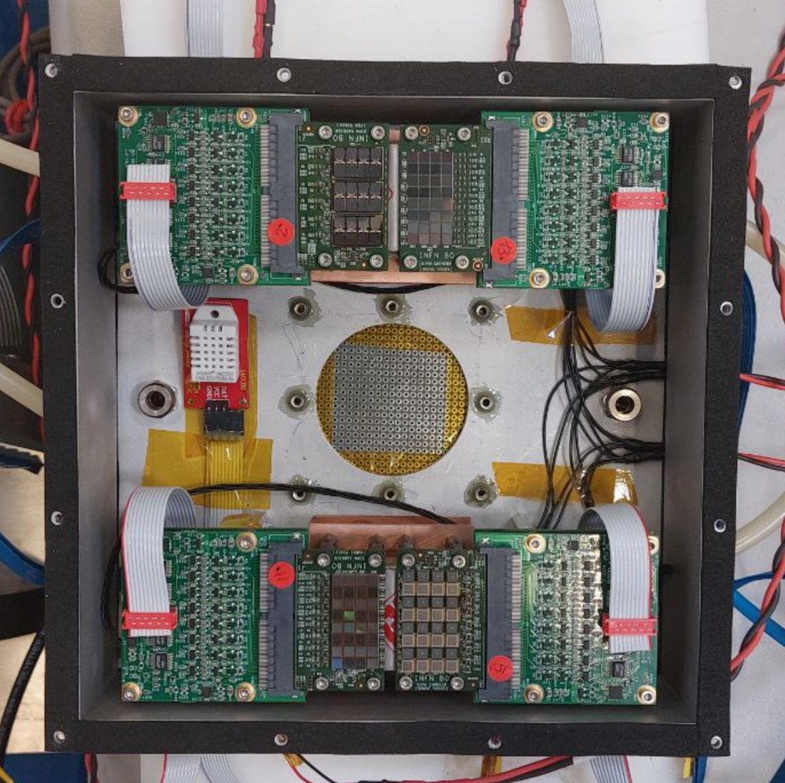
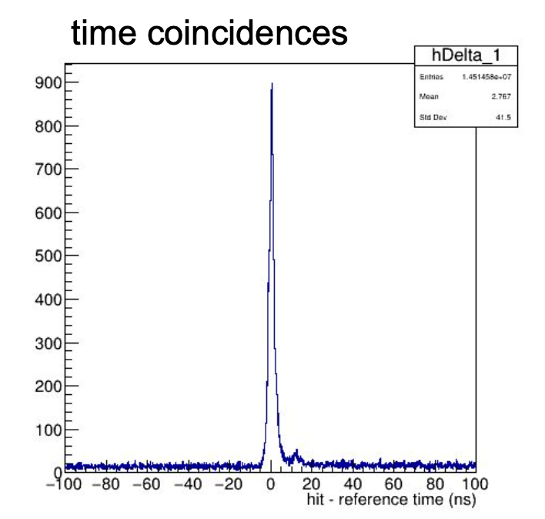
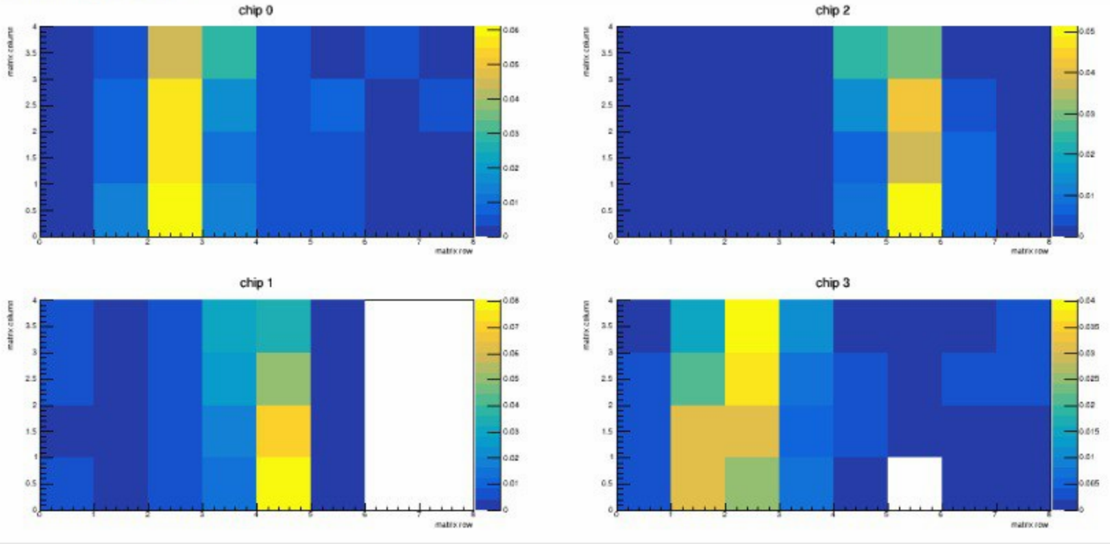
Bringing irradiated sensors on a dRICH (prototype)
CERN PS T10 October 2022
cooling keeps sensors at T= -30 ºC
irradiated/annealed sensors
timing
Cherenkov photons visible!
ALCOR streaming readout
time tagger with scintillators
29 November 2022
P. Antonioli - CPAD 2022 Workshop

Slide 24
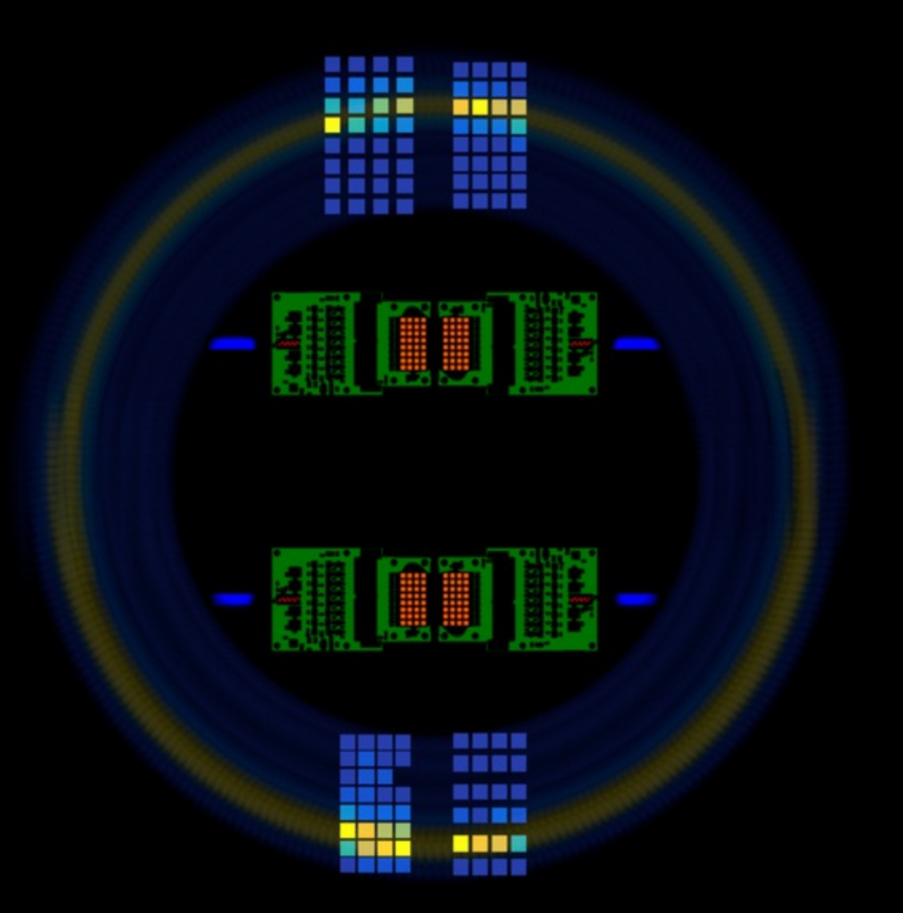
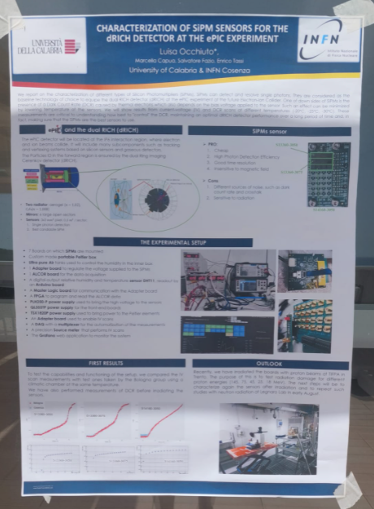
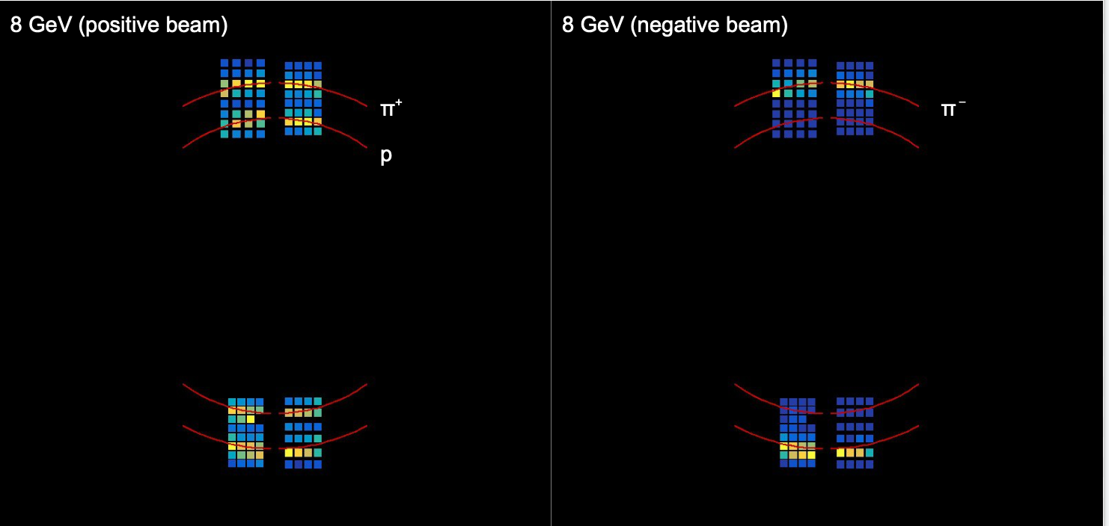
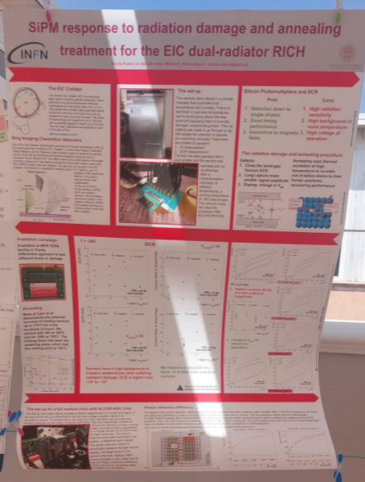
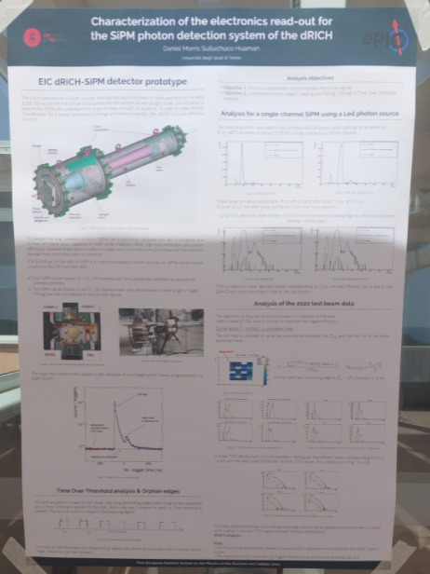
Irradiated sensors on test beam/dRICH prototype
see also Daniel, Luisa and Nicola's posters

Slide 25
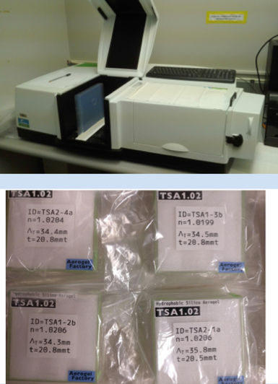
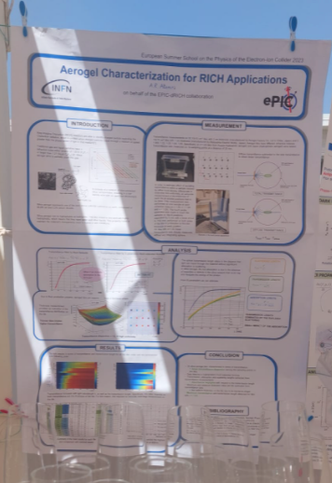
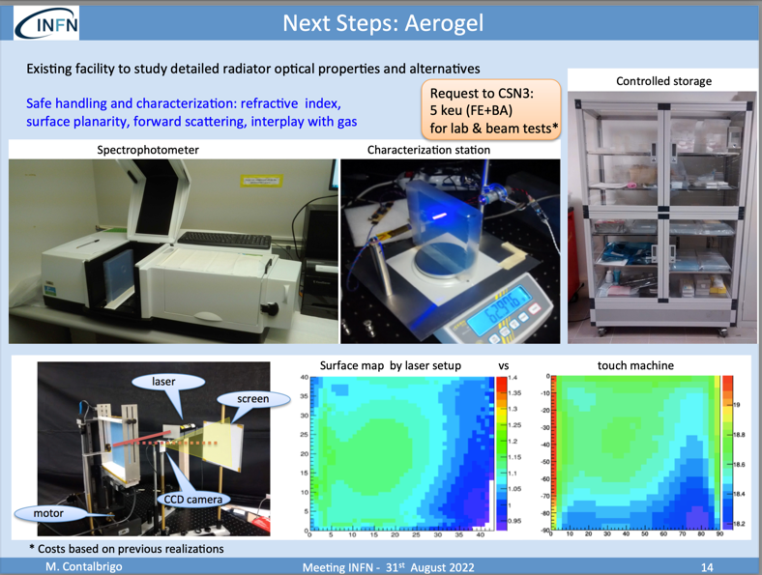
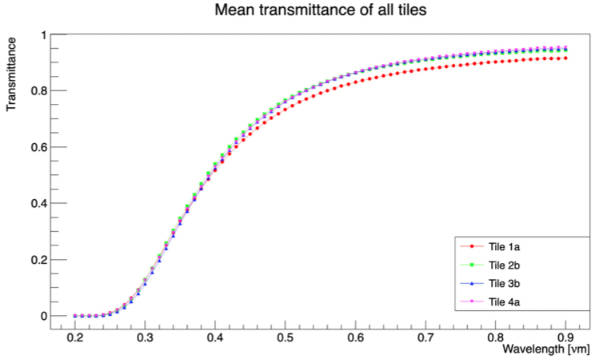
dRICH: the next steps (happening in 2023)
Assess Aerogel producers (Aerogel Factory – Japan and Aspen USA, no longer Budker availability [Russia!])
Equip dRICH prototype with SiPM plane (eRD102 milestone)
Explore the pressurized-Argon option (as gas replacement, high GPW: 11100!)
Explore mirror options (preferred: carbon fiber CMA-USA)
Annalisa's poster!
Synergy with ALICE3/RICH
FE BA

Slide 26
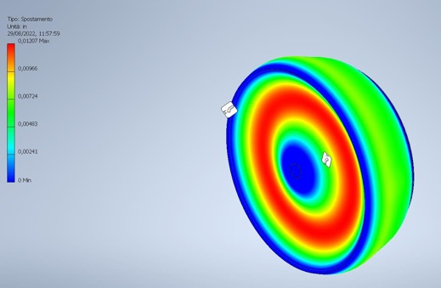
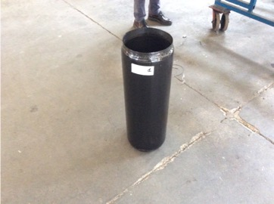
Pressurized-Ar vessel
Original idea discussed by S. Dalla Torre at first YR meeting (March 2020) https://indico.bnl.gov/event/7449/contributions/35912/attachments/27095/41303/DallaTorre_RICH_high-p_March2020_Temple.pdf
Increase Ar pressure to increase number of photons
Identified material (DuPont® Nomex® 410) in carbon –fiber + honeycomb
First prototype to evaluate FME: to be delivered now
A sector protoype?
FE / LNS + BNL/Jlab

Slide 27
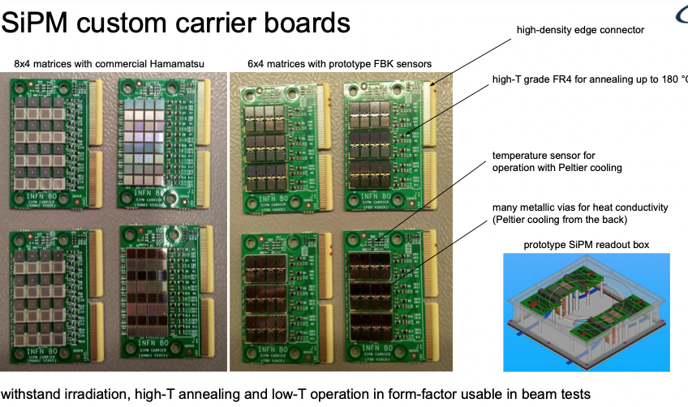
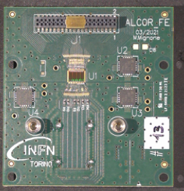
SiPM: radiation tolerance studies and FEE
Readout via ALCOR (candidate ASIC for SiPM readout)
ALCOR v2:
Just delivered to us
Will be used in 2023
TO
BO FE CS SA CT

Slide 28
Setup for SiPM characterization
DCR
I-V
Pseudo-efficiency (with LED): integrated coincdence/triggers as proxy
Next steps (will be reported tomorrow)
Laser measurement
Local Cooling (SiPM readout box)
BO FE CS SA CT
see Luisa's poster
on readout box

Slide 29
Some results on irradiation campaigns
Irradiation at Centro di Protonterapia @ Trento
2021 campaign: irradiation at different levels + 1 annealing cycle
2022 repeated (small) irradiation and annealing cycles
Next steps:
Complete 2022 campaign (Nov/Dec)
Investigating effects with neutron source at LNL
Use data to model annealing cycles in the experiment (pre-TDR!)
Timing analysis with laser
“dRICH cooled tile” possibly going to -40 C (or -50 C) [LHCb synergy]
Next steps:
Investigating ALCOR capabilities in gated mode
Preparing for ALCOR v3
Test methodology for in-situ annealing
Bring on board “Southern Italy cluster” CS-CT-SA

Slide 30
Run with FBK?
Agree with FBK a devoted run (under convenzione INFN-FBK) to explore:
Improvements on DCR standard rate [“optimization”]
Development of monolithic mini-tiles (2x2 or 4x4) to optimize geometrical acceptance
Light concentration (microlensing or nanophotonics approaches)
A successful run with FBK might be “win-win” operation for TDR/CD-3
Note recently released results from FBK, A. Gola @RICH2022

Slide 31
LAPPD / HRPPD
SiPM and LAPPD validation would make PID@EIC “safe”
LAPPD are “large size” MCPs at moderate cost
Large gain and low noise, uses ALD to increase lifetime
INCOM → spin-off of Argonne + Chicago Univ.
Strips readout, prototypes available with capacitive coupling (pixelated version)
LAPPD R&D kept “open” for dRICH (plan B if SiPM is not validated). Strategic for INFN to achieve know-how on this sensor.
Large interest in the community. First LAPPD workshop on 21 March 2022 by INFN TS, BNL and ANL https://indico.bnl.gov/event/15059/
GE TS
S. Dalla Torre, Meeting with INFN referees

Slide 32
2021 results in US
Setup lab in TS, joint effort with GE (readout) in 2022!

Slide 33
Starting activities in 2022 and next steps
Next steps
Time resolution measurements at test beam
Space resolution measurement in the lab (existing laser, needed motor stage)
Test variation of gain/efficiency in magnetic field → test planned in US and in Italy

Slide 34
see Deb's poster!

Slide 35
Silicon tracker (vertexing)
In both initial detector proposals (ATHENA and ECCE) "ITS3" MAPS ALICE technology selected
ATHENA
ECCE

Slide 36
Silicon tracker (vertexing)
BA PD TS
INFN EIC groups working on EIC Silicon vertex:
are active members in ITS3/ALICE: access to 65 nm technology
R&D activities within ITS3 / ALICE so far
+ work in EPIC tracking WG → “stitched sensors” scheme for EIC (see next slide)

Slide 37
Silicon tracker (vertexing)
Synergy with ALICE can be really a win-win operation for INFN vis a vis EIC project.
INFN consider synergistic investment on 65 nm technology for ALICE and ePIC
Different options under discussion:

Slide 38
Simulation (dRICH)
Simulation work for dRICH mainly from TS (a post-doc)
+ Duke University
Convened dRICH software group at EPIC level (the only one PID detector) with INFN-DUKE-NISER-(BNL)
Miniworkshop sharing experience among RICH detectors on reconstruction algorithms
TS

Slide 39
Simulation (tracking)
BA developed fast simulation tool that is well suited to give feedback on different configuration
Already adapted from ATHENA to ECCE → EPIC
Versatile tool for simulation
BA
LNS SA joining BA TS on simulation efforts

Slide 40
Physics (last but not least!)
Activity in CS (S. Fazio) on exclusive processes (critical for GPD studies) generators
Example: DCVS on deuterium gives access to neutron structure measurement
Other interests:
TO: diffractive
dRICH → SiDIS
Vertexing → HF
PV CS TO

Slide 41
A map end of 2022
dRICH
SiTracker
streaming readout
BA TS PD
GE RM2
FE TS LNF (RM1)
optics
mechanics
radiators
photosensors
MAPS 65 nm technology
El. cal. @JLAB + TRIDAS
BO FE
CS-SA-CT
aerogel
pressurized Argon vs C₂F₆
SiPM
LAPPD
DAQ for dRICH
FE BA
TS LNS + BNL/JLab
GE TS
Toward detector definition and optimization, simulation capacity will be key: a big working space for all our groups
ALCOR
TO
TS BA LNS SA + Duke + NISER
PV CS TO
Simulation & computing
Physics (SIDIS, Exclusive tagging, diffractive, hadron spectroscopy and hadronization, ...)
TS CT CS BA

Slide 42
some update (not all)
dRICH
SiTracker
μRWELL
BA TS PD PV
GE RM2
FE TS LNF (RM1)
optics
mechanics
radiators
photosensors
MAPS 65 nm technology
exploring this possibility!
BO FE
CS-SA-CT
BO ( + RM2/GE)
aerogel
pressurized Argon vs C₂F₆
SiPM
LAPPD
DAQ for dRICH
FE BA
FE LNS + BNL/JLab
GE TS
Toward detector definition and optimization, simulation capacity will be key: a big working space for all our groups
ALCOR
TO
TS BA LNS SA + Duke + NISER
PV CS TO
Simulation & computing
Physics (SIDIS, Exclusive tagging, diffractive, hadron spectroscopy and hadronization, ...)
TS CT CS BA

Slide 43
aerogel proximity focusing pfRICH
imaging EMCal

Slide 44
Status EIC_NET initiative and EIC project
My == Your!
The Italian Contribution to the Electron Ion Collider
?

Slide 45
Detector
Physics

