Slide 1

Overview on Spectroscopy
Annalisa D’Angelo
University of Rome Tor Vergata & INFN Rome Tor Vergata Rome – Italy

Slide 2

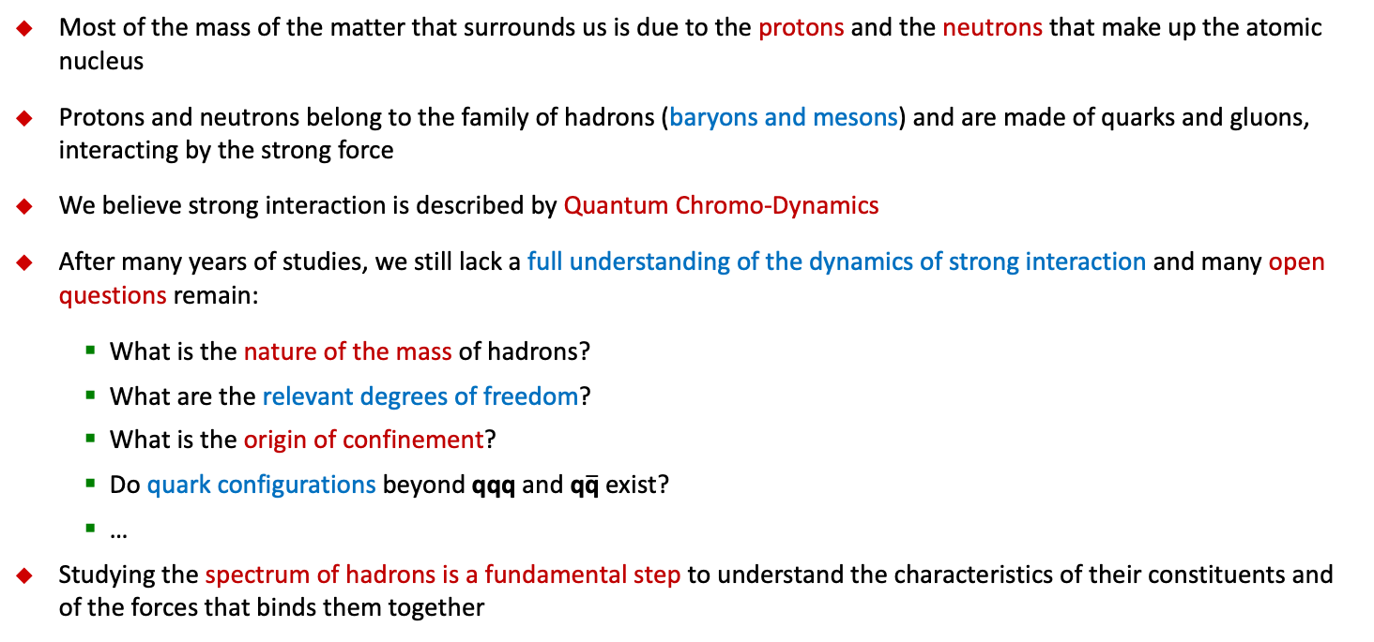
Critical QCD Questions Addressed
Most of the mass of the matter that surrounds us is due to the protons and the neutrons that make up the atomic nucleus
Protons and neutrons belong to the family of hadrons (baryons and mesons) and are made of quarks and gluons, interacting by the strong force
We believe strong interaction is described by Quantum Chromo-Dynamics
After many years of studies, we still lack a full understanding of the dynamics of strong interaction and many open questions remain:
  What is the nature of the mass of hadrons?
  What are the relevant degrees of freedom?
  What is the origin of confinement?
  Do quark configurations beyond qqq and q$\overline{\text{q}}$ exist?
  …
Studying the spectrum of hadrons is a fundamental step to understand the characteristics of their constituents and of the forces that binds them together

Slide 3
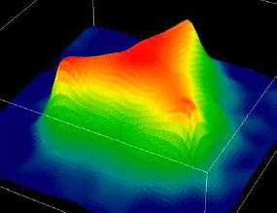
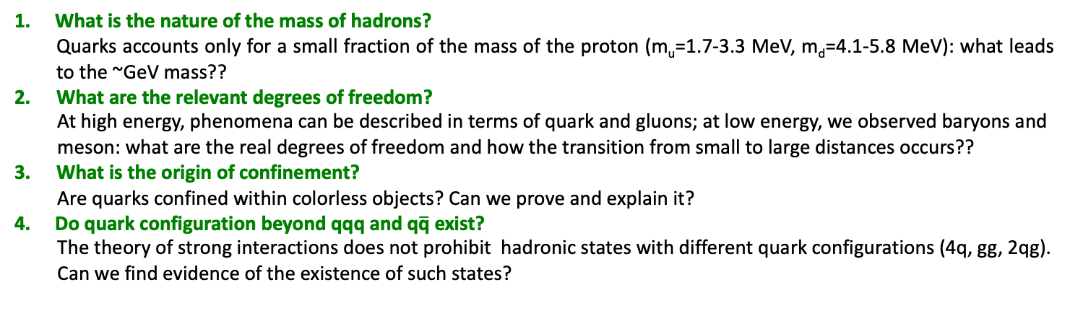
Hadron Spectroscopy
What is the nature of the mass of hadrons?
Quarks accounts only for a small fraction of the mass of the proton (m_{u}=1.7-3.3 MeV, m_{d}=4.1-5.8 MeV): what leads to the ~GeV mass??
What are the relevant degrees of freedom?
At high energy, phenomena can be described in terms of quark and gluons; at low energy, we observed baryons and meson: what are the real degrees of freedom and how the transition from small to large distances occurs??
What is the origin of confinement?
Are quarks confined within colorless objects? Can we prove and explain it?
Do quark configuration beyond qqq and q$\overline{\text{q}}$ exist?
The theory of strong interactions does not prohibit hadronic states with different quark configurations (4q, gg, 2qg). Can we find evidence of the existence of such states?
<< 0.1 fm
0.1 – 1 fm
> 1 fm
π
p
Quarks and Gluons
Effective Degrees of Freedom
Mesons & Baryons

Slide 4
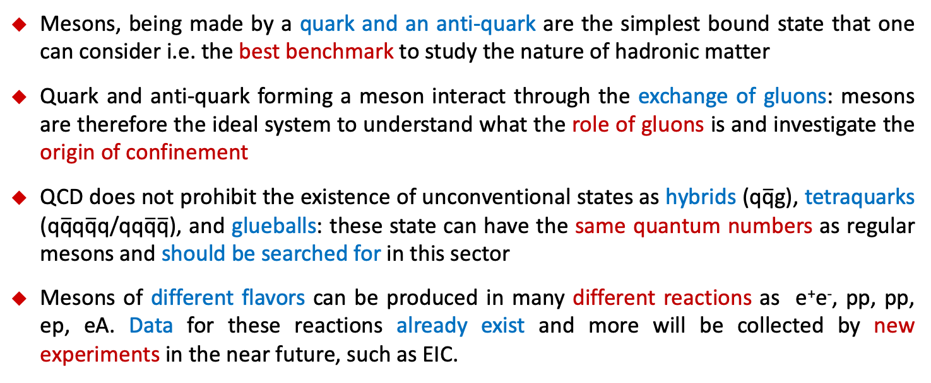
Why Meson Spectroscopy
Mesons, being made by a quark and an anti-quark are the simplest bound state that one can consider i.e. the best benchmark to study the nature of hadronic matter
Quark and anti-quark forming a meson interact through the exchange of gluons: mesons are therefore the ideal system to understand what the role of gluons is and investigate the origin of confinement
QCD does not prohibit the existence of unconventional states as hybrids (q$\overline{\text{q}}$g), tetraquarks (q$\overline{\text{q}}$q$\overline{\text{q}}\text{q}$/qq$\overline{\text{q}}\overline{\text{q}}$), and glueballs: these state can have the same quantum numbers as regular mesons and should be searched for in this sector
Mesons of different flavors can be produced in many different reactions as e⁺e⁻, pp, pp, ep, eA. Data for these reactions already exist and more will be collected by new experiments in the near future, such as EIC.

Slide 5
Meson Spectroscopy
Outline:
The discovery of mesons and the importance of spectroscopy for the development of modern particle physics
The Constituent Quark Model and the classification of mesons
Discovery of unconventional states XYZ and more
Experimental searches and analysis techniques
Search for exotics at EIC

Slide 6
Meson Spectroscopy
Outline:
The discovery of mesons and the importance of spectroscopy for the development of modern particle physics
The Constituent Quark Model and the classification of mesons
Discovery of unconventional states XYZ and more
Experimental searches and analysis techniques
Search for exotics at EIC

Slide 7
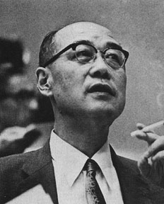
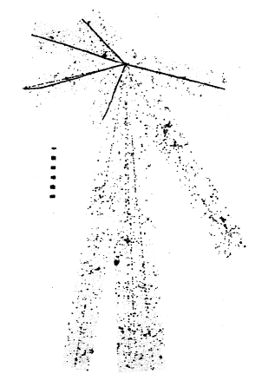
The discovery of the pion
In the early decades of the twentieth century, matter was believed to be made of electrons and protons
In 1935 Yukawa predicted the existence of meson particles as carrier of the strong nuclear force that bind the atomic nucleus.
From the range of the force, he predicted the particle mass to be ~ 100 MeV. He was awarded the Nobel prize in 1949.
In 1947 C. Powell, C. Lattes and G. Occhialini found the first evidence for the existence of charged pions in cosmic-ray induced events recorded at high altitude with photographic emulsions. Pions were produced by the collision of high energy cosmic particles in the atmosphere and could be distinguished from protons or a-particles because they were moving fast toward the earth. Powell was awarded the Nobel prize in 1950 for the development of photographic emulsions.

Slide 8
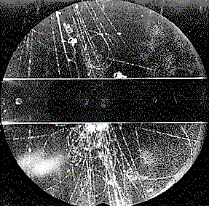
Strange Mesons
A new type of unstable particles, called V-particles for their peculiar decay, were observed in cloud chambers exposed to cosmic rays
This particles were neutral since they were leaving no signals and had a surprisingly long life-time (~10⁻¹⁰s), leading to the peculiar vertex shape
They seemed to be produced in strong interaction processes involving, protons neutrons and pions with significant rates
To explain the long lifetime and the strong interaction production, V-particles were assumed to be representatives of a new family of particles with special properties
G.D. Rochester and C.C. Butler, Nature 160 (1947) 855.
K⁰
π⁺
The property which caused it to live so long was called strangeness, and led to the discovery of the strange quark
π⁻

Slide 9
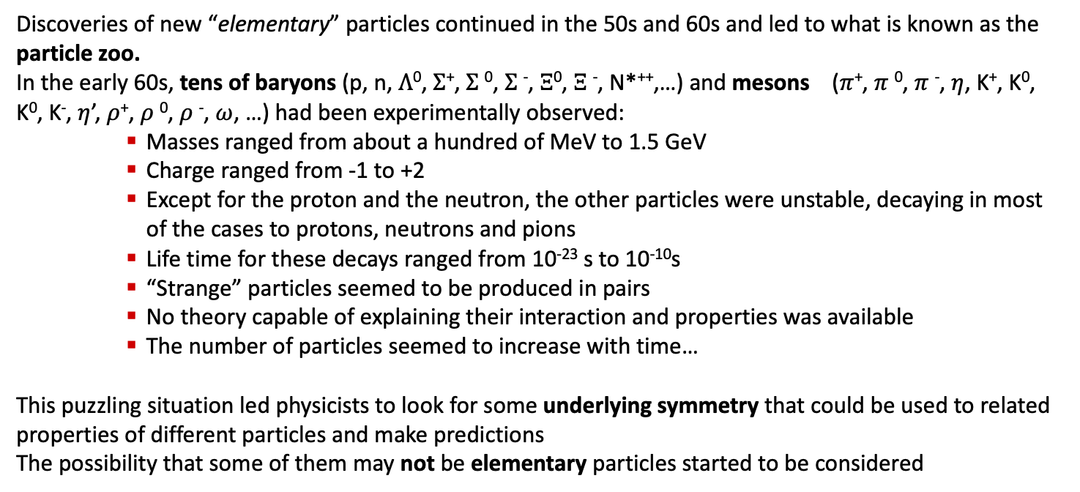
The particle Zoo
Discoveries of new “elementary” particles continued in the 50s and 60s and led to what is known as the particle zoo.
In the early 60s, tens of baryons (p, n, $Λ$⁰, $Σ$⁺, $Σ$⁰, $Σ$⁻, $Ξ$⁰, $Ξ$⁻, N*⁺⁺,…) and mesons ($π$⁺, $π$⁰, $π$⁻, $η$, K⁺, K⁰, K⁰, K⁻, $η$’, $ρ$⁺, $ρ$⁰, $ρ$⁻, $ω$, …) had been experimentally observed:
    Masses ranged from about a hundred of MeV to 1.5 GeV
    Charge ranged from -1 to +2
    Except for the proton and the neutron, the other particles were unstable, decaying in most of the cases to protons, neutrons and pions
    Life time for these decays ranged from 10⁻²³ s to 10⁻¹⁰s
    “Strange” particles seemed to be produced in pairs
    No theory capable of explaining their interaction and properties was available
    The number of particles seemed to increase with time…
This puzzling situation led physicists to look for some underlying symmetry that could be used to related properties of different particles and make predictions
The possibility that some of them may not be elementary particles started to be considered

Slide 10
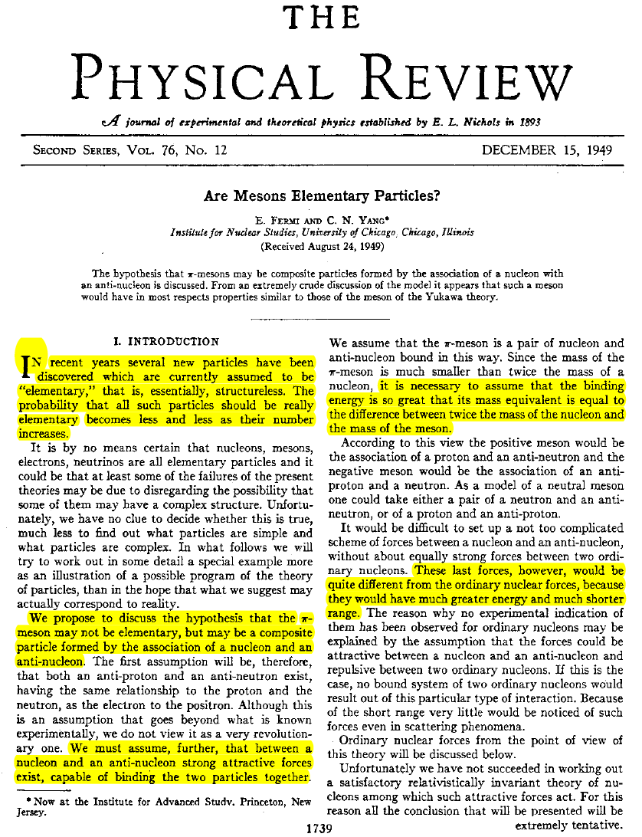
Are the elementary particles elementary?
E. Fermi and C. N. Yang, Phys. Rev. 76 (1949) 1739.
“In recent years several new particles have been discovered which are currently assumed to be "elementary," that is, essentially, structureless. The probability that all such particles should be really elementary becomes less and less as their number increases.”
Pions as bound states of a nucleon and an anti-nucleon
Strong attractive force is needed to explain the existence of the bound state, it’s long lifetime and to compensate mass difference (binding energy)
Force needs to be very different from the ordinary nucleon-nucleon interaction

Slide 11
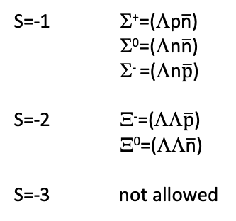
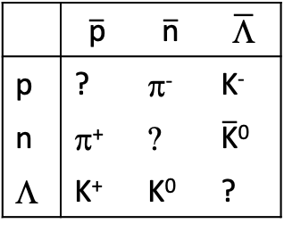
The Sakata Model
Shoichi Sakata, Prog. Theor. Phys. 16 (1956) 686
Sakata extended the idea of Fermi and Yang suggesting hadrons may bound states of nucleons, Λ particles and of their antiparticles
 | $$\overline{\text{p}}$$ | $$\overline{\text{n}}$$ | $$\overline{\text{L}}$$
p | ? | π⁻ | K⁻
n | π⁺ | ? | $\overline{\text{K}}$⁰
Λ | K⁺ | K⁰ | ?
All mesons known at that time fit well in the model
3 neutral states are expected:
  π⁰=(pp+nn)/√2
  (pp-nn)/√2
  ΛΛ
Mesons (B=0)
Baryons (B=1)
S=-1 Σ⁺=(Λp$\overline{\text{n}}$)
Σ⁰=(Λn$\overline{\text{n}}$)
Σ⁻ =(Λn$\overline{\text{p}}$)
S=-2 Ξ⁻=(ΛΛ$\overline{\text{p}}$)
Ξ⁰=(ΛΛ$\overline{\text{n}}$)
S=-3 not allowed
Sigma and Cascade baryons are compatible with the model assumption but no S=-3 baryon (Ω⁻) would be allowed
Many additional states predicted by the model were not found in experiments
Wrong magnetic moments are predicted

Slide 12
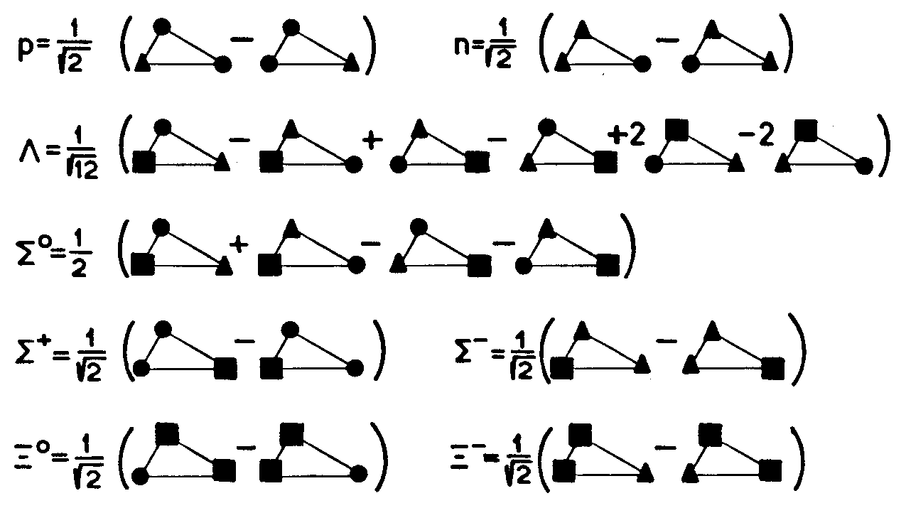
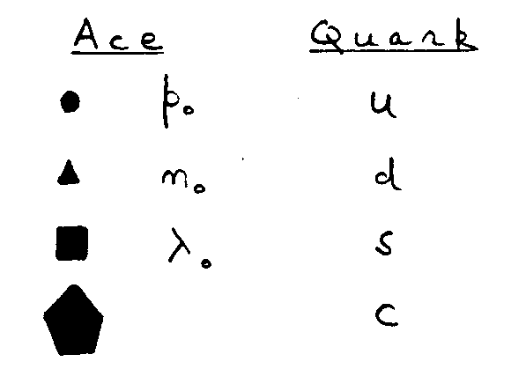
Quarks and ACEs
In 1964, Gell-Mann and Zweig independently proposed that hadrons could be made by elementary constituents that Gell-Mann called quarks and Zweig called aces
Gell-Mann considered quarks as mathematical objects and was more interested in the symmetry of strong interaction that defined the number of quark bound states and their properties
Zweig considered aces as real objects and focused on determining their properties
G. Zweig, “Origins of the Quark Model”
Baryon 1980 Conference

Slide 13
Quarks and SU(3)
The scheme proposed to organize the zoo of baryons and mesons was based on SU(3) symmetry
Baryons and mesons were assumed to be composite states of three quarks and quark-antiquark pairs
These assumptions were compatible with the multiplicity of observed states and with constraints as the Gell-Mann-Nishijma relation
Quarks were assumed to have:
        spin=1/2
        fractional charge
        baryonic number B=1/3
        mass ~1/3 of the nucleon mass
    “Fractional charge bothered me because I wanted a correspondence between leptons and constituents of hadrons. To have one set of these particles integrally-charge and the other set fractionally-charge was ugly, but at this point there seemed to be no choice ”(G. Zweig)

Slide 14
Meson Spectroscopy
Outline:
The discovery of mesons and the importance of spectroscopy for the development of modern particle physics
The Constituent Quark Model and the classification of mesons
Discovery of unconventional states XYZ and more
Experimental searches and analysis techniques
Search for exotics at EIC

Slide 15
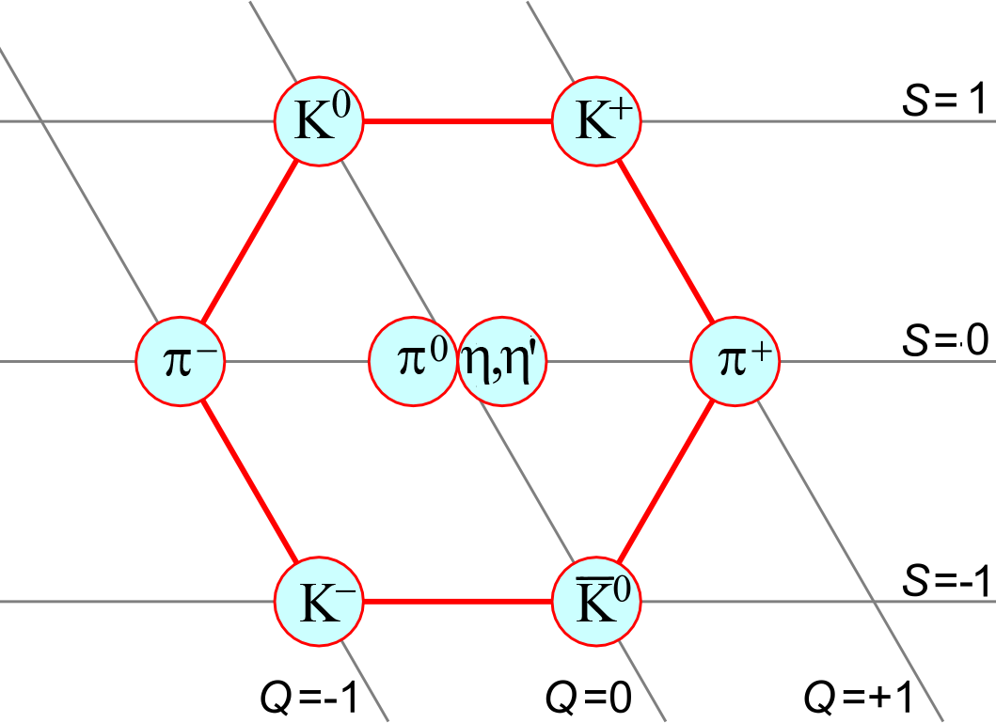
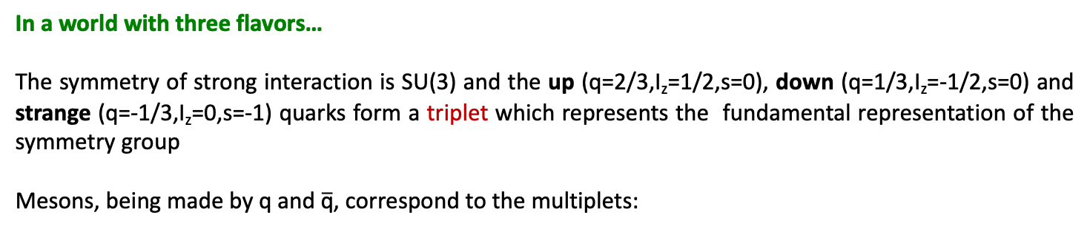
Constituent Quark Model
In a world with three flavors…
The symmetry of strong interaction is SU(3) and the up (q=2/3,I_{z}=1/2,s=0), down (q=1/3,I_{z}=-1/2,s=0) and strange (q=-1/3,I_{z}=0,s=-1) quarks form a triplet which represents the fundamental representation of the symmetry group
Mesons, being made by q and $\overline{\text{q}}$, correspond to the multiplets:
Y
I₃

Slide 16


Meson Multiplets
 | Q | B | J | I | I_{z} | S
u | 2/3 | 1/3 | 1/2 | 1/2 | 1/2 | 0
d | -1/3 | 1/3 | 1/2 | 1/2 | -1/2 | 0
s | -1/3 | 1/3 | 1/2 | 0 | 0 | -1
Quark and anti-quarks can pair giving total spin S=0 (singlet) or S=1 (triplet) and have a non-zero orbital angular momentum L
$J=L⨁$S
$$\left|L−S\right|≤J≤\left|L+S\right|$$
For each combination of L and S there will be a nonet (8⊕1) of states, usually classified with the spectroscopic notation
state | S | L | J | P | C | J^{PC} | Mesons
¹S₀ | 0 | 0 | 0 | - | + | 0⁻⁺ | π | η | η’ | K | pseudo-scalar
³S₁ | 1 | 0 | 1 | - | - | 1⁻⁻ | ρ | ω | ϕ | K* | vector
¹P₁ | 0 | 1 | 1 | + | - | 1⁺⁻ | b₁ | h₁ | h’₁ | K₁ | pseudo-vector
³P₀ | 1 | 1 | 0 | + | + | 0⁺⁺ | a₀ | f₀ | f’₀ | K*₀ | scalar
³P₁ | 1 | 1 | 1 | + | + | 1⁺⁺ | a₁ | f₁ | f’₁ | K*₁ | axial vector
³P₂ | 1 | 1 | 2 | + | + | 2⁺⁺ | a₂ | f₂ | f’₂ | K*₂ | tensor
P = (-1)^{L+1}
C = (-1)^{L+S}

Slide 17
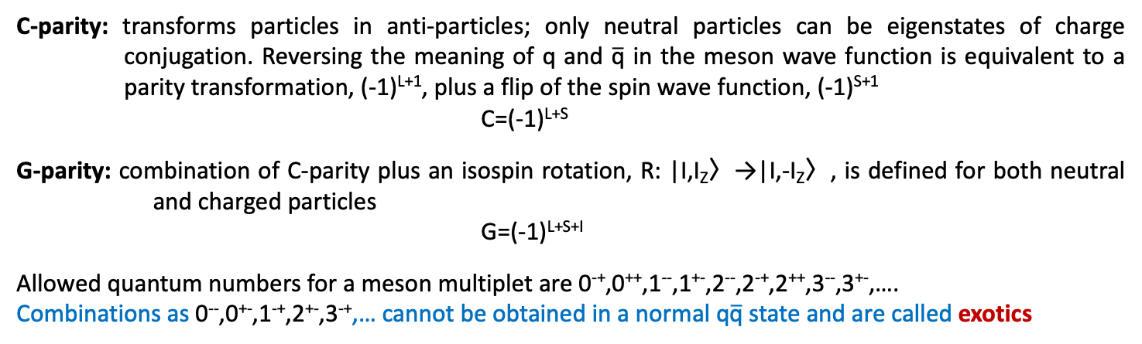
Quantum Numbers
parity
Parity: reflection operator that transform ψ(r)→ψ(-r); depends on the orbital angular momentum and intrinsic parity; quarks and antiquarks have opposite intrinsic parity
P=(-1)^{L+1}
J^{PC}
C-parity
total angular momentum
C-parity: transforms particles in anti-particles; only neutral particles can be eigenstates of charge conjugation. Reversing the meaning of q and $\overline{\text{q}}$ in the meson wave function is equivalent to a parity transformation, (-1)^{L+1}, plus a flip of the spin wave function, (-1)^{S+1}
C=(-1)^{L+S}
G-parity: combination of C-parity plus an isospin rotation, R: |I,I_{Z}〉→|I,-I_{Z}〉, is defined for both neutral and charged particles
G=(-1)^{L+S+I}
Allowed quantum numbers for a meson multiplet are 0⁻⁺,0⁺⁺,1⁻⁻,1⁺⁻,2⁻⁻,2⁻⁺,2⁺⁺,3⁻⁻,3⁺⁻,….
Combinations as 0⁻⁻,0⁺⁻,1⁻⁺,2⁺⁻,3⁻⁺,… cannot be obtained in a normal q$\overline{\text{q}}$ state and are called exotics

Slide 18
SU(3) breaking and mixing
The SU(3) symmetry is not exact because of the different masses of quarks. As a consequence, the I=0 state of the octet and the single state can mix and the physical state can differ from the SU(3) states.
Physical states
For angles θ~35° the mixing is called “ideal”, corresponding to the situation where s$\overline{\text{s}}$ components are completely separated from u$\overline{\text{u}}$ and d$\overline{\text{d}}$ components:
J^{PC}=0⁻⁺ : η and η’
J^{PC}=1⁻⁻ : ω and ϕ
J^{PC}=0⁺⁺ : f₀ and f₀’
….
Among the first multiplets, mixing can affect:

Slide 19
Mixing in the 1⁻⁻ multiplet
The decays of ω and ϕ were crucial to understand mixing and quark properties
ϕ
K*⁰
K*⁺
KΚ
K*
ρ⁻
ρ⁰
ω,ϕ
ρ⁺
ω
ρ⁰
ρ
Kπ
K*⁻
K*⁰
3π
mass
2π
Experimental evidence indicated that the dominant decay mode of the ϕ was to K$\overline{\text{K}}$, while decay to pions was highly suppressed. On the contrary the main decay mode of the ω was to 3 pions
This is also related to the quark mass difference:

Slide 20
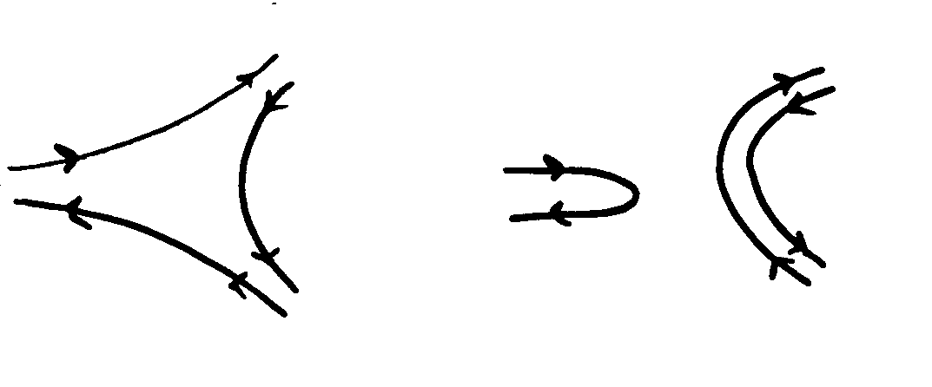

Decays and the OZI rule
The dominance of the ϕ decay to K$\overline{\text{K}}$, indicates that processes where quarks in the initial states annihilate and (several) quark pairs are created from the vacuum are suppressed
allowed forbidden
This feature is known as the Okubo-Zweig-Izuka or OZI rule and indicates an important property of strong interaction
u
s
s
u
u
d
u
d
s
u
u
s

Slide 21
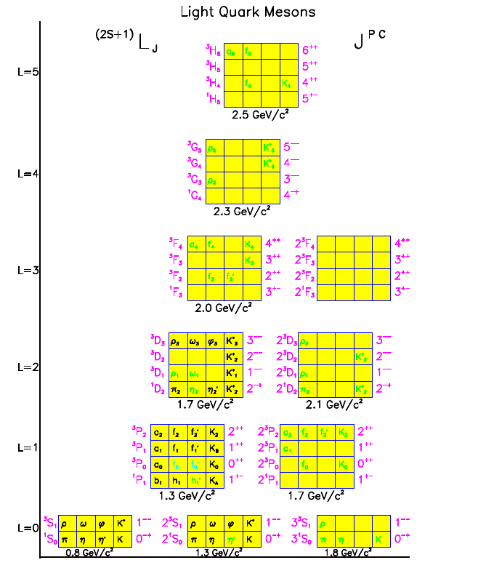
Missing states
Yellow: expected nonets of meson states as a function of the mass and angular momentum
Black: established states
Green: tentative assignments
A number of predicted states is not experimentally observed and assignments are uncertain:
limitations in the experimental techniques?
states are too wide to be clearly identified?
…

Slide 22
Quark Model: summary
Gave first indication of the existence of quarks
Construction based on SU(3) flavor symmetry
Reproduces well the main features of the spectrum (multiplets and quantum numbers)
Rather successful in explaining the known phenomenology
….
Quarks are massive constituents (effective degrees of freedom) and differ from the current quarks observed in high energy experiments
Cannot predict masses or widths but needs input from experimental data
Model does not include gluons
Cannot explain confinement
…
pro
con

Slide 23




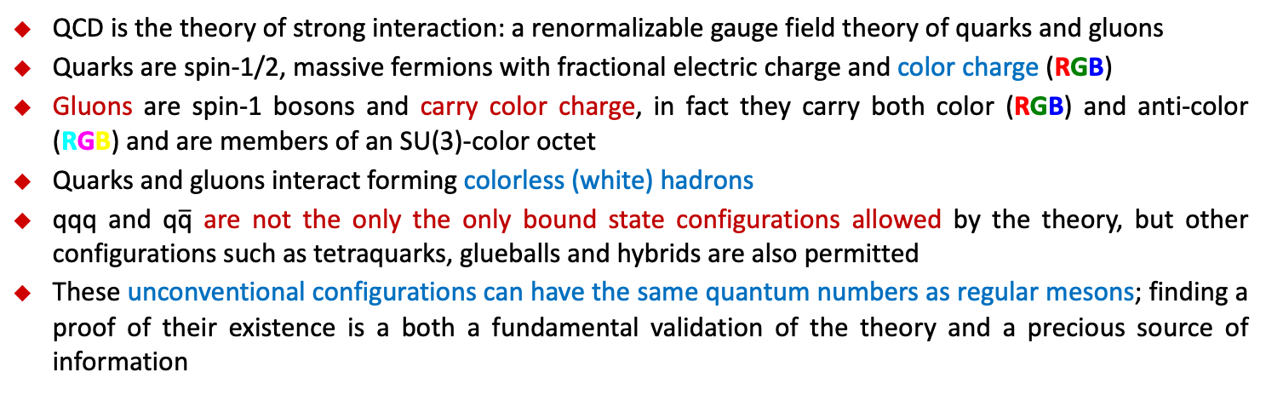
Quantum Chromo Dynamics
QCD is the theory of strong interaction: a renormalizable gauge field theory of quarks and gluons
Quarks are spin-1/2, massive fermions with fractional electric charge and color charge (RGB)
Gluons are spin-1 bosons and carry color charge, in fact they carry both color (RGB) and anti-color (RGB) and are members of an SU(3)-color octet
Quarks and gluons interact forming colorless (white) hadrons
qqq and q$\overline{\text{q}}$ are not the only the only bound state configurations allowed by the theory, but other configurations such as tetraquarks, glueballs and hybrids are also permitted
These unconventional configurations can have the same quantum numbers as regular mesons; finding a proof of their existence is a both a fundamental validation of the theory and a precious source of information
regular meson
tetraquark
glueball
hybrid

Slide 24
Meson Spectroscopy
Outline:
The discovery of mesons and the importance of spectroscopy for the development of modern particle physics
The Constituent Quark Model and the classification of mesons
Discovery of unconventional states XYZ and more
Experimental searches and analysis techniques
Search for exotics at EIC

Slide 25
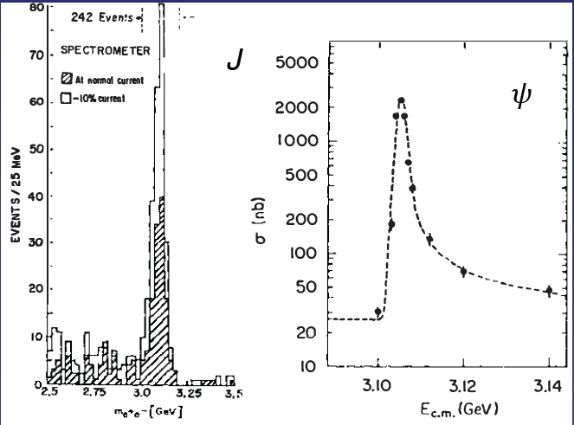
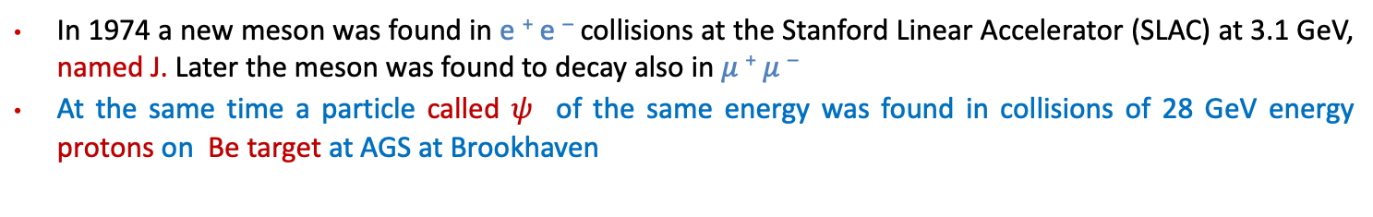
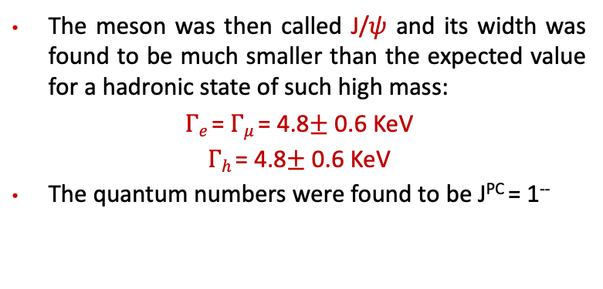
The Heavy Sector
In 1974 a new meson was found in e ⁺ e – collisions at the Stanford Linear Accelerator (SLAC) at 3.1 GeV, named J. Later the meson was found to decay also in $μ$ ⁺ $μ$ –
At the same time a particle called $ψ$ of the same energy was found in collisions of 28 GeV energy protons on Be target at AGS at Brookhaven
The meson was then called J/$ψ$ and its width was found to be much smaller than the expected value for a hadronic state of such high mass:
$Γe$ = $Γμ$ = 4.8$±$ 0.6 KeV
$Γh$ = 4.8$±$ 0.6 KeV
The quantum numbers were found to be J^{PC} = 1⁻⁻
The narrow width could be explained introducing
a new quark: the charm c
The J/$ψ$ is postulated to be bound state of c$\overline{c}$ with quantum number c=0 (hidden charm)

Slide 26
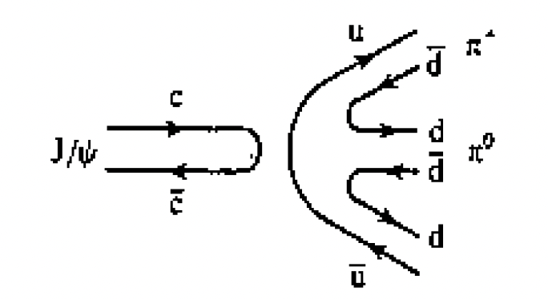
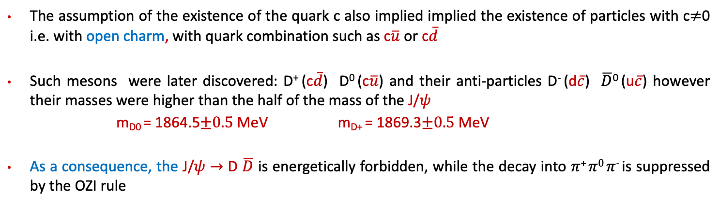
The charm quark
The assumption of the existence of the quark c also implied implied the existence of particles with c$≠$0 i.e. with open charm, with quark combination such as c$\overline{u}$ or c$\overline{d}$
Such mesons were later discovered: D⁺ (c$\overline{d}$) D⁰ (c$\overline{u}$) and their anti-particles D⁻ (d$\overline{c}$) $\overline{D}$⁰ (u$\overline{c}$) however their masses were higher than the half of the mass of the J/$ψ$
m_{D0} = 1864.5$±0.5$MeV m_{D+} = 1869.3$±0.5$MeV
As a consequence, the J/$ψ$ $→$ D $\overline{D}$ is energetically forbidden, while the decay into $π$⁺ $π0$ $π$⁻ is suppressed by the OZI rule
c
c
d
c
d
c
Energetically Forbidden
OZI rule suppressed

Slide 27
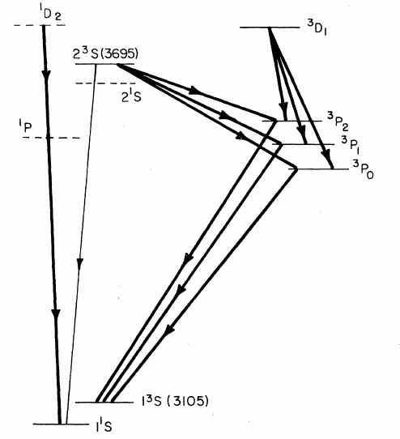
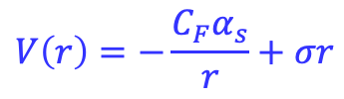
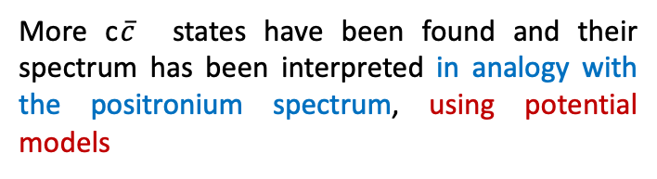
The charmonium
Mass [MeV]
More c$\overline{c}$ states have been found and their spectrum has been interpreted in analogy with the positronium spectrum, using potential models
4100
ψ
′′′
(4040)
3
P
2
(~ 3940)
3900
3
P
(~ 3880)
3
D
(~ 3800)
$$V\left(r\right)=−\frac{C_{F}α_{s}}{r}+σr$$
1
3
ψ
′′
(3770)
3
P
0
(~ 3800)
1
D
2
D
(Cornell potential)
3
D
3
2
3700
ψ
′
(3686)
1
DD
Threshold
η
′
c
(3590)
2⁺⁺
χ
2
(3556)
1⁺⁺
h
c
(3525)
χ
(3510)
3500
1
χ
0
(3415)
0⁺⁺
3300
3100
ψ
(3097)
η
c
(2980)
C
1 fm
C
2900
1⁻⁻
1⁺⁻
Solve NR Schrödinger eq. → spectrum
J^{PC}
0⁻⁺

Slide 28
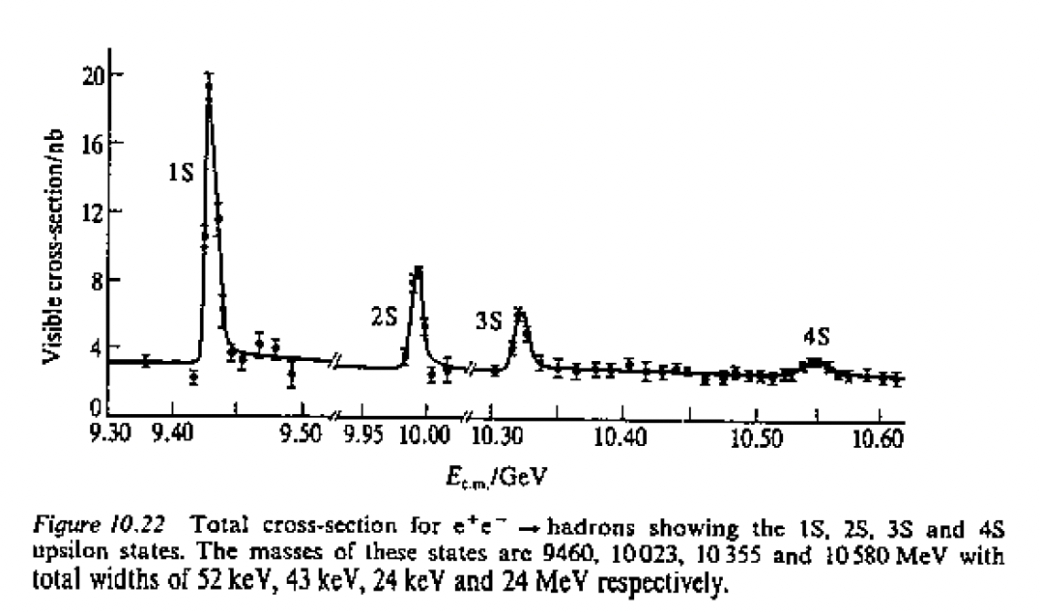
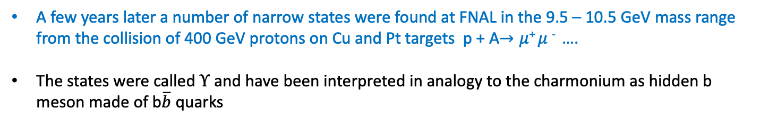
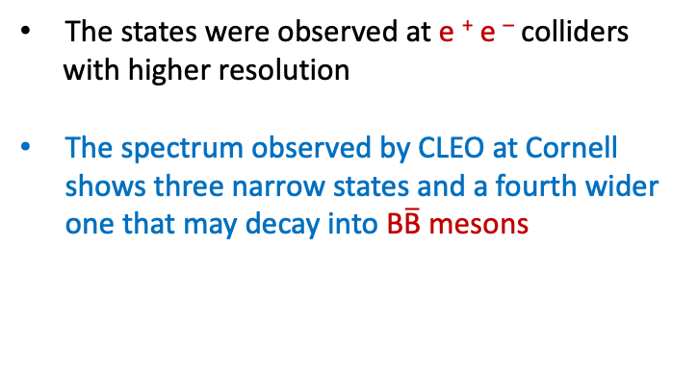
The bottonium
A few years later a number of narrow states were found at FNAL in the 9.5 – 10.5 GeV mass range from the collision of 400 GeV protons on Cu and Pt targets p + A$→μ$⁺ $μ$ ⁻ ….
The states were called $Υ$ and have been interpreted in analogy to the charmonium as hidden b meson made of b$\overline{b}$ quarks
The states were observed at e ⁺ e – colliders
with higher resolution
The spectrum observed by CLEO at Cornell shows three narrow states and a fourth wider one that may decay into B$\overline{\text{B}}$ mesons

Slide 29
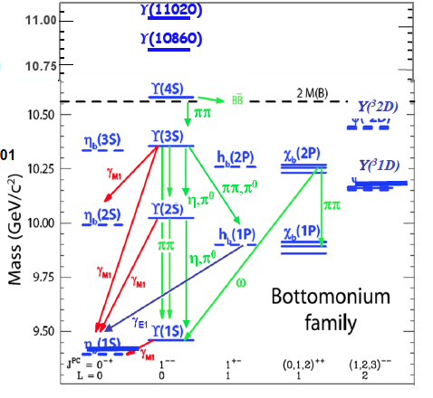
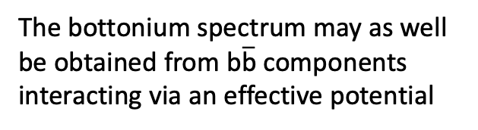
The bottonium
$$V\left(r\right)=−\frac{C_{F}α_{s}}{r}+σr$$
The bottonium spectrum may as well be obtained from b$\overline{\text{b}}$ components interacting via an effective potential

Slide 30
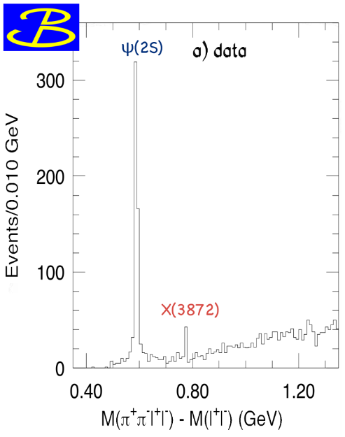
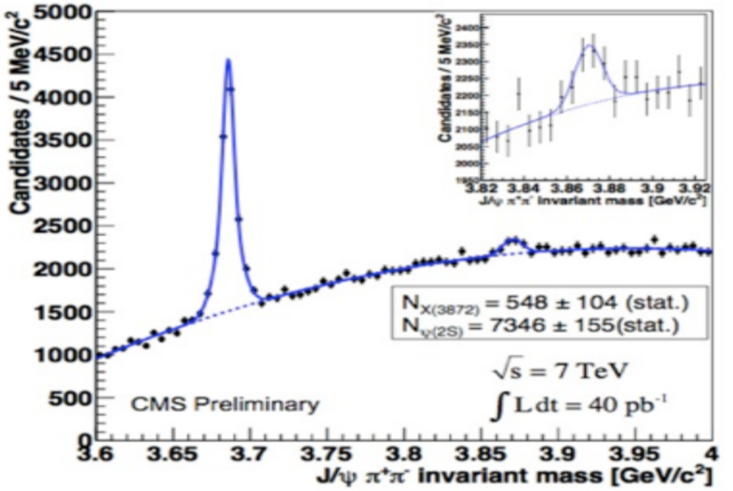
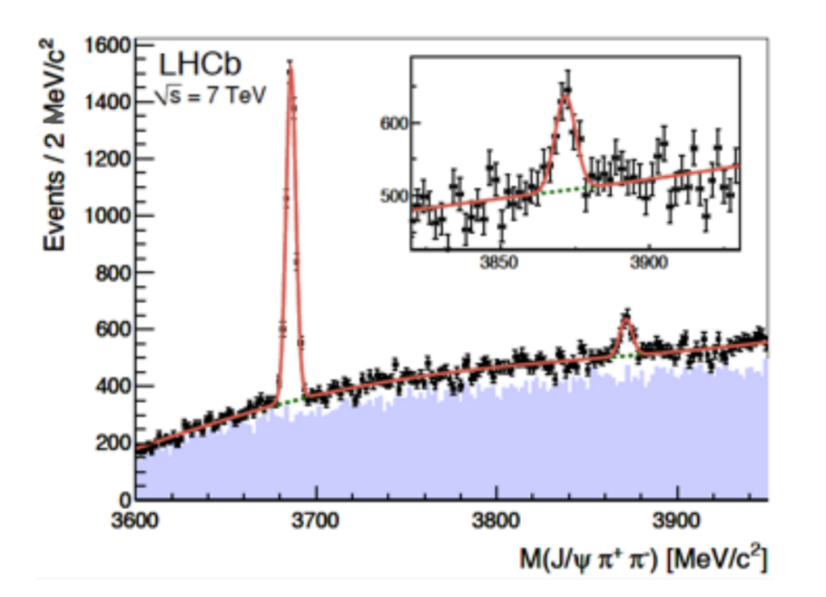
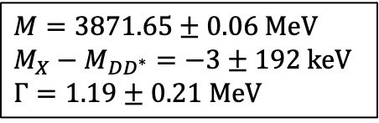
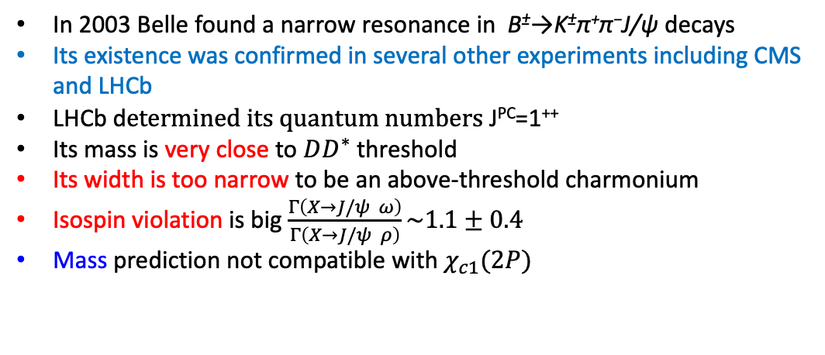
X (3872): the first exotic candidate
PRL 91, 262001 (2003)
In 2003 Belle found a narrow resonance in B±→K±π⁺π⁻J/ψ decays
Its existence was confirmed in several other experiments including CMS and LHCb
LHCb d$etermined its quantum numbers \text{J}\text{PC}\text{=1}\text{++}$
Its mass is very close to $DD^{∗}$ threshold
Its width is too narrow to be an above-threshold charmonium
Isospin violation is big $\frac{Γ\left(X→J/ψ ω\right)}{Γ\left(X→J/ψ ρ\right)}\sim 1.1±0.4$
Mass prediction not compatible with $χ_{c1}(2P)$
$M=3871.65±0.06$MeV
$$M_{X}−M_{DD^{∗}}=−3±192 \text{keV}$$
$Γ=1.19±0.2\text{1 }\text{MeV}$

Slide 31
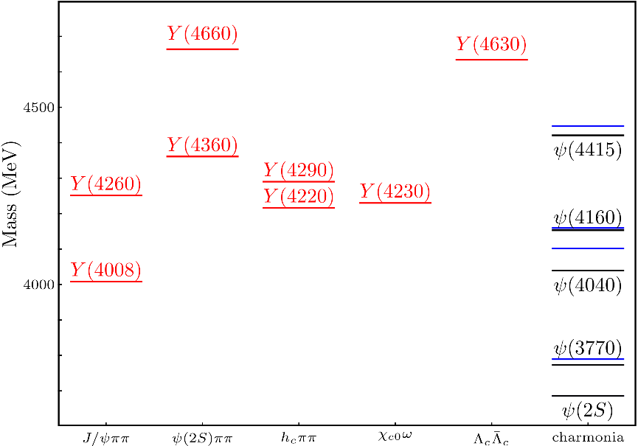
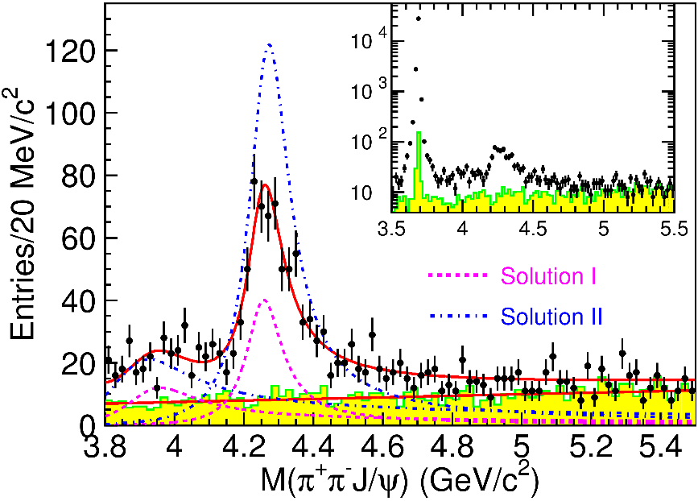
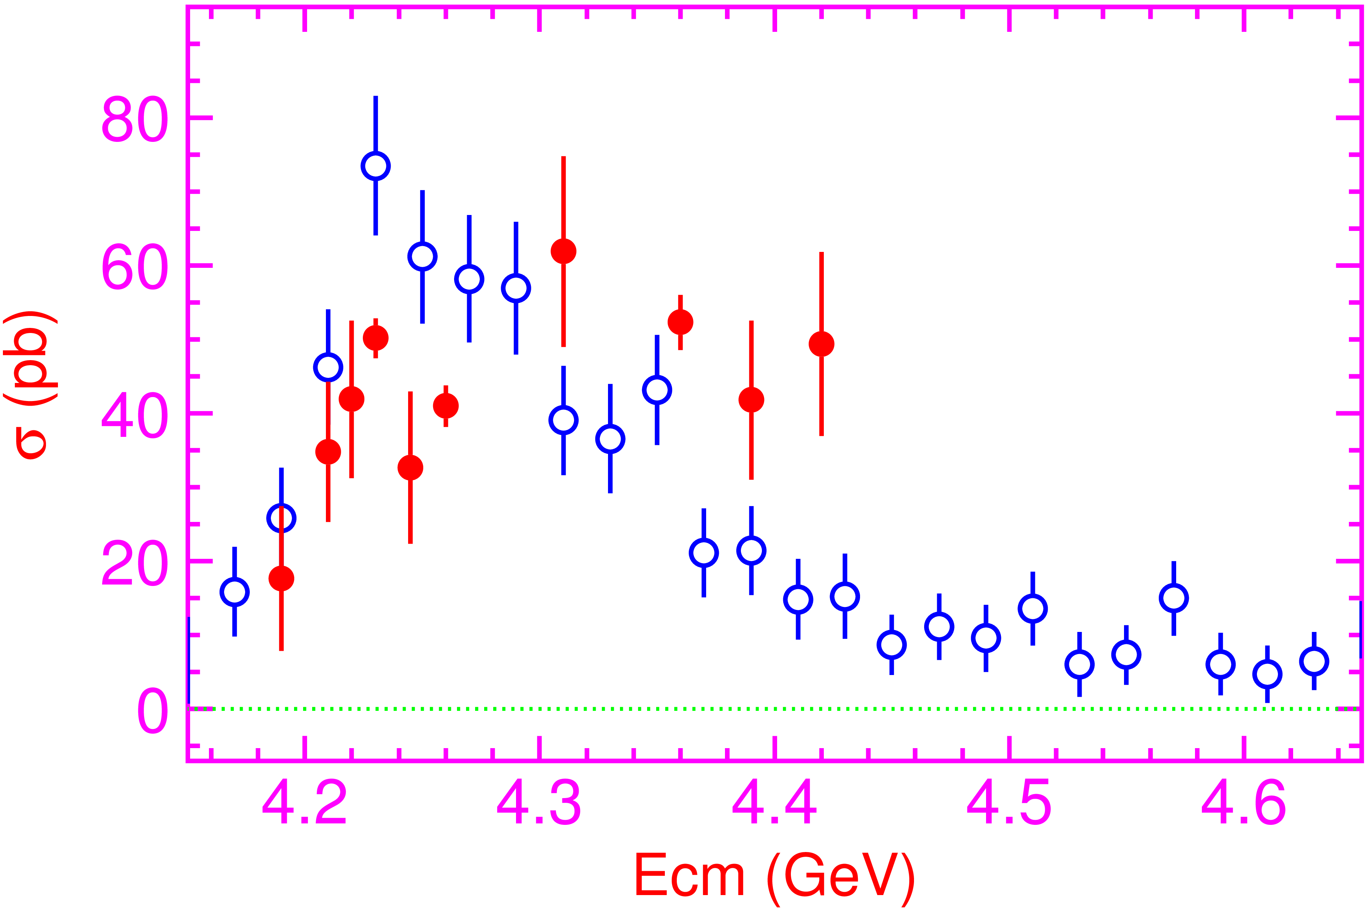

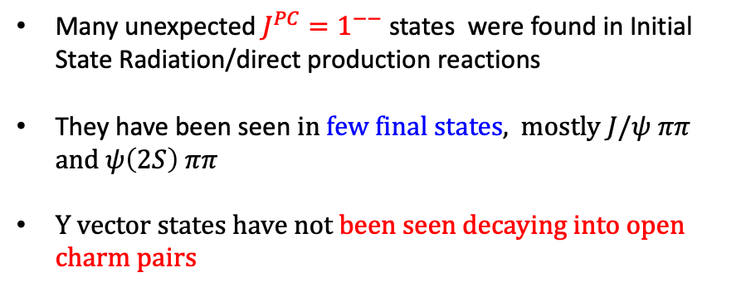
Vector $Y$ states
Many unexpected ${J^{PC}=1}^{−−}$ states were found in Initial State Radiation/direct production reactions
They have been seen in few final states, mostly $J/ψ ππ$ and $ψ\left(2S\right) ππ$
Y vector states have not been seen decaying into open charm pairs
Their decay violates the heavy quark spin symmetry, which implies that in the direct decay of a heavy quarkonium with spin S, only lower lying heavy quarkonia with the same spin S can be produced.

Slide 32
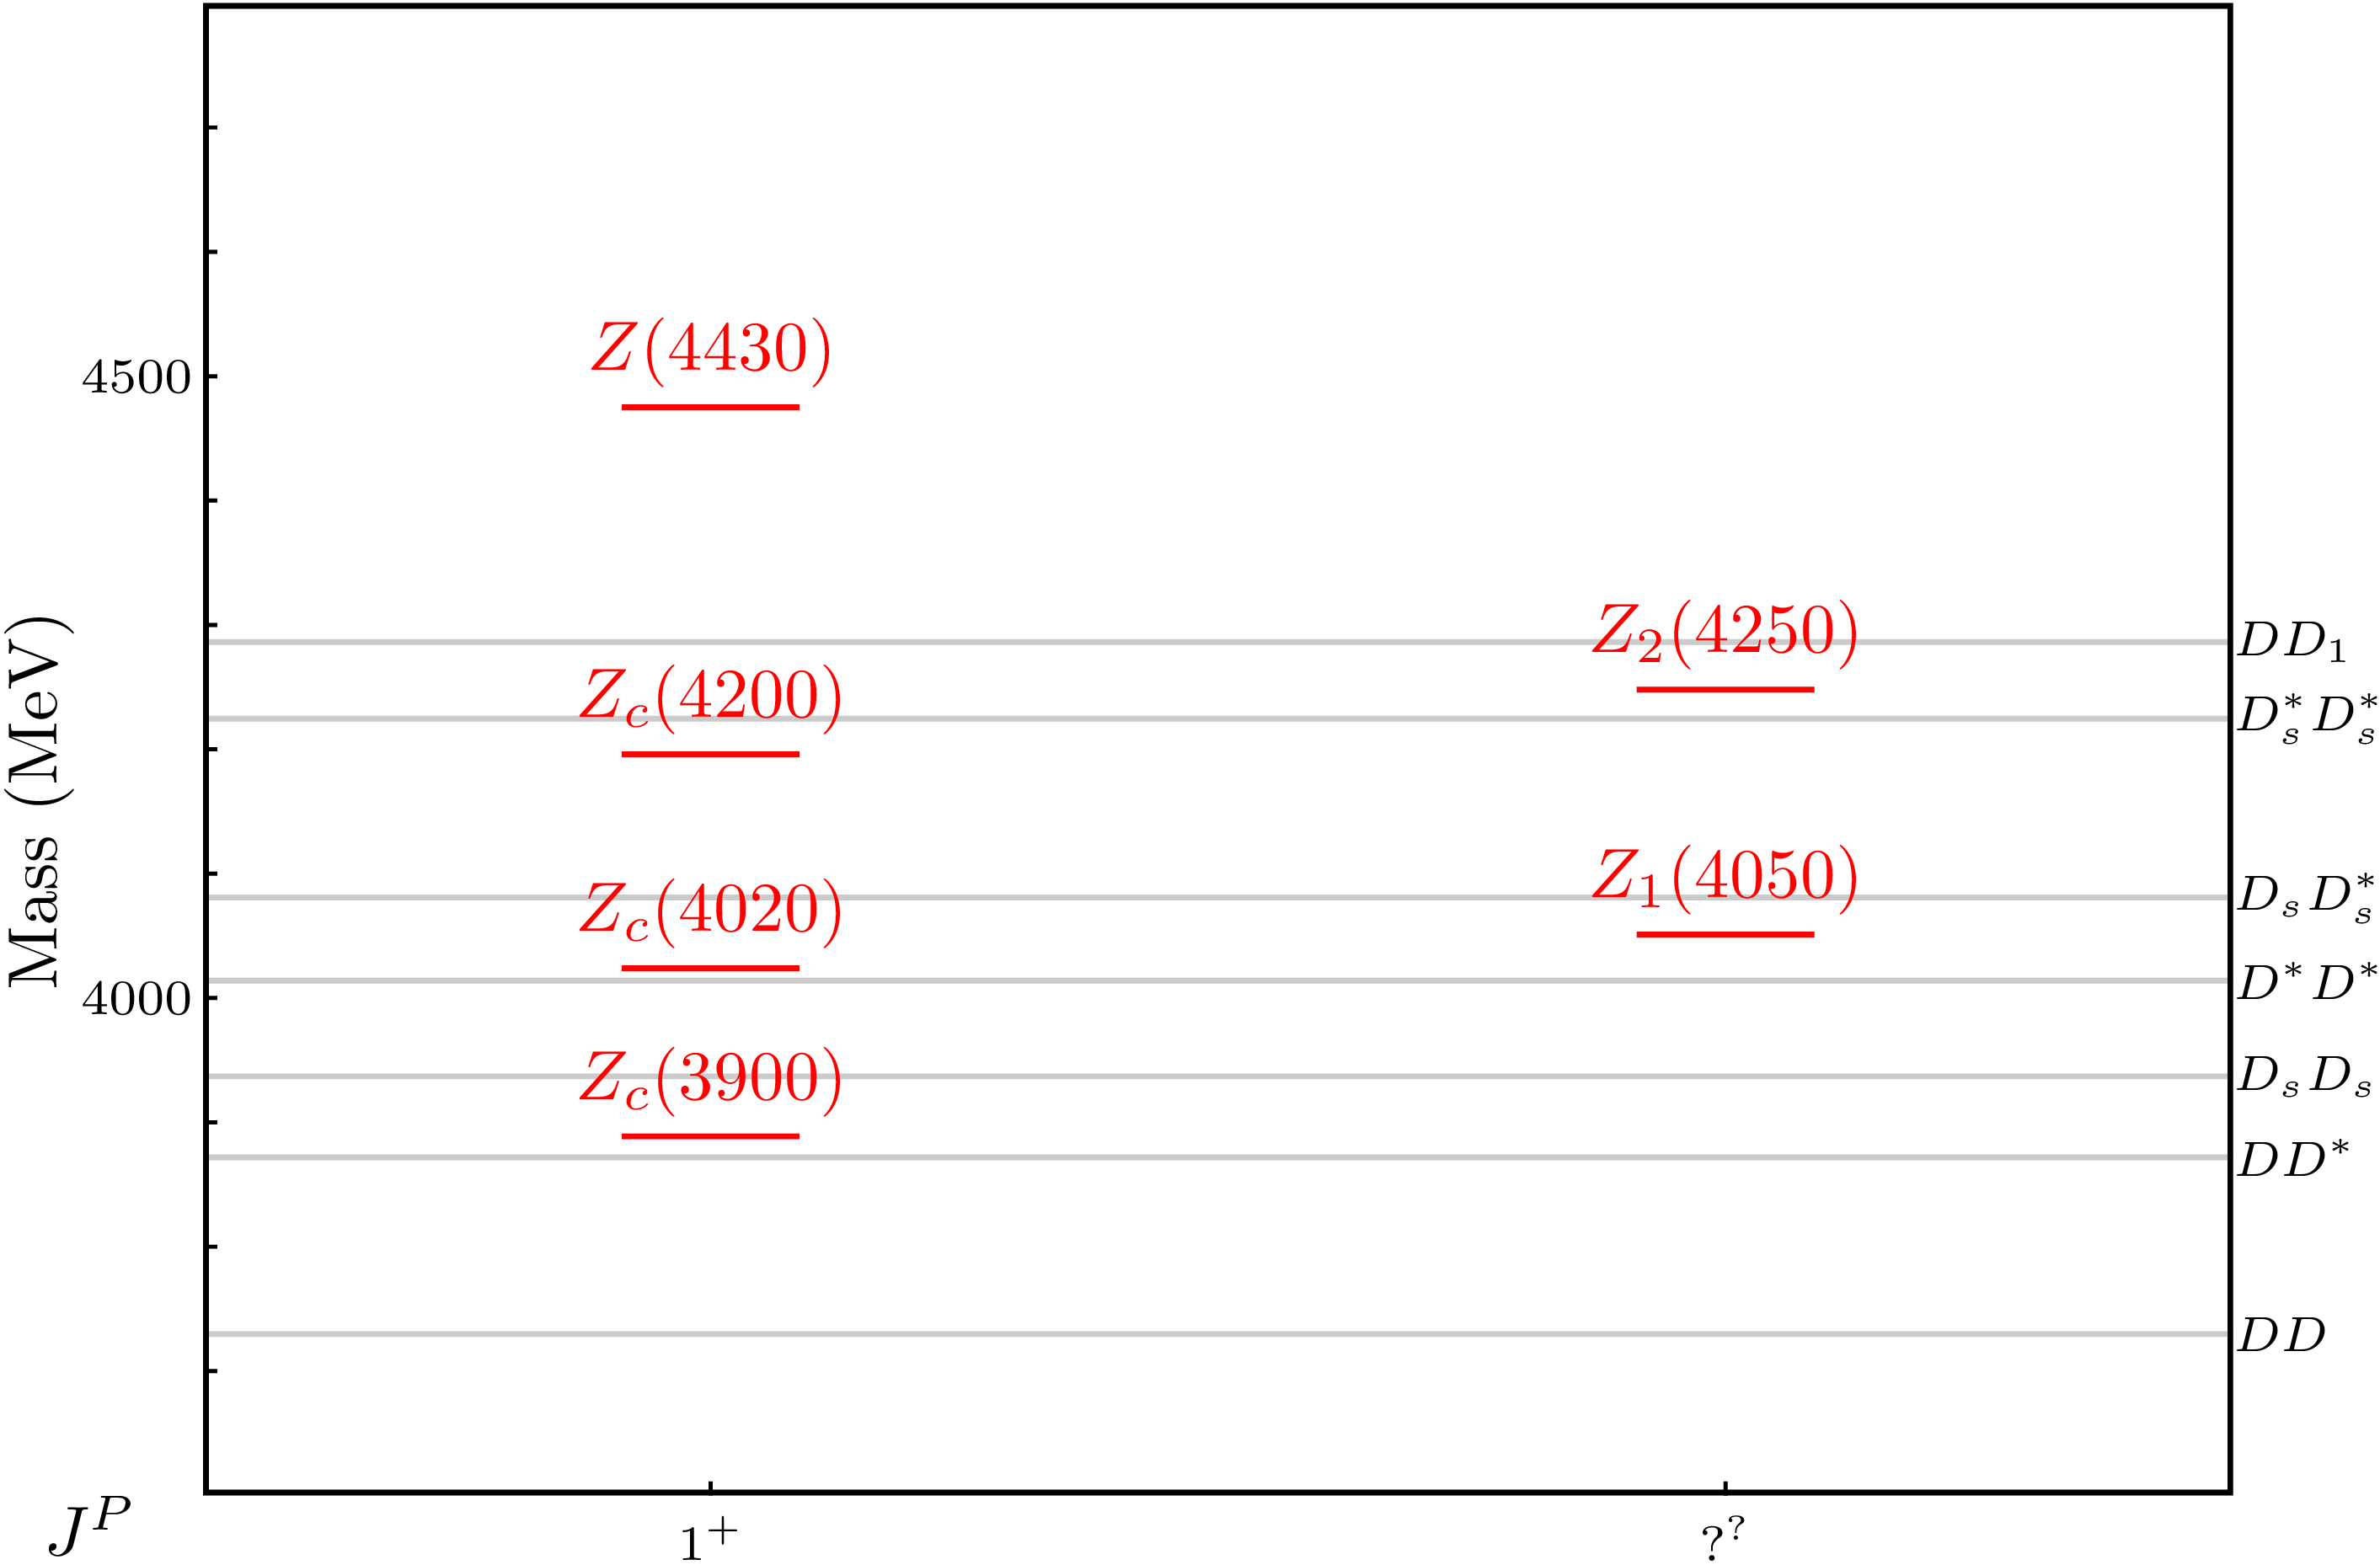
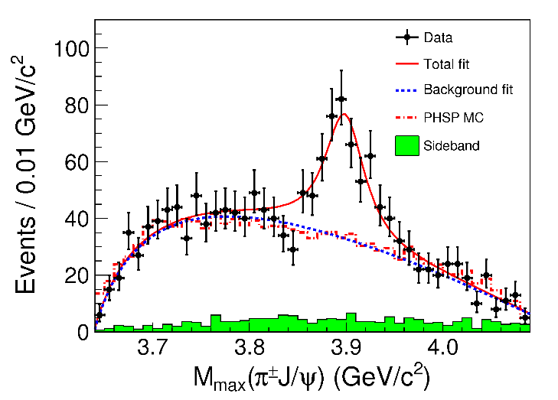
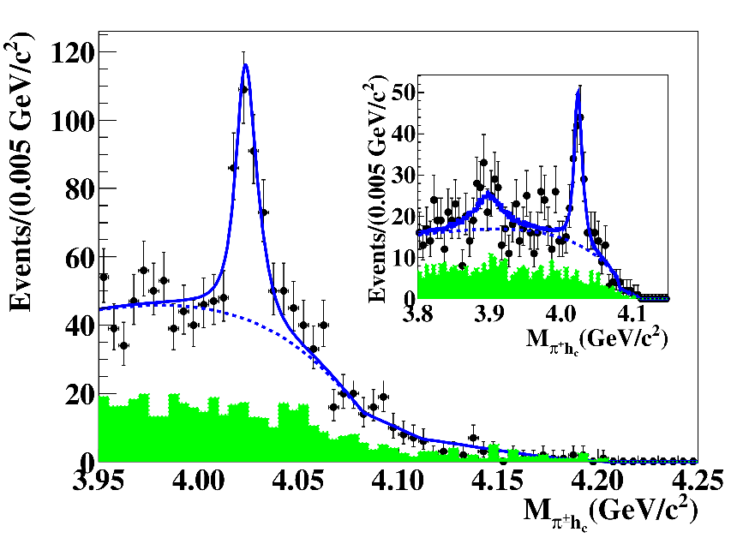
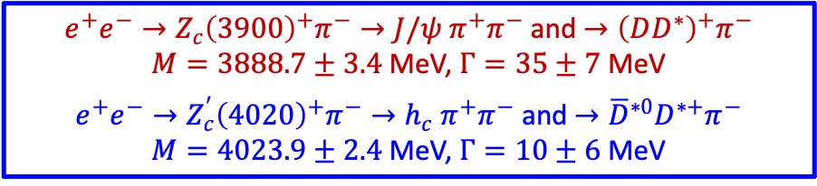

Charged $Z$ states: $Z_{c}\left(3900\right), Z_{c}^{′}(4020)$
Charged quarkonium-like resonances have also been found, which require 4q to acquire their charge
Two states $J^{PC}=1^{+−}$ appear slightly above $D^{(∗)}D^{∗}$ thresholds
$e^{+}e^{−}→Z_{c}{\left(3900\right)}^{+}π^{−}→J/ψ{ π}^{+}π^{−}$ and $→{\left(DD^{∗}\right)}^{+}π^{−}$
$M=3888.7±3.4$MeV, $Γ=35±7$ MeV
$e^{+}e^{−}→Z_{c}^{′}{\left(4020\right)}^{+}π^{−}→h_{c}{ π}^{+}π^{−}$ and $→{\overline{D}}^{∗0}D^{∗+}π^{−}$
$M=4023.9±2.4$MeV, $Γ=10±6$ MeV

Slide 33
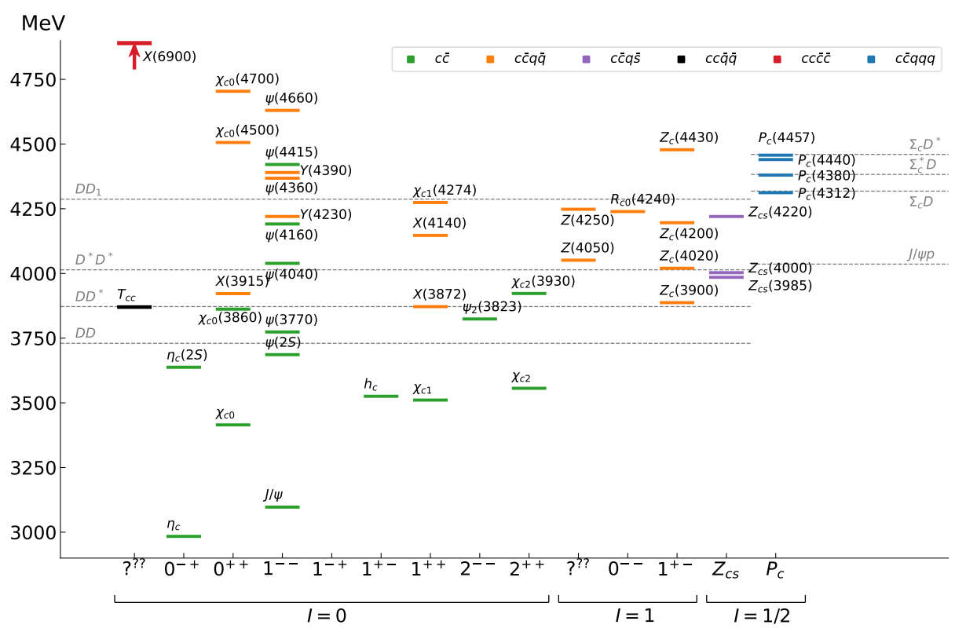

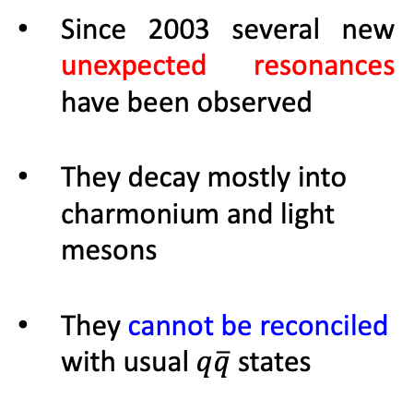
Exotic Landscape in c$\overline{\text{c}}$
Esposito, AP, Polosa, Phys.Rept. 668
JPAC, arXiv:2112.13436
Since 2003 several new unexpected resonances have been observed
They decay mostly into charmonium and light mesons
They cannot be reconciled with usual $q\overline{q}$ states
The nature of the new XYZ states has not been fully established

Slide 34
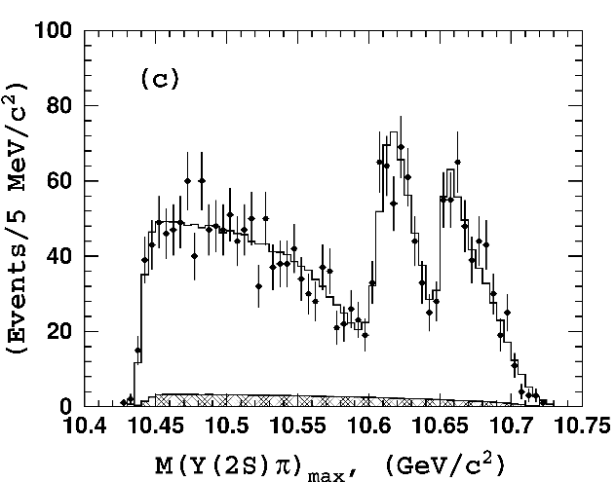
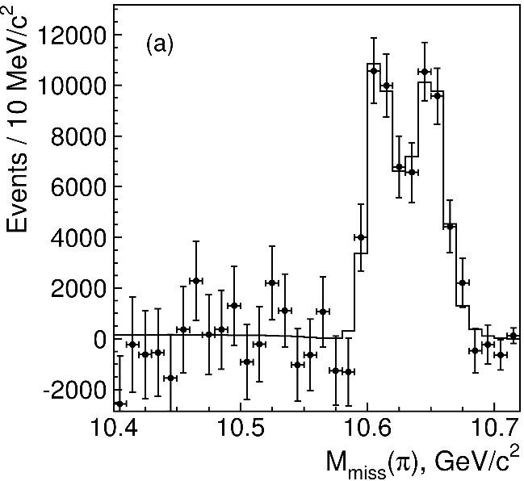

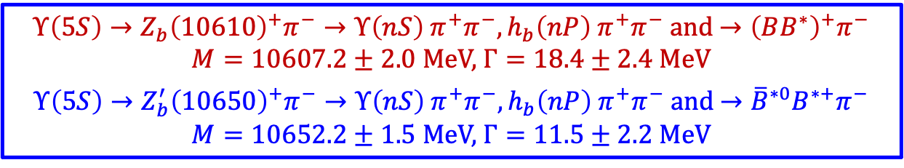


Charged $Z$ states: $Z_{b}\left(10610\right), Z_{b}^{′}(10650)$
Anomalous dipion width in $Υ\left(5S\right)$ decay, 2 orders of magnitude larger than $Υ\left(nS\right)$
Moreover, observed $Υ\left(5S\right)→h_{b}\left(nP\right)ππ$ which violates the heavy quark spin symmetry
2 twin resonances!
$Υ\left(5S\right)→Z_{b}{\left(10610\right)}^{+}π^{−}→Υ\left(nS\right){ π}^{+}π^{−},h_{b}\left(nP\right){ π}^{+}π^{−}$ and $→{\left(BB^{∗}\right)}^{+}π^{−}$
$M=10607.2±2.0$MeV, $Γ=18.4±2.4$ MeV
$Υ\left(5S\right)→Z_{b}^{′}{\left(10650\right)}^{+}π^{−}→Υ\left(nS\right){ π}^{+}π^{−},h_{b}\left(nP\right){ π}^{+}π^{−}$ and $→{\overline{B}}^{∗0}B^{∗+}π^{−}$
$M=10652.2±1.5$MeV, $Γ=11.5±2.2$ MeV

Slide 35
Exotic Landscape
Tremendous experimental progress has been made in the last two decades because of the operation of the modern generation of experiments such as the B factories BABAR and Belle, the high-luminosity electron–positron collision experiments such as BESIII, and the experiments at hadron colliders including CDF, D0, ATLAS, CMS, LHCb and COMPASS.
The nature of the new Exotic states has not been fully established

Slide 36



Tetraquarks
With the first open-charm tetraquark discovered in 2021 by the LHCb collaboration
T_{cc} with quark content cc$\overline{\text{u}}\overline{\text{d}}$
the family of hadrons has continued to expand and now also includes states with double hidden charm ($T_{cc\overline{c}\overline{c}}$) and open strangeness (T_{cs}).
Lattice calculations show that doubly-heavy open-flavor states like bbud can form stable tetraquarks, but how their properties change with the quark mass is not yet clear.

Slide 37




Pentaquarks
LHCb, PRL 115, 072001
LHCb, PRL 117, 082003
Two states seen in $Λ_{b}→\left(J/ψ p\right) K^{−}$,
evidence in $Λ_{b}→\left(J/ψ p\right) π^{−}$
$$M_{1}=4380±8±29 \text{MeV} \\ Γ_{1}=205±18±86 \text{MeV}$$
$${ M}_{2}=4449.8±1.7±2.5 \text{MeV} \\ Γ_{2}=39±5±19 \text{MeV}$$
Quantum numbers
$$J^{P}=\left({\frac{3}{2}}^{−},{\frac{5}{2}}^{+}\right) \text{or}\left({\frac{3}{2}}^{+},{\frac{5}{2}}^{−}\right)\text{or}\left({\frac{5}{2}}^{+},{\frac{3}{2}}^{−}\right)$$
Opposite parities needed for the interference to correctly describe angular distributions, low mass region contaminated by $Λ^{∗}$ (model dependence?)
No obvious threshold nearby

Slide 38


New Pentaquarks Discovered
LHCb, PRL 122, 222001
A higher statistics 1D analysis is able to resolve the fine structure of the $P_{c}(4450)$ peak.
Moreover, a new isolated $P_{c}(4312)$ at the $Σ_{c}^{+}{\overline{D}}^{0}$ threshold appears
The old assignment of quantum numbers might be jeopardized by this new finding

Slide 39


The unresolved nature
Elementary particles
Nature
States could also be mimic by
Rescattering effects
Quarks & gluons
Color-singlet mesons and baryons
PRD 92 (2015) 071502
PLB 757 (2016) 231
PLB 757 (2016) 61
and others
strong interaction
(long-distance effects)
Compact tetra/pentaquark
Hadronic molecules
PRL 105 (2010) 232001,
PRL 115 (2015) 122001
PRD 100 (2019) 011502 (R)
and others
Diquark-antidiquark
PRD 71, 014028 (2005)
PLB 662 424 (2008)
qqg hybrid, glueball or mixture
Color Forces
Hadrocharmonium/adjoint charmonium
PLB 666 344 (2008)
PLB 671 82 (2009)
Nuclear Forces
39

Slide 40
Meson Spectroscopy
Outline:
The discovery of mesons and the importance of spectroscopy for the development of modern particle physics
The Constituent Quark Model and the classification of mesons
Discovery of unconventional states XYZ and more
Experimental searches and analysis techniques
Search for exotics at EIC

Slide 41

Mass Spectra
A meson resonance can be observed studying the invariant mass spectrum of its decay product.
For an isolated resonance X decaying to two particles (M₁ and M₂)
there will be a peak in the M_{x} spectrum with a width that is related to the life-time of the resonance
Counts
M₁
X→π⁺π⁻
X
M₂
Mass(GeV)
In real life, resonances do not always appear so clearly in a mass spectrum because they are not isolated:
The mass spectrum will be determined by the amplitude for the resonant process and the amplitudes of the other competing processes (background, other resonances, …)
Since amplitudes are complex quantities, different processes can interfere leading to very different mass spectra shapes
Depending on the relative magnitude and phase of the different amplitudes, a resonance can appear as a bump, as a cusp or be hidden

Slide 42
Resonances and Breit-Wigners
For a narrow, well isolated resonance, far from threshold, the amplitude for the resonant process is well described by the so-called Breit-Wigner function
Decay product momentum in the resonance rest frame
Non relativistic:
Relativistic:
Blatt-Weisskopf barrier factor, see PDG for definitions and references
- Non relativistic - Relativistic
|BW|²
Im(BW)
ϑ(rad)
M(MeV)
Re(BW)
M(MeV)

Slide 43
Resonances and Poles
Formally, a resonance is defined as a pole in the complex amplitude describing the process
Going through the pole, the amplitude will have strong variations in magnitude and phase
Im(m)
M_{X}
Re(m)
Γ_{X}
ϑ
For a narrow, well isolated resonance, far from threshold the Breit-Wigner shape is a good parameterization for a resonant amplitude and the BW parameters agree with the pole position
m=M_{X}-iΓ_{X}/2
- Non relativistic - Relativistic
|BW|²
Im(BW)
ϑ(rad)
M_{X}~M₀
Γ_{X}~Γ₀
M(MeV)
Re(BW)
M(MeV)

Slide 44

Decay Angular Distributions
M. Alekseev et al. (COMPASS Collaboration), Phys.Rev.Lett.104:241803,2010.
In reality, in most of the cases, resonances are not narrow and are not isolated….
For example in:
π⁻
π⁻
π⁻
X
π⁺
A
A
Dominant contributions to the 3-pion spectrum are:
a₁(1260)→ρπ ⇒ 1⁺⁺ → 1⁻⁻0⁻⁺ in S wave
a₂(1320)→ρπ ⇒ 2⁺⁺ → 1⁻⁻0⁻⁺ in D wave
π₂(1670)→f₂π ⇒ 2⁻⁺ → 2⁺⁺0⁻⁺ in S wave
The different resonant contributions can be separated analyzing the angular distribution of the decay products
The separation will have to be performed as a function of the invariant mass of the final states and of any other variable that can affect the dynamics of the process (energy, …)
A proper model to write the amplitudes of the process will be needed
S wave ⇒
D wave ⇒

Slide 45
Partial Wave Analysis
π⁻
Purpose: extract the intensity of the different angular waves as a function of the invariant mass of the final state particles
π⁻
π⁻
X
Method:
Measure events for the process of interest, determining the 4-vectors of the final states particles and other variable of interest (energy of incoming particles, momentum transfer, polarization,…)
π⁺
A
A
Build a model that describes the process based on a set of free parameters θ, predicting the probability of having an event with a particular set of kinematic variables Ω (angles, invariant mass, etc.)
Fit the model to the data my maximizing the probability given by the model for the entire data set (likelihood)
L

Slide 46
PWA Model
The model is typically built from a set of complex amplitudes, that can include resonant and non resonant processes.
In the simple case of two resonant amplitudes A₁ and A₂ (Breit-Wigner) functions of the invariant mass squared (Ω=s)
where V₁ and V₂ are complex parameters.
The numerator, called Intensity, represent a number of events per unit of phase space. It can be generalized to an arbitrary number of waves
decay amplitudes:
resonance and angular structure
Intensity (number of events) at a kinematic point Ω
production amplitudes:
complex fit parameters
Sum over partial waves

Slide 47


The Isobar Model
Most of presently available PWA tools are based on the isobar model:
Process is factorized in production and decay amplitudes
Resonance decay to multi-particle final state is built as series of subsequent two-body decays
The isobar model is supported by the data, since most known resonances seem to prefer two-body decays to direct decays to many particles
It is an efficient and generalizable approach since with a limited set of amplitude it is possible to build amplitude for complex, multi-step decays
It includes intrinsic approximations (no 3-body diagrams, …) that have been estimated to be correct at the 20% level and violate unitarity
Crucial and critical component for partial wave analysis

Slide 48
PWA FIT
Fits are performed using a likelihood (unbinned) method
After removing constant factors, the quantity that is maximized is the log-likelihood
parameter vector
L
Intensity normalization integral
detector acceptance
L
Model is contained in the A’s; if the A’s do not contain parameters, can be computed and cached for every event
Integrals are computed using Monte Carlo integration with high-statistics detector MC sample
These terms never changes if A’s are fixed, but can become most computationally-expensive parts if A’s depends on parameters (e.g. the resonance mass). e.g. N_{mc}=10⁶,N_{amp}=10⇒ sum of 10⁸ numbers
Sum of N logs each with N²_{amps} need to be performed at every fit iteration and can drives fit time:
e.g. N=10000, N_{amps}=10 ⇒ 10⁶ terms

Slide 49
PWA limitation and critical issues
Number of kinematic variables needed to fix the phase-space point (Ω) can be large: masses, helicities, angles,…
An accurate model requires a large number of amplitudes that will depend on all the kinematic variables mentioned above
Amplitudes will have to contain fit parameters as masses and widths
Number of amplitudes and therefore fit parameters (complex number!) can easily explode…
To constrain a large number of parameter, a large data set is needed
Monte Carlo event samples used to evaluate normalization integrals have to be large to reduce the associated statistical uncertainty to negligible levels with respect to data statistical uncertainty and systematics
Very close collaboration between theorist and experimentalist to develop, adapt and use most accurate models for PWA’s
Need to develop clever algorithms and computational approaches to reduce fitting time

Slide 50

Dalitz Plot
Dalitz plots can be used to visualize the dynamics of a three-body decay (X→123).
A three body system produced from an unpolarized initial state at rest can be described by two independent variables that Dalitz chose to be the squared invariant masses of two pairs of particles, m²₁₂ and m²₂₃.
R. H. Dalitz, Philosophical Magazine, 44 (1953) 1068

Slide 51


Parallel Computing and GPUs
PWA is intrinsically a parallel calculation:
Events are independent: terms in the sum can be computed in parallel
Exactly the same (relatively simple) calculation for each event
Every event has its own data, only fit parameters are shared
Ideal for GPU implementation
Graphical Processor Units (GPUs):
Built for 3D computer games
Calculate projections of complex objects on the screen, evaluating colors and accounting for lights and shadows
Do all this in parallel
Architecture is optimized to operate on many (pixels) 4-tuples (3 colors + transparency) of floating point values and lookups in large tables ⇒ just what is needed
Cheap and powerful hardware

Slide 52

Performance CPU/GPU
Data by N. Berger (BES Collaboration)
Performance studied with a toy model for J/ψ → γ K⁺K⁻ analysis
Fortran code (no parallel computing) running on a CPU
OpenCL-based code (parallel computing) on CPU
Brook+-based code (parallel computing) on ATI GPU
OpenCL-based code (parallel computing) on GPU
factor 100
OpenCL: vendor- and hardware independent standard for parallel computing
Brooks+: high level framework for parallel computing developed by ATI. Now discontinued

Slide 53
Meson Spectroscopy
Outline:
The discovery of mesons and the importance of spectroscopy for the development of modern particle physics
The Constituent Quark Model and the classification of mesons
Discovery of unconventional states XYZ and more
Experimental searches and analysis techniques
Search for exotics at EIC

Slide 54


THE FUTURE: EIC @ BNL
E_{e} =100-140 GeV
Electron-Ion Collider
101 INFN Physicists
16 INFN Institutes
Si Vertex detector
Dual RICH
Streaming Read-out

Slide 55


Exotic hadrons via photoproduction at EIC
COMPASS proved
that photo-production of exotic states is possible
COMPASS, PLB 783 (2018) 334
O (105) XYZ events in six months at 10³³ cm-² s⁻¹ luminosity @EIC
Z $→$J/$ψ$ $π$ ⁺ (and J J/$ψ$ $→$e⁺e⁻)
It has been studied by the JPAC group

Slide 56



Exclusive (quasi-real) photoproduction
XYZ have so far not been seen in photoproduction: independent confirmation
Not affected by 3-body dynamics: determination of resonant nature
Experiments with high luminosity in the appropriate energy range are promising
We study near-threshold (LE) and high energies (HE)
Couplings extracted from data as much as possible, not relying on the nature of XYZ
M. Albaladejo et al. [JPAC], PRD
$$<λ_{𝒬}λ_{N}^{′}|T|λ_{γ}λ_{N}>=\underset{V,ℰ}{∑}\frac{ef_{V}}{m_{V}}𝒯_{λ_{V}=λ_{γ},λ_{𝒬}}^{α_{1}⋯α_{j}}𝒫_{α_{1}⋯α_{j};β_{1}⋯β_{j}}ℬ_{λ_{N}λ_{N}^{′}}^{β_{1}⋯β_{j}}$$
Bottom vertex from standard photoproduction pheno,
exponential form factors to further suppress large t
Top vertex from measured $𝒬→Vℰ$ decay width
VMD is used to couple the incoming photon
to a vector quarkonium V
A. Pilloni – Exotic hadron spectroscopy

Slide 57




$Z$ photoproduction
The $Zs$ are charged charmoniumlike $1^{+−}$ states close to open flavor thresholds
Focus on $Z_{c}{\left(3900\right)}^{+}→J/ψ π^{+}$, $Z_{b}{\left(10610\right)}^{+},Z_{b}^{′}{\left(10650\right)}^{+}→Υ(nS) π^{+}$
The pion is exchanged in the $t$-channel
Sizeable cross sections especially at Low Energies
A. Pilloni – Exotic hadron spectroscopy

Slide 58





$X$ photoproduction
Focus on the famous $1^{++} X\left(3872\right)→J/ψ ρ,ω$
Studying also $X\left(6900\right)→J/ψ J/ψ$ (assumed $0^{++}$)
𝛚 and 𝛒 exchanges give main contributions:
need to assume the existence of a OZI-suppressed $X\left(6900\right)→J/ψ ω$
Extremely suppressed cross sections at HE: LE most promising
A. Pilloni – Exotic hadron spectroscopy
58

Slide 59

Studying exotic hadrons nature via eA
3 10⁴ – 1.5 10⁵ events assuming
300 fb-1intergrated luminosity
Pan-Pan Shi et al., arXiv:2208.02639
59

Slide 60
Conclusion
Search for exotics at EIC is possible
May provide complementary information with respect to e+ e- colliders and hadron facilities

Slide 61
Thank you !

Slide 62





$Y$ (vector) photoproduction
Diffractive production, dominated by Pomeron (2-gluon) exchange
Existing data allow to put a 95% upper limit
on the ratio of $ψ′/Y(4260)$ yields
Assuming previous formula, one gets:
$Γ_{ee}^{Y}=930 eV$
(cfr. hep-ex/0603024, 2002.05641)
$BR\left(Y→J/ψππ\right)=0.96\%$
$R_{Y}=0.84$
$$R_{Y}=\frac{ef_{ψ}}{m_{ψ}}\sqrt{\frac{g^{2}(Y→ψππ)}{g^{2}(ψ→γgg)}\frac{g^{2}(ψ^{′}→ψgg)}{g^{2}(ψ^{′}→ψππ)}}$$
A. Pilloni – Exotic hadron spectroscopy
62

Slide 63


THE FUTURE: EIC @ BNL
E_{e} =100-140 GeV
Electron-Ion Collider
Color Glass Condensate
In QCD, the large soft-gluon density drives the non-linear gluon-gluon recombination. This gives rise to a saturation scale Qs, at which gluon splitting and recombination reach a balance.
At this scale, the density of gluons is expected to saturate, and may produce new and universal forms of
hadronic matter.
R.G. Milner

Slide 64




Vector $Y$ states
BESIII, PRL118, 092001 (2017)
$$e^{+}e^{−}→J/ψ ππ$$
BESIII, PRL118, 092002 (2017)
New BESIII data show a peculiar lineshape for the $Y(4260)$
The state appear lighter and narrower, compatible with the ones in $h_{c}ππ$ and $χ_{c0}ω$
A broader old-fashioned $Y(4260)$ is appearing in $\overline{D}D^{∗}π$, maybe indicating a ${\overline{D}D}_{1}$ dominance

Slide 65




Interpretation of exotic states
Meson/Baryon+continuum
Ferretti et al., PRC88, 015207
Ferretti et al., PRD90, 094022
Ferretti et al., 1806.02489
Diquark-Antidiquark
Maiani, et al. PRD71, 014028
Faccini, AP, et al. PRD87, 111102
Maiani, et al. PRD89, 114010
Maiani, et al., PLB778, 247
Hybrids & tetraquarks
Kou and Pene, PLB631, 164
Braaten, PRL111, 162003
Berwein et al., PRD92, 114019
Hadroquarkonium
Dubynskiy et al., PLB 666, 344
Dubynskiy and Voloshin, PLB 671, 82
Li and Voloshin, MPLA29, 1450060
$$π$$
$$π$$
$$J/ψ$$
$$π$$
Molecule
Tornqvist, Z.Phys. C61, 525
Braaten and Kusunoki, PRD69 074005
Swanson, Phys.Rept. 429 243-305
Kinematical effects
Szczepaniak, PLB747, 410
Szczepaniak, PLB757, 61
Guo et al., PRD92, 071502
Swanson, IJMPE25, 1642010

