Slide 1
Introduction to Machine Learning Techniques
G. Miniello – Ph. D.
INFN - bari

Slide 2
Overview
WHAT IS MACHINE LEARNING?
DIFFERENT TYPES OF MACHINE LEARNING
SUPERVISED MACHINE LEARNING AND CLASSIFICATION PROBLEMS
DATA PREPROCESSING, MODEL TRAINING AND EVALUATION
FROM THE MCP PERCEPTRON TO ARTIFICIAL NEURAL NETWORKS
FROM THE DEEP NEURAL NETWORKS TO THE CONVOLUTIONAL NEURAL NETWORKS
AI4EIC

Slide 3
Introduction to machine learning
ALL YOU NEED IS…DATA!
Nowadays we have an abundance of structured and unstructured data
Machine Learning (ML) is a branch of Artificial intelligence (AI) and Computer Science which focuses on the use of data and algorithms to mimic the way that humans learn, gradually improving its performance.
Many applications in everyday life and in basic and applied science
Structured data: categorized as quantitative data, highly organized and easily decipherable
Unstructured data: categorized as qualitative data, cannot be processed and analyzed via conventional data tools and methods
https://www.thetechnologyheadlines.com/images/Most_Popular/2019/8/Machine-Learning-Applications-in-Real-World.jpg

Slide 4
GENERAL ALGORITHM STRUCTURE IN MACHINE LEARNING
Input data
Model
Output

Slide 5
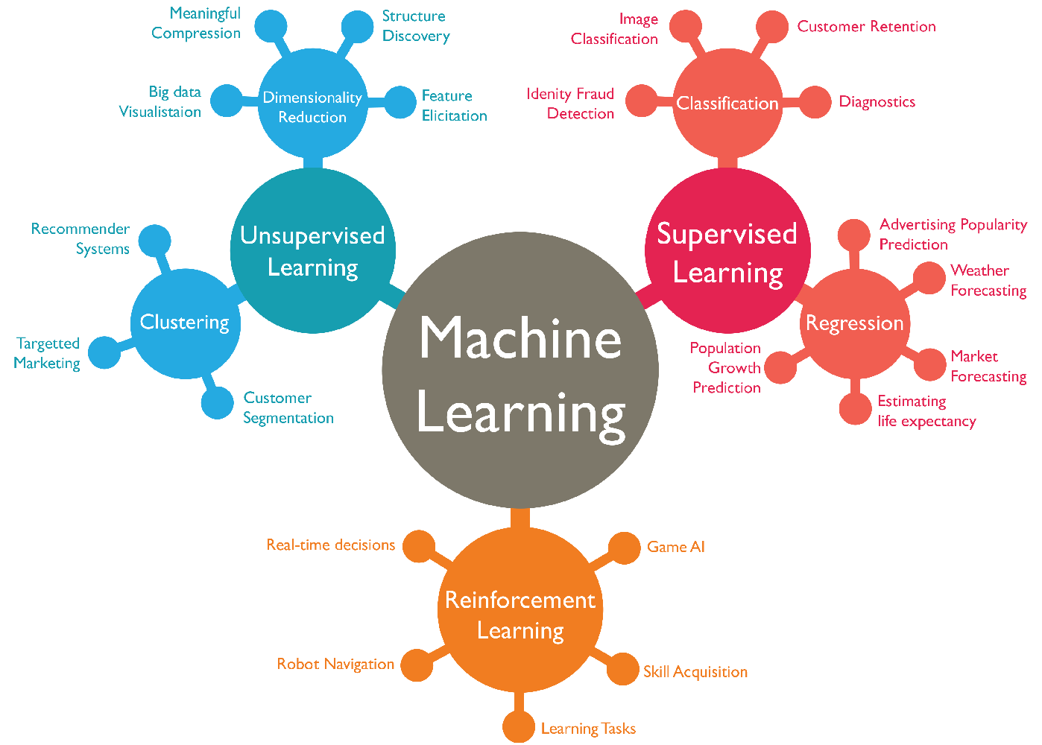
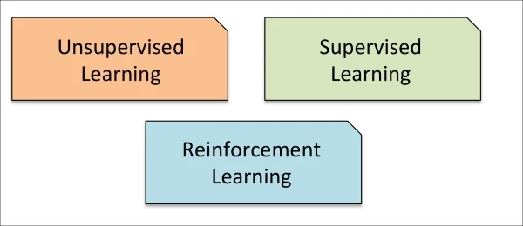
WHAT IS Machine learning?
“Machine learning evolved as a subfield of artificial intelligence that involved the development of self-learning algorithms to gain knowledge from data in order to make predictions”
S. Raschka
DIFFERENT TYPES OF MACHINE LEARNING
Credits: https://wordstream-files-prod.s3.amazonaws.com/s3fs-public/machine-learning.png

Slide 6
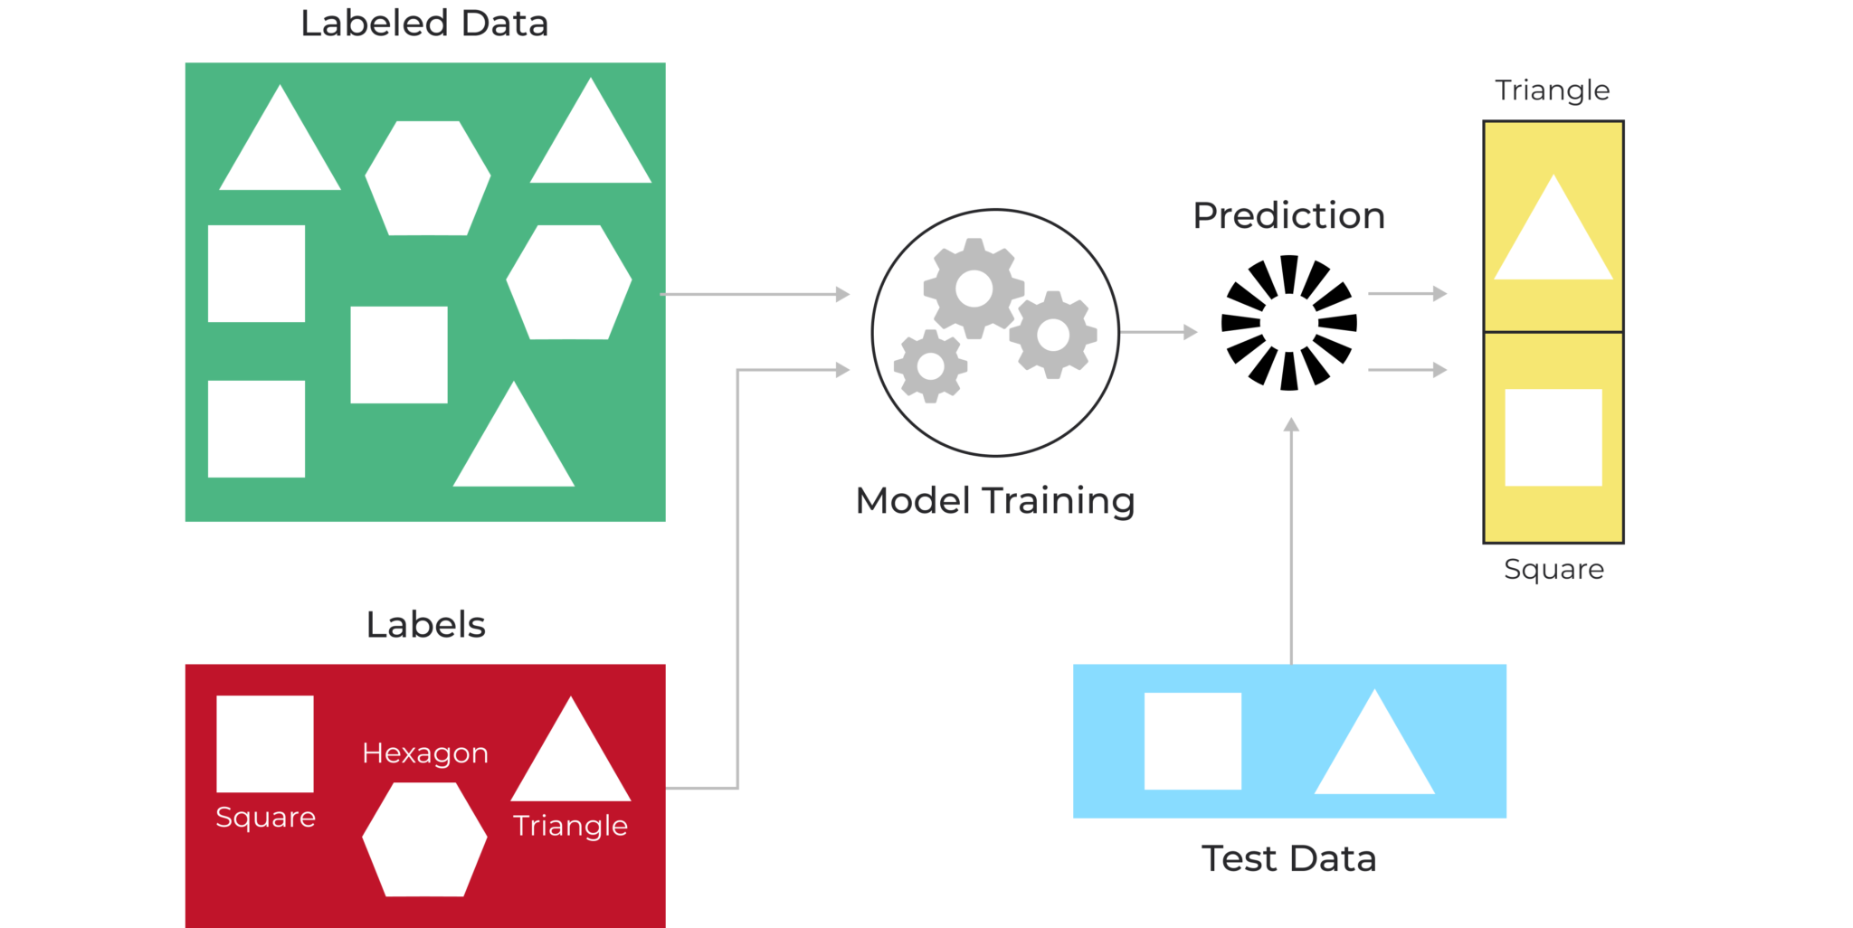
Supervised learning
Supervised refers to a set of samples where the desired output signals (labels) are already known.
GOAL: learning a model from labeled training data that allows us to make predictions about unseen data.
Credits: https://postindustria.com/how-to-know-which-machine-learning-algorithms-to-use-techniques-in-machine-learning/

Slide 7
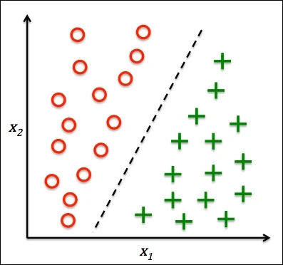
SUPERVISED LEARNING: CLASSIFICATION
Class A
Class B
The goal of the classification is to predict the categorical class labels of new data based on past observations. Classic examples are:
EMAIL SPAM: binary classification
HANDWRITTEN DIGIT RECOGNITION: multiple class classification

Slide 8
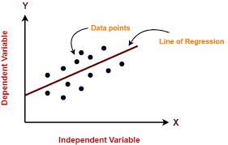
SUPERVISED LEARNING: REGRESSION
The goal of the regression is the prediction of continuous outcomes
SCORE
PREDICTIONS

Slide 9
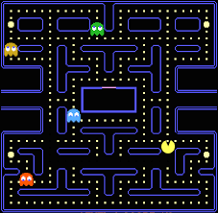
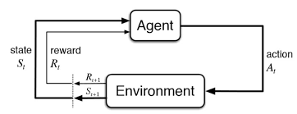
REINFORCEMENT LEARNING
The goal of reinforcement learning is the development of a system which improves by interacting with the environment
PACMAN GAME

Slide 10
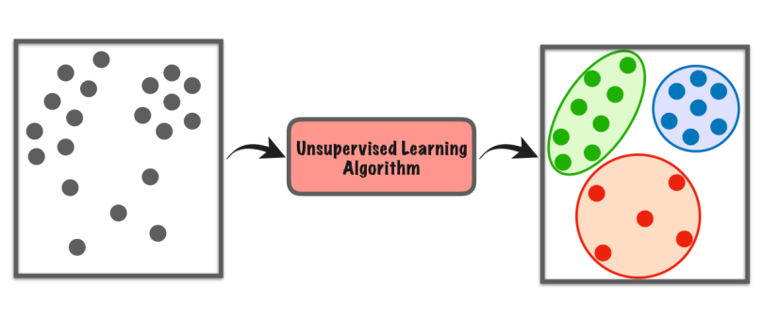
UNSUPERVISED LEARNING
The goal of unsupervised learning is to explore the structure of data in order to extract meaningful information without the guidance of a known outcome variable or reward function
Clustering: organize information into meaningful subgroups (clusters) without having any prior knowledge of their group memberships
Dimensionality Reduction

Slide 11
Supervised Machine Learning

Slide 12
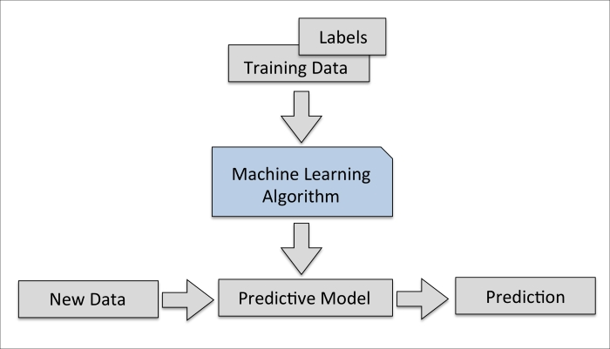
Supervised Learning goals and features
learning a model from labeled training data allowing to make predictions about unseen data
supervised → samples where the desired output signals (labels) are already known
discrete output (e-mail spam-filtering): classification
continuous output values : regression

Slide 13
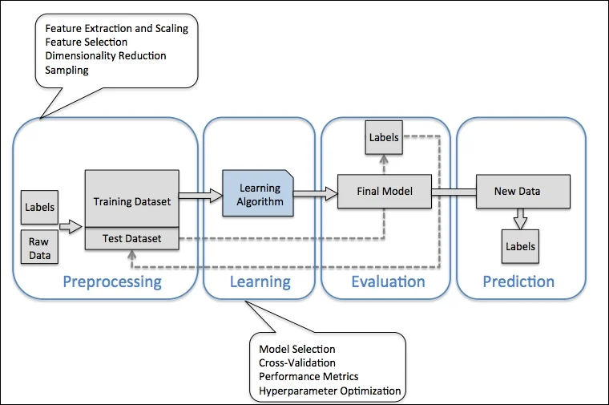
Roadmap for building Machine Learning systems

Slide 14
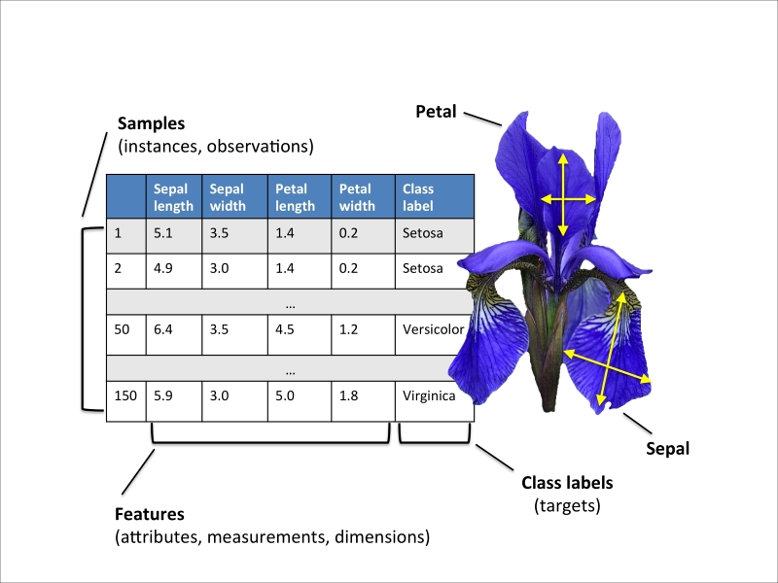
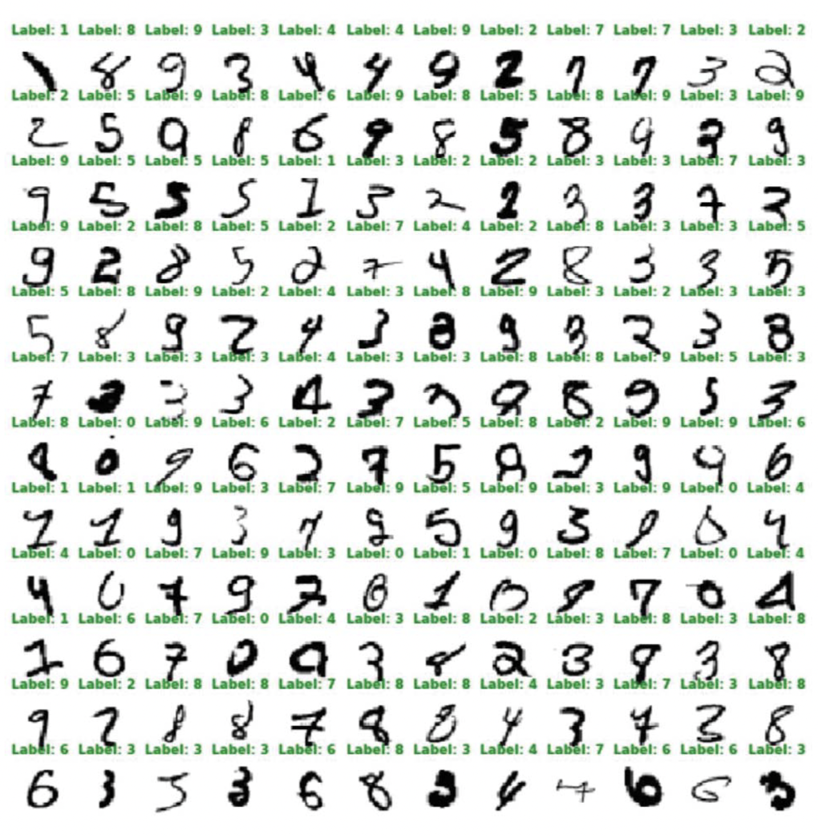
LABELED DATA
IRIS DATASET
IRIS MNIST

Slide 15
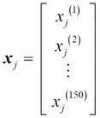
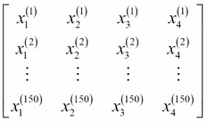
Basic terminology and notation
The Iris dataset → 150 iris flowers from species:
Setosa,
Versicolor,
Virginica.
1 row of X= 1 flower (4-dim row vector)
1 column of X= 1 feature (150-dim column vector)
y= class label vector (150-dim column vector)
$$x_{j}∈ ℝ^{150×1}$$
X=
X$∈ ℝ^{150×4}$
$$x^{i}∈ ℝ^{1×4}$$
y $∈ ℝ^{150×1}$

Slide 16
PREPROCESSING

Slide 17
What is preprocessing?
Raw data usually must be suitably shaped to be processed by a learning algorithm→ preprocessing
EXAMPLE: in Iris dataset raw data is a series of flower images from which we want to extract meaningful features ( color, the hue, the intensity of the flowers, the height, flower lengths and widths,…).
Many machine learning algorithms require that selected features are on the same scale for optimal performance (normalization)
Dataset divided into training dataset and test dataset to determine if the ML algorithm can generalize well on new data:
Some of the selected features may be highly correlated and therefore redundant to a certain degree →, dimensionality reduction techniques ( less storage space required → ML algorithm can run much faster!!!)
training dataset to train and optimize our machine learning model
test dataset kept until the very end for evaluation of the final model.

Slide 18
SUPERVISED LEARNING Algorithms
Perceptron
ADALINE
Logistic Regression
Artificial neural network
Support Vector Machine
Decision Trees
K-nearest neighbors

Slide 19
SUPERVISED LEARNING Algorithms
Perceptron
ADALINE
Logistic Regression
Artificial neural network
Support Vector Machine
Decision Trees
K-nearest neighbors

Slide 20
A brief history of early ML models
Biological Neuron
Mc Culloch-Pitts Neuron
Perceptron
Multi-layer perceptron

Slide 21
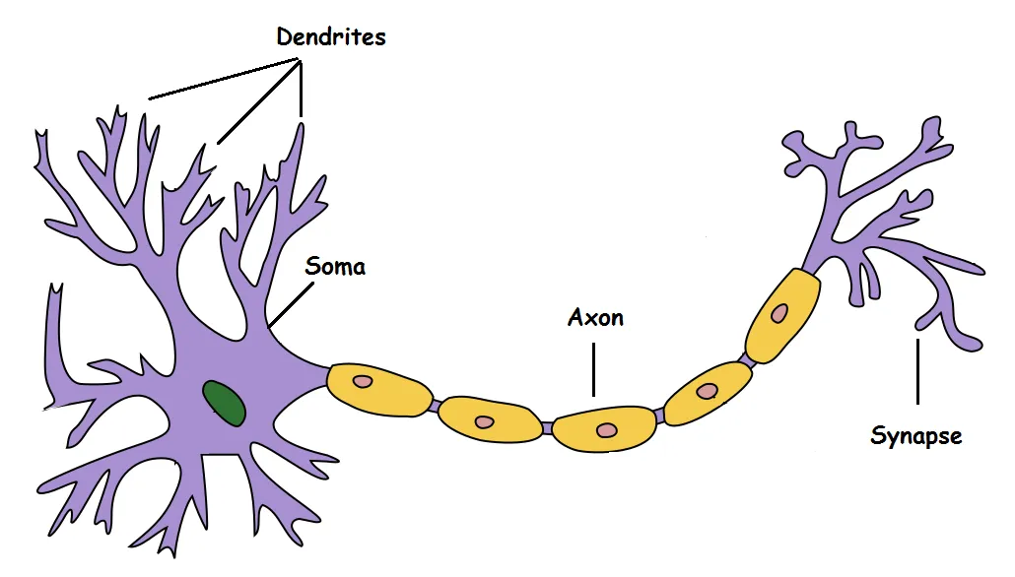
What are neurons and how do they look like?
Neurons: interconnected nerve cells in the brain involved in the processing and transmitting of chemical and electrical signals
Dendrite: Receives signals from other neurons
Soma: Processes the information
Axon: Transmits the output of this neuron
Synapse: Point of connection to other neurons

Slide 22
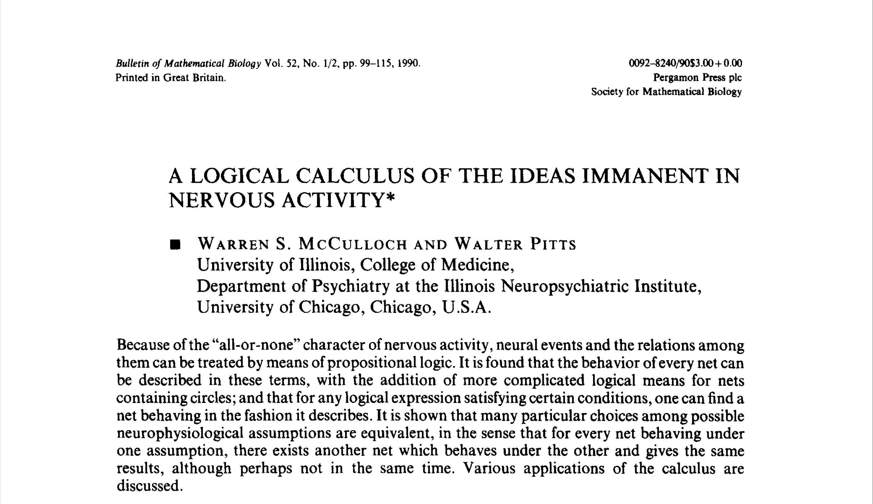
Mc Culloch-Pitts Neuron: the simplest artificial neuron
1943: Warren McCullock and Walter Pitts published the first model of a simplified brain cell, the so-called McCullock-Pitts (MCP) neuron, in 1943 (W. S. McCulloch and W. Pitts. A Logical Calculus of the Ideas Immanent in Nervous Activity. The bulletin of mathematical biophysics, 5(4):115–133, 1943).

Slide 23
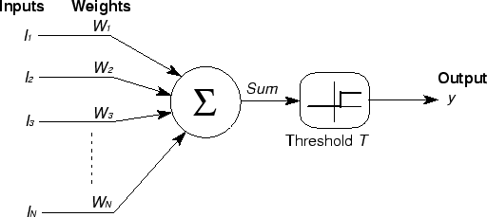
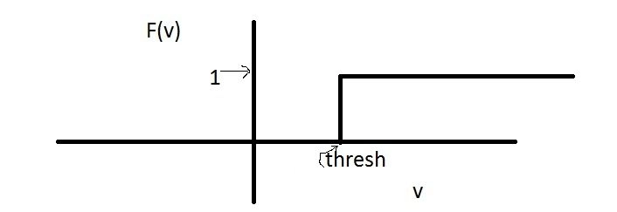
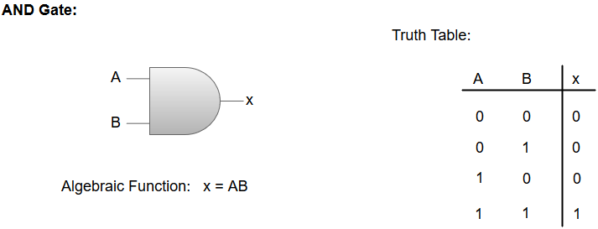
Mc Culloch-Pitts Model
Mc Culloch and Pitts describe a nerve cell as a logic gate with binary outputs
multiple signals arrive at the dendrites and integrated into the cell body
if the total signal exceeds a certain threshold $ν$ an output is generated and pass on by the axon
if the total signal exceeds a certain threshold 𝜈 an output is generated and pass on by the axon

Slide 24
Limitations of Mc Culloch-Pitts Model
Non boolean inputs
What if we want to assign more importance to some inputs?
How can we set a threshold?

Slide 25
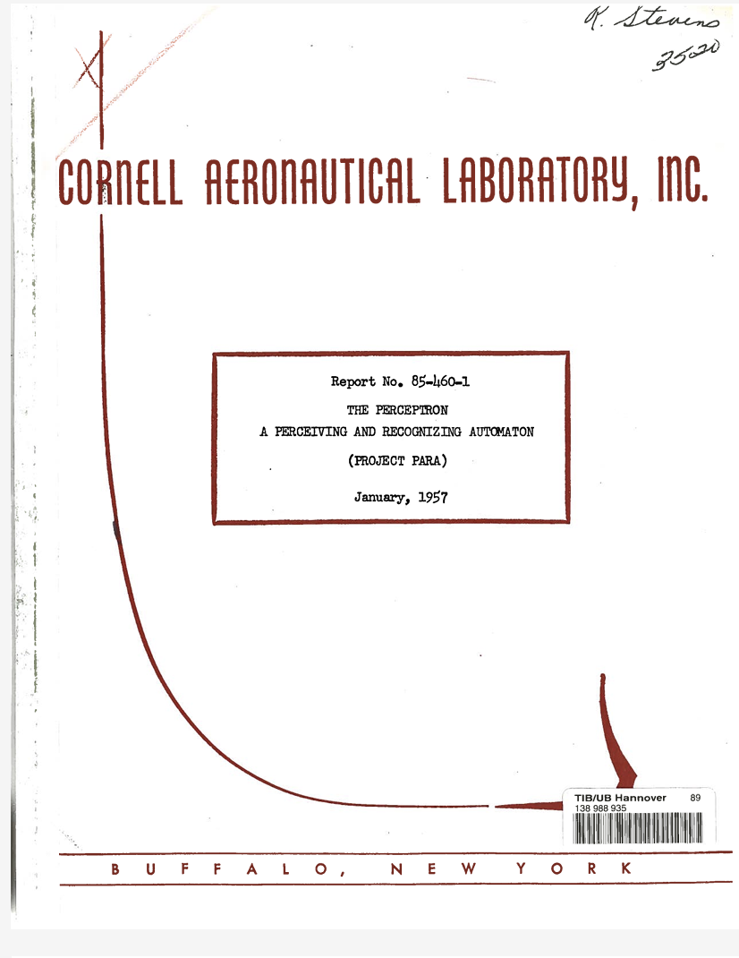
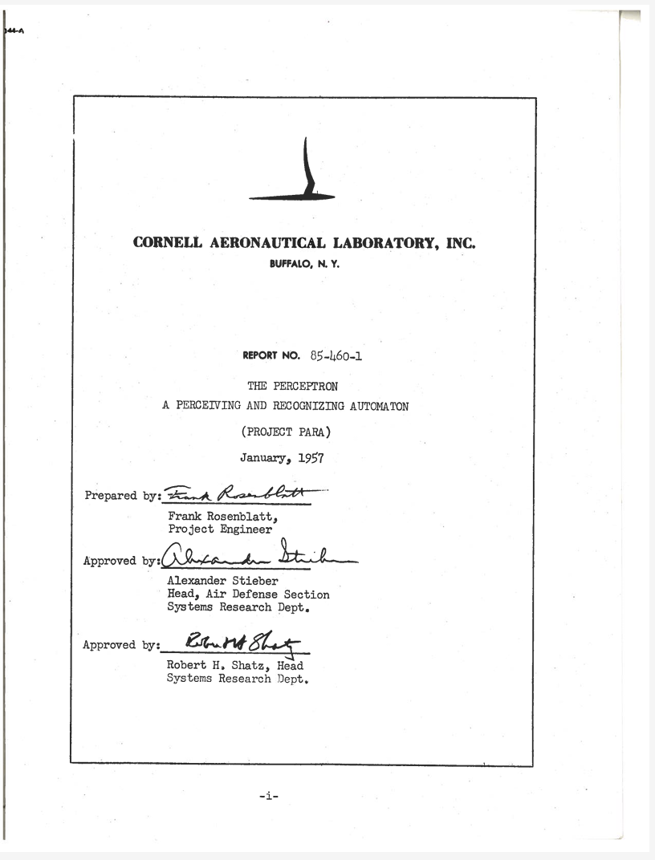
Rosenblatt’s Perceptron
Few years later, Frank Rosenblatt published the first concept of the perceptron learning rule based on the MCP neuron model (F. Rosenblatt, The Perceptron, a Perceiving and Recognizing Automaton. Cornell Aeronautical Laboratory, 1957)
Rosenblatt proposed an algorithm that automatically learns the optimal weight coefficients that are then multiplied with the input features in order to make the decision of whether a neuron fires or not.
In the context of supervised learning and classification, such an algorithm could then be used to predict if a sample belonged to one class or the other.

Slide 26
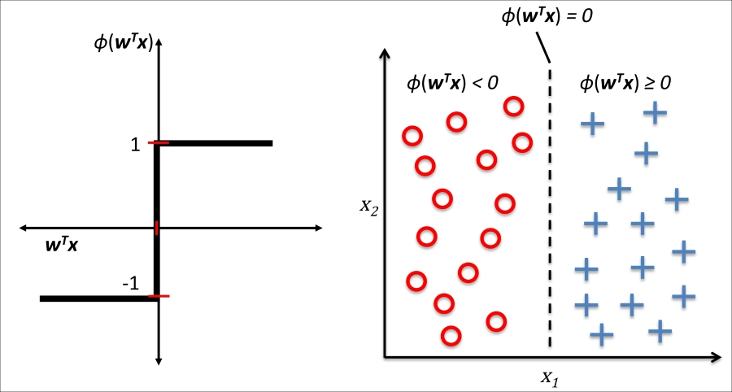
Rosenblatt’s Perceptron
Let’s think about a binary classification task where we refer to our two classes as 1 (positive class) and -1 (negative class) for simplicity.
We can define an activation function $φ(z)$ as a linear combination of input values x (feature vector) and corresponding weights
z is the net input
If the activation function $φ$ of z is greater than a defined threshold $θ$ we predict 1, otherwise we predict -1: step function
We bring $θ$ on the left side: $z−θ≥0$
We define a weight-zero as (bias) and , rewriting z in a more compact form:
The net input z is squashed in a binary output -1 or 1 by $φ(z)$ and it can be used to discriminate between two linearly separable classes (right subfigure)
Heaviside step function
LINEAR DECISION BOUNDARY

Slide 27
Rosenblatt’s Perceptron Rules
The idea behind the MCP neuron and Rosenblatt's thresholded :
using a reductionist approach to mimic how a single works: it either fires or it doesn’t.
Rosenblatt's initial perceptron rule is fairly simple and can be summarized by the following steps:
Initialize the weights to 0 or small random numbers.
For each training sample x_{i} perform the following steps:
Compute the output value (predicted) ${\hat{y}}_{i}$
Update the weights
The update can be calculate using this formula where $η$ is the learning rate which a constant value ranges from 0.0 to 1.0, $y_{i}$ is the true class label of the i-th training sample and ${\hat{y}}_{i}$ is the value of the i-th training sample predicted by the algorithm
!!! It is important to note that all weights in the weight vector are updated simultaneously, which means that we do not recompute the ${\hat{y}}_{i}$ until all the weights are updated!!!

Slide 28
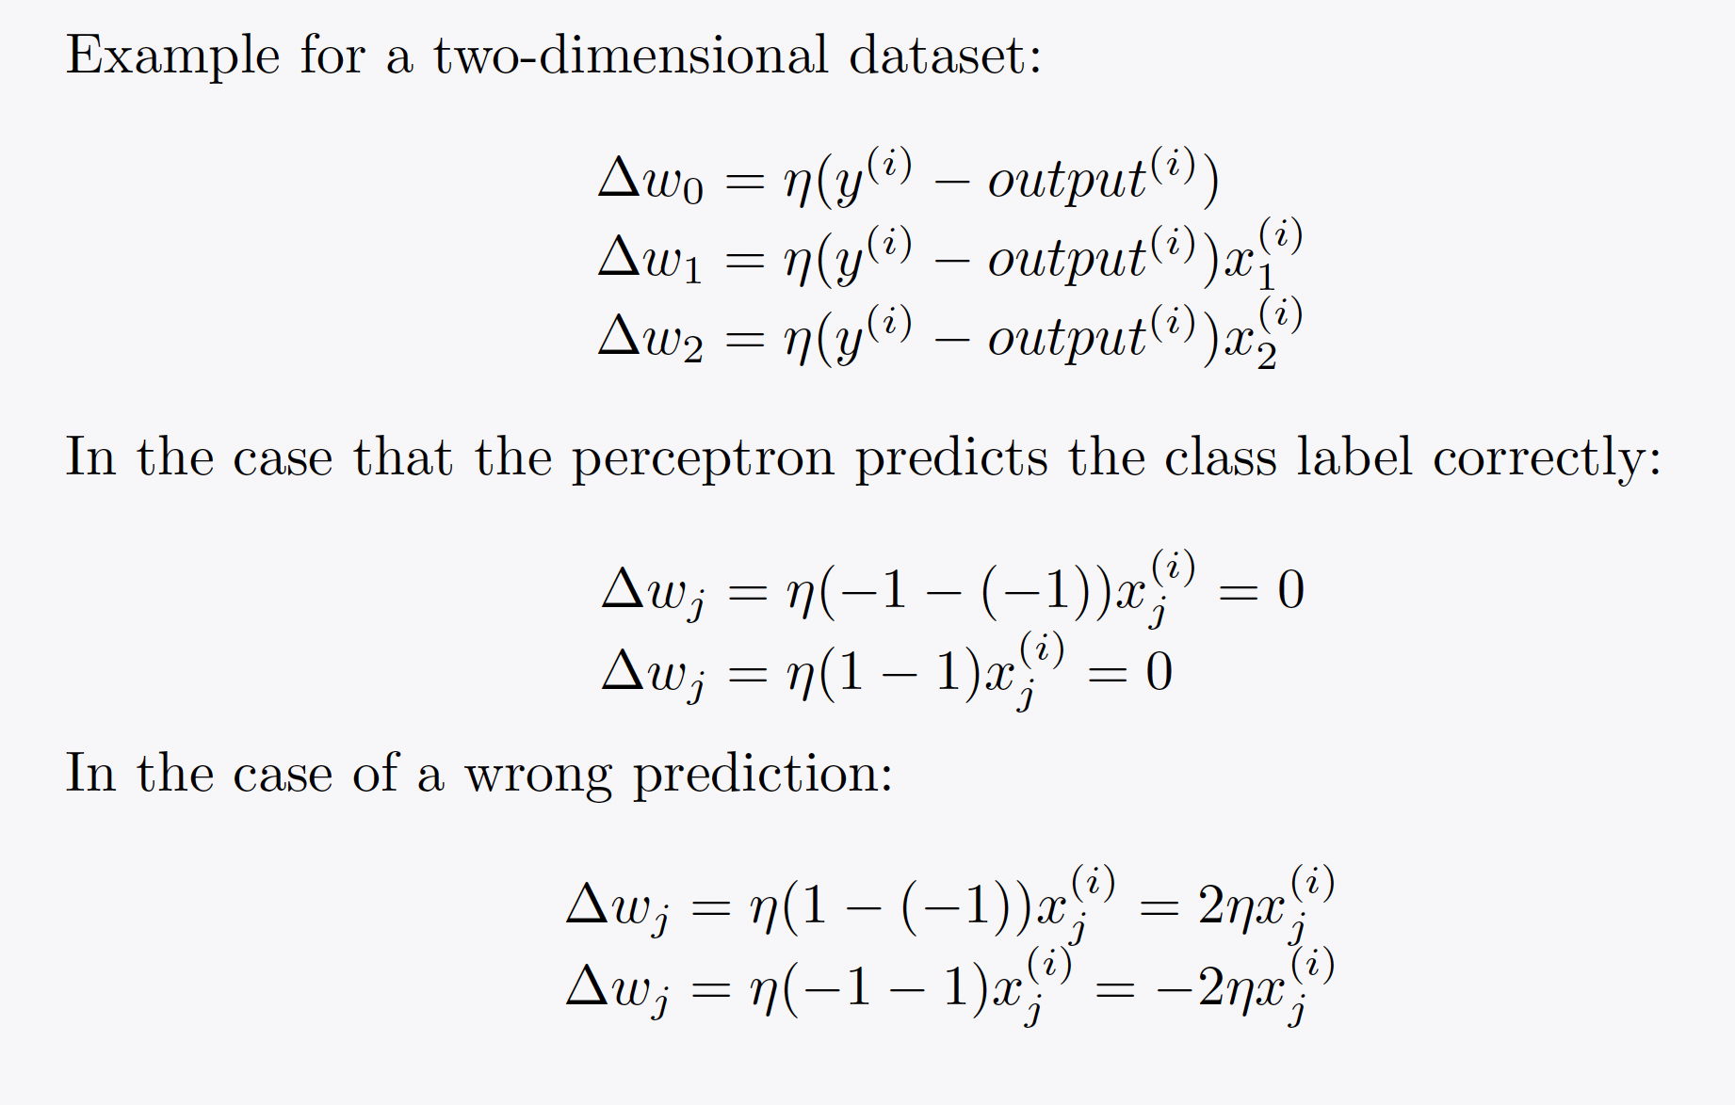
Rosenblatt’s Perceptron Example

Slide 29
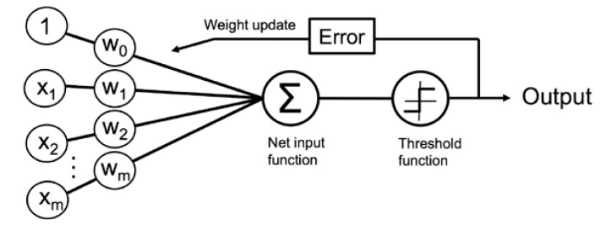
Rosenblatt’s Perceptron: Final scheme
The learning algorithm passes
over the training dataset until all
the input vectors are classified
correctly (until it achieves
convergence)
MCP Model

Slide 30
!!! IMPORTANT !!!
The convergence of the perceptron is only guaranteed if the two classes are linearly separable and the learning rate is sufficiently small.
If the two classes can't be separated by a linear decision boundary, we can set a maximum number of passes over the training dataset (epochs) and/or a threshold for the number of tolerated misclassifications—the perceptron would never stop updating the weights otherwise!!!!
DEEP NEURAL NETWORK OR KERNEL FUNCTION

Slide 31
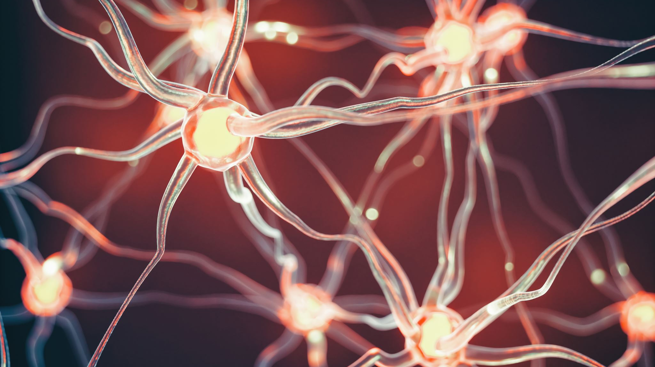
Adaptive linear neurons and the convergence of learning

Slide 32
ADAptive LInear NEuron (Adaline)
Adaline was published only a few years after Frank Rosenblatt's perceptron algorithm, by Bernard Widrow and his doctoral student Tedd Hoff
It can be considered as an improvement on the latter (B. Widrow et al. Adaptive "Adaline" neuron using chemical "memistors". Number Technical Report 1553-2. Stanford Electron. Labs. Stanford, CA, October 1960.
The Adaline algorithm illustrates the key concept of defining and minimizing cost functions, which will lay the groundwork for understanding more advanced machine learning algorithms for classification (e.g. logistic regression)

Slide 33
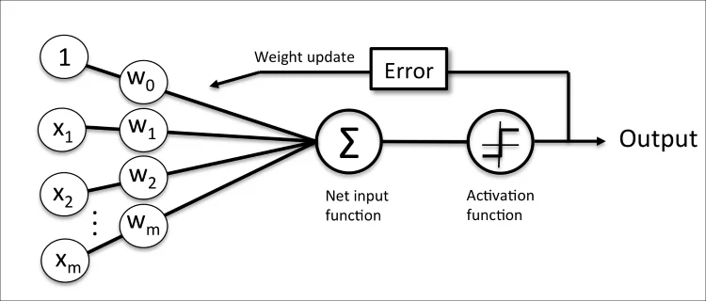
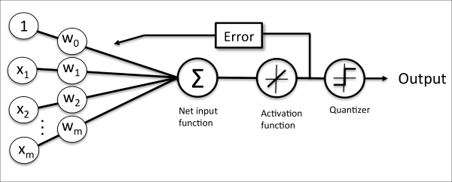
Adaline
The key difference between the Adaline rule (a.k.a. the Widrow-Hoff rule) and Rosenblatt's perceptron is that the weights are updated based on a linear activation function rather than a unit step function like in the perceptron.
In Adaline, this linear activation function φ(z) is simply the identity function of the net input so that
While the linear activation function is used for learning the weights, a quantizer, which is similar to the unit step function that we have seen before, can then be used to predict the class labels
If we compare the preceding figure to the illustration of the perceptron algorithm that we saw earlier, the difference is that we use the continuous valued output from the linear activation function to compute the model error and update the weights, rather than the binary class labels, which is more “powerful” since it tells us by “how much” we are right or wrong
Rosenblatt’s Perceptron

Slide 34
Minimizing cost functions with gradient descent
In supervised machine learning algorithms we define an objective function that must be optimized during the learning process.
This objective function is often a cost function that we want to minimize.
In the case of Adaline, we can define the cost function J to learn the weights as the Sum of Squared
Errors (SSE) between the calculated outcomes and the true class labels
The term is to make it easier to derive the gradient
The main advantage of this continuous linear activation function —in contrast to the unit step function— is that the cost function becomes differentiable.
Another property of this cost function is that it is convex; thus, we can use a simple, yet powerful, optimization algorithm called gradient descent to find the weights that minimize our cost function to classify the samples in the Iris dataset.

Slide 35
Adaline’s Cost function
Principles behind gradient descent:
climbing down a hill until a local or global cost minimum is reached.
In each iteration we take a step away from the gradient where the step size is determined by the value of the learning rate as well as the slope of the gradient

Slide 36
Adaline vs Perceptron
Although the Adaline learning rule looks identical to the perceptron rule is a real number and not an integer class label
The weight update is calculated based on all samples in the training set (instead of updating the weights incrementally after each sample), which is why this approach is also referred to as "batch" gradient descent.

Slide 37
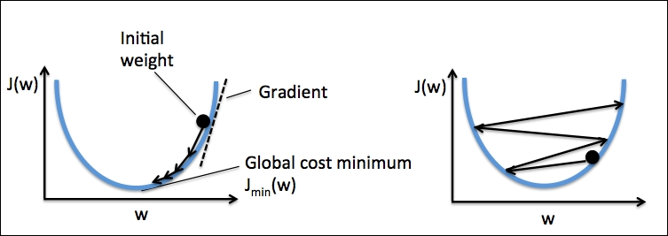
Gradient Descent: Learning Rate
• 𝜂 is the learning rate constant that determines the size of the steps
Small 𝜂
High 𝜂
With a very low learning rate, we can
move in the direction of the negative
gradient since we are recalculating it frequently,
but calculating the gradient is time-consuming,
so it will take us a very long time to get to the
bottom.
With a high learning rate we can cover more
ground each step (so it learns faster), but we
risk overshooting the lowest point since the
slope of the hill is constantly changing

Slide 38
Scaling and Logistic Regression

Slide 39
Scaling Data
Feature data can have different scales and ranges.
This can be a problem for gradient descent:
The weights updated is proportional to feature value, so, with features being on different scales
certain weights may update faster than others
It is difficult to select the most suitable learning rate value
If we choose the value based on the input value having the smallest range, small learning rate it takes ages for the large range to converge.
if we choose high value for learning rate, the gradient descent might not converge for small ranges.
Feature scaling is a method used to normalize the range of features of data.
!!! If we have features on a similar scale we help the gradient descent to converge faster to the minimum !!!

Slide 40
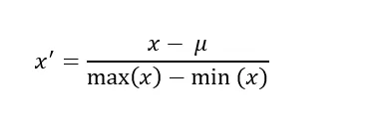
Scaling Data: Normalization
Normalization is a scaling technique in which values are shifted and rescaled so that they end up ranging between 0 and 1.
The general formula for a min-max of [0, 1] is given as the top-left equation
Another form of normalization is called mean-normalization:
it calculates and subtracts the mean for every feature. The formula is the equation in the top-right

Slide 41
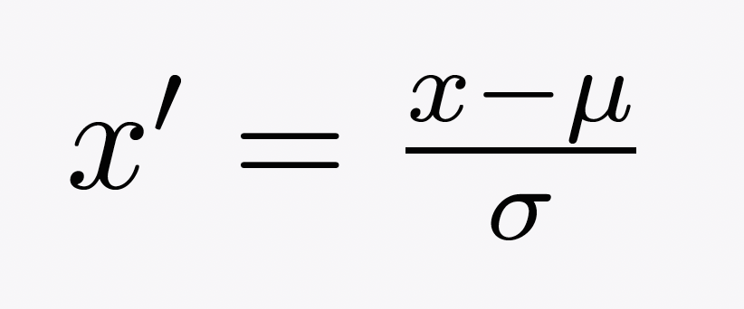
SCALING DATA: FEATURE STANDARDIZATION
Feature standardization makes the values of each feature in the data have zero-mean (when subtracting the mean in the numerator) and unit-variance.
The general method of calculation is to determine the distribution mean and standard deviation for each feature. Next, we subtract the mean from each feature. Then we divide the values (mean is already subtracted) of each feature by its standard deviation

Slide 42
Logistic Regression

Slide 43
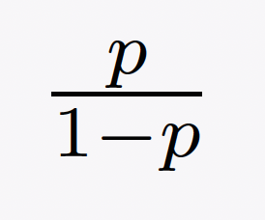
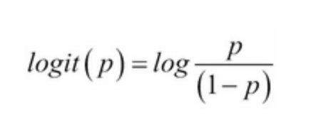
Logistic Regression
To explain the idea behind logistic regression as probabilistic model for binary classification we introduce the odds in favor of a particular event.
The logit function is the logarithm of the odds:
Logit function takes input values in range 0 and 1 and transforms them to values over the entire real-number range, which we can use to express a linear relationship between feature values and the log-odds

Slide 44
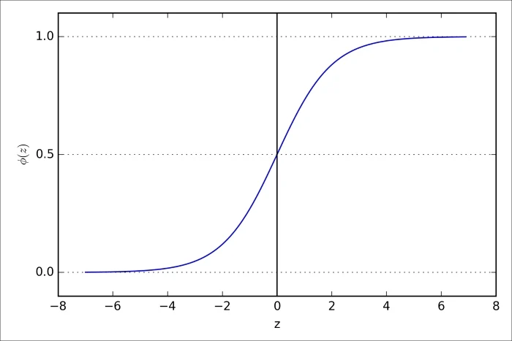
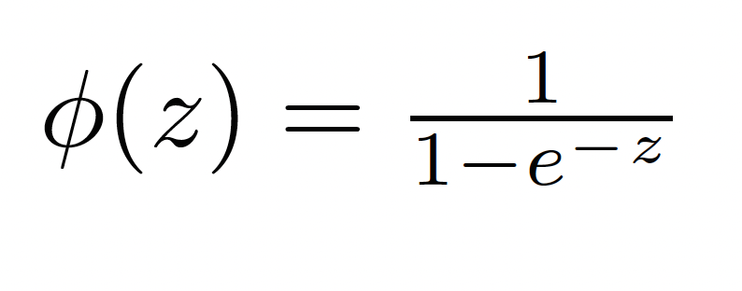
Logistic Regression: Sigmoid Function
We are actually interested in predicting the probability that a certain example belongs to a particular class, which is the inverse form of the logit function.
It is also called the logistic sigmoid function, which is sometimes simply abbreviated to sigmoid function due to its characteristic S-shape→ a new NOT LINEAR activation function with an intrinsic probability meaning!

Slide 45
Logistic Regression: HOW TO MAKE PREDICTION - Decision Boundary
The predicted probability can then simply be converted into a binary outcome via a quantizer (unit step function)

Slide 46
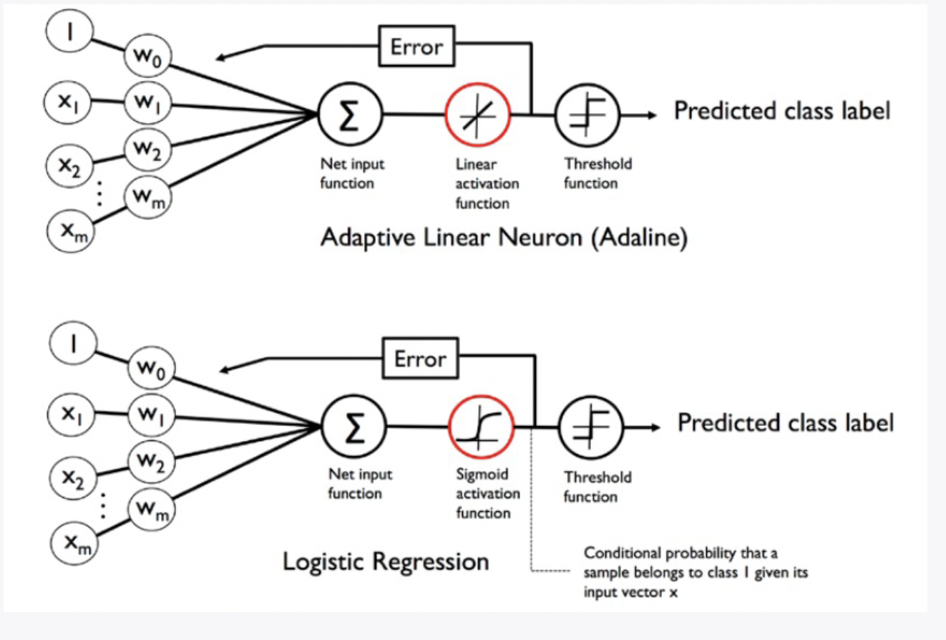
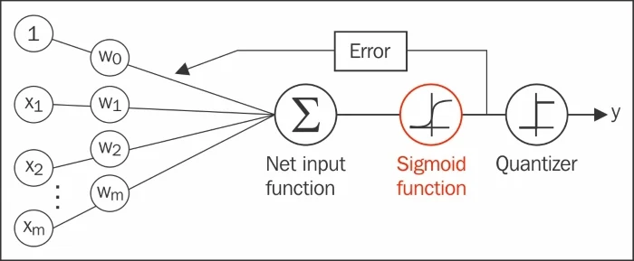
Logistic Regression: Scheme
In Adaline, we used the identity function
𝜙(𝑧) = 𝑧 as activation function.
In logistic regression, this activation function simply becomes the sigmoid function
There are many applications where we are not only interested in the predicted class labels, but where the estimation of the class-membership probability is particularly useful
Using LR we should maximize the likelihood function L
LR uses gradient descent after converting the log-likelihood function in the cost function J
Logistic Regression
Adaline VS LR
LOG-LIKELIHOOD
COST FUNCTION

Slide 47
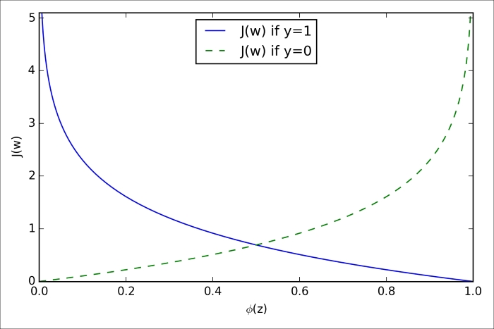
GOING DEEPER INTO THE LR COST FUNCTION…

Slide 48
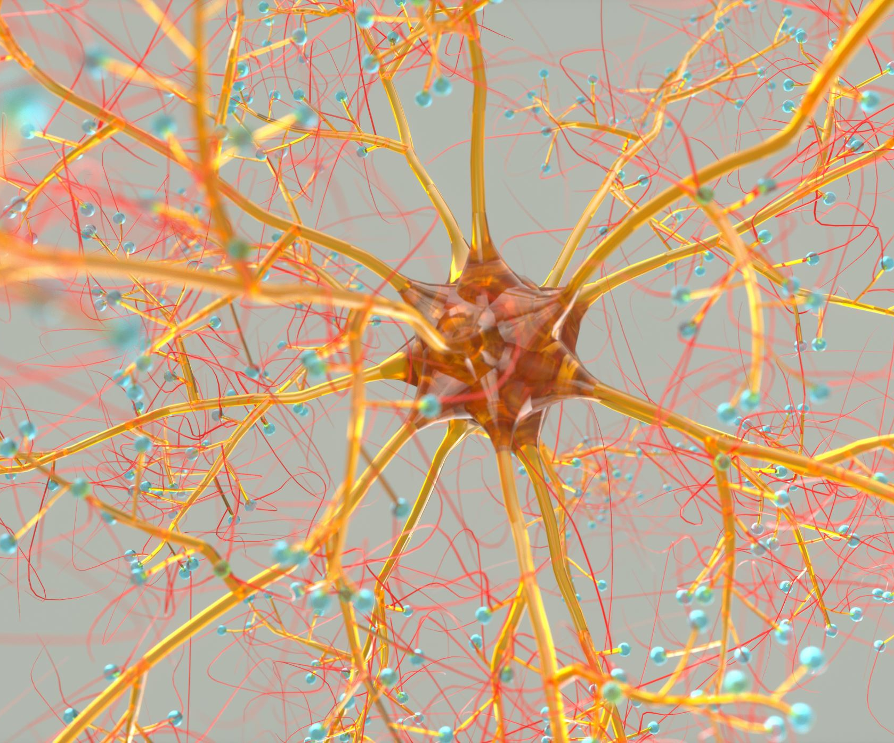
ARTIFICIAL Neural Networks

Slide 49
Contents
Machine Learning classification problem
Multi-layer perceptron and NN
Activation functions
Batch size and minimization algorithms
Loss functions
Validation procedure
Hyperparameters in a NN
Overfitting
Evaluation metrics
Historical Recap

Slide 50
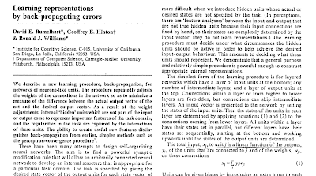
HISTORICAL ReCap
Artificial neurons represent the building blocks of the multi-layer ANNs
The basic concept behind artificial neural based on hypotheses and models of how the human brain works to solve complex problem tasks.
Early studies of NNs in 1940s with Warren McCulloch and Walter Pitt
In 1950s the first implementation of the McCulloch-Pitt neuron model and then Rosenblatt's perceptron in the 1950s
After 1950s many researchers and machine learning practitioners lost interest in NNs since no one had a good solution for training a neural network with multiple layers.
In 1986 the interest in NNs was rekindled when D.E. Rumelhart, G.E. Hinton, and R.J. Williams were involved in the (re)discovery and popularization of the backpropagation algorithm to train neural networks more efficiently (Rumelhart, David E.; Hinton, Geoffrey E.; Williams, Ronald J. (1986). Learning Representations by Back-propagating Errors. Nature 323 (6088): 533–536).

Slide 51
ML Classification PROBLEM
A Neural Network is a very powerful classification algorithm
The simplest version of a Neural Network is the Perceptron
Perceptron can be considered the building block of a NN
GOAL: the discrimination between 2 classes or among more classes through a training done on a specific dataset.
The algorithm, during the train, adapts several number of parameters in order to discriminate the defined classes
It is quite similar to perceptron algorithm, but we have a more complicated parameter structure

Slide 52
Classification problem
FIRST STEP: selection of our dataset in which there are a set of features that describes what we want to discriminate (for example the discrimination of different types or irises)
SECOND STEP: defining classes and targets (in the previous example: Iris-setosa, Iris-versicolor and Iris-virginica)

Slide 53
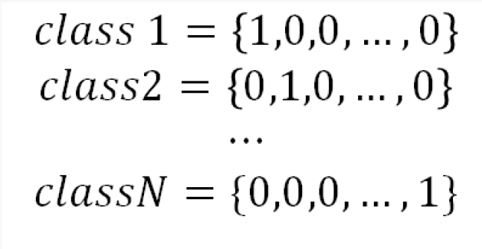
CLASSIFICATION PROBLEM
We often start from the X (feature array) and Y (label array) of information.
For our algorithm we need to transform the Y information in a numeric information in order to insert that in the loss function.
The simplest way to do that is to order our classes from 0 to N where N is the number of classes but we must avoid to use it, because it adds an intrinsic order between our classes: the algorithm could prefer the class with the highest number due to the definition of the loss function.
The most used method is to create dummy variables
FOCUS ON:
A dummy variable is a variable that takes values of 0 and 1, where the values indicate the presence or absence of something.

Slide 54
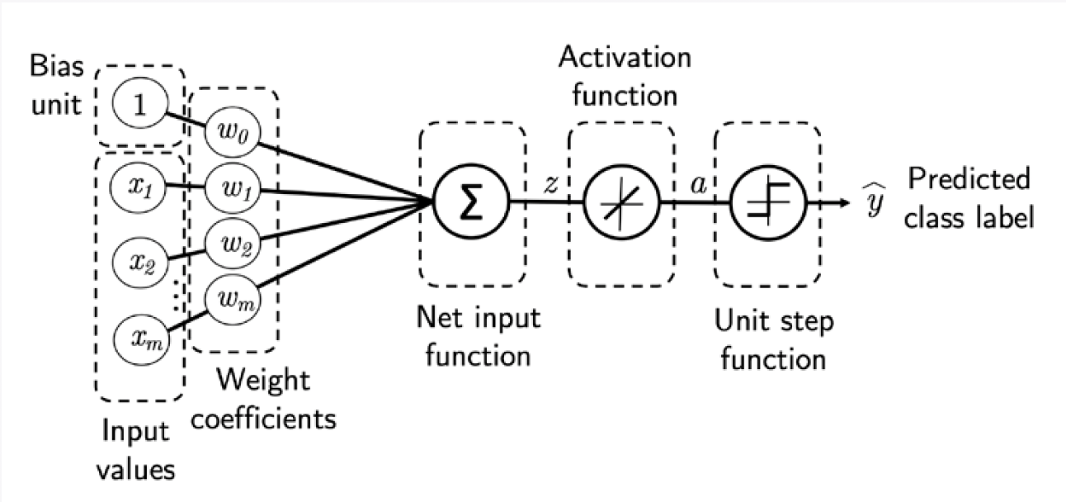
SINGLE-LAYER NEURAL NETWORK RECAP
CLASSIFICATION PROBLEM
The simplest algorithm able to discriminate between two classes (binary classificator) is the perceptron.
The perceptron is the fundamental building-block of a Neural Network but…we will need a lot of them!
In a single perceptron we have:
m+1 weights (where m is the number of input variables)
an activation function
an output that is a linear function of inputs and weights
In every epoch (pass over the training set), we updated the weight vector :
ADALINE

Slide 55
Linear or not linear…this is the question!
Linear approach in the perceptron implies the weaker assumption of monotonicity: any increase in our feature must always cause an increase in our model’s output (if the corresponding weight is positive), or always causes a decrease in our model’s output (if the corresponding weight is negative).
LIMIT: the probability related to something is not always proportional to features
Use Case: we want to predict probability of death based on body temperature. For individuals with a body temperature above 37°C , higher temperatures indicate greater risk. However, for individuals with body temperatures below 37°C, higher temperatures indicate lower risk! In this case, we might resolve the problem with some clever pre-processing. Namely, we might use the distance from 37°C as our feature.
In order to overcome these limitations of linear models and handling a more general class of functions by incorporating one or more hidden layers between input and output.
We can introduce non linearity also in the activation function:
the output became a complicated function of the input variables → losing the linearity of our model.

Slide 56
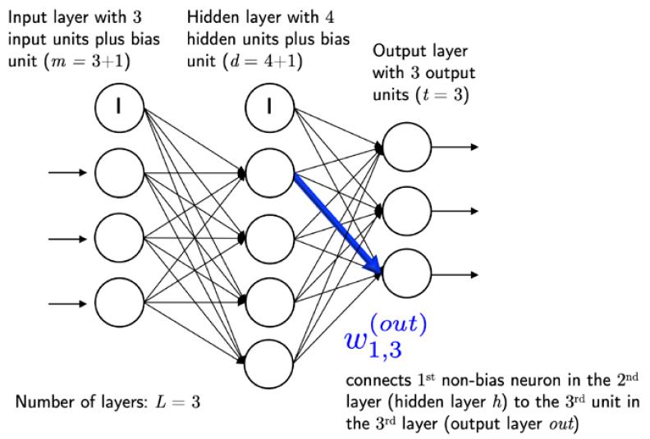
MULTI-LAYER PERCEPTRON
First example of NN: Multilayer perceptron
a net of fully connected perceptron
In the schematical view on the right every circle is a perceptron with a fixed number of inputs and outputs
In the example (on the right) we have an input layer, only one hidden layer and an output layer

Slide 57
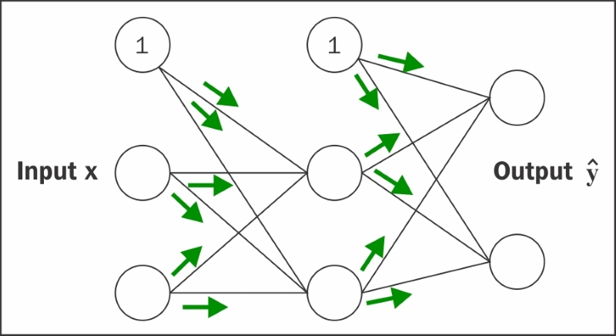
MULTI-LAYER PERCEPTRON
For every line (which represents a connection from a neuron belonging to a layer to a neuron belonging to the next one) we have an associated weight.
In this case we just have:
2 input variables
an hidden layer with size 2 (i.e. with 2 neurons)
and 2 outputs,
$\left(\#neurons in the next layer∙\#variables\right)+\#neurons in the layer=6 weigths$
(between input layer and hidden layer)
$\begin{aligned}\left(\#neurons in the next layer∙\#hidden layers size\right)+\#neurons in the layer=6 weigths \end{aligned}$
(between hidden layer and output layer)
TOTAL=12 WEIGHTS

Slide 58
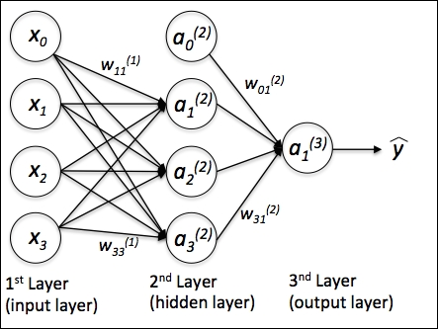
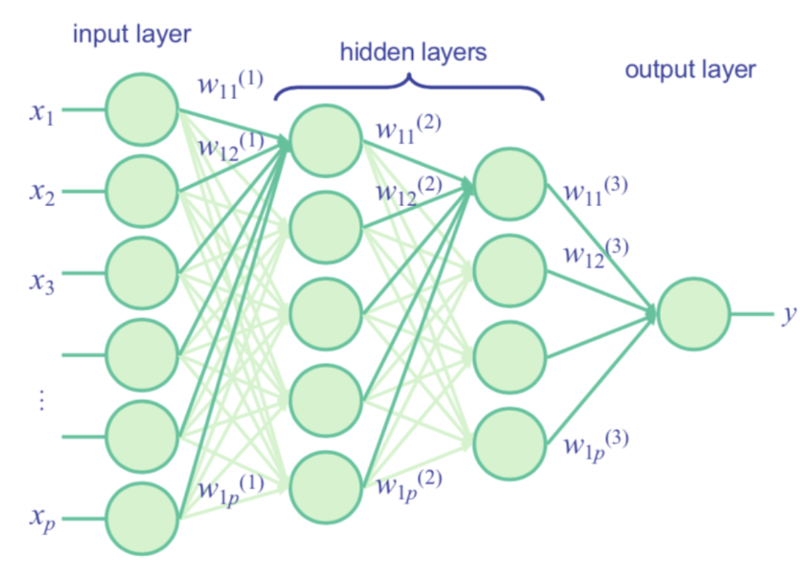
Introducing the multi-layer neural network architecture
Problem: how can we connect multiple single neurons to a multi-layer feedforward neural network?
This special type of network is also called a multi-layer perceptron (MLP).
The following figure explains the concept of an MLP consisting of three layers: one input layer, one hidden layer, and one output layer.
The units in the hidden layer are fully connected to the input layer, and the output layer is fully connected to the hidden layer.
If such a network has more than one hidden layer, we also call it a deep artificial neural network.
3 LAYERS
FOCUS ON TERMINOLOGY
Hidden layer: it is a layer between the input layer and the output layer. It takes in a set of weighted inputs and produces output through an activation function. This layer is named hidden because it does not constitute the input or the output layer.
Fully connected: A fully connected layer refers to a neural network in which each neuron applies a linear transformation to the input vector through a weights matrix. As a result, all possible connections layer-to-layer are present, meaning every input of the input vector influences every output of the output vector.
Dense layer: a NN layer is called a dense layer to indicate that it’s fully connected.
Feed Forward Networks: a neural network where connections between the nodes do not form a cycle. In a feed-forward network information always moves one direction, from input to output, and it never goes backward. Feedforward NN can be viewed as mathematical models of a function f: R^{N}→R^{M}
MULTIPLE LAYERS

Slide 59
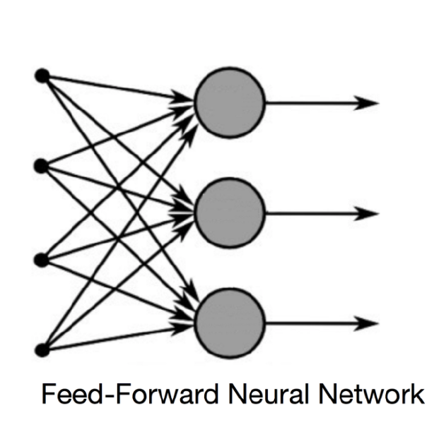
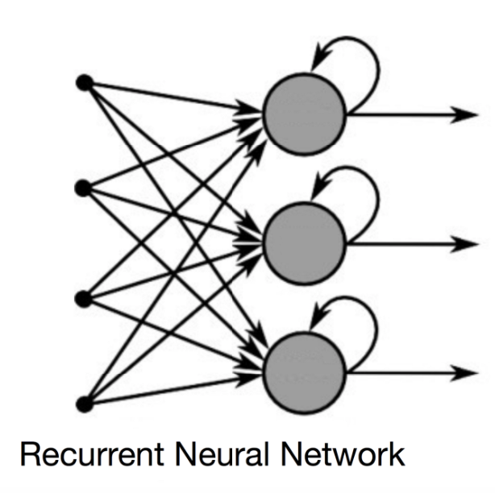
FOCUS NN Topologies
A Neural Networks (NN) can be classified according to the type of neuron interconnections and the flow of information:
Feed Forward Networks: a neural network where connections between the nodes do not form a cycle. In a feed-forward network information always moves one direction, from input to output, and it never goes backward. Feedforward NN can be viewed as mathematical models of a function f: R^{N}→R^{M}
Recurrent Neural Network: allows connections between nodes in the same layer, among each other or with previous layers. Unlike feedforward neural networks, RNNs can use their internal state (memory) to process sequential input data.
We could add an arbitrary number of hidden layers to the MLP to create deeper network architectures. Practically, we can think of the number of layers and units in a neural network as additional hyperparameters that we want to optimize for a given problem task
The error gradients calculated later via backpropagation would become increasingly small as more layers are added to a network.
This vanishing gradient problem makes the model learning more challenging. Therefore, special algorithms have been developed to pretrain such deep neural network structures, which is called deep learning.

Slide 60
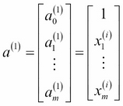
Introducing the multi-layer neural network architecture
we denote the ith activation unit in the lth layer as a_{i}^{(l)}
the activation units a₀⁽¹⁾ e a₀⁽²⁾ are the bias units set equal to 1
The activation of the units in the input layer is just its input plus the bias unit:
Each unit in layer l is connected to all units in layer l+1 via a weight coefficient.
For example, the connection between the kth unit in layer l to the jth unit in layer l+1 would be written as w^{l}_{j,k}
The superscript i in x_{m}^{(i)} stands for th ith sample (not layer)
While one unit in the output layer would suffice for a binary classification task, we saw a more general form of a neural network to perform multi-class classification via a generalization of the One-vs-All (OvA) technique→ one-hot representation of categorical variables.
For example, we would encode the three class labels in the familiar Iris dataset (0=Setosa, 1=Versicolor, 2=Virginica) as follows:

Slide 61
Activation funCTION
ACTIVATION FUNCTION
The activation function provides to the activation or not of a node
The functions are in general differentiable operators in order to transform the inputs to outputs
Most of them provides to add non-linearity to the model
The activation function σ has as input the weighted sum of the input variables x, added with the bias b

Slide 62
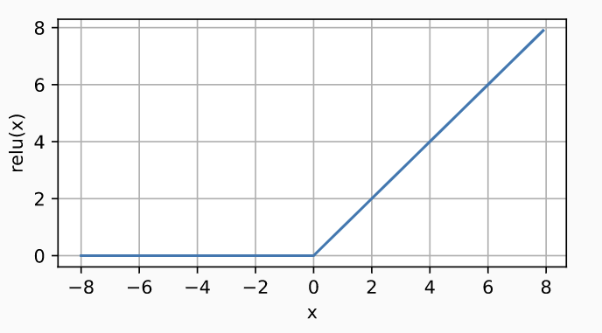
ReCTIFIED LINEAR UNIT (RELU)
RECTIFIED LINEAR UNIT (RELU)
One the most popular non-linear activation function is the REctified Linear Unit (ReLU).
It provides a non-linear transformation and returns the max value between the input x (the argument) and 0.

Slide 63
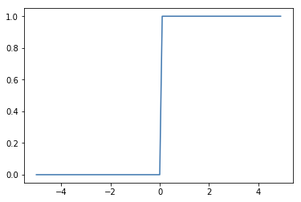
RECTIFIED LINEAR UNIT (RELU)
The ReLU function is also differentiable in R-{0} and its derivative is the Heaviside function.
In case the input is equal to zero, it is used the left-side derivative.

Slide 64
Scaled EXPONENTIAL LINEAR UNIT (SELU)
Another choice is the Scaled Exponential Linear Unit (SELU).
The functions depends on two parameters and the equation is the following:

Slide 65
Scaled EXPONENTIAL LINEAR UNIT (SELU)
The function is not differentiable in zero.
Also here is convention to use the left-side value of its derivative.

Slide 66
SIGMOID FUNCTION
Sigmoid function:
Derivative Sigmoid function:

Slide 67
TANH FUNCTION
Tanh function:
Derivative Tanh function:

Slide 68
MULTILAYER PERCEPTRON
Example: in this case there are two outputs.
The hidden layer output h is function of the input x:
The output o is a different function of its input, i.e. h:

Slide 69
MULTILAYER PERCEPTRON
How can we interpret the two values?
In classification problem the goal is to understand how the input x is related to a certain class
The output o could be seen as the vector of probabilities of belonging to each class
However this is not straightforward

Slide 70
SOFTMAX REGRESSION
To solve this issue→ we define Softmax activation function which is defined as follows:
So that (for construction):
=
>

Slide 71
PARAMETRIZATION COST
The layers we are handling are fully-connected
Adding new neurons (perceptrons) to a network layer or adding a new layer makes our model more complex and capable of facing a wide range of more challenging problems→ we are facing PARAMETRIZATION COST
The complexity of the model, however, faces directly with the increase of computational time, which could become extremely high.

Slide 72
PARAMETRIZATION COST
Suppose to have a hidden layer with d input and q outputs.
$$q=\#neurons$$
The parametrization cost is ∝
It is possible to reduce the parametrization cost introducing an hyperparameter n so that:

Slide 73
VECTORIZATION FOR MINIBATCHES → BATCH SIZE n
TELLS US
Input
Weights
Bias
Outputs
How many samples are feeding our network
AT THE SAME TIME!
SAVING COMPUTATIONAL TIME

Slide 74
LOSS FUNCTION
To measure the quality of our predicted probabilities we need a loss function
We will suppose that the entire dataset (or the batch we are considering) has n samples {X,Y}
The i-th{X,Y} entry is made by the feature vector x-ith and the one-hot label vector y-ith
The predicted class can be compared with the real class by checking the probability associated to the actual class according to the model.
According to the maximum likelihood estimation, we want to maximize P(Y|X), or minimize the negative log-likelihood.

Slide 75
CROSS-ENTROPY LOSS FUNCTION
The negative log-likelihood is equal to:
Where l(y,ypred) is the loss function, also called cross-entropy, defined as:

Slide 76
CROSS-ENTROPY LOSS FUNCTION
The cross-entropy loss function is a common choice in classification problems
Moreover it is generalizable when the vector of label y doesn't contain only binary entries like (1,0,0), but is a generic probability vector
This is the case where we observe not just a single outcome but an entire distribution over outcomes

Slide 77
CROSS-ENTROPY LOSS FUNCTION AND SOFTMAX
The softmax and the corresponding loss function are very common but…what is the corresponding loss function?
Let’s compute it:
REMINDER:
CROSS-ENTROPY
SOFTMAX

Slide 78
CROSS-ENTROPY LOSS FUNCTION AND SOFTMAX
To understand better let's have a look at the derivative w.r.t. any output o i-th:
The derivative is the difference between the probability assigned by our model,
as expressed by the softmax operation, and the y true vector.

Slide 79
EXAMPLES OF OTHER LOSS FUNCTIONS for anns
Mean Squared Error(MSE)/ Quadratic Loss/ L2:
Mean Absolute Error (MAE)/ L1 Loss:
Mean Bias Error (MBE):

Slide 80
VALIDATION PROCEDURE

Slide 81
VALIDATION
Task: we want to optimize our model, without touching the test dataset and avoiding the risk of overfitting
We are going to use our test dataset only after the training is finished in order to assess the very best model
The best practice to address this problem is to split our dataset in three (instead of two) parts, incorporating a validation dataset (or validation set) in addition to the training and test datasets.

Slide 82
Training description
The main idea of the model training is to iterate over the network different times (number of epochs).
In each epoch k stochastic minibatches of n (batchsize) entries (items) are selected from the dataset
We then compute the derivative (gradient) of the average loss on the minibatch regarding the model parameters.
Finally, we multiply the gradient by a predetermined positive value η (the learning rate) and subtract the resulting term from the current parameter values.
The epoch ends after k iterations, i.e. all over the k batches.

Slide 83
Minibatch stochastic gradient deSCent
We iteratively sample random minibatches from the data, updating the parameters in the direction of the negative gradient.
Backward propagation of the training, parameters updating as follows:

Slide 84
HYPERPARAMETERS
An hyperparameter is an internal parameter of the model that must be fixed before training, such parameter influences the fit procedure in a way not well known a priori.
We cannot know which value is perfect for our model and we need to try different reasonably values to figure out which one is the best.
No Free Lunch theorem: no single classifier works best across all possible scenarios

Slide 85
HYPERPARAMETERS
With a DNN we can change a lot of parameters, most of which are:
The loss function
The activation function of every layer
The learning rate
The number of epochs
The number of hidden layers and the number of cells in them
…many others
The hyperparameters can change from an algorithm to another, here we mentioned only the main parameters of a DNN.

Slide 86
LEARNING RATE
Adjusting the learning rate 𝜂 is often just as important as the actual algorithm
If 𝜂 is too large the optimization does not converge → we may simply end up bouncing around the minimum and thus not reach optimality
if 𝜂 is too small it takes too long to train or we end up with a suboptimal result
What we can do: we can decide to start from a reasonable value for the learning rate and then use the method implemented in Keras: "ReduceLROnPlateau".
It reduces the value of 𝜂 when a monitor (set by us) has stopped improving→ we can obtain a large 𝜂 value at the beginning of the training with a progressive reduction when we are approaching to the optimized model.

Slide 87
NUMBER OF EPOCHS
Epoch: a complete step of the training
it includes the evaluation and the consecutive updating of the weights
Number of epochs is a delicate choice:
A large number of epochs can induce our model to an overfitting problem
a too small number of epochs can lead to an under fitting problem
To avoid a wrong choice we can use the 'EarlyStopping', also implemented by Keras:
it allows to stop the training when a monitor (set by us and tipically the loss function) has stopped improving.

Slide 88
HIDDEN LAYERS
The number of hidden layers add complexity to our model.
Adding hidden layers makes our algorithm more performing, but at the same time we lead it to an overfitting problem
Another crucial factor is the number of cells in the hidden layer, also in this case a lot of cells increase the complexity of the model and increase the risk to an overfitting problem
This choice has to be done carefully, it is the most difficult one and only comparing the evaluation metrics between different approaches we can know which is the best one.

Slide 89
How to analyze data in ML

Slide 90
Training-Test data splitting

Slide 91
Overfitting and underfitting
Overfitting is a common problem in machine learning:
where a model performs well on training data but does not generalize well to unseen data (test data).
If a model suffers from overfitting, we also say that the model has a high variance, which can be caused by having too many parameters → too complex
Similarly, our model can also suffer from underfitting (high bias), which means that our model is not complex enough to capture the pattern in the training data
→ low performance on unseen data.

Slide 92
Illustrating over/underfitting
The problem of overfitting and underfitting can be best illustrated by using a more complex, nonlinear decision boundary as shown in the figure above

Slide 93
OVERFITTING PROBLEM
The more complex the model is, the higher is the risk of overfitting.
Here a clear example of overfittig, the train loss keeps going down while the validation loss get worse. It is always important to split the training in train and validation set and to have a clear picture of the train history.
In order to avoid overfitting and make the training stable we have different approach

Slide 94
FACING OVERFITTING PROBLEM – 1
Introduce a callback function that stops the training if the validation loss get worse and restore the best parameters (Early Stop function). Reduce overtraining and time needed for the training.
Stop and restore best parameters

Slide 95
FACING OVERFITTING PROBLEM – 2
"Weight Decay": introduce penalty terms in the loss function if a weight becomes too large.

Slide 96
FACING OVERFITTING PROBLEM – 3
Dropout: it refers to the practice of disregarding certain nodes in a layer at random during training. A dropout is a regularization approach that prevents overfitting by ensuring that no units are co-dependent with one another.

Slide 97
EVALUATION METRICS

Slide 98
EVALUATION METRICS
The idea of building machine learning models works on a constructive feedback principle:
building a model, getting a feedback from metrics, making improvements and continuing until you achieve the desired accuracy
An important aspect of evaluation metrics is their capability to discriminate among model results
The real goal is creating and selecting a model which gives high accuracy on sample data:
It is crucial to check the accuracy of your model prior to computing predicted values.

Slide 99
Metrics
DIFFERENT TYPES OF METRICS
A metric is a function that is used to evaluate the performance of your model.
Metric functions are similar to loss functions, except that the results from evaluating a metric are not used during the training of the model.
IN H.E.P.:
POSITIVE: SIGNAL
NEGATIVE: BACKGROUND
TP (true positive): the event is POSITIVE, the prediction is POSITIVE
FP (false positive): the event is NEGATIVE, but the prediction is POSITIVE
TN (true negative): the event is NEGATIVE, the prediction is NEGATIVE
FN (false negative): the event is POSITIVE, the prediction is NEGATIVE
NOTE: Precision == purity; recall==sensitivity == TPR == signal efficiency; FPR = FP/(FP+TN)

Slide 100
CONFUSION MATRIX
The confusion matrix helps us visualizing whether the model is "confused" in discriminating between two or more classes.
In the figure we have an example of binary model and the corresponding confusion matrix.
The 4 elements of the matrix represent the 4 metrics that count the number of correct and incorrect predictions the model made.

Slide 101
ACCURACY
The most famous metrics is the accuracy defined as the ratio between the number of correct predictions to the total number of predictions
Accuracy values range between 0 and 1. Obviously an accuracy values near to 1 means that our model fits well the datasets
It is important to stress that a good accuracy value on the training dataset does not imply a good discrimination on the test dataset

Slide 102
PRECISION/ PURITY
The precision is calculated as the ratio between the number of Positive samples correctly classified to the total number of samples classified as Positive (either correctly or incorrectly). The precision is intuitively the ability of the classifier not to label as positive a sample that is negative
When the model makes many incorrect Positive classifications, or few correct Positive classifications, this increases the denominator and makes the precision small. On the other hand, the precision is high when:
The model makes many correct Positive classifications (maximize True Positive).
The model makes fewer incorrect Positive classifications (minimize False Positive).

Slide 103
Recall/ SENSITIVITY/ TPR/ SIGNAL EFFICIENCY
The recall is calculated as the ratio between the number of Positive samples correctly classified as Positive to the total number of Positive samples. The recall is intuitively the ability of the classifier to find all the positive samples.
The recall cares only about how the positive samples are classified. This is independent of how the negative samples are classified, e.g. for the precision.
The decision of whether to use precision or recall depends on the type of problem to be solved:
If the goal is to detect all the positive samples (without caring whether negative samples would be misclassified as positive) then we can use recall;
if the problem is sensitive to classifying a sample as Positive in general, i.e. including Negative samples that were falsely classified as Positive we can use precision.

Slide 104
F1-SCORE
F1-Score is the harmonic mean of precision and recall values for a classification problem.
It takes the harmonic mean because punishes extreme values more.
For example, if we have a model with Precision = 0 and Recall =1, it is clear that this result comes from a dumb classifier which just ignores the input and just predicts one of the classes as output. In this example we will have a F1 score equal to 0

Slide 105
AUC-ROC
A Receiver Operating Characteristic curve, or ROC curve, is a plot that illustrates the true positive rate against the false positive rate defined as follows:
The metric connected to the ROC curve is the area under the curve AUC.
An AUC near to 1 indicates a ROC curve near to the best result, an AUC near to 0 indicates a random classifier.

Slide 106
Convolutional Neural Networks

Slide 107
Overview
Digital image classification problem
1
An introduction to convolution in 1 and 2 dimensions
2
An overview on the different layers of a CNN
3
A brief explanation of the Data Augmentation
4

Slide 108
Digital images
Convolutional Neural Networks are a powerful family of DNNs that are specifically designed for the Images Processing Task (but not only!)
WHAT ARE IMAGES DIGITALLY SPEAKING?
From Wikipedia: "A digital image is an image composed of picture elements, also known as pixels, each with finite, discrete quantities of numeric representation for its intensity."
Images can be seen as matrices, where every cell represents a pixel.
To every cell (= to every pixel) a number is associated
In a greyscale image each pixel value is the grey intensity

Slide 109
Digital images
Colored images are usually coded with the RGB color model: each pixel is associated to three numbers, corresponding to the Red, Green and Blue intensity
The image is obtained as the sum of the three components
Silvia Auricchio & Francesco Cirotto, Università degli studi di Napoli "Federico II" - INFN Napoli

Slide 110
Digital images
An RGB image is therefore represented by a matrix (weight)x(height)x3
A greyscale image is (weight)x(height)x1
Silvia Auricchio & Francesco Cirotto, Università degli studi di Napoli "Federico II" - INFN Napoli
=
RED
GREEN
BLUE

Slide 111
HOW CAN WE CLASSIFY IMAGES?

Slide 112
Images classification with DNN
As we already know, a classification problem can be easily addressed from a NN:
The more the problem is complex and not linear the better DNNs perform with respect to single layer networks.
Images can be given in input to DNN by flattening pixels to form a 1D array.
DNNs are also invariant to input features order, therefore they could also be shuffled before being fed the network
Silvia Auricchio & Francesco Cirotto, Università degli studi di Napoli "Federico II" - INFN Napoli
with pixels content

Slide 113
Images classification with DNN
Example:
the input is a 64x64 grayscale image. Such an image can be represented by 64x64x1 = 4096 values
the input layer of a DNN processing such an image has 4096 nodes
if the (fully connected) inner layer has 500 nodes, we will have 4096x500 = 2048000 weights between the input and the hidden layer
If the image were an RGB image the input layer would have 64x64x3 = 12288 nodes
For complex problems, we usually need multiple hidden layers...
Silvia Auricchio & Francesco Cirotto, Università degli studi di Napoli "Federico II" - INFN Napoli
A DNN CANNOT SCALE TO HANDLE LARGE IMAGES. WE NEED A MORE SCALABLE ARCHITECTURE!!!

Slide 114
Convolutional Neural Networks
To flat an image into a 1D array is not the best way to model images
any spatial relationship in the data is ignored
A Convolutional Neural Network (CNN) maintains the spatial structure of the data, and is better suited for finding spatial relationships in the image data
​The idea behind: to use filters that automatically learns the most discriminants features in an image, such as edges, filled patterns, specific geometric forms and so on
Silvia Auricchio & Francesco Cirotto, Università degli studi di Napoli "Federico II" - INFN Napoli

Slide 115
Convolutional Neural Networks
Silvia Auricchio & Francesco Cirotto, Università degli studi di Napoli "Federico II" - INFN Napoli
BASIC CONCEPTS:
Sparse connectivity: A single element in the feature map is connected to only a small patch of pixels.
Parameter-sharing: the same weights are used for different patches of the input image
from Spatial Invariance Principle: whatever method is used to recognize objects it should not be concerned with the precise location of the object in the image

Slide 116
The Convolutional Layer
Let's start from the Convolutional Layer:
It is the core building block of a Convolutional Network that does most of the computational heavy lifting
INTUITION WITHOUT BRAIN STUFF
The CONV layer’s parameters consist of a set of learnable filters.
Every filter is small​ spatially (along width and height) and extends through the full depth of the input volume.
The output is a single layer with a certain spatial size (width x height x1)
Silvia Auricchio & Francesco Cirotto, Università degli studi di Napoli "Federico II" - INFN Napoli

Slide 117
The Convolutional Layer
Let's start from the Convolutional Layer:
It is the core building block of a Convolutional Network that does most of the computational heavy lifting
INTUITION WITHOUT BRAIN STUFF
Example:
a typical​ filter on a first layer of a CNN has size 5x5x3
Let's suppose we have a 28x28 pixel RGB image
Convolution is the process of placing the filter 5x5x3 on the top left corner of the image, multiplying filter values by the pixel values and adding the results, moving the filter to the right one pixel at a time and repeating this process
Silvia Auricchio & Francesco Cirotto, Università degli studi di Napoli "Federico II" - INFN Napoli

Slide 118
The Convolutional Layer
THE MATHEMATICAL VIEW
Now let's explain the convolution in mathematical details
Discrete convolution in one dimension
A discrete convolution between two vectors with finite size, x and w, is mathematically defined as:
w is typically called filter or kernel
The index i runs through each element of the output vector y
In ML applications we always deal with finite feature vectors
In real word x and w have finite dimensions, let’s say n and m respectively, where 𝑚 ≤ 𝑛.
Silvia Auricchio & Francesco Cirotto, Università degli studi di Napoli "Federico II" - INFN Napoli

Slide 119
The Convolutional Layer
THE MATHEMATICAL VIEW
The convolution becomes:
x and w are indexed in different directions in this summation.
Computing the sum with one index going in the reverse direction is equivalent to computing the sum with both indices in the forward direction after flipping one of those vectors
This operation is repeated like in a sliding window approach to get all the output elements.
Silvia Auricchio & Francesco Cirotto, Università degli studi di Napoli "Federico II" - INFN Napoli

Slide 120
The Convolutional Layer
THE MATHEMATICAL VIEW
Example:
x = [3 2 1 7 1 2 5 4], w = [½, ¾, 1, ¼ ]
Silvia Auricchio & Francesco Cirotto, Università degli studi di Napoli "Federico II" - INFN Napoli

Slide 121
Padding Layer
The result of this convolution is a tensor with a smaller shape than the input one
To preserve/increase input shape we can use the so called padding procedure:
It consists in padding zero pixels to input tensor
Usually, a same padding procedure is used, meaning that the output vector has the same size as the input one.
Valid padding: we are not adding anything
Silvia Auricchio & Francesco Cirotto, Università degli studi di Napoli "Federico II" - INFN Napoli
P = kernel size -1
P: input size = output size
P = 0

Slide 122
Stride Parameter
MOVING ALONG INPUTS
One concept introduced in the previous example is the number of cells the filter is moved when shifted across the vector x (to pass from a y index to another)
It is called stride
Example:
N=7, filter = 3
Stride = 1
Output = 5
The bigger is the stride
the smaller is the output dimension!
Stride = 2
Output = 3

Slide 123
The output size
OUTPUT SIZE
The size of the vector obtained by a convolution can be calculated as follows:
$$o= \left[\frac{n+2p−m}{s}\right]+1$$
Silvia Auricchio & Francesco Cirotto, Università degli studi di Napoli "Federico II" - INFN Napoli
o = output dimension
n = input dimension
p = padding
m = kernel size
s = stride

Slide 124
Convolution in 2D
THE MATHEMATICAL VIEW
The concepts we have now discussed are easily extendible to 2D case:
𝑿_{𝑛1×𝑛2} and 𝑾_{𝑚1×𝑚2} are now two matrices -> Y is a 2D matrix as well
Silvia Auricchio & Francesco Cirotto, Università degli studi di Napoli "Federico II" - INFN Napoli
Example:
input matrix 𝑿_{3×3}
kernel matrix 𝑾_{3×3}
p=(1, 1)
stride s=(2, 2)

Slide 125
Convolution in 2D
THE MATHEMATICAL VIEW
We can rotate the filter to perform the sum on indices running in the same directions
Silvia Auricchio & Francesco Cirotto, Università degli studi di Napoli "Federico II" - INFN Napoli

Slide 126
Convolution in 2D
How does a convolutional layer work on a RGB image?
For each channel color there is a different filter
The three outputs are added together
The output of a convolutional layer with a multi-layer input is a single layer
Silvia Auricchio & Francesco Cirotto, Università degli studi di Napoli "Federico II" - INFN Napoli

Slide 127
Convolution in 2D
Silvia Auricchio & Francesco Cirotto, Università degli studi di Napoli "Federico II" - INFN Napoli

Slide 128
Strides and padding in 2D
Zero-padding and strides concepts are the same of 1D case
The output size of a 2D filter is still calculable with the formula seen before, applied on weight and height separately
Input dimension
Zero-padding
Kernel dimension
stride
Applied along x and y axes
padding (1,1)
strides (2,2)
The input shape is lowered
padding (1,1)
strides 1
The input shape is preserved (padding 'same')

Slide 129
THE POOLING LAYER
Tuning zero-padding and strides it is possible to change (usually reduce) the output dimension w.r.t. input dimension
This task can be also performed with a "Pooling" layer
TWO KINDS OF POOLING:
Maximum Pooling (or Max Pooling): Calculate the maximum value for each patch of the feature map.
Average Pooling: Calculate the average value for each patch on the feature map.

Slide 130
Different Pooling Layers
Which pooling do I have to choose????
It depends!
White → 1.0
Black → 0
Silvia Auricchio & Francesco Cirotto, Università degli studi di Napoli "Federico II" - INFN Napoli
In this case min pooling let us preserving better the original information!

Slide 131
Different Pooling Layers
In this case max pooling let us preserving better the original information!

Slide 132
The Max Pooling Layer
MAIN ASPECTS:
Pooling (max-pooling) introduces a local invariance. This means that small changes in a local neighbourhood do not change the result of max-pooling
Let’s take X₁ and X₂ which are
similar but not the same matrix (i.e. 2
Images which are similar
but not the same!!)
Pooling decreases the size of features, which results in higher computational efficiency. Furthermore, reducing the number of features may reduce the degree of overfitting as well (and complexity!).
Traditionally, pooling is assumed to be non-overlapping (pooling size = stride)→ so that we have an output in which pixels are independent from one another)
Silvia Auricchio & Francesco Cirotto, Università degli studi di Napoli "Federico II" - INFN Napoli
ROBUSTNESS W.R.T. NOISE

Slide 133
Putting everything together in a CNN
A convolutional neural network is a sequence of the following layers ordered in different ways:
Convolutional
Pooling
Dense layer
Silvia Auricchio & Francesco Cirotto, Università degli studi di Napoli "Federico II" - INFN Napoli

Slide 134
FILTERS WEIGHTS ARE LEARNT FROM DATA DURING TRAINING
THE NETWORK LEARNS WHICH ARE THE MOST DISCRIMINANT PATTERNS
A CNN PERFORMS THE CLASSIFICATION BY READING THESE EXTRACTED FEATURES
A DNN READS ONLY PIXELS VALUES
Silvia Auricchio & Francesco Cirotto, Università degli studi di Napoli "Federico II" - INFN Napoli

Slide 135
Putting everything together in a CNN
A convolutional layer is tipically composed of:
N filters
In a convolution layer, usually several filters are stacked together
Each filter learns some different information from the same image
Conv operation

Slide 136
Putting everything together in a CNN
A convolutional layer is tipically composed of:
N filters + activation function
+

Slide 137
Putting everything together in a CNN
A convolutional layer is tipically composed of:
N filters + activation function + pooling layer​
+
+
Silvia Auricchio & Francesco Cirotto, Università degli studi di Napoli "Federico II" - INFN Napoli

Slide 138
Putting everything together in a CNN
The sequence convolutional + pooling is not the only possible choice:
Modern networks do not use pooling but adjust the output size by tuning the padding and strides of the convolutional layers
Silvia Auricchio & Francesco Cirotto, Università degli studi di Napoli "Federico II" - INFN Napoli

Slide 139
Dense layers for classification
Now we must flatten the final output and feed it to a regular Neural Network for classification purposes
Adding a Fully-Connected layer is a way of learning non-linear combinations of the high-level features (from filters)
The image is flattened into a column vector
then fed to a fully-connected neural network
Silvia Auricchio & Francesco Cirotto, Università degli studi di Napoli "Federico II" - INFN Napoli

Slide 140
Activations and Loss functions for classification
Now what our model misses is the final probabilistic interpretation of the output Z to perform classification:
An activation function should be applied to the output of the last fully-connected layer:
'Sigmoid' for binary classification
'Softmax' for multi-classification
Recall: Sigmoid and Softmax are both probabilities for an event to belong to a given class, therefore they are used only in the outer layer. Other activation functions, like ReLU and tanh are mainly used in the intermediate (hidden) layers to add non-linearities to our model
Silvia Auricchio & Francesco Cirotto, Università degli studi di Napoli "Federico II" - INFN Napoli

Slide 141
CNN regularization: Dropout
Choosing the size of a network has always been a challenging problem
Small networks, or networks with a relatively small number of parameters, are likely to underfit, resulting in poor performance
very large networks may result in overfitting, where the network will do extremely well on the training dataset while achieving a poor performance on the test dataset
One way to address this problem is to build a network with a relatively large capacity to do well on the training dataset, then to prevent overfitting we can apply one or multiple regularization schemes to achieve a good performance on new data
Silvia Auricchio & Francesco Cirotto, Università degli studi di Napoli "Federico II" - INFN Napoli
Too few parameters!
Too many parameters!

Slide 142
CNN regularization: Dropout
Dropout has emerged as a popular technique for regularizing: during the training phase a fraction of the hidden units is randomly dropped at every iteration with a certain probability (rate)​
During prediction, all neurons will contribute to computing the pre-activations of the next layer​
Silvia Auricchio & Francesco Cirotto, Università degli studi di Napoli "Federico II" - INFN Napoli

Slide 143
ARTIFICIAL INTELLigence for the Electron-ion collider

Slide 144
ELECTRON-ION COLLIDER
The EIC will be a particle accelerator that collides electrons with protons and nuclei to produce snapshots of those particles’ internal structure.
The electron beam will reveal the arrangement of the quarks and gluons that make up the protons and neutrons of nuclei.
The EIC will allow us to study the strong nuclear force (that holds quarks together) carried by the gluons, and the role of gluons in the matter.
What we learn from the EIC could power the technologies of tomorrow
EIC will be operating in 2030's: by then AI may also leverage on technologies that are currently Computing Frontiers.

Slide 145
Eic vs rhic
The Electron-Ion Collider (EIC)
at Brookhaven Lab will reuse the infrastructure from the Relativistic Heavy Ion Collider (RHIC) and
build on discoveries at RHIC and the Continuous Electron Beam Accelerator Facility (CEBAF) at Thomas Jefferson National Accelerator Facility (Jefferson Lab)
EIC will have new features that greatly expand our ability to explore the building blocks of visible matter.
RHIC: Two ion accelerator/storage rings (inside RHIC tunnel).
EIC: One ion accelerator/storage ring plus one electron accelerator ring and one electron storage ring.

Slide 146
AI4EIC: Background
Artificial Intelligence contributes to all phases of the Electron Ion Collider starting from the Design and R&D.
The A.I. goals for EIC: optimization of this complex problem characterized by multiple parameters and objectives like detector performance and costs.
AI provides :
insight on hidden correlations among the design parameters
identify optimal tradeoff solutions
The AI-supported Optimization of the Accelerator and Detector Design needs reliable Streaming Readout and Simulations followed by Reconstruction and Analysis:

Slide 147
AI4EIC outreach
AI in our society will be the economic driver of the next decade when EIC will be operating
The EIC detector can be one for the first large-scale detector to be designed with the assistance of AI in the following areas (in progress):
Accelerator and Detector Design
Simulations
Analysis and Reconstruction
Accelerator and Detector Control
Streaming Readout
Computing Frontiers
Theory and Phenomenology

Slide 148
ReferenceS
MACHINE LEARNING:
Raschka, Sebastian. Python machine learning. Packt publishing ltd, 2015.
Dive Into Deep Learning: http://d2l.ai/chapter_preface/index.html
Keras Guide: Developer guides (keras.io)
Scikit: https://towardsdatascience.com/convolution-vs-correlation-af868b6b4fb5
AI4EIC:
https://meetings.triumf.ca/event/269/contributions/3407/attachments/2634/3124/WNPPC_2022_ECCE_AI_Ksuresh.pdf
https://eic.ai/
C. Fanelli «Design of Detectors at the Electron Ion Collider with Artificial Intelligence», https://doi.org/10.1088/1748-0221/17/04/C04038
https://ai4eicdetopt.pythonanywhere.com
https://cfteach.github.io/nnpss

Slide 149
BACKUP

Slide 150
FOCUS ON ENCODING CLASS LABELS
Many machine learning libraries require that class labels are encoded as integer values.
It’s good practice to provide class labels as integer arrays to avoid technical glitches.
To encode the class labels we can map ordinal features
Thus, we can simply enumerate the class labels starting from 0:
Next we can use the mapping dictionary to transform the class labels into integers:
We can reverse the key-value pairs in the mapping dictionary as follows to map the converted class labels back to the original string representation:
Alternatively, there is a convenient LabelEncoder class directly implemented in scikit-learn to achieve the same:
>>> import numpy as np
>>> class_mapping = {label:idx for idx,label in
... enumerate(np.unique(df['classlabel']))}
>>> class_mapping
{'class1': 0, 'class2': 1}
>>> df['classlabel'] = df['classlabel'].map(class_mapping)
>>> df
color size price classlabel
0 green 1 10.1 0
1 red 2 13.5 1
2 blue 3 15.3 0
>>> inv_class_mapping = {v: k for k, v in class_mapping.items()}
>>> df['classlabel'] = df['classlabel'].map(inv_class_mapping)
>>> df
color size price classlabel
0 green 1 10.1 class1
1 red 2 13.5 class2
2 blue 3 15.3 class1
>>> from sklearn.preprocessing import LabelEncoder
>>> class_le = LabelEncoder()
>>> y = class_le.fit_transform(df['classlabel'].values)
>>> y
array([0, 1, 0])

Slide 151
ONE-HOT ENCODING
Instead of using a simple dictionary-mapping approach to convert the ordinal size feature into integers. Since scikit-learn's estimators treat class labels without any order, we used the convenient LabelEncoder class to encode the string labels into integers.
It may appear that we could use a similar approach to transform the nominal color column of our dataset, as follows:
After executing the preceding code, the first column of the NumPy array X now holds the new color values, which are encoded as follows:
If we stop at this point and feed the array to our classifier, we will make one of the most common mistakes in dealing with categorical data:
Although the color values don't come in any particular order, a learning algorithm will now assume that green is larger than blue, and red is larger than green. Although this assumption is incorrect, the algorithm could still produce useful results.
WORKAROUND: one-hot encoding
the idea behind this approach is to create a new dummy feature for each unique value in the nominal feature column
We convert the color feature into three new features: blue, green, and red. Binary values can then be used to indicate the particular color of a sample; for example, a blue sample can be encoded as blue=1, green=0, red=0.
To perform this transformation, we can use the OneHotEncoder that is implemented
in the scikit-learn.preprocessing module:
>>> X = df[['color', 'size', 'price']].values
>>> color_le = LabelEncoder()
>>> X[:, 0] = color_le.fit_transform(X[:, 0])
>>> X
array([[1, 1, 10.1],
[2, 2, 13.5],
[0, 3, 15.3]], dtype=object)
>>> from sklearn.preprocessing import OneHotEncoder
>>> ohe = OneHotEncoder(categorical_features=[0])
>>> ohe.fit_transform(X).toarray()
array([[ 0. , 1. , 0. , 1. , 10.1],
[ 0. , 0. , 1. , 2. , 13.5],
[ 1. , 0. , 0. , 3. , 15.3]])

Slide 152
ONE-HOT ENCODING
An even more convenient way to create those dummy features via one-hot encoding is to use the get_dummies method implemented in pandas. Applied on a DataFrame, the get_dummies method will only convert string columns and leave all other columns unchanged:
>>> pd.get_dummies(df[['price', 'color', 'size']])
price size color_blue color_green color_red
0 10.1 1 0 1 0
1 13.5 2 0 0 1
2 15.3 3 1 0 0

Slide 153
Activations and Loss functions for classification with cnns
Focusing on classification problems, depending on the type of problem and the type of output (logits versus probabilities), we should choose the appropriate loss function to train our model
With 'from_logits=True' logits are provided as inputs to the loss function (not the activation output), the inverse of the sigmoid function:
It is preferred due to numerical stability reasons

Slide 154
An ensemble view
Silvia Auricchio & Francesco Cirotto, Università degli studi di Napoli "Federico II" - INFN Napoli
Since the first convolutional filters learn high level features in the image in input and the input size is larger than in inner layers, the number of filters is relatively small in order to not insert too many weights
A good practice is to increment this number in the subsequent convolutional steps
Dropout can be inserted not only between dense layers but also between a Conv layer and its input

Slide 155
Data Augmentation for cnns
When the size of training dataset is small, it is a good practice to increase the fit performances applying Data Augmentation:
It consists in replicating existent images by applying small changes to it (rotation, translation, resizing, flip..)
In this way not only the number of training samples increases but each picture is fed to the network with different prospections
THE NETWORK GENERALIZES BETTER!!!
EXAMPLE:
a poorly trained neural network would think that these three tennis balls shown below are distinct images, instead they are not
Silvia Auricchio & Francesco Cirotto, Università degli studi di Napoli "Federico II" - INFN Napoli

Slide 156
Data Augmentation
In the real-world scenario, we may have a dataset of images taken in a limited set of conditions, but our target application may exist in a variety of conditions, such as different orientation, location, scale, brightness etc.
A convolutional neural network that can robustly classify objects even if it is placed in different orientations is said to have the property called invariance to translation, viewpoint, size or illumination
We account for these situations by training our neural network with additional synthetically modified data
Silvia Auricchio & Francesco Cirotto, Università degli studi di Napoli "Federico II" - INFN Napoli

Slide 157
Data Augmentation
Data augmentation can help to increase the amount of relevant data in the dataset
Example:
Let's suppose you have to train a CNN for learning to distinguish between two car brands:
Brand A (Ford)
Brand B (Chevrolet)​
Silvia Auricchio & Francesco Cirotto, Università degli studi di Napoli "Federico II" - INFN Napoli
In the dataset all Brand A cars are facing left and all Brand B cars are facing right
Now, you feed this dataset to your “state-of-the-art” neural network, and you hope to get impressive results once it’s trained

Slide 158
Data Augmentation
From training you get a 95% accuracy on your dataset
If you feed a Brand A car to the CNN ….
.... your neural network output is a Brand B car!
Why did this happen?
A CNN finds the most obvious features that distinguishes one class from another, here all cars of Brand A were facing left and all cars of Brand B were facing right
Silvia Auricchio & Francesco Cirotto, Università degli studi di Napoli "Federico II" - INFN Napoli
Solution

Slide 159
GRID SEARCH
Grid-search is used to find the optimal hyperparameters of a model which results in the most ‘accurate’ predictions.
https://towardsdatascience.com/grid-search-for-model-tuning-3319b259367e
https://keras.io/api/keras_tuner/tuners/grid/

