Slide 1
Validation of the simplified Model
AMS-02 Upgrade

Slide 2
Agenda
Model
Materials
Contacts
Joints
Constraints
Eigenfrequencies

Slide 3
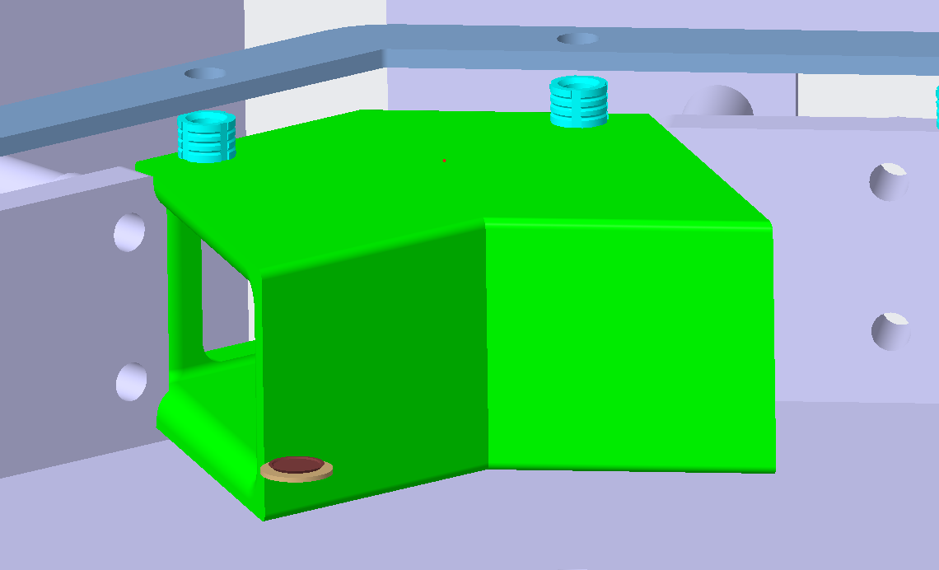
Model Problems
Interference between Connectors / Plates inside octoframe

Slide 4
Mass of simplified Model
Property | Value
Total Mass | 76.962 kg
Volume | 0.12563 $m^{3}$

Slide 5
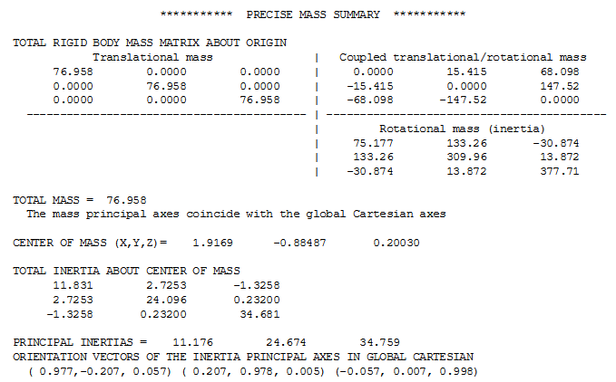
Center of Mass of simplified Model

Slide 6
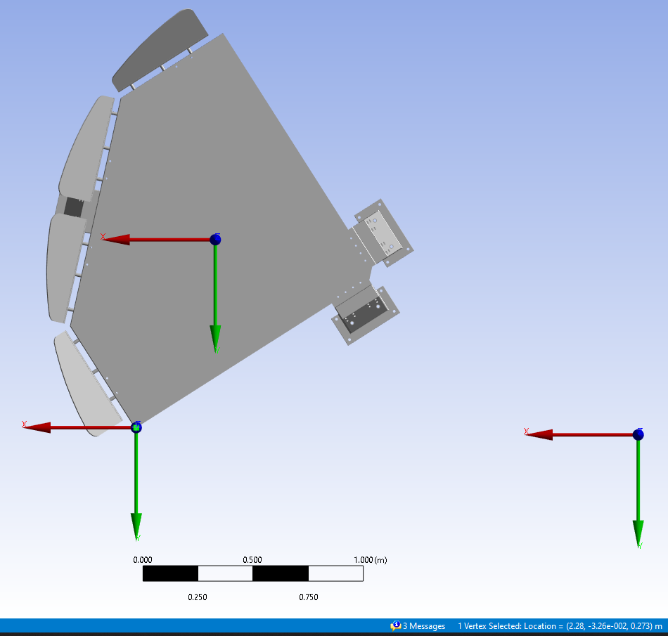
Distance Vertix - COM
Vertix: Upper Edge of Upper mechanical Structure
Position of COM depending on the Vertix Coordinate System: (-0.3631 m I -8.8813 m I – 0.0727 m)
COM
Global Coordinate System
Vertix

Slide 7
Materials
Object | Material | Material in ANSYS
 |  | Reference | Density [kg/m3] | Compressive Modulus [MPa] | Shear Modulus [MPa]
Feet, Radiator, Radiator Fixation, Vibration Bracket | Aluminum | Aluminum Alloy | 2770 | 69 080 | 26 692
Vibration bracket Interior | PEEK | PEEK (40% carbon fiber) | 1445 | 203 000 | 124 290
Honeycombs | Carbon Fiber | *Honeycomb | 36* | 890* | 380*
Sensors | Anisotropic Silicon | Silicon Anisotropic | 2330 | - | -
LEF, LBB | PCB – FR4 | PCB laminate, Epoxy/ Glass fiber, FR-4 | 1990 | 11 264 | 10 827
Octoframe, Octo frame Fixation | M46/EX-1515 | Epoxy Carbon UD (395 Gpa) Prepreg | 1566.4* | - | -
Mechanical structure, Skins | M55J/EX-1515 | Epoxy Carbon UD (395 Gpa) Prepreg | ? | - | -
* Ansys reference material is corrected with these given values

Slide 8
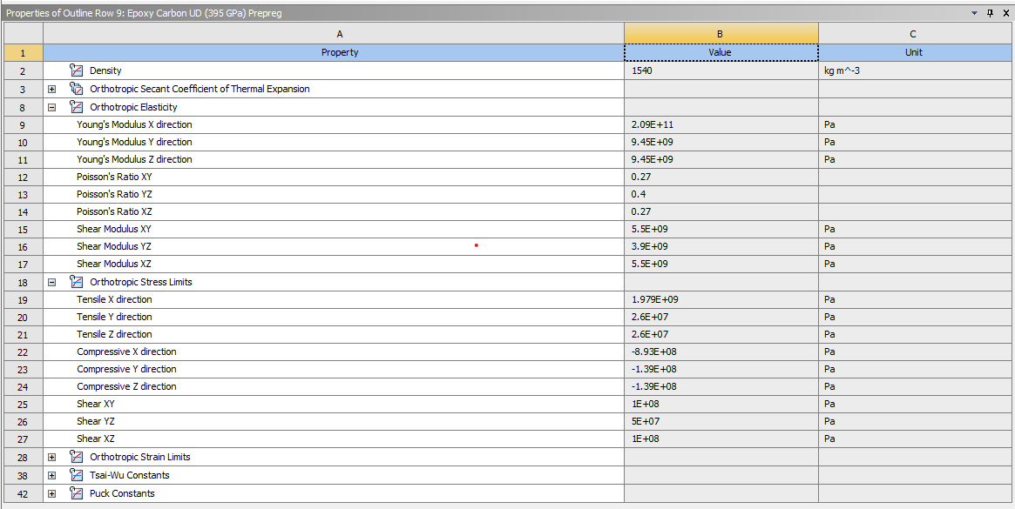
ANSYS Material: Epoxy Carbon UD (395 Gpa) Prepreg

Slide 9
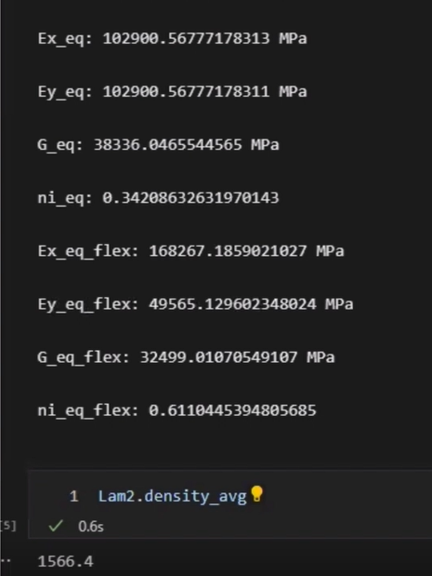
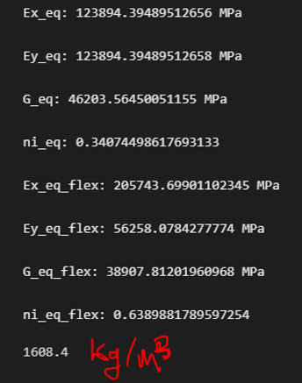
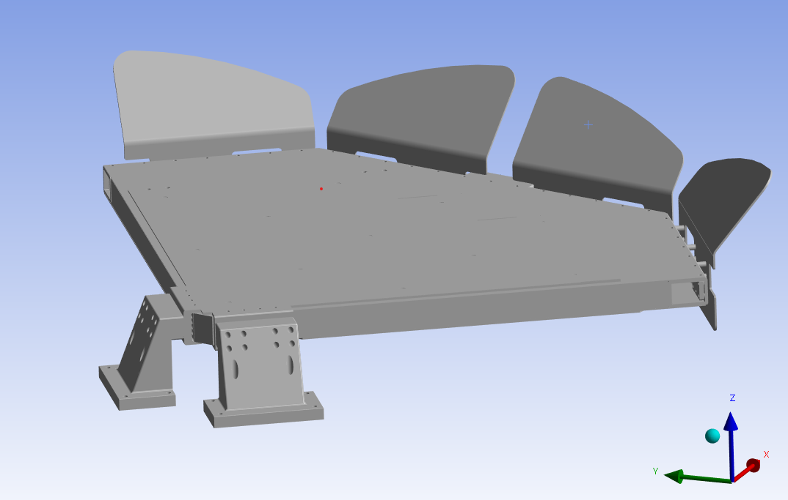
Material Calculation for M46J/EX-1515 and M55/EX-1515
M46 M55
Meeting Outcome: No Correction of the Young Modulus to the Flexular Modulus needed since the object to be examined is out of sandwich structure and not a lamina of composite materials.
Instruction: Correct Young Modulus, Density Poisson ratio and the remaining values and the rest of the data remains in Ansys standard.
Question: I'm a little confused right now about the correct assignment of axes in terms of the model, or how relevant that is.

Slide 10
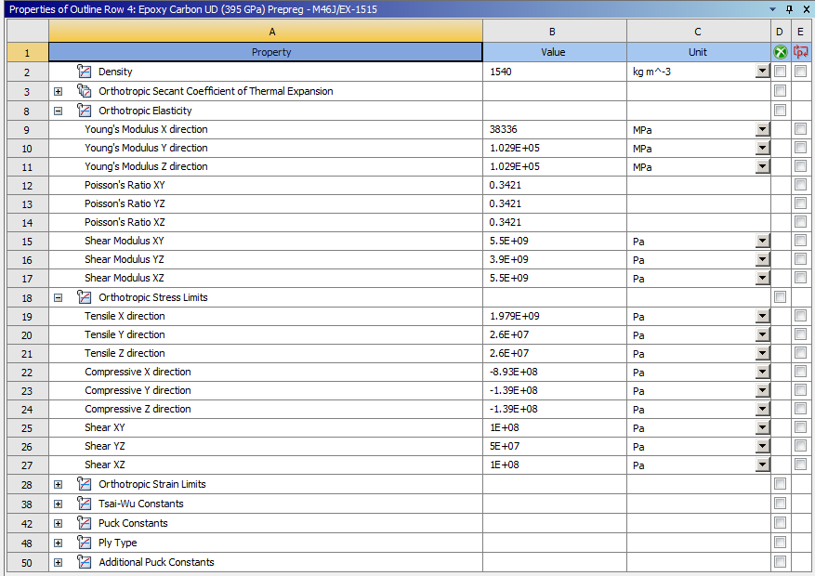
Corrected ANSYS Material to M46J/EX-1515

Slide 11
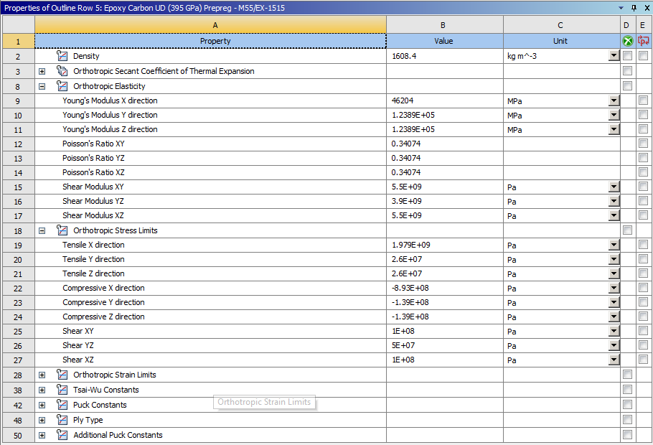
Corrected ANSYS Material to M55J/EX-1515

Slide 12
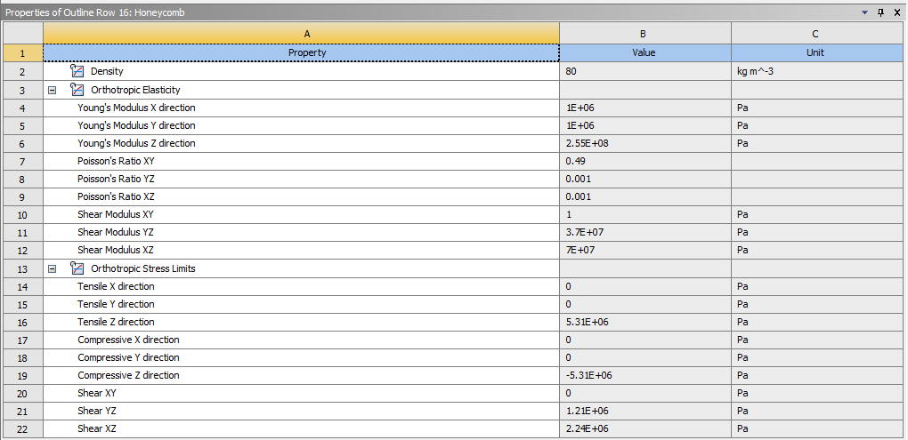
ANSYS Material: Honeycomb

Slide 13
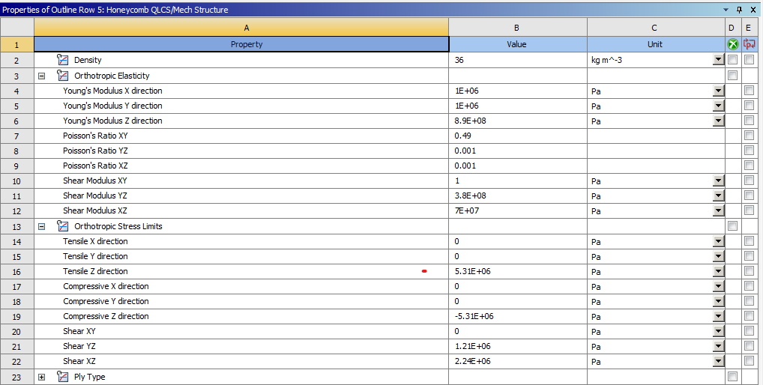
Corrected ANSYS Material to Honeycomb

Slide 14
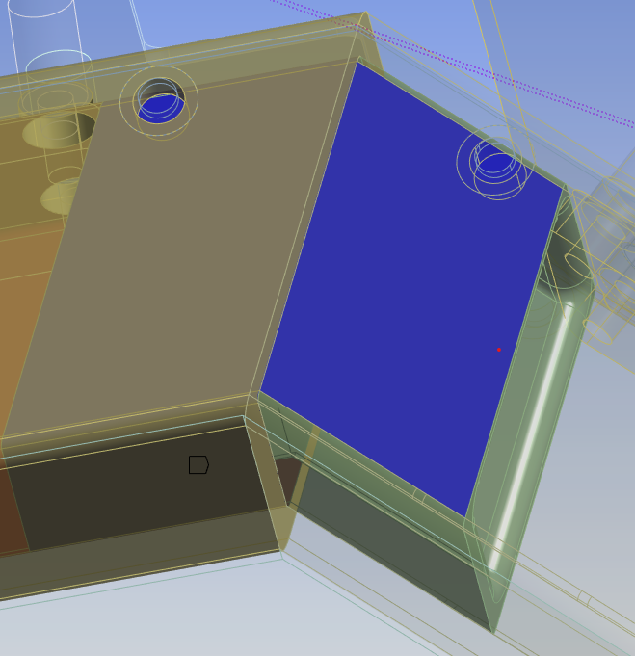
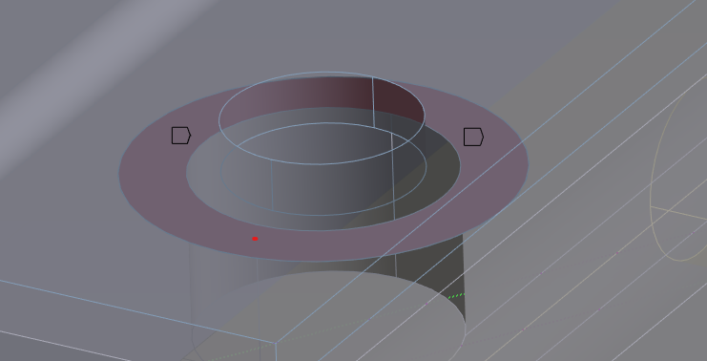
Contacts
Full bonded contacts on small parts and QLCS
QLCS Layers
Fixation Plates, Octoframe, Feet
Bonded Imprinted surfaces on big parts
Upper and Lower Mechanical Structure
How is the 70 mm Honeycomb fixed? As first I assumed it is bonded from each side

Slide 15
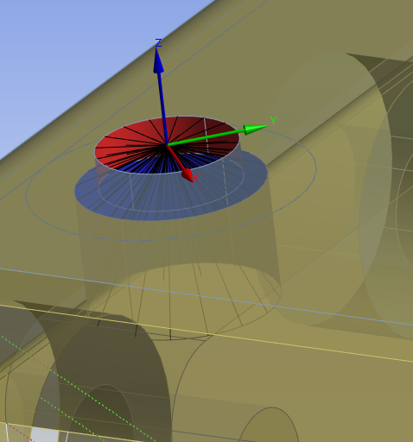
Joints
RBE2 Elements modelling the screws in the Vibration brackets, Feet, Mechanical Structures and Fixations for the Radiator and Octoframe
1 free DOF in z (fixed through contacts)

Slide 16
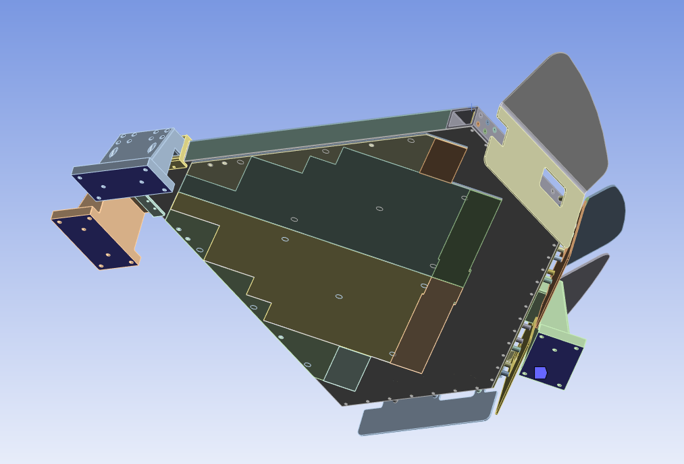
Constraints
Fixed Bottomside of the Feet to approximate stiff plate below it

Slide 17
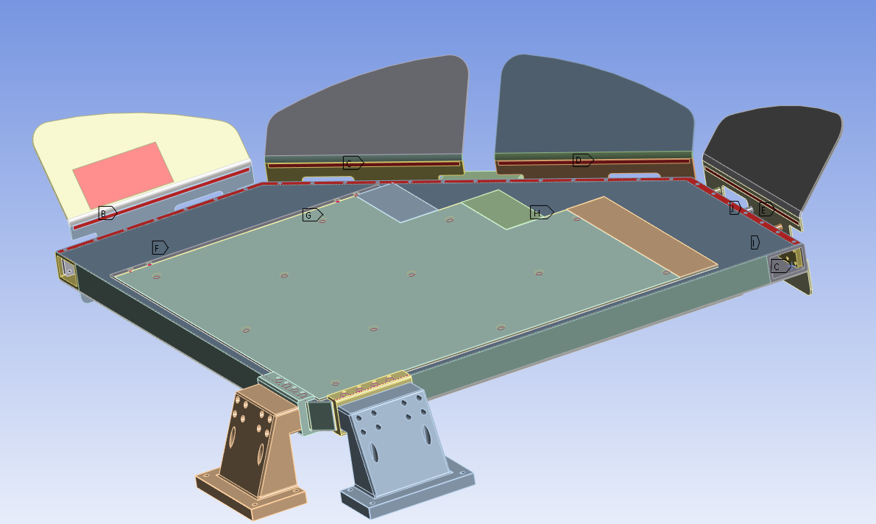
Distributed Masses

Slide 18
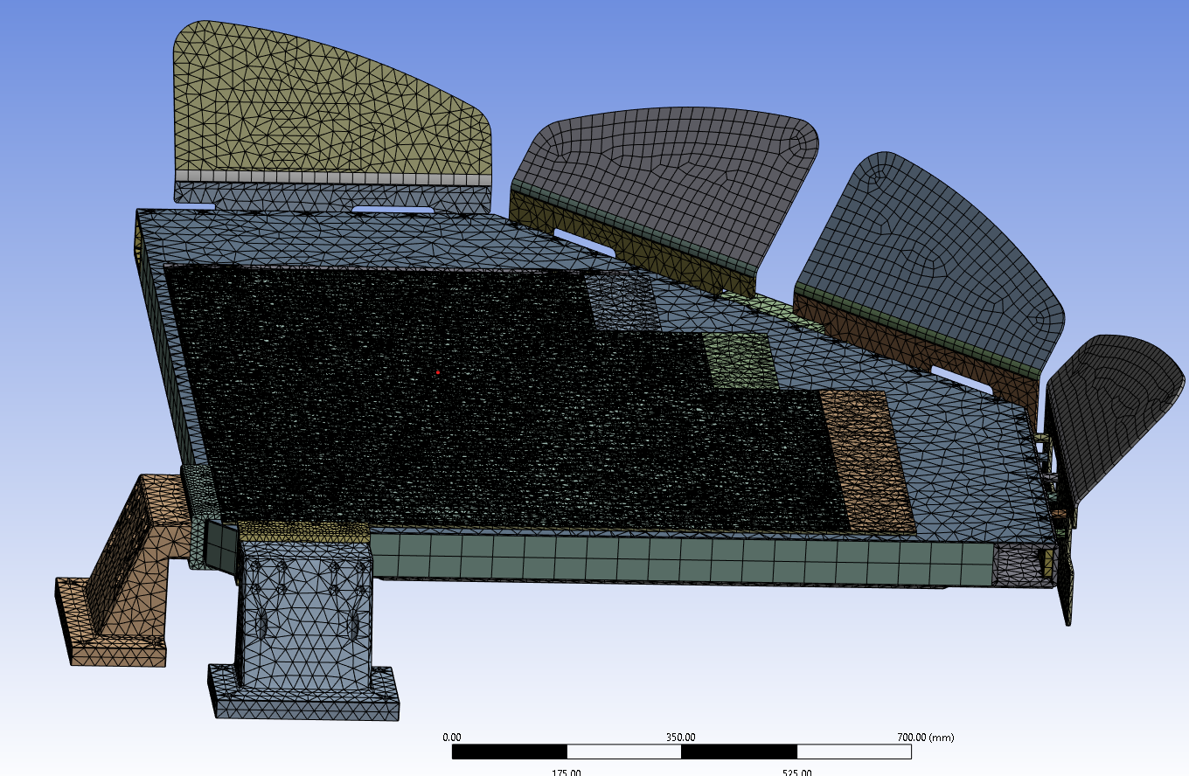
Mesh
Coarse Mesh but the Eigenfrequencies do not change a lot while refinement (around 10 Hz, and already they are pretty low)
It may be possible to refine the mesh of the QLCS a little more , but only to a limited extent. When I tried to apply 5 mm, the solver already could not solve it due to missing memory. The smallest mesh here is at 15 mm.

Slide 19
Eigenfrequencies

Slide 20
Mode Shape 1: 47 Hz

Slide 21
Mode Shape 2: 51 Hz

Slide 22
Mode Shape 3: 52 Hz

Slide 23
Mode Shape 4: 52 Hz

Slide 24
Mode Shape 5: 68 Hz

Slide 25
Mode Shape 6: 100 Hz

Slide 26
Mode Shape 7: 105 Hz

Slide 27
Mode Shape 8: 110 Hz

Slide 28
Mode Shape 9: 110 Hz

Slide 29
Mode Shape 10: 113 Hz

