Slide 1

The Geant4
simulation toolkit: an introduction
Pavia January 16-20, 2023

Slide 2
G4 School Outline
Generals on C++
Generals on Monte Carlo
Basic capability of Geant4
Basic structure of the Geant4 components
At the end of the school
Configuration
Generation of particles
Geometry and materials
Tracking
Physics
Scoring

Slide 3
Lesson Outline
Introduction to the Monte Carlo method
Introduction to Geant4
Structure of the Geant4 Kernel
Structure of a typical Geant4 application

Slide 4
Monte Carlo method

Slide 5
Monte Carlo techinque
Numerical solution of a (complex) macroscopic problem, by simulating the microscopic interactions among the components
Uses random sampling, until convergence is achieved
  Name after Monte Carlo's casino
Applications not only in physics and science, but also finances, traffic flow, social studies
  And not only problems that are intrisically probabilistic (e.g. numerical integration)
l metodo Monte Carlo è un'ampia classe di metodi computazionali basati sul campionamento casuale per ottenere risultati numerici. Può essere utile per superare i problemi computazionali legati ai test esatti (ad esempio i metodi basati sulla distribuzione binomiale e calcolo combinatorio, che per grandi campioni generano un numero di permutazioni eccessivo).
Il metodo è usato per trarre stime attraverso simulazioni. Si basa su un algoritmo che genera una serie di numeri tra loro incorrelati, che seguono la distribuzione di probabilità che si suppone abbia il fenomeno da indagare. L'incorrelazione tra i numeri è assicurata da un test chi quadrato.

Slide 6
Monte Carlo techinque
Produce a configuration (or a "final state"), according to some "laws", e.g.
  People mostly arrive in pairs
  Audience members prefer an un-obstructed view of the stage
  Audience members prefer seats in the middle, and close to the front row
  Only one person can occupy a seat
Contrarily e.g. to physics, the laws are not known
  Rather use "working assumptions"
The math (exact) formulation can be impossible or unpratical => MC is more effective

Slide 7
MC in science
In physics, elementary laws are (typically) known => MC is used to predict the outcome of a (complex) experiment
  Exact calculation from the basic laws is unpractical
  Optimize an experimental setup, support data analysis
Can be used to validate/disproof a theory, and/or to provide small corrections to the theory
In this course: Monte Carlo for particle tracking (interaction of radiation with matter)

Slide 8
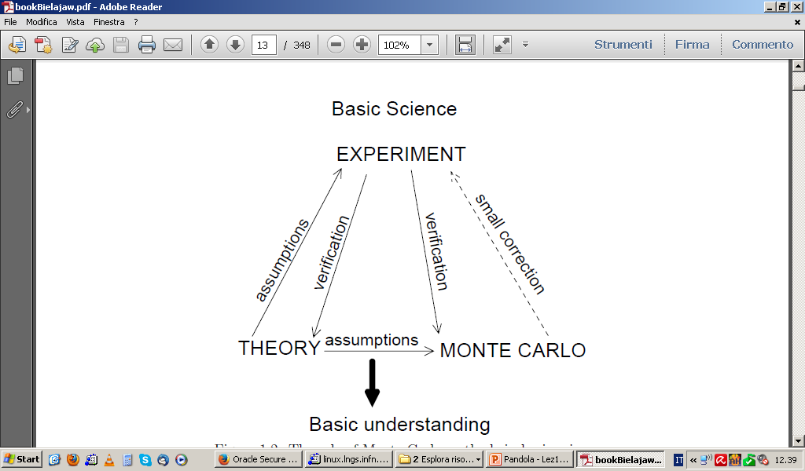
Interplay between theory, simulations and experiments

Slide 9

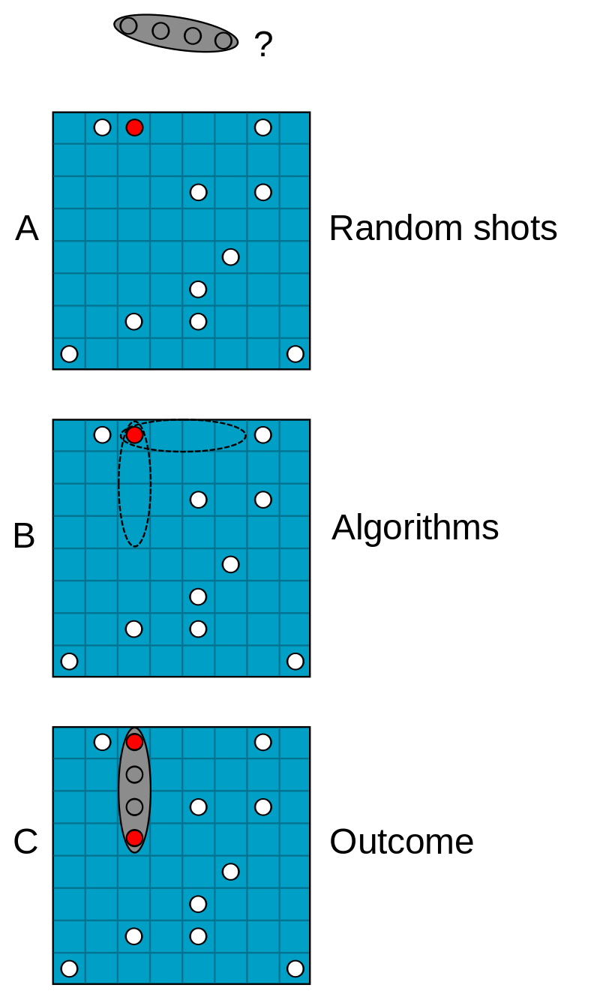
MC application
naval battle
Monte Carlo methods vary, but tend to follow a particular pattern:
1) Define a domain of possible inputs
2) Generate inputs randomly from a probability distribution over the domain
3) Perform a deterministic computation on the inputs
4) Aggregate the results
Can you sink the ship?

Slide 10

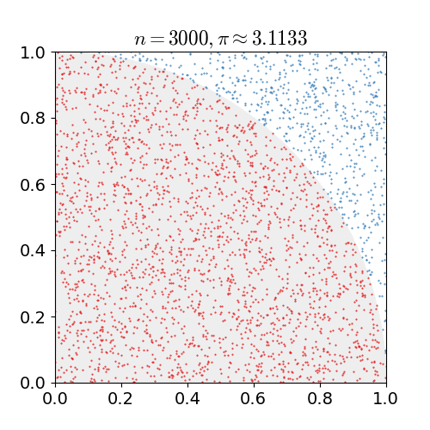
The simplest MC application
0<x<1
0<y<1
For example, consider a quadrant (circular sector) inscribed in a unit square. Given that the ratio of their areas is π/4, the value of π can be approximated using a Monte Carlo method
M(x,y)
Sia M un punto di coordinate (x,y) con 0<x<1 e 0<y<1 e scegliamo casualmente i valori di x e y.
Se {\displaystyle x^{2}+y^{2}<1}allora il punto M appartiene al settore di disco (un quarto del cerchio a cui appartiene) di centro (0,0) di raggio 1.
L'area di tale disco è il raggio elevato al quadrato per π diviso 4. Nell'esempio il raggio è pari a uno e quindi l'area di interesse è 1*π/4 = π/4. Il punto può cadere quindi o nel cerchio o nel quadrato circoscritto al cerchio. La probabilità che il punto cada all'interno del settore di disco è quindi pari al rapporto tra l'area del settore π/4 e l'area del quadrato circoscritto al settore di disco che è 1; quindi la probabilità è π/4.
Facendo il rapporto del numero dei punti che cadono nel settore di disco con il numero dei tiri effettuati si ottiene un'approssimazione del numero π/4 se il numero dei tiri è grande.
Eseguendo numericamente l'esempio si ottiene un andamento percentuale dell'errore mostrato nel grafico sottostante.

Slide 11
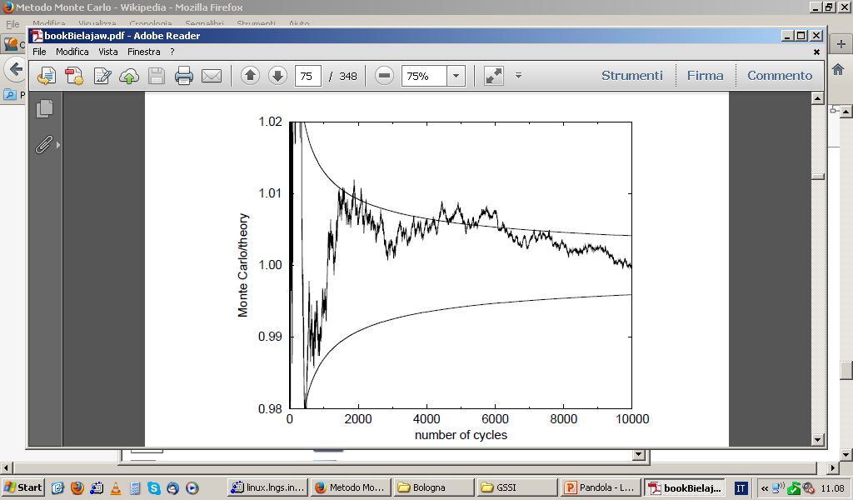
The simplest MC application
0<x<1
0<y<1
Shoot N couples (x,y) randomly in [0,1]
Count n: how many couples satisfy (x²+y²≤1)
M(x,y)
n:N = r²*π/4:1
(ratio of areas)
Probability=Asector/Asquare
Convergence as 1/ √N
Sia M un punto di coordinate (x,y) con 0<x<1 e 0<y<1 e scegliamo casualmente i valori di x e y.
Se {\displaystyle x^{2}+y^{2}<1}allora il punto M appartiene al settore di disco (un quarto del cerchio a cui appartiene) di centro (0,0) di raggio 1.
L'area di tale disco è il raggio elevato al quadrato per π diviso 4. Nell'esempio il raggio è pari a uno e quindi l'area di interesse è 1*π/4 = π/4. Il punto può cadere quindi o nel cerchio o nel quadrato circoscritto al cerchio. La probabilità che il punto cada all'interno del settore di disco è quindi pari al rapporto tra l'area del settore π/4 e l'area del quadrato circoscritto al settore di disco che è 1; quindi la probabilità è π/4.
Facendo il rapporto del numero dei punti che cadono nel settore di disco con il numero dei tiri effettuati si ottiene un'approssimazione del numero π/4 se il numero dei tiri è grande.
Eseguendo numericamente l'esempio si ottiene un andamento percentuale dell'errore mostrato nel grafico sottostante.

Slide 12
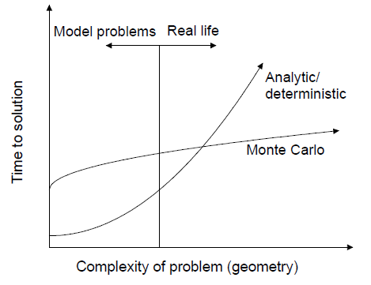
When are MC useful to the math solution?
Usually the Monte Carlo wins over the exact (mathematical) solution for complex problems

Slide 13
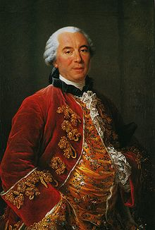

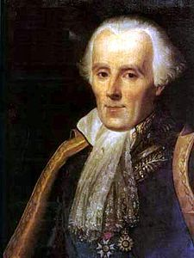
A bit of history
Very concept of Monte Carlo comes in the XVIII century (Buffon, 1777, and then Laplace, 1786)
  Monte Carlo estimate of π
Concept of MC is much older than real computers
  one can also implement the algorithms manually, with dice (= Random Number Generator)

Slide 14
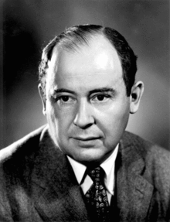
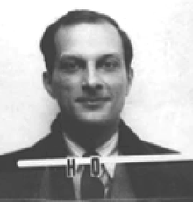


A bit of history
Boost in the '50 (Ulam and Von Neumann) for the development of thermonuclear weapons
Von Neumann invented the name "Monte Carlo" and settled a number of basic theorems
First (proto)computers available at that time
  MC mainly CPU load, minimal I/O

Slide 15

Geant4

Slide 16
Monte Carlo codes and Geant4
MCNP (neutrons mainly)
Penelope (e- and gamma)
PETRA (protons)
EGSnrc (e- and gammas)
PHIT (protons/ions)
FLUKA (any particle)
Geant4
  GEometry ANd Traking
  Geant4 - a simulation toolkit
  Nucl. Inst. and Methods Phys. Res. A, 506:250-303 (2003);
  Geant4 developments and applications
  Transaction on Nuclear Science 53, 270-278 (2006);
  Recent developments in Geant4
  Nucl. Inst. and Methods Phys. Res. A,
  835:186-225 (2016)

Slide 17
Facts about Geant4
Geant4 started at CHEP 1994 @ San Francisco
  “Geant steps into the future”, R Brun et al.
  “Object oriented analysis and design of a Geant based detector simulator”,
  K Amako et al
Dec ’94 - CERN RD44 project starts
Apr ’97 - First alpha release
Jul ’98 - First beta release
Dec ’98 - First Geant4 public release - version 1.0
........
December, 2021 - Geant4 11.1
Current version in the VM
We currently provide one public release every year

Slide 18
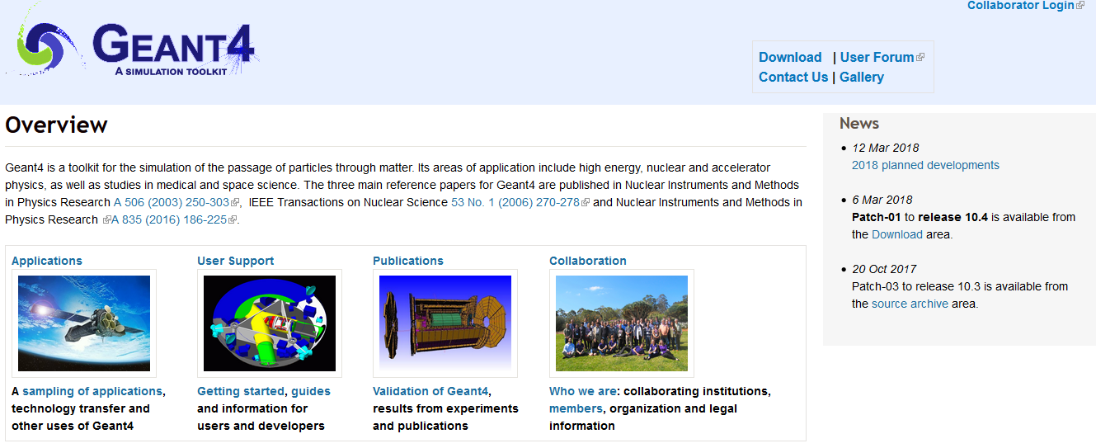
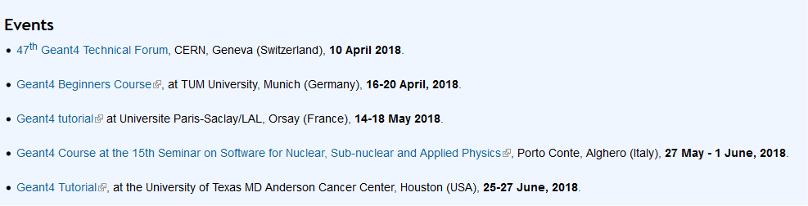
Facts about Geant4
http://geant4.org
Code and documentation available in the main web page
Regular tutorial courses held worldwide

Slide 19
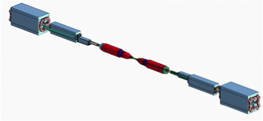
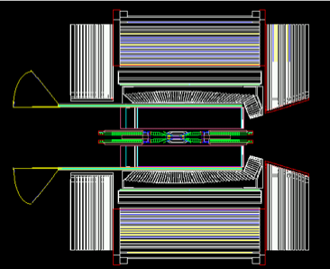

Facts about Geant4
BaBar is the pioneer HEP experiment in use of OO technology and the first customer of Geant4
  During the R&D phase of Geant4 a lot of evaluable feedbacks were provided
BaBar started its simulation production in 2000 and had produced more than 10 bilion events at more than 20 sites in Europe and North America.

Slide 20
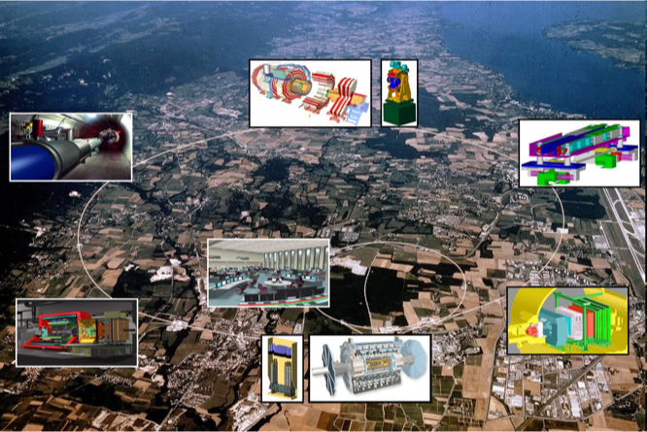
Facts about Geant4

Slide 21
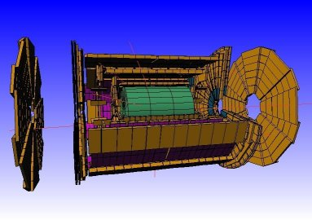
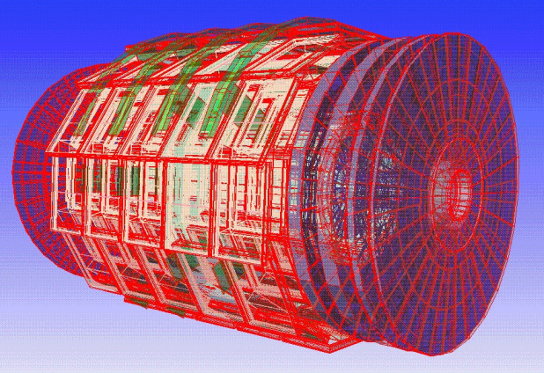
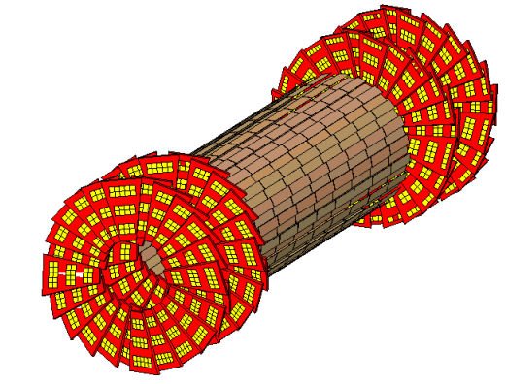
LHC @CERN
ATLAS
All four big LHC experiments have a Geant4 simulation
  M of volumes
  Physics at the TeV scale
Benchmark with test-beam data
Key role for the Higgs searches
CMS

Slide 22
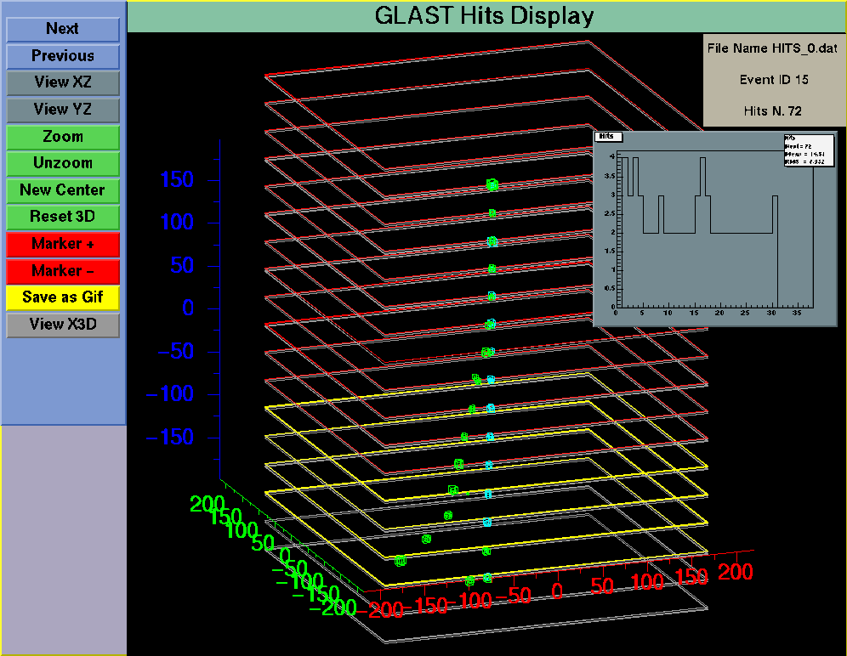
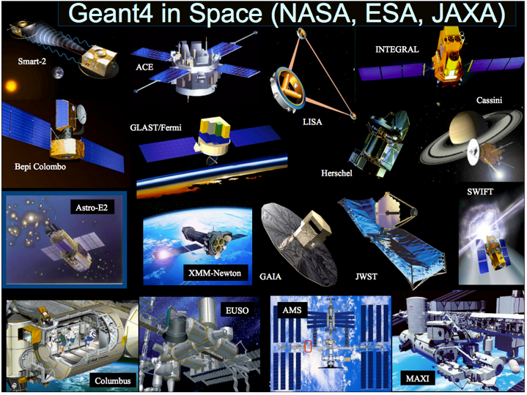
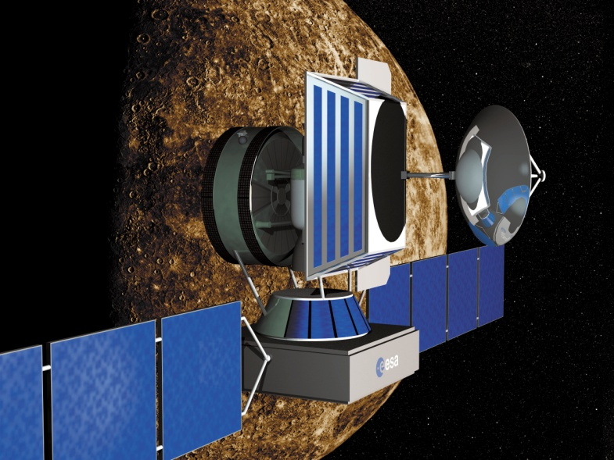
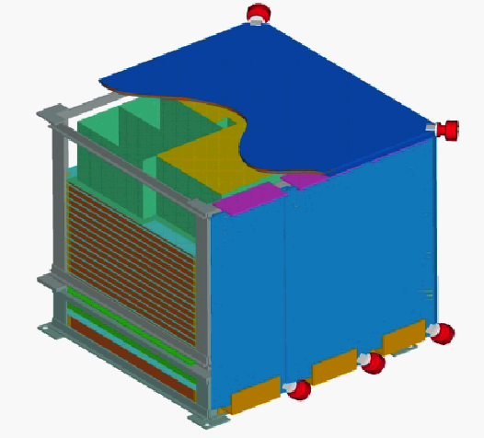
Space application
Satellites (γ astrophysics, planetary sciences)
Funding from ESA
GLAST
AGILE
Typical telescope:
Tracker
Calorimeter
Anticoincidence
shelding effect of the human body

Slide 23
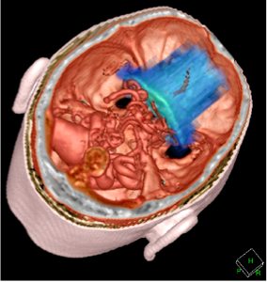
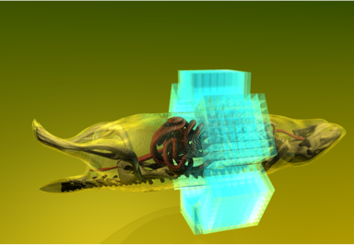
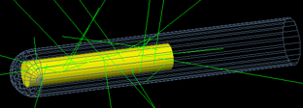
Facts about Geant4
Major use cases
  Beam therapy
  Brachytherapy
  Imaging
  Irradiation study
  Nuclear medicine and radioisotopes
  Biological damage
Huge work for the medical physics

Slide 24
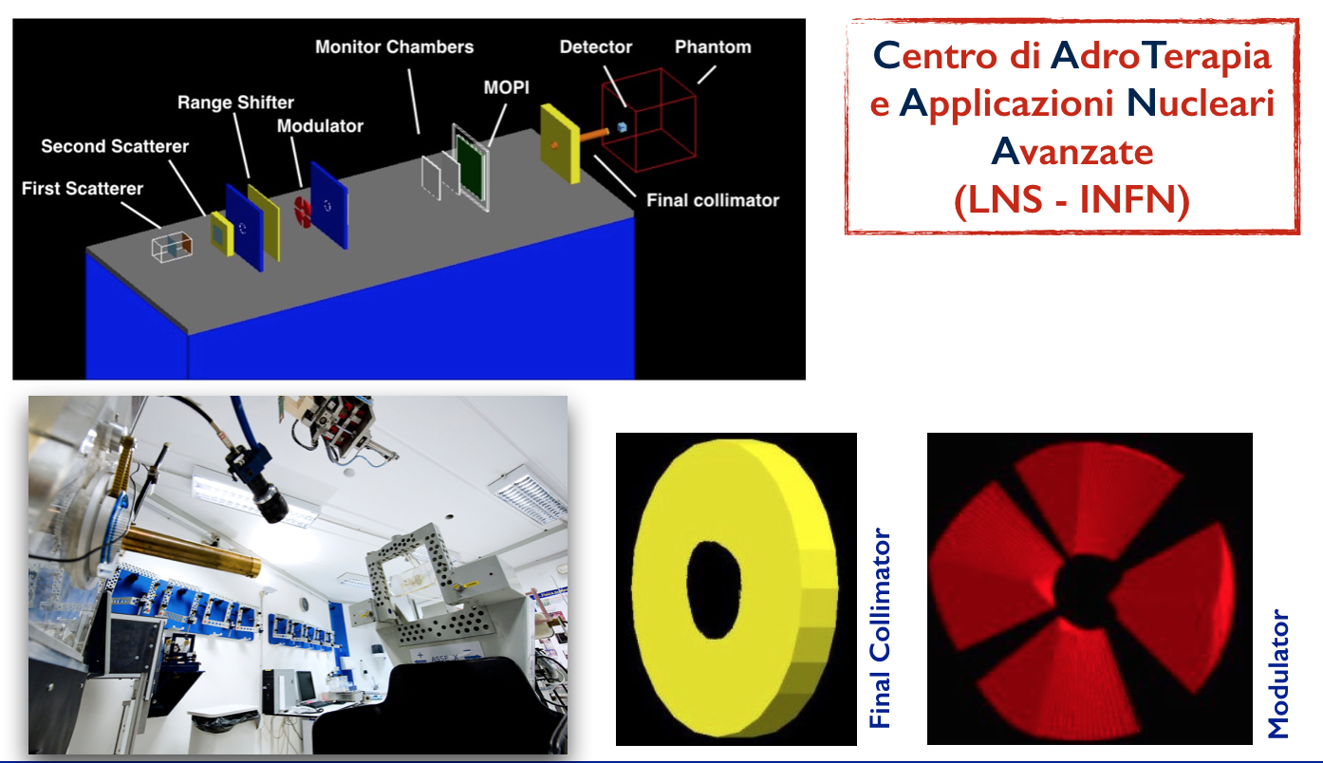
Medical Physics
Treatment planning for hadrontherapy and proton-therapy systems
  Goal: deliver dose to the tumor while sparing the healthy tissues
  Alternative to less-precise (and commercial) TP software
Medical imaging
Radiation fields from medical accelerators and devices
  medical_linac
  gamma-knife
  brachytherapy
Medical Physics group of LNS-INFN

Slide 25
Basic concepts and Geant4 capabilities

Slide 26
Geant4 overview
C++ language
Object Oriented
Open Source
Once per year released
It is a toolkit, i.e. a collection of tools the User can use for his/her simulation
Consequences:
  There are not such concepts as “Geant4 defaults”
  You must provide the necessary the necessary information to configure your simulation
  You must choose the Geant4 tool to use
Guidance: many examples are provided:
  Basic examples: overview of the Geant4 tools
  Extended examples: showing specific Geant4 functionalities
  Advanced Examples: Geant4 tools in real-life applications
An important things that you know when you start to use geant4

Slide 27
Geant4 basics
What you MUST do:
  Describe your experimental set-up
  Provide the primary particles input to your simulation
  Decide which particles and physics models you want to use out of those available in Geant4 and the precision of your simulation (cuts to produce and track secondary particles)
You MAY ALSO WANT:
  To interact with the Geant4 kernel to control your simulation
  To visualise your simulation set-up and particles
  To produce histograms, tuples, etc. to be further analysed

Slide 28
Multi-threading
Geant4 supports multi-thread (MT) approach that can be used in multi-cores machines
Simulation is automatically split on a event-by-event basis
Different events are processes by different cores
Unique copy of Geometry and Physics
All cores have them as read-only
Functionality in place since Geant4 10.0
Backward compatible with the sequential mode
MT programming requires some cares
Need to avoid conflicts between threads
Starting to the Geant4 10.0

Slide 29

Multi-threading
Master
Geometry
Physics
RunAction
READONLY
Workers
Primary
Primary
Primary
RunAction
RunAction
RunAction
EvtAction
EvtAction
EvtAction

Slide 30
Files composing a Geant4 application
Main() file
Sources files (*.cc)
  usually included in the src/ folder
Header files (*.hh)
  usually included in the include/ files
Three classes are necessary (with the Main.cc ons), each typically in a dedicated header/source pair of files
  The PrimaryGeneratorAction (.cc and .hh)
  The DetectorConstruction (.cc and .hh)
  The PhysicsList (.cc and .hh)

Slide 31
Mandatory User’s classes – v1
Initialisation classes
Invoked at the initialisation
G4VUserDetectorConstruction
G4VUserPhysicsList
Action classes
Invoked during the execution loop
G4VUserPrimaryGeneratorAction
G4UserRunAction
G4UserEventAction
G4UserTrackingAction
G4UserStackingAction
G4UserSteppingAction

Slide 32

Mandatory User’s classes – v2 (MT)
Initialisation classes
Invoked at the initialisation
G4VUserDetectorConstruction
G4VUserPhysicsList
Action classes
Invoked during the execution loop
G4VUserActionInitialization
G4VUserPrimaryGeneratorAction
G4UserRunAction (*)
G4UserEventAction
G4UserTrackingAction
G4UserStackingAction
G4UserSteppingAction
Global: only one instance of them exists in memory, shared by all threads (readonly).
Managed only by the master thread.
Local: an instance of each action class exists for each thread.
(*) Two RunAction's allowed: one for master and one for threads

Slide 33
The main() file

Slide 34
The main()
Geant4 does not provide a main() file
  Geant4 is a toolkit!
  The main() is part of the User application
In his/her main(), the user must:
  Construct the G4RunManager
  Notify the G4RunManager the mandatory user classes derived from:
    runManager -> SetUserInitialization
    (new MyApplicationDetectorConstruction)
  G4RunManager is used to inizialize the geometry and the physics of your detector
SetUserInitialization è un metodo

Slide 35
The main()
The user MAY define in his/her main():
  Optional user action classes
  VisManager, (G)UI session
The User has also to take care of retrieve and save the relevant information from the simulation (Geant4 will not do that by default)
Do not forget to delete the G4RunManager at the end

Slide 36
An example of sequential main()
{
// Construct the default run manager
G4RunManager* runManager = new G4RunManager;
// Set mandatory user initialization classes
MyDetectorConstruction* detector = new MyDetectorConstruction;
runManager -> SetUserInitialization(detector);
MyPhysicsList* physicsList = new MyPhysicsList;
runManager -> SetUserInitialization(myPhysicsList);
// Set mandatory user action classes
runManager -> SetUserAction(new MyPrimaryGeneratorAction);
// Set optional user action classes
MyEventAction* eventAction = new MyEventAction();
runManager -> SetUserAction(eventAction);
MyRunAction* runAction = new MyRunAction();
runManager -> SetUserAction(runAction);
}
It’s a little bit complicate to follow perhaps

Slide 37
Methods for Users classes
G4UserRunAction
  BeginOfRunAction(const G4Run*) // book histos
  EndOfRunAction(const G4Run*) // store histos
G4UserEventAction
  BeginOfEventAction(const G4Event*) //initialize event
  EndOfEventAction (const G4Event*) // analyze event
G4UserTrackingAction
//decide to store/not store a given track
  PreUserTrackingAction(const G4Track*)
  PostUserTrackingAction(const G4Track*)

Slide 38
Methods for Users classes
G4UserSteppingAction
  UserSteppingAction(const G4Step*)
  //kill, suspend, pospone the track, draw the step, …
G4UserStackingAction
  PrepareNewEvent()
  //reset priority control
  ClassifyNewTrack(const G4Track*)
  // Invoked when a new track is registered (e.g. kill, pospone)
  NewStage()
  // Invoked when the Urgent stack becomes empty (re-classify, abort event)

Slide 39
Selection of physics processes and optional capabilities

Slide 40
Physics processes
IThe collaboration provide a set of physics list
Geant4 doesn’t have any default particles or processes
Derive your own concrete class from the G4VUserPhysicsList abstract base class
  Define all necessary particles
  Define all necessary processes and assign them to proper particles
  Define particles production threshold (in terms of range)
Methods of G4VUserPhysicsList:
  ContructParticles()
  ConstructProcesses()
  SetCuts()

Slide 41

Physics Lists
Geant4 doesn’t have any default particles or processes
  Partially true: there is no default, but there are a set of "ready-for-use" physics lists released with Geant4, tailored to different use cases. Mix and match
  Different sets of hadronic models (depending on the energy scale and modelling of the interactions)
Different options for neutron tracking
  Do we need (CPU-intensive) description of thermal neutrons, neutron capture, etc?
Different options for EM physics
  Do you need (CPU-intensive) precise description at the low-energy scale (< 1 MeV)?
    E.g. fluorescence, Doppler effects in the Compton scattering, Auger emission, Rayleigh diffusion

Slide 42

Optional (G)UI
In your main(), taking into account your computer environment, instantiate a G4UISession provided by Geant4 and invoke its SessionStart() method:
  mysession -> SessionStart();
Geant4 provides:
  G4UIterminal;
  csh or tcsh like shell
  G4UIBatch
  Bach job with macro files
Interfaces to various
graphics drivers
Dawn
Wired
RayTracer
OpenGL
OpenInventor
VRML

Slide 43
Summary: general recipe for novice Users

Slide 44
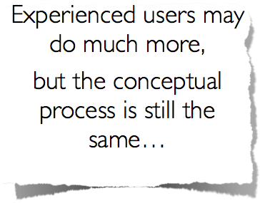
A general recipe
Design your application .... requires preliminary thinking (what is supposed to do?)
Create your derived mandatory user classes
  MyDetectorConstruction
  MyPhysicsList
  MyPrimaryGeneratorAction
Create optional derived user action classes
  MyUserRunAction, MyUserEventAction
Create your main() file
  Instantiate G4RunManager
  Notify the RunManager of your mandatory and optional user classes
  Optionally initialise your favourite User Interface and Visualisation

Slide 45
Thank you

