Slide 1
The Near-Universe Value of H₀
From Cepheids and TRGB
Stefano Casertano
Space Telescope Science Institute

Slide 2
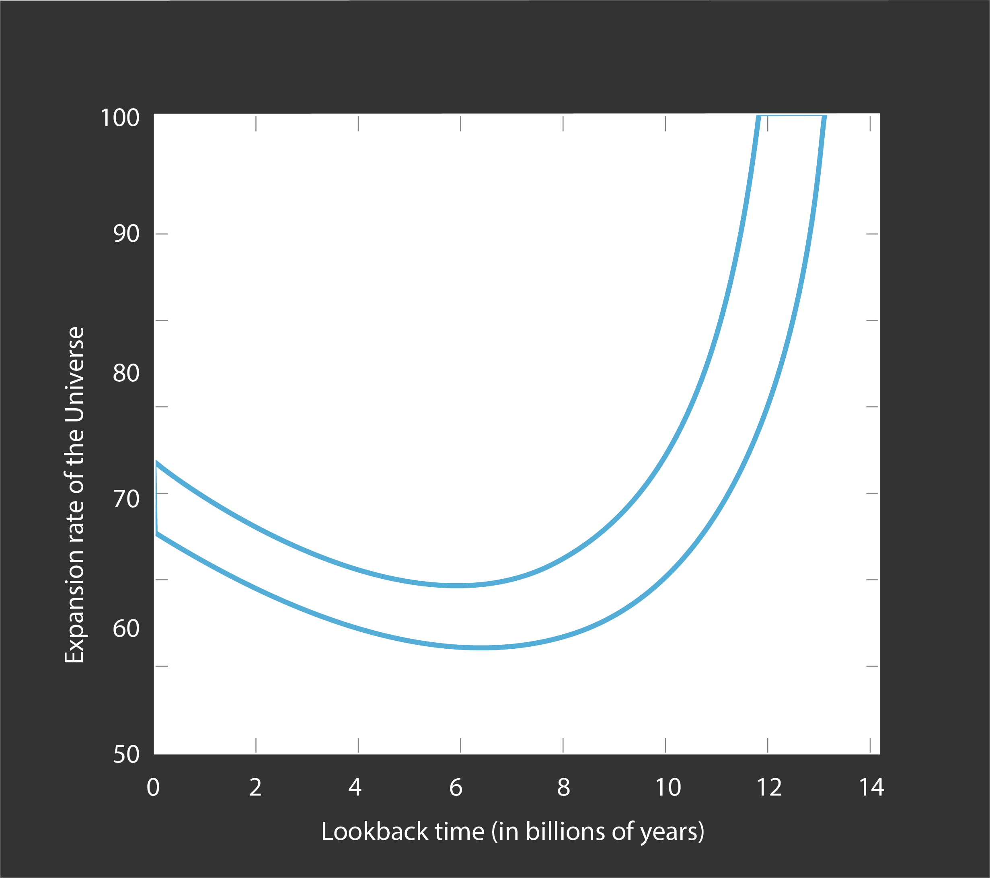
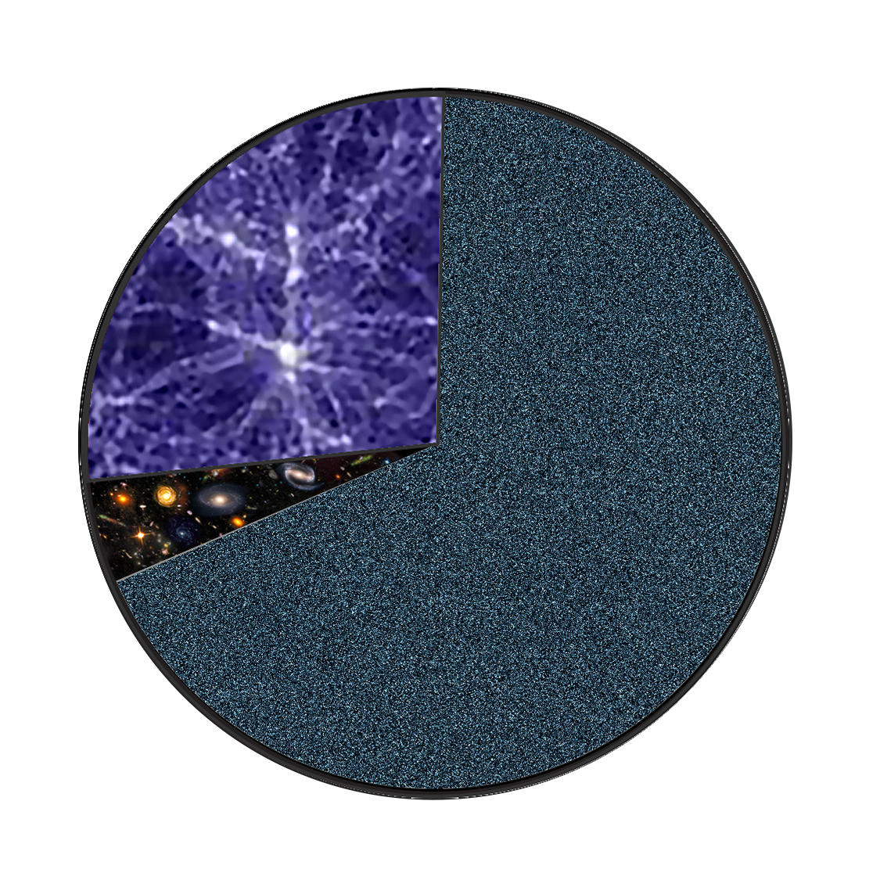
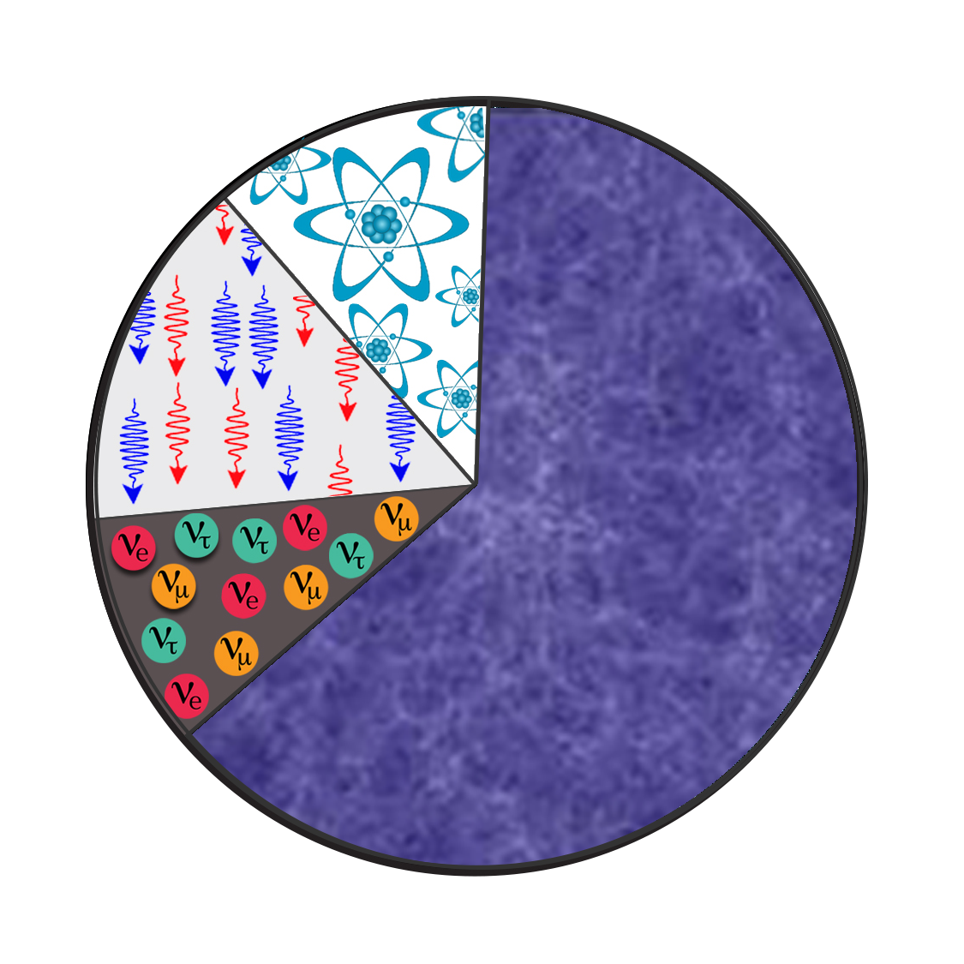
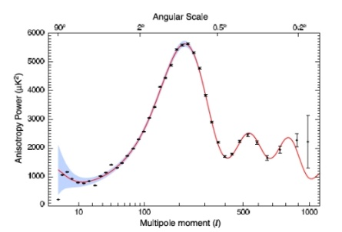
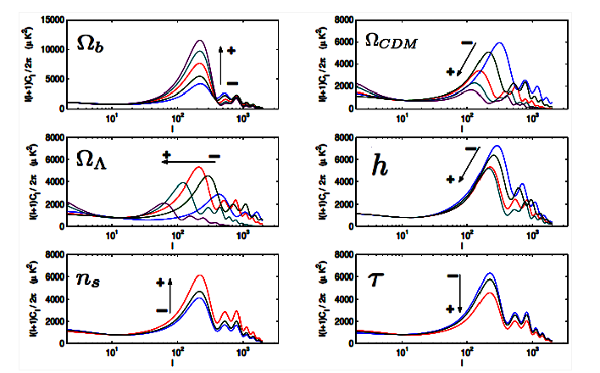
Hardly needed: a reminder of the H₀ local-cosmological connection
Expansion history from ΛCDM
Direct,
Model-free,
Present
route
z=0
z=1000
Dark
Matter
?
Big Bang afterglow
Compare fluctuation
spectrum to ΛCDM:
6 parameters, early physics to determine linear scale
Atoms
photons
Dark
Matter
?
Atoms
Dark
Energy
?
Neutrinos
3?
Dark Matter Dominated
ΛCDM
(6 parameters, Vanilla)
Dark Energy Dominated
Big
Bang
H₀
CMB Predicted,
H₀=67.4+/-0.5 km/s/Mpc

Slide 3
A direct, local, ~percent precision H₀ with HST
The SH₀ES Project (since 2005)
(Gen 2: 20 HST proposals, ~1000 orbits, now 2 JWST proposals)
Empirical distance ladder: anchors, calibrators, SNe Ia
Three simple precepts, rigorously applied:
Only geometric distance calibrations (parallaxes, red detached eclipsing binaries, megamaser)
Always use same filters with the same instrument (no zero point issues, filter transformations, etc)
Near Infrared primary filter (WFC3/IR F160W, now JWST F150W)
Also:
Highest quality SNe Ia data (Vincenzi talk this afternoon)
Rigorous error propagation, covariance, multiple analysis variants
All data public

Slide 4
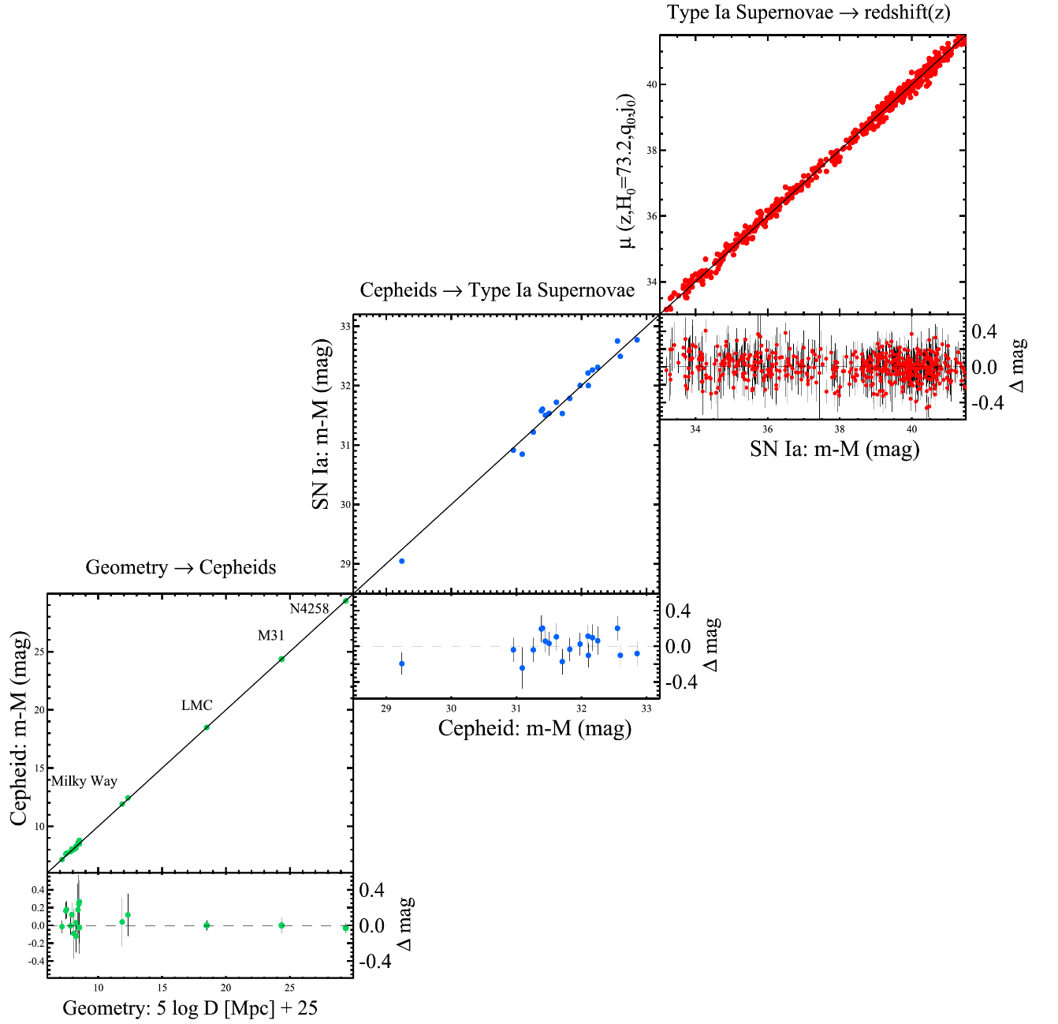
The H₀ distance ladder (circa 2016)
3
Supernovae in the Hubble flow
redshift ↔︎ luminosity distance
2
Cepheids in SN host
→ SN luminosity
1
Geometric distance
to Cepheids

Slide 5
The Evolution of the Distance Ladder:
The Local Distance Ladder Network
< 1%
Cepheids
NGC 4258 (Maser)
SN Host + JWST
1-2%
2-3%
Cepheids
5 (11) SNe Ia
> 3%
TRGB + MIRAs
MW field Cepheids
Cepheids
42 SNe Ia
Hubble flow
SN Hosts + HST
Cepheids
Cluster Cepheids
Cepheids
Redshift + flows
TRGB
TRGB
TRGB
LMC + SMC (DEB)
H₀!
MW field TRGB
GC TRGB

Slide 6
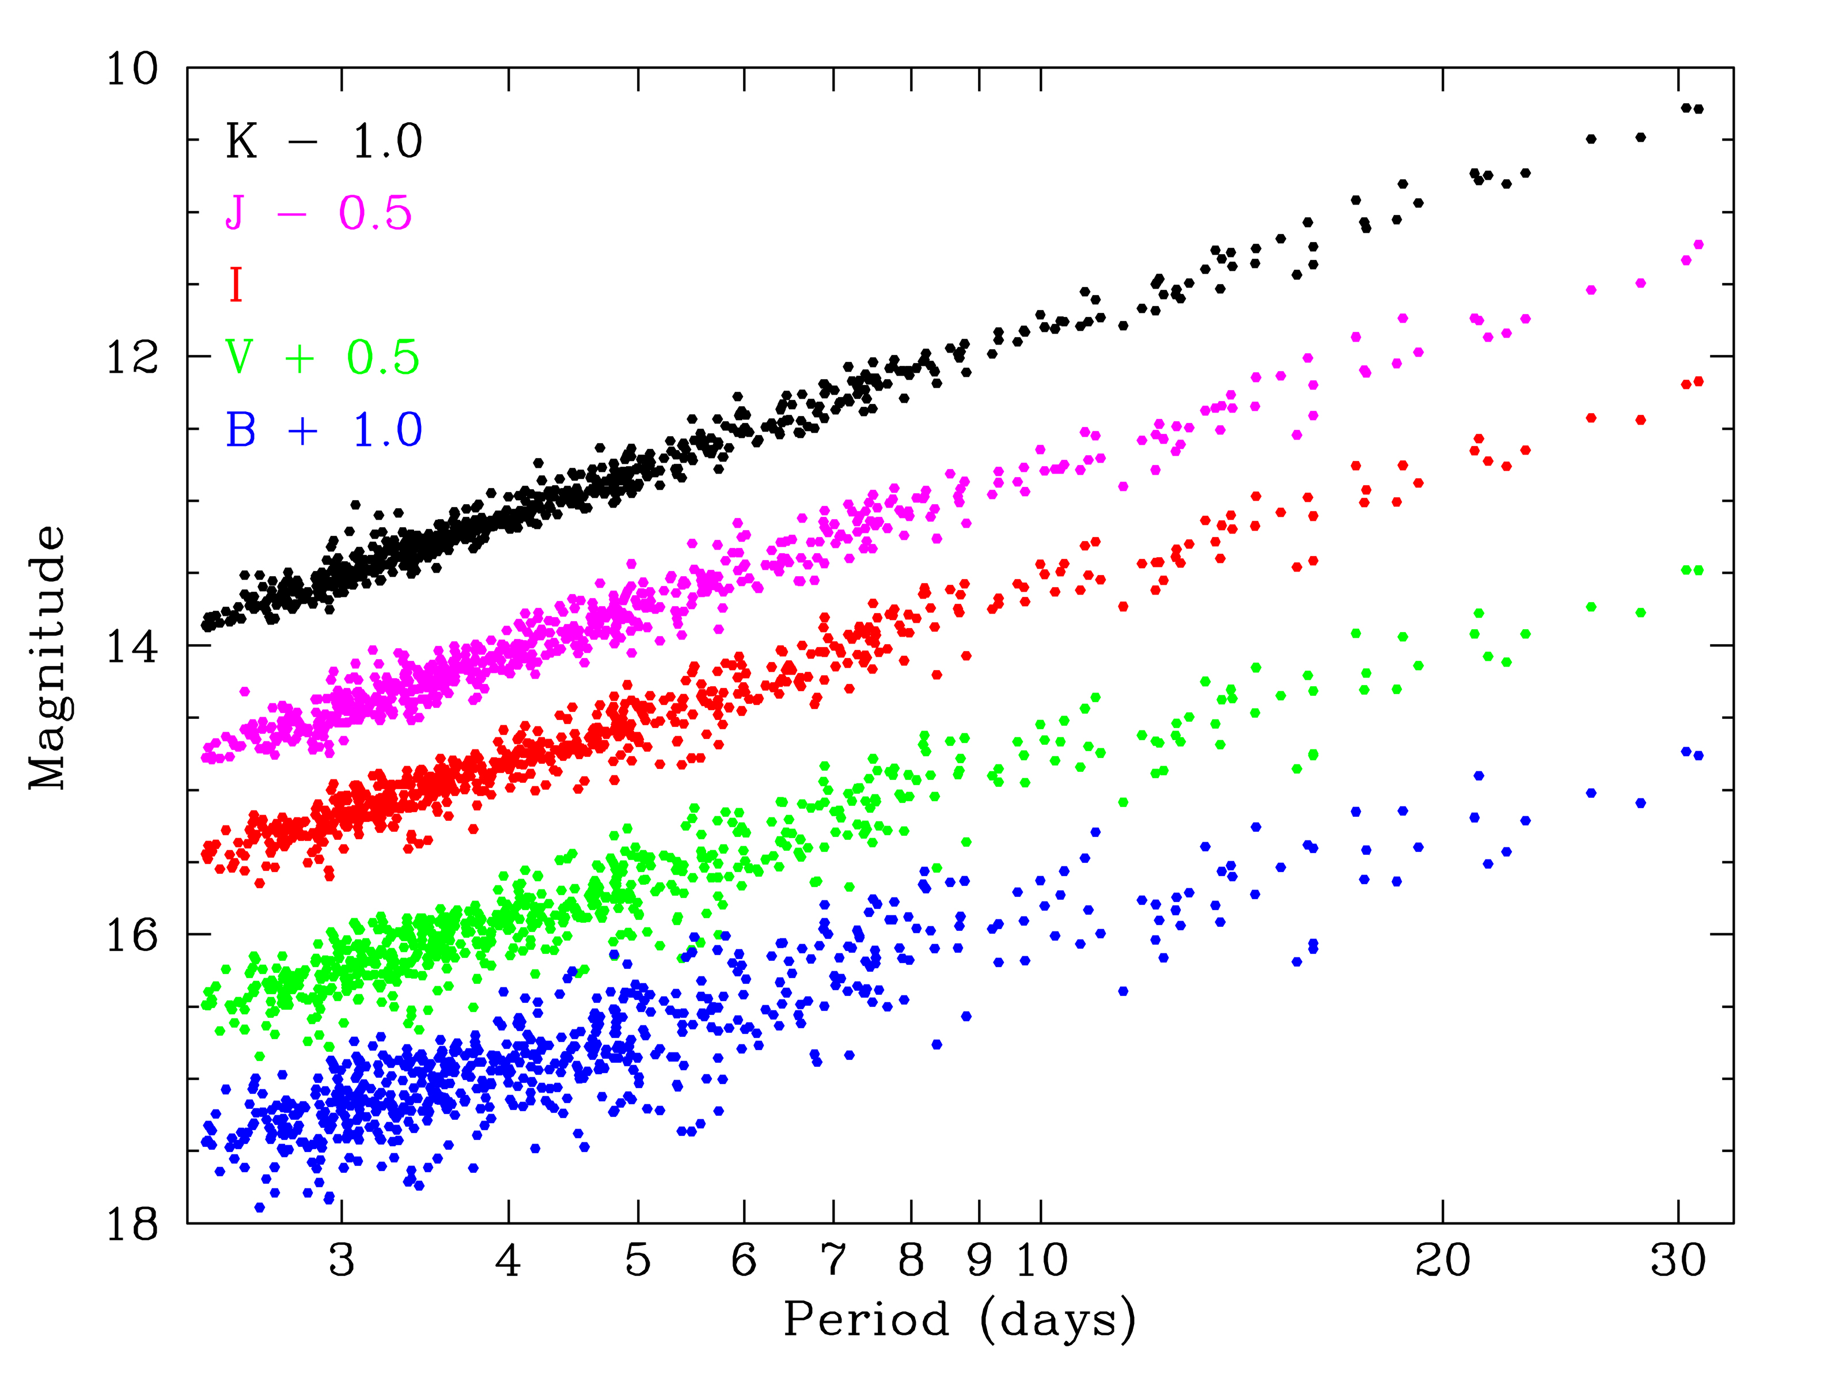
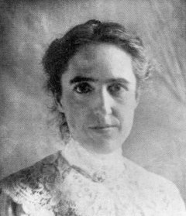
Precision Calibrators: Cepheids and the Leavitt Law
The Leavitt Law in the LMC (Udalski+ 1999, Macri+ 2015)
Accurate Period-luminosity calibration (3 geometric anchors)
Use NIR to reduce sensitivity to metallicity, extinction
H band available in HST WFC3 (+ JWST F150W)
Measurable to > 40 Mpc (hosts to 42 SNe Ia)
K 2.2μm
J 1.2μm
I 0.8μm
V 0.6μm
B 0.4μm
LMC
1 mag
σ=0.08 Mag
magnitude
Leavitt
3
5
10
20
30
Period (days)

Slide 7
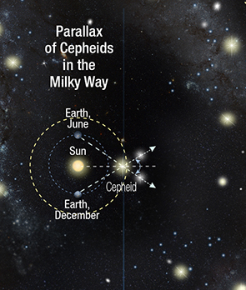
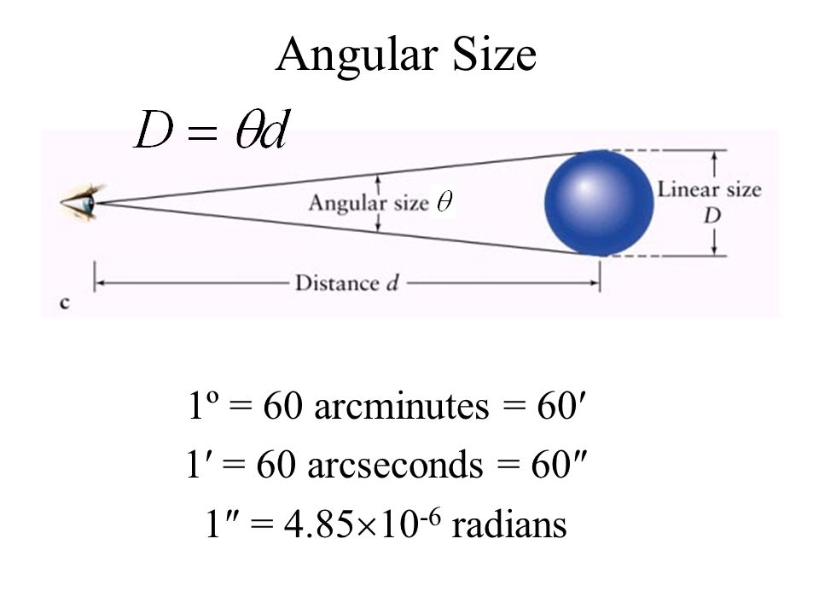

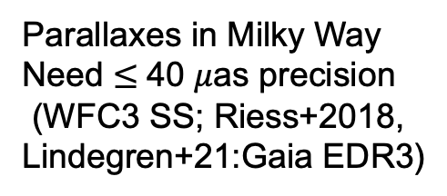
The main geometric anchors
Parallaxes in Milky Way
Need $≤$40 $μ$as precision
(WFC3 SS; Riess+2018, Lindegren+21:Gaia EDR3)
Detached Eclipsing
Binaries in LMC
(Pietrzynski+2019)ç
Masers in NGC 4258,
Keplerian Motion
(Reid,Pesce,Riess 2019)
1.0%
1.3%
1.5%
20 DEBs in LMC
$σ$_{D}=1.2% (Pietrzynski et al. 2019)

Slide 8
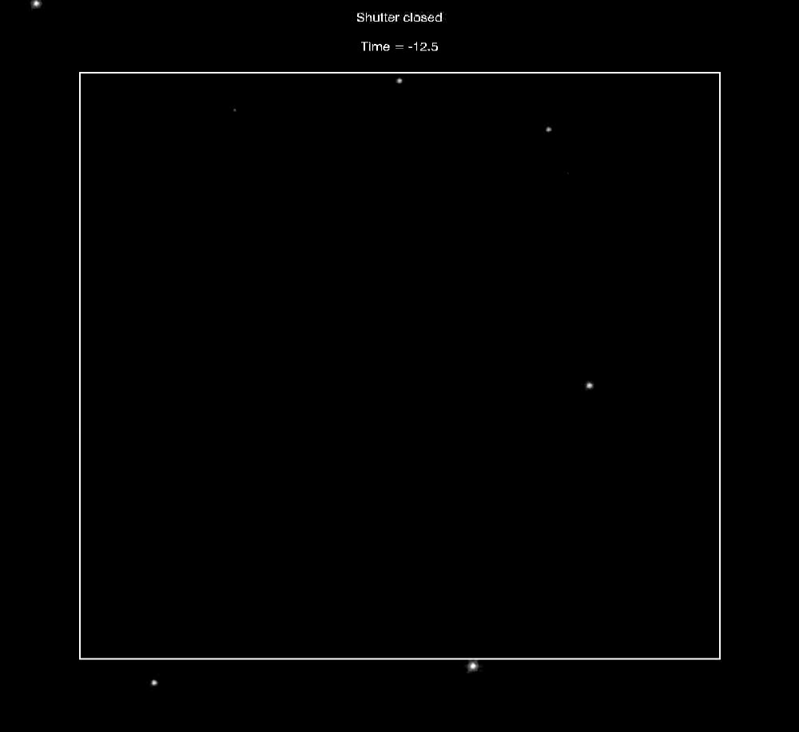
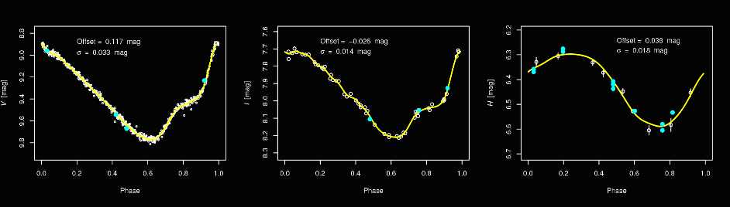
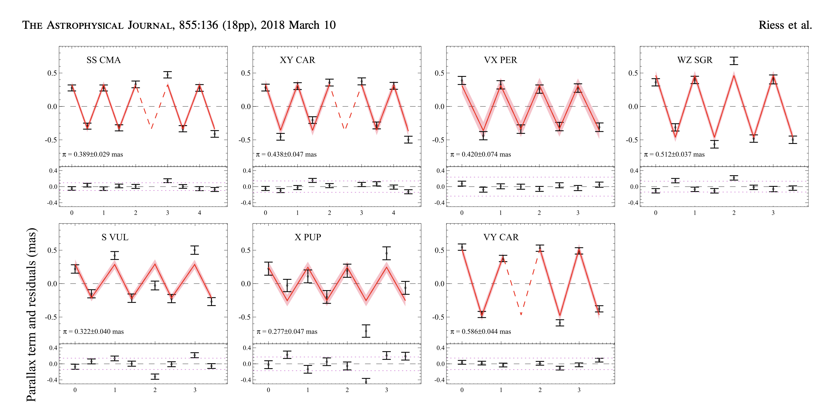
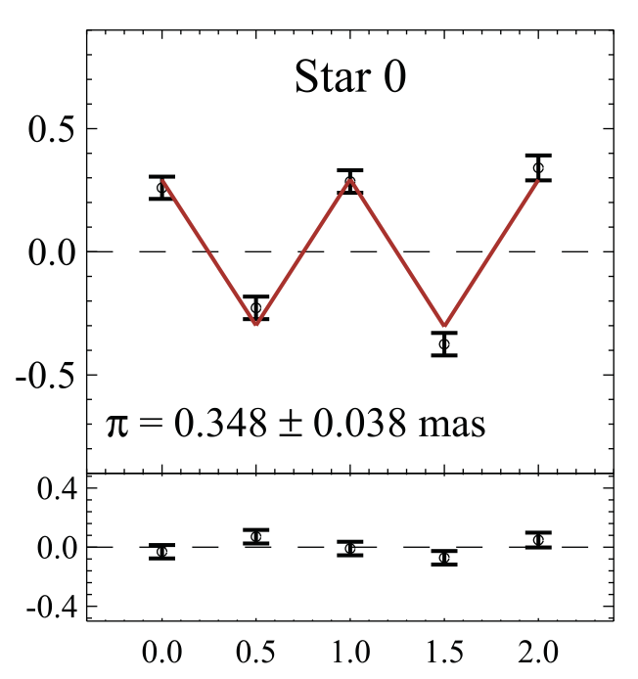
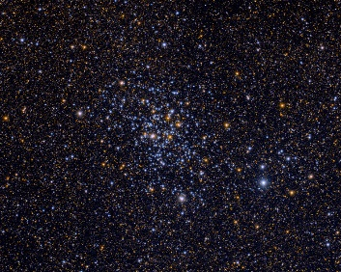
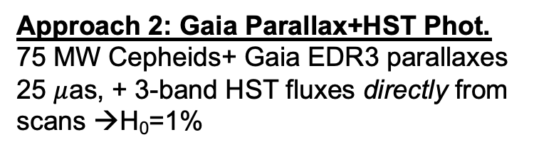
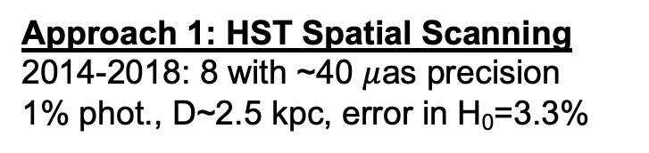
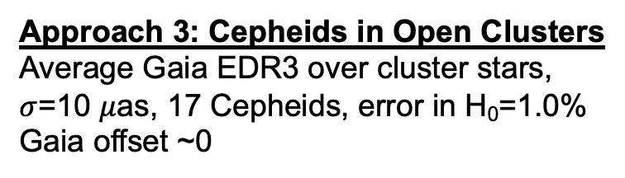
Three sources of parallaxes for MW Cepheids
Approach 1: HST Spatial Scanning
2014-2018: 8 with ~40 $μ$as precision
1% phot., D~2.5 kpc, error in H₀=3.3%
Approach 2: Gaia Parallax+HST Phot.
75 MW Cepheids+ Gaia EDR3 parallaxes
25 $μ$as, + 3-band HST fluxes directly from scans →H₀=1%
F555W
F814W
F160W
0.4”/sec
Approach 3: Cepheids in Open Clusters
Average Gaia EDR3 over cluster stars,
$σ$=10 $μ$as, 17 Cepheids, error in H₀=1.0%
Gaia offset ~0
SS CMA
Casertano+ 2016, Riess+ 2018

Slide 9
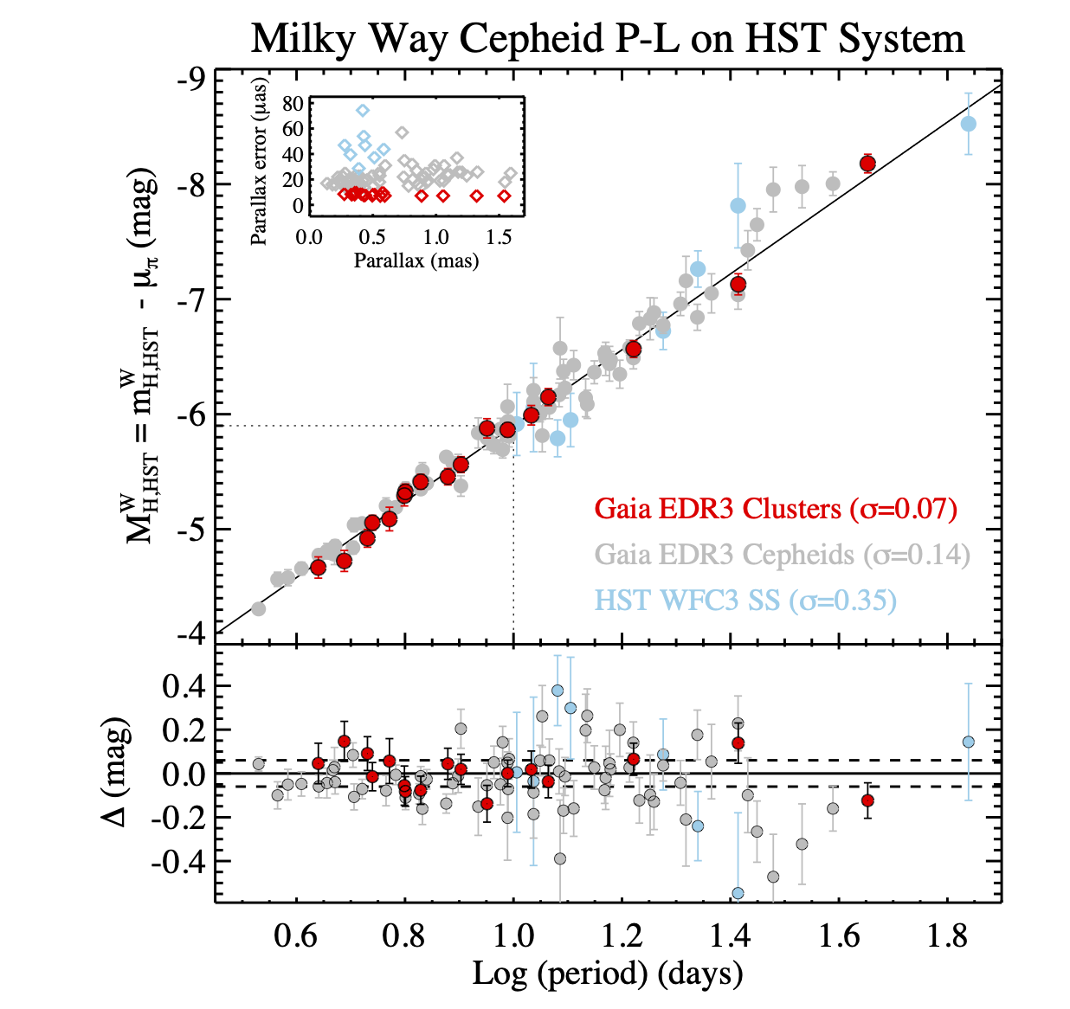
MW calibration for Cepheids
All Cepheids have HST photometry
Systematics cross-checks
Still collecting!
Final sample by DR5: H₀~0.4%!
Riess et al., 2022, ApJ, 938, 36

Slide 10
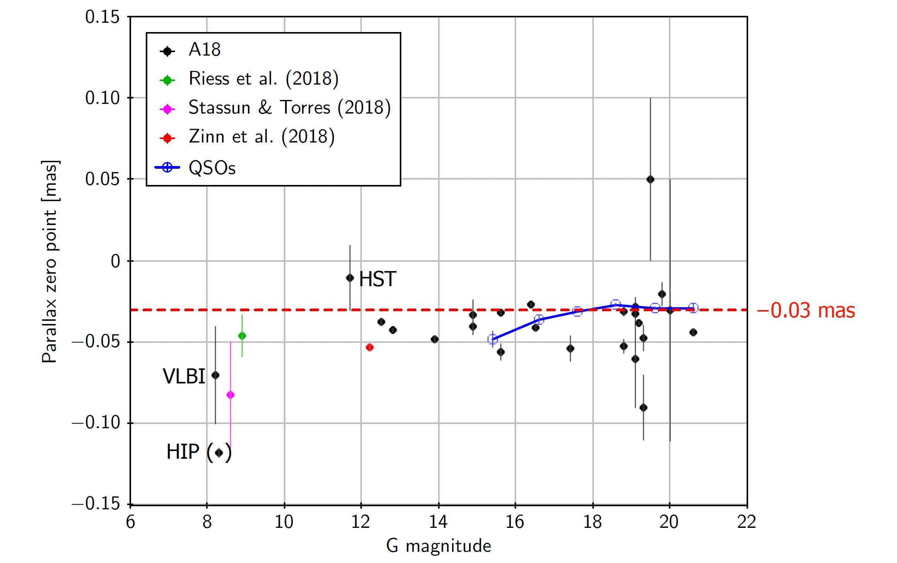
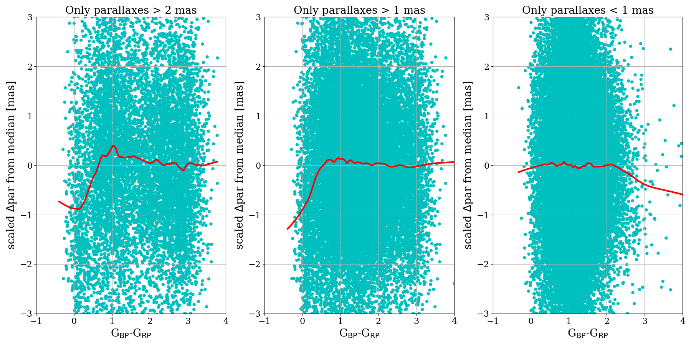
An aside: the Gaia parallax offset
Gaia parallaxes are known to have a bias/offset (also known as “zero point”)
Originally considered a consequence of Basic Angle variations; reasons likely more complex
Found after DR2 to depend on source position and properties
Arenou+ (2018): cluster members vs median cluster parallax
Lindegren (2018): parallax offsets for various astrophysical samples

Slide 11
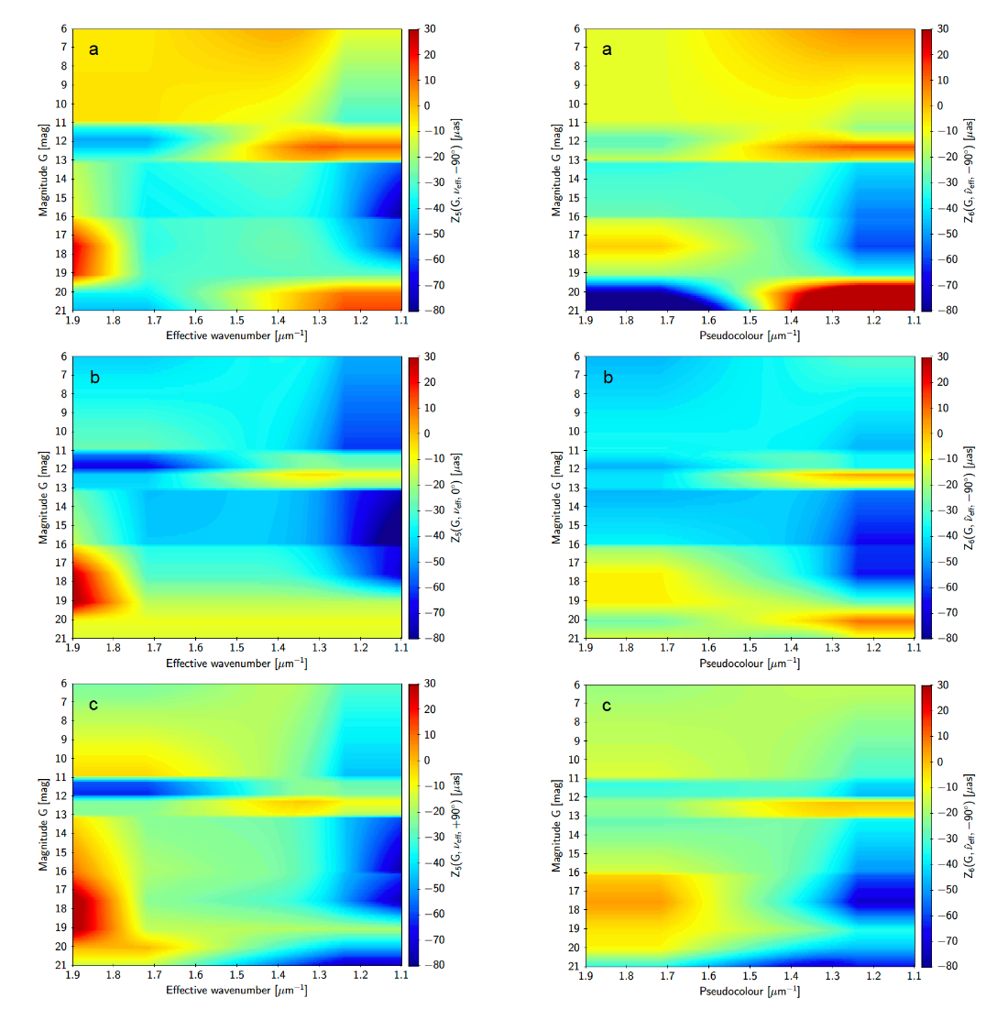
Offset correction formula for EDR3
For EDR3, the Gaia team addressed the issue of the parallax bias more comprehensively
  Lindegren+ (2020) produced a 3-parameter correction function to “adjust” the parallax
    Combination of QSO, physical pairs, and LMC stars
    Correction is a function of magnitude, color, and ecliptic latitude
    Correction function varies sharply near some critical values (esp. magnitude)
    Caveat: only a single magnitude and color are used for each source (variable stars notwithstanding)
The correction function generally does a good job of adjusting the catalog parallax, but some systematics remain
Potential issue for Cepheids: brighter, redder than most stars used for offset determination
Parallax correction vs. magnitude and color
at three ecliptic latitudes (Lindegren+ 2020b)

Slide 12
EDR3 Offset for Field Cepheids
Range of distances in our sample of Cepheids allows partial separation of offset (additive) and Cepheid calibration (multiplicative)
Residual offset of -14 ± 6μas; little dependence on G, color, 𝝱
Calibration uncertainty 0.022 mag (would be 0.015 mag without offset uncertainty)
  The loss of precision is about 50%; it was 150% for DR2

Slide 13
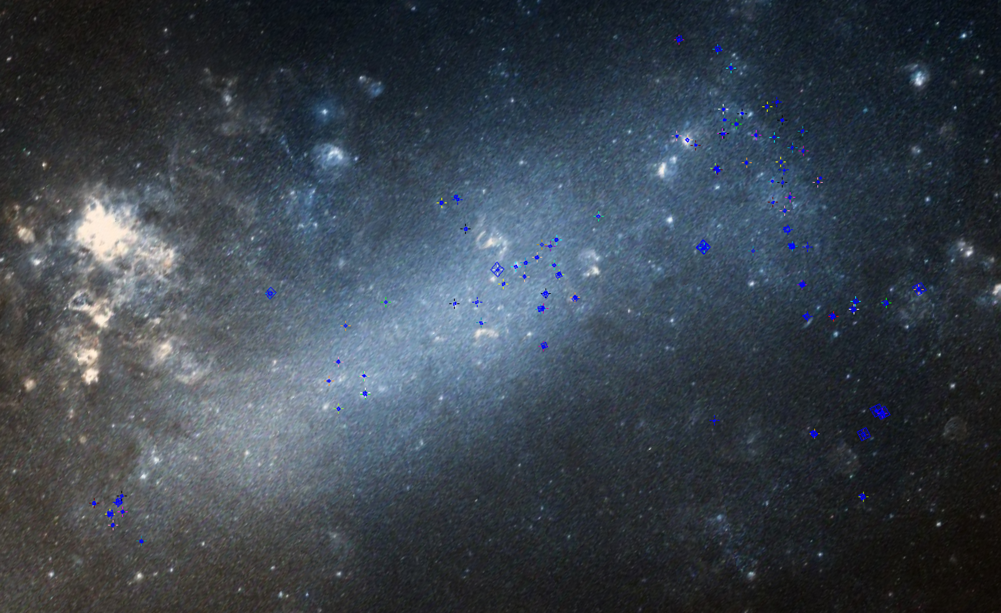
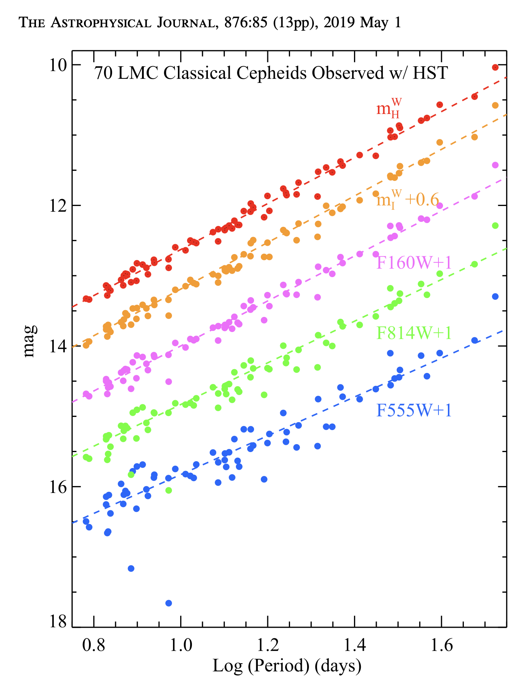
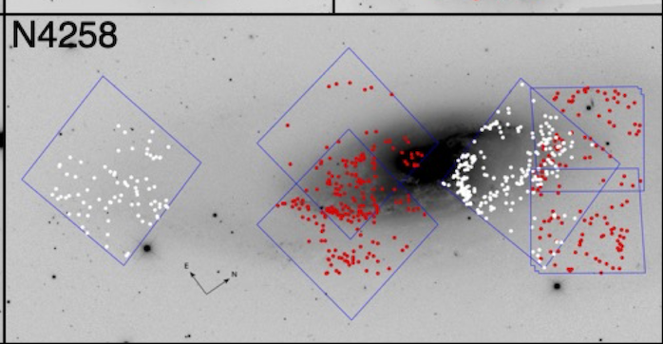
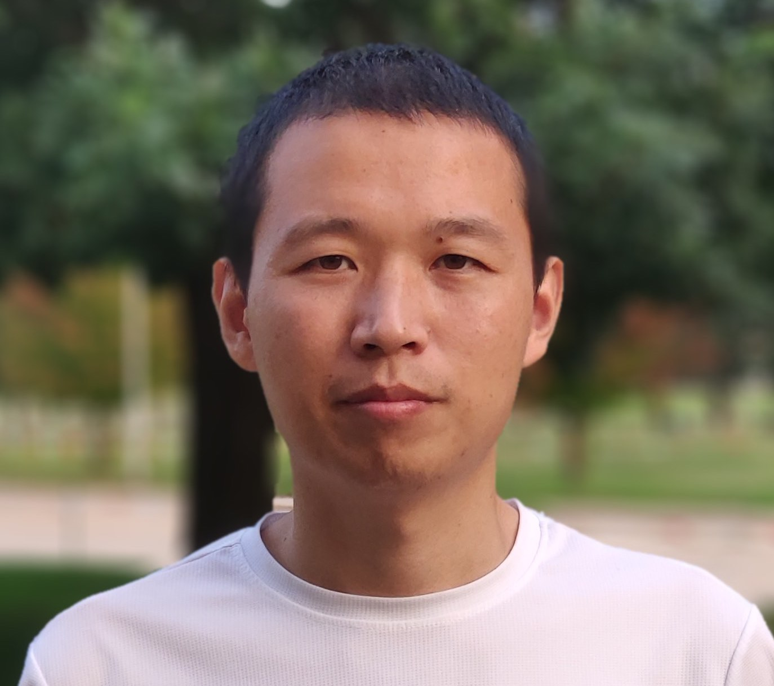
Other Cepheid calibrations
LMC HST DASH (2019)
(SMC in progress)
NGC 4258 (2022)
669 Cepheids in 6 HST Fields
doubled sample in 2022 (red=new)
Dereddened:
F160W-0.386(F555W-F814W)
σ=0.07 Mag
1.6μm
0.8μm
0.55μm
Yuan+ 2022
Riess+2019

Slide 14
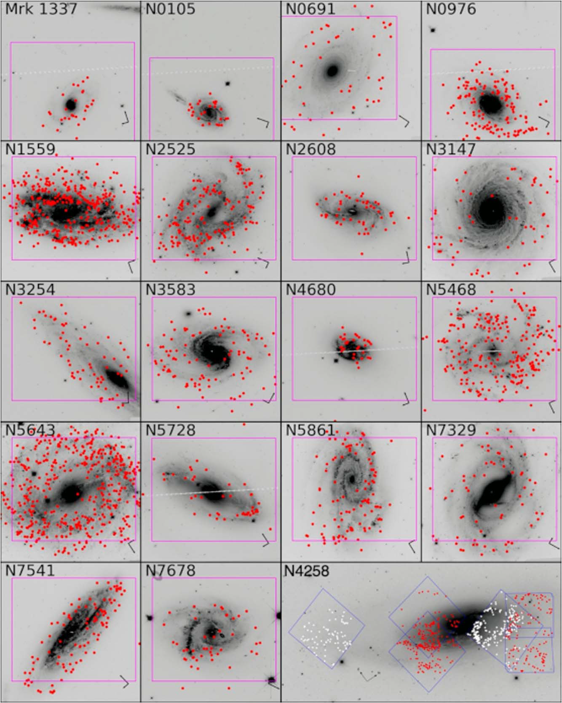
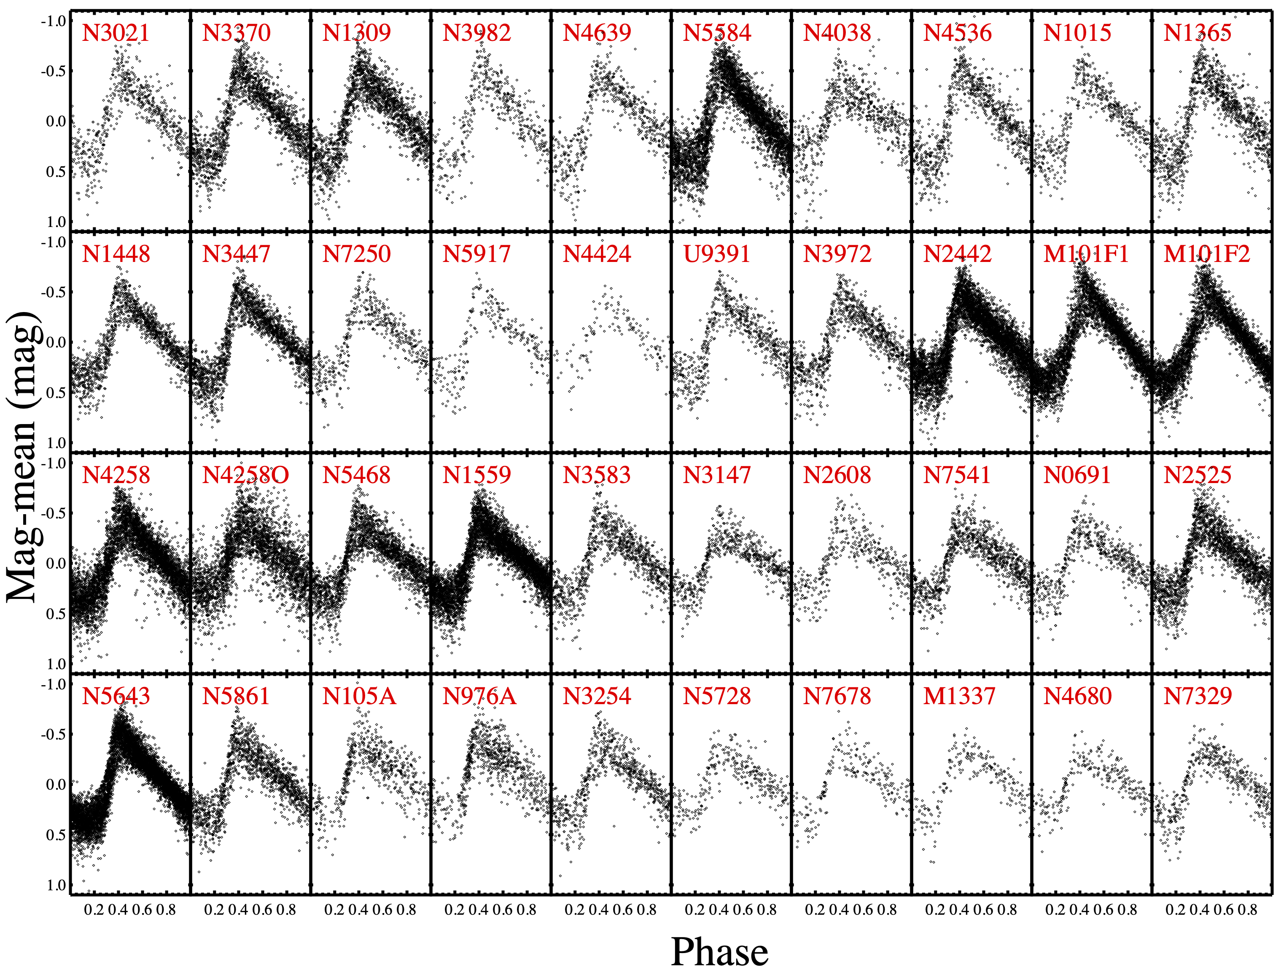
Step 2: Cepheids in SN Ia hosts
Calibrated Cepheid luminosity yields distances to SN Ia
19 new galaxies (Riess+ 2022a)
Distances to hosts of 42 SN Ia (total)
Composite light curves for all Cepheids
in SN hosts

Slide 15
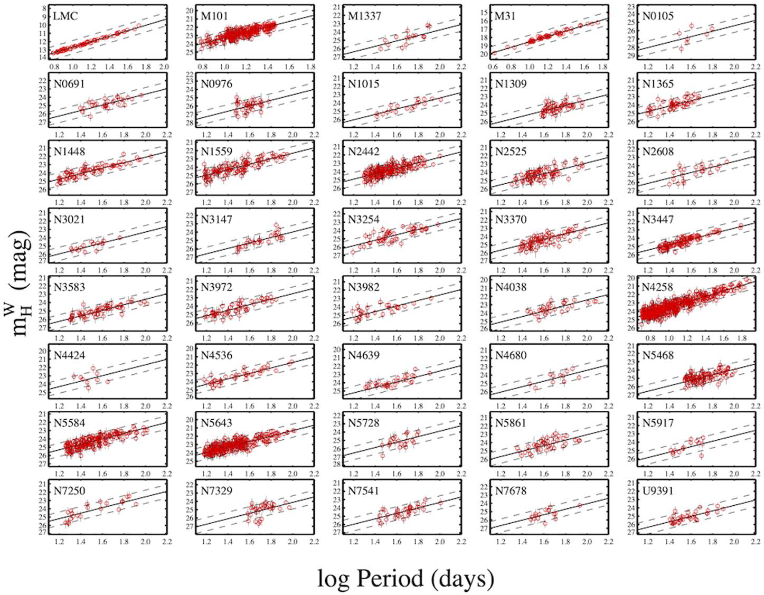
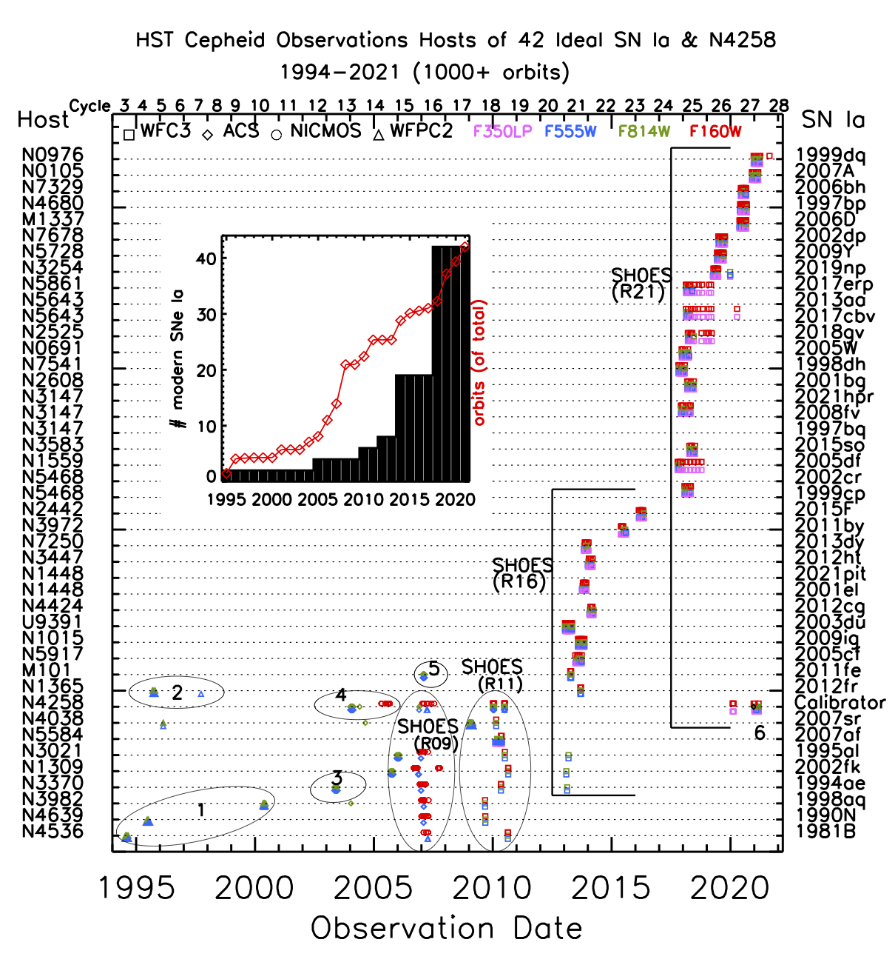
Step 2: Cepheids in SN Ia hosts
Calibrated Cepheid luminosity yields distances to SN Ia
Now include all suitable SNe Ia
through 2021 (z < 0.01)
Combined Leavitt laws for all galaxies
(calibrators and hosts)

Slide 16
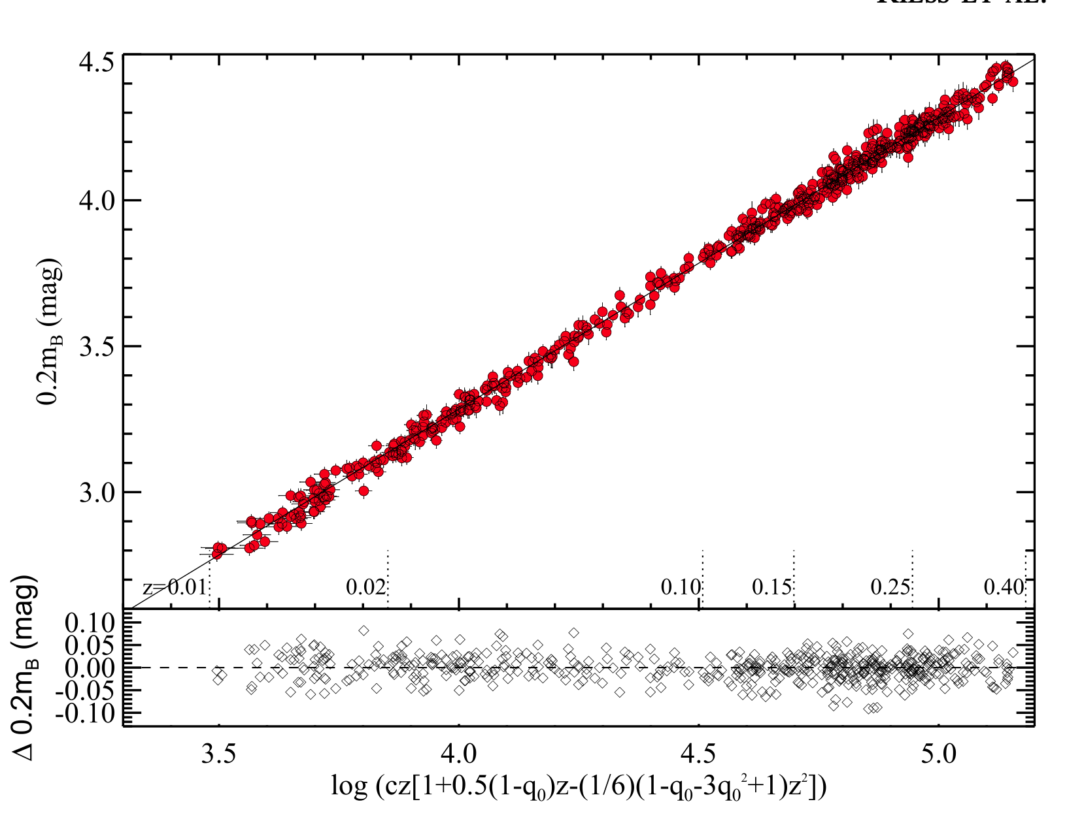

Step 3: SN Ia probe the Hubble flow
~300 SN Ia
in spiral hosts
same as rung 2
Less sensitive to local flows
Less sensitive
to $q0, j0, Ω,w$
SNe Ia from Pantheon+ (Scolnic+ 2022, Brout+ 2022)
See Maria Vincenzi’s talk

Slide 17
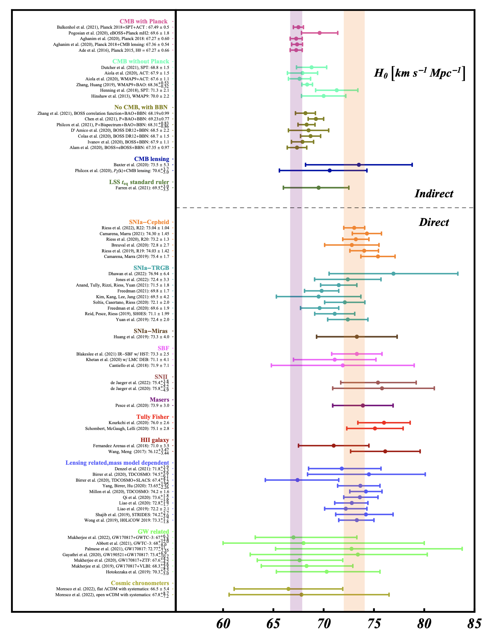
What can we change in the analysis?
67 Analysis variants in 12 categories (Riess+ 2022)
Optical Cepheid data only (72.7)
Different pec. vel map or none (73.1,72.7)
SN scatter ind. wave+mass step (73.5)
No pre-2000 SNe (73.2)
closest half hosts (73.1)
most crowded half (73.4)
least crowded half (73.3)
Skip “local hole” z>0.06 (73.4)
All host types (73.3)
include TRGB (consistent) jointly (72.5)
No metallicity term (73.5)
Break in PL at P=10 days (72.7)
No dust correction (74.8)
Individual host dust law (73.9)
Free param dust law (73.3)
Low R_{V}=2.5 dust law (73.2)
Two of three anchors (73.0,73.4,73.2)
No outlier rejection (73.4)
Exhaustive tests: hard to get below 72.5, above 73.5, propagate dispersion as systematic error

Slide 18
Cepheid photometry with JWST
Crowding is a significant source of noise in HST IR data

Slide 19
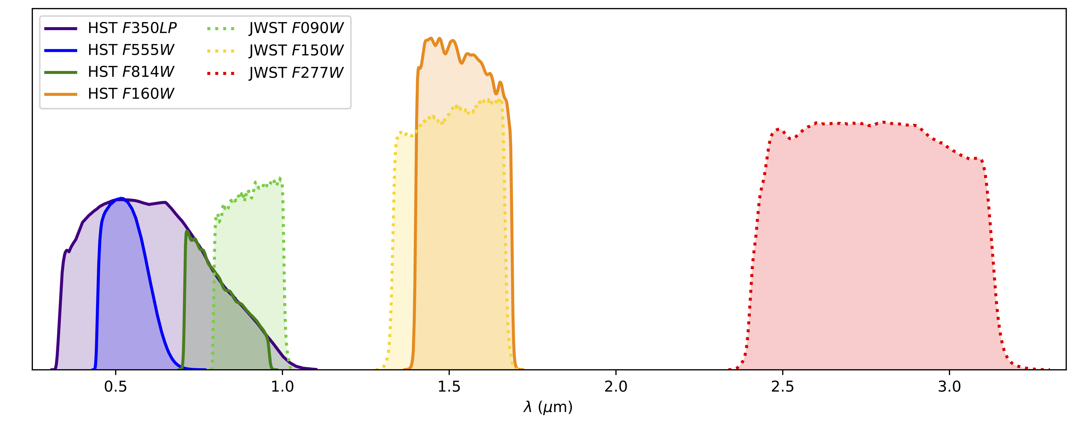
Upcoming observations of anchor, 11 hosts
(16 SNe)
Two epochs separated by ~2-3 weeks : 3 reasons: Confirm Cepheids, check stability, phasing
Cepheid Richest
Highest Backgrounds
Cycle 1 (2 epochs)
----------------
NGC 4258
NGC 5584 (1)
NGC 5468 (2 SN Ia)
NGC 1559 (1)
NGC 5643 (2 SN Ia)
NGC 1448 (2 SN Ia)
Cycle 2 (1 epoch)
----------
NGC 3147 (3)
NGC 2525 (1)
NGC 5861 (1)
NGC 3370 (1)
NGC 5728 (1)
NGC 2608 (1)
Done

Slide 20
Results for first 2 targets
JWST scatter 2.5 times less than HST at 1.5 microns, excellent agreement of intercepts
Rung 2-1
HST
JWST
zeropoint
independent

Slide 21
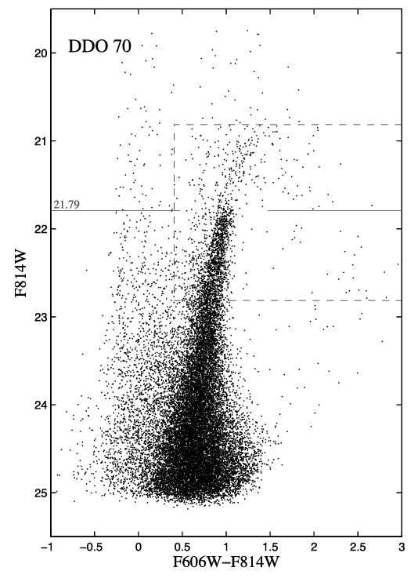
Another distance indicator: The TRGB
The Tip of the Red Giant Branch (TRGB) is emerging as a competitive distance indicator
  Marks a break in the luminosity function in an evolved stellar population at M_{I} ~ -4
  Required depth observationally easy to achieve in galaxies out to ~ 15 Mpc (with space-based data)
  Brightness weakly dependent on metallicity, star formation history (in I band)
Can replace Cepheids or other variable stars as the middle step in the distance ladder
Benefits:
  Available for early-type galaxies
  Single-epoch observations sufficient
Disadvantages
  Calibration challenging
  Statistical in nature
  More limited reach before JWST (this is starting to change)
  Some aspects (color, zonal variations) still need investigation
Makarov+ 2006

Slide 22
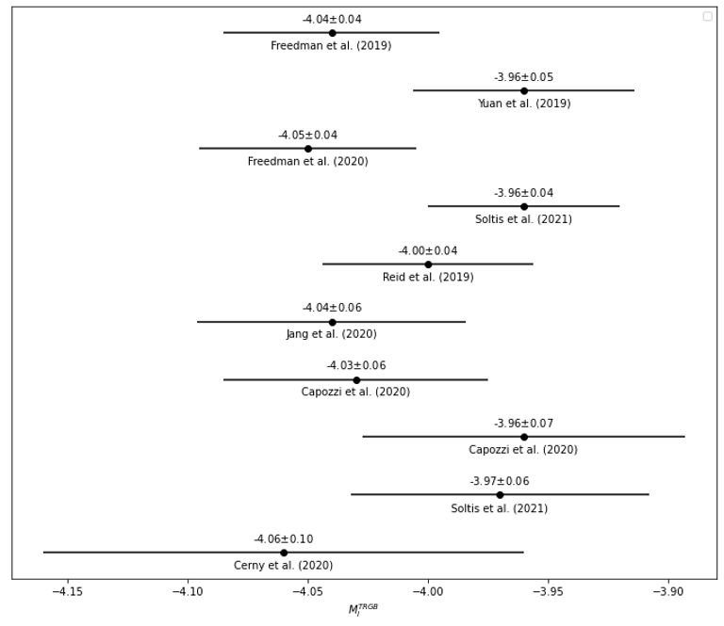
TRGB calibration
Multiple calibrations exist
  LMC, SMC, based on DEB distances
  Milky Way Globular Clusters (including Gaia parallaxes)
  NGC 4258 (maser distance)
Calibrations differ by ~ 0.1 mag
  Range from -4.06 to -3.96
  Corresponds to H0 ~ 70 to 74 km/s/Mpc
Differences include:
  Assumed calibrator distance
  Extinction correction
  Measurement method
Is there more to TRGB than just a break?
Some recently published values of M_{I}^{TRGB}

Slide 23
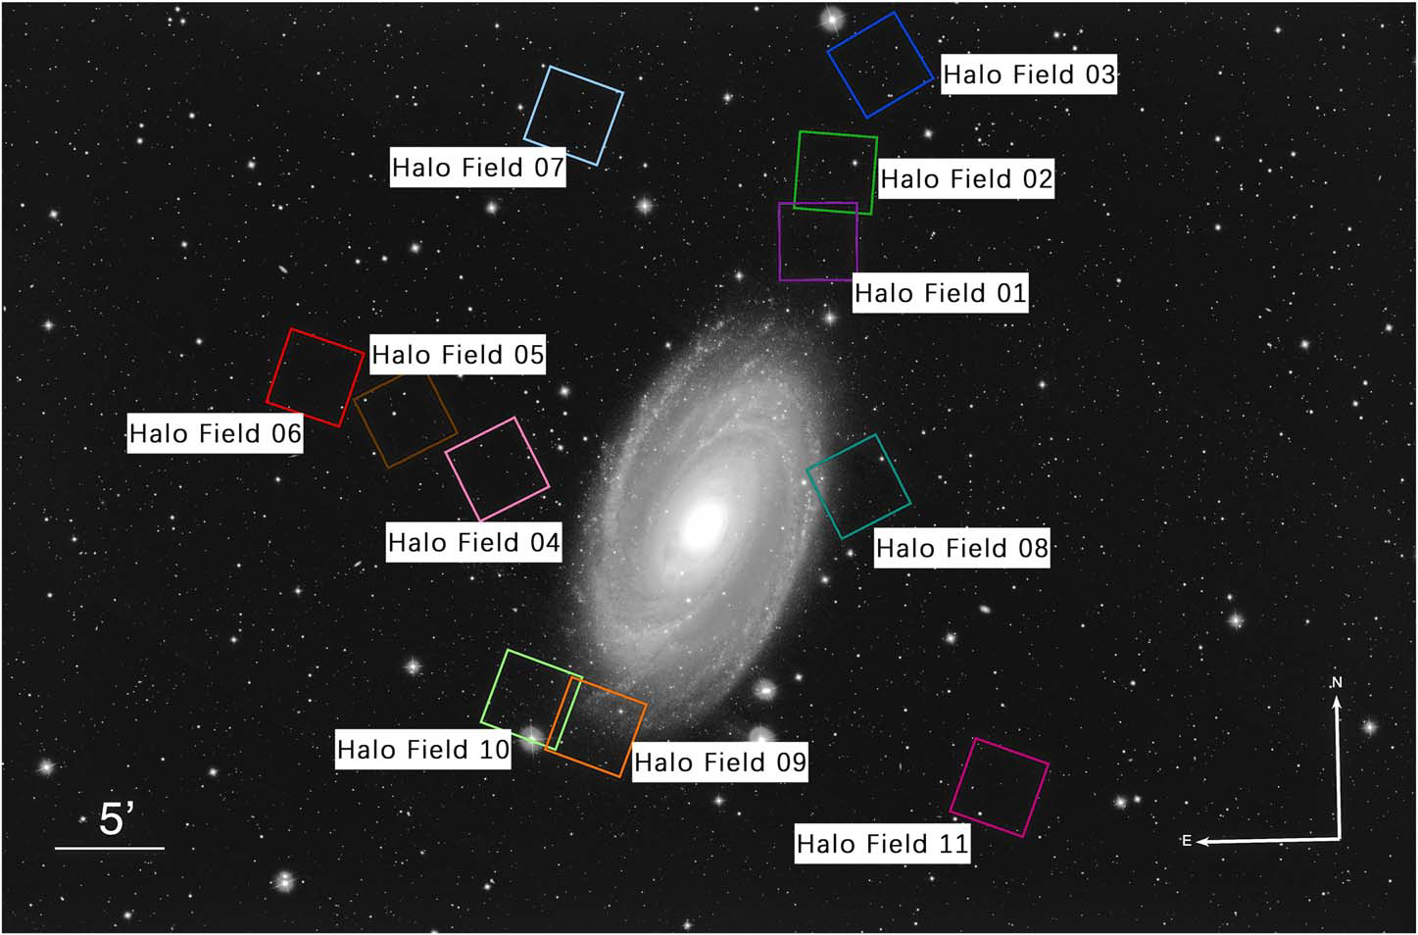
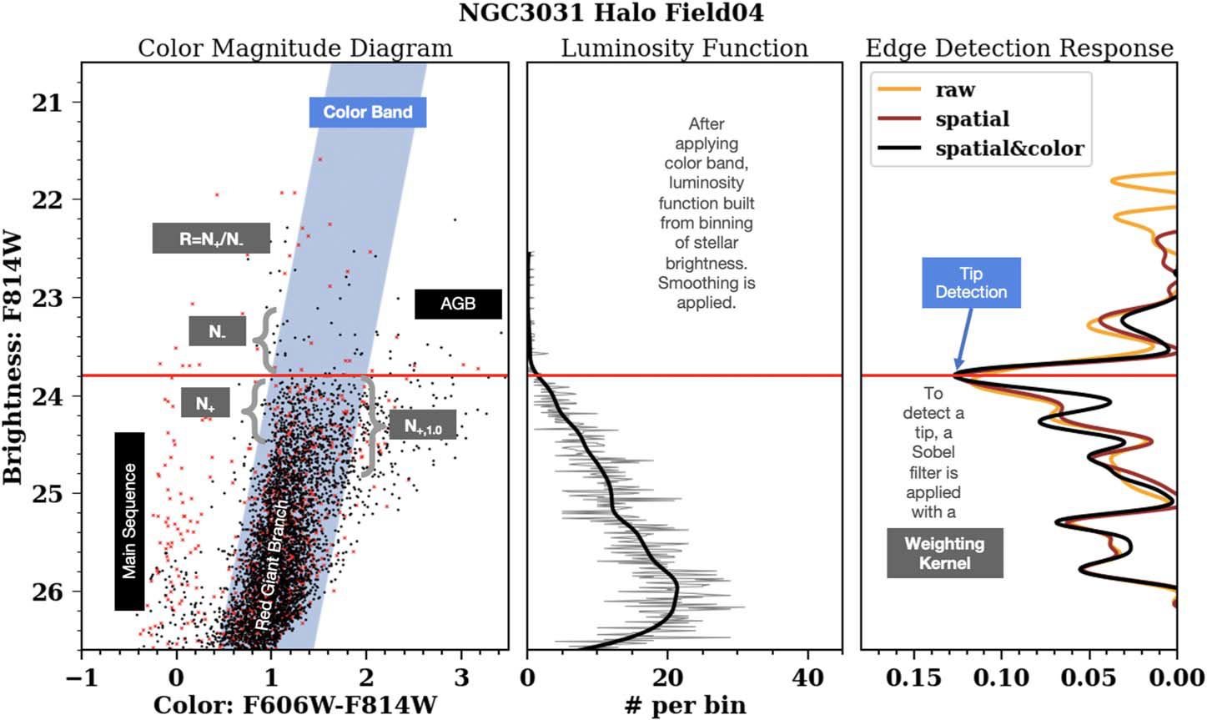
How consistent are TRGB measurements?
11 fields around M81
with HST/ACS data
Do they all yield the
same tip brightness?
The answer is, maybe…
Measuring a tip brightness requires
many steps, and many choices

Slide 24
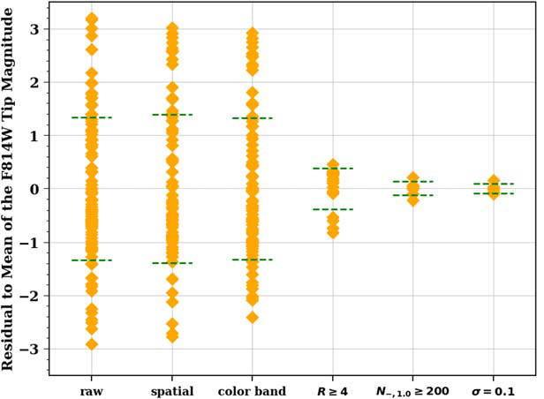
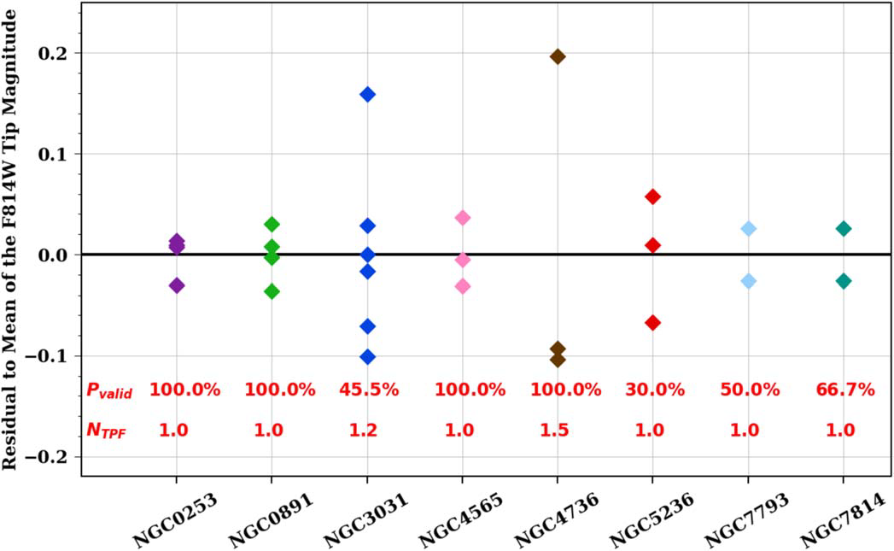
CATs: Comparative Analysis of TRGBs
(or, how to obtain TRGB measurements without subjective choices…)
Led by Jiaxi Wu (Duke)
Systematic study of multiple fields around GHOSTS galaxies (Radburn-Smith+ 2011)
  10 galaxies with 2 to 11 fields each
  All have ACS data in same filters (F606W/F814W)
  Techniques developed using results from EDD (Anand+ 2021)
Vary analysis and rejection parameters:
  Spatial clipping (to exclude young populations)
  Color selection
  Smoothing of Luminosity Function
  Weighting Kernel
  Required contrast ratio (# above/below tip)
  Required number of stars
The CATs procedure
  Produces low dispersion within each galaxy
  Yields a unique peak for most fields
  Retains most fields with adequate data

Slide 25
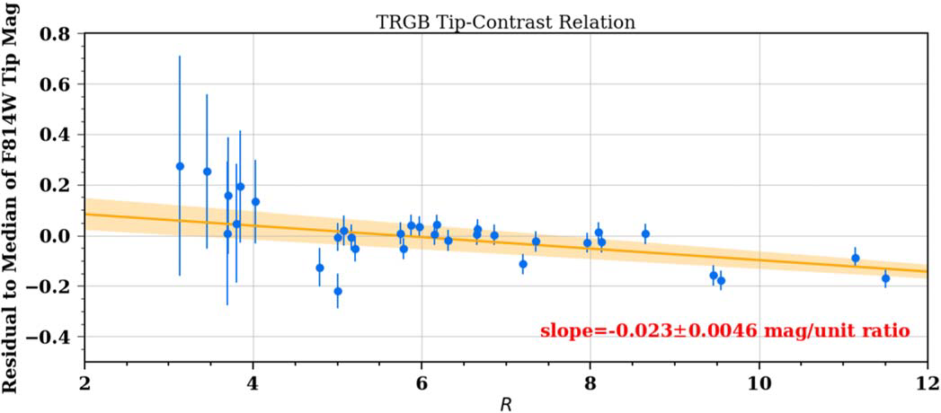
BUT: Tip brightness NEEDS Standardization
TCR: Tip-Contrast Relation
TRGB is systematically brighter when the contrast (fractional drop at the break) is larger
  High significance (~ 5 σ)
  Confirmed for a different sample of galaxies (SN hosts)
  Possibly related to different age and mix of stellar population
  Interpretation still ongoing
For TRGB values to be comparable, they must be corrected for TCR

Slide 26
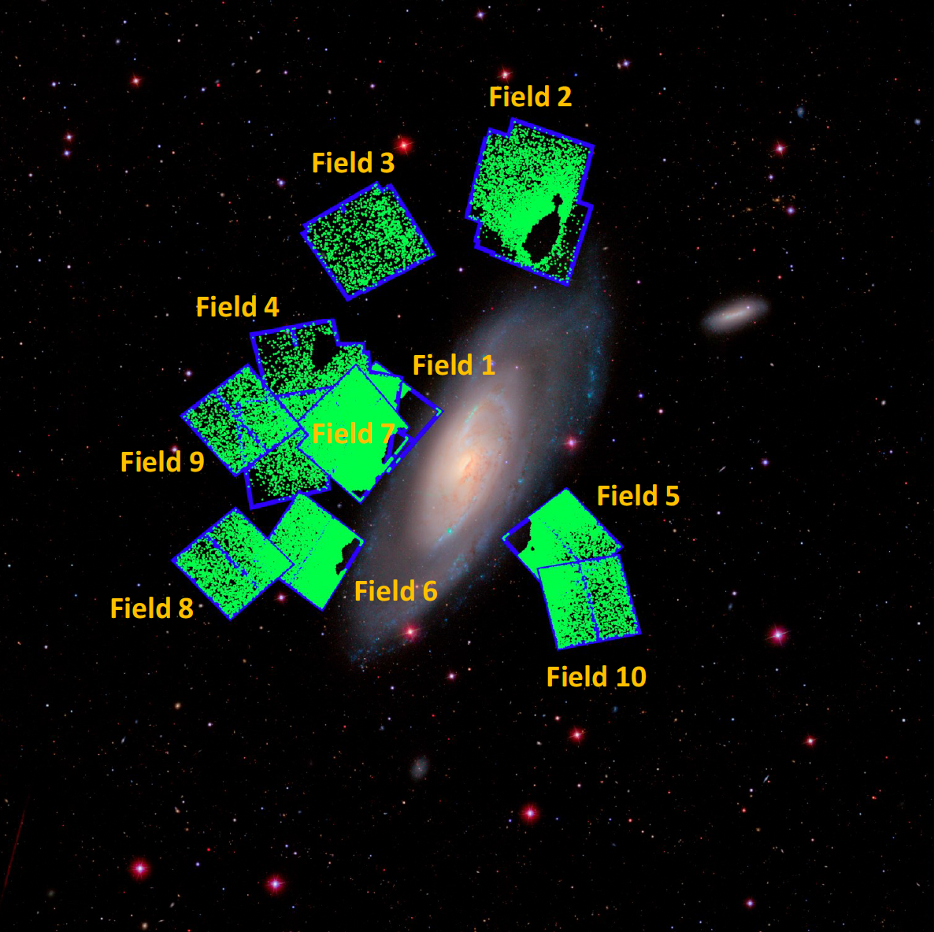
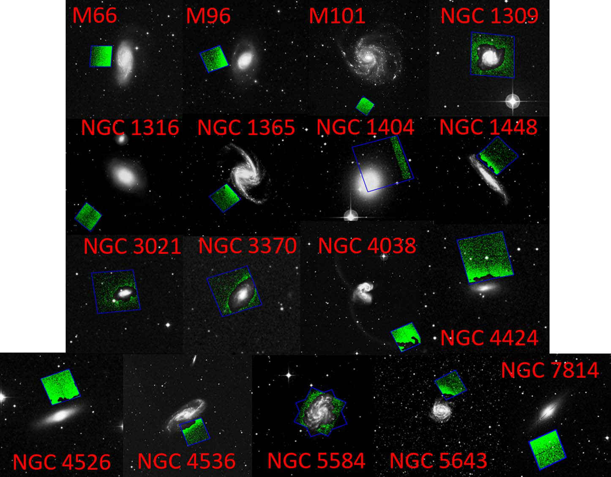
H₀ with TRGB (and standardization)
17 SNe Ia hosts with TRGB data
TRGB fields in NGC 4258

Slide 27
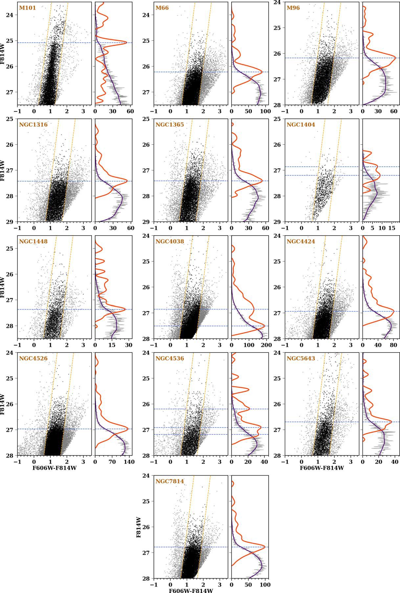
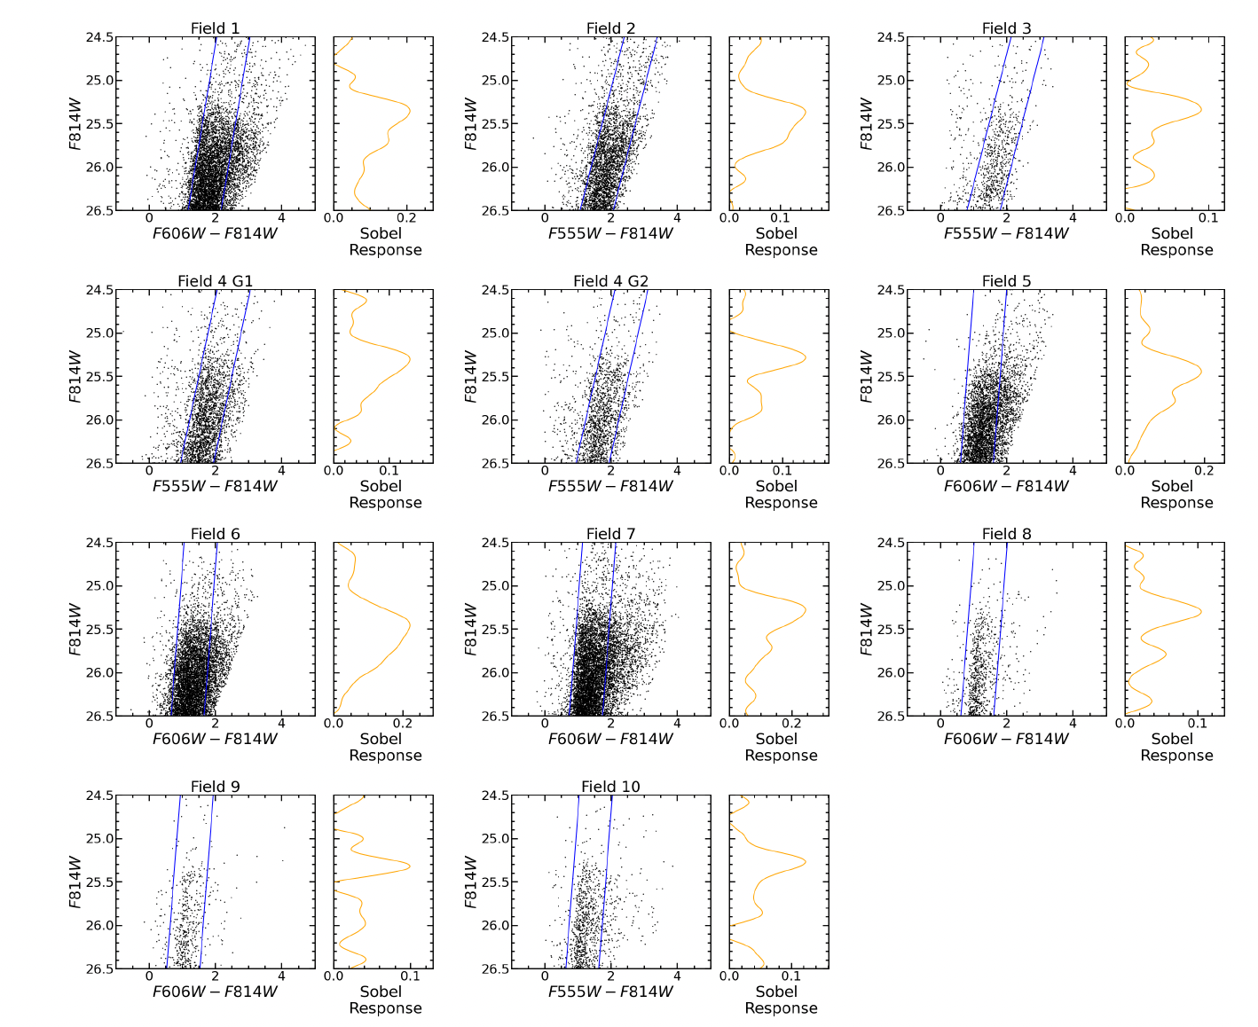
H₀ with standardized TRGB (1)
13 SNe Ia hosts with TRGB measurements (based on CATs procedures)
Anchored to NGC 4258 with maser distance (10 fields)
TRGB in NGC 4258 (Li+ 2023)
TRGB in SN hosts (Scolnic+ 2023)

Slide 28
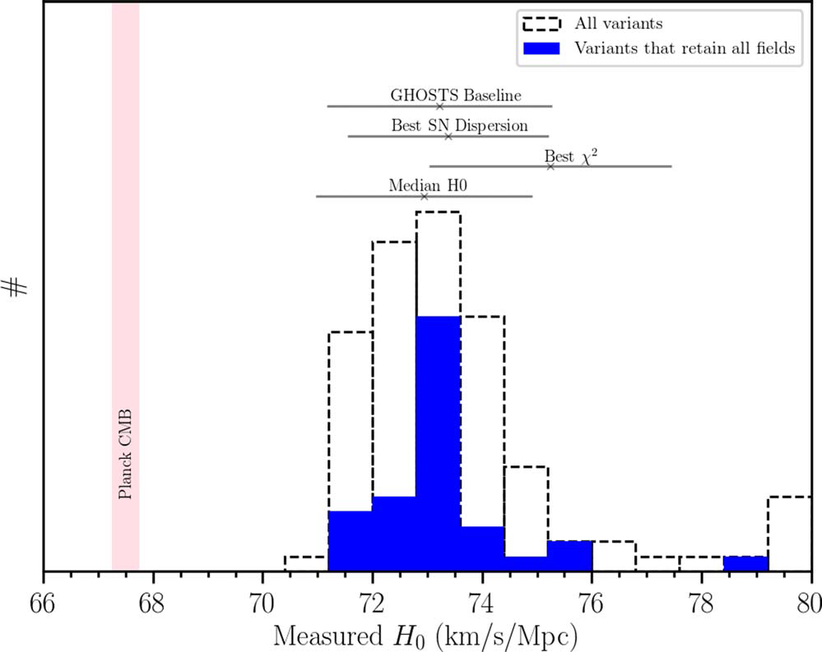
H₀ with standardized TRGB (2)
Baseline value: H0 = 73.22 +/- 2.06 (one anchor only)
  Include distance to NGC 4258, tip uncertainties
Analysis variants have broad range, but remain well above Planck value
Difference with other TRGB results due to improved SN sample [Vincenzi talk], tip standardization (comparable impact)

Slide 29
Summary
New observations reinforce the local H0 value
  The discrepancy remains very significant (> 5σ)
  No significant changes in near-universe H₀
  JWST observations are coming on line, so far confirm HST
The classic “distance ladder” is adding many more threads
  Improved anchor distances: Gaia could reach 0.4% end-of-mission
  New anchors coming on line (SMC, in progress)
  TRGB improving
    Requires standardization
    JWST observations will increase reach, possibly accuracy
  Other indicators (e.g., JAGB, Miras) may soon become competitive as well
  Plus time delay, SBF, megamasers, …
There is now a variety of diverse methods yielding comparable results
  Assuming systematics in a specific method is less likely a solution
The fun with the Tension is unlikely to end soon 😀

Slide 30

A final note
This is not the first time the local H0 is ”too high”
1930-1950:
H₀>300 km s⁻¹ Mpc⁻¹→ t₀ << age of Earth
Why? Two populations of stars! Early and late, poor and rich.
1990s*:
60<H₀<85 & Ω_{M}=1 → t₀ (10 Gyr) < oldest stars (14 Gyr)
Why? Dark energy! Ω_{M}~0.3, Ω_{Λ}~0.7
* Internally inconsistent measures of H₀ indicated systematics not new features
2010-2022+:
H₀=73.1 +/- 1.0→ 5.3σ higher than Planck CMB+ΛCDM
What will be discovered ?
?

Slide 31
Backup

Slide 32
Selecting “least crowded” Cepheids produces bias
SH0ES team projects
Freedman and Madore (arXiv 2309.05618) state:
“With our sample of the least crowded stars in the HST data (chosen as described above, based on the crowding information provided by the new, higher-resolution JWST data, (O23)[128] find a +0.45 +/- 0.14 mag systematic difference from (R22)[8] in the Wesenheit, W(H,VI) mag. This ΔW corresponds to a (very large) 23% difference in distance.”
Is that surprising? Concerning?

Slide 33
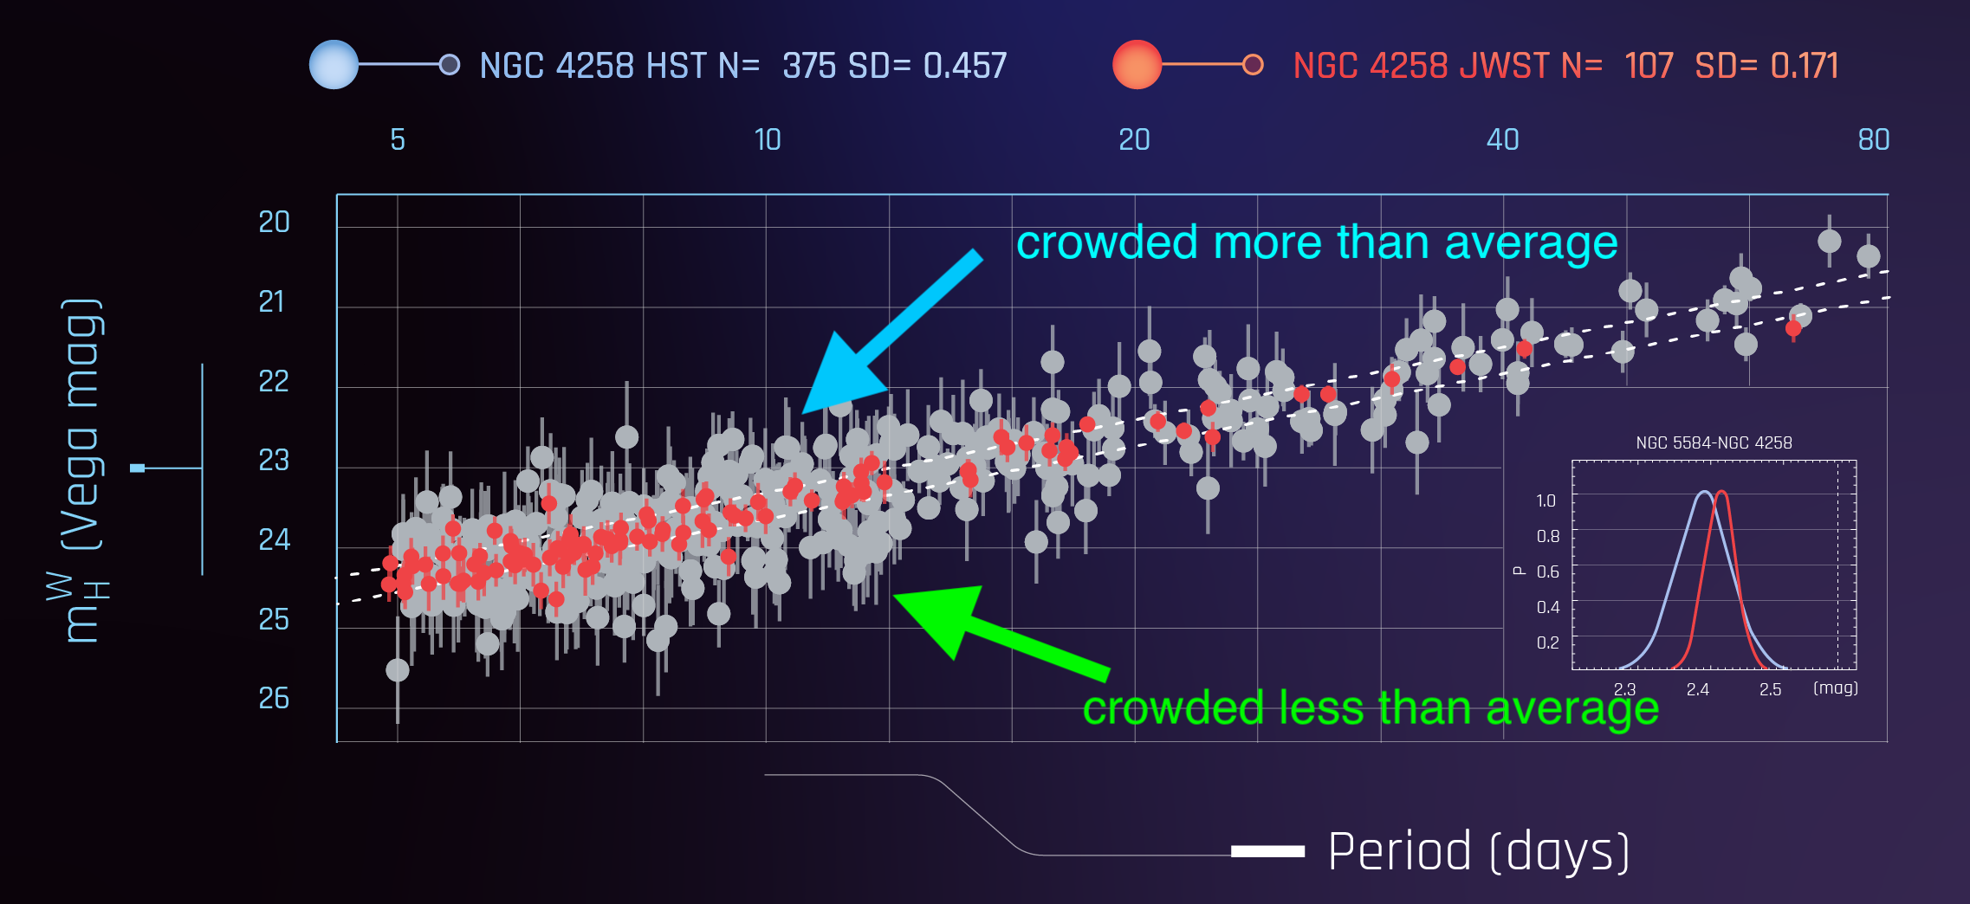
Why Can’t I Just Select the Least Crowded Cepheids from HST once I have JWST Images?
Less than average
More than average
Average
Less crowded are balanced by more crowded (when correcting statistically), so selecting less only
without applying same selection to artificial stars yields a biased HST sample

Slide 34
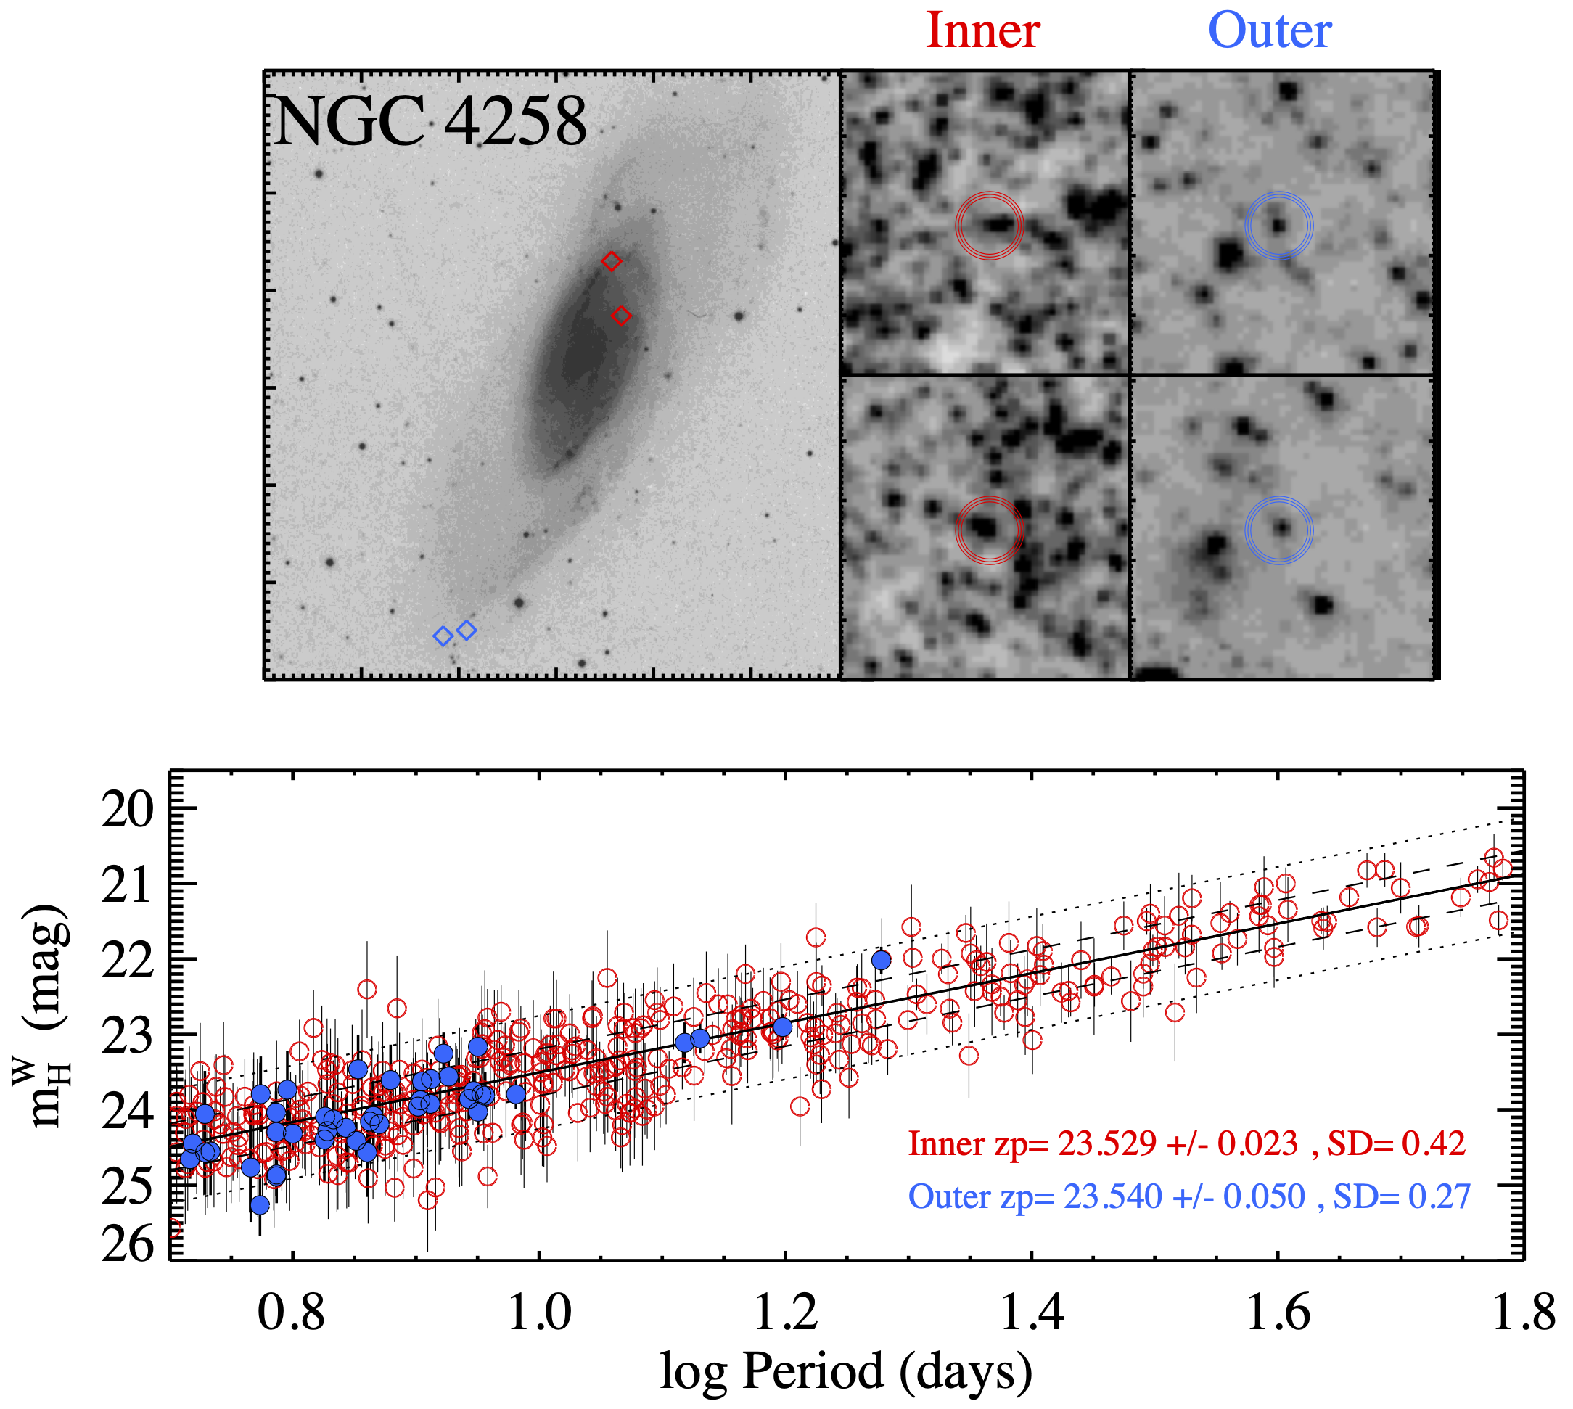
How reliable is HST Cepheid Photometry (w/ artificial stars) ?
Two independent tests of absolute photometry (aperture, other groups)
Six validation tests of backgrounds/crowding, here is one:
Compare Cepheids in high and low background/crowding, same distance
Difference in distance
between inner
and outer <0.02 mag
Photometry insensitive
to background level

Slide 35
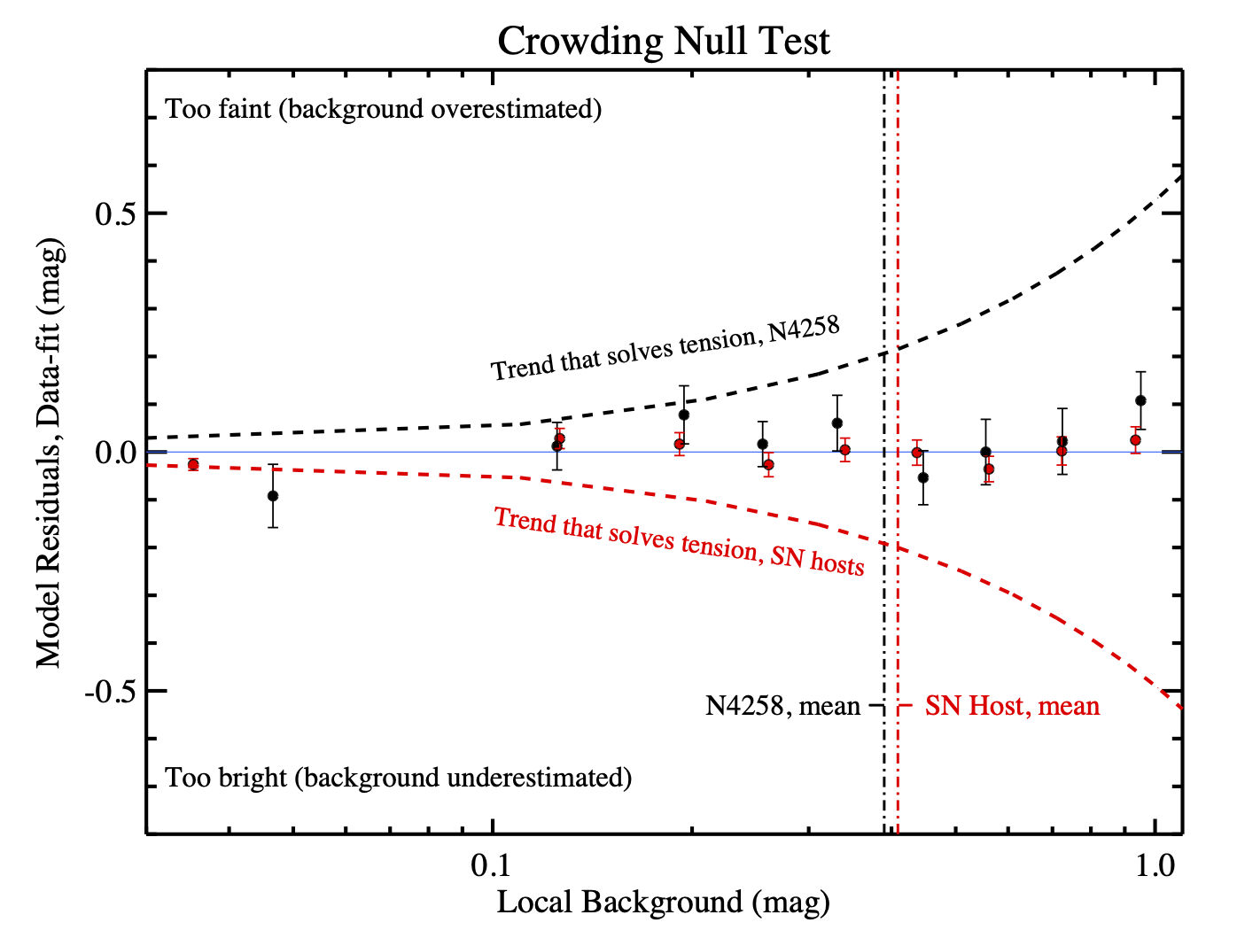
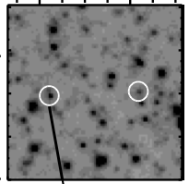


Baseline Fit Residuals vs Background/Crowding
Strong (null) test: compare fit residuals to Cepheid backgrounds
-backgrounds are independent of model, part of (local) measurement
Passes, would need to underestimate backgrounds in SN hosts (red line) 0.2 mag on average and/or overestimate in NGC 4258 (black line) to match Planck+$Λ$CDM, strongly ruled out (>8 $σ$)
Cepheids in SN hosts
Cepheids in N4258

Slide 36

Retaining Only the Least Crowded Data…JWST Preview
JWST

Slide 37


An alternative: Cepheids in Clusters
Several Cepheids are members of clusters
Many stars in the cluster match the range of magnitude and color for which the Lindegren+ correction was originally derived
Riess+ (2022b) studied 17 cluster Cepheids with HST photometry
Riess+ 2022b

Slide 38
Cluster Cepheids: results
Cluster Cepheids yield luminosity calibration comparable to the larger sample of field MW Cepheids
  No offset recalibration may be needed?
Parallax accuracy is improved by averaging many cluster stars
  Angular covariance limits the gain achieved by averaging
See also paper by Anderson+ 2022
Riess+ 2022b

